Slide 1





MEMS Magnetic Vector Sensor Detecting Hinge Angles for Soft Robotics
BOSTON MCGARRAHAN, UNIVERSITY OF ARIZONA
DR. CINDY HARNETT, UNIVERSITY OF LOUISVILLE
NSF REU Award ID #2348869
NSF NNCI Award ID # 2025075

Slide 2
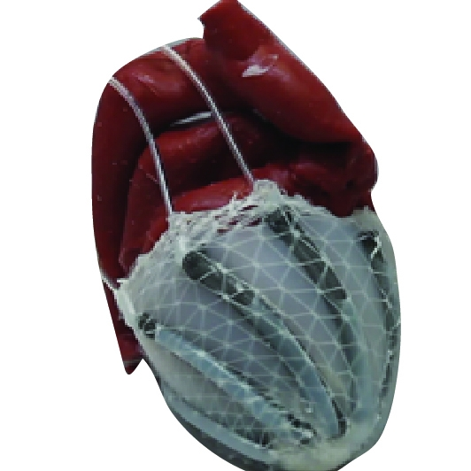
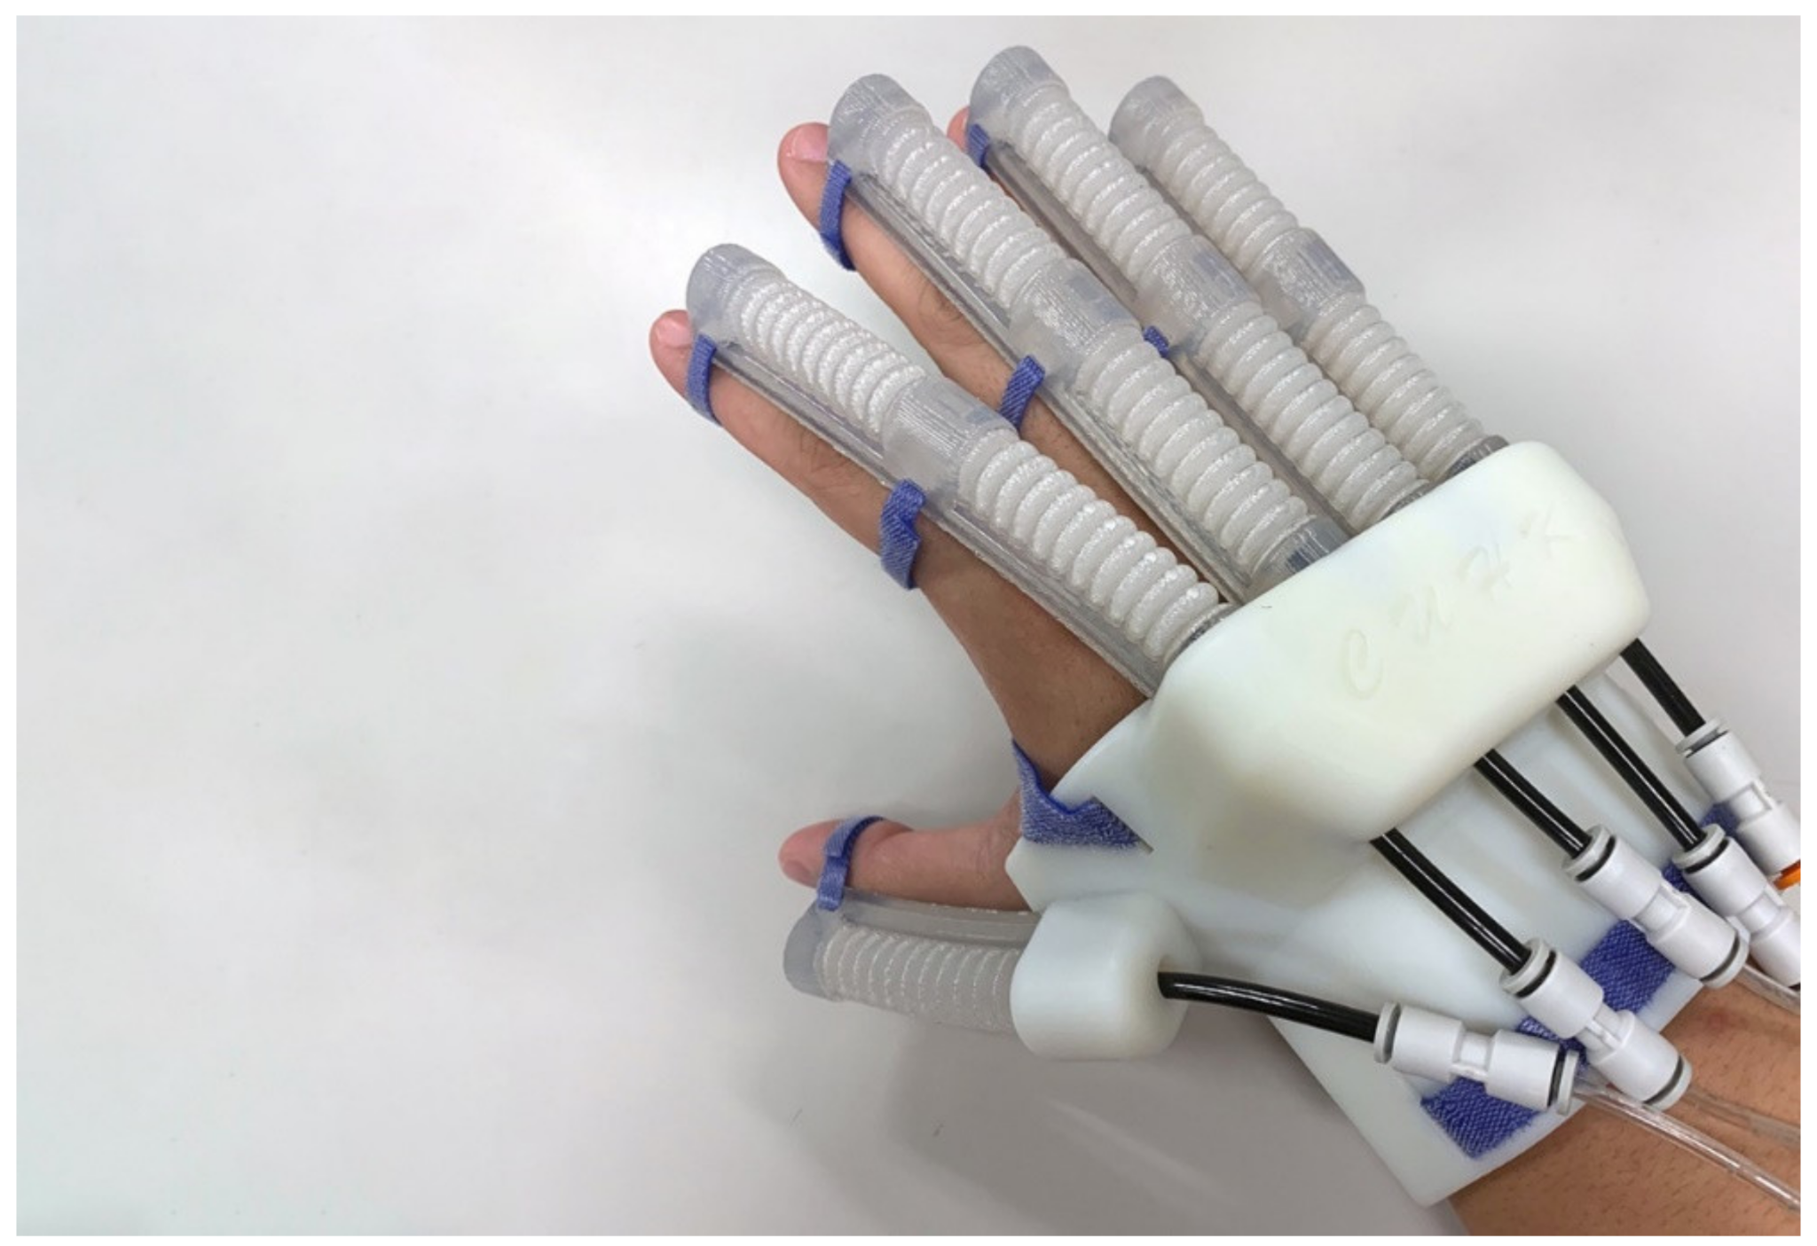
BACKGROUND: SOFT ROBOTICS
A type of robot made from flexible, deformable materials
Conforms to irregular shapes to meet unique demands
Safe for human contact, ideal for wearables
Often powered using pneumatics or hydraulics, electrical power requires high voltage (not skin safe)
Pneumatic soft heart sleeve that assists the heart in beating [3]
Soft robotic glove for rehabilitation [6]

Slide 3
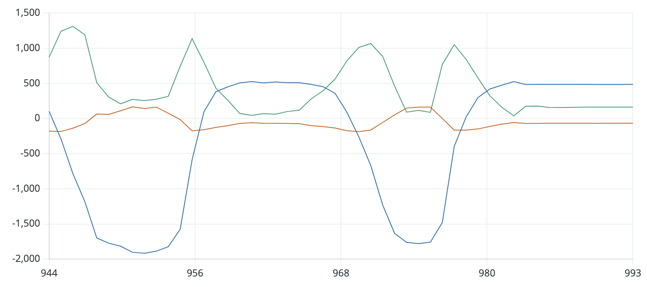
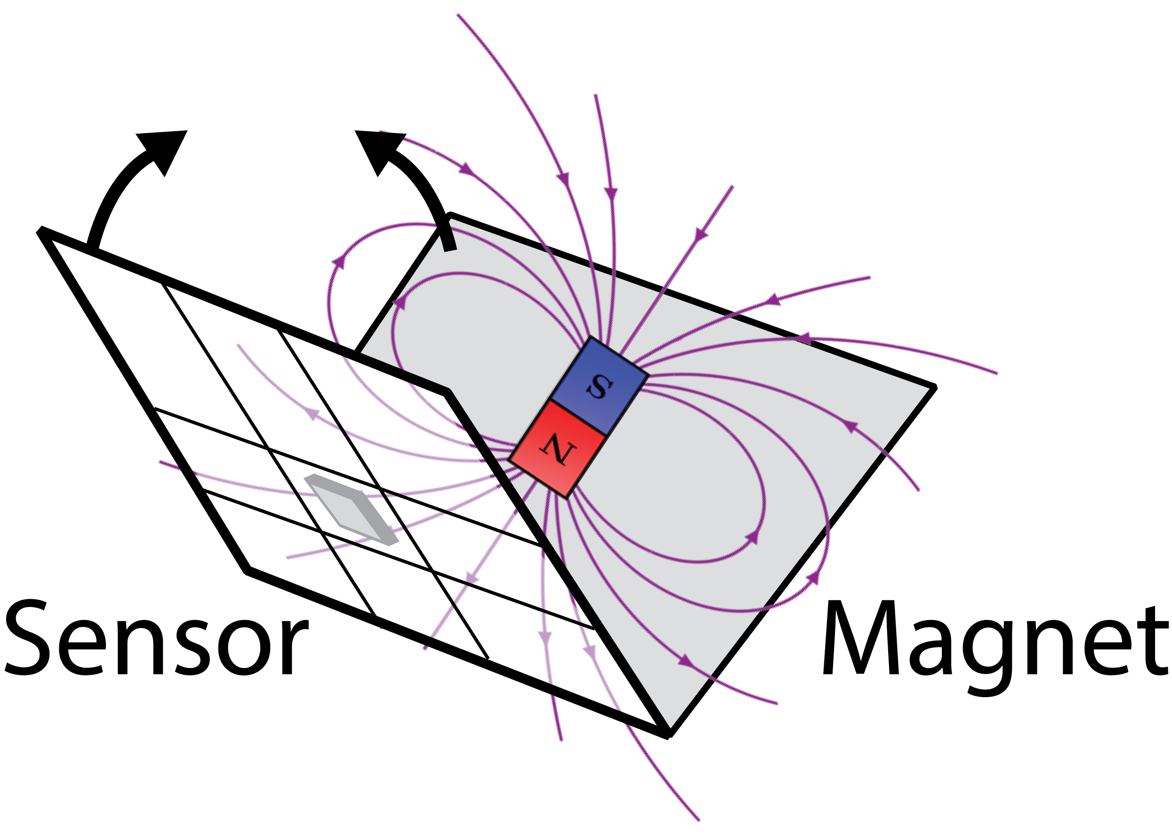
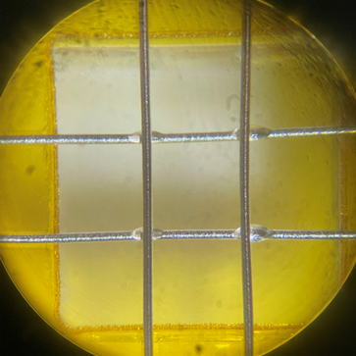
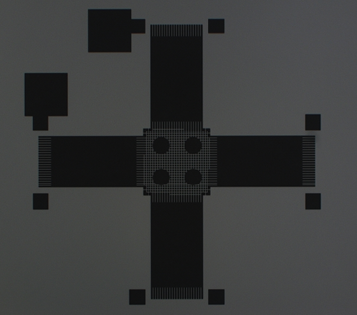
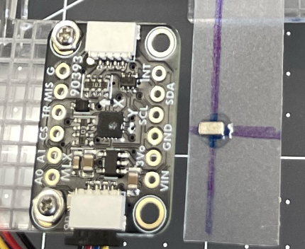
EMBEDDING SENSORS IN SOFT MATERIALS: SUMMER 2025 REU PROJECT
STUDENT: Boston McGarrahan. MENTOR: Dr. Cindy Harnett.
Soft, deformable, and breathable circuit boards will put electronics in new places. The specific goal for this REU is to measure folding in fabric and other thin materials using tiny sensors. The goal is a sticker that uses a small magnet embedded in fabric to sense a bending angle at a hinge in a folding structure without interfering with motion.
Prototyping
Miniaturizing
Mask layout with pins for sensor and four microgrippers
MMC5603 temperature/
magnetic vector sensor
Binding sites for microgrippers
Notes:
Original project name is ATTACHING MICRODEVICES TO FIBERS FOR FLOW-THROUGH ELECTRONICS

Slide 4
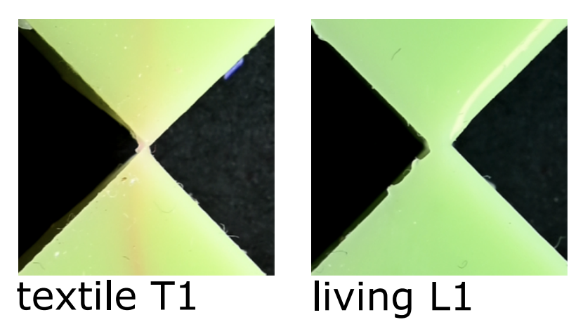
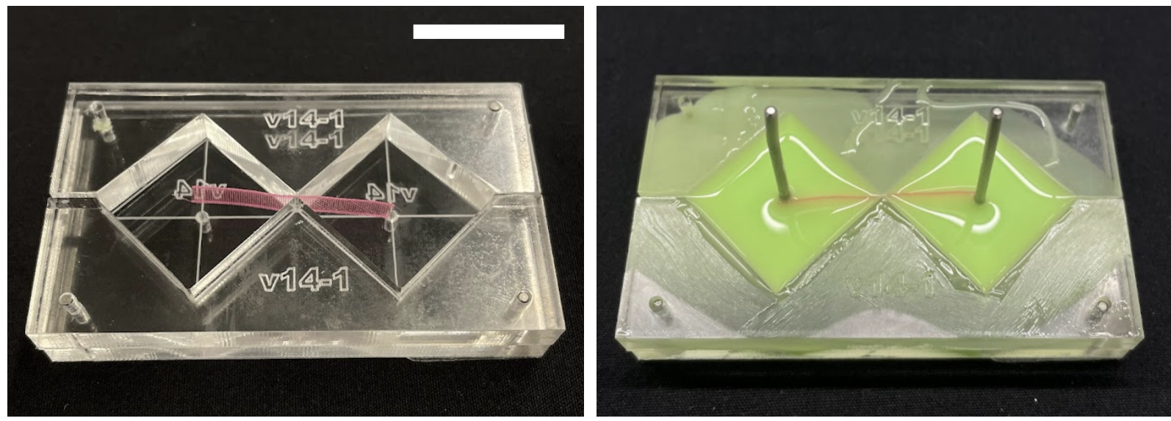
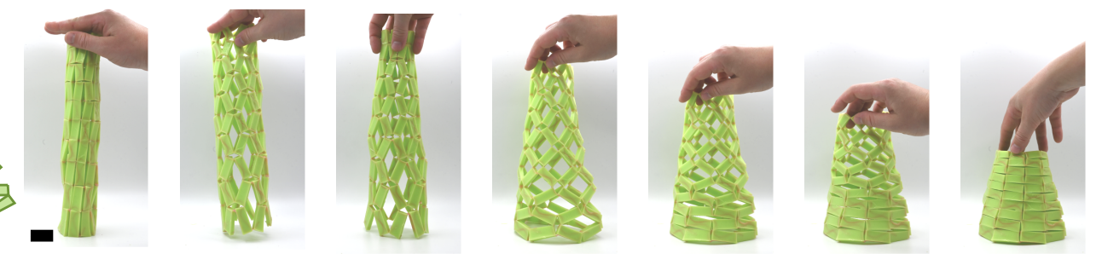
MOTIVATION: SELF-RESTORING HINGES
Actuate to open hinge, will return to stable condition automatically
Angle sensors are a necessary step in developing these devices
Collaborator at RWTH Aachen U. is also developing 3D folding structures to pair with our sensor
(A.S. Meussen et al)

Slide 5
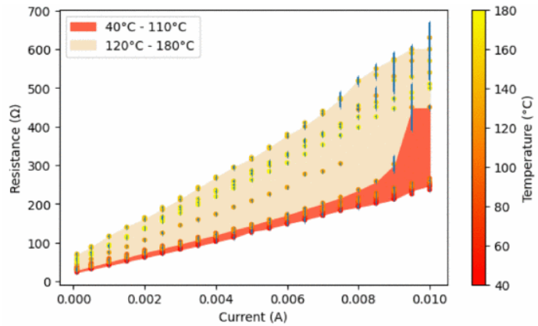
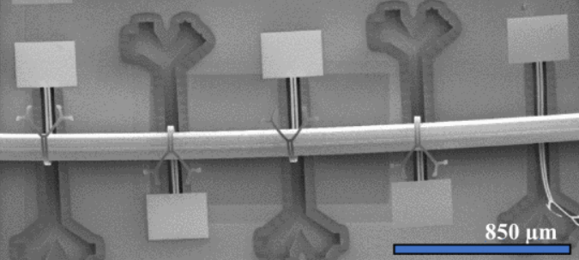
MOTIVATION: DETECTING CURRENTS IN NEARBY WIRES
MEMS microgrippers flex across a seam to power devices
Magnetic field sensors can characterize currents through these wires to track performance and power loss
(N. Song et. al)

Slide 6
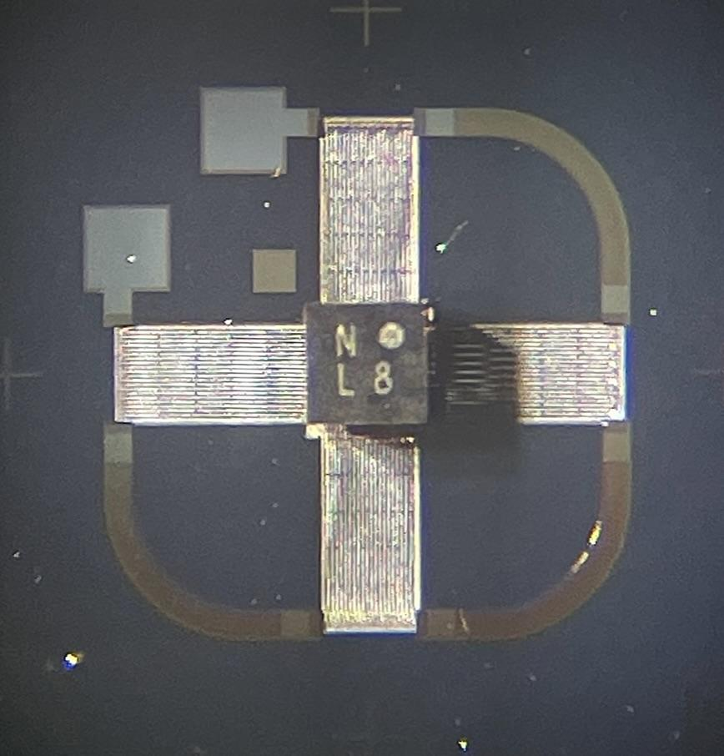
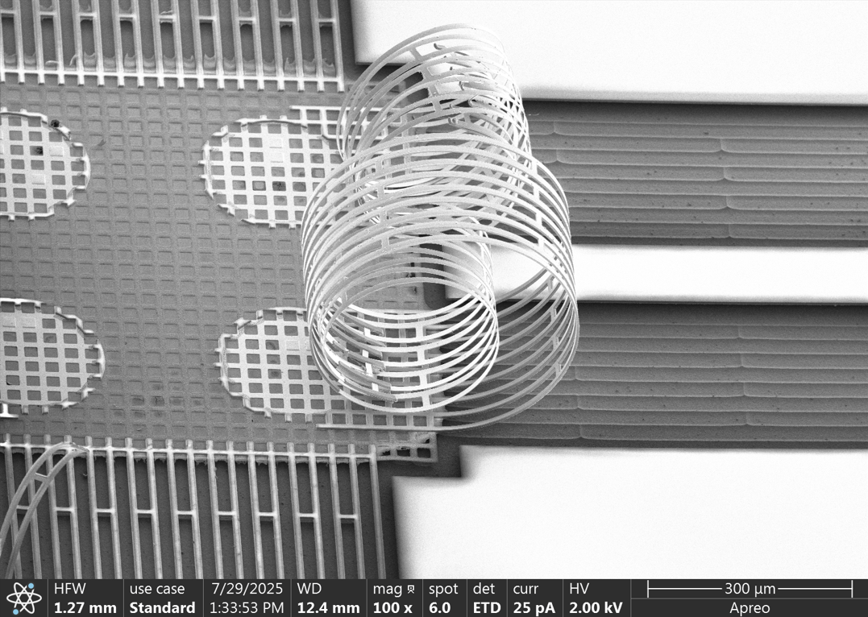
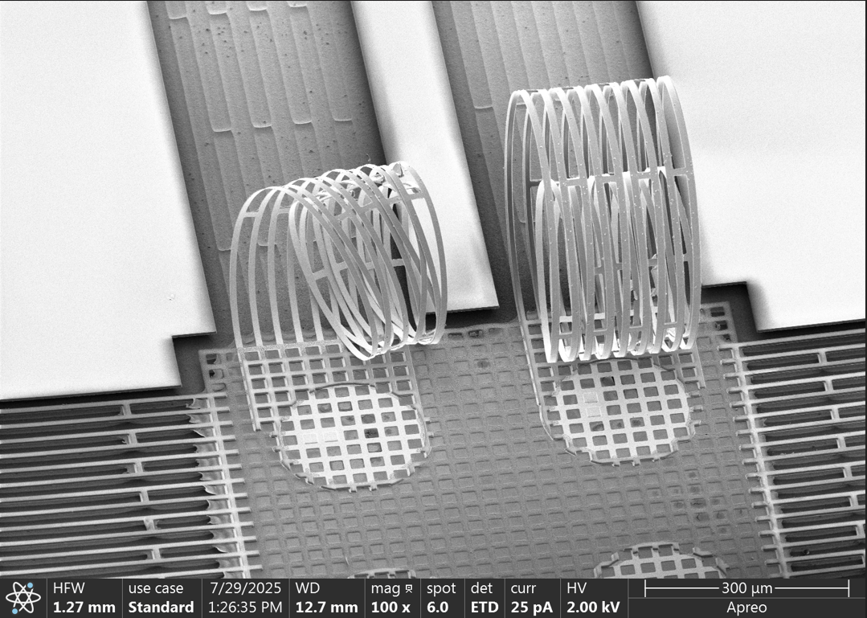
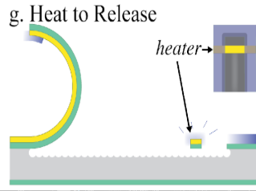
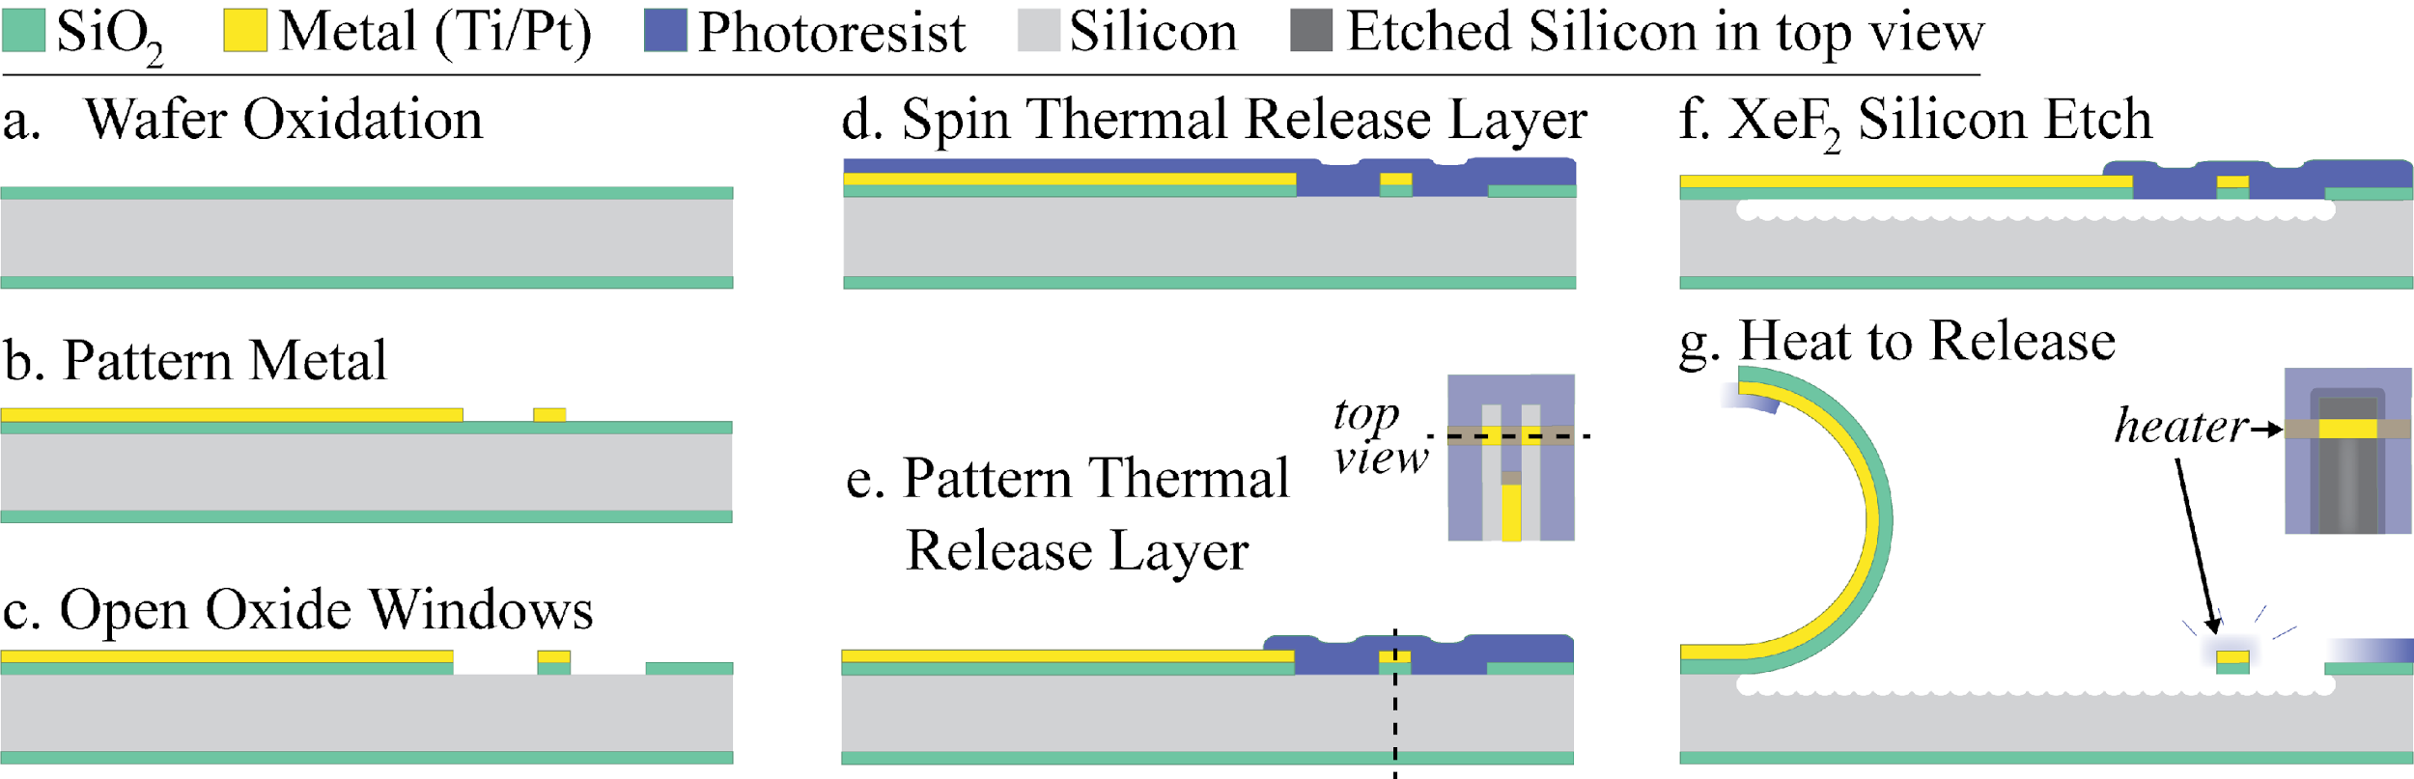
MEMS MICROFABRICATION
Oxidized silicon wafers create compressive stress, creating ‘pop-up’ structures for rapid microassembly of circuits
Sensor pins are mapped to specific grippers, allowing for each binding site to represent a pin header
Magnetic field sensor attached to MEMS device
(Beharic, Jasmin, and Cindy Harnett)
SEM images of grippers after release

Slide 7
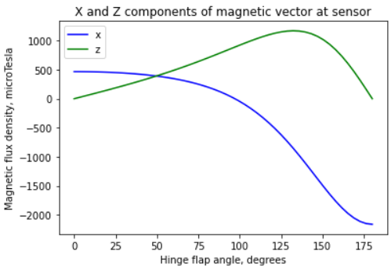

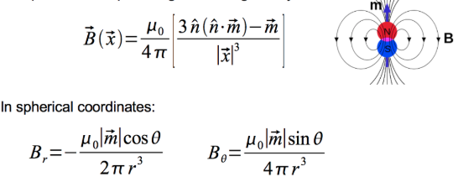

MAGNETIC FIELD VECTORS
Magnetic dipoles: a simplified model that represents the magnetic field of a volume as if it were a single point
As radius decreases, the geometry of the magnet becomes increasingly relevant
The most precise model uses a sum of sine and cosine terms, which isn’t feasible for our design

Slide 8
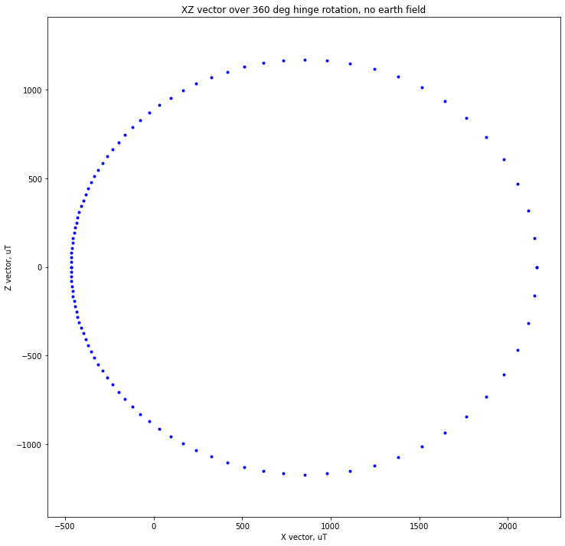
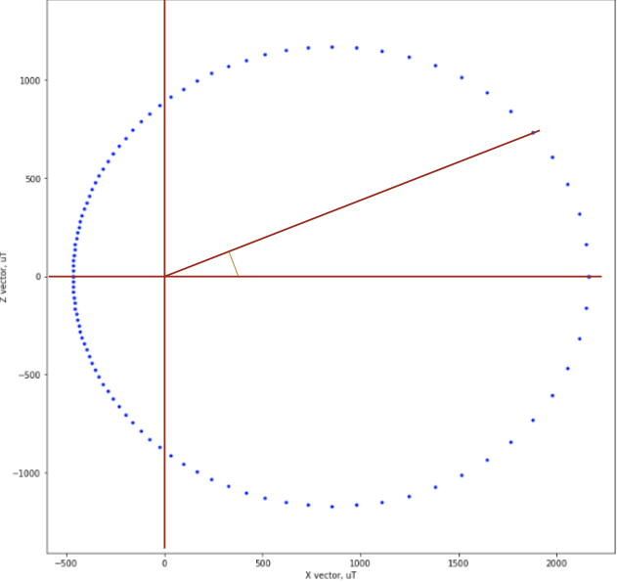
GOAL: CURVE FITTING IN C++
Problem: Final product is a small microcontroller with limited library access
Solution: Calculate angle as 𝜶 = tan⁻¹ (B_{z} / B_{x}) and fitting that to known hinge angle where 𝛉 = A𝜶² +B𝜶 + C
A, B, and C will be determined experimentally
α

Slide 9
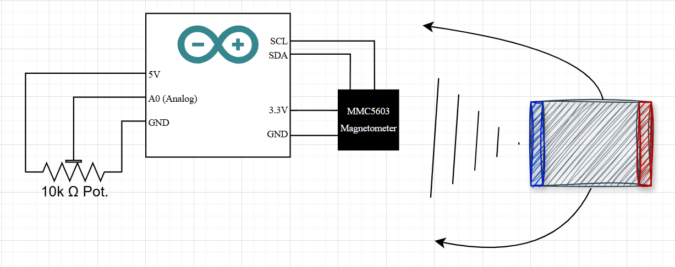
Magnetic Angle Sensor Testing Circuit Diagram
MLX90393
S
N
Magnetic Dipole

Slide 10
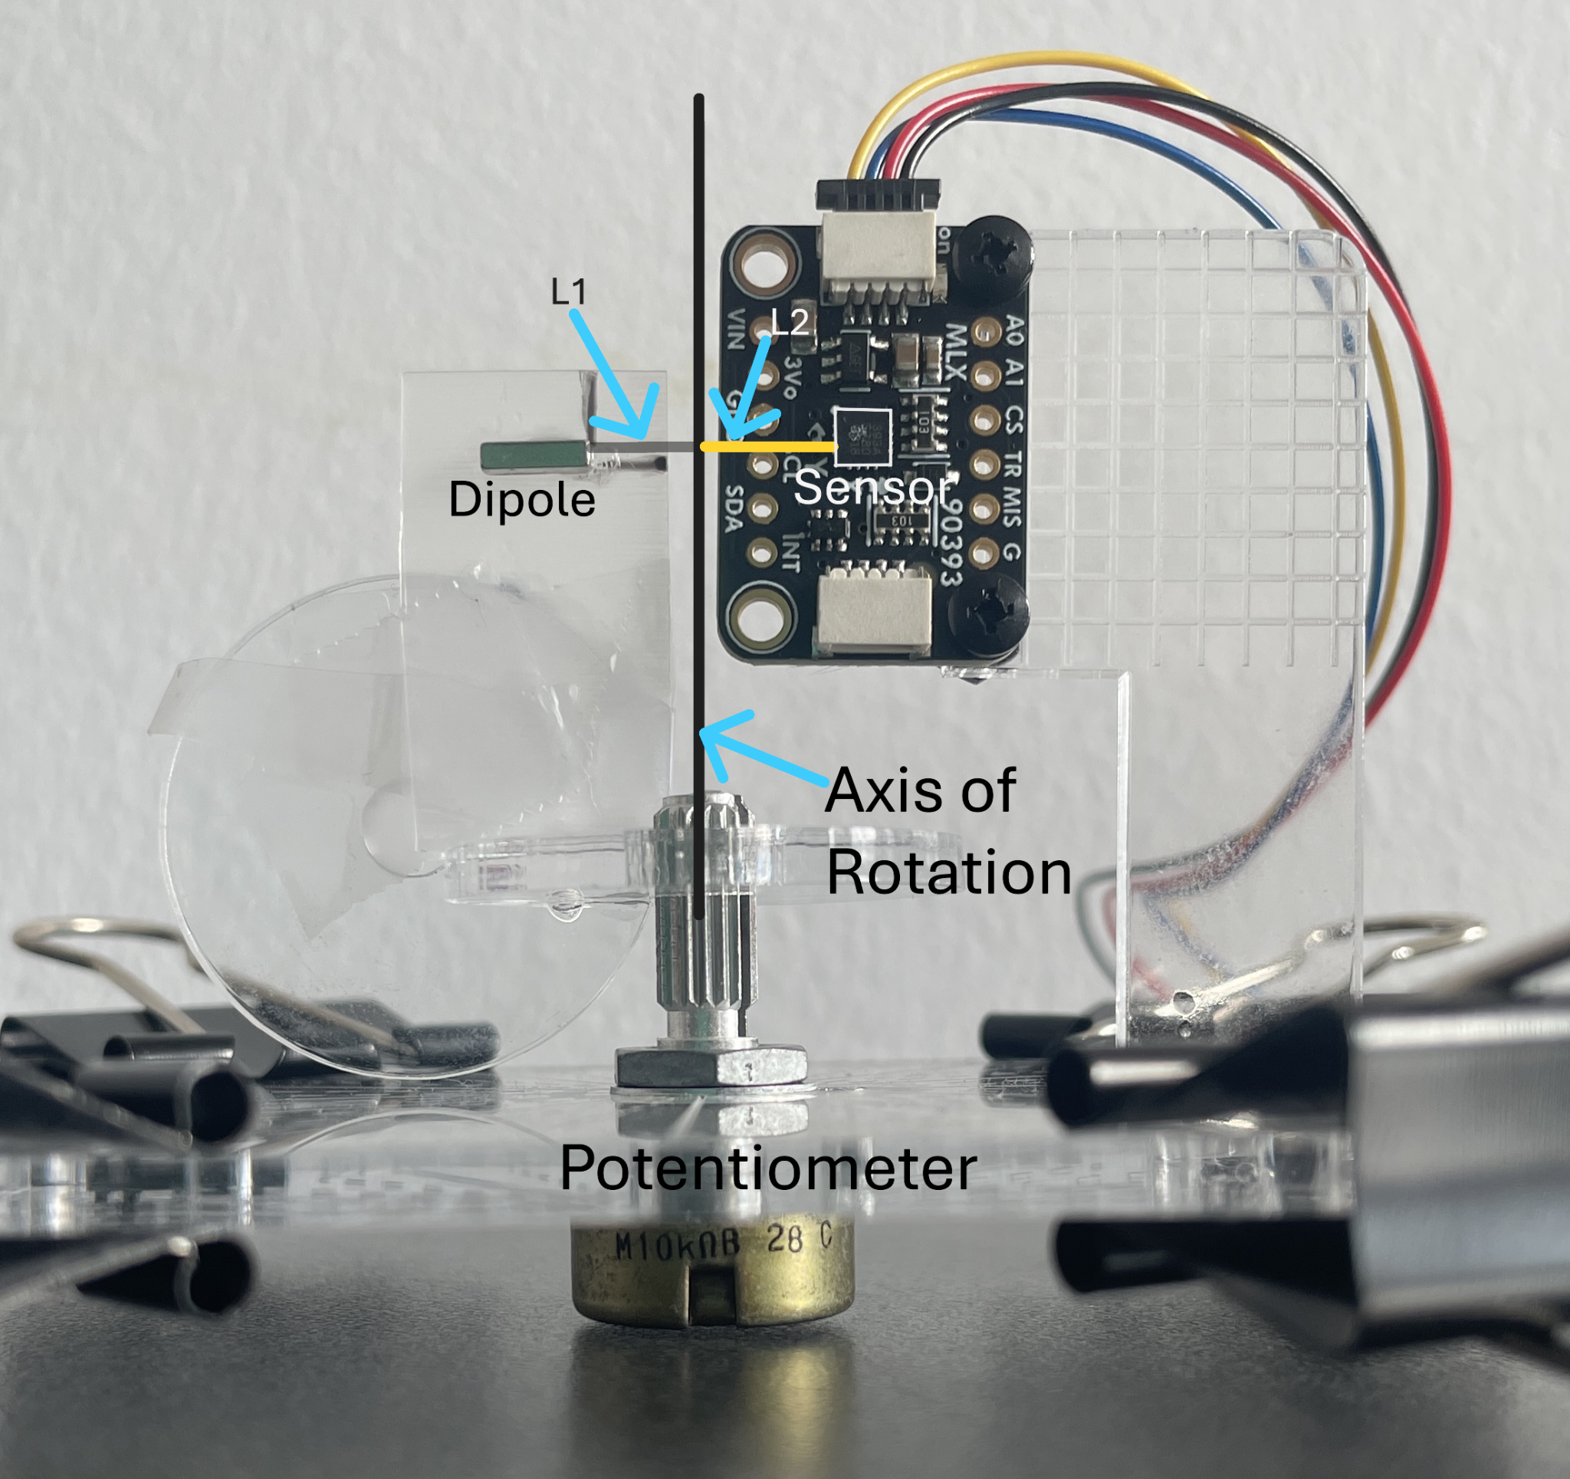
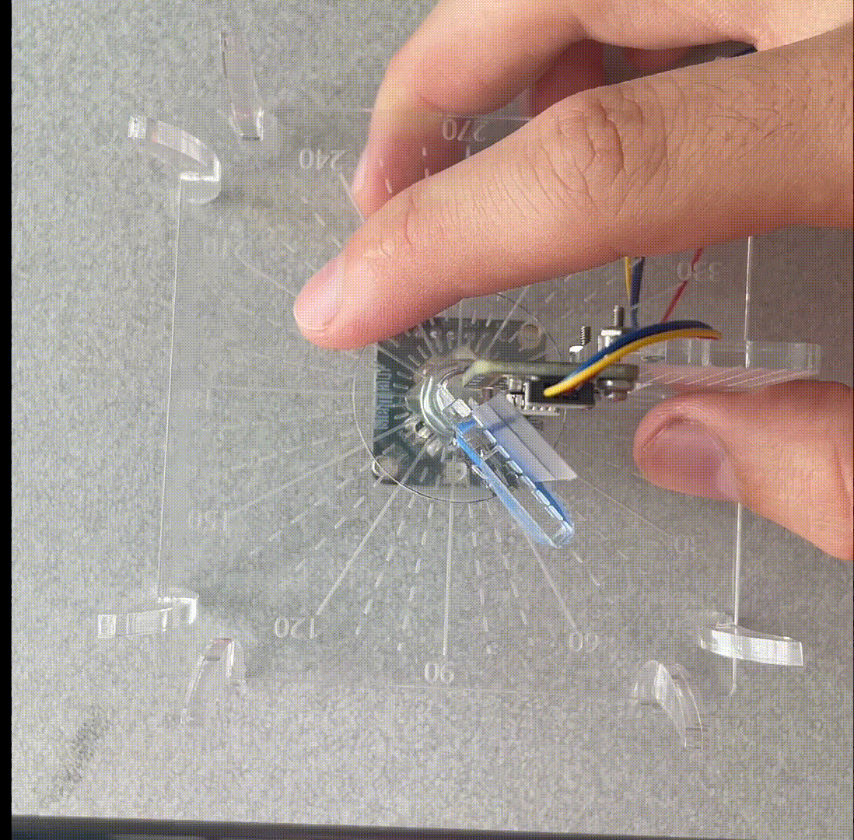
Magnetic Angle Sensor Test Stand

Slide 11
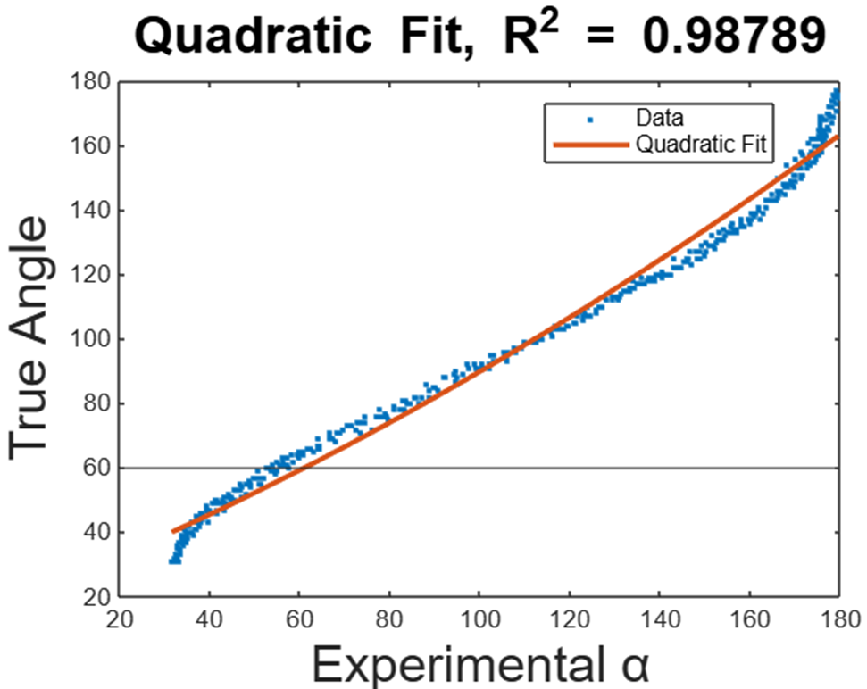
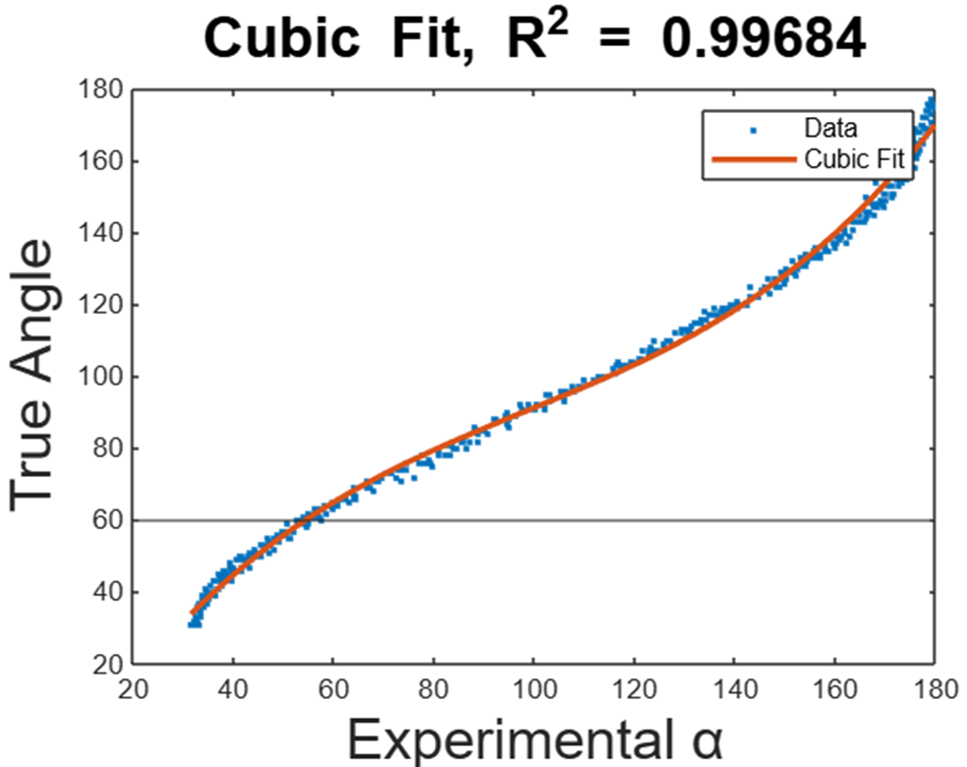
FITTING DATA: MLX90393 MAGNETOMETER
Using either fit with too many significant digits causes integer overflow on microcontroller
Noticing a hysteresis effect over longer sampling periods

Slide 12
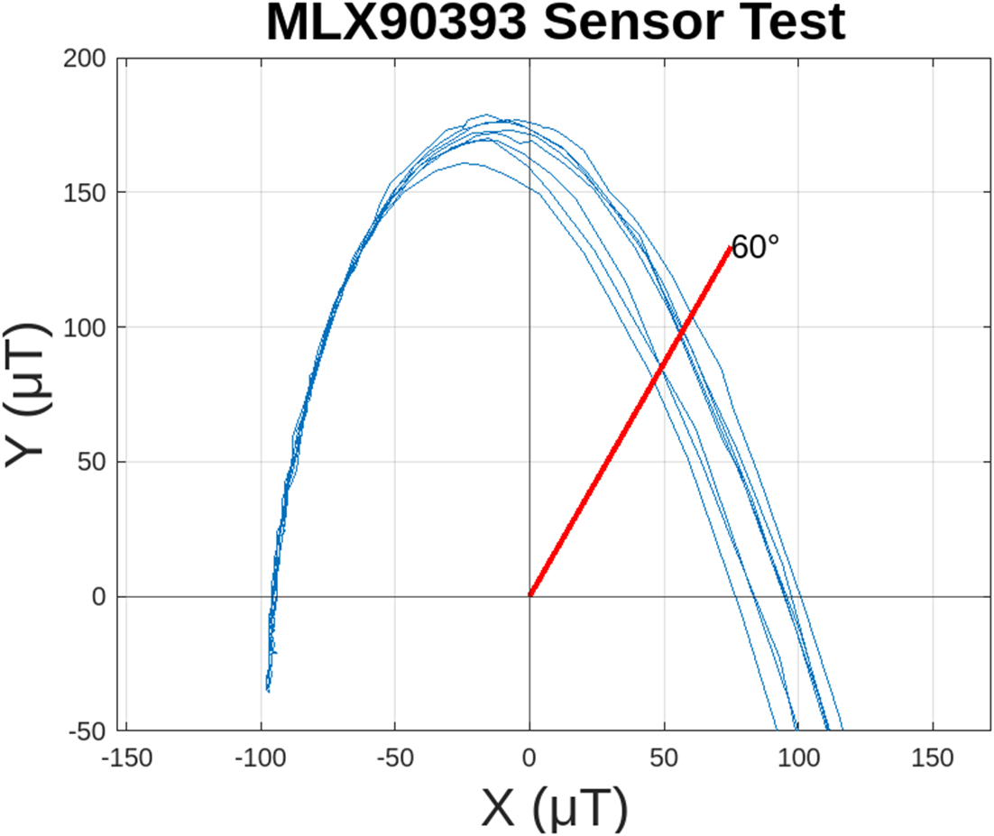
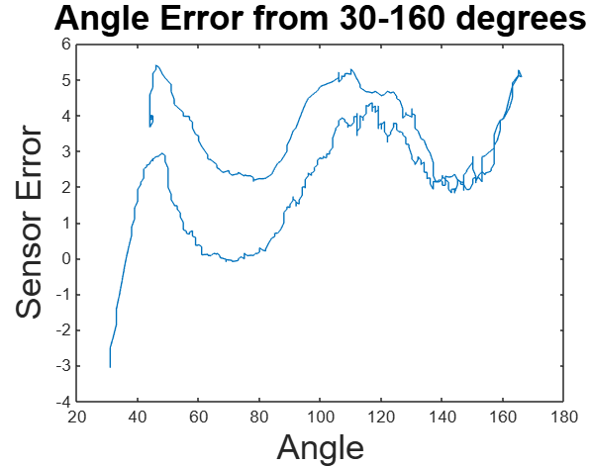
MLX90393 ERROR: HYSTERESIS EFFECT
~160°
~60°
~160°
Unknown if this is due to sensor fatigue or the potentiometer having a nonlinear resistance
Angle error is 2.64 ± 1.77°

Slide 13
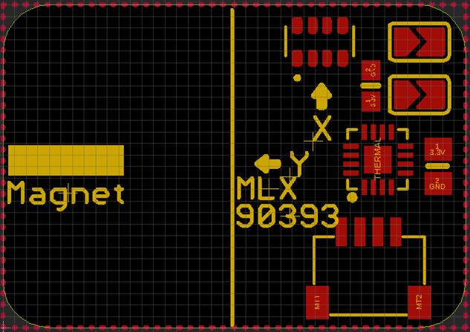
DISCUSSION:
B_{Earth} is subject to change across hemispheres, is potentially another source of angle error
0.7x1” Polyimide PCB printing
has been delayed
MEMS carrier will make further
miniaturization possible
L1
L2
Notes:
This board has hit a delay at Oshpark where they switched to a new facility for flex PCB manufacturing. What normally takes 10 days is on Day 20 and counting.

Slide 14
ACKNOWLEDGMENTS
Dr. Cindy Harnett, Department of Electrical and Computer Engineering
Ana Sanchez Galiano, J.B. Speed School of Engineering
James (JD) Morris, PhD, MNTC Process Engineer
Jasmin Beharic, PhD, MNTC Process Engineer
Dr. George Lin, LARRI/ECE Staff
All of my IMPACT-NG REU Cohort

Slide 15
References
¹A.S. Meeussen, G. Bordiga, A.X. Chang, B. Spoettling, K.P. Becker, L. Mahadevan, K. Bertoldi, Textile
hinges enable extreme properties of mechanical metamaterials, arXiv [Cond-Mat.Soft] (2024).
http://arxiv.org/abs/2408.16059.
²Beharic, Jasmin, and Cindy Harnett. 2025. “Thermally Switchable Tethers for Rapid Release of Strained
Microstructures.” J. Microbio Robot. 21 (1): 3. https://doi.org/10.1007/s12213-025-00183-6.
³Ellen T. Roche et al.,Soft robotic sleeve supports heart function.Sci. Transl.
Med.9,eaaf3925(2017).DOI:10.1126/scitranslmed.aaf3925
⁴L.S. Novelino, Q. Ze, S. Wu, G.H. Paulino, & R. Zhao, Untethered control of functional origami
microrobots with distributed actuation, Proc. Natl. Acad. Sci. U.S.A. 117 (39) 24096-24101,
https://doi.org/10.1073/pnas.2013292117 (2020).
⁵N. Song, D. Wei and C. K. Harnett, "Powering Wire-Mesh Circuits through MEMS Fiber-Grippers," 2023
IEEE International Conference on Flexible and Printable Sensors and Systems (FLEPS), Boston, MA, USA, 2023, pp. 1-4, doi: 10.1109/FLEPS57599.2023.10220225.
⁶Su, H., Hou, X., Zhang, X., Qi, W., Cai, S., Xiong, X., & Guo, J. (2022). Pneumatic Soft Robots:
Challenges and Benefits. Actuators, 11(3), 92. https://doi.org/10.3390/act11030092

