Slide 1




Dynamic Energy Transfer in Hierarchical Multicomponent Alginate Composite Materials
Participant: Nattasha Wongse-Sanit, Northern Arizona University
Mentors: Ysaris Sosa and Manuel Guerrero, Northern Arizona University
Advisor: Dr. Gabriel Montaño, Northern Arizona University
1

Slide 2
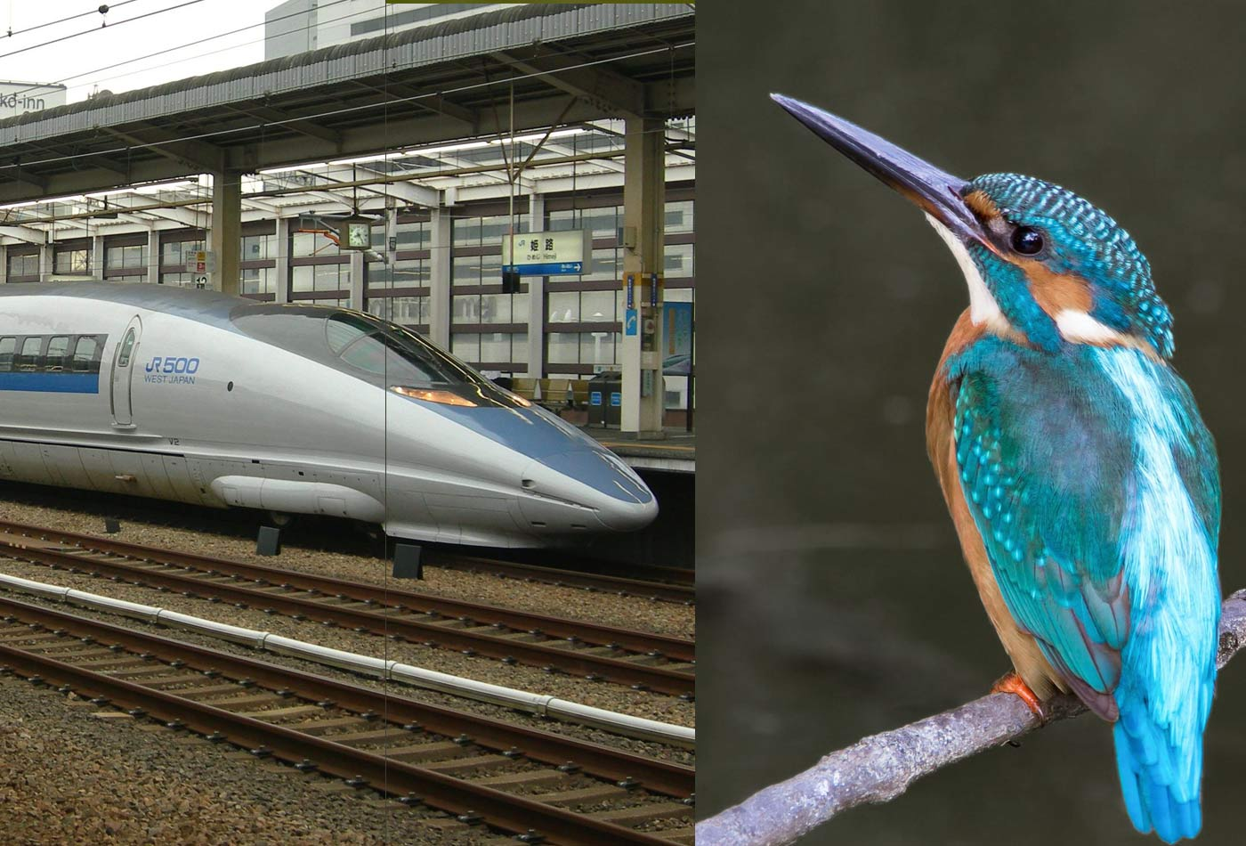
Why Biomimetics?
Biomimetics seeks to replicate structural and functional biological properties in synthetic materials.
Structural mimicry involves generating materials that physically resemble a structure in nature, while functional mimicry involves generating materials that functionally mimic the behavior of a biological structure/complex.
Example: the kingfisher bird’s beak inspired the design of the Japanese Bullet Train
[1]
Kondos, Rebecca. “What Happens When You Combine a Kingfisher and a Bullet Train? Innovation.” O’Reilly Media, 6 June 2017, www.oreilly.com/content/what-happens-when-you-combine-a-kingfisher-and-a-bullet-train-innovation/.
2

Slide 3
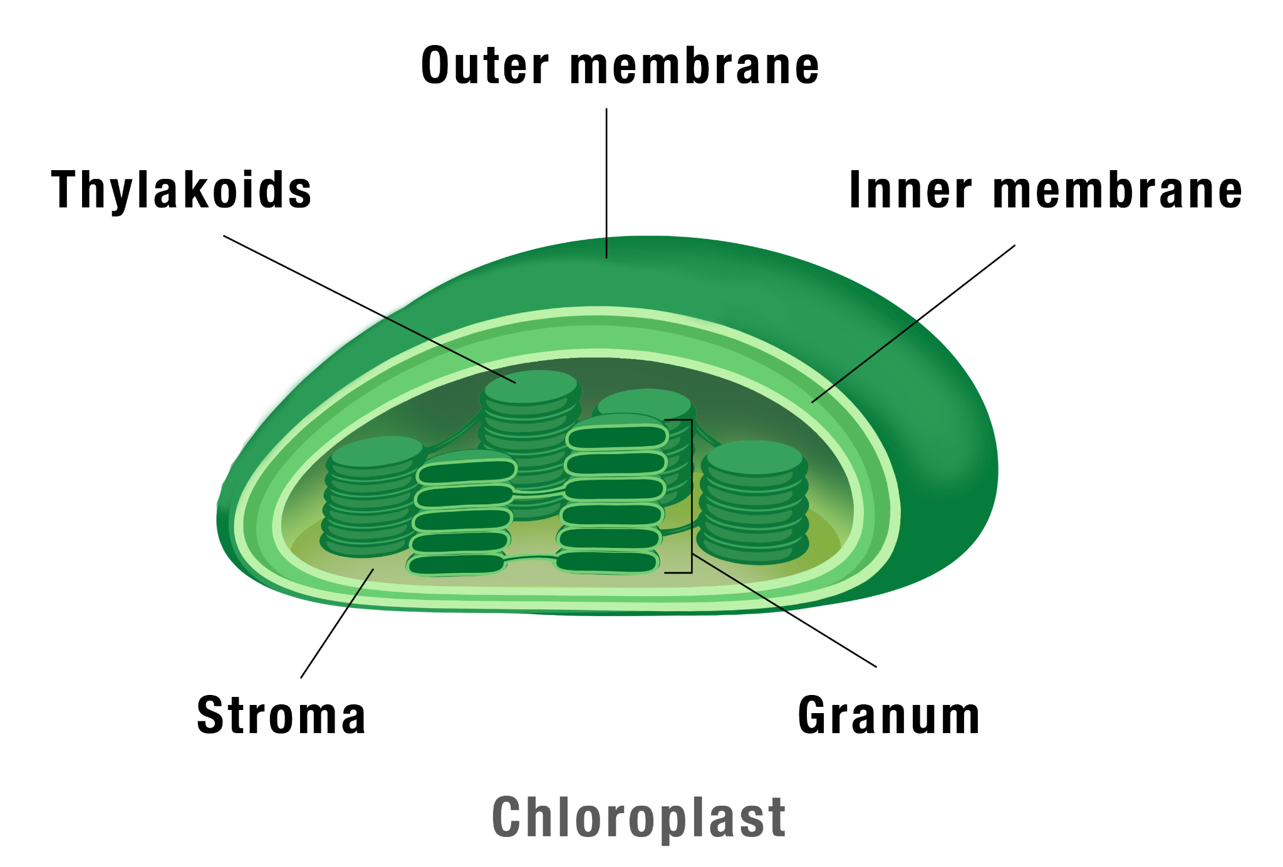
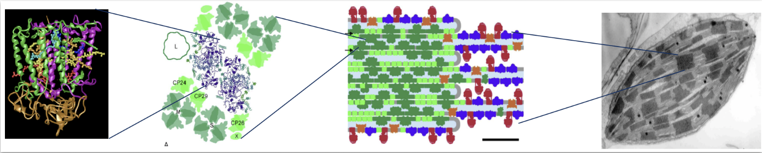
Hierarchical Organization
The compartmentalization and multiscaled organization found within cells facilitates photosynthesis, converting light energy into usable energy for plants.
Chromophores and proteins (molecular) organize into supramolecular complexes (mesoscale) that organize into organelles (microscale) resulting in complex function.
[2]
[3]
Monash University. “The Process of Photosynthesis.” Student Academic Success, 14 Jan. 2025, www.monash.edu/student-academic-success/biology/photosynthesis/the-process-of-photosynthesis.
Dekker, Biochim. Biophys. Acta, 1706, 12, 2005
3

Slide 4
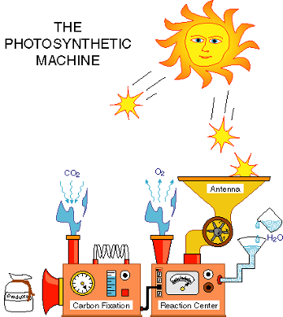
Overall Goal
[4]
Our goal is to mimic multiscaled cellular communication processes such as regulated light-harvesting and energy transfer in polymer membrane materials.
4

Slide 5
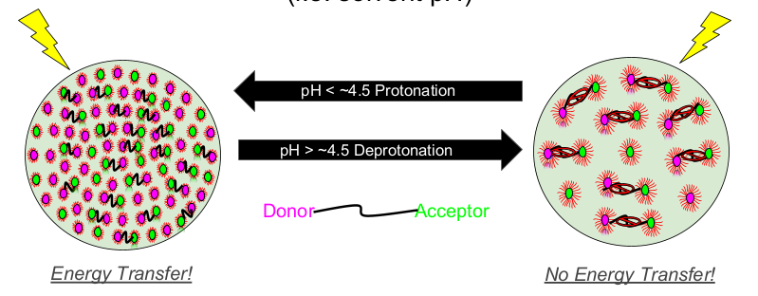
Project Approach
[5]
Encapsulate photonic cofactors (Donors and Acceptors) in amphiphilic block copolymer (ABC) micelles
Organize ABC micelles in alginate polymer microbeads for dynamic energy transfer
5

Slide 6
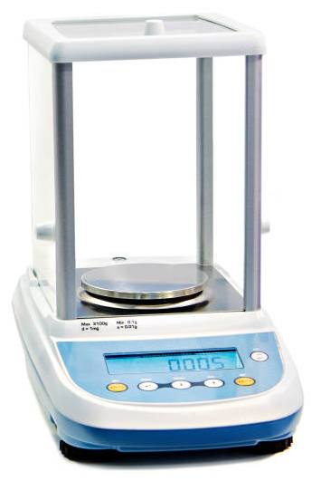
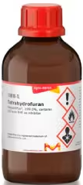
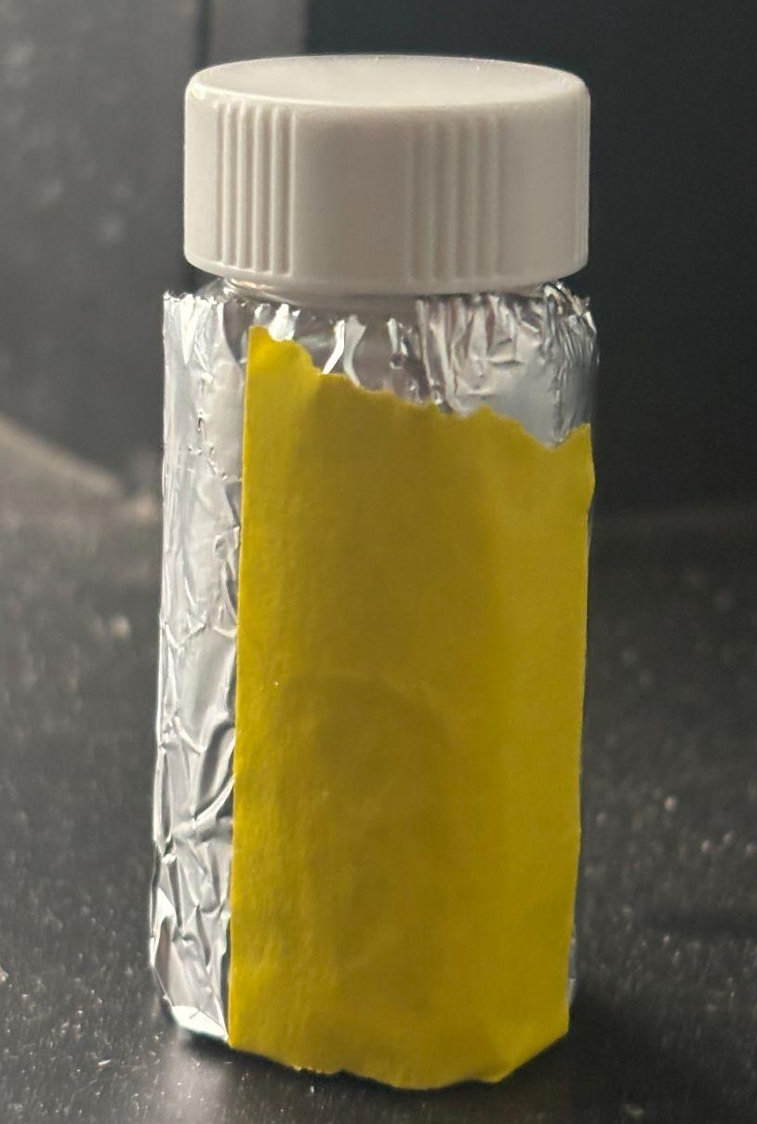
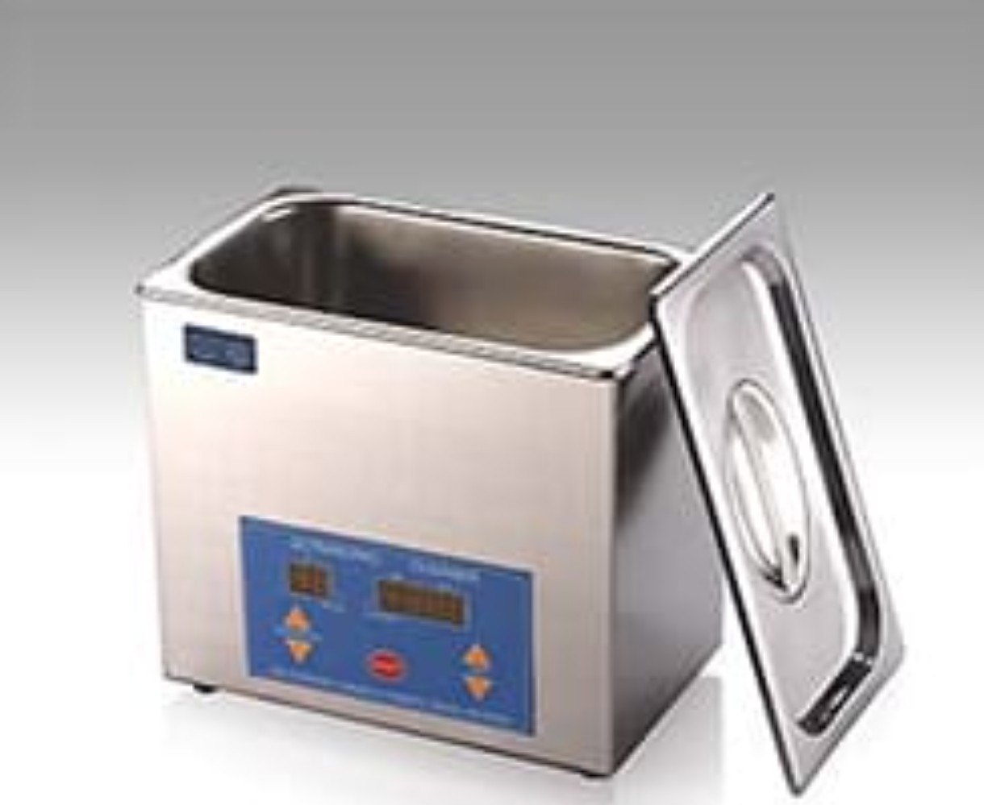
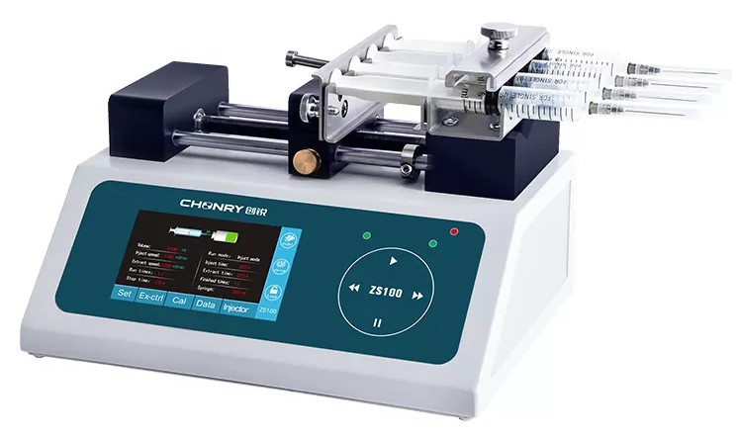
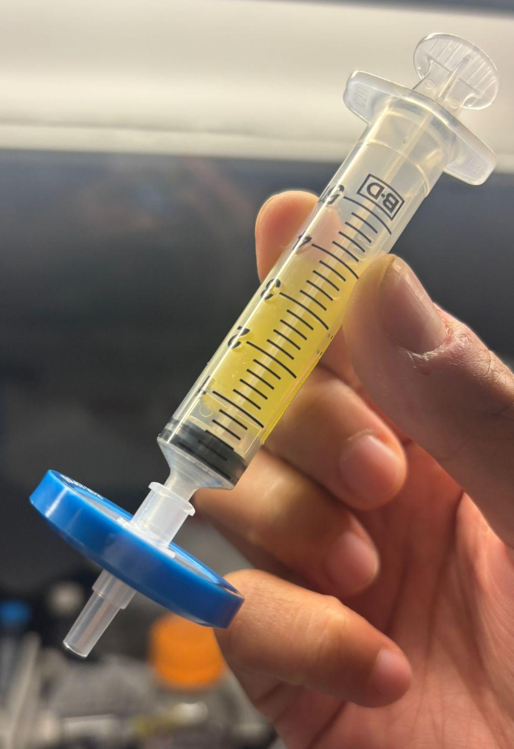

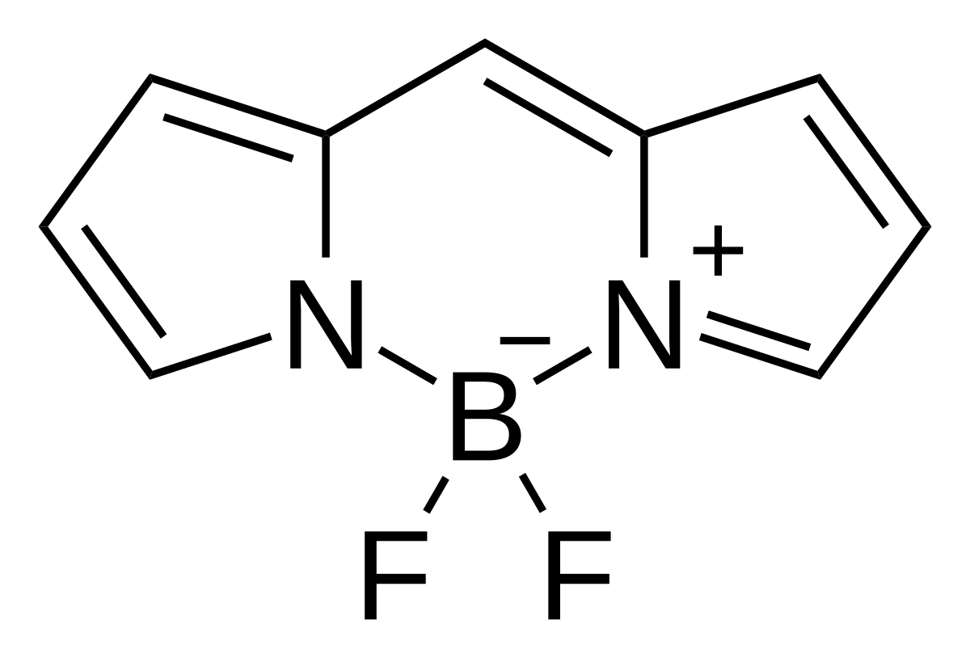
ABC Polymer Micelle Synthesis
[6]
Weigh out the desired amount of polymer
Add desired amount of organic solvent
Parafilm and sonicate for 10-15 minutes
Create a foil wrap to minimize light exposure
BODIPY = boron-dipyrromethene
Add desired amount of fluorophores to the sample
Infuse with water and let organic solvent evaporate for 24 hours
Filter out impurities with syringe filter
~1.5 mL of fluorescent micelles
6

Slide 7
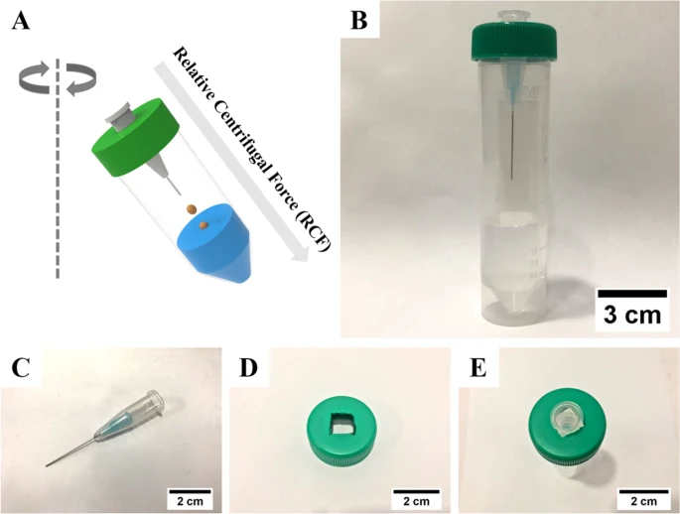
Alginate Microbead Synthesis
During centrifugation, sodium alginate is forced through the micronozzle into the calcium chloride (CaCl₂) solution below. CaCl₂ induces cross-linking of the alginate.
The combination of centrifugation and cross-linking forms alginate microbeads.
[7]
Kang, Sung-Min, et al. “Centrifugal Force-Driven Modular Micronozzle System: Generation of Engineered Alginate Microspheres.” Scientific Reports, vol. 9, no. 1, 4 Sept. 2019, https://doi.org/10.1038/s41598-019-49244-4. Accessed 31 July 2020.
7

Slide 8
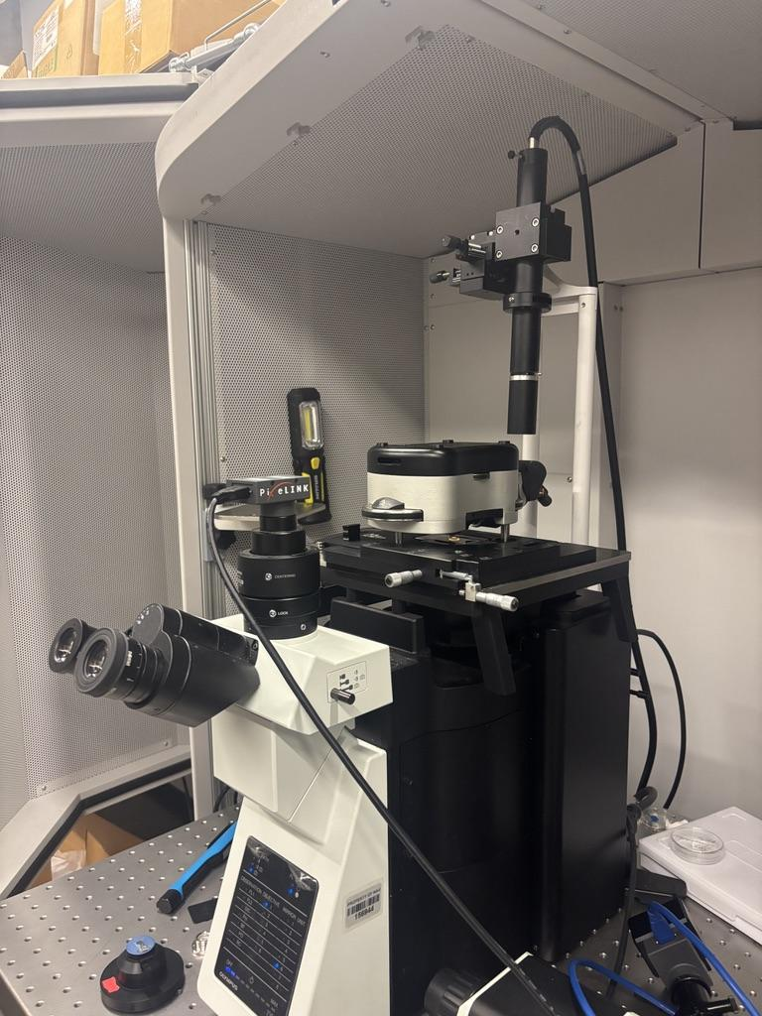
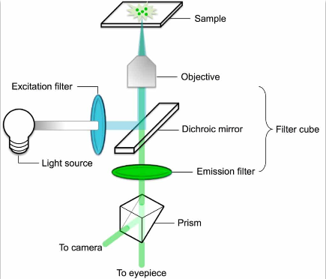
Characterizing via Optical Microscopy
[8]
[9]
Minn, Su, et al. “The Synthesis and Design of Nanoparticles for Measuring Traction Forces in Living Cells.” Springer EBooks, 1 Jan. 2021, pp. 759–772, https://doi.org/10.1007/978-981-15-9472-4_64. Accessed 28 July 2025.
8

Slide 9
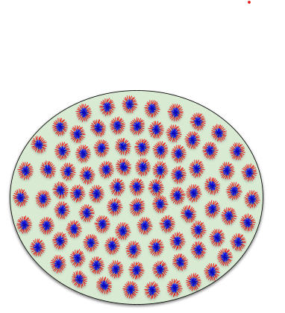
Structured Goals
Understand the variables behind microbead formation
  Understand how to alter morphology through the micronozzle system
Encapsulate cargo in the polymer system
  Encase micelles within the alginate using micronozzle system or other methods
Show inter-compartment energy transfer
  Add varying amounts of donor and acceptor micelles and measure that energy transfer
[10]
[11]
[12]
Kang, Sung-Min, et al. “Centrifugal Force-Driven Modular Micronozzle System: Generation of Engineered Alginate Microspheres.” Scientific Reports, vol. 9, no. 1, 4 Sept. 2019, https://doi.org/10.1038/s41598-019-49244-4. Accessed 31 July 2020.
9

Slide 10
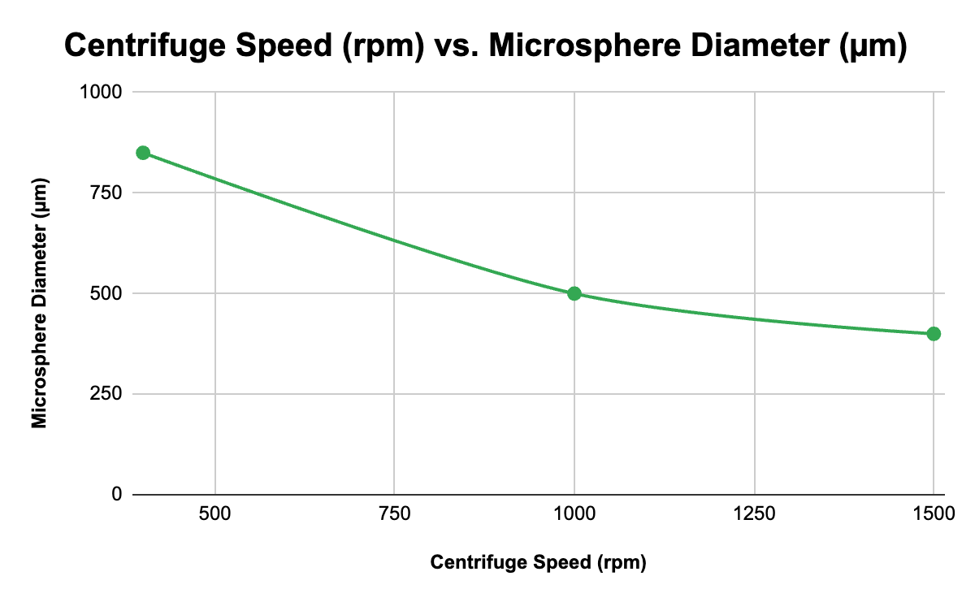
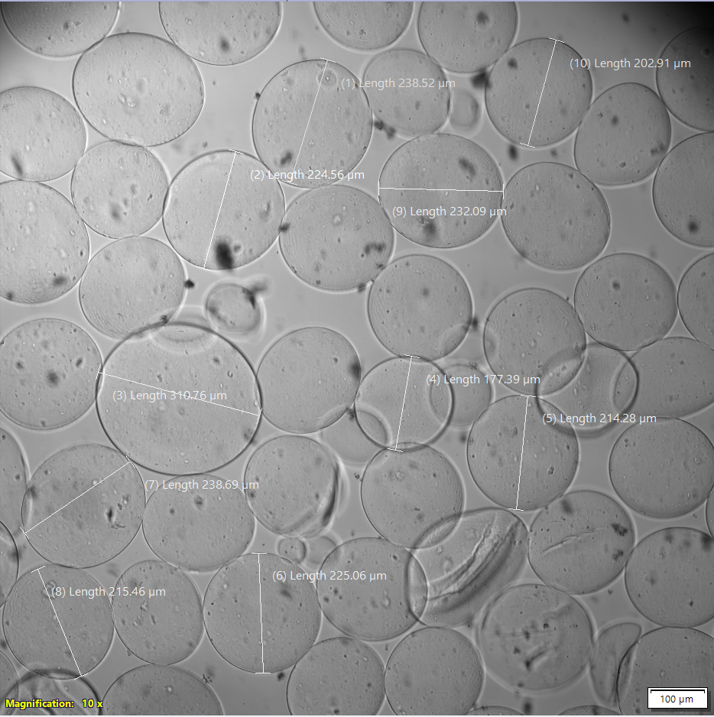
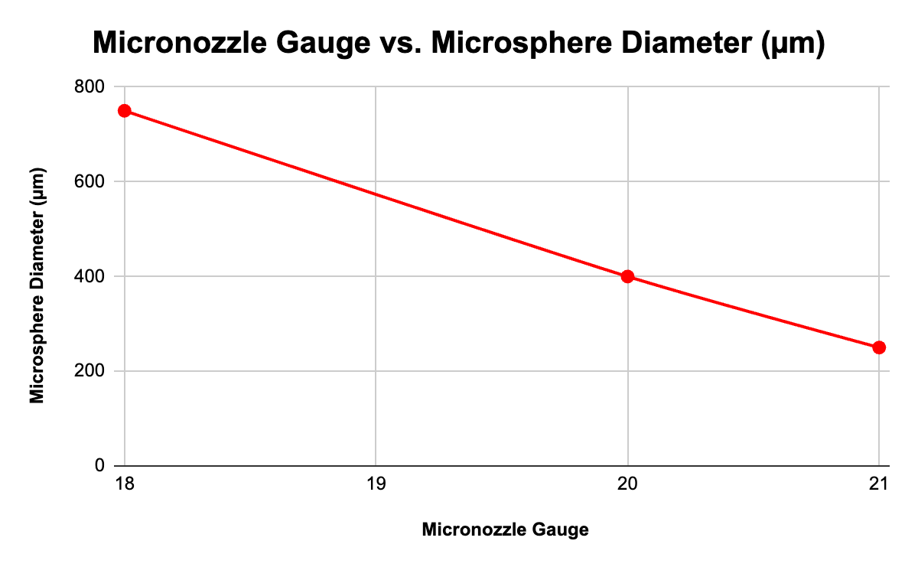
Centrifuge Speed Variable
[14]
[15]
[13]
10

Slide 11
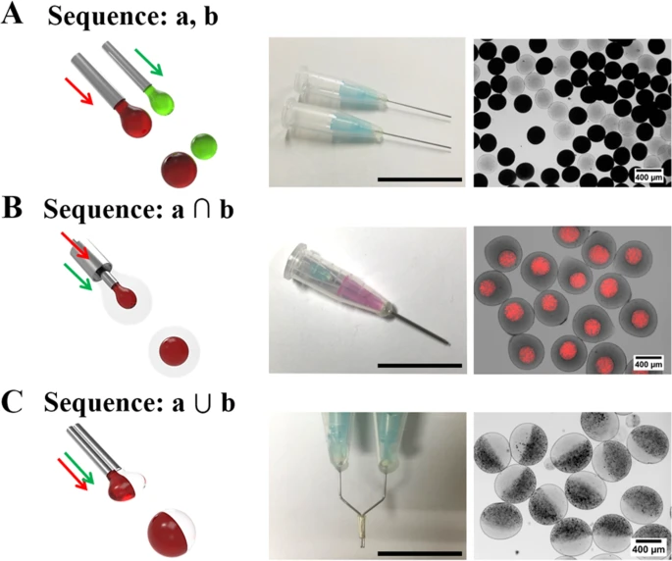
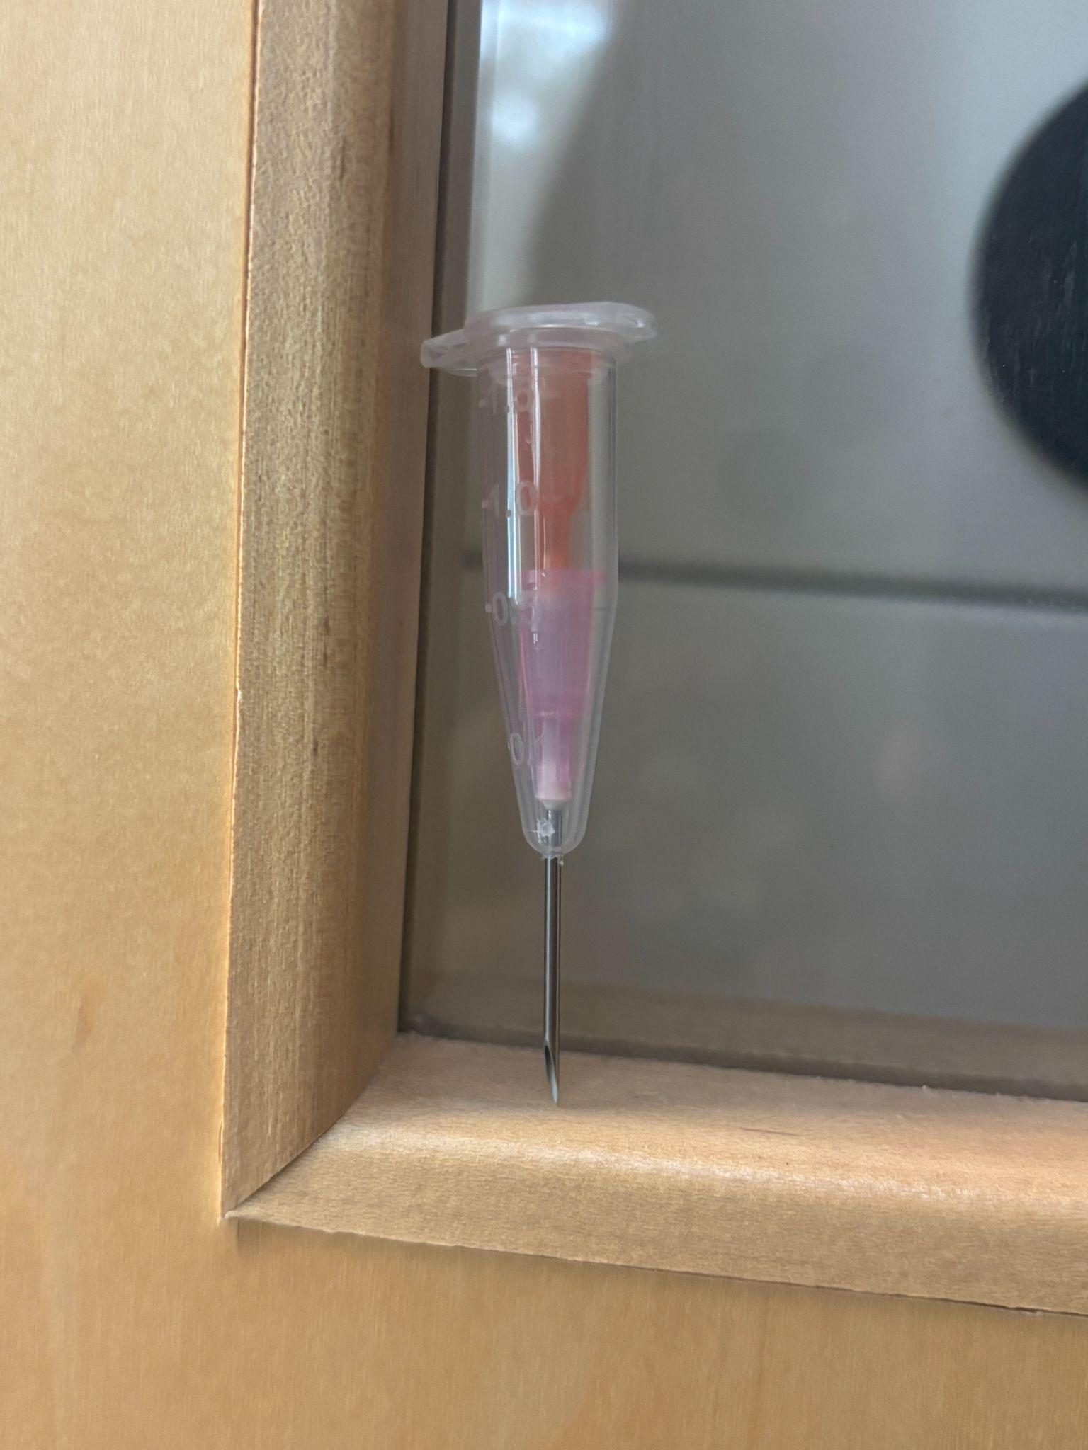
The “a⋂b” Sequence
[16]
[17]
[18]
Kang, Sung-Min, et al. “Centrifugal Force-Driven Modular Micronozzle System: Generation of Engineered Alginate Microspheres.” Scientific Reports, vol. 9, no. 1, 4 Sept. 2019, https://doi.org/10.1038/s41598-019-49244-4. Accessed 31 July 2020.
11

Slide 12
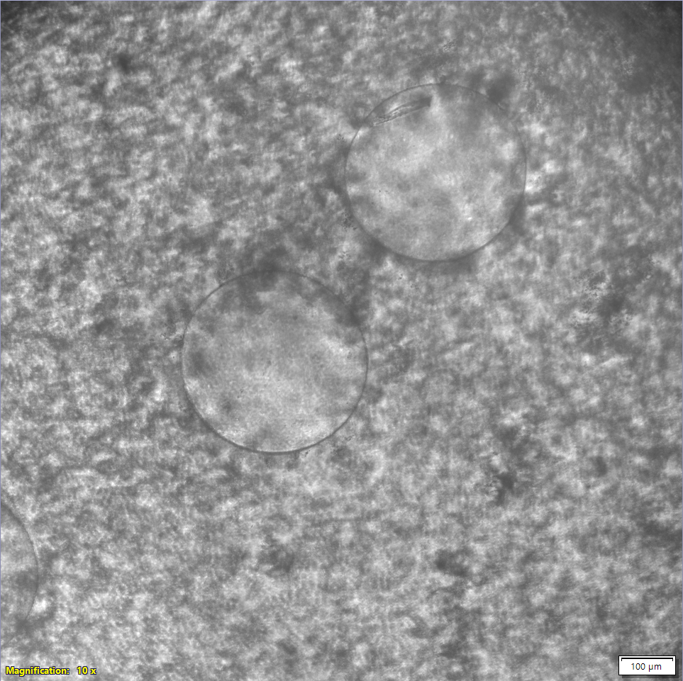
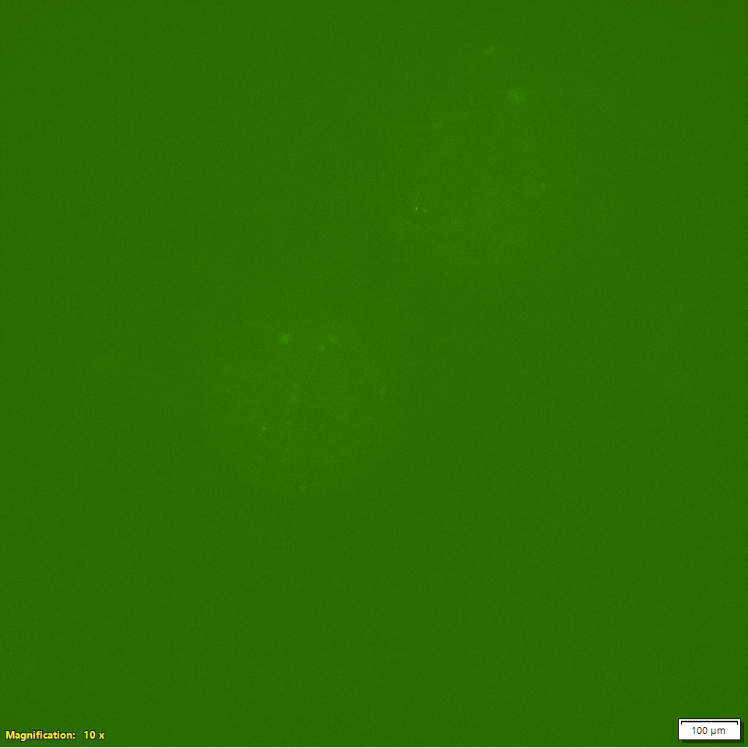
Encapsulation Attempts
[19]
[20]
Brightfield
Fluorescence
12

Slide 13
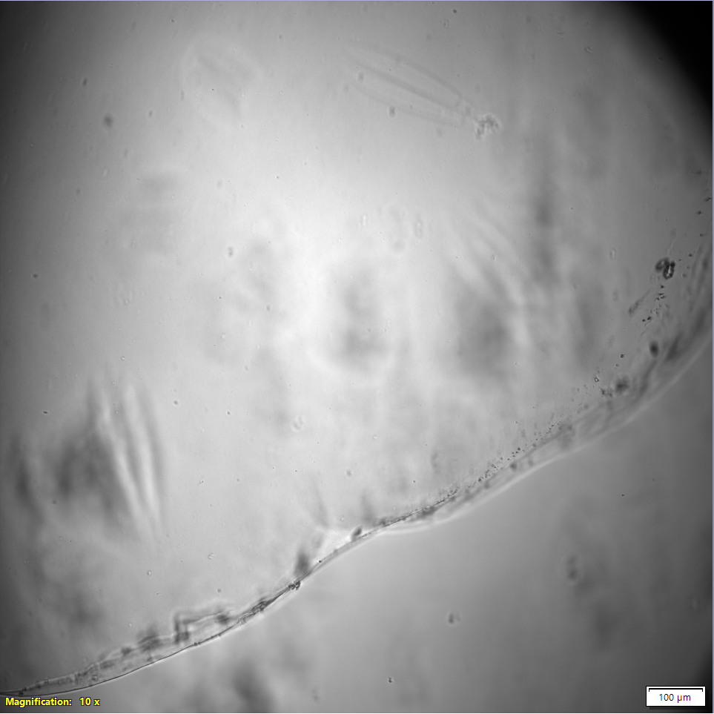
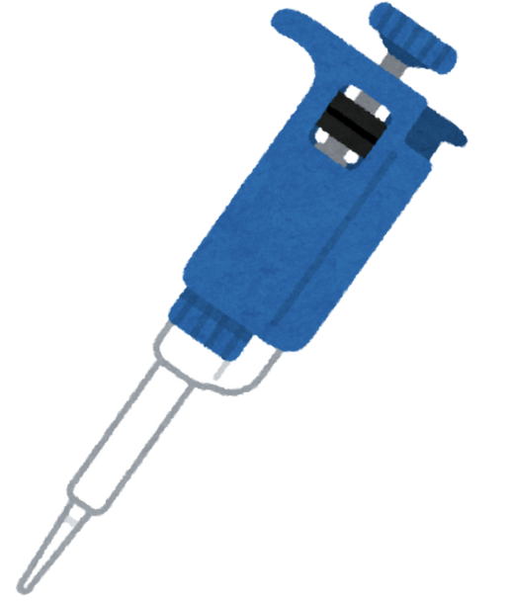
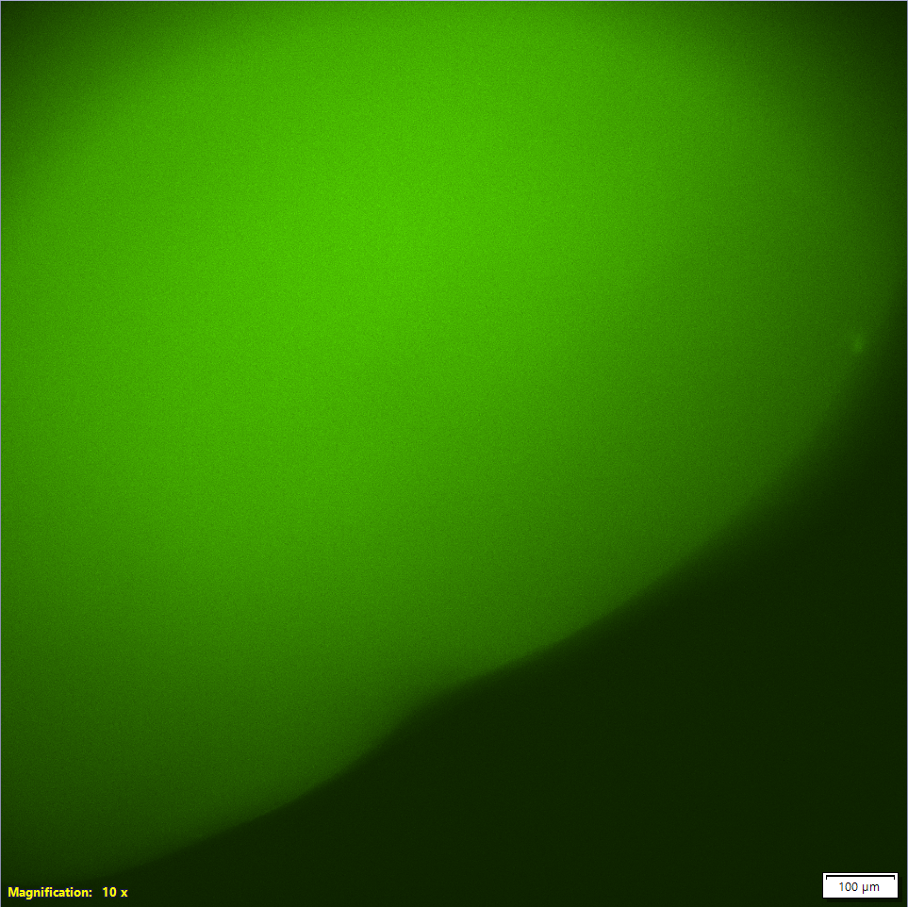

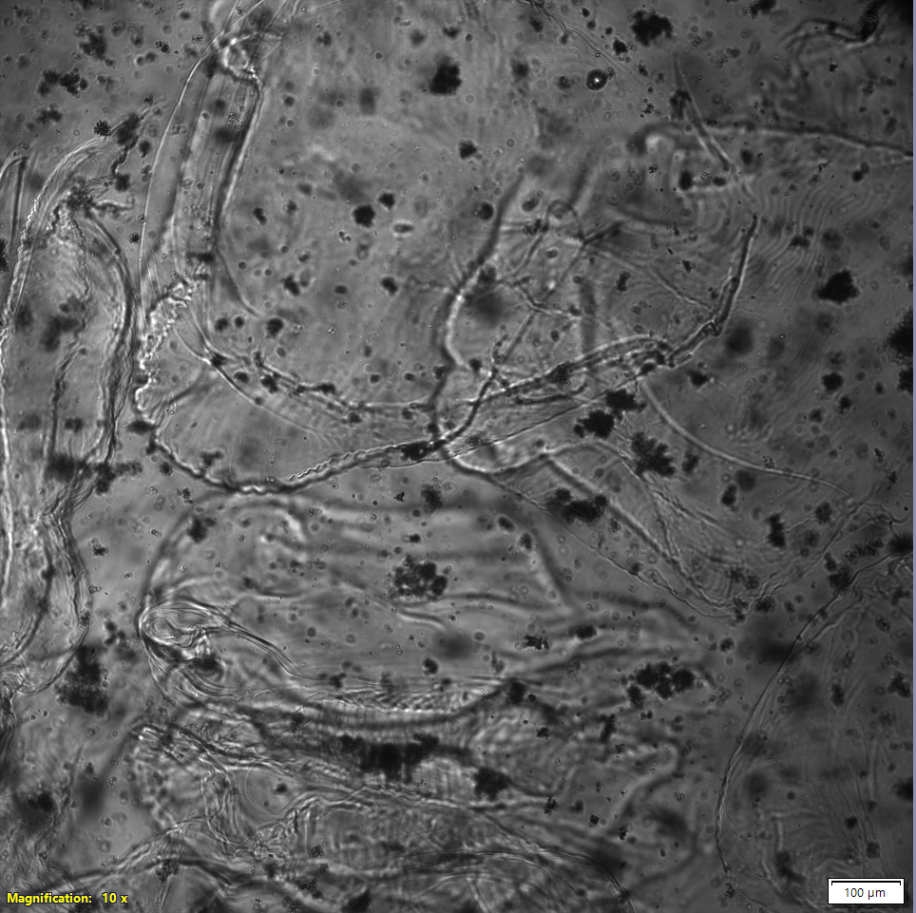
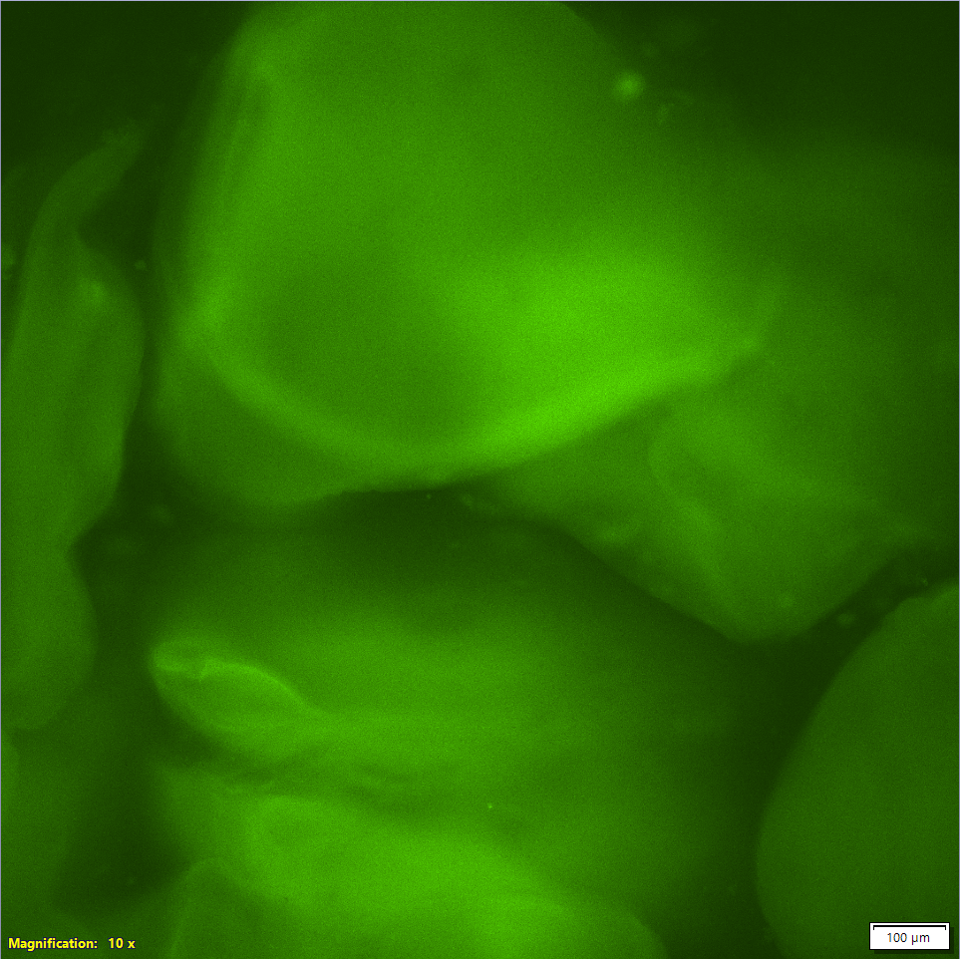
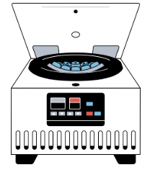

Encapsulation Success
[21]
[22]
[23]
[24]
13

Slide 14
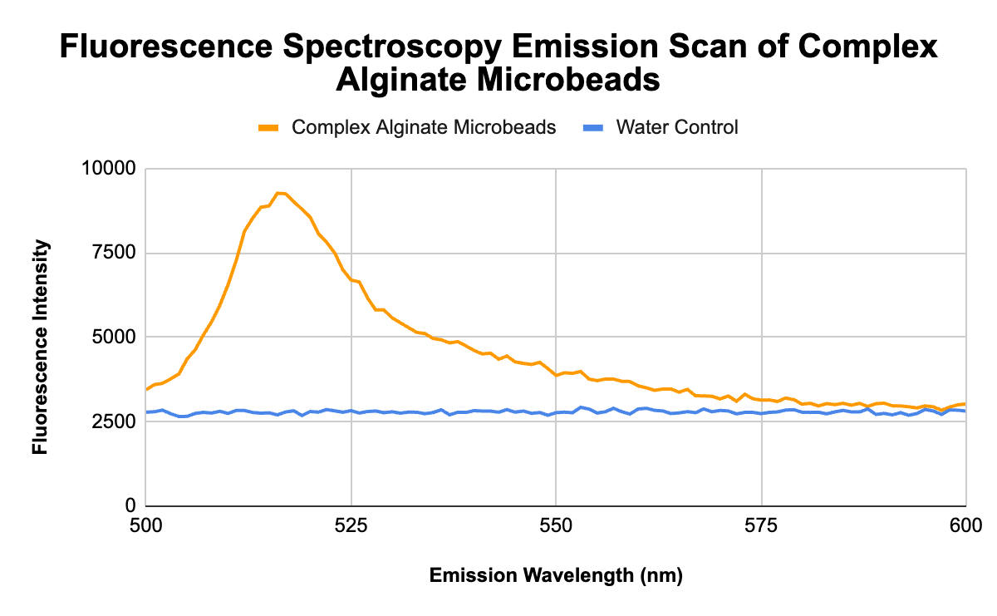
Data & Findings
[25]
Microbeads were thoroughly rinsed to remove excess micelles.
They were characterized via fluorescence spectroscopy.
The microbeads remained fluorescent post rinsing, indicating micelles were located within the alginate microbeads.
14

Slide 15
Results & Takeaways
Results indicate successful encapsulation of polymer micelles in alginate microbeads.
Resulting structures appear to be in a non-equilibrium state.
While this was not predicted, it does make sense and resembles organizations such as thylakoid membranes.
[26]
[27]
[28]
[29]
[30]
15

Slide 16
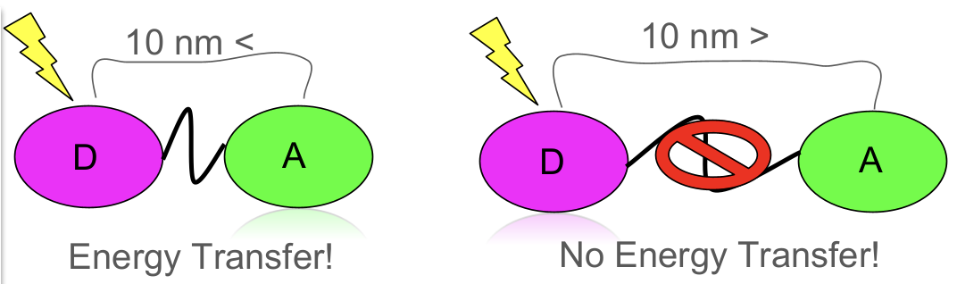
Next Steps
[31]
Encapsulate micelles using the “a∩b” micronozzle sequence
Encapsulate donor and acceptor micelles to investigated controlled intercompartmental energy transfer
Explore non-equilibrium structures and impact on energy transfer efficiency
Encapsulate multiple cargos, such as carbon dots toward complex photonic properties.
[32]
[33]
Kang, Sung-Min, et al. “Centrifugal Force-Driven Modular Micronozzle System: Generation of Engineered Alginate Microspheres.” Scientific Reports, vol. 9, no. 1, 4 Sept. 2019, https://doi.org/10.1038/s41598-019-49244-4. Accessed 31 July 2020.
16

Slide 17


Acknowledgements
Dr. Gabriel Montaño
Ysaris Sosa
Manuel Guerrero
Celedonio Rodriguez
Jessica Hauer
Contact: nattwongse@gmail.com / (702)-764-4515
17

Slide 18
Thank you! Any Questions?
18

Slide 19
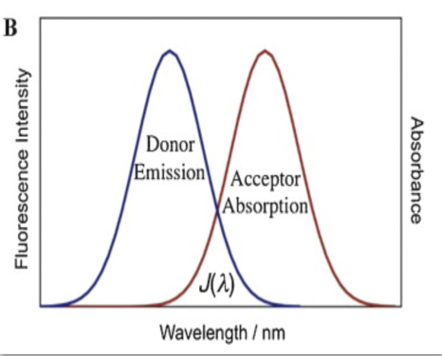
Donors & Acceptors
boron-dipyrromethene (BODIPY) = donor
zinc tetraphenylporphyrin (ZnTPP) = acceptor
Donors emit light at a specific wavelength where acceptors will absorb it (energy transfer).
They will only transfer energy when within a certain distance of each other.
McNeil, A. R. (2021) Synthesis Of Multi-Compartment Architectures For Use In Synthetic Cellular Communication (Publication No. 28714038) [Master's Dissertation, Northern Arizona University] ProQuest Dissertations Publishing
19

Slide 20
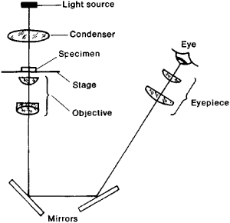
Inverted Light Microscopy
Inverted microscopes. MicroscopeGenius.com. (n.d.). https://microscopegenius.com/microscope-basics/compound-microscopes/inverted-microscopes/
20

Slide 21
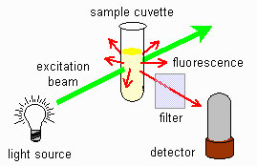
Fluorescence Spectroscopy
“Fluorescence Spectrometry - Fluorescence Spectrometry - Chromedia.” Chromedia.org, 2019, www.chromedia.org/chromedia?waxtrapp=mkqjtbEsHiemBpdmBlIEcCArB&subNav=cczbdbEsHiemBpdmBlIEcCArBP.
21

Slide 22
Energy Transfer Diagram
22

Slide 23
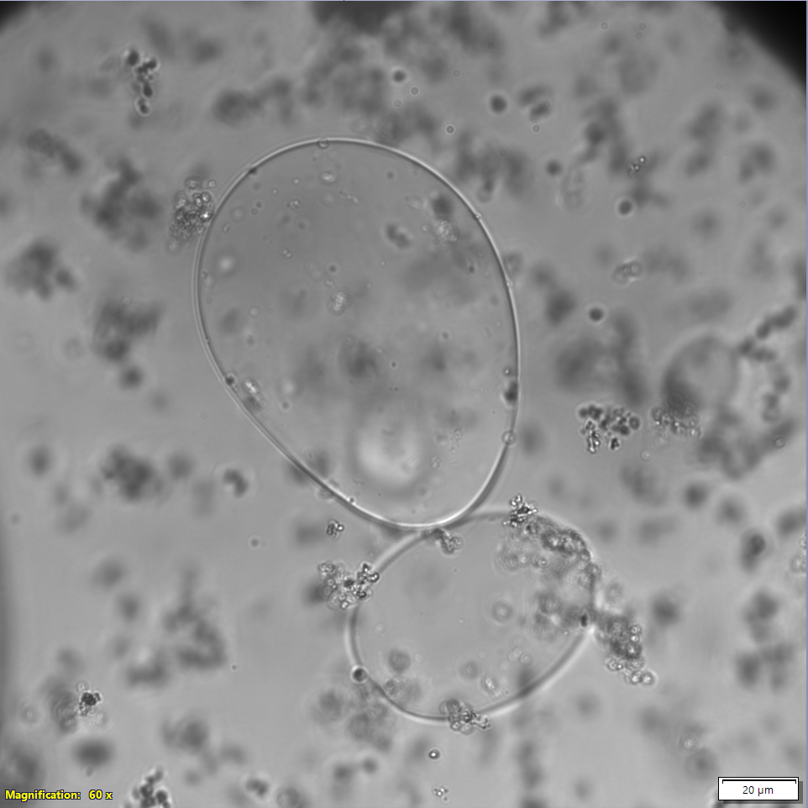
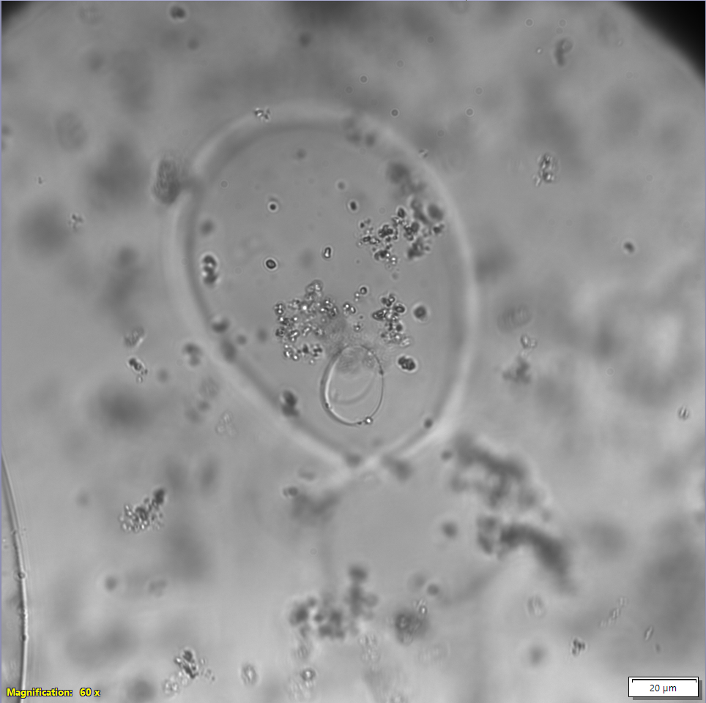
Alginate in Alginate
Alginate in alginate sample, focused in at a height of 9910.6 µm.
Same alginate in alginate sample, focused in at a height of 9938.5 µm.
23

Slide 24
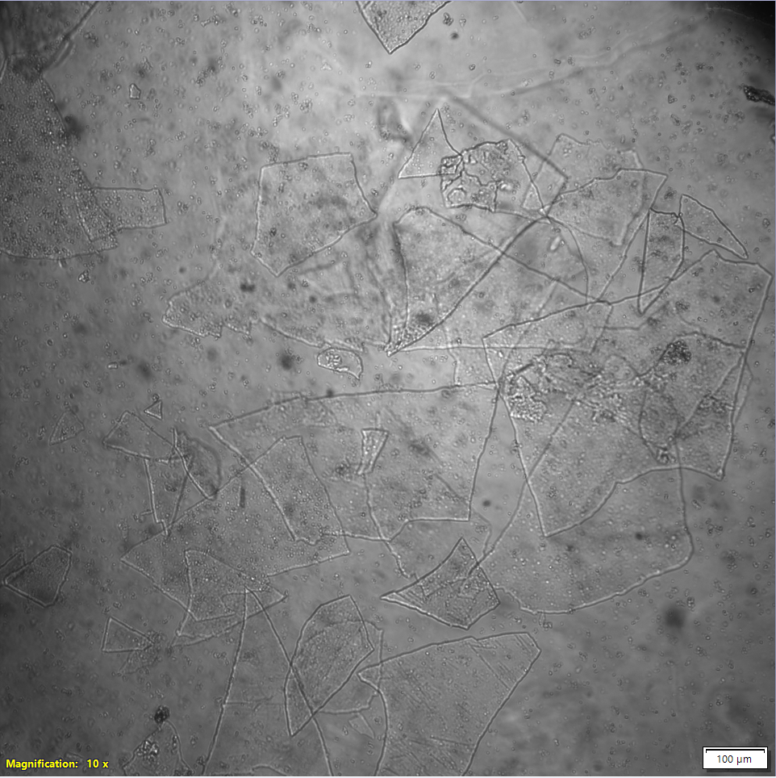
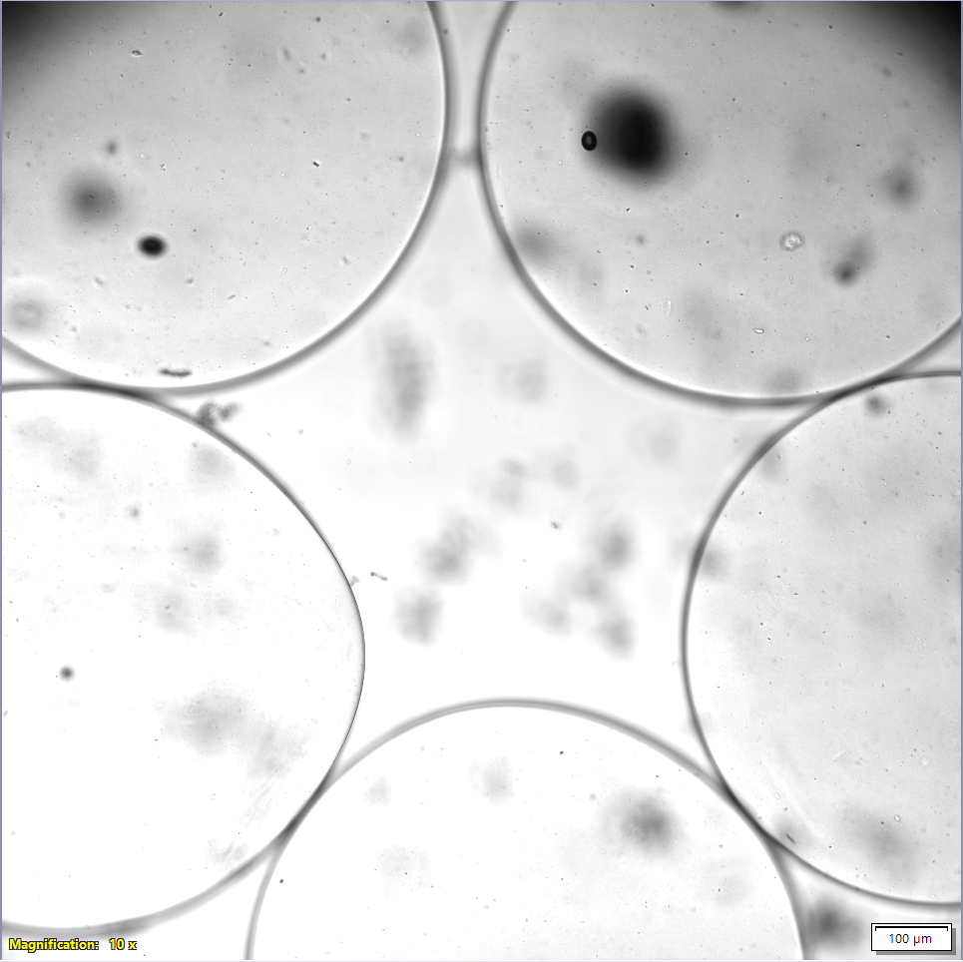
Changing Morphology
24

