Slide 1







Characterization and Functionalization of Bovine Milk-Derived Extracellular Vesicles
Jayden Williams, Kameron Burton, Lance Pye, Dr. Kristen Dellinger
Campbell University, North Carolina Agricultural and Technical State University, The Joint School Nanoscience Nanoengineering
Notes:
Can't read the JSNN and Phi Delta logos here

Slide 2
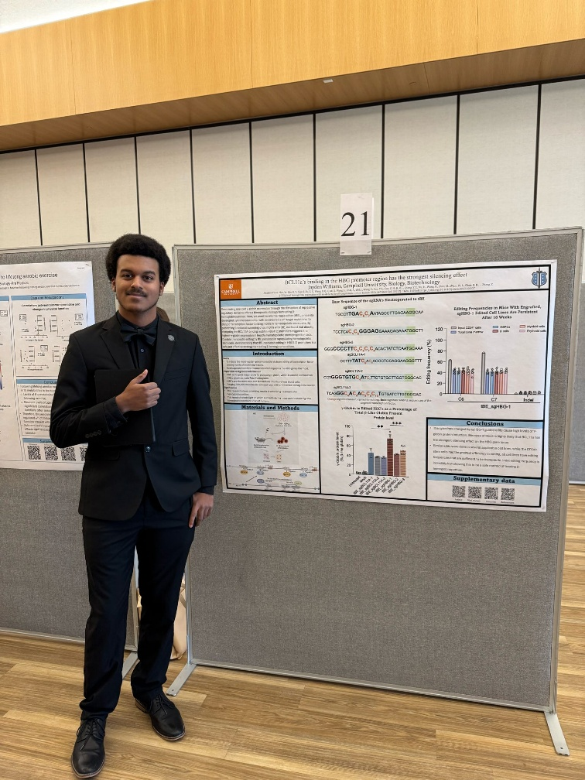


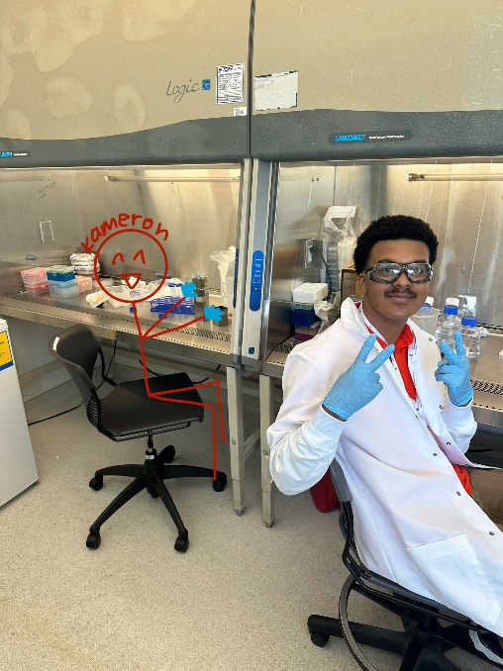
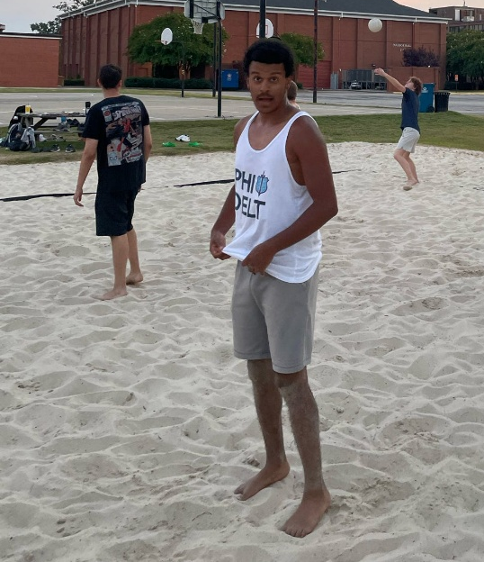
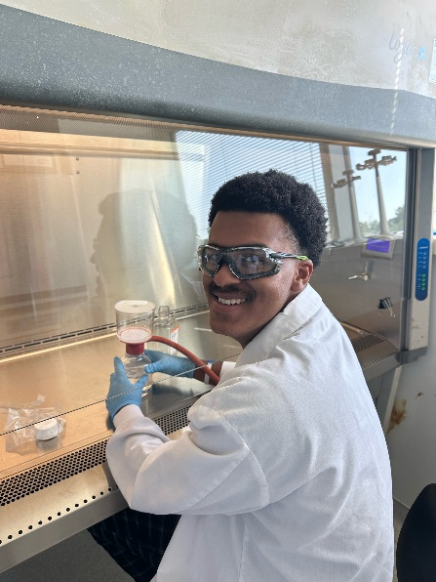
About Me!
Just turned 21 on 7/24!
Biotechnology Major at Campbell University (Roll Humps)
Member of Phi Delta Theta
I Play Oboe, English Horn, and Clarinet
My graduate mentor.

Slide 3
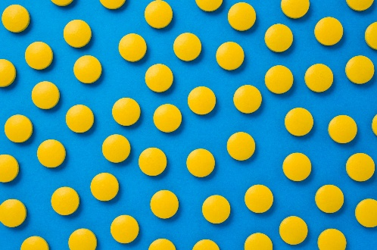


Drug Delivery
There are many ways of delivering drug, ranging from oral ingestion to injections and topical methods.
Oral Delivery:
Pros
People are generally comfortable with pills / drinkable medicines
Cost effective
Easy to administer
Cons
Absorption rates vary
GI tract can degrade the payload
First-pass metabolism
Intravenous Injections:
Pros
Avoids first-pass problems
Rapid onset
Best method in worst case scenarios (comatose / oral ingestion impossible)
Cons
Needles hurt
Small chance of infection
Topical Delivery:
Pros
Avoids first-pass metabolism
More targeted
Convenience
Can be dosed continuously
Cons
The natural barrier of the skin limits applications
Variable absorption
Lower load / dosing
Enzymatic activity
Kim, J., & De Jesus, O. (2023). Medication routes of administration. National Library of Medicine; StatPearls Publishing. https://www.ncbi.nlm.nih.gov/books/NBK568677/
Choi, E., Nahm, F. S., Han, W. K., Lee, P. B., & Jo, J. (2020). Topical agents: a thoughtful choice for multimodal analgesia. Korean journal of anesthesiology, 73(5), 384–393. https://doi.org/10.4097/kja.20357

Slide 4
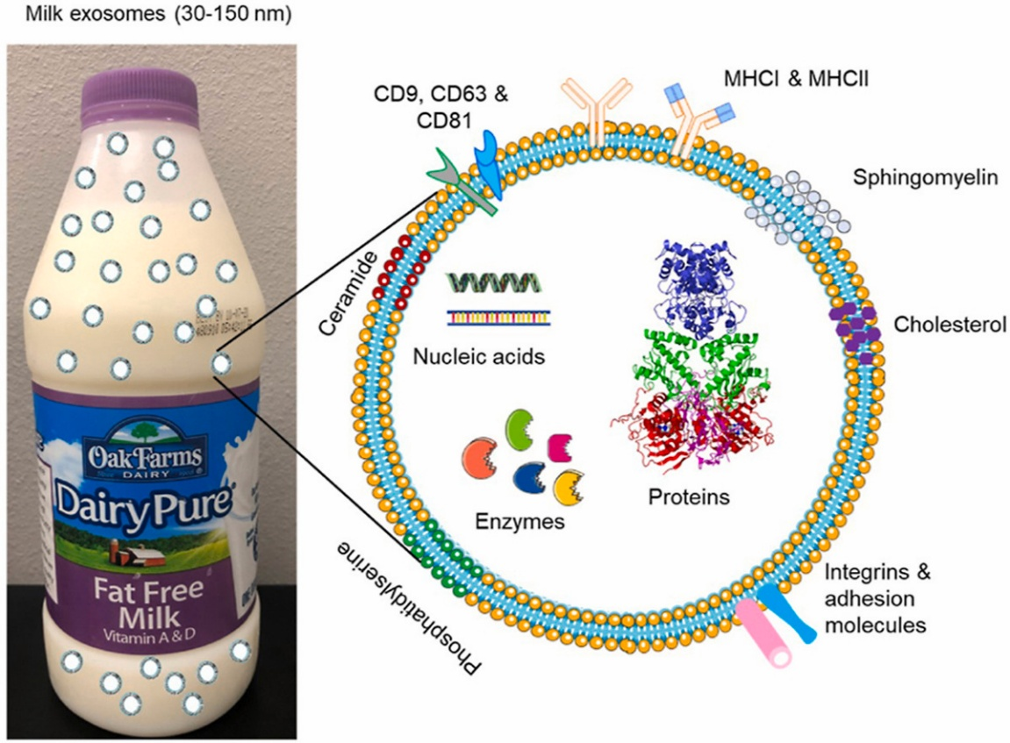
What Are Extracellular Vesicles?
Extracellular vesicles (EVs) are membrane-bound structures secreted by most cell types. In vivo, these lipid nanoparticles are used to communicate from cell to cell via the proteins, enzymes, and nucleic acids contained within.
Pros
Incredibly bioactive
Highly stable
Generally limited immunogenicity
Cons
Isolation isn’t standardized
Loading typically damages EVs
Cytotoxicity (depending on EV source)
Bovine milk-derived EV composition map
Benilde Adriano, Nycol M. Cotto, Neeraj Chauhan, Meena Jaggi, Subhash C. Chauhan, Murali M. Yallapu, Milk exosomes: Nature's abundant nanoplatform for theragnostic applications, Bioactive Materials, Volume 6, Issue 8, 2021, Pages 2479-2490, ISSN 2452-199X, https://doi.org/10.1016/j.bioactmat.2021.01.009.

Slide 5
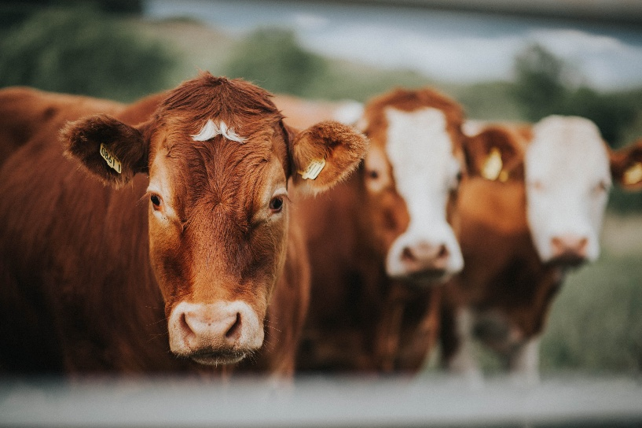

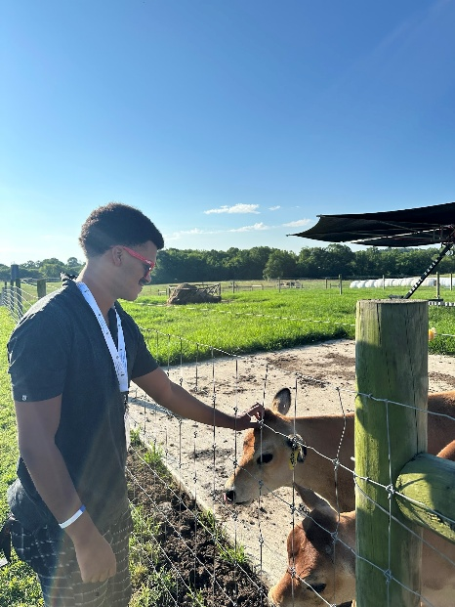
Why Milk-derived EVs?
Pros:
Milk-derived EVs (mEVs) are found readily in high concentrations
No cell culture / starvation necessary to give cells “something to talk about”
Humans regularly drink cow’s milk, meaning the cytotoxicity isn’t in question, end-product should also be drinkable
Cons:
Isolation protocol from milk is not yet standardized (removing excess fats, calcium, etc.)
How do you target where the EV goes?
Notes:
Why don't you add pic of you at the farm?

Slide 6
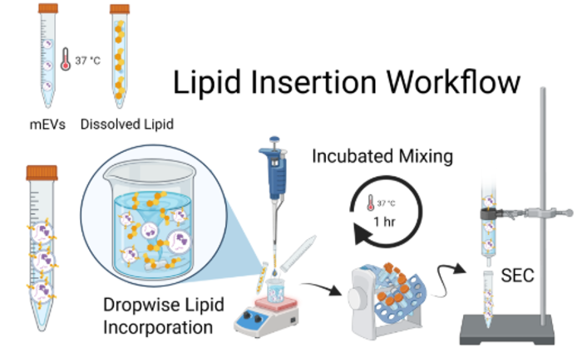

Functionalization
One potential method for functionalizing isolated EVs can be done via inserting lipids which, contain a functional group allowing for the binding of a target molecule.
We plan to use lipids with an Azide group, ($N_{3}$) due to their willingness to participate in click reactions with alkyne groups, (-C≡C-).
(Targeting Ligand for functionalization or a fluorophore for characterizing insertion.)

Slide 7
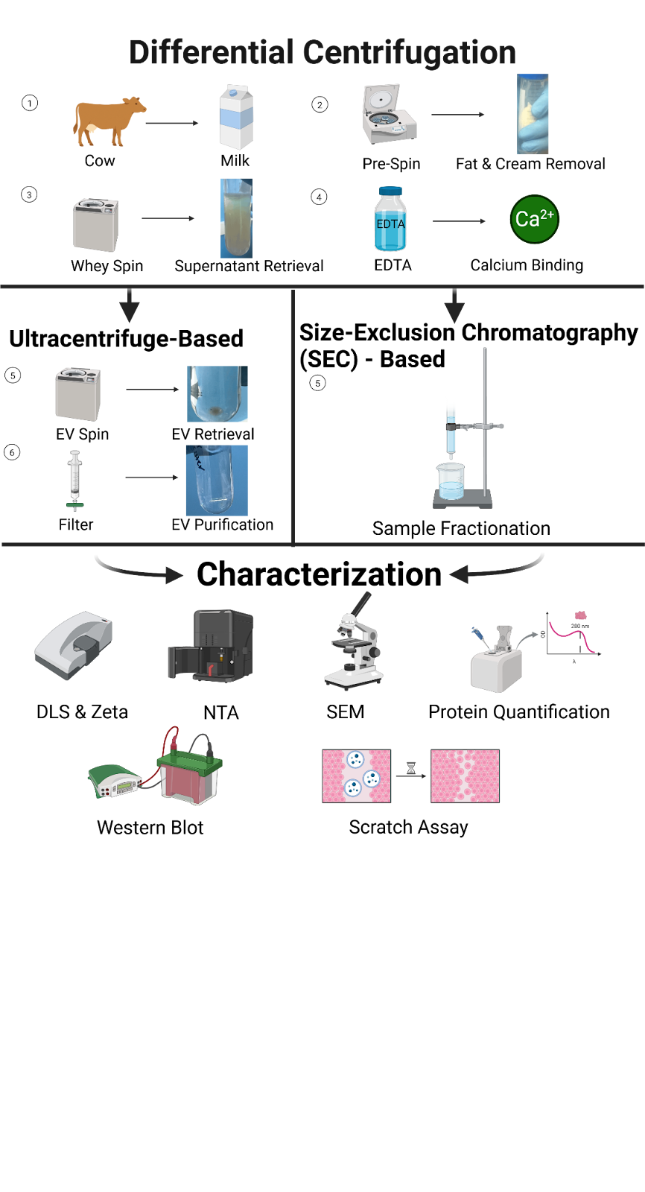
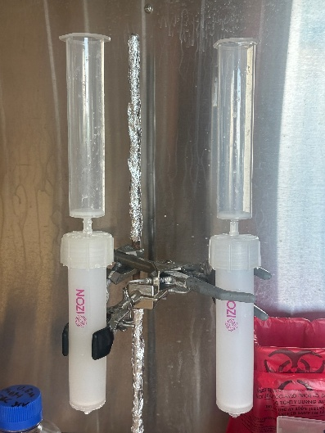
mEV Isolation
Before we isolate the EVs from milk, we must remove as much unwanted material from the milk as possible.
After these steps, I used a QEV10 Izon Size Exclusion Chromatography Column (SEC column)
Notes:
Can't see this figure

Slide 8
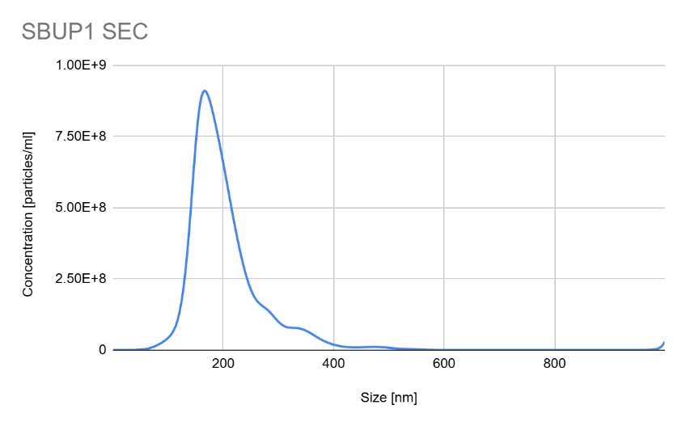
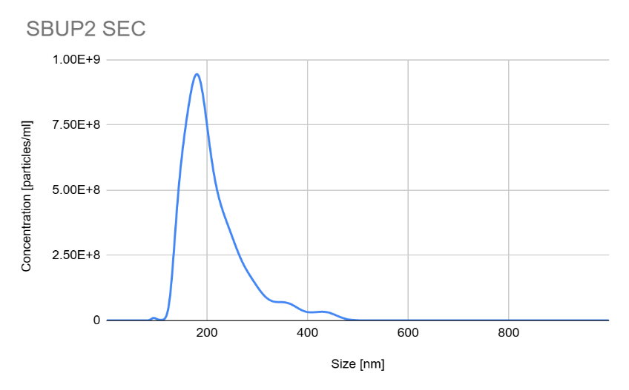
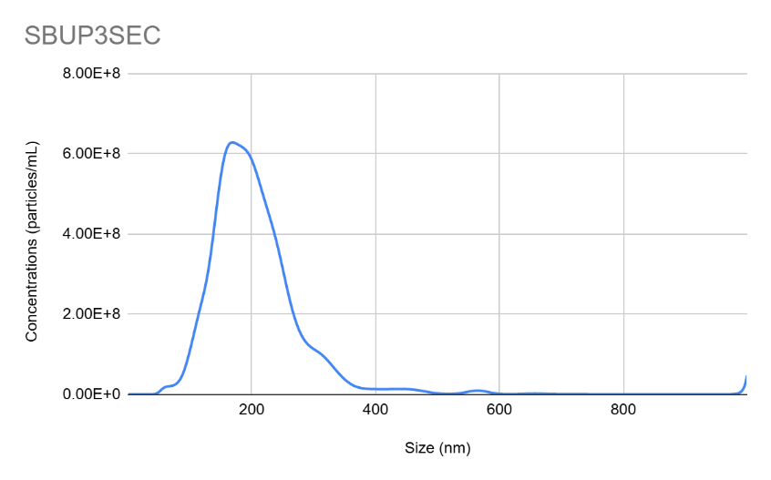
EV Characterization
The best way to confirm we have EVs is by measuring its characteristics:
size, concentration, surface charge, polydispersity index, and protein concentration.
SEC UP | Avg. Size (nm): | Mode Size (nm) | Std Deviation (nm) | PI: | Zeta: | Protein Quantification (µg/mL) | Concentration [particles/ml]
SBUP1 SEC | 204 | 166.5 | 75 | 0.2374 | -27.59 | 121 | 9.00E+10
SBUP2 SEC | 212 | 179.5 | 63 | 0.2526 | -25.26 | 118 | 9.54E+10
SBUP3 SEC | 206 | 168.5 | 83 | 0.222 | -25.08 | 140 | 8.58E+10

Slide 9
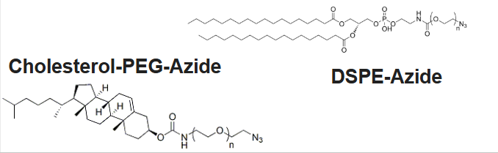
Lipid Insertion Ratio Screen
EV to DPA Ratio (1:n) | PI | Zeta | Concentration (Particles/mL) | Mode Size (nm) | Average Size (nm) | Std Deviation
200 | 0.4389 | -21.43 | 1.43E+08 | 100.5 | 121 | 73
400 | 0.8466 | -22.89 | 2.25E+08 | 5.5 | 168 | 222
600 | 0.678 | -22.83 | 4.36E+07 | 74.5 | 221 | 182
800 | 0.4937 | -18.23 | 4.29E+07 | 113.5 | 164 | 171
1000 | 1 | -35.5 | 1.68E+08 | 91.5 | 144 | 129
For lipid Insertion we used two lipids, Cholesterol-PEG-Azide (CPA) and DSPE-Azide (DPA)
We inserted both lipids at a ratio of
200, 400, 600, 800, 1000 lipids per EV
Lowered concentrations expected
EV to CPA Ratio (1:n) | Pi | Zeta | Concentration (Particles/mL) | Mode Size (nm) | Average Size (nm) | Std Deviation
200 | 0.4411 | -22.73 | 1.47E+08 | 999.5 | 247 | 204
400 | 0.4827 | -25.02 | 6.86E+07 | 118.5 | 202 | 234
600 | 0.5366 | -26.43 | 1.86E+08 | 83.5 | 141 | 96
800 | 0.753 | -13.54 | 1.67E+08 | 77.5 | 142 | 103
1000 | 0.6415 | -15.98 | 1.22E+08 | 93.5 | 155 | 134

Slide 10
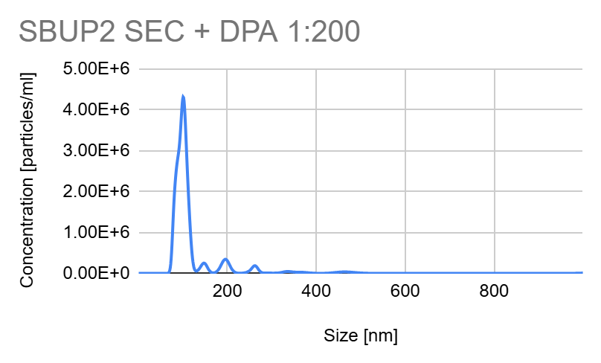
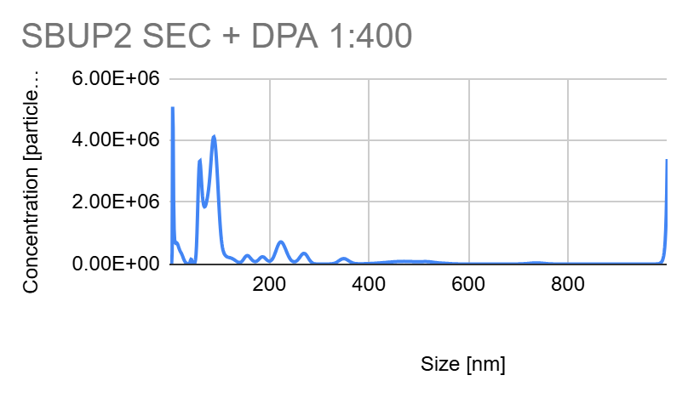
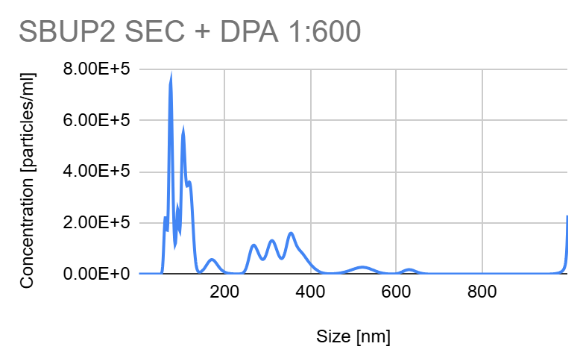
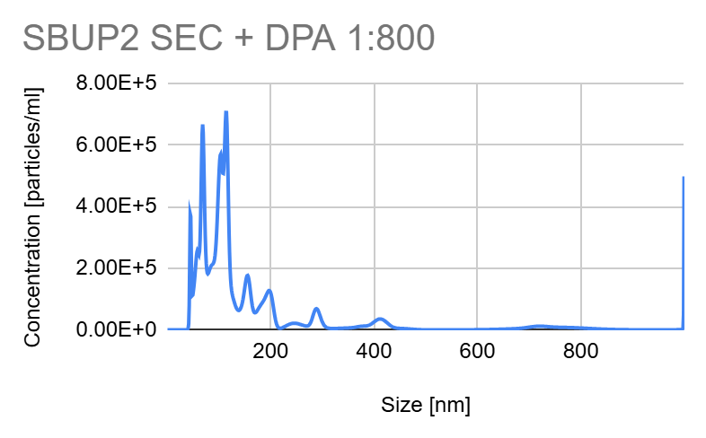
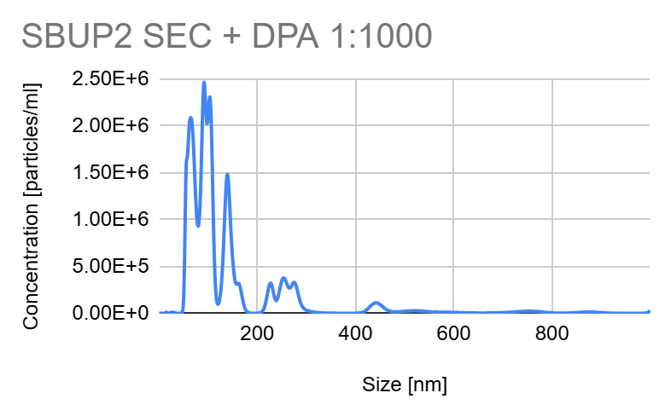
DPA Insertion NTA
Micelle Formation?

Slide 11
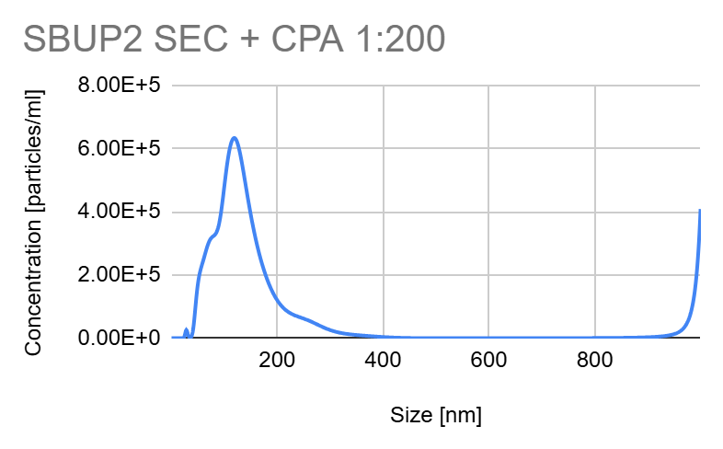
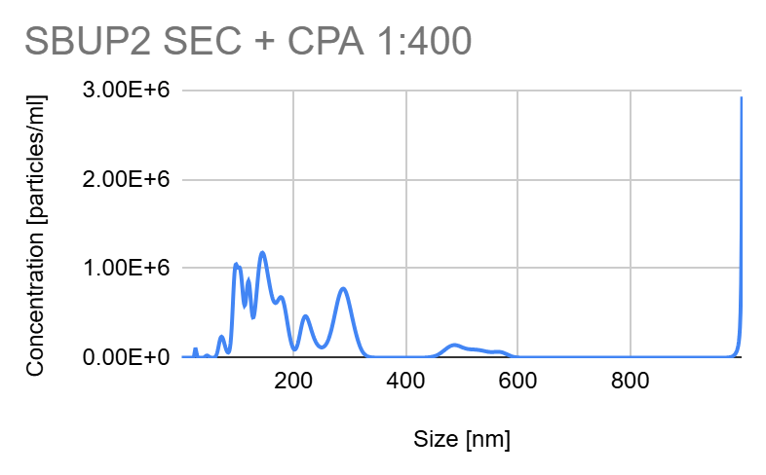
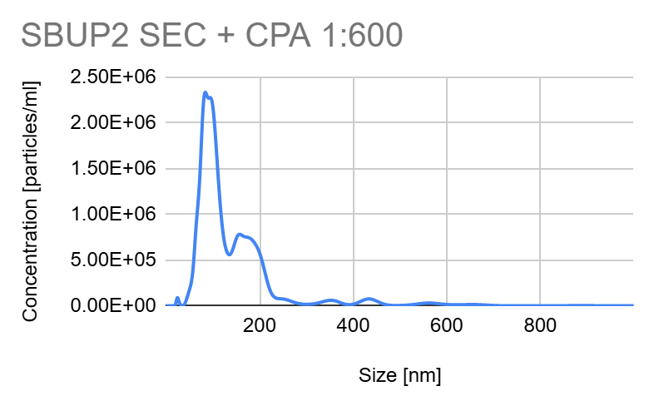
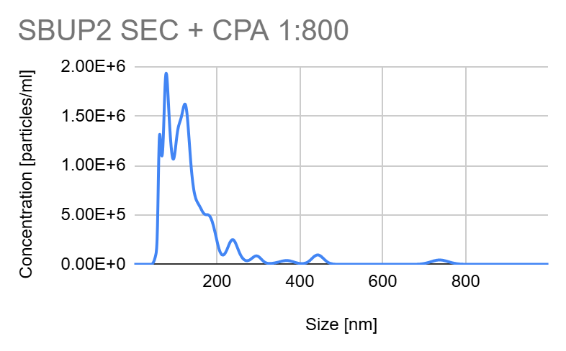
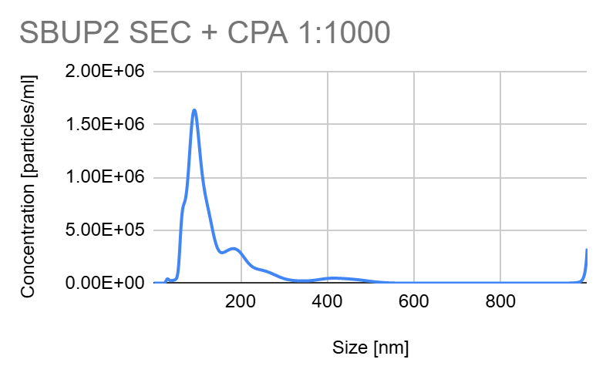
CPA Insertion NTA

Slide 12
In Conclusion…
Conclusions
EV isolation and characterization so far is looking promising
EV : lipid ratios for insertion must have been too high
User error certainly possible, but not very likely
Next Steps
Confirm the presence of EV biomarkers in samples (anti-CD81, CD9, CD63, etc?)
Confirm the bioactivity of EVs
Test the cytotoxicity of EVs
Try lower ratio screens of EV:Lipid (1:10? 1:50? 1:100?)
Click reaction with fluorophore to quantify insertion

Slide 13
Acknowledgements
Thank you to Dr. Kristen Dellinger, the NBI lab PI, for fostering a comfortable yet driven environment for me and those working with her to delve into their curiosity in such a new field!
Thank you to my graduate mentor and friend Kameron Burton, his guidance has taught me more than I would ever learn in a semester at Campbell.
This research was partially supported by NSF REU Site: Southeastern Undergraduate Internship in Nanotechnology (SUIN), under award# EEC-2349519
This work was performed at the Joint School of Nanoscience and Nanoengineering, a member of the National Nanotechnology Coordinated Infrastructure (NNCI), which is supported by the National Science Foundation (Grant ECCS-2025462)
Notes:
Aww :)

Slide 14

Thank you!

