Slide 1



Engineering a Macrophage-Targeted Oligonucleotide Delivery System for the Control of Chronic Inflammation
Hunter Vu^{1,2}, Yusif Abdul-Rashid¹, Richard Sedeafor¹, Zahra Sabet¹, Sindhu Yalavarthi¹, Morgan Gyger¹, Jordan Mack¹, Chad Markert³, Kerui Wu¹
¹Department of Nanoscience, Joint School of Nanoscience and Nanoengineering, University of North Carolina at Greensboro, Greensboro, NC
²J. Crayton Pruitt Family Department of Biomedical Engineering, University of Florida, Gainesville, FL
³Department of Exercise Physiology, and Biomedical Research Infrastructure Center, Winston-Salem State University, Winston-Salem, NC

Slide 2
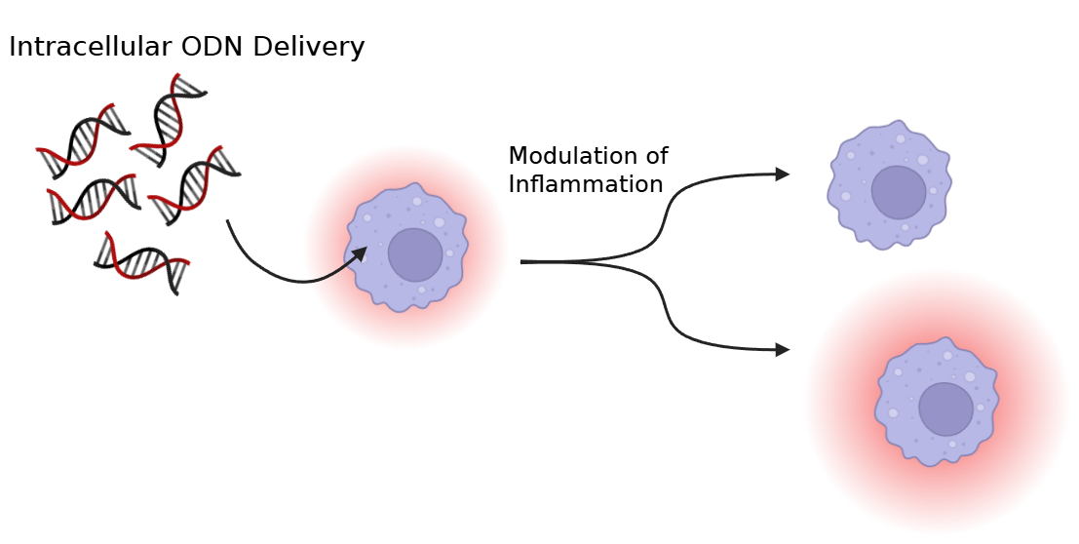
Introduction
Chronic Inflammation
COPD
Neurodegenerative disease
  Alzheimer’s
  Parkinson’s

Slide 3
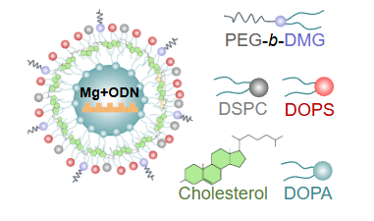
Magnesium Ion-Nourisher Nanoparticle
DOPS promotes macrophage uptake
Mg²⁺ neutralizes negative charge of ODN
  also reduces inflammation
GOAL: Use the combination of intracellular delivery of Mg²⁺ and ODN to reduce inflammation

Slide 4
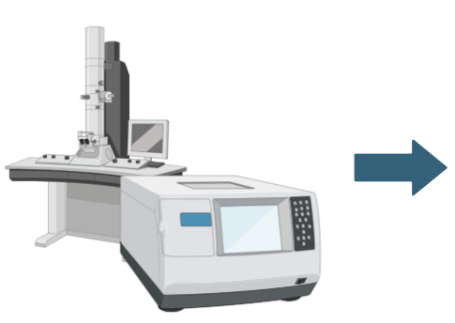
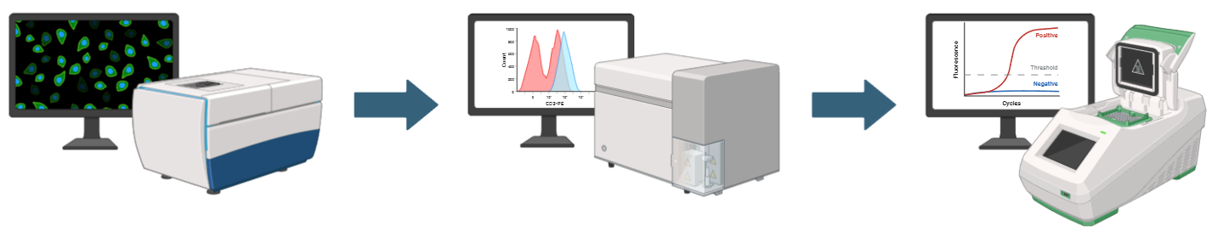
Methodology
Dynamic Light Scattering
&
TEM
Fluorescent Imaging
Flow Cytometry
qPCR

Slide 5
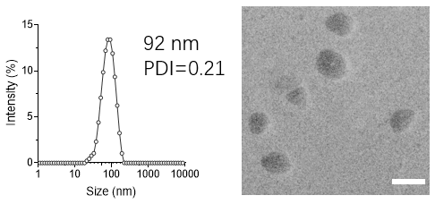
Dynamic Light Scattering & TEM
100 nm scale bar

Slide 6
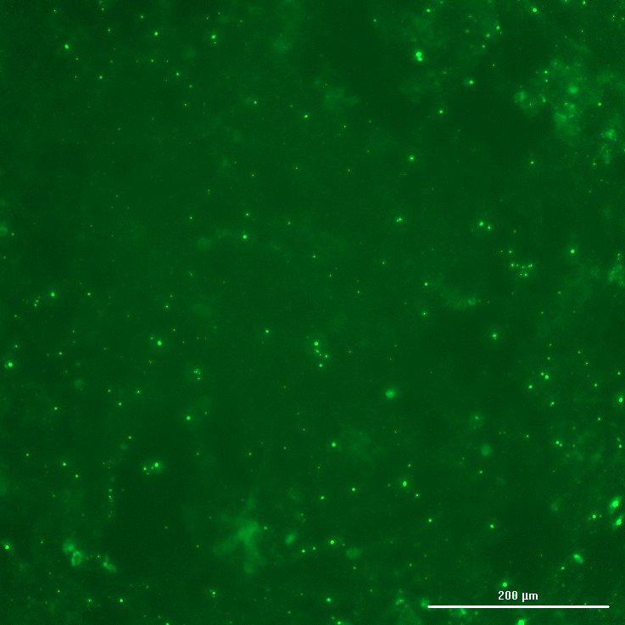
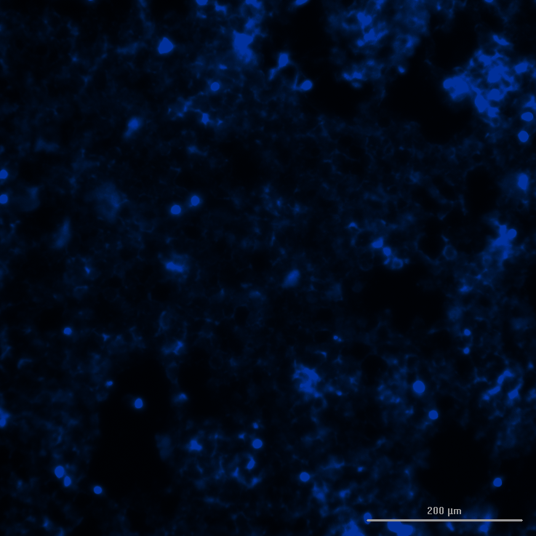
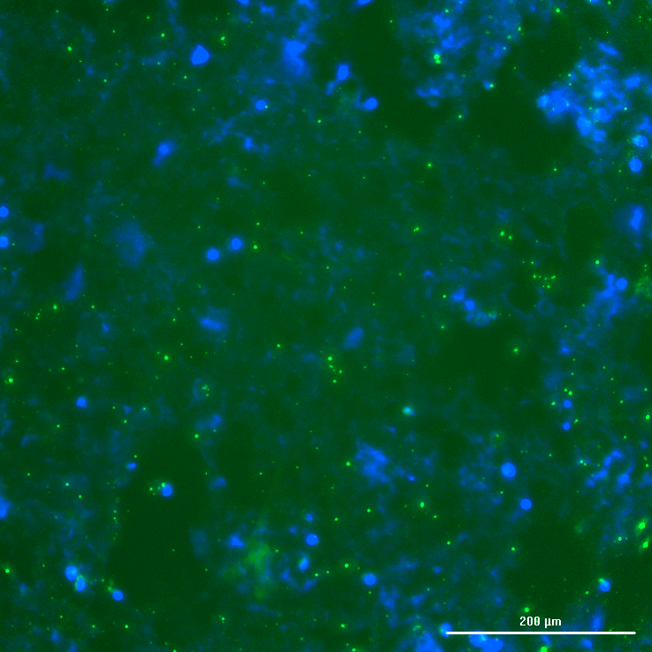
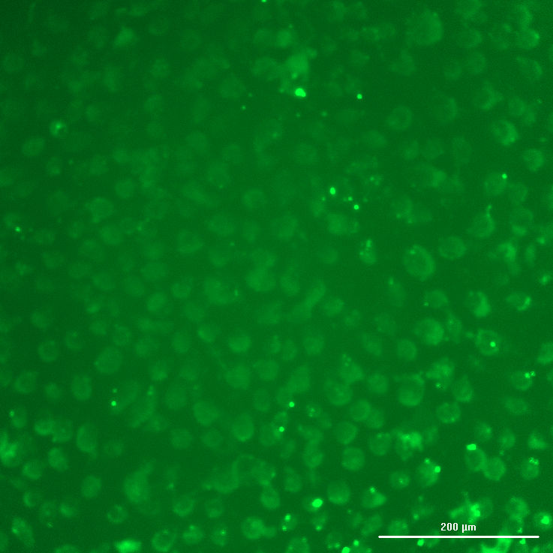
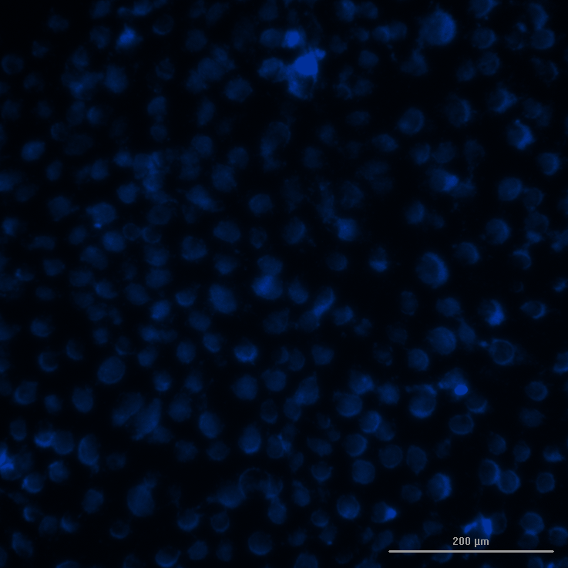
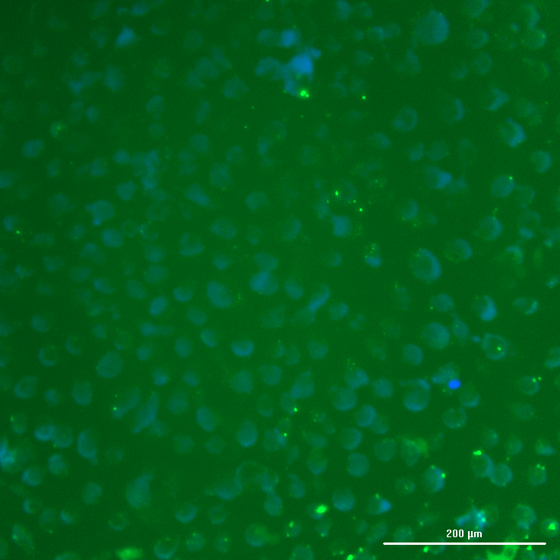
Fluorescent Imaging – Non-Macrophages
HEK 293
HPD6C7

Slide 7
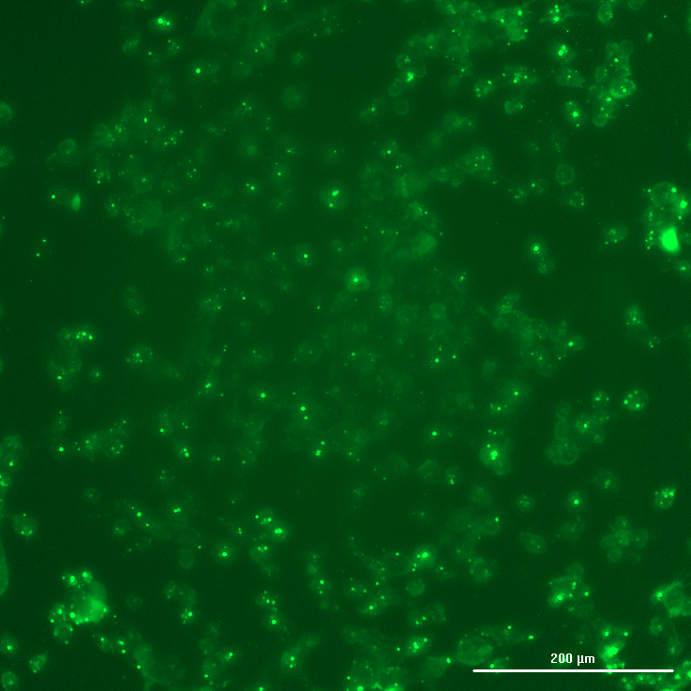
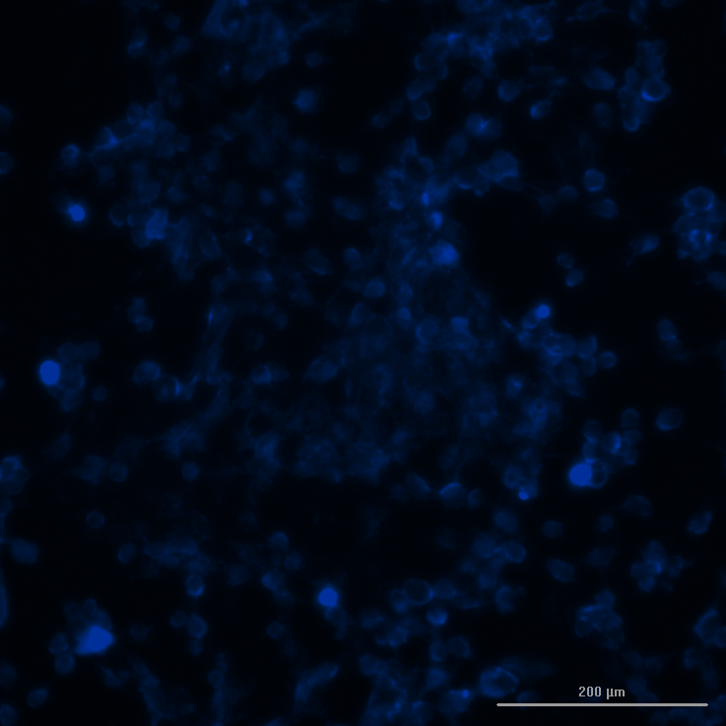
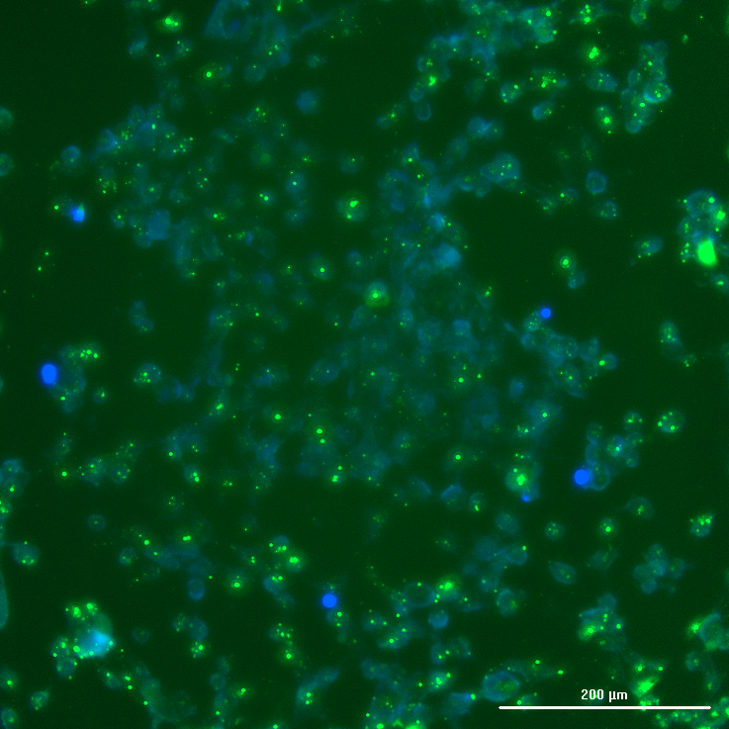
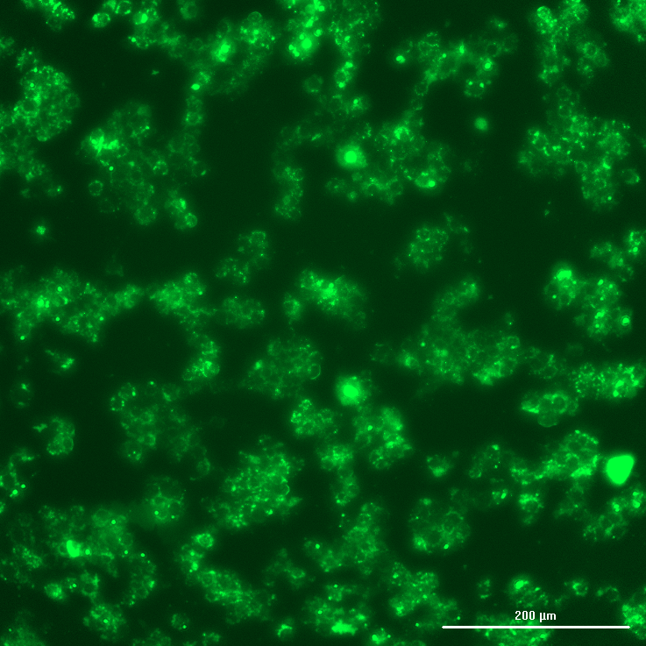
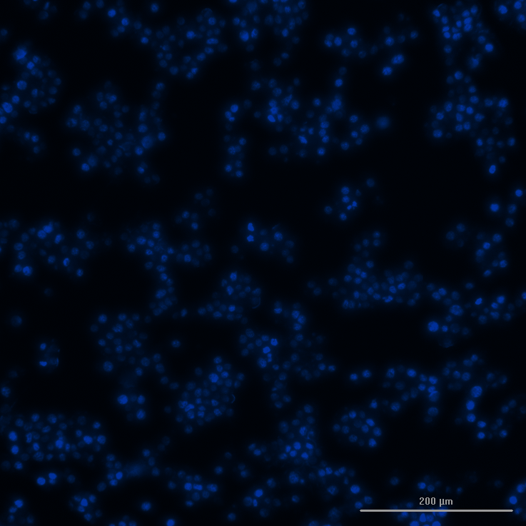

Fluorescent Imaging – Macrophages
HMC3
RAW 264.7
(THP-1 analogue)

Slide 8
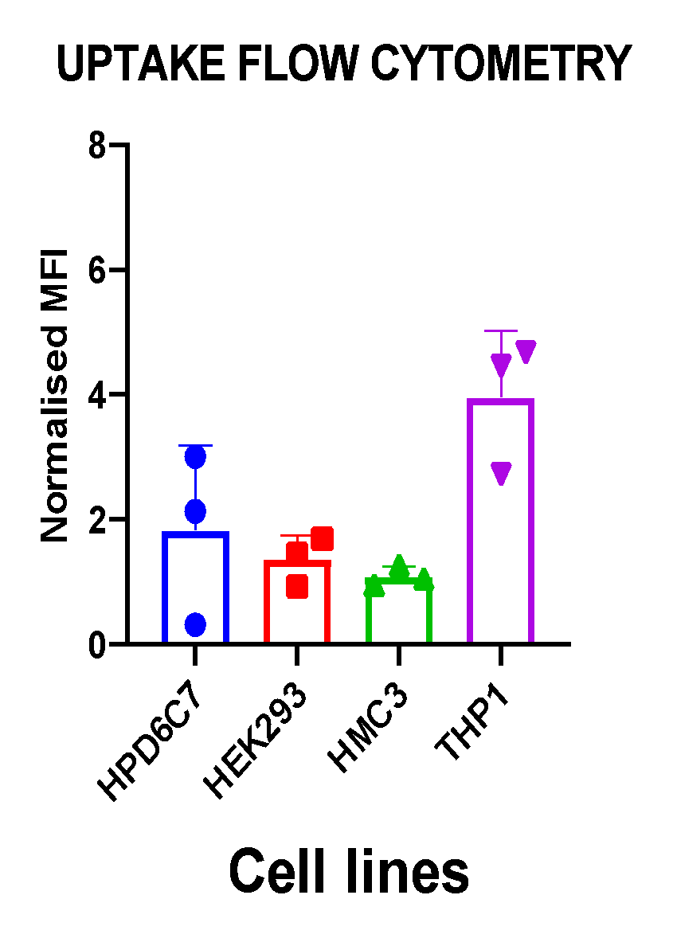
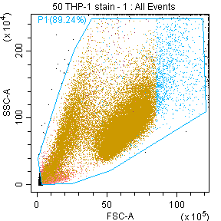
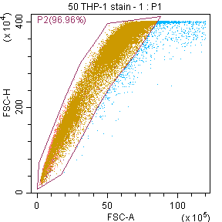
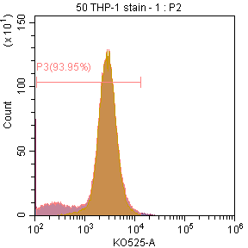
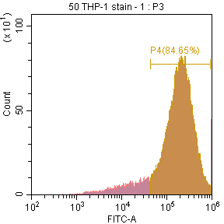
Flow Cytometry
THP-1

Slide 9
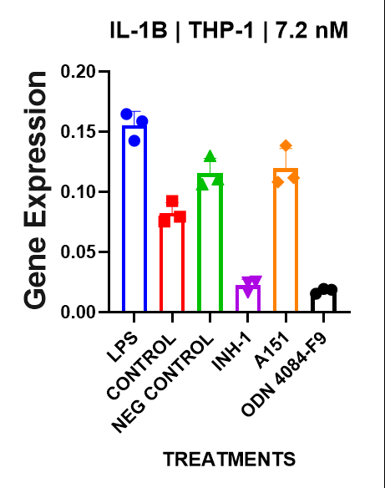
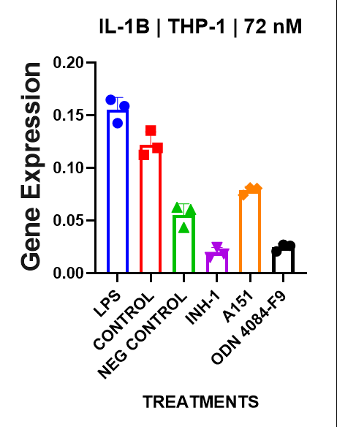
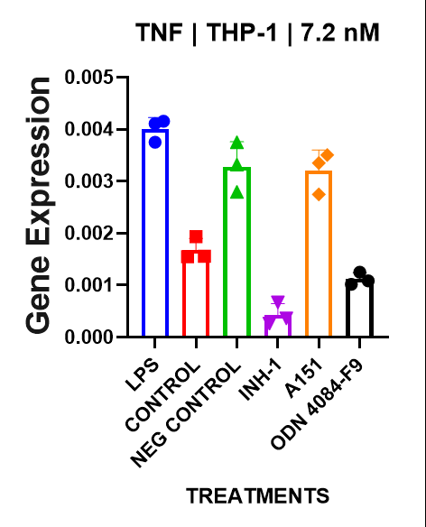
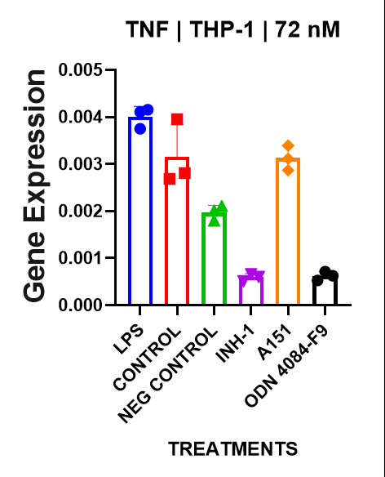
qPCR
THP-1

Slide 10
Conclusion
Normal macrophages show significant uptake and a decrease in inflammatory gene expression when introduced to nanoparticle treatment (particularly INH-1 & 4084-F9)
Non-macrophages show no significant nanoparticle uptake
Microglia require further investigation in regards to uptake and gene expression

Slide 11

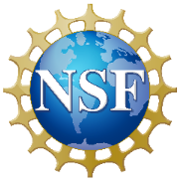


Acknowledgements
The Wu Lab
Principal Investigator
Kerui Wu, Ph.D.
Graduate Students
Sindhu Yalavarthi
Yusif Abdul-Rashid
Kiki Parker
I'yanah Gunter
Richard Sedeafor
Morgan Gyger
Zahra Sabet
Postdoctoral Researcher
Li Wang, Ph.D.
Undergraduate Students
Zenith Soni
Olivia Mahfoud
High School Trainees
Emily Cao
Ethan Li
This work was supported by the Department of Defense (HT9425-24-1-0043, K.W.), the North Carolina Biotechnology Center (2024-FLG-0078, K.W.), the National Science Foundation (2501889, K.W.), Intel and Micron at the Joint School of Nanoscience and Nanoengineering/North Carolina A&T State University, and NSF REU Site: Southeastern Undergraduate Internship in Nanotechnology (SUIN), under award# EEC-2349519. Portions of this work were performed at the Joint School of Nanoscience and Nanoengineering, a member of the Southeastern Nanotechnology Infrastructure Corridor (SENIC) and the National Nanotechnology Coordinated Infrastructure (NNCI), which is supported by the National Science Foundation (ECCS-2025462).

