Slide 1






Investigation of Protease-Sensitive Lipid Nanoparticles for Delivery of mRNA to the Brain
By
Alexa Warren
Rowan University &
San Diego Nanotechnology Infrastructure (SDNI)
Faculty PI: Dr. Ester Kwon, Shu Chien-Gene Lay Department of Bioengineering, UC San Diego
Mentor: Yazmin Hernandez, Shu Chien-Gene Lay Department of Bioengineering, UC San Diego
Presented at the 2025 NNCI REU Convocation, University of California, San Diego, CA
August 4-5, 2025

Slide 2
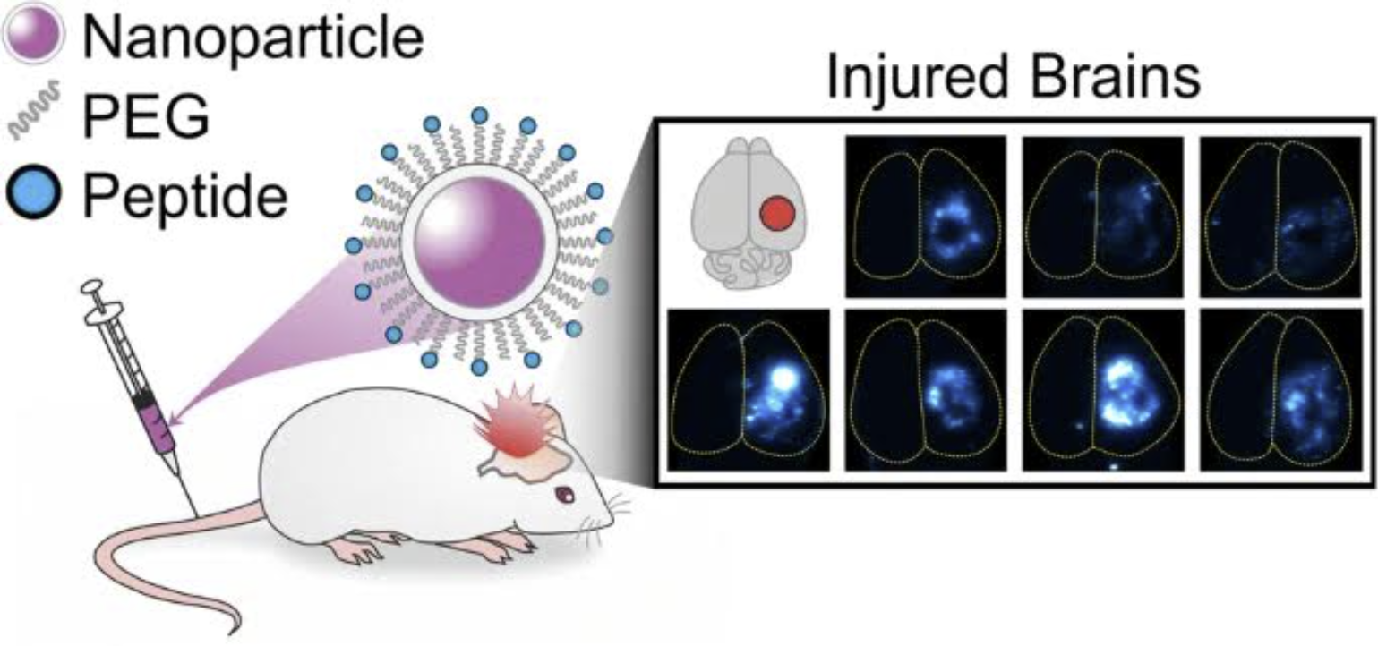
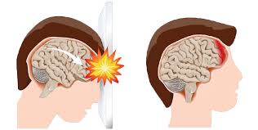
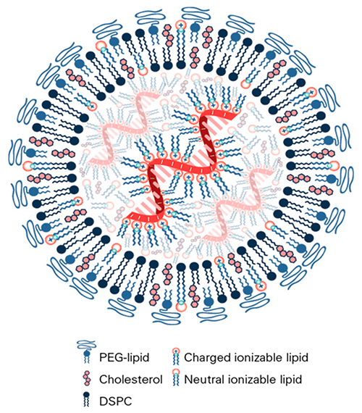
Background
What is the PEG Dilemma?
PEG is a stealthing agent used in LNP’s to help them avoid getting cleared by RES organs. Too much PEG and the LNPs are unable to penetrate the cell membrane of the cells they are trying to enter.
Our Solution: Protease-Sensitive LNP’s
Make LNPs that respond to proteases in the injured brain environment! The LNPs would be conjugated to a protease-sensitive peptide via crosslinking with PEG. The PEG would remain intact to help the particles reach the brain, but in the presence of elevated proteases, LNPs would destabilize and improve LNP endosomal escape.
What is TBI?
Traumatic Brain Injury is brain dysfunction that is normally caused by a physical blow to the head. It can cause permanent damage and affects about 1 million people a year.
What are LNP’s?
Lipid Nanoparticles are the most advanced clinically approved non-viral gene delivery vehicle.
Notes:
https://www.internationalbrain.org/resources/brain-injury-facts
‹#›

Slide 3
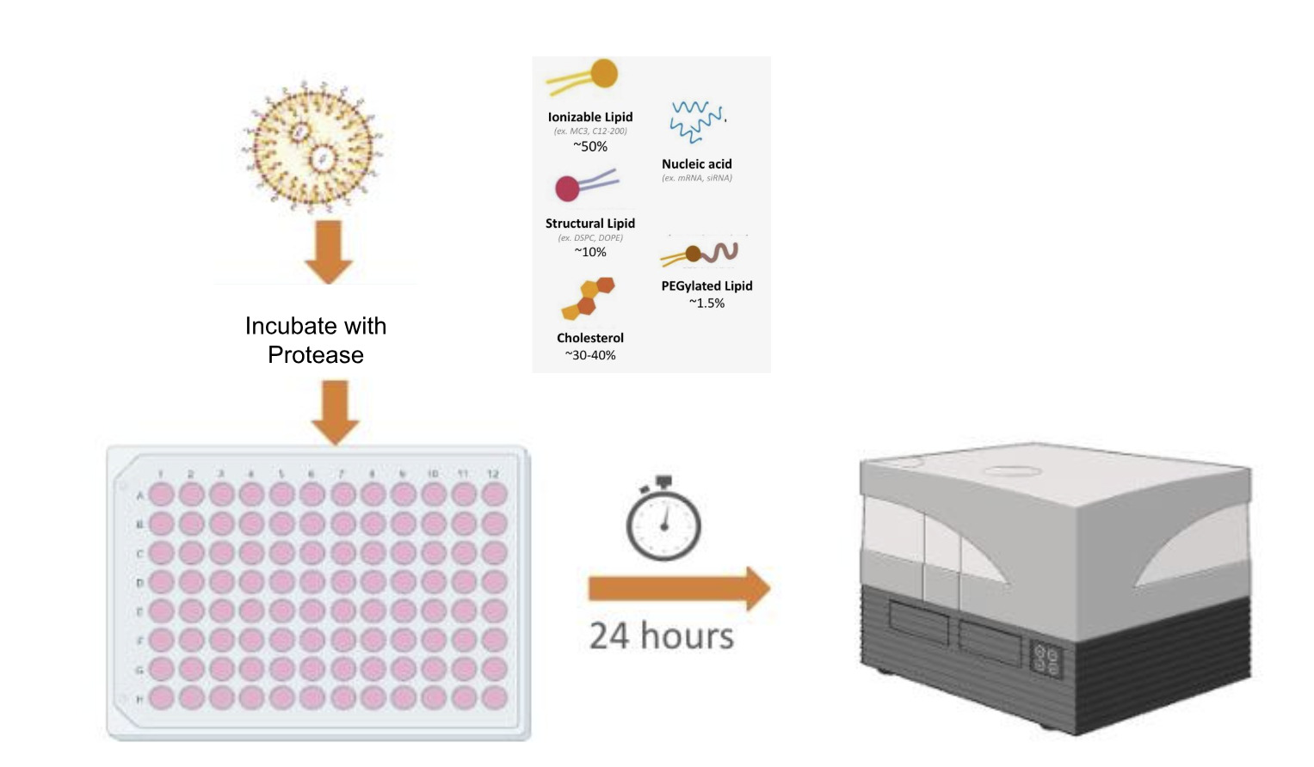
Synthesizing Protease-Sensitive LNPs
Lipid* | Mole%
MC-3 | 50
Chol | 40-x
DSPC | 10
DSPE-PEG-MAL 3.4K | x
Hand pipette LNPs
Incubate with protease for 1h at 37°C
Transfect LNPs into cells at 100ng mRNA
X= 1.5, 3, 5, 7, or 10 Protease-sensitive peptide added at 1:1 to DSPE-PEG-MAL content via mal-thiol chemistry

Slide 4
Characterizing Varying PEG Percentages in LNPs
Main Takeaways:
- PDI is highest in the 7 and 10 formulations
- In general, Z-Average is not affected by increasing PEG.
- Increasing PEG percentages has a minimal effect on encapsulation efficiency

Slide 5
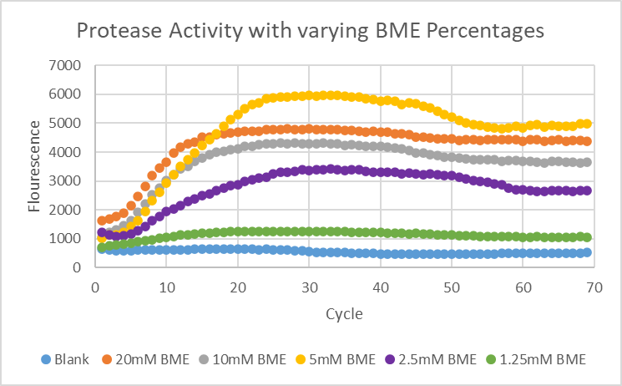
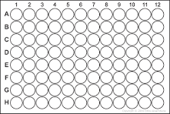
Piloting Protease Activity Assays
Without Protease
With Protease
Blank 1.5x 3x 5x 7x 10x
Main Takeaways:
We want to minimize toxicity to the cells after transfection, so we played around with buffer concentrations
5mM BME Buffer is best for our transfection studies
  Low concentration of BME and the highest cleavage
Notes:
‹#›

Slide 6
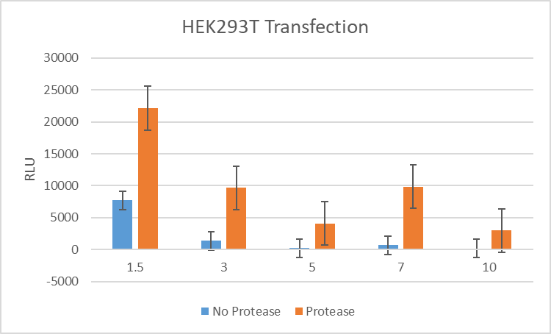
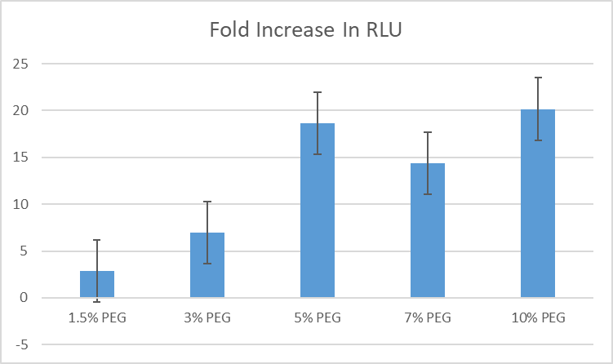
Incubation with Protease Improves LNP Transfection in HEK293Ts
Main Takeaways:
Without the protease, transfection is highest for 1.5% PEG and decreases with increasing PEG, as expected
1.5% PEG has the highest transfection with and without protease
The fold change in activity increases for LNPs with greater PEG %
We hypothesize that the protease is destabilizing the LNP and improving endosomal escape
Notes:
‹#›

Slide 7
Incubation with Protease Results in LNP Aggregation
Main Takeaways:
Before the protease addition, all LNPs were below 120nm with PDIs under 0.4
After protease addition, LNPs are above 2000nm with PDIs over 0.3
DLS measurements of the LNPs show aggregation after addition of the protease, which supports our hypothesis of protease-mediated destabilization

Slide 8
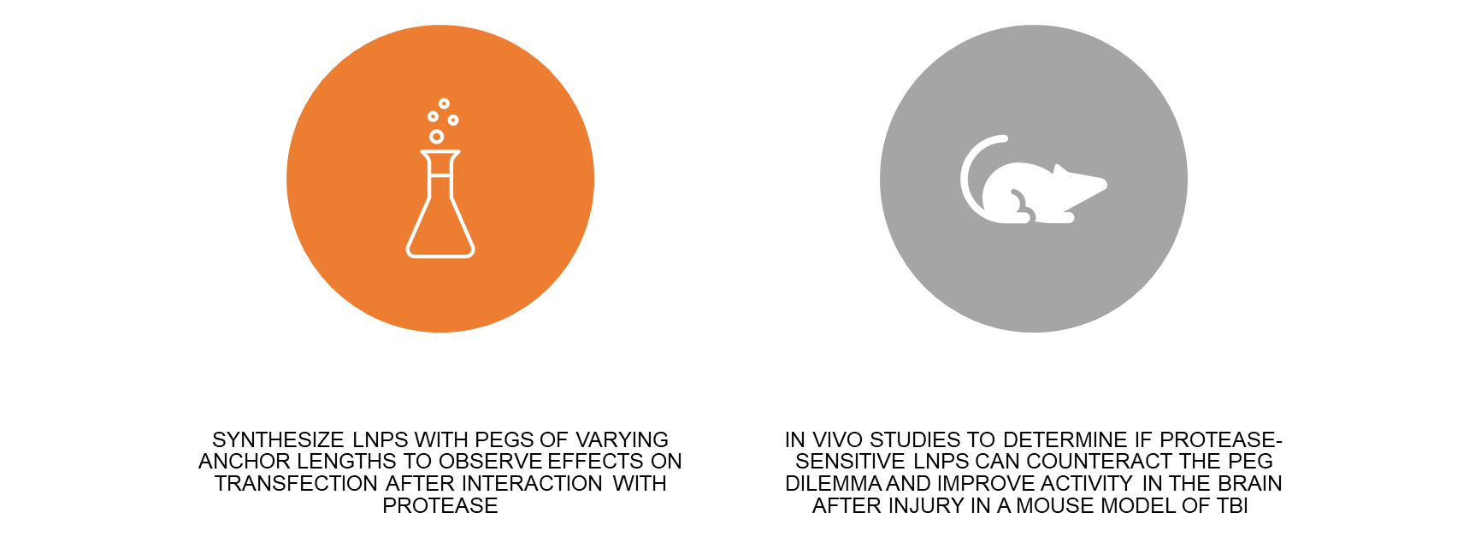
Next Steps

Slide 9
Acknowledgements
I would like to sincerely thank:
The National Science Foundation
Our host, University of California San Diego
San Diego Nanotechnology Infrastructure (SDNI)
Dr. Kwon, Shu Chien-Gene Lay Department of Bioengineering, UC San Diego
Yazmin Hernandez, Shu Chien-Gene Lay Department of Bioengineering, UC San Diego
All of Kwon Lab for their support and guidance
Yves Theriault, SDNI Executive Director, Education and Outreach
Yuhwa Lo, SDNI Faculty Director
The audience for listening and for their time!
This program was supported by NSF grant ECCS 2025752

