Slide 1
High-Temperature High-Pressure Synthesis of Cubic Boron Nitride on Diamond Substrates
Sandra Loerdal, Arizona State University
Rajesh Shrestha (grad student), Arizona State University
Dr. Robert Nemanich (professor), Arizona State University
My colleagues at ASU: Dr. David Smith, Dr. Ramandeep Mandia, Kyusei Tsuno, Dr. Martha McCartney, Dr. Kevin Hatch, Dr. Ali Ebadi Yekta, Jessica Hauer and Dr. Trevor Thornton
Acknowledgement: This material is based upon work primarily supported by the National Science Foundation under award No.ECCS-2025490.

Slide 2
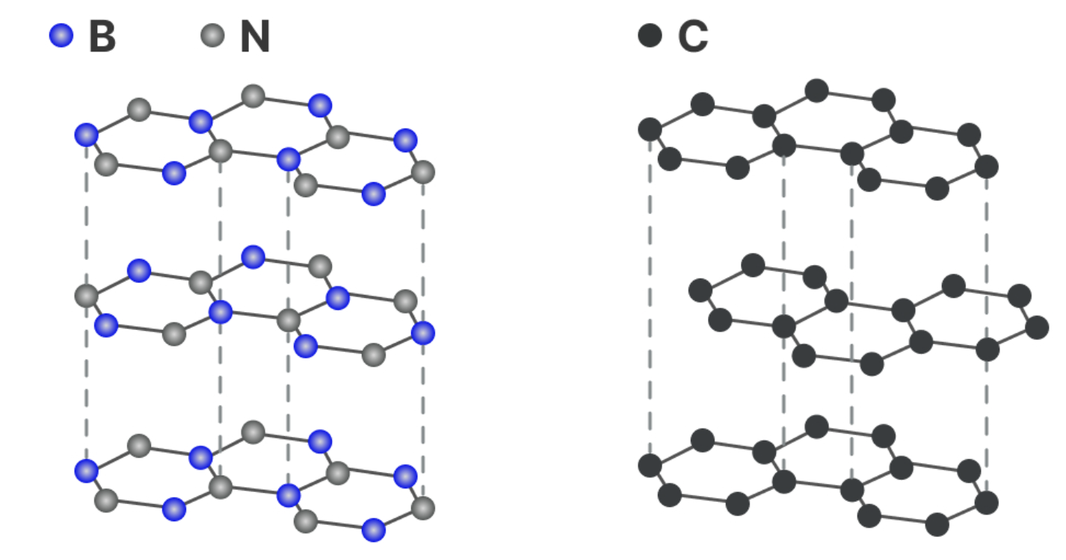
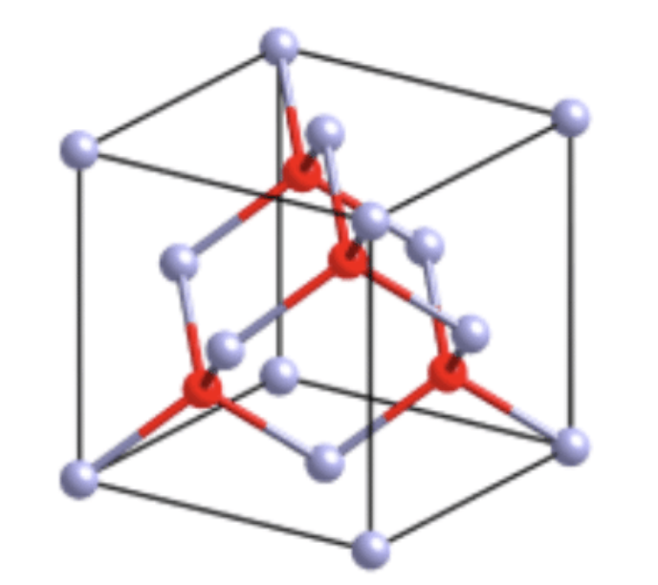
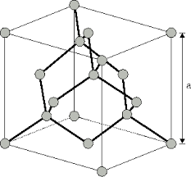
Boron Nitride and Diamond
Hexagonal boron nitride (h-BN) is similar to graphite.
Cubic boron nitride (c-BN) is similar to diamond.
Unique properties:
Hardness
Thermal Conductors -> electronics
Wide bandgap
Stable in harsh environments (high heat, high vacuum, etc.)
Application:
Power electronics and much more
.
Figure 1: H-BN & Graphite
Figure 2: C-BN
Figure 3: Diamond
Acknowledgement: This material is based upon work primarily supported by the National Science Foundation under award No.ECCS-2025490.
Notes:
Picture sources:
https://www.samaterials.com/content/hexagonal-boron-nitride-h-bn-structure-properties-and-applications.html
https://www.iue.tuwien.ac.at/phd/ungersboeck/node27.html
https://www.researchgate.net/figure/Schematic-diagram-of-fundamental-crystal-structures-of-boron-nitride-cubic-and-wurtzite_fig1_333745352

Slide 3
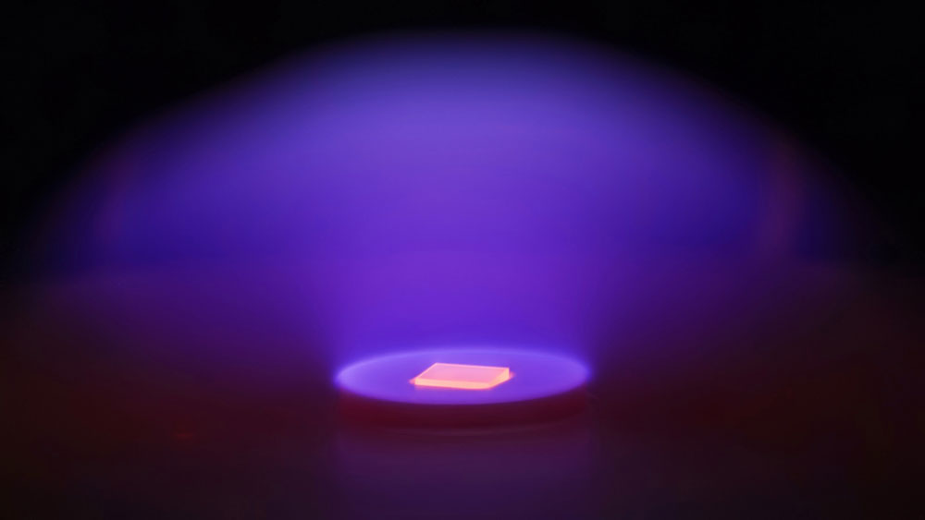
Moving Towards Boron Nitride Technologies
The problem with silicon:
Reaching its physical limits
Breaks down under extreme heat
Fails under high voltage and
Radiation
Challenges with BN on diamond:
Imperfect interface
H-BN is the naturally stable form, but c-BN is more useful for electronics
How can we grow high-quality BN on diamond and improve the interface, transforming h-BN into c-BN to unlock better electronic properties?
Figure 4: Growing Diamond; By Franz Koeck/ASU

Slide 4
From Deposition to Analysis
Diamond Substrate
Diamond Substrate with Boron Nitride on Top
Analysis with TEM/FFT
High Pressure High Temperature (HTHP)
Plasma enhanced chemical vapor deposition (PECVD)
Observe Results
Analysis with TEM/FFT
Acknowledgement: This material is based upon work primarily supported by the National Science Foundation under award No.ECCS-2025490.

Slide 5
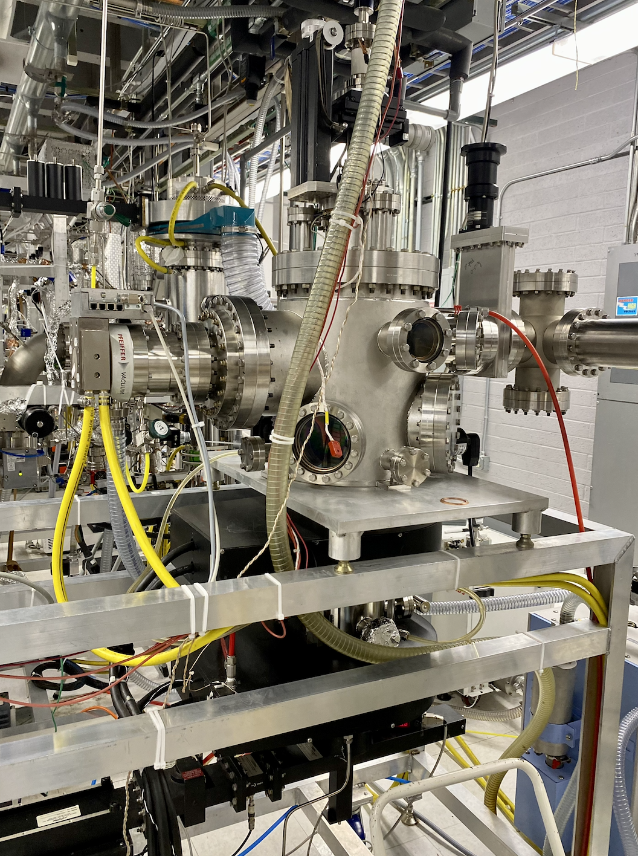
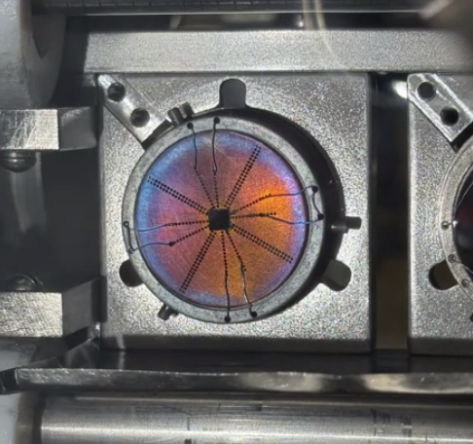
PECVD- Deposition of BN
Technique to grow thin film.
It involves using gas precursors
A plasma is generated using radio frequency (RF) power
The reactive species then settle onto the surface of the substrate, forming a solid BN layer
Grow on single crystal diamond –> same diamond in jewelry but it is boron doped, hence the color
1 inch
Figure 4: The sample is 3 x 3 mm
Figure 5: PECVD System (NSL Lab)
Acknowledgement: This material is based upon work primarily supported by the National Science Foundation under award No.ECCS-2025490.

Slide 6
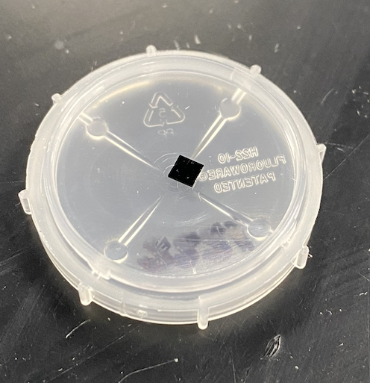
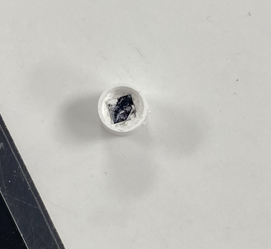
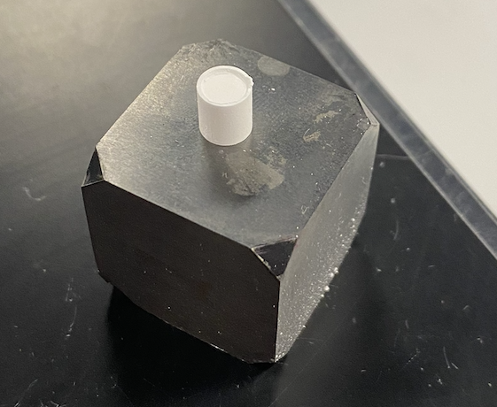
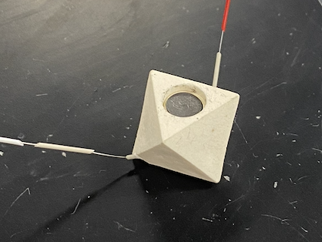
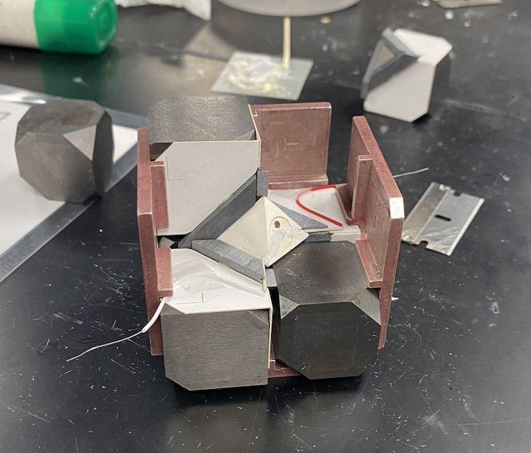
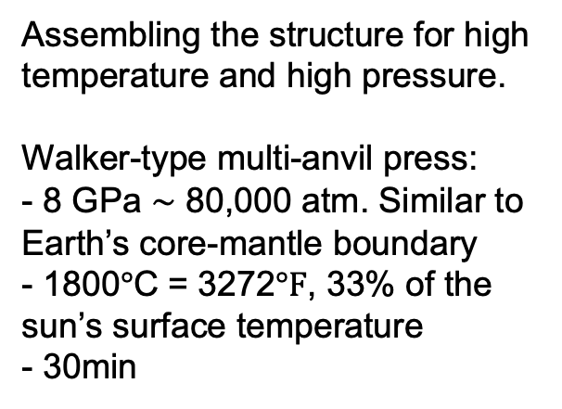
HTHP- High-Temperature, High-Pressure
Assembling the structure for high temperature and high pressure.
Walker-type multi-anvil press:
- 8 GPa $\sim$ 80,000 atm. Similar to Earth’s core-mantle boundary
- 1800$°$C = 3272$°F$, 33% of the sun’s surface temperature
- 30min
1 inch
3mm =
0.11 inch
Figure 6: Substrate
Figure 7: Inside Cylinder
Figure 8: Cylinder Covered with MgO
Figure 9: Octahedron Structure
Figure 10: High-Pressure Cell
Acknowledgement: This material is based upon work primarily supported by the National Science Foundation under award No.ECCS-2025490.

Slide 7
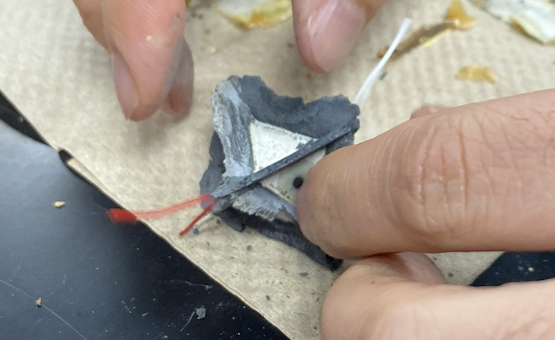
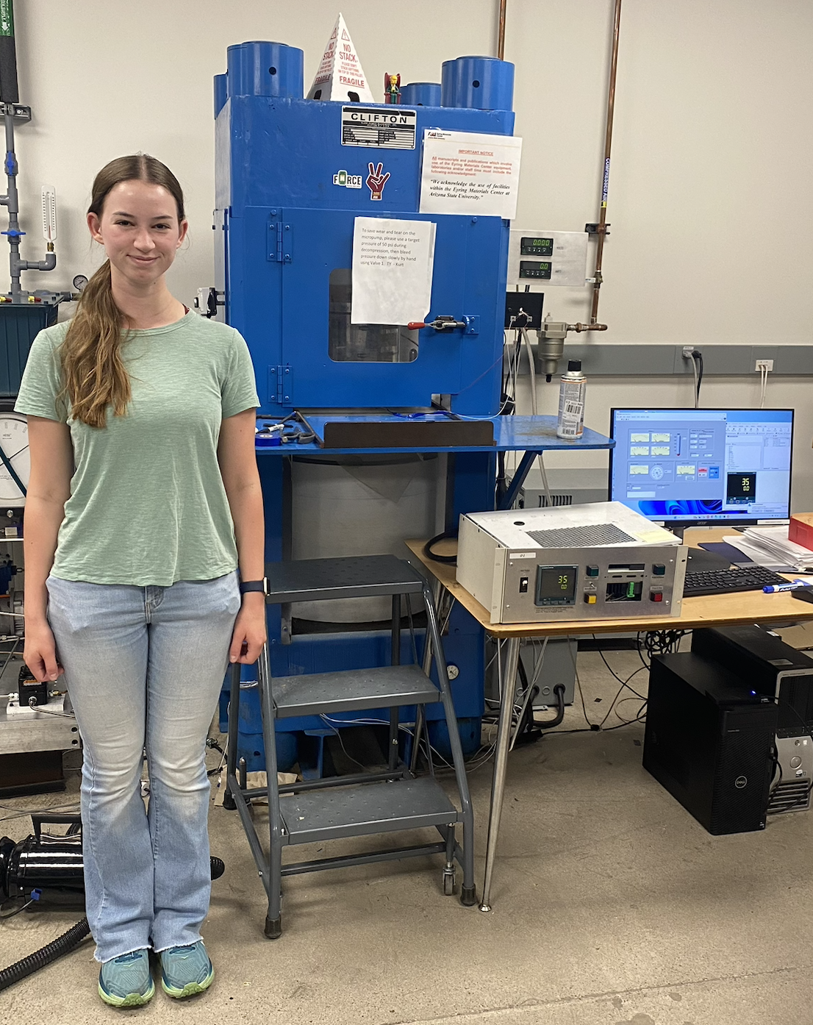
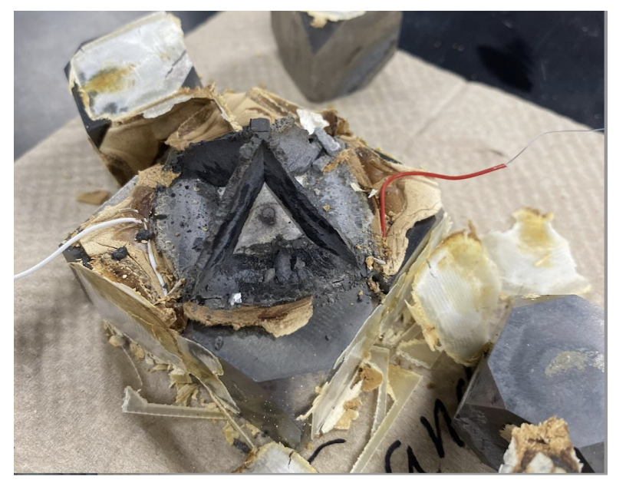
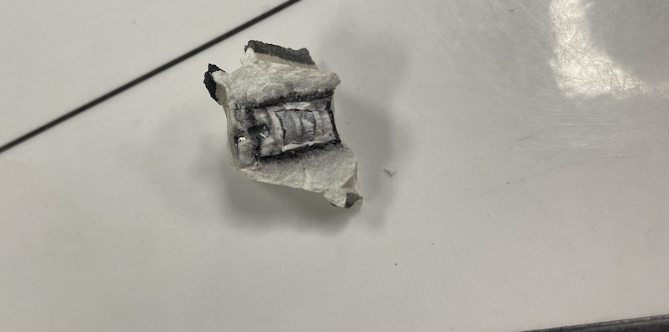
HTHP; After the Pressure and Heat
Figure 12
Figure 11:
Figure 14: The Multi-Anvil Press
Figure 13
Acknowledgement: This material is based upon work primarily supported by the National Science Foundation under award No.ECCS-2025490.

Slide 8
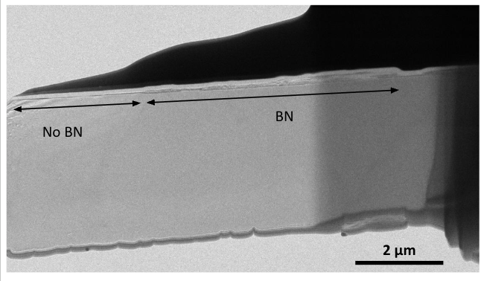
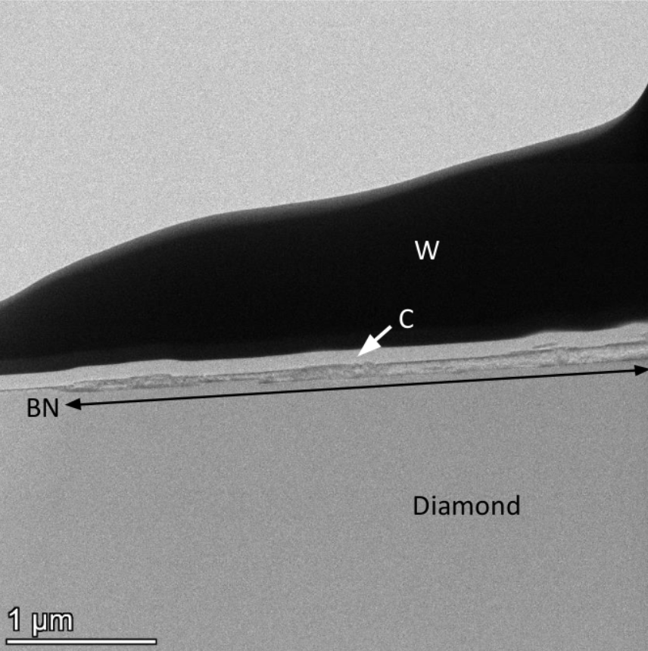
Results: TEM Analysis
Figure 15
Figure 16
Temperature: 1800C
Pressure: 8 GPa
Time: 30 minutes
Thickness: 10 nm - 80 nm
Highly uneven diamond surface.
BN is intact in some regions
Pictures by Ramandeep Mandia and Dr. David Smith (06/11/25)
Acknowledgement: This material is based upon work primarily supported by the National Science Foundation under award No.ECCS-2025490.

Slide 9
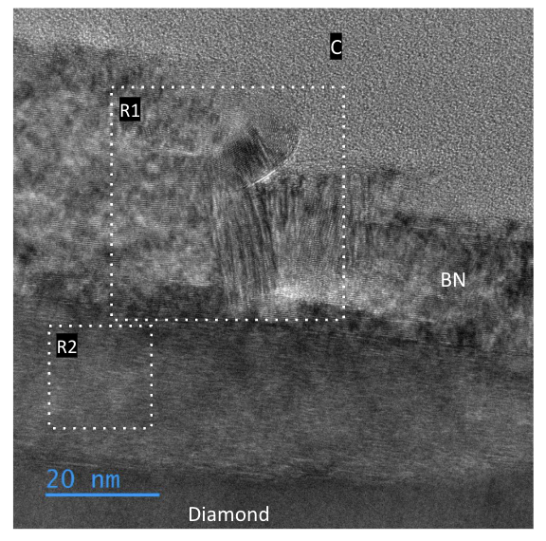
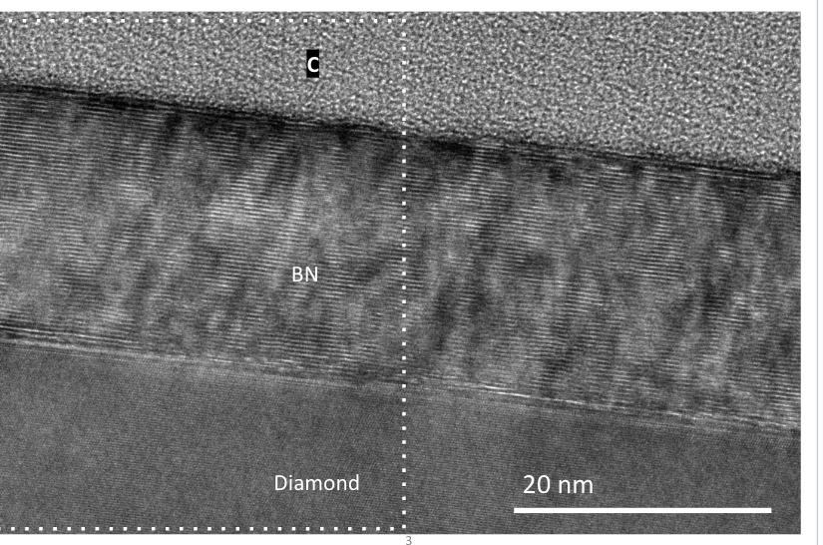
TEM of BN-on-Diamond Interface
Figure 17
Figure 18
High-quality hexagonal structures were observed in the right image, while the left image shows some cubic regions disrupting the h-BN lattice.
Pictures by Ramandeep Mandia and Dr. David Smith (06/11/25)
Acknowledgement: This material is based upon work primarily supported by the National Science Foundation under award No.ECCS-2025490.

Slide 10
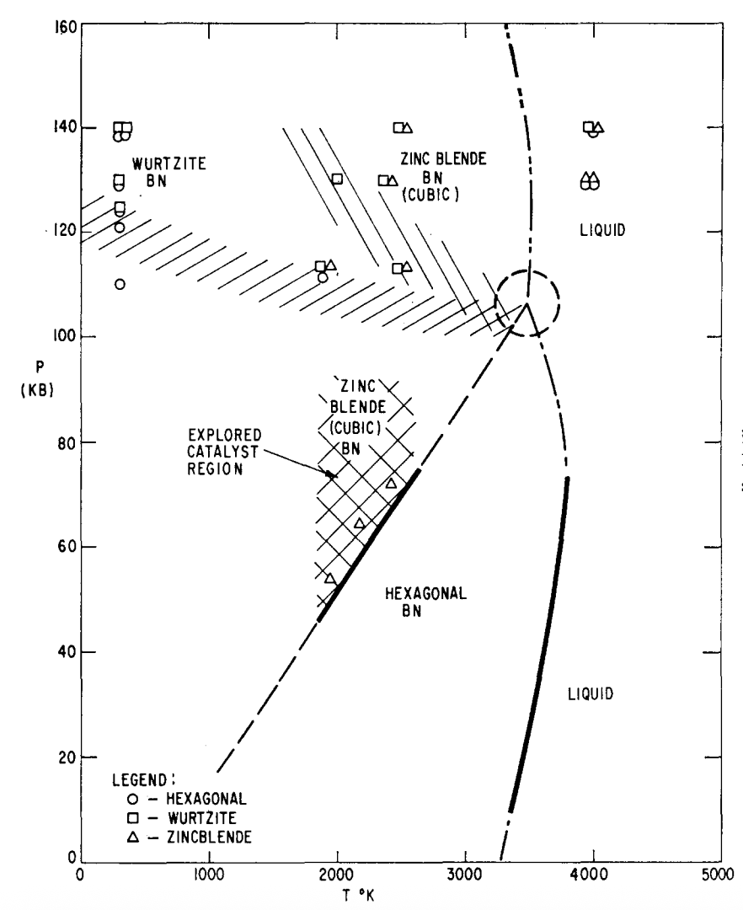
Phase Diagram & Further Plans
Further Plans:
Explore new pressure-temperature conditions
Aim to improve phase conversion
Work toward sharper, cleaner interface
Long-Term Vision:
Grow and stabilize c-BN on diamond
Create a perfect heterointerface between c-BN and diamond, the two hardest known materials
No catalyst was used and therefore hexagonal is expected in the region of 80 KB and 2100K.
Figure 19: Bundy, F.P., & Wentorf, R.H. (1963). Direct transformation of hexagonal boron nitride to denser forms. Journal of Chemical Physics , 38(5), 1144-1149
Acknowledgement: This material is based upon work primarily supported by the National Science Foundation under award No.ECCS-2025490.

Slide 11

Acknowledgements & Contact Info
I would like to thank Dr. Robert J. Nemanich for his invaluable guidance and support throughout this project as my PI and mentor. I am also grateful for Jessica Heuer and Trevor Thornton for supporting me through the REU program. I am thankful for Dr. David Smith and Dr. Ramandeep Mandia for aid with TEM and FFT analysis and meaningful insights. I also thank my colleagues at ASU: Rajesh Shrestha, Kyusei Tsuno, Dr. Martha McCartney, Dr. Kevin Hatch, Dr. Ali Ebadi Yekta.
This research was supported by the U.S. National Science Foundation under grant DMR-2003567. This research was supported by the U.S. Department of Energy (DOE) Office of Science, Basic Energy Sciences (BES) through ULTRA, an EFRC under Award No. DE-SC0021230.
Sandra Loerdal
Sandralordalm@gmail.com
Arizona State University,
Tempe, AZ, USA
Acknowledgement: This material is based upon work primarily supported by the National Science Foundation under award No.ECCS-2025490.

Slide 12
Bibliography
Figure 1: Standford Advanced Materials - ”H-BN vs. Graphite Structure,” from Hexagonal Boron nitride (h-BN): Structure, Properties and Applications. Accessed 26 July 2025.
Figure 2: Institute of Microelectronics, TU Wien – “Basic Properties of the Diamond Structure.” Accessed 26 July 2025.
Figure 3: Vuong, P. – “Schematic Diagram of fundamental Crystal Structures of Boron Nitride,” ResearchGate. Accessed 26 July 2025.
Figure 4: Growing Diamond; By Franz Koeck/ASU
Figure 15-18 & 20-21: Mandia, R. & Smith, D. – Original TEM photos, photographs on 11 June 2025.
Original micrographs
Figure 19: Bundy, F. P., & Wentorf, R. H. – High pressure phase-diagram illustration (1963)
Acknowledgement: This material is based upon work primarily supported by the National Science Foundation under award No.ECCS-2025490.

Slide 13
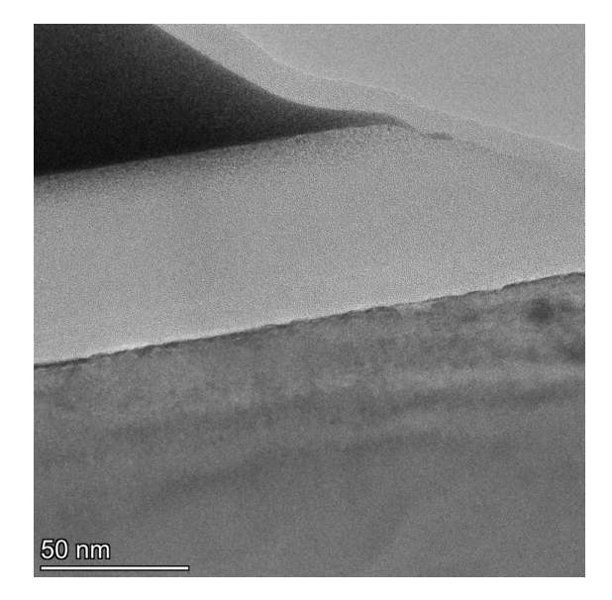
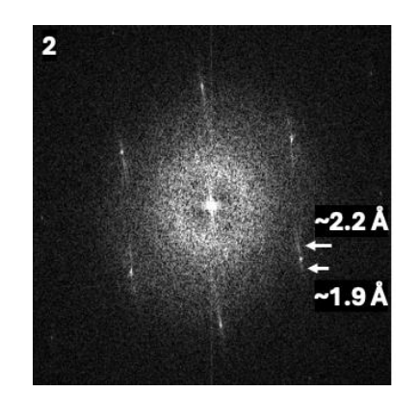
Results of First Round: No BN
There was no visible 20 nm thick BN layer after HTHP. Some small additional spots in the FTT -> either a thin layer or disorder.
Round 1:
Temperature: 1500 degrees C
Pressure: 7.0 GPa
Time: 3 hours
Figure 21
Figure 20
Pictures by Ramandeep Mandia and Dr. David Smith
Acknowledgement: This material is based upon work primarily supported by the National Science Foundation under award No.ECCS-2025490.
Notes:
.

Slide 14
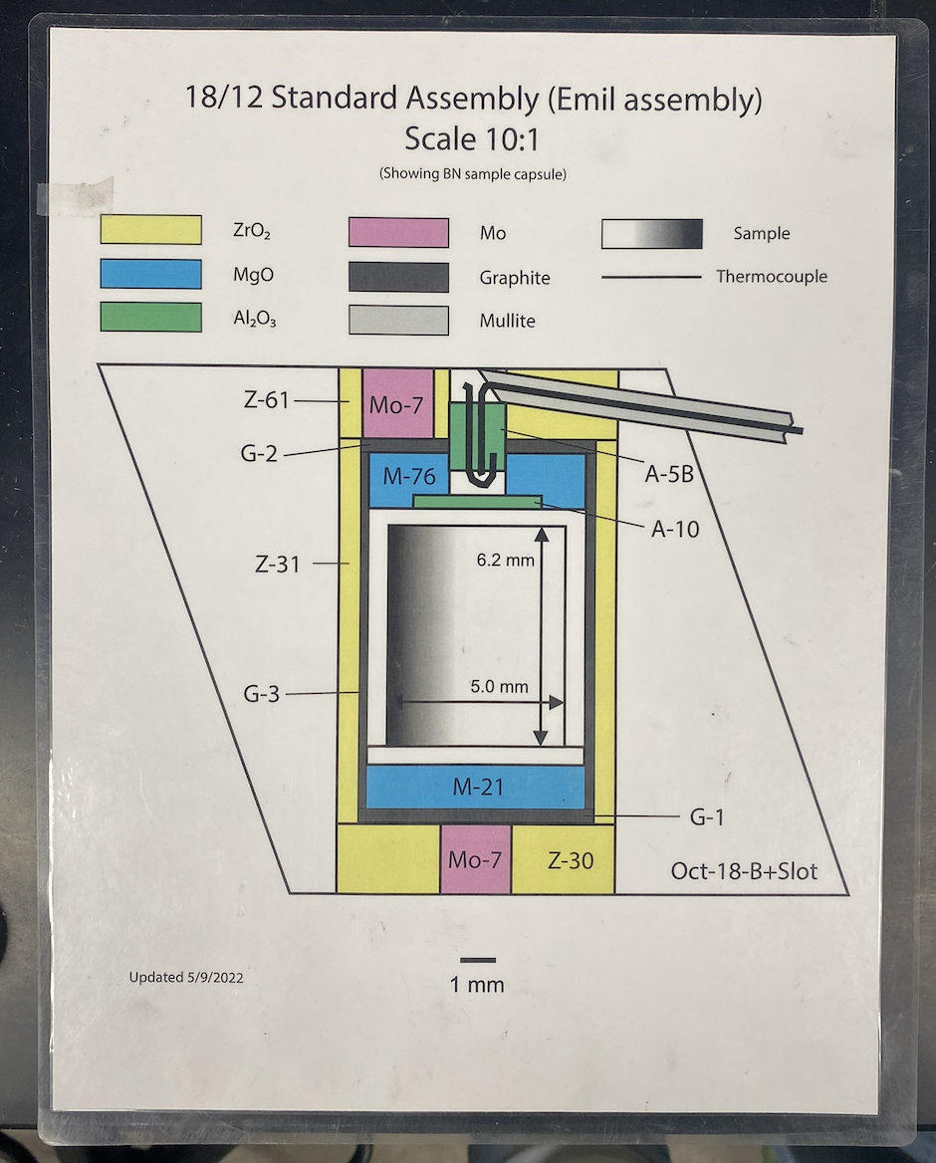
HTHP Assembly
G-1 Graphite Layer
Figure 22
Mo-7 Molybdenum Cylinder Inside the Zirconium Plate
Figure 23
Figure 24
Acknowledgement: This material is based upon work primarily supported by the National Science Foundation under award No.ECCS-2025490.

