Slide 1
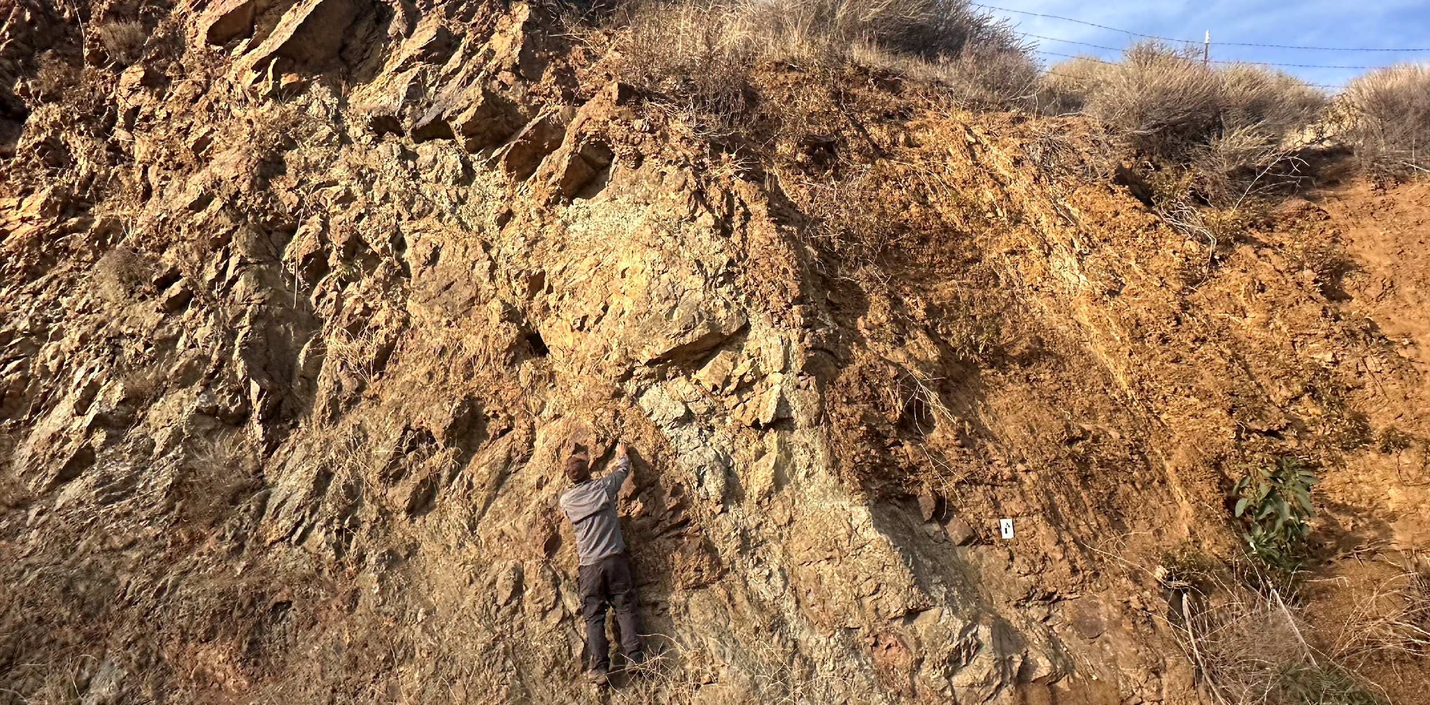
Petrologic characterization of the Coast Range Ophiolite, central California using petrographic and scanning electron microscopy
MSU ECE REU Site Summer 2025 Project Presentation
Presenter: Jessica Rains-Meyer
Mentors: Dr. Devon Orme, Rebekah Kennedy

Slide 2
Introduction: What is an Ophiolite?
A suite of rocks representing the lower crust and upper mantle, associated with extension in convergent plate tectonics.
2
Notes:
Ophiolite can be defined as: A suite of rocks representing the lower crust and upper mantle, associated with extension in convergent plate tectonics.
What does any of this mean? Some of the audience with a geological background may understand but for those who do not, let's do a very brief intro to the most basic geology concepts, due to time constraints if you have any other questions relating to this please feel free to ask me after the presentation, I'd be more than happy to answer them to the best of my knowledge.

Slide 3
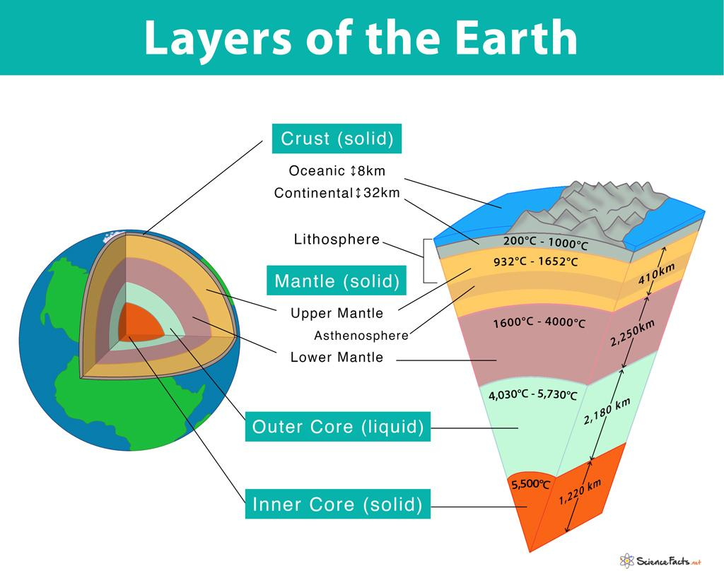
Intro to the Earth overview:
3
Mukherjee, S., Bhuyan, S., 2023, Sciencefacts.net, Geosphere
Notes:
Zooming out as broadly as we can, the interior of the Earth can be divided into some basic layers – Inner core, Outer Core, Mantle, and Crust – and these are hundreds to thousands of kilometers in depth. The area we stand on is the crust, and most of tectonic action is generated in the lithosphere which is the upper mantle and the crust.

Slide 4
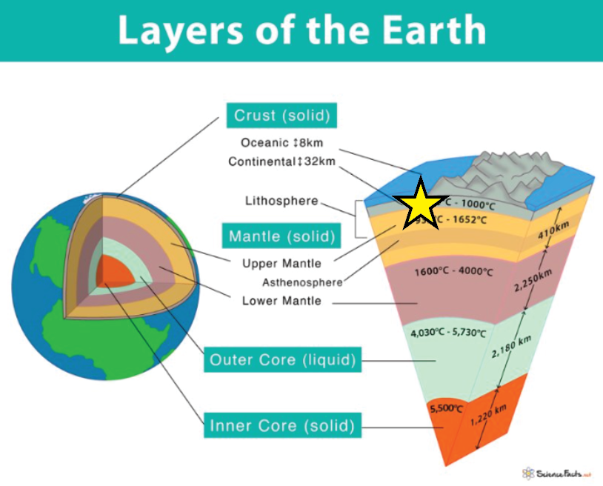
Intro to the Earth overview:
4
Mukherjee, S., Bhuyan, S., 2023, Sciencefacts.net, Geosphere
Notes:
The lithosphere is what we are mostly interested in for ophiolite.

Slide 5
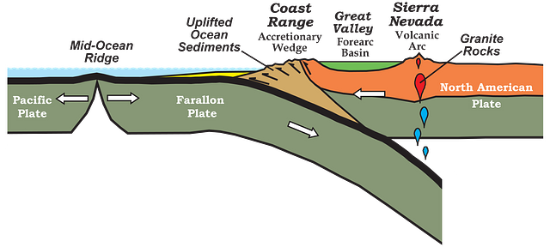
Introduction: Why is ophiolite important?
Ophiolites helps us understand the processes that occur in the Earth that we can't typically see
  Formation of new oceanic crust
    Preservation of lithospheric rock sequence
  Study mantle melting and magma evolution
  Adds to the Earth's material "budget"
Earle, S., 2021, Environmental Geology: 2.4 Plate Tectonics
5

Slide 6

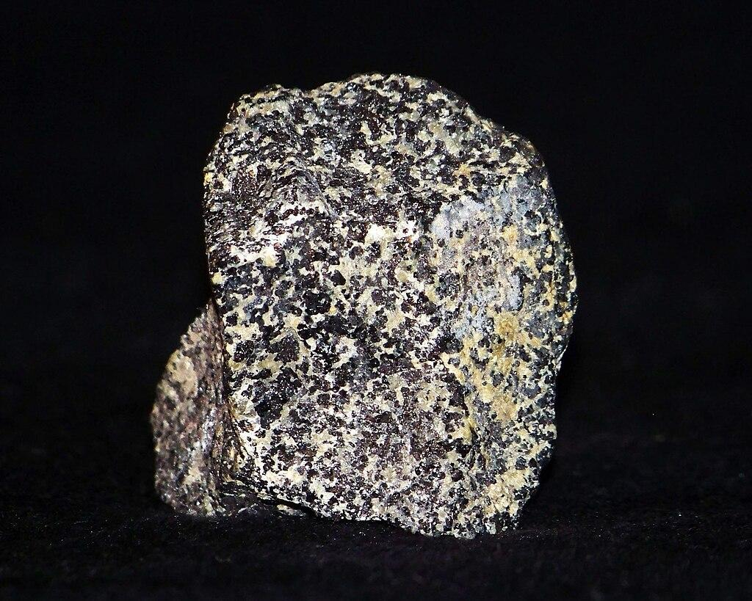
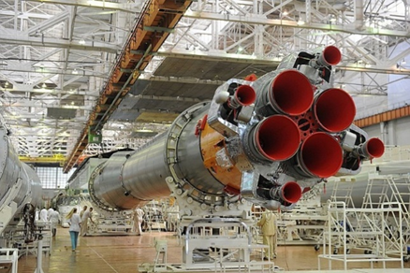
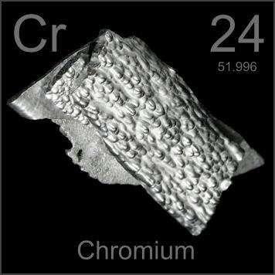
Introduction: Why is ophiolite important?
Economic importance – Critical Minerals
  Chromite ore = chromium – a component of stainless steel
    Thermally and structurally stabilizing, non-corrosive
2010, USGS: Chromium – Makes Stainless Steel Stainless
6

Slide 7
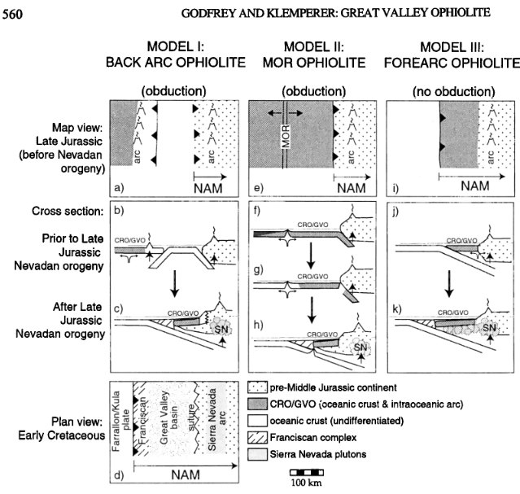
Background: Ophiolite creation – 3 models
Abbreviations are as follows: CRO, Coast Range ophiolite; GVO, Great Valley ophiolite; SN, pluton emplacement associated with the Sierra Nevada batholith; MOR, mid-ocean ridge; and NAM, North American plate.
Godfrey, N. J., Klemperer, S. L., 1998
Notes:
3 main models where Ophiolite could be created introduced by Dickinson, Hopson and Saleeby in 1996
Model 1: Back arc extension of an island arc Model 2: Mid-Oceanic Spreading center – both model 1 and 2 involve obduction after the oceanic plate subducts.
Model 3 created in a forearc extension in a Suprasubduction zone setting, where ophiolite is not obducted, rather it is formed in situ and then exhumed.
While all 3 models are still debated and dependent on geographical areas of study, we will focus on model 3 as the main process for the formation of the Coast Range Ophiolite in California
Additional questions: This is based on geochemical and structural evidence pointing to a Suprasubduction zone (extensional forearc setting) rather than a mid-ocean ridge.
U-Pb dating also coincides with the initiation of subduction 160-170Mya. Additionally, it lies structurally underneath the "Great Valley Sequence" sedimentary deposits and yet above the Franciscan subduction mélange sequence (serpentinites, schists, eclogites, etc.)

Slide 8
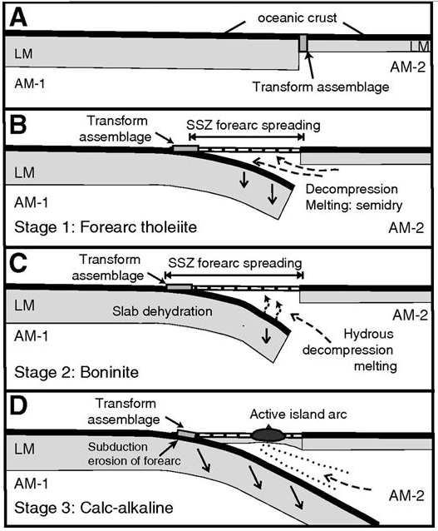
Subduction zone – forearc basin formation
8
Shervais, J. W., Choi, S. H., 2012​
Notes:
Forearc model, example of what happened in California.

Slide 9
Research Question
What are the minerals and rocks present in the California Jurassic Coast Range Ophiolite, and what does the rock suite imply about the formation and subsequent alteration of oceanic crust?
Notes:
What are the minerals and rocks present in the California Jurassic Coast Range Ophiolite, and what does the rock suite imply about the formation and subsequent alteration of oceanic crust?

Slide 10
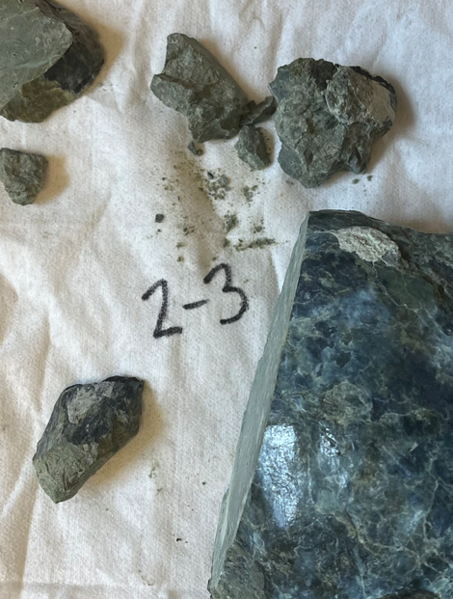
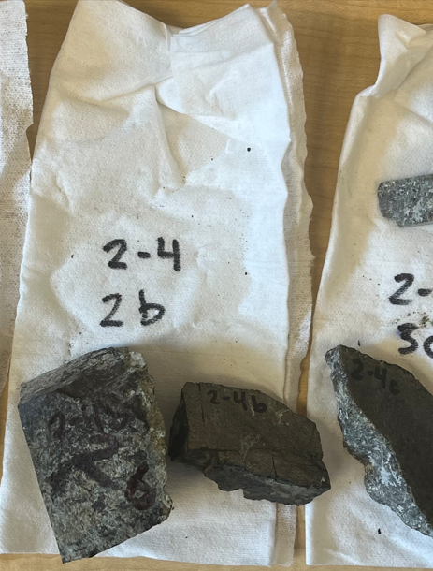
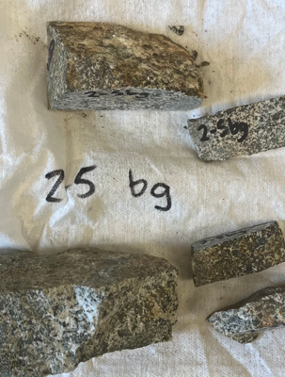
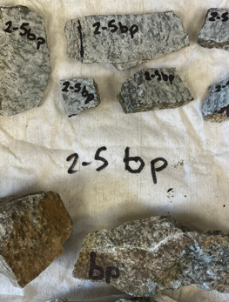
Project plan: Collect Hand Samples

Slide 11
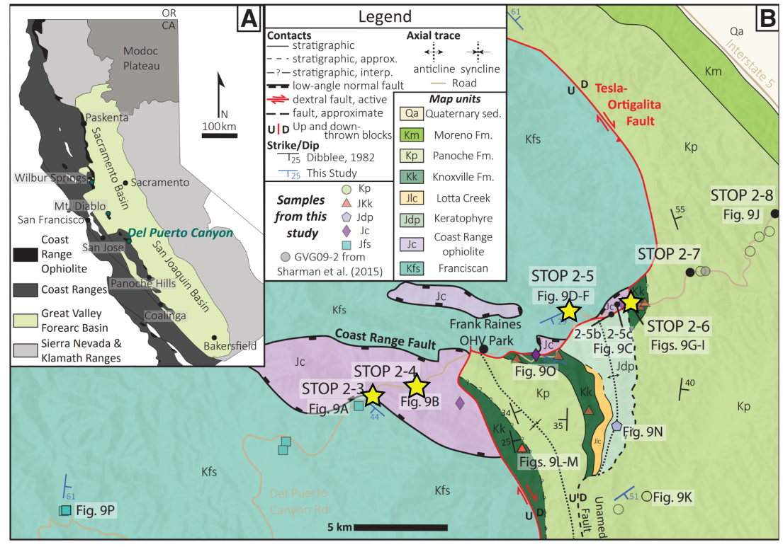
Wakabayashi, J., and Orme, D. A., 2025
11

Slide 12
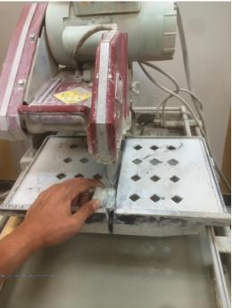
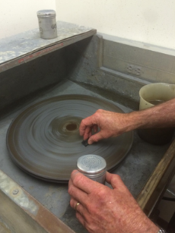
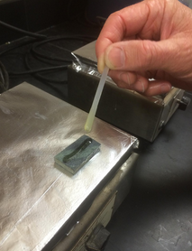
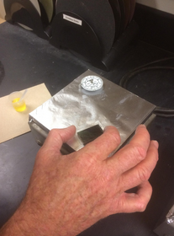

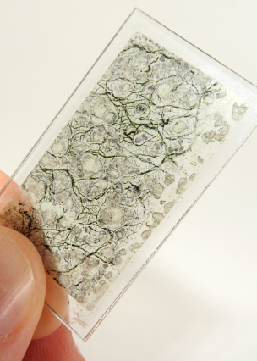
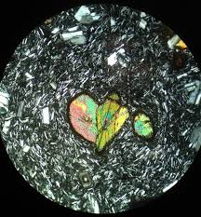
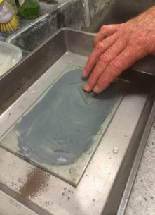
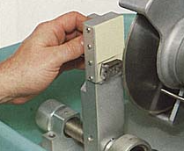
30 µm thick
Mooney, P., 2014
12
Notes:
Quality Thin Sections in Arizona.

Slide 13
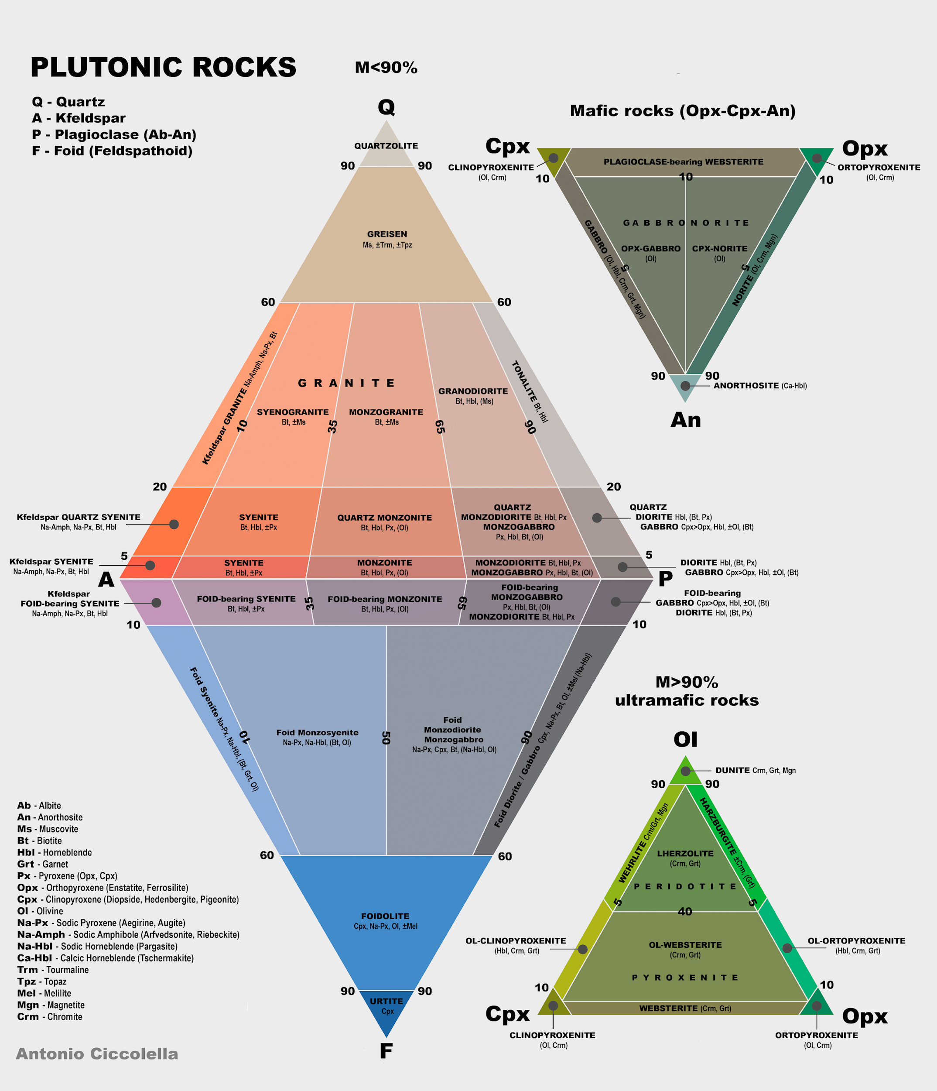

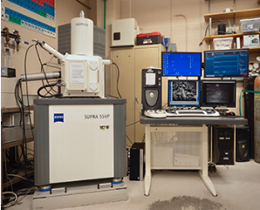
Field Emission Scanning Electron Microscope
Zeiss SUPRA 55VP
To categorize rock types based on minerals present
Petrographic Microscope
Leica DM750 P
QAPF Diagram
To determine elements present and to identify opaque minerals
To analyze optical properties
13

Slide 14
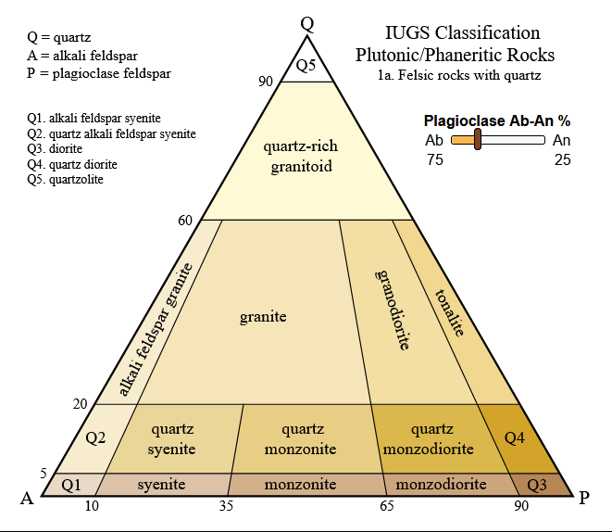
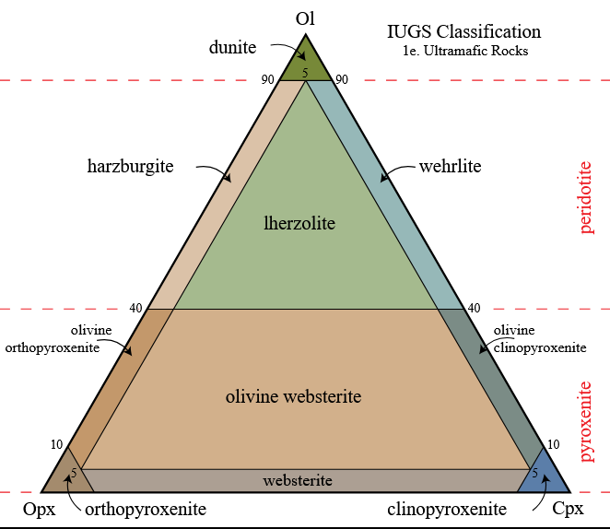
Ol = Olivine
Cpx = Clinopyroxene
Opx = Orthopyroxene
14

Slide 15
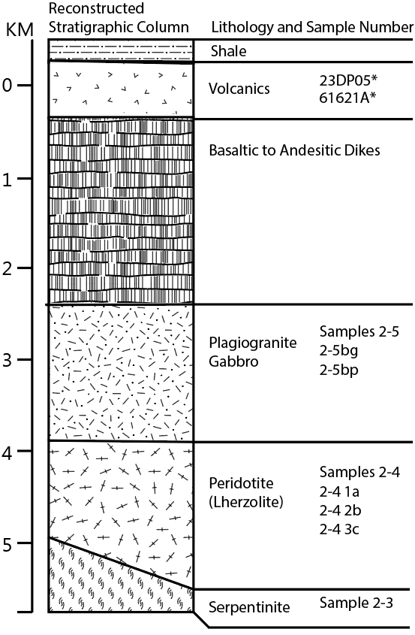
Research
Rock samples general classification
  Hand sample characterization
    Serpentinite – originally peridotite mantle rock, hydrothermally altered
    Ultramafics – phaneritic, subhedral pyroxene, olivine
    Gabbro – phaneritic, subhedral mafic-intermediate rocks
    Plagiogranite – phaneritic, subhedral intrusive intermediate rocks
    Volcanics – aphanitic, euhedral extrusive andesites
Strat column – depth of formation
  Down to 5km at crystallization of upwelled mantle rock
15

Slide 16
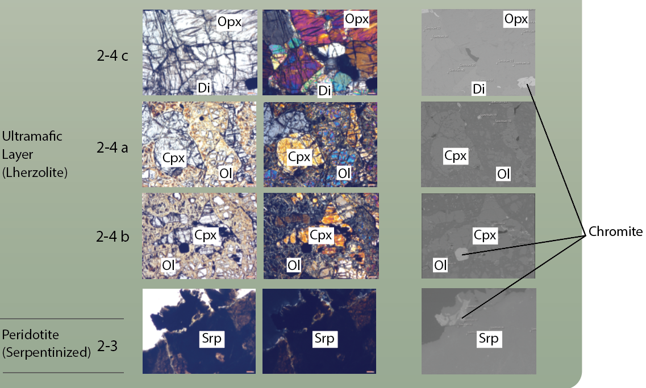
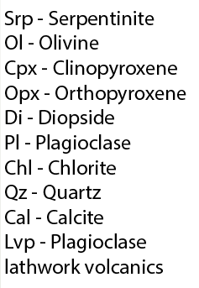
Petrography and SEM Results
16

Slide 17
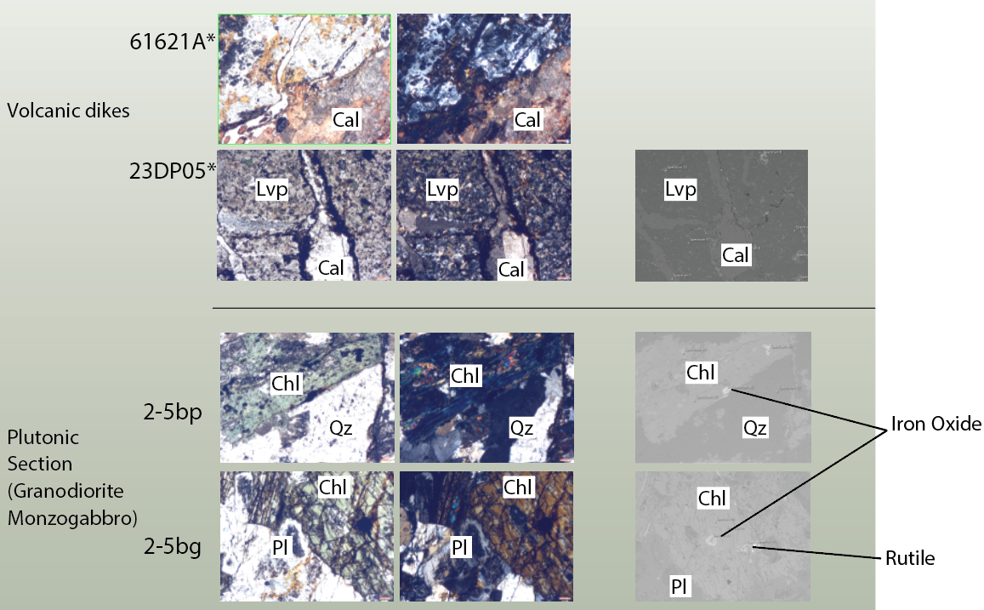
Petrography and SEM Results
No samples of basaltic dikes
17

Slide 18
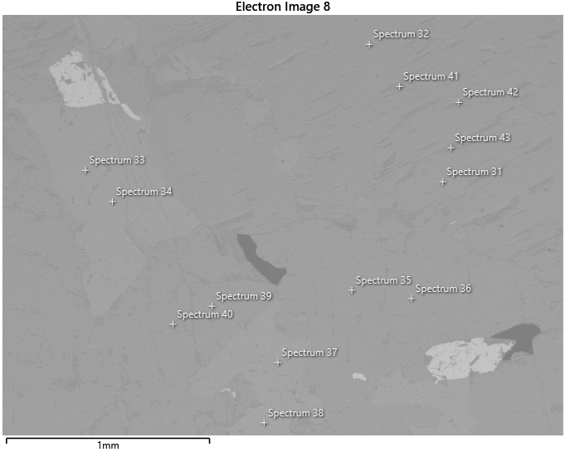
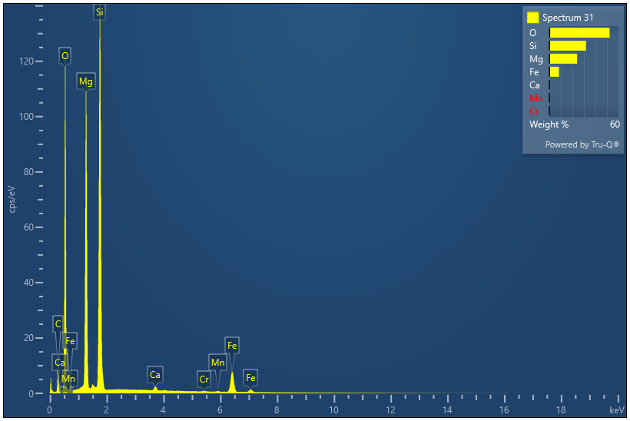
SEM work
A note about use of SEM for petrologic work:
Elemental sprectra output are in weight percent, therefore the researcher needs to consider differences in the atomic weight of each element in determining relative abundance of elements. For example, the sample above has <0.3 atomic % Calcium, but the mineral is an orthopyroxene, not Ca rich-clinopyroxene.
18

Slide 19
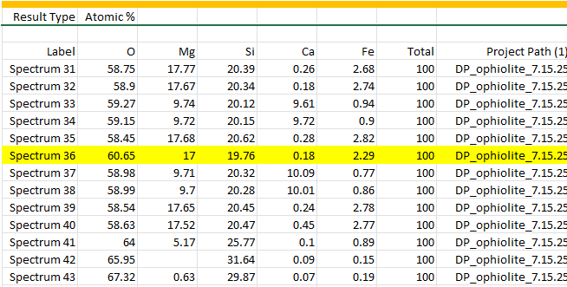
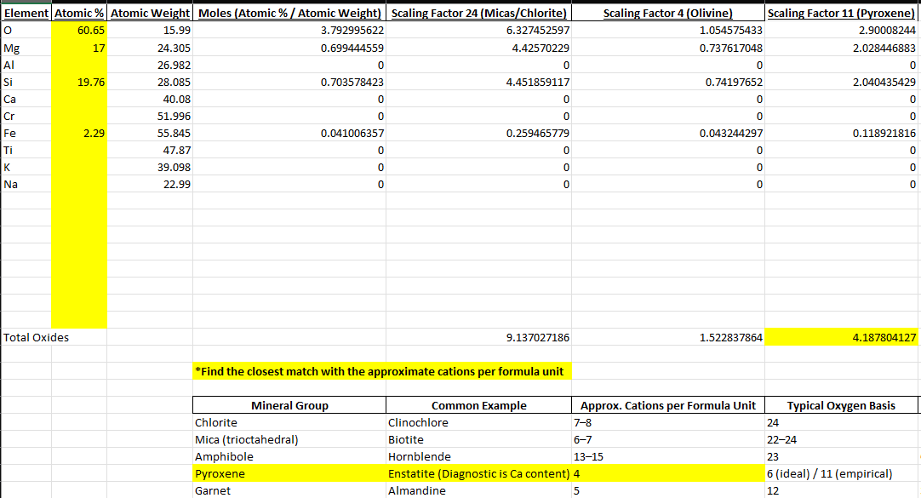
Atomic % of elements
in a scanned point (from SEM)
Normalization spreadsheet to help match cation-to-oxygen ratio
(made by me)
19

Slide 20
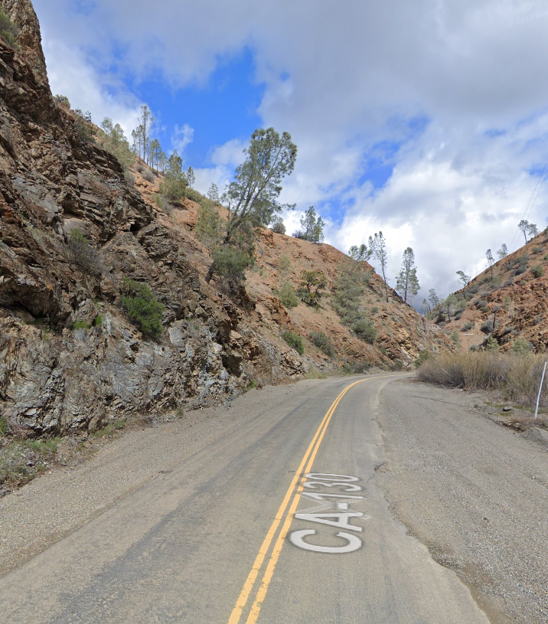
Conclusions
The top (23DPO5/61621A) and bottom (2-3) of the section are highly altered, either diagenetically from calcium bearing fluids or through serpentinization from fluids of the subducting plate, respectively.
The ultramafic series (samples 2-4) are Lherzolite, which is an olivine rich mafic rock with clinopyroxene and orthopyroxene varying in abundance by sample.
The plutonic section is made up of monzogabbro (2-5bg) with preserved plagioclase and plagiogranite (2-5bp) that is rich in quartz, but the plagioclase is altered to saussurite.
SEM work helped identify opaque minerals such as chromite and forms of iron oxide, which are challenging to identify in petrographic scope work alone.
Del Puerto Canyon Rd, near Adobe Springs
20

Slide 21
Conclusions
Summary:
Petrological analysis is consistent with the model that California Coast Range Ophiolite was formed in a forearc setting, and displays alteration caused by the initiation of true subduction as well as diagenesis of layered sedimentation in the forearc basin above.
Highlights:
Further defining the research on ophiolite formation and deformation. Mineral content. Still debated process.
Learning about igneous petrology, using an SEM, taking data to make tectonic interpretations
Learned a lot about optical properties and solid solutions of peridotite and plagioclase, as many of these samples were very much on the extreme ends optically, yet consistent with solid solution chemistry.
  Exsolution Lamellae in olivine and pyroxene
  Sericite/Saussurite alteration of plagioclase
Created an excel sheet to help match chemical atomic percentages with an oxide-to-oxygen ratio, with the help of AI.
Research steps can be simplified and recreated as a lab to be used by other universities and colleges by uploading to SERC

Slide 22


Acknowledgments
This material is based upon work supported by the National Science Foundation under Grant No. 2349091.
NNCI (MONT)
Devon Orme, Rebekah Kennedy, Tim Campbell – Orme lab
Wataru Nakagawa, Bradley Whittaker, David Dickensheets, and Heather Rauser at MSU, and Kathryn Hollar and Bill Wilson at Harvard for helping facilitate my coming here
Yajaira Ortega, SSU alumni, who encouraged me to apply to an REU this year
Marissa Mnich, Owen Anfinson, Matty Mookerjee, Phil Mooney (Sonoma State University Geology Department Faculty)

Slide 23
References
Dickinson, W.R., Hopson, C. A., and Saleeby, J.B., 1996, Alternate Origins of the Coast Range Ophiolite (California): Introduction and Implications: GSA Today, v. 6, no. 2, p. 1–10.
Evarts, R. C., Coleman, R. G., Schiffman, P., 1999, The Del Puerto Ophiolite: petrology and tectonic setting: Geologic field trips in Northern California: centennial meeting of the Cordilleran Section of the Geological Society of America, v. 119, p. 136-149
Godfrey, N. J., Klemperer, S. L., 1998, Ophiolitic basement to a forearc basin and implications for continental growth: The Coast Range/Great Valley ophiolite, California: Tectonics, Col. 17 (4), P. 558-570. doi: https://doi.org/10.1029/98TC01536
Shervais, J. W., Choi, S. H. 2012, Subduction initiation along transform faults: The proto-Franciscan subduction zone: Lithosphere, v. 4, (6), p. 484-496. doi: https://doi.org/10.1130/L153.1
Orme, D.A., Weis, N., Surpless, K.D., Laskowski, A.K., Crowley, J.L., Stine, N., Colliver, I., Ross, C., and Sweet, E., 2025, Age, provenance, and geochemical relationships amongst the Great Valley Group, Coast Range Ophiolite, and Franciscan subduction complex at Del Puerto Canyon, central California: GSA Bulletin, doi: https://doi.org/10.1130/b38093.1
Wakabayashi, J., Ghatak, A., Basu, A. R., 2010, Suprasubduction-zone ophiolite generation, emplacement, and initiation of subduction: A perspective from geochemistry, metamorphism, geochronology, and regional geology: GSA Bulletin, v. 122, (9-10), p. 1548–1568, doi: https://doi.org/10.1130/B30017.1
Wakabayashi, J. and Orme, D. A., 2025, The classic forearc triad of the Franciscan subduction complex, Coast Range ophiolite, and Great Valley forearc basin, eastern California Coast Ranges, in Garcia, P., Nelson, D., Shimabukuro, D., and Wakabayashi, J., eds., From the Late Mesozoic Forearc to the Quaternary Great Basin: Geological Society of America Field Guide 73, p. 1–44, doi: https://doi.org/10.1130/2025.0073

Slide 24
Image credits
Earth Layer: Mukherjee, S., Bhuyan, S., 2023, Sciencefacts.net, Geosphere: https://www.sciencefacts.net/layers-of-the-earth.html (June 2025)
Tectonic plates, convection: Earle, S., 2021, Environmental Geology: 2.4 Plate Tectonics: Thomspon Rivers University (Creative Commons Attribution-NonCommercial-ShareAlike 4.0 International License): https://environmental-geol.pressbooks.tru.ca/chapter/plate-tectonics/, (June 2024)
Chromium: 2010, USGS: Chromium – Makes Stainless Steel Stainless: https://pubs.usgs.gov/fs/2010/3089/pdf/fs2010-3089.pdf (June 2025)
Chromium: 2022, Chrompik: https://chrompik.com/chromium/ (June 2025)
Chromium: Wikipedia, Chromium: https://en.wikipedia.org/wiki/Chromium (June 2025)
Chromium: Grey, T., Whitby, M., Mann, N., 2017, Chromium: https://periodictable.com/Elements/024/index.html (June 2025)
Forearc ophiolite diagrams:
Stern, B., Reagan, M., Ishizuka, O., Ohara, Y., Whattam, S., 2012, To understand subduction initiation, study forearc crust: To understand forearc crust, study ophiolites. Lithosphere. v. 4, (6) p. 469–483. doi: https://doi.org/10.1130/L183.1
Shervais, J. W., Choi, S. H. 2012, Subduction initiation along transform faults: The proto-Franciscan subduction zone: Lithosphere, v. 4, (6), p. 484-496. doi: https://doi.org/10.1130/L153.1
Thin Section: Mooney, P., 2014, "Thin Section Tutorial", Sonoma State University: https://geology.sonoma.edu/research/thin-section-training (June 2025)
Plag-hornblende heart: 2017, Learning Geology: 30+ Thin Section Photos That Will Develop Your Interest in Petrography: https://geologylearn.blogspot.com/2017/03/30-thin-section-photos-that-will.html (June 2025)
Qpf Diagram: Wikipedia, QAPF Diagram: https://en.wikipedia.org/wiki/QAPF_diagram (June 2025)
IUGS Ultramafics diagrams: https://www.science.smith.edu/~jbrady/petrology/rock-library/rl-page15.php (July 2025)
California Mezosoic: Bentley, C., Historical Geology, California’s Coast Ranges: a Mesozoic accretionary wedge complex: https://opengeology.org/historicalgeology/case-studies/coast-ranges-accretionary-wedge/ (June 2025)

Slide 25
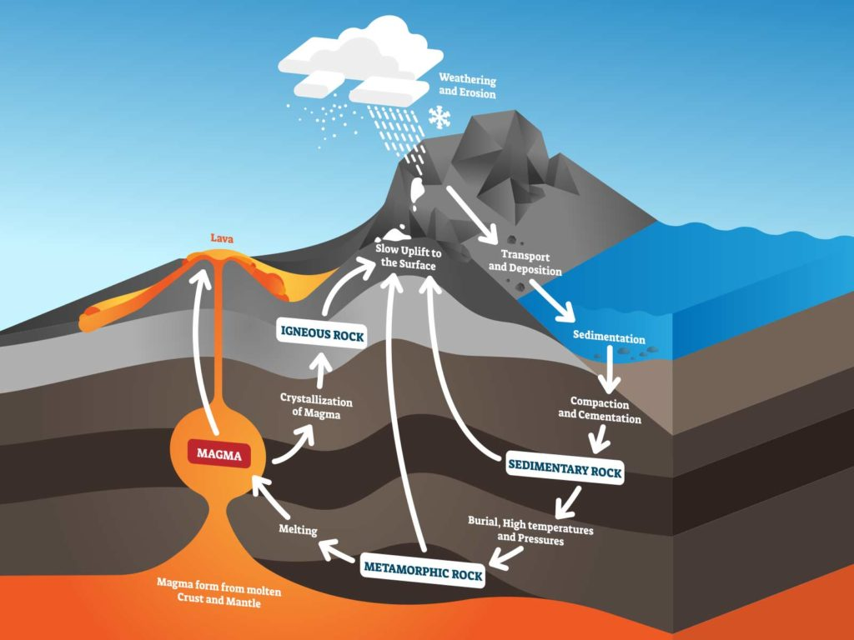
Intro to the Earth overview:
A
Notes:
All of the rock types on the planet can be put into 3 categories: Igneous (formed from magma and volcanics), sedimentary (formed from settling out and precipitation of broken down rocks and minerals), and metamorphic rock (any other type of rock, subject to change via high temp, pressure via burial, proximity to magma, or hydrothermal. Ophiolite is mainly concerned with the igneous and metamorphic setting.

Slide 26
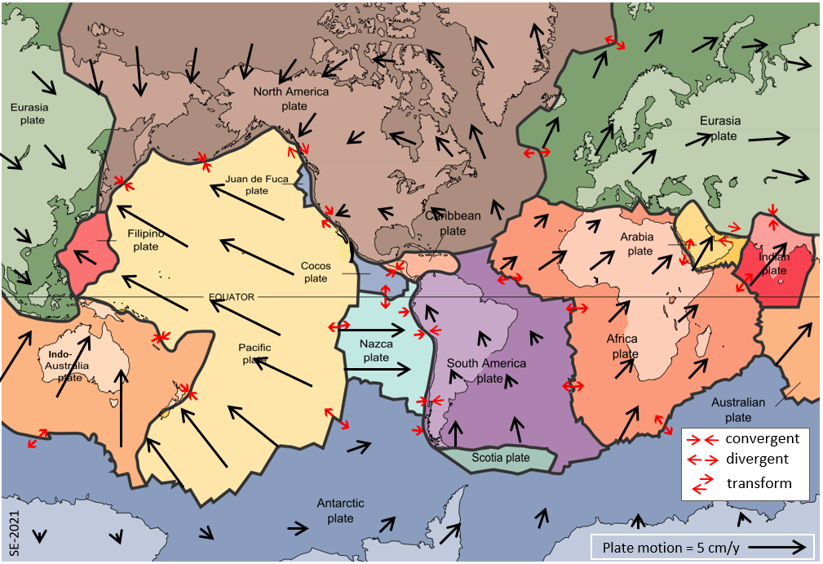
Intro to the Earth overview:
B
Notes:
What drives all the rock systems on Earth are plate tectonics. There are spreading centers, especially in the middle of oceans, convergent boundaries, where two plates collide, and transverse boundaries, where two plates slide laterally against each other. All of this is primarily driven by convection.

Slide 27
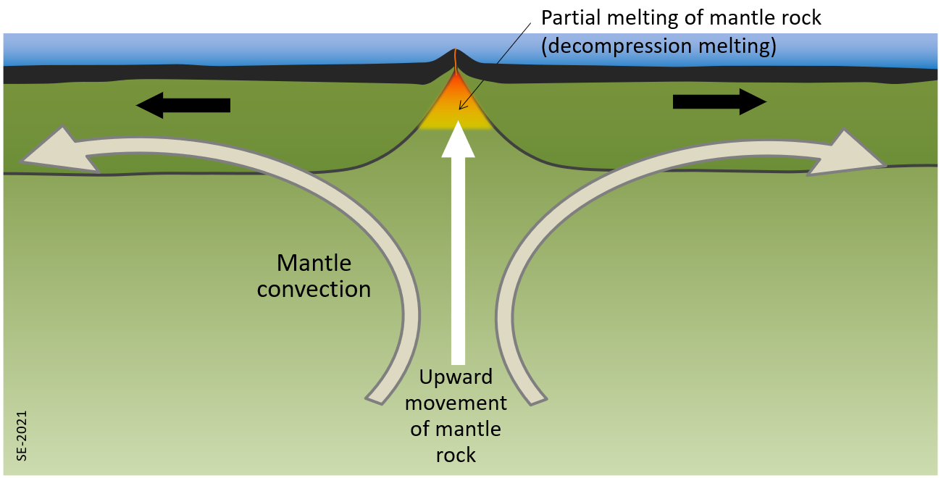
C
Notes:
As the Earth cools, releasing heat from its formation 4.5 billion years ago, as well as heat from radiation, this heat rises – much like water boiling. As it reaches the surface, it cools. These convection cells then spread out to make room for more rising heat, and as it cools it sinks back down. Why is this related to ophiolite?

Slide 28
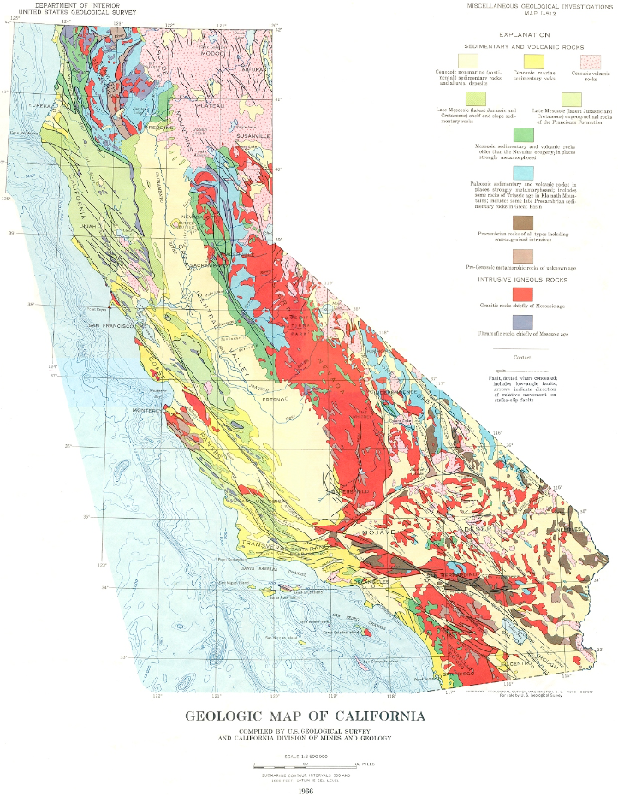
D
Notes:
Across the planet there are plate tectonics that drive the motions of continents and oceans, and are drivers for things like volcanos and earthquakes and creation and destruction of Earth materials. What better place to experience and study this than California. California displays just about every tectonic setting – compression, extension, subduction, transverse. The Ocean is subducting here, the plates are moving side by side here and here, there's extension here, and *was* extension here.

Slide 29
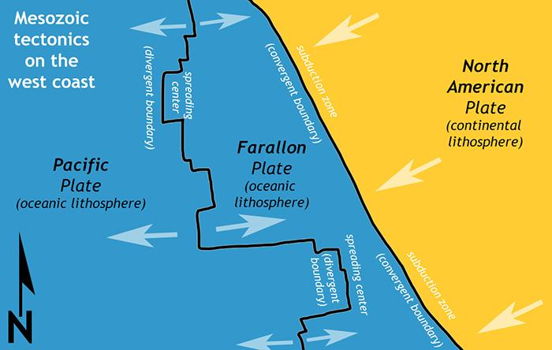
E
Notes:
Mesozoic tectonics (Jurassic, 170-160Ma)

Slide 30
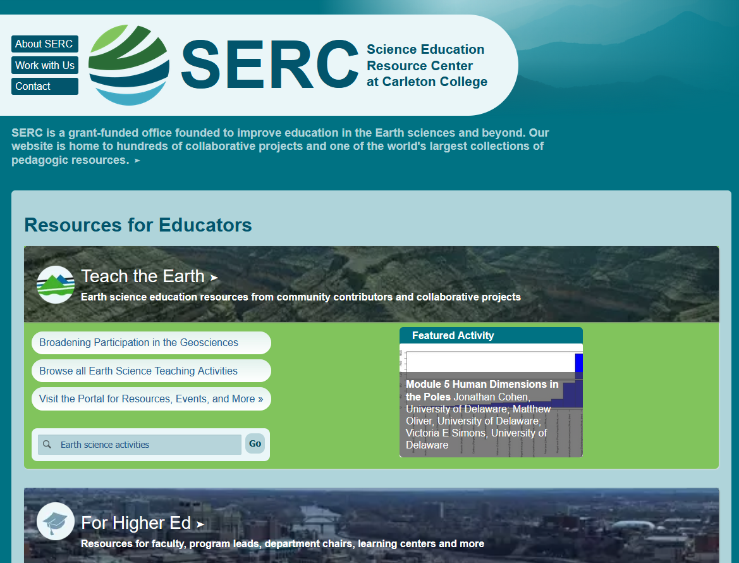
GG

Slide 31
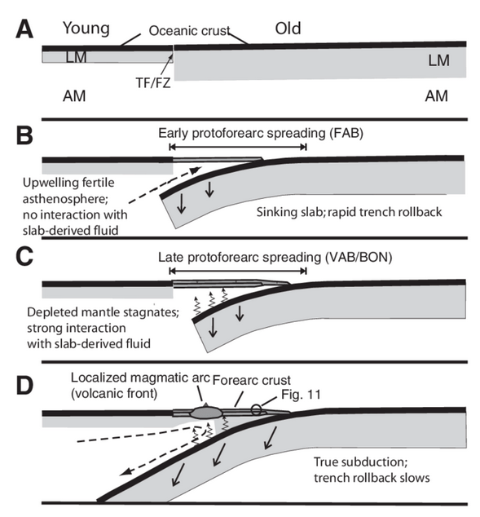
Subduction zone – forearc basin formation
F
Stern et al., 2012
Notes:
Forearc model, example of what happened in California . Izu-Bonin-Mariana arc system

Slide 32
Project Plan
Collected rock samples from specific locations in the Del Puerto Canyon
Cut samples into Billets – thin sections
  sent to Quality Thin Sections in Tuscon, AZ
Petrographic microscope – identify minerals visually
Use SEM to confirm mineral and elemental composition
Using this data, classify rock types and infer formation and alteration
Assess tectonic implications
Construct a workable lab through this process to share with other universities though SERC
Notes:
SERC is a grant-funded office founded to improve education in the Earth sciences and beyond. Our website is home to hundreds of collaborative projects and one of the world's largest collections of pedagogic resources.

