Slide 1






PLASMON FIELD EFFECT TRANSISTOR (PFET) FOR A SENSING PLATFORM
By Abrahim Hamdan, University of Kentucky
Mentored By Dr. Sung Jin Kim, University of Louisville
& Dr. Zhong Yang, University of Louisville
NSF REU Award ID #23448869
NSF NNCI Award ID # 2025075

Slide 2

Purpose
Growing need for precision detection in healthcare, environmental, and industrial applications
Traditional methods are slow, bulky, and lack sensitivity for low-concentration detection
Compact sensors enable faster, on-site testing (POCT) for immediate results
Critical for real-time monitoring in medicine, pollution control, and industrial safety

Slide 3
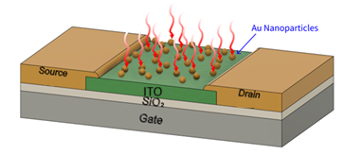
What is a PFET
FET: Transistor that uses the electric field to control the flow between two terminals (Source and Drain). Used for amplifying or to switch signals.
When we add gold nanoparticles in between the channels, through LSPR we can convert plasmonic energy to an electrical signal [2].
This device can be used in biomedical sensors, gas sensors, or tailored photodetectors [2].
Figure 1: schematic showing Gold Nanoparticles connected to the TFT

Slide 4
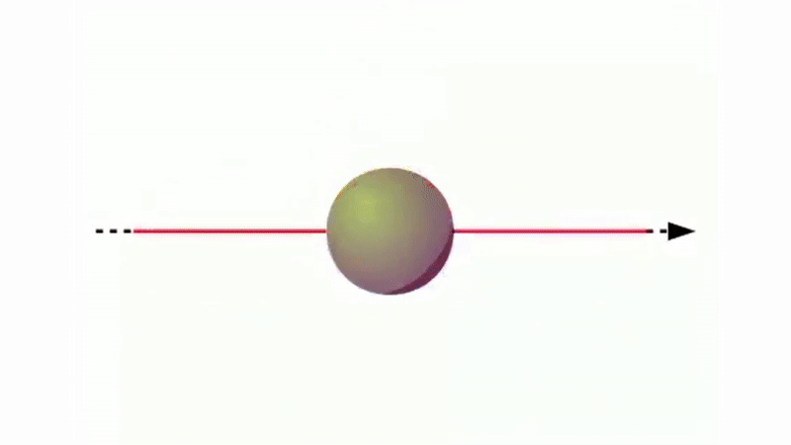
What is LSPR
Localized Surface Plasmon Resonance
When light hits metal nanoparticles, it makes their free electrons vibrate. If the light's frequency matches the electrons natural frequency, a resonance condition is met.
At this resonant condition, the nanoparticles either absorb the light completely or scatter it strongly, creating a noticeable peak in the light spectrum that we can measure [6].
This resonance causes all the electrons to move together, creating separated positive and negative charges that produce a strong electric field on the nanoparticle surface [6].
Figure 2: The oscillation of electrons when light is shined on the surface of a metal nanoparticle.

Slide 5
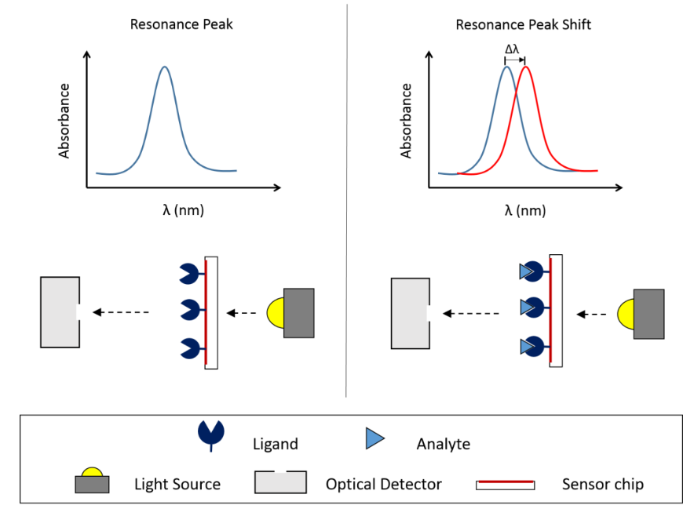
How PFET Will Be Used
When light strikes the nanoparticles, it generates a localized electric field that enhances the FET's drain-source current, amplifying the detection signal.
A synthetic polymer coating on the gold nanoparticles enables selective biomolecular interactions.
Its tailored properties facilitate specific binding with the target protein for precise detection.
Figure 3: Absorption peak shifting depending on the material being detected [1]

Slide 6
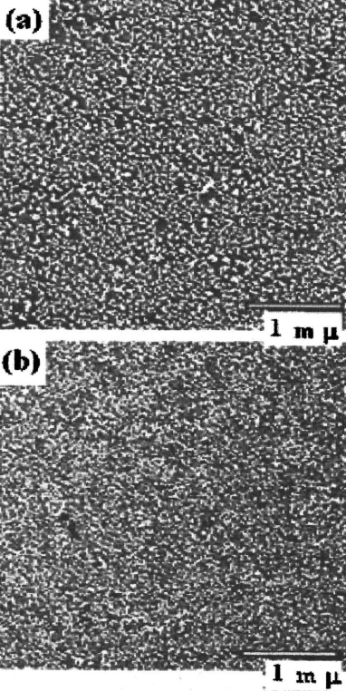
The Goal
The device performance depends on gold nanoparticle size, quantity, environmental conditions, and the ITO substrate properties for optimal effectiveness.
We will evaluate the PFET's performance using an ITO substrate to determine its advantages and limitations compared to alternative substrate materials.
Understanding these relationships helps optimize sensor design since ITO substrates require specific nanoparticle sizes and optical properties for different applications.
Figure 4: FE-SEM images of gold nanoparticle attached ITO surfaces [5].

Slide 7
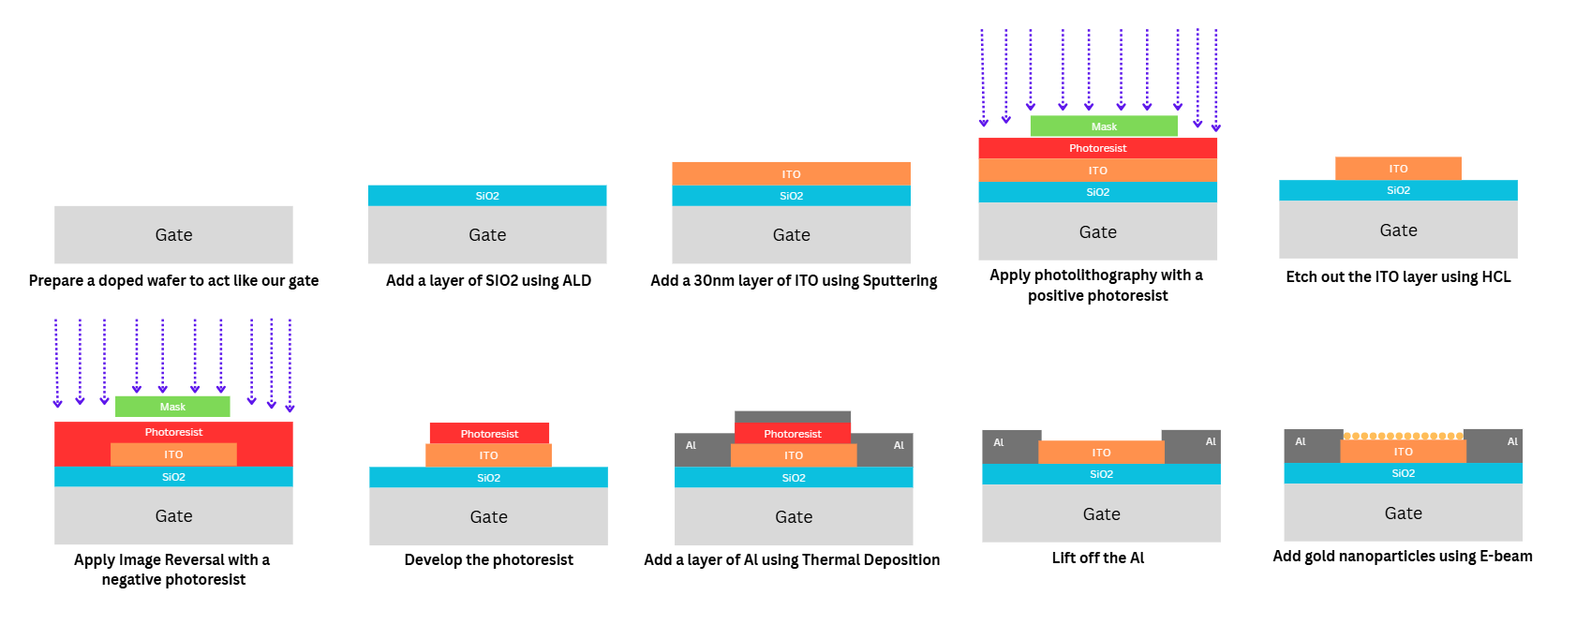
Fabrication Process
Figure 5: Fabrication process of the PFET

Slide 8

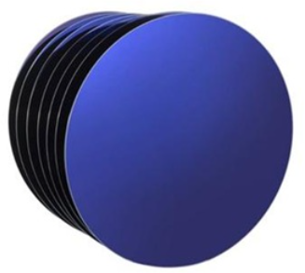
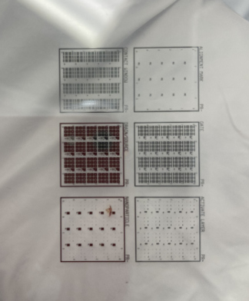
Provided Items
Wafer
Si wafer 3in diameter
Doped with Boron
Layer of SiO2
Cut in half for ITO sputtering.
Mask
2 layouts that will be using
  Active Layer
  Source/Drain

Slide 9
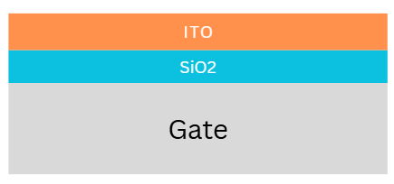
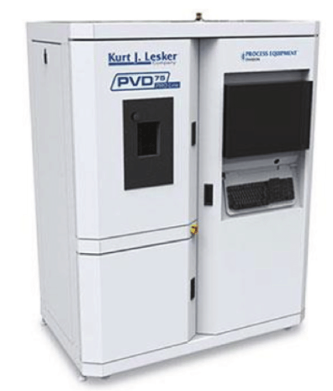
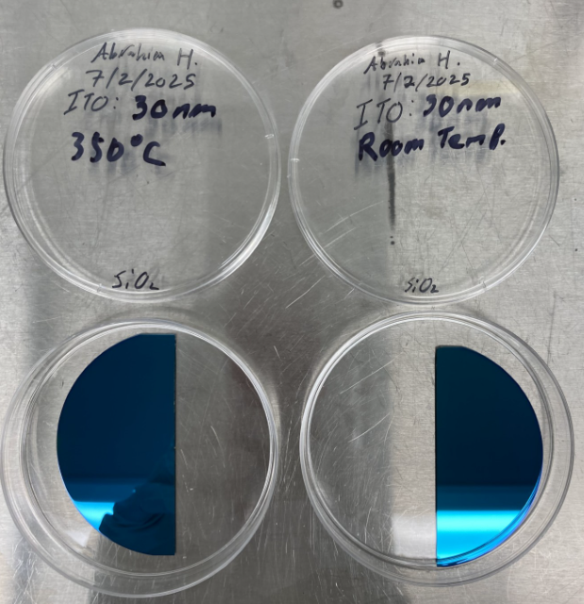
Sputtering ITO
Sputtered 30nm of ITO:
Using PVD 75
Ar 15sccm
5 mTorr pressure
DC 60W ramp up 0.5W/s
4 min sputtering
One half of wafer at room temperature
One half of wafer at 350 C

Slide 10
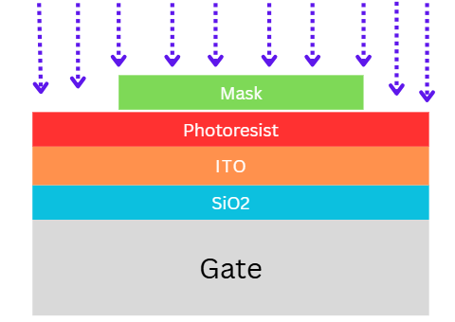
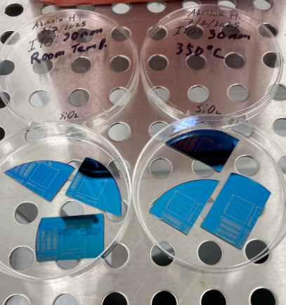
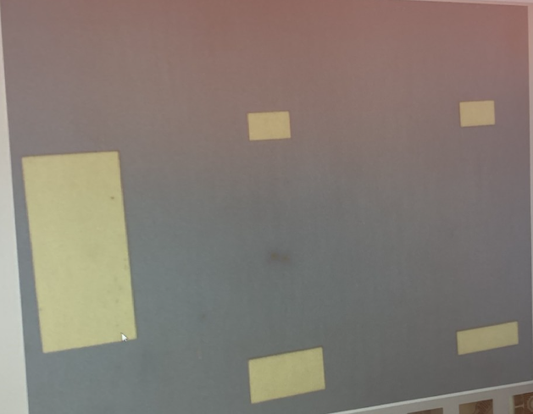
Active Layer
Using spinning bench
5 sec at 500rpm
30 sec at 5000rpm
HDMS
Isopropyl alcohol
AZ5214 (Can be negative with image reversal)
Thickness around 1.2um
Baked at 90C for 5 min
UV exposure for 25 sec
Developed for 1 min using MF-319

Slide 11
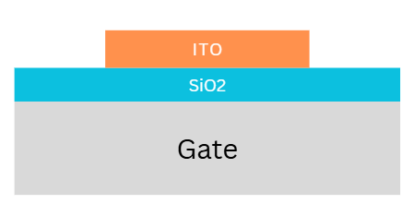
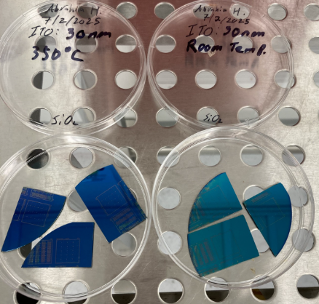
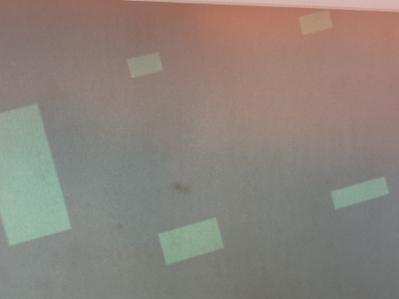
Etching
Etchant
HCl:H2O 1 to 1 ratio
100mL with 50mL each
Etched for 1 min and 22 sec for the 350 C
Etchec for 10 sec for room temp

Slide 12
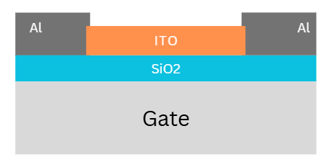
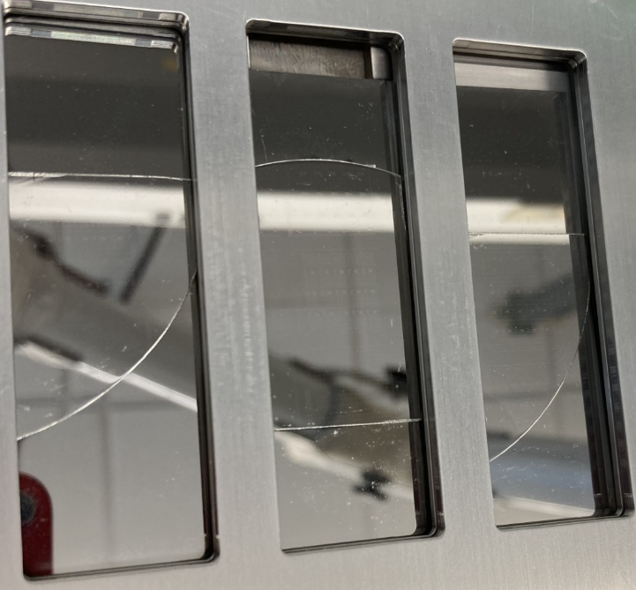
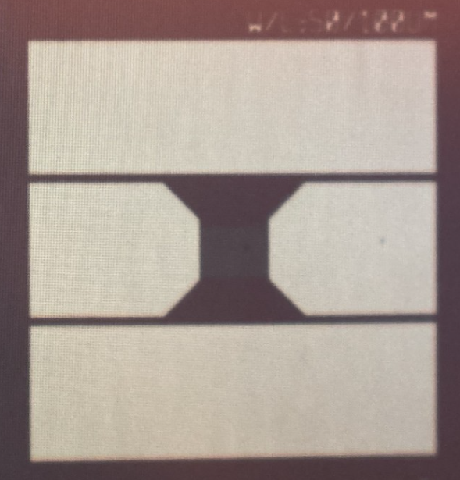
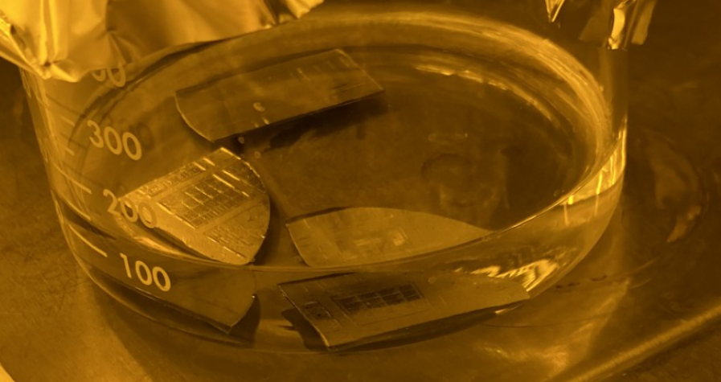
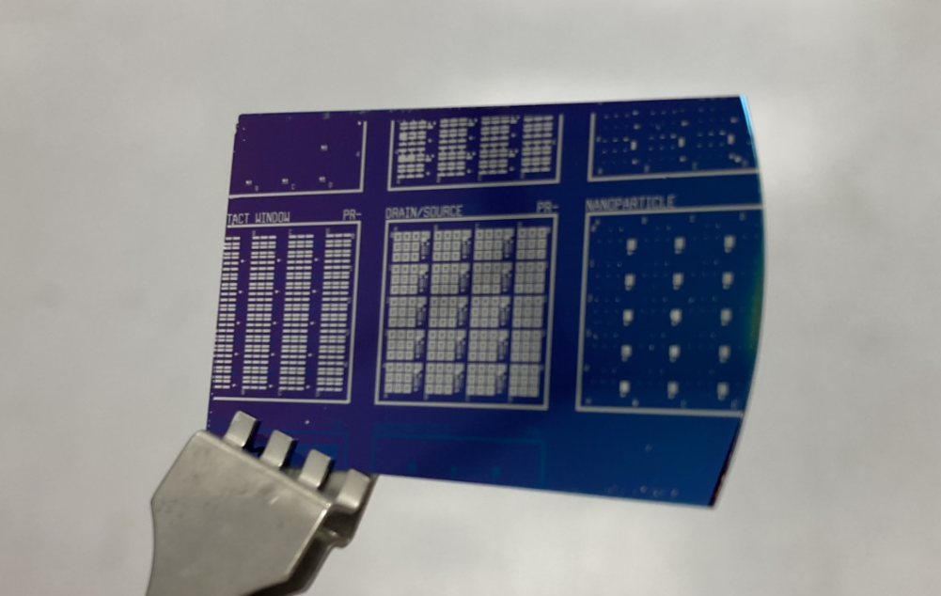
Thermal Deposition
Image Reversal
Using Active Layer Photolithography
  Exposure for 12.5 sec
  Baked for 90 sec at 125 C
  Flood Exposure 36 sec
  Developed for 2min using MF-319
Depositing 200nm of Aluminum
Deposition rate of 2.2 Aº/s
10% power

Slide 13
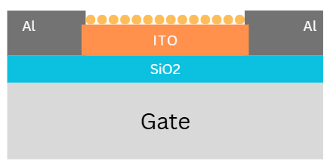
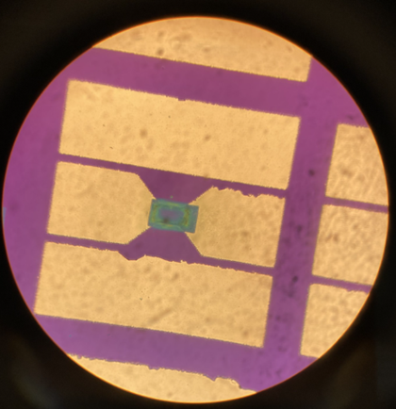
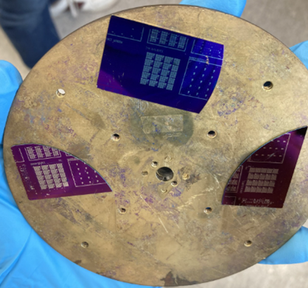
Electron Beam
5nm of Thin Gold Film on ITO
Base pressure of 1.31e-5 Torr
0.3mA of Emission Current
Deposition rate of 0.3 Aº/s
Voltage at 467kV
Heat treated for 10 min at 350ºC

Slide 14
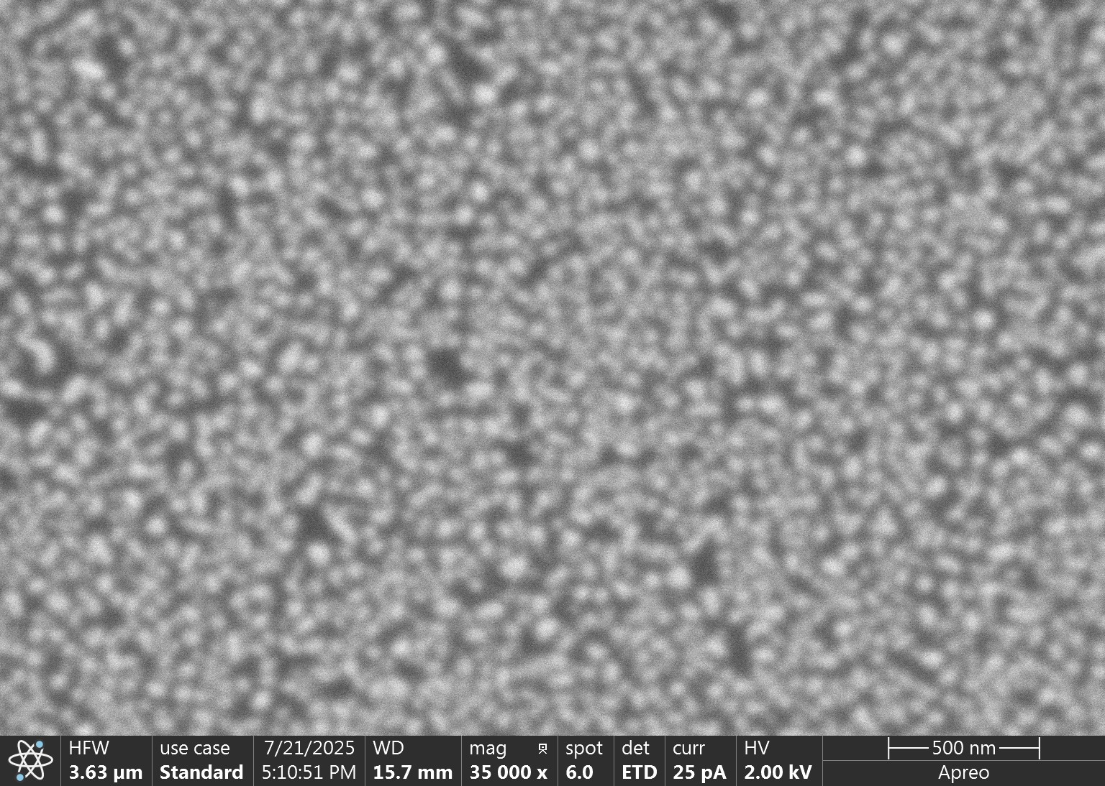
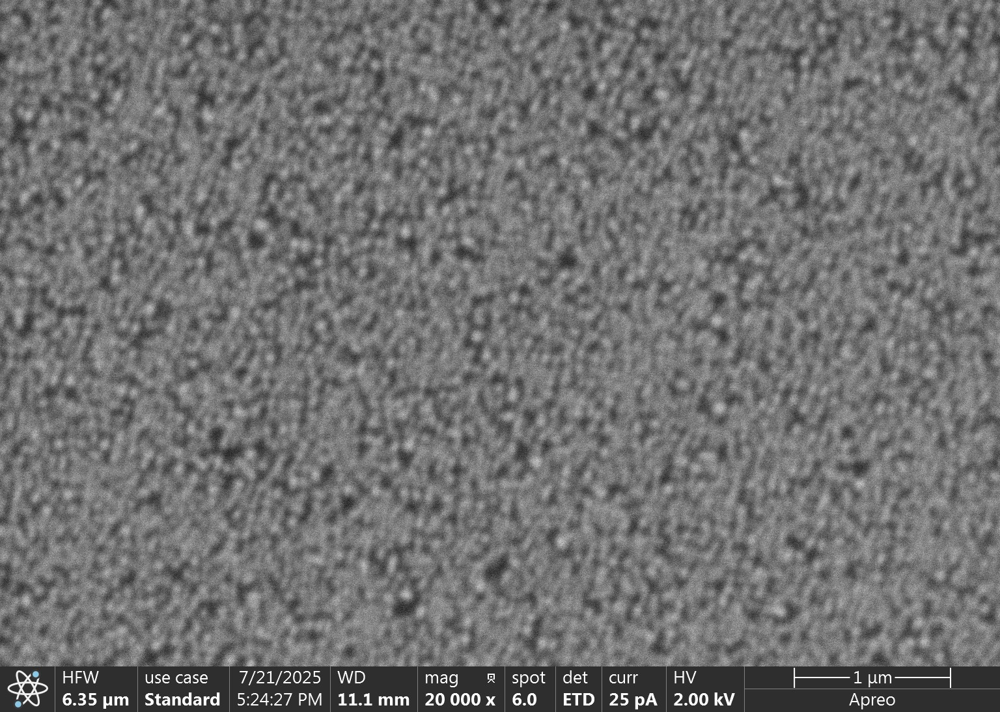
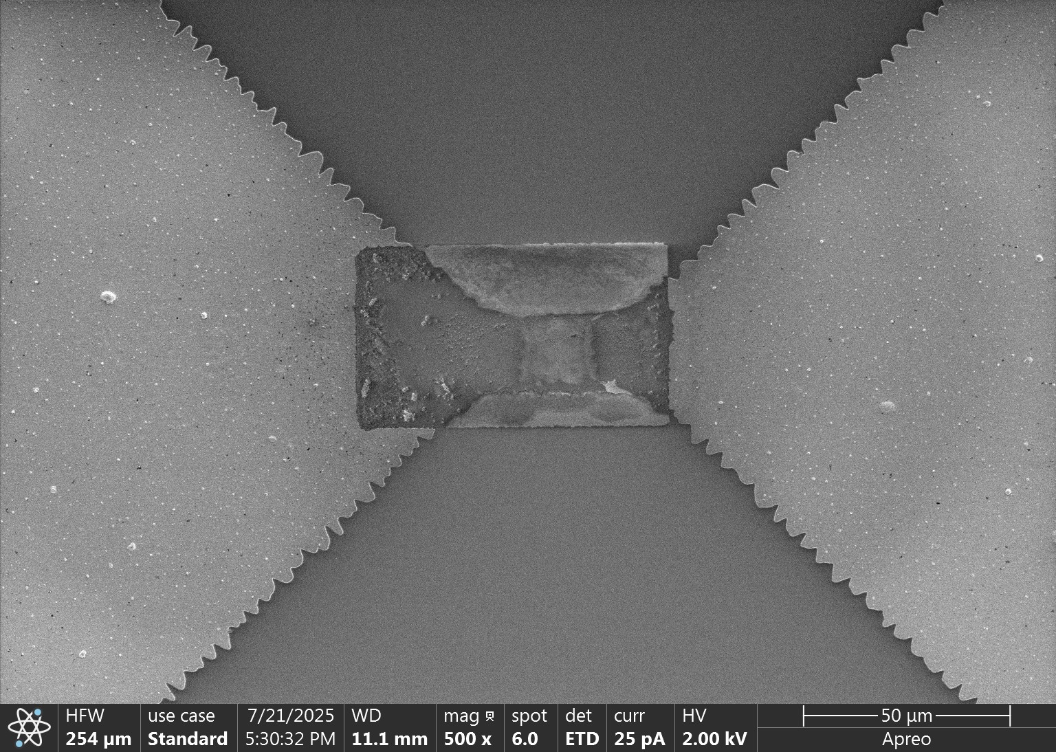
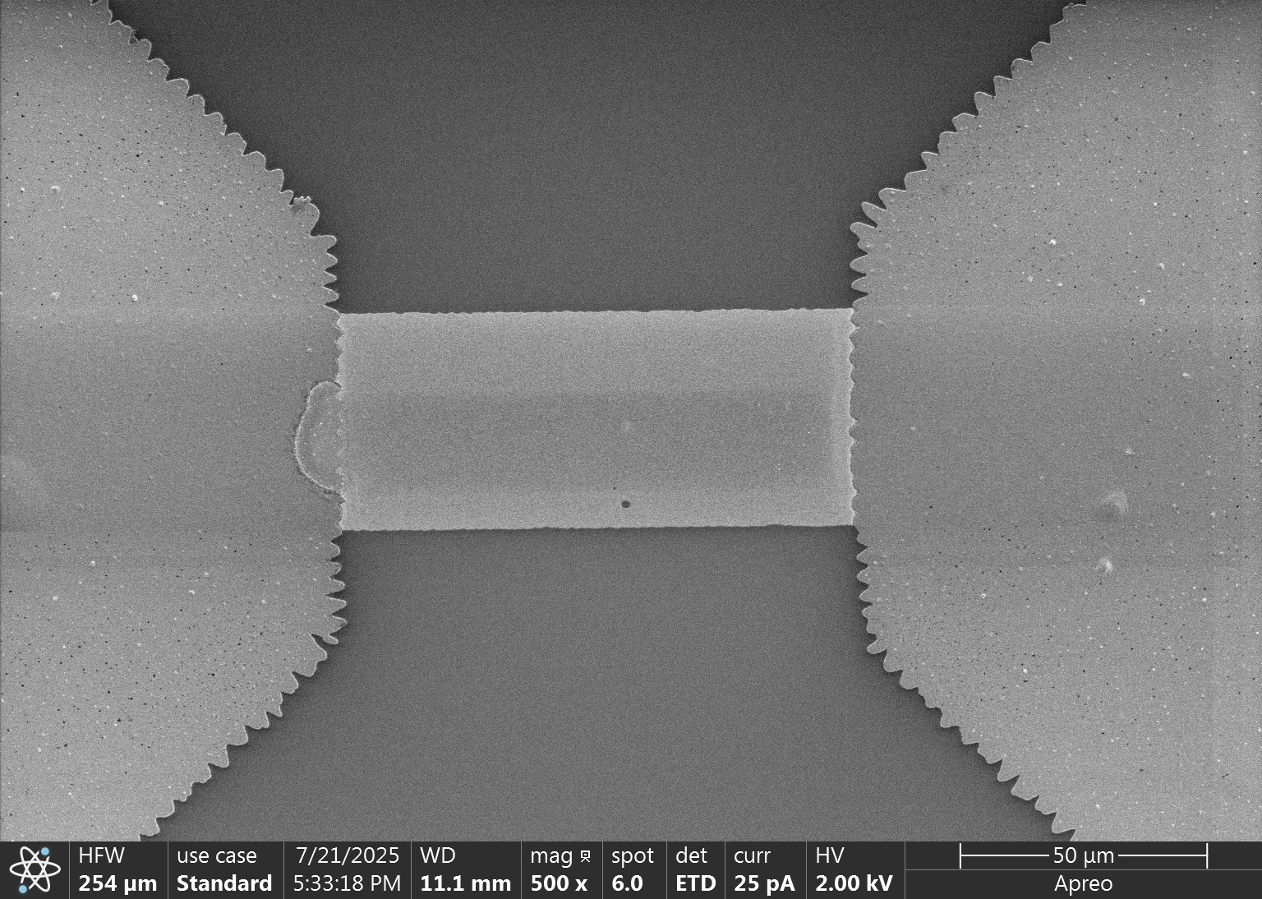
SEM

Slide 15
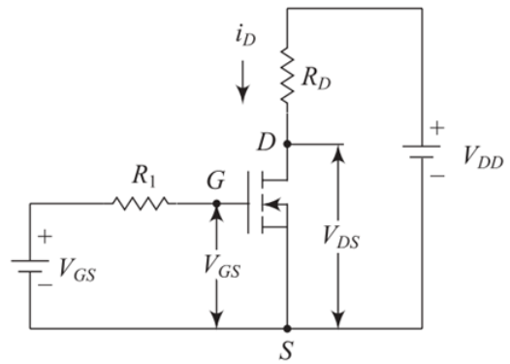
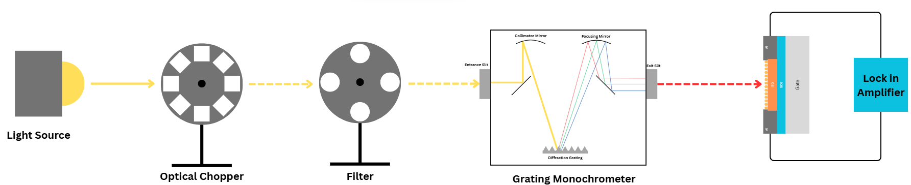
Testing Setup
I-V Curve
Implemented a source meter to display the output and transfer characteristics of our device.
Absorption spectrum
Implemented Spectrometer to get the absorption spectrum of the PFET

Slide 16
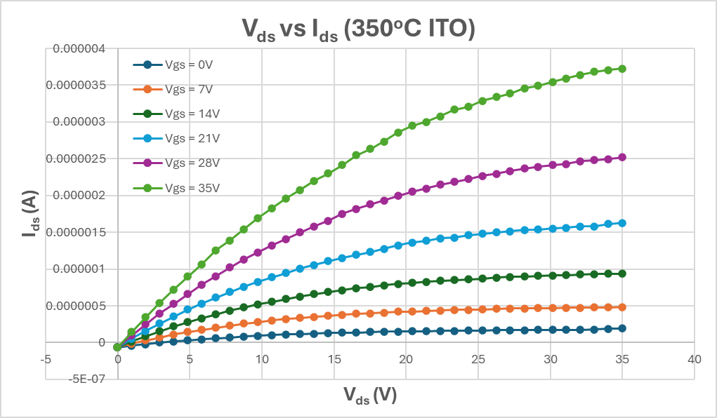
Results

Slide 17
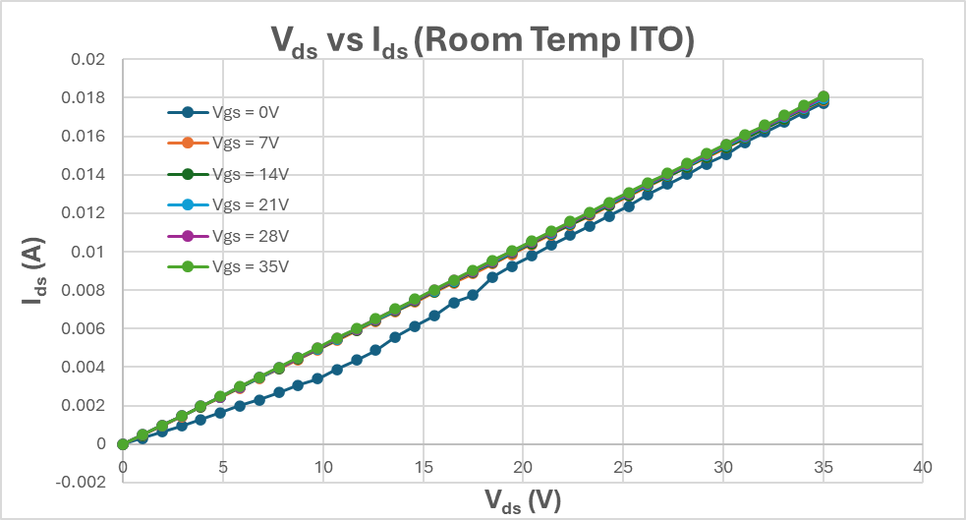
Results

Slide 18
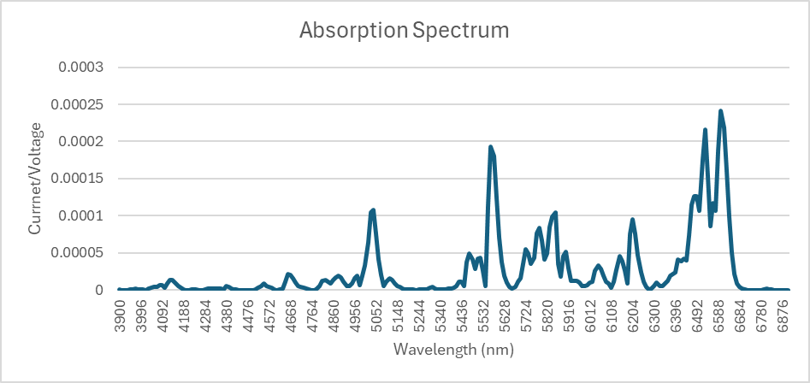
Results

Slide 19
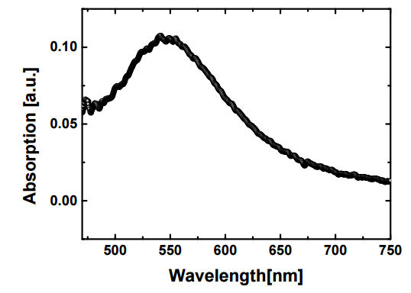
Discussion
Elevated temperature ITO sputtering (350°C) enhances crystallinity and carrier mobility, enabling high-performance transistor operation [7].
Room temperature deposited ITO exhibits resistive behavior due to disordered structure and insufficient carrier control [7].
The absorption spectrum did not match the expected bell curve (Figure 6), likely due to device damage during gold nanoparticle heat treatment.
Figure 6: Example of Bell curve shaped Absorption Spectrum [2].

Slide 20
References
[1] nicoLIFE, "LSPR vs SPR: What's the Difference?," *nicoLIFE*. 2021, Available: https://nicoyalife.com/resources/what-is-spr/lspr-vs-spr-2/
[2] H. S. Kojori et al., "Plasmon Field Effect Transistor for Plasmon to Electric Conversion and Amplification," Dec 10th, 2015.
[3] F. Shan et al., “Gap Plasmonics of Single Gold Nanoparticle Above a Gold Substrate Covered with Thin Gain Film,” Oct 4th, 2022.
[4] I. V. Kityk et al., “Control of the plasmon absorption of gold nanoparticles with a two-color excitation,” Oct 20th, 2005
[5] A. Schmidt, "FETs (Field-Effect Transistors)," DigiKey Electronics Community Forum, Mar. 2021. [Online]. Available: https://forum.digikey.com/t/fets-field-effect-transistors/13119.
[6] S. Unser et al., “Localized Surface Plasmon Resonance Biosensing: Current Challenges and Approaches,” July 2nd, 2015. Available: https://pmc.ncbi.nlm.nih.gov/articles/PMC4541850/
[7] K. Zhang et al., “Indium tin oxide films prepared by radio frequency magnetron sputtering method at a low processing temperature,” Aug 2nd, 2000. Available: https://www.sciencedirect.com/science/article/abs/pii/S0040609000014188#:~:text=Table%201.,at%20a%20low%20processing%20temperature.&text=ITO%20films%20fabricated%20by%20a,applications%20in%20flexible%20panel%20displays.

Slide 21

Acknowledgement
Dr. Sung Jin Kim
Dr. Zhong Yang
Ana Sanchez Galiano
James Morris
All IMPACT-NG REU Members
NSF REU Award ID #23448869
NSF NNCI Award ID # 2025075

Slide 22
Questions?

