Slide 1

Characterization of Greener Cements by Scanning Electron Microscopy
Enmanuel Rijo
PI: Dr. Kimberly Kurtis
Mentor: Alan Wang

Slide 2

Context

Slide 3
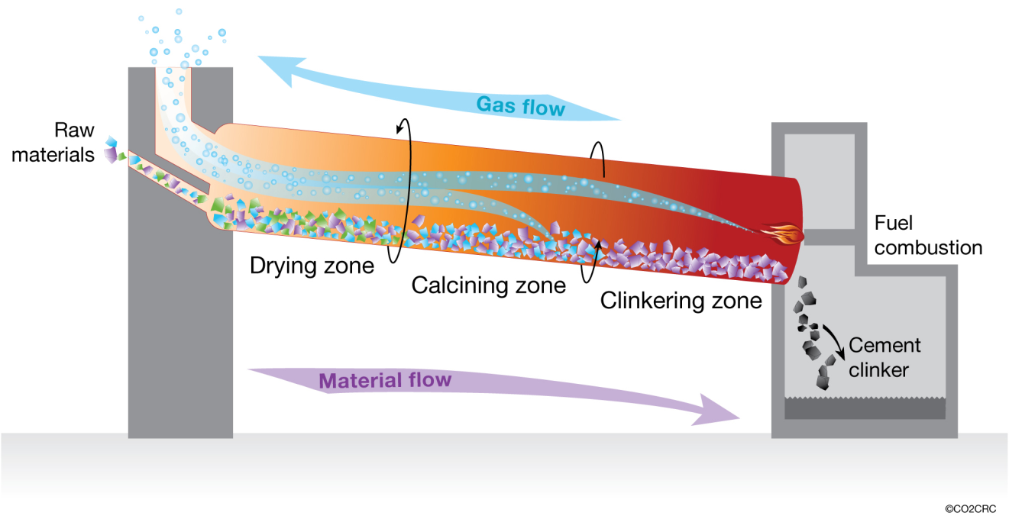
Context
Portland cement is responsible for 5–8% of global human-made CO₂ emissions.

Slide 4
Context
Calcination
Fuel combustion
Portland cement is responsible for 5–8% of global human-made CO₂ emissions.

Slide 5
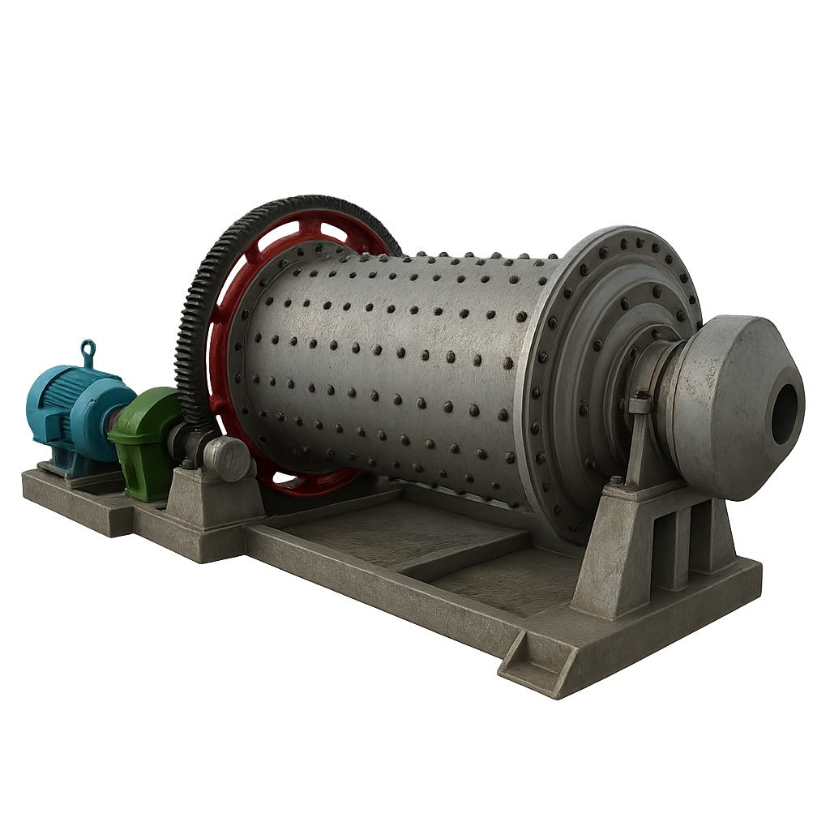

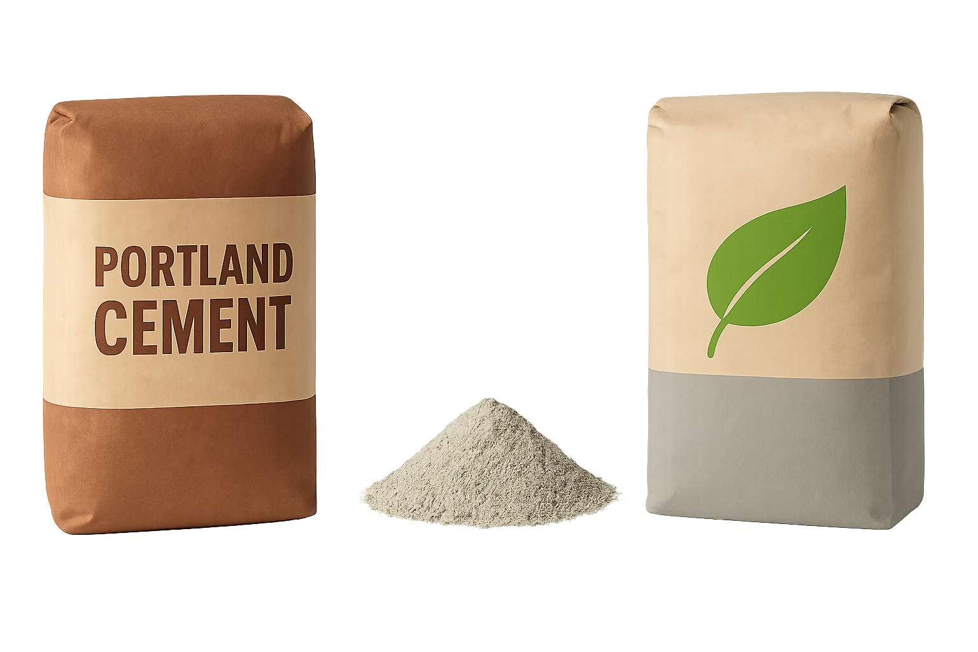
Context
1)
Cement Ball Mill
=
2)
ASTM C595 type IL Cement
+
Portland Cement
Blended limestone

Slide 6
Context
Why Understanding Cement Microstructure Is Important?
Microstructure influences cement performance.
Grinding and mixing in enhancing performance.
Linking physical features to environmental and mechanical outcomes.
Enables comparative analysis of samples.

Slide 7
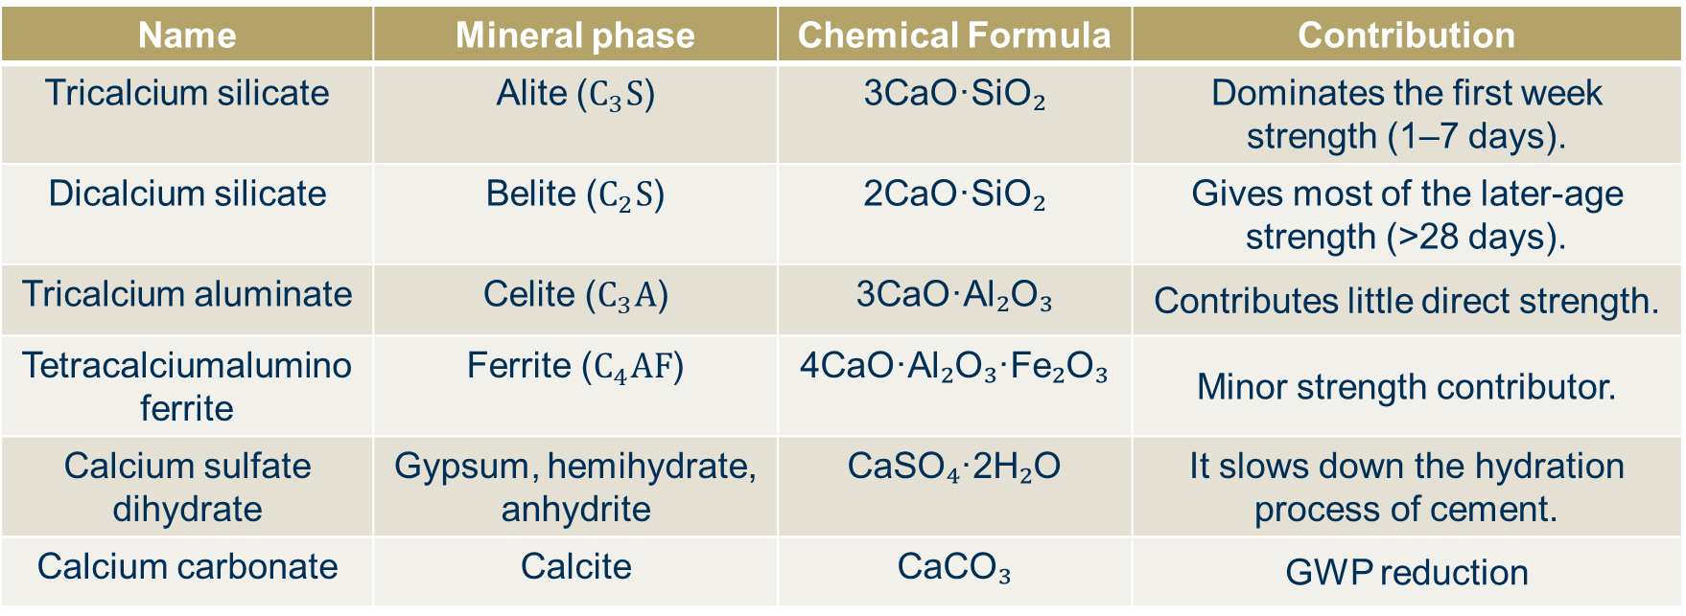
Cement Minerals
Name | Mineral phase | Chemical Formula | Contribution
Tricalcium silicate | Alite ($C_{3}S$) | 3CaO·SiO₂ | Dominates the first week strength (1–7 days).
Dicalcium silicate | Belite ($C_{2}S$) | 2CaO·SiO₂ | Gives most of the later-age strength (>28 days).
Tricalcium aluminate | Celite ($C_{3}A$) | 3CaO·Al₂O₃ | Contributes little direct strength.
Tetracalciumalumino ferrite | Ferrite ($C_{4}AF$) | 4CaO·Al₂O₃·Fe₂O₃ | Minor strength contributor.
Calcium sulfate dihydrate | Gypsum, hemihydrate, anhydrite | CaSO₄·2H₂O | It slows down the hydration process of cement.
Calcium carbonate | Calcite | CaCO₃ | GWP reduction
Clinker
Added

Slide 8
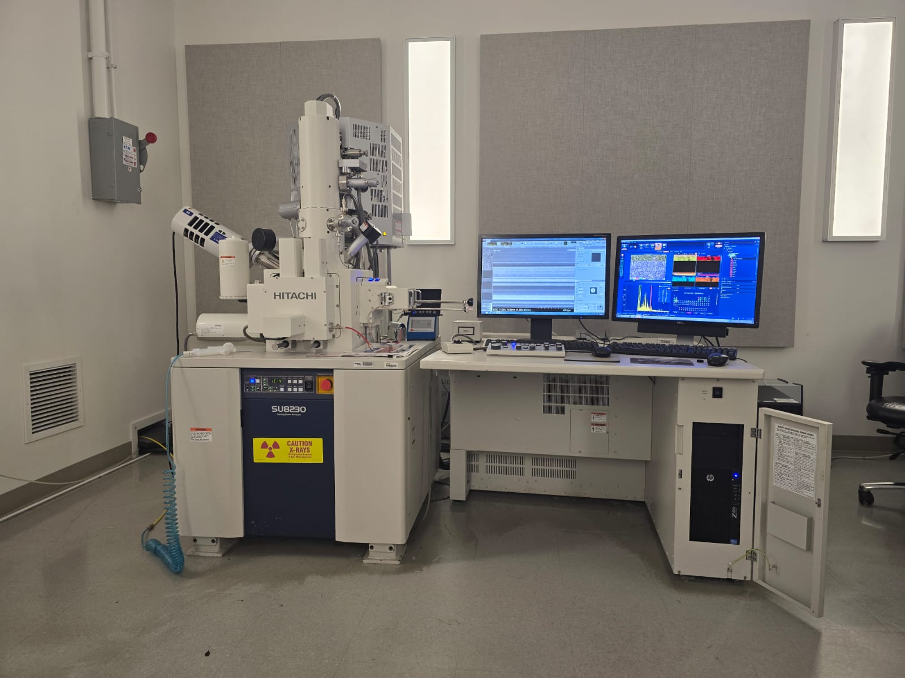
Context
Tools
Scanning Electron Microscopy (SEM)
High-resolution images
Reveals morphology
Energy Dispersive Spectroscopy (EDS)
Provides elemental composition
Support phase quantification and classification
Hitachi 8320 at Georgia Tech by Enmanuel Rijo

Slide 9
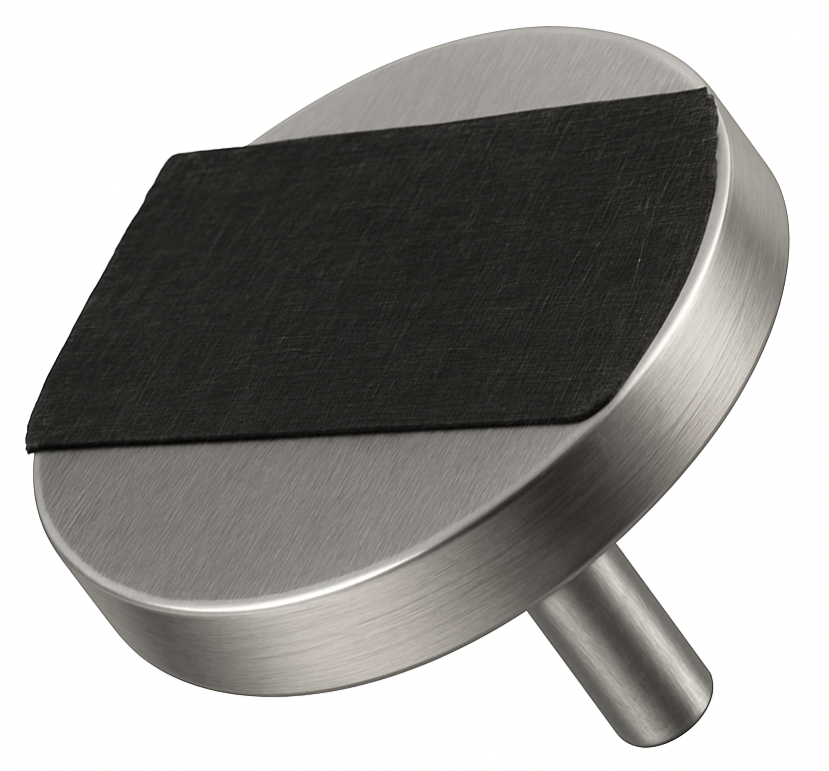
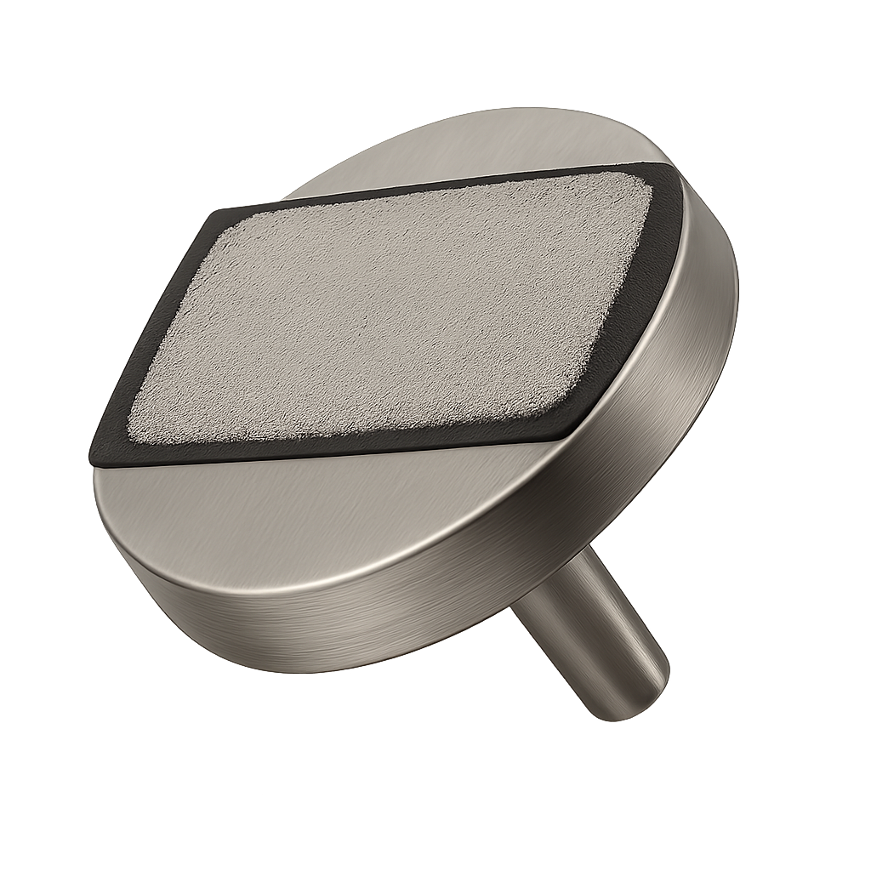
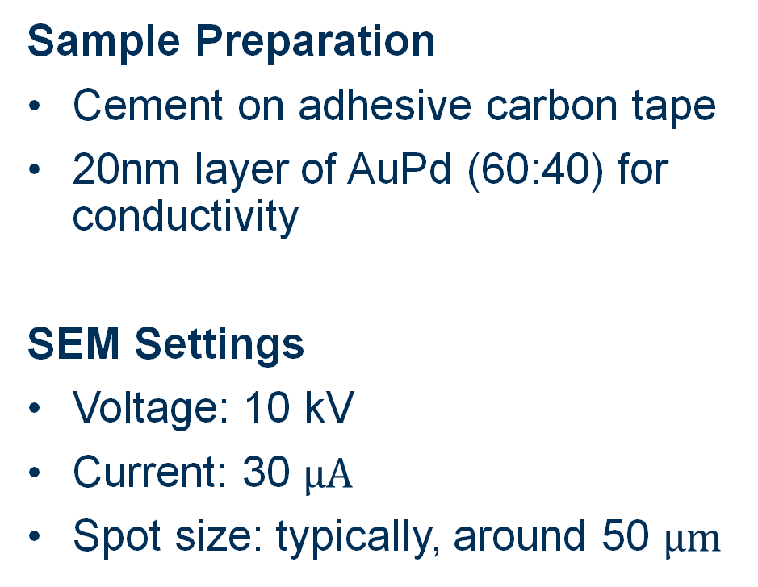
Context
Sample Preparation
Cement on adhesive carbon tape
20nm layer of AuPd (60:40) for conductivity
SEM Settings
Voltage: 10 kV
Current: 30 $μA$
Spot size: typically, around 50 $μm$

Slide 10

Context
Sample Preparation
Cement on adhesive carbon tape
20nm layer of AuPd (60:40) for conductivity
SEM Settings
Voltage: 10 kV
Current: 30 $μA$
Spot size: typically, around 50 $μm$

Slide 12
Objectives
1
SEM Characterization to study the morphology
2
Identify and quantify elements with EDS
3
Gain a better understanding of chemical composition of type IL cements
SEM and EDS characterization
Study the morphology

Slide 13
Work Done

Slide 14


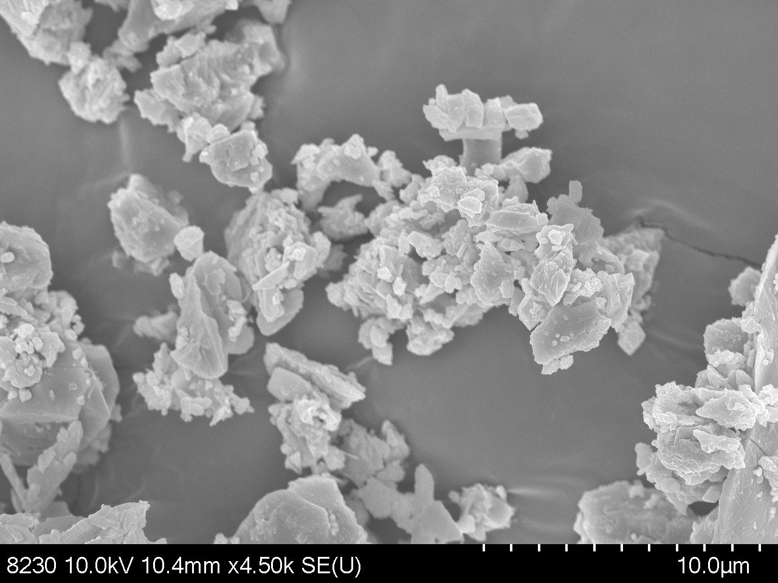
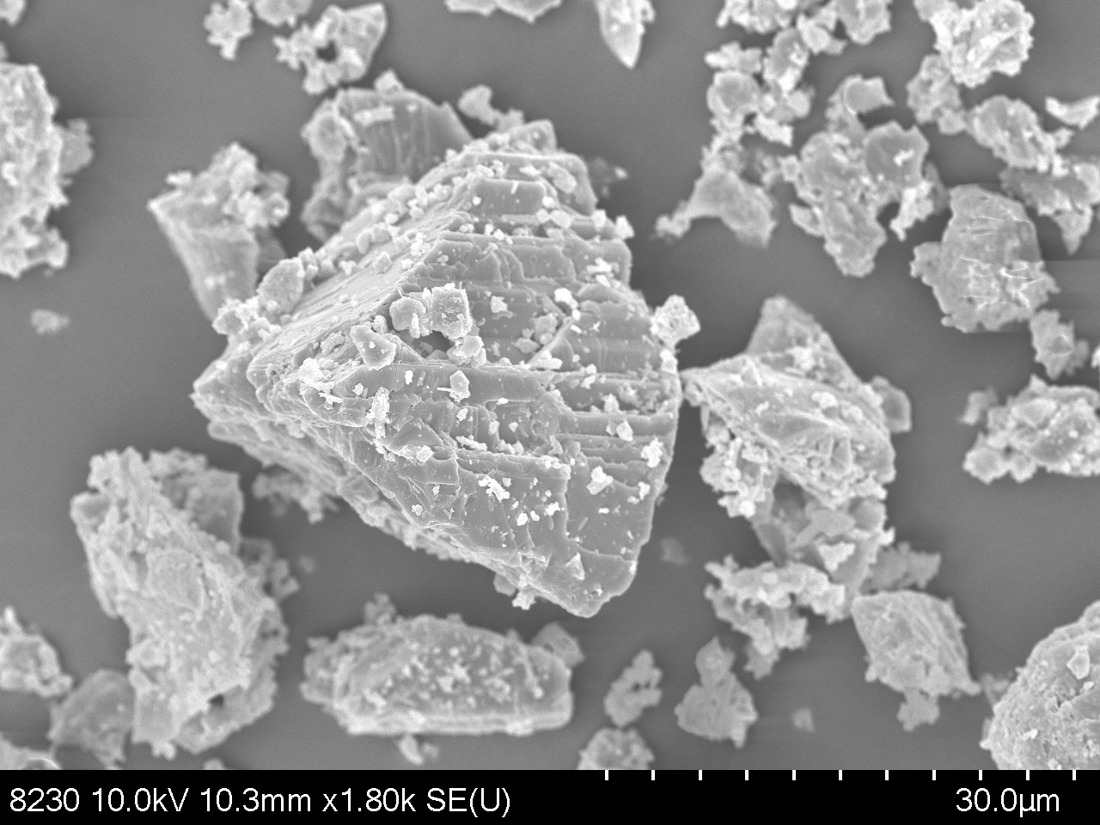
SEM

Slide 15
SEM
Sample: HC04

Slide 16
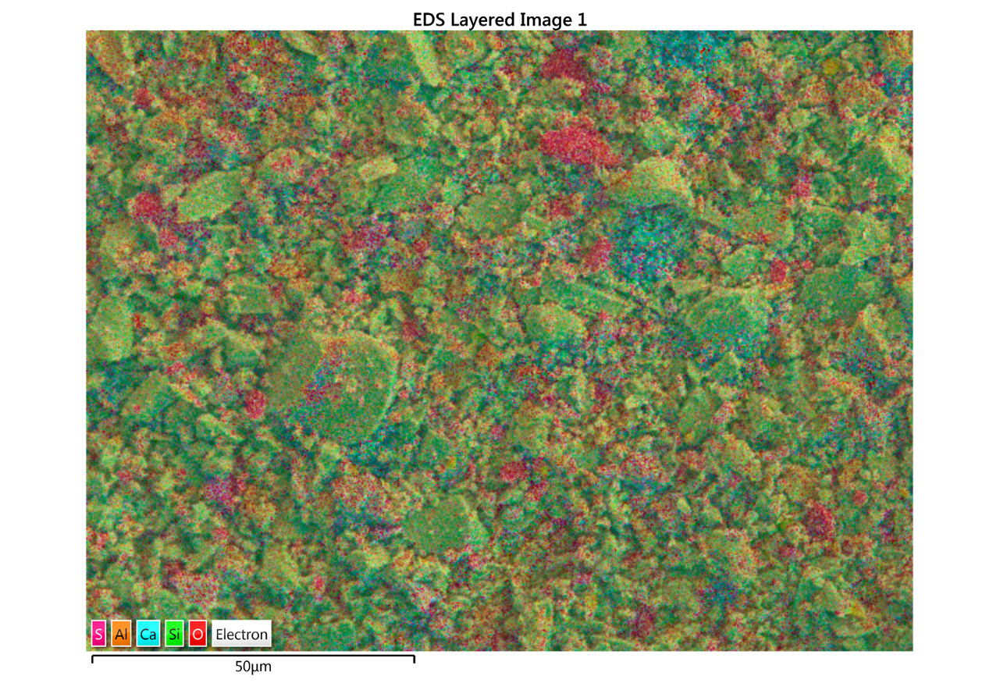
SEM

Slide 17
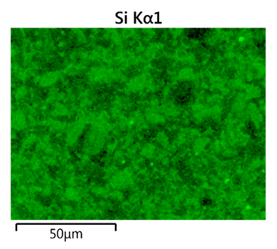
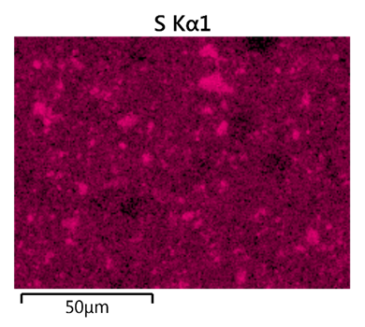
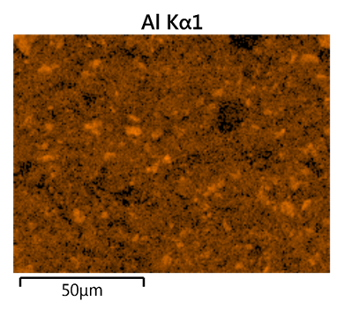
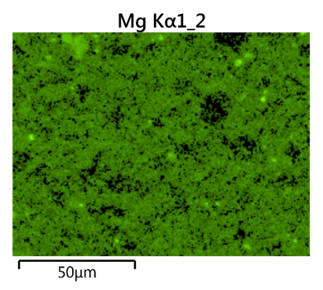
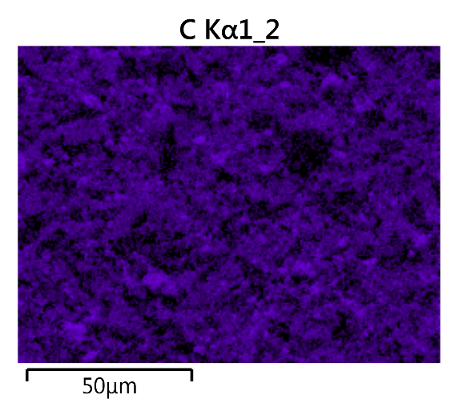
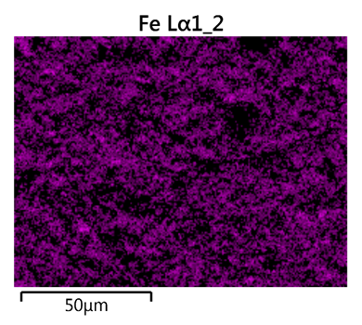
EDS

Slide 18
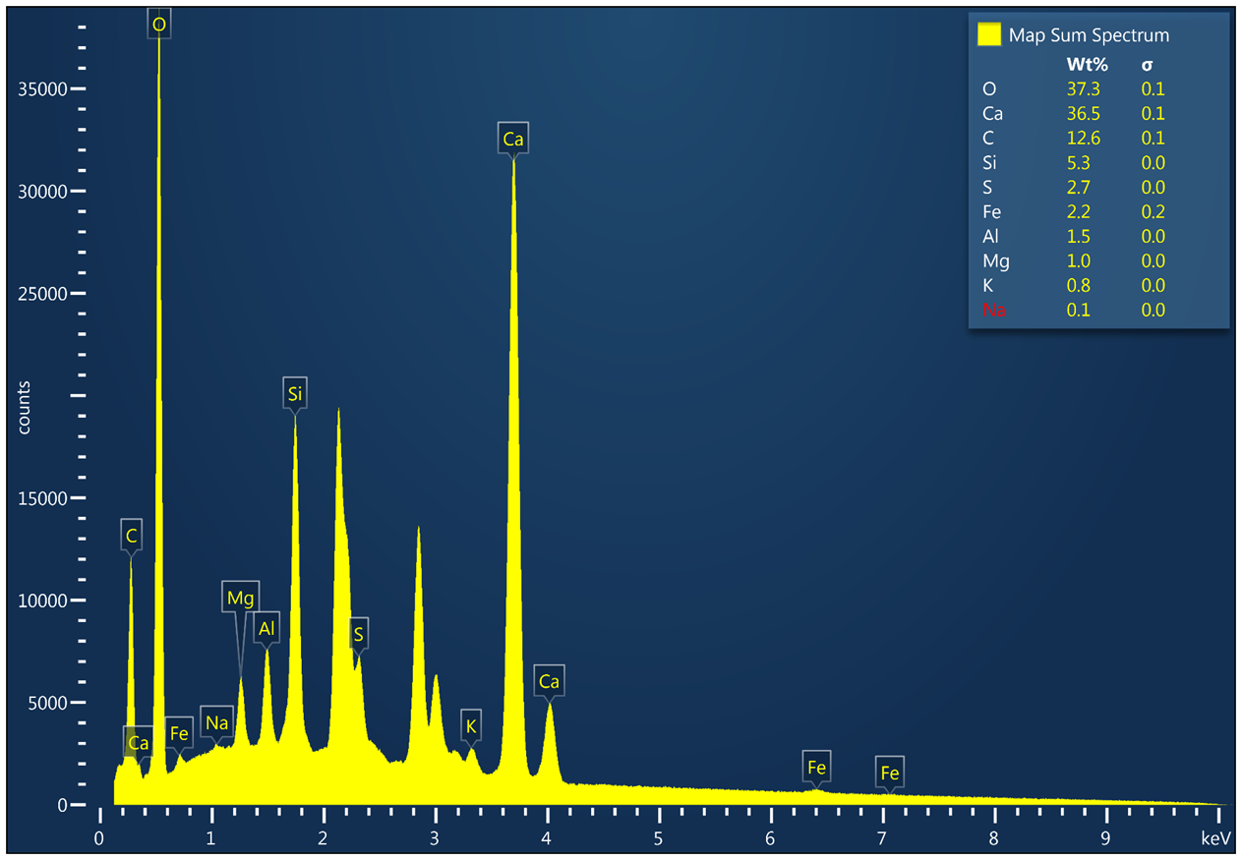
EDS
The unlabeled picks correspond to the 20nm conductive layer of AuPd.
Counts
keV

Slide 20
Conclusions
Consistent major chemistry. Calcium (≈ 35–41 wt %) and silicon (≈ 5–6 wt %) dominate every sample, giving Ca/Si mass ratios of ≈ 6–7.
Limestone addition confirmed. Carbon contents of 9–14 wt % correspond to ~10–15 % calcite.
Minor elements stable. S, Fe, Al, K, Mg, and Na each remain below ~5 wt %, with limited scatter, indicating uniform raw‑mix control and grinding practice across plants.
Inter‑plant variability low. The spread in Ca and C is <5 wt %, suggesting that despite different production sites (CM, HC, AR, TA, AG, BU series), overall chemical composition is tightly clustered.

Slide 21
Future Recommendations
Using a tape or adhesive made from a material not found in cement for EDS analysis.
Future Work
To translate compositional insights into performance metrics, the next phase will involve electrical resistivity testing of the same cement powders. These measurements will help to explore how the observed cement composition and limestone content influence ionic transport and durability.

Slide 22
References
Briki, Y., Zajac, M., Ben Haha, M., & Scrivener, K. L. (2021). Impact of limestone fineness on cement hydration at early age. Cement and Concrete Research, 147, 106515.https://doi.org/10.1016/j.cemconres.2021.106515
Poudyal, L., Adhikari, K., & Won, M. (2021). Mechanical and durability properties of Portland‑limestone cement (PLC) incorporated with nano calcium carbonate (CaCO₃). Materials, 14(4), 905. https://doi.org/10.3390/ma14040905

Slide 23




Acknowledgments:
Ms. Leslie O’Neill
Dr. Mikkel Thomas
Dr. Kimberly Kurtis
Alan Wang
Collins Twum
Thank you!

