Slide 1



3D Printing of Nanoparticle Inks for Radio Frequency Devices
Dr. Blair Brettmann & Laurel Hilger Fernando Sisniega

Slide 2




What are Radio-Frequency Devices?
Devices that send or receive info via radio waves.
  Ex. Wi-Fi routers, satellites, antennas, bluetooth, radar.
Common RF Devices

Slide 3

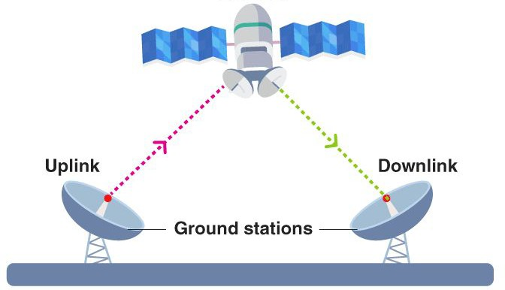
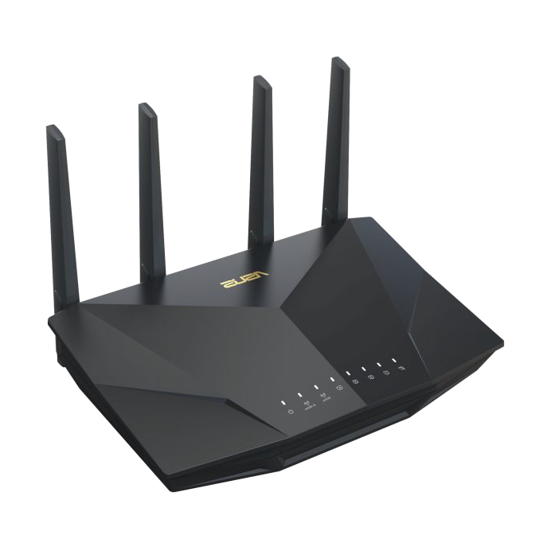
Background
Radio-frequency devices rely on smooth signal flow.
Problem
Commonly, materials inside these devices often have abrupt changes in properties.
These changes can cause signal loss, distortion or interference.
Idea: We’re 3D printing materials with gradually changing properties.

Slide 4
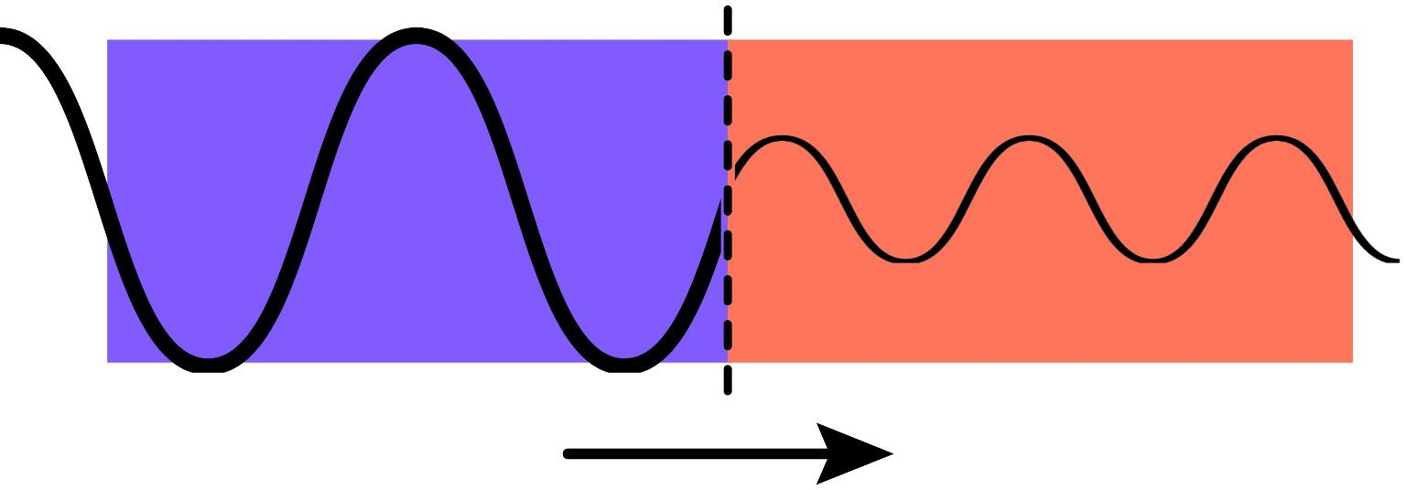
Material A
Material B
Radio wave becomes distorted as it travels through abrupt material change.

Slide 5

Material A
Material B
Radio wave passes through graded material without signal distortion

Slide 6
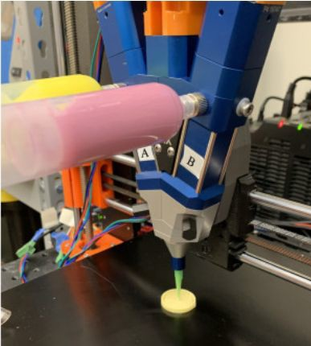
Project Overview
Use Direct Ink Writing (DIW) with active mixing to create graded dielectric materials for RF devices.
Steps I’ve been working on:
Building and configuring a custom DIW printer.
Formulate and testing inks.
Print materials that gradually change composition.
Figure adapted from Sevcik et al., 2024.

Slide 7
DIW 3D Printer

Slide 8
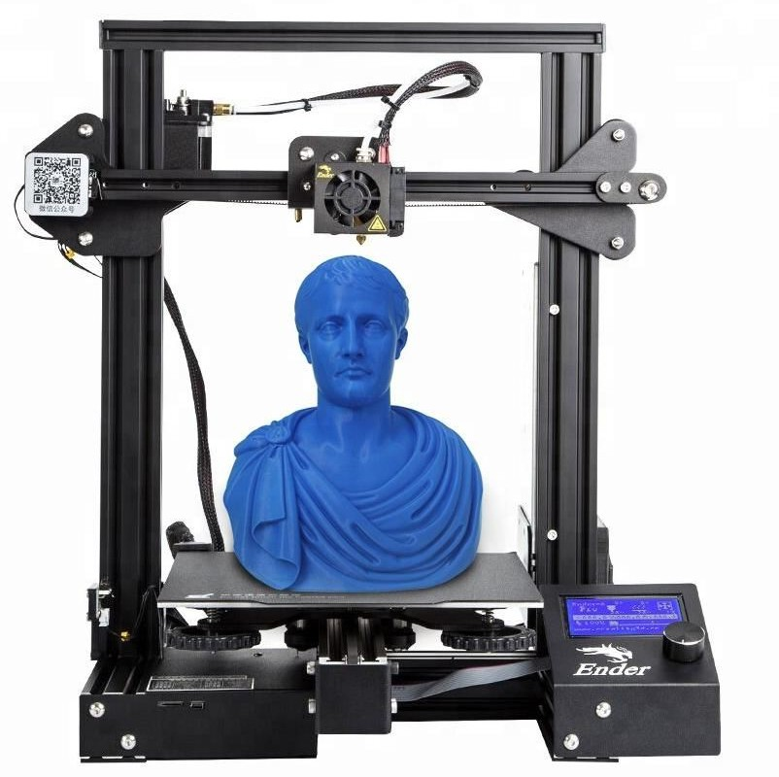
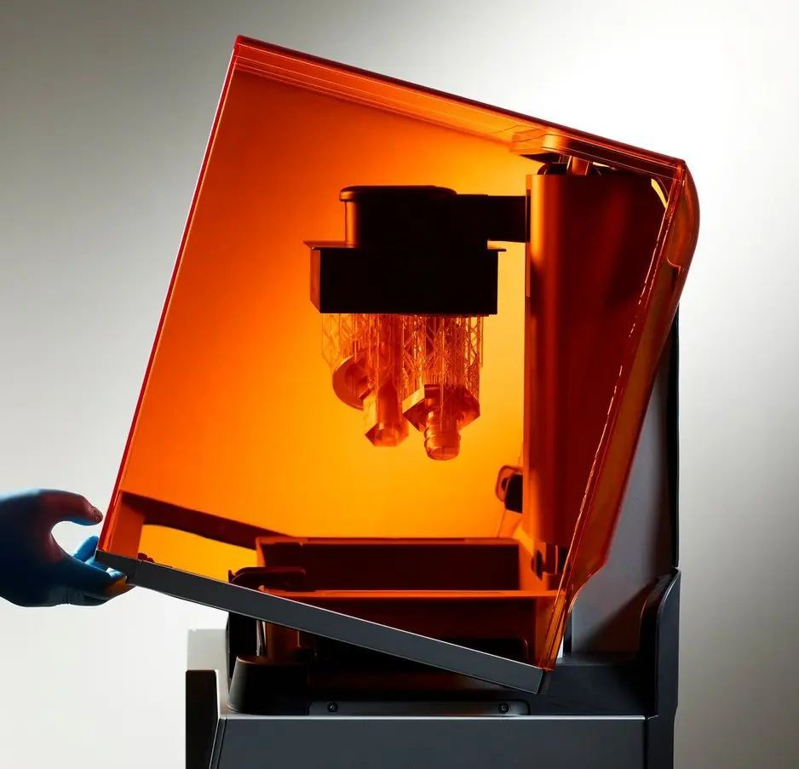
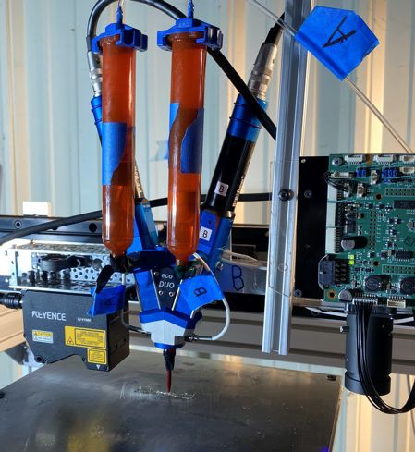
What is 3D Printing?
A process that builds objects layer by layer.
Great for custom shapes and testing.
Extrusion 3D Printing
Resin Printing
Direct Ink Writing

Slide 9
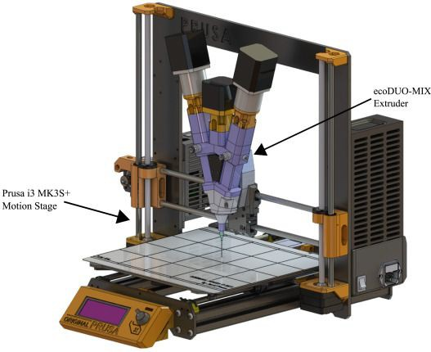
Direct Ink Writing Set Up
Integrated a Prusa MK3S+ gantry and a eco-DUOMIX 450 extruder for printing nanocomposite inks.
Worked on:
Wiring and electrical set up.
Arduino programming.
Hardware integration.
Figure adapted from Sevcik et al., 2024.

Slide 10
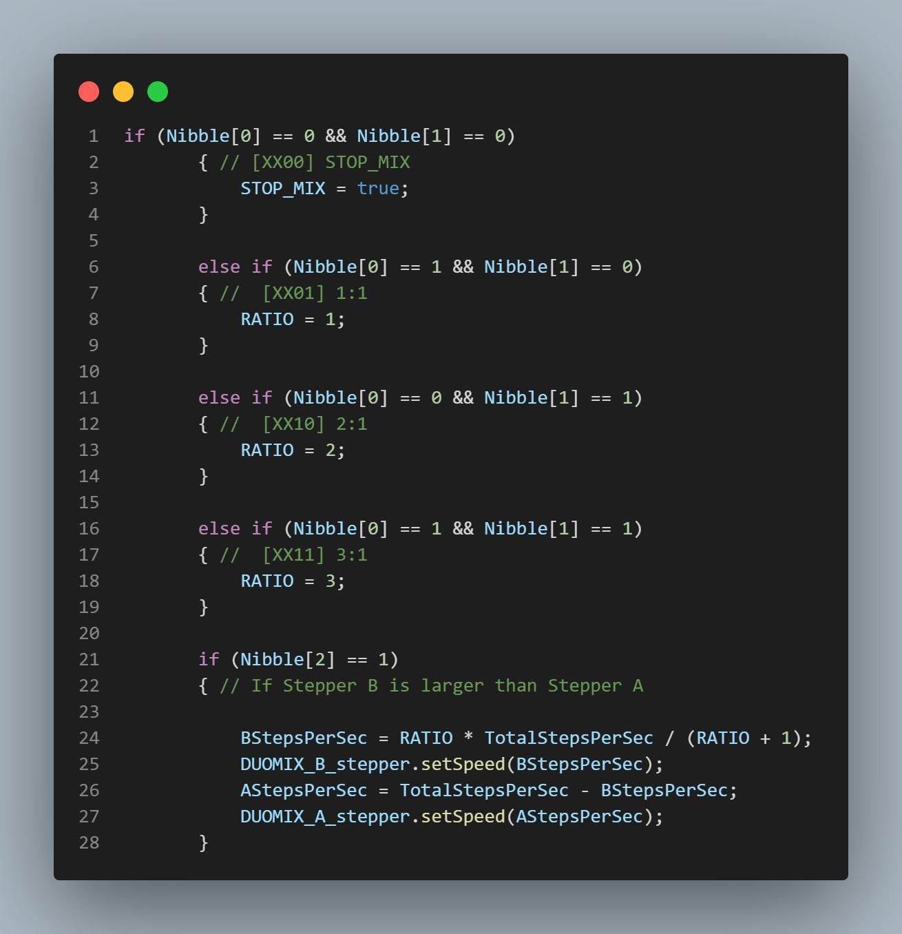
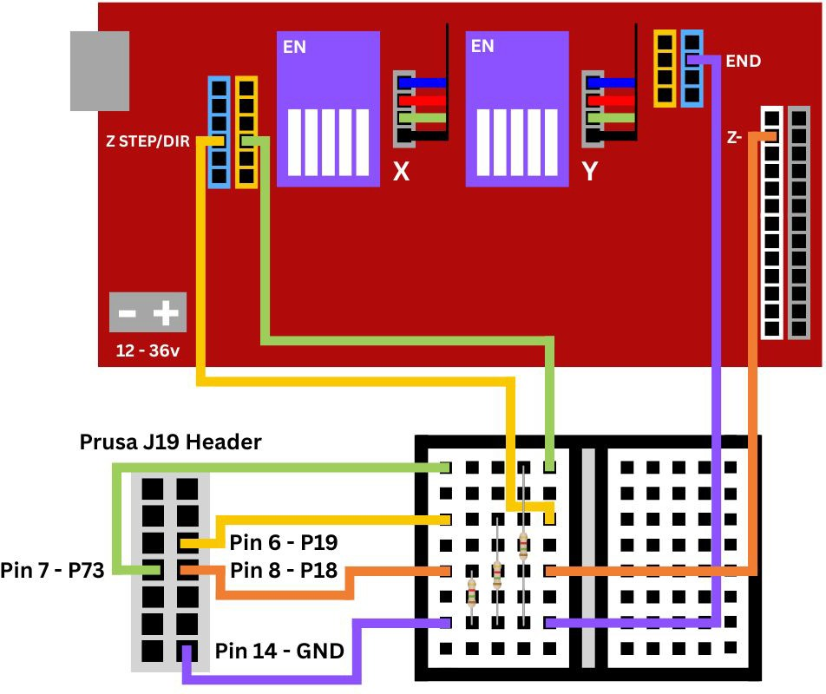
Hardware & Software Integration
Arduino Uno and Breadboard Schematic
Arduino Uno - C Program

Slide 11
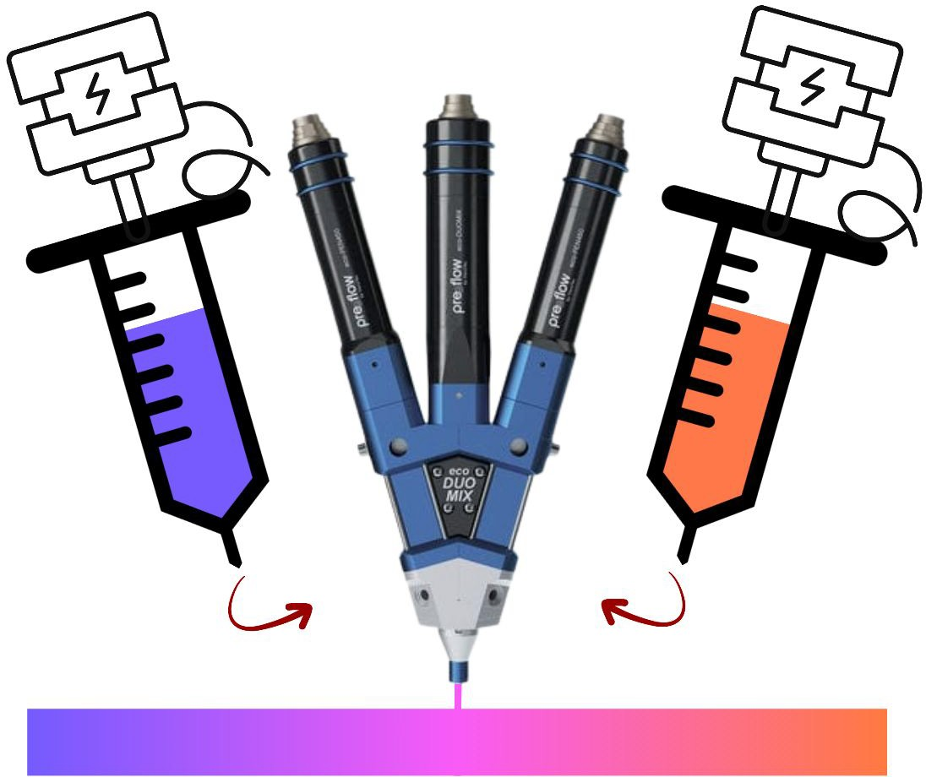
Extrusion Stepper Ratio
How It Works:
Each stepper motor controls one ink syringe.
Motor speed ratio (A:B) determines composition.
Switching motor ratio during printing creates gradient.
A
B
Extrusion Diagram

Slide 12
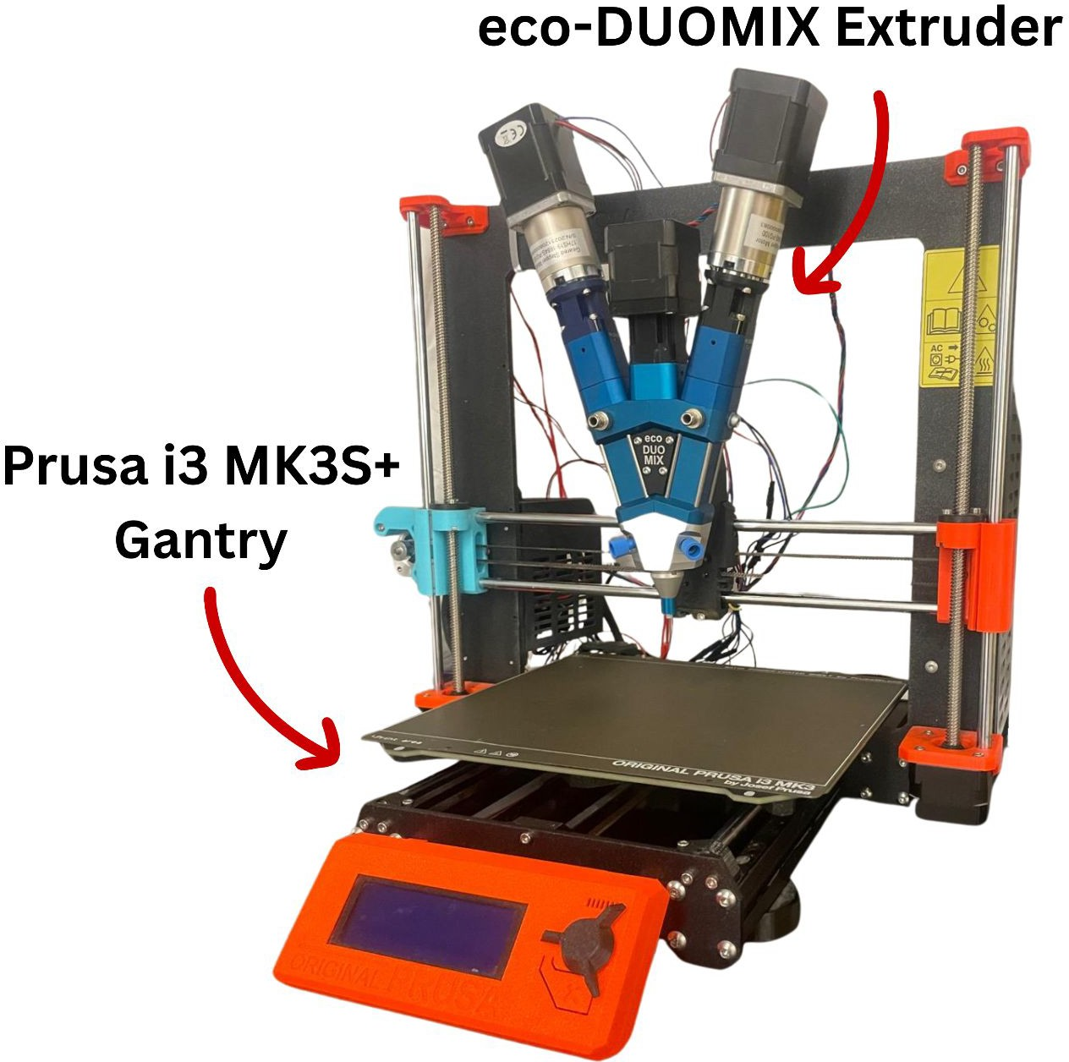
Final DIW Printer Setup
Hardware:
Gantry: Prusa i3 MK3S+
Extruder: ViscoTec eco-DUOMIX 450
Electronics: Arduino Uno + 2 geared stepper motors
Software
Arduino IDE
Pronterface
MATLAB Post-Processor

Slide 13
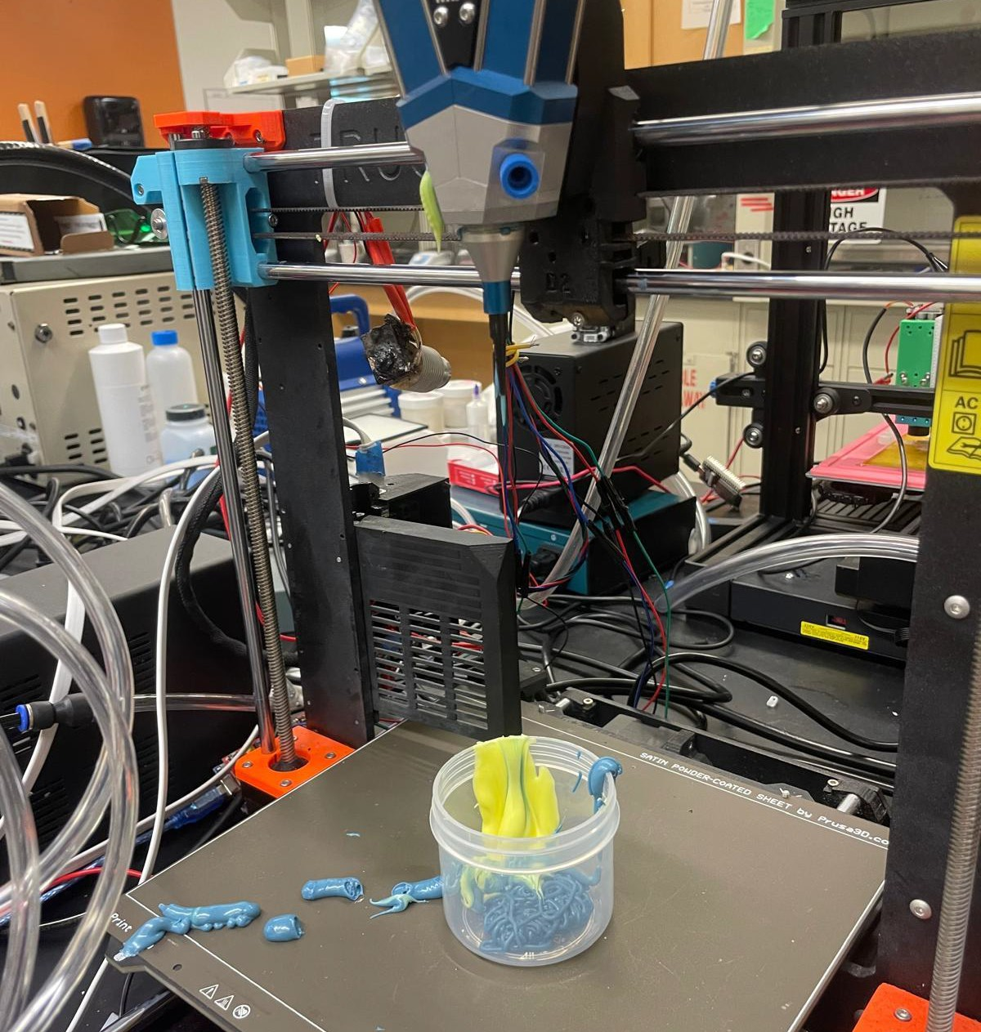
Current Challenge
The printer is currently unable to dispense material reliably.
The stepper motors rotate too fast.
The ink sticks inside the rotor assembly.
Ink gets spilled everywhere.

Slide 14
Nanocomposite Inks

Slide 15
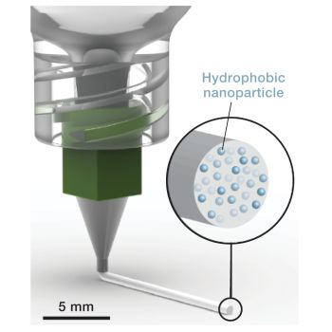
What’s in the Inks?
Nanoparticles:
Add dielectric properties.
Control signal performance in RF devices.
Polymer Matrix:
Printable base for the ink.
Dielectric Constant (εᵣ) - Measures how well material stores electrical energy.
Figure from Duncan et al., 2023.

Slide 16
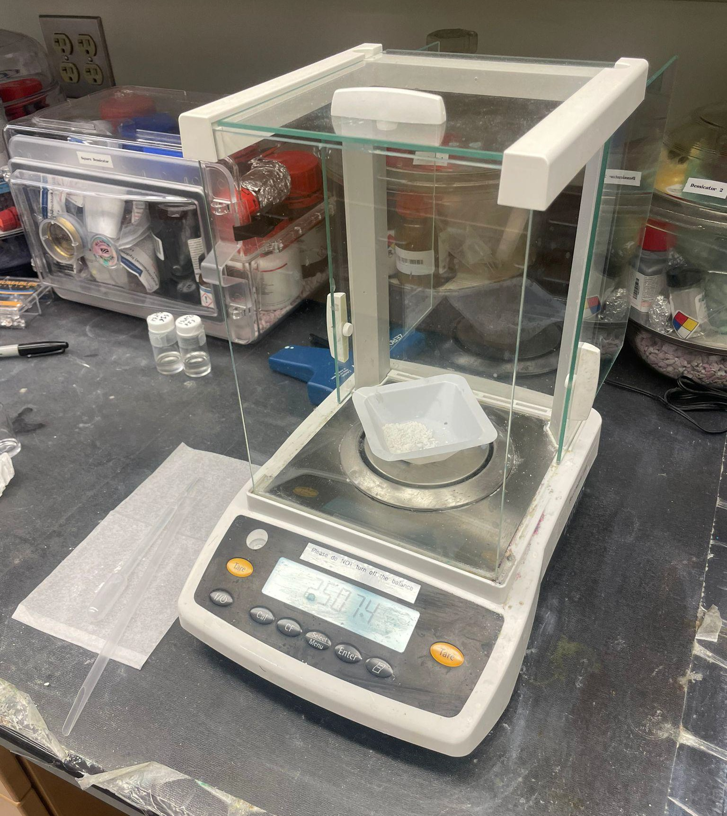
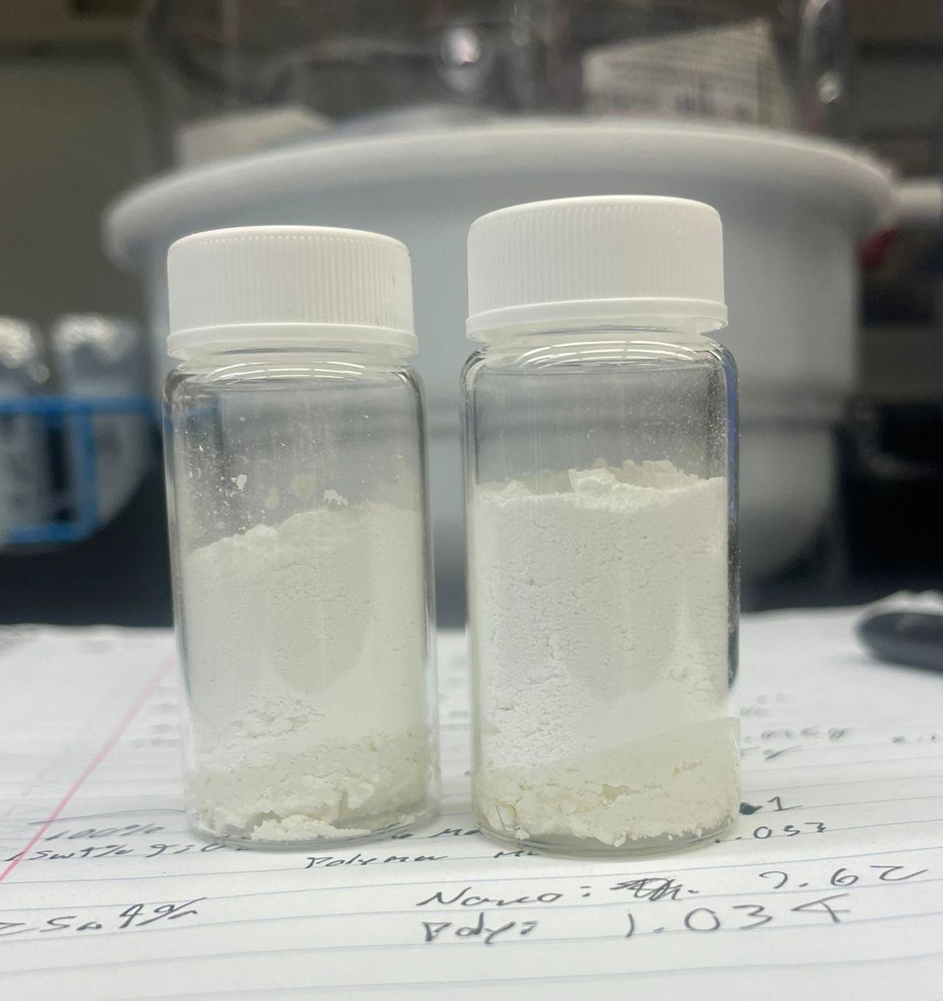
Nanocomposite Inks
Nanoparticles (60 vol% of ink):
Al₂O₃ (Aluminum Oxide)
TiO₂ (Titanium Dioxide)
SrTiO₃ (Strontium Titanate)
Glass Microparticles
Polymer Binder (40 vol% of ink):
SIS: Provides structure
Maleic Anhydride: Enhances nanoparticle dispersion
Toluene: Solvent

Slide 17
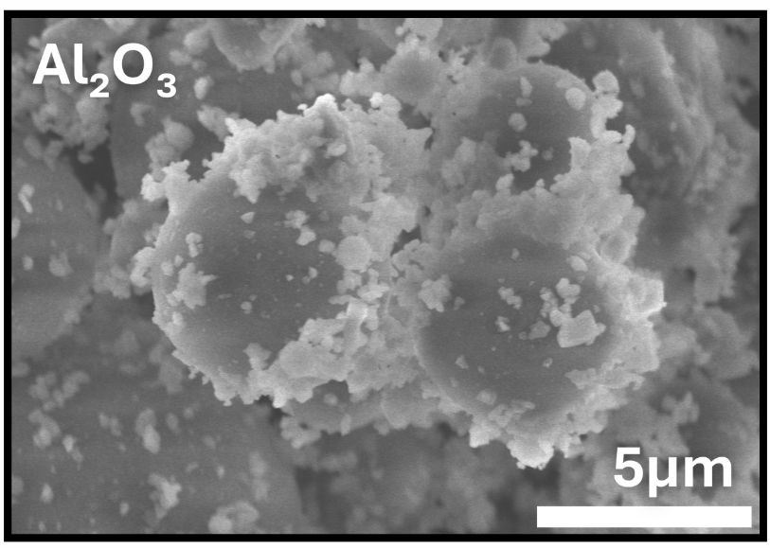
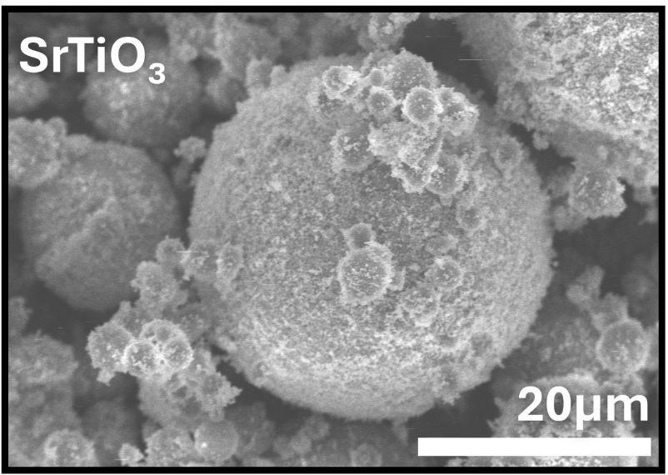
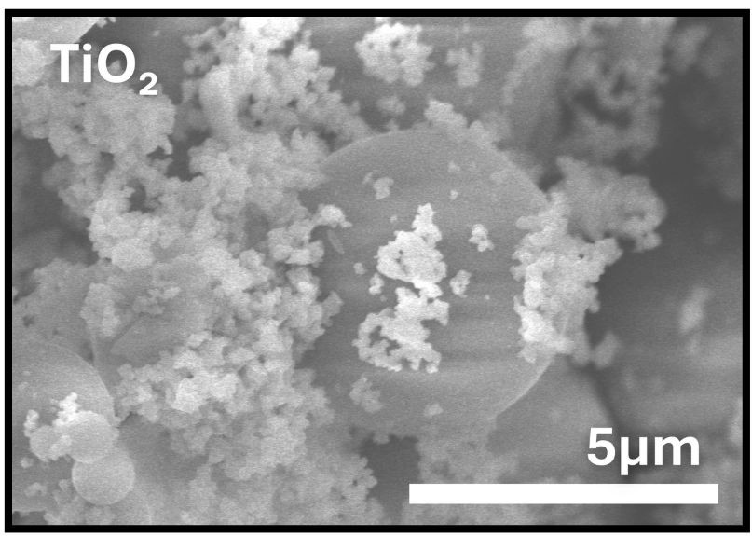
SEM images of nanoparticle + glass mixture showing differences in particle shape, surface, and size.

Slide 18
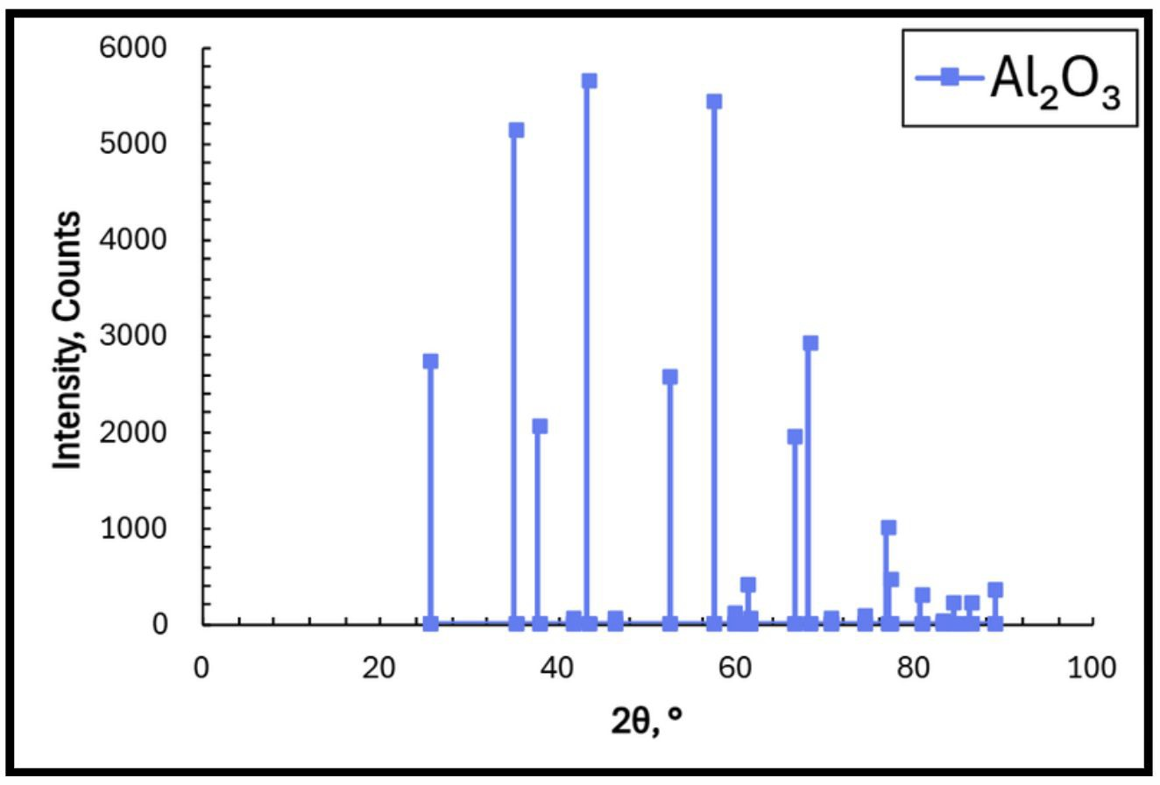
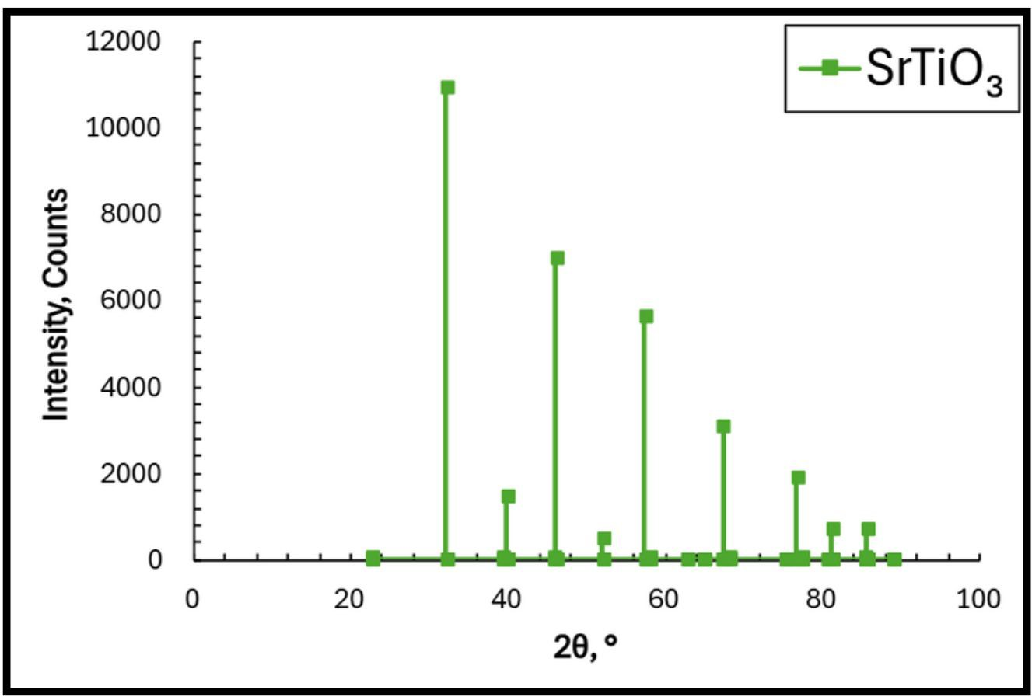
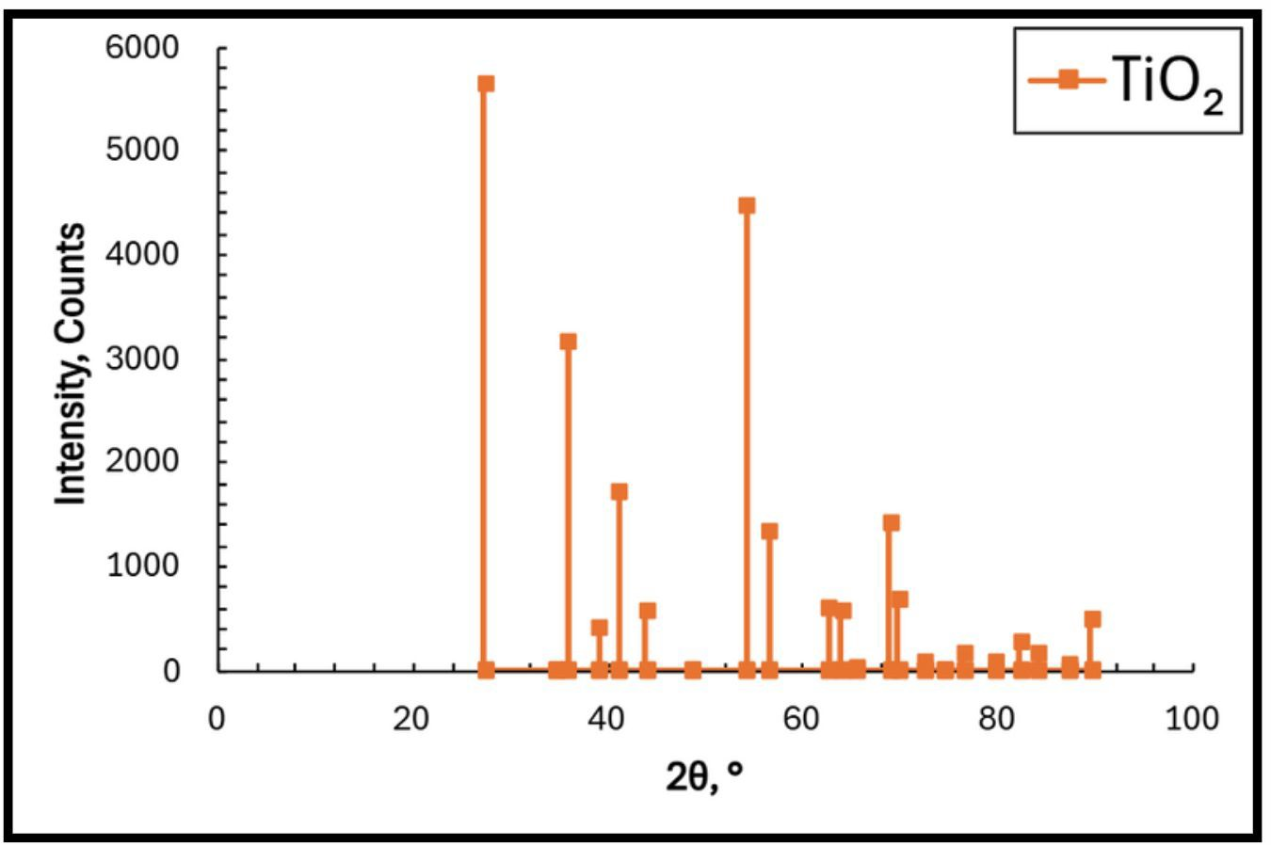
X-Ray Generator: 40
kV, 15 mA

Slide 19
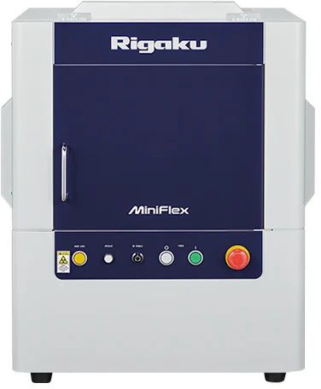
XRD Analysis
XRD confirms crystalline structure and high purity.
Clear peaks in the graph mean the nanoparticles are crystalline.
Crystalline materials have stable properties. Ideal for RF devices.
Rigaku Miniflex Powder XRD

Slide 20
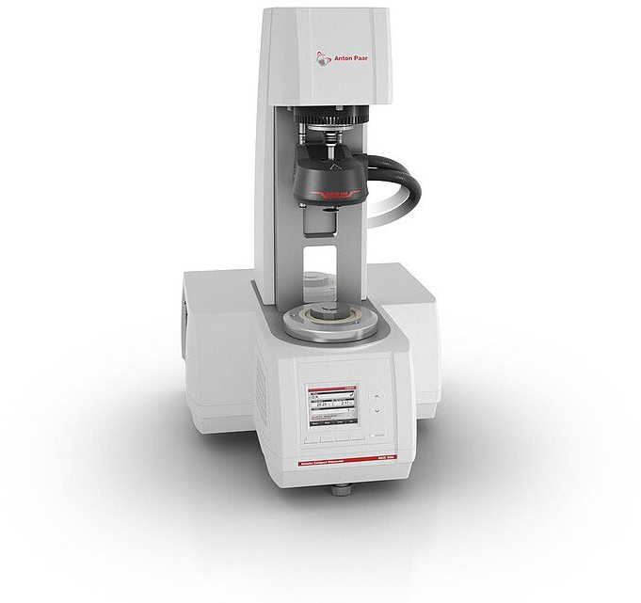
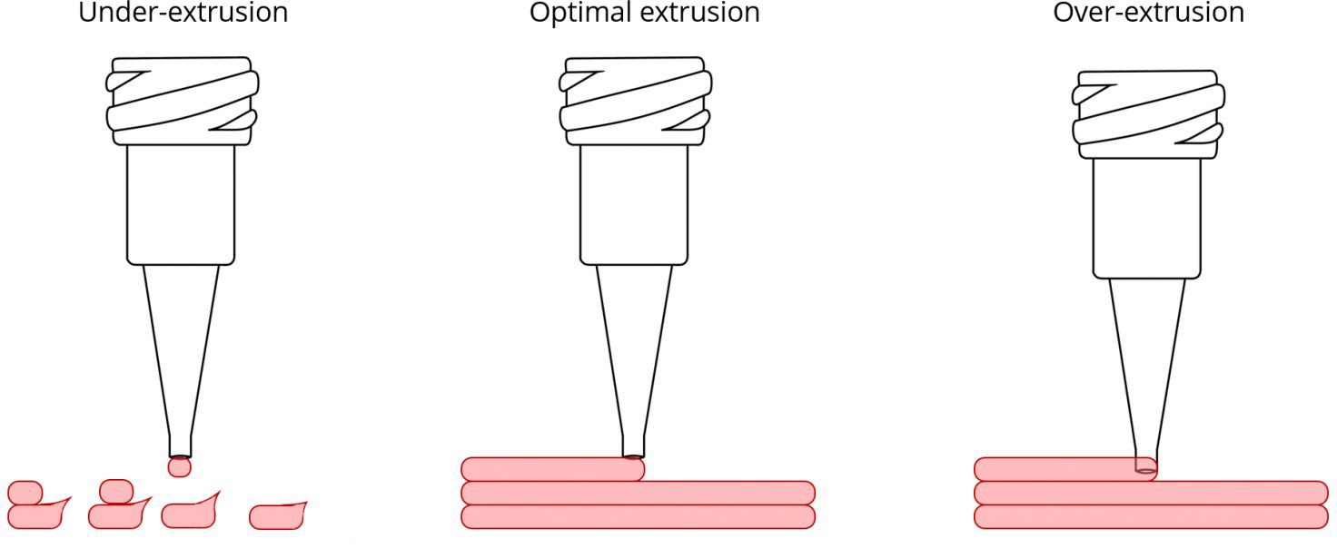
Rheology Testing
Measures how thick and how easily our inks flow when force is applied.
Why we test:
To make sure the material can flow smoothly through the printer without clogging.
Anton Paar MRC302 Rheometer
Extrusion Image

Slide 21
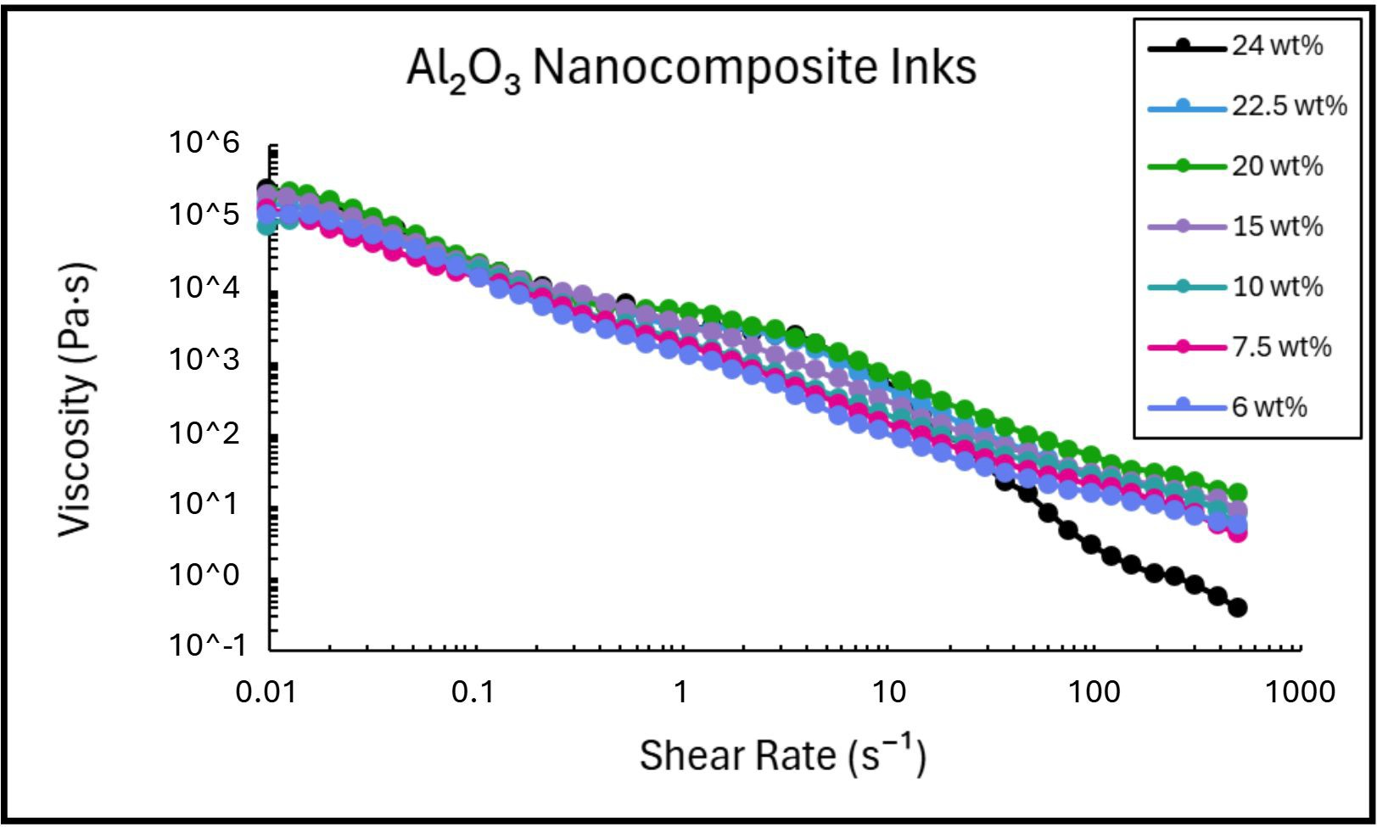
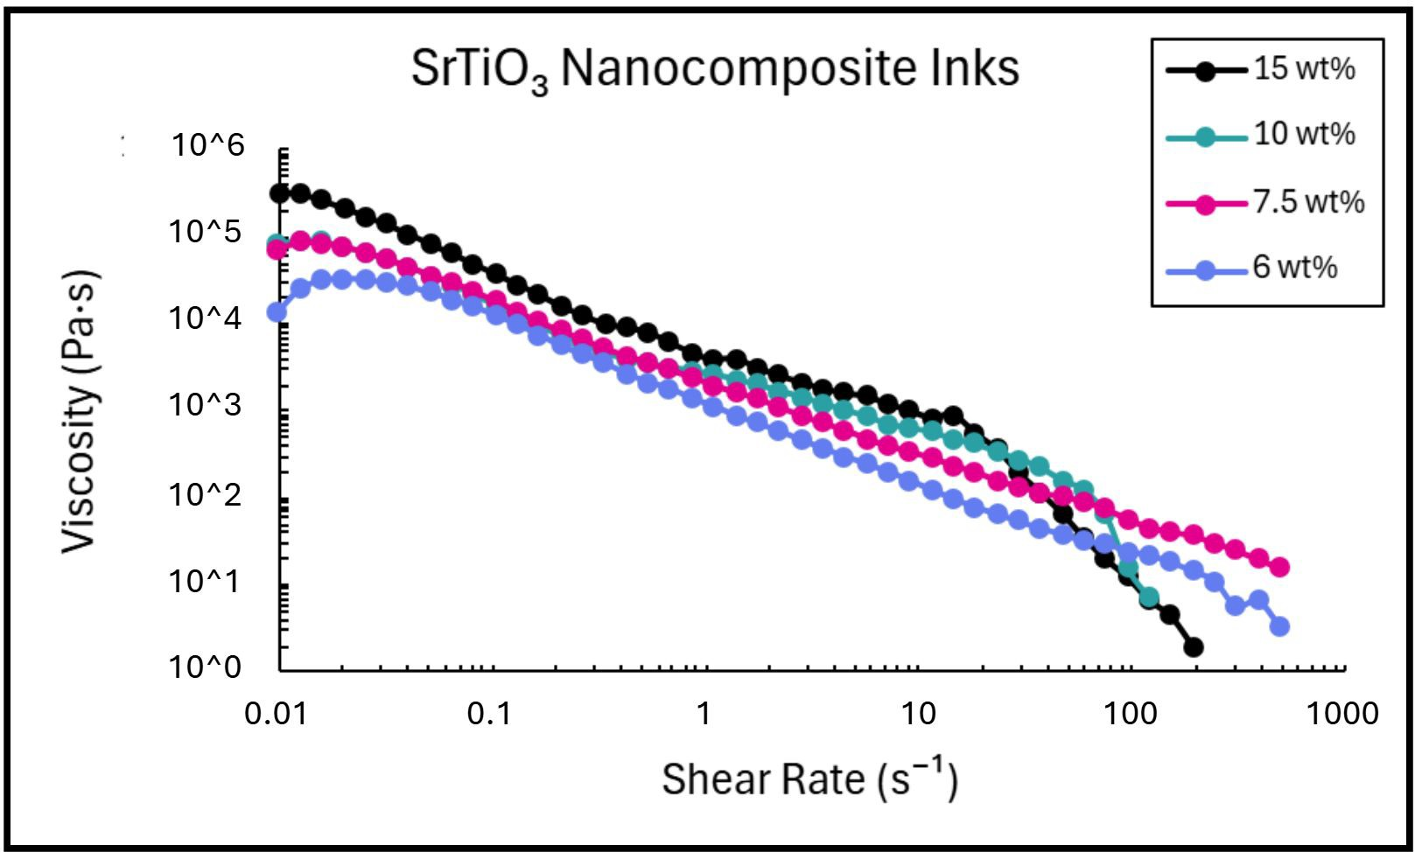
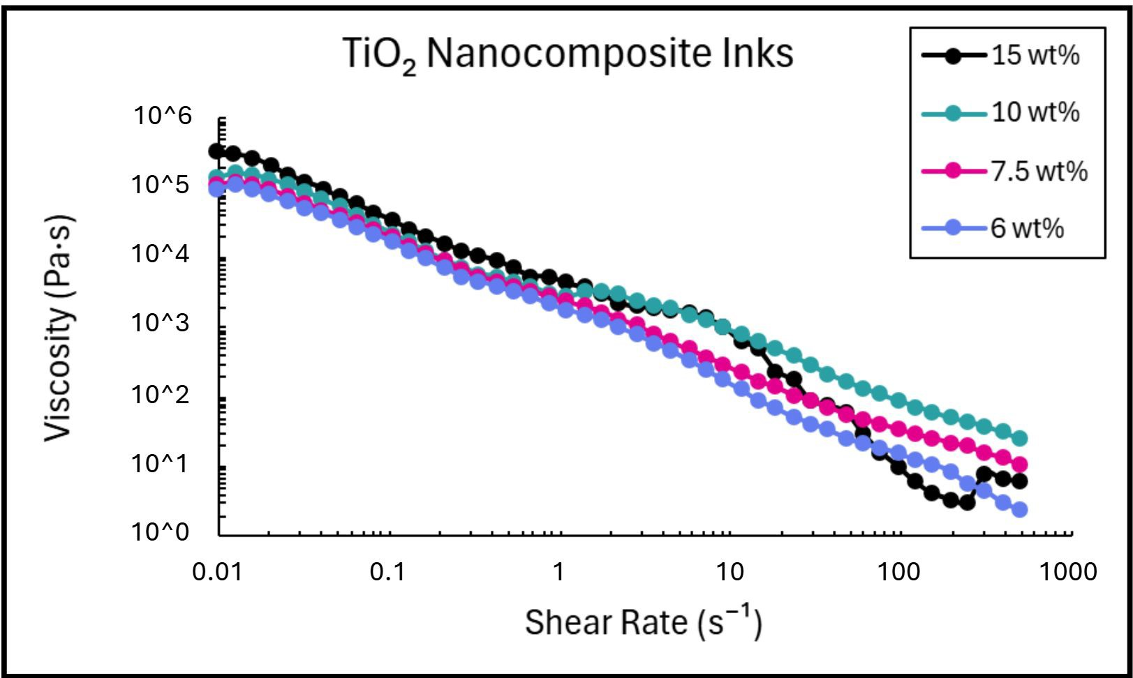
Nanocomposite inks at varying nanoparticle amounts.
The black line marks the highest printable viscosity. Above this, inks were too thick to print.

Slide 22
Rheology Takeaways
All inks displayed shear-thinning behavior, ideal for smooth extrusion and shape retention.
Maximum printable nanoparticle concentrations:
– Al₂O₃: ~24 wt% | TiO₂: ~15 wt% | SrTiO₃: ~15 wt%
Higher nanoparticle concentrations became too viscous or solid-like, making them unusable for printing.

Slide 23
Conclusion
A custom DIW 3D printer with active mixing was developed to fabricate graded nanocomposite inks.
Rheological testing identified optimal nanoparticle ratios: Al₂O₃ (~24 wt%), TiO₂ (~15 wt%), and SrTiO₃ (~15 wt%) to ensure smooth extrusion.
Future work includes:
Measuring dielectric properties using a VNA.
Printing solid test structures with tunable gradients.

Slide 24




Acknowledgements
Special thanks to Laurel Hilger for her guidance throughout the process, and to Dr. Blair Brettmann for the lab opportunity.
Thank you to Dr. David Tavakoli for SEM and XRD training.
Thank you to Ms. Leslie O’Neill and Dr. Mikkel Thomas for their support.
This work was supported by the National Science Foundation (Award #2349519), the NNCI program, and the Georgia Tech Institute for Materials and Systems.

Slide 25
References
Duncan, B., Weeks, R. D., Barclay, B., Beck, D., Bluem, P., Rojas, R., Plaut, M., Russo, J., Uzel, S. G. M., Lewis, J. A., & Fedynyshyn,
T. (2023). Low-loss graded dielectrics via active mixing of nanocomposite inks during 3D printing. Advanced Materials Technologies.
Muralidharan, A., Rasheed, A., & Roy, U. (2021, May). Design and simulation of micro-ring resonator based optical comparator. In
2021 International Conference on Emerging Trends in Information Technology and Engineering (ic-ETITE) (pp. 1–4). IEEE.
Rau, D., Williams, C., & Bortner, M. (2023). Rheology and printability: A survey of critical relationships for direct ink write materials design. Progress in Materials Science, 140, 101188.
Sevcik, M. J., Golson, J., Bjerke, G., Snyder, I., Taylor, G., Wilson, F., Rabinowitz, G. I., Kline, D. J., Grapes, M. D., Sullivan, K. T., Belof, J. L., & Eliasson, V. (2024). Dual feed progressive cavity pump extrusion system for functionally graded direct ink write 3D printing. HardwareX, 17, e0051

