Slide 1
Automating the Fabrication of Thin Films for Energy Applications
Rafael Sanchez, Phoenix College
Arkita Chakrabarti, Arizona State University
Mariana Bertoni, Arizona State University

Slide 2
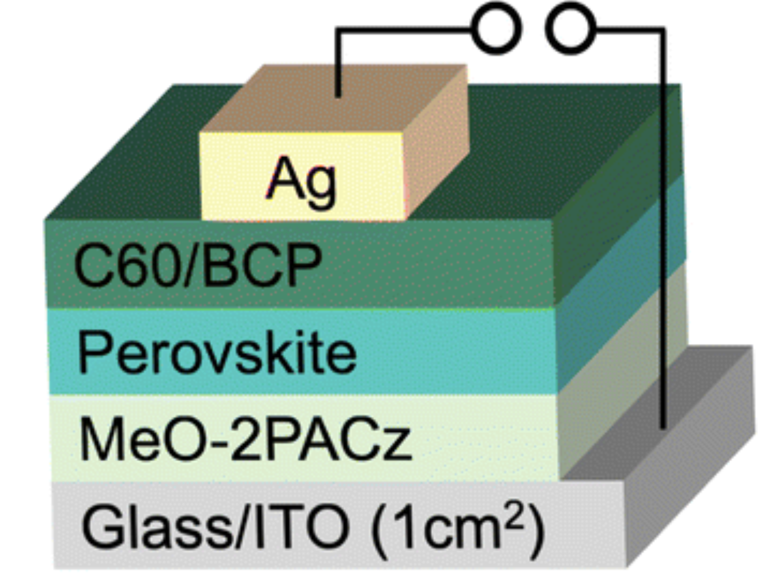
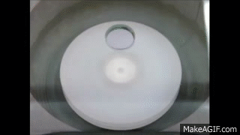
Solar Cell Anatomy & Making films
A solar cell consists of several thin films of material
These films have to get manufactured
In our lab, we’ve been making these films by placing drops of solution onto spin coaters and annealing them
Fig. 2 Example of layers of a solar cell. Not all cells are like this one.
Fig. 1 Example of Spin Coating

Slide 3

Quality Control Problems
Making these films is a very sensitive and tedious process
Human error can lead to inconsistent results over time
These inconsistencies make reproducibility very difficult

Slide 4
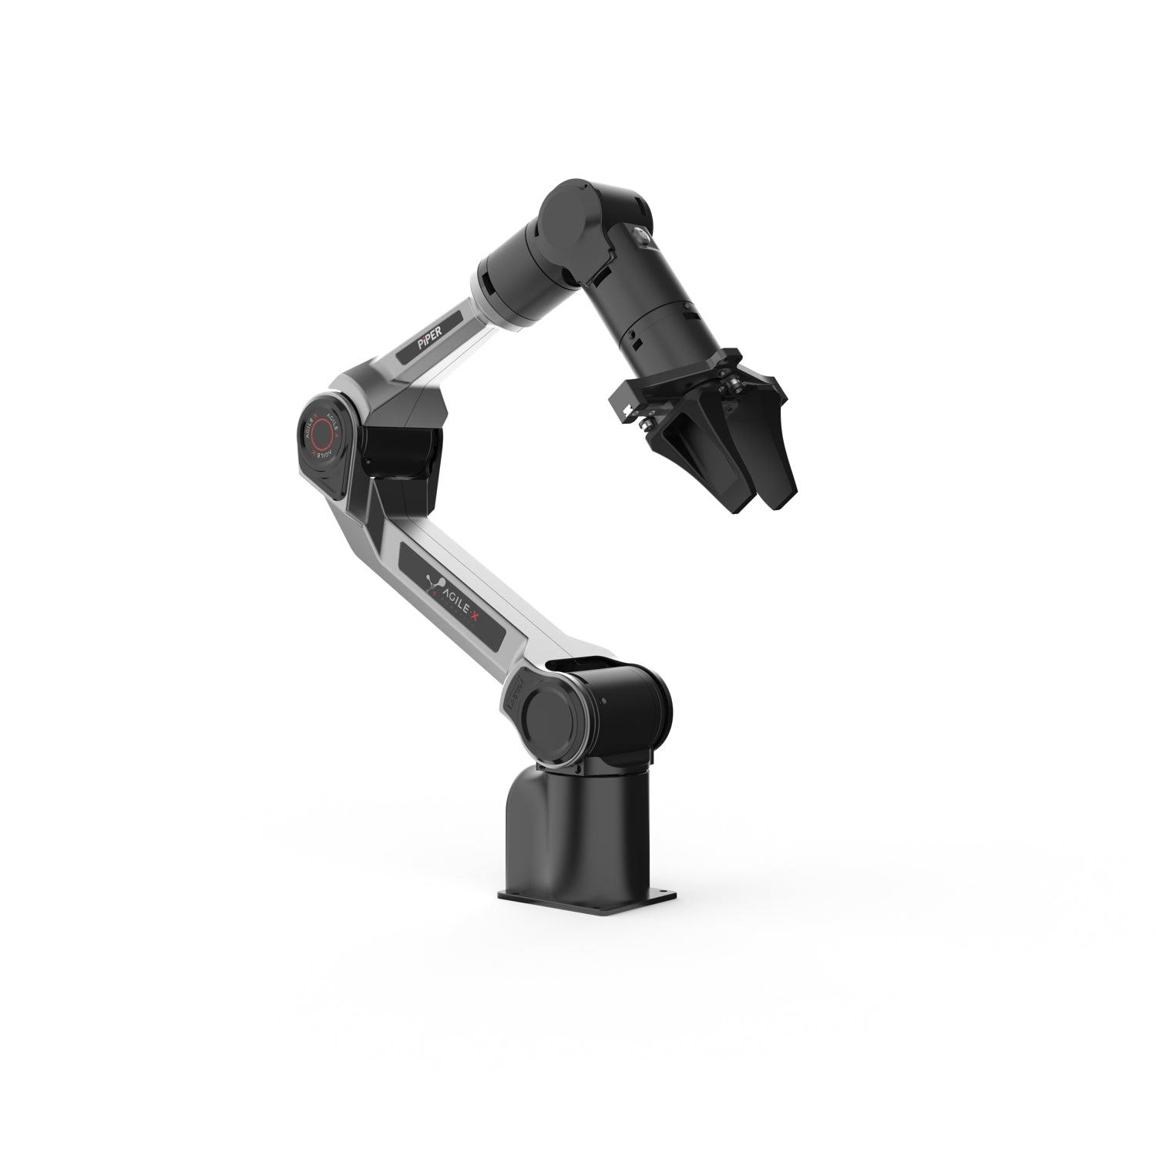
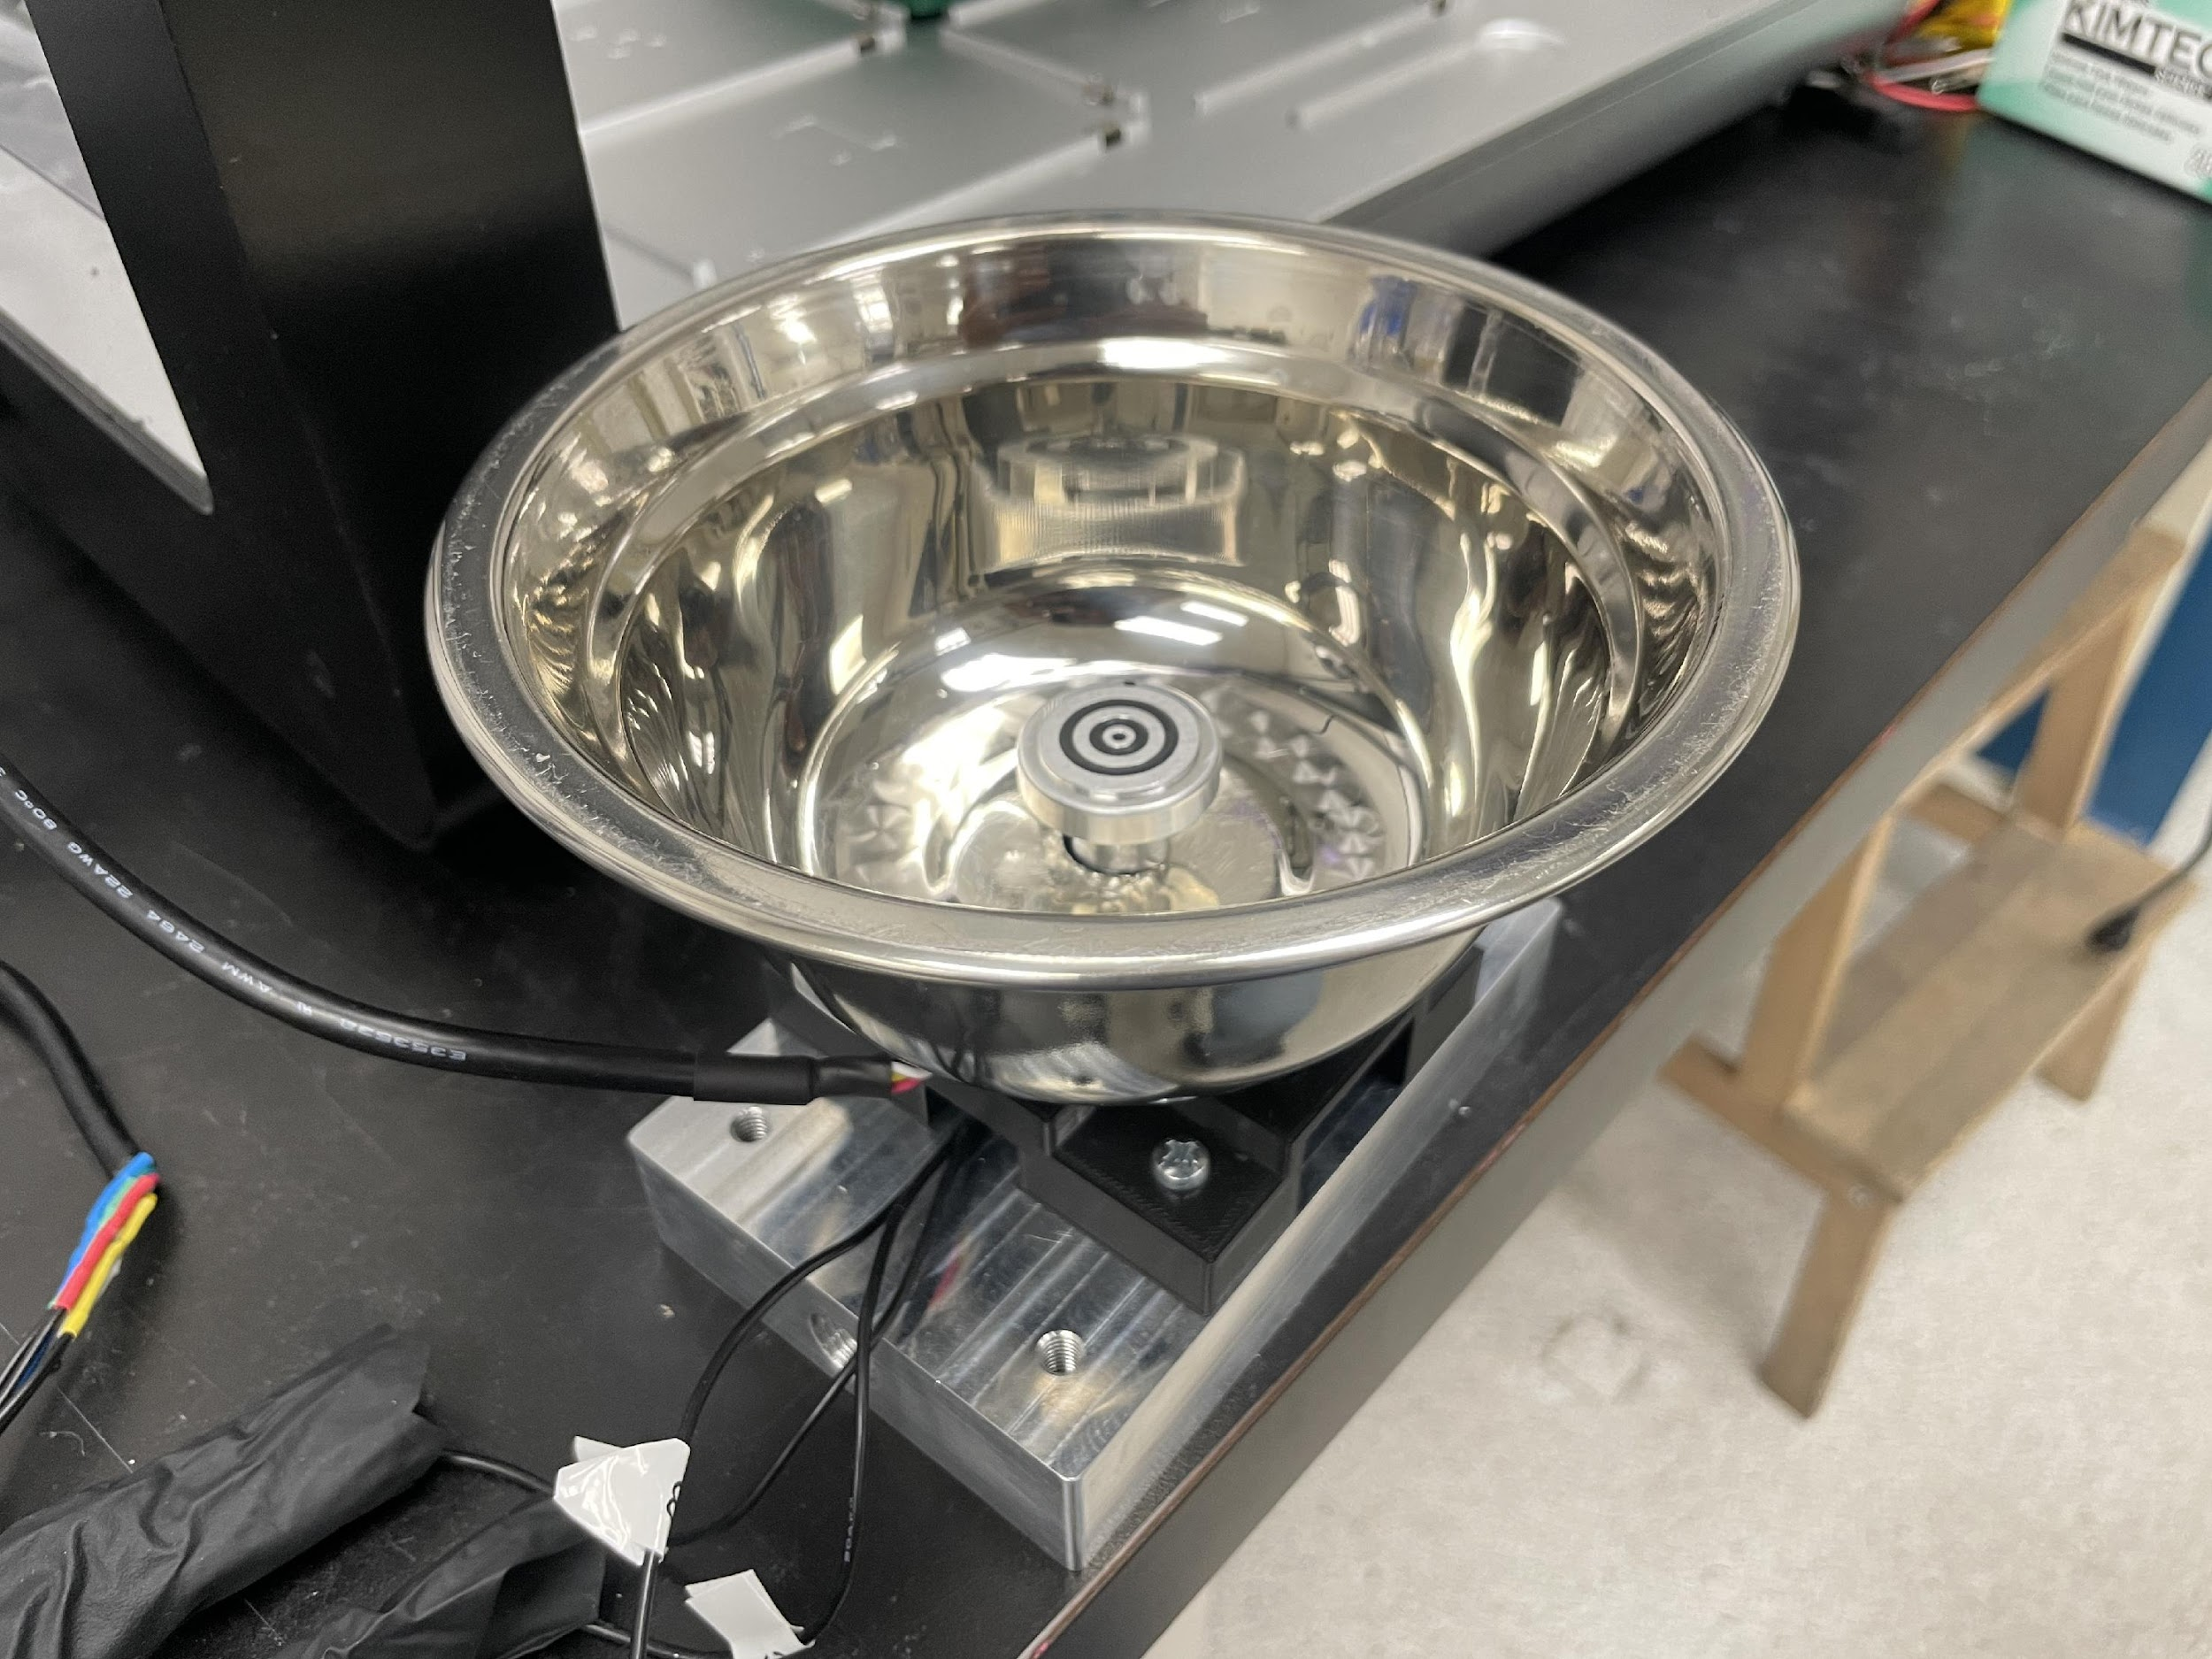
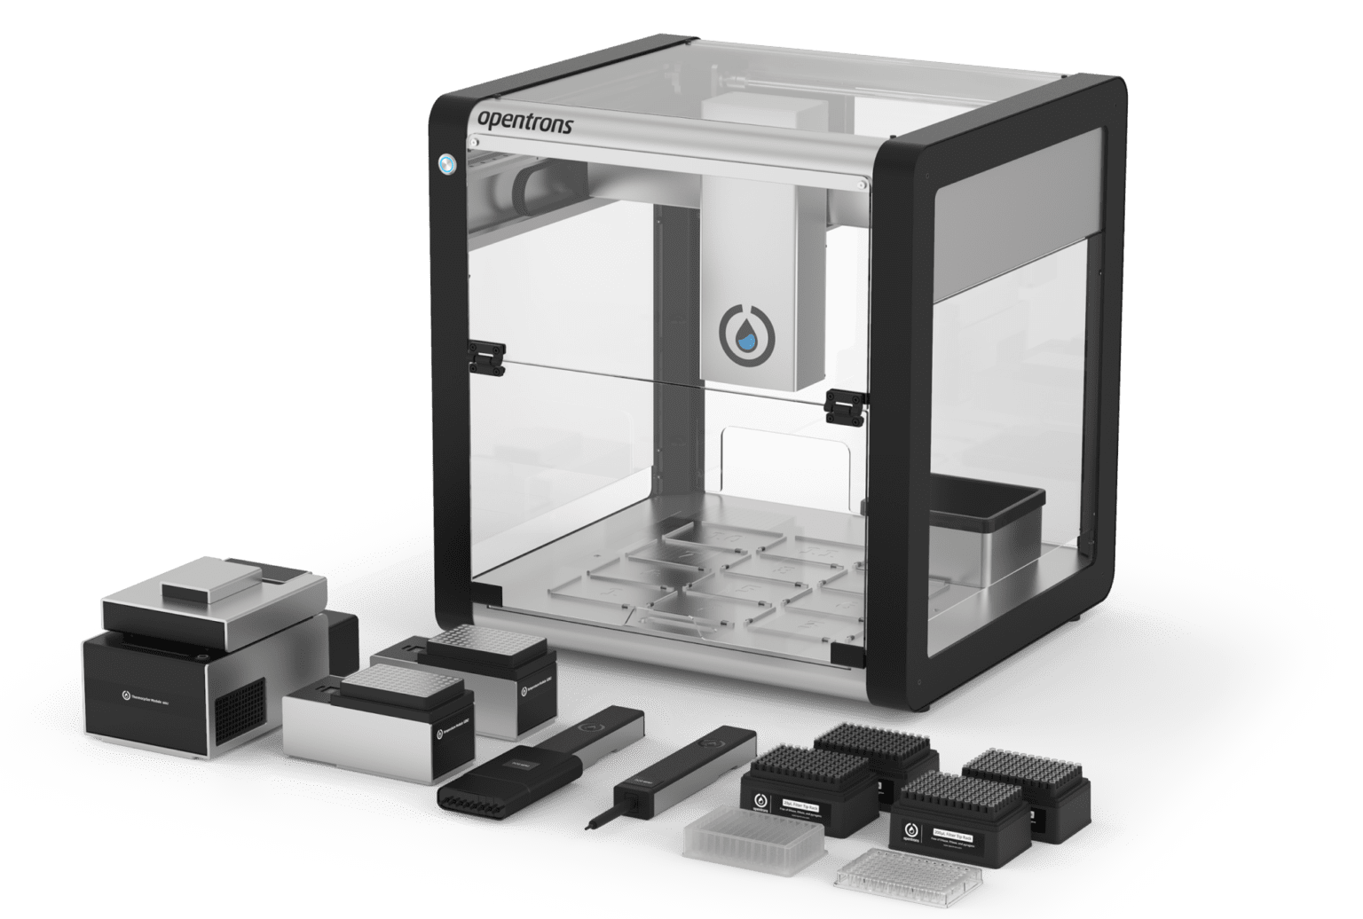
The Solution: Robots
The Robots in Question
Fig. 3 Homemade Python controlled spincoater
Fig. 4 Opentrons OT2 Liquid Handler Robot
Fig. 5 AGILEX PiPER Robotic Arm

Slide 5

How We Use These Robots
Python packages allow us to send commands to components using a python script
Putting them in same script lets us easily synchronize them
Robotic consistency will ideally lead to reproducible results
Fig. 6

Slide 6

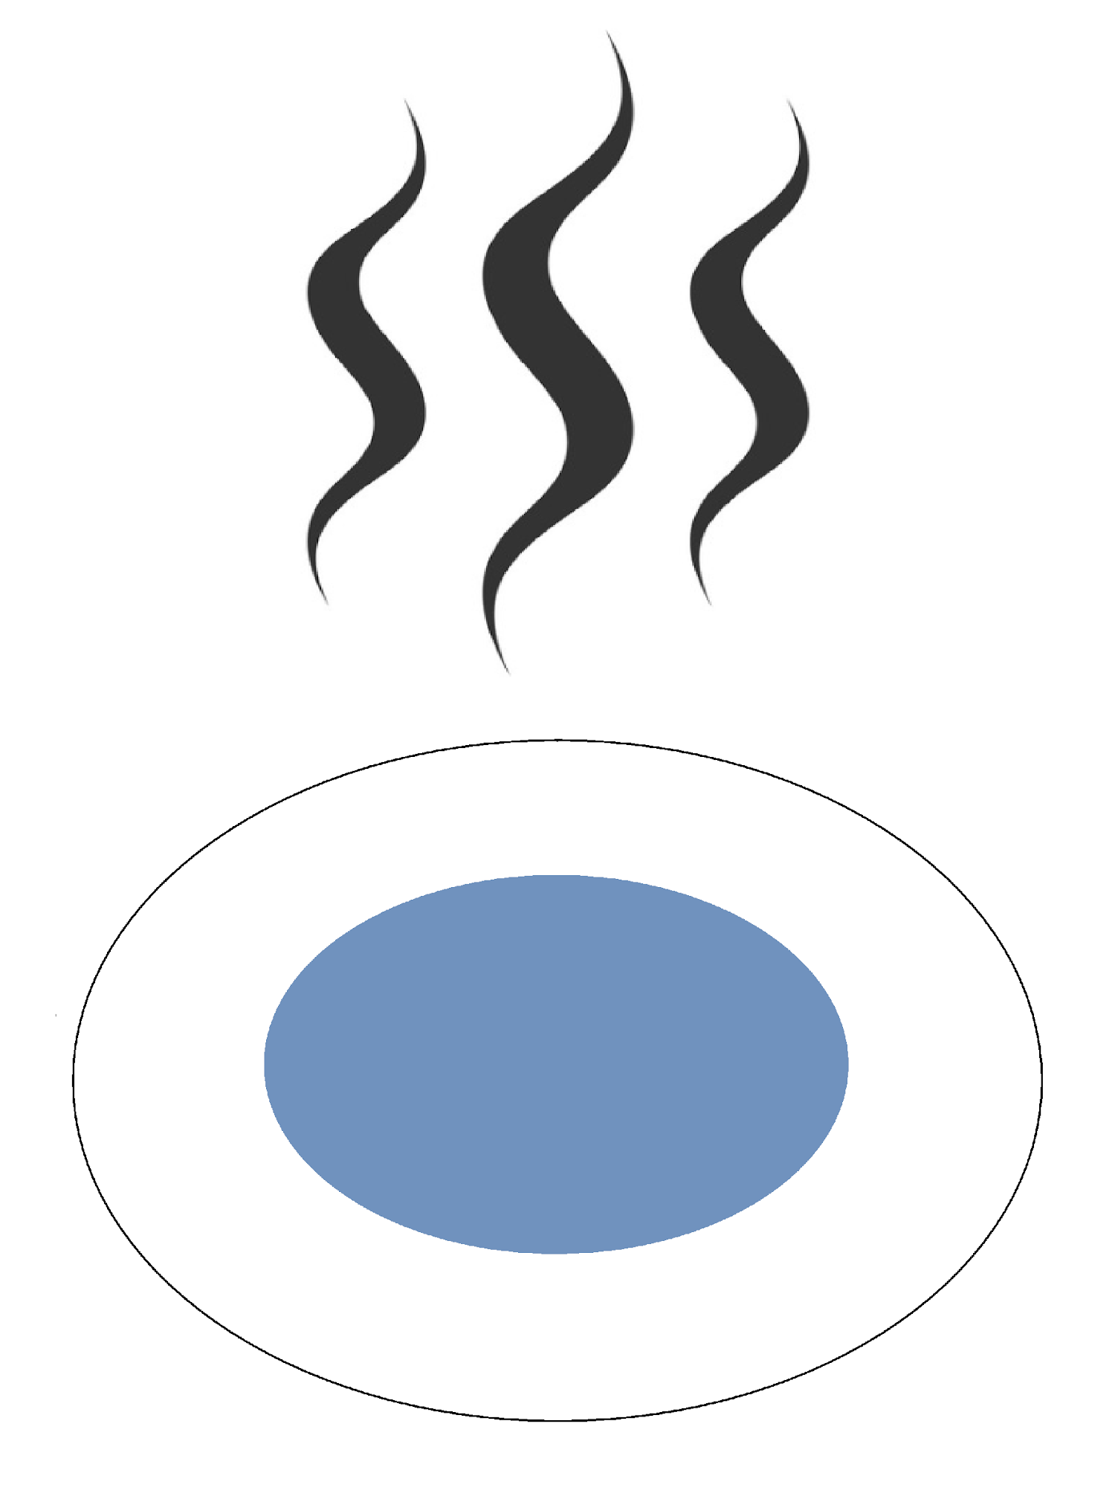
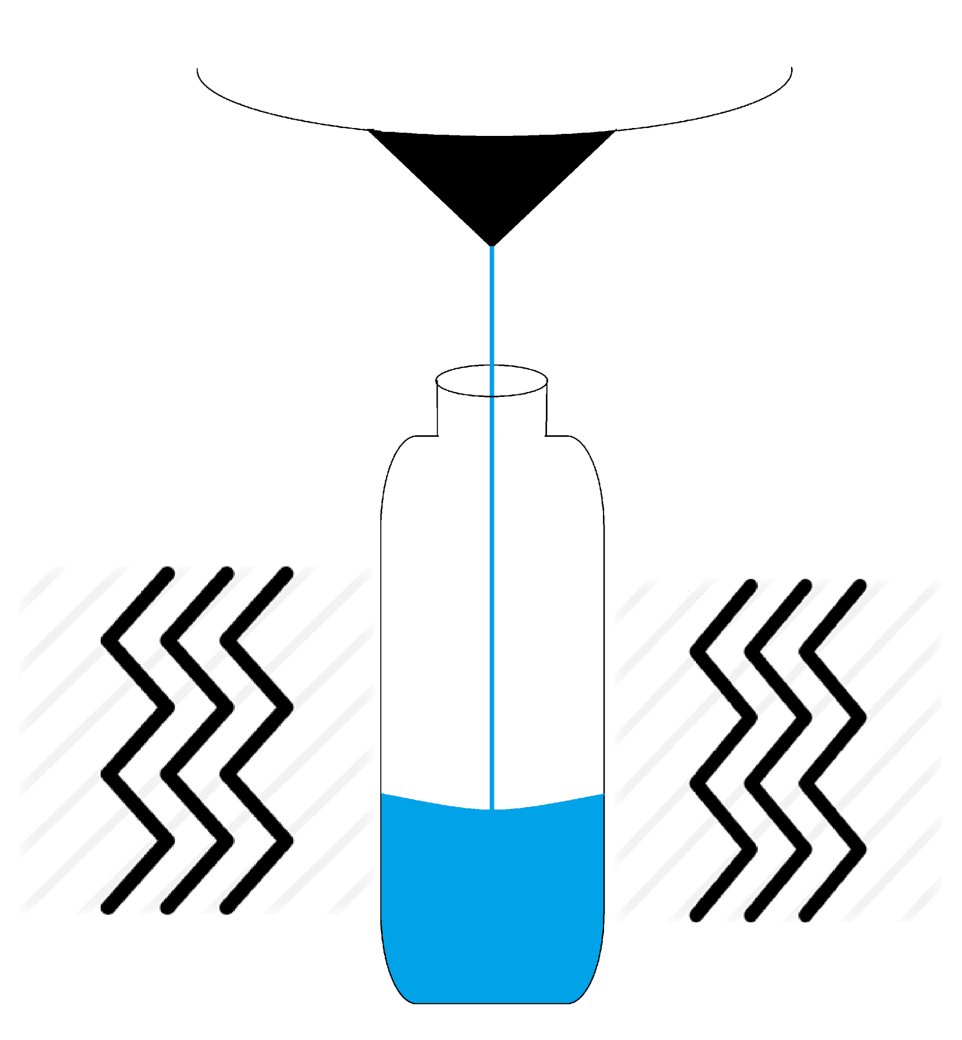
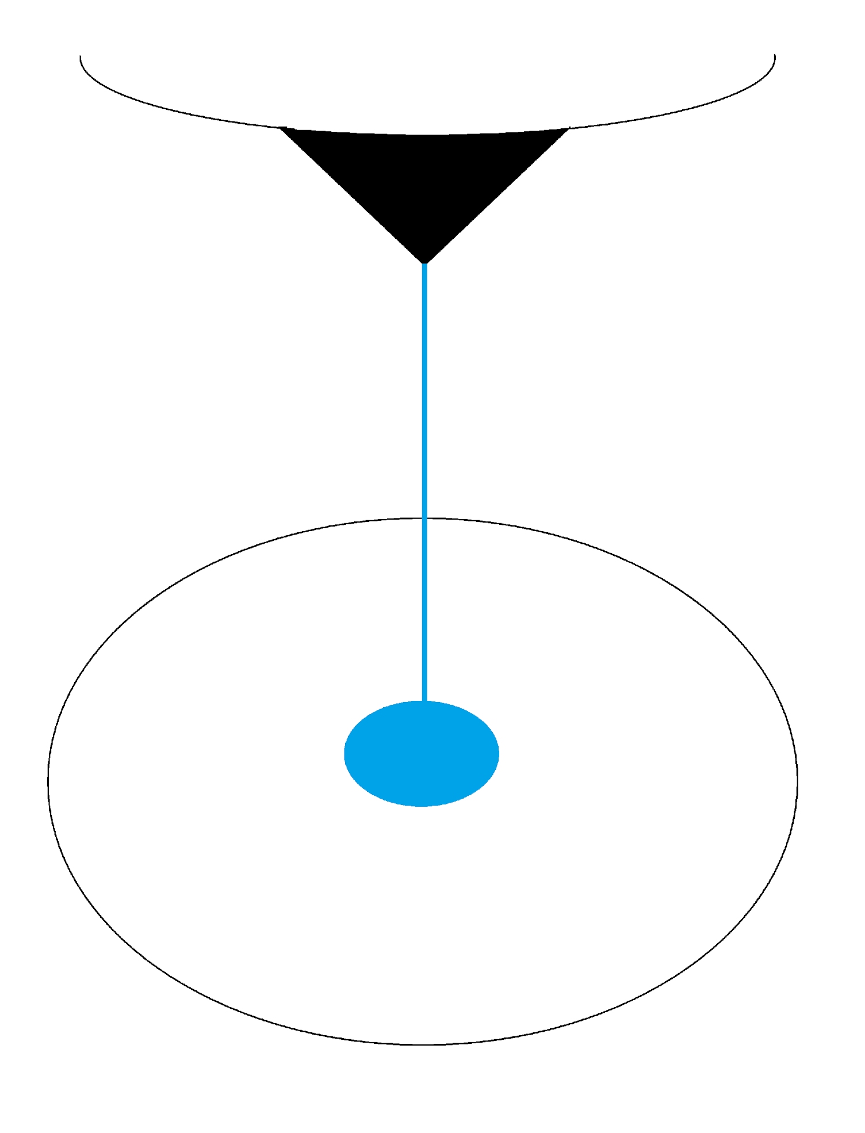
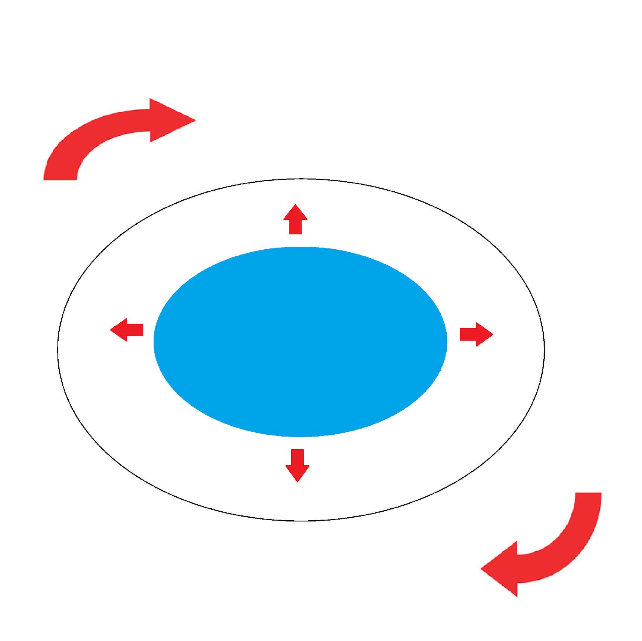
Robotic Manufacturing Process
1: Liquid handler mixes solution to be dispensed onto substrate
2: Liquid handler dispenses solution onto spincoater substrate
3: Spincoater spins up, creates film
4: Robotic arm grabs substrate, places onto hotplate
5: Hotplate anneals substrate, film is finished!

Slide 7
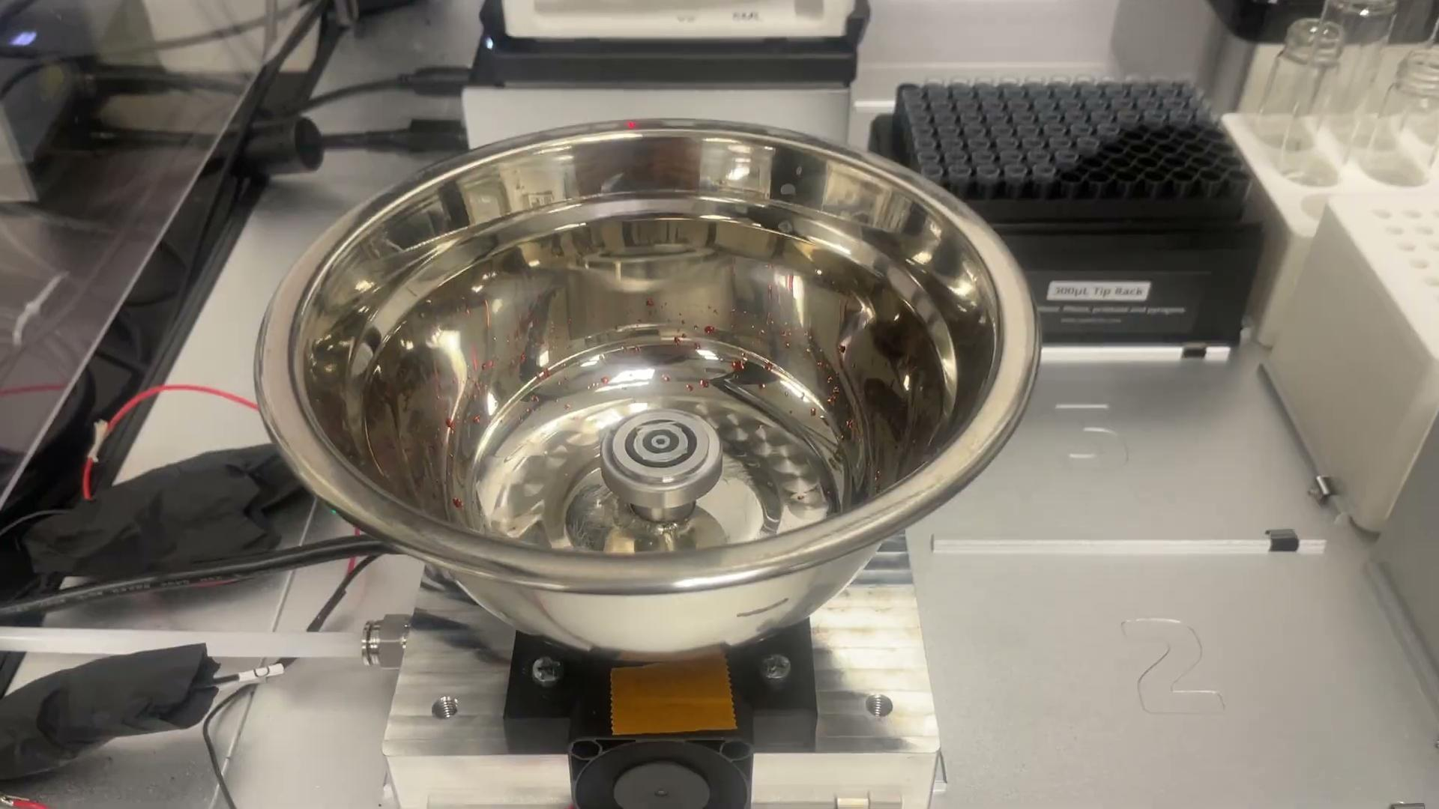
In Practice
Spincoater and solenoid commands have been successfully integrated into the OT2 protocol
Steps 1-3 are taken care of ☺

Slide 8

Next Steps
Integrate robotic arm into the process
Implement time tracking feature in script
Figure out how to improve film quality by controlling parameters
Fig. 7

Slide 9




Acknowledgements
I would like to thank Arkita Chakrabarti and Mariana Bertoni for assisting and mentoring me throughout this project. I would also like to thank Jessica Hauer and Trevor Thornton of NCI-SW for their help throughout the program. Lastly, I would like to thank ASU, NCI-SW, the DEfECT lab, and the NSF for providing me with this opportunity.
Sources
Fig. 1: https://makeagif.com/gif/spin-coating-techniques-two-stage-spin-to-prevent-corner-beads-BZN-L-
Fig. 2: Cakan, D. N., Kumar, R. E., Oberholtz, E., Kodur, M., Palmer, J. R., Gupta, A., Kaushal, K., Vossler, H. M., & Fenning, D. P. (2024). PASCAL: The perovskite automated spin coat assembly line accelerates composition screening in triple‑halide perovskite alloys. Digital Discovery, 3(6), 1236–1246. https://doi.org/10.1039/D4DD00075G
Fig. 4: Opentrons, https://opentrons.com/wp-content/uploads/2023/01/hero-14010ce8ebd017d4d6f8f4dd46efd240-1536x1036.png
Fig. 5: AGILEX, https://global.agilex.ai/products/piper
Fig. 6: https://www.vecteezy.com/png/12697295-3d-python-programming-language-logo
Fig. 7: https://unsplash.com/photos/toddlers-standing-in-front-of-beige-concrete-stair-bJhT_8nbUA0

