Slide 1




QUANTITATIVE CHARACTERIZATION OF CELLULOSE DISSOLUTION IN IONIC LIQUIDS AND SUBSEQUENT BIOMIMIETIC APPLICATIONS
Pierre A. Simonian
Liberty D. Yoder
Evan L. McDowell
Dr. Jeffrey R. Alston
Notes:
Good morning! My name is Pierre Simonian, and over the course of this summer I’ve been working on the characterization of cellulose dissolution in ionic liquids and subsequent biomimetic applications!

Slide 2
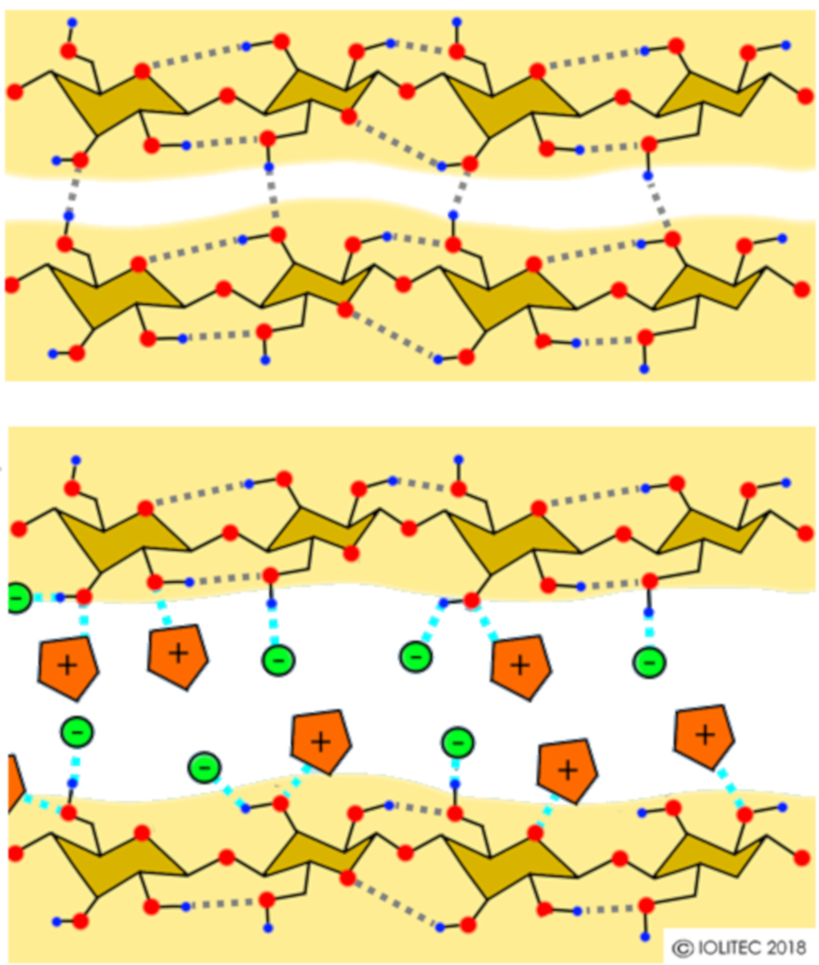
Why Dissolve Cellulose in Ionic Liquids?
Biopolymer cellulose properties include:
Biocompatibility
Biodegradability
However, intermolecular hydrogen bonds of cellulose make it insoluble and difficult to work with.
Ionic liquids such as 1-allyl-3-methylimidazolium chloride (AMImCl) can disrupt these hydrogen bonds.
Renewability
Low Toxicity
[AMIM]⁺ Cl⁻
+
-
Scheme 1- The breaking-down of cellulose H-bonds by AMImCl
Iolitec - Ionic Liquids Technologies
Notes:
Literature has already expressed the many properties that the biopolymer cellulose has: its biocompatibility, biodegradability, renewability, and low toxicity. However, its hydrogen bonds that make up its structure make it insoluble and hard to work with, making it difficult to be applied in different fields.
Ionic liquids such as 1-allyl-3-methylimidazolium chloride (AMImCl) can disrupt these hydrogen bonds, as you can see in this scheme here. Cellulose can then be molded into how we want it to be before regenerating it into a biomaterial.

Slide 3
Research Objective – Dissolution Characterizations
Biopolymers derived from different sources exhibit unique dissolution profiles. Reliably using these materials from a dissolved state requires “KNOWING” how well they are dissolved.
Biopolymer-IL dissolutions can be characterized qualitatively with polarized light microscopy (PLM), and quantitatively through viscosity measurements and molecular weight analysis.
Characterization sets the foundation for future projects
Rate of cellulose (biopolymer) dissolution
Measure viscosities to measure dissolution quality
Compare molecular weights of different cellulose types
Notes:
The text in red highlights the reason for conducting characterizations. Biopolymers from different sources exhibit unique dissolution profiles. Reliably using these materials in their dissolved states requires a good understanding of how well they are dissolved.
Thus, the characterization done here will serve as a foundation for future projects that use these biopolymers. For the purposes of this project, we looked at the rate of cellulose dissolution, the viscosities to measure dissolution quality, and the molecular weights of different cellulose types.

Slide 4
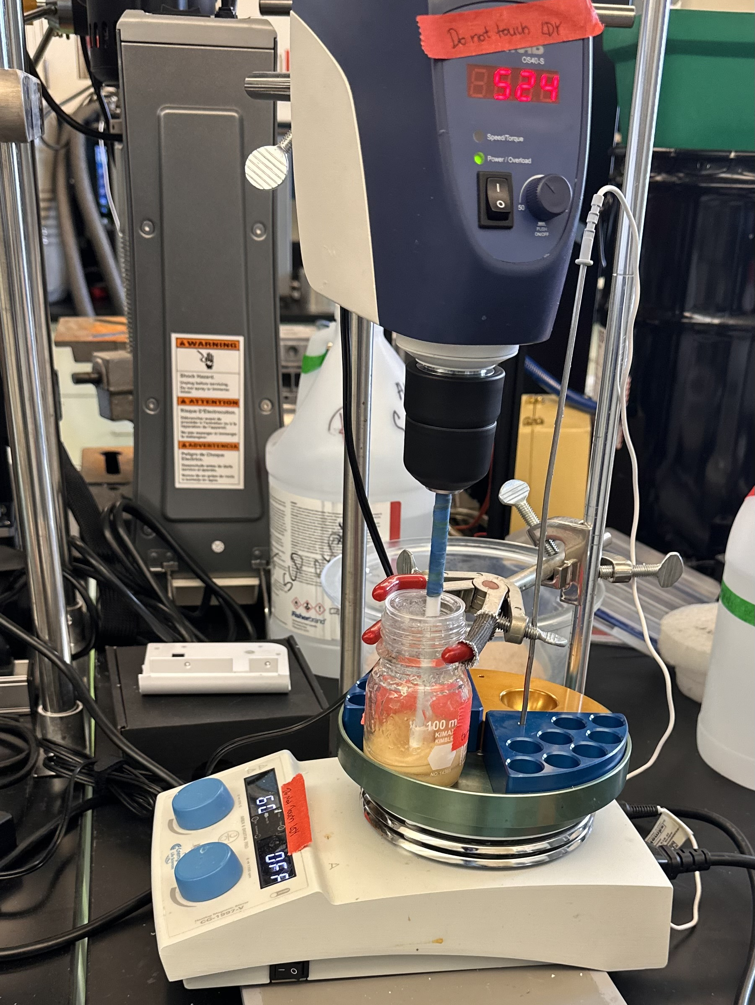
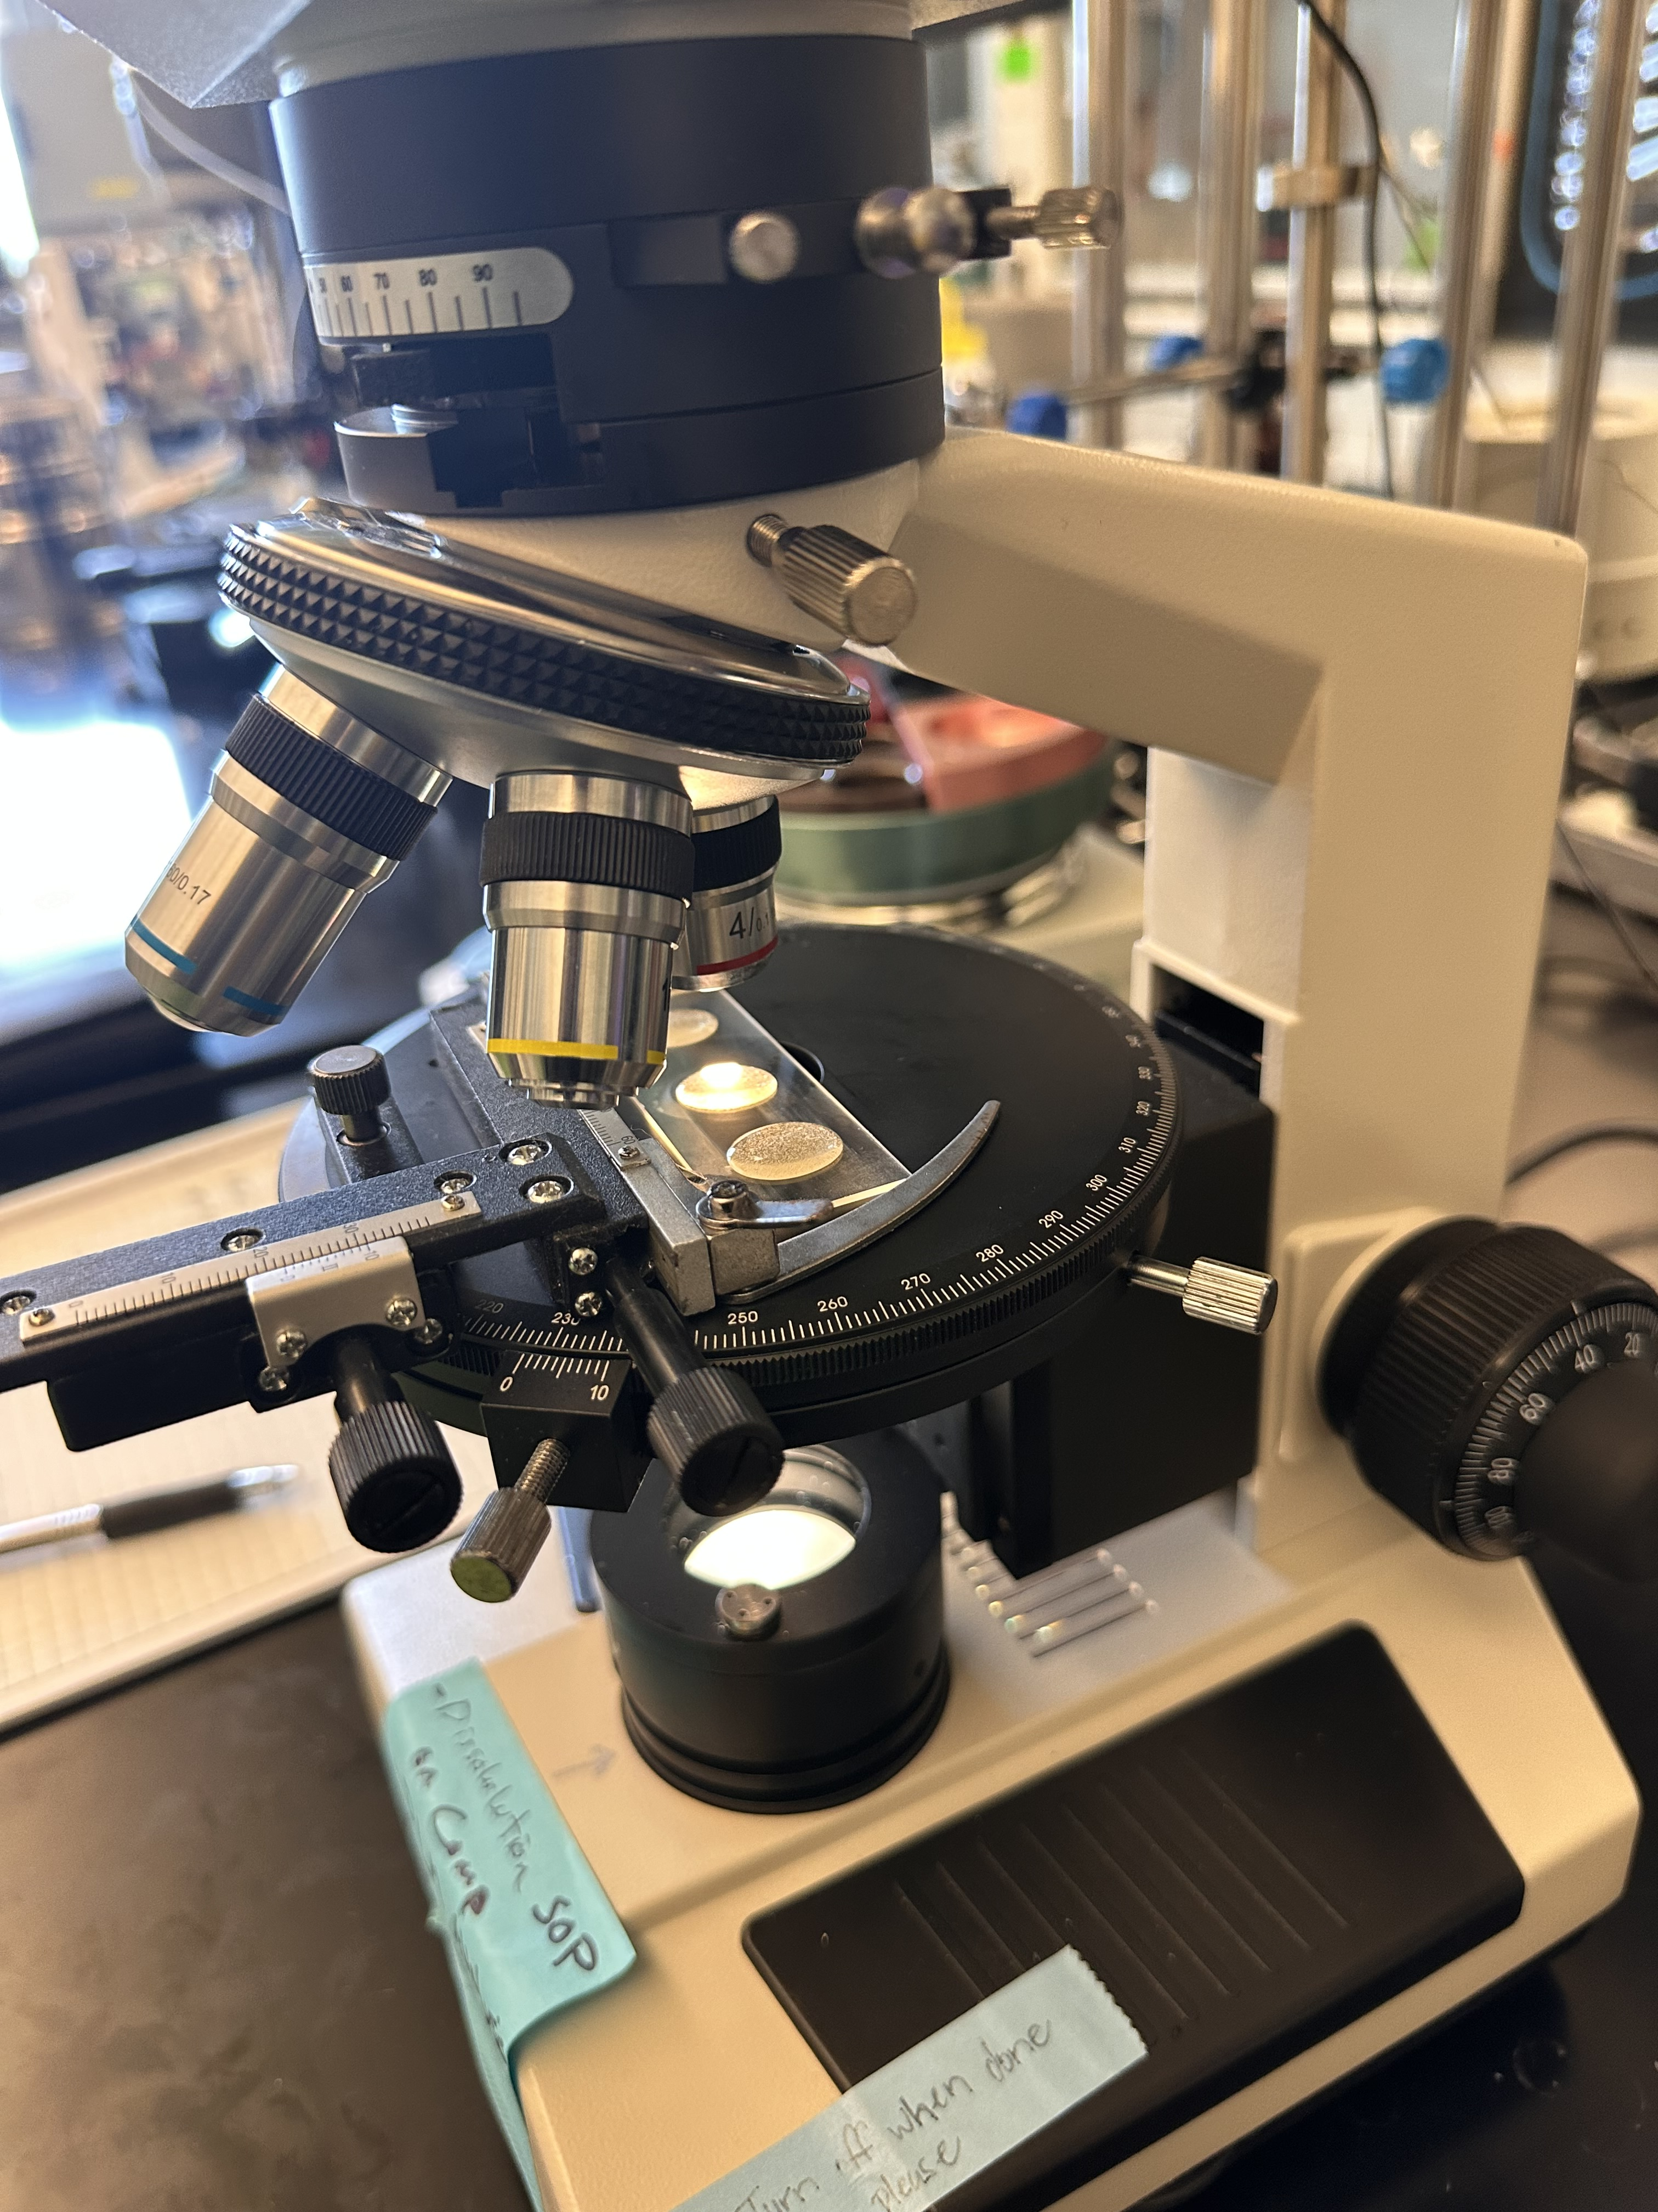
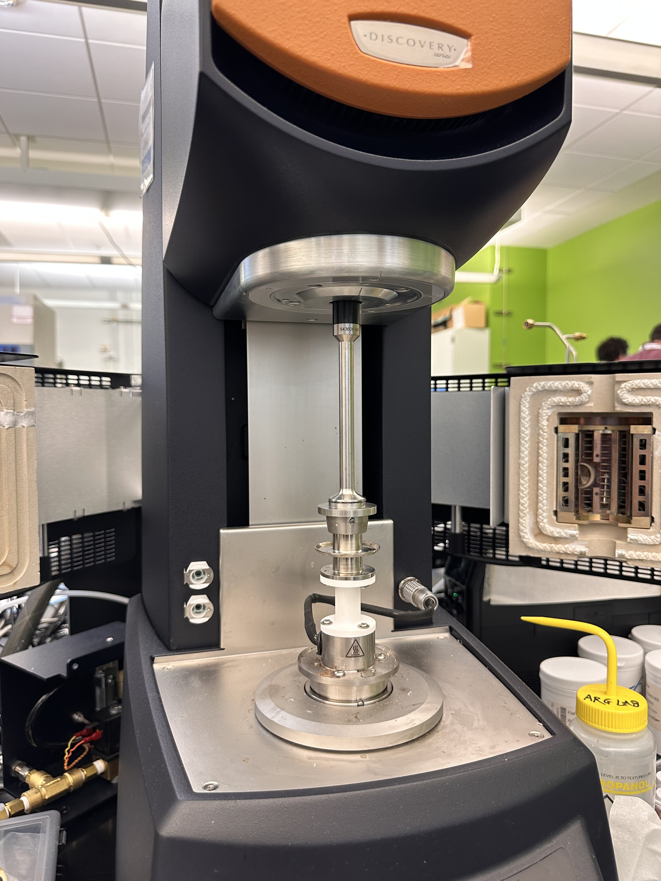
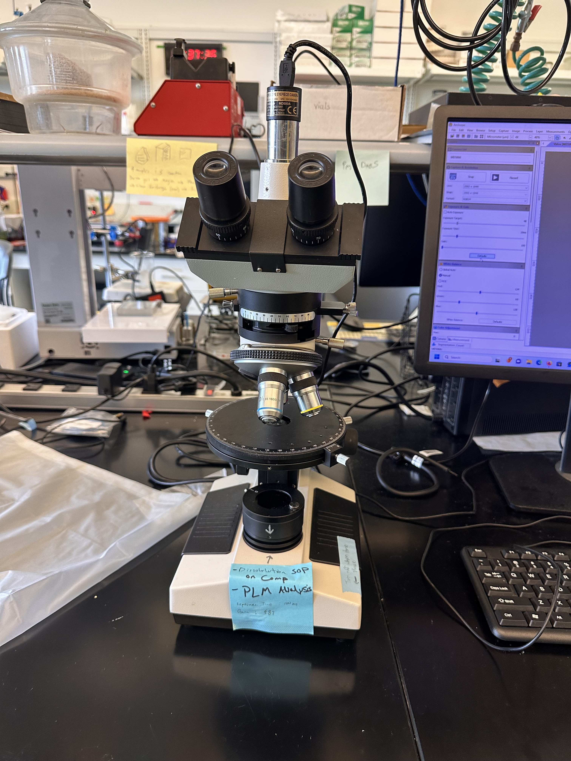
Experimental Methods
Figure 1a- Developing an AMImCl MCC dissolution
Figure 1b, 1c- Polarized Light Microscope (PLM) and PLM examining samples on glass slide
Figure 1d- Dissolution undergoing rheometry
Notes:
Our experimental model was primarily composed of three phases.
The first phase included developing the dissolution itself. In doing so, we gather a jar of ionic liquid (AMImCl) and added our MCC (microcrystalline cellulose) to the jar incrementally. First in 0.5 wt% increments until 2.0wt%, and then 1 wt% until we reached a maximum of 7 wt%. Each increment was mixed for around 45 minutes with an overhead stirrer and heated at 60 degrees Celcius.
Every 15 minutes of that 45 minute period, we would stop the mixing, gather a sample of the dissolution from the top, middle, and bottom of the container, and then place it on a polarizing light microscope (PLM) to measure the degree in which the MCCs dissolved.
Once we reached 3, 5, and 7 wt% values respectively, we took a sample and measured them in an HR20 Rheometer to measure their resulting viscosities.

Slide 5


















Polarizing Light Microscope (PLM) Particle Analysis
3wt% MCC in AMImCl
4wt% MCC in AMImCl
Top
3wt%
t15
42 pc
3wt%
t30
105 pc
3wt%
t45
12 pc
4wt%
t15
51 pc
4wt%
t30
47 pc
4wt%
t45
13 pc
Middle
3wt%
t15
428 pc
3wt%
t30
51 pc
3wt%
t45
213 pc
4wt%
t15
55 pc
4wt%
t30
162 pc
4wt%
t45
0 pc
Bottom
3wt%
t15
46 pc
3wt%
t30
66 pc
3wt%
t45
12 pc
4wt%
t15
47 pc
4wt%
t30
12 pc
4wt%
t45
10 pc
Heated Mixing Time (min)
Heated Mixing Time (min)
Figure 2- The remnant amount of MCC particles in an AMImCl dissolution mixture at 3 wt% and 4 wt% at varying mixing times and locations.
Notes:
Right Figure - 3wt% MCC AMImCl 06.06.25
Left Figure - 4wt% MCC AMImCl 06.10.25 Pierre’s Sample
Here you can see two different PLM images of two different dissolutions, one at 3wt% and one at 4wt%. You can see the samples from the top, middle, or bottom, and at the mixing times of 15, 30, or 45 minutes. Each white particle represents an MCC crystal, and the resulting particle count is also found on the image bottom right. We can see that, as the mixing time increases, the particle count usually decreases, which means that our MCC is dissolving.
However, you can see some instances in which, crystal clumps will remain that are harder to dissolve due to their large size. At this point, although it would be nice, we are not looking to completely dissolve the MCCs- that will be for a future project.

Slide 6
HR20 Rheometer Viscosity Results
Average Viscosities of Microcrystalline Cellulose in AMImCl
3 wt% Average |  | 5 wt% Average |  | 7 wt% Average
Shear rate | Viscosity | Shear rate | Viscosity | Shear rate | Viscosity
1/s | Pa.s | 1/s | Pa.s | 1/s | Pa.s
0.199527 | 3.315684 | 0.199525 | 221.0382 | 0.199529 | 332.9354
0.251185 | 2.791435 | 0.251187 | 169.6967 | 0.251189 | 265.8285
0.316226 | 2.095335 | 0.316231 | 118.9888 | 0.316224 | 224.8837
0.398111 | 1.696981 | 0.398114 | 78.39349 | 0.398109 | 166.4954
0.501182 | 1.592681 | 0.50119 | 59.96897 | 0.501194 | 126.9157
0.630948 | 1.587127 | 0.630947 | 37.9228 | 0.630952 | 100.2836
0.794329 | 1.337809 | 0.794324 | 31.9354 | 0.794328 | 85.11819
0.999989 | 1.141702 | 0.999992 | 26.7876 | 0.999998 | 71.75648
1.25891 | 1.002095 | 1.2589 | 22.99425 | 1.25892 | 59.43894
1.58487 | 0.872811 | 1.58489 | 18.09557 | 1.5849 | 51.24843
1.99524 | 0.812328 | 1.99526 | 14.8546 | 1.99522 | 44.05854
2.51185 | 0.791568 | 2.51192 | 10.232 | 2.51192 | 36.29793
3.16225 | 0.781003 | 3.16228 | 7.861838 | 3.16227 | 29.887
3.98103 | 0.766772 | 3.98107 | 7.000411 | 3.98107 | 24.56936
5.01183 | 0.756543 | 5.0118 | 6.128779 | 5.0119 | 20.00267
6.30951 | 0.748743 | 6.30948 | 5.332086 | 6.30955 | 17.36698
7.94323 | 0.741551 | 7.94318 | 4.868473 | 7.94321 | 15.51817
9.99994 | 0.736056 | 9.9999 | 4.47361 | 9.99991 | 13.78726
Viscosity (Pa.s)
Shear Rate (1/s)
Figure 3- Averaged three, five, and seven wt% values of three different samples of MCC in AMImCl
Table 1- Tabulated values of Figure 3
Notes:
The data from this figure was taken from a rheometer, and it measures the viscosities at 3, 5, and 7 wt% MCC in AMImCl. And as we had three MCC AMImCl dissolutions, this figure is actually the average of all three’s 3, 5, and 7 wt% values.
We can see that, as the weight percent increases, so too does our viscosity. We hypothesize that this increase in viscosity leads to an increase in the strength of our regenerated biomaterial, although this will be proven in a future project.

Slide 7






Determining Molecular Weight
Relative Viscosity
Specific Viscosity
Intrinsic Viscosity (Huggins/Kraemer equations)
Degree of Polymerization and Molecular Weight
$$η_{r}=\frac{η}{η_{0}}, { η}_{0}≈0.14 Pa∙s$$
$η_{sp}=$ $η_{r}−1$
$$\frac{η_{sp}}{c}=\left[η\right]+k_{H}{[η]}^{2}c$$
$$\frac{ln⁡(η_{r})}{c}=\left[η\right]+{(k}_{H}−0.5){[η]}^{2}c$$
Figure 4- Flowchart detailing the steps taken to determine molecular weight and DP values
$$DP=190×{[η]}_{Cuen}$$
$$MW=162×DP$$
Utomo, Nyalaliska W., et al. “Determination of intrinsic viscosity of native cellulose solutions in ionic liquids.” Journal of Rheology, vol. 64, no. 5, 24 July 2020, pp. 1063–1073, https://doi.org/10.1122/8.0000015.
Notes:
Up to this point we primarily used MCC and AMImCl. Since we want to use different cellulose types, we figured that the best method to compare them would be through a comparison of their molecular weights. To do so, we decided to model the mathematical process after a different study, “Determination of intrinsic viscosity of native cellulose solutions in Ionic Liquids” by Utomo, et al.
Due to this, we used a different type of ionic liquid: 1-ethyl-3-methylimidazolium acetate (EMImAc). We developed 0.2 and 1 wt% dissolutions of each of the cellulose types (cotton linters, raw cotton, bacterial cellulose, and MCC) in EMImAc.
With our viscosity values of the 0.2 and 1 wt% dissolutions, we calculated the relative viscosity eta R. We then used that to calculate specific viscosity, eta sp.
We then plotted 2 graphs: specific viscosity over concentration by concentration, and ln(relative viscosity)/concentration by concentration. We averaged the y-intercepts of both graphs to find our intrinsic viscosity.
Using an equation from the paper, we then converted the intrinsic viscosity of EMImAc to the intrinsic viscosity of Cuen to find the Degree of polymerization and molecular weight.

Slide 8
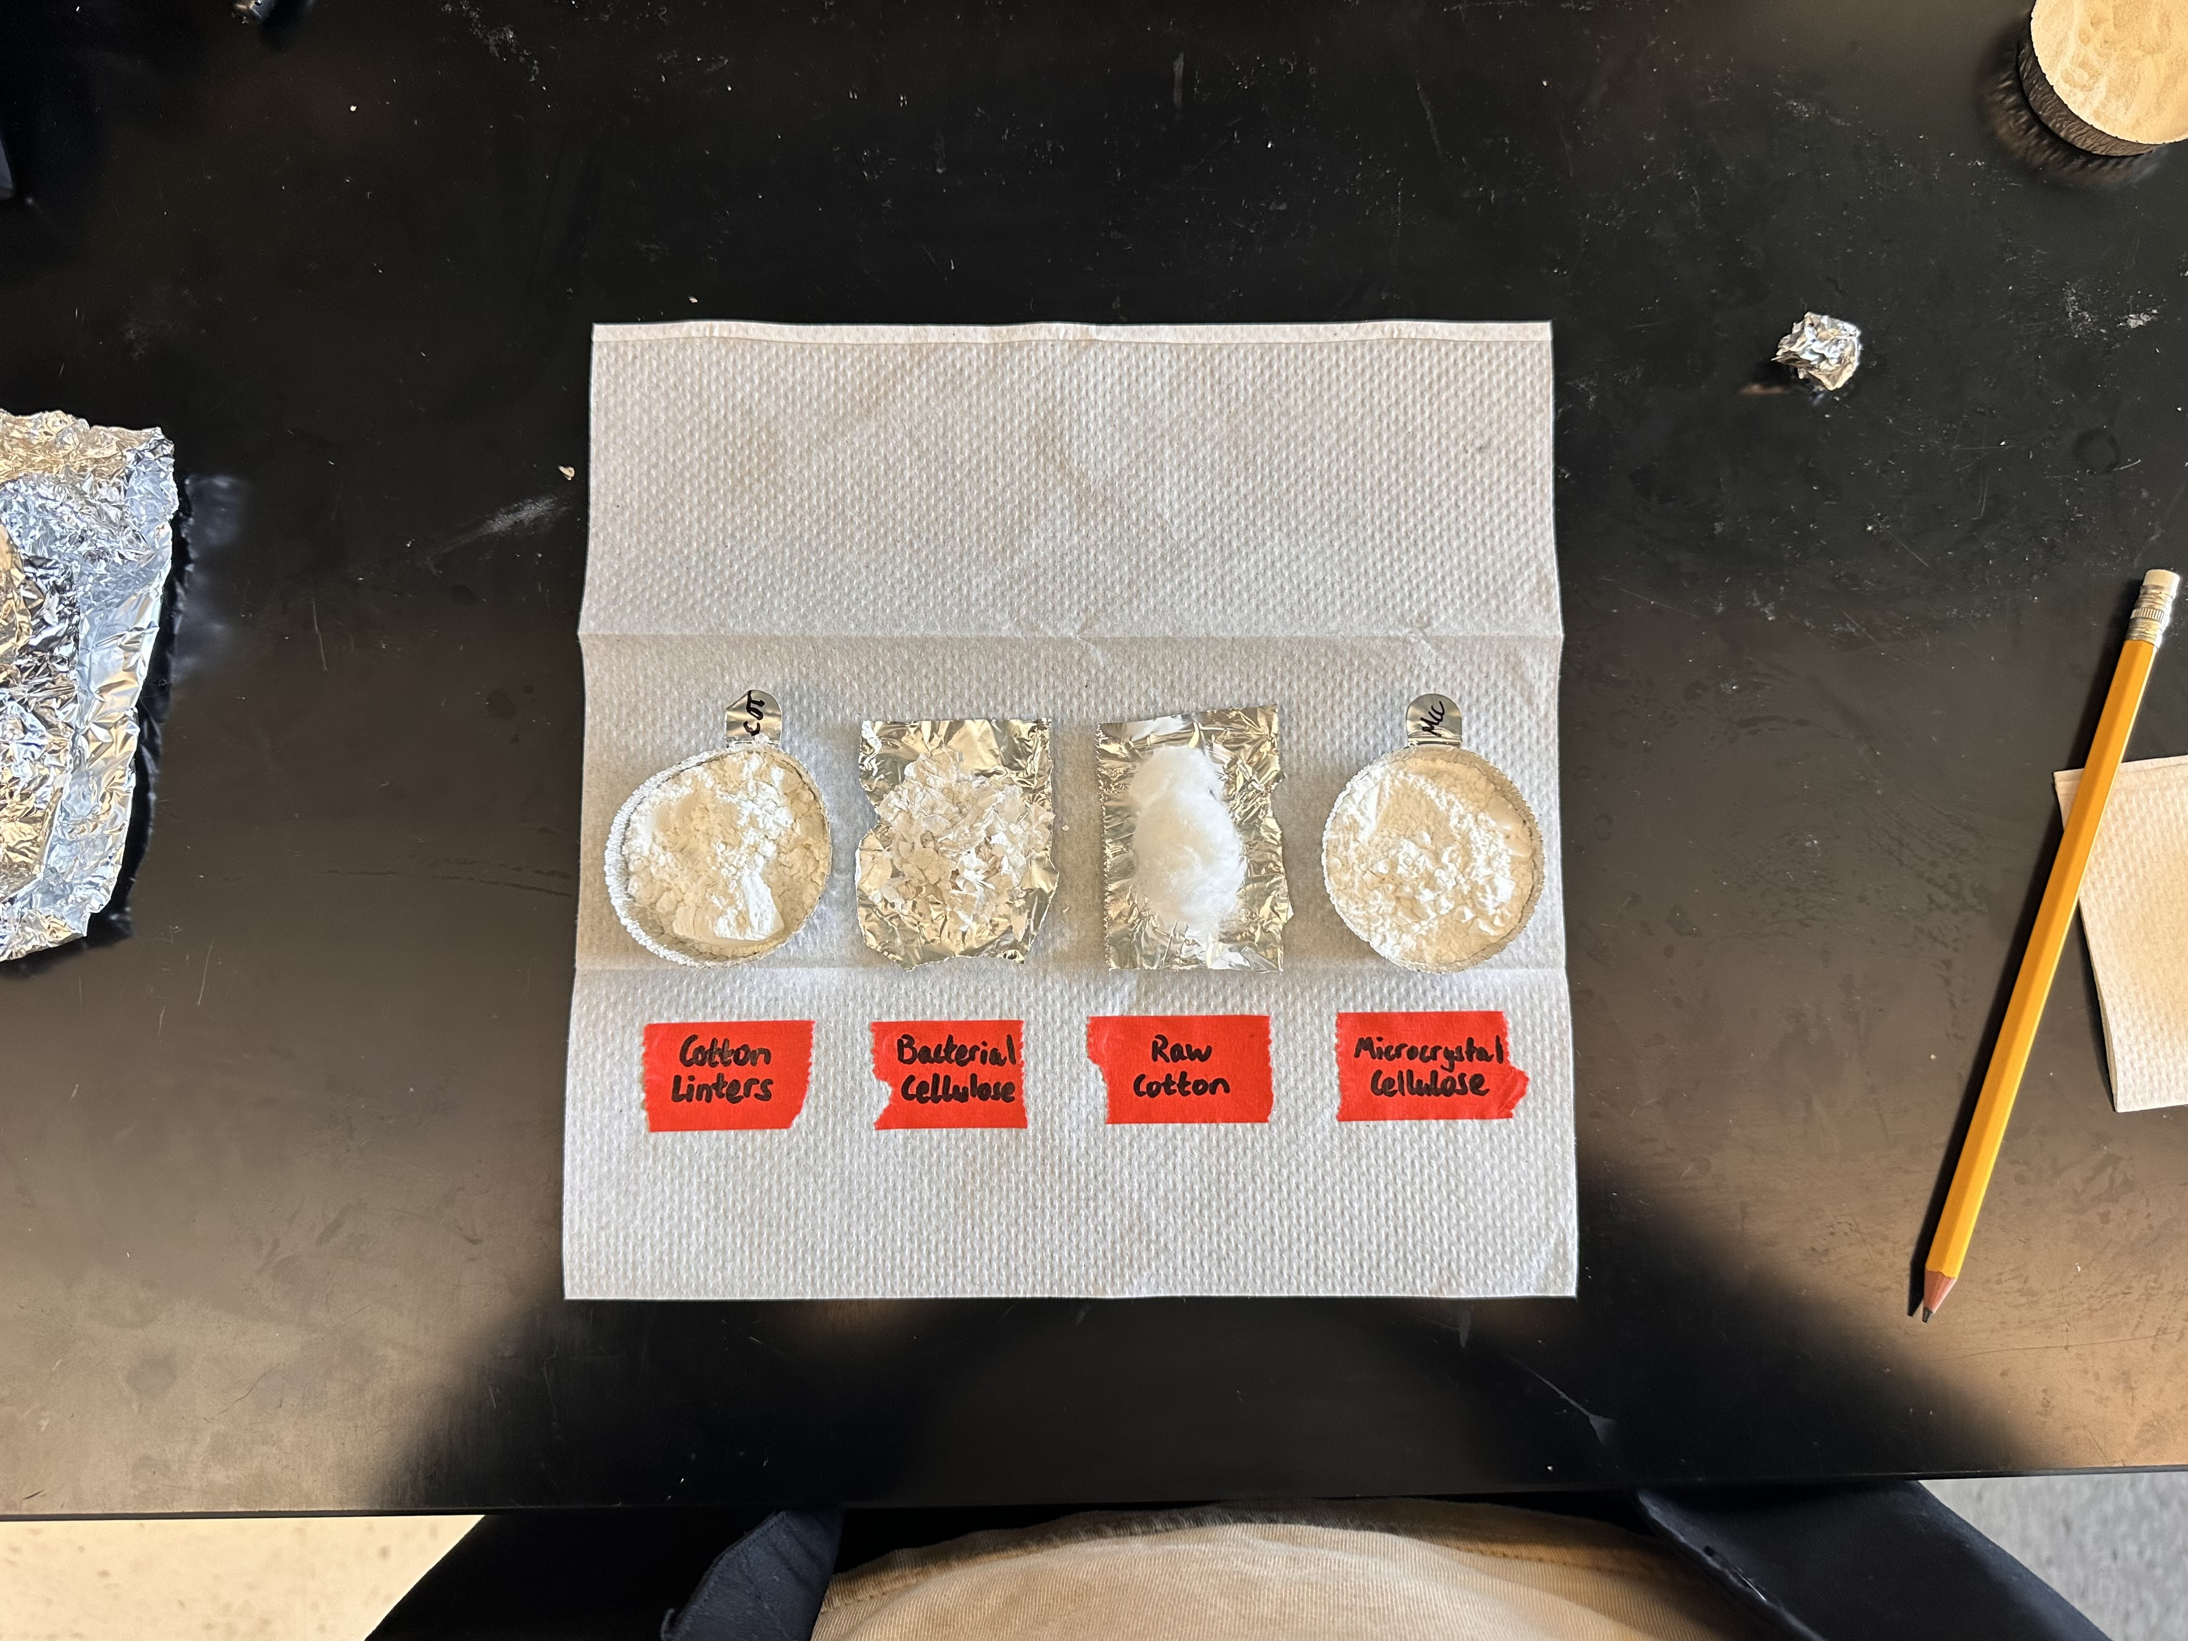
Comparison of Four Cellulose Types in EMImAc
Molecular Weight (g/mol) | 28526 | 562260 | 32933 | 18663
Degree of Polymerization | 176 | 3471 | 203 | 115
Figure 5- The four cellulose types tested with their subsequent molecular weight and DP values
Notes:
Anhydroglucose units of glucose

Slide 9
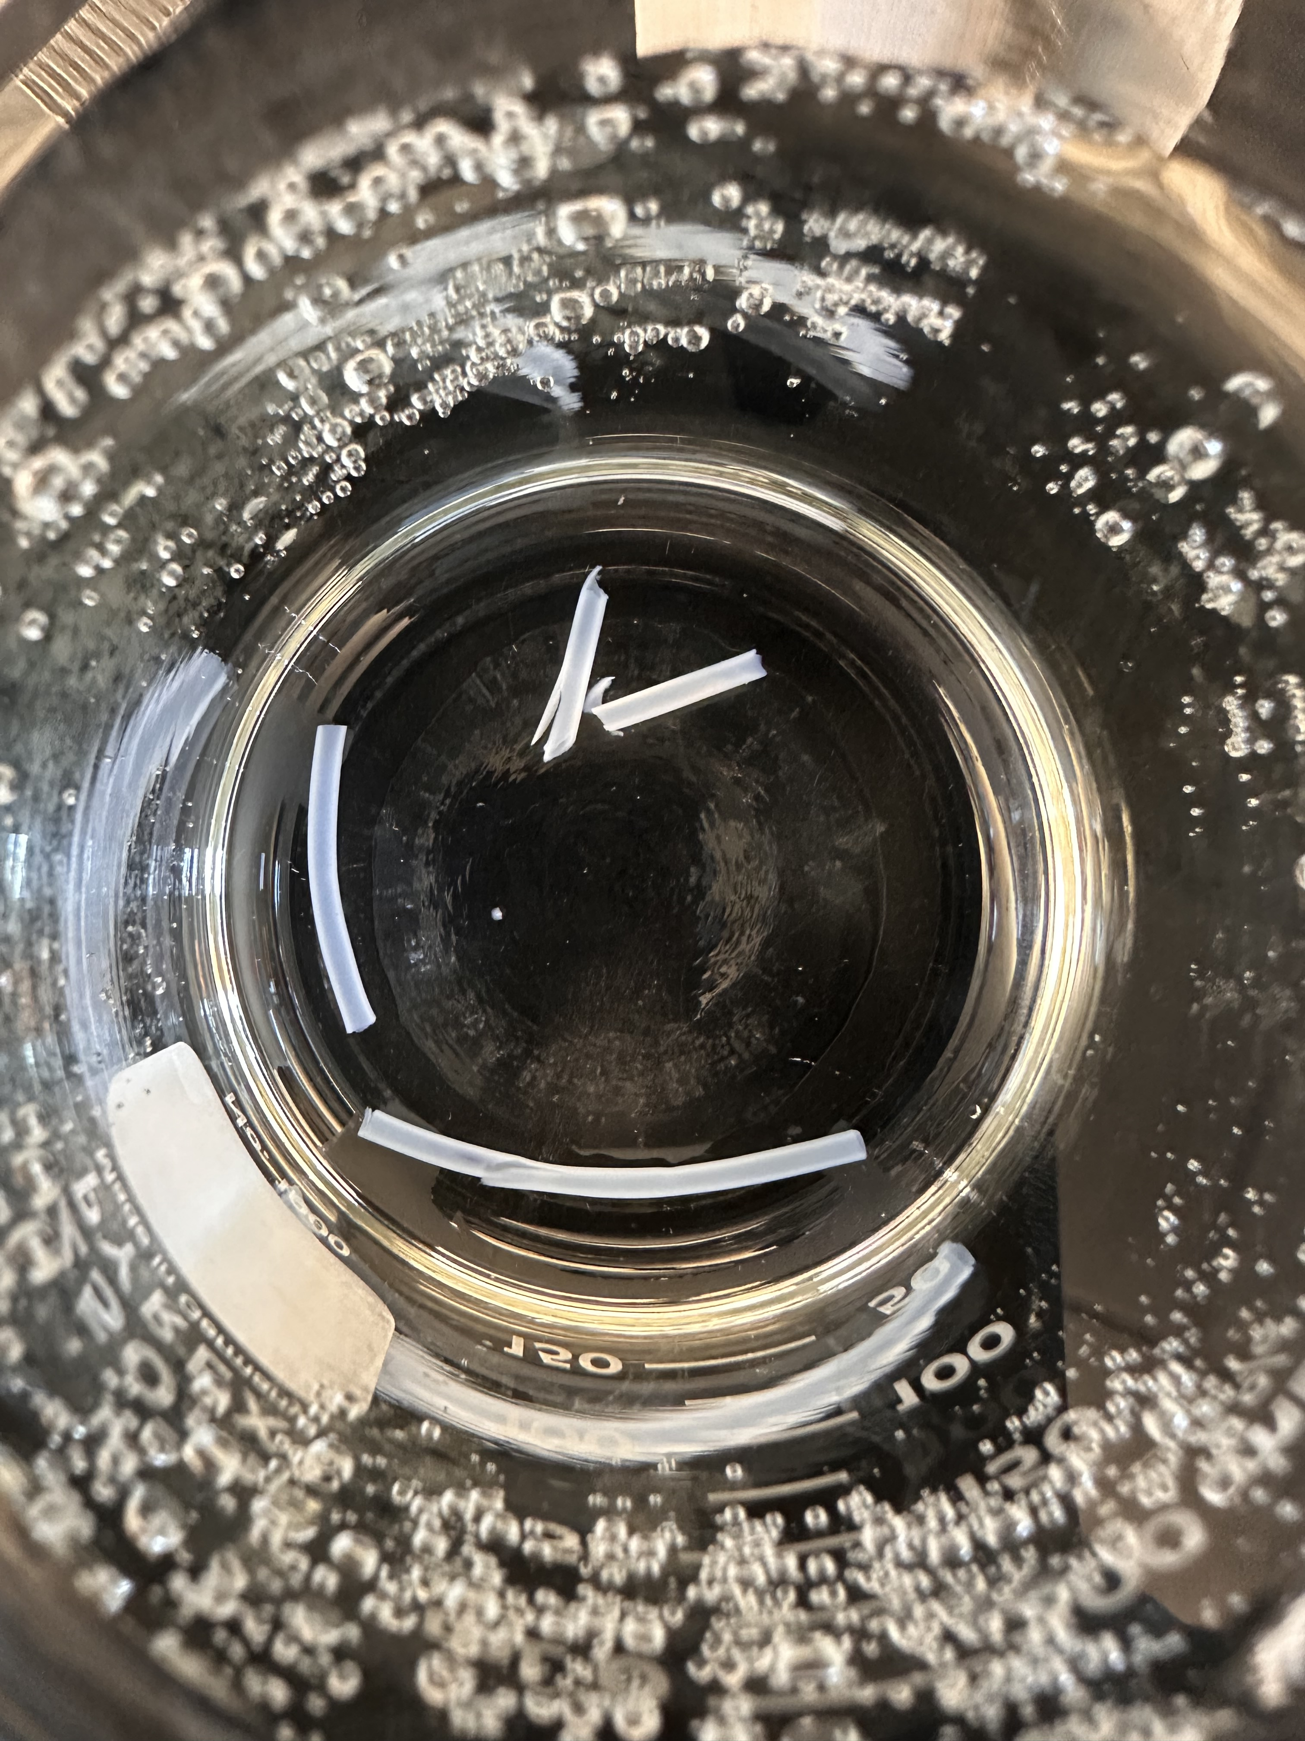
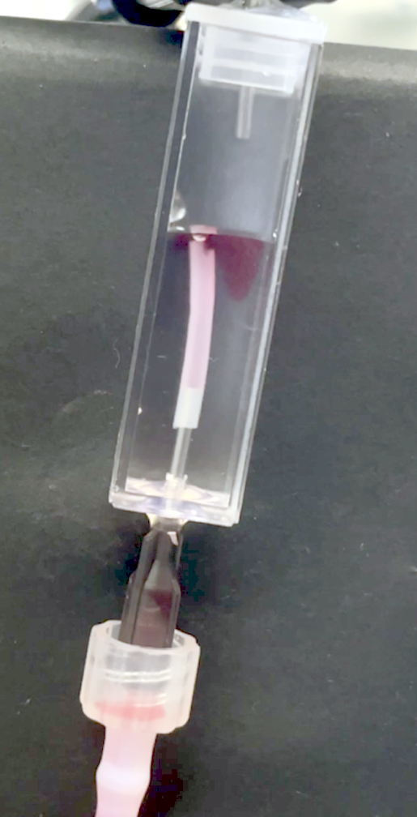
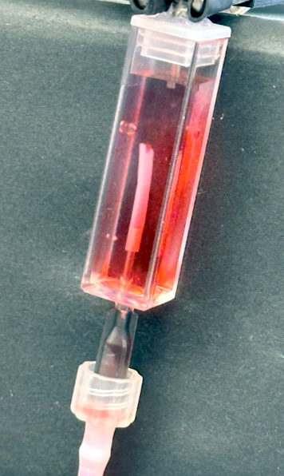
Potential Application – Cardiovascular Technologies
Figure 6- 1.62 mm-in-diameter synthetic blood vessels hydrated in distilled water.
Figure 7- Red food coloring being pumped through synthetic blood vessel

Slide 10
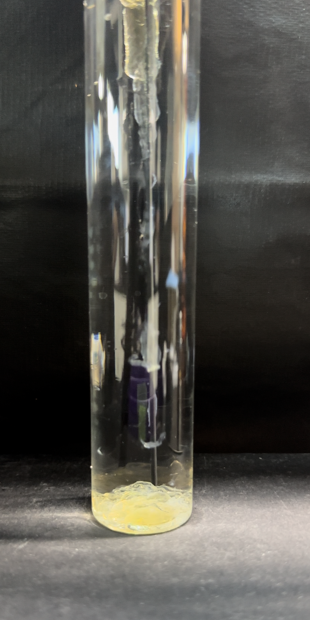
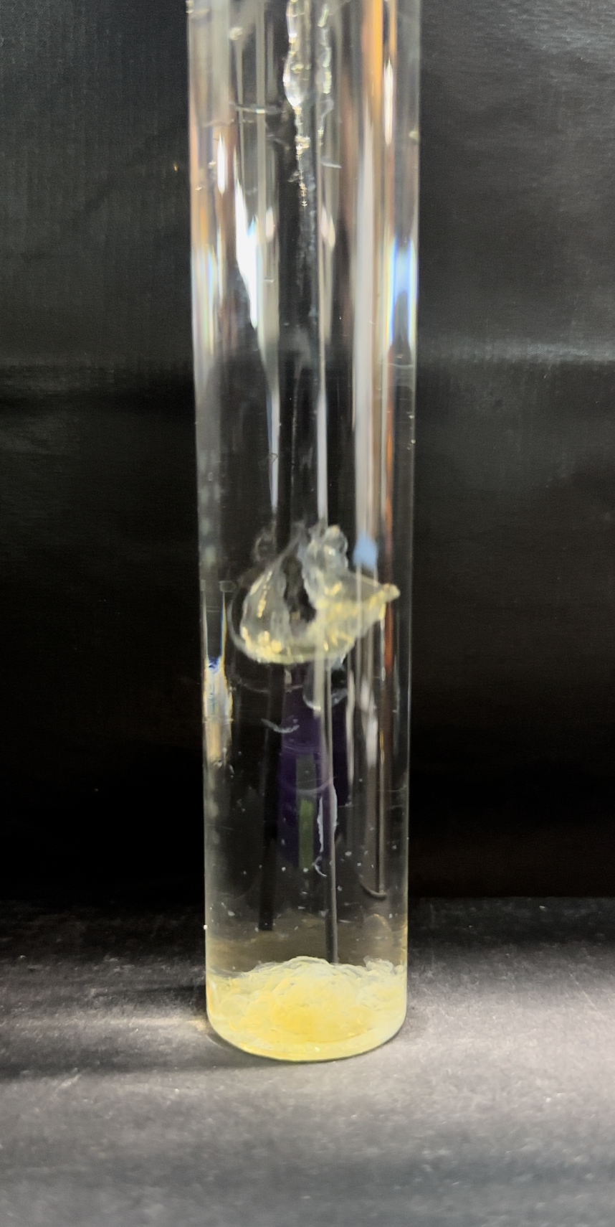
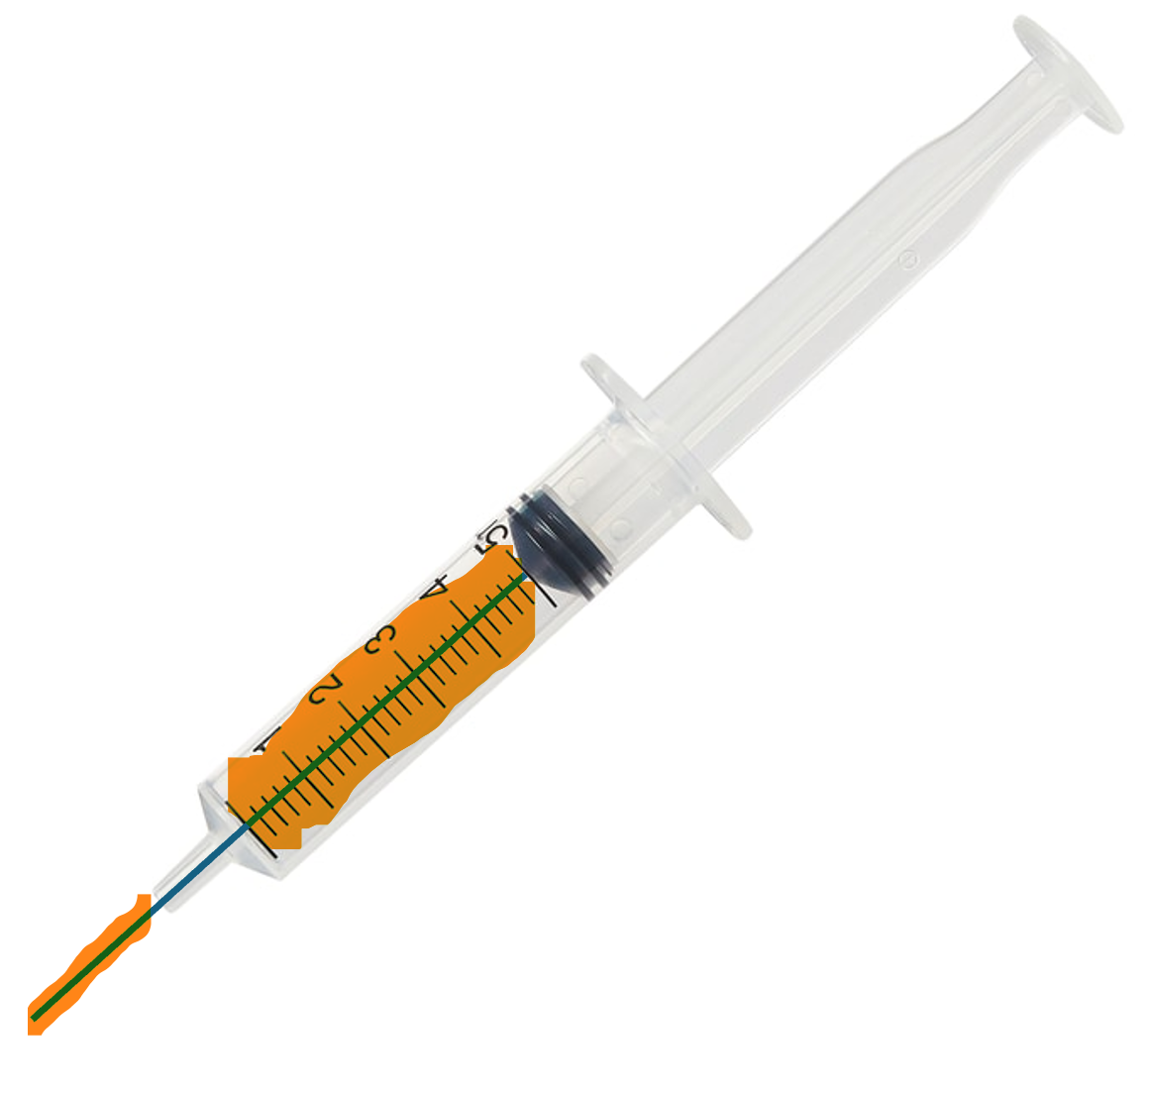
Potential Application – Cardiovascular Technologies
Figure 8- Potential method of replicating synthetic blood vessel production
Figure 9- Images taken from trial of potential method seen in Figure 8
https://www.fishersci.co.uk

Slide 11
Acknowledgements and References
This research was partially supported by NSF REU Site: Southeastern Undergraduate Internship in Nanotechnology (SUIN), under award# EEC-2349519. This work was performed at the Joint School of Nanoscience and Nanotechnology, a member of the National Nanotechnology Coordinated Infrastructure (NNCI), which is supported by the National Science Foundation (Grant ECCS-2025462).
Chen, Zixiang, et al. “Molecularly engineer protic ionic liquids for simultaneous dissolution of silk fibroin/cellulose and wet-spinning composite fibers preparation through hydrogen-bonding-acceptor-strengthening strategy.” ACS Sustainable Chemistry &amp; Engineering, vol. 12, no. 17, 16 Apr. 2024, pp. 6697–6708, https://doi.org/10.1021/acssuschemeng.4c00560.
Pal, S., et al. “Imidazolium-based Ionic liquid–assisted processing of natural biopolymers containing amine/amide functionalities for sustainable fiber production.” Materials Today Sustainability, vol. 14, Oct. 2021, p. 100082, https://doi.org/10.1016/j.mtsust.2021.100082.
Park, Saerom, et al. “Characterization of blended cellulose/biopolymer films prepared using Ionic liquid.” Cellulose, vol. 27, no. 9, 11 Apr. 2020, pp. 5101–5119, https://doi.org/10.1007/s10570-020-03152-3.
Rizvi, Sarmad, and Hrushikesh M. Gade. “Imidazolium-based ionic liquids as cellulose solvents: Mechanism and molecular insights.” Biomass and Bioenergy, vol. 196, May 2025, p. 107758, https://doi.org/10.1016/j.biombioe.2025.107758.
Utomo, Nyalaliska W., et al. “Determination of intrinsic viscosity of native cellulose solutions in ionic liquids.” Journal of Rheology, vol. 64, no. 5, 24 July 2020, pp. 1063–1073, https://doi.org/10.1122/8.0000015.

