Slide 1



Geometry & Synchronization in BZ Soft Gels
Anandita Pathak
PI: Suzanne Ahmed
Mentor: Emmanuel Appiah

Slide 2
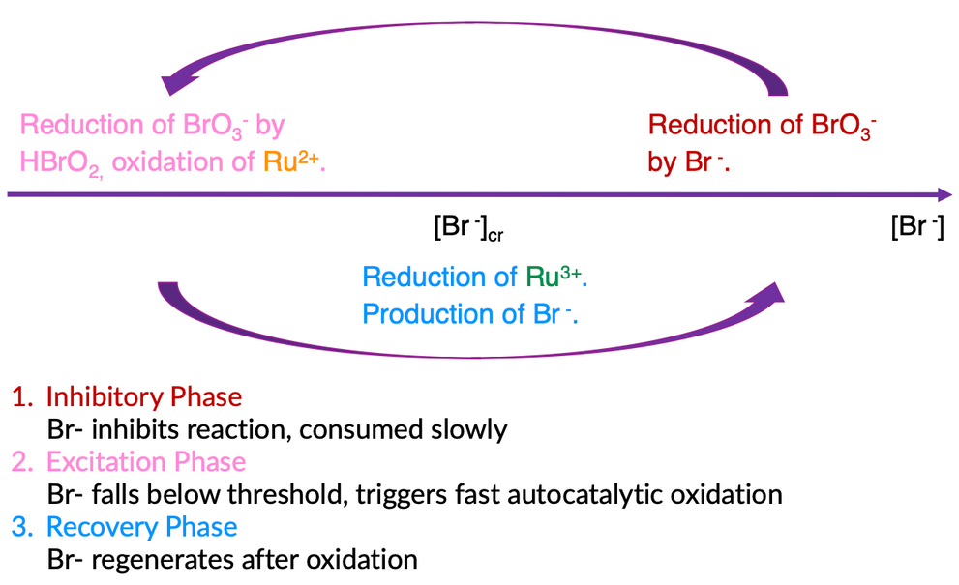
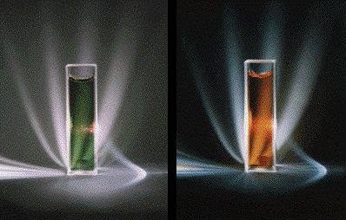
The Belousov-Zhabotinsky Reaction: A Chemical Oscillator
(Ruoff, 2023)
(Barzykina, 2020)

Slide 3
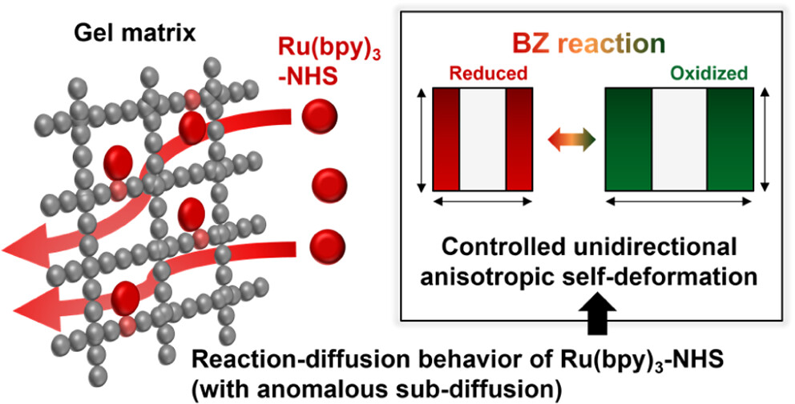
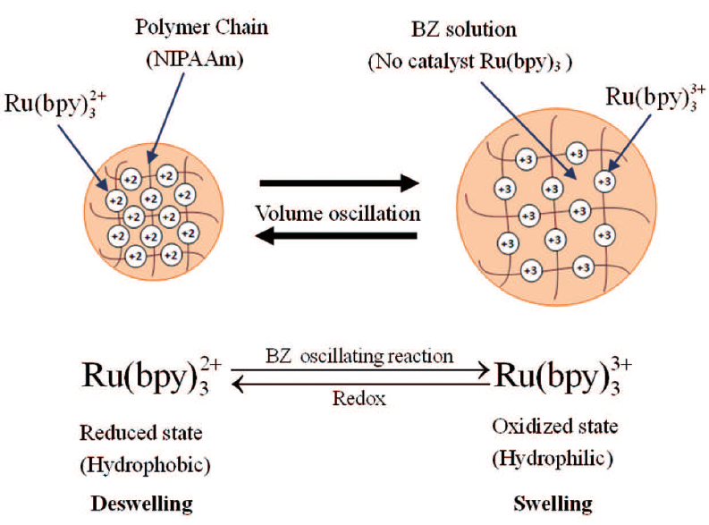
Self-Oscillating Gels
(Lee et al., 2025)
(Wang et al., 2013)

Slide 4
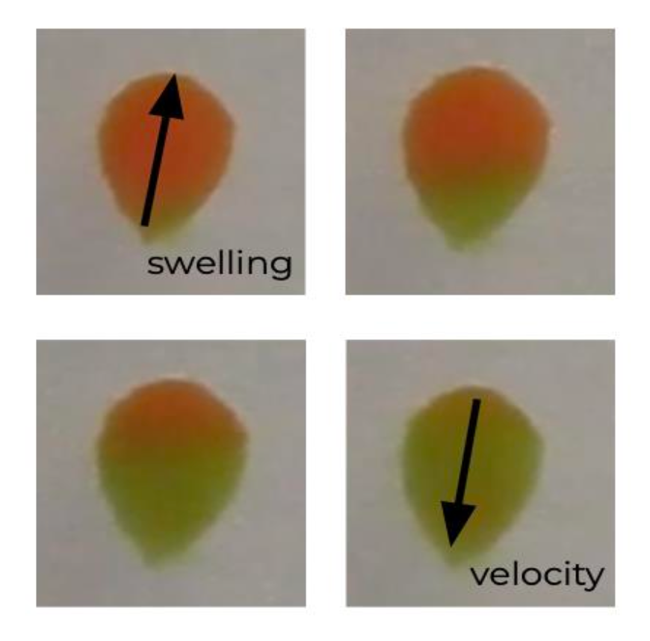
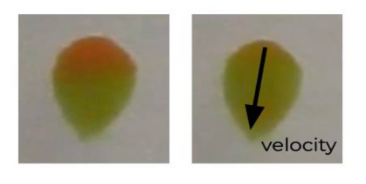
Asymmetry Drives Motion

Slide 5
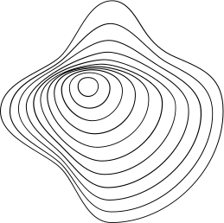
How does geometry affect wave propagation? Can gels communicate? How can we better control gel motion?

Slide 6
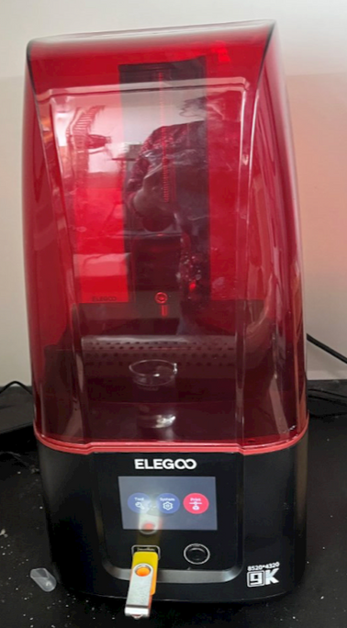
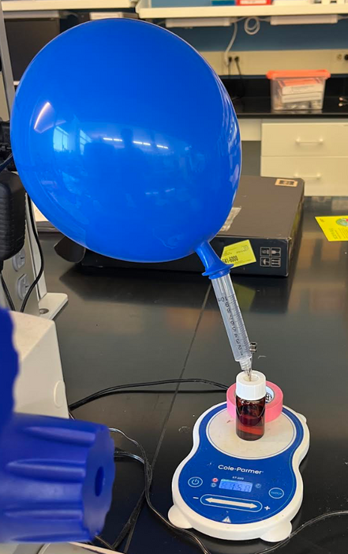
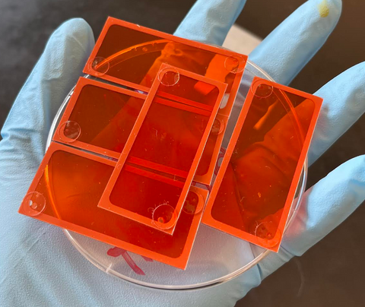
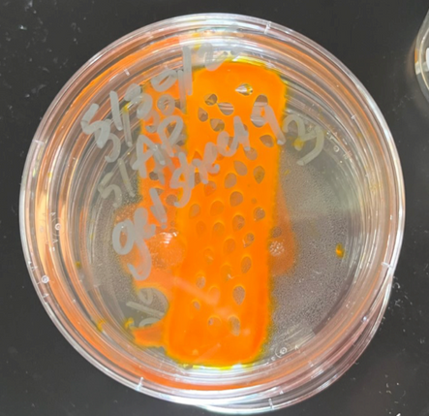
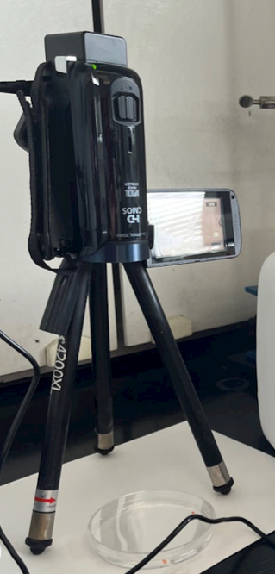
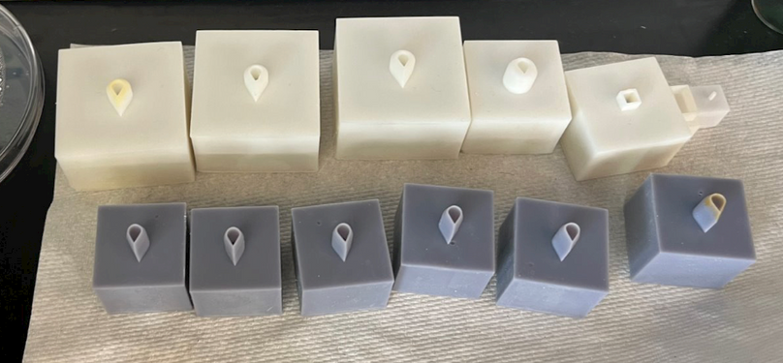
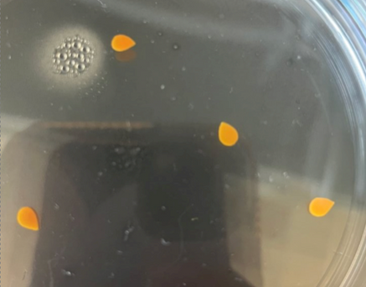
Materials & Methods
1. Design molds with 3D printer.
2. Create pre-gel solution & purify.
3. Fill sealing chambers. Cure samples. Make appropriate cuts using molds.
4. Set-up BZ reaction.

Slide 7
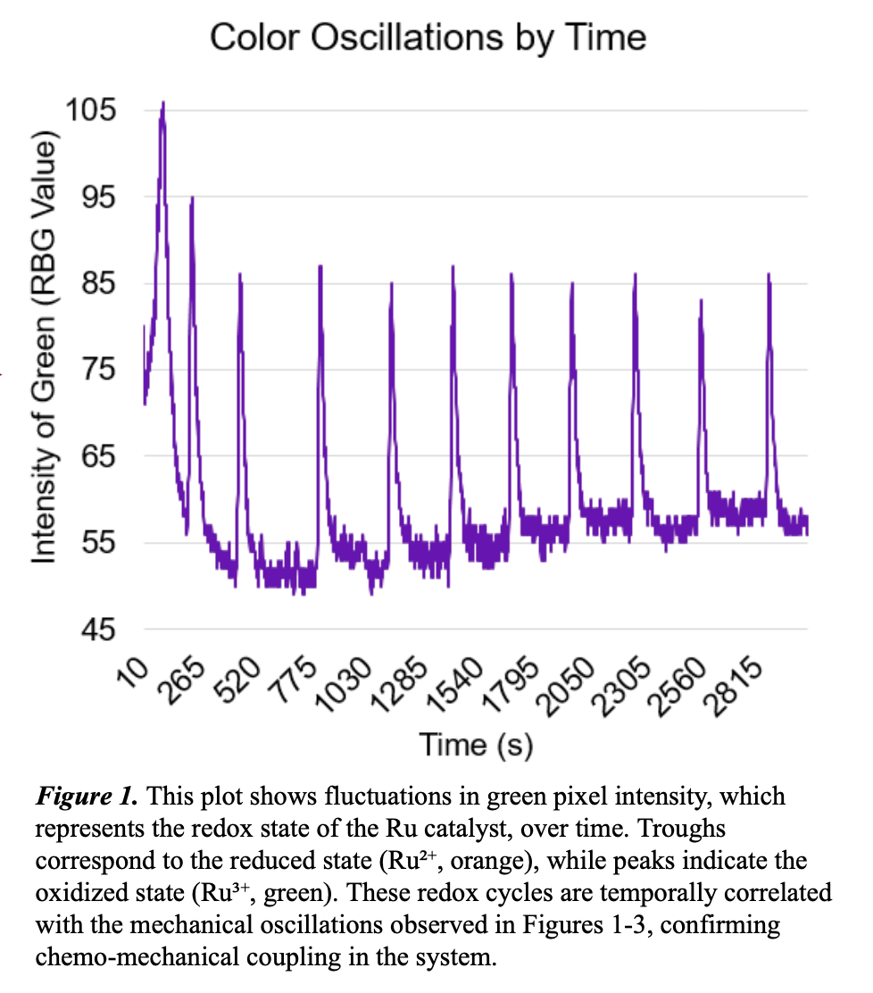
Color Oscillations by Time

Slide 8
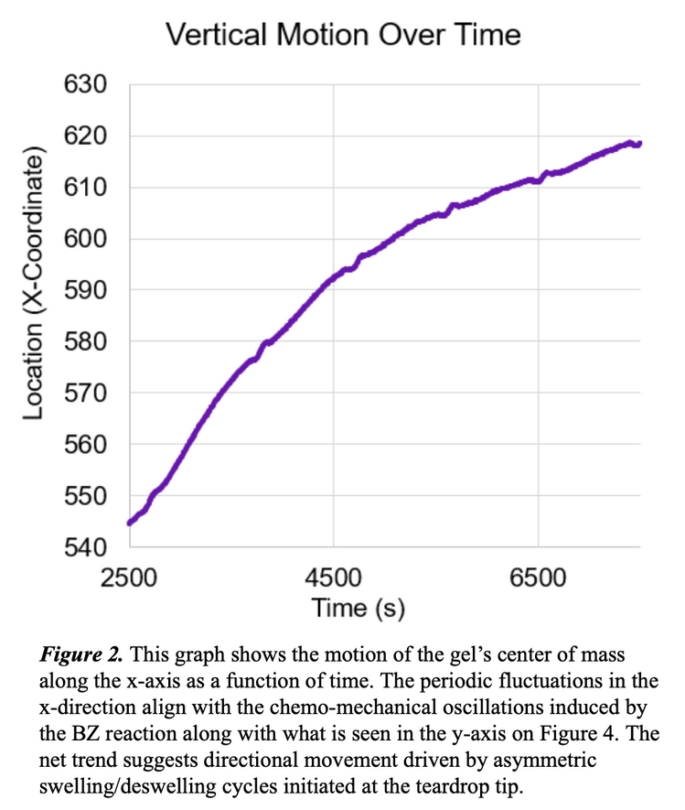
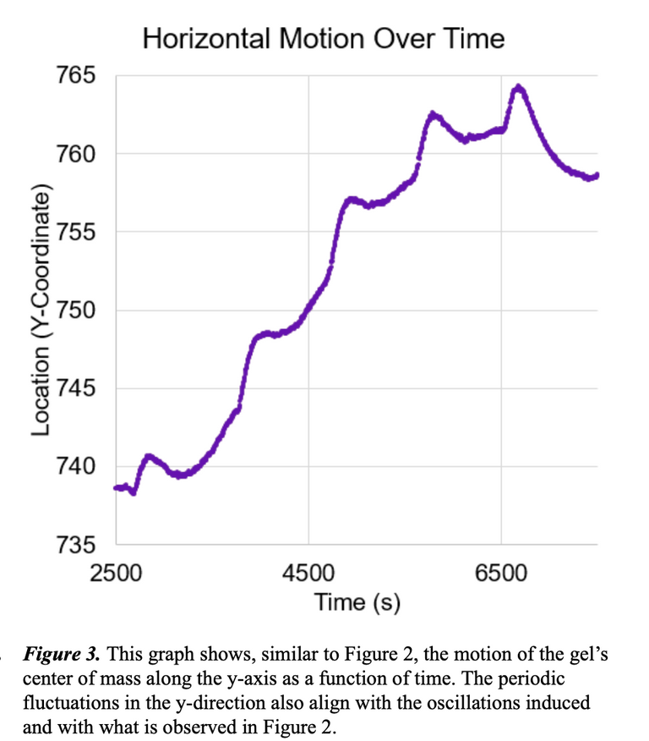
Motion Over Time

Slide 9
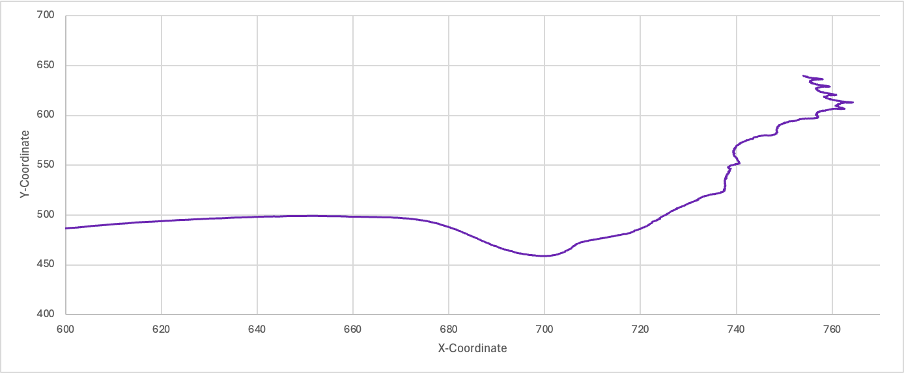
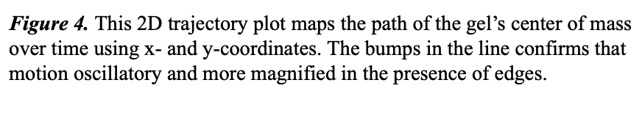
Path Over Time

Slide 10
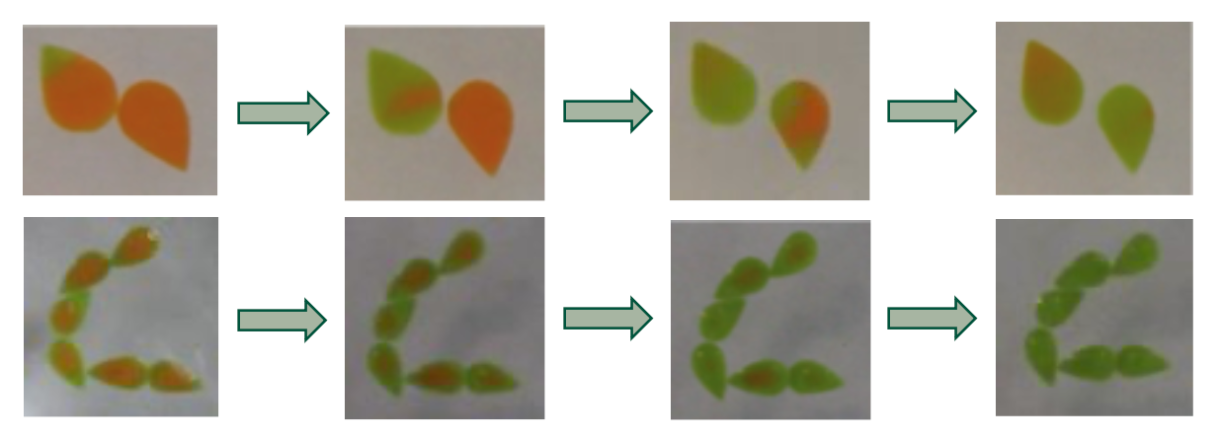
Emergent Multi-Gel Behaviors

Slide 11
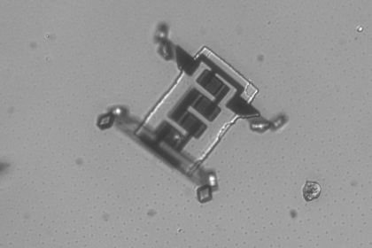
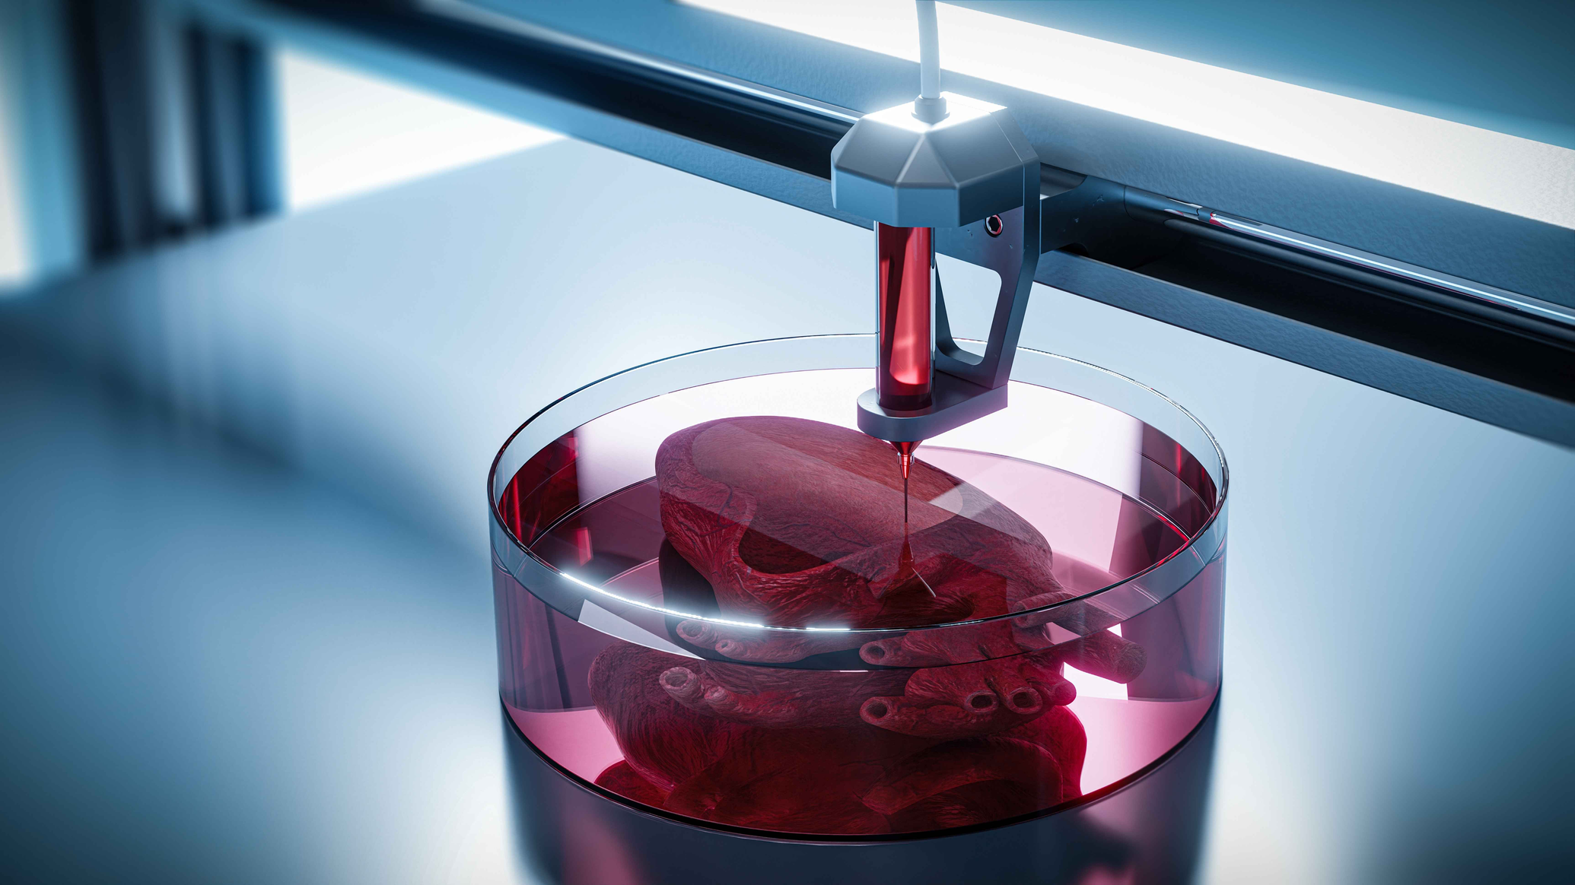
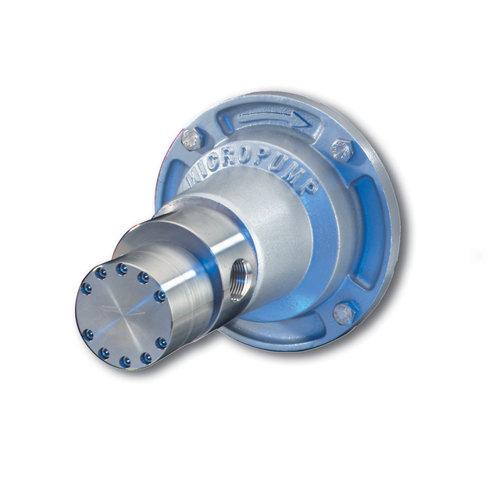
Future Work & Applications
  Shape-Tuned Motion
  Multi-Gel Synchronization & Communication
  Photo-Controlled BZ Gels
⟶ Soft Robotics
⟶ Bio-inspired Systems
⟶ Adaptive Materials
⟶ Distributed Control Networks
⟶ Minimalist Computation & Sensing
(Lerner, 2015; Crane Engineering, 2025; John Curtin School of Medical Research, 2025)

