Slide 1






Overcoming the Sabatier Limit with Ferroelectric HZO
By
Sean Sims
University of Florida
San Diego Nanotechnology Infrastructure (SDNI)
David Fenning, Nanoengineering Department, UC San Diego
Tejas Nivarty, Nanoengineering Department, UC San Diego
Presented at the 2025 NNCI REU Convocation, University of California San Diego, CA
August 4-5, 2025

Slide 2
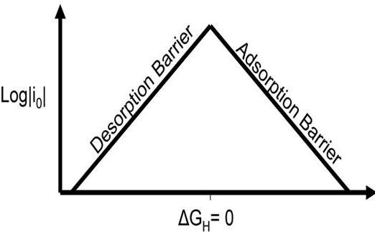
Background
H2 gas is needed in the energy sector, and for the Haber Bosch process
(which sustains ~3.5 billion people)[6]
Current H2 production via steam-methane reforming releases GHGs
Water electrolysis with catalysis is a cleaner method
Electrocatalytic process design in three stages:
  1. Reducing the process overpotential – historically limited by scaling relations
  2. Making the system durable: resistant to corrosion and decay
  3. Large scale economic feasibility
A
Zn, Fe, Ni, & Co
These metals are poor static catalysts in this realm, but may have exceptional dynamic catalytic behavior

Slide 3
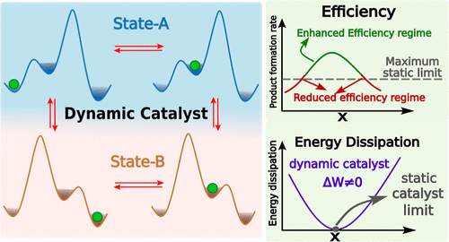
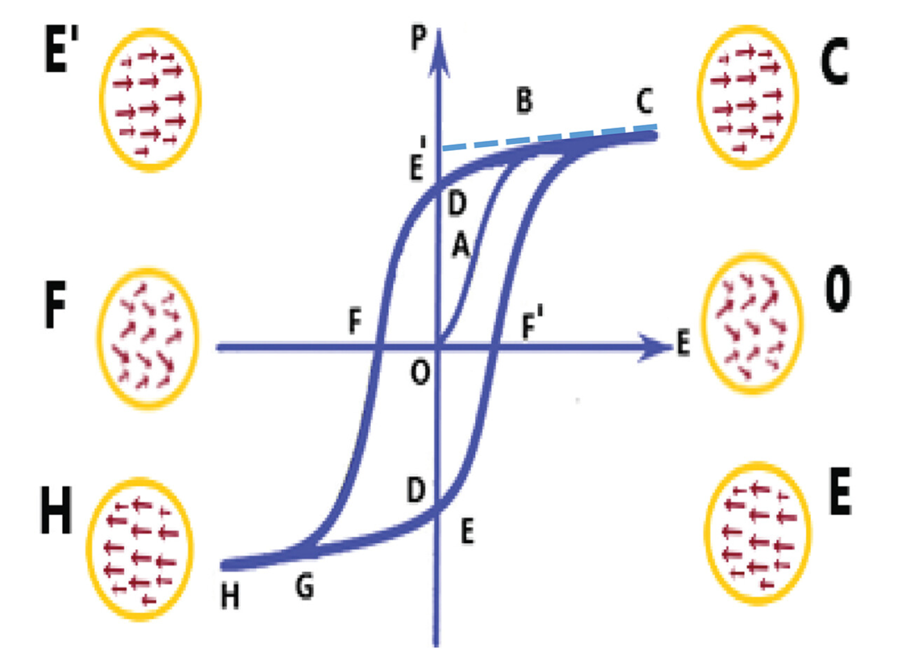
Background
Dynamic catalysis shows promise to significantly reduce the overpotential needed for H2 electrolysis, surpassing the Sabatier limit [3]
  The catalyst’s binding energy oscillates – now it can optimize two reaction steps
  An oscillating voltage applied to a ferroelectric base induces dipole changes to the catalysts anchored to its surface
  This has promising early results on BaTiO3, but it’s hard to scale
  HZO displays ferroelectric properties and is structurally & chemically stable, but hasn’t been explored as a catalytic support material in electrolysis
  This experiment tests HfZrO4 (HZO) as a single atom catalyst (SAC) support
A
B
B
Fig. 1 Sabatier Volcano plot. The peak is the performance limit of static catalysts (A) [2], a model of dynamic catalysis breaking scaling relations (B) [3], and a representation of voltage induced ferroelectric polarity switching (C) [4].
C

Slide 4
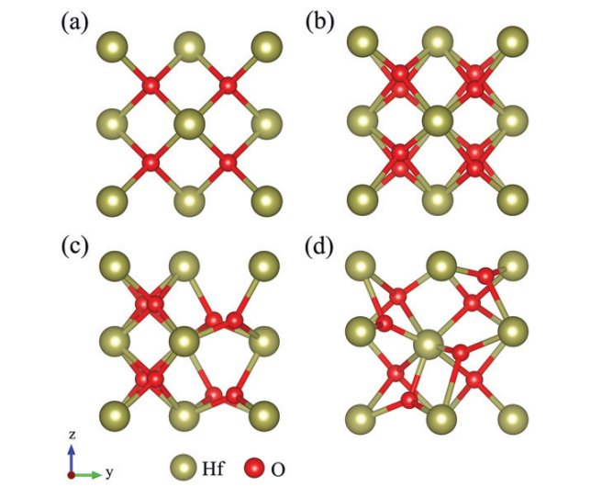
HZO
Hafnium Zirconium Dioxide (HZO)
In our case, the single atom catalyst (SAC) is bonded to defects at the top of HZO
Ferroelectric behavior of HZO expected to change charge density, and should induces dipole changes in the single atom catalyst. If the SAC clumps or forms a top layer, it is no longer as affected by the oscillating electric field & does not have dynamic behavior
A
HZO
W
P-Si
B
Fig. 2 Phase structures of HZO (A) from Chen, J. et. al., EPL, 2022, Model of catalyst with base layers (B)

Slide 5
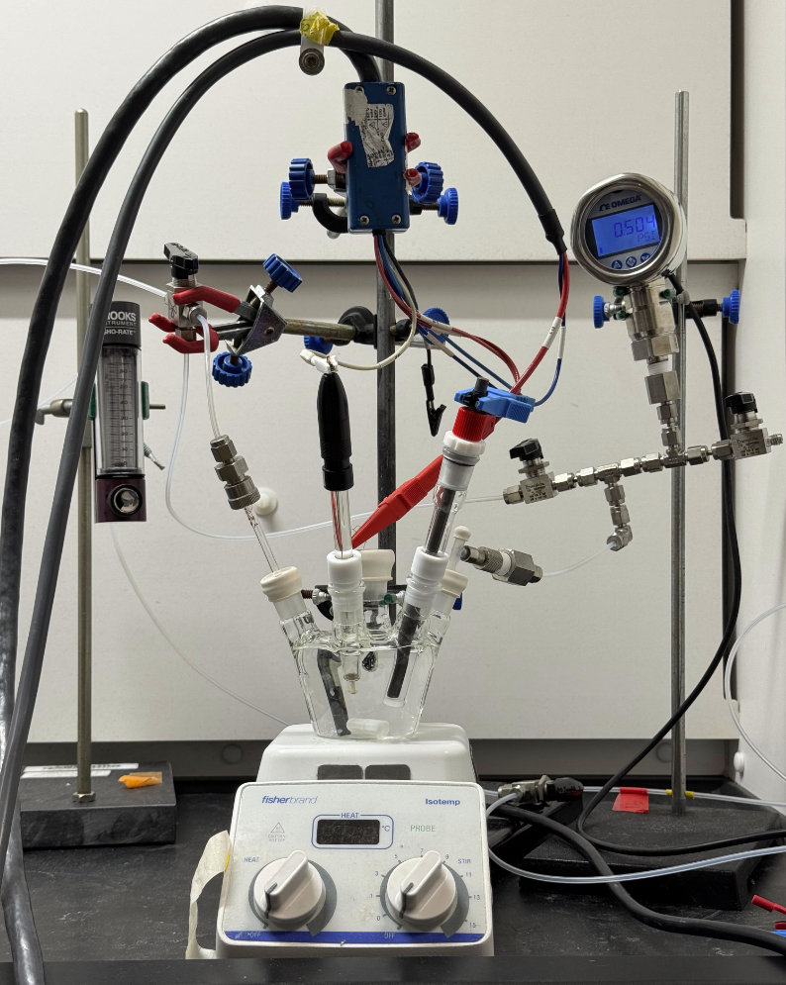
Objectives
Further dynamic catalysis of water from stage 1, towards stages 2 & 3 – durability and cost optimization
  Anchoring transition metal single atom catalysts (SACs) to HZO
  Electric chemical testing
    Characterizing device performance & durability
    Informing dynamic catalytic system design
A

Slide 6
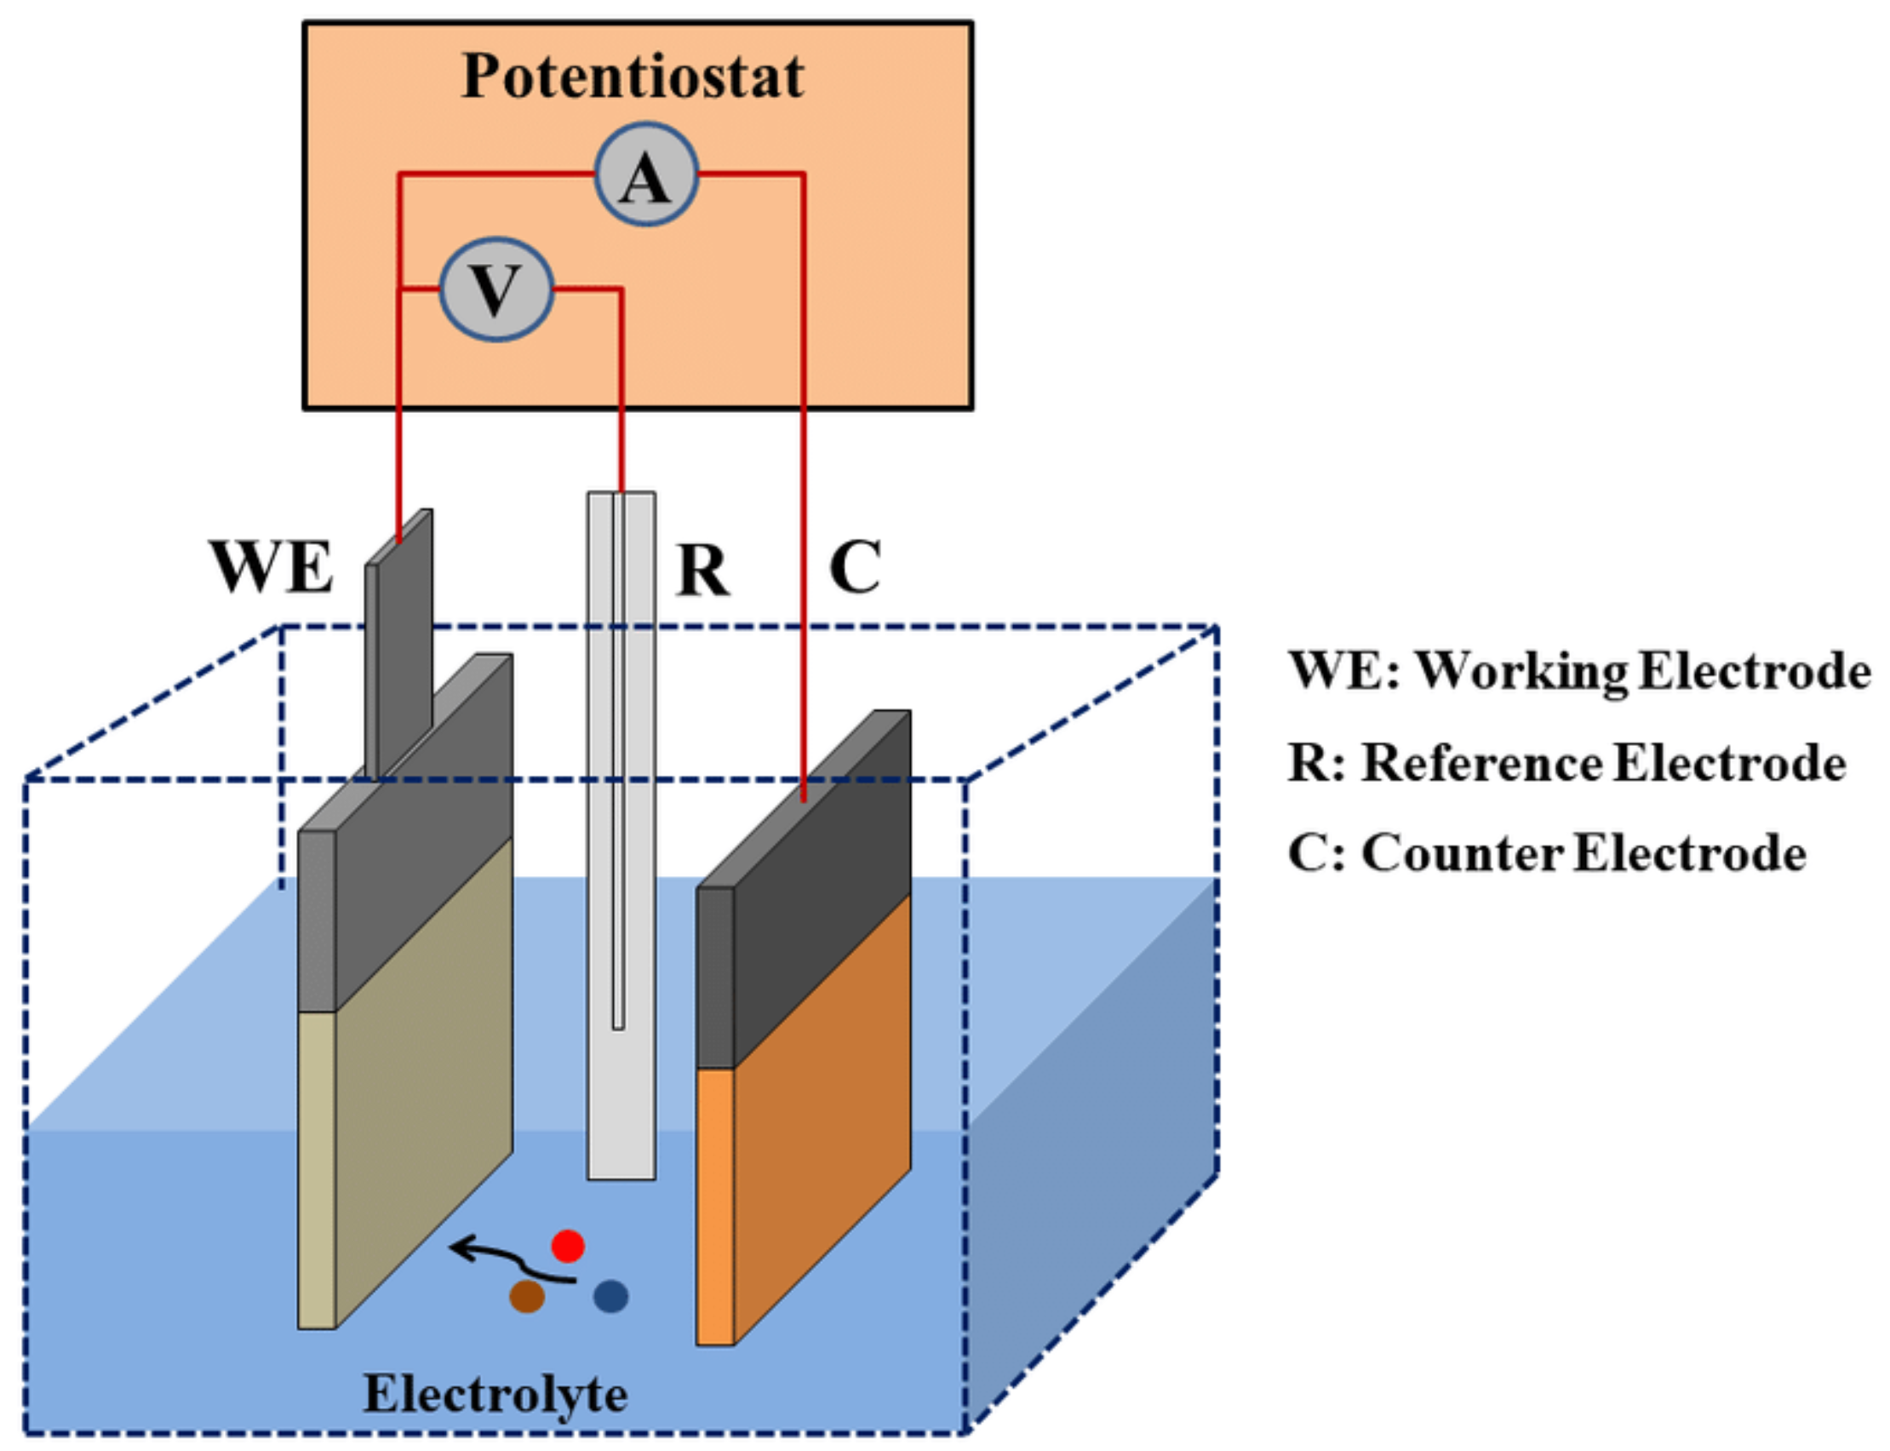
Methods
HZO is important to the semiconductor industry, so is a very well-developed atomic layer deposition processes.
Deposit HZO onto a conductive Tungsten layer above a P-doped Silicon layer, via 30 cycle atomic layer deposition.
Electrodeposition deposits single-atom metal catalysts onto surface defects (such as oxygen vacancies) of HZO using an electrolytic cell [1].
  Tune the energy system so that it’s thermodynamically favorable for the catalyst to reduce onto defects, but not form nanoclusters [1]
B
Table I: Three electro-chemical testing methods
Chronoamperometry (CA) | Cyclic Voltammetry (CV) | Electrical Impedance Spectroscopy (EIS)
Current response to a sudden, constant voltage | Current response to a sweeping voltage | Characterizing system response to a range of AC frequencies
Fig. 3 (A) The electrolytic setup, photo from Tejas Nivarty, and a representation of electrodeposition using this setup for SAC electrodeposition (B) (Mediterranean Journal of Chemistry 2019, 7(6), 433-451)

Slide 7
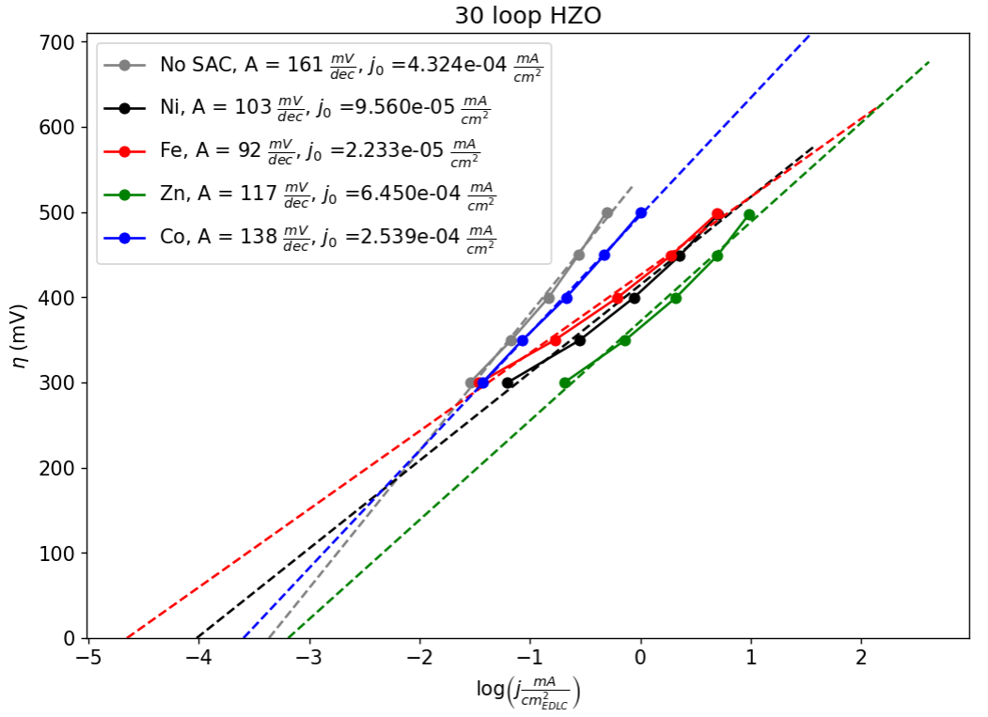
Catalytic performance
Fig. 5 Tafel plots comparing the performance of each catalyst tested, and the control – a HZO support. Ni, Fe, and Zn catalyst depositions perform better than the control. Co performs similarly to the control, indicating that deposition did not work for Co.

Slide 8
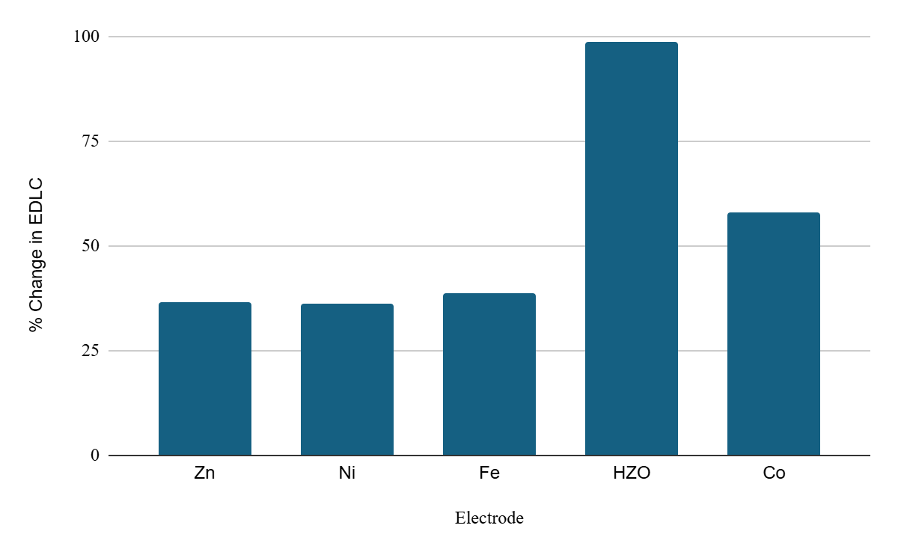
Catalytic performance
Fig. 6 Change in Electric Double Layer Capacitance (EDLC). A change near 100% indicates a large change in surface area, and potential degradation. Zn, Ni, and Fe catalyst depositions passivated defects, likely increasing longevity. Co didn’t deposit as well, which is why its surface area changed more and is at higher risk of degradation.

Slide 9
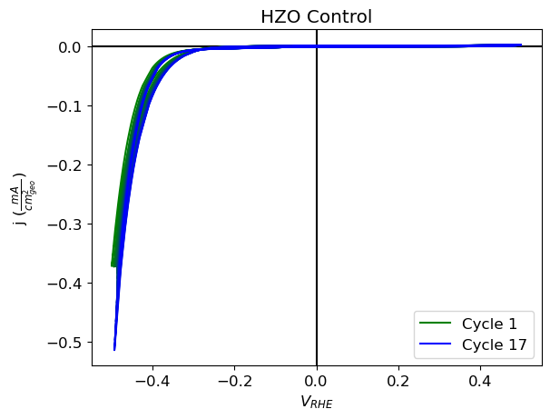
Catalytic performance
Fig. 4 (A) CV testing in the hydrogen evolution reaction (HER) window on the control: a HZO base fully exposed to water

Slide 10
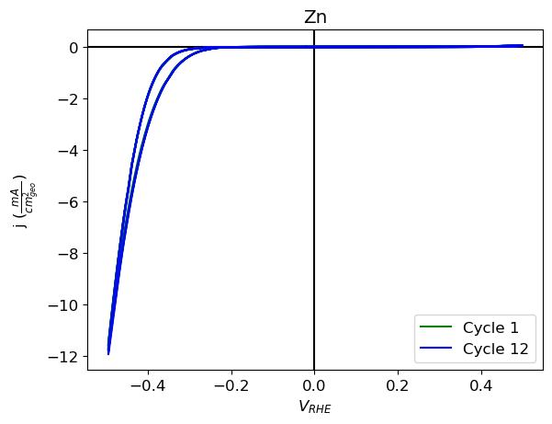
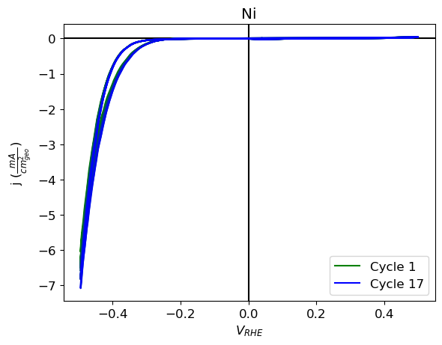
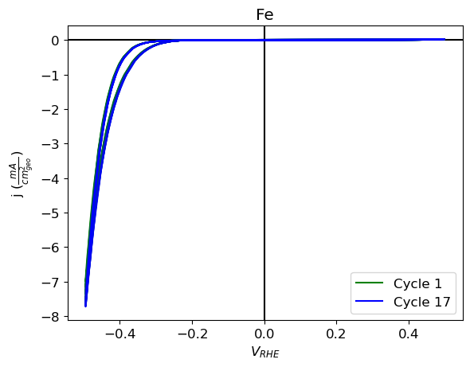
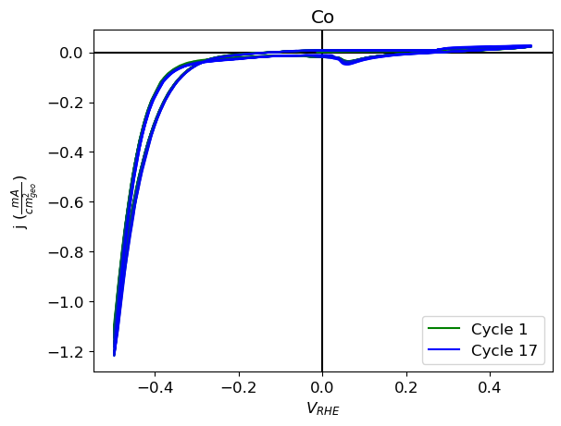
Catalytic performance
B
A
C
D
Fig. 7 Cyclic Voltammetry signatures of Zn (A), Ni (B), Fe (C), and Co (D) depositions. Zn, Ni, and Fe depositions induce HER better than the control, and had CV signatures comparable before and after testing. Co induces some secondary reduction around 0.05V.

Slide 11
Conclusion
HZO shows promise as a support structure for SAC dynamic catalysis
Electrodeposition successfully anchored catalysts to HZO, which showed static catalytic performance of HER
  When transition metals successfully deposit onto HZO, they display durability under testing
  Depositions passivate surface defects that otherwise induce degradation under electrochemistry
While Zn, Ni, and Fe are unideal static catalysts in this realm because they’re on a lower side of the Sabatier volcano plot, they may have exceptional performance as dynamic catalysts.
Next Steps: Run microscopy to characterize the catalytic surface. Anneal a HZO base to induce ferroelectric properties, deposit SACs, and run dynamic catalytic testing. Optimize the Oxygen Evolution Reaction – the rate-limiting step in water electrolysis.

Slide 12
References
References:
[1] Zhang, Z., Feng, C., Liu, C. et al. Electrochemical deposition as a universal route for fabricating single-atom catalysts. Nat Commun 11, 1215 (2020). https://doi.org/10.1038/s41467-020-14917-6
[2] Singh, A., Monga, S., Sharma, N., Sreenivas, K., & Katiyar, R. S. (2022). Ferroelectric, Piezoelectric Mechanism and Applications. Journal of Asian Ceramic Societies, 10(2), 275–291. https://doi.org/10.1080/21870764.2022.2075618
[3] Pankaj Jangid, et al. “Theoretical Understanding of Dynamic Catalysis.” The Journal of Physical Chemistry C, vol. 128, no. 22, 23 May 2024, pp. 9077–9089, https://doi.org/10.1021/acs.jpcc.4c02713. Accessed 30 July 2025.
[4] Singh, A., Monga, S., Sharma, N., Sreenivas, K., & Katiyar, R. S. (2022). Ferroelectric, Piezoelectric Mechanism and Applications. Journal of Asian Ceramic Societies, 10(2), 275–291. https://doi.org/10.1080/21870764.2022.2075618
[5] Yang, Lixia, et al. “Fabrication and Characterization of Pt/C−TiO₂Nanotube Arrays as Anode Materials for Methanol Electrocatalytic Oxidation.” Energy & Fuels, vol. 23, no. 6, 7 May 2009, pp. 3134–3138, https://doi.org/10.1021/ef900039w. Accessed 30 July 2025.
[6] Ritchie, Hannah. “How Many People Does Synthetic Fertilizer Feed?” Our World in Data, Nov. 2017. ourworldindata.org, https://ourworldindata.org/how-many-people-does-synthetic-fertilizer-feed.

Slide 13
Acknowledgements
I would like to sincerely thank:
The National Science Foundation
Our host, University of California San Diego
San Diego Nanotechnology Infrastructure (SDNI)
Dr. David Fenning, Faculty PI
Yves Theriault, SDNI Executive Director, Education and Outreach
Yuhwa Lo, SDNI Faculty Director
Thank you Tejas Nivarty for vital support and guidance. Thank you Sean Lin for fabricating HZO against all odds.
The audience for listening and for their time!
This program was supported by NSF grant ECCS 2025752

