Slide 1




AmoeBot : A Soft Robotic Platform for Active Matter and Autonomous Behavior
Matthew Hernandez, Adams State University
John Hardy, Northern Arizona University
Carlo daCunha, Northern Arizona University
1
Notes:
Hello everyone my name is Matthew Hernandez Im from adams state and this summer I spent my time at Northern Arizona working under Professor Carlo daCunha and my mentor John Hardy.
Today I will be presenting about the AMOEBOT which is a platform that will be used to learn about self-coordination

Slide 2
Outline
Introduction
  Active matter & self-coordination
Methods
  Nitinol Wire test
  Polypyrrole Test
Results
  Movement?
Future improvements
2
Notes:
First Here is a quick outline of the topics I will cover during this presentation. The introduction, methods, results, and future improvements

Slide 3
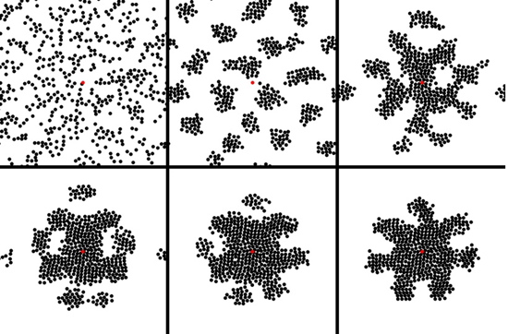
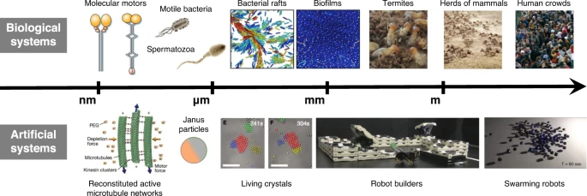
How does active matter achieve self-coordination?
Self-coordinating
Active matter
Fig 1. Active matter sizes
Fig 2. Self-coordination with shapes
David Breen. Geometric Biomedical Computing Group. Drexel University. | Stackhouse, B. et al. (2022). 3D bioprinting of a Mars analog soil for human life support systems. Nature npj Microgravity, 8(1).
3
Notes:
How does active matter achieve self coordination?
in nature you will often see self-coordination which leads to efficiency adaptiveness and resilience.
to start I want to give a little background as to what active matter and self-coordination means
Active matter in basic terms describes a living or nonliving system that consumes energy and generates a force autonomously. On screen I included a few systems both biological and artificial to give a better idea. this diagram also shows scale in order to highlight how active matter exist in many length.
https://www.nature.com/articles/s41526-022-00230-7/figures/1
https://pubs.rsc.org/en/content/articlehtml/2020/sm/d0sm90137g
Self-coordination is the ability of a system to organize and/or synchronize its actions without external control or commands.
https://www.cs.drexel.edu/~deb39/geom_biomed_comp.html

Slide 4
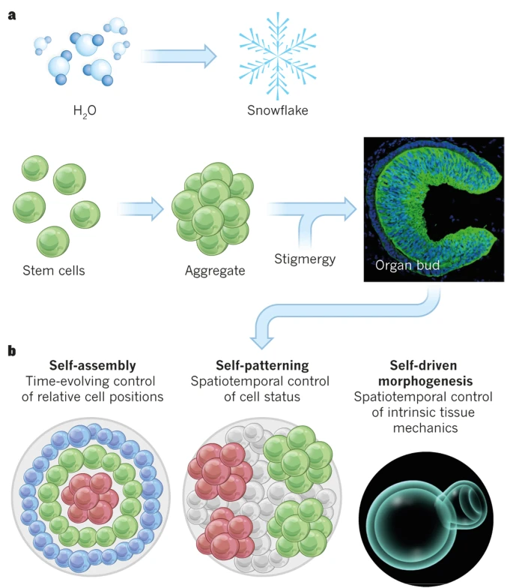

Self-Coordination seen in nature
Self-coordination in nature allows for flocks of birds or schools of fish to function. (Hemelrijk and Hildenbrandt, 2012).
Cells also exhibit self-coordination (Sasai Y., 2013).
Fig 3. Flock of birds
Fig 4. Cells using self-organization
Mrosovsky, N. et al. (2013). Circadian rhythms and depression: human and animal studies. Nature, 493, 498–503. | How flocks of birds are able to fly close together. (n.d.). BBC Wildlife Magazine.
4
Notes:
I do want to expand a little more on self coordination to give a better idea
A very common example of self-coordination in nature is a flock of birds or a school of fish. They don't have a leader telling them where to go instead each individual follows the movement of their neighbors resulting in complex and coordinated group behavior.
https://www.discoverwildlife.com/animal-facts/birds/how-flocks-of-birds-are-able-to-fly-close-together (bird pic)
https://pmc.ncbi.nlm.nih.gov/articles/PMC3499122/ (Hemelrijk and Hildenbrandt, 2012)
Cells also use self-coordination and example would be how they can self-organize to create larger multicellular bodies or how blood cells would move to heal a wound without needing to communicate. .
https://doi.org/10.1038/nature11859 (Sasai Y., 2013) (And also the image)

Slide 5
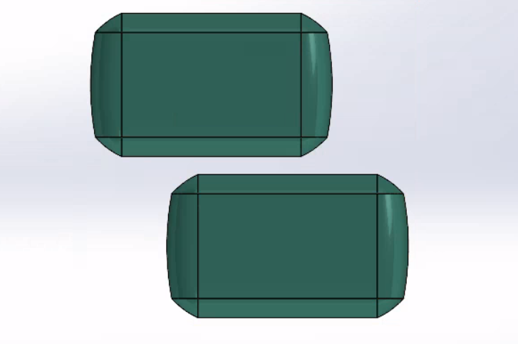
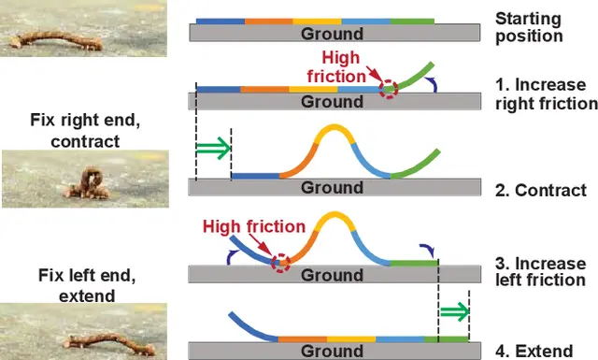
Create a platform that will help us to understand self-coordination in nature
v/s
Why is understanding and re-creating self-coordination difficult:
Methods
Imperfections
2v/s
Fig 5. Differing speeds
Fig 6. Body deformation and friction
Zhang, Y. et al. (2021). Piezoelectric soft robot: Inchworm motion by crawling, contraction, and elongation. CatalyzeX
5
Notes:
My goal of this reu was to create a platform that could be used to help us understand self-coordination in nature.
So why is understanding and re-creating self-coordination difficult?
one aspect is the method , simulations can be useful, but can overlook important variables or subtleties that are needed to understand self-coordination. Building a physical system forces those imperfection to be accounted for allowing for a more true form of self-coordination.
imperfections are a key aspect of what makes re-creating self coordination difficult. reproducing the messy unpredictable nature of the real world can be difficult. I included a few variables on screen to give an idea, things like changing speeds, material deformation, inconsistent friction, or environmental factors
https://www.science.org/doi/10.1126/science.1254295
first is the method that you choose, if you choose to use a simulation you will find limitations quickly. A simulation will fail to faithfully reproduce the variability of real life. In the end you will need a physical model to truly recreate the environment. this is because of imperfections.

Slide 6
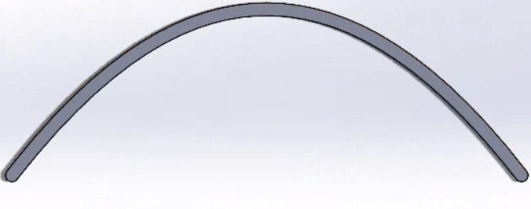
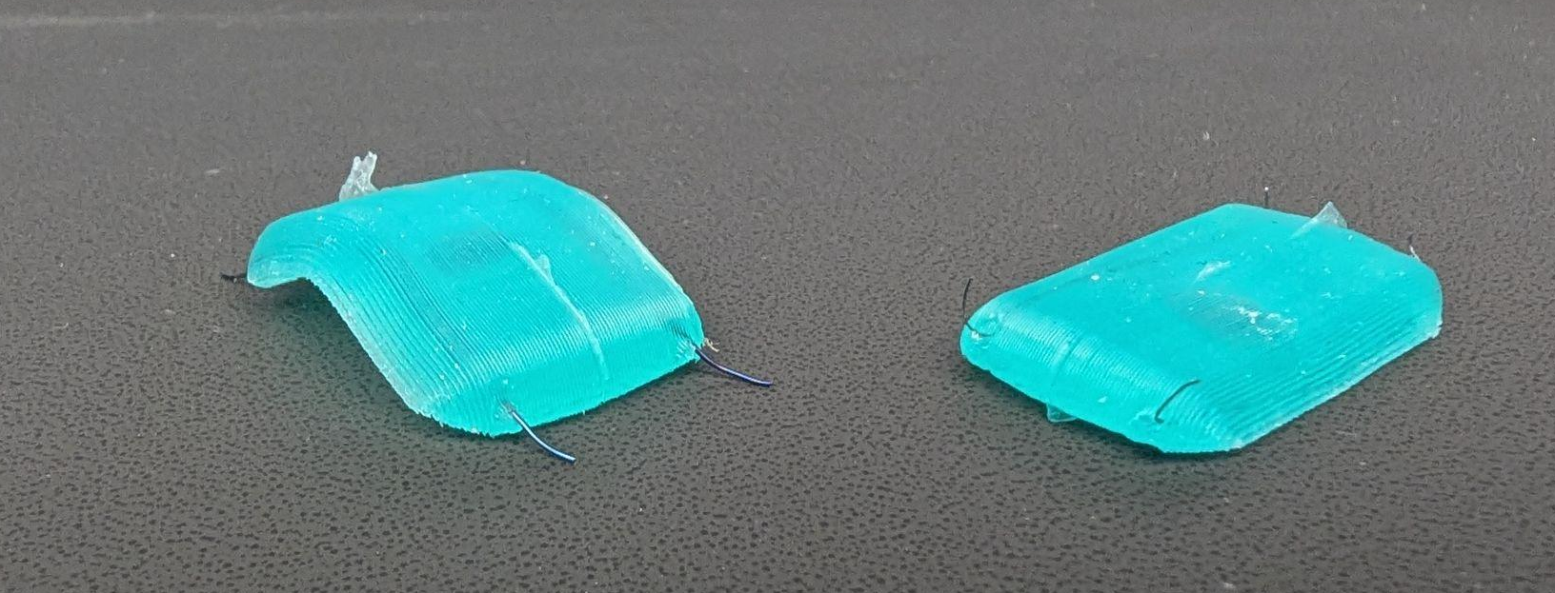
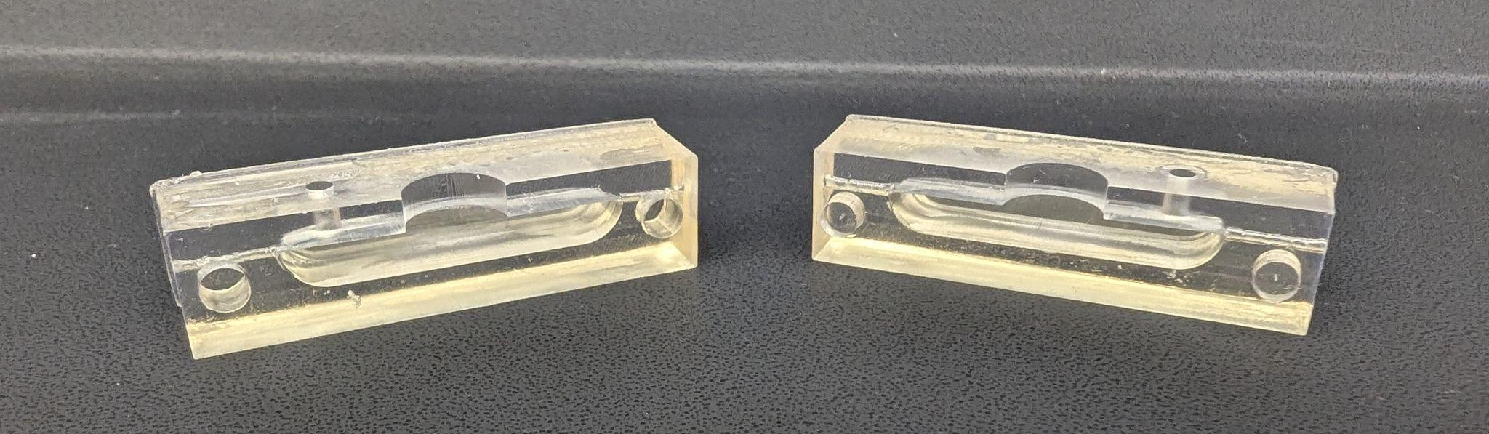
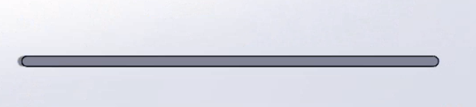
AmoeBot the soft robotic system
Bent with force
The AmoeBot
Back to original shape: Heated or electric pulse
Fig 7. Silicone Amoebot
Fig 9. Nitinol bending
Fig 8. 3D printed resin mold
6
Notes:
The Amoebot is a soft robot that serves as a physical system to experiment with self-coordination
Its body is made using silicone which is cast into a 3d printed mold
The movement of The AmoeBot comes from Nitinol Wires known as memory wire. An electric current heats the wire, causing it to contract and return to a preset shape in this case we used its properties to produce motion.
https://dynalloy.com/wp-content/uploads/2025/03/TCF1140.pdf

Slide 7
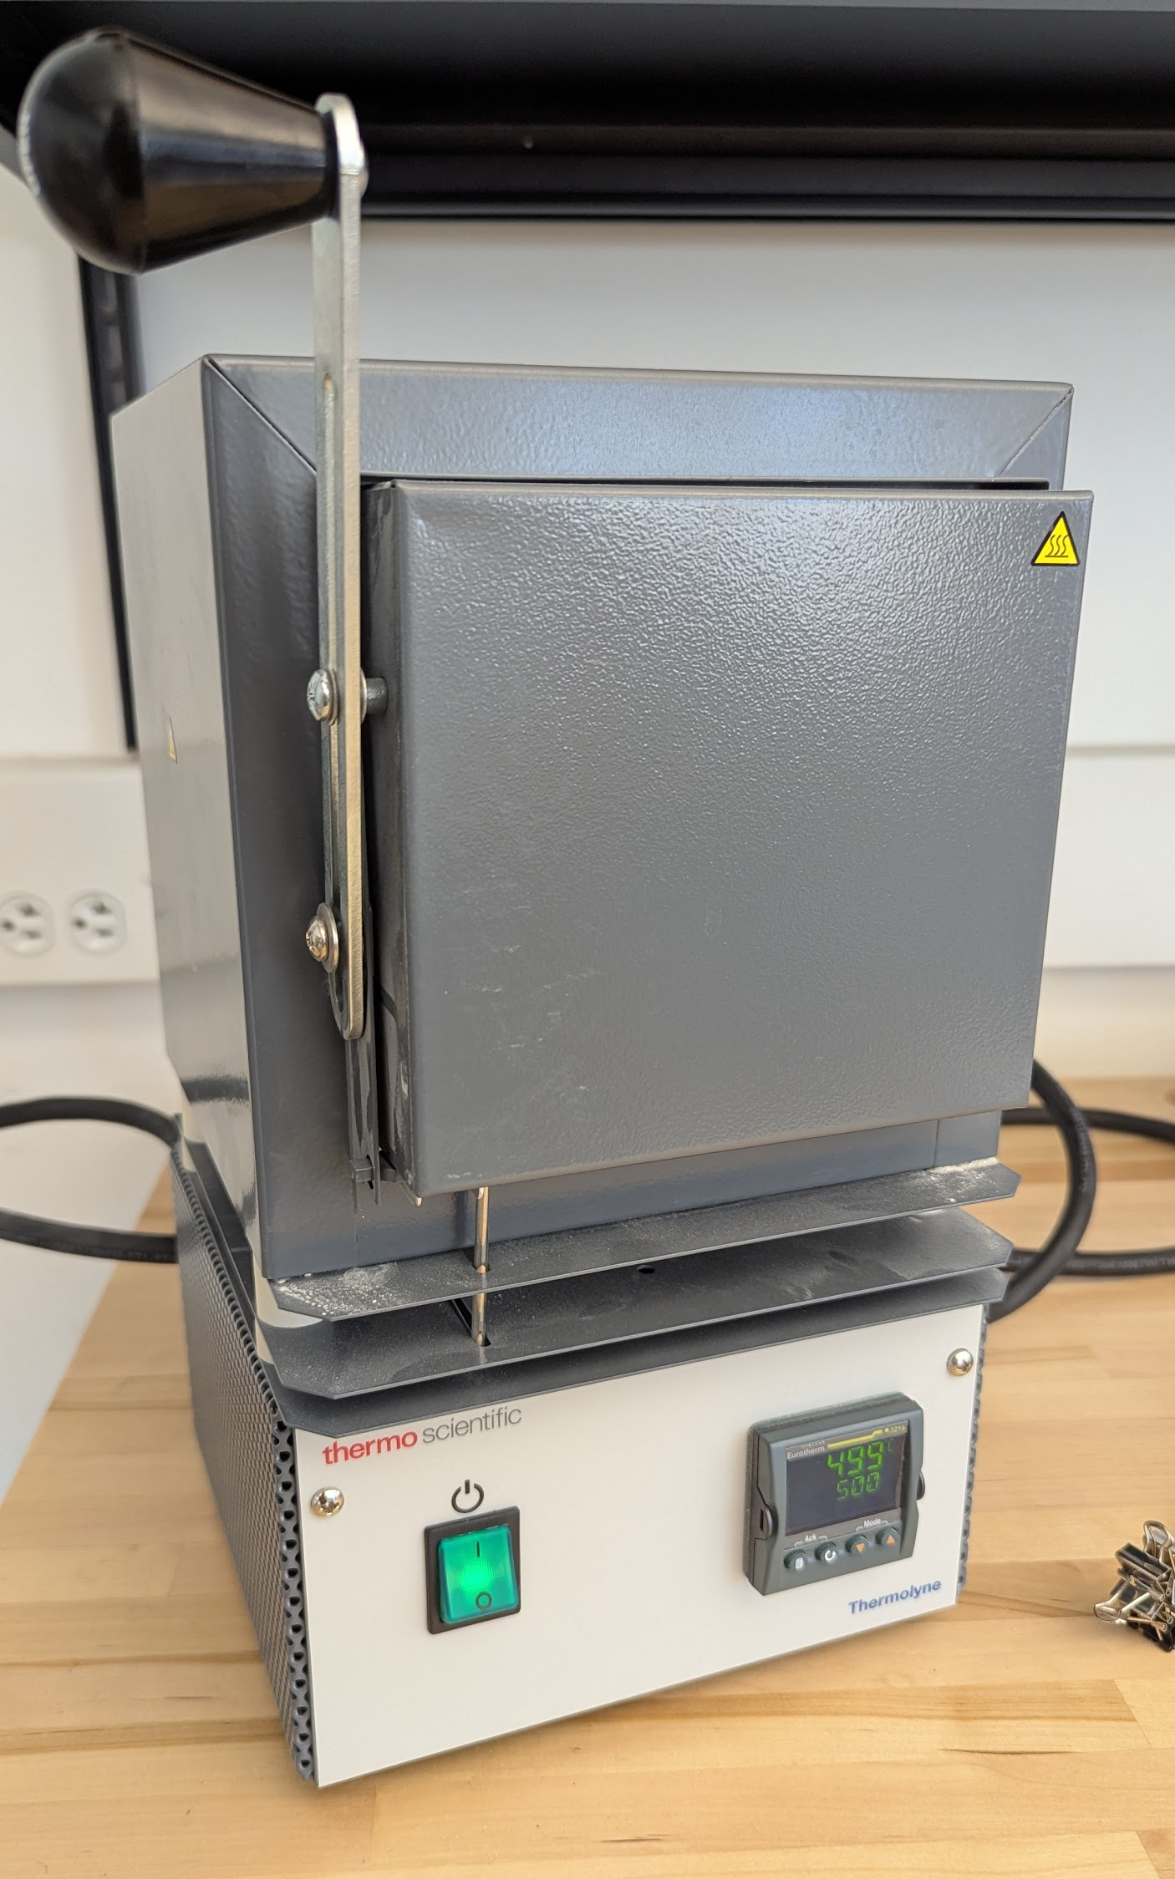
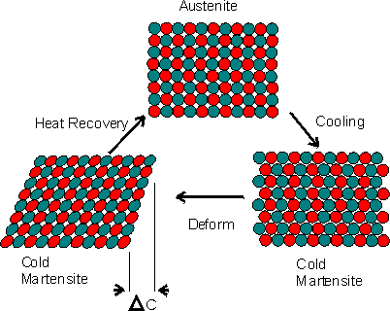
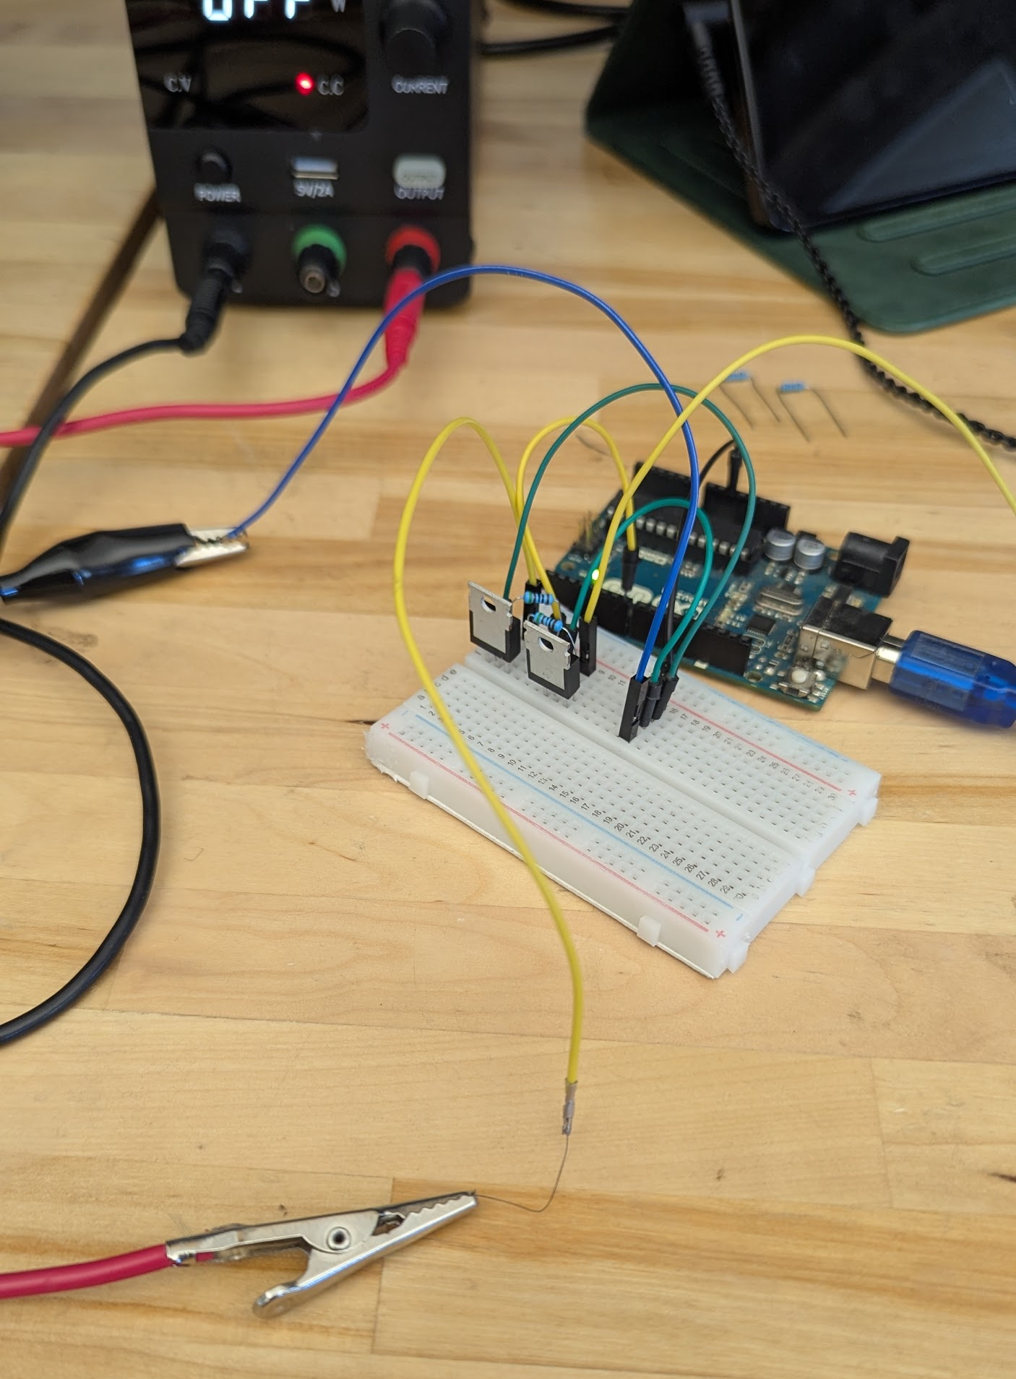
Nitinol Wire Tests
Nitinol Integration
Shape and heat wire up to 400°C-500°C for 1-5 min
Cool down in air or dunk in water
Actuation temp 75°C-80°C
Fig 10. Muffle furnace
Fig 11. Arduino setup
Fig 12. Crystalline forms of nitinol
Nitinol: The Shape Memory Alloy with a Memory. (n.d.). Images Scientific Instruments.
7
Notes:
Now I have already mentioned nitinol but I want to expand more on the process
first how does it work nitinol is a nickel titanium alloy that can remember a shape through heat treatment. It transitions between 2 crystalline phases the Martensite Phase and the Austenite Phase
at room temperature it is at the Martensite phase you can move it freely and make a shape. at 75°-80° celsius this is the Austenite phase or where it will return to its remembered shape. pushing past it to 400°-500° celsius you get to its shape setting or training phase. during this time a new remembered shape will be imprinted.
Additionally during the shape setting phase the amount of time and the temperature will determine how fast the movement is during the austenite phase. however having it at higher temperatures and for longer periods of time can cause the actuation temperature to go up.
https://www.imagesco.com/articles/nitinol/03.html
I used a muffle furnace during my lab and tested out an array of times and temperatures to find the optimal settings.
personally I found that using 450° for 3 min was optimal.
I also tested the nitinol wire using a simple set up that includes transistors a dc power supply and an arduino. A basic code controls the heating cycle, activating it for 250 milliseconds and allowing it to cool for 1 second. this setup makes it easy to adjust the timing, helping to determine minimum heating for maximum contraction and the shortest cooling time required to reset the wire.

Slide 8
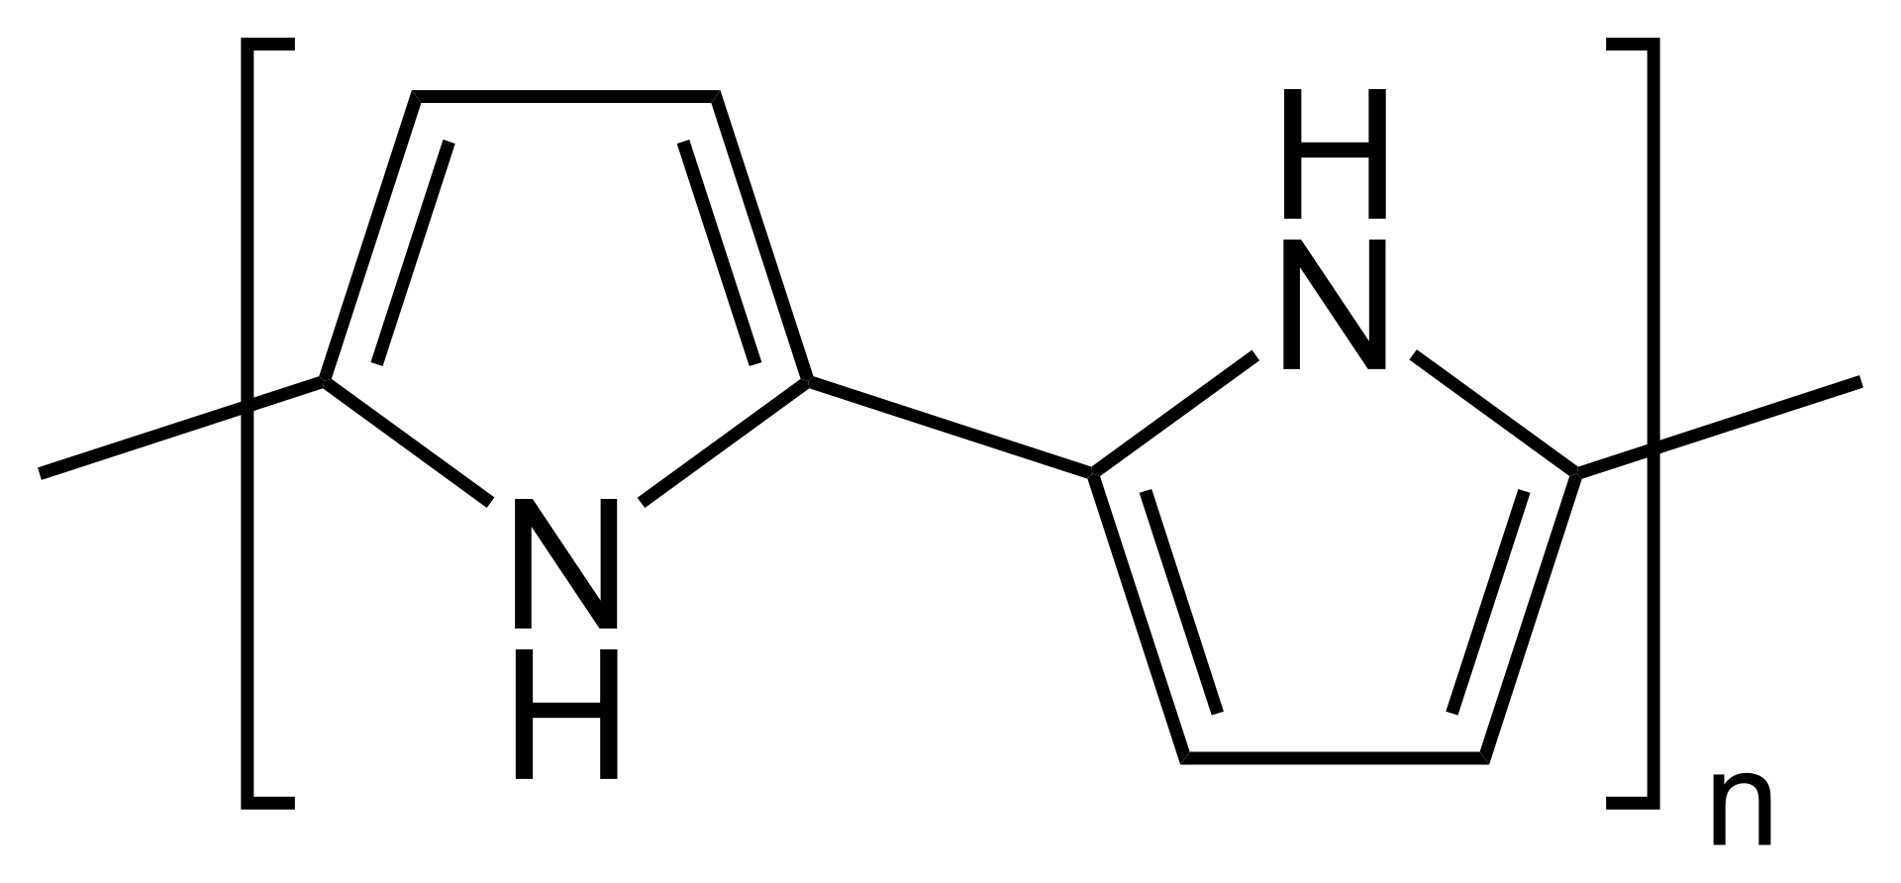
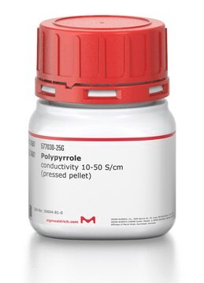
Polypyrrole used for Tactile sensing
Polypyrrole features
Conductive
Flexible
Lightweight
Fig 14. Polypyrrole Structure
Fig 13. Polypyrrole pellets
Sigma-Aldrich. (n.d.). Polypyrrole (≥97%). Retrieved July 25, 2025 | Wikipedia contributors. (2025, July 28). Polypyrrole. In Wikipedia.
8
Notes:
Another key property of the AmoeBot is its outer Skin which is made using polypyrrole
Polypyrrole or ppy is used as a way for it to sense things, it responds to physical interaction by changing electrical properties. unlike metals ppy’s electrical properties can change when its touched, stretched or compressed.
There are a few key features that make it perfect for the job.
first is that it is conductive we need a way for the amoebot to sense things and this makes it possible
next it is flexible unlike other electronics which would be hard to incorporate into the soft body of the amoebot
last is its lightweight so it does not interfere with movement
so where does ppy get its conductivity from?
to start it is a conjugated polymer meaning it has alternating single and double bonds, this enables delocalization of electrons making it semiconductive or conductive. this conductivity can be further improved by doping the ppy which can result in a conductivity ranging from 10^-3 to 10^2 Siemens/cm all depending on doping levels
https://ui.adsabs.harvard.edu/abs/1997RuCRv..66..443V/abstract

Slide 9
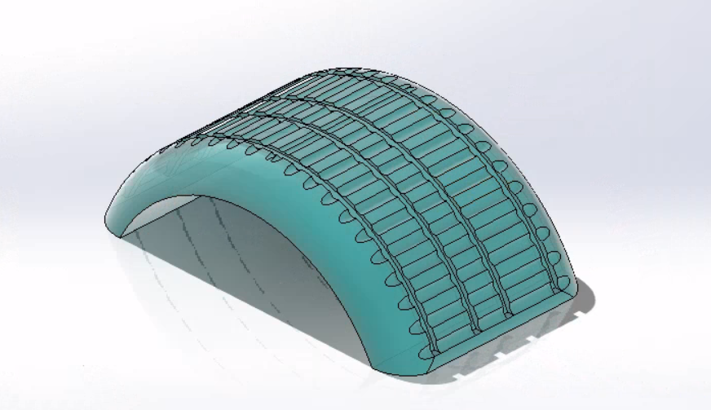
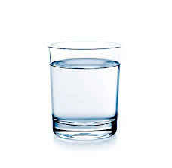
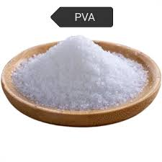
Incorporating PPy
Different techniques
Microchannels
  3D printed channels into mold
  small polypyrrole reservoirs
Polypyrrole (PPy) Ink
  simple to make and apply
  works on most surfaces with preparation
Fig 15. Grooved Amoebot
Fig 16. PVA dust
Fig 17. Polypyrrole pellets
Fig 18. Water
Sigma-Aldrich. (n.d.). Polypyrrole (≥97%). Retrieved July 25, 2025 | Made-in-China. (n.d.). High grade polyvinyl alcohol (PVA/PVOH) powder 17-88/088-20 BP 17 PVA. Retrieved July 25, 2025 | iStock. (n.d.). Glass of water [Photograph]. Retrieved July 25, 2025,
9
Notes:
There is many different techniques that can be used to incorporate Polypyrrole. but My research into the matter focused on 2 main techniques Microchannels and Polypyrrole ink.
For microchannel integration, Grooves will be formed along the body of the Amoebot to house the PPy, these grooves would be incorporated into the mold when 3d printing , additionally there will be small deposits or reservoirs of ppy placed at specific points of the body to enhance the contact sensing and improve the signal.
Next is Polypyrrole ink its simple to make by combining PPy powder with water and PVA. The ink is also easy to modify by changing ratios, and applying it is as easy as brushing it on to the surface of the body. The ink works on most surfaces but with silicone you need to do an IPA wash. (Ipa = isopropyl alcohol)
I think using a combination of both of these techniques would result in the best form of contact sensing.

Slide 10
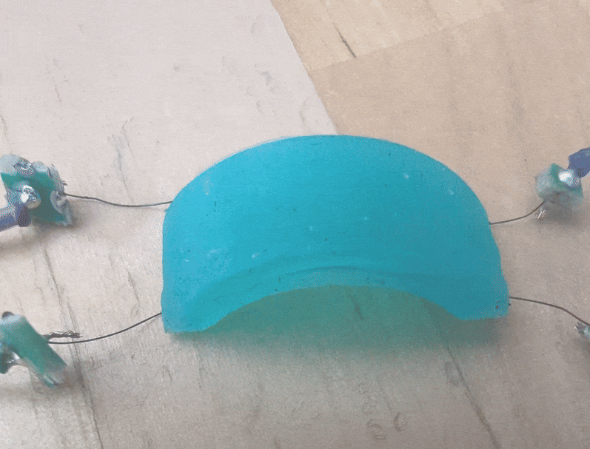


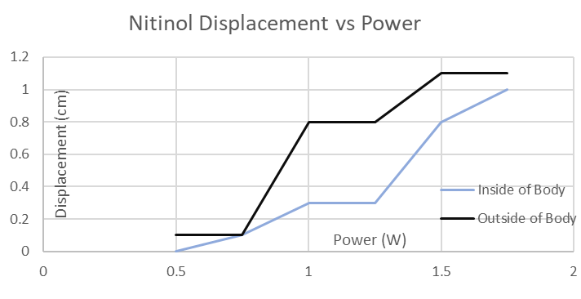

Results
limited movement and inconsistent
  Body shape
  Anchored to setup
Nitinol
  High power usage
Fig 19. Amoebot movement
Fig 20. Nitinol displacement vs power
10
Notes:
With the basic prototype I found 2 main limiting factors.
First is that the movement of the amoebot is inconsistent and limited. this is due to a few reasons. First is most likely the body shape or size. Nitinol wire is not super strong but it should have the strength to bend the silicone body. and as you can see on the videos linked through the qr code that does not happen. another problem is how the body is anchored, because it is tethered to heavier wires the added weight keeps it from moving.
Next is the nitinol although a super cool idea it really is just not the best for the job. Its size does lends itself to working with smaller projects but the problem comes in its power consumption. if the amoebot is ever to advance it needs to be free from a tethered set up. but with the amount of power that the nitinol draws that would be impossible.

Slide 11
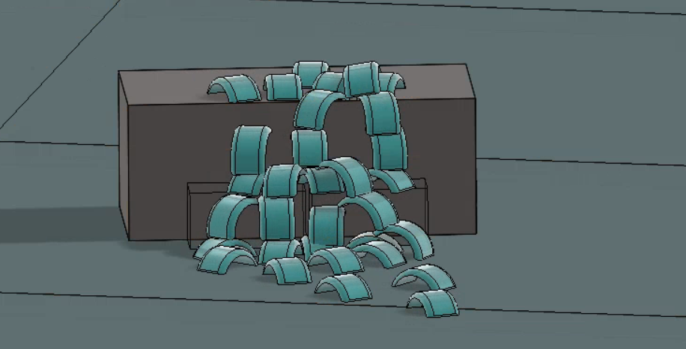
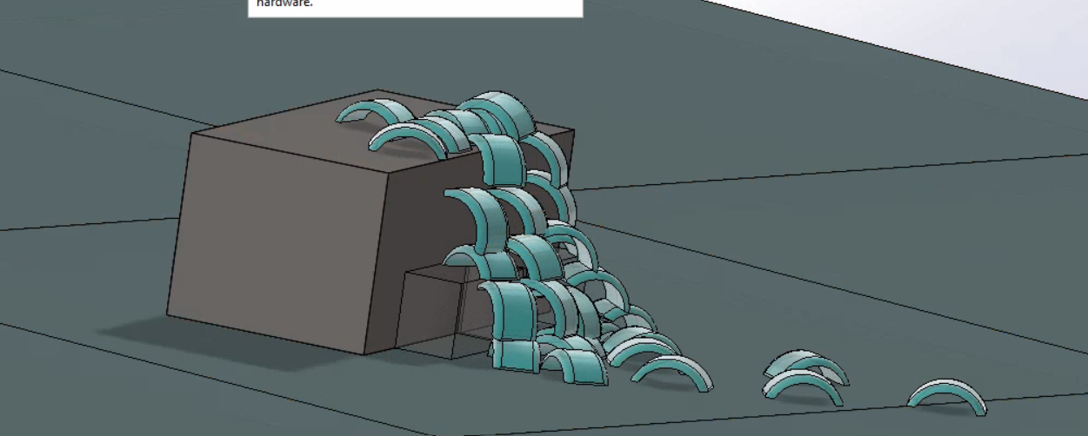
Future Improvements
Improve movement using a different method
Scale amoebot down
Make it self-contained
Make a better model that is easier to mass produce
Fig 21. Amoebot swarm 1
Fig 22. Amoebot swarm 2
11
Notes:
If i were to continue working on the amoebot these are the things I would like to focus on.
First is the movement Because the nitinol did not work great, finding a different method to produce that motion would be important
next is scaling down the amoebot is meant to be a swarm robot. So scaling it down would reduce cost when making a swarm.
the next also relates to movement but it would be a big task in itself, the amoebot is tethered to the breadboard and dc power supply so a super important factor would be to make it self-contained so that i could move around
and last is improving the model since the amoebot is supposed to work in a swarm it's important to have a design that can be produced in mass and with little to no differing qualities between them.

Slide 12
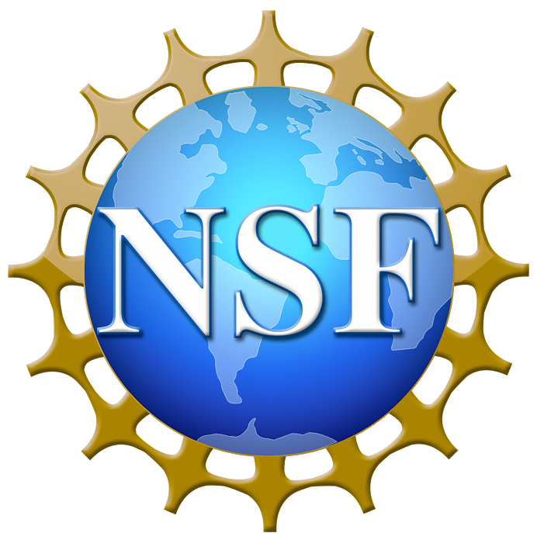


Acknowledgements
Dr. Carlo daCunha
John Hardy
Guilherme Giardini
My Email: matthew.hernandez.w@gmail.com
12
Notes:
I want to give a big thanks to
Dr. Carlo daCunha
John Hardy
and
Guilherme Giardini
for helping me along the way with this project.
if there are any question I will answer them now.

