Slide 1
Aluminum Electrothermal
MEMS Actuators
Presenter: Ryan Otten-Reimer
Mentor: Dr. Andrew Lingley
1
Notes:
If you don't already know me, I'm Ryan and I'm working with Dr. Andrew Lingley this summer on fabricating thermal actuators

Slide 2
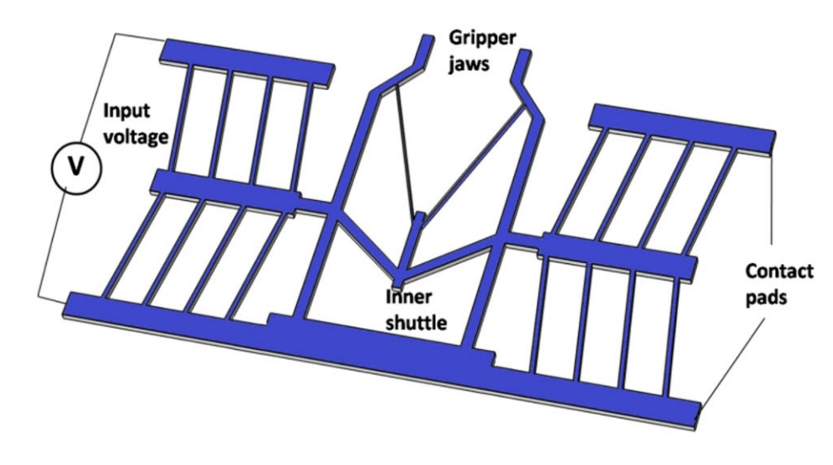
Introduction
Microelectromechanical systems (MEMS)
  Tiny mechanical devices
  Utilize semiconductor fabrication processes
Electrothermal Actuator
  Thermal expansion via a current to expand beams
Applications
  Micromanipulation (biomedical)
  Micromirror stabilization
  RF switches
Transactions on Electrical and Electronic Materials (2024) 25:685–694
Notes:
Motivation is to provide additional data to the field on aluminum MEMS devices, but mainly to provide more access to trainees

Slide 3
Background
Why aluminum actuators?
  Ease of design and fabrication
  Lower cost
  Fast turnaround/prototyping
What's the best outcome?
  Encourage accessibility to semiconductor fabrication education
  Understand the applications and limits of aluminum-based MEMS devices

Slide 4
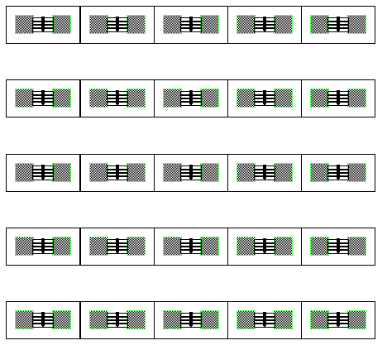
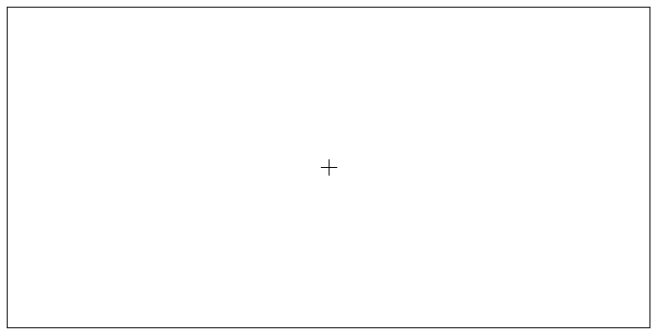
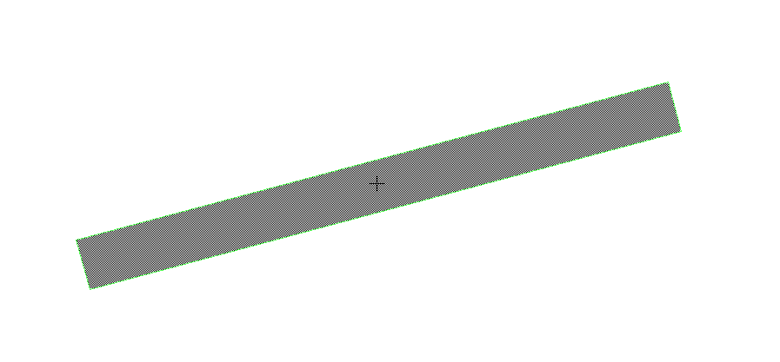

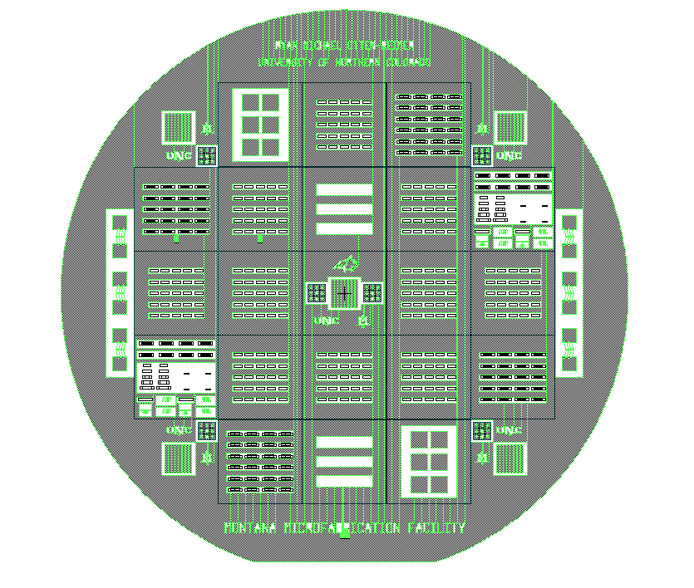
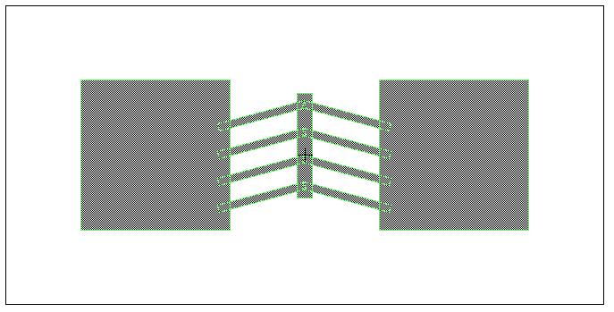

Slide 5
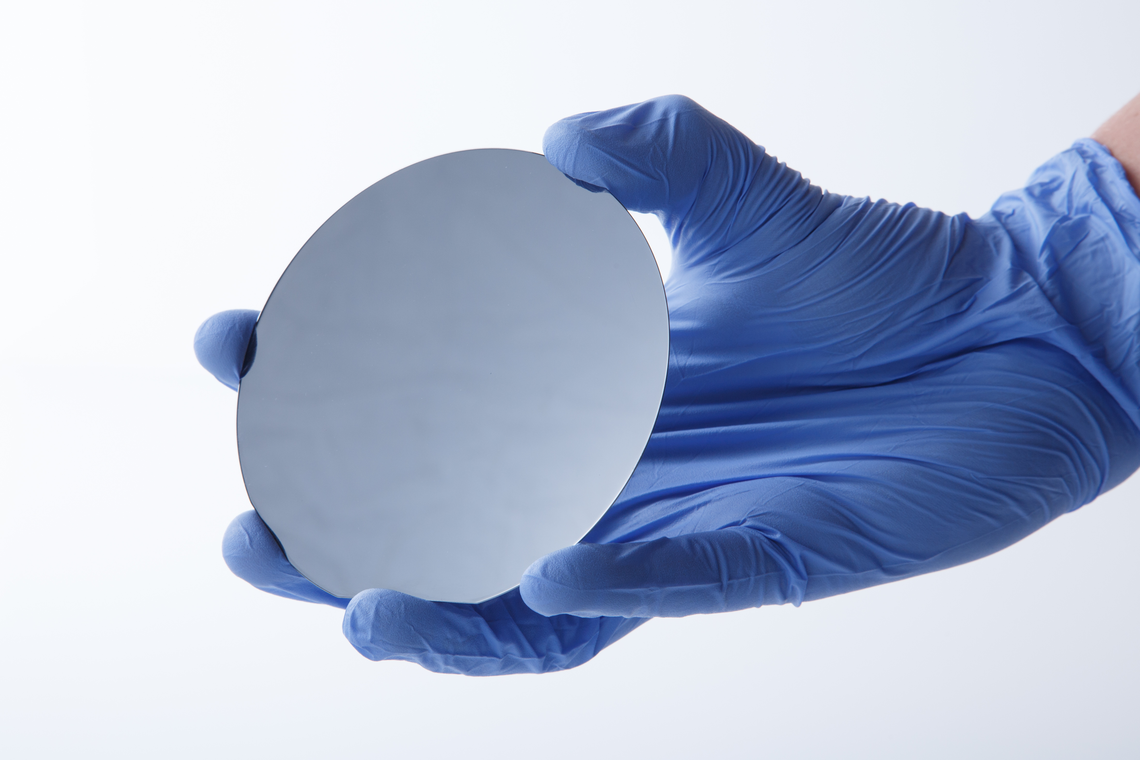
Cross-section representation
Silicon wafer (500μm x 4mm)
*Colors may not be accurate, sizes are not to scale

Slide 6
Cross-section representation
Aluminum (~1μm)
Deposit aluminum layer via electron beam evaporation.
*Colors may not be accurate, sizes are not to scale
Notes:
Sublimation by using electron beam

Slide 7
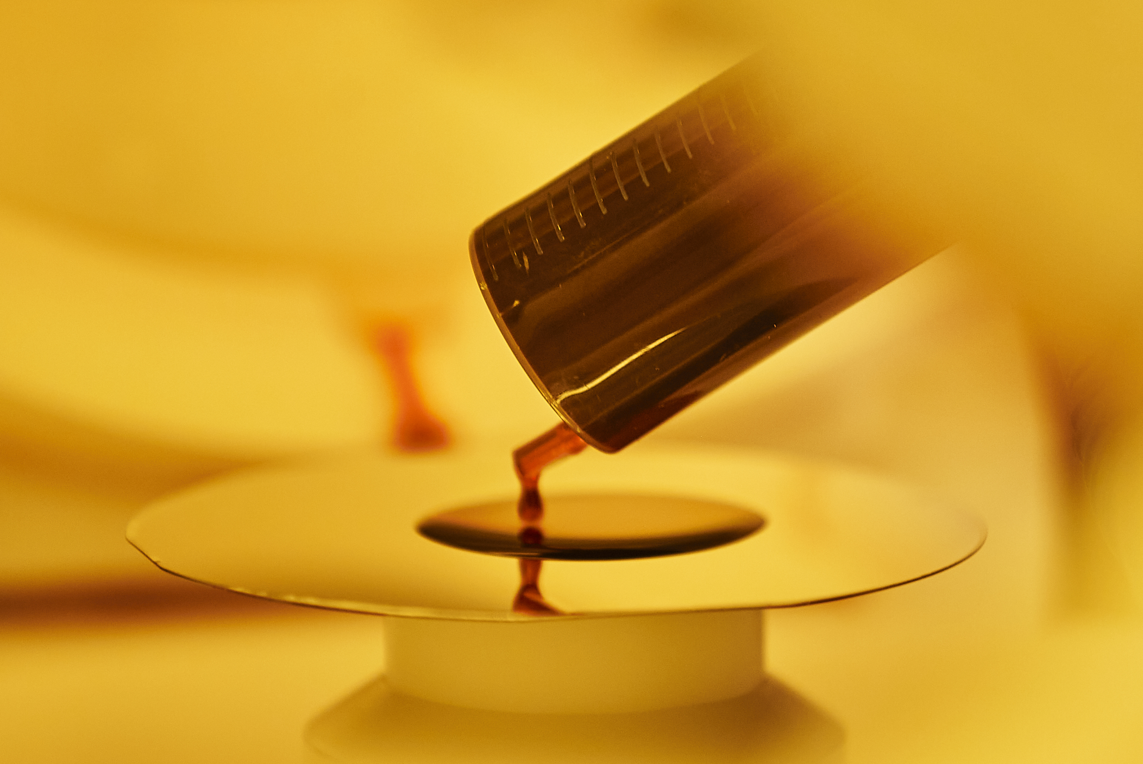
Cross-section representation
Photoresist (~1um)
Bake on a thin layer of photoresist, a non-soluble polymer that protects the wafer.
*Colors may not be accurate, sizes are not to scale
Notes:
Protector for aluminum

Slide 8
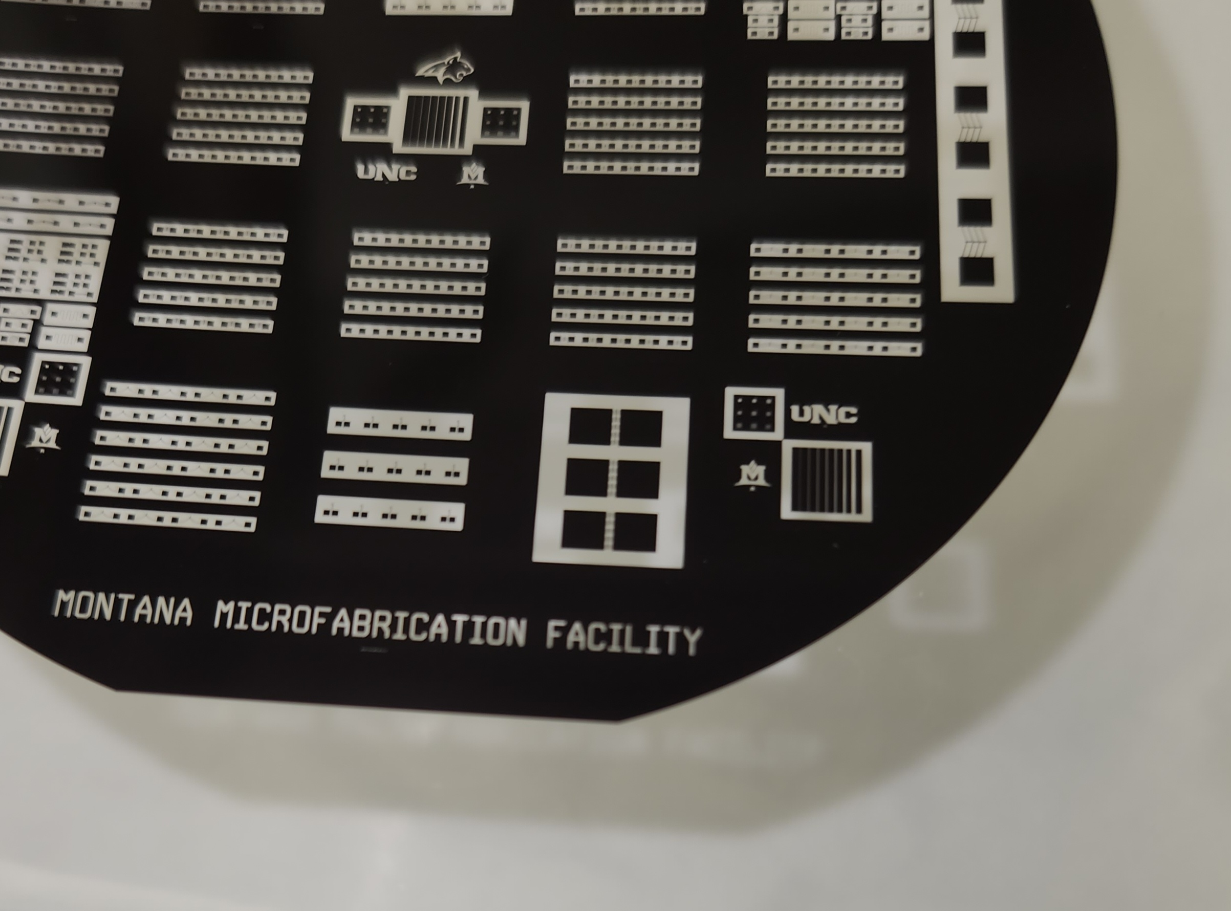
Cross-section representation
Ultraviolet
Photomask
The photomask is placed over the wafer and is exposed to UV light. The exposed photoresist goes through a chemical reaction that makes it soluble in developer.
*Colors may not be accurate, sizes are not to scale

Slide 9
Cross-section representation
Cross-section representation
Cross-section representation
Developer:
~2.5% Tetramethylammonium hydroxide (TMAH)
Wash away the soluble photoresist, revealing selected regions of aluminum.
*Colors may not be accurate, sizes are not to scale
Notes:
Developer (Tetramethylammonium hydroxide)

Slide 10
Cross-section representation
Aluminum etchant:
<80% Phosphoric Acid
<5% Acetic Acid
<5% Nitric Acid
Etch the unprotected photoresist to expose the silicon.
*Colors may not be accurate, sizes are not to scale
Notes:
Acid, phosphoric acid?

Slide 11
Cross-section representation
Plasma
The shuttle is suspended by beams
Al
Al
Silicon is etched by a plasma.
*Colors may not be accurate, sizes are not to scale
Notes:
Plasma is ionized gases like free fluorine radicals. Isotropic does not redeposit any protective gas layer and radicals bounce around

Slide 12
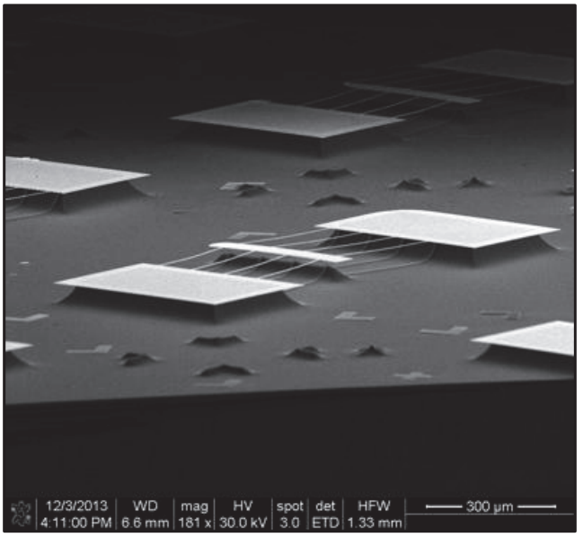
Top view
Aluminum
Shuttle
Beams
Etched Silicon
Anchors
AIP Conf. Proc. 1646, 25 (2015); doi: 10.1063/1.4908578
*Colors may not be accurate, sizes are not to scale

Slide 13
Top view
DC source is disconnected
Actuator beams experience thermal expansion due to resistive heating.
*Colors may not be accurate, sizes are not to scale

Slide 14
Top view
DC source is connected
Actuator beams experience thermal expansion due to resistive heating.
*Colors may not be accurate, sizes are not to scale

Slide 15
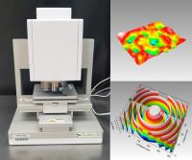
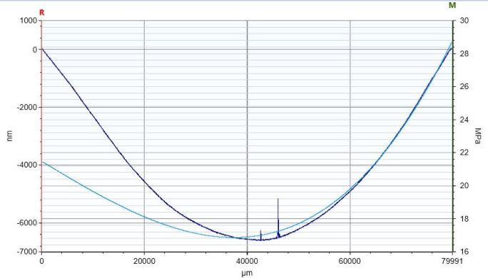
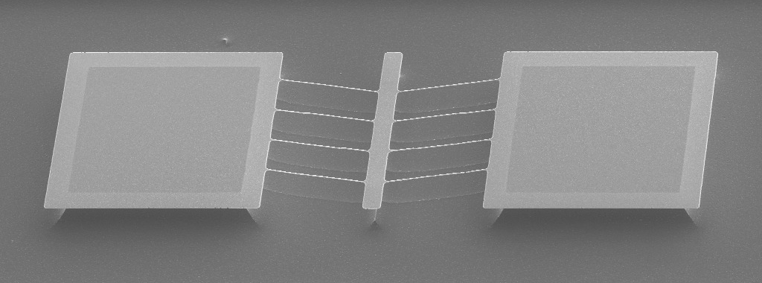
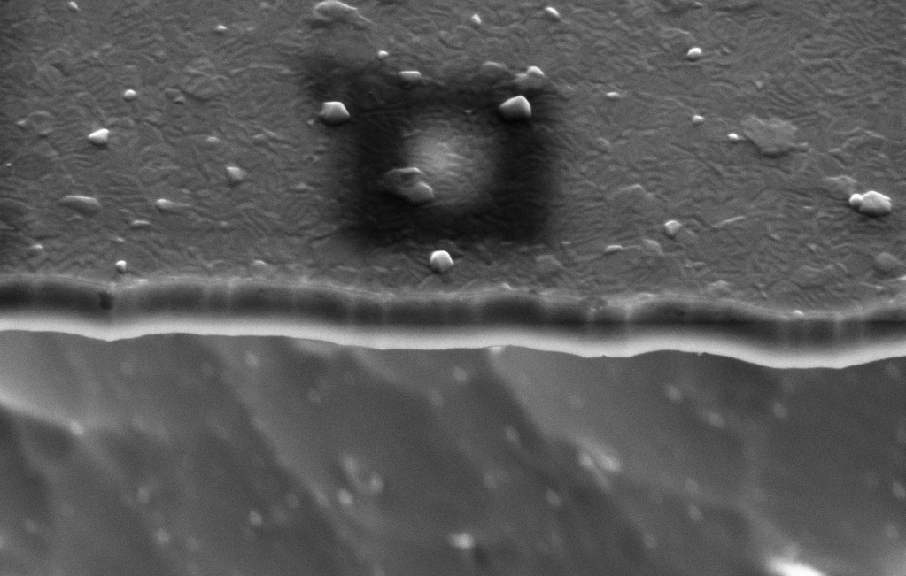
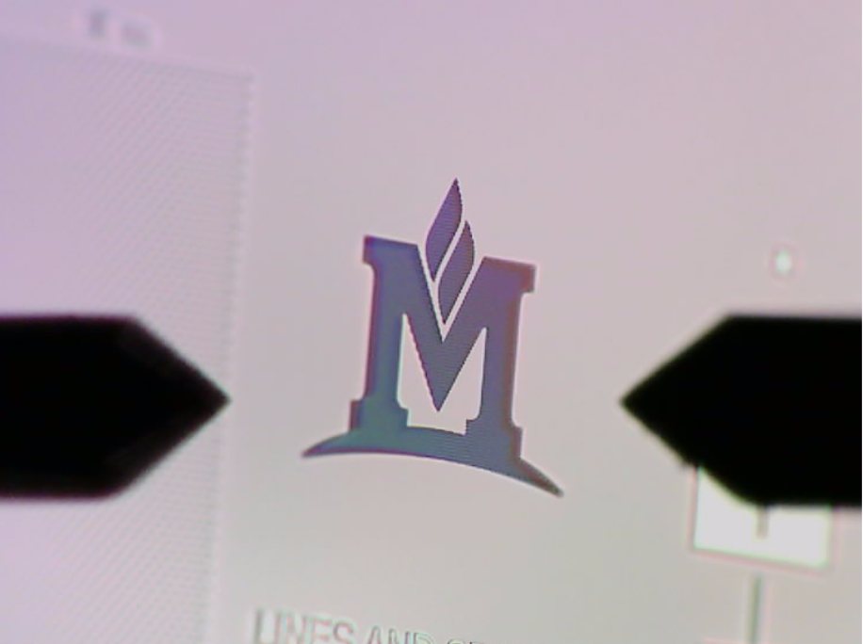
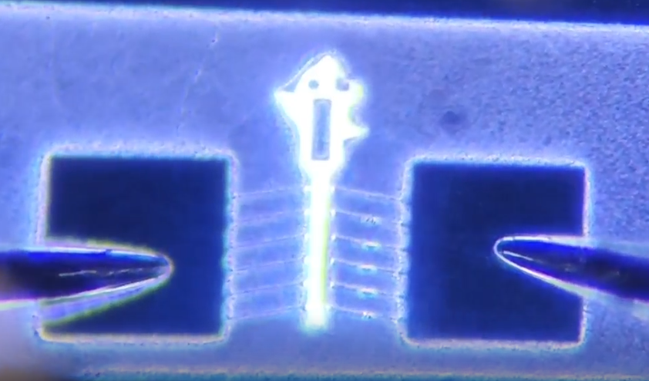
Characterization
*surface profiling too
Stylus Profilometer
Electron Microscope
Probing Station
Notes:
Critical stress is applied force over the cross sectional area (Max allowable force in pascals)

Slide 18
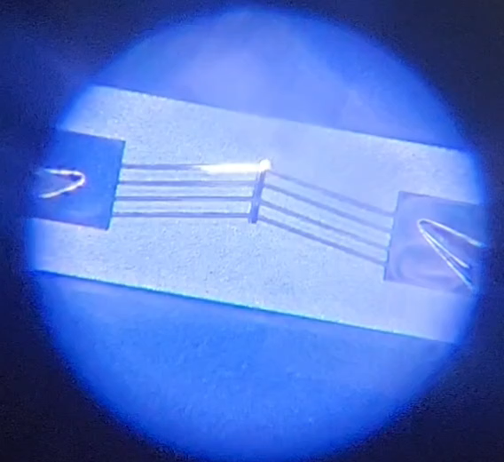
Notes:
Critical stress is applied force over the cross sectional area (Max allowable force in pascals)

Slide 19
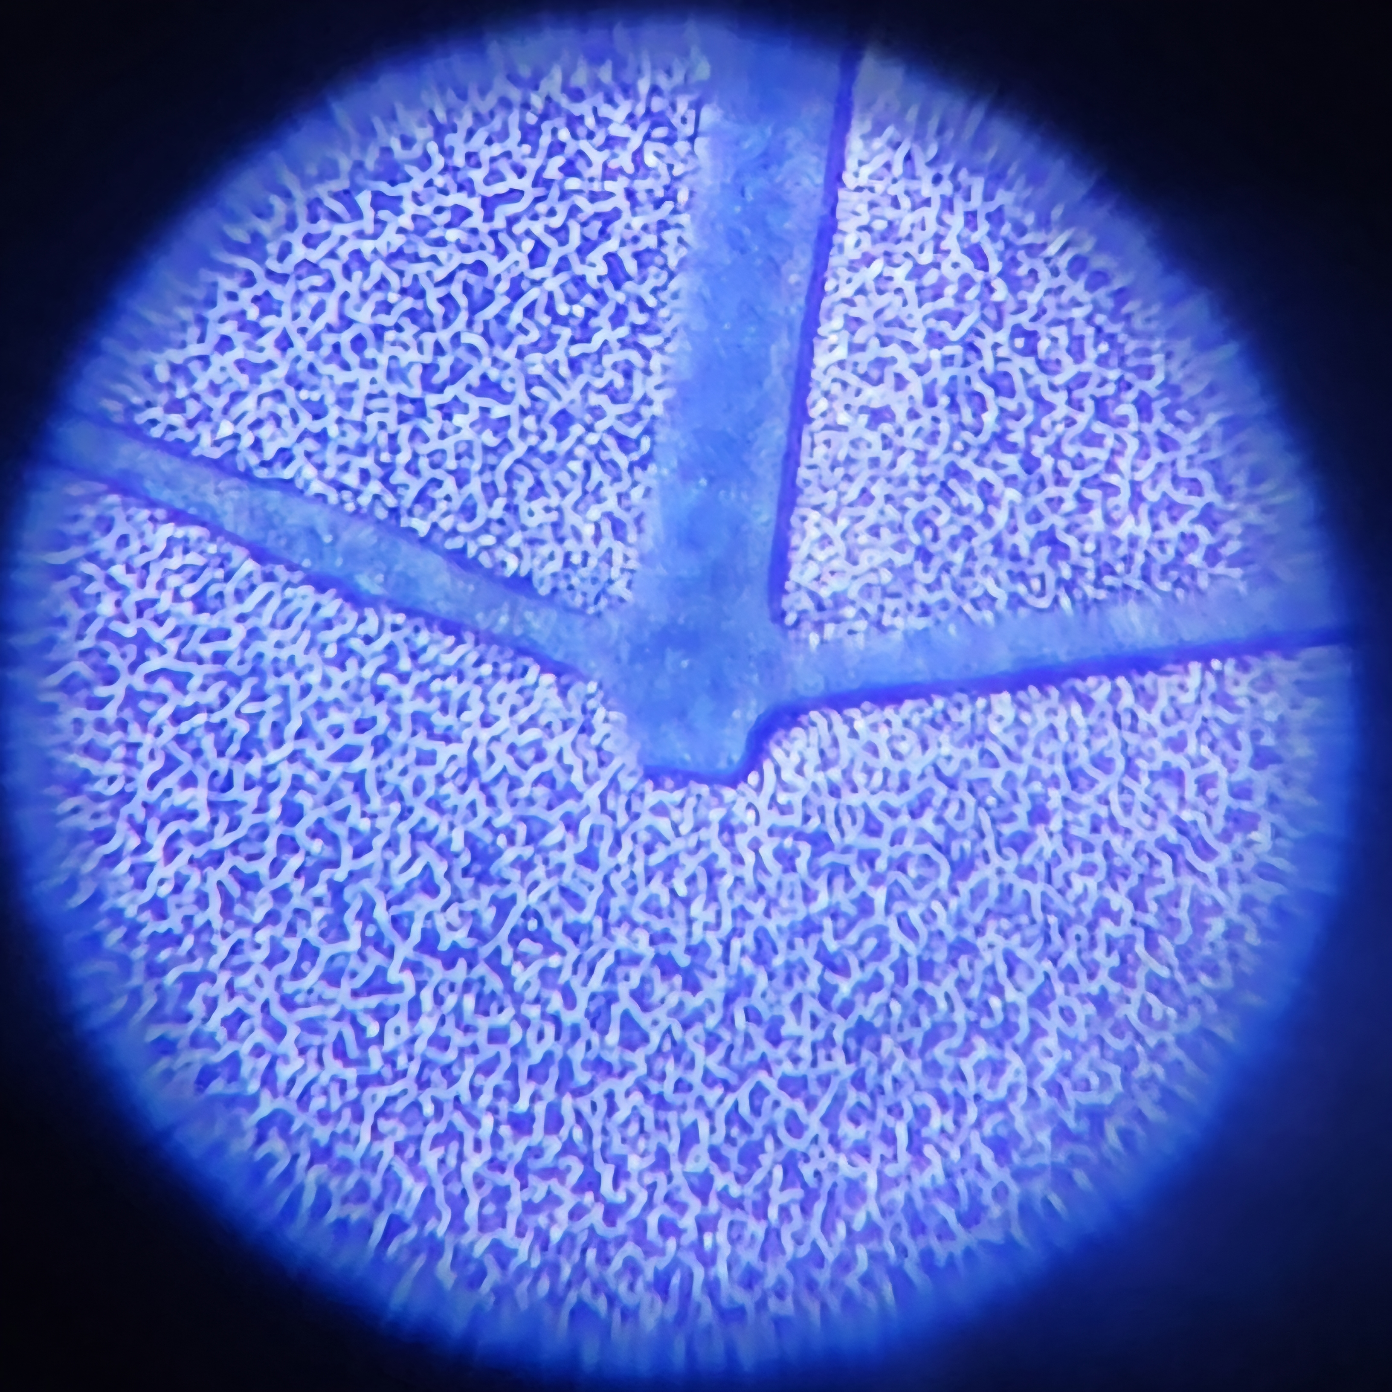
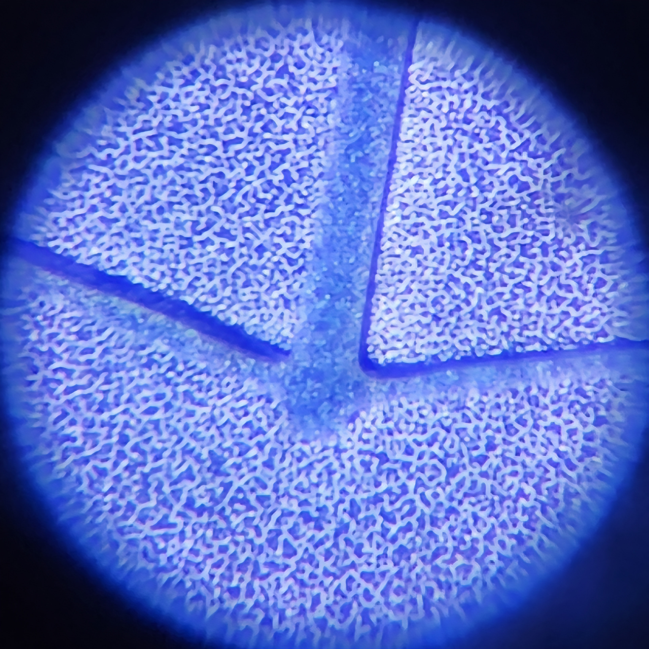

Slide 20
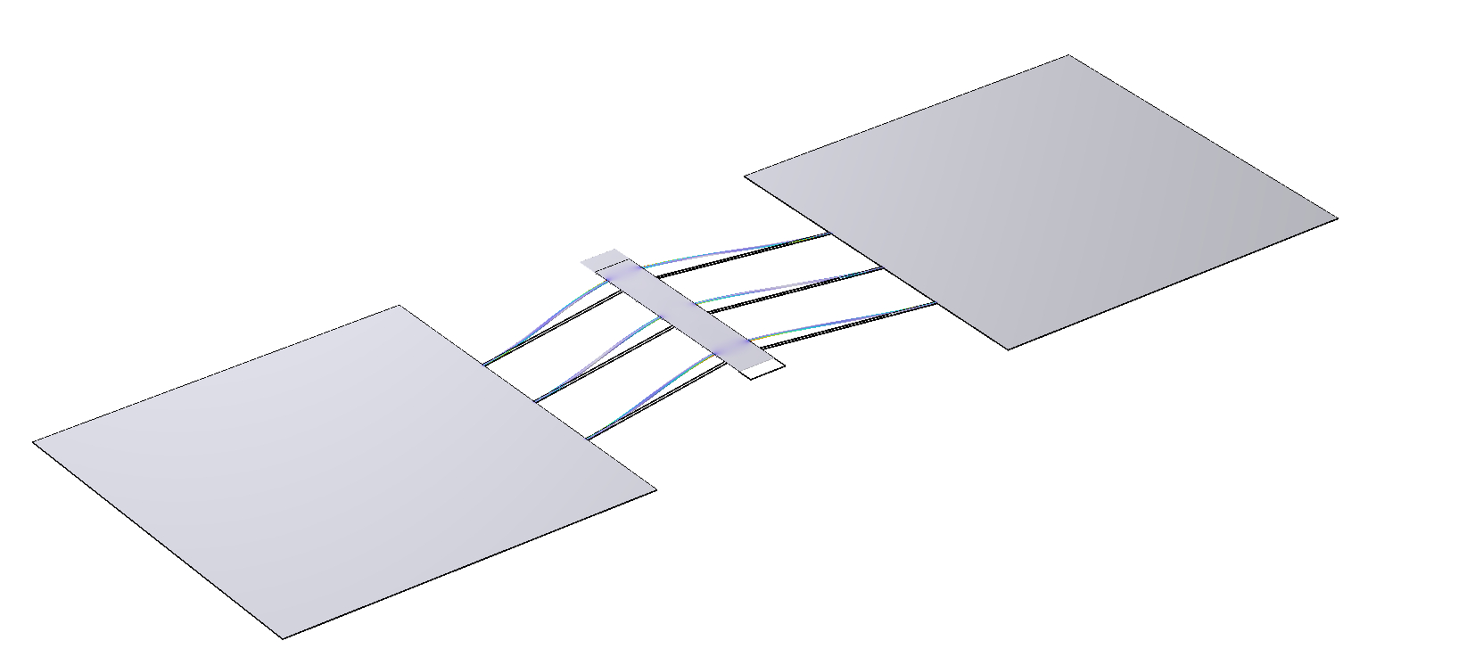
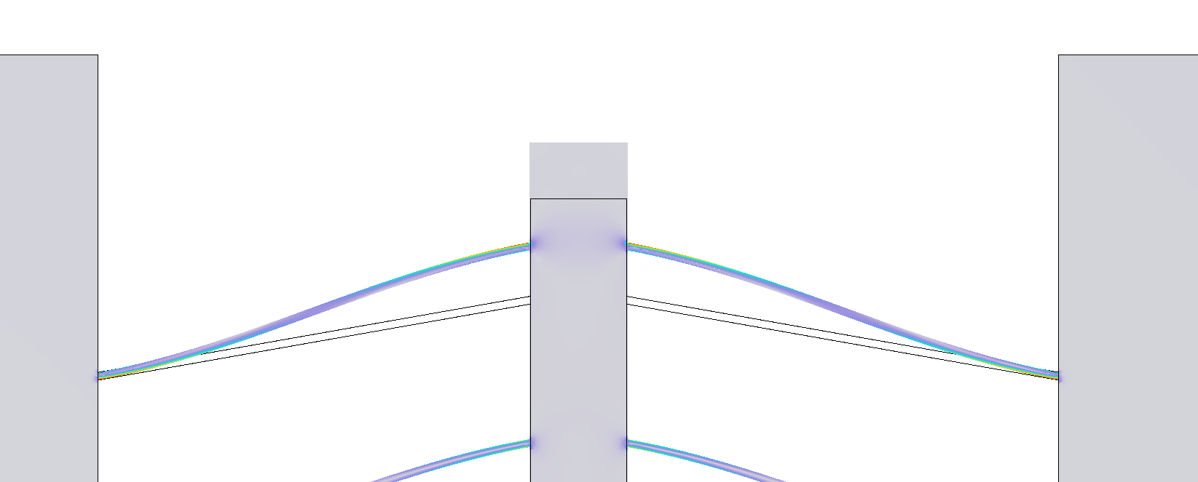
Modeling

Slide 21
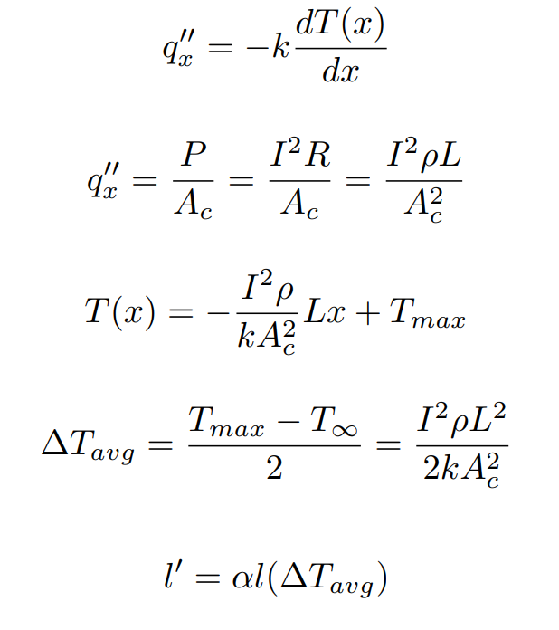
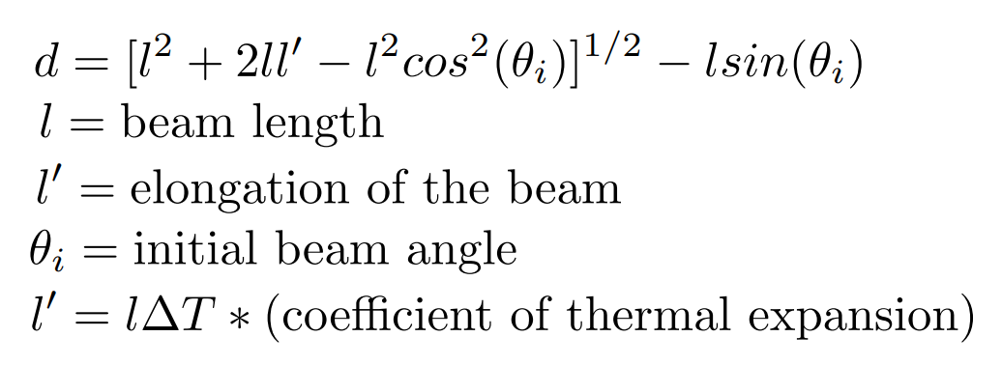
Modeling

Slide 22

Modeling

Slide 23
Conclusion
Aluminum MEMS actuators are fast to produce and require minimal training
A simple analytical model can predict displacement accurately
Films can be temperamental
Aluminum actuators actuate even under bad circumstances

Slide 24
References
Baracu, A., Voicu, R., Müller, R., Avram, A., Pustan, M., Chiorean, R. S., Birleanu, C., & Dudescu, M. (2015). Design and fabrication of a MEMS chevron-type thermal actuator. AIP Conference Proceedings, 1646, 25-30. https://doi.org/10.1063/1.4908578
Heinke, R., Ehrhardt, M., Lorenz, P., & Klaus, Z. (2021). Dry etching of monocrystalline silicon using a laser-induced reactive micro plasma. Applied Surface Science Advances, 6, 100169. https://doi.org/10.1016/j.apsadv.2021.100169
Potekhina, A., & Wang, C. (2019). Review of Electrothermal Actuators and Applications. Actuators, 8(4), 69. https://doi.org/10.3390/act8040069
Pustan, M., Chiorean, R., Birleanu, C., Dudescu, C., Müller, R., Baracu, A., & Voicu, R. (2017). Reliability design of thermally actuated MEMS switches based on V-shape beams. Microsystems Technologies, 23, 3863–3871. https://doi.org/10.1007/s00542-015-2789-8
Ramya, S., Aravind, T., Kumar, S.P., & Ram, G. D. (2024). Design of Chevron Electrothermal Microgripper and its Prototyping Using SLM Based Additive Manufacturing. Transactions on Electrical and Electronic Materials, 25, 685–694. https://doi.org/10.1007/s42341-024-00552-1

Slide 25

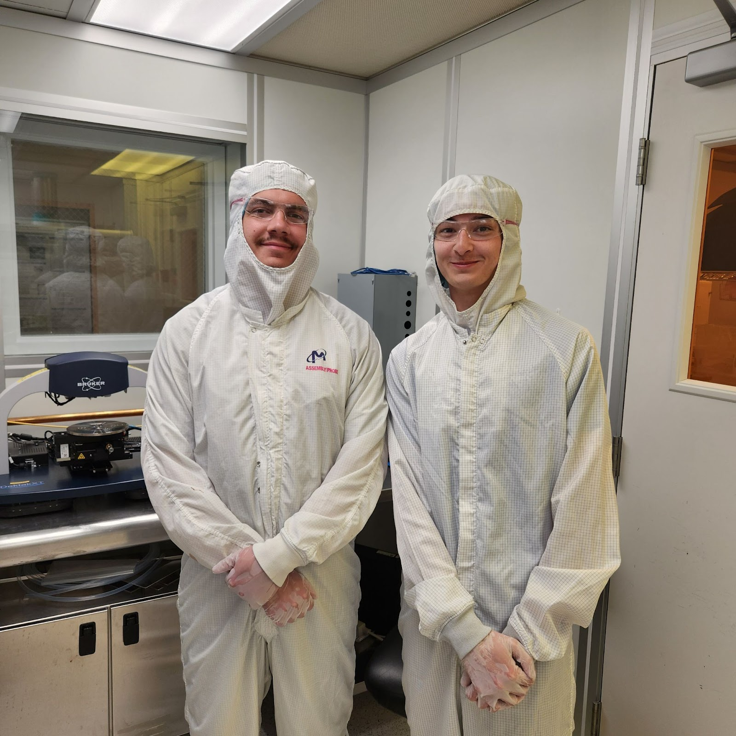
Thank you to Dr. Andrew Lingley and the Montana Microfabrication Facility.
This work was supported by National Science Foundation Grant 2349091 & 2025391.

