Slide 1





Nonvolatile Computer Memory with Bistable Beams
Mihir Gutti, University of San Francisco
Dr. Shamus McNamara, University of Louisville
NSF REU Award ID #2348869
NSF REU Award ID #2025075

Slide 2
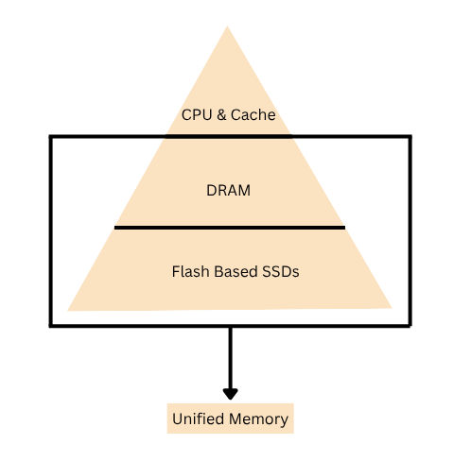
The Need for a Better Memory
DRAM is fast but volatile
SSD (Flash) is non-volatile and low cost, but slow
Constant data movement between DRAM and SSD → slow and power hungry
Combine RAM & SSD into one unified layer → no copyback delays
Data stored in one place → simpler, faster, cheaper
Mechanical: Stores data as position not charge

Slide 3
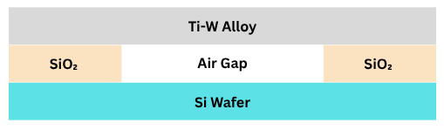
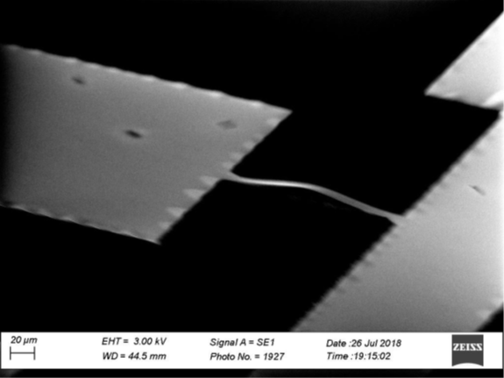
How the MEMS Beam is Made
MEMS Beam: Ti-W alloy
Substrate: Silicon wafer
Air Gap Formation: Sacrificial SiO₂ layer sets the spacing between the beam and wafer. Creates air gap below the beam
Bistable: Beam can bend up or down representing ‘0’ or ‘1’
Nonvolatile: Holds position without power.

Slide 4
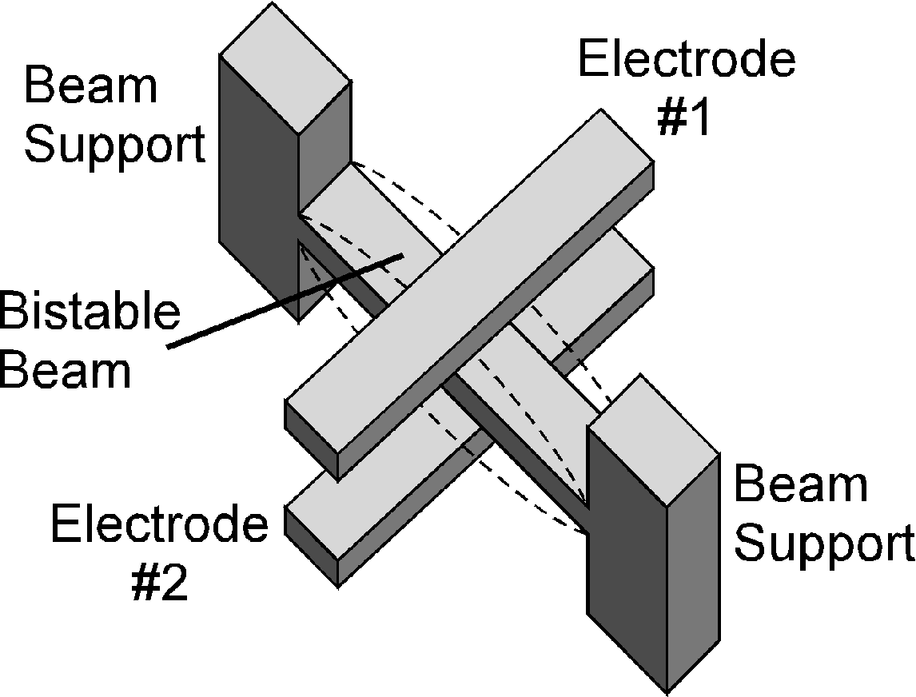
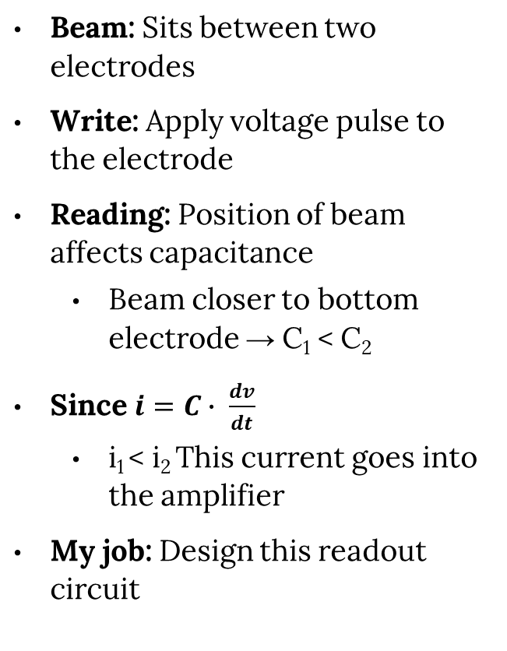
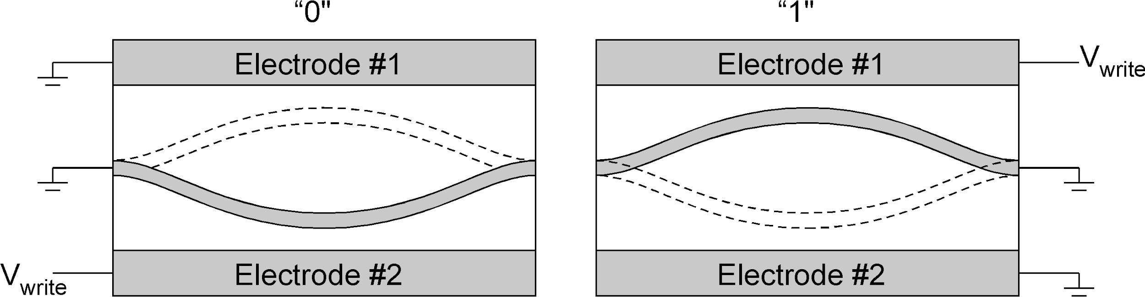
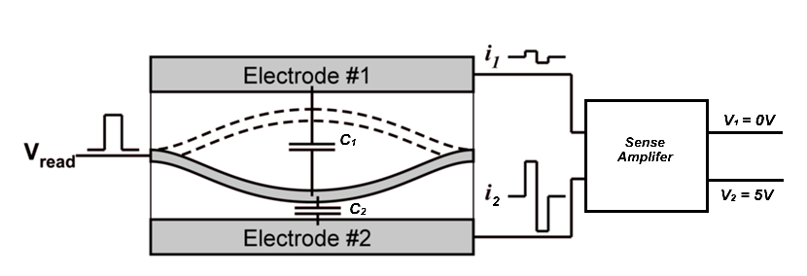
How it Works?
Xie, K., & McNamara, S. (2022, July). Simulating a buckled-beam MEMS memory cell.

Slide 5
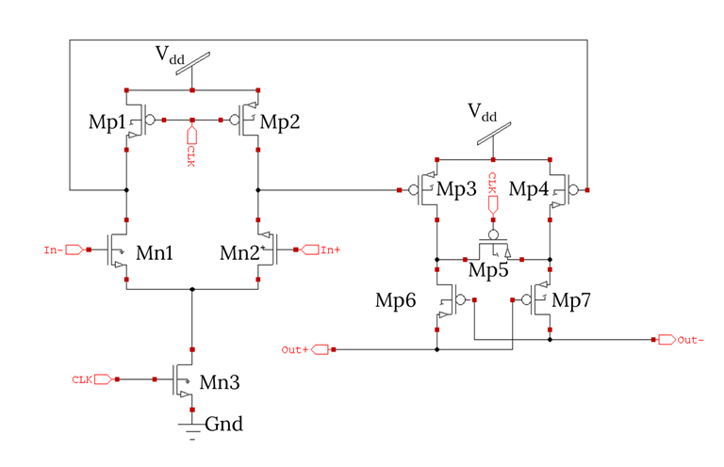
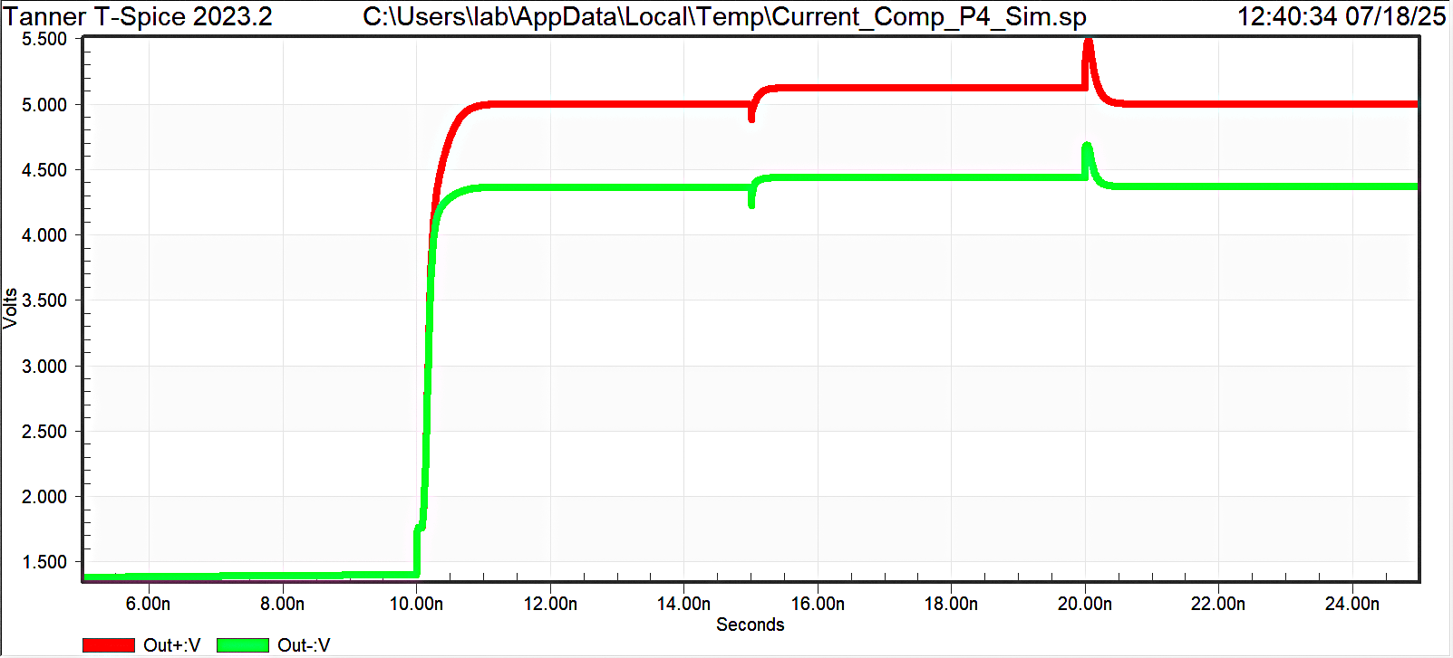
First Design
Researched dynamic comparators
Developed initial current comparator design
Two stage design:
  Stage 1 converts current input to voltage
  Stage 2 amplifies voltage
Issue: Outputs did not reach full digital levels
  High voltage = 5V
  Low voltage = ~4.3V
Based on: Taghizadeh et al., Int. J. Electron. Commun., 81, 163–170 (2017)
Output Voltage

Slide 6
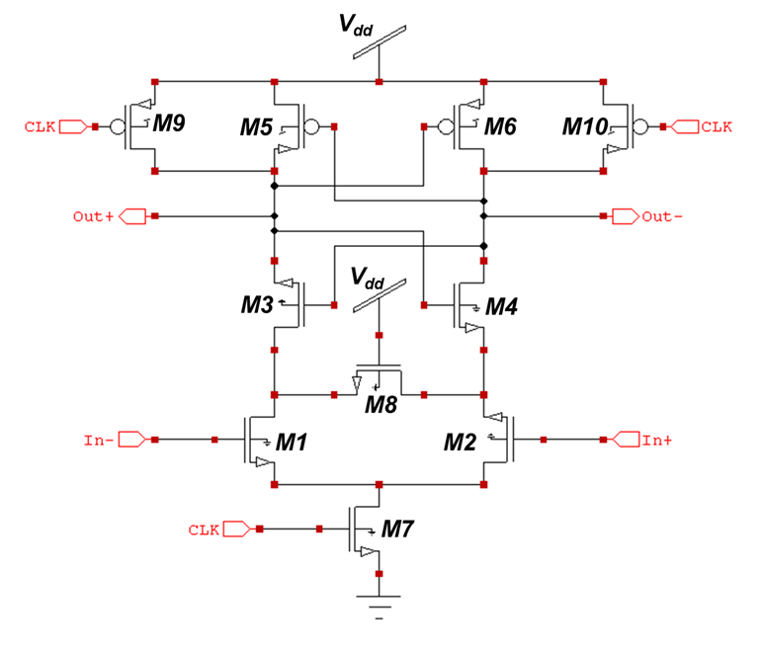
StrongARM Latch Architecture
Input Differential Pair (M1, M2): Connected to Input (In-, In+)
Function: Senses and compares two input voltages
Operation: Higher input → corresponding transistor conducts more current
Cross-Coupled Pair: M3, M4 (NMOS) & M5, M6 (PMOS)
Function: Provides positive feedback amplification
Result: Converts small differences into full rail-to-rail outputs
M7 (Tail Current): Clock-controlled switch
M8: Output control and load isolation
M9, M10: Pre-charge transistors for reset
Schematic adapted from Razavi, IEEE SSCS Mag., 2015

Slide 7
StrongARM Operation Details
Three-Phase Operation
Phase 1: Reset (CLK = LOW)
M7 (Tail): OFF → No current path, zero static power
Recharge switches: ON → All nodes charged to VDD
Purpose: Initialize circuit, eliminate memory effects
Phase 2: Amplification (CLK = HIGH)
M7 (Tail): ON → Enables current flow through differential pair
M1, M2: Active sensing based on input voltage difference
Schematic adapted from Razavi, IEEE SSCS Mag., 2015

Slide 8
StrongARM Output & Advantages
Phase 3: Regeneration (CLK = HIGH)
  Cross coupled action: M3-M6 create exponential positive feedback
  Decision process: One output → 0V, other output → VDD
Advantages:
  Zero static power
  High speed
  Rail to rail outputs
Schematic adapted from Razavi, IEEE SSCS Mag., 2015

Slide 9
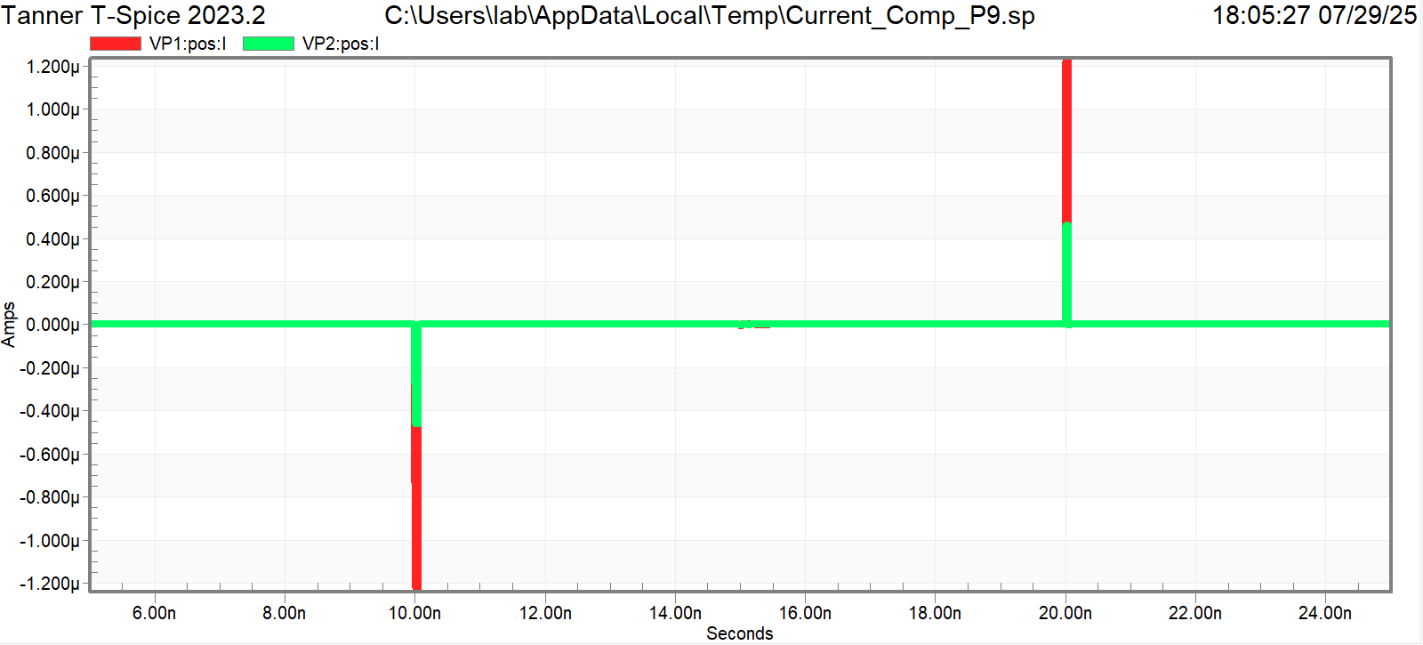
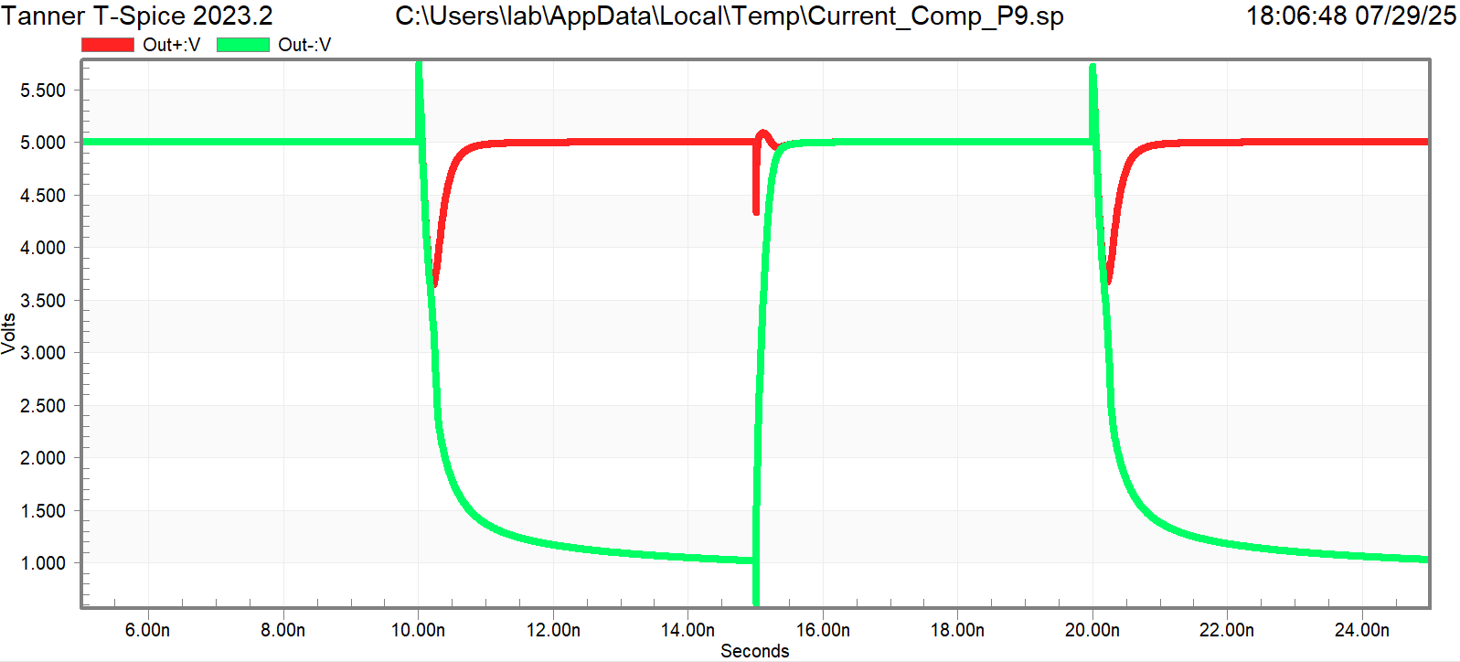
Simulation Results
Circuit amplifies input current differences from MEMS cell
Outputs are ~ digital:
  Out+ goes to 5V (HIGH)
  Out- to 1V (LOW)—Not ideal
Fast, reliable decision
Voltage gap allows clear memory state
Output levels can be further optimized for full CMOS compatibility
Input Current
Output Voltage

Slide 10
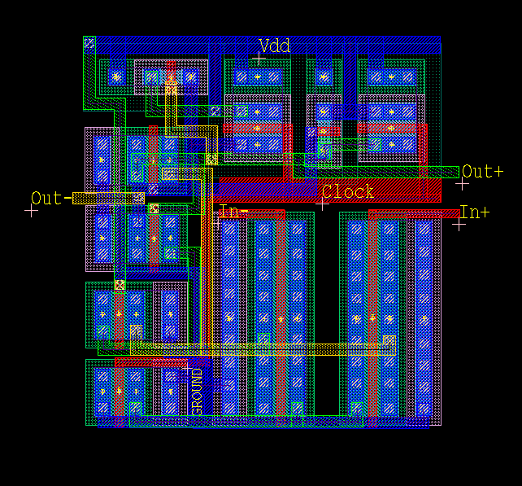
Photomask & Design Layout
Designed the photomask for fabrication using 0.25μm NMOS/PMOS process
Mask includes layers for:
  Active (transistor regions)
  Poly (gate)
  Metals (wiring)
  Contact (connections)
Followed design rules for spacing, minimum width, and alignment

Slide 11
Conclusion & Future Work
Designed and simulated a clocked current comparator for reading MEMS beam memory cell
Circuit reliably detects small current differences → enabling fast, accurate nonvolatile memory readout
Completed layout for standard 0.25 μm CMOS process
Next steps:
  Get lower output to 0V
  Finalize complete photomask layout in L-Edit
  Manufacture the photomask for fabrication
  Connect fabricated circuit to real MEMS beam for testing and validation

Slide 12
Acknowledgements
Dr. Shamus McNamara
National Science Foundation: NSF REU Award ID #2348869
Ana Galiano Sanchez

Slide 13
Questions?

