Slide 1





Low Temperature Fusion of Surface-Activated Copper Micro Particles
Omarion Hixson
PI: Dr. Paul Kohl
Mentors: Jose Lopez, Kaijun Feng

Slide 2
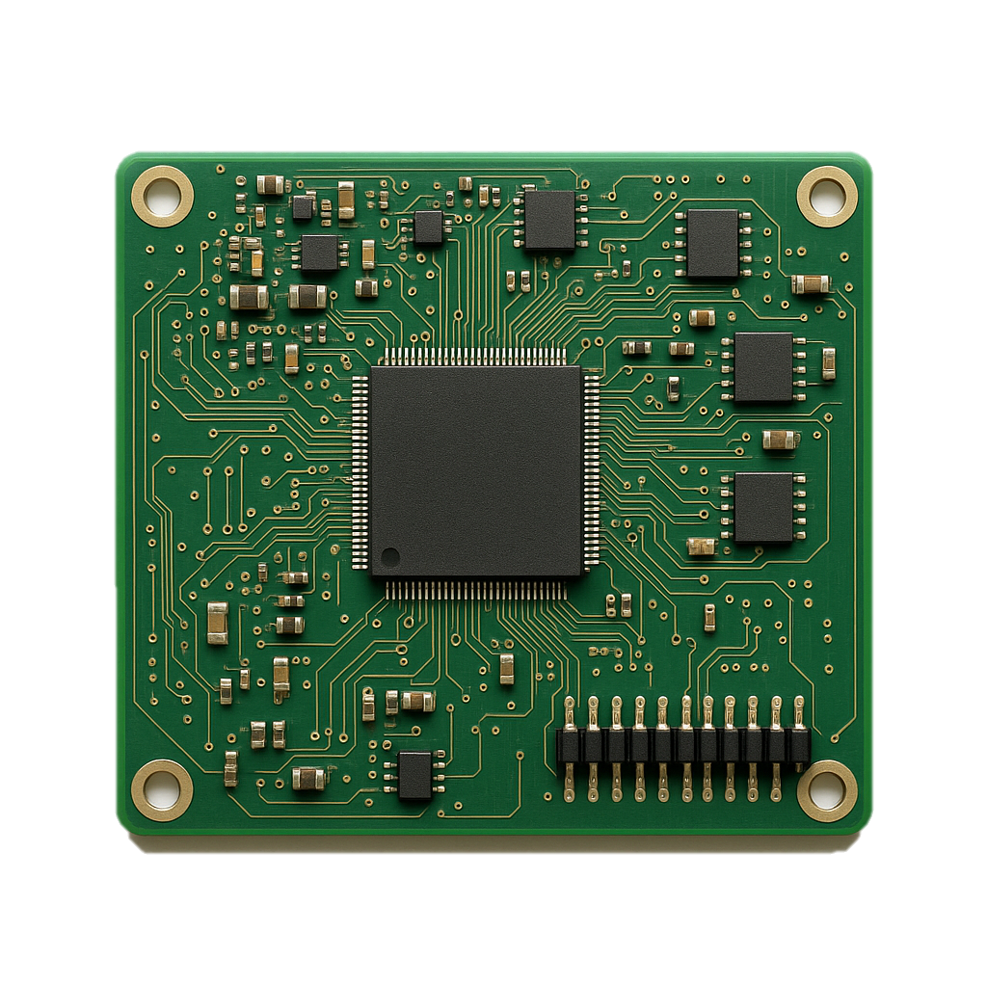
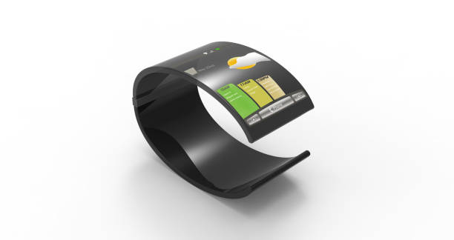
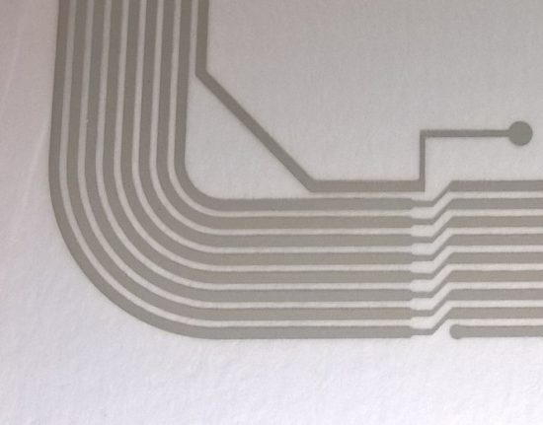
Background
In microelectronics, interconnects and chip bonding ensure electrical signals and power to the device
These processes, especially in printable electronics such as Printed Circuit Boards (PCBs) and flexible screens, rely on low thermal interaction as high temperature causes polymer degradation at > 200°C
conductive silver ink patterns, Google
image of a PCB, chat GPT
flexible display, Google
Notes:
Maybe redo this slide
Why do we need low temp bonding for microelectronics
what is microelectronic bonding: chip attach, interconnects
why do people care about do this at low temperature
This is why I need to solve this issue and why we’re doing this project

Slide 3
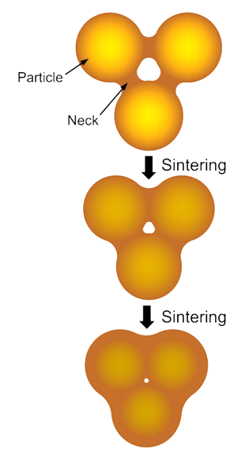
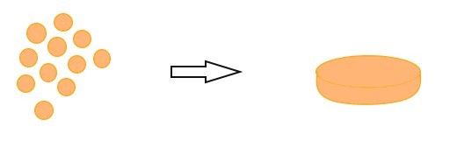
What is Sintering?
Compacting and forming a solid mass of material by heat and/or pressure without melting.
The goal is to fuse the copper particles to give strength
Powder
Solid Mass
Temperature, Pressure
low temperature sintering process, Low-temperature copper sinter-joining technology for power electronics packaging: A review
Notes:
Combined with sintering slide, removing surface diffusion/grain boundary melding for clarity
previous slide
200-250 C done today
how do I make this work at low temperatures
attractive option
c
copper melts at 1000C; sintering + pressure

Slide 4
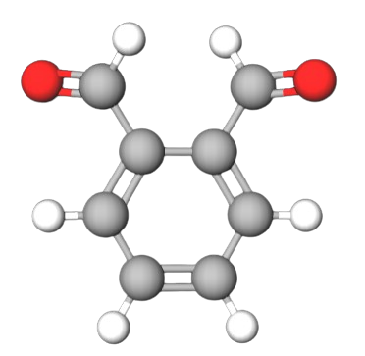
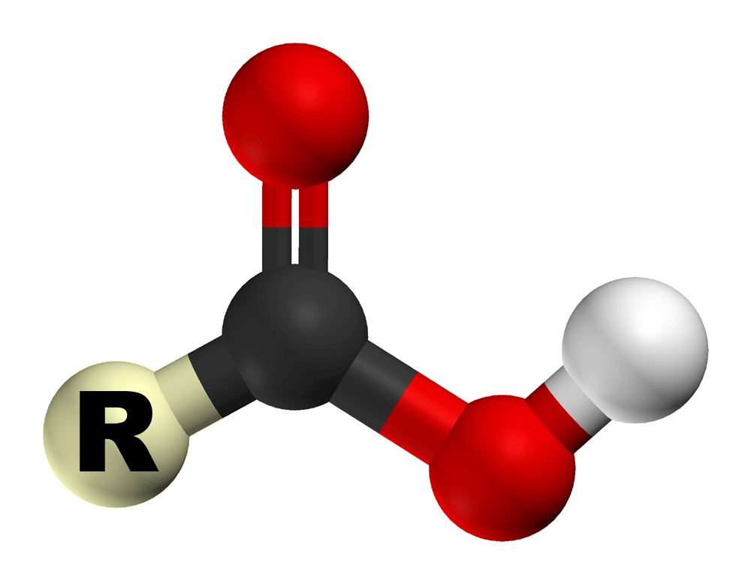
Surface Activation using Additives
Chemical effect
Reducing agent is oxidized, while the copper oxide is reduced to copper metal.
Physical Effect
Acids like sulfuric and hydrochloric work to dissolve copper oxide.
o-Phthalaldehyde, made in MolView
Carboxylic acid structure, Google
Notes:
This is where I’ll introduce the carboxylic acids as surface treatment + the original research with the aldehydes such as OPA and our polymer (PPA)
what is a reducing agent?
Why reducing agent?
reducing agent will remain on surface and help with the metal-metal bonding
external pressure will be added
explain this is what what happening and what I’m looking for
reducing
a and Ad

Slide 5
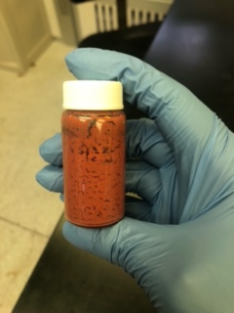
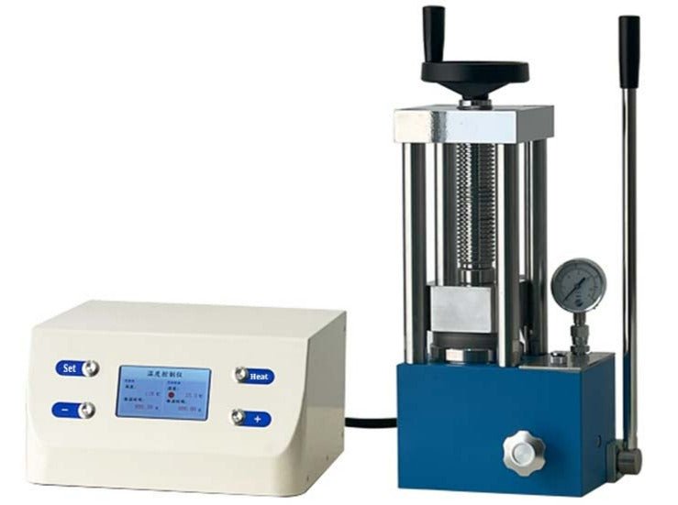
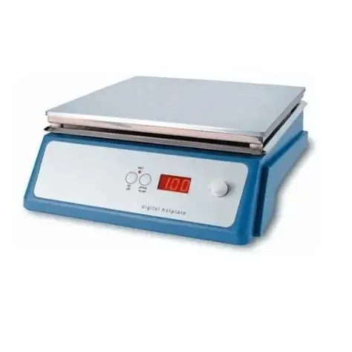
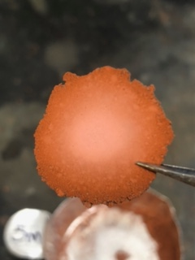
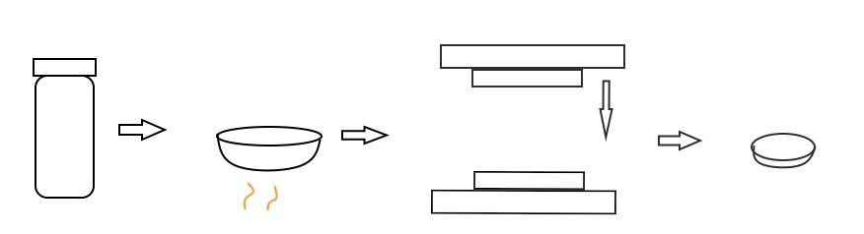
Experiment
Processing
Cu 3-um particles mixed with additives
Formulation
Press
Drying
Digital controller
Plate
Notes:
Mixed reducing agent with the copper 3 um

Slide 6
Sample Scale
Terrible
Overview of Results
No plate formed
Plate barely formed
Plate formed and takes some force to break
Plate formed and takes more force to break
Plate formed and takes significantly more force to break tool required to measure hardness
Survey of Additives
Temperature
Pressure
Time
1
2
3
4
5
Wonderful
Notes:
Capitalize P

Slide 7
Survey of Additives
Conditions: 10 MPa with temperatures ranging from 200-175°C at 10 minutes
1
2
3
4
5
Name | Reducing Agent | Dissolution Agent | Both | Scale
Formic acid (FA) |  |  |  | 5
Acetic acid (AA) |  |  |  | 5
Formic acid w/ OPA |  |  |  | 5
Oxalic acid (OA) |  |  |  | 4
O-Phthalaldehyde (OPA) |  |  |  | 3
Formaldehyde |  |  |  | 2
Benzaldehyde |  |  |  | 2
Sulfuric acid (SA) |  |  |  | 2
Hydrochloric acid (HCL) |  |  |  | 2
Vickers Hardness
34.0
40.3
25.5
Formic acid and formic acid with OPA showed the best overall results in terms of plate strength
Acetic acid worked well after soaking copper for >= 30min
Pure copper has Vickers hardness values ranging from 70-100
Notes:
Table of all the different reducing agents
formic acid works
trying different conditions and finding where these things don’t work
red
results most important
what conditions used
Switch OPA and Oxalic
what a 5 and 2 means based on a microhardness scale & SEM (next slide)
why would I care whether it’s…

Slide 8
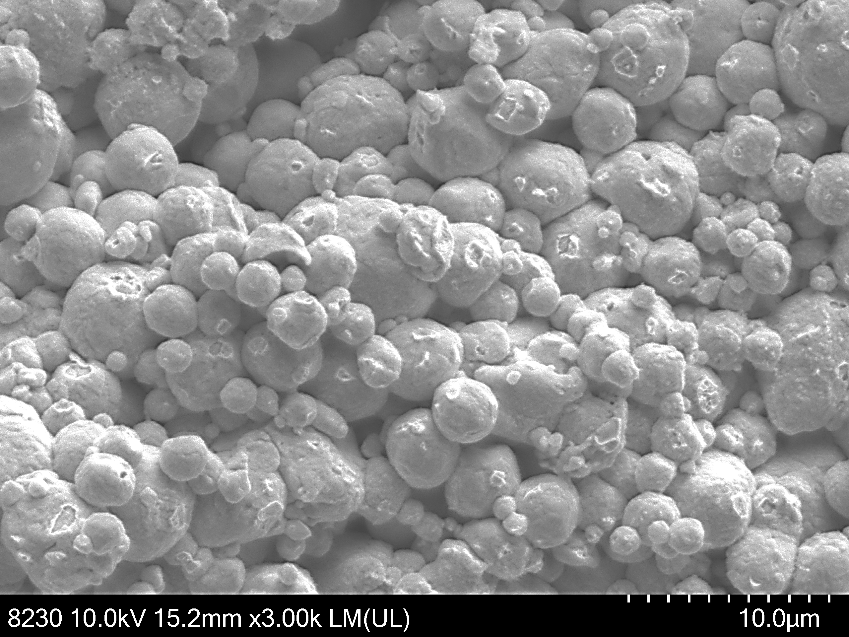
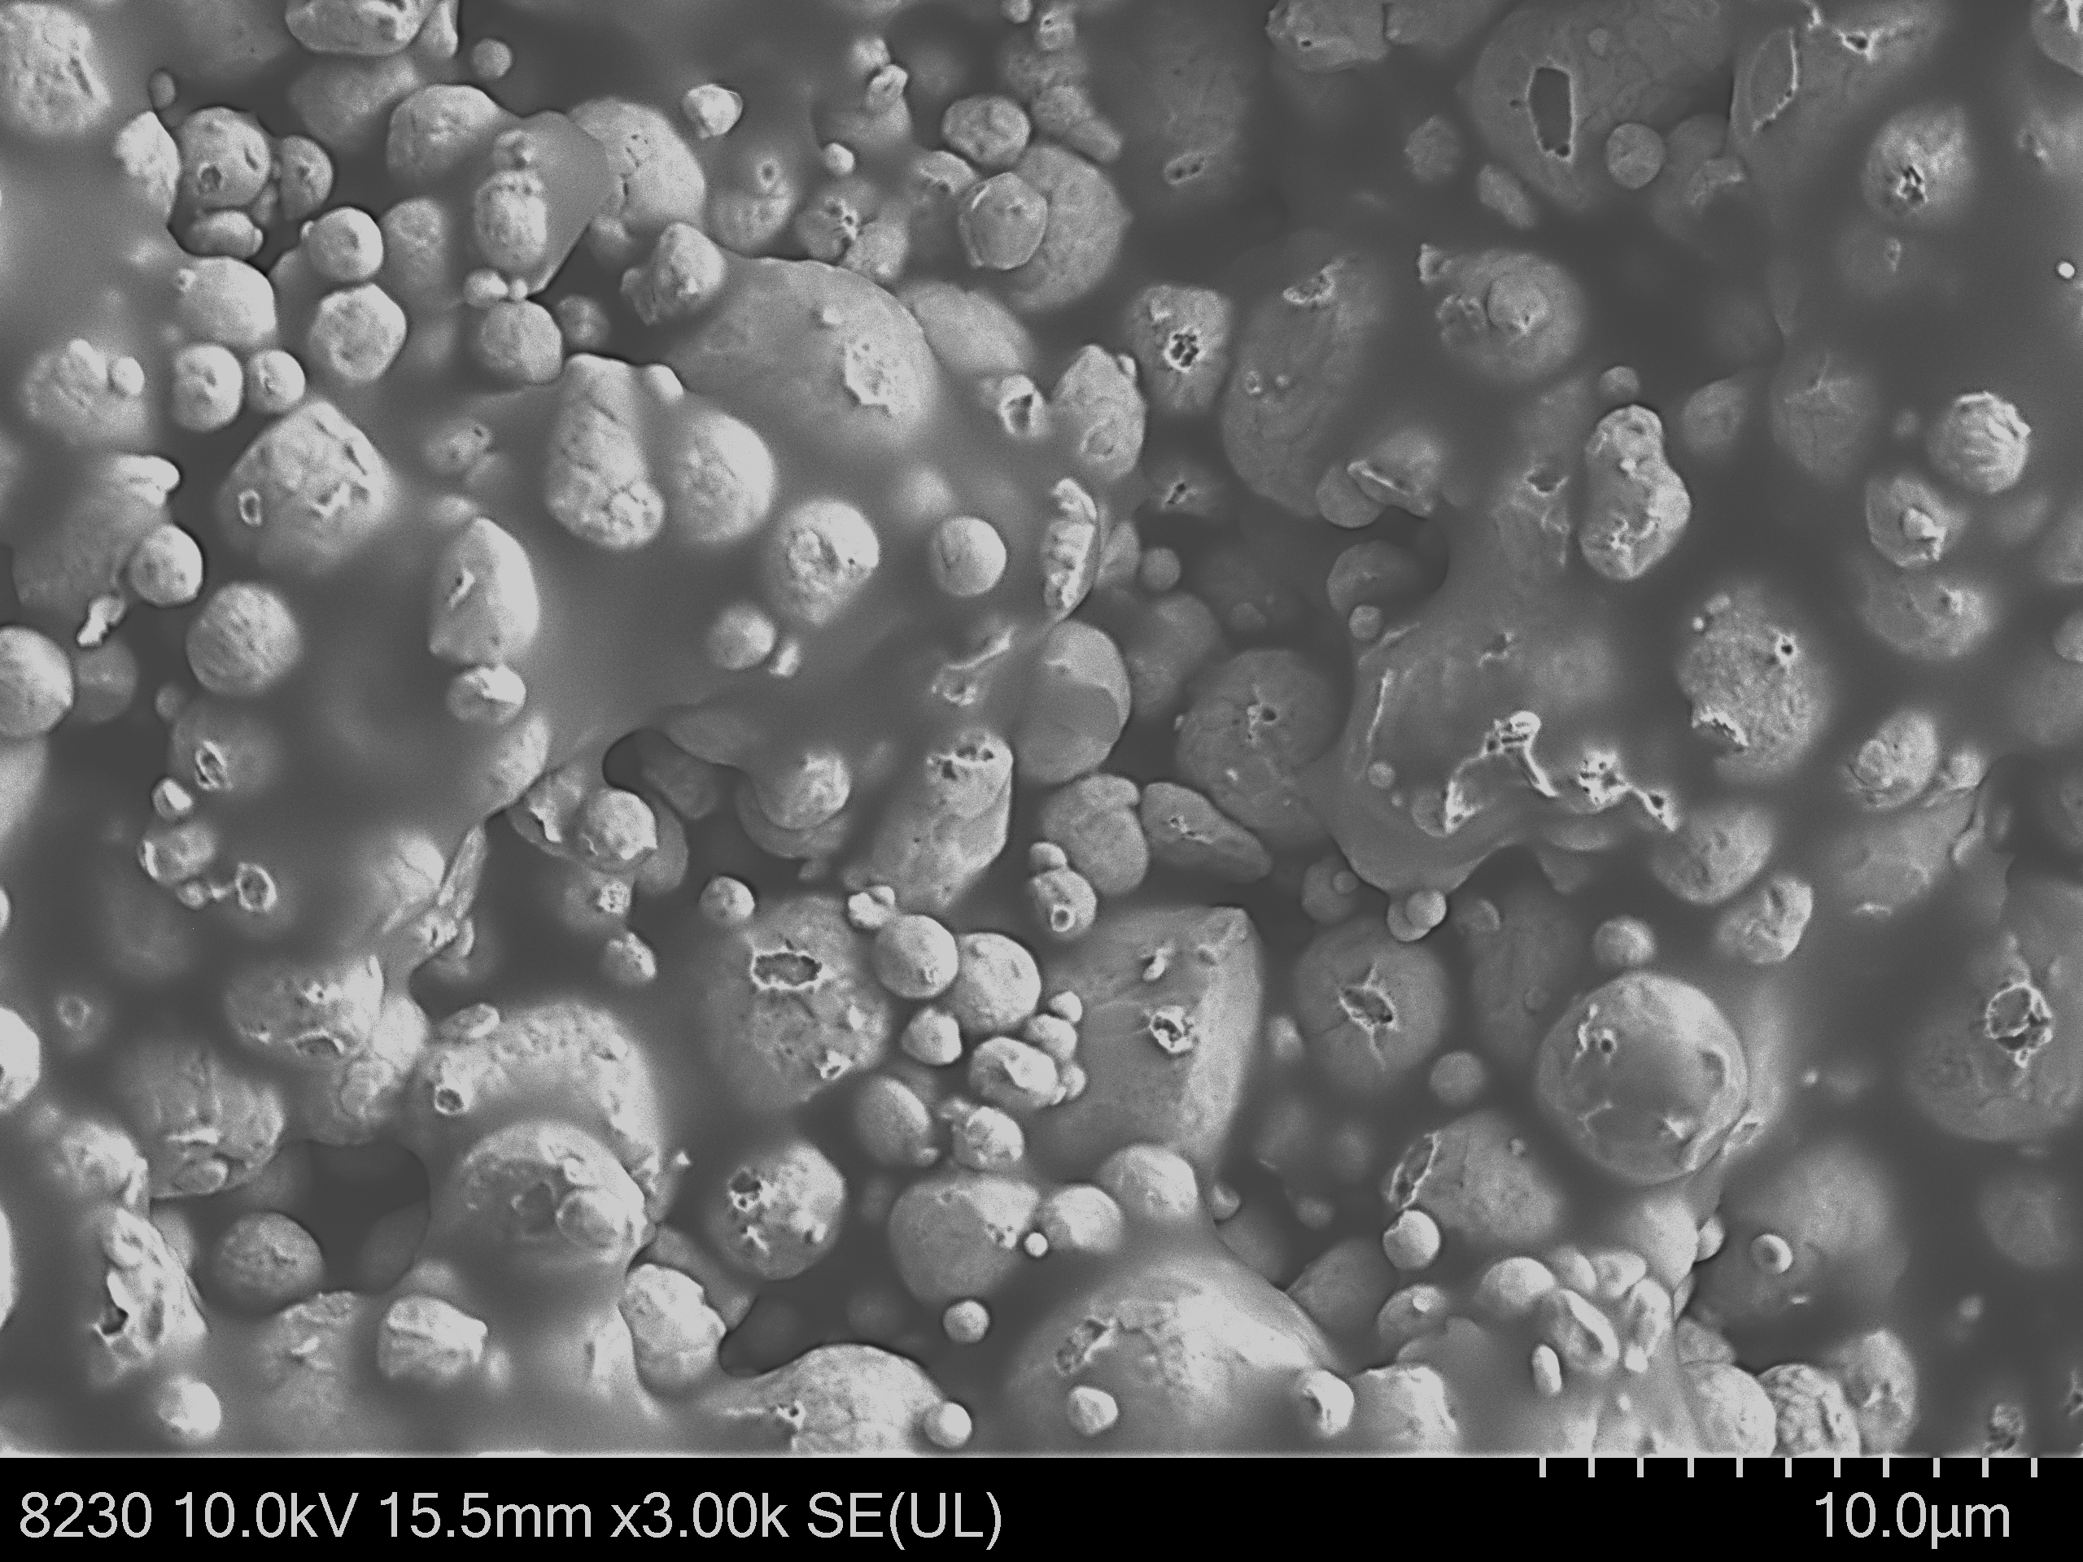
10wt% FA
10wt% OPA, 10wt% FA
FA = Formic acid
OPA = o-Phthalaldehyde
Notes:
This is where I’ll show the results of the different reducing agents and the original research before pivot

Slide 9
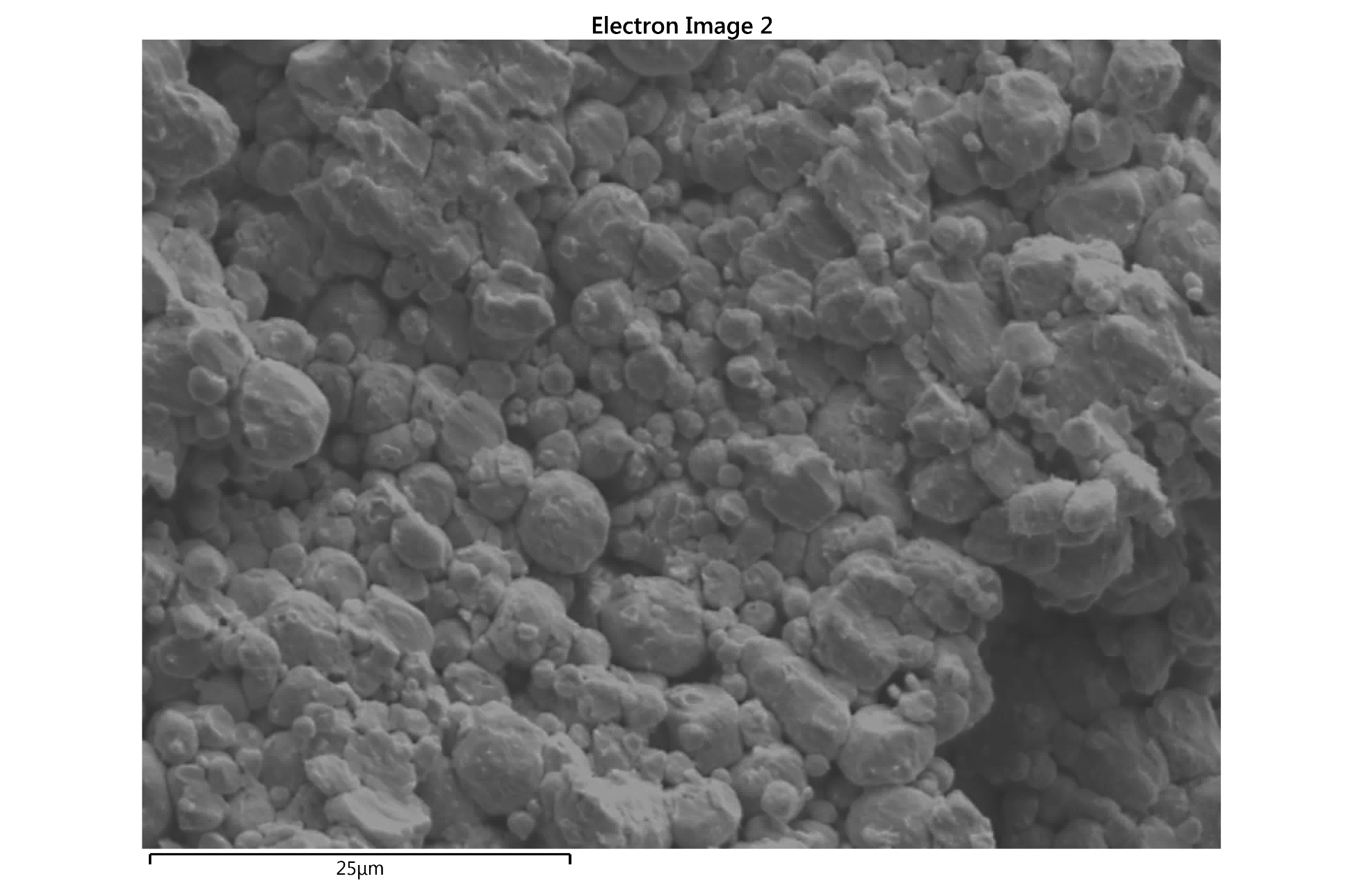
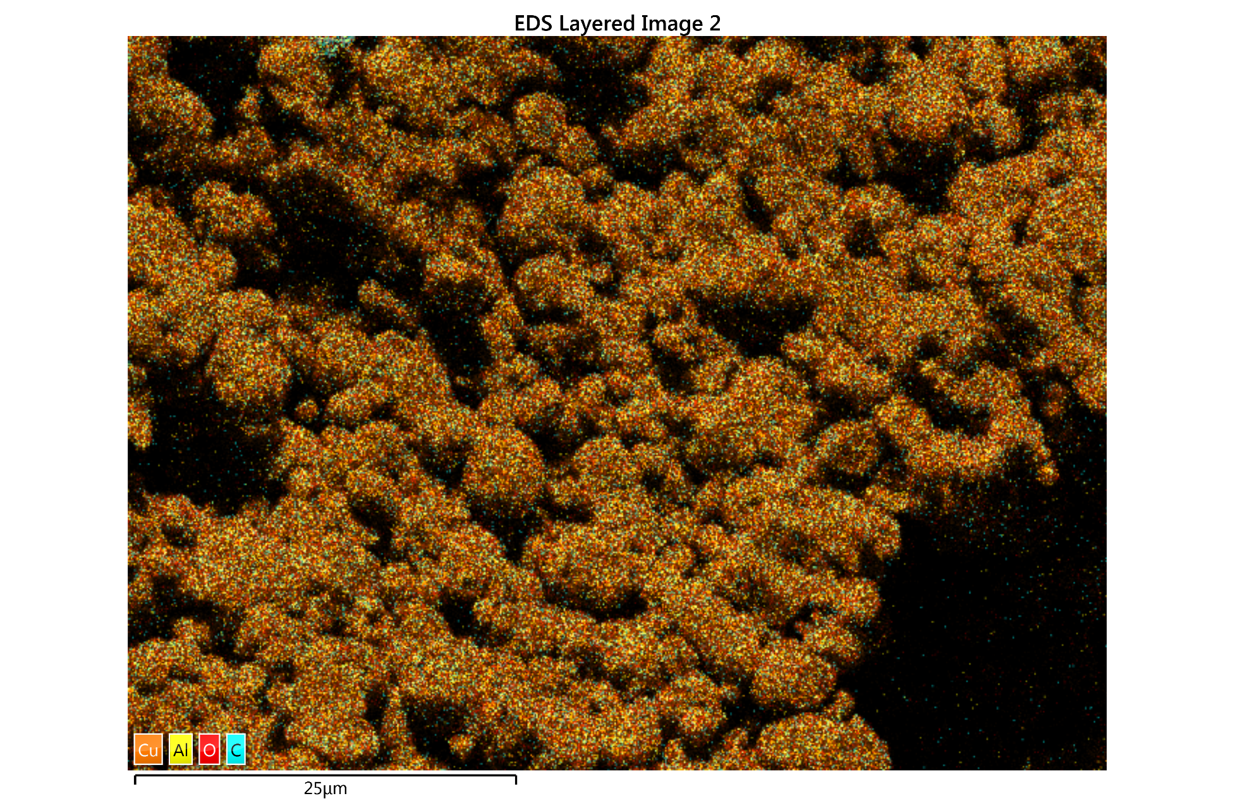
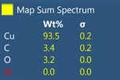
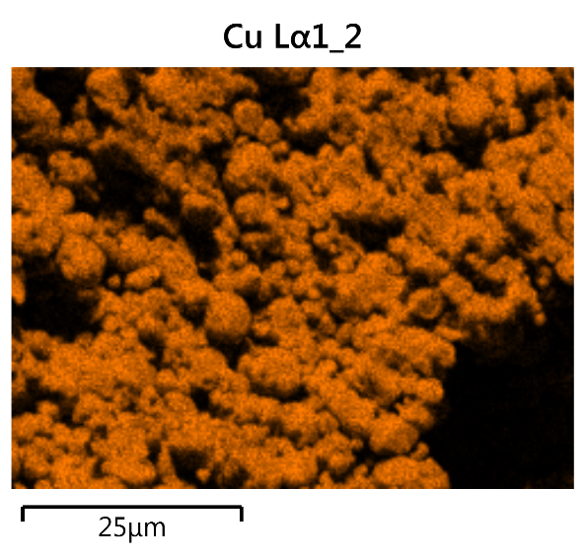
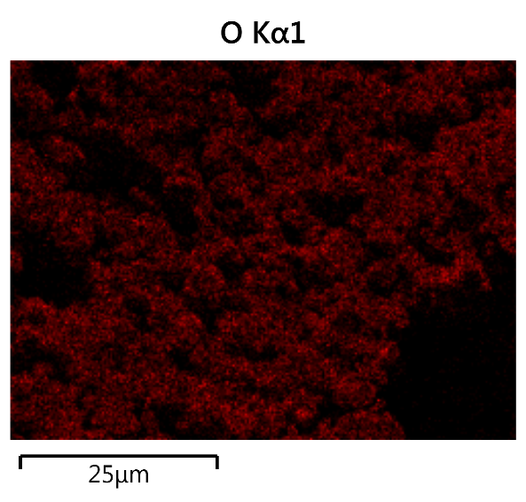
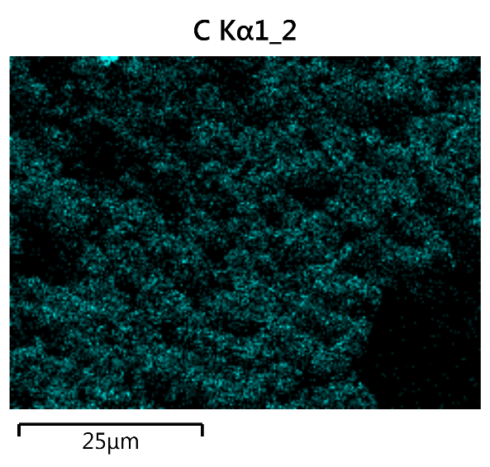
Formulation:
1g Cu
10wt% Formic acid
Notes:
EDS Results

Slide 10
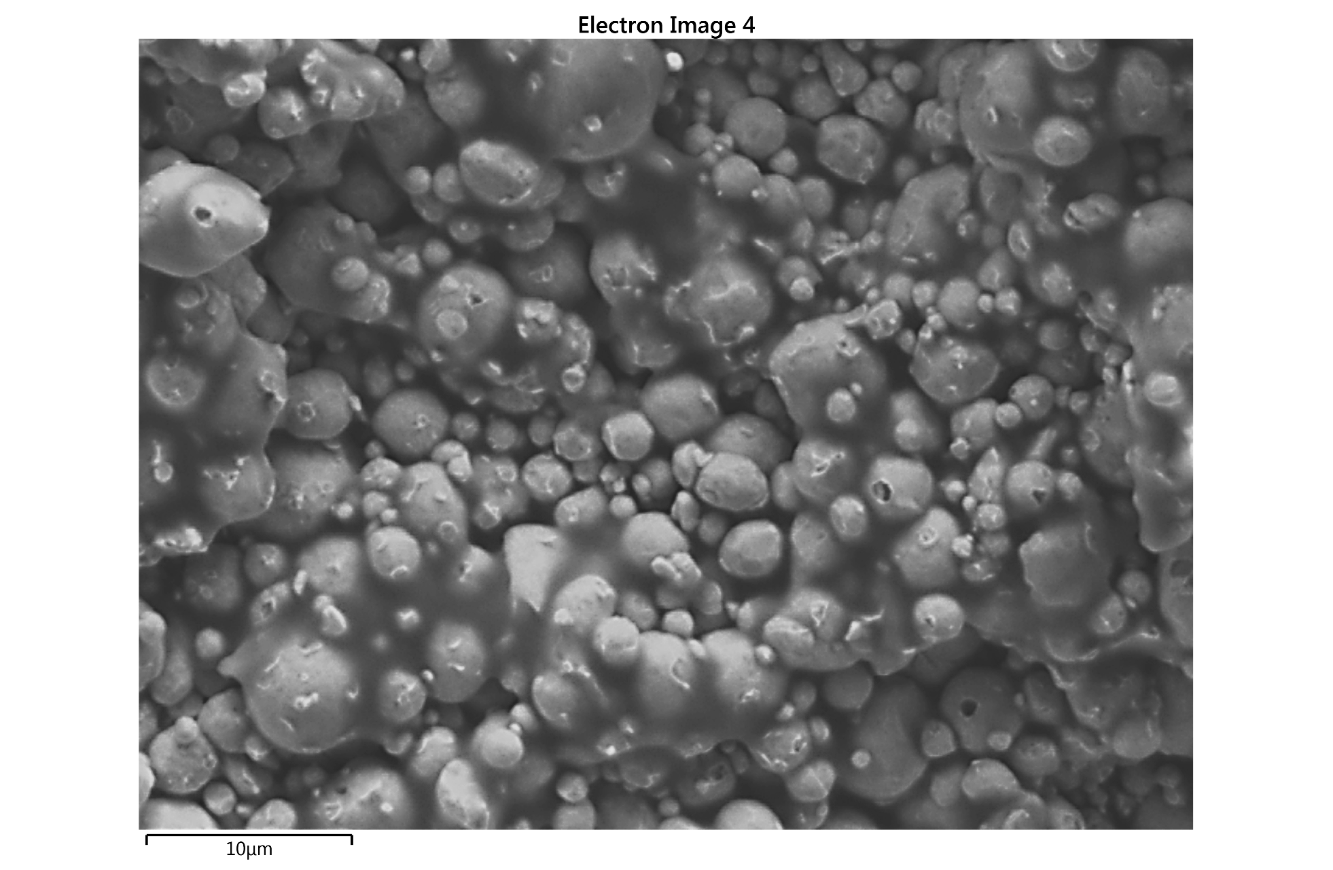
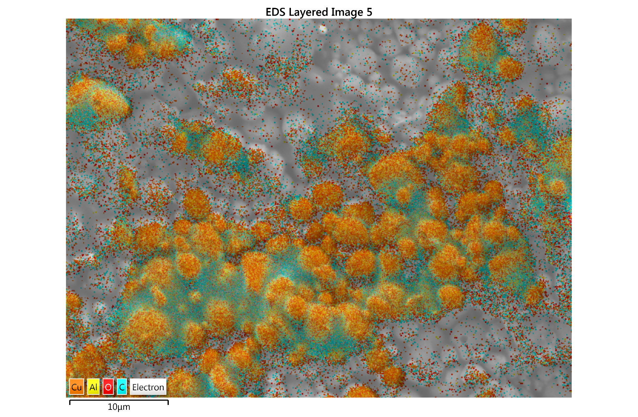
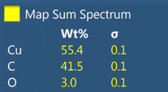
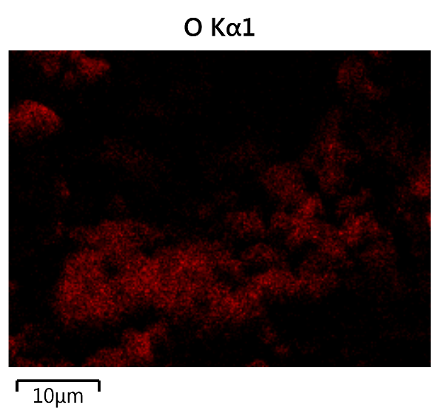
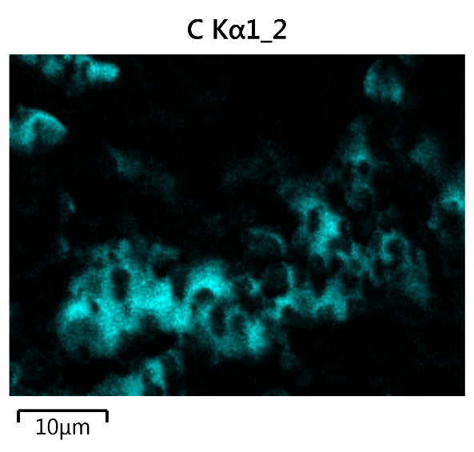
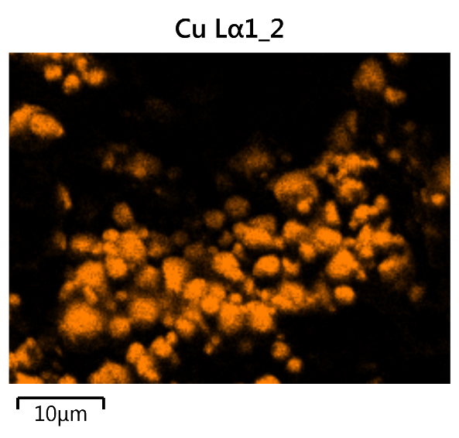
Formulation:
1g Cu
10wt% o-Phthalaldehyde (OPA),
10wt% Formic acid

Slide 11
Temperature Tests
1
2
3
4
5
Formulation:
1g Cu
10wt% Formic acid
Conditions:
10 MPa
10 min
As temperature decreased, the plate strength decreased with 135°C showing a significant difference
At 135°C processing just copper resulted in no plate forming
(No formic acid)
Notes:
2nd Temperature tests
Graph as temp decreases, strength decreases
changing pressure (control of pressure)

Slide 12
Pressure Tests
Formulation: 1g Cu, 10 wt% Formic acid
Sample ID | Temperature | Pressure | Time | Scale
P1 | 135°C | 30 MPa | 10 min | 5
P2 | 135°C | 30 MPa | 5 min | 5
P3 | 135°C | 30 MPa | 1 min | 5
P4 | 135°C | 30 MPa | 30 sec | 5
P5 | 120°C | 30 MPa | 10 min | 5
P6 | 110°C | 30 MPa | 10 min | 5
P7 | 100°C | 30 MPa | 10 min | 5
P8 | 100°C | 30 MPa | 5 min | 5
P9 | 100°C | 30 MPa | 1 min | 5
P10 | 100°C | 30 MPa | 30 sec | 5
P11 | 100°C | 20 MPa | 10 min | 5
P12 | 100°C | 20 MPa | 5 min | 4
P13 | 100°C | 20 MPa | 1 min | 4
Notes:
Surface activation seems to work at these temperatures and pressure seems to play a much larger role at bonding
explain it better that pressure is a major factor in the sintering process

Slide 13
Conclusion and Next Steps
Organic acids can dissolve and reduce the metal oxide resulting in better fusion
Of those organic acids used, formic acid facilitates superior plate formation
Higher pressure allows for strong plate formation at temperatures as a low as 100°C
Further Research
A more systematic study of pressure
Added copper ions could increase the amount of copper metal formed by the reducing agent
Notes:
N, S
O

Slide 14
Acknowledgements
Questions
A special thank you to:
Dr. Paul Kohl
Jose Lopez
Kaijun Feng
Dr. Mikkel Thomas
Leslie O’Neill
?
Notes:
Thank you

