Slide 1
Mixed-Cation Chiral 2D Perovskites Targeting Long Spin Lifetime
Rebecca Guan^{1,2}, Ruitao Wen², Lina Quan²
¹Cornell University, ²University of North Carolina at Chapel Hill

Slide 2
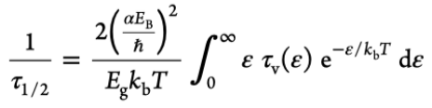
Background
Spin Lifetime
Dyakonov-Perel (DP) spin relaxation mechanism: the loss of the polarization of electron spins due to the precession of electrons around a momentum-dependent effective magnetic field
2D Chiral Hybrid Halide Perovskites
Hybrid halide perovskites have the general formula ABX₃, where A is an organic monovalent cation, B is typically a divalent metal, and X is a halide
The inversion symmetry breaking and spin splitting in chiral perovskites help prolong τ_{1/2}
2D phase perovskites are desired due to their quantum well-like structures
Cation Mixing
Previous studies have found that the incorporation of an achiral –OH into 2D perovskite structures leads to a small exciton binding energy and, thus, a relatively long spin lifetime¹
However, studies using a single chiral cation with a –OH didn’t form the 2D phase²
Notes:
Recently, materials with spins have been studied for spintronic applications, where the spin degree of freedom is used to store data. One challenge is that the electrons lose their spin orientation too quickly to be useful through spin relaxation mechanisms like the Dyakonov-Perel spin relaxation mechanism. In this mechanism, the electron spins lose their polarization due to the precession of electrons around a momentum-dependent effective magnetic field. In addition, the equation modeling the Dyakonov-Perel mechanism shows that the spin lifetime is inversely related to the exciton binding energy.
Hybrid halide perovskites have the general formula ABX3, where A is an organic monovalent cation, B is typically a divalent metal, and X is a halide. Chiral perovskites, in specific, exhibit inversion symmetry breaking and spin splitting, which help prolong the spin lifetime. 2D phase perovskites are desired due to their quantum well-like structures and tunable band gaps.
Previous studies found that 2D perovskites with a –OH group lead to a small exciton binding energy and a long spin lifetime. The highly polar hydroxyl group raises the dielectric constant of the organic layer, providing a dielectric screening effect on the inorganic framework, thus weakening the binding energy between the electron and hole within the exciton.
However, studies using a single chiral cation with a –OH didn’t form the 2D phase. It was found that the –OH forms hydrogen bonds with the inorganic framework, distorting the structure. In addition, chiral molecules with side chains increase the conformational restrictions. This necessitates the exploration of mixed-cation systems, one with an achiral –OH and another with a chiral amine.

Slide 3
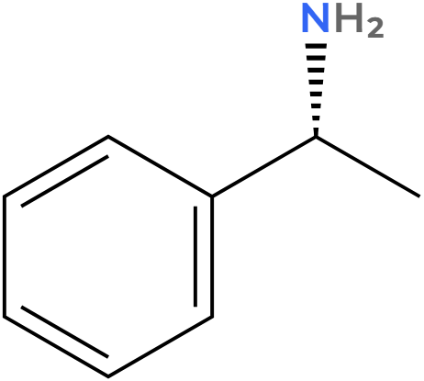
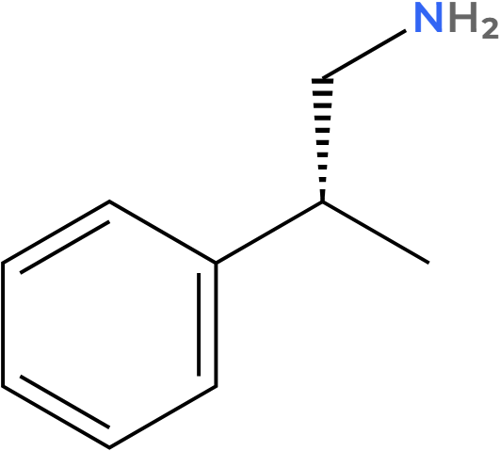
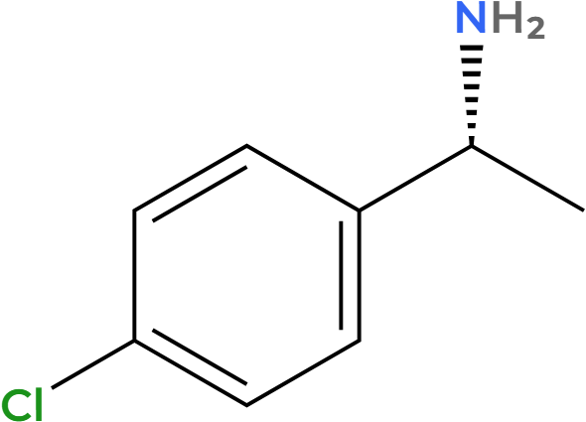
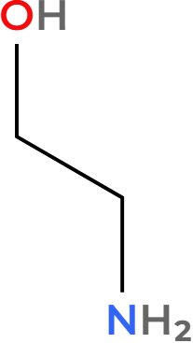
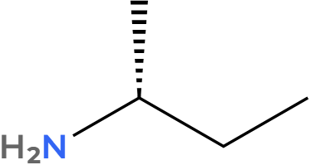
Materials and Methods
Solutions were made by mixing the following materials and then sonicating the solution at 50°C until the solute dissolved:
PbI₂
HI
methanol
1.
2.
3.
4.
R-methylbenzylamine
(R-MBA)
R-methylphenylethylamine
(R-MePEA)
R-chloro-methylbenzylamine
(R-Cl-MBA)
R-butylamine
(R-BA)
ethanolamine
(EOA)
Slow Evaporation
Spin Coating
Seal solution vial with parafilm
Poke hole in
parafilm using needle
Store vial in glove box for slow evaporation
Filter solution using needle
Spin coat at 2000 rpm for 60 sec
Anneal on hot
plate for 10 min

Slide 4
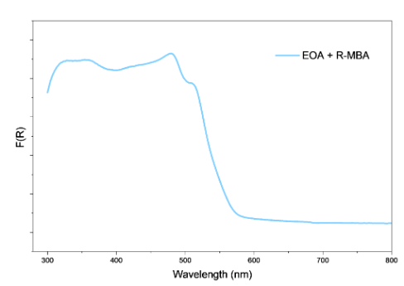
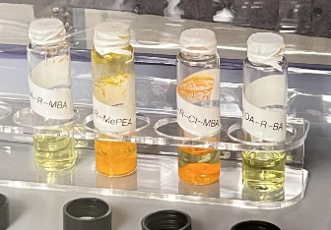
Results: Crystals From Slow Evaporation
Crystals:
Absorbance Data:
Broad excitonic absorption features
EOA + R-MePEA and EOA + R-Cl-MBA solutions started crystallizing almost immediately
EOA + R-BA solution never crystallized
The broad excitonic absorption features suggest that the crystals have a relatively long spin lifetime

Slide 5
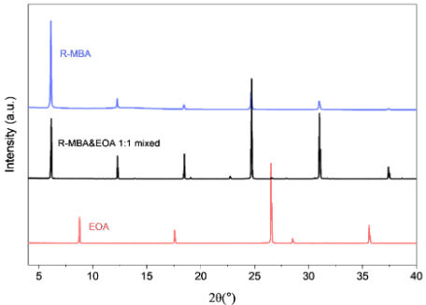
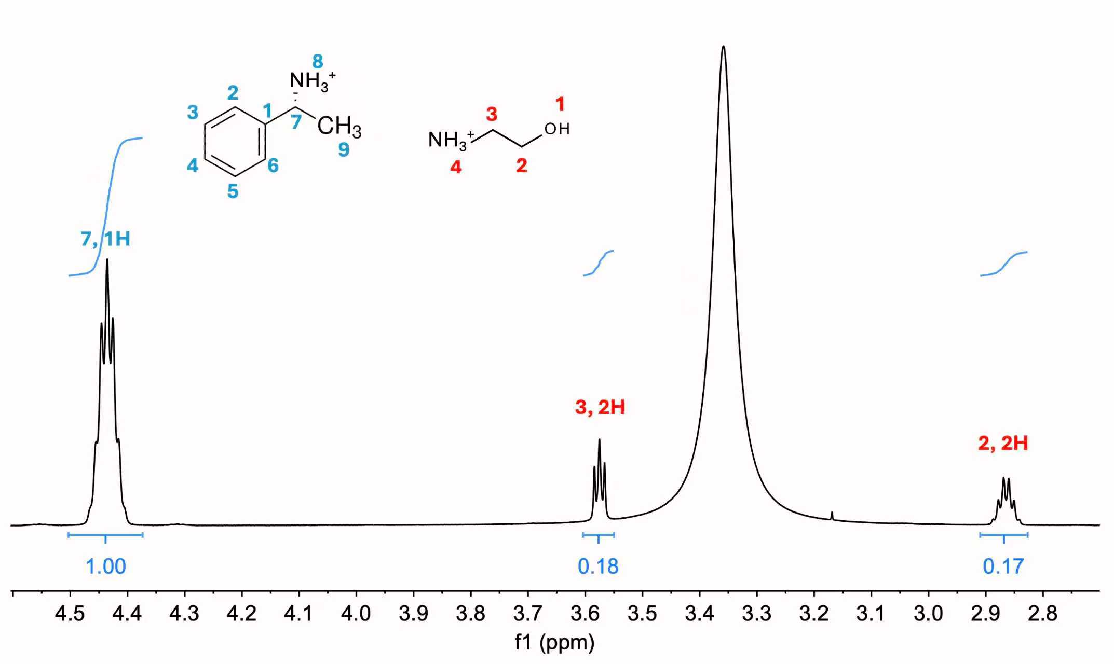
Results: Crystals From Slow Evaporation
P-XRD Data:
NMR of Single Crystal Data:
XRD data show that the crystals’ interlayer spacing resembles that of the amine
NMR data show that the overall structure may have ~7% EOA

Slide 6
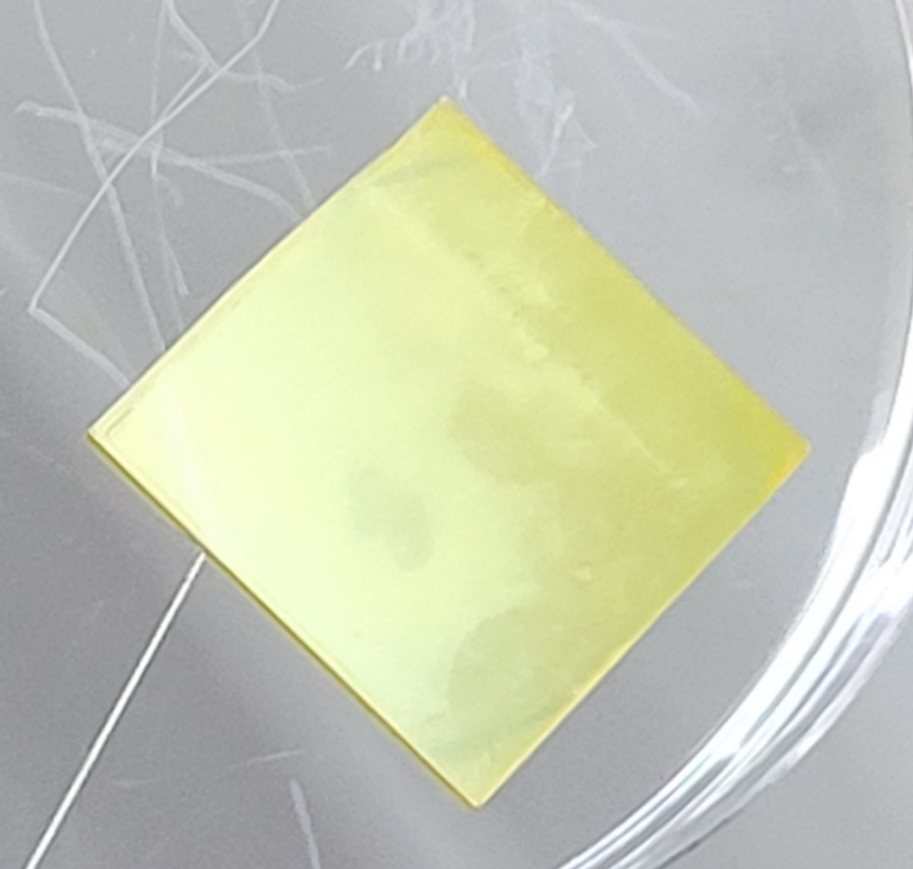
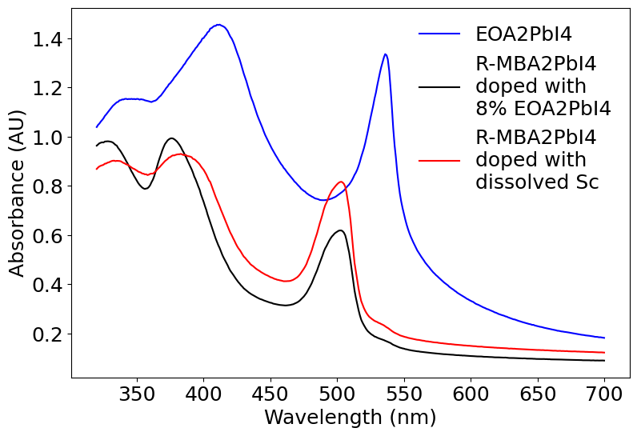
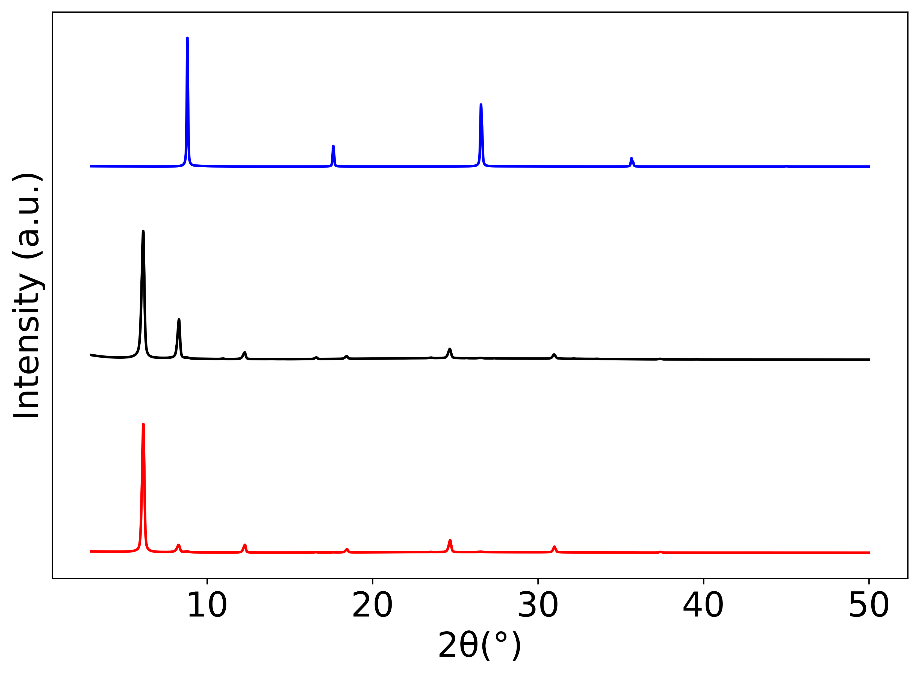
Results: Thin Films From Spin Coating
R-MBA film:
Absorbance Data:
P-XRD Data:
The absorbance and XRD data suggest phase segregation into EOA and R-MBA-based 2D structures
Might be due to moisture-induced EOA recrystallization

Slide 7
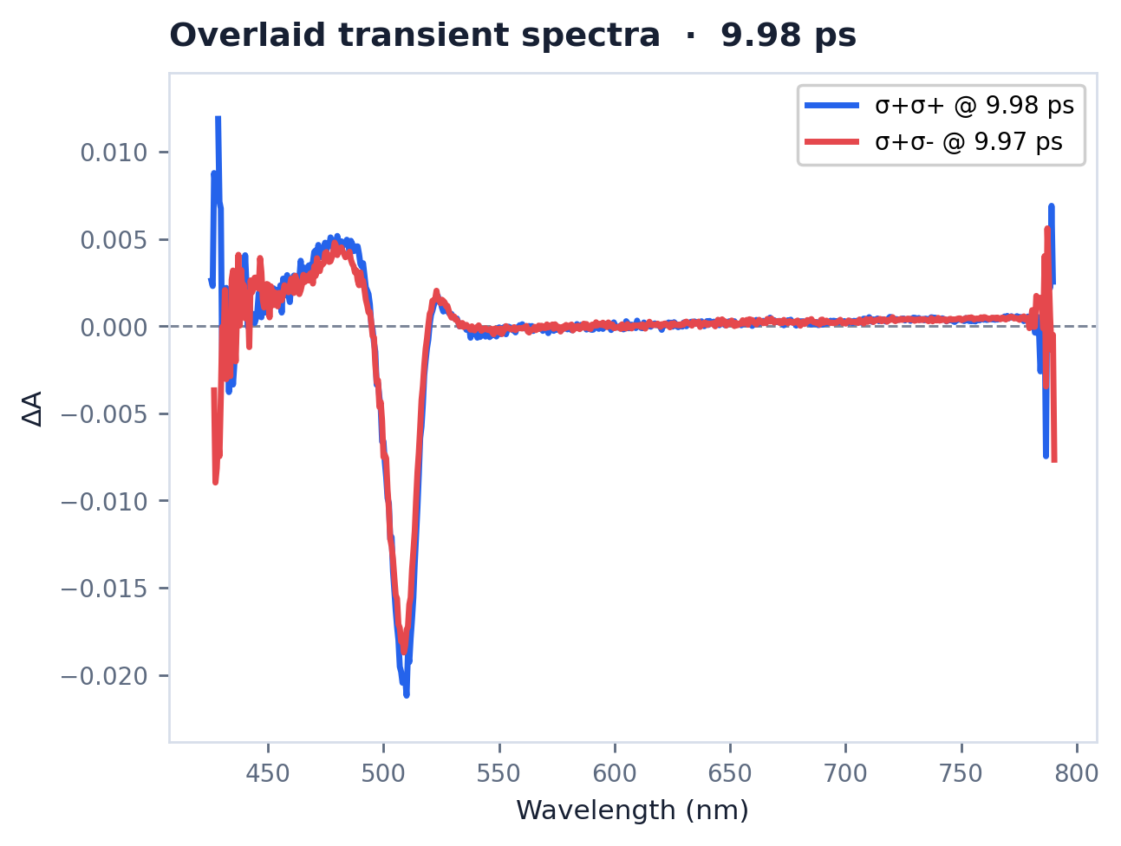
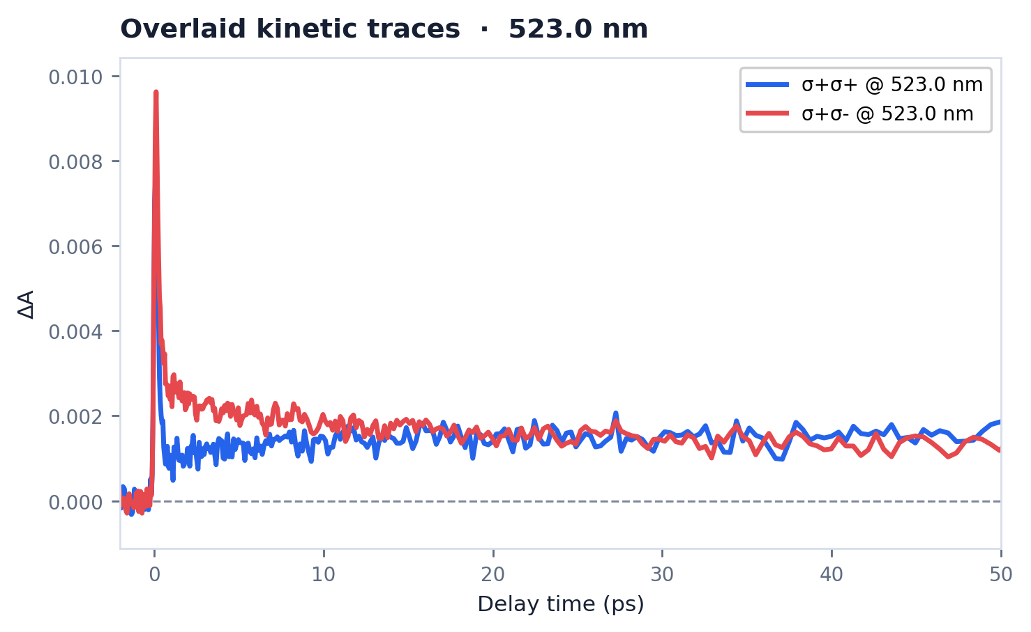
Results: Thin Films From Coating
TAS Data:
By encapsulating the sample inside a glove box, we ensure there is no phase segregation → signal suggests a pure phase
The right plot shows a spin lifetime of ~10 picoseconds

Slide 8
Conclusions and Future Directions
Conclusions
We attempted to incorporate EOA and R-MBA to form a chiral 2D lead iodide perovskite
XRD and NMR measurements indicate that EOA is incorporated at ~7%
Encapsulation during sample preparation eliminated the phase segregation observed under ambient conditions, suggesting formation of a pure mixed-cation phase
Transient absorption spectroscopy indicates a spin lifetime of ~10 picoseconds
Future Directions
Potential future directions include:
Synthesize 2D EOA lead iodide perovskite and 2D R-MBA lead iodide perovskite to compare the spin lifetimes
Taking spin lifetime measurements for the other synthesized samples that crystallized (EOA + R-MePEA + PBI₄ and EOA + R-Cl-MBA + PbI₄)
Solving the single crystal structure of the above-mentioned single crystals
Exploring the structures formed from different mixed cation ratios

Slide 9
Thank You!
Acknowledgements
This material is based upon work which is supported by the National Science Foundation (award numbers 2447827, 2447828, 2447829 and ECCS-2025064). Any opinions, findings, and conclusions or recommendations expressed in this material are those of the author(s) and do not necessarily reflect the views of the National Science Foundation. In addition, the author thanks their mentor and PI for the support given during research.
Contact for any questions: rzg5@cornell.edu
References
¹Beard et al., J. Am. Chem. Soc. 2021, 143, 46, 19438–19445
²Coccia et al., ACS Mater Lett. 2025 Jul 18;7(8):2980–2987

