Slide 1




Kinetics of Nanotopography-Induced Transient Nuclear Membrane Rupture and Repair
By
Aashi Venkat
University of California, San Diego &
San Diego Nanotechnology Infrastructure (SDNI)
Faculty PI: Zeinab Jahed, PhD, Aiiso Yufeng Li Family Department of Chemical and Nano Engineering, UC San Diego
Mentor: Hamed Naghsh-Nilchi, Aiiso Yufeng Li Family Department of Chemical and Nano Engineering, UC San Diego
Presented at the 2026 NNCI REU Convocation, GA Tech, Atlanta, Georgia
August 3-4, 2026
Notes:
Hello, my name is Aashi Venkat, an undergraduate student in the Bioengineering department at UCSD. I am working under the supervision of Dr. Jahed’s lab and mentorship of a PhD student, Hamed.
The goal of this project is to study the kinetics of nanotopography-induced transient nuclear membrane rupture and repair. using live cell imaging.
transition: To understand the project, I will first intrudyce nuclear envelope rupture, explain why it matters, and then show how we use nanopillars and NLS-GFP reporter to observe these events.

Slide 2
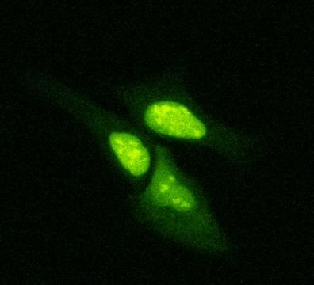
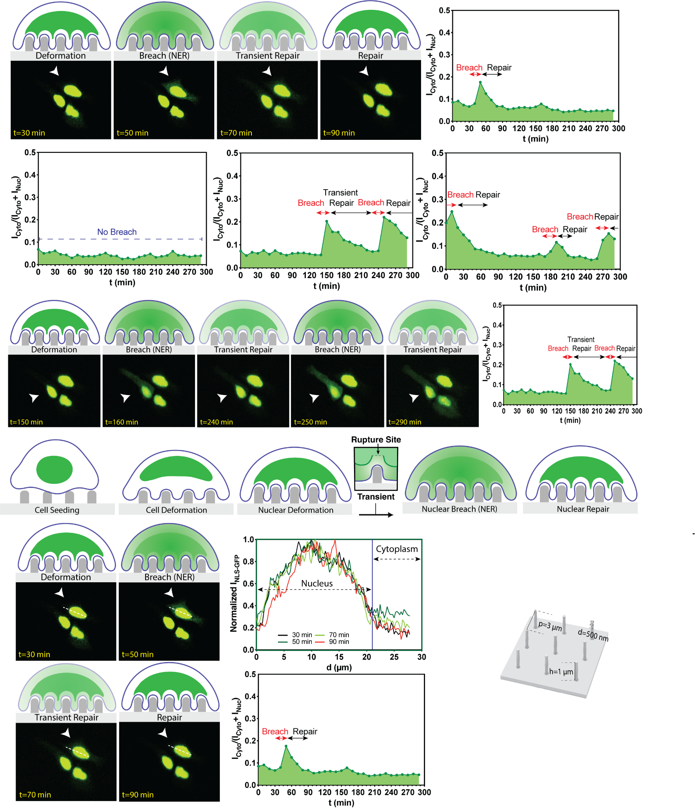
Overview
Inducing nuclear envelope rupture via curvature on the membrane.
Use of live imaging microscopy to track the process of nuclear envelope rupture and repair.
Provides a platform for future investigation of proteins and pathways involved in nuclear envelope repair.
1
Notes:
Just to provide an overview before getting started, we investigate if nanoscale surface curvatures can deform the nucleus and if this curvature can induce nuclear envelope rupture. We use live cell imaging to track the nuclear envelope stability over time rather than observing only fixed time points. This helps us to determine when rupture happens, and if the cell repairs it, or if we can see more rupture events in a single cell.
Establishing a workflow provides us a platform for future studies of proteins and pathways involved in nuclear envelope repair.

Slide 3
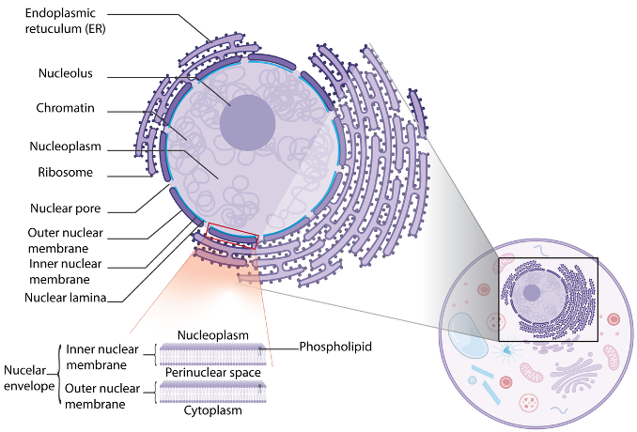
The Nucleus and the Nuclear Envelope
Nucleus
A membrane bound organelle in eukaryotic cells that contains cell’s genetic makeup
Nuclear Envelope (NE)
A double-layer phospholipid membrane (inner and outer nuclear membrane) that separates the nucleoplasm from the cytoplasm and regulates all nucleo-cytoplasmic transport
Nuclear Lamina
A mesh of lamin (supporting protein filaments) lining the inner nuclear membrane, providing structural support to the nucleus
Ungricht, Rosemarie, and Ulrike Kutay. Nature Reviews molecular cell biology 18.4 (2017): 229-245.
2
Notes:
The nucleus stores and protects the genetic information of the cells. The nucleus is protected by nuclear envelope, that is two double layer phospholipid bilayer, and a lamin filament meshwork that provides mechanical stability.
In eukaryotic cells, genetic information is stored within the nucleus in the form of chromatin. This nucleus is surrounded by the nuclear envelope, consisting of the ONM, INM, and perinuclear region. Spanning this envelope are nuclear pores, which allow for nucleocytoplasmic transport. In addition to this, the nucleus also has a lamina, which is a mesh framework of protein filaments (lamins) that provides the nucleus with structural support and rigidity.

Slide 4
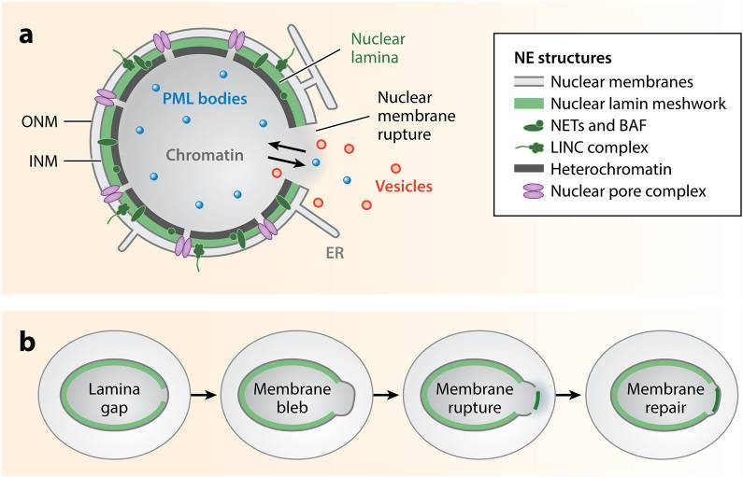
How Nuclear Envelope Rupture (NER) Happens
Mechanical stress is applied to the nuclear lamina
Weak points in the lamina leads to membrane blebbing and rupture
Repair proteins and machinery are recruited to the site of rupture
3
Notes:
However, the nuclear envelope can rupture, which typically occurs due to mechanical stress being applied to the lamina. This results in weakening of the lamina and the NE as a whole, eventually resulting in nuclear decompartmentalization and rupture. During this rupture period, DNA and nuclear proteins can exit into the cytoplasm, just as cytoplasmic nucleases and other proteins can enter the nucleus. However, the rupture event also results in the recruitment of repair proteins and machinery that aid in the relocalization of mislocalized proteins/DNA, in addition to repairing the ruptured envelope and gaps in the lamina. While the cell will rarely die from a single rupture, it is important to note that repeated rupture or unrepaired ruptures can result in irreparable DNA damage, triggering an inflammatory response.

Slide 5
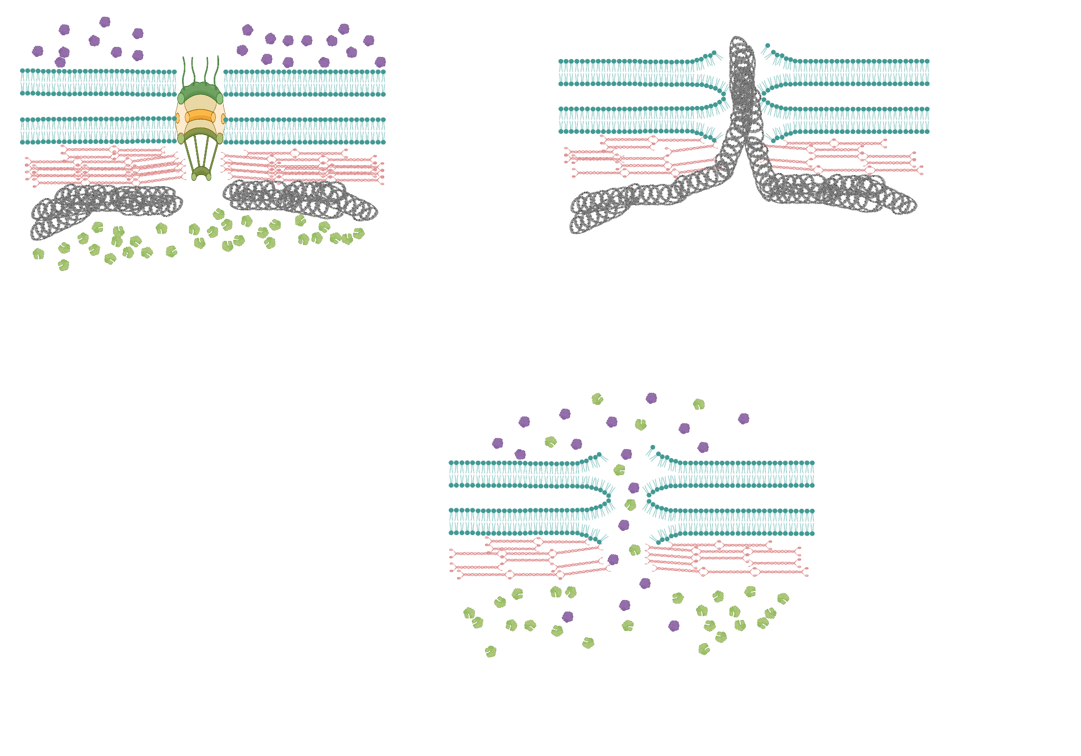
Implications of NER
During rupture, nuclear proteins enter the cytoplasm and cytoplasmic proteins enter nucleus
Chromatin bulges into the cytoplasm through the rupture site, where cytoplasm nucleases digest exposed DNA
The cell rarely dies from a single rupture, but repeated or unrepaired ruptures causes DNA damage and triggers inflammatory response
Halfmann, Charles T., et al. Journal of Cell Biology 218.7 (2019): 2136-2149.
4
Maciejowski, John, and Emily M. Hatch. Annual review of cell and developmental biology 36.1 (2020): 85-114.
Notes:
However, the nuclear envelope can rupture, which typically occurs due to mechanical stress being applied to the lamina. This results in weakening of the lamina and the NE as a whole, eventually resulting in nuclear decompartmentalization and rupture. During this rupture period, DNA and nuclear proteins can exit into the cytoplasm, just as cytoplasmic nucleases and other proteins can enter the nucleus. However, the rupture event also results in the recruitment of repair proteins and machinery that aid in the relocalization of mislocalized proteins/DNA, in addition to repairing the ruptured envelope and gaps in the lamina. While the cell will rarely die from a single rupture, it is important to note that repeated rupture or unrepaired ruptures can result in irreparable DNA damage, triggering an inflammatory response.

Slide 6
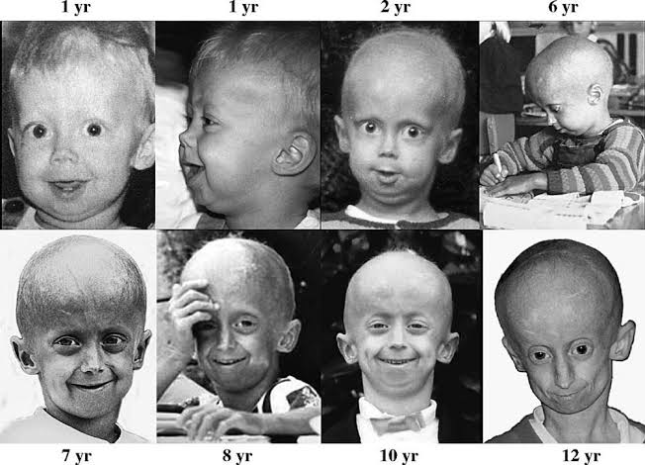
Diseases and Disorders Associated with NER
When NER Repair Fails or is Incomplete
Cancer Metastasis
Cancer cells can experience NER when migrating through tight tissue, and these ruptures result in DNA damage and loss of DNA repair proteins. This can also contribute to cancer metastasis.
Increased Risk of NER
Laminopathy Disorders (i.e. Progeria)
Damaged or mutated lamins weaken the nuclear lamina, increasing risk of rupture. Persistent rupture can trigger inflammatory response.
Denais, Celine M., et al. Science 352.6283 (2016): 353-358.
Docquity. (2023). https://docquity.com/articles/about-hutchinson-gilford-progeria-syndrome/
Hatch, Emily M. Current Opinion in Cell Biology 52 (2020): 66-72.
Hatch, Emily M and Martin W. Hetzer. Journal of Cell Biology 215.1 (2016): 27-36
5
Notes:
What happens if the repair process fails? This can result in chromatin herniation, which exposes DNA to the cytoplasm. This often leads to DNA damage due to cytoplasmic nucleases breaking down the exposed DNA, and this increases the development of cancerous mutations. In addition, mutated lamina makes it easier for the NE to rupture, which is why laminopathy disorders contribute to an increase of NER and thereby an increase in inflammatory response due to trigger of the cGAS-STING pathway.

Slide 7
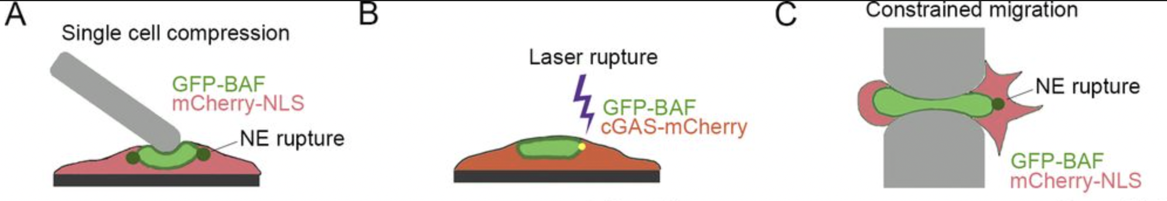
Inducing NER to Understanding Biology and Therapeutic Development
Atomic Force Microscopy
Laser Induced Rupture
Microfluidics Constriction
Physically compressing the cell and nucleus induced NER
Focused laser at constant wavelength targets a specific spot on NE, inducing NER
Cells migrate through a microfluidic constriction (3 µm gap), squeezing the nucleus inducing NER
Direct force application
Spatially precise
Physiologically relevant
Captures NER during migration
Low throughput (1 cell at a time)
Skilled operator required
Low throughput (1 cell at a time)
Photoxic side effects
Limited to migratory cells
Halfmann, C. et. al. Journal of Cell Biology 218.7 (2019): 2136-2149
6
Notes:
People want to study NER to find cures to the previously mentioned diseases and disorders. These are existing methods that have been used to study NER.
Throughout the years, different ways to scientifically induce NER have arisen. One example is Atomic Force Microscopy (or AFM), where a probe is applied onto the cell at a constant pressure, eventually leading to rupture. This is beneficial because scientists are able to directly apply the force that results in rupture, but is inefficient due to how only one cell can be ruptured at a time. Additionally, a skilled technician is required to ensure proper nuclear rupture. Another common example is Laser Induced Rupture, where a laser is focused at a specific region of the nuclear envelope, weakening the NE to eventually result in rupture. This method is beneficial because scientists are able to control exactly where on the nucleus rupture occurs, but is inefficient due to low throughput and harmful due to the laser having phototoxic side effects on the sample. Yet another commonly used method is constrained migration, where cells are forced to migrate through a tight space, leading to rupture of the nucleus. This method is beneficial due to its physiological relevance – it is able to mimic how cells in the body often experience NER when attempting to migrate through tight interstitial spaces. However, this method is limited in only studying migratory cells, and therefore cannot be applied to all cell lines.
Creating NER events in a controlled setting can provide us with better understanding of how cancerous mutations and laminopathy disorders develop or worsen as a result of NER and improper repair. This can also provide a platform for drug screening and therapeutic development.

Slide 8
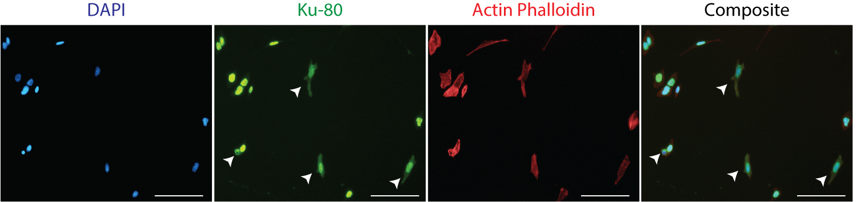
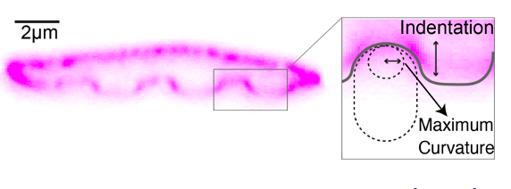
Curvature Induced Nuclear Envelope Rupture
Nanopillars induces localized stress in the cells, resulting in the bending and eventual rupture of the nuclear membrane as a response
Lamin A/C
Sarikhani, Einollah, et al.Advanced functional materials 35.6 (2025): 2410035.
7
Notes:
In this experiment, we have chosen to use nanopillars, inducing NER via curvature of the nucleus. As imaged above, the cells and their nucleus warp around the nanopillars, which allows the nanopillars to induce localized stress in the cells. This results in the weakening and eventual rupture of the nuclear membrane.
Nanopillar-induced rupture is analyzed in the bottom right image, which monitors nuclear and cytoplasmic levels of Ku80 (a DNA repair factor, localized in the nucleus). Nuclear levels of Ku80 are shown in green, whereas cytoplasmic levels are in red. As seen in the first four breached cells on the bottom of the figure, cytoplasmic levels of Ku80 increase due to nuclear breach (aka rupture), which is proof that the nanopillar-induced curvature is successful in inducing rupture of epithelial cells and cardiomyocytes.
versatile among various cell types (epithelial, stem cells, fibroblast cells)
Non-migratory cell types such as cardiomyocytes and neurons cannot be studied with migration based methods, a curvature controlled platform can democratize NER research across cell types

Slide 9
AIM
We want to capture these NER events using live microscopy
This can provide insights on:
How long rupture and repair process takes
How frequent rupture and repair happen
What proteins accumulate at the site of rupture
Which molecules mislocalized during rupture
What pathways are involved in during rupture and repair
8
Notes:
In this experiment, our 3 aims were to successfully culture and transduce the analyzed cell line with NLS-GFP, optimize the live imaging microscopy process to capture the dynamic event of rupture and repair, and quantify rupture kinetics across different geometries.

Slide 10
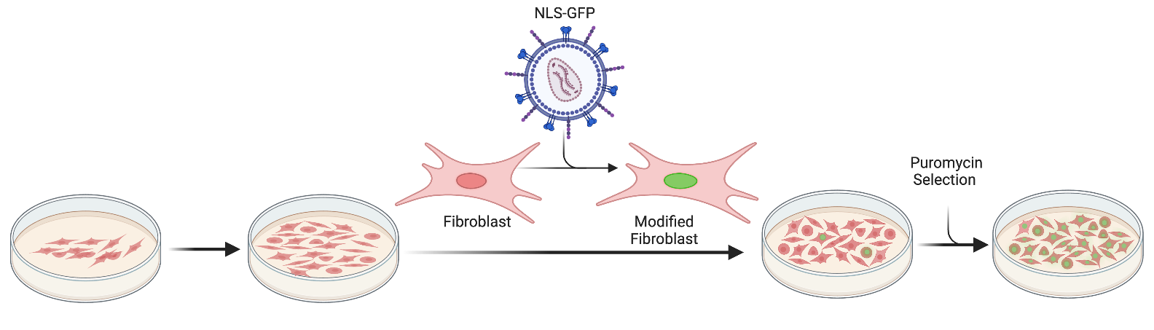
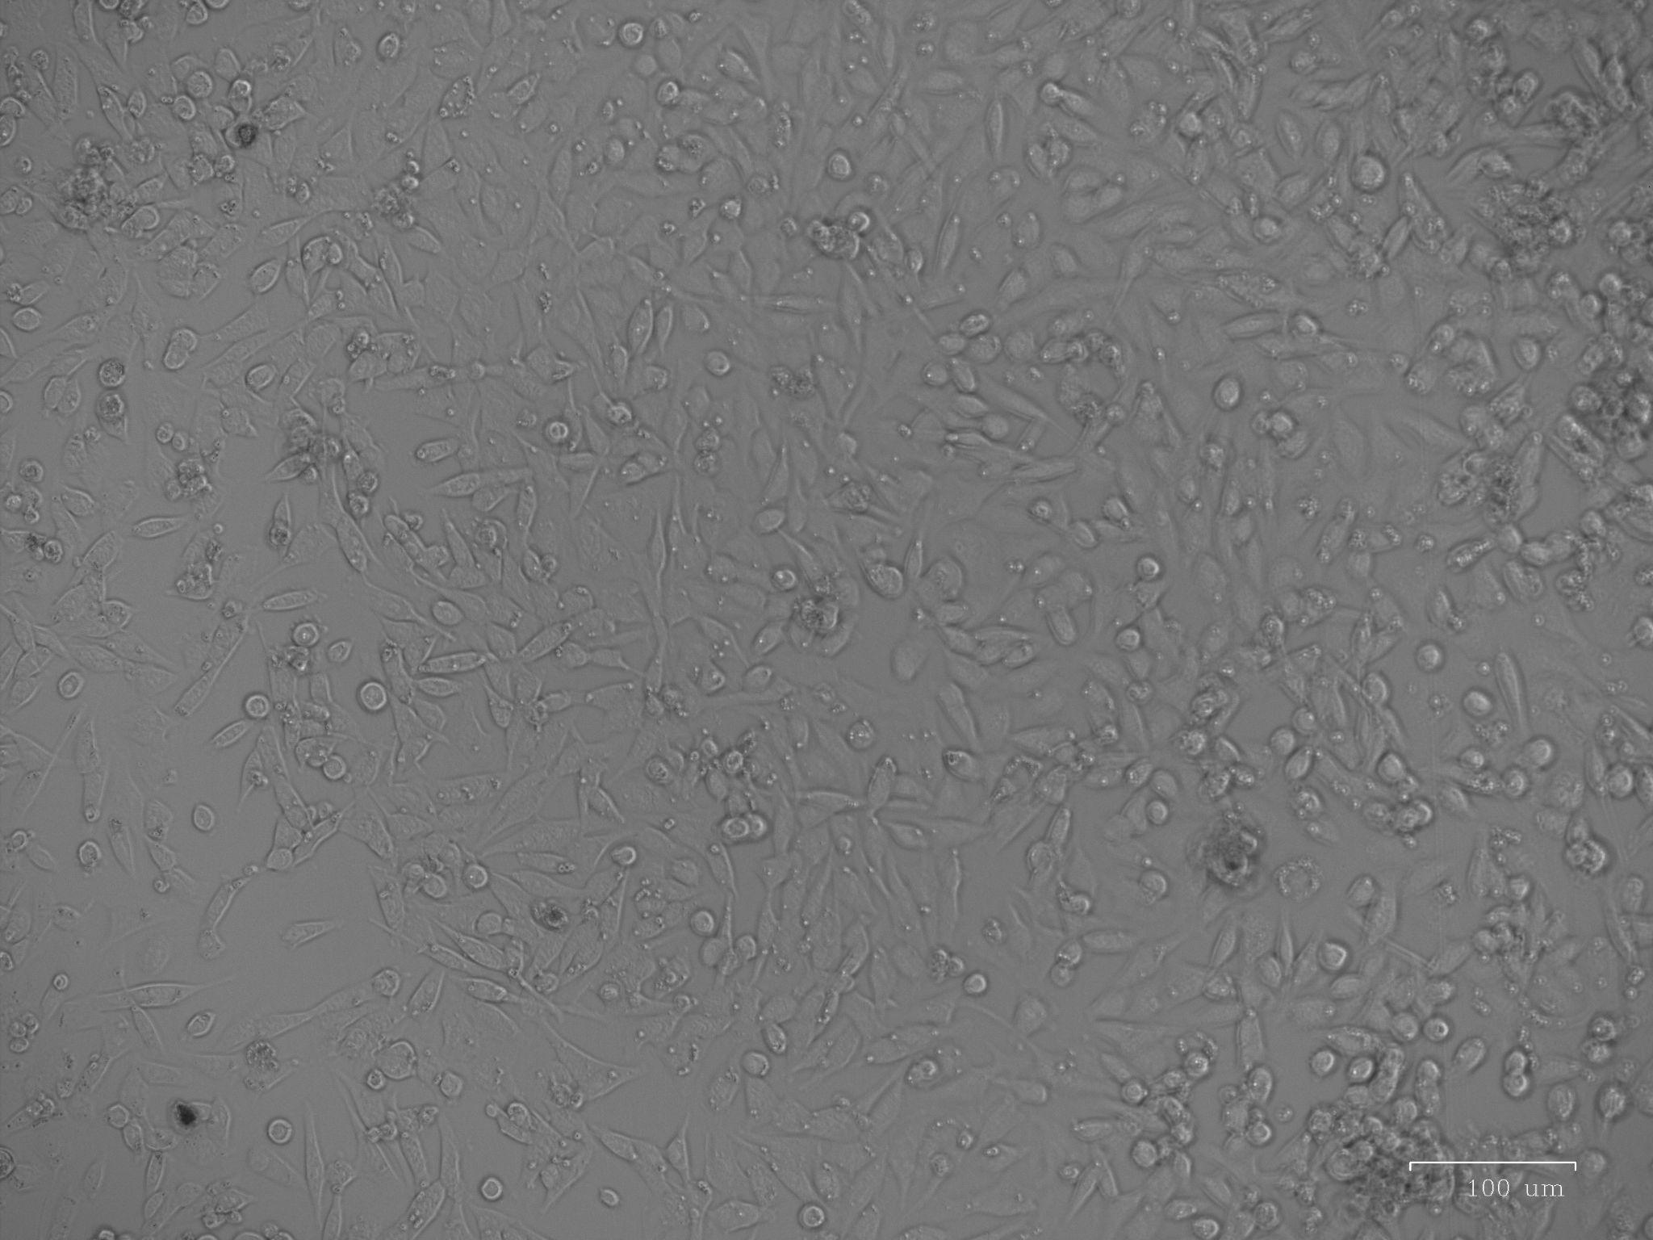
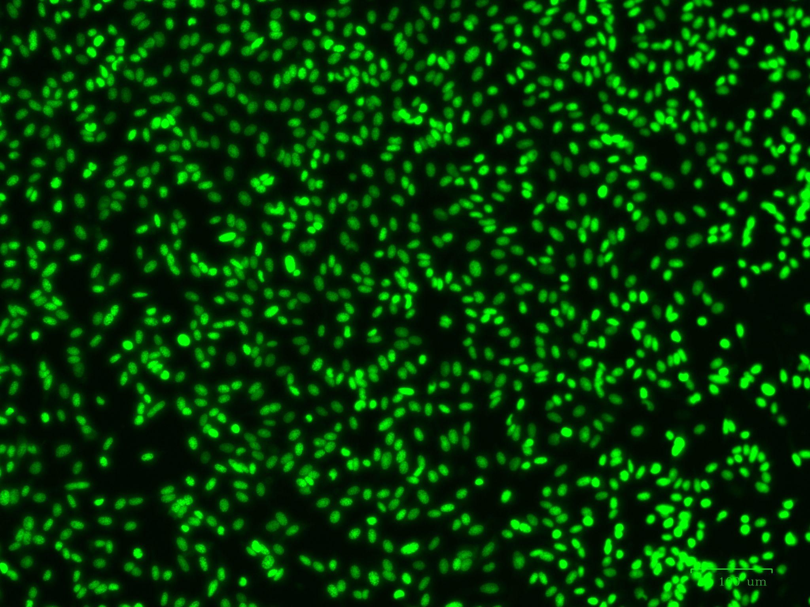
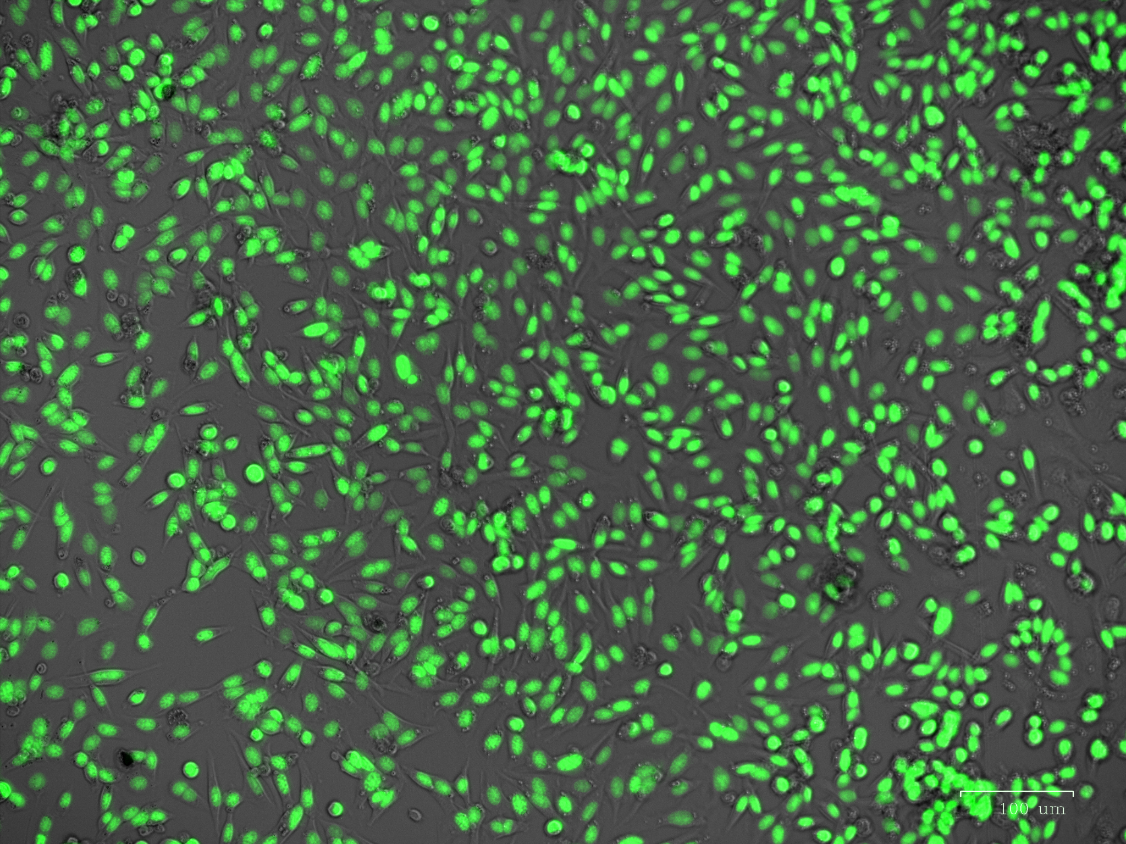
NLS-GFP as a key reporter for NER
Transduction of U2OS cells with Nuclear Localization Signal (NLS)-GFP and a puromycin resistance gene (pac)
Selection: 1 µg/mL puromycin in medium
Brightfield
NLS-GFP
Merge
100 µm
9
100 µm
100 µm
Notes:
In this experiment, we chose to use NLS-GFP as a reporter of rupture. This is a green fluorescent protein that is localized to the cellular nucleus, but mislocalizes to the cytoplasm during rupture and relocalizes after repair. Thus, by tracking its intensity, we are able to analyze which cells have experienced NER and repair.
We use U2OS cells in this experiment, which do not naturally produce NLS-GFP, nor exhibit puromycin resistance. Then, we use lentiviral transduction of an NLS-GFP expressing plasmid to genetically modify the U2OS cells to express NLS-GFP. This plasmid is also resistant to puromycin, meaning that successfully transduced U2OS cells will also express puromycin resistance. Therefore, to maximize the number of U2OS NLS-GFP expressing cells in the sample, we added 1 microgram/mL of puromycin to the sample, which kills U2OS that were not successfully transduced.

Slide 11
Experimental Workflow
Nanopillar Chip Preparation
Live Imaging
Data Analysis
Clean and functionalize glass nanopillar chips
Incubate sample at 37℃ and 5% CO₂
Draw line profiles of the cell, nucleus, and background
Coat with Gelatin (serves as extracellular matrix)
Select regions of interest, capturing both cells on both nanopillars and glass
Calculate intensity of mislocalized NLS-GFP by dividing cytoplasmic intensity by total cellular intensity of NLS-GFP
Seed U2OS cells at 20,000 cells/cm². Allow 2-3 hours for cells to adhere and spread
Take images every 10 minutes
10

Slide 12
Live Imaging of Nuclear Poration and Repair
11

Slide 13
Live Imaging of Nuclear Poration and Repair
12

Slide 14
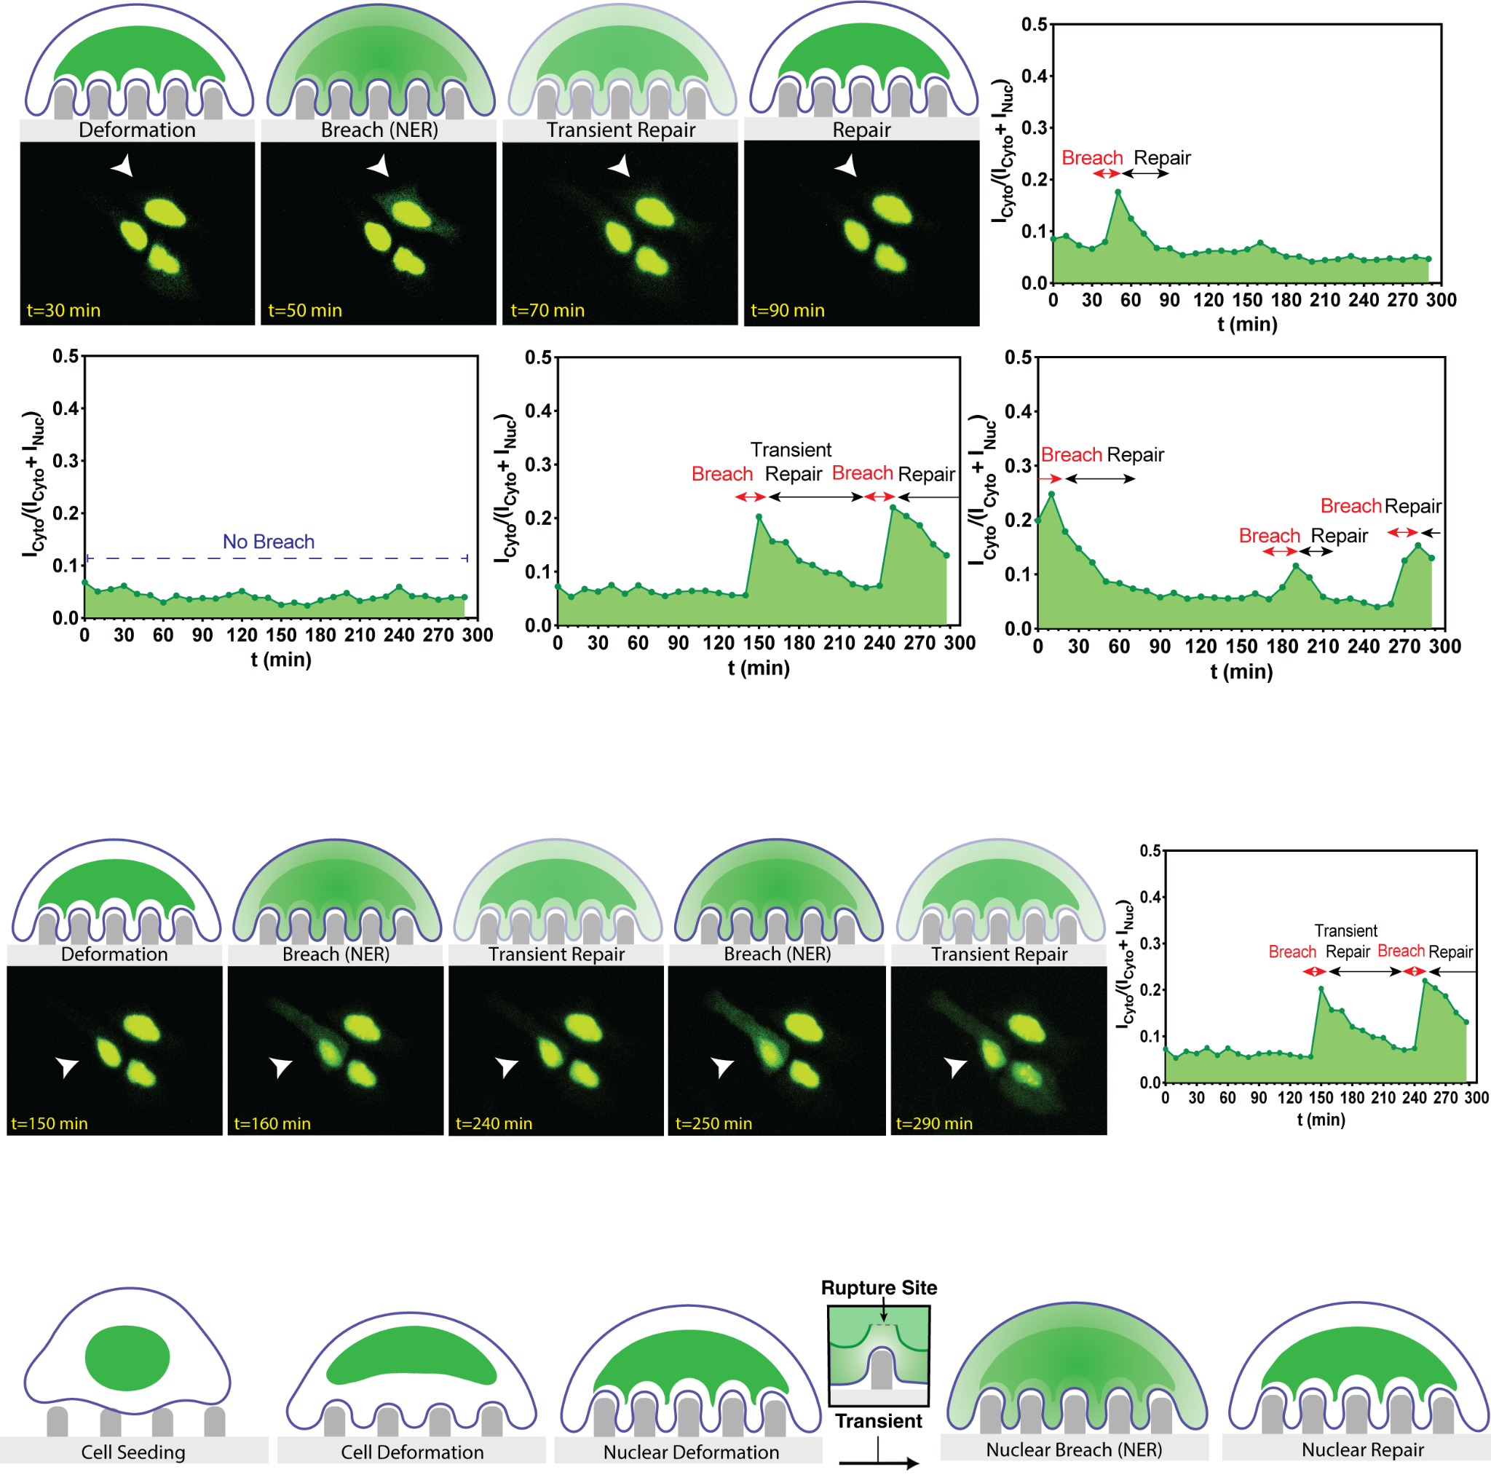
Live Imaging of Nuclear Poration and Repair
13

Slide 15
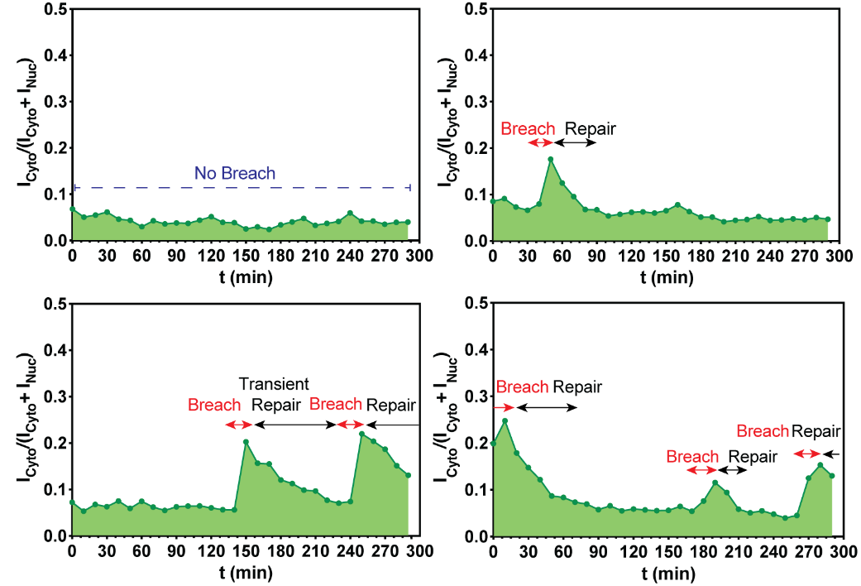
Live Imaging of Nuclear Poration and Repair
14
Notes:
The live NER imaging shows different NER dynamics with a cell showing one NER event with duration ~40 min. We see cells with multiple NER events, and also an NER event where the nucleus does not fully repair and undergo another NER event.
Control Cell: For cells with no nuclear poration, no peak is detected.

Slide 16
Conclusion and Future Work
Established a NLS-GFP reporter for live imaging
Observed and quantified a pipeline for nuclear envelope rupture and repair
Automate cell tracking and segmentation to quantify NER.
Validate NLS-GFP events with orthogonal rupture markers, such as BAF and cGAS.
15
Notes:
Complete kinetic analysis
Automated image analysis
Dual Reporter to capture exact timing of rupture and repair
Extension to other cell lines

Slide 17
Acknowledgements
I would like to sincerely thank:
The National Science Foundation
Our host, Georgia Institute of Technology
The San Diego Nanotechnology Infrastructure (SDNI), UC San Diego
Dr. Zeinab Jahed, Faculty PI
Hamed Naghsh-Nilchi, Mentor (under NIH training grant T32EB009380)
Dr. Yves Theriault, SDNI Executive Director, Education and Outreach
Dr. Yuhwa Lo, SDNI Faculty Director
The audience for listening and for their time!
This program was supported by NSF grant ECCS 2025752

Slide 18
References
Amiad Pavlov, Daria, et al. "Microtubule forces drive nuclear damage in LMNA cardiomyopathy." Nature Cardiovascular Research 4.11 (2025): 1501-1520.
Denais, Celine M., et al. "Nuclear envelope rupture and repair during cancer cell migration." Science 352.6283 (2016): 353-358.
Docquity. (2023). About Hutchinson-Gilford Progeria syndrome.
Earle, Ashley J., et al. "Mutant lamins cause nuclear envelope rupture and DNA damage in skeletal muscle cells." Nature materials 19.4 (2020): 464-473.
Halfmann, Charles T., et al. "Repair of nuclear ruptures requires barrier-to-autointegration factor." Journal of Cell Biology 218.7 (2019): 2136-2149.
Hatch, Emily M. “Nuclear envelope rupture: little holes, big openings.” Current Opinion in Cell Biology 52 (2020): 66-72.
Hatch, Emily M and Martin W. Hetzer. “Nuclear envelope rupture is induced by actin-based nucleus confinement.” Journal of Cell Biology. 215.1 (2016): 27-36
Kim, Paul H., et al. "Nuclear membrane ruptures underlie the vascular pathology in a mouse model of Hutchinson-Gilford progeria syndrome." JCI insight 6.16 (2021): e151515.
Kristiani, Lidya et al. “Role of the Nuclear Lamina in Age-Associated Nuclear Reorganization and Inflammation.” Cells 9.3 (2020): 718
Maciejowski, John, and Emily M. Hatch. "Nuclear membrane rupture and its consequences." Annual review of cell and developmental biology 36.1 (2020): 85-114.
Sarikhani, Einollah, et al. “Engineered Nanotopographies Induce Transient Openings in the Nuclear Membrane.” National Institute of Medicine. 35.6 (2024): 2410035
Ungricht, Rosemarie, and Ulrike Kutay. "Mechanisms and functions of nuclear envelope remodelling." Nature Reviews molecular cell biology 18.4 (2017): 229-245.
Wang, A.S., Ong, P.F., Chojnowski, A. et al. “Loss of lamin B1 is a biomarker to quantify cellular senescence in photoaged skin.” Sci Rep 7, 15678 (2017).

Slide 19
Supplementary Information

Slide 20
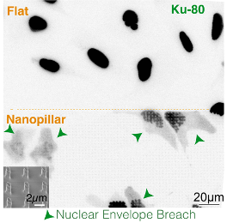
Nanopillar Curvature: Flat control vs. NP
Nanopillar arrays exert defined, reproducible curvature on adherent cells inducing NER at high-throughput without plasma membrane disruption
Sarikhani, Einollah, et al.Advanced functional materials 35.6 (2025): 2410035.

Slide 21
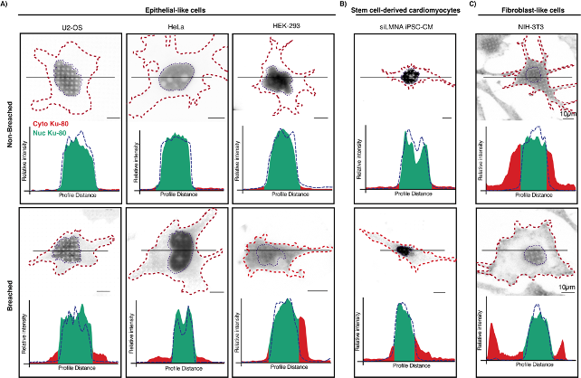
Curvature Induced Nuclear Envelope Rupture
Applicable to different cell lines
No NER Ruptured
NER Ruptured
Sarikhani, Einollah, et al.Advanced functional materials 35.6 (2025): 2410035.
Notes:
In this experiment, we have chosen to use nanopillars, inducing NER via curvature of the nucleus. As imaged above, the cells and their nucleus warp around the nanopillars, which allows the nanopillars to induce localized stress in the cells. This results in the weakening and eventual rupture of the nuclear membrane.
Nanopillar-induced rupture is analyzed in the bottom right image, which monitors nuclear and cytoplasmic levels of Ku80 (a DNA repair factor, localized in the nucleus). Nuclear levels of Ku80 are shown in green, whereas cytoplasmic levels are in red. As seen in the first four breached cells on the bottom of the figure, cytoplasmic levels of Ku80 increase due to nuclear breach (aka rupture), which is proof that the nanopillar-induced curvature is successful in inducing rupture of epithelial cells and cardiomyocytes.
versatile among various cell types (epithelial, stem cells, fibroblast cells)
Non-migratory cell types such as cardiomyocytes and neurons cannot be studied with migration based methods, a curvature controlled platform can democratize NER research across cell types

Slide 22
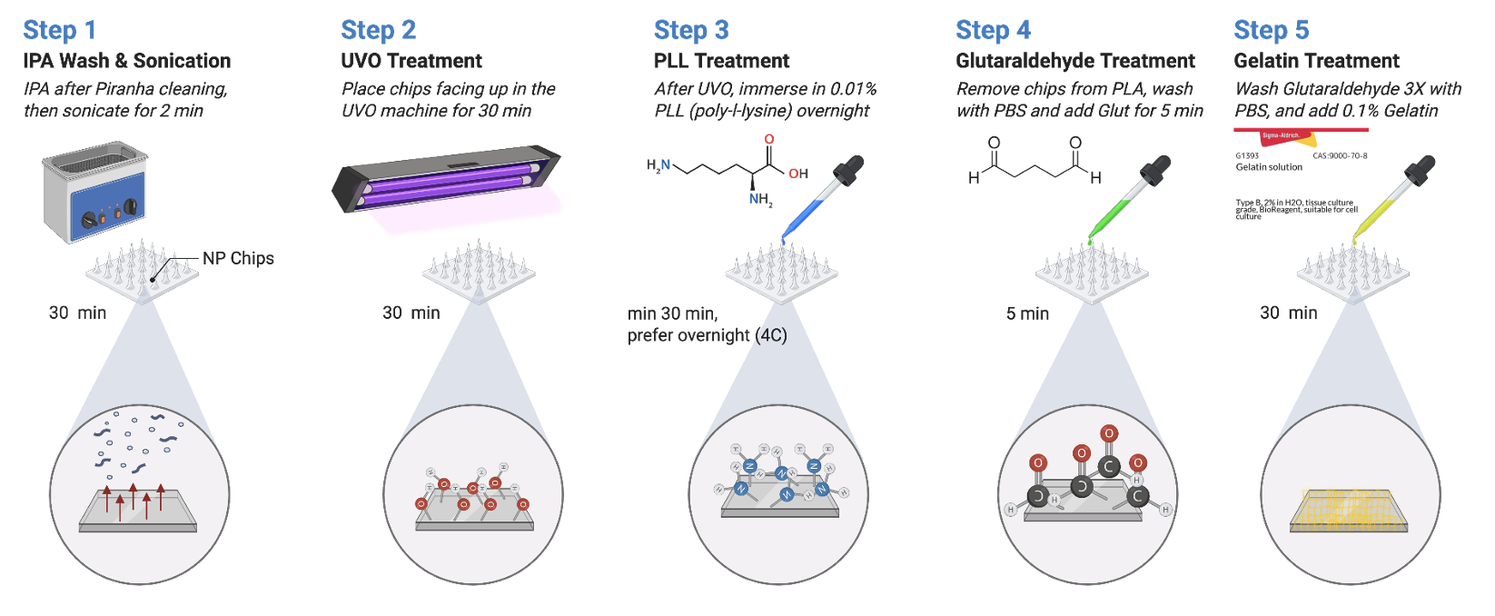
Chip Preparation Process
Notes:
To prepare the nanopillar chips for cell seeding, we first use strong acids (sulfuric and hydrochloric) and then a sonicator to clean large chunks of organic matter from the chips. Then, we use UVO to bombard the chips with ultraviolet light and ozone, which aids in the cleaning of organic matter and leaves a layer of oxygen radicals on the chip. Poly L Lysine (PLL) is then added onto the chips, which binds to the oxygen radicals, leaving a layer of amine groups. The PLL is removed and the chip is washed, then Glutaraldehyde is added and washed – the glutaraldehyde is able to bind to the amine groups, and leaves behind free aldehyde groups. Finally, gelatin is added, which binds to the aldehyde groups. The gelatin serves as a material for cells to seed onto, and is functionally similar to the ECM. The gelatin is then washed, and the chip is ready to be seeded with cells.

Slide 23
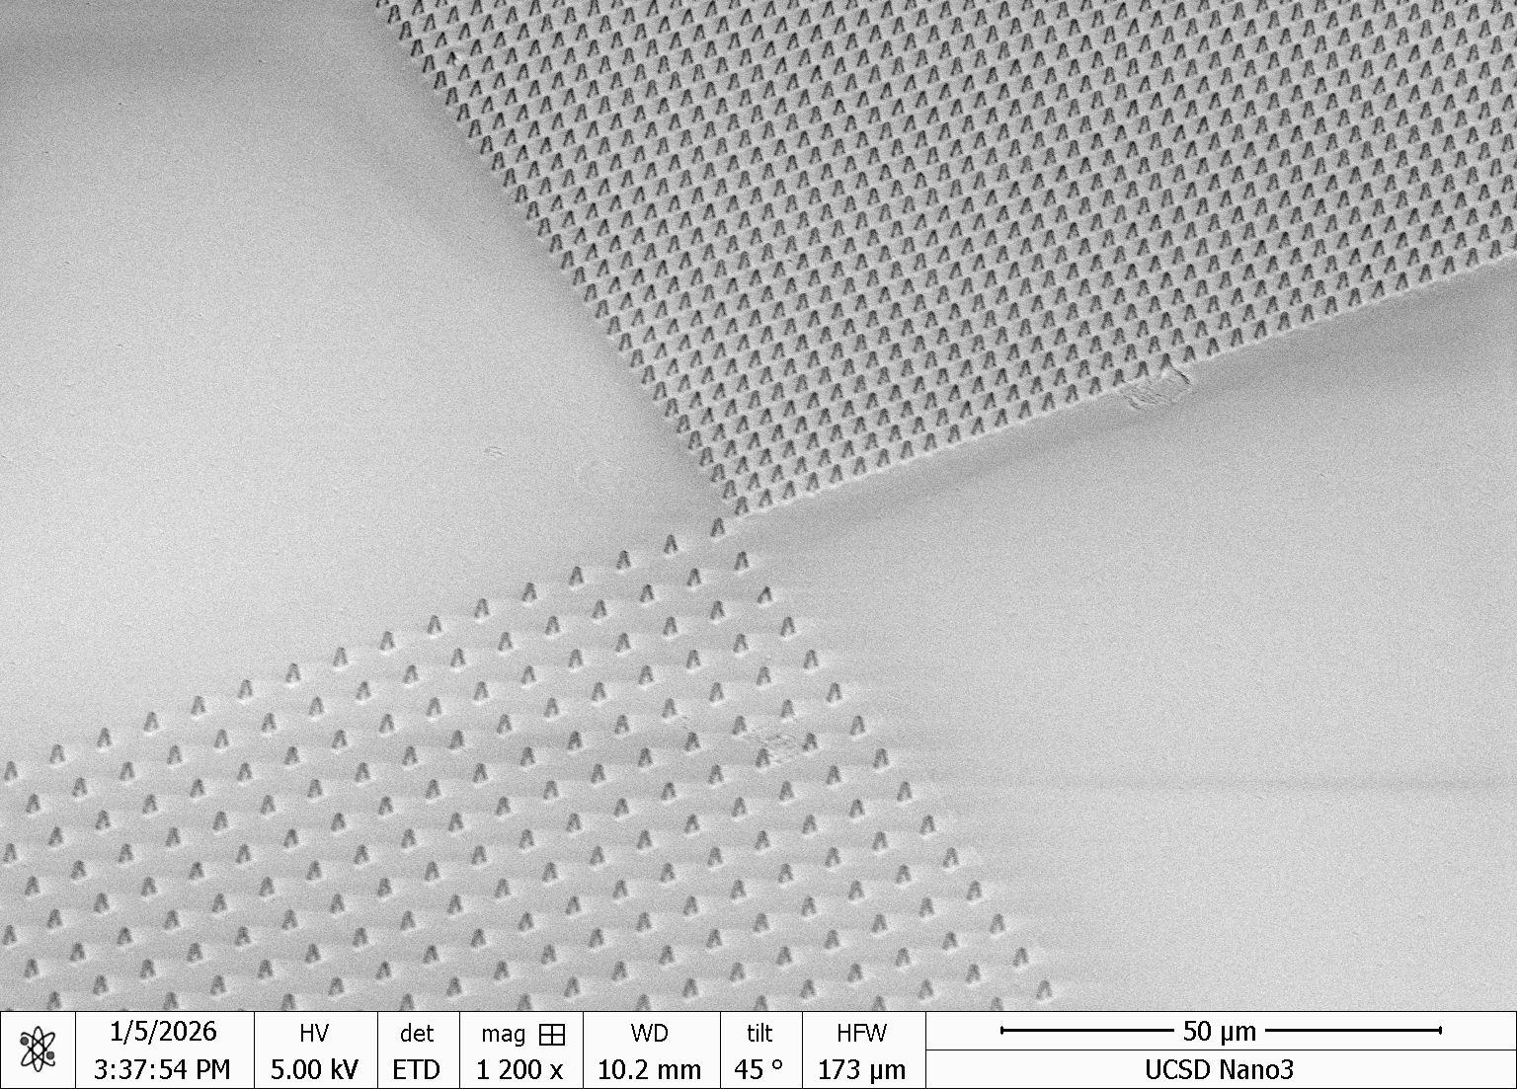
Device Design → We will be looking at different geometries (different pitch pillars)
3µm-Pitch
6µm-Pitch
10 µm
Notes:
This is an example of a nanopillar chip, which consists of two glass regions and two nanopillar regions of varying distance between each nanopillar. This helps us with analyzing how different degrees of curvature can have a different effect on NER, and the glass is a control to assess NER of cells on a flat surface

Slide 24
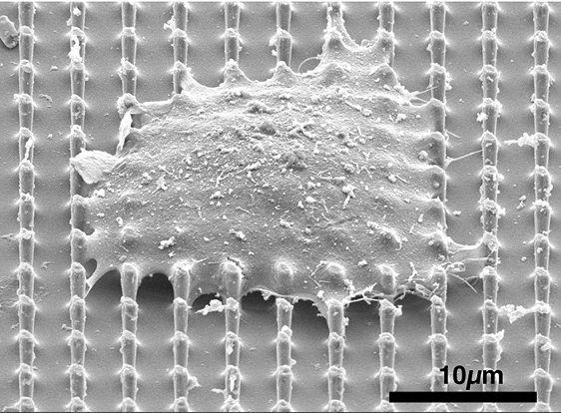
Cell spreading over Nanopillar (SEM)
3µm-Pitch
6µm-Pitch
10 µm
Sarikhani, Einollah, et al.Advanced functional materials 35.6 (2025): 2410035.
Notes:
This is an example of a nanopillar chip, which consists of two glass regions and two nanopillar regions of varying distance between each nanopillar. This helps us with analyzing how different degrees of curvature can have a different effect on NER, and the glass is a control to assess NER of cells on a flat surface

Slide 25
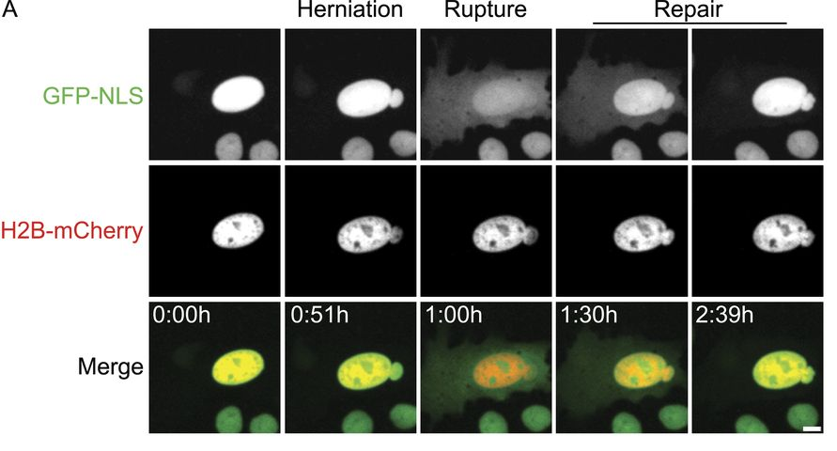
NER Leads to DNA Damage and Cancer Risk
When NER Repair Fails or is Incomplete
Chromatin Herniation
Chromatin bulges into the cytoplasm through the rupture site, becoming disorganized and inaccessible to nuclear repair factors
DNA Damage
Cytoplasm nucleases break down exposed DNA
Cancer Mutation Risk
Loss of DNA repair proteins at rupture events leave double-strand breaks unrepaired, increasing the risk of mutation
Denais, Celine M., et al. Science 352.6283 (2016): 353-358.
Hatch, Emily M. Current Opinion in Cell Biology 52 (2020): 66-72.
Hatch, Emily M and Martin W. Hetzer. Journal of Cell Biology 215.1 (2016): 27-36
Notes:
What happens if the repair process fails? This can result in chromatin herniation, which exposes DNA to the cytoplasm. This often leads to DNA damage due to cytoplasmic nucleases breaking down the exposed DNA, and this increases the development of cancerous mutations.

Slide 26
NER Links to Laminopathy Diseases
Laminopathies
LMNA mutations weaken nuclear stability
Defective lamin A/C assembly creates local mechanical weak spots in the nuclear lamina
Under cytoskeletal or external mechanical stress, these weak spots rupture (NER)
NER causes nucleocytoplasmic mixing, DNA damage, and loss of nuclear compartmentalization
Cardiomyopathy
Beating cells amplify nuclear stress
Mutations in LMNA account for 5% of autosomal dominant dilated cardiomyopathy (DCM)
Pressure overload (hypertension and aortic stenosis) transmits mechanical stress via LINC complex leading to NER
NER can cause fibrosis, and inflammatory transcription
Kim, Paul H., et al. JCI insight 6.16 (2021): e151515.
Earle, Ashley J., et al. Nature materials 19.4 (2020): 464-473.
Amiad Pavlov, Daria, et al. Nature Cardiovascular Research 4.11 (2025): 1501-1520.
Notes:
Additionally, mutated or defective lamin A/C can increase the likelihood of nuclear rupture. This occurs due to defective Lamin A/C resulting in the weakening of the nuclear lamina, which reduces the mechanical stress required to induce rupture and therefore increases the likelihood of NER occurring. This pattern is frequently seen in laminopathies, and even in cardiomyopathies, where the overload of pressure and weakened lamina makes NER more frequent, thus increasing inflammatory events as a result.

Slide 27
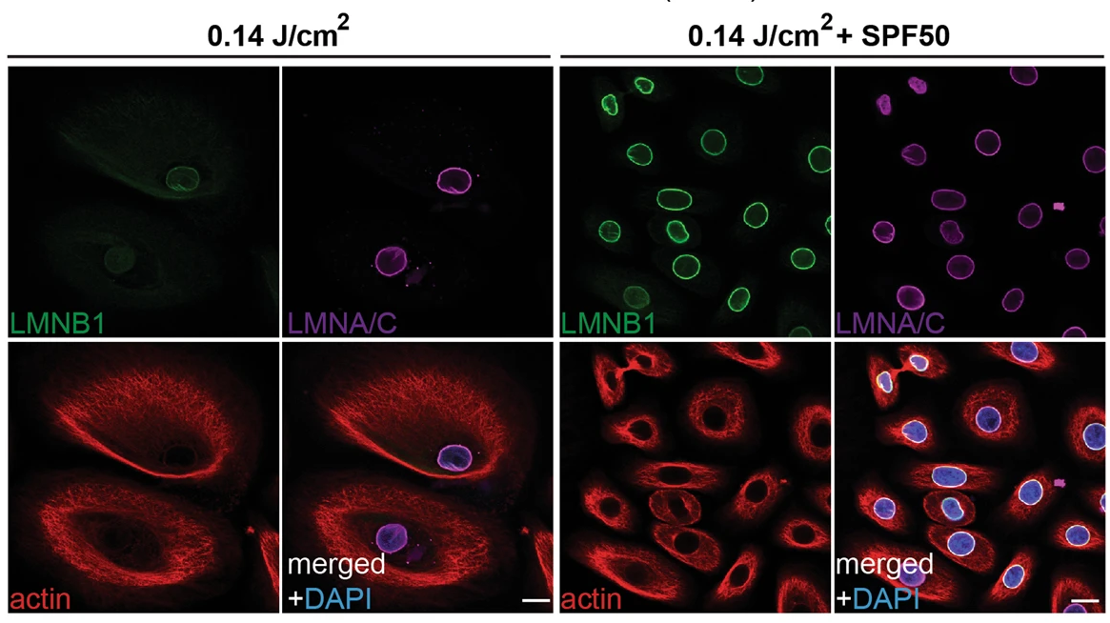
NER Links to Laminopathy Diseases and Accelerated Aging
Laminar Disorganization
Disorganization of the laminar region leads to damage of individual lamins
Development of Laminopathy Diseases
Severe degradation of Lamin B1 results in senescence
Senescent cells secrete proinflammatory cytokines, resulting
Speeds up the aging process
Kristiani, Lidya, et. al. Cells 9.3 (2020): 718
Wang, Audrey S. et. al. Scientific Reports 7, 15678 (2017)
Notes:
https://pmc.ncbi.nlm.nih.gov/articles/PMC7140666/ (nuclear lamina degradation during rupture, and how this leads to inflammation and aging) → No rupture in the paper.

Slide 28
Live Imaging of Nuclear Poration and Repair
Notes:
For uppermost graph: Nuclear poration detected ~ 40 min time point, and complete repair ~90 min. Duration of this poration ~50 min.
Control Cell: For cells with no nuclear poration, no peak is detected.

