Slide 1


Silver Thione and Selone Complexes with Potential Antifungal Activity
Grace Pavel
Southeastern Undergraduate Internship in Nanotechnology (SUIN) REU Program
Summer 2026

Slide 2
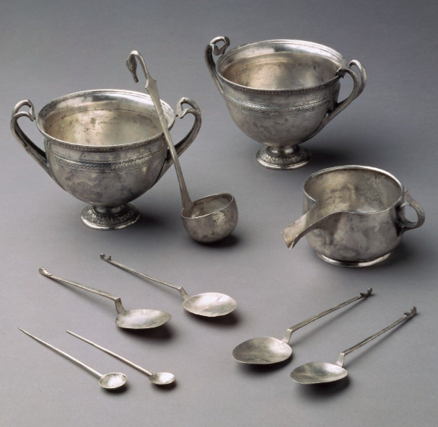
Silver Bioinorganic Chemistry
Silver has many medicinal applications due to its antimicrobial, antiseptic, anti-inflammatory, and anticancer activity
The first use of silver as an antimicrobial agent can be dated back to ancient civilization, where silver containers were used for the preservation of food and water
Silver particles can interact with microorganisms by penetrating the cell membrane and compromising function, leading to either death or inhibition of the microbe.
Recently, silver(I) complexes have begun to be studied as potential drugs against microbes, but much is still not known about them.
Roman silver utensils, mid-1st century BCE,
obtained from: The Metropolitan Museum of Art

Slide 3
N-Heterocyclic Thiones (NHT) and Selones (NHSe)
We study NHT and NHSe ligands, which are derived from NHCs
NHCs lead to high stabilization and synthetic tunability of the metal complexes
For this project, work was done with imidazole-based ligands, which were denoted as IRE^{R’}
E = S, Se; R, R’ = Me or Bz

Slide 4
Our NHT and NHSe Ligands
IMeSMe
IMeS^{Bz}
IBzS^{Bz}
IMeSeMe
IMeSe^{Bz}
IBzSe^{Bz}

Slide 5
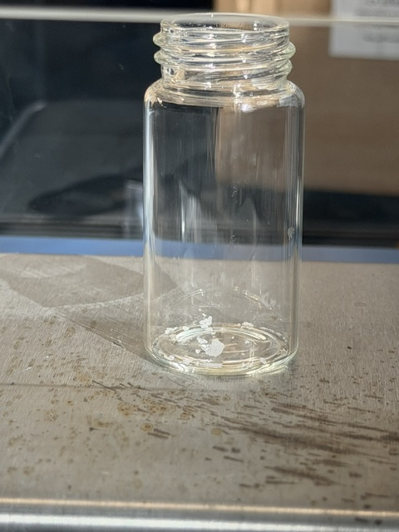
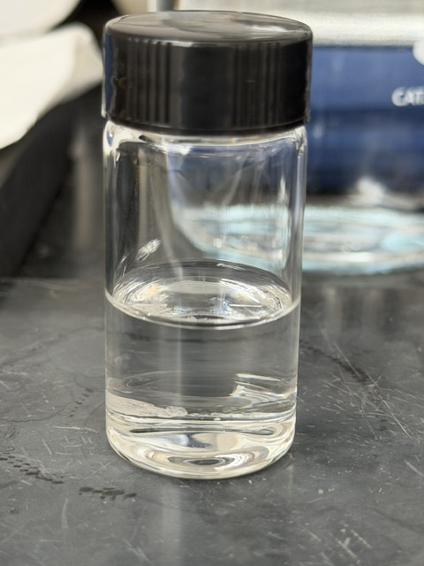
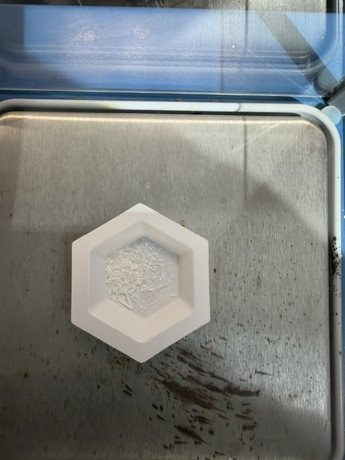
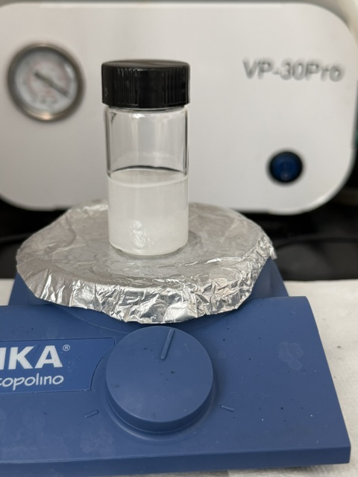
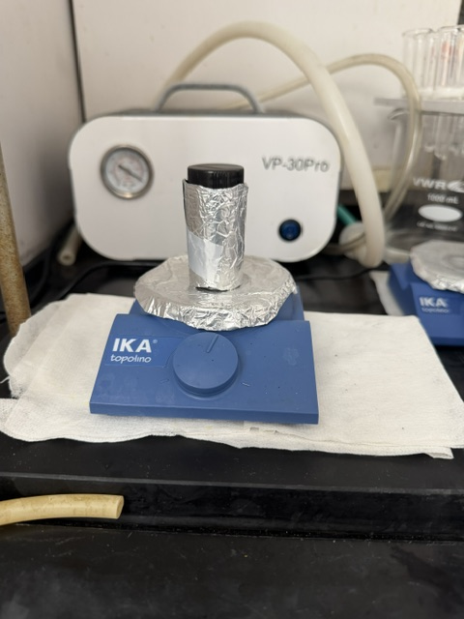
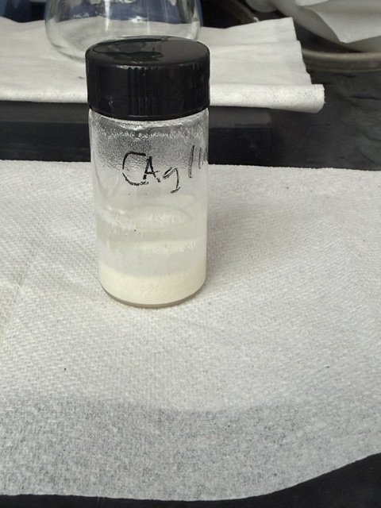
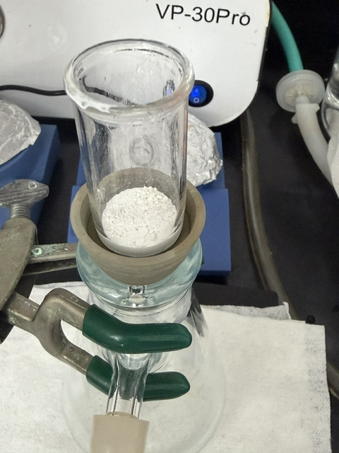
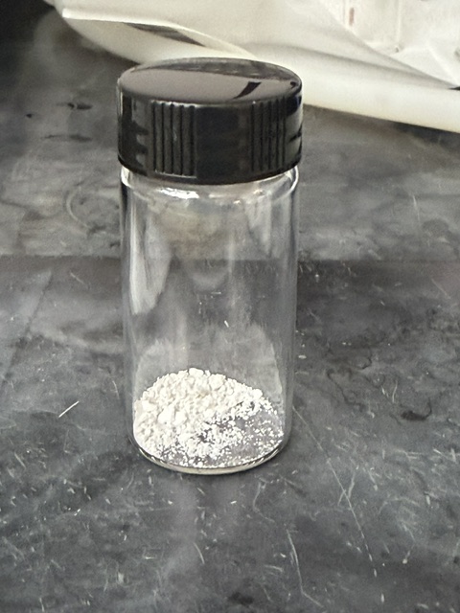
Synthesis of 1:2 Silver Complexes
AgX + 2 IRE^{R’} →[Ag(IRE^{R’})₂]X
X = NO₃, BF₄, ClO₄
General Structure

Slide 6
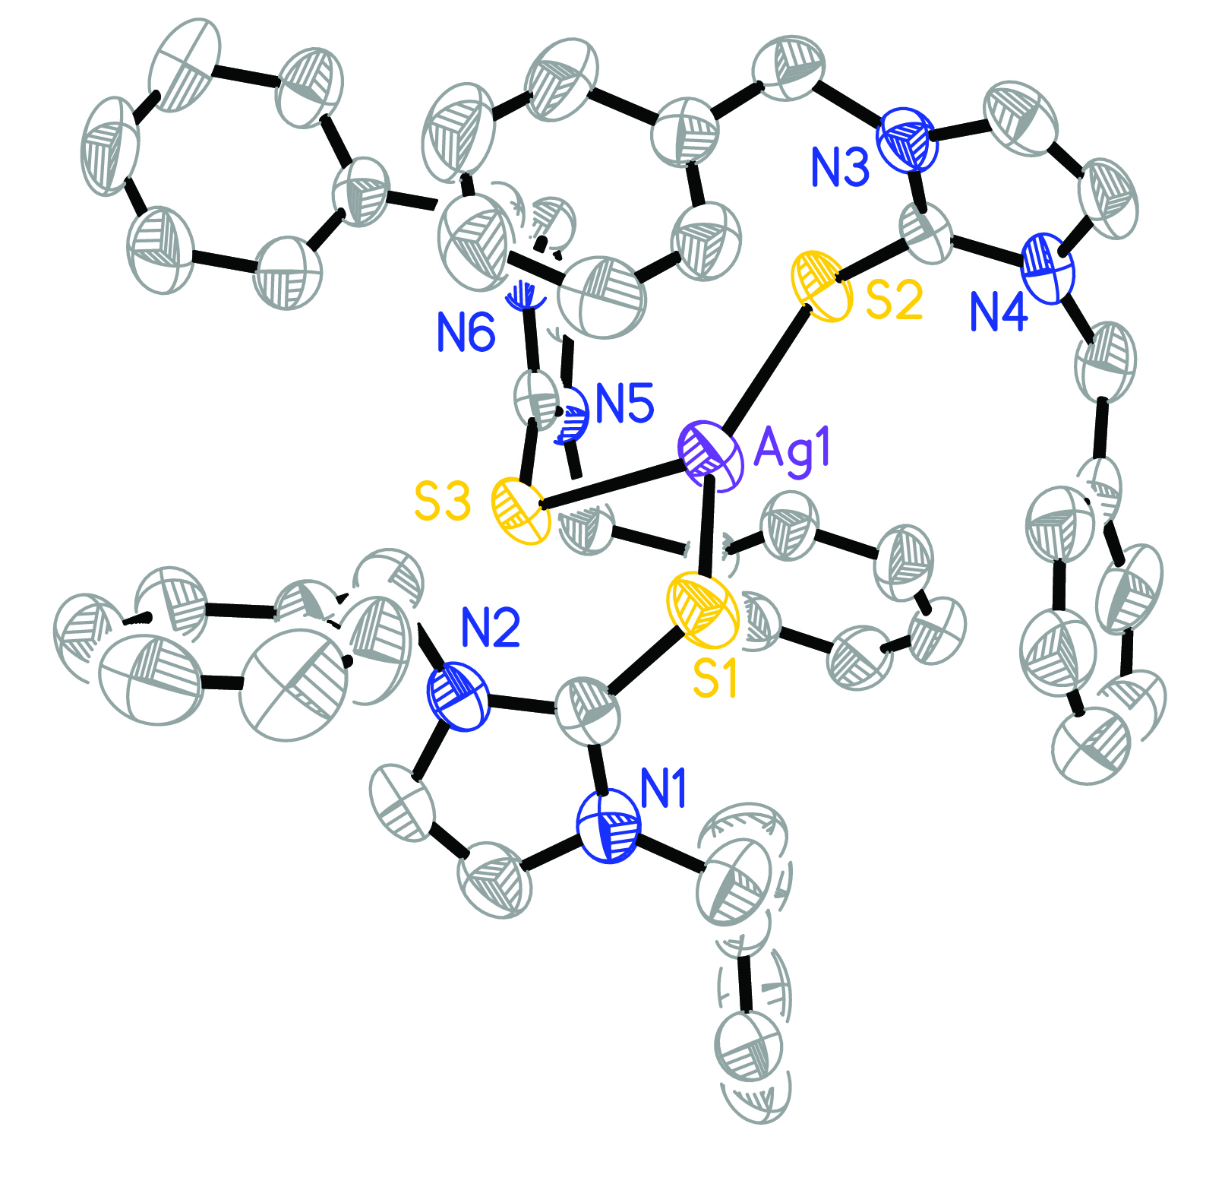
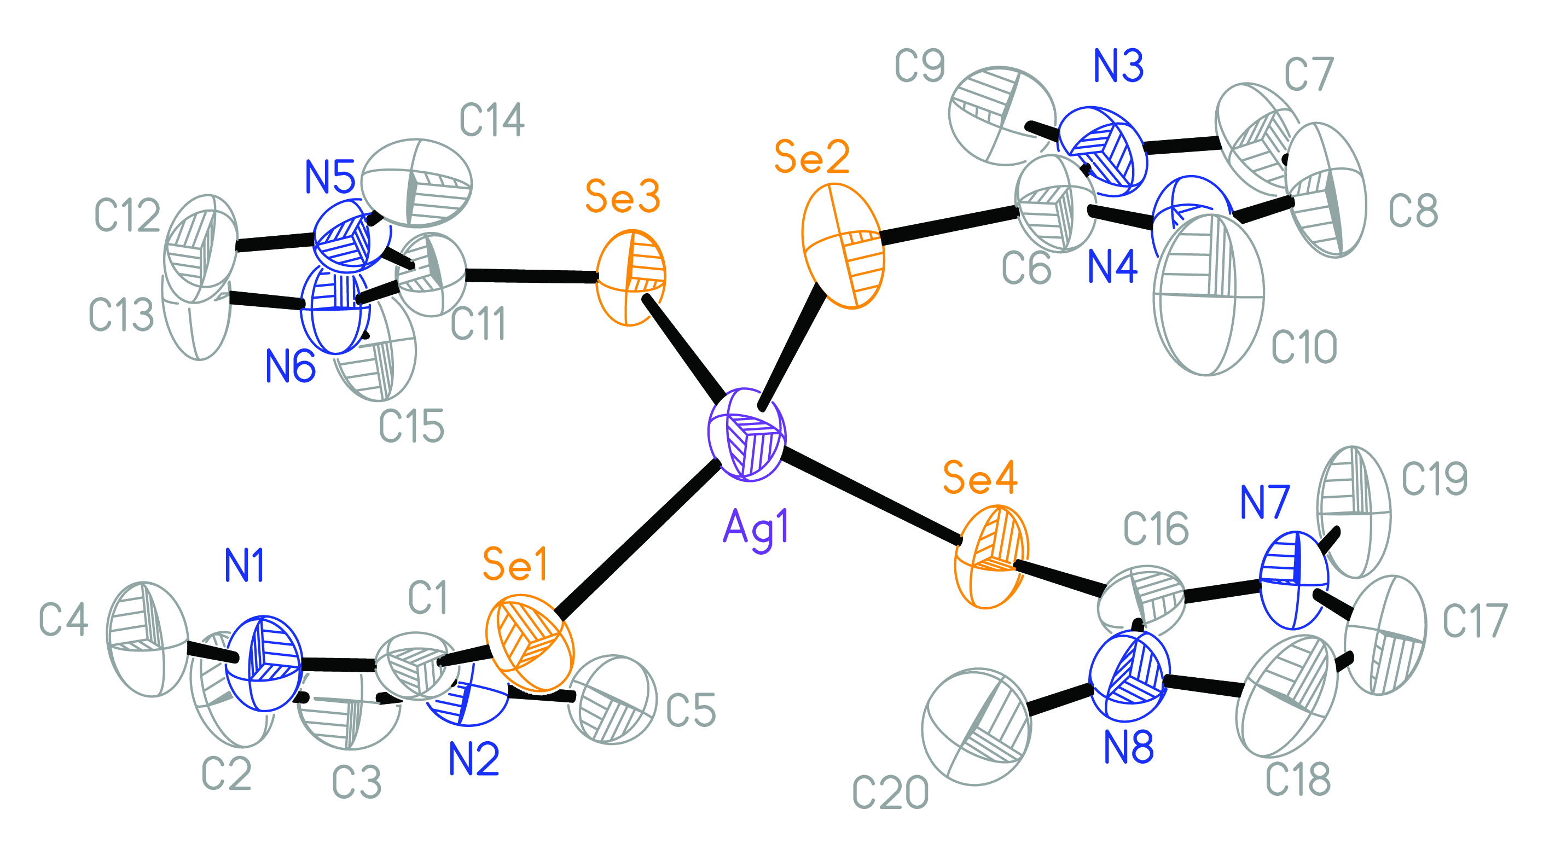
1:3 and 1:4 Silver Complexes
[Ag(IMeSeMe)₄]BF₄
(anions not shown)
[Ag(IBzS^{Bz})₃]ClO₄

Slide 7
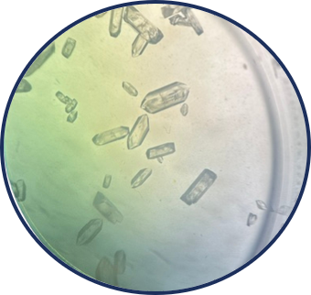
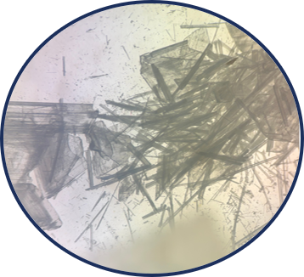
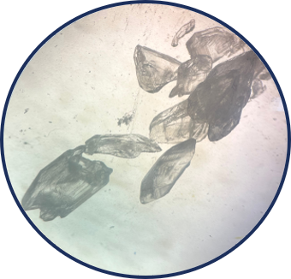
Crystallizations
Two common crystallization techniques have been used to obtain single crystals suitable for X-ray crystallography: slow evaporation and vapor diffusion
[Ag(IBzS^{Bz})₂]ClO₄
[Ag(IBzSBz)2]ClO4
[Ag(IBzSBz)2]BF4

Slide 8
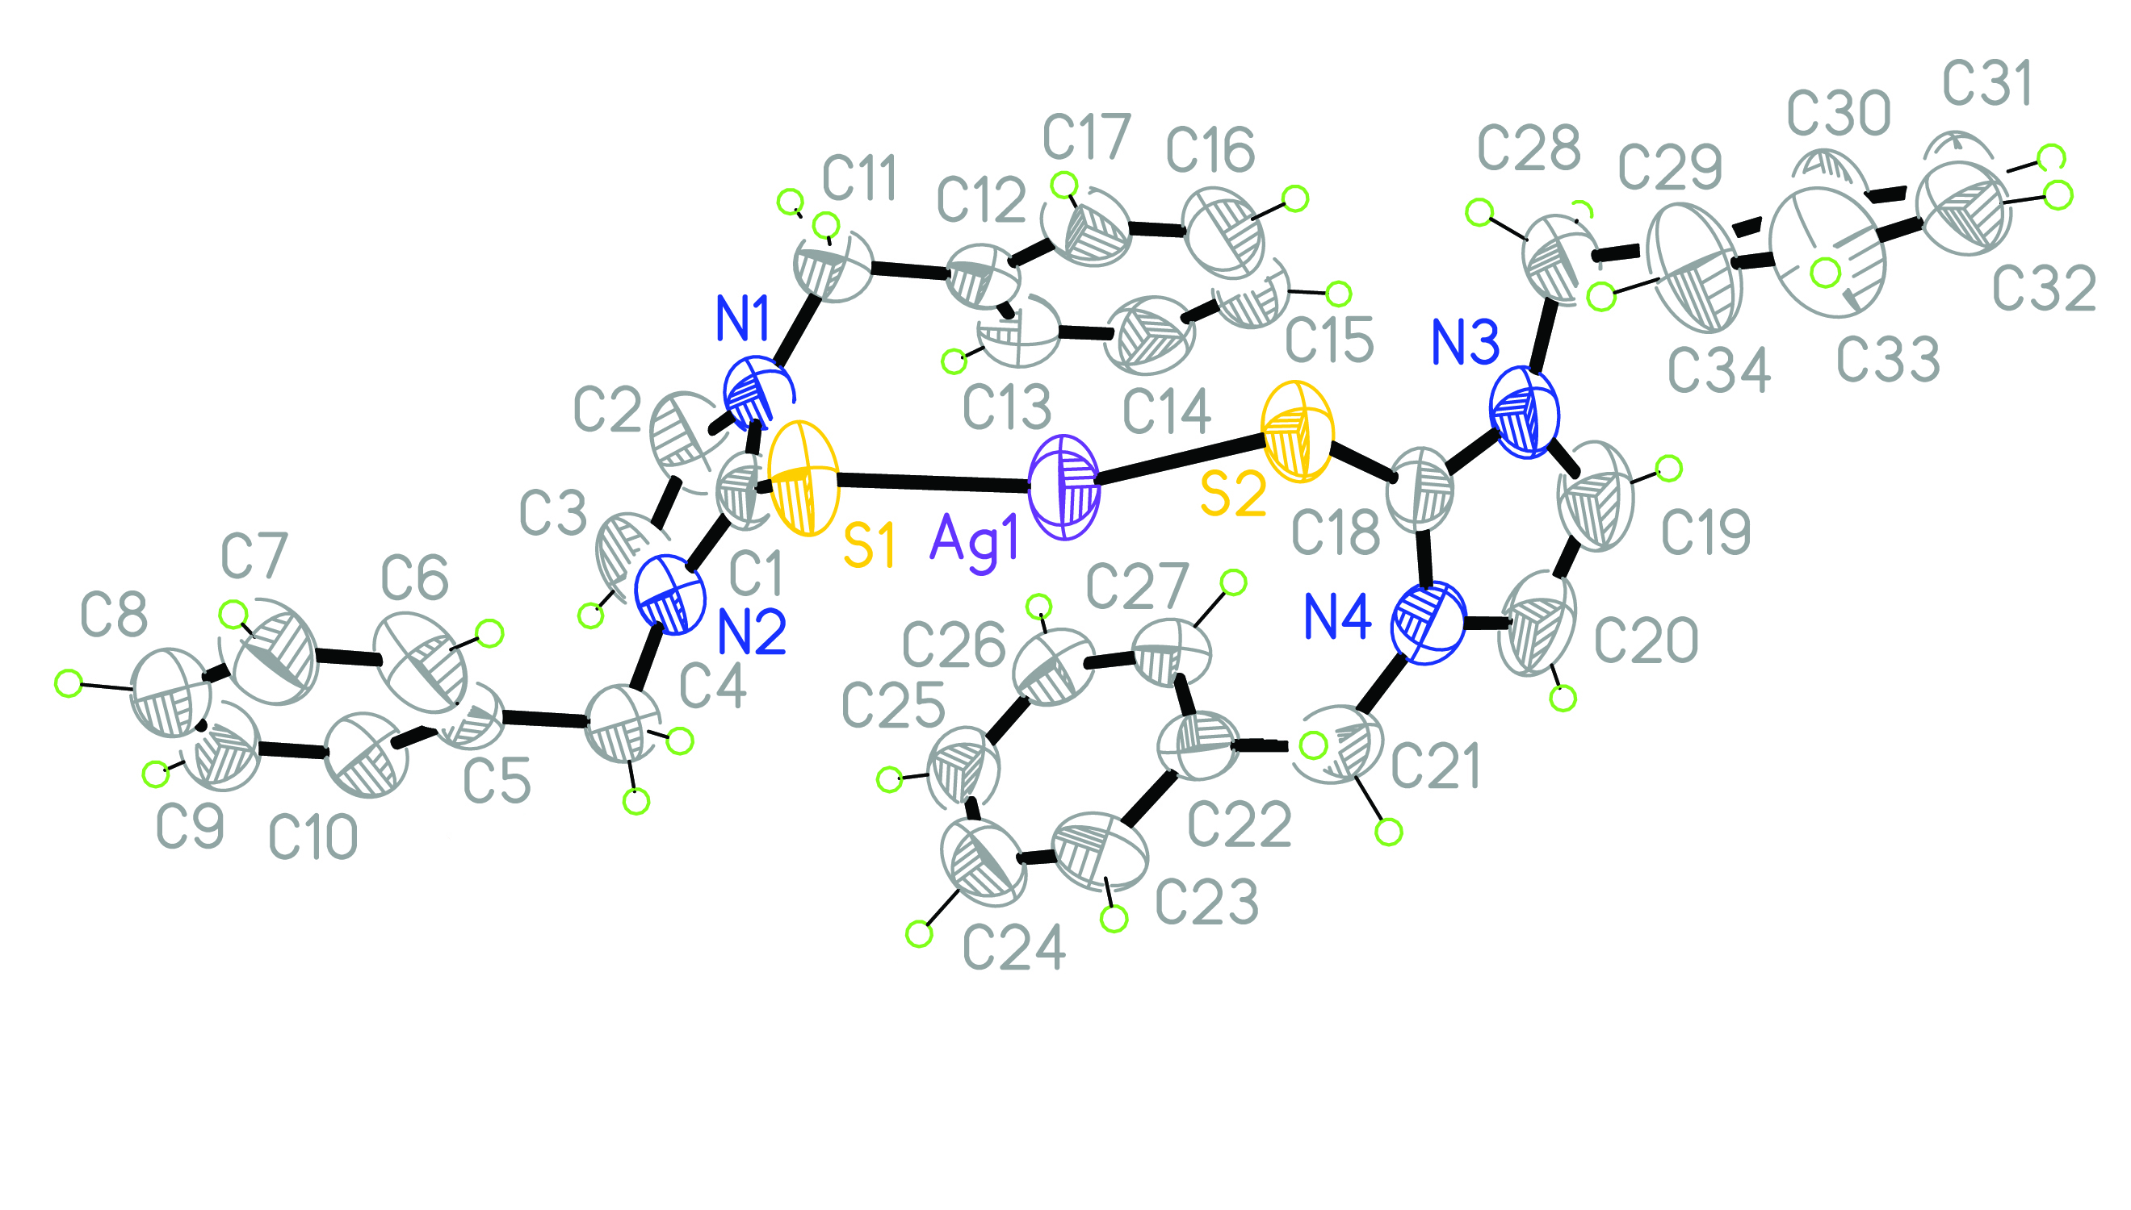
Molecular Structure of [Ag(IBzS^{Bz})₂]ClO₄
(anion not shown)

Slide 9
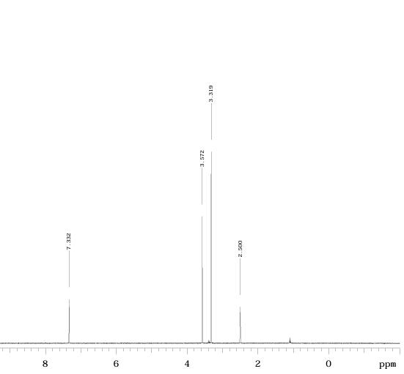
Characterization
¹H NMR spectrum is taken initially to verify if the reaction took place
The compound is then sent to elemental analysis (EA) to assess purity
Additional characterization data includes mp, ¹³C NMR & IR spectroscopy and (if possible) XRD
Biological testing can then be conducted on the product to determine how effective it is as an antifungal agent
Initial ¹H NMR: [Ag(IMeSeMe)₂]BF₄

Slide 10
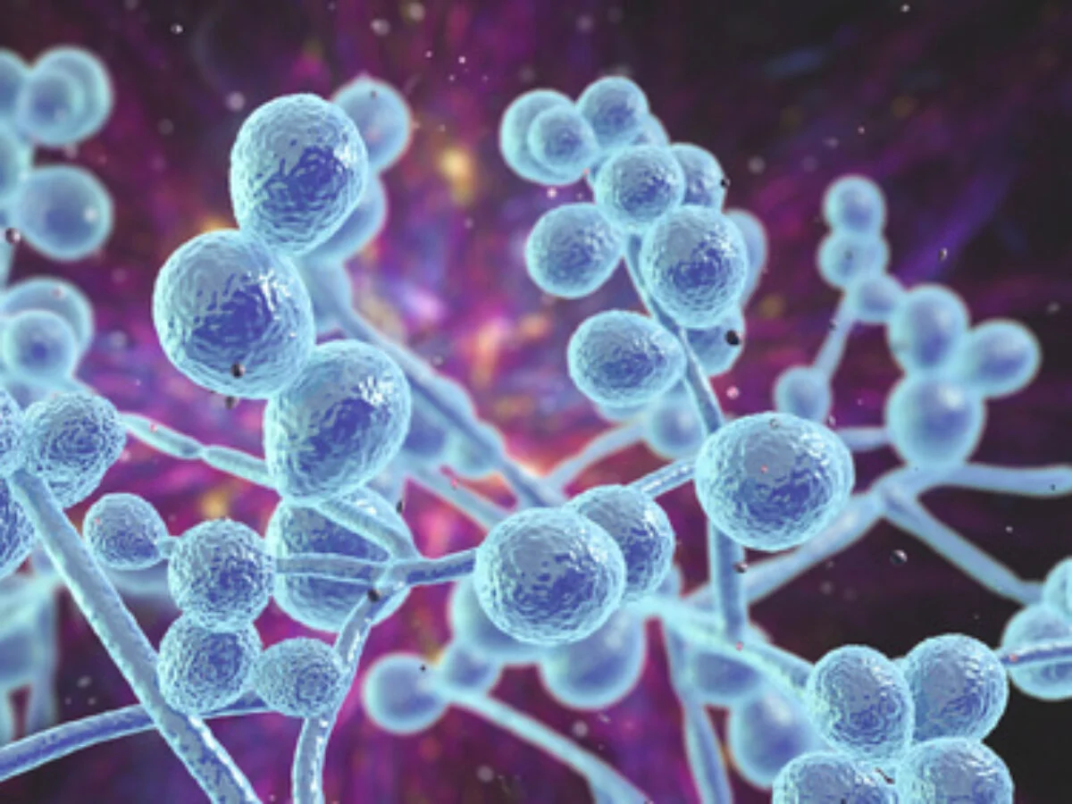
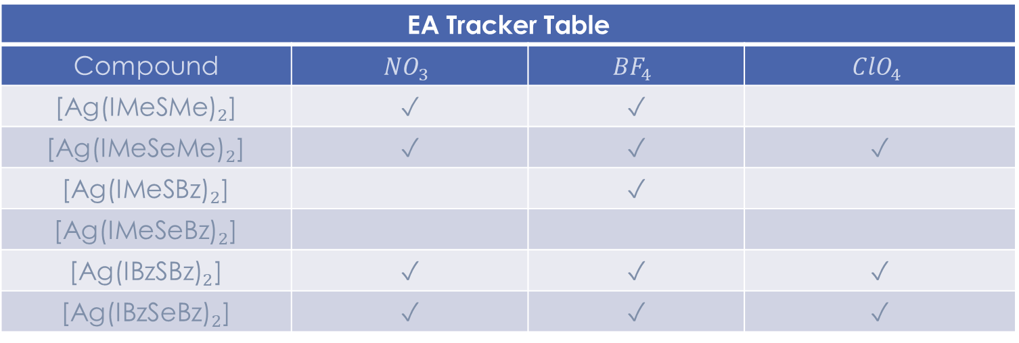
Summary and Future Work
EA Tracker Table
Compound | $${NO}_{3}$$ | $${BF}_{4}$$ | $${ClO}_{4}$$
[${\text{Ag}\text{(}\text{IMeSMe}\text{)}}_{2}$] | ✓ | ✓
[${\text{Ag}\text{(}\text{IMeSeMe}\text{)}}_{2}$] | ✓ | ✓ | ✓
[${\text{Ag}\text{(}\text{IMeSBz}\text{)}}_{2}$] |  | ✓
[${\text{Ag}\text{(}\text{IMeSeBz}\text{)}}_{2}$]
[${\text{Ag}\text{(}\text{IBzSBz}\text{)}}_{2}$] | ✓ | ✓ | ✓
[${\text{Ag}\text{(}\text{IBzSeBz}\text{)}}_{2}$] | ✓ | ✓ | ✓
Biological testing is being conducted on antifungal activity against C. albicans. The anticancer and antibacterial activity of these complexes will also be explored.

Slide 11

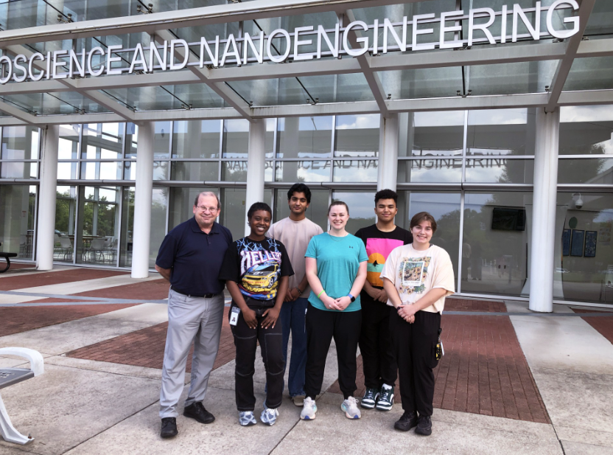


Acknowledgments
Thanks to the SENIC REU program for funding (Award No. 2349519)
Prof. Dan Rabinovich (JSNN)
Prof. Catherine Denning-Jannace (UNCG Chemistry)
Prof. James Golen (UMass Dartmouth)
Maggie Mahanes (G1)
Summer Hunter (B.S. ‘27)
Gabriel Carter (H.S. ‘27)
Dhruv Revankar (H.S. ’27)
Ms. Sequoia Nichols
9

Slide 12


Slide 13
Synthesis of IRE^{R’} Ligands

