Slide 1
MAPbI₃ Thin Film Optimization for a Piezo-Acoustic Memristor
Ava Foreman
Home Institution: University of North Carolina at Asheville
REU Host Institution: Duke University
Yi Xie¹, Hintsa Fisseha Hishe², Arijit Sarkar², Tania Roy², David B. Mitzi¹
¹Thomas Lord Department of Mechanical Engineering & Materials Science, Duke University, Durham, NC 27708
² Pierre R. Lamond Department of Electrical and Computer Engineering, Duke University, Durham, NC 27708

Slide 2
Motivation
Memristors
  Class of neuromorphic device
  Ability to process, compute and store data
  Resistance based on history of experienced current/voltage
Piezo-Acoustic Memristor
  Conductance states tuned through sound waves
  Applications in healthcare, AI, and more
Resistor Memristor
Resistance
Time
Vishwanath, S. K. et al. Material Horizons 2024, 11 (11), 2643–2656
Liu, Z. et al. Advanced Materials Interfaces 2023, 10 (2), 2201513
Notes:
conductance states induced by external stimulation

Slide 3
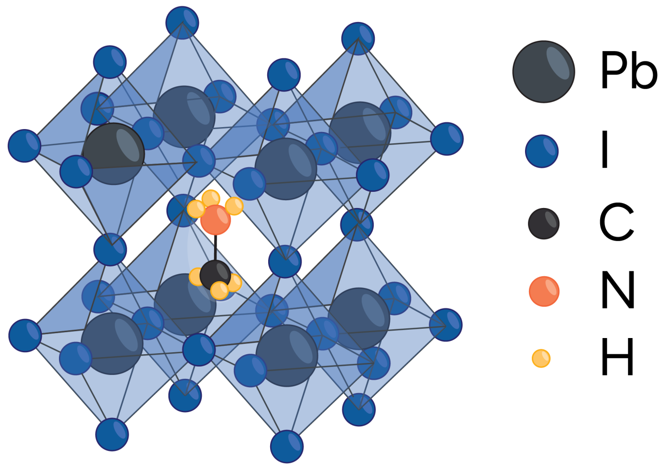
Motivation
Methylammonium Lead Iodide (MAPbI₃)
  Organic-inorganic perovskite
  Inexpensive and simple fabrication
  Commonly used for photovoltaic properties
MAPbI₃ Memristor
  Asymmetrical organic spacer component enables self polarization
  Tolerant to a variety of substrates
  Strong piezoelectric response previously measured
https://www.energy.gov/cmei/systems/perovskite-solar-cells
electrode
active layer
electrode
memristor general structure
Liu, Z. et al. Advanced Science 2024, 11 (10), 2308383

Slide 4
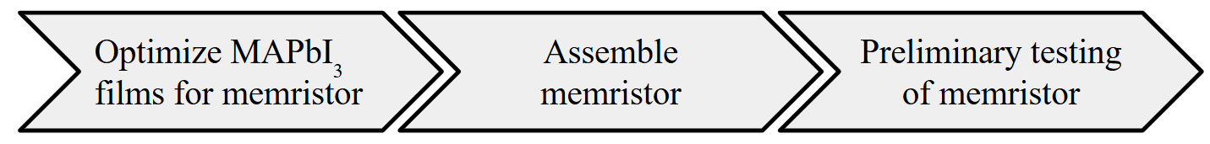
Project Flow

Slide 5
MAPbI₃ Thin Film Deposition
Deposition Approach:
Dispense precursor on glass substrate
Spincoat (4000 rpm, 30 s)
Anneal at 70℃ for 1 minute, and then 110℃ for 10 minutes
Features of an Ideal MAPbI₃ Thin Film:
Pure tetragonal phase
Free of defects and pinholes
Uniform distribution of film across substrate

Slide 6
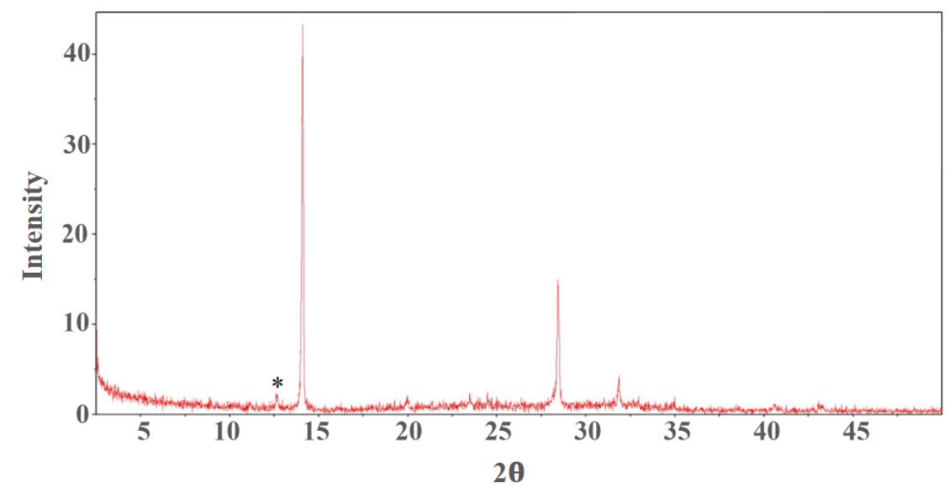
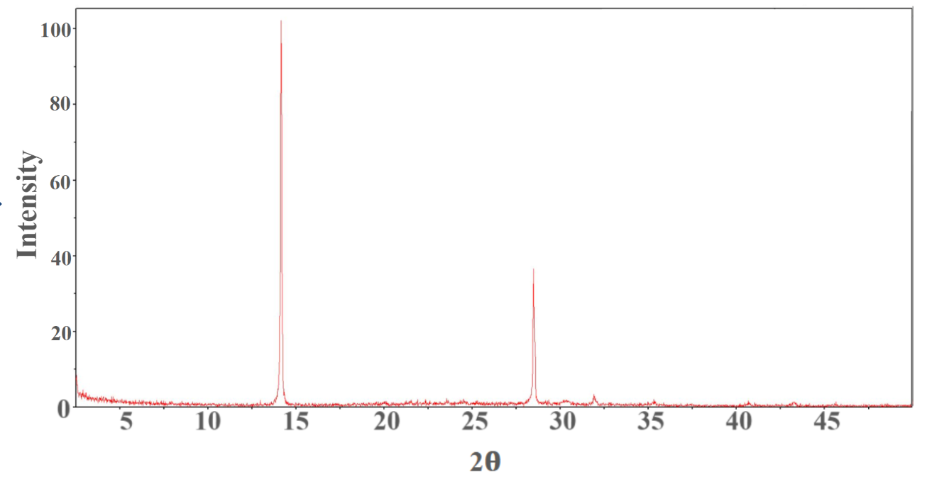
Optimizing MAPbI₃ Thin Films
Obtaining the desired phase of MAPbI₃
1:1 molar ratio MAI:PbI₂ (in DMF)
1.05:1 molar ratio MAI:PbI₂ (in DMF)
X-ray diffraction patterns

Slide 7
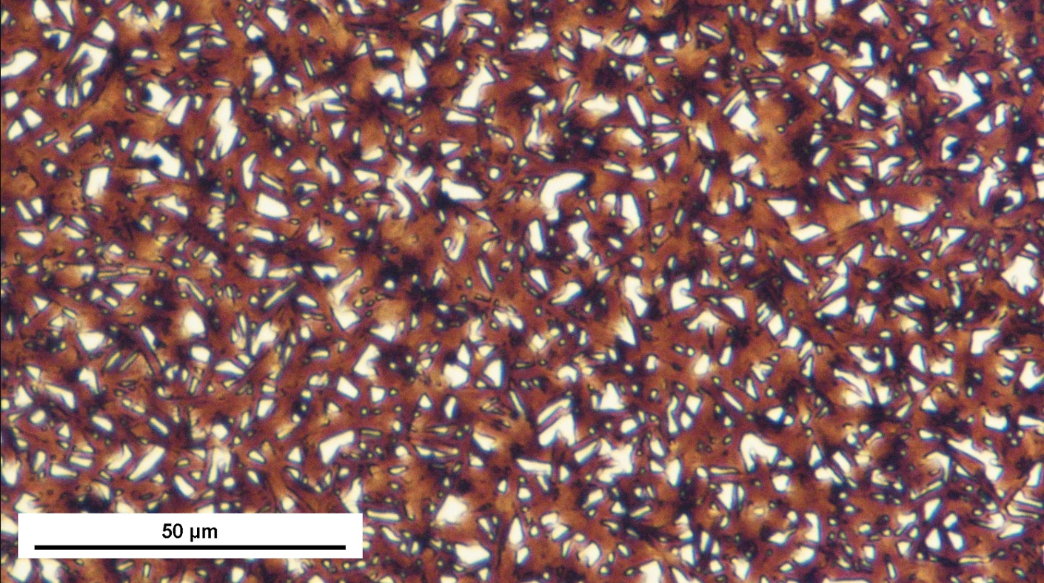
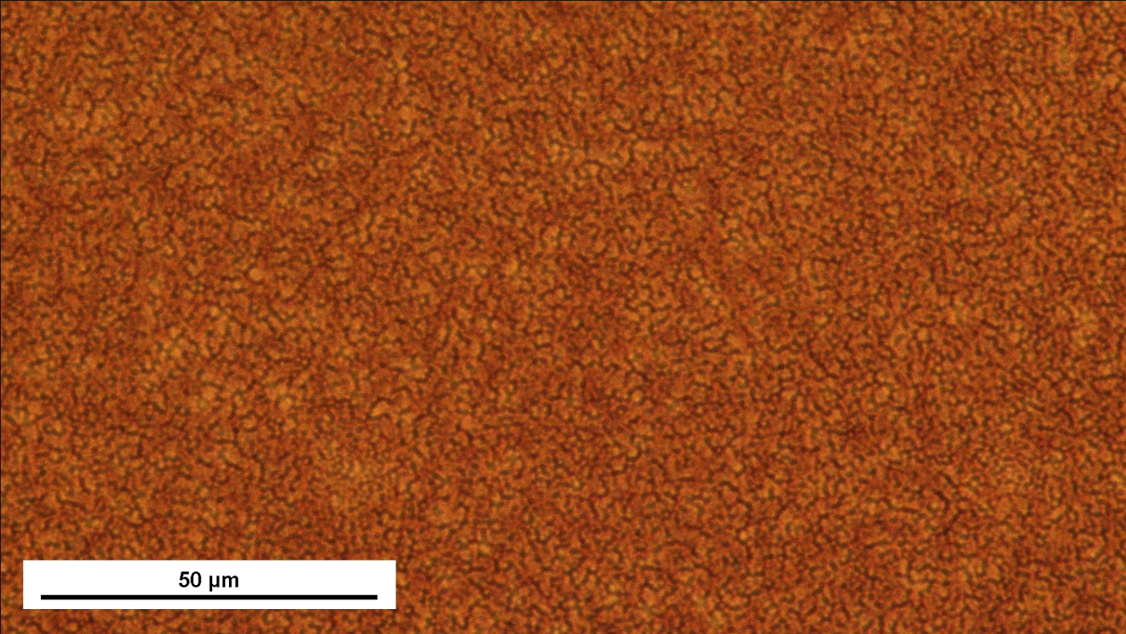
Optimizing MAPbI₃ Thin Films
Eliminating pinholes in films
Solvent: DMF
Antisolvent: n/a
Solvent: 8:2 volume ratio DMF:DMSO
Antisolvent: diethyl ether
Optical microscope images

Slide 8
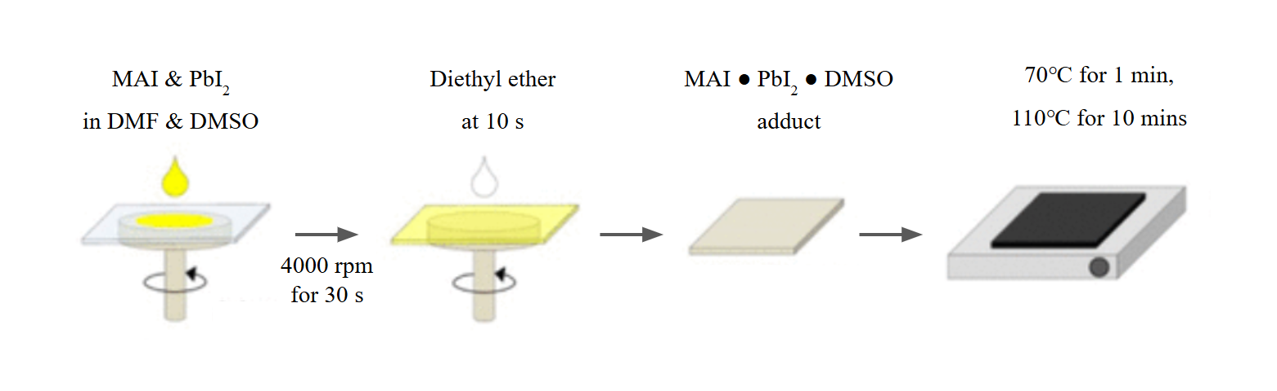
Optimized MAPbI₃ Thin Film Fabrication
Figure adapted from Ahn, N. et al.Journal of the American Chemical Society. 2015, 137 (27), 8696–8699
Obtained reproducible uniform films with a thickness of ~200 nm

Slide 9
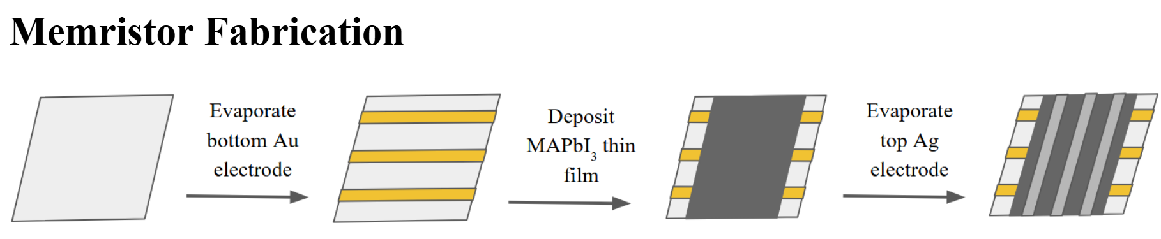
Assembling the MAPbI₃ Memristor

Slide 10
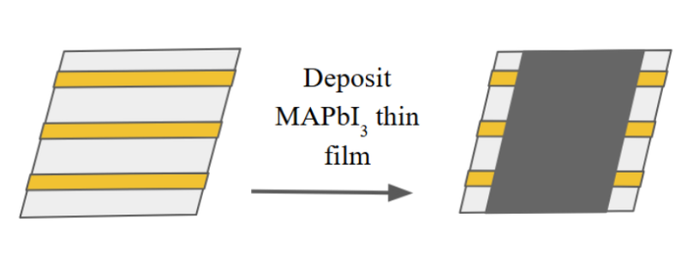
Reproducing High Quality MAPbI₃ Thin Film on Bottom Electrode

Slide 11
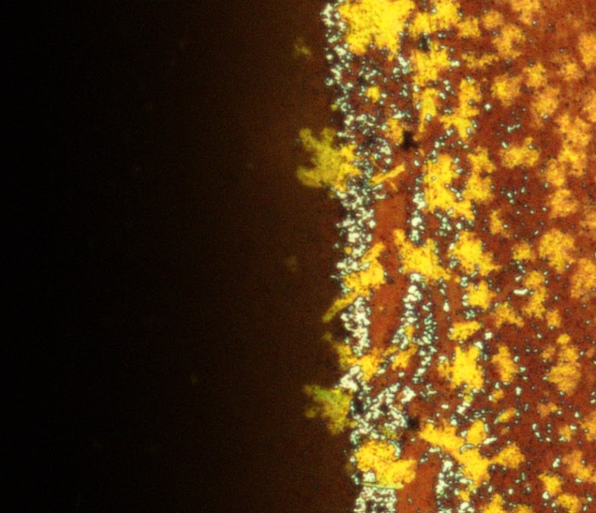



Optimizing MAPbI₃ Thin Films for a Piezo-Acoustic Memristor
Reproducing film quality on substrate with bottom electrode deposited
  Ti/Au electrodes with height of 100 nm
Electrode
MAPbI₃
sites for pinholes
MAPbI₃
Au
Glass substrate

Slide 12
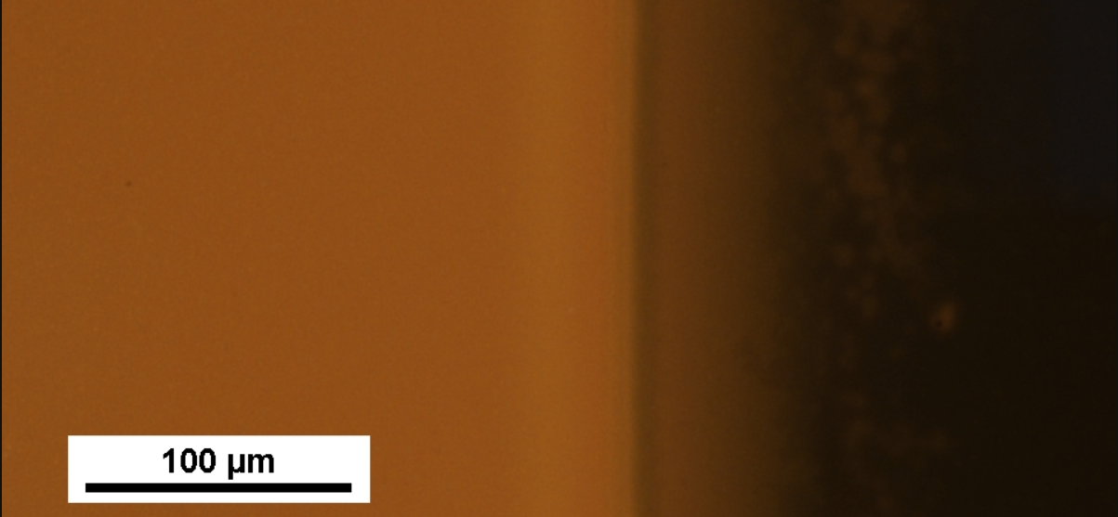
Optimizing MAPbI₃ Thin Films for a Piezo-Acoustic Memristor
Reproducing film quality on substrate with bottom electrode deposited
  Ti/Au electrodes with height of 30 nm
Electrode
MAPbI₃
reduced chance of pinholes

Slide 13
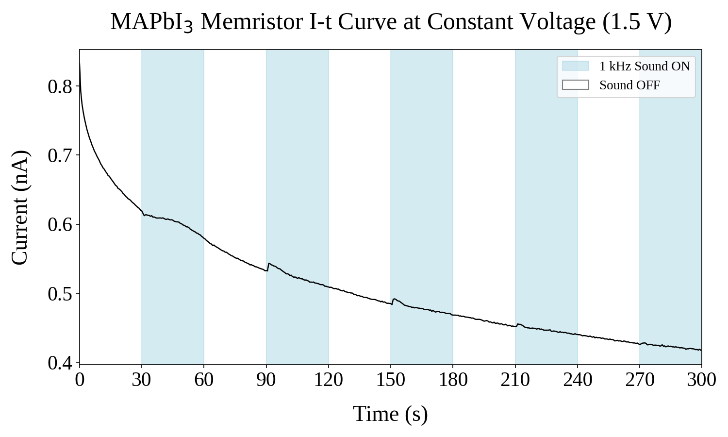
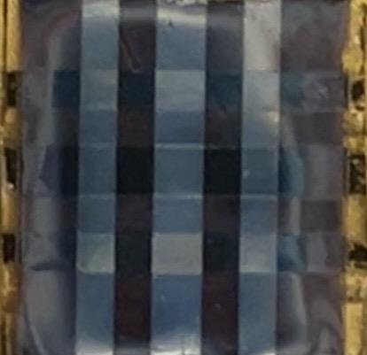
A MAPbI₃ Memristor
Acoustically modulated conductance states consistent with piezotronic mechanism

Slide 14
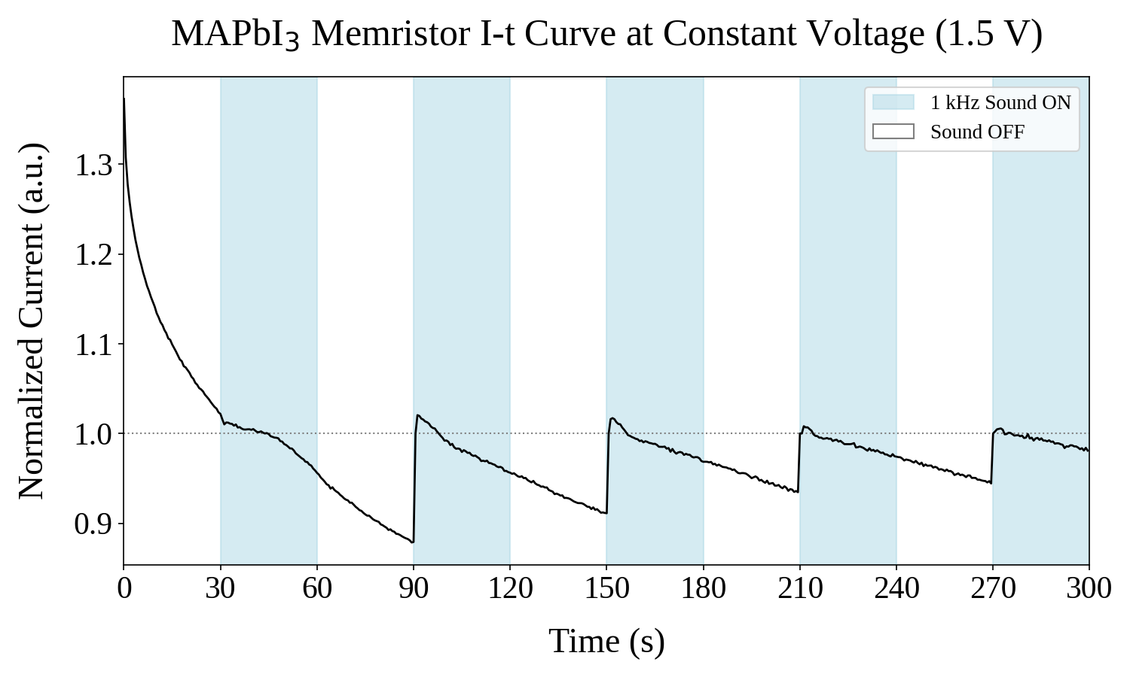
A MAPbI₃ Memristor
Acoustically modulated conductance states consistent with piezotronic mechanism

Slide 15
Future Work
Further testing of MAPbI₃ memristors piezo-acoustic response
Test different materials for electrodes (e.g ITO) and compare performance
Examine switching mechanism of memristor

Slide 16
Thank You!
Thank you to my mentors Yi Xie, Hintsa Fisseha Hishe and Arijit Sarkar for their support in this project!
Thank you to my PI’s Prof. David B. Mitzi and Prof. Tania Roy for their guidance and expertise!
My email address: aforema2@unca.edu feel free to reach out for further questions/discussion!
This material is based upon work which is supported by the National Science Foundation (award numbers 2447827, 2447828, 2447829 and ECCS-2025064). Any opinions, findings, and conclusions or recommendations expressed in this material are those of the author(s) and do not necessarily reflect the views of the National Science Foundation.

