Slide 1





Microfabricated Gas Sensor Array
For The Detection Of Airborne
Toxic Organic Compounds
Madilyn Tran, Colby College
Dr. Xiao-An Fu, University of Louisville
NSF REU Award ID # 2348869
NSF NNCI Award ID # 2025075

Slide 2

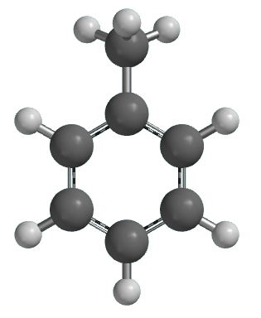

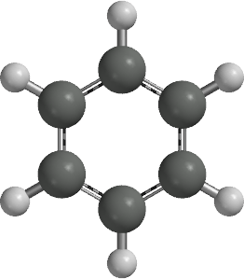
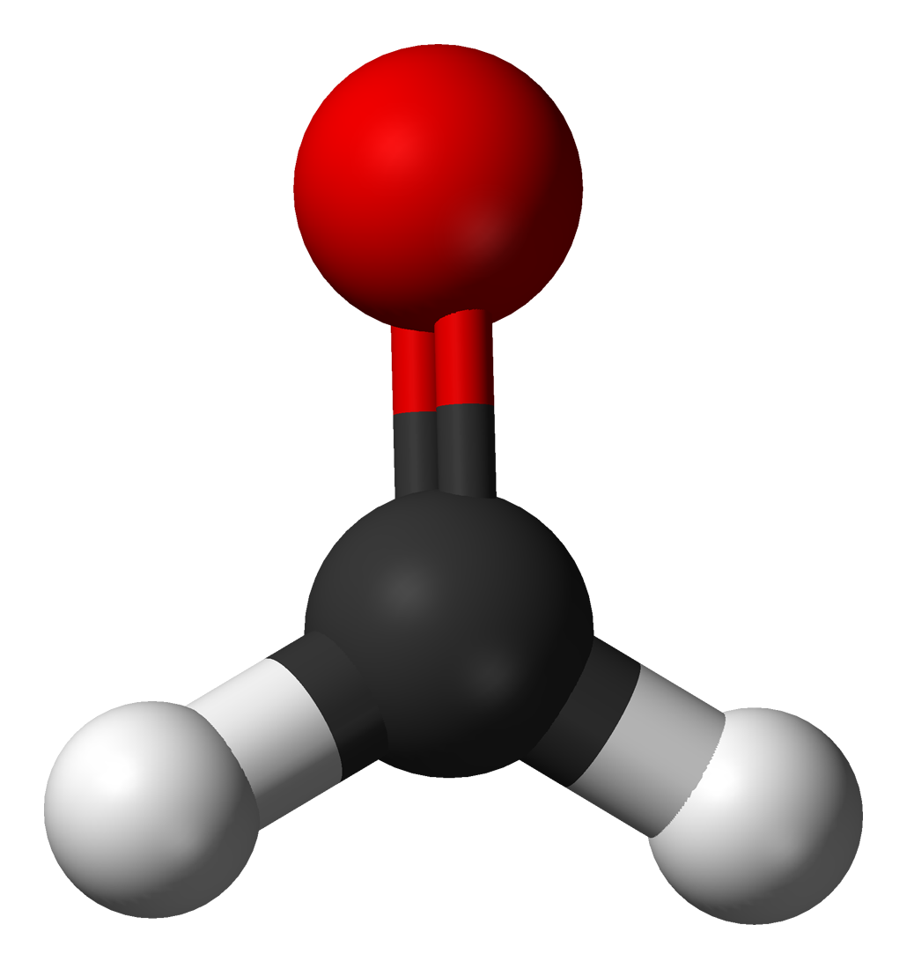
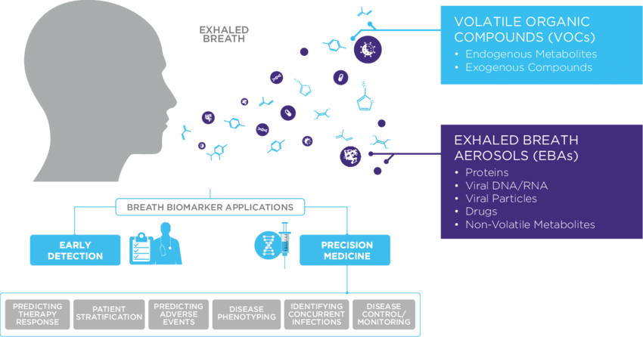
Introduction and Purpose
Humans spend roughly 90% of their lives indoors (U.S. EPA, May 2022).
In these rooms, almost every physical item leaves a unique chemical trace: paints, solvents, household cleaners
Patients with type 1 diabetes produce acetone when lacking insulin
They’re invisible! (almost)
Why should we care about these microscopic chemical exposures?
1
Giuseppe Ferrandino, Owlstone Medical
Notes:
Humans spend roughly 90% of their lives indoors. This comes from the EPA in 2022, and that number is astounding. For reference, if you lived to be 80, you would have spent 72 of those years just being inside. And in these rooms, almost every physical item is leaving some sort of chemical trace. Toluene in the paint on the walls, methylene chloride/DCM in the cleaning solution, formaldehyde in pressed wood furniture and flooring. Not to mention the ones that are naturally produced by humans. Patients with type 1 diabetes will begin exhaling higher concentrations of acetone when they need insulin.
And the worst part is that they're invisible. Well, almost. You can't see them, or feel them, or hear them, but if you have a keen nose, you might be able to smell them. You might be able to smell that the gas stove is on. Or that your roommate is deep cleaning the living room. Or that your neighbors are hosting a bonfire in their backyard. But what does this have to do with anything?
Why should we care about these chemical exposures? Is it just because you might not like how they smell?

Slide 3
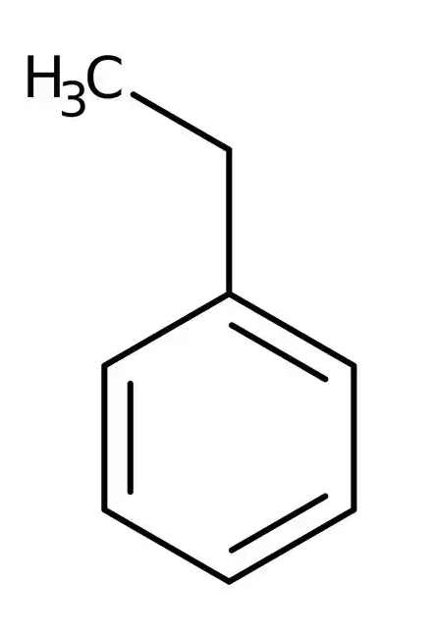
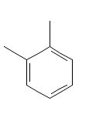
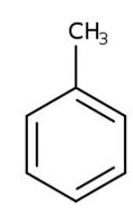
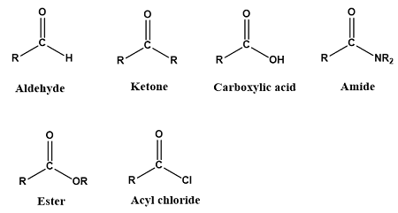
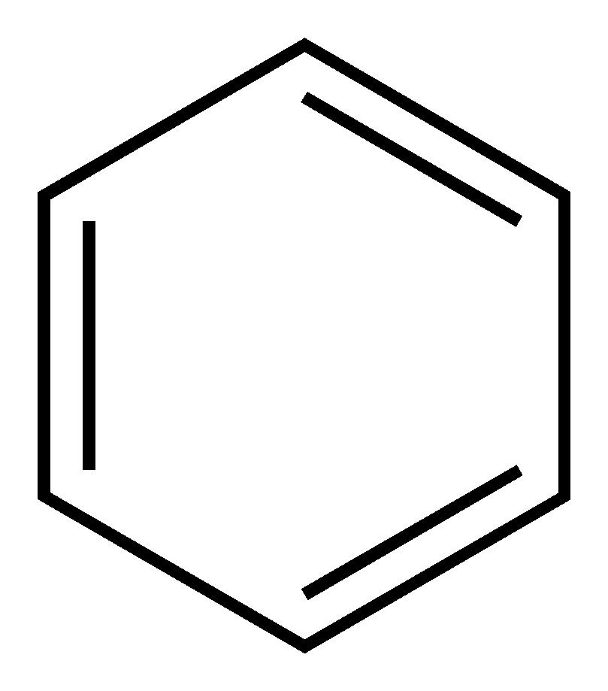
Introduction and Purpose
BTEX
Benzene, Toluene, Ethylbenzene, Xylene
Carbonyl
Aldehydes, Ketones, Carboxylic Acids, Esters
B
T
E
X
Volatile Organic Compounds (VOCs): carbon-containing chemicals with high vapor pressure and low boiling points.
2
Notes:
The majority of the previously mentioned chemicals fall into one of two categories. BTEX and Carbonyls. BTEX compounds include Benzene, Toluene, Ethylbenzene, and Xylene, and Carbonyls are a group of organic compounds like aldehydes, ketones, carboxylic acids, and esters. They are carcinogens and are known as toxic Volatile Organic Compounds, or VOCs.
They can evaporate into the air at room temperature, where they can be inhaled or absorbed through the skin. Exposure to VOCs can cause adverse effects on human health, ranging from acute irritation to chronic diseases. In high enough doses, benzene can cause damage to bone marrow, anemia, and leukemia. Toluene can cause permanent brain damage, hearing loss, or color vision loss. At lower exposures, these compounds are known to cause headaches, dizziness, and nausea.

Slide 4
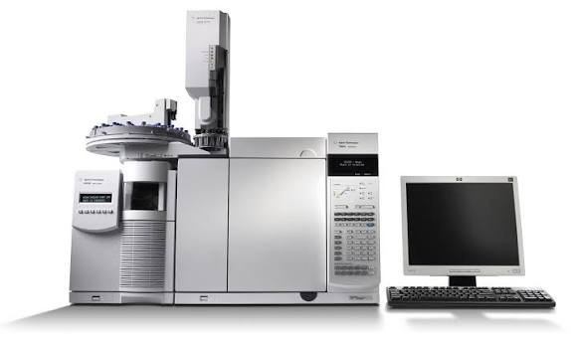
Introduction and Purpose
Diagnosis of toxicity overexposure requires bloodwork and laboratory testing for confirmation:
Blood tests, ABG panels, CBC
Identifying these toxic compounds can require mass spectrometry:
Gas Chromatography-Mass Spec.
Liquid Chromatography-Mass Spec.
3
Notes:
Diagnosing any toxic gas exposure symptoms requires extensive bloodwork and laboratory testing, many of which are very invasive. And once they obtain these samples, identification can require specialized techniques, like mass spec. (GC-MS, or LC-MS). But what if you are a patient who is unaware of having type 1 diabetes and has never taken insulin? Or you are a patient who comes in with a simple case of headache or nausea, and is not even aware of a nearby formaldehyde leak until the lab results come back. All of these tests are costly, take time to set up, and are not very portable.

Slide 5
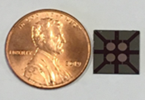
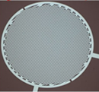
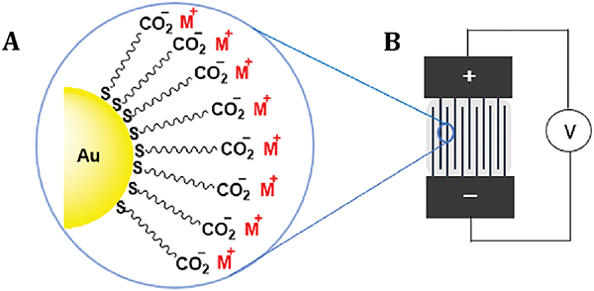
Sensor Design and Mechanism
Gas sensors to detect toxic VOCs at multiple concentrations, while also identifying the analytes
Chemiresistor: a material whose electrical resistance experiences a change in response to the surrounding chemical environment.
Thiol-functionalized gold nanoparticles (AuNPs)
4
Notes:
Instead, imagine you had a chip. Hardly the size of a penny. Imagine we could develop a sensor that detected these elevated concentrations of acetone, or any of those toxic volatile organic compounds, with high selectivity and accuracy in the field. The world needs reliable, low-cost, and portable techniques for identifying VOCs.
Our chips function as chemiresistors, meaning that they experience a measurable change in their resistance when exposed to each of these gas environments (whether it's benzene, acetone, or another VOC, or a mixture), and utilize thiol-functionalized gold nanoparticles.
Adhihetty PK, Halder S, Jasinski JB, Fu XA, Nantz MH. Harnessing the cation-π interactions of metalated gold monolayer-protected clusters to detect aromatic volatile organic compounds. Talanta. 2023 Feb 1;253:123915. doi: 10.1016/j.talanta.2022.123915. Epub 2022 Sep 13. PMID: 36155323; PMCID: PMC10210835.

Slide 6
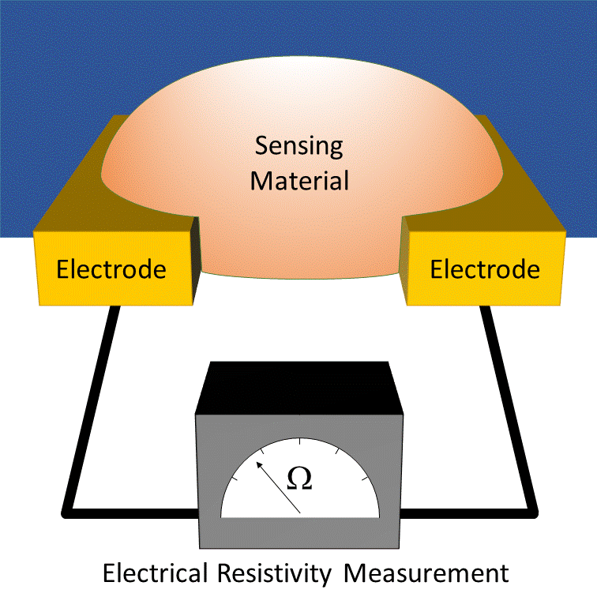
Sensor Design and Mechanism
VOCs attracted to thiol ligands and bind to the surface of the AuNPs
Absorption of gas samples creates localized restructuring
Temporarily lowers the physical gaps between gold metal centers, causing a measurable drop in resistance
5
https://en.wikipedia.org/wiki/Chemiresistor
Notes:
-When we expose VOCs to our sensors, the analytes are immediately attracted to the thiol ligands of the gold nanoparticles. They are absorbed and create localized restructuring. Imagine these nanoparticles folding up, or squeezing closer, or collapsing into each other. And so, as long as the VOCs are exposed to the sensors and interacting with the surface of these nanoparticles, the physical gaps between each metal center decrease. The electrons have far less distance to travel, and we see a measurable drop in resistance.

Slide 7
Selectivity and Sensitivity
Identifying suitable functional groups that can target each of the VOCs:
Hydrogen bonding
Polar, non-polar
π-π interactions
e⁻ donor, e⁻ acceptor
Steric hindrance
6
Notes:
A challenge this project faces is choosing exactly which ligands to coordinate onto our gold metal centers to provide the best results. If we select functional groups that can target each VOC’s characteristics, we can introduce selectivity to our results. For example, acetone is polar, and benzene is aromatic. Our chosen ligands must reflect these attributes and be able to create responses that can distinguish between them.

Slide 8
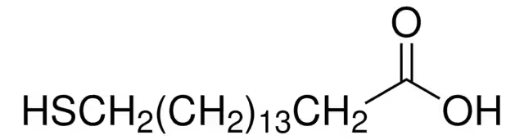
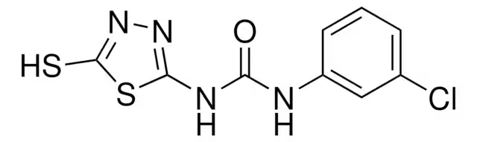
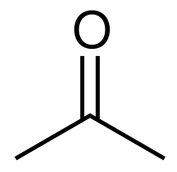


Selectivity and Sensitivity
16-MHA
2-YL
7
Notes:
Let’s look at two of the thiol-functionalized gold nanoparticles I synthesized. We have 16-MHA and 2-YL. Immediately, we can see the differences that we needed to facilitate alternative reactions with our gas samples. The analytes I focused on include, from left to right: benzene, acetone, hexane, and ethanol. And so, when our sensors interact with these VOCs, they induce different characteristic features of their response curves. We start seeing distinct slopes and magnitudes depending on which combination of nanoparticles and analyte we select. The response kinetics can now be used to identify analyte samples and distinguish them from one another.

Slide 9
Experimental Procedure
8
Notes:
Our experiments use a setup similar to this. Graduate students microfabricated the sensors before arrival, and the gold nanoparticles were synthesized with a two-phase procedure over the course of a week and suspended in methanol. The first step is here:

Slide 10
Experimental Procedure
Chamber attached to two valves:
Vacuum pump
Teflon bag containing gas sample
  Increasing concentrations from 100 ppb to 10,000 ppb (10 ppm)
Sensor
Vacuum pump
Valves
Chamber
Gas sample
8
Notes:
We have a chamber that is connected to two valves, one with a vacuum pump attached and the other with our gas sample. These are sets of 0.8 L Teflon bags with increasing concentrations of whichever VOC we are measuring. For example, we can fill a bag with 500 mL of synthetic air and add some microliters of benzene to create a concentration of 1000 ppm. Then, we can continuously dilute this sample 1:10 with more synthetic air, creating lower and lower concentrations. We go from 1000 ppm to 100 ppm, to 10 ppm, all the way down to 10 ppb.
Inside the chamber is our sensor array, with wires soldered onto the pads. The nanoparticles are deposited with a micropipette. Then, the valves are switched off every 5 minutes between the vacuum and the gas sample, exposing the sensor and, more importantly, the thiol-functionalized nanoparticles to a controlled concentration of the VOC sample before removing it from the chamber with the vacuum once again and repeating.

Slide 11
Experimental Procedure
Keithley 2400 SourceMeter
Supplies constant voltage (5 V) across the sensor and measures current
Calculates resistance and collects data over time
Resistance changes when exposed to the VOC samples.
Sensor
Computer
SourceMeter
9
Notes:
These sensor responses are collected by a Keithley 2400 SourceMeter. It supplies constant voltage and measures the current. Using Ohm’s Law, the software calculates the resistance and collects that data over time. Thus, as we expose the nanoparticles to increasing concentrations of the gas samples, we can see clear intervals in the data where the resistance changes in response.

Slide 12
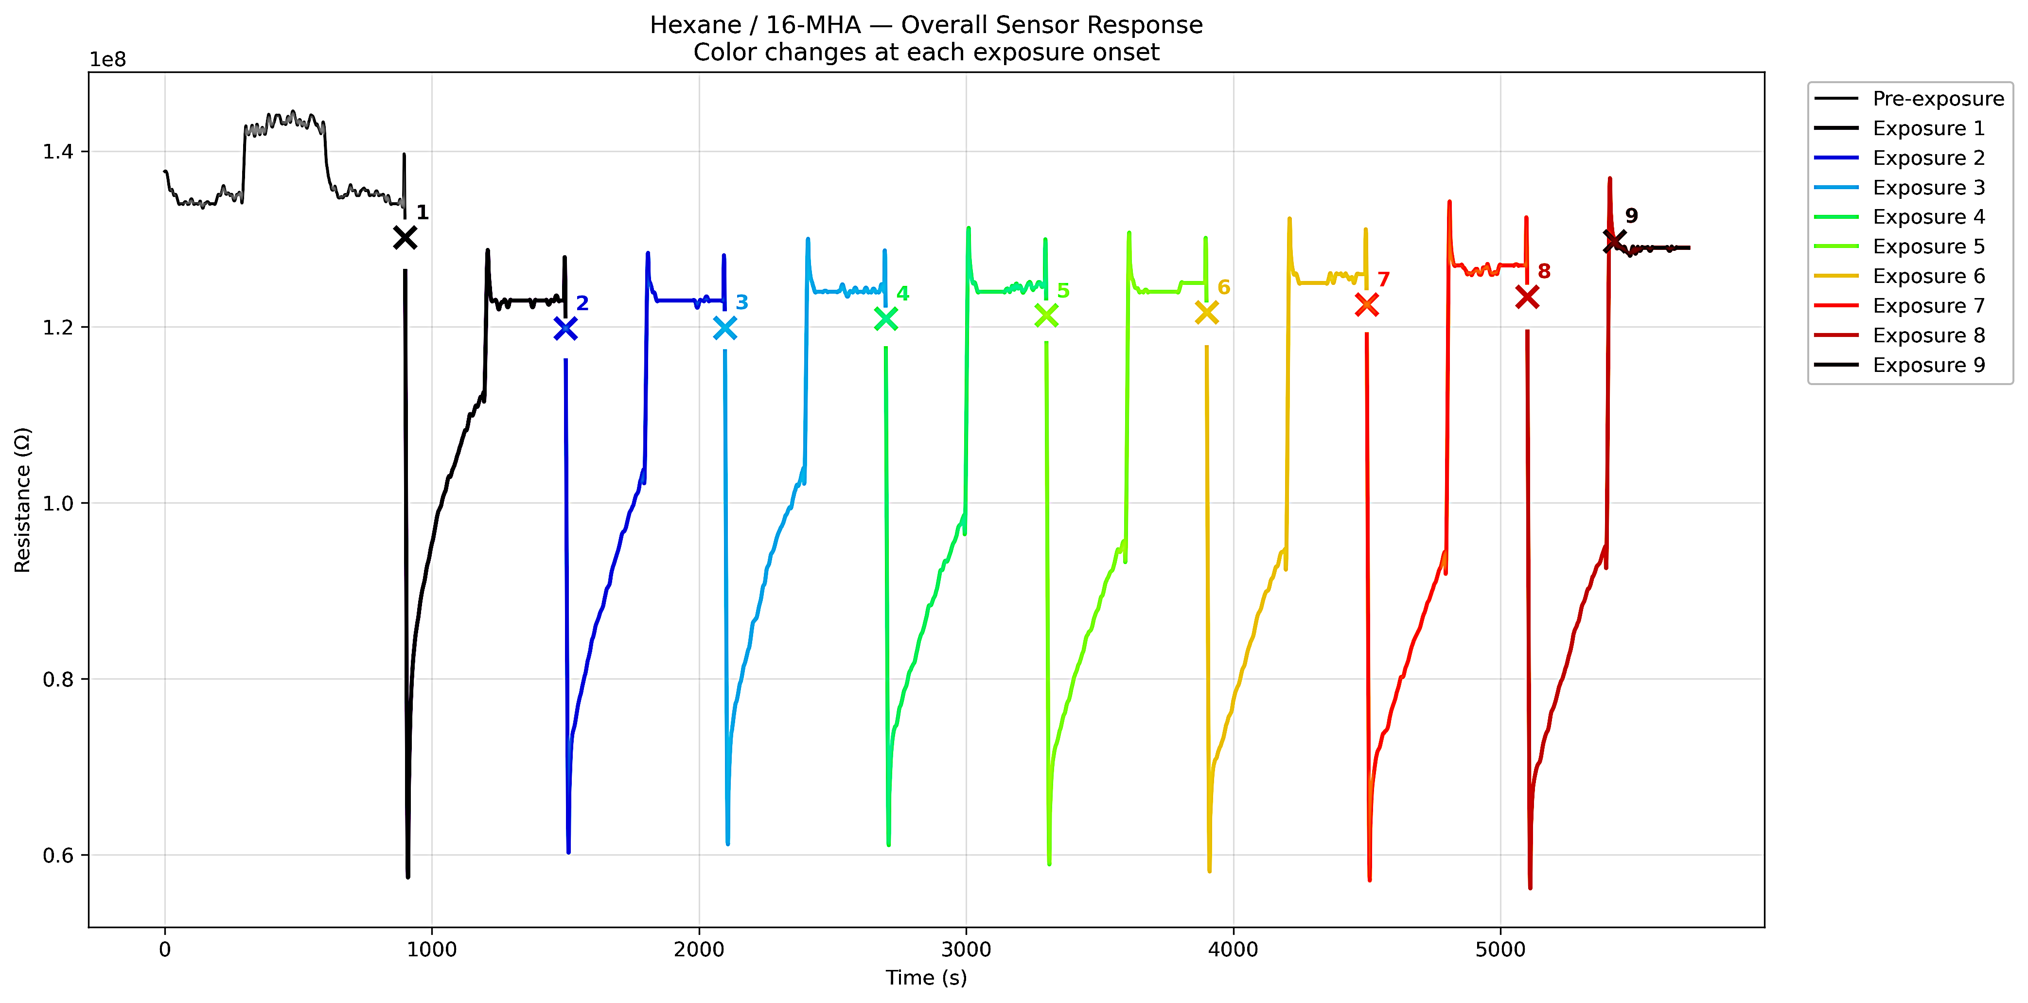
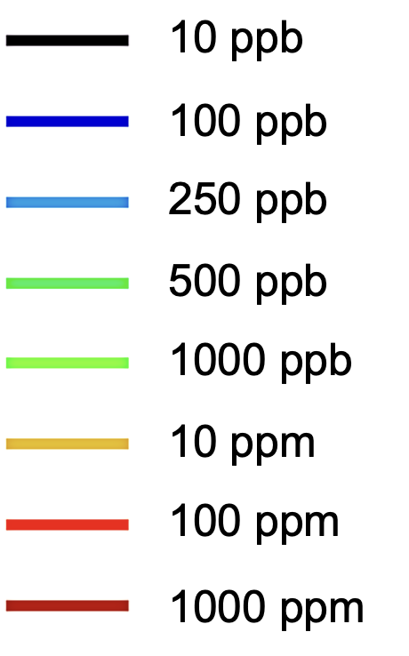
Data: 16-MHA / Hexane
Resistance Changes Over Time, As Analyte Concentration Increases
10 ppb
10 ppb
100 ppb
100 ppb
250 ppb
250 ppb
500 ppb
500 ppb
1000 ppb
1 ppm aa
10 ppm
10 ppm
100 ppm
100 ppm
1000 ppm
1000 ppm
10
Notes:
Here’s a graph of 16-MHA gold nanoparticles reacting with hexane. We can immediately tell that as soon as I switch the valve and expose 16-MHA to Hexane gas samples, the resistance drops. As soon as I switch it to vacuum, it returns to the baseline resistance. As we move rightward, the concentration of hexane in the samples increases. We start with 10 ppb, move to 100 ppb, then end up at 1000 ppm. You’ll also notice the sharpness of the peaks. These are indicative of the recovery time.
Recovery time is a way to measure how long is takes the nanoparticles to return to their baseline resistance: meaning if I was not there to switch a valve and turn on a vacuum, how long would it take for 16-MHA to ‘recover’ from hexane? As you might have guessed, higher concentrations mean higher recovery time.
So that’s it! You might be thinking, Maddy, you’ve done it. You found a way to detect VOCs from the air! Well, I mentioned that two goals are selectivity and sensitivity. 16-MHA is definitely sensitive to hexane, but..

Slide 13
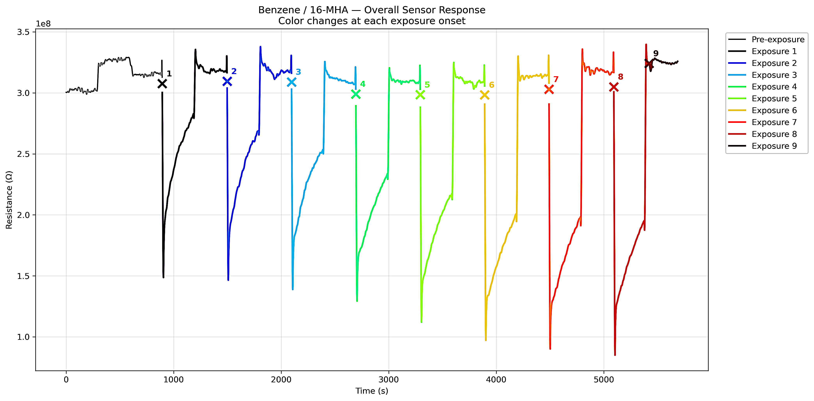
Data: 16-MHA / Benzene
Resistance Changes Over Time, As Analyte Concentration Increases
10 ppb
10 ppb
100 ppb
100 ppb
250 ppb
250 ppb
500 ppb
500 ppb
1000 ppb
1 ppm aa
10 ppm
10 ppm
100 ppm
100 ppm
1000 ppm
1000 ppm
11
Notes:
This is 16-MHA reacting to benzene. Maybe you don’t want to hurt my feelings, but they look exactly the same. So these particular thiol-functionalized nanoparticles using 16-MHA, are not sensitive enough.

Slide 14
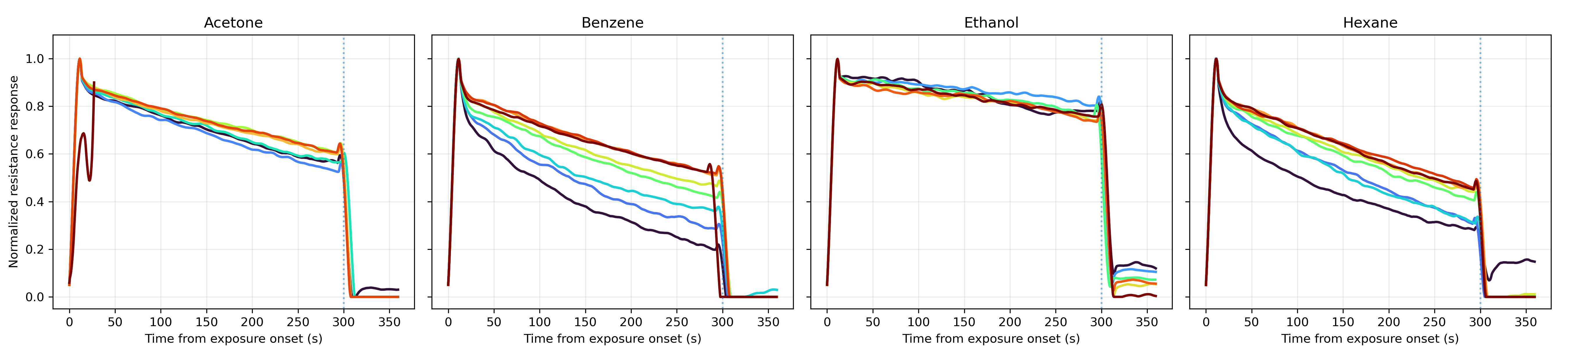
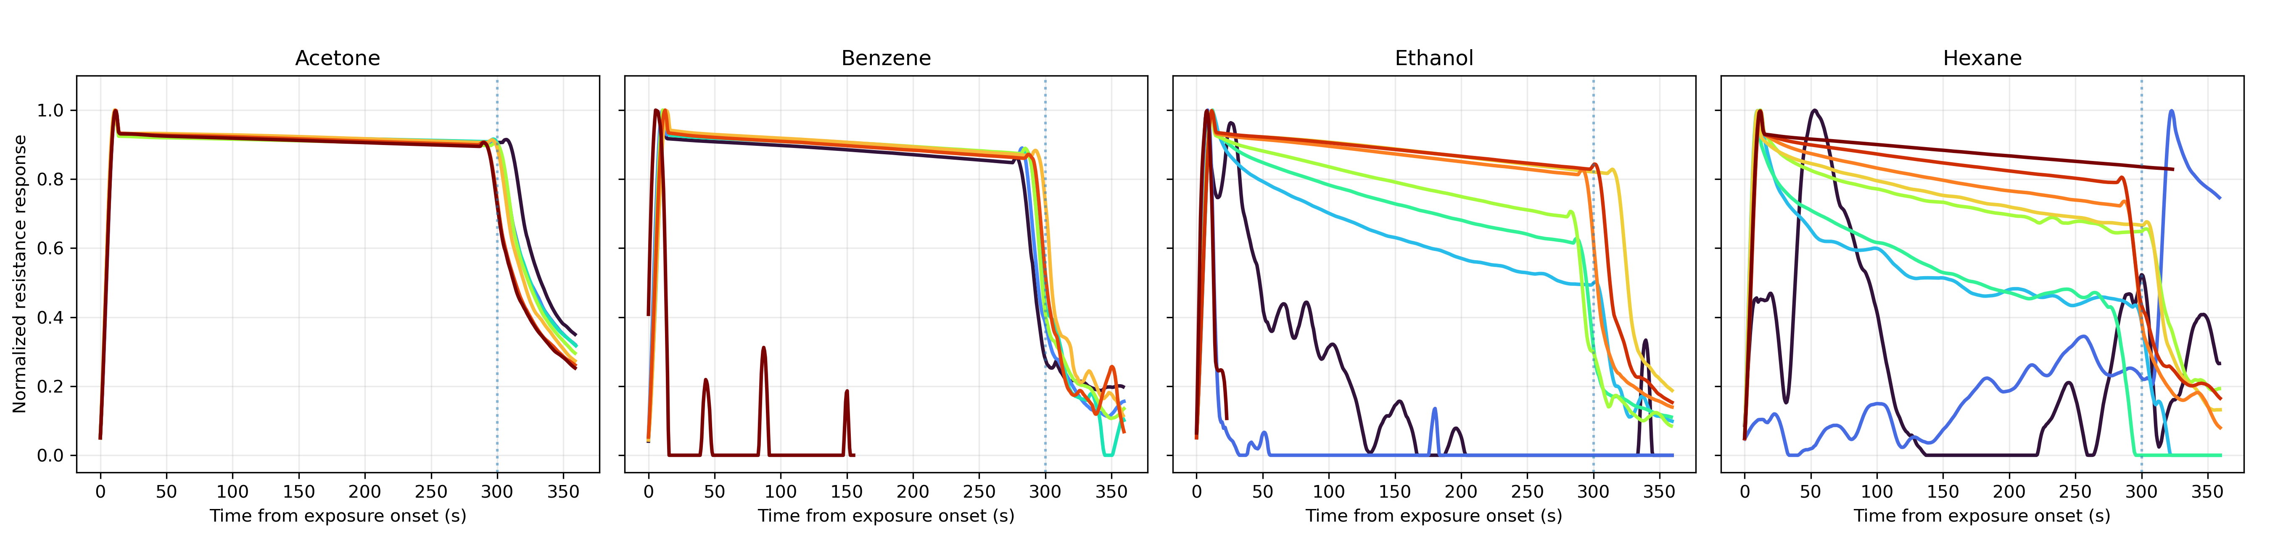
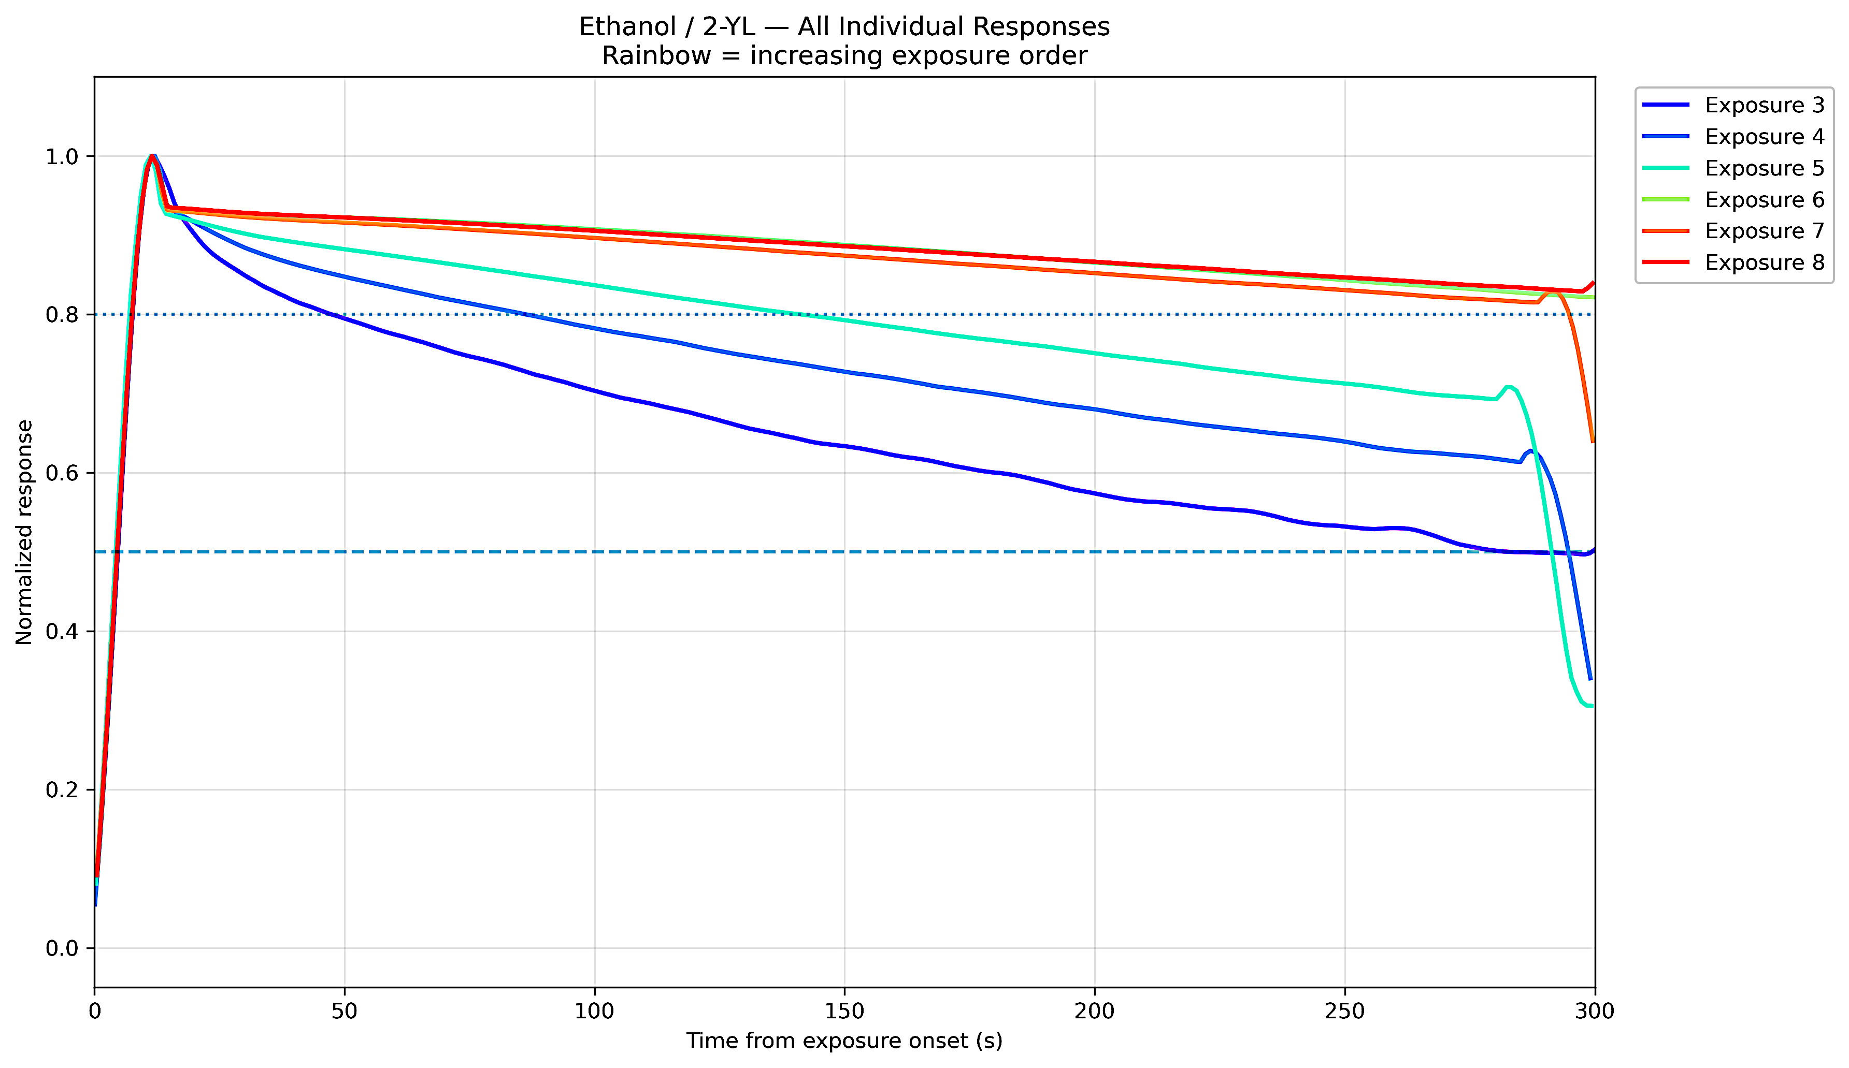
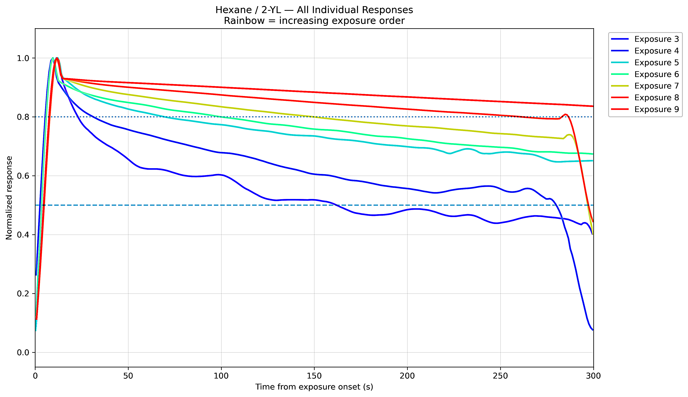
Response Curves Across Sensors, Analytes
Acetone
Benzene
Ethanol
Hexane
16-MHA
ΔR/R_{o}
ΔR/R_{o}
2-YL
12
Notes:
Here are the response curves across all eight combinations: meaning two thiols (16-MHA on top, 2-YL on the bottom), and our four analytes (Acetone, Benzene, Ethanol, Hexane). The colors here also represent the concentration, so you’ll notice that some of the analytes will show nice gradients and a relationship between sensor response and sample concentration, and others will not.
Look at Benzene and Hexane. Just like the resistance data, their response curves are nearly identical with 16-MHA. But when we combine this information with the 2-YL sensors, we can start seeing differences. This means that, although one sensor was able to distinguish concentration levels, it didn’t do a good job in identifying the analytes; we can use another sensor in tandem to achieve both of our goals.

Slide 15
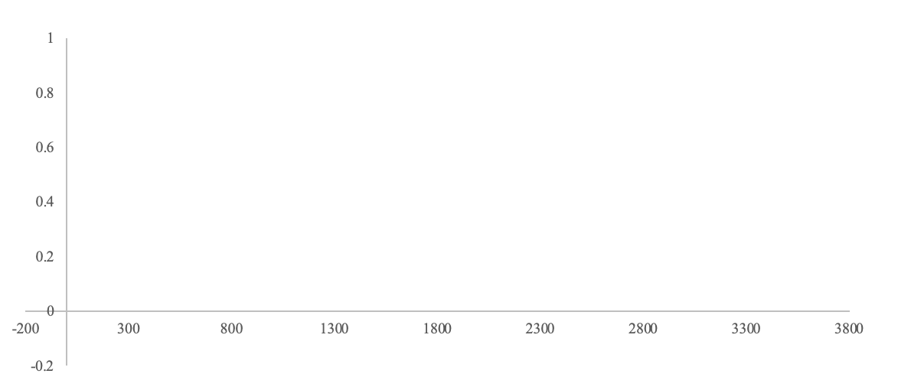
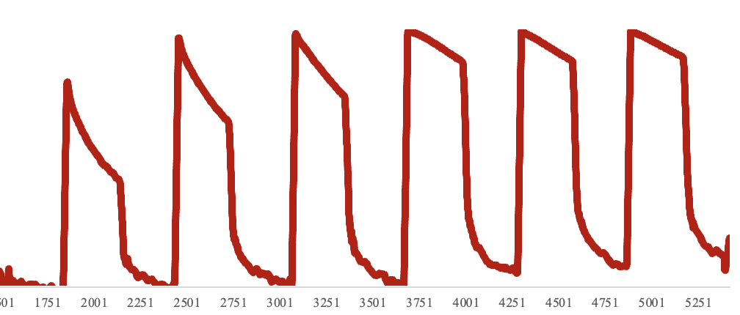
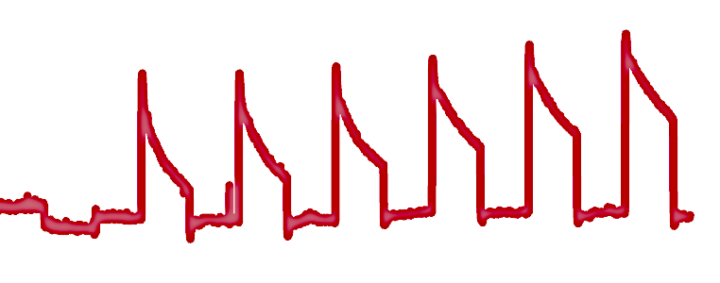
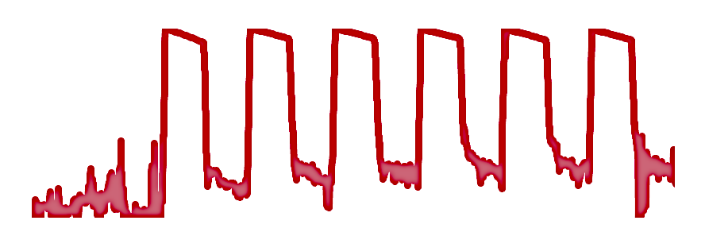
Data and Analysis: Benzene
16-MHA
I II III IV V VI
16-MHA can distinguish details that are missed by 2-YL:
Concentration relationship
Distinct curves
ΔR/R_{o}
2-YL
I II III IV V VI
Concentration Key
I: 10 ppb
II: 100 ppb
III: 250 ppb
IV: 500 ppb
V: 1000 ppb/1 ppm
VI: 10,000 ppb/ 10 ppm
ΔR/R_{o}
Time (s)
13
Notes:
Let's take a look at benzene. The response curves look totally different! Now, there is a way to distinguish benzene from hexane that wasn’t available with just a 16-MHA sensor. We might not be able to see distinct curves or a relationship between concentration and 2-YL (on the bottom), however, we can say that 2-YL’s job is just identifying that this sample is benzene.

Slide 16
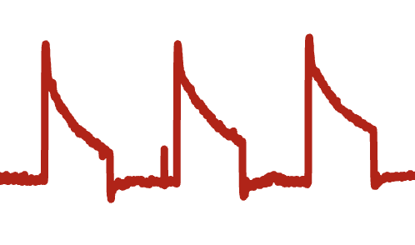

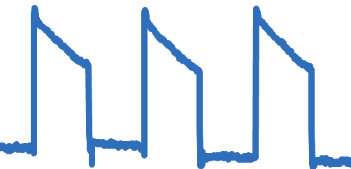
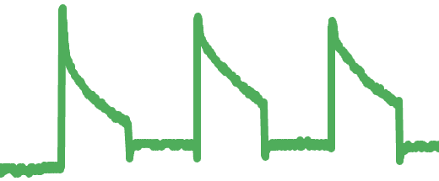
Conclusions
All AuNPs produced results
Significant progress was made in establishing connections between the chosen thiolate ligand and interactions with various VOCs.
Identifying analytes by characteristic curves
Determining relationships between sensor responses and sample concentration
Future Work
Experimenting with additional thiols and AuNPs
Higher focus on mixtures (two or more VOCs together)
14
Notes:
Here is a small summary. Thankfully, all gold nanoparticles produced results. None of them were just a straight line across, and the ones that I worked with were all able to detect some sort of VOC in the air sample. We were able to make significant progress in developing each thiol-nanoparticle-sensor profile and characterize what interactions looked like with various VOCs. Future work is going to focus on experimenting with additional thiols and focus on mixtures. I also included a small diagram of what each of the different compounds looks like. Benzene, acetone, hexane, and ethanol all look different.

Slide 17
Thank YOU!
Acknowledgements
This work was supported by the National Science Foundation (NSF) under award #2348869 and the National Nanotechnology Coordination Infrastructure (NNCI) KY Multiscale under award #2025075.
I want to thank Dr. Xiao-An Fu, Shadmin Chowdhury, Wendell Pimental De Almeida, and Ana Galiano for their continued support throughout this program.
References
Xie Z, Ramakrishnam Raju MV, Stewart AC, Nantz MH, Fu XA. Imparting sensitivity and selectivity to a gold nanoparticle chemiresistor through thiol monolayer functionalization for sensing acetone. RSC Adv. 2018 Oct 21;8(62):35618-35624. doi: 10.1039/c8ra06137h. Epub 2018 Oct 18. PMID: 30555687; PMCID: PMC6238108.
Notes:
Thank you all for being a wonderful audience and for listening to my presentation. I want to especially thank Dr. Xiao-An Fu and the Fu lab, including Shadmin and Wendell, as well as Ana for all of their support throughout this program. Again, thank you all, and does anyone have any questions?

Slide 18
Extra slides

Slide 19
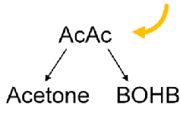
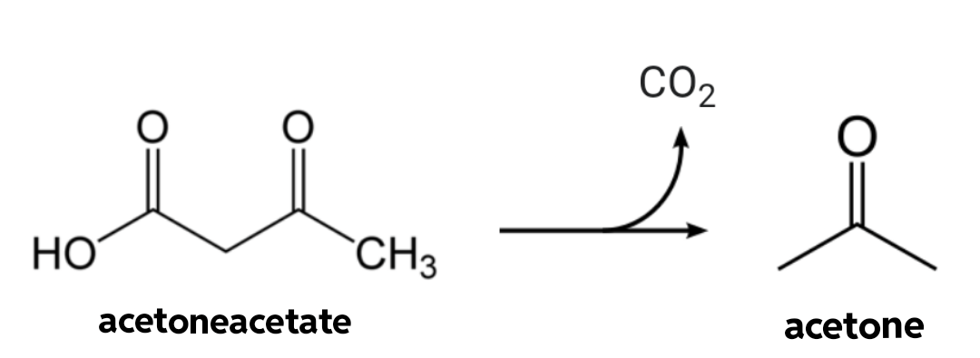
Introduction and Purpose
Acetone is a natural byproduct of the human metabolism, especially in the breakdown of fats.
Higher concentrations of acetone in the body are an indication of severe, uncontrolled diabetes.
Diabetic ketoacidosis: rapid metabolism of fats that causes a toxic buildup of acetone in the body
acetoacetate
2
Notes:
Acetoacetate, which is a highly unstable beta-keto acid, will want to decompose and lose its carboxyl group in the form of carbon dioxide and become acetone. Thus, acetone becomes a natural byproduct of the that builds and builds in the body until removed through the lungs.
But we know that glucose is the primary source of energy for the body, so why care about an aspect of metabolism that only occurs when your body is actively starving? Here’s something you may not have thought about. Patients with type 1 diabetes do not naturally produce the insulin needed to process sugars. Therefore, in the event of a severe lack of managed insulin and glucose, patients will see higher concentrations of acetone in their body. Subsequently, they develop diabetic ketoacidosis, which may be fatal if left untreated.

Slide 20
Data and Analysis: 16-MHA
12
Notes:
When we expose each sensor to increasing concentrations of the analyte samples
Label the concentrations
talk about the concentrations
highest is only about 10 ppb/ppm

Slide 21
Data: 16-MHA / ???
14

Slide 22
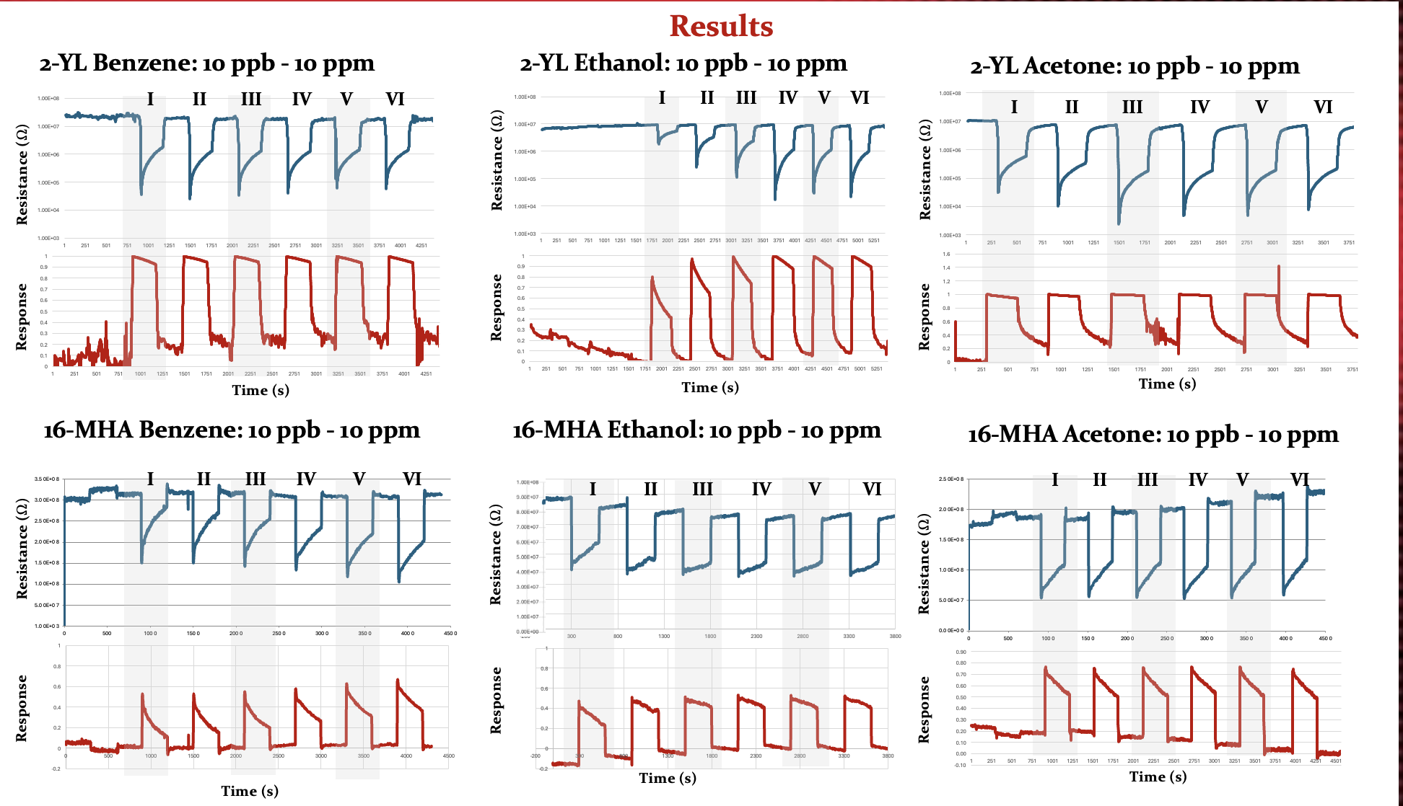
Notes:
add about BTEX and formaldehyde, especially for smoking --> COPD for smokers can not breathe well.. produce a lot of compounds
add a conclusion

Slide 23
Data and Analysis: Ethanol
ΔR/R_{o}
2-YL
Concentration Label Key
I: 10 ppb
II: 100 ppb
III: 250 ppb
IV: 500 ppb
V: 1000 ppb/1 ppm
VI: 10,000 ppb/ 10 ppm
I II III IV V VI
ΔR/R_{o}
16-MHA
Time (s)
12
2-YL response curves
Notes:
When we expose each sensor to increasing concentrations of the analyte samples
Label the concentrations
talk about the concentrations
highest is only about 10 ppb/ppm

Slide 24
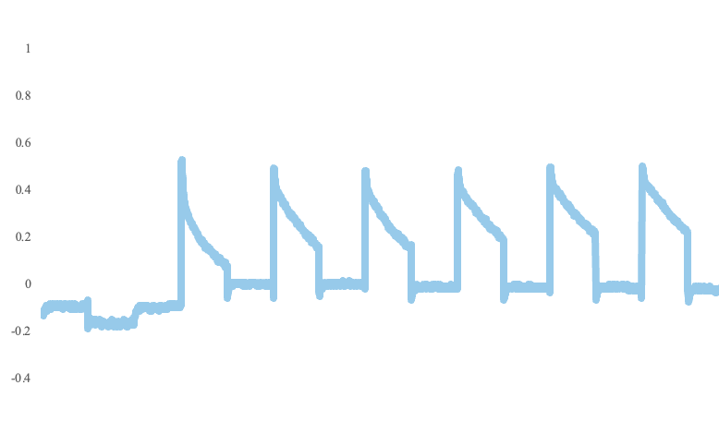
Data and Analysis: 16-MHA
Acetone
Ethanol
Hexane
Benzene
12
Notes:
When we expose each sensor to increasing concentrations of the analyte samples
Label the concentrations
talk about the concentrations
highest is only about 10 ppb/ppm

Slide 25
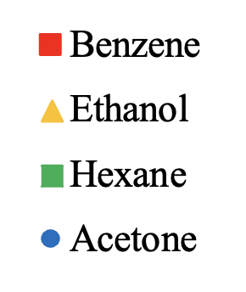
Calibration Curves

Slide 26
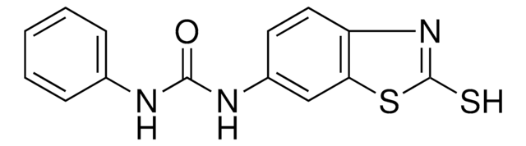
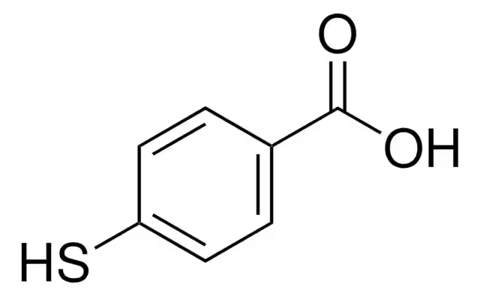
Thiol Information
16-MHA: 16-mercaptohexadecanoic acid thiol
6-YL: 1-(2-mercapto-benzothiazol-6-YL)-3-phenyl-urea thiol
2-YL: N-(3-chlorophenyl)-N’-(5-Mercapto-1,3,4-Thiadiazol-2-YL) urea thiol
BA: 4-mercaptobenzoic acid thiol
8
Notes:
put this in the group meeting and include one of the data results to show

Slide 27
Sensor Design and Mechanism
Notes:
If we carefully select which functional groups and ligands we want on our gold metal centers, we can even begin introducing selectivity.

Slide 28
