Slide 1





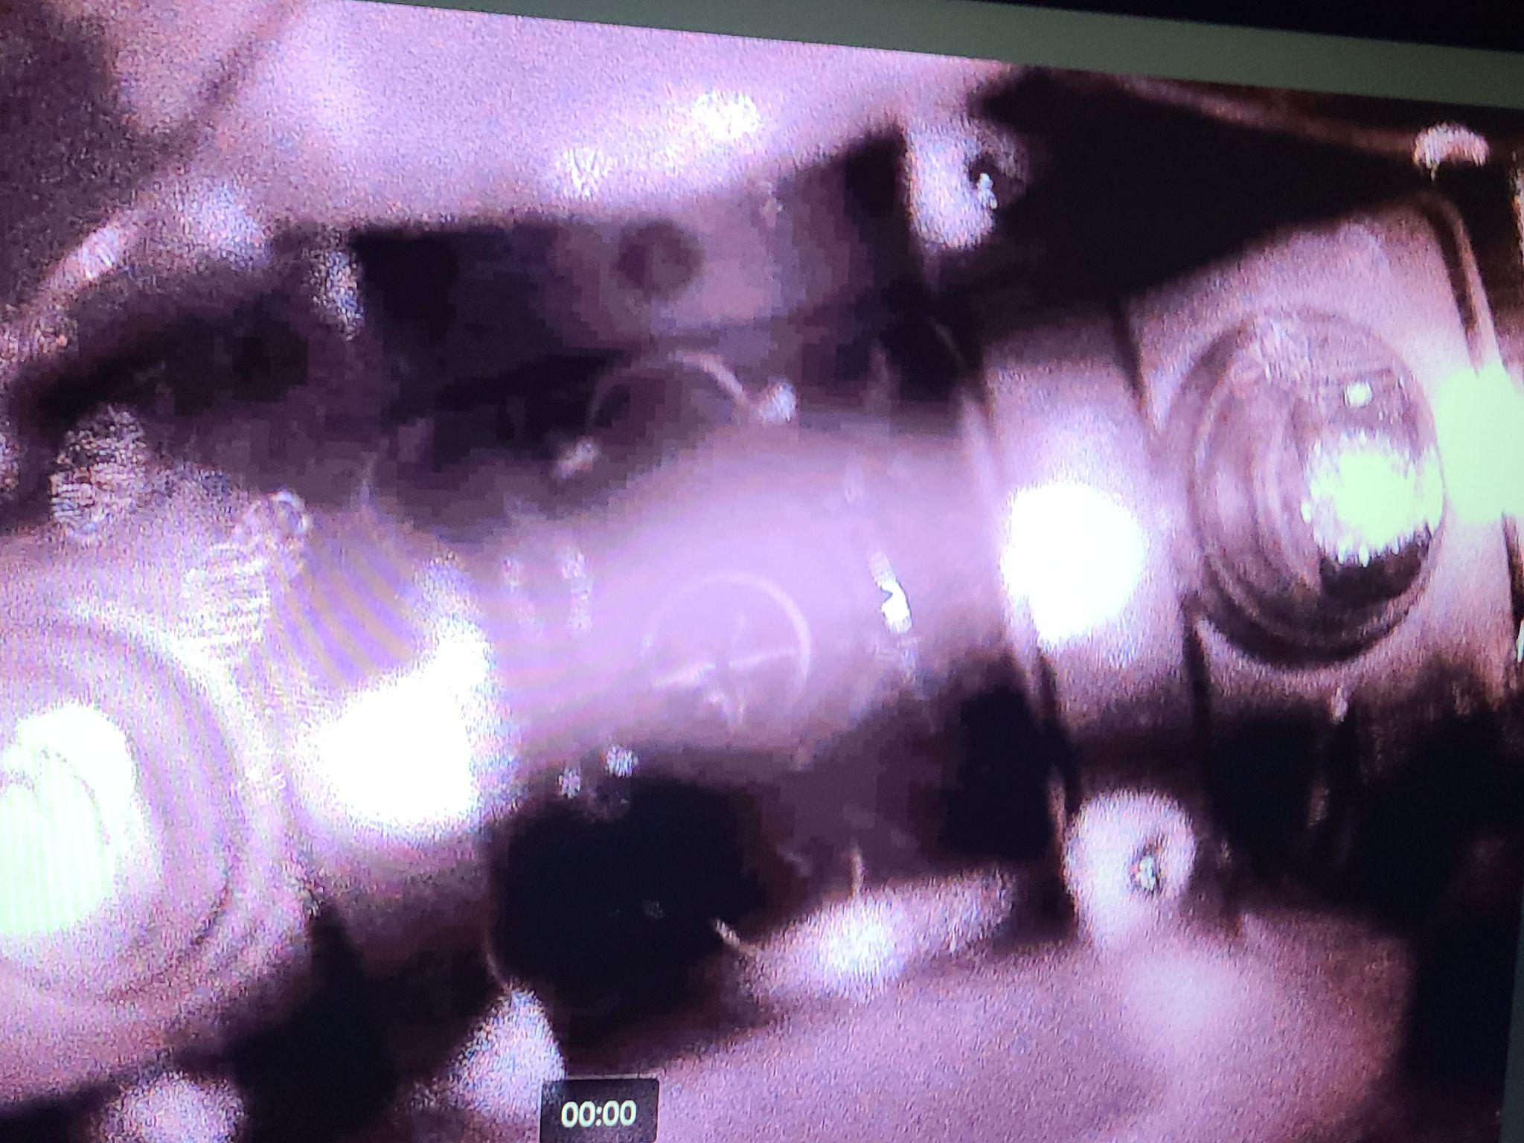
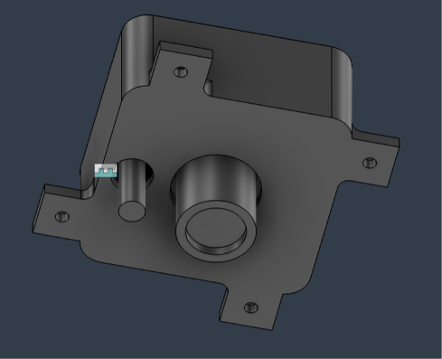
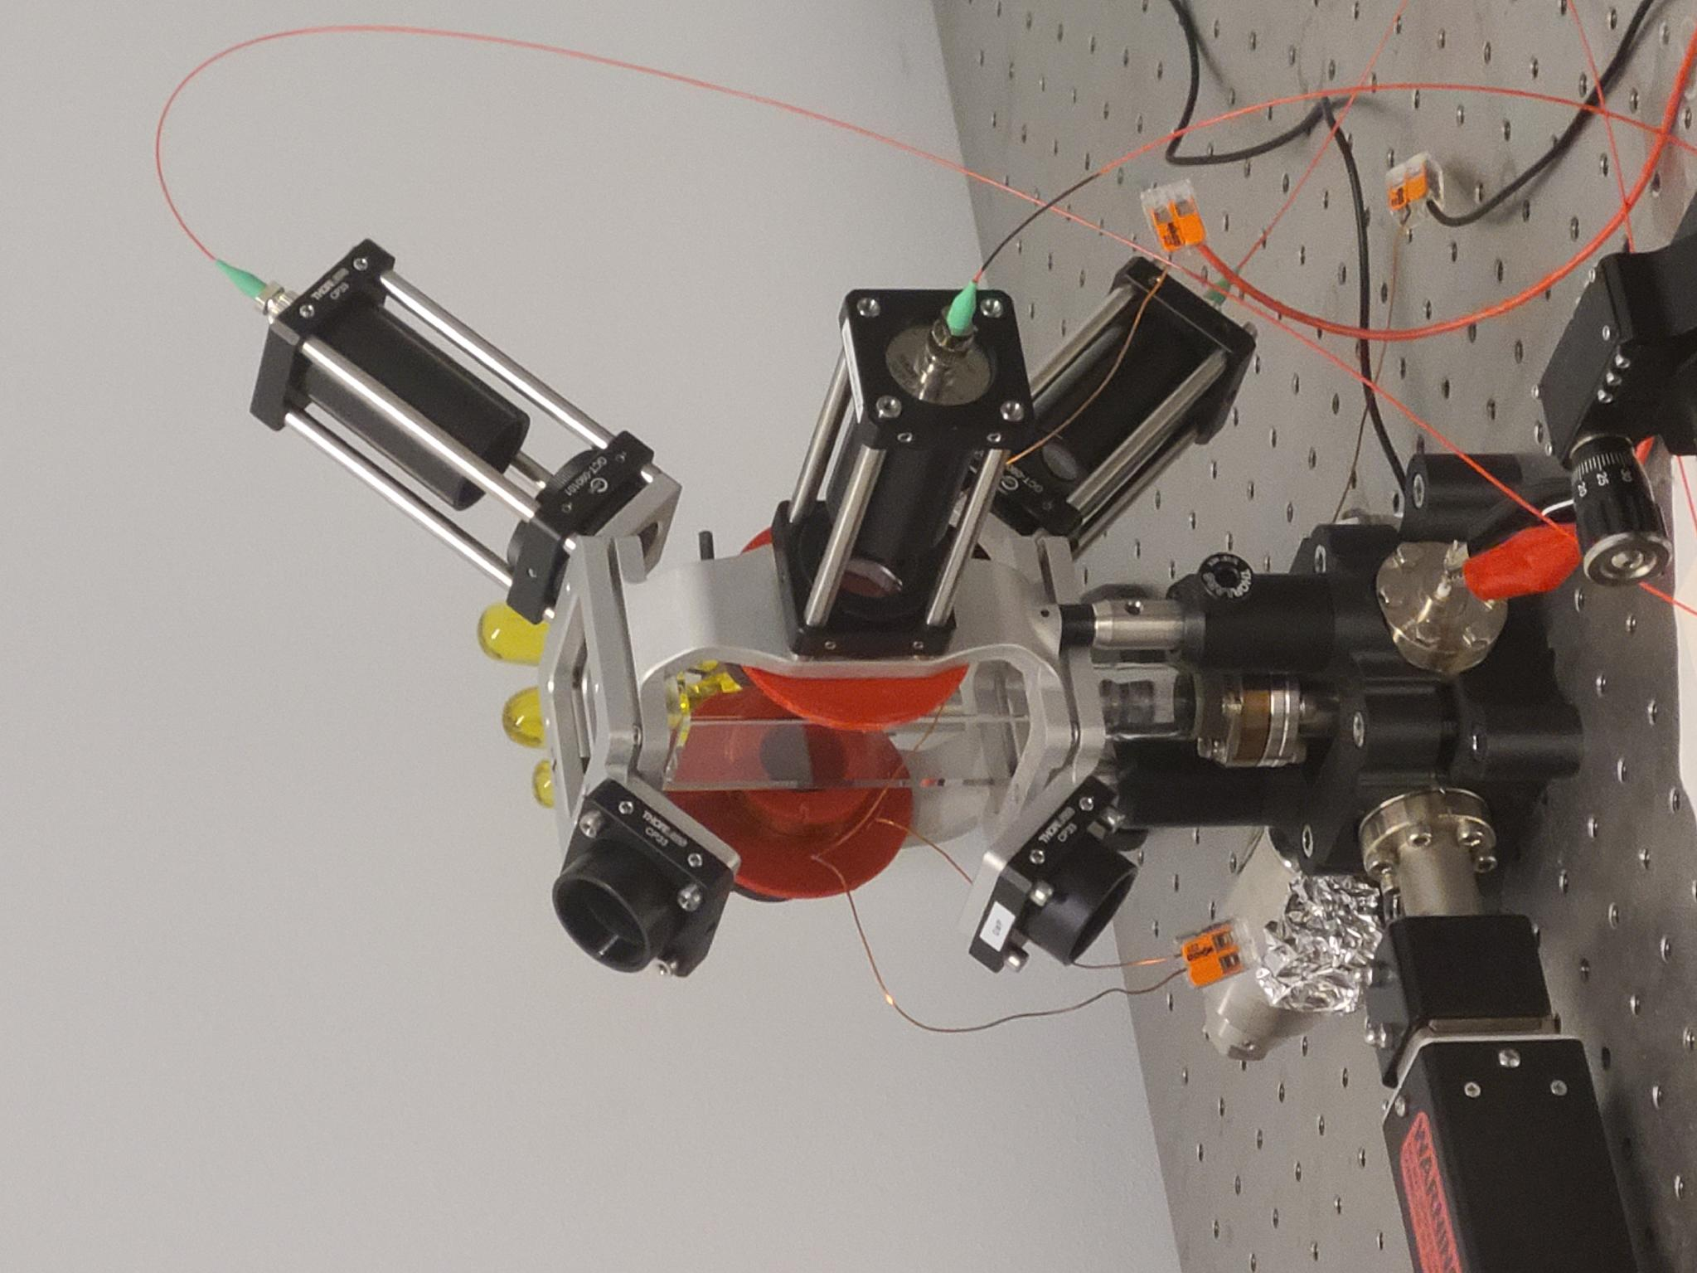
Development of a Fluorescence Imaging System for Data Acquisition and Analysis in a Magneto-Optical Trap
Jesus Daniel Zermeno, Phoenix College / Arizona State University
Jaime Diaz, Northern Arizona University
M. Jaden Brewer, Northern Arizona University
Inès Montaño, Northern Arizona University
1

Slide 2
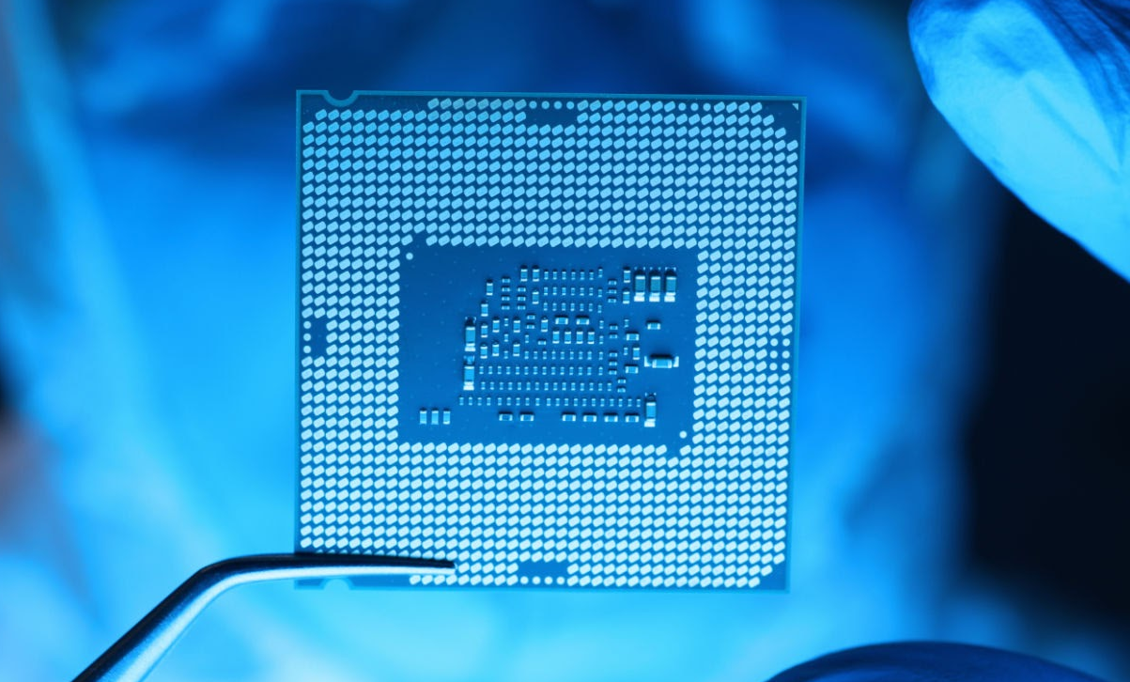
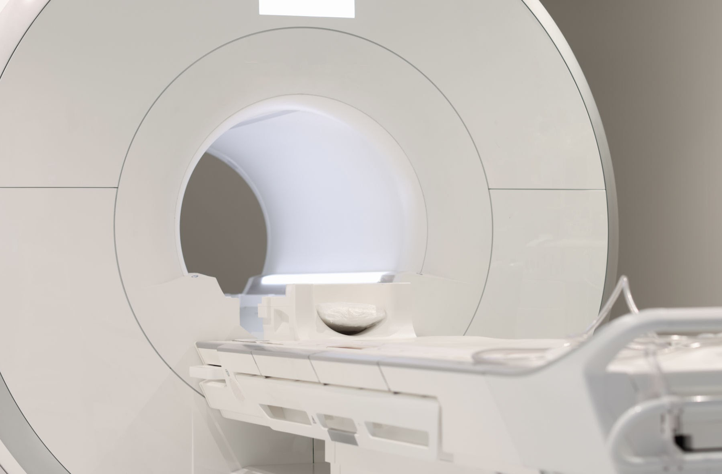
Importance of the Next Generation of Quantum Science
Already existing related technologies
Further advancements in quantum will change how…
  information is processed rapidly via qubits
  we interact with the physical world via ultra-precise sensors and navigators
The next step in research is control
Figure 1. LGA processor chip in a laboratory setting. From LLYC Global.
Figure 2. MRI magnetic resonance imaging device in hospital. From Megaflopp, 2022, Shutterstock.
Acknowledgement: This material is based upon work primarily supported by the National Science Foundation under award No.ECCS-2025490
2
Notes:
In the world today, Quantum already exists in our semiconductors, lasers, MRI scans, and GPS systems.
These technologies are based on collective quantum principles and mechanics
We’re not gonna stop there, we’re working on advancing the next generation of quantum technology.
One day, future breakthroughs will change society through advancements, such as qubits rapidly processing information
and quantum sensors that are ultra-precise in detecting changes in gravitational waves.
The next era of quantum is manipulate controlling the individual atoms directly
And with that, comes with its own challenges and limitations

Slide 3
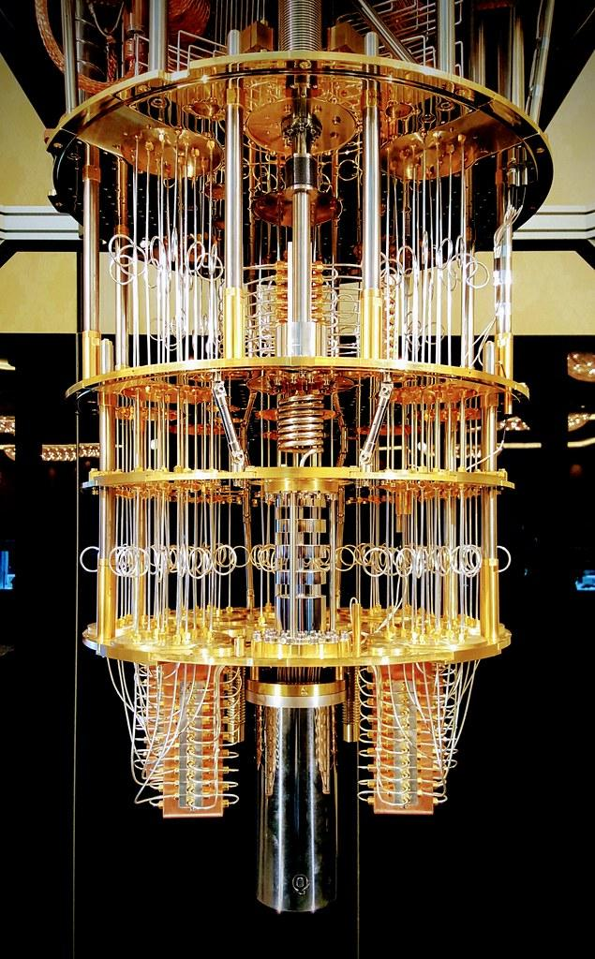
Challenges & Limits
Quantum decoherence
  atoms in quantum states are highly fragile
  never perfectly isolated from environmental noise
Room-temperature atoms bounce and collide at hundreds of meters per second
Continuous, random collisions instantaneously destroy fragile quantum state and induce noise
Solution: significantly reduce kinetic energy via lasers
Figure 3. Internal components of an IBM Quantum Computer. From IBM Research, 2018.
Acknowledgement: This material is based upon work primarily supported by the National Science Foundation under award No.ECCS-2025490
3
Notes:
Why aren’t we there yet?
Quantum decoherence
Atoms in quantum states are highly fragile
Making it difficult to study them or manipulate them reliability
especially when room-temperature atoms are bouncing and colliding at hundreds of meters per seconds.
(Quantum decoherence is the process by which a fragile quantum system loses its unique properties—like superposition and entanglement—by interacting with its surrounding environment.)
Environmental Noise, such as Stray photons, air molecules, thermal vibrations, and electromagnetic fields can continually bump into the quantum systems and make them lose their quantum states.
As a solution to this, we can slow down these atoms, basically cool them down atom.
which greatly reduce their kinetic energy for easier control. This is where our **Magneto-Optical Trap (MOT)** setup becomes critical.

Slide 4
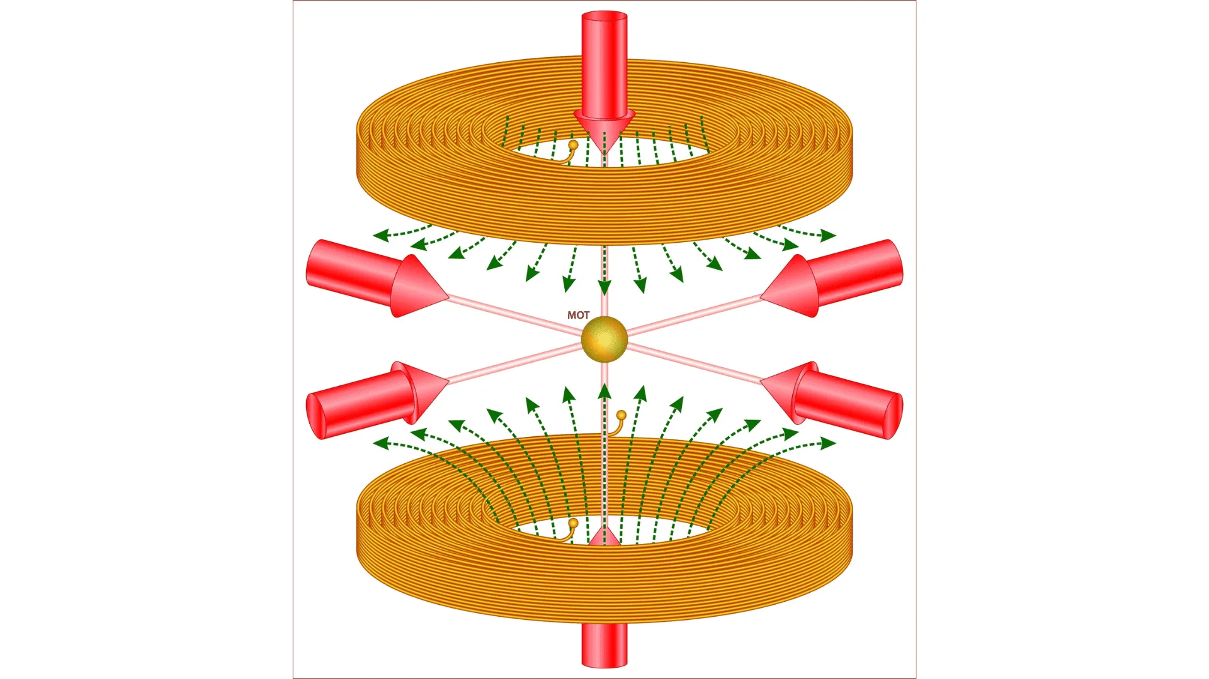
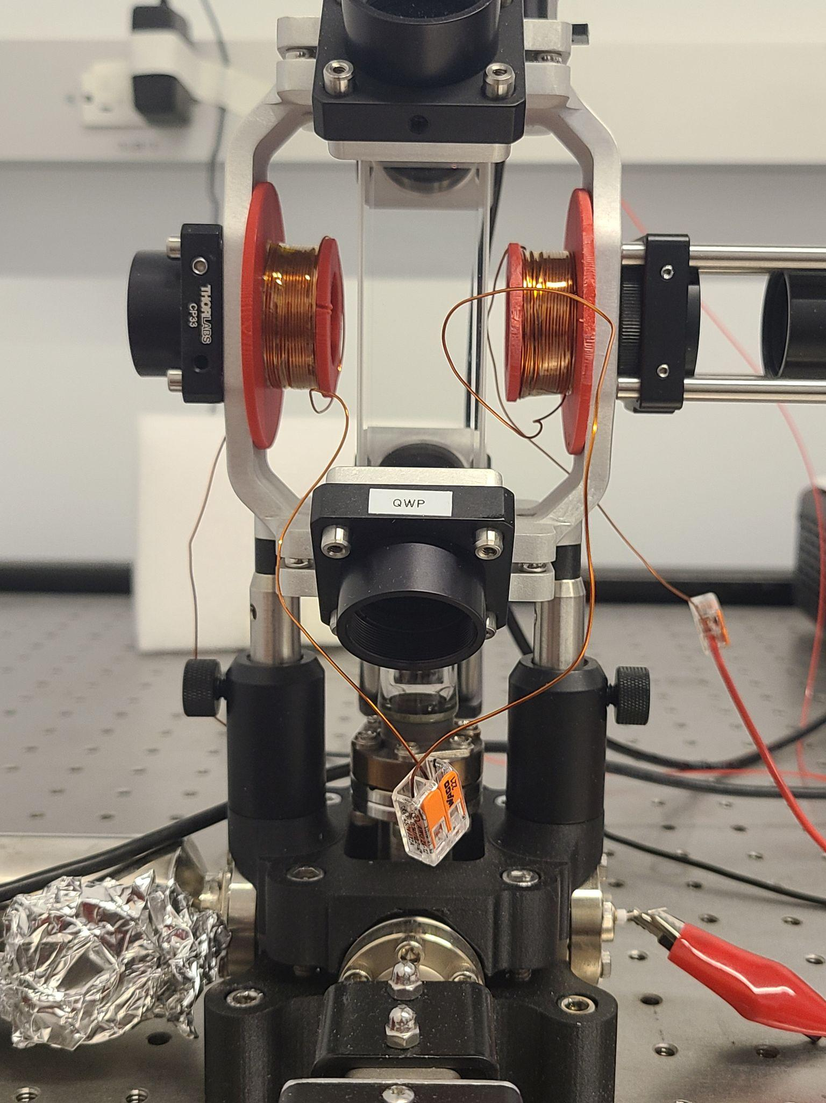
The Magneto-Optical Trap (MOT)
An experimental apparatus cools and traps atoms simultaneously using two basic components:
  lasers for cooling
  magnetic trapping w/ coils
MOT Vacuum Chamber
Figure 4. Magneto-optical trap (MOT) apparatus. From Saad, 2023, Shutterstock.
Acknowledgement: This material is based upon work primarily supported by the National Science Foundation under award No.ECCS-2025490
4
Notes:
A scientific apparatus that can trap a group of individual atoms within a region of space, using magnetic coils and lasers.
We split 3 infrared lasers into a total of 6 counter-propagating beams
Moving atoms towards these beams absorbing photons only when moving *towards* a laser, generating a dampening force, which slow them down, affectly cool them down, reaching temperatures close to mirco-kevins
Then, we apply magnetic coils in a anti-helmholts confirmation (BASICALLY, CURRENT in these two coils are moving opposite direction of each other, one clockwise, other counterclockwise), just to center them inside of a vacuum chamber for viewing.

Slide 5
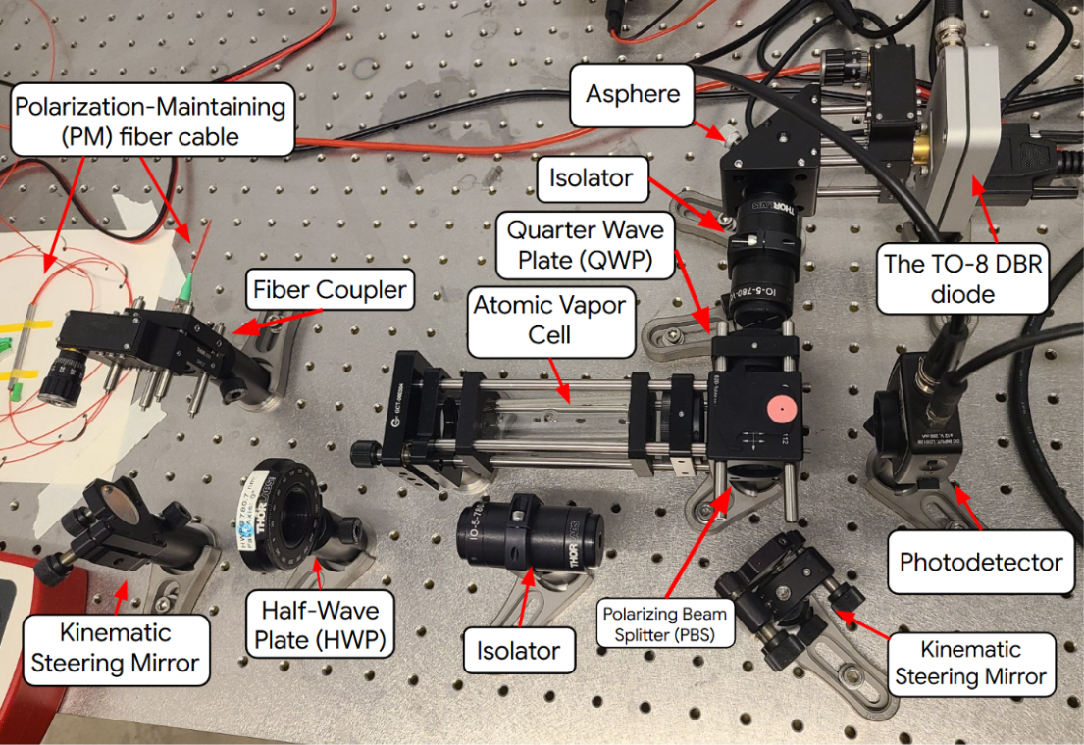
Acknowledgement: This material is based upon work primarily supported by the National Science Foundation under award No.ECCS-2025490
11

Slide 6
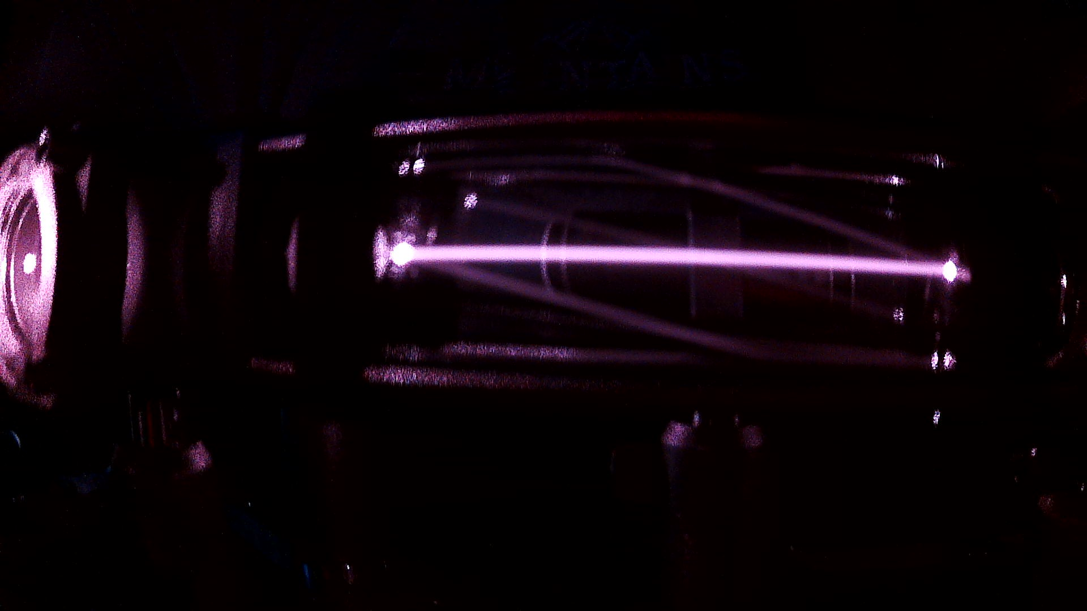
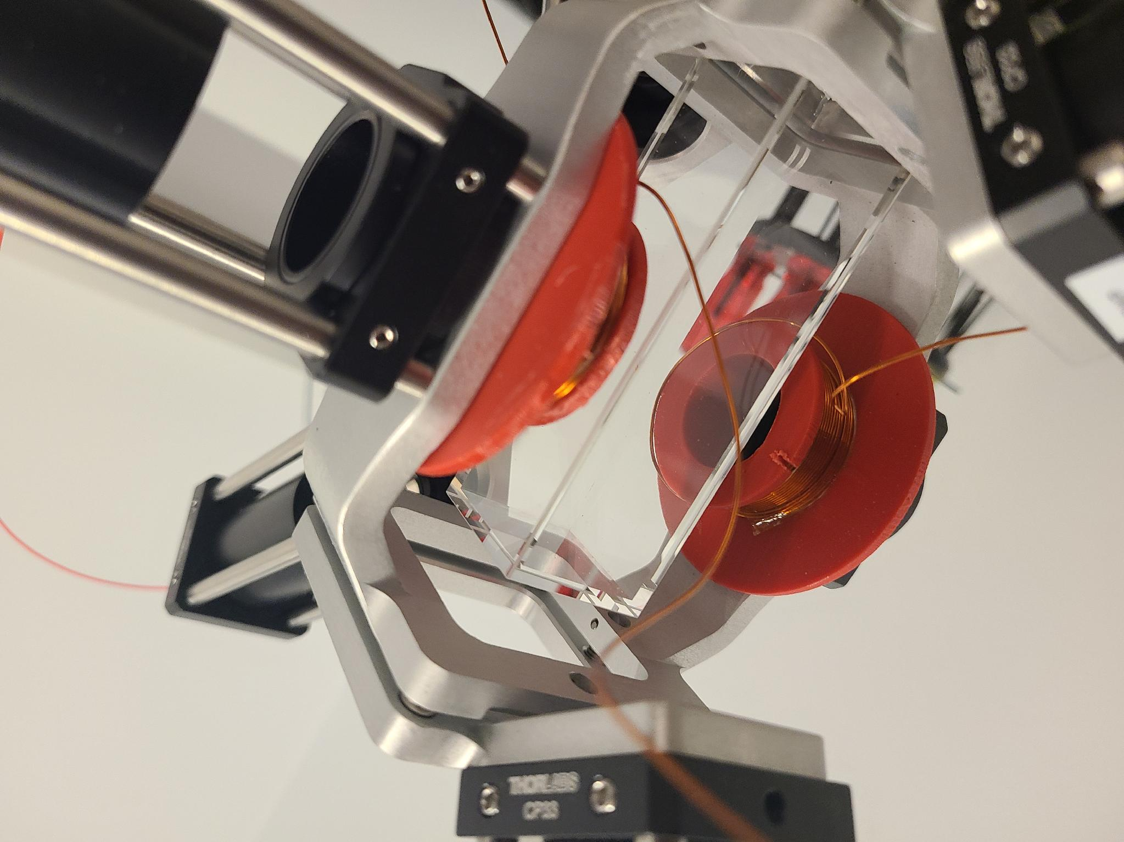
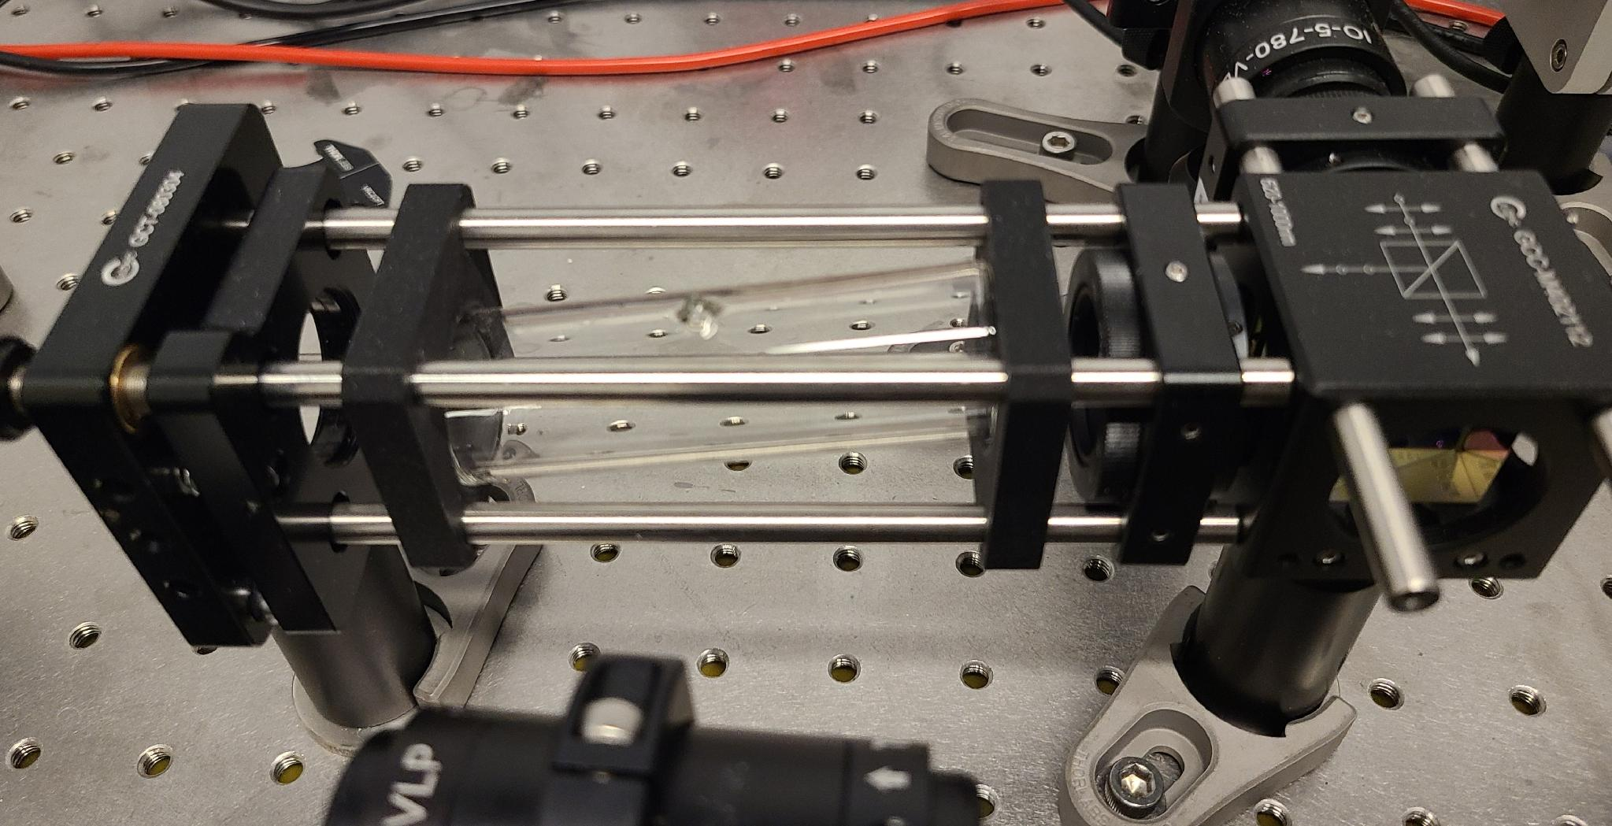
The Magneto-Optical Trap (MOT)
Rubidium-85 (with Rb-87)
780 nm infrared laser
Saturated Absorption Spectroscopy (SAS)
Utilizes the Linien software to control drift and lock onto the F = 3 → F’ = 4 cooling transition
MOT Vacuum Chamber
Atomic Vapor Cell
Acknowledgement: This material is based upon work primarily supported by the National Science Foundation under award No.ECCS-2025490
5
Notes:
vaporized Rubidium-85 (and 87 isotopes),
theyred located inside two components in the MOT:
atomic vapor celL TO perform saturated absolution spectocpy to a frenqency
theres another container that can pump more into the MOT Cavvum Chamber, siompley for trapping rtese atoms
780 nm infrared laser (that resonates with the specific energy cooling transition that we want to lock on to, using the Linien software.
The AtOMIC vapor cell is where Saturated Absorption Spectroscopy of the RB atoms takes place, ltuizitng a pump and probe beam to bypassing the doppler effect of the fast moving atoms. Otherwise, we’ll get a board absorption.
(Linien: An open-source program to stabilize laser frequency.
Sweeps across frequencies to perform Saturated Absorption Spectroscopy, which occurs inside of the atomic vapor cell.
Can lock the laser to an atomic transition frequency.)

Slide 7
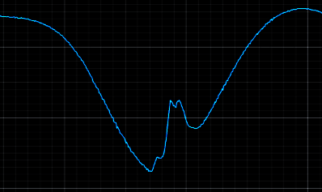
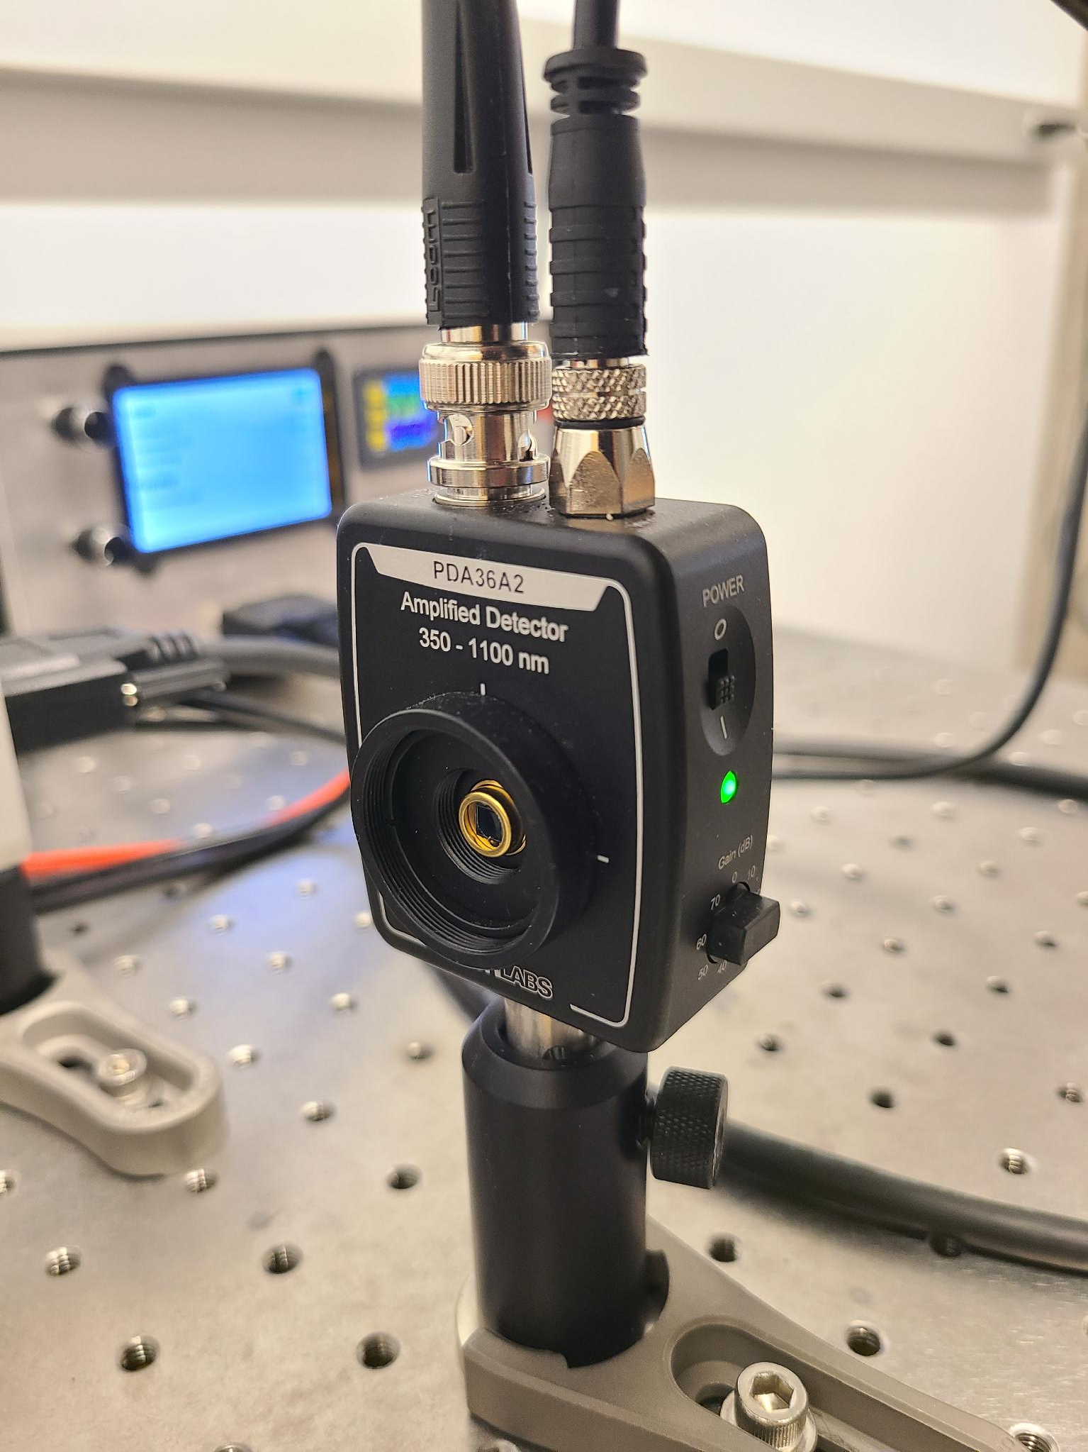
Saturated Absorption Spectroscopy (SAS)
RB-85
Photodiode
Acknowledgement: This material is based upon work primarily supported by the National Science Foundation under award No.ECCS-2025490
6
Notes:
WHen the probe beam exits the atomic vapor cell, it hits the photodiode, which converts the beam into an electrical signal.
This signal is display on Linien as a blue line, representing the raw voltage output of the beam across frequencies.
This is our spectroscopy of the RB-85 atoms, displaying mini peaks in a trough, representing the different transition in our isotope.
Again, thanks to the pump probe beams from the atomic vapor cell, we were able to bypass the doppler shift of the atoms flying towards the beam of light and avoid a smeared, broad signal.

Slide 8
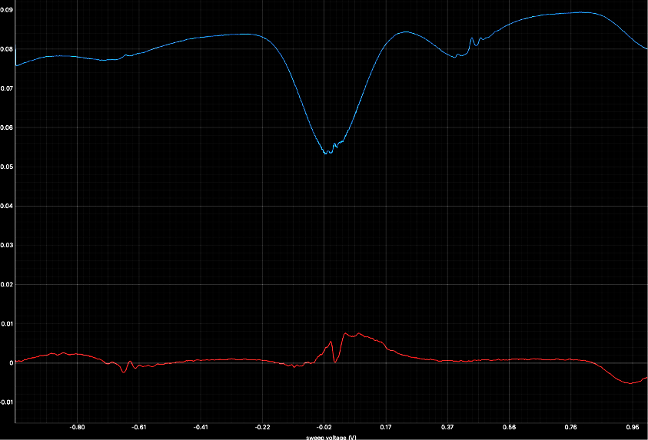
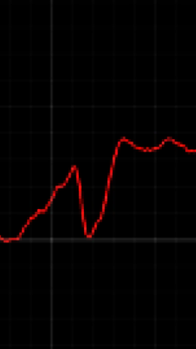
Locking Frequency
Y-axis: Photodiode Voltage (V)
X-axis: Sweep Voltage (V)
Acknowledgement: This material is based upon work primarily supported by the National Science Foundation under award No.ECCS-2025490
7
Notes:
Lasers naturally drift due to noise, current and temperature fluctuations. So, Linien locks onto a laser to combat against environmental factors, using the red error signal.
What is the red signal? a derivative demodulation of the raw blue absorption signal.
We’ll demodulate or manipulate the shape of this red line to create The steepest and tallest slope possible, called the zero-crossing, right underneath trough of the RB-85 with its transitions.
This steep slope will help create a more drift resistant lock on our target frequeniy.
which feeds into software’s feedback-based control loop tool.
Once locked, our atoms are still too fast to be in the correct cooling transition, do We then detuned the frequency to slightly below our target energy trantiion resonance,
and behold…

Slide 9
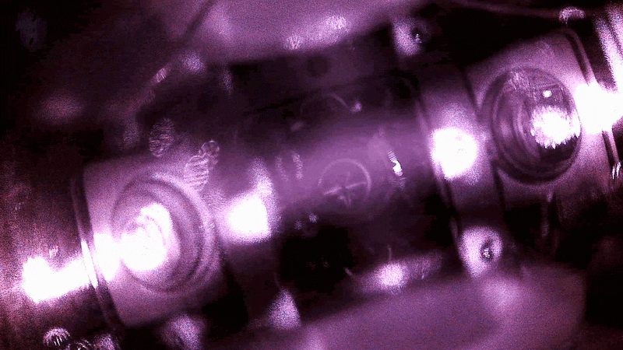
Successfully Trapping a Few Atoms
Acknowledgement: This material is based upon work primarily supported by the National Science Foundation under award No.ECCS-2025490
8
Notes:
How well can you guys see the atomic vapor cloud, or the DOT?
Not so well? Why not?
NOISE, stray light, reflections, etc.
Imagine trying to do analysis on this image.
We have to improve the process of data aquaistuion

Slide 10
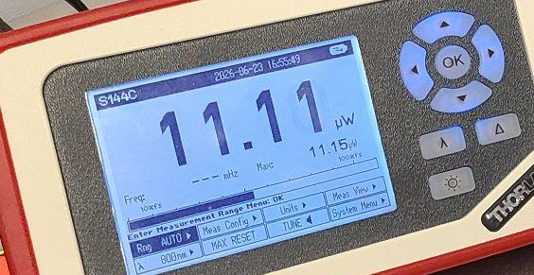
Challenges with the MOT
The MOT @ day 1
Very sensitive to environmental factors and noises, such as
  temperature
  vibrations
  magnetic field fluctuations
Tuning the best settings for Linien software to control drift from noise
Limited camera coverage for measurements and laser alignment tuning
Acknowledgement: This material is based upon work primarily supported by the National Science Foundation under award No.ECCS-2025490
9
Notes:
DAY 1
mention what it CAN (like trapping) but can’t do (measurments, data extraction, trapping consistently, easpiauly for the majority of the summer). Just trapping and viewing camera feed isnt enough!
Environments noise > drift > power wattage issues (stuck in the micro-watts) > prevents trapping
Couldn’t trap atoms in the MOT anymore; everything from the components, polarization of light, and the software were not optimal for strong trapping.
A lot of troubleshooting occurs
Align optical paths and steering mirrors, maintain vacuum pressure in the chamber, and calibrate polarization of light, just to keep drift at a minimum.
So, our mission for most of the summer was learn deeply about the mot, understand and calibrate each of its components, in order TO COMBAT against drift caused by external noise and Start TRAPPING AGAIN.
But this is expected, think about it:
The neutral atoms’ extreme vulnerability to environmental changes (weather, thermal fluctuations, acoustic noise) is actually the exact physical property that makes cold-atom systems the ultimate basis for next-generation quantum sensors (sensing gravity shifts, magnetic anomalies, etc.).
We are constantly fighting against the nature of these quantum atoms; their strength, their hyper-sentatie; their promises… are our constant struggle to control

Slide 11
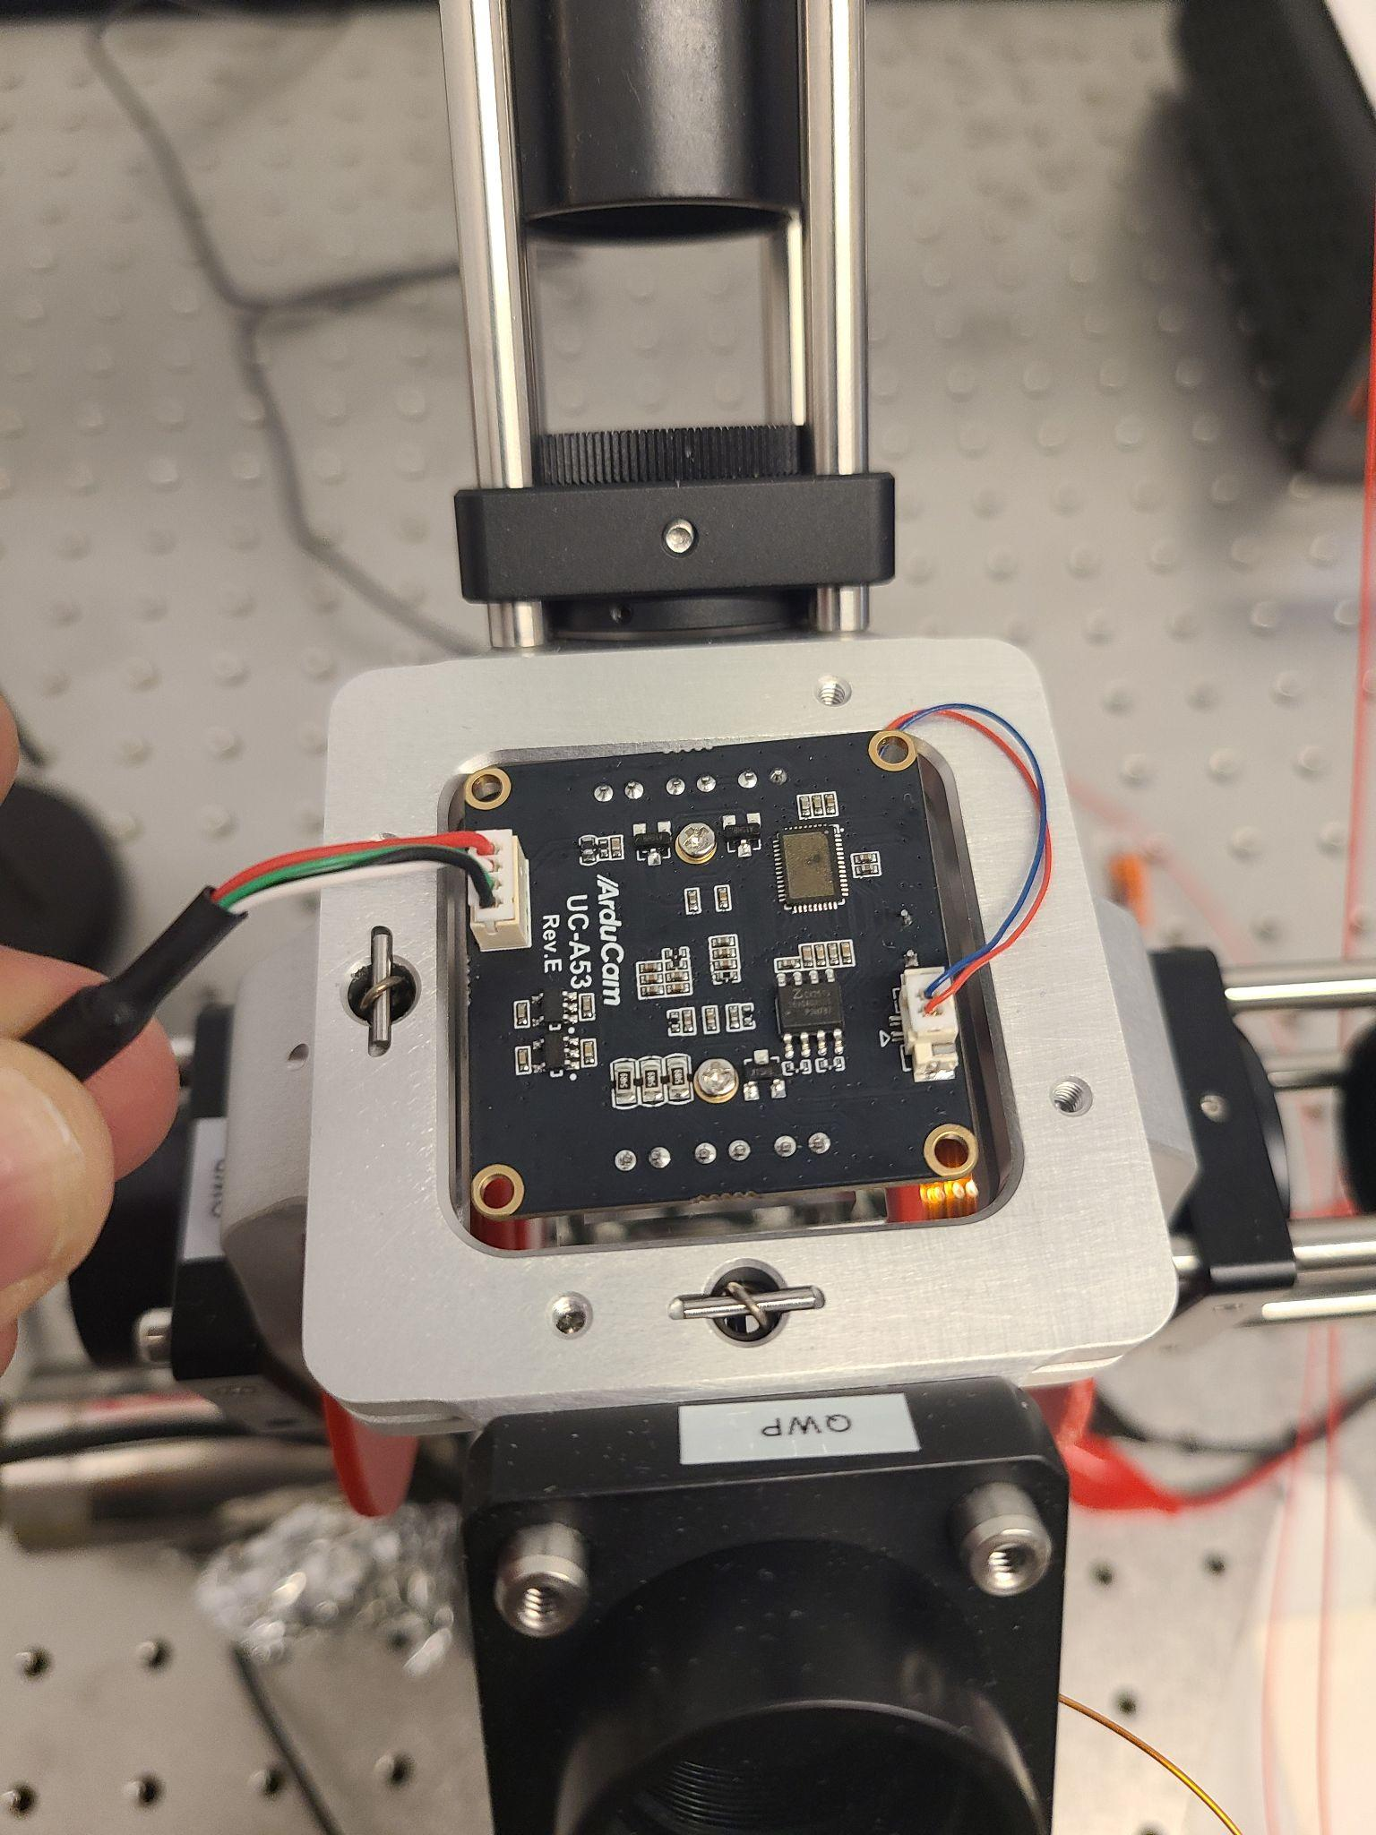
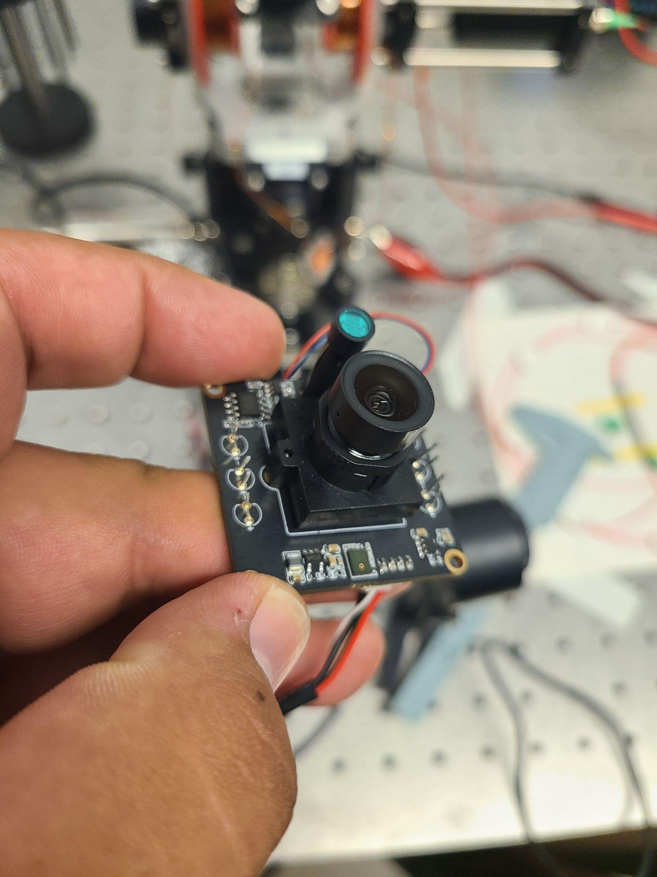
The Original Camera Set-Up
Acknowledgement: This material is based upon work primarily supported by the National Science Foundation under award No.ECCS-2025490
10
Notes:
explain the camera, no sisstnetly, it wiggles, etc
Data integrity wasn’t possible yet.
My objective towards that goal is impleamting a rigid, standardized imaging system

Slide 12
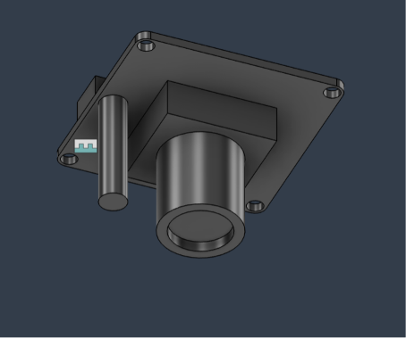
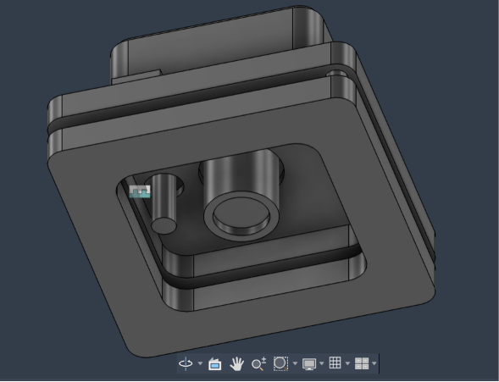
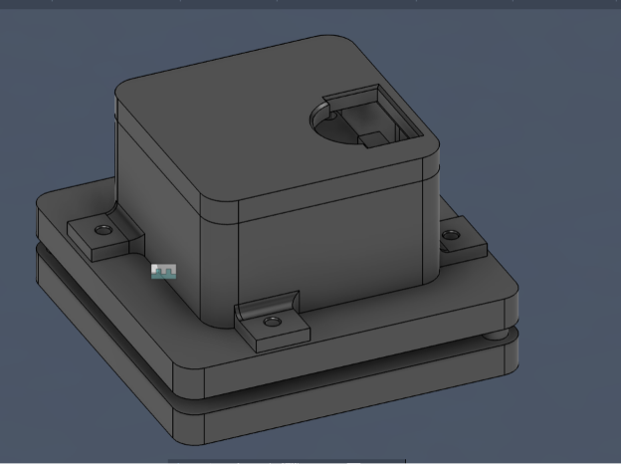
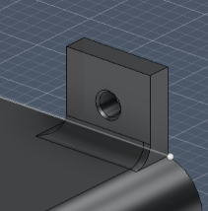
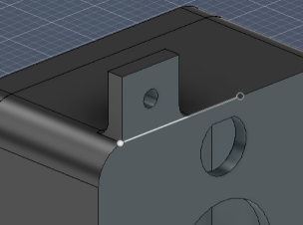
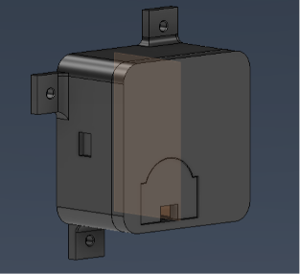
Custom Casing Mount
Acknowledgement: This material is based upon work primarily supported by the National Science Foundation under award No.ECCS-2025490
11

Slide 13
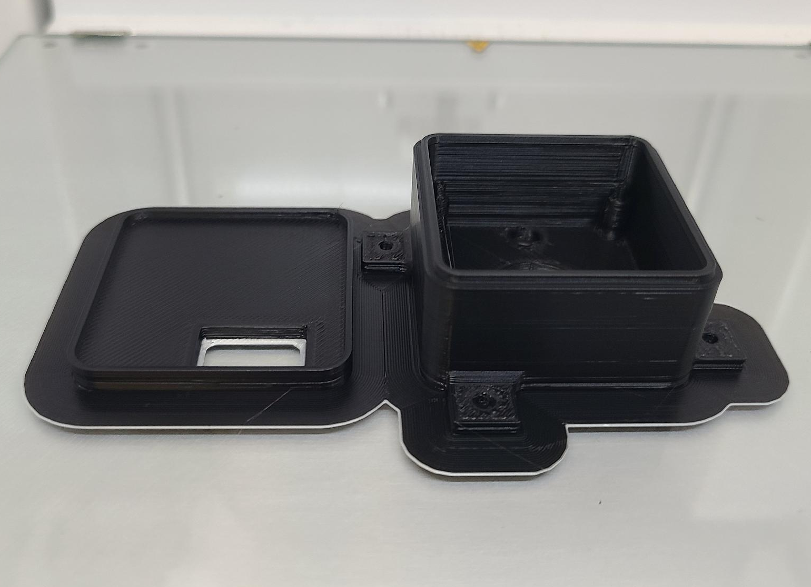
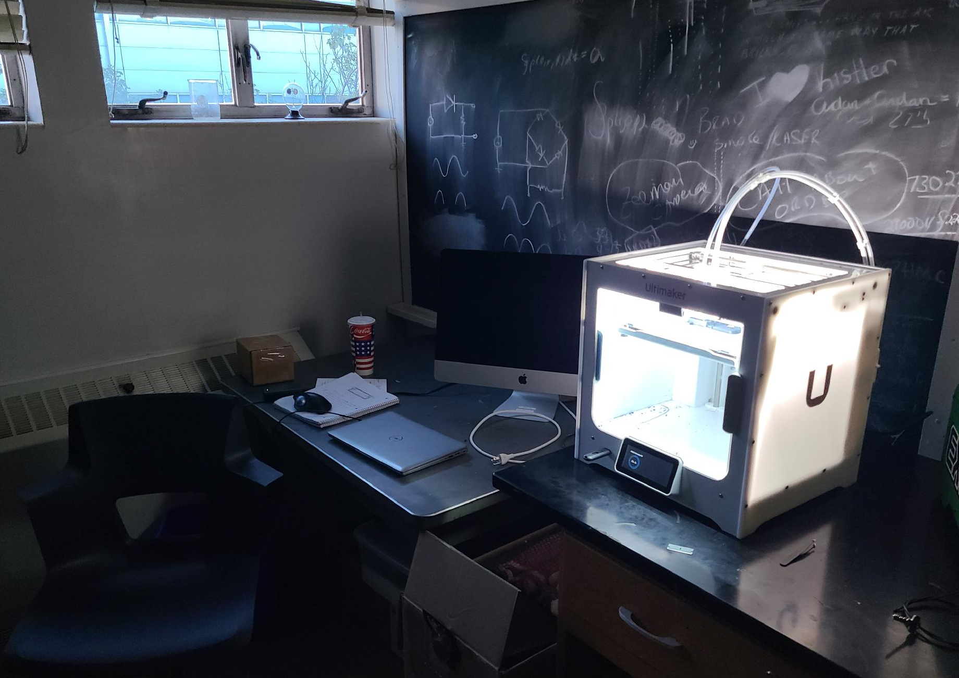
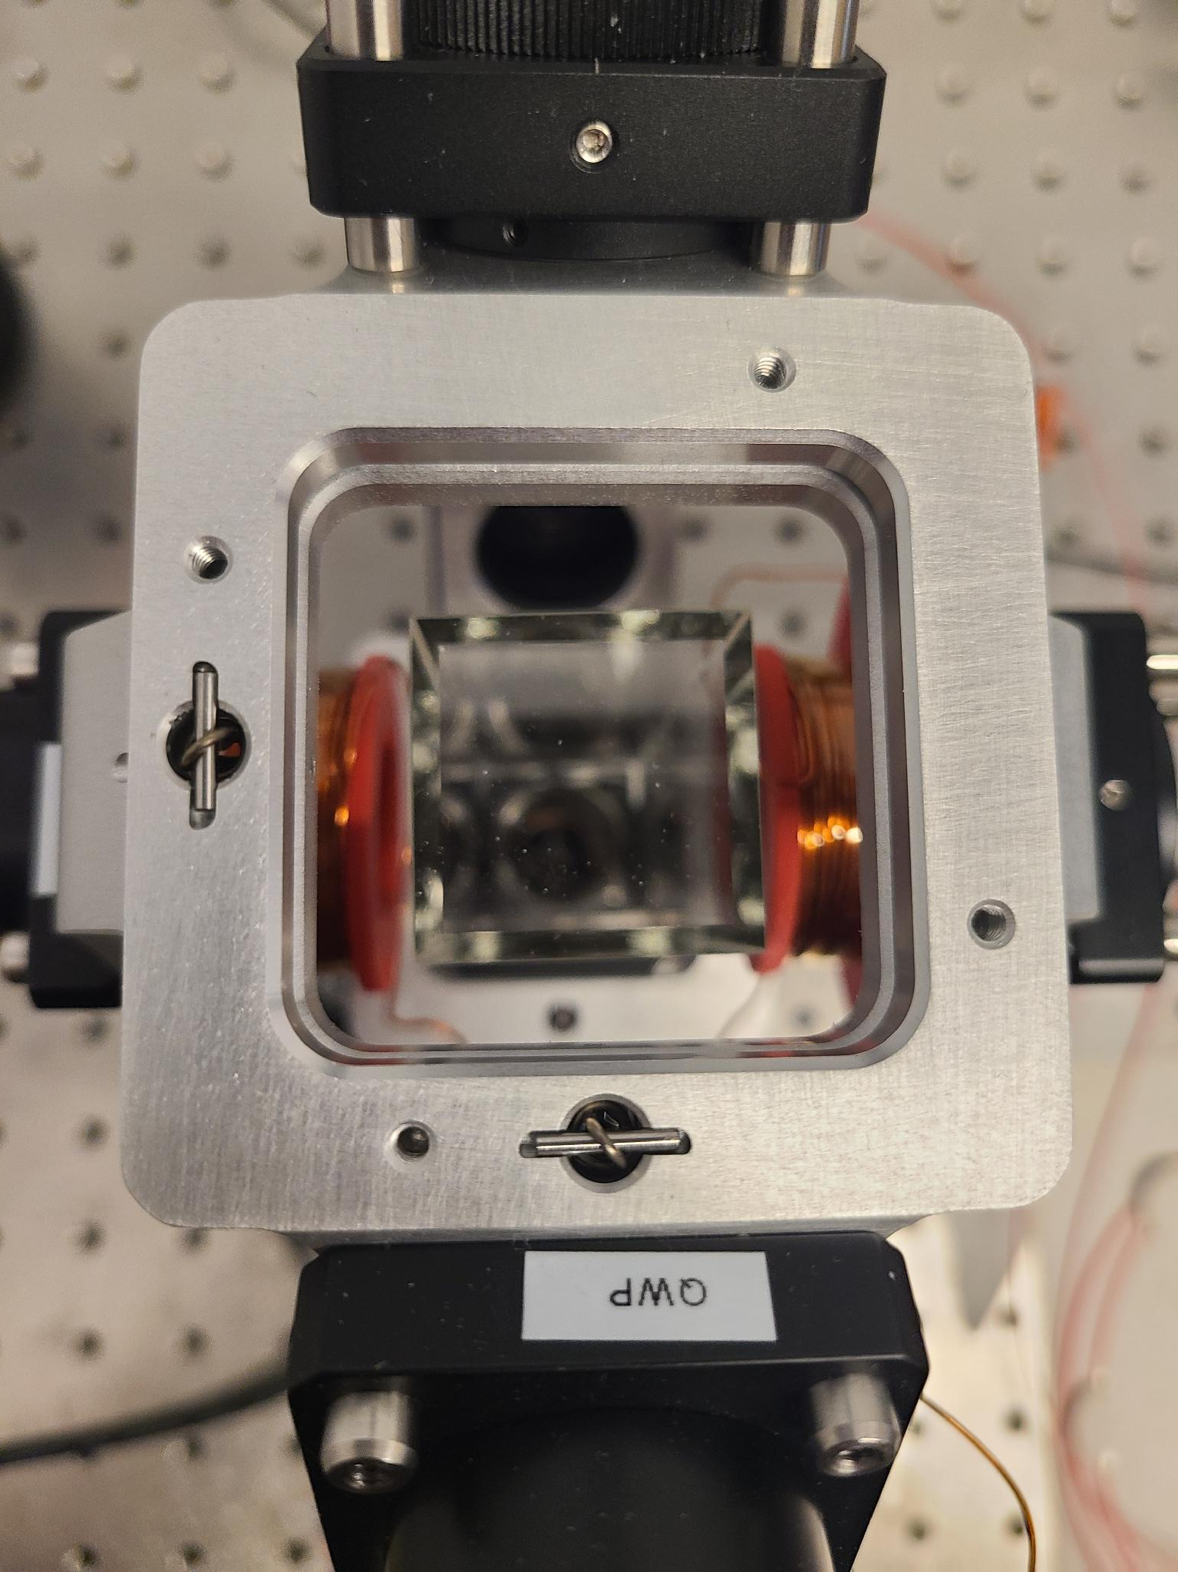
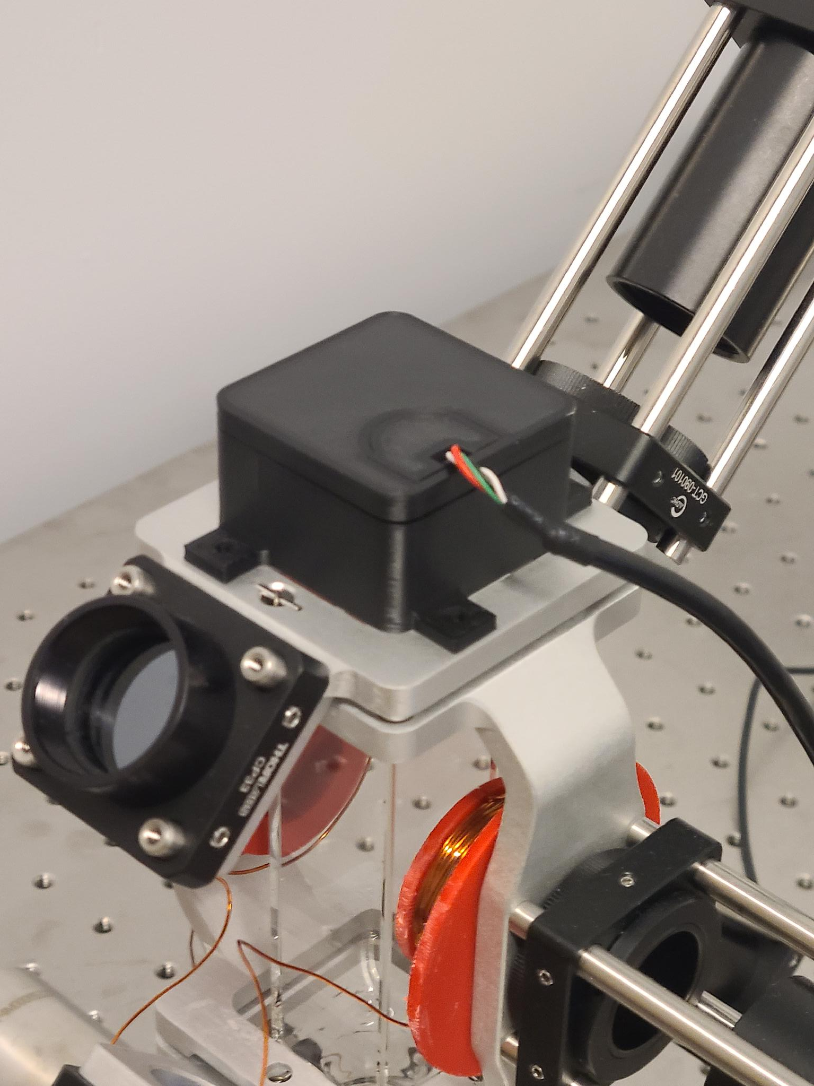
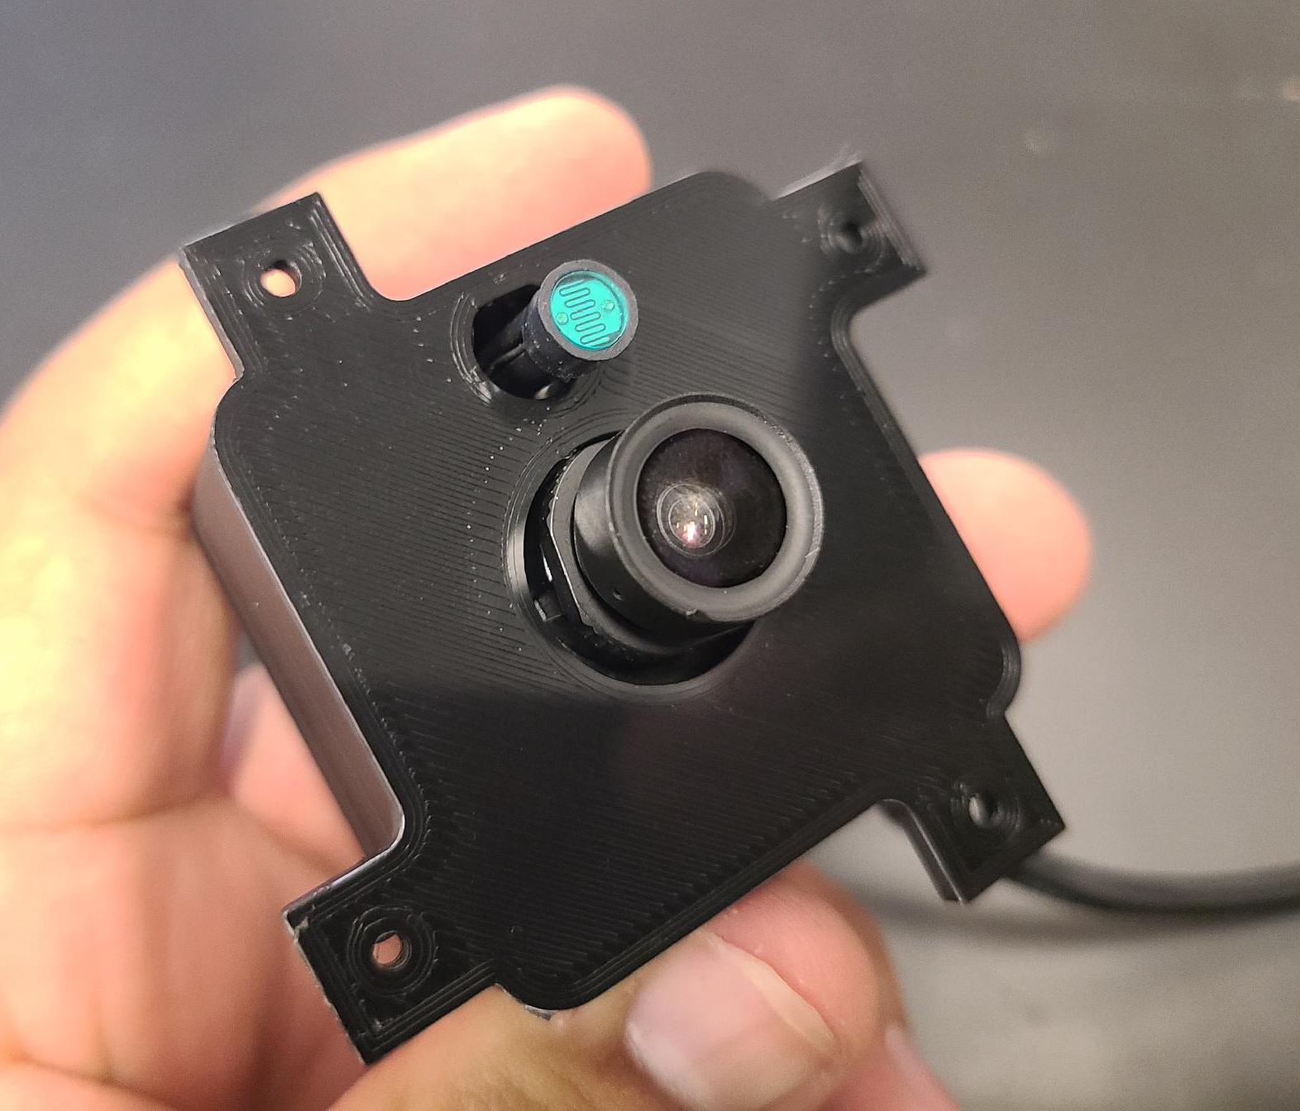
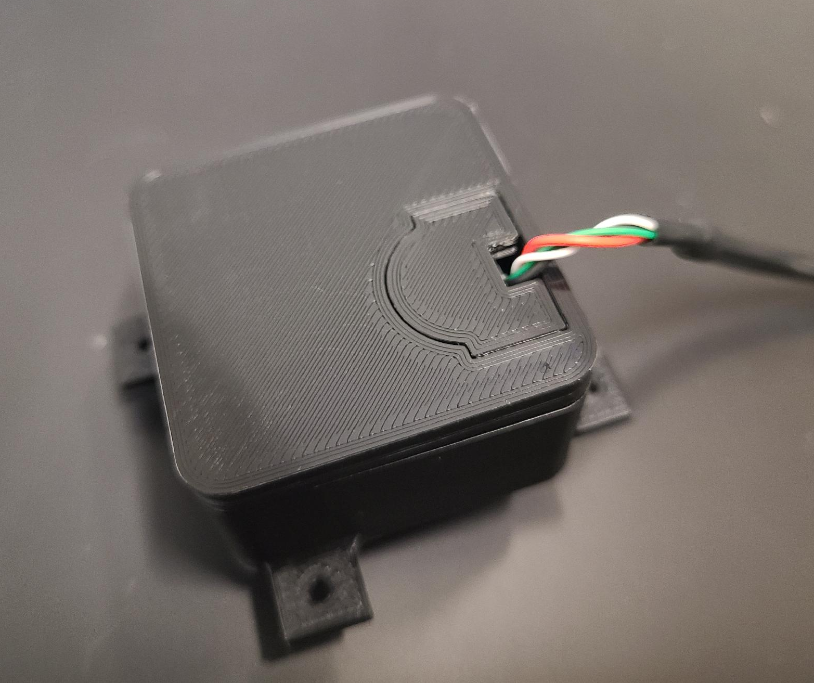
3D Printing & Implementation
Acknowledgement: This material is based upon work primarily supported by the National Science Foundation under award No.ECCS-2025490
12
Notes:
did this while fixing the mot, and by the early or mid July…

Slide 14
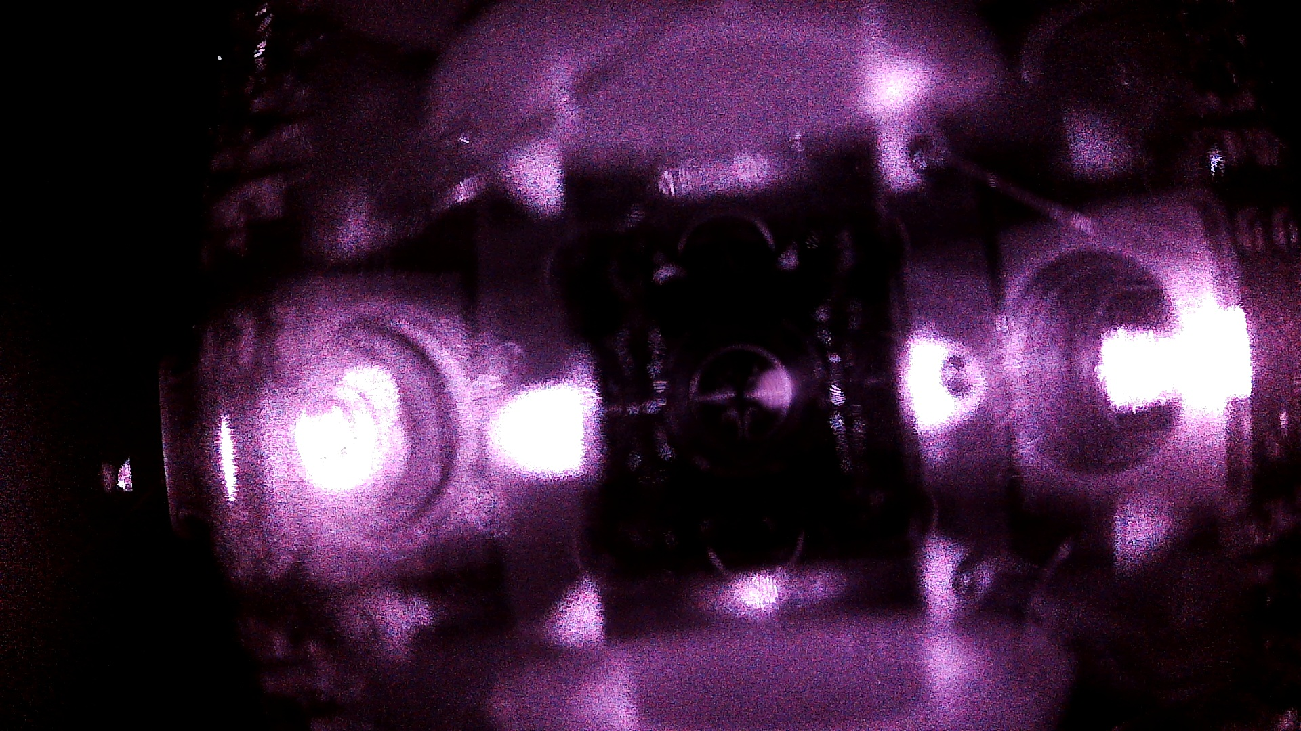

We’ve successfully trapped Atoms again!
Acknowledgement: This material is based upon work primarily supported by the National Science Foundation under award No.ECCS-2025490
13

Slide 15
But…
Acknowledgement: This material is based upon work primarily supported by the National Science Foundation under award No.ECCS-2025490
14

Slide 16
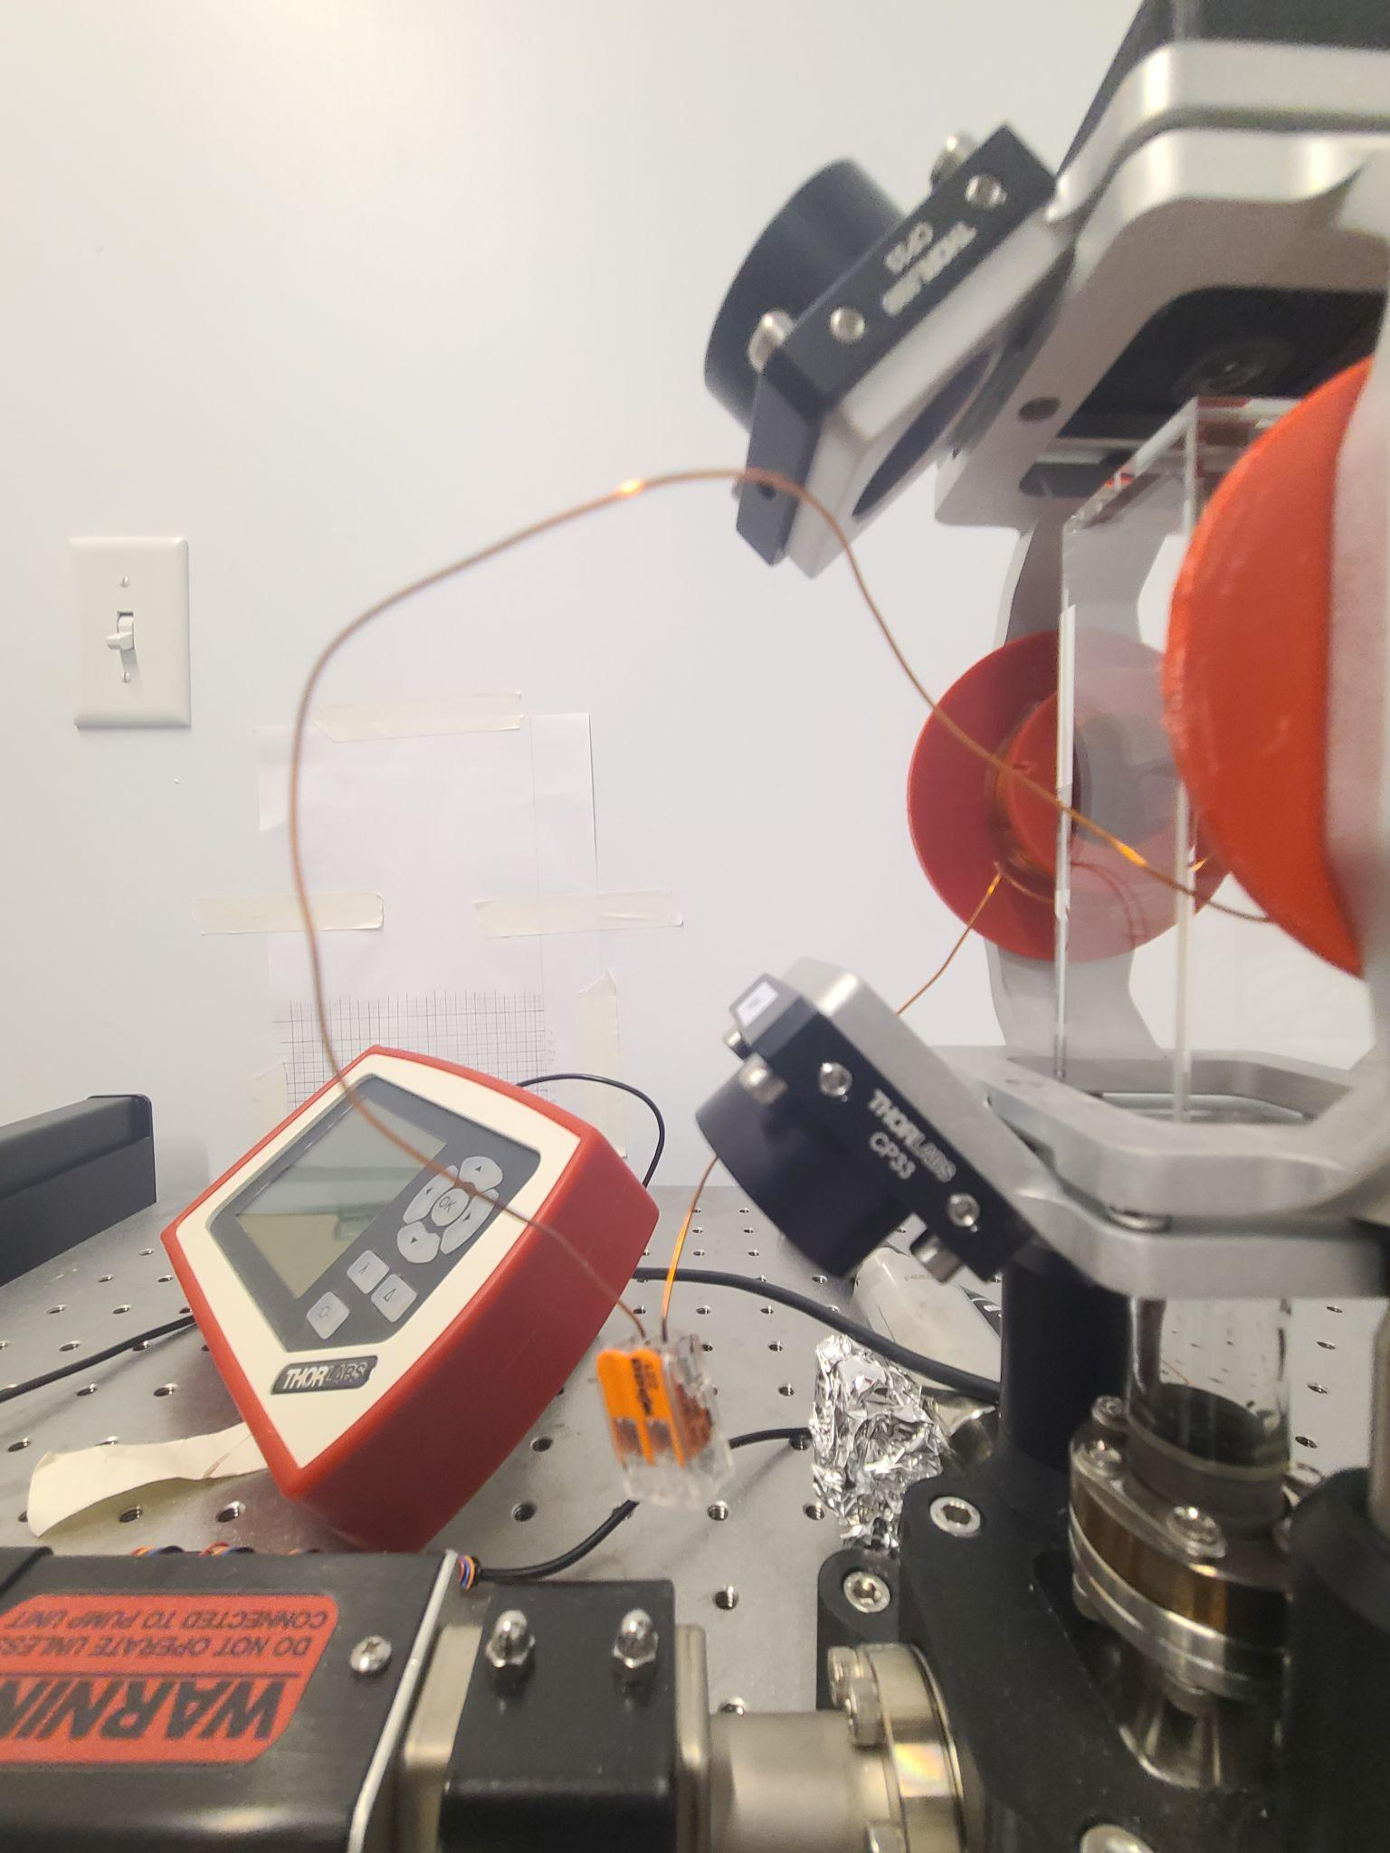
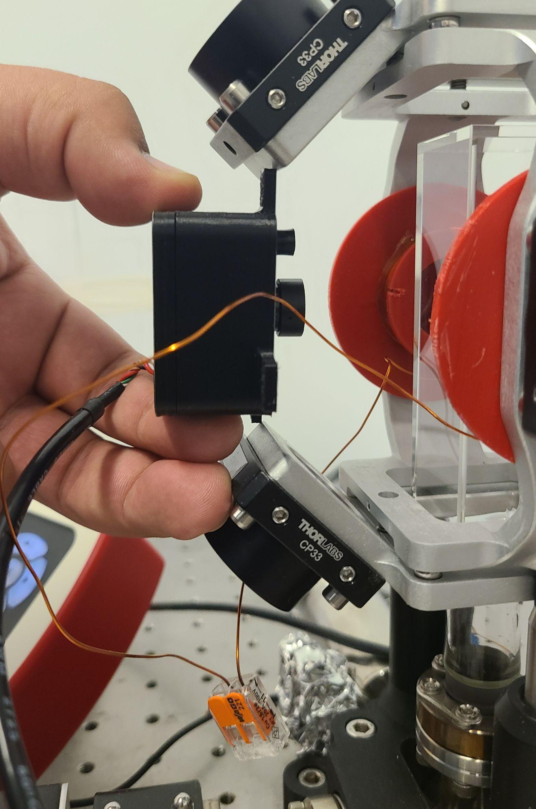
New Camera Angle: The Front Side View
Acknowledgement: This material is based upon work primarily supported by the National Science Foundation under award No.ECCS-2025490
15

Slide 17
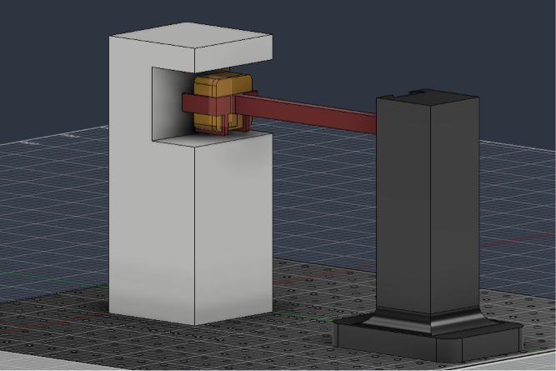
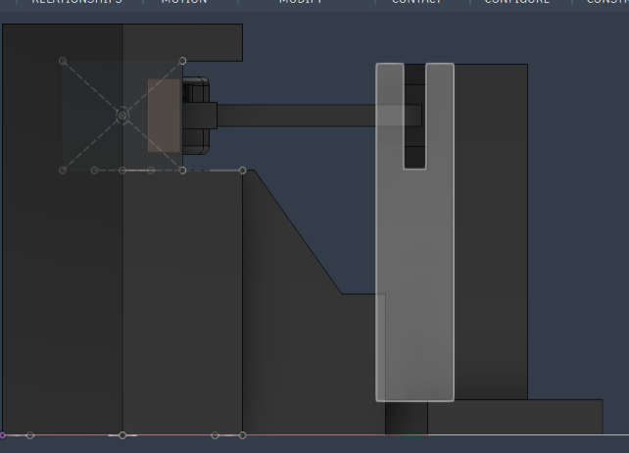
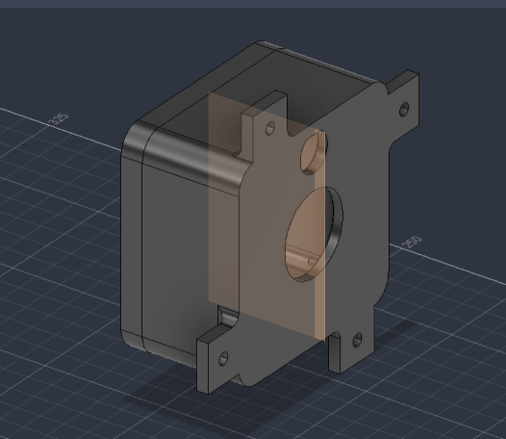
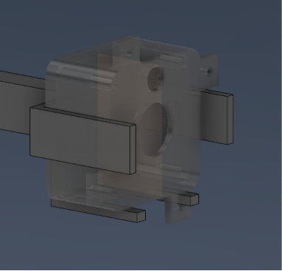
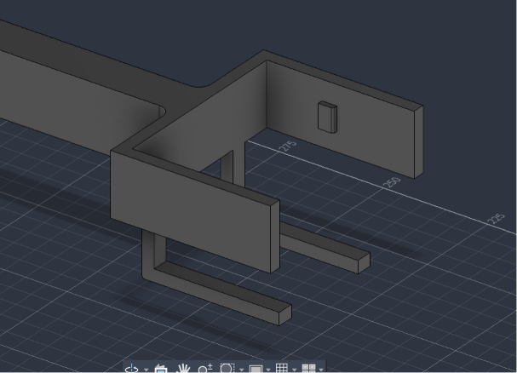
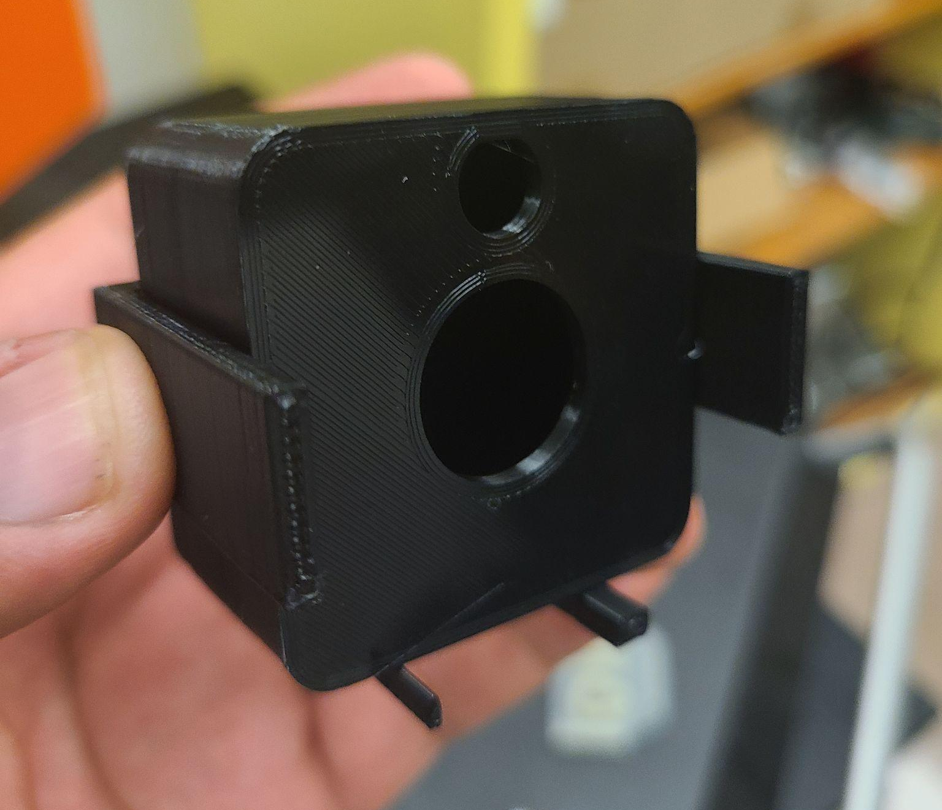
Designing The Arm and Tower Mounts
Acknowledgement: This material is based upon work primarily supported by the National Science Foundation under award No.ECCS-2025490
16
Notes:
combined with previous slide

Slide 18
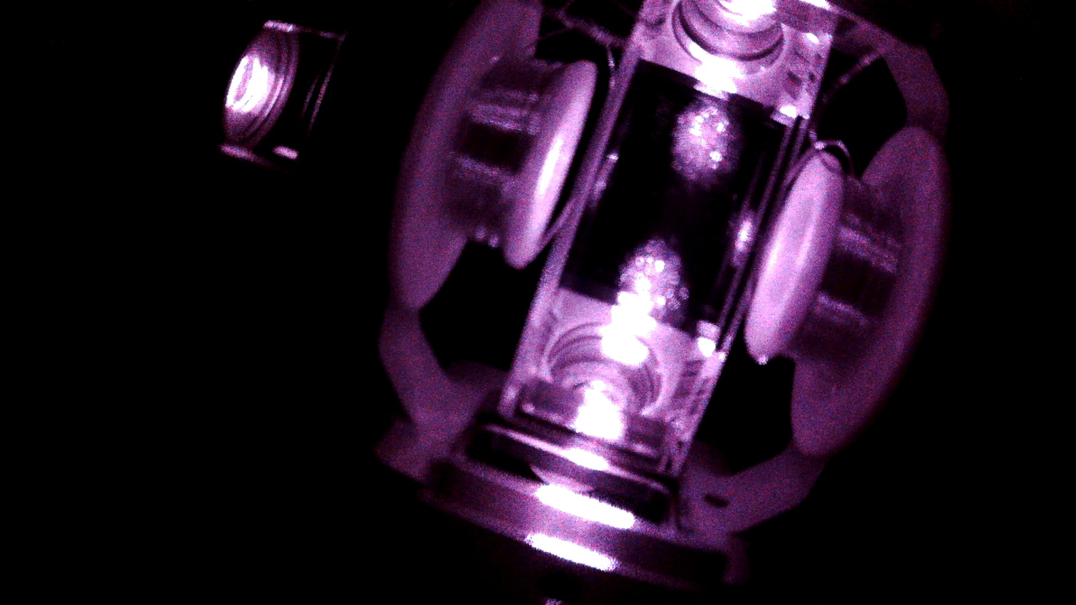
Front-Side View of MOT
Acknowledgement: This material is based upon work primarily supported by the National Science Foundation under award No.ECCS-2025490
17

Slide 19

Front-Side View of MOT
Acknowledgement: This material is based upon work primarily supported by the National Science Foundation under award No.ECCS-2025490
18

Slide 20

Image Subtraction
Acknowledgement: This material is based upon work primarily supported by the National Science Foundation under award No.ECCS-2025490
19

Slide 21
Final Result
● Custom Python scripts successfully execute background subtraction
● Isolated atomic cloud for quantitative analysis, such as fluorescence by pixel
Acknowledgement: This material is based upon work primarily supported by the National Science Foundation under award No.ECCS-2025490
20
Notes:
Add future plan of automated process
And the takeaway; why do this? why does this matter?
(Mot, foundation to study; playground; importance of reliable, streamlined data process)

Slide 22
Future & Takeaway
● Stream real-time spectroscopy via InfluxDB software
● Track multi-day drift against weather and thermal shifts.
● Automatically measure cloud size during trials of laser-frequency and magnetic-field sweeps.
Acknowledgement: This material is based upon work primarily supported by the National Science Foundation under award No.ECCS-2025490
21
Notes:
if i had more time:
Add future plan of automated process
And the takeaway; why do this? why does this matter?
(Mot, foundation to study; playground;
This localized cloud of ultracold atoms serves as a fundamental sandbox for to study and manipulate neutral-atoms for potential experiments..
The highly responsive nature of cold-atom traps highlights their massive potential for advanced, next-generation quantum sensors (e.g., gravimeters, atomic clocks, and magnetometers).
my work was important
importance of reliably collect consisten images without flawed data
streamlined data collecting process for potential future experience on these neutral atoms in the MOT.
future people will work on the MOt with these tools set up in place for them, and theyre plenty of room for improvements. Im proud for that.

Slide 23
Thank You & Acknowledgements
Elaine Ngo, M. Jaden Brewer, Jaime Diaz, Inès Montaño
Everyone in ¡MIRA! (Materials Interfaces in Research and Applications)
Everyone in Department of Applied Physics and Materials Science
The National Nanotechnology Coordinated Infrastructure (NNCI)
NCI-Southwest- Nanotechnology Collaborative Infrastructure Southwest (NCI-SW)
National Science Foundation (NSF)
Acknowledgement: This material is based upon work primarily supported by the National Science Foundation under award No.ECCS-2025490
22

Slide 24
Referferences
IBM Research. (2018). IBM Q quantum computer on display [Photograph]. P.C. Rossin College of Engineering & Applied Science.
LLYC Global. (n.d.). LGA processor chip in a laboratory setting. https://llyc.global/en/noticias/whats-up-health-y-medicina-personalizada-cuales-son-los-avances-y-los-desafios-de-las-empresas-que-lideran-en-nanomedicina-y-medicina-genomica/
Megaflopp. (2022). MRI magnetic resonance imaging device in hospital [Stock photograph]. Shutterstock. shutterstock.com
Saad, F. A. (2023). Magneto-optical trap MOT apparatus which uses laser cooling and a spatially-varying magnetic field [Vector illustration]. Shutterstock. https://www.shutterstock.com/image-vector/magnetooptical-trap-mot-apparatus-which-uses-2255199015
Acknowledgement: This material is based upon work primarily supported by the National Science Foundation under award No.ECCS-2025490
23

