Slide 1

Design and simulation of opto-electronic flash memory
Andrew Fang¹ | Advisor: Dr. Stanley Cheung²
¹School of Electrical and Computer Engineering, Georgia Institute of Technology
²Associate Professor, Department of Electrical and Computer Engineering, North Carolina State University

Slide 2
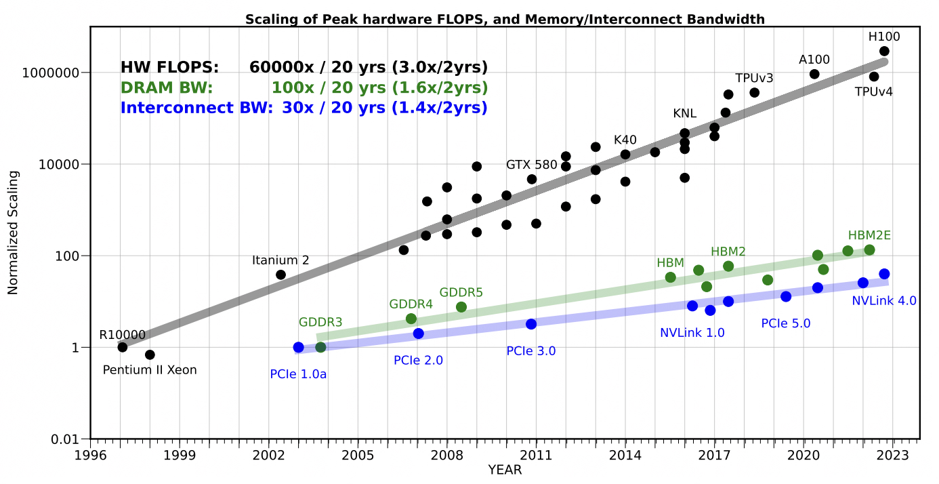
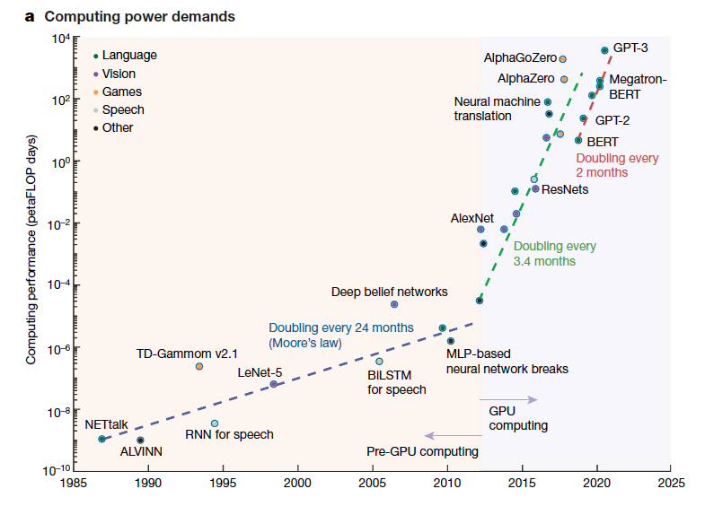
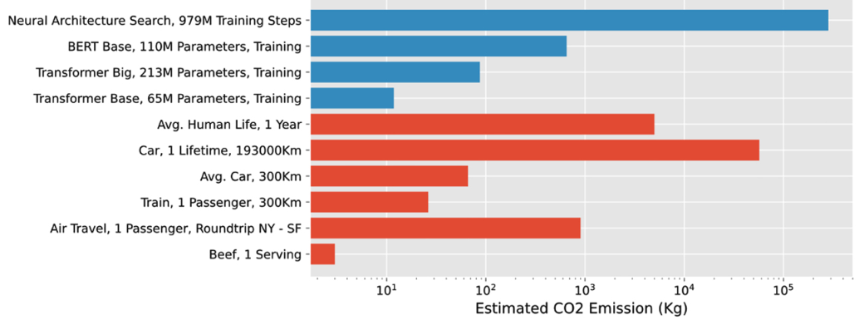
Grand Challenges: AI Workloads Strain Conventional Computing Architectures
Memory Wall and Interconnect Bandwidth
Exponentially Increasing Compute Demand
Gholami, Amir et al. “AI and Memory Wall.”
IEEE Micro 44 (2024): 33-39.
Energy Efficiency and Sustainability
Mehonic et al., “Brain-inspired computing needs a master plan”
Stark et al., “Opportunities for integrated photonic neural networks”

Slide 3
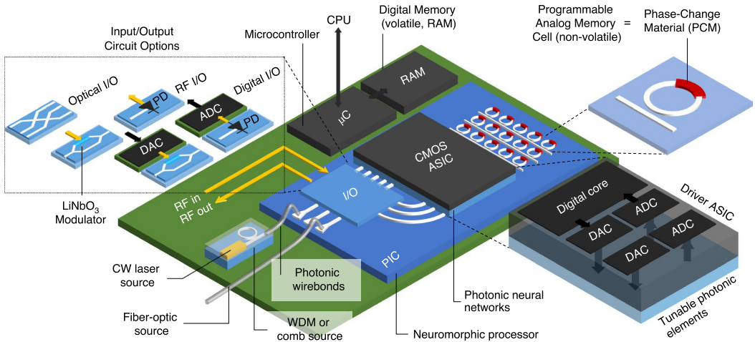
Optical AI/ML Accelerators Offer a New Paradigm to Match Workload Demands
Key Advantages
Data transmission at light-speed
Minimal RC delay or loss
Massively parallel data transmission
Near-instantaneous, one-shot calculation
Shastri, B. J., Tait, A. N., Ferreira de Lima, T., Pernice, W. H., Bhaskaran, H., Wright, C. D., & Prucnal, P. R. (2021). Photonics for artificial intelligence and neuromorphic computing. Nature Photonics, 15(2), 102-114.

Slide 4
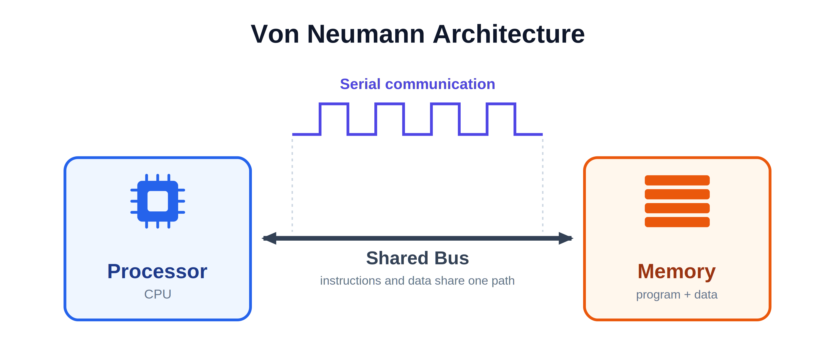
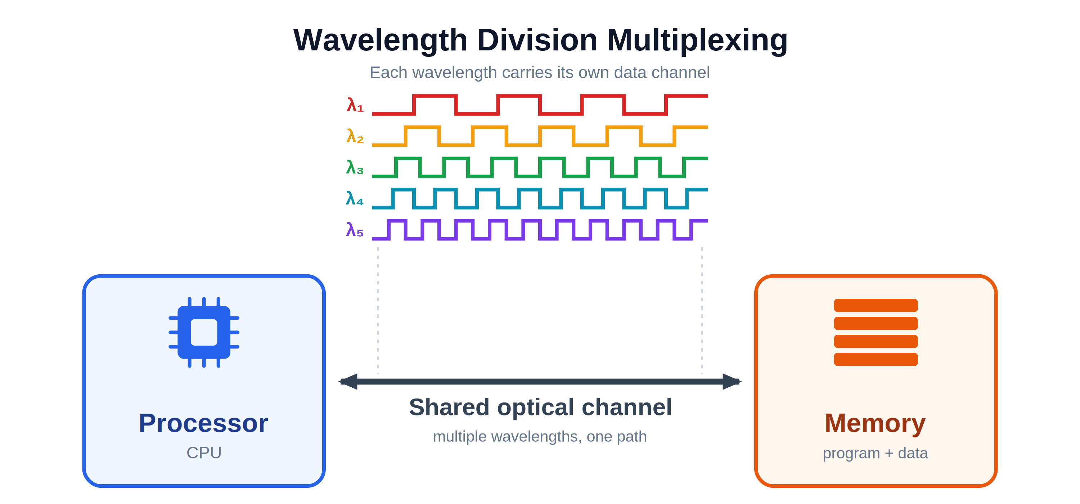
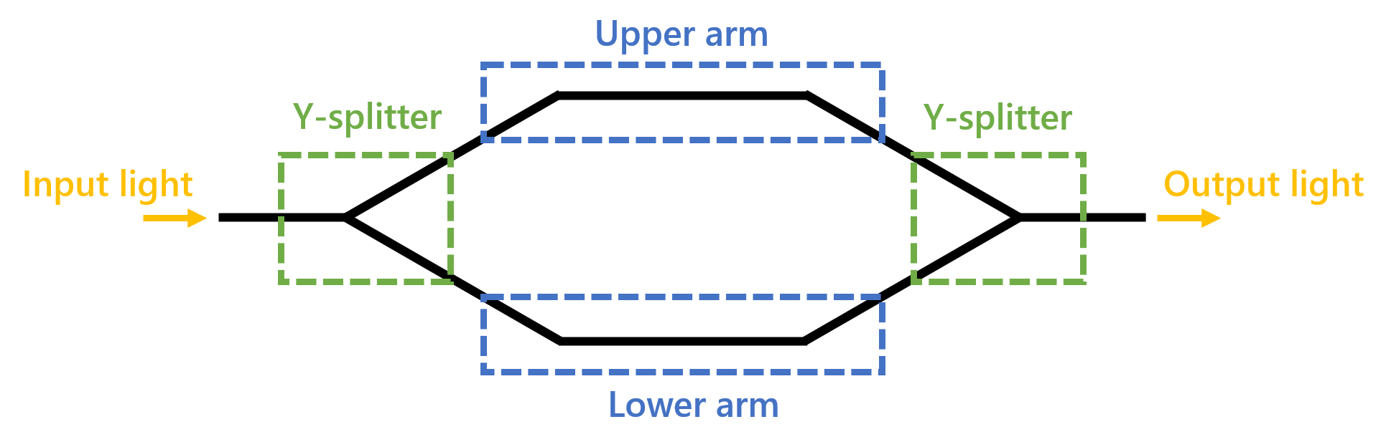
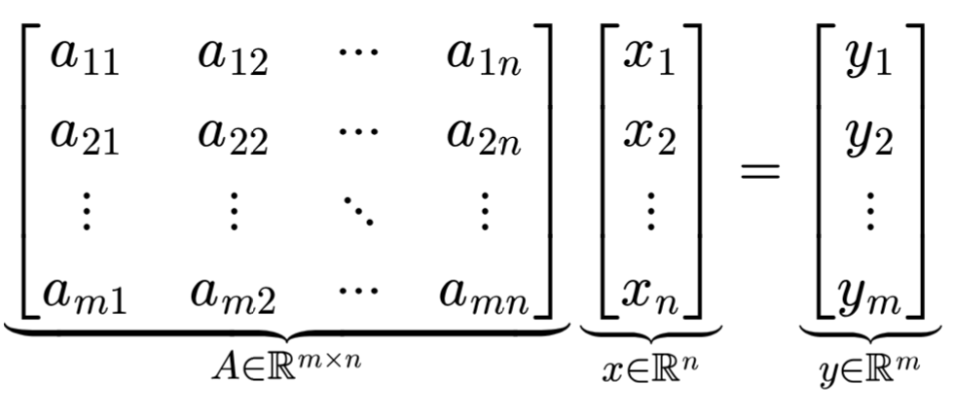
Wavelength-Division Multiplexing
High Throughput Parallel Data Transmission
Compute-in-Memory Matrix-Vector Multiplication
Photonic Flash Memory Cell
Single
Operation
Matrix-Vector Multiplication
Mach-Zehnder Interferometer

Slide 5
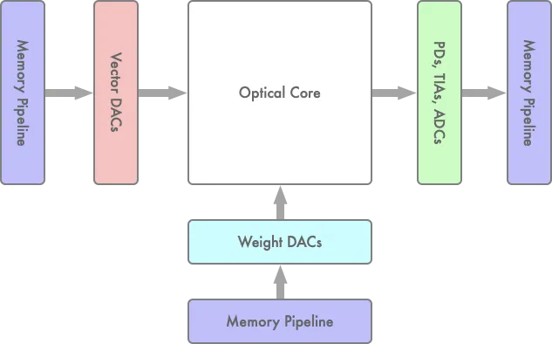
The Bottleneck: Memory Accesses and Electrical/Optical Conversions
Lightmatter Optical Compute Core
Model training requires constant memory accesses to retrieve weights and training data and to store outputs
Lack of a non-volatile memory technology with optical readout requires optical-to-electrical (O/E) and electrical-to-optical (E/O) conversions
These conversions fundamentally limit speed, bandwidth, and energy efficiency
https://medium.com/lightmatter/techniques-for-performing-design-verification-of-a-mixed-signal-digital-analog-and-optical-d0068c9ff868

Slide 6
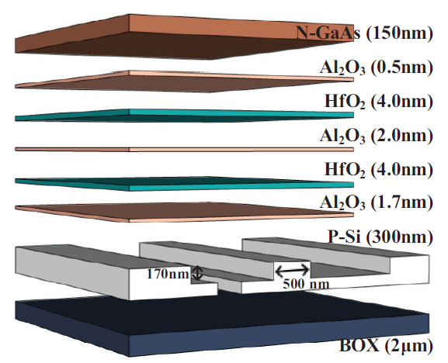
Opto-electronic Flash Memory: A Near-Term Solution
Opto-electronic Flash Memory Cell
Key Advantages
Fully CMOS-Compatible
High-density
Well-established for storing weights and training datasets
Cheung et al., Laser & Photonics Review (2024)

Slide 7
Objectives
TCAD modeling: Developing Technology Computer-Aided Design (TCAD) models for rapid simulation of opto-electronic flash memory designs
Memory performance evaluation: Simulating programming, retention, and erase operations to characterize speed, retention, and optical performance
Dielectric stack engineering: Proposing a novel cell design incorporating bandgap-engineered tunnel-oxides^{[1]} optimized for improved performance
[1] Hang-Ting Lue et al., "BE-SONOS: A bandgap engineered SONOS with excellent performance and reliability," IEEE International Electron Devices Meeting, 2005. IEDM Technical Digest, Washington, DC, USA, 2005, pp. 547-550, doi: 10.1109/IEDM.2005.1609404.

Slide 8
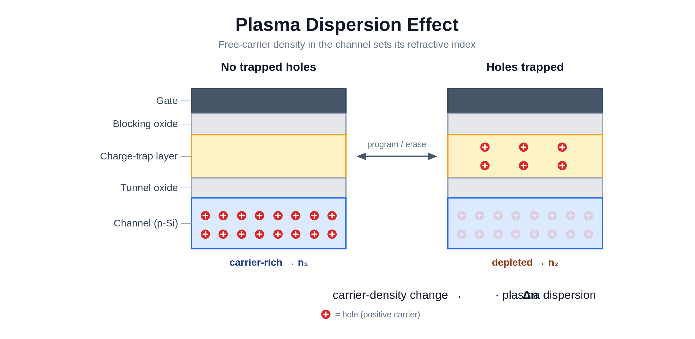
Opto-Electronic Flash Memory and the
Plasma Dispersion Effect
Programmed State
(Charge Trapped & Channel Depleted)
Initial/Erased State
(No Trapped Charge)
Charge Trapping
(Flash)
Quantum Tunneling
Electrostatic
Repulsion
Laser beam
(unprogrammed)
Laser beam
(programmed)
Plasma Dispersion Effect
Optical Readout
(Opto-electronic)

Slide 9
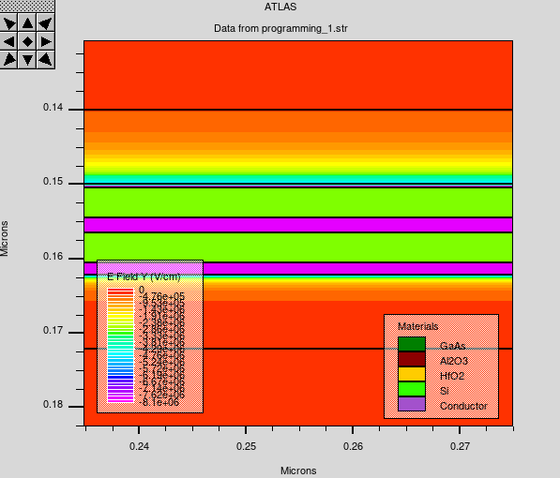
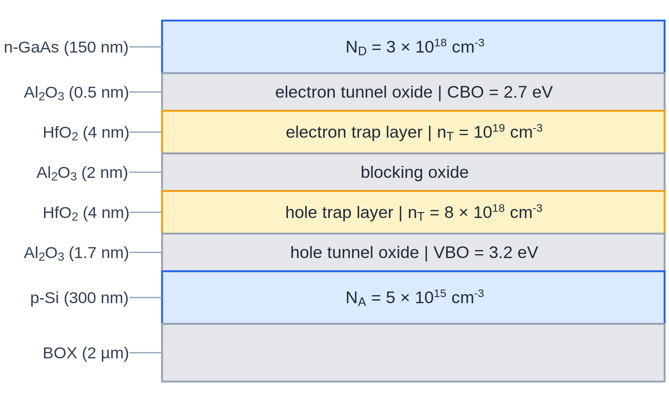
Methodology & Simulation Setup
Technology Computer-Aided-Design (TCAD)
  Software: Silvaco ATLAS TCAD
  Simulates testing and device physics, providing internal insight to expose design flaws prior to fabrication
Simulated Internal Electric Field during Programming
Original Opto-electronic Flash Cell Design^{[1]}
III-V/Si platform for integration of photonic devices on GaAs
Two HfO₂ charge trap layers for trapping of electrons and holes, respectively
[1] Cheung et al., Laser & Photonics Review (2024)

Slide 10
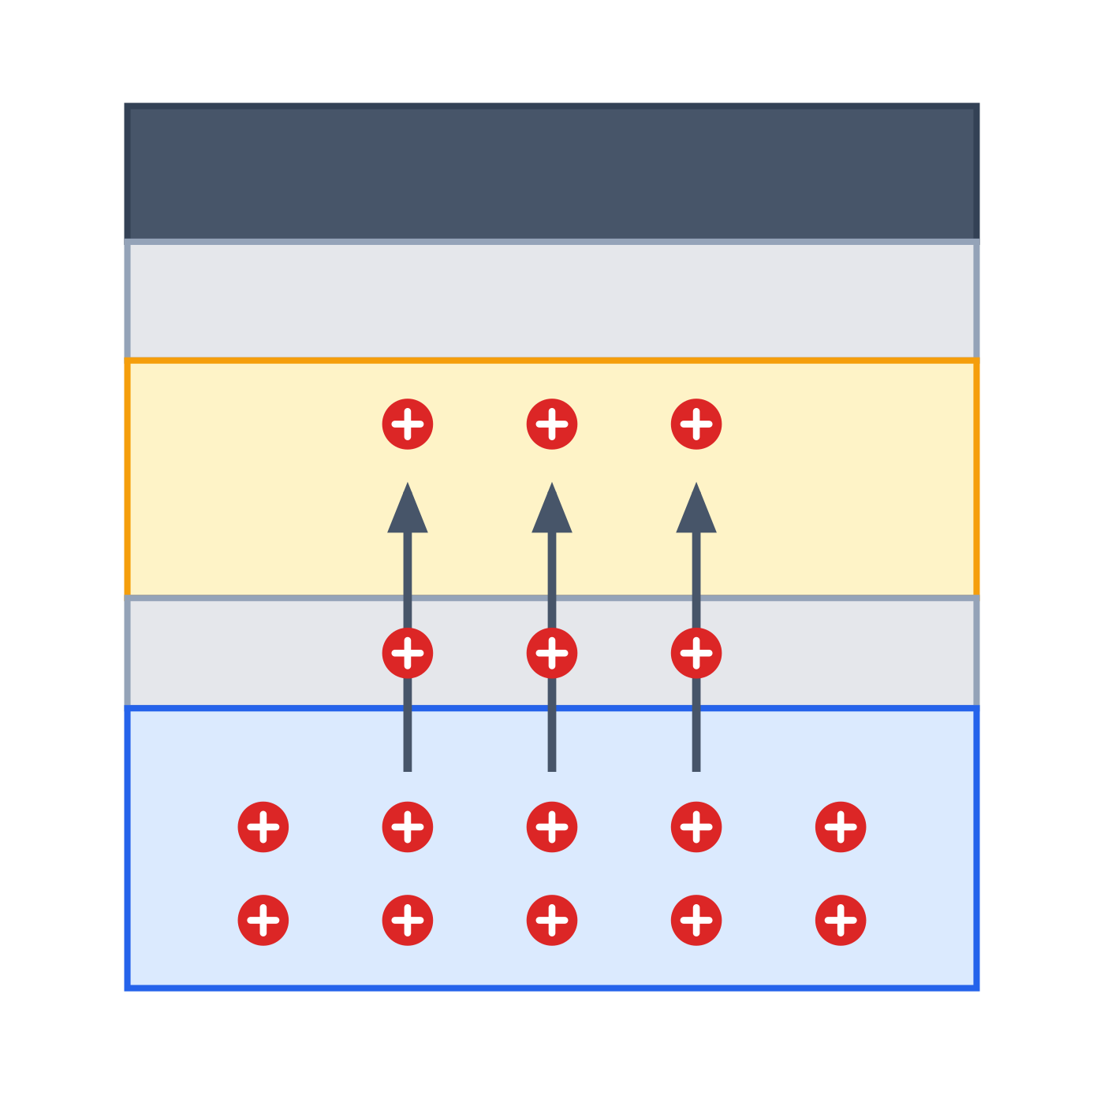
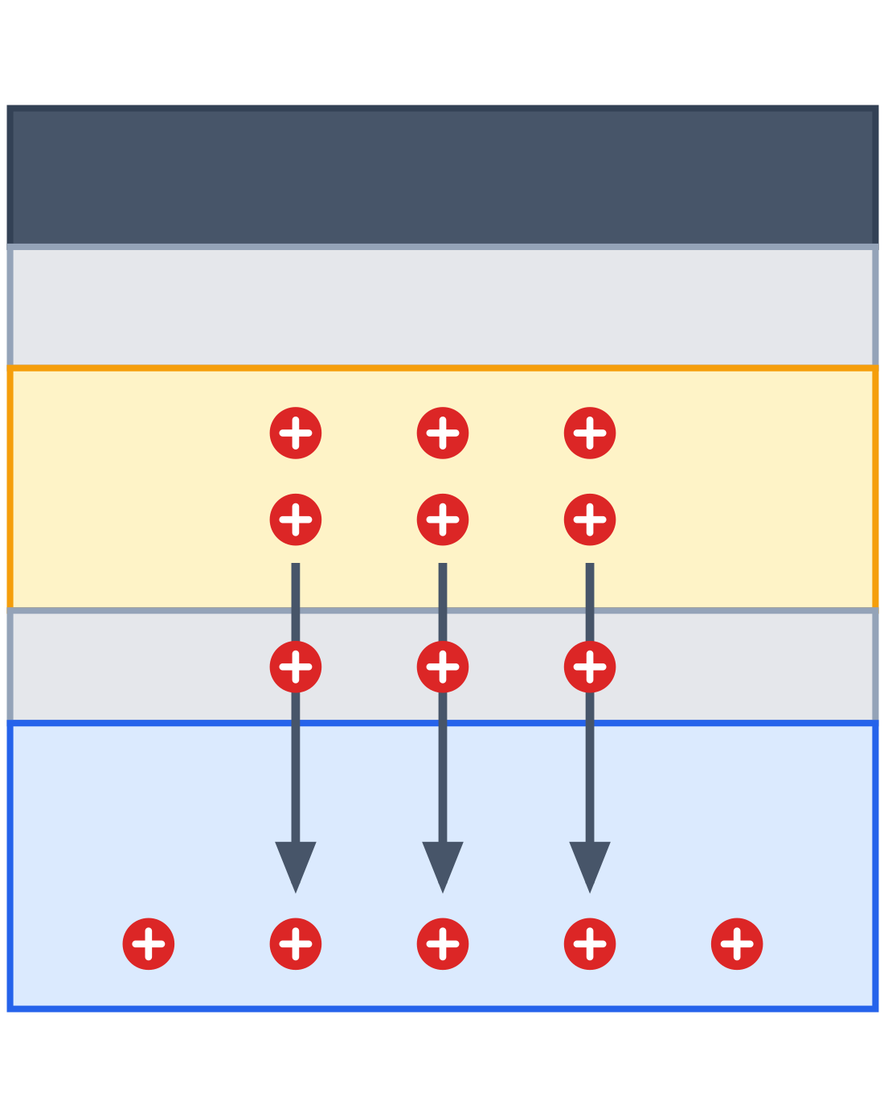
Simulation results
Initial
Programming
Retain
Erase
Return
Read
+9V
Read
-5V
Read

Slide 11
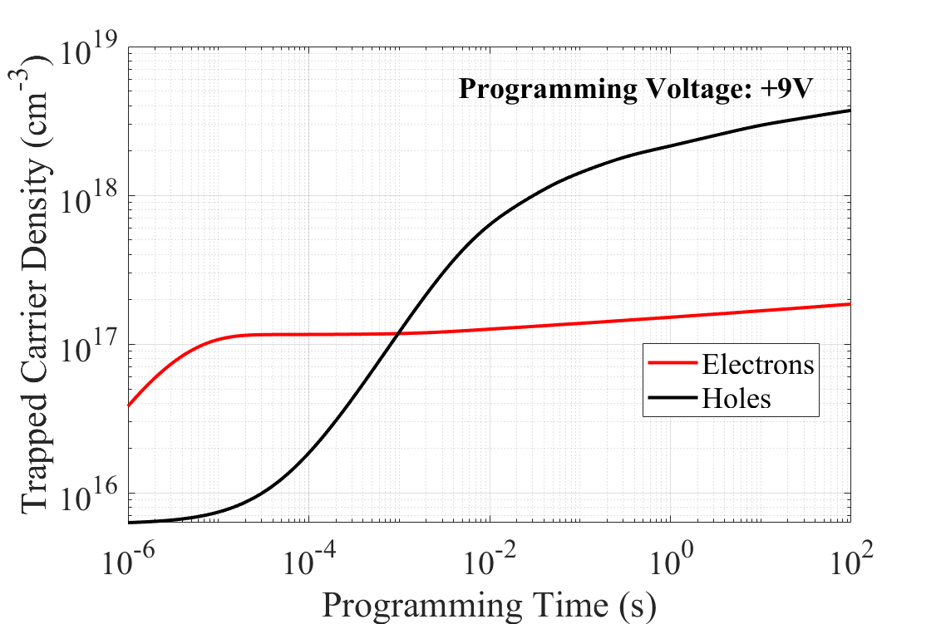
Programming | +9V
Trapped Carrier Density During Programming Operation
Asymmetric Programming:
  Electrons: Early saturation in 10μs of trapped electrons with low trap occupancy (~1%)
  Holes: Later saturation of trapped holes with relatively higher trap occupancy
  (26.7% at t=1s)
Electron trap density: 10¹⁹ cm⁻³
Hole trap density: 8x10¹⁸ cm⁻³

Slide 12
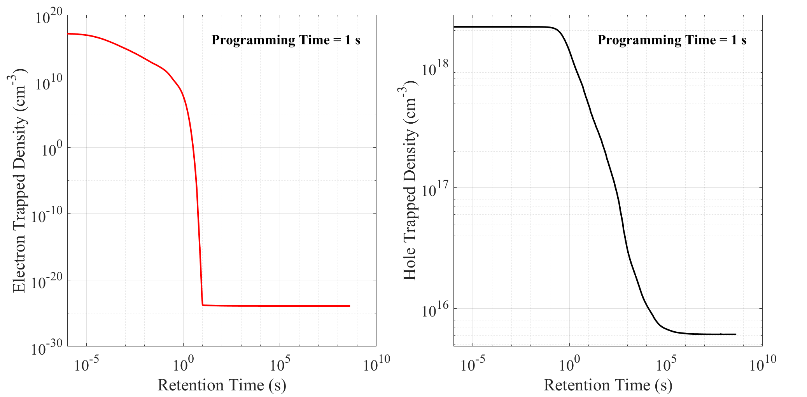
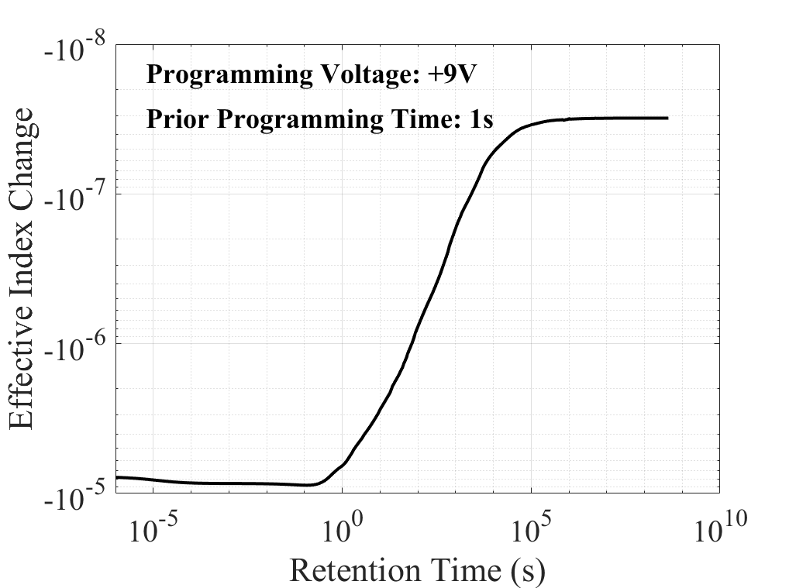
Retention | 0V | Read State
Electron Detrapping During Retention
Hole Detrapping During Retention
Effective Index Change During Retention
Non-volatile state
Hole
Detrapping
Electron
Detrapping
Redshift following programming
Volatile blueshift
~1.16 days
~1.16 days
Poor carrier retention: Complete loss of trapped electrons within 10s and gradual 343x decrease in trapped hole density over one day timespan
Read-state volatility: Redshift followed by volatile blueshift consistent with hole de-trapping before settling to non-volatile state

Slide 13
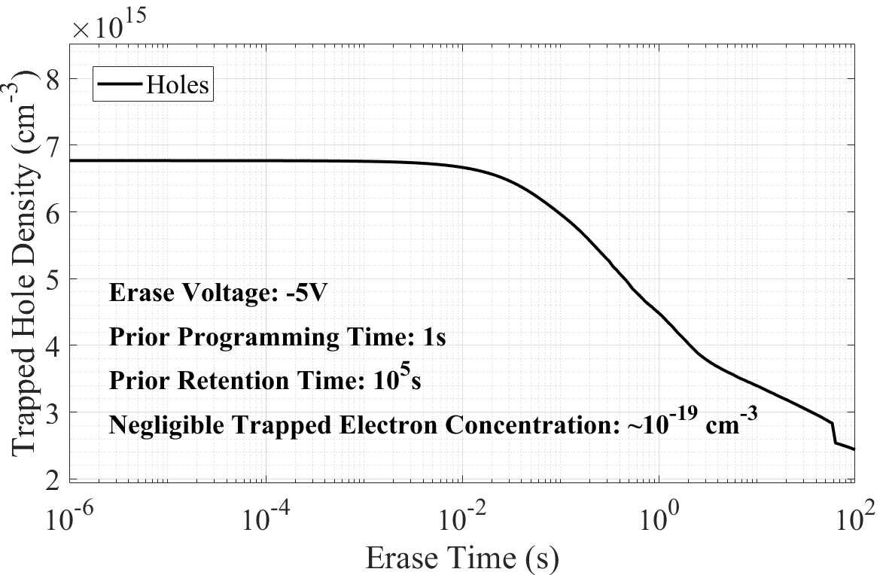
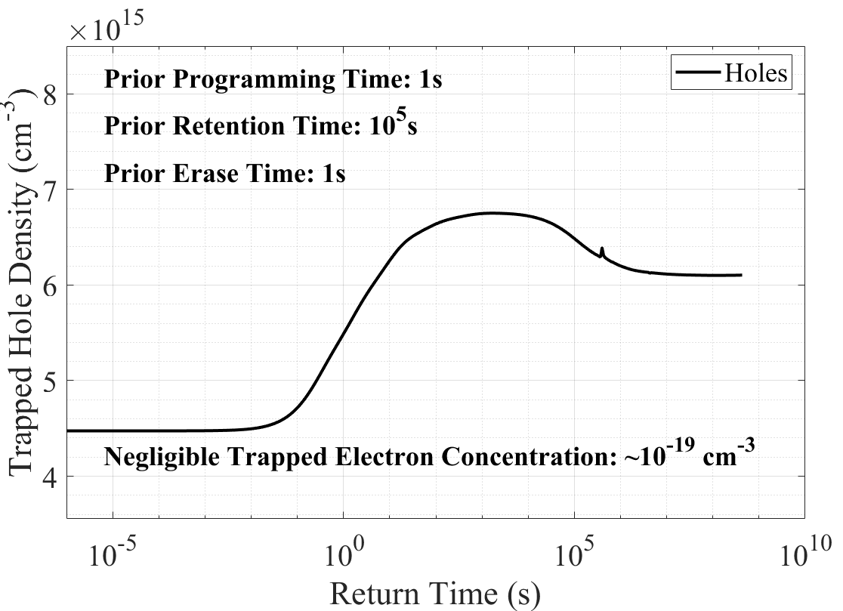
Erase | -5V & Return | 0V
Trapped Hole Density During Erase Operation
Trapped Hole Density Following Erase
Initial equilibrium density
Initial equilibrium density
Complete erase: Initial and final state following 100ms erase show identical effective indices

Slide 14
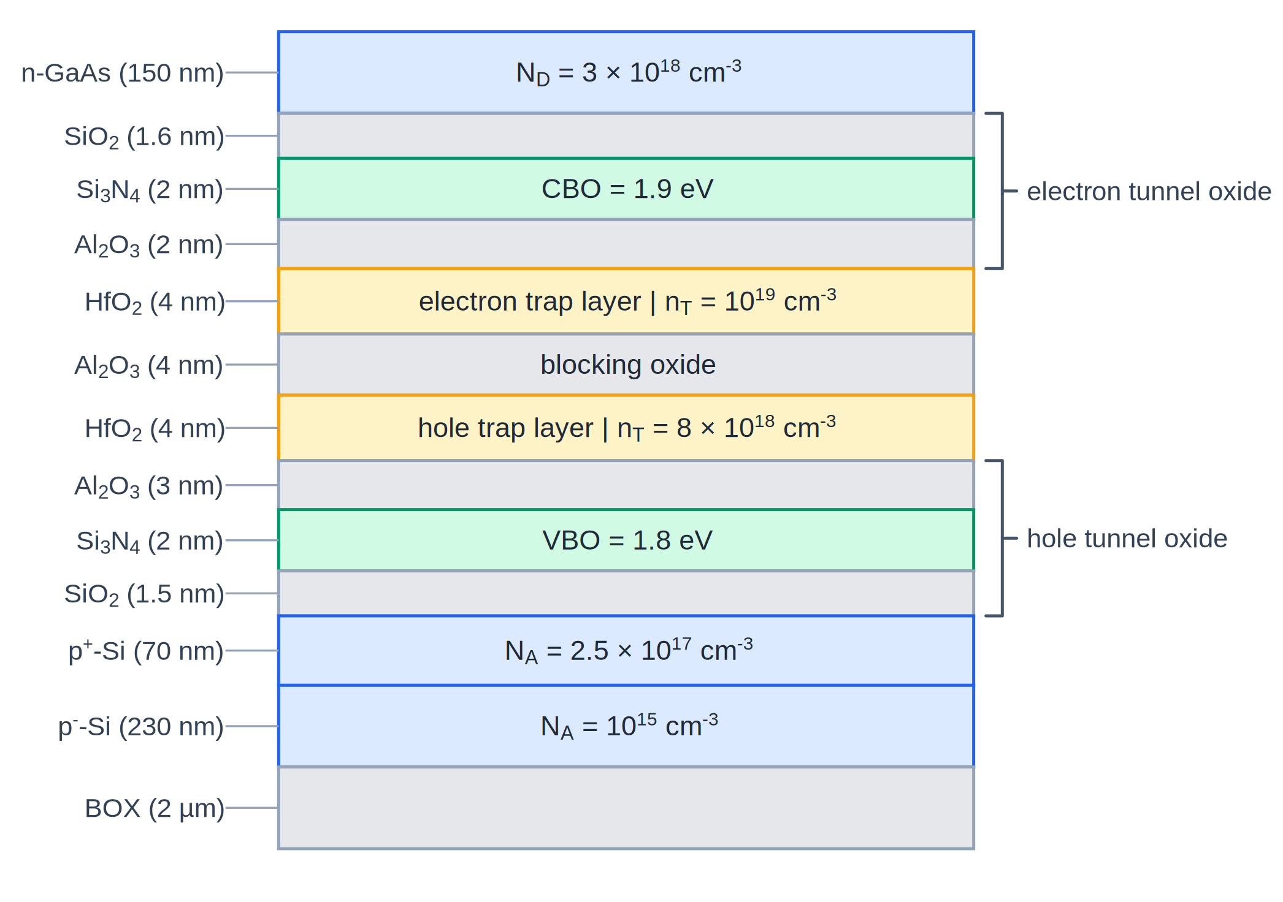
Device design
Proposed Device Design
Original Device Design

Slide 15
Identified Performance Issues
Asymmetric programming
Poor carrier retention
Volatile read state
Original Device Design
Contributing Factor:
III-V/Si Platform Integration
GaAs/Si Workfunction
difference causes depletion of
Si carriers with no applied voltage
Fundamentally limits programming efficiency
Carrier concentration changes contribute to read state volatility

Slide 16
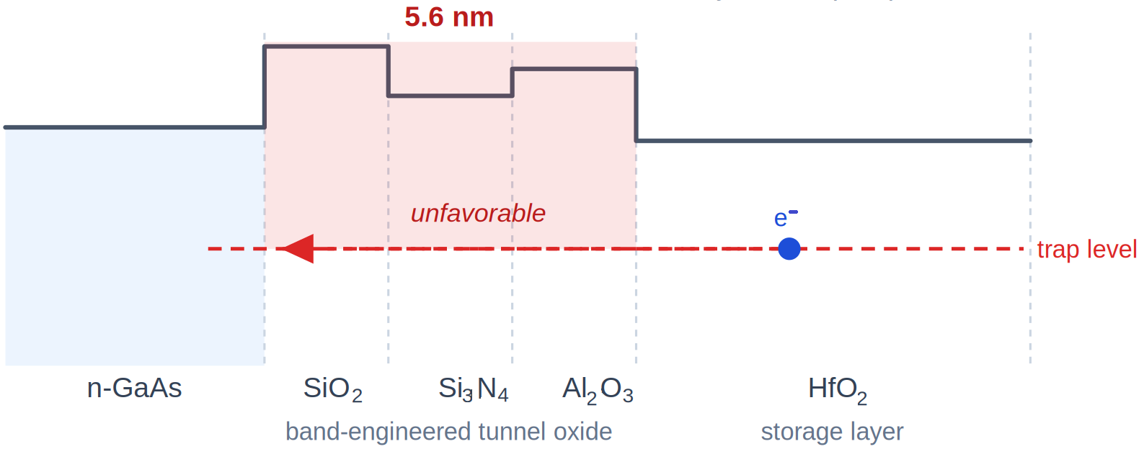
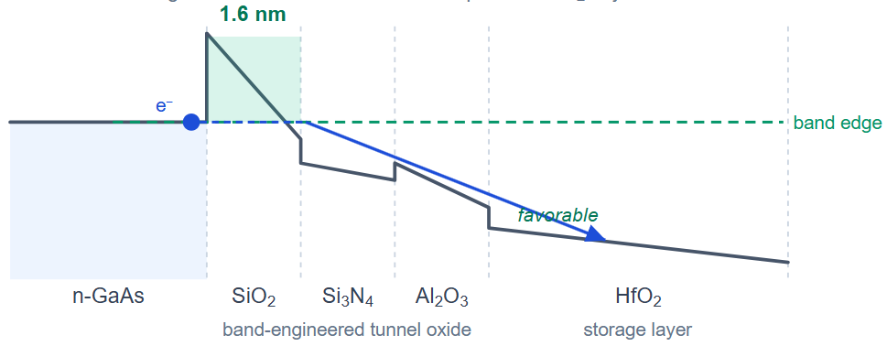
Bandgap-Engineered Tunnel Oxides Improve Speed and Retention Simultaneously
Initial/Retention State:
Free carriers in channel and trapped carriers both face thick 5.6nm, energetically unfavorable barrier: Low tunneling rate
Tri-layer Tunnel Oxide Structure
Programming (+9V):
Programming voltage lowers band energy of second and third barrier
Tunneling electron experiences thin 1.6 nm barrier: High tunneling rate

Slide 17
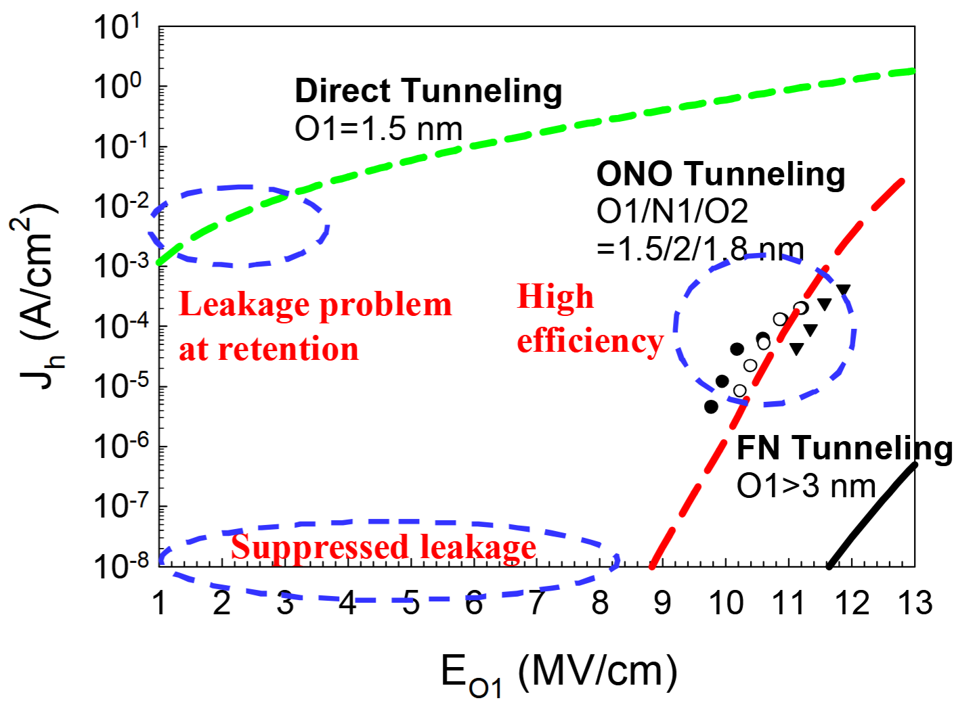
Opto-electronic Cell Implementation
Proposed Design
Tunneling Regimes in SiO₂^{[1]}
Proposed Design at +15V Programming
(E = 13.2 MV/cm)
Proposed Design at Retention
Layered P⁺/P⁻ doping structure ensures high Si carrier density with minimal addition optical loss (25.72 mdB/cm)
[1] Hang-Ting Lue et al., "BE-SONOS: A bandgap engineered SONOS with excellent performance and reliability," IEDM (2005)

Slide 18
CONCLUSION
Using TCAD modeling and simulation, performance deficiencies relating to the dielectric stack structure were identified in an initial opto-electronic Flash memory cell design.
A novel cell design using bandgap-engineered tunnel oxides is proposed to remedy these deficiencies, to be simulated in future work.
Acknowledgements
This work was partially supported by the Microelectronics Commons Program, a DoW initiative, under award number N00164-23-9-G059.
Distribution Statement A: Approved for public release. Distribution is unlimited.

