Slide 1
Determining Phonon Band Structures of Inorganic Lead Halide Perovskite Alloys
Via First Principles Calculations
Isabella J. Palit
Home Institution: Columbia University in the City of New York
Host Institutions: Duke University and University of North Carolina Chapel Hill
Gabriel J. Graf (Duke), Aaron M. Schankler (UNC), Yosuke Kanai (UNC), Volker Blum (Duke)

Slide 2
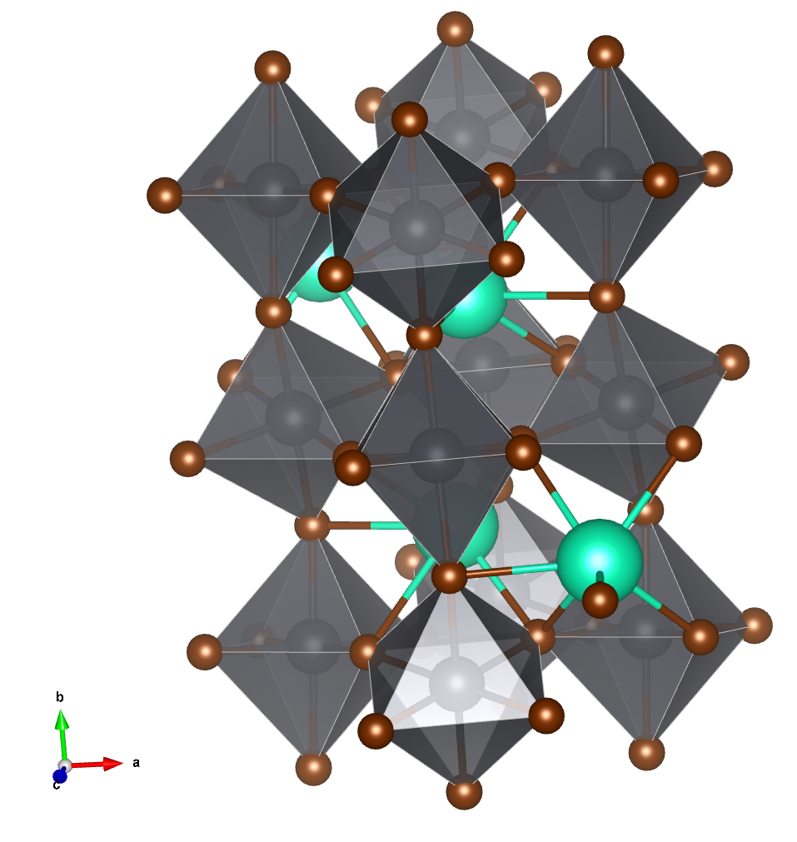
Project Background: Perovskites
Perovskites
Compounds of form ABX₃ and the same crystal structure as CaTiO₃ ¹
  A: organic or inorganic cation
  B: metal cation
  X: halide anion
All-Inorganic Lead Halide Perovskites
CsPbX₃ (X = Cl, Br, I) can form perovskites
Octahedra with Pb at center in a periodic crystal lattice
Easy to solution-process
Tunable due to property dependence on morphology and composition
High power conversion efficiency for solar cells and promising as photodetectors ²
Br (X)
Pb (B)
Cs (A)
Figure: Crystal structure of CsPbBr₃, visualized in VESTA.
¹Linaburg, Matthew R., Eric T. McClure, Jackson D. Majher, and Patrick M. Woodward. 2017. Chemistry of Materials 29 (8): 3507–14.
²Deng, Jianping, Jinglei Li, Zhi Yang, and Minqiang Wang. 2019. Journal of Materials Chemistry C 7 (40): 12415–40.

Slide 3
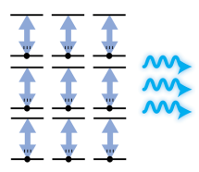
Project Background: Superfluorescence
Superfluorescence
Superfluorescence: excited quantum states in a crystal lattice spontaneously align their dipoles and relax, emitting a burst of coherent light ¹
Materials optimized for superfluorescence could improve optoelectronics
Superfluorescence might help us better understand quantum entanglement
Superfluorescence has largely been observed at low temperatures (6 to 100 K)², but was recently observed at room temperature in CsPbBr₃
Superfluorescence fluctuations in CsPbBr₃ occur in the range of longitudinal optical rocking phonon modes, implying a connection between the two³
Figure: Superfluorescence ¹
¹Russ, Brendan, and Carissa N. Eisler. 2024. Nanophotonics 13 (11): 1943–51.
²Huang, Kai, Kory Kevin Green, Ling Huang, Hans Hallen, Gang Han, and Shuang Fang Lim. 2022. Nature Photonics 16 (10): 737–42.
³Biliroglu, Melike, Mustafa Türe, Antonia Ghita, et al. 2025. Nature 642 (8066): 71–77.

Slide 4
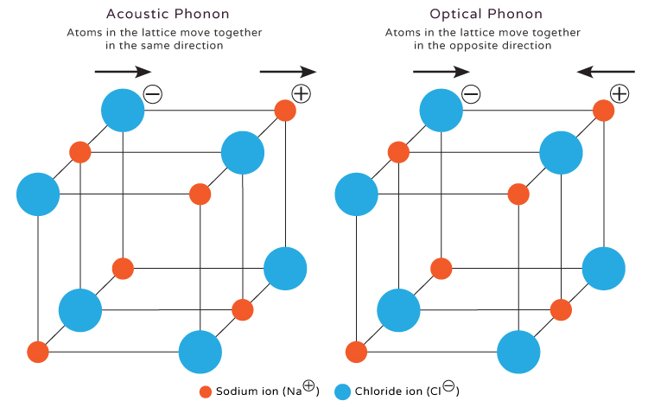
Project Background: Phonons
Phonons
Phonons: quantized vibrations in a crystal lattice
3 x (atoms in unit cell) phonon modes
  3 acoustic, and the rest optical
  Longitudinal (LO) and transverse (TO) optical modes
Figure: Phonons in NaCl¹
¹Bhuyan, Satyam. 2025. Science Facts.

Slide 5
Project Goal
Calculate phonon band structures for the spectrum of CsPbX₃ perovskites to determine the composition-dependence of phonons and eventually a step towards predicting superfluorescence from electron-phonon coupling.

Slide 6
Methods: Experimental Structures
Experimental
Structure¹
Experimental
Structure²
Experimental
Structure³
CsPbCl₃
CsPbBr₃
CsPbI₃
Details:
Experimental structures and lattice parameters were taken from experiments at 298K, 1atm.
¹Linaburg, Matthew R., Eric T. McClure, Jackson D. Majher, and Patrick M. Woodward. 2017. Chemistry of Materials 29 (8): 3507–14.
²López, Carlos A., Carmen Abia, María Consuelo Alvarez-Galván, et al. 2020. ACS Omega 5 (11): 5931–38.
³Stoumpos, Constantinos C., Christos D. Malliakas, and Mercouri G. Kanatzidis. 2013. Inorganic Chemistry 52 (15): 9019–38.

Slide 7
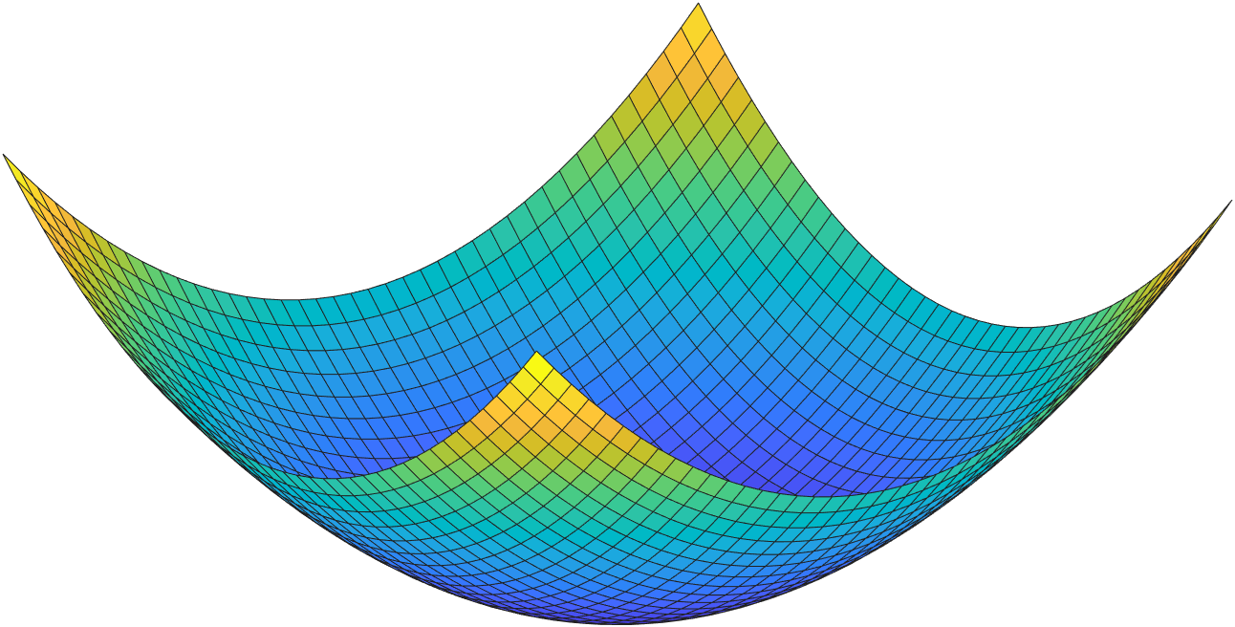
Methods: Relaxing Pure Halides
Experimental
Structure
Experimental
Structure
Experimental
Structure
CsPbCl₃
CsPbBr₃
CsPbI₃
Fully Relax
Fully Relax
Figure: Traversing energy landscape to find local minimum.
Fully Relax
CsPbCl₃
CsPbBr₃
CsPbI₃
Details:
The unit cell was fully relaxed until the max force was under 5x10⁻³eV/Å, then further relaxed to 2x10⁻⁴eV/Å.
FHI-aims code¹ was used for Density Functional Theory (DFT) calculations.
DFT approximation was PBE functional with Tkatchenko-Scheffler² term for long range van der Waals interactions added, but using the parametrization described and benchmarked in the supplementary information of Reference³
¹Blum, V., Gehrke, R., Hanke, F., Havu, P., Havu, V., Ren, X., Reuter, K. and Scheffler, M. 2009.Computer Physics Communications 180 (11): 2175-2196.
²Tkatchenko, A. and Scheffler, M. 2009. Physical Review Letters 102 (7): 073005.
³Kim, Y.-H., Song, R., Hao, J. et al. 2022. Advanced Functional Materials 32 (25): 2200454.

Slide 8
Methods: Halide Subsitution
Experimental
Structure
Experimental
Structure
Experimental
Structure
Replace halide by 1/3
Replace halide by 1/3
CsPbCl₃
CsPbBrCl₂
CsPbBr₂Cl
CsPbBr₃
CsPbBr₂I
CsPbBrI₂
CsPbI₃
Intermediate Relaxation
Intermediate Relaxation
Fully Relax
Fully Relax
Fully Relax
CsPbCl₃
CsPbBr₃
CsPbI₃
Details:
Each arrangement was relaxed with intermediate settings prior to comparing total energies.
Note: there are no Cl - I alloys because Cl and I differ too much in size to realistically produce a stable alloy

Slide 9
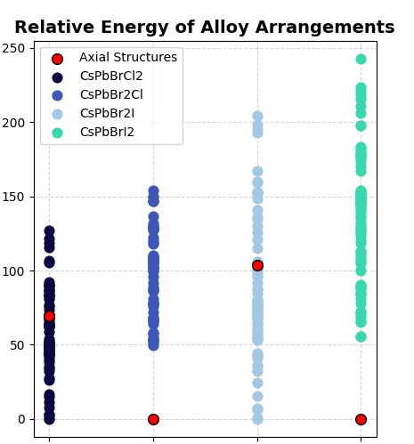
Results: Finding Lowest Energy Arrangements
For CsPbBr₂Cl and CsPbBrI₂, the structure with Pnma symmetry was significantly lower energy. ​
For CsPbBrCl₂ and CsPbBr₂I, there were many structures of equivalent symmetry near the lowest energy, and the axial structure was considerably higher energy. ​
  CsPbBrCl₂: Pmna​
  CsPbBr₂I: Imma​
Relative Energy (meV) per 20-atom unit cell
Imma
Pmna
Pmna
Pmna

Slide 10
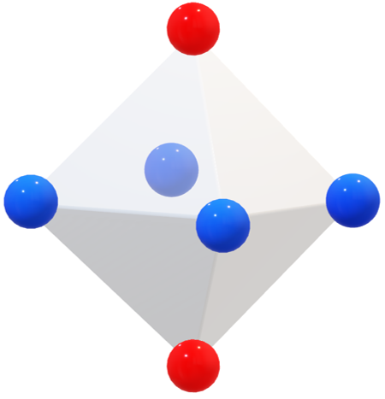
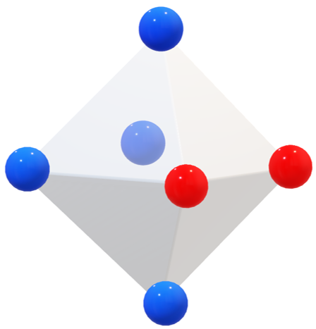
Results: Symmetry of Lowest Energy Arrangements
Composition | Space Group | Point Group | Fig
CsPbBrCl₂ | Pmn2₁ (31) | mm2 | b
CsPbBr₂Cl | Pnma (62) | mmm | a
CsPbBr₂I | Pmc2₁ (26) | mm2 | b
CsPbBrI₂ | Pnma (62) | mmm | a
(a)
(b)
Details:
Red represents the substitute halide
Blue represents the original halide from the pure structure
Ex: for CsPbBrCl₂, Br is red and Cl is blue and looks like (b)

Slide 11
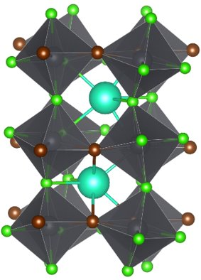
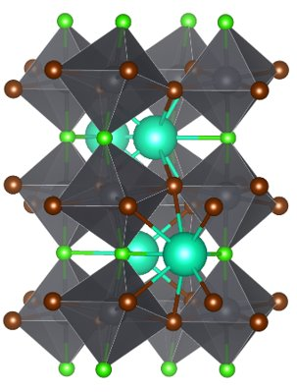
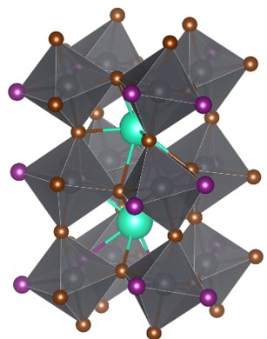
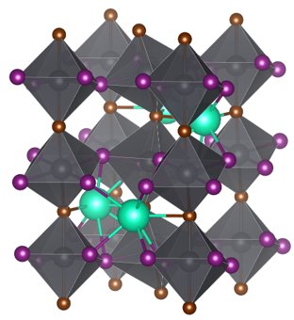
Methods: Picking Lowest Energy Structure
Experimental
Structure
Experimental
Structure
Experimental
Structure
Replace halide by 1/3
Replace halide by 1/3
CsPbCl₃
CsPbBrCl₂
CsPbBr₂Cl
CsPbBr₃
CsPbBr₂I
CsPbBrI₂
CsPbI₃
Intermediate Relaxation
Intermediate Relaxation
Fully Relax
Pick Best
Pick Best
Fully Relax
Pick Best
Pick Best
Fully Relax
CsPbCl₃
CsPbBr₃
CsPbI₃
** these structures are partially relaxed before picking the lowest energy one

Slide 12
Methods: Fully Relaxing Alloys
Experimental
Structure
Experimental
Structure
Experimental
Structure
Replace halide by 1/3
Replace halide by 1/3
CsPbCl₃
CsPbBrCl₂
CsPbBr₂Cl
CsPbBr₃
CsPbBr₂I
CsPbBrI₂
CsPbI₃
Pick Best
Pick Best
Pick Best
Pick Best
Fully Relax
Fully Relax
Fully Relax
CsPbCl₃
CsPbBr₃
CsPbI₃
Fully Relax
Fully Relax
CsPbBrCl₂
CsPbBr₂Cl
CsPbBr₂I
CsPbBrI₂

Slide 13
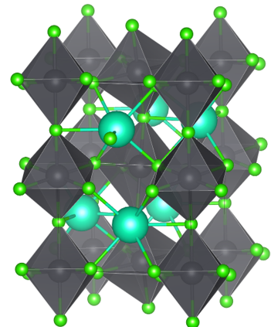
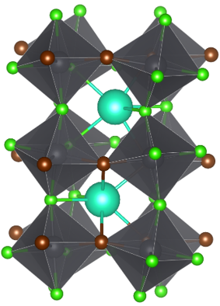
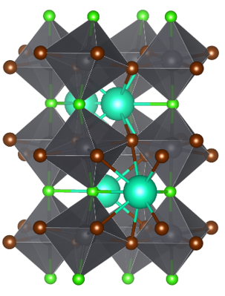
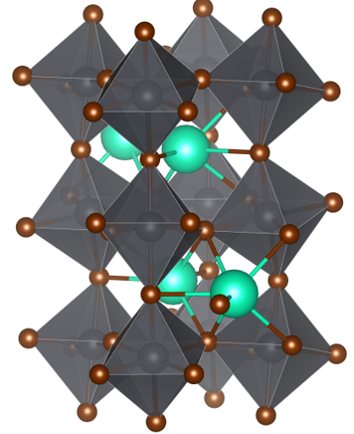

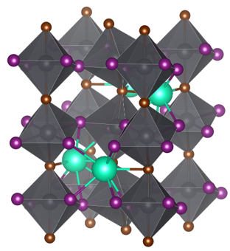
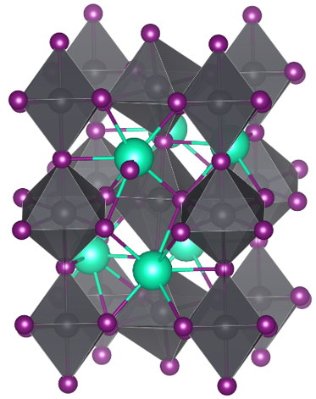
Results: Final Relaxed Structures
CsPbCl₃
CsPbBrCl₂
CsPbBr₂Cl
CsPbBr₃
CsPbBr₂I
CsPbBrI₂
CsPbI₃
Pnma
Pmn2₁
Pnma
Pnma
Pmc2₁
Pnma
Pnma

Slide 14
Methods: Phonon Calculations
Experimental
Structure
Experimental
Structure
Experimental
Structure
Replace halide by 1/3
Replace halide by 1/3
CsPbCl₃
CsPbBrCl₂
CsPbBr₂Cl
CsPbBr₃
CsPbBr₂I
CsPbBrI₂
CsPbI₃
Pick Best
Pick Best
Pick Best
Pick Best
Fully Relax
Fully Relax
Fully Relax
CsPbCl₃
CsPbBr₃
CsPbI₃
Fully Relax
Fully Relax
CsPbBrCl₂
CsPbBr₂Cl
CsPbBr₂I
CsPbBrI₂
Calculate Phonons
CsPbCl₃
CsPbBrCl₂
CsPbBr₂Cl
CsPbBr₃
CsPbBr₂I
CsPbBrI₂
CsPbI₃

Slide 15
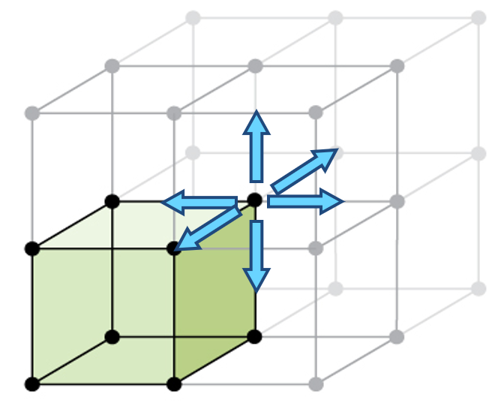
Methods: Calculating Phonons
Create a sufficiently large supercell (40Å in each direction)
Displace each atom in the unit cell in ±x, ± y, ± z directions and assemble the force constant matrix
Take atomic mass into account to create the dynamical matrix
Solve for the vibrational frequencies and eigenvectors
Calculate the Born effective charges and dielectric tensor
Combine to produce the phonon band structure
Figure: Displacement of one atom in the unit cell, adapted from ¹
¹Flowers, Paul, William R. Robinson, Richard Langley, and Klaus Theopold. 2015. Chemistry LibreTexts, March 11.

Slide 16
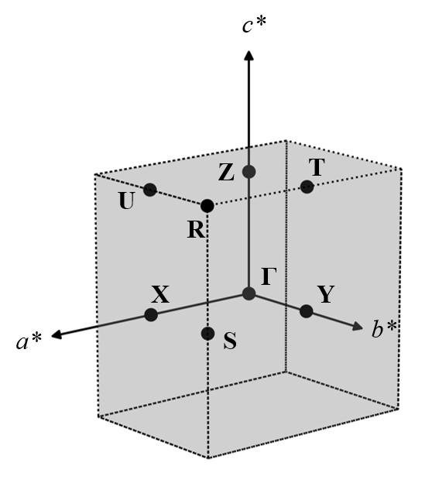
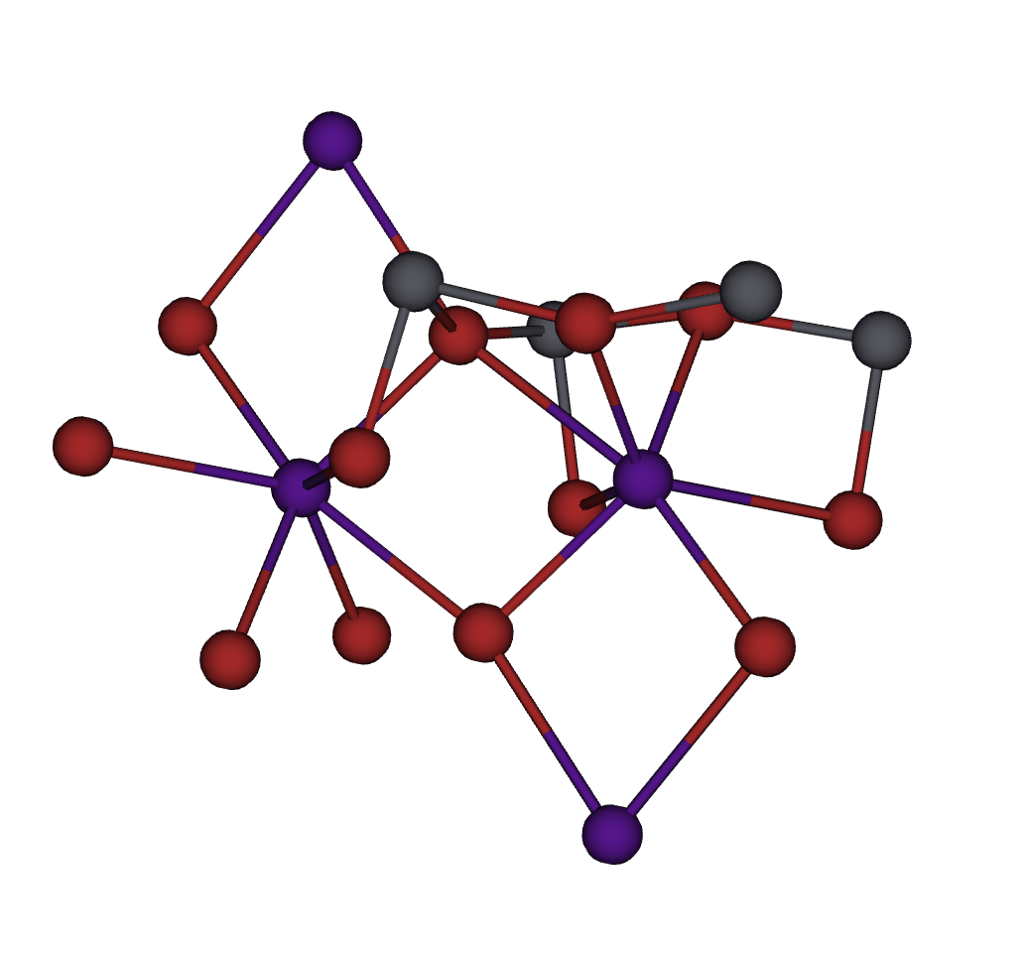
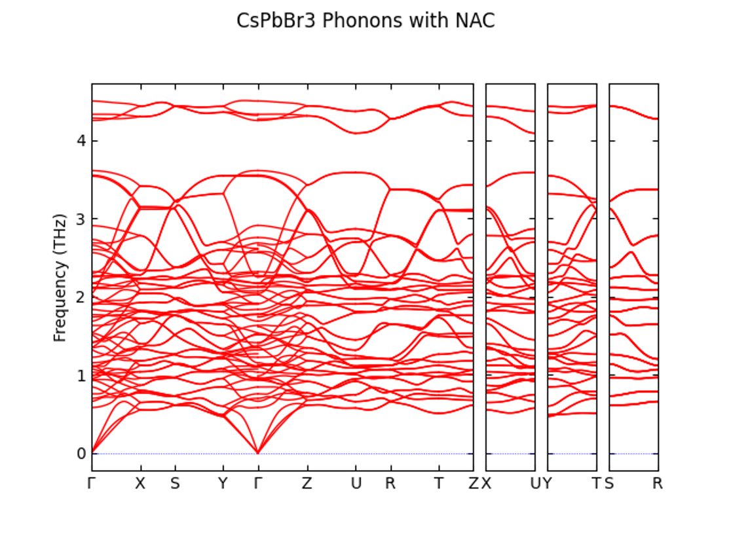
How to Interpret Phonon Band Structures: Gamma Point
1st Brillouin zone
CsPbBr₃
Optical Modes
Gamma Point
Points of interest in reciprocal space
Acoustic Modes

Slide 17
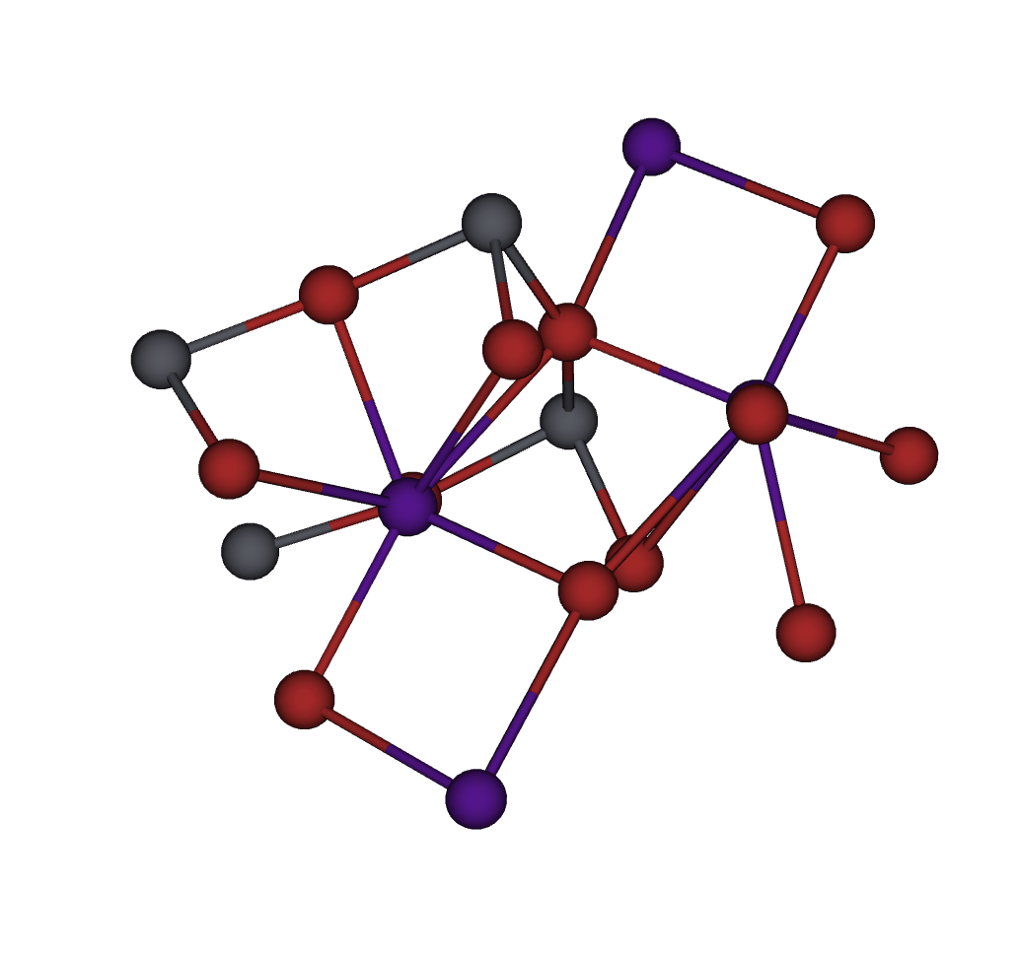
How to Interpret Phonon Band Structures: Acoustic Modes
1st Brillouin zone
CsPbBr₃
Optical Modes
Gamma Point
Points of interest in reciprocal space
Acoustic Modes

Slide 18
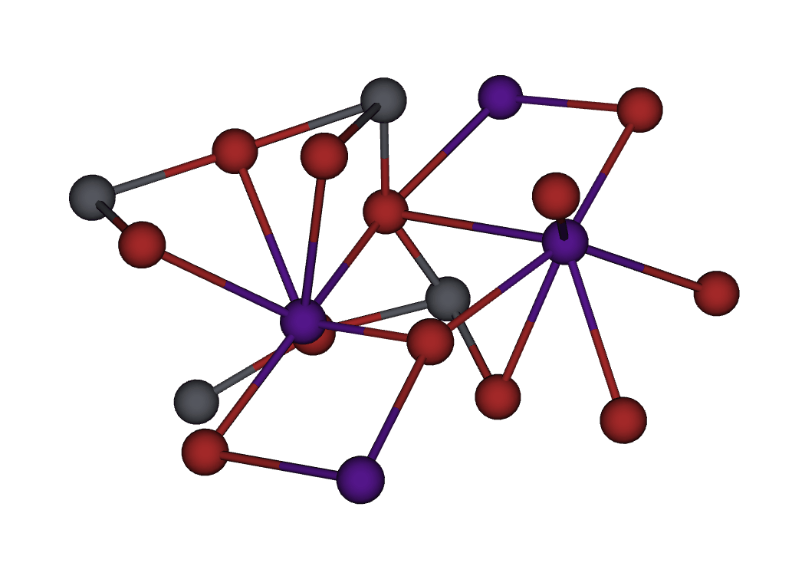
How to Interpret Phonon Band Structures
1st Brillouin zone
CsPbBr₃
Optical Modes
Gamma Point
Points of interest in reciprocal space
Acoustic Modes

Slide 19
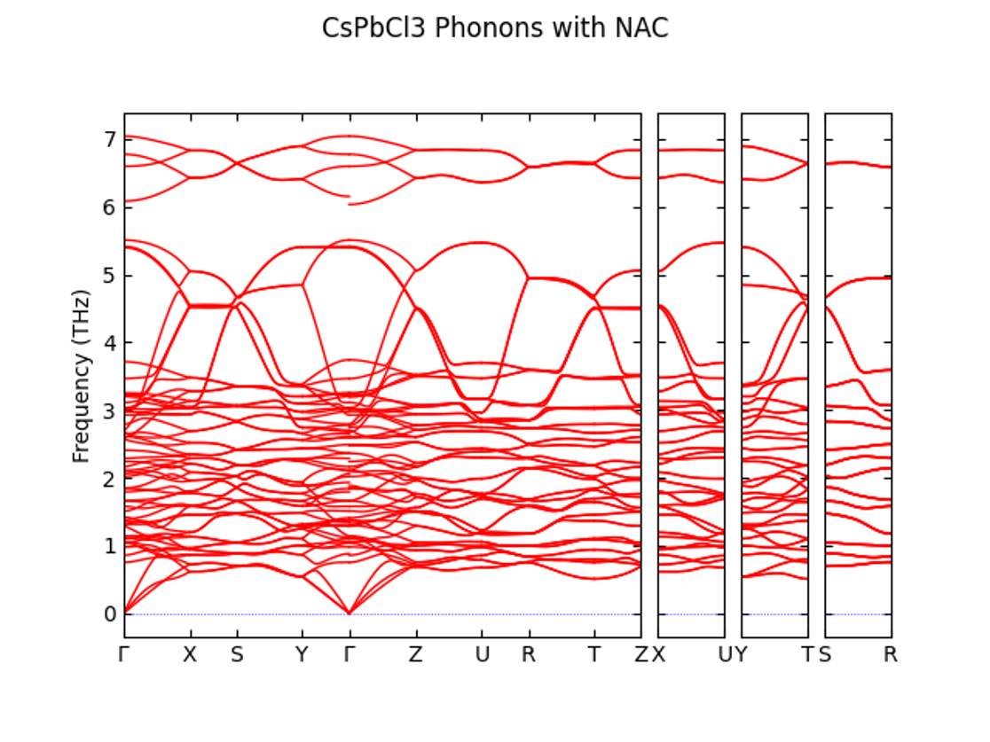
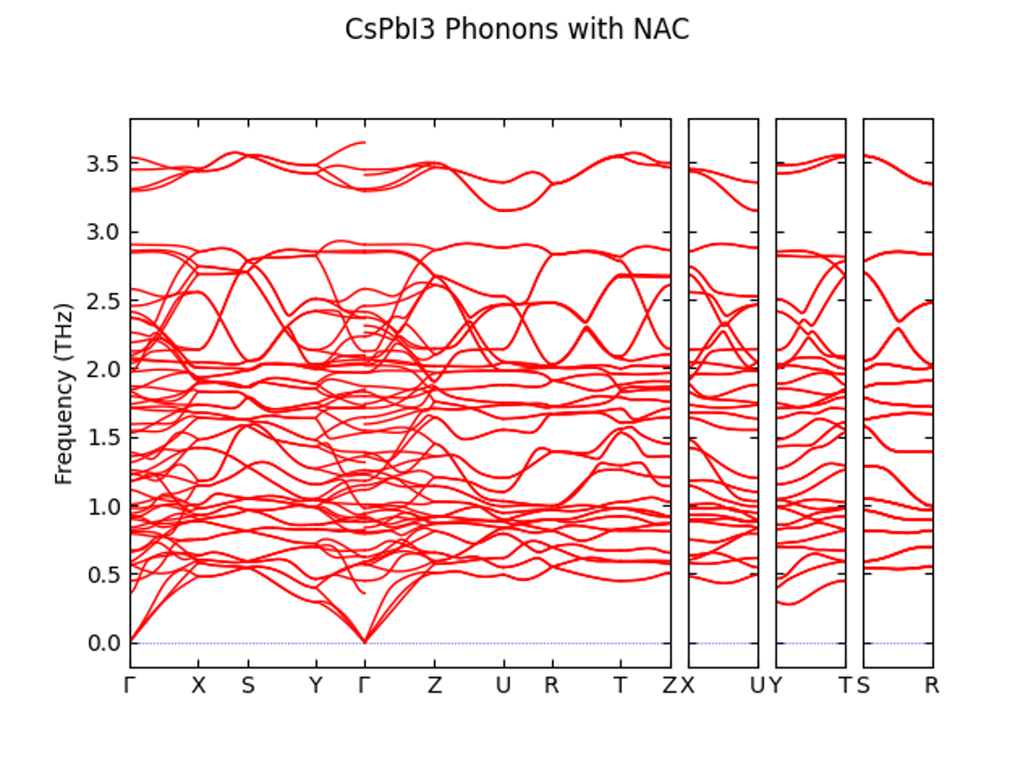
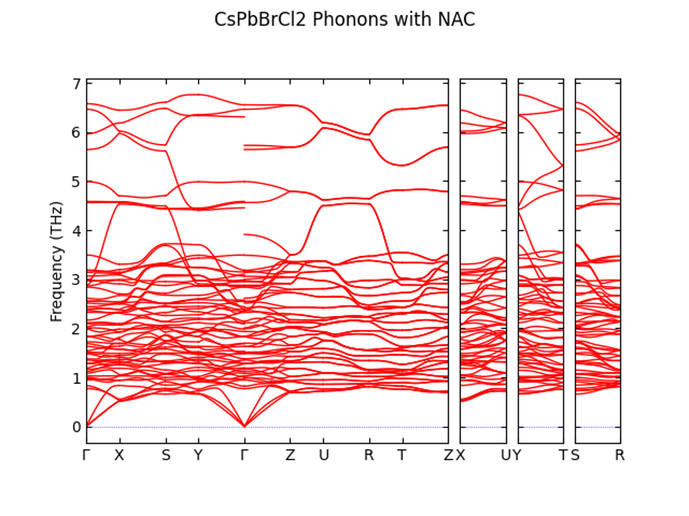
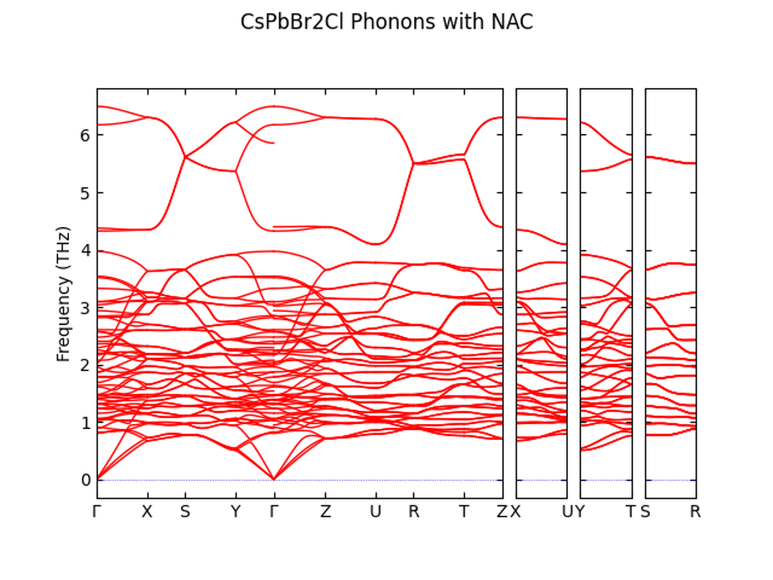
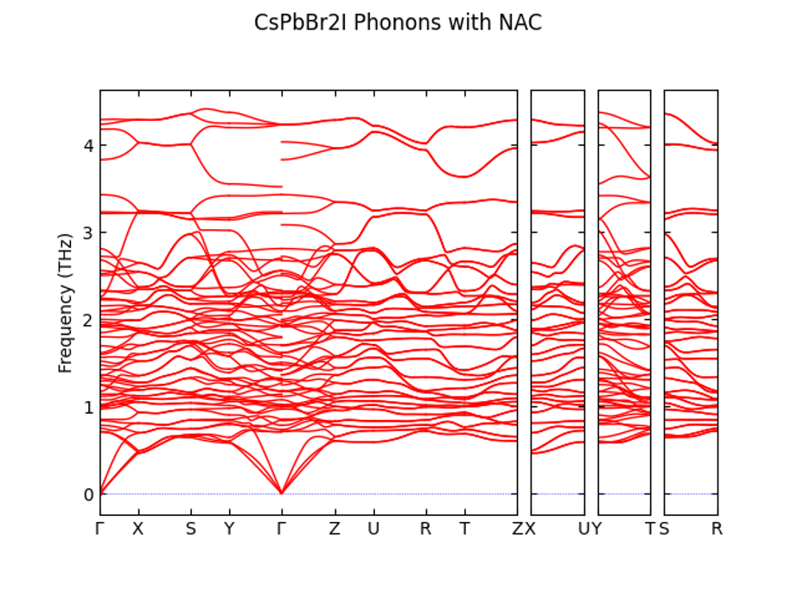
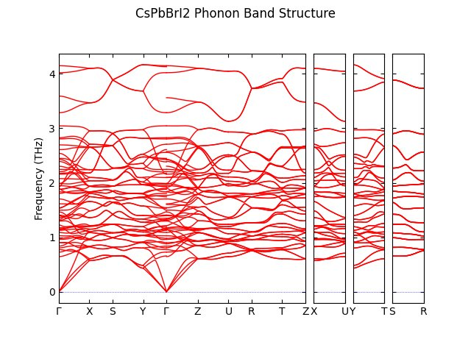
Results: Phonons
CsPbCl₃
CsPbBr₃
CsPbI₃
CsPbBrCl₂
CsPbBr₂Cl
CsPbBr₂I
CsPbBrI₂

Slide 20
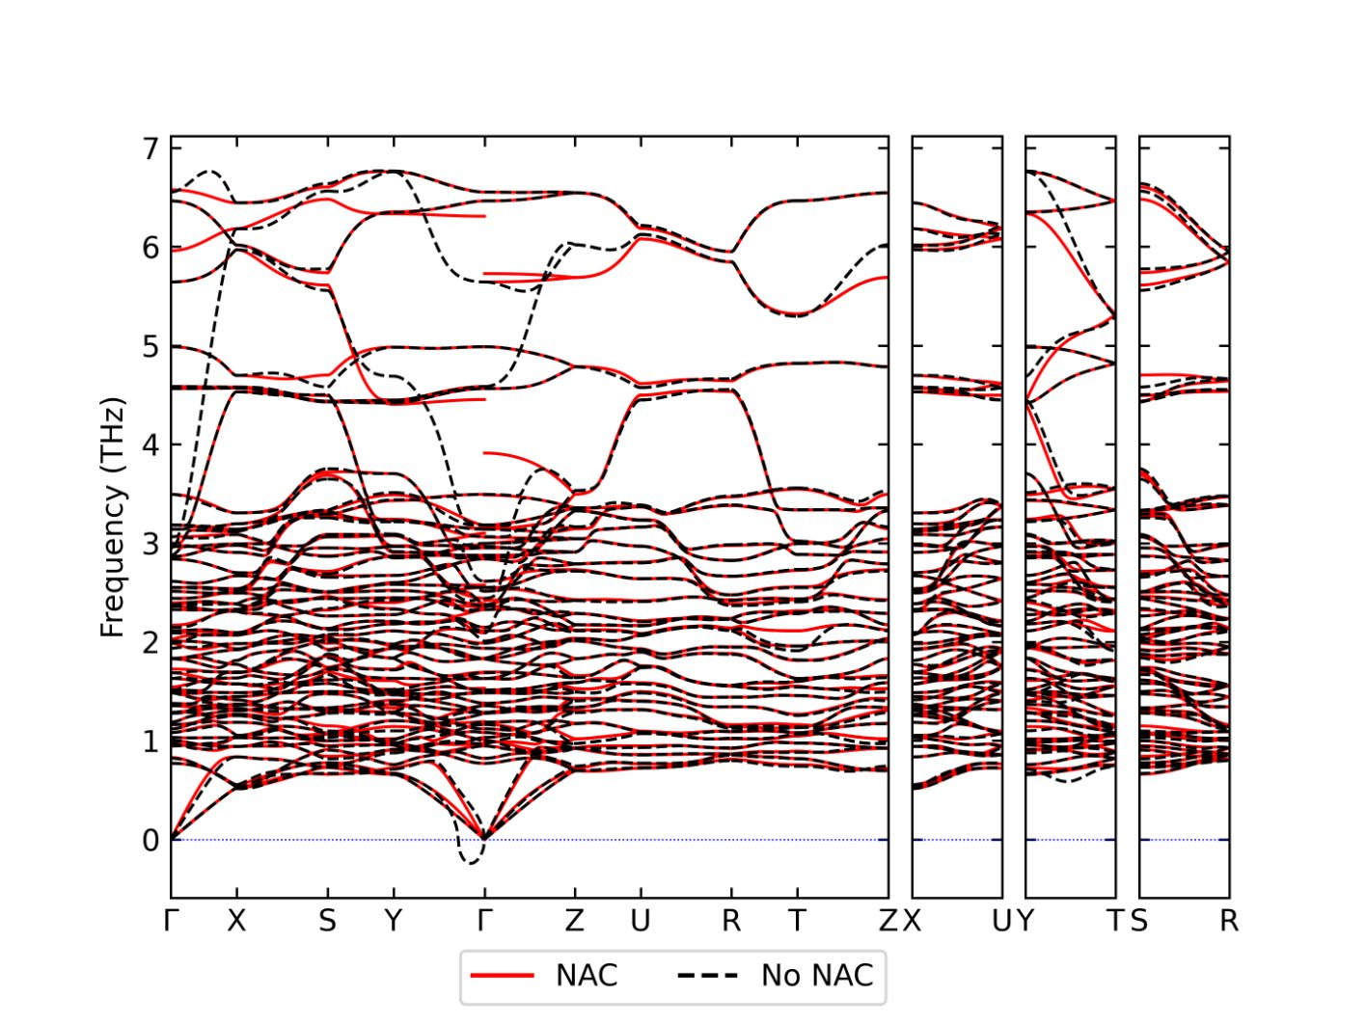
Results: Nonanalytical Corrections
CsPbBrCl₂
Nonanalytical corrections (NACs) take into account Born Effective Charges (BECs) and the dielectric tensor
Imaginary mode near gamma removed with NACs
  This imaginary mode is unphysical, and NACs eliminate a calculation artifact

Slide 21
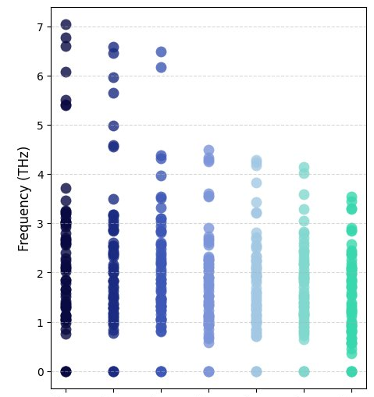
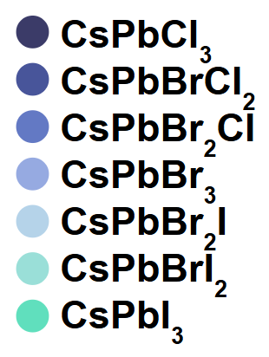
Results: Frequencies at Gamma
Gamma Point Frequencies
Acoustic modes at gamma have 0 THz frequency
Highest optical mode frequencies decrease as the halide mixture gets heavier
For pure halide compositions, the lowest optical modes decrease in frequency with an increase in mass

Slide 22
Conclusions and Future Work
Conclusions
For CsPbX₂Y, X the heavier halide, the structure with Pnma symmetry was significantly lower energy.
For X light, there were many structures of equivalent symmetry near the lowest energy, and the axial structure (Pnma or Imma) was considerably higher energy.
The lighter the halides present in the perovskite, the higher the phonon mode frequencies at the gamma point.
Nonanalytical force corrections completely removed any imaginary modes at gamma due to large born effective charges.
Future Work
Analyze symmetry of phonon modes at gamma
Repeat procedure using fully relativistic DFT methods (Quasi 4-component)
Extract electron-phonon coupling constants to explain quantum coherence phenomena in these materials

Slide 23
References
Alhashmi, Afnan, Mohammed Benali Kanoun, and Souraya Goumri-Said. 2023. Materials 16 (7): 2657.
“Background - FHI-Vibes.” n.d. Accessed July 22, 2026.
Biliroglu, Melike, Mustafa Türe, Antonia Ghita, et al. 2025. Nature 642 (8066): 71–77.
Blum, Volker, Ralf Gehrke, Felix Hanke, et al. 2009. Computer Physics Communications 180 (11): 2175–96.
Deng, Jianping, Jinglei Li, Zhi Yang, and Minqiang Wang. 2019. Journal of Materials Chemistry C 7 (40): 12415–40.
Flowers, Paul, William R. Robinson, Richard Langley, and Klaus Theopold. 2015. Chemistry LibreTexts, March 11.
Havu, V., V. Blum, P. Havu, and M. Scheffler. 2009. Journal of Computational Physics 228 (22): 8367–79.
Huang, Kai, Kory Kevin Green, Ling Huang, Hans Hallen, Gang Han, and Shuang Fang Lim. 2022. Nature Photonics 16 (10): 737–42.
Kim, Young-Hoon, Ruyi Song, Ji Hao, et al. 2022. Advanced Functional Materials 32 (25): 2200454.
Linaburg, Matthew R., Eric T. McClure, Jackson D. Majher, and Patrick M. Woodward. 2017. Chemistry of Materials 29 (8): 3507–14.
Russ, Brendan, and Carissa N. Eisler. 2024. Nanophotonics 13 (11): 1943–51.
Tkatchenko, Alexandre, and Matthias Scheffler. 2009. Physical Review Letters 102 (7).
Togo, Atsushi. 2023. Journal of the Physical Society of Japan 92 (1): 012001.
Togo, Atsushi, Laurent Chaput, Terumasa Tadano, and Isao Tanaka. 2023. Journal of Physics: Condensed Matter 35 (35): 353001.
Togo, Atsushi, and Isao Tanaka. 2015. Scripta Materialia 108 (November): 1–5.
Yu, Victor Wen-zhe, Fabiano Corsetti, Alberto García, et al. 2018. Computer Physics Communications 222 (January): 267–85.

Slide 24
Thank You!
Please contact me if you have any other questions!
Email: ijp2113@columbia.edu
Thank you to Gabriel J. Graf, Aaron M. Schankler, Yosuke Kanai, and Volker Blum for mentoring me. Thank you to the organizers of the RTNN REU, particularly David Mitzi and Phillip Strader.
This research used resources of the National Energy Research Scientific Computing Center (NERSC), a U.S. Department of Energy (DOE) Office of Science User Facility operated under Contract no. DEAC02-05CH11231. A portion of this research was performed using computational resources sponsored by the U.S. Department of Energy's Office of Critical Minerals and Energy Innovation and located at the National Laboratory of the Rockies. This material is based upon work which is supported by the National Science Foundation (award numbers 2447827, 2447828 & 2447829 and ECCS-2025064). Any opinions, findings, and conclusions or recommendations expressed in this material are those of the author(s) and do not necessarily reflect the views of the National Science Foundation. Contributions by GG, AMS, VB, YK were supported by the National Science Foundation under Award Numbers 2323803 and 2323804.

Slide 25
Questions?

Slide 26
Supplementary Slides

Slide 27
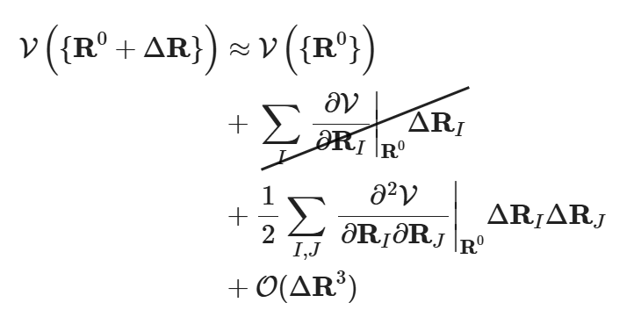
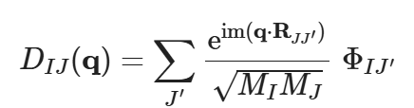
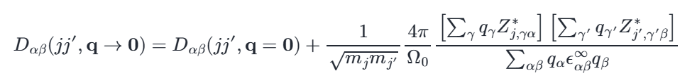


Equations
Taylor Expansion of Potential Energy Well:
Fourier Transform into Reciprocal Space
Dynamical Matrix
Forces ≈ 0
Force Constants
Evaluated at each q-point
Adjusting for mass of atoms I and J
Φ_{IJ} (Hessian)
Force Constants
3N x 3N matrix
Nonanalytical Corrections (for q → 0):
Solve the eigenvalue problem:
New
Dynamical Matrix
in
different notation
Eigenvector
Eigenvalue (frequency)
NACs
Equations from FHI-vibes background

Slide 28
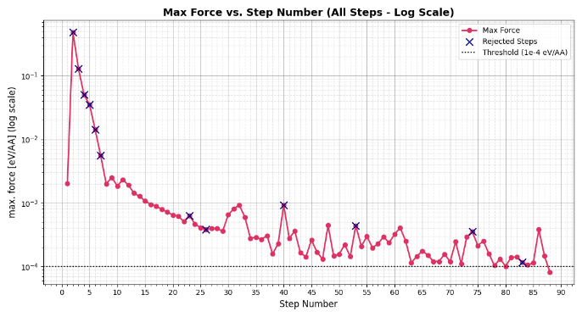
Max Force Across Relaxation Steps for CsPbBr₃

Slide 29
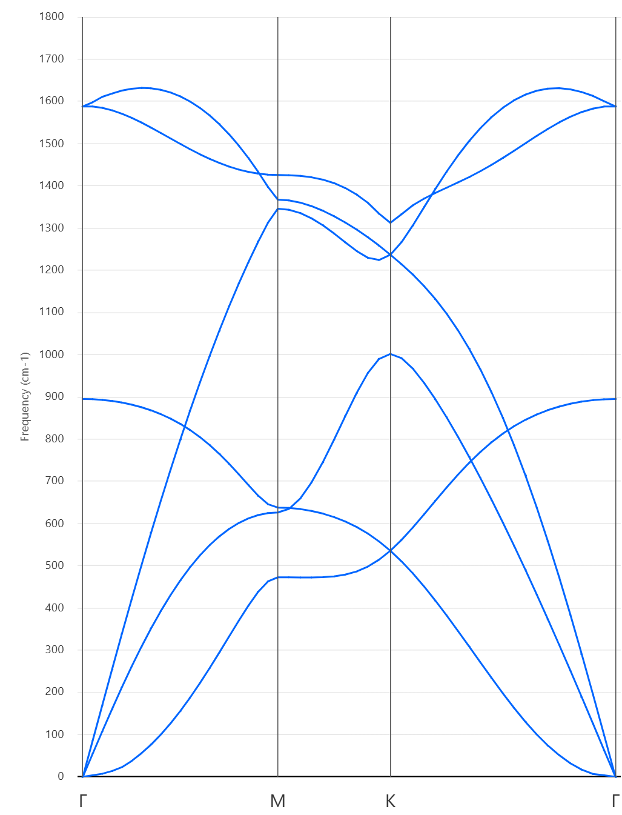
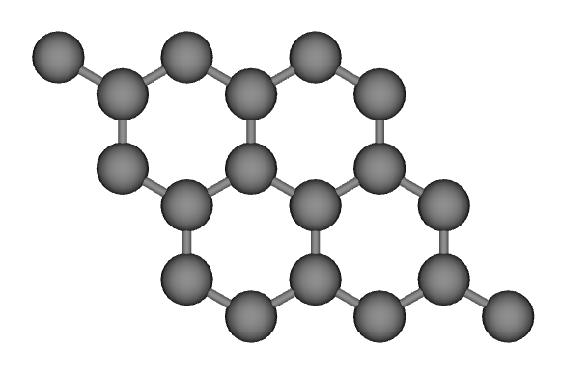
Phonon Visualization: Gamma Point
Visualized with the Phonon Website

Slide 30
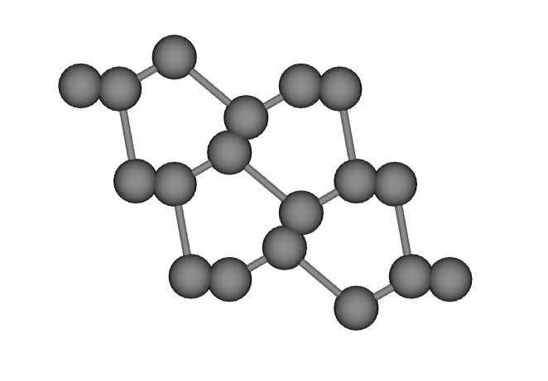
Phonon Visualization: Optical Mode
Visualized with the Phonon Website

Slide 31
Results: Symmetry of Lowest Energy Arrangements
Composition | Space Group | Point Group
CsPbCl₃ | Pnma (62) | mmm
CsPbBrCl₂ | Pmn2_1 (31) | mm2
CsPbBr₂Cl | Pnma (62) | mmm
CsPbBr₃ | Pnma (62) | mmm
CsPbBr₂I | Pmc2_1 (26) | mm2
CsPbBrI₂ | Pnma (62) | mmm
CsPbI₃ | Pnma (62) | mmm
(a)
(b)

Slide 32
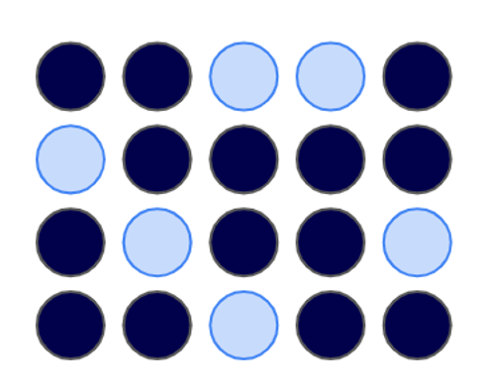
Methods: Determining Alloy Structures
Code Details
Lattice parameters were taken from experiments at 298K, 1atm.
FHI-aims code was used for Density Functional Theory (DFT) calculations.
The unit cell was fully relaxed until the max force was under 5x10⁻³eV/Å, then further relaxed to 1x10⁻⁴eV/Å.
A Van der Waals correction was used.
Phonopy was used for phonon calculations.
Replace 1/3 of the original halide with the substitute and determine each unique arrangement.
Traverse the potential energy landscape to find the lowest energy molecular arrangement for each one.
Determine the overall lowest energy arrangement and fully relax the structure

Slide 33
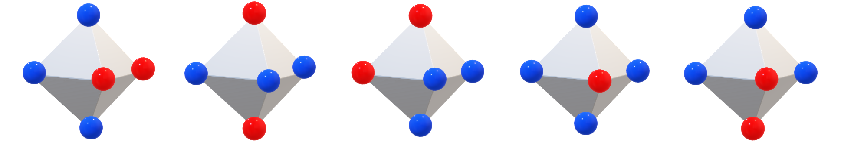
Methods: Overview
Experimental
Structure
Experimental
Structure
Experimental
Structure
Replace halide by 1/3
Replace halide by 1/3
CsPbCl₃
CsPbBrCl₂
CsPbBr₂Cl
CsPbBr₃
CsPbBr₂I
CsPbBrI₂
CsPbI₃
Fully Relax
Fully Relax
Fully Relax
CsPbCl₃
CsPbBr₃
CsPbI₃

