Slide 1
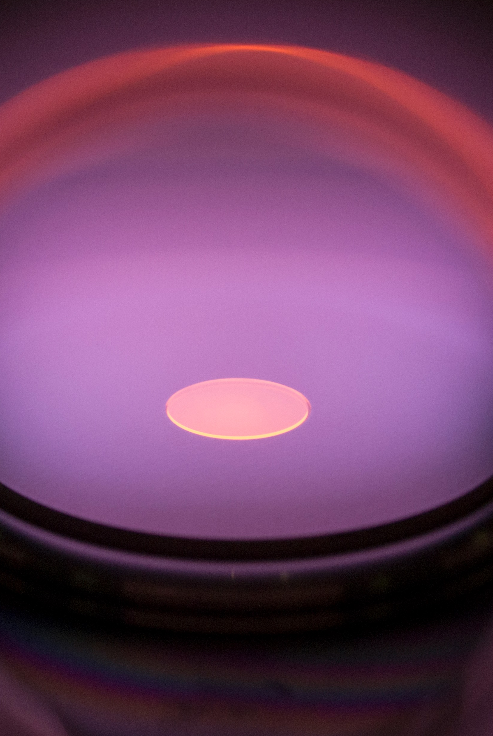
Raman Spectroscopy to Characterize Diamond
Quantum Sensors
Jessen Carriveau
Mentor: Professor Robert Nemanich
Photo by Franz Koeck

Slide 2
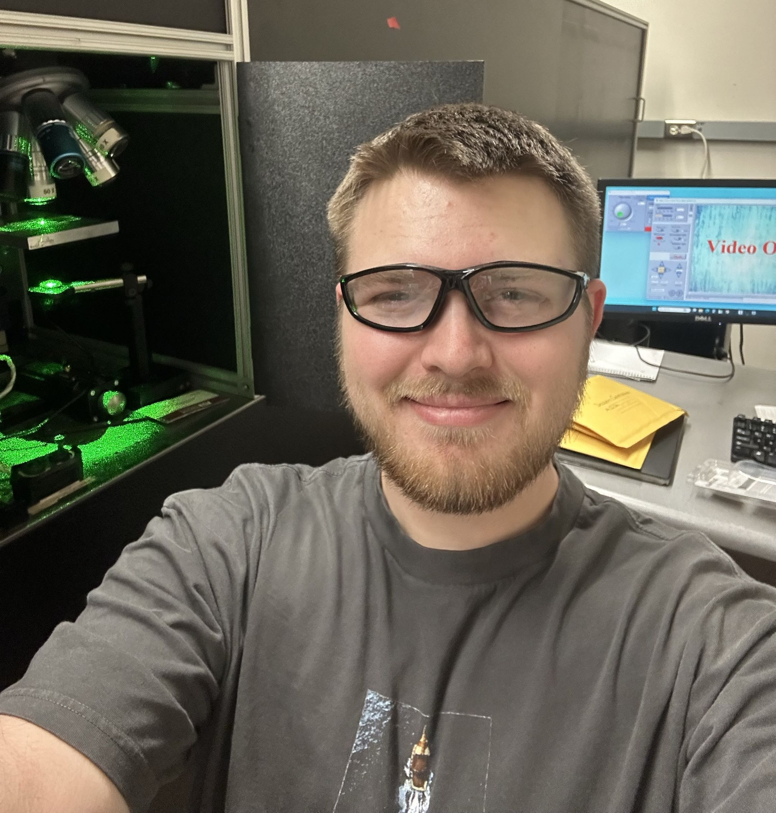
About Me
Jessen A. Carriveau
Phoenix, Arizona
ASU Physics Undergraduate
Honors Thesis and REU project with Prof. Robert Nemanich

Slide 3
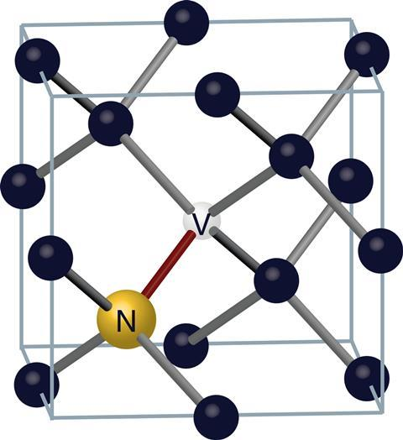
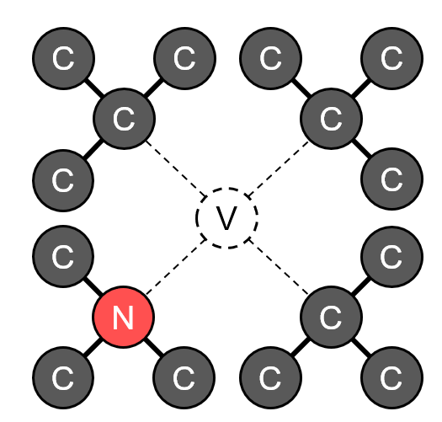
Nitrogen Vacancy Center (NVC)
What are they?
Carbon lattice defect with nitrogen substitution and adjacent vacancy
Physical Characteristics:
Spin-1 color center
Measured with visible light (ODMR)
Magnetic resonance spectrum at room temperature
3D View
2D View
¹ T. Wogan, and P. Allen, “Putting a New Spin on Things,” Chemistry World, (2017).

Slide 4
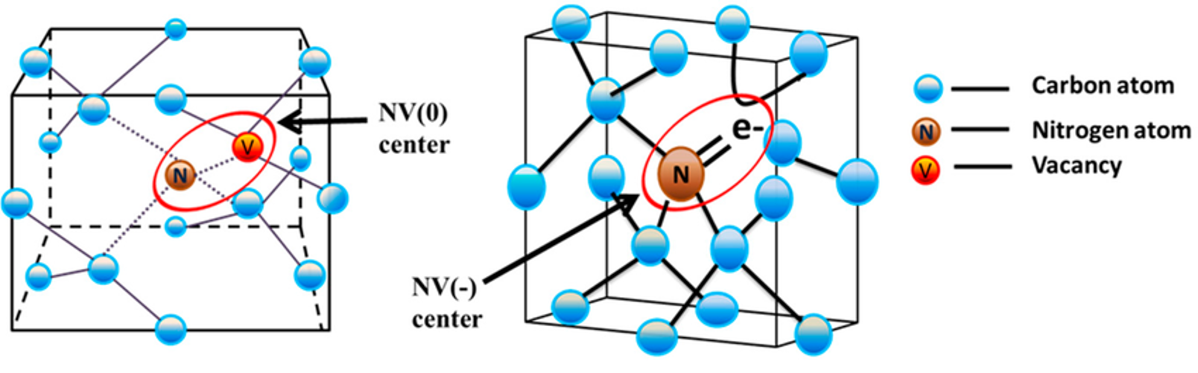
NV⁰ vs NV⁻
⁷ A. Haque, and S. Sumaiya, “An Overview on the Formation and Processing of Nitrogen-Vacancy Photonic Centers in Diamond by Ion Implantation,” Journal of Manufacturing and Materials Processing (JMMP) 1(1), 6 (2017).
NV⁰ – “neutral” charge state, N atom has 5 valence electrons
NV⁻ – “negative” charge state, extra electron in vacancy forms spin-1 pair with a valence electron. Ideal for our applications.

Slide 5
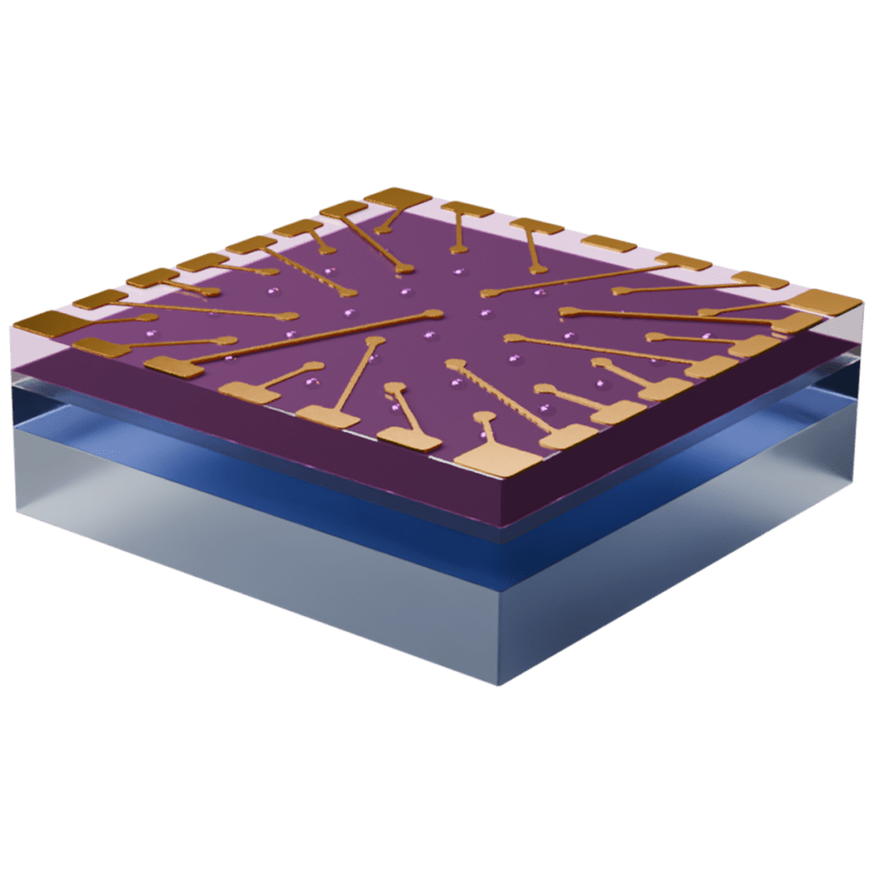

NVC Applications
Quantum Computing “Qubits”
Quantum alternative to the classical “bit"
Quantum Sensors
Robust temperature, electric field, and magnetic field sensors at nanoscale
² Quantum Brilliance, “Applications,” Quantum Brilliance, (2026)

Slide 6
Why Diamond?
High Thermal Conductivity
~10x better than silicon ⁴
Ultrawide-Bandgap
Conduction/Valence bands do not interfere with NVC electronic state ⁵
Electrical Properties
High electron mobility (4500 cm²/V*s) and breakdown field (10 MV/cm) ⁶

Slide 7
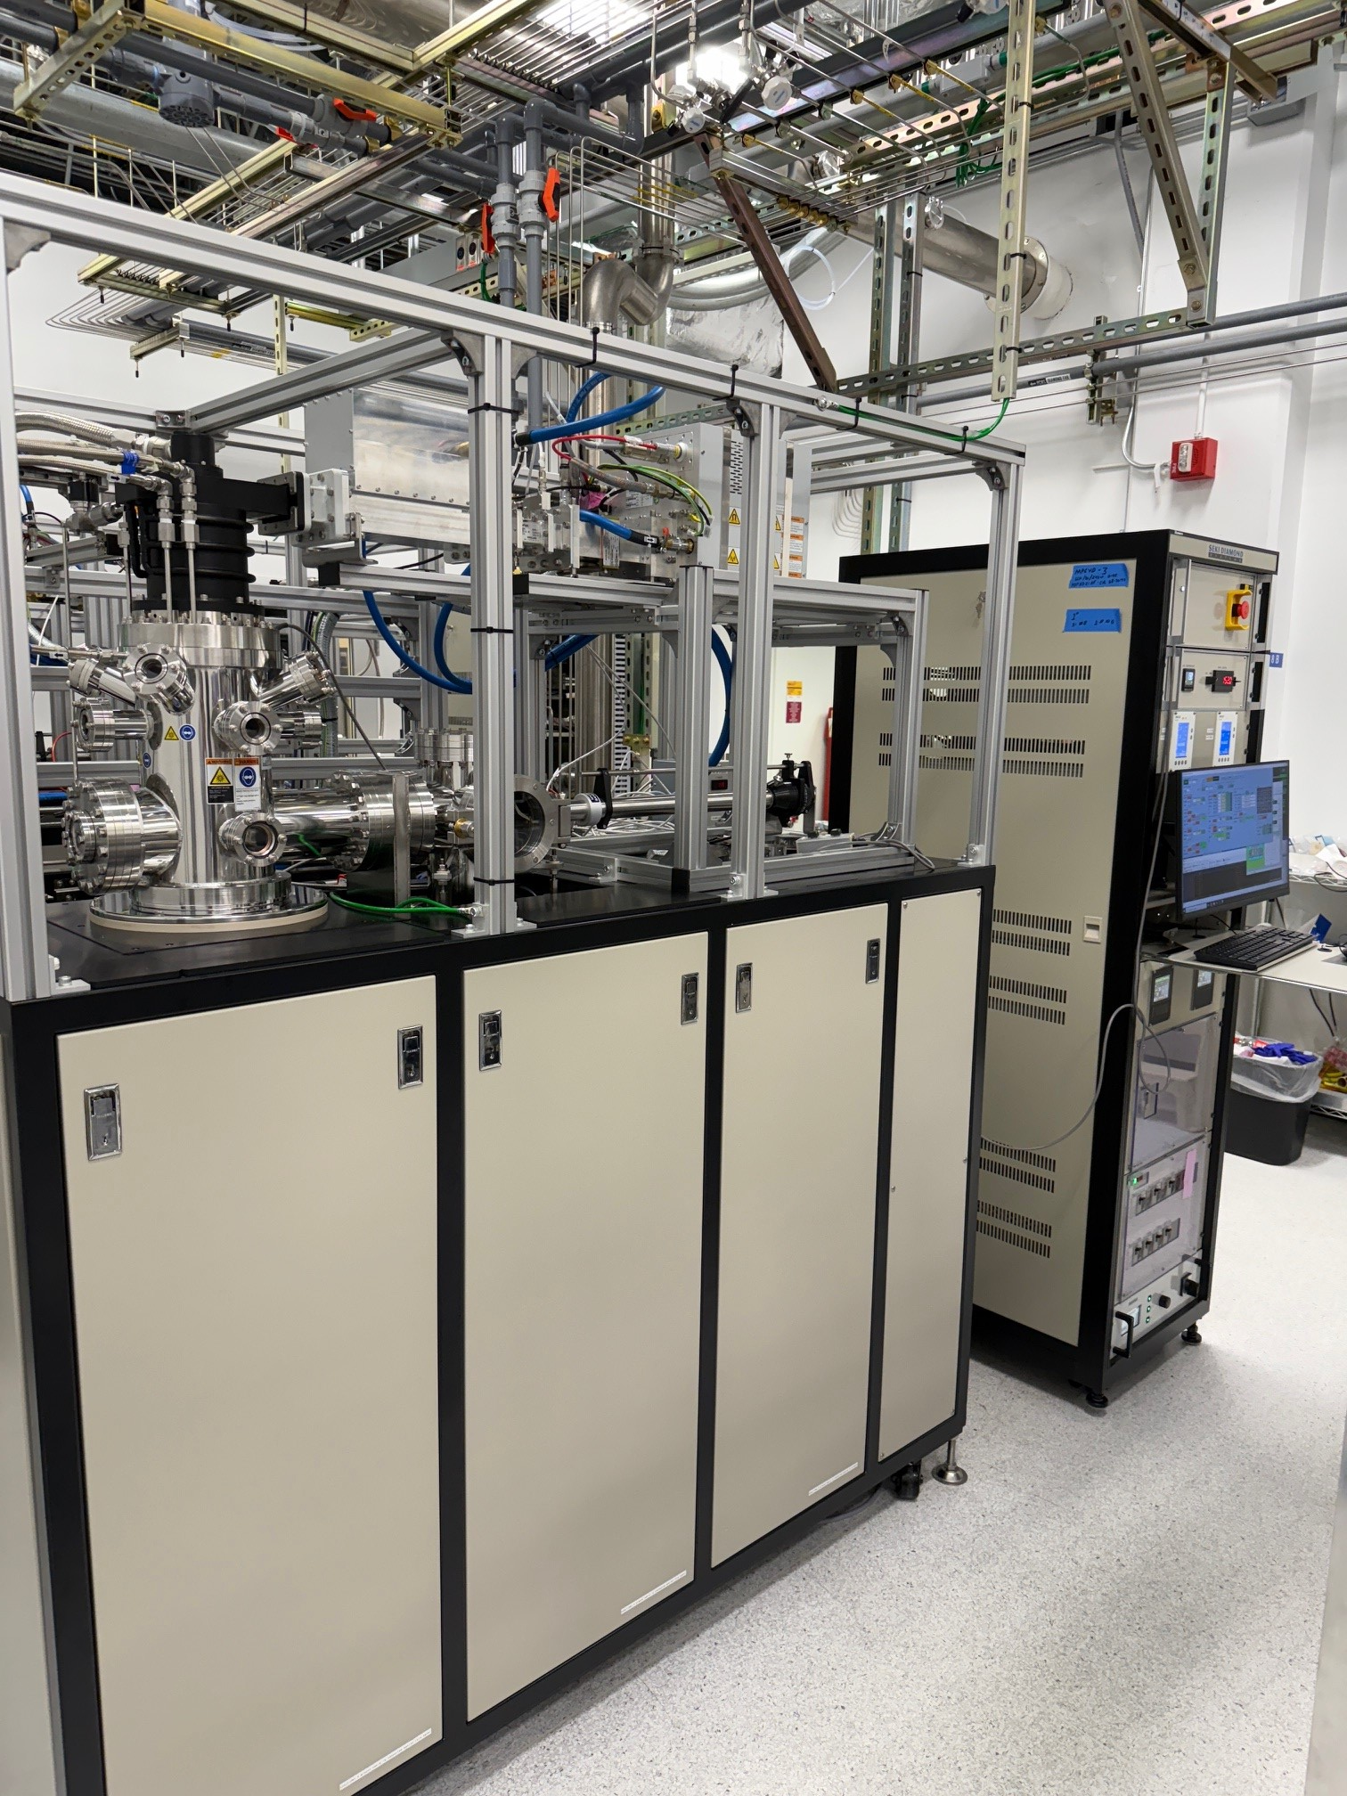
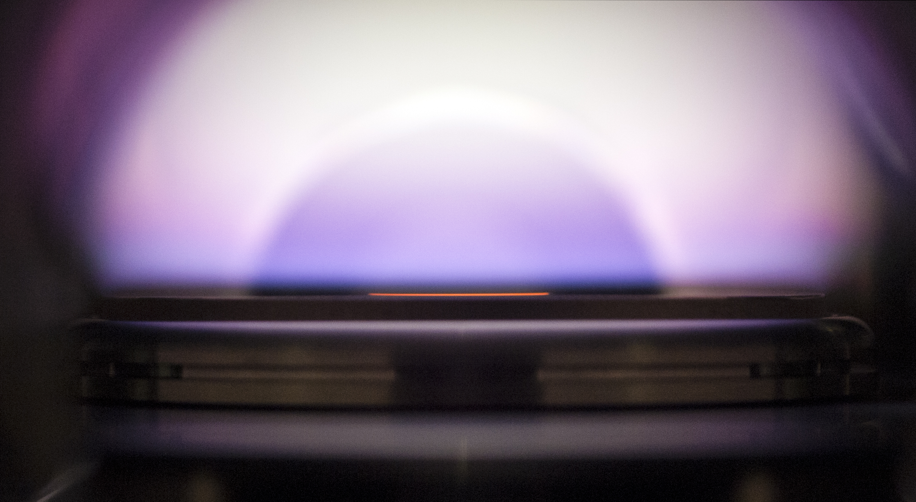
The Problem
Plasma-Enhanced Chemical Vapor Deposition (PECVD) machine
How do we maximize the number of NVCs in our diamond?
NVC density variables:
Diamond growth method
Location on diamond
Depth in diamond
Photos by Franz Koeck
Diamond wafer growing in PECVD machine

Slide 8
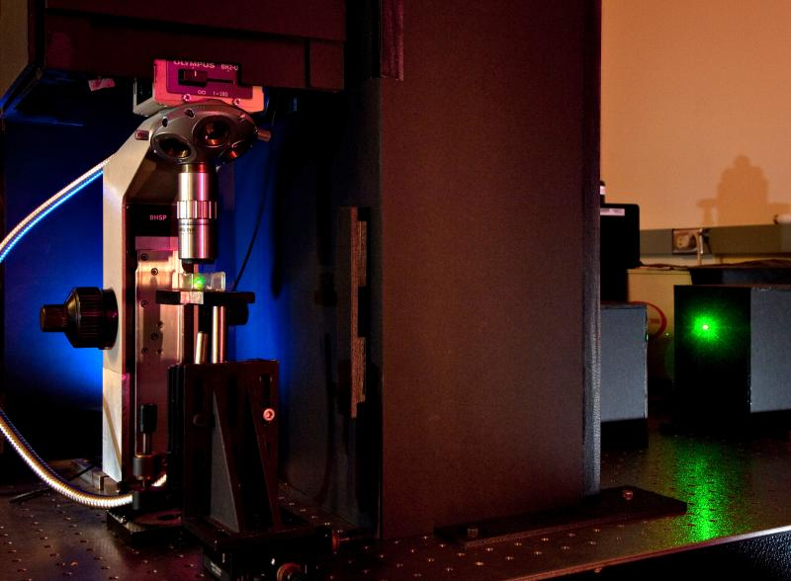
Raman Spectroscopy
Identifies chemical structure by detecting changes in photon energy due to molecular vibrations
Micro-Raman Grating Spectrometer
Microscope + Raman spectrometer
Variable gratings
Multiple laser wavelength settings
Nondestructive towards sample
Can gather photoluminescence (PL) spectra as well
³ Eyring Materials Center, “Raman Spectrometer (Custom Built Multi-Wavelengths),” Asu.edu, (2025).

Slide 9
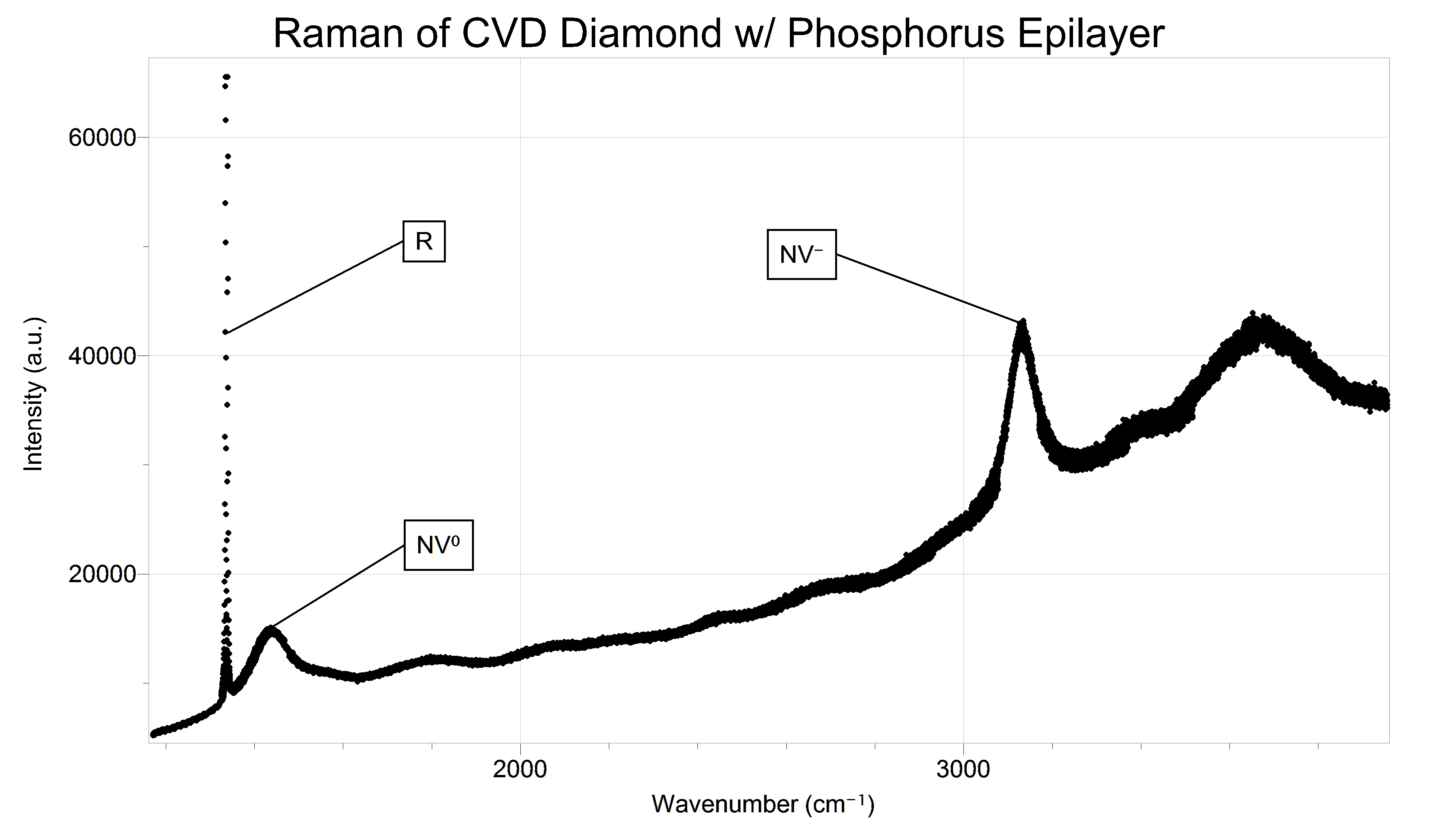
High Resolution Raman Spectrum

Slide 10
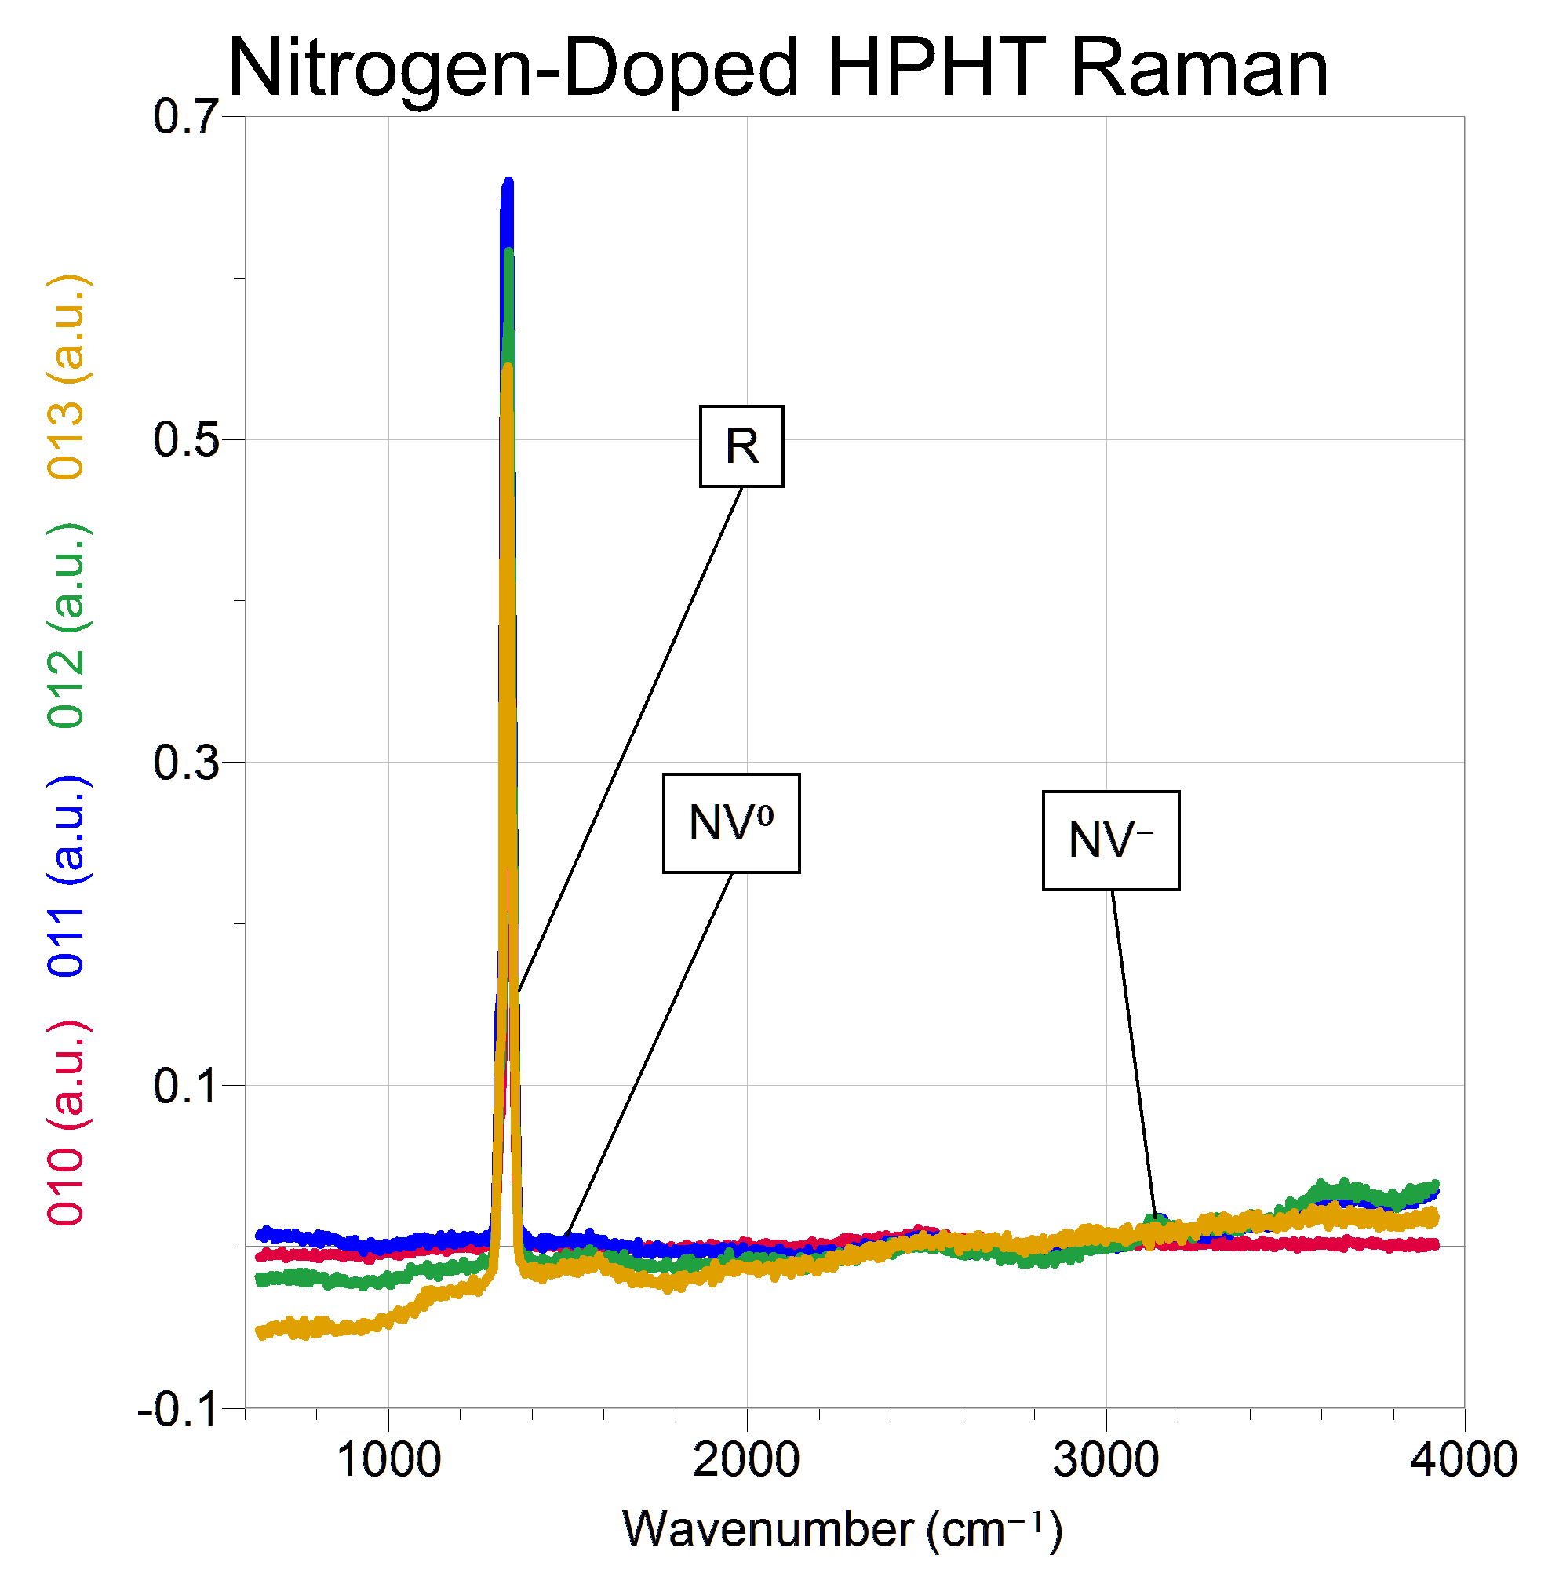
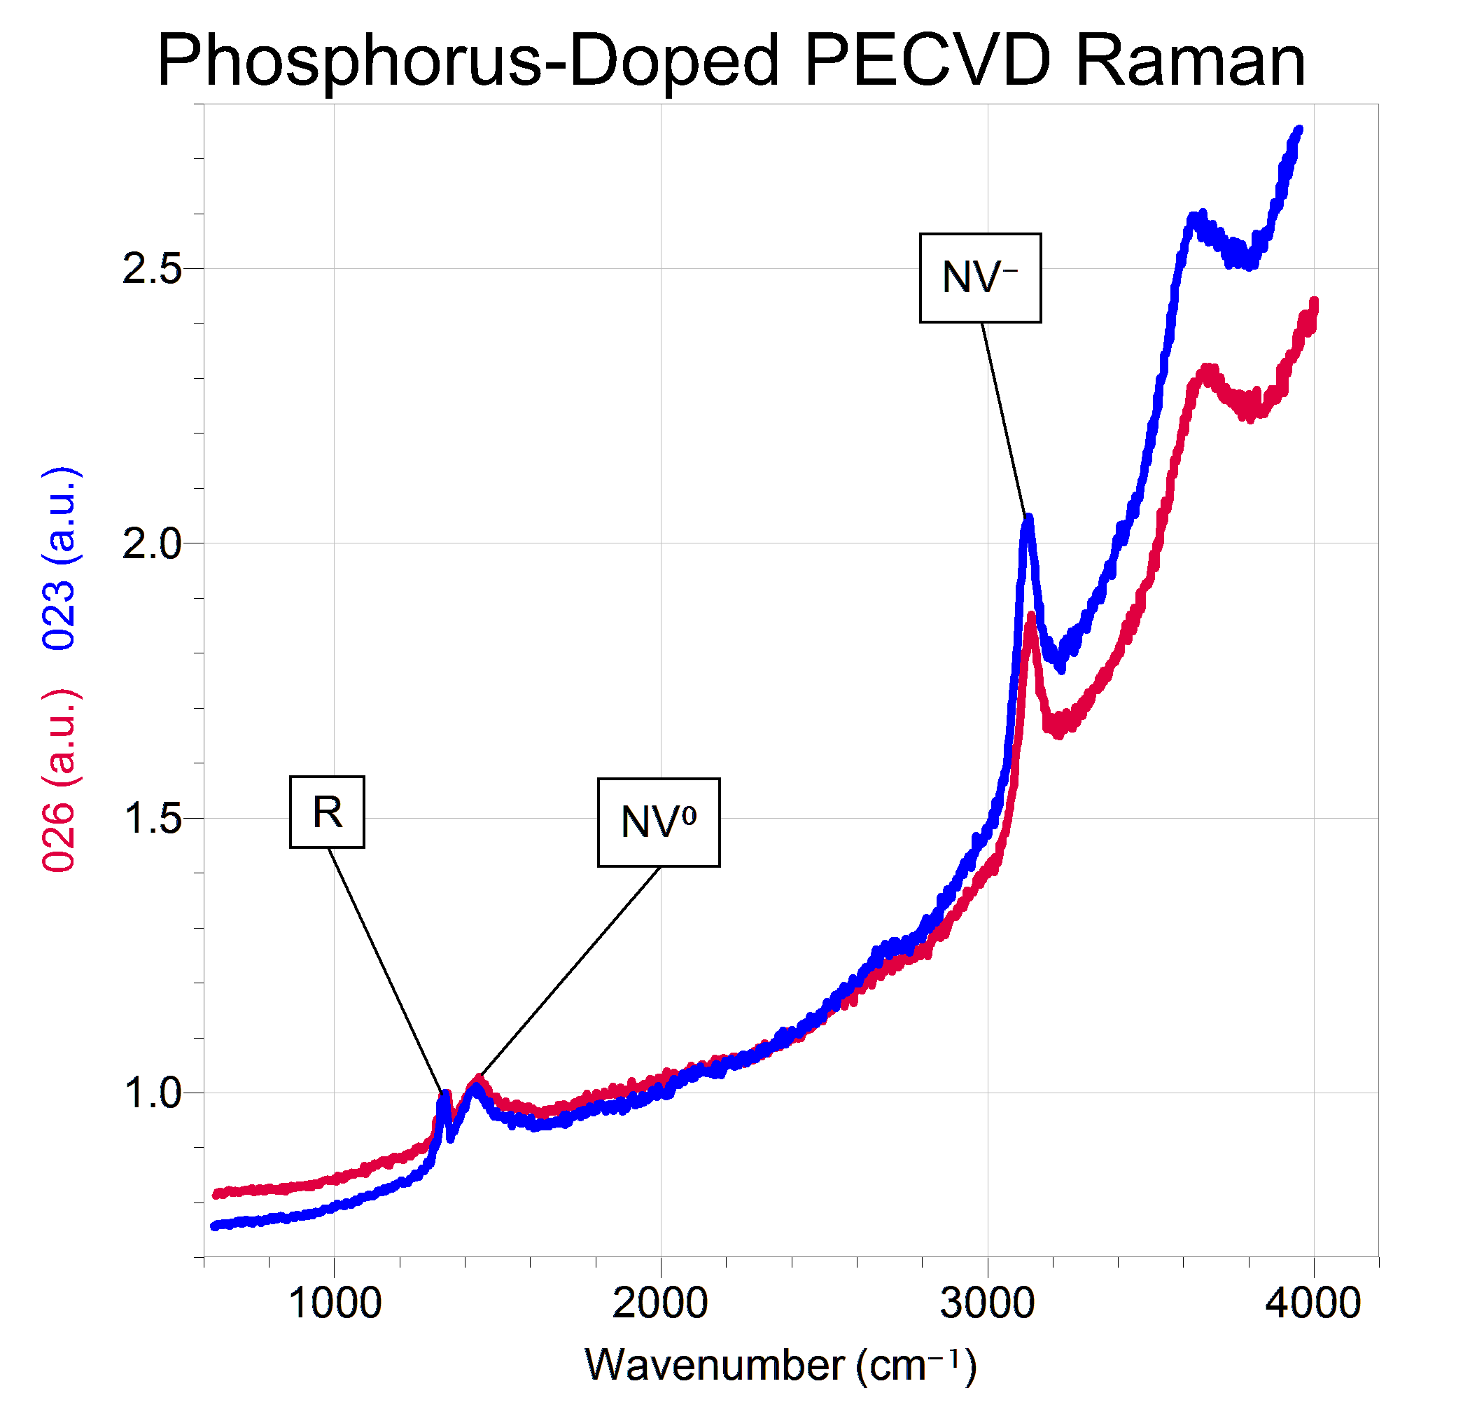
Nitrogen-Doped High-Pressure, High Temperature (HPHT) vs Phosphorus-Doped PECVD

Slide 11
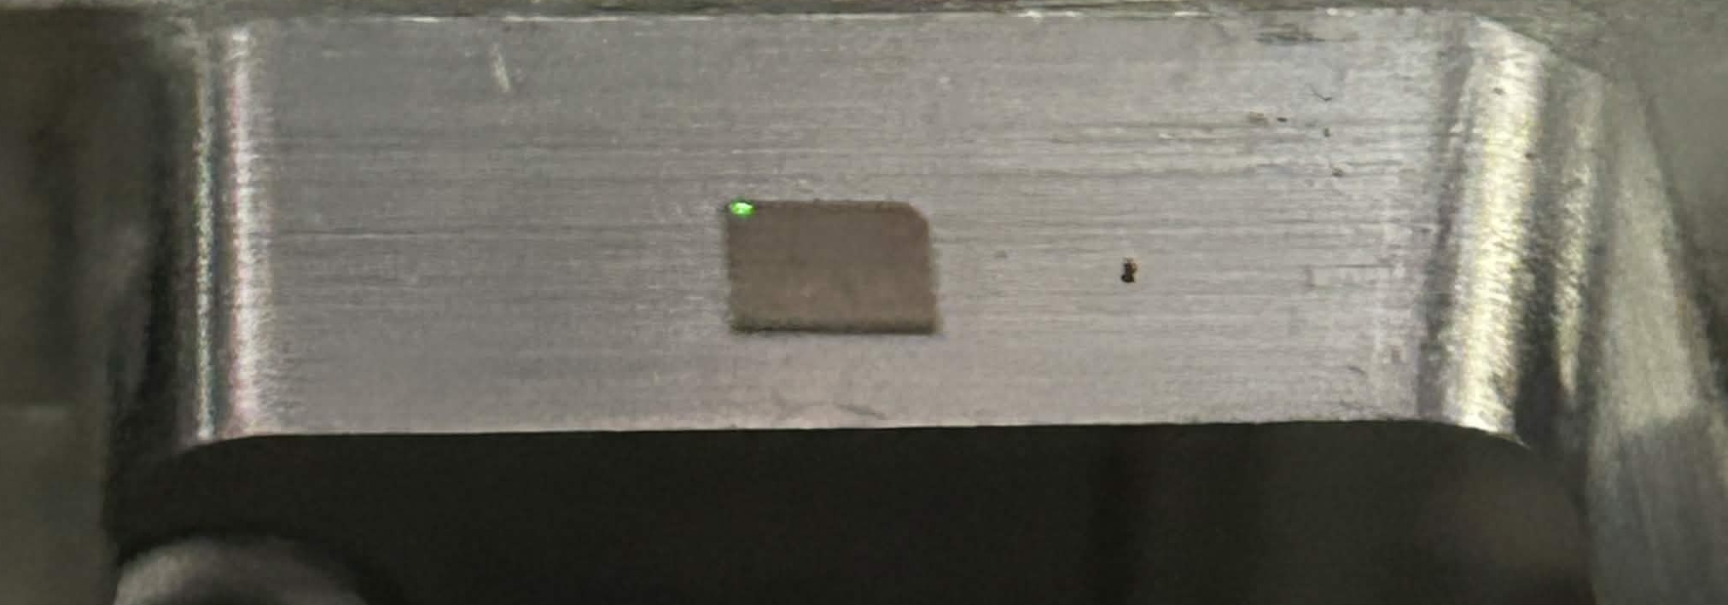
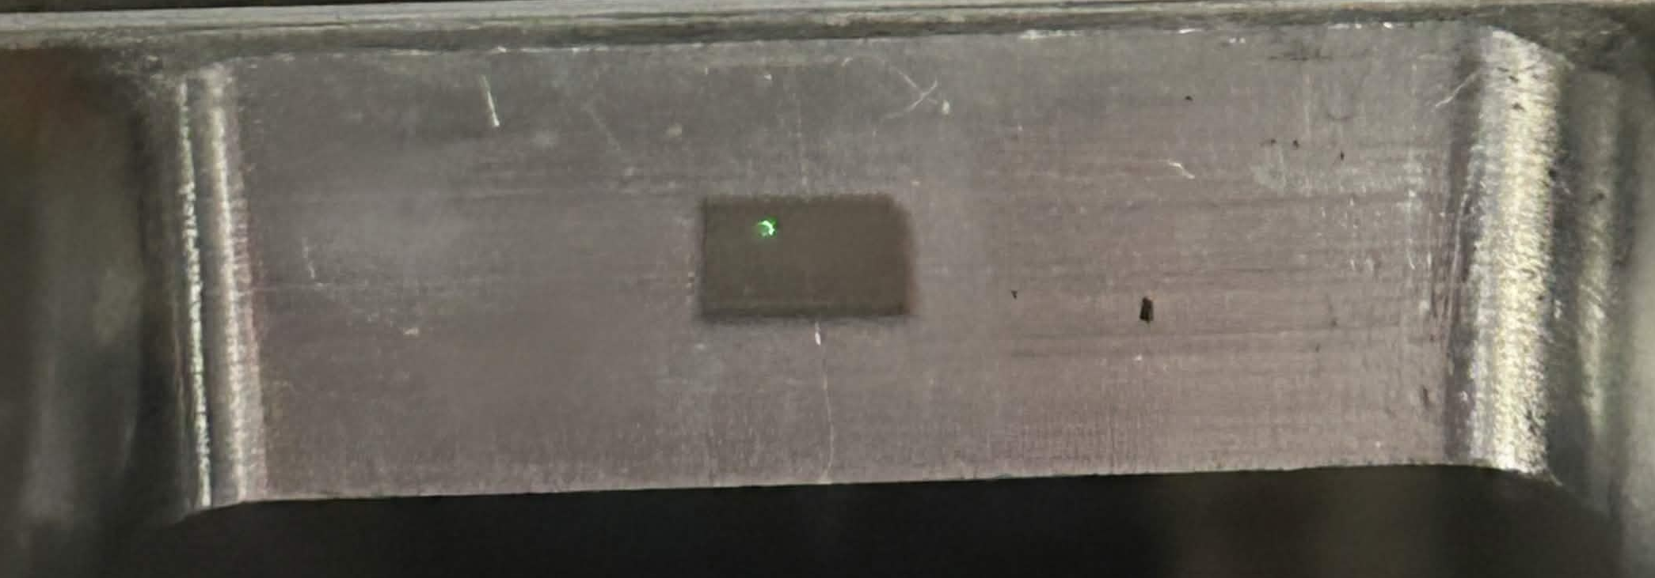
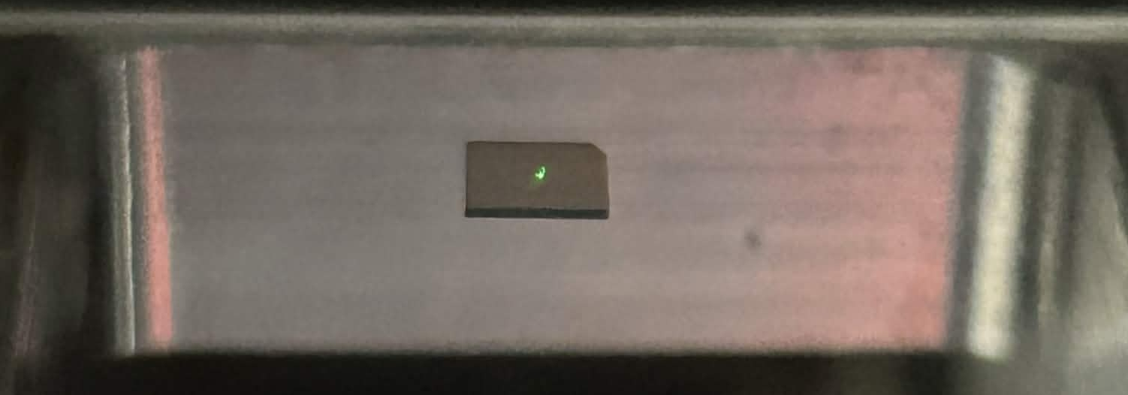
“Spots” on Sample
1
2
3
4 mm
4 mm

Slide 12
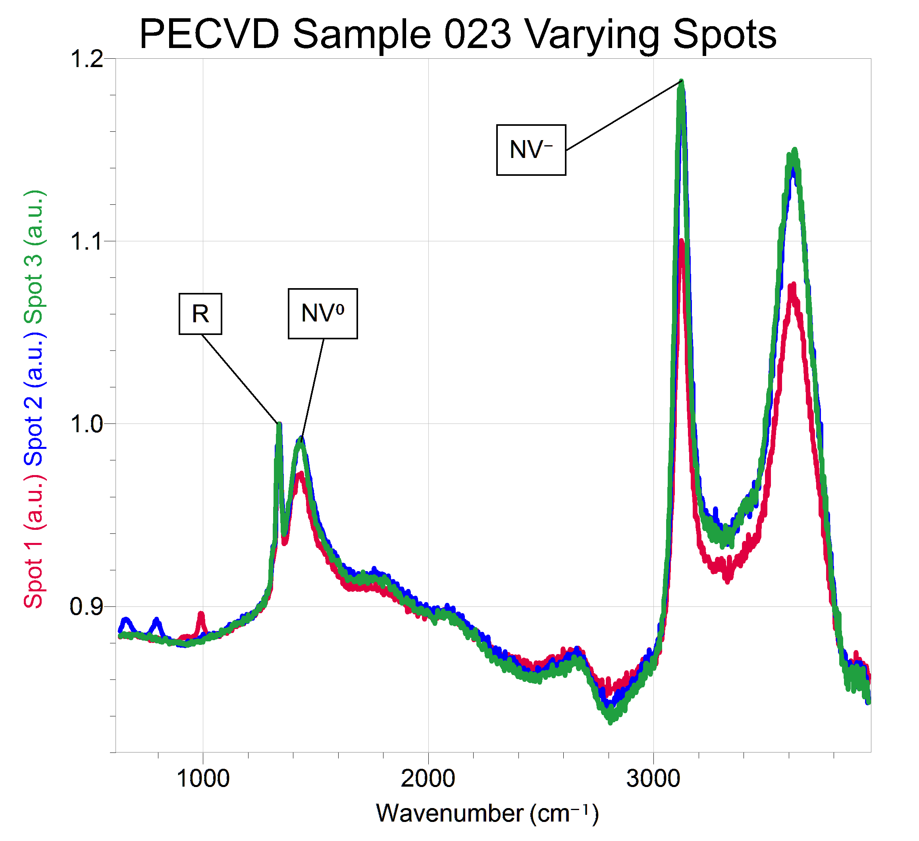
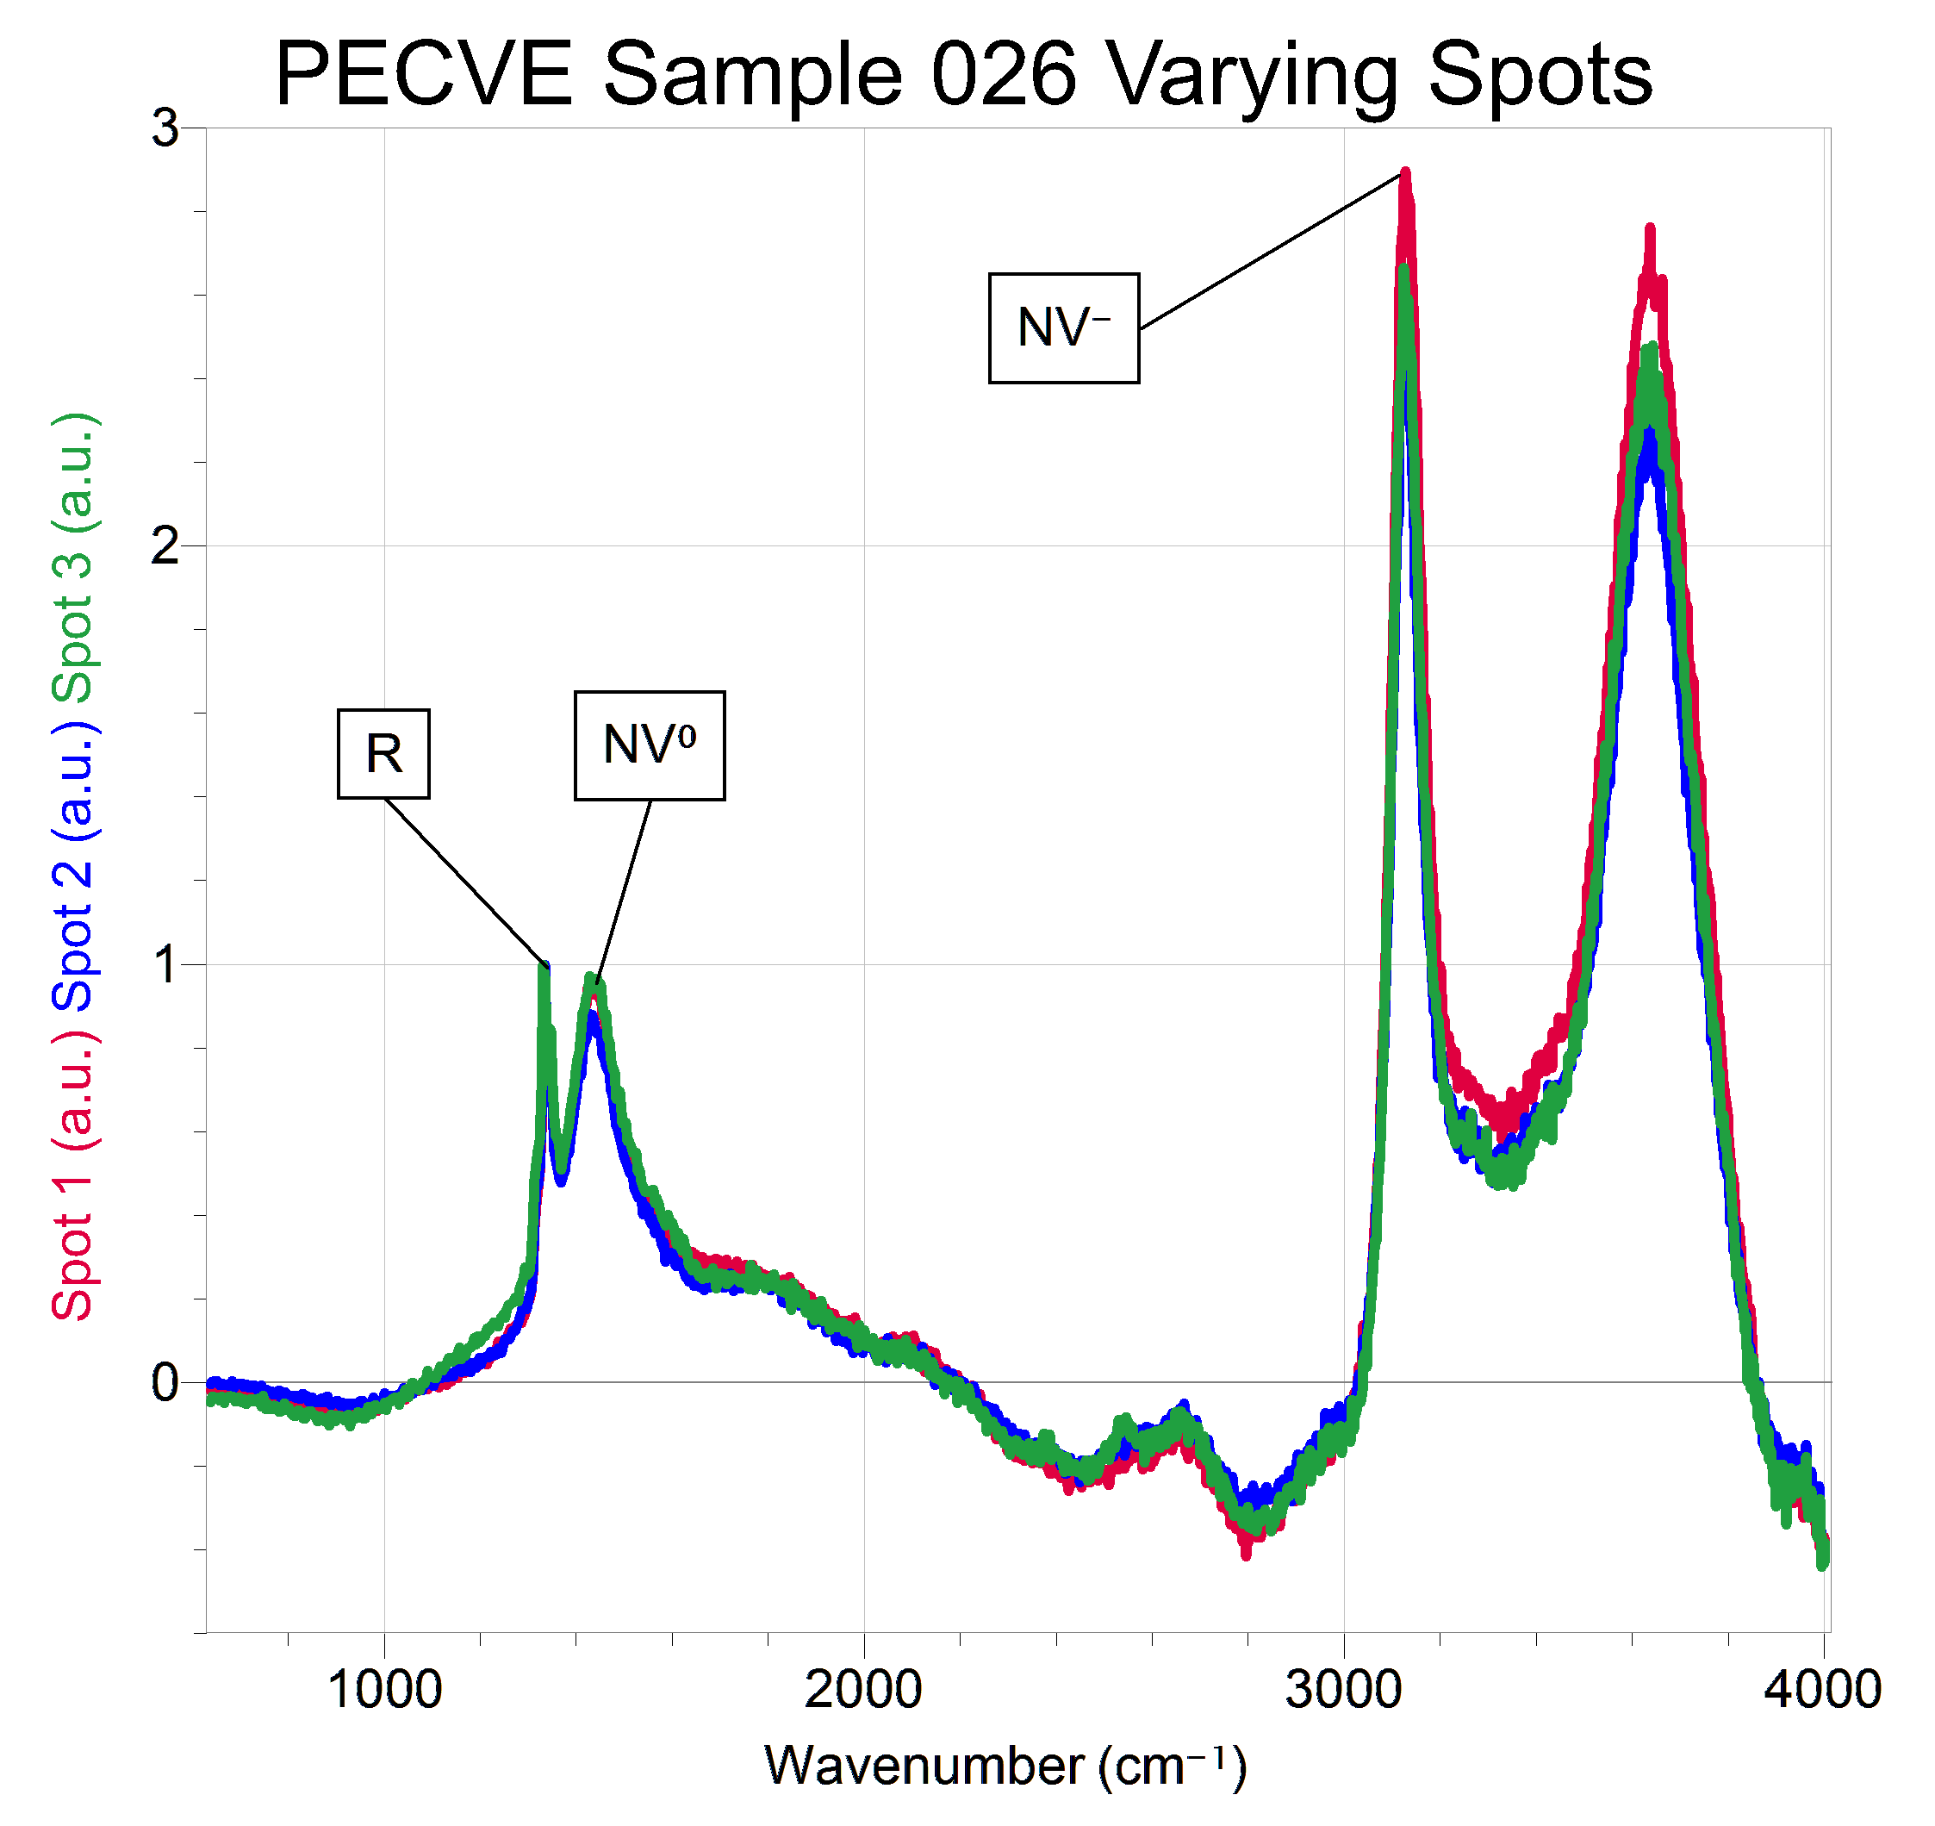
NVC Density at Varying Spots

Slide 13
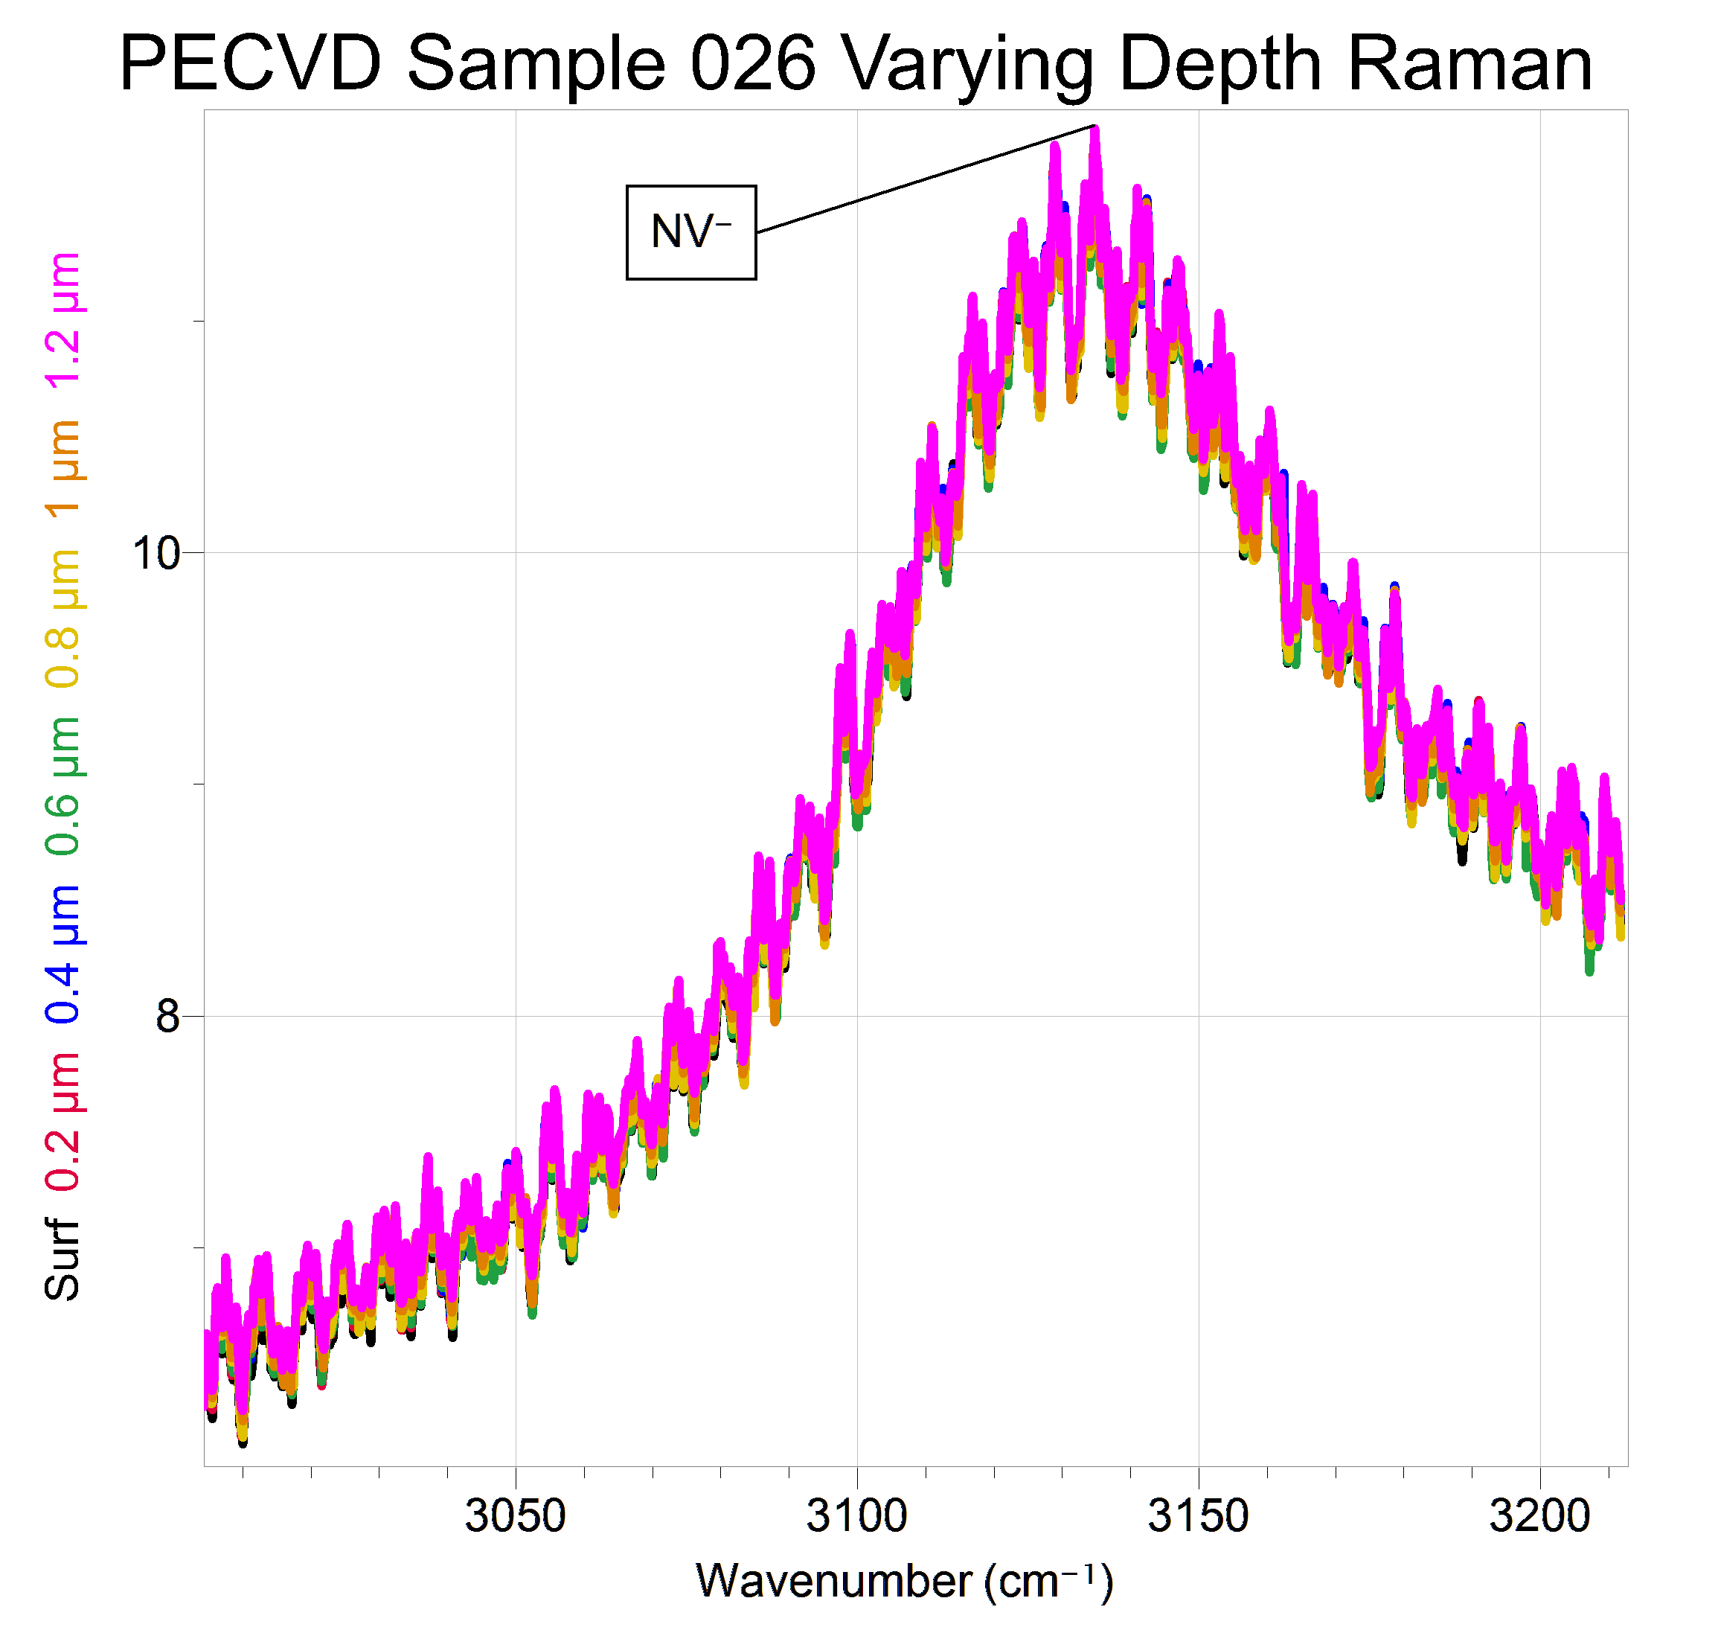
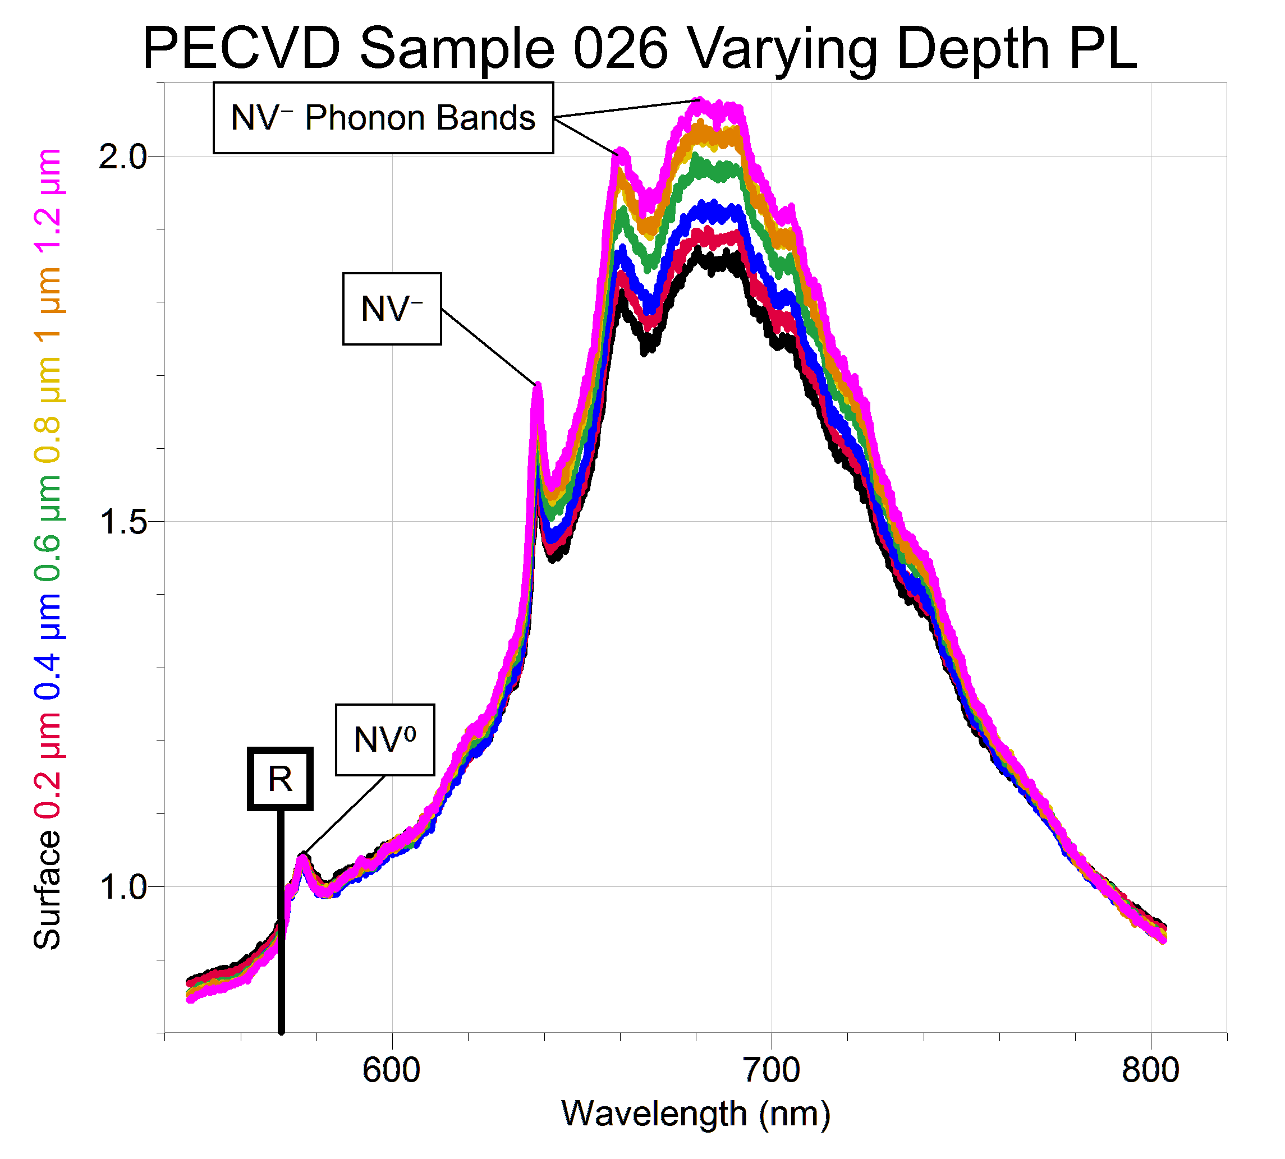
NVC Density at Varying Depths

Slide 14
Conclusions
Growth Method
Phosphorus-doped PECVD gives stronger NV⁻ peaks than nitrogen-doped HPHT
Location on Sample
NVC density appears to vary at different spots on sample, but the distribution depends on the sample
Depth in Sample
PL spectra show increasing NVC density with depth when Raman does not, so the data is inconclusive

Slide 15
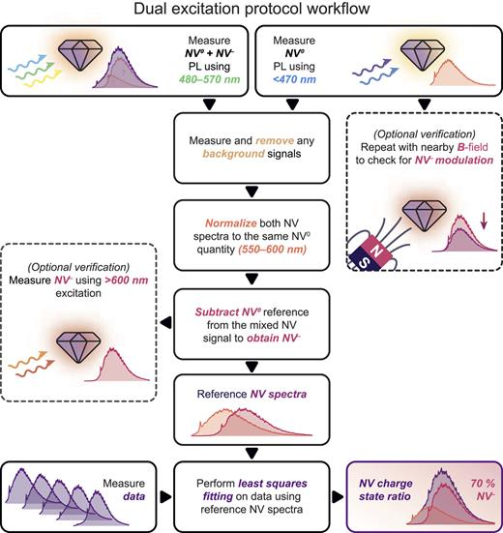
Future Work
We want to investigate the ratio of NV⁰ and NV⁻ using just the micro-Raman grating spectrometer.
We are waiting on a blue (~450 nm) laser to do this.
⁸ G., D.J. McCloskey, A. Mameli, A.J. Healey, C. PattinsoThalassinosn, D. Simpson, B.C. Gibson, A. Stacey, N. Dontschuk, and P. Reineck, “Robust Quantification of the Diamond Nitrogen-vacancy Center Charge State via Photoluminescence Spectroscopy,” APL Photonics 10(10), (2025).

Slide 16
Works Cited
¹ T. Wogan, and P. Allen, “Putting a New Spin on Things,” Chemistry World, (2017).
² Quantum Brilliance, “Quantum Brilliance,” Quantum Brilliance, (2026).
³ Eyring Materials Center, “Raman Spectrometer (Custom Built Multi-Wavelengths),” Asu.Edu, (2025).
⁴ F. Zhao, Y. He, B. Huang, T. Zhang, and H. Zhu, “A Review of Diamond Materials and Applications in Power Semiconductor Devices,” Materials 17(14), 3437–3437 (2024).
⁵ S. Arya, “Quantum Sensing 101: The Nitrogen-Vacancy Center in Diamond,” Medium, (2025).
⁶ M.H. Wong, O. Bierwagen, R.J. Kaplar, and H. Umezawa, “Ultrawide-bandgap semiconductors: An overview,” Journal of Materials Research 36(23), 4601–4615 (2021).
⁷ A. Haque, and S. Sumaiya, “An Overview on the Formation and Processing of Nitrogen-Vacancy Photonic Centers in Diamond by Ion Implantation,” Journal of Manufacturing and Materials Processing (JMMP) 1(1), 6 (2017).
⁸ G. Thalassinos, D.J. McCloskey, A. Mameli, A.J. Healey, C. Pattinson, D. Simpson, B.C. Gibson, A. Stacey, N. Dontschuk, and P. Reineck, “Robust Quantification of the Diamond Nitrogen-vacancy Center Charge State via Photoluminescence Spectroscopy,” APL Photonics 10(10), (2025).

Slide 17




Acknowledgements
& Contact Information
Thanks to:
Prof. Robert Nemanich
Prof. Antia Botana
Jessica Hauer
Dr. Douglas Daniel
Contact me via email:
jessencarriveau@gmail.com

