Slide 1






Development of Microfabricated DSC Sensors with Integrated RTDs
Savannah Stephenson, University of Kentucky
Dr. Thomas Roussel, University of Louisville
Dr. Michael Martin, University of Louisville
Dr. Nichola C. Garbett, University of Louisville
NSF REU Award ID # 2348869
NSF NNCI Award ID # 2025075

Slide 2
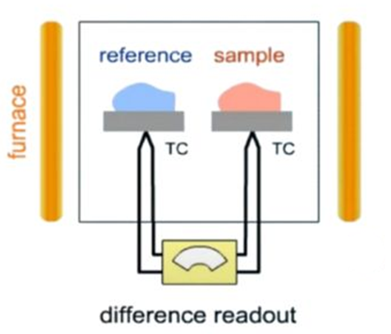
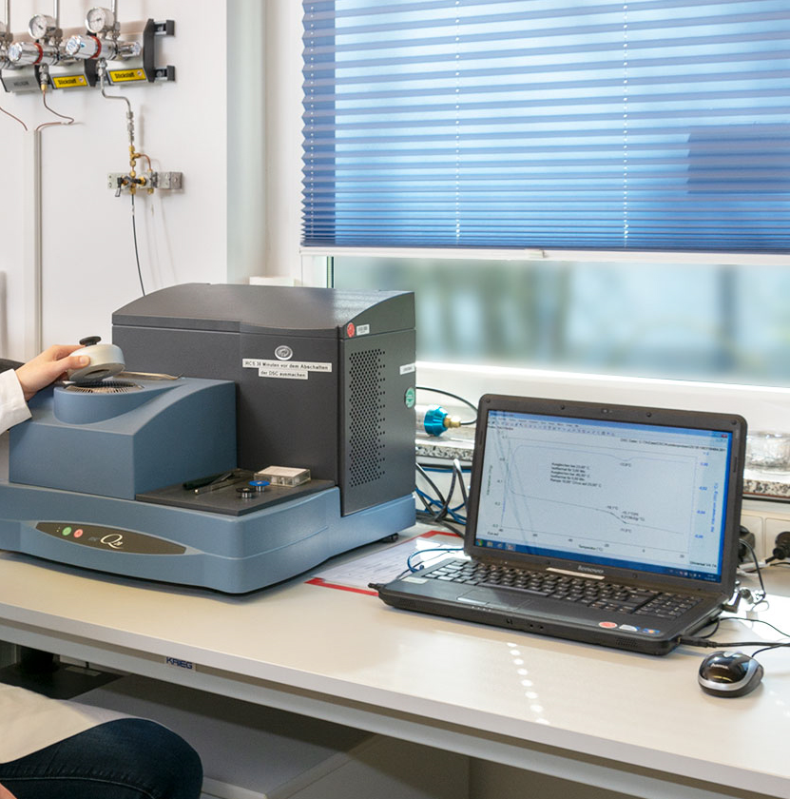
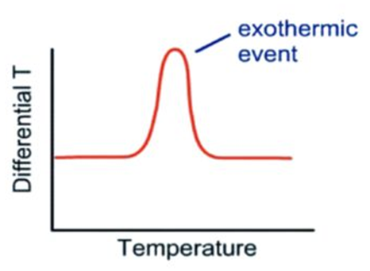
What is Differential Scanning Calorimetry (DSC)?
Compares Sample against a Reference
Quantifies Heat Flow vs. Temperature
Example Benchtop DSC
Notes:
Limitations of benchtop equipment

Slide 3
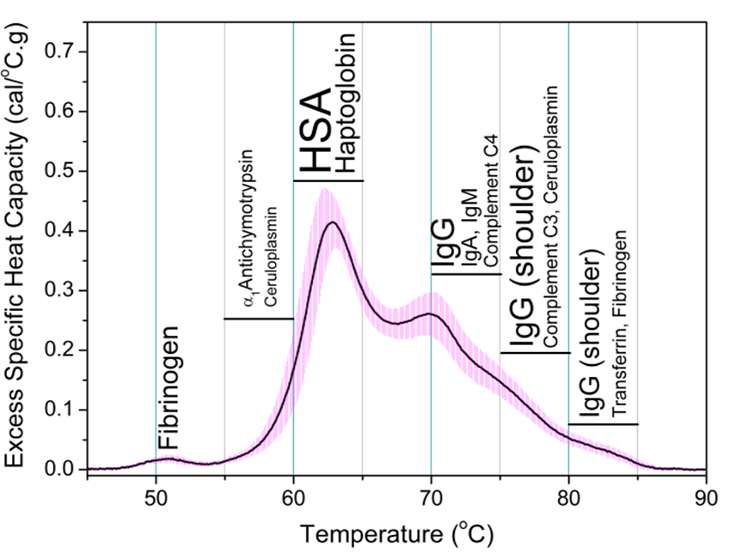
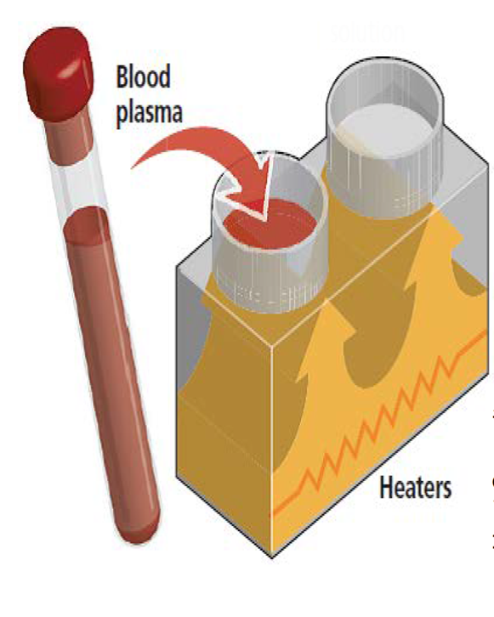
DSC of Biological Material (Blood Plasma)
“Healthy” subject
Using DSC with Blood Plasma generates a “thermogram” which is essentially a plot of proteins “unfolding”
Notes:
Different proteins will denature (unfold) at different temperatures, so the thermogram gives a snapshot of the protein content or distribution

Slide 4
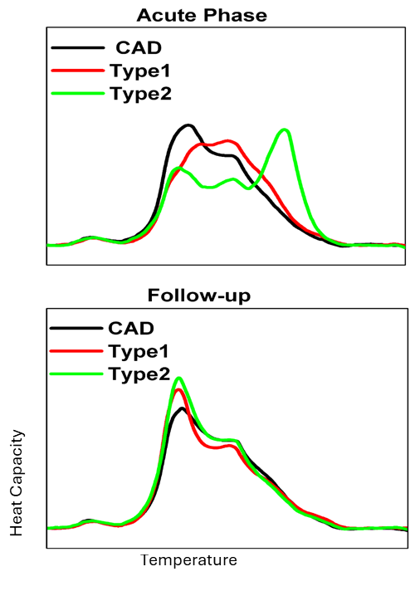
DSC of Biological Material (Blood Plasma)
Stable Coronary Artery Disease
Type 1 Heart Attack (Clot)
Type 2 Heart Attack (Demand)
Example: Heart Attacks alter the “normal” spectrum of proteins
Notes:
In this plot, CAD is stable coronary artery disease (close to a “normal” distribution of proteins), Type 1 Heart Attack that involves a blood clot (big change in protein); Type 2 is a “demand” heart attack, where blockage is choking off blood supply (minor but significant change in protein content)

Slide 5
DSC of Biological Material (Blood Plasma)
Example: Heart Attacks alter the “normal” spectrum of proteins
Return to normal after treatment
Notes:
All three return to “normal” after a month or two of treatment; normal being “Stable” CAD

Slide 6
DSC of Biological Material (Blood Plasma)
We can use DSC to diagnose diseases!
Example: Heart Attacks alter the “normal” spectrum of proteins
Return to normal after treatment
Notes:
This really means that we can use DSC to diagnose diseases. Over 17 different diseases have been researched using DSC, but we are focusing on heart attacks since there is currently no clinical diagnostic to differentiate between Type I and Type II and the treatment for each is DRAMATICALLY different.

Slide 7
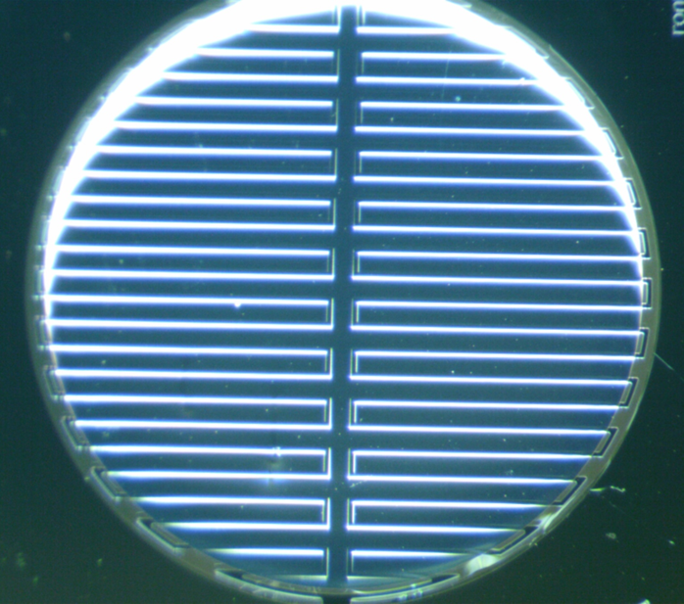
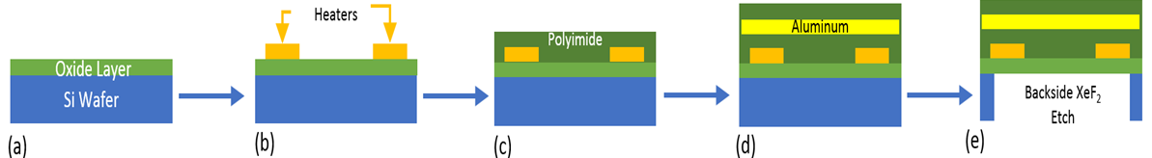


Microfabricated DSC Sensor Development
Existing Fabrication Process
Backside DRIE Etch
Electrical trace features:
  Heats the sample
  Measure Temp via Resistance vs. Temperature curve
Temperature measurement not sensitive enough for DSC
We need to improve temperature measurement sensitivity
Notes:
We found that while the original trace could be used to in fer temperature, it wasn’t sensitive enough, so we need to add a secondary temperature sensing element

Slide 8
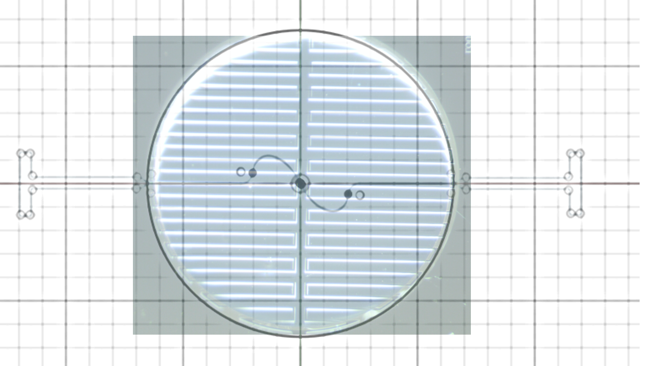
Microfabricated DSC Sensor Development
Summer Goals:
Assist in the design of the next generation
MEMS DSC Sensor
Add a temperature sensing element to
existing design
Thin-Film Resistive Temperature Detector (RTD)
  Design sensor
  Develop fabrication process flow
  Characterize temperature sensing accuracy and sensitivity
RTD design superimposed
on original sensor

Slide 9
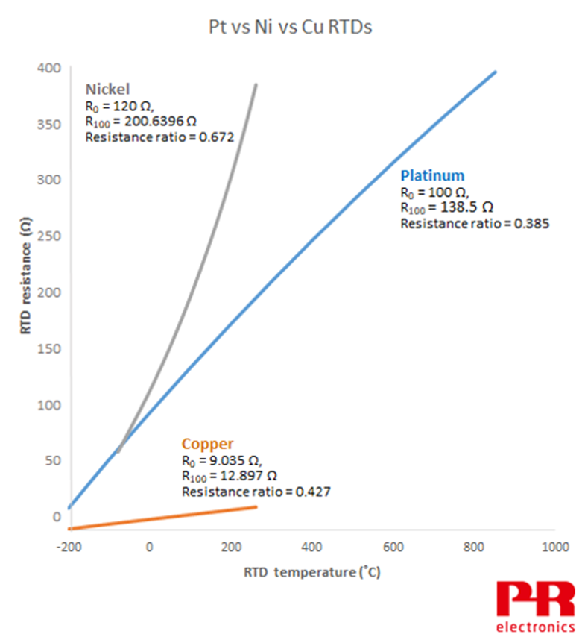
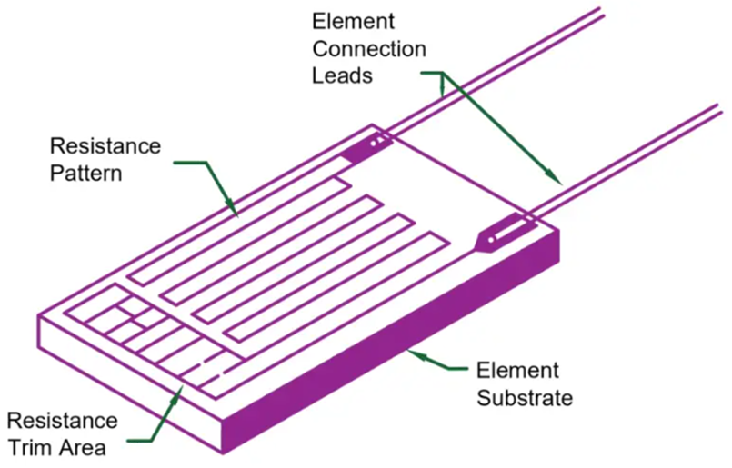
Initial Research:
Thin-Film RTDs
Target temperature window (25-100C)
Researching Thin-Film RTDs
  Metals used (Nickel, Platinum)
  Geometries
  Sensitivity
  Fabrication Techniques

Slide 10

RTD Trace Designs
9mm “meander”
Trace width of 10 microns
10 mm die size
No sharp edges
Bond pads attached
Targeting 100 Ohms

Slide 11

RTD Trace Designs
90mm “Spiral”
Trace width of 10 microns
10 mm die size
No sharp edges
Bond pads are attached
Targeting 1000 ohms

Slide 12
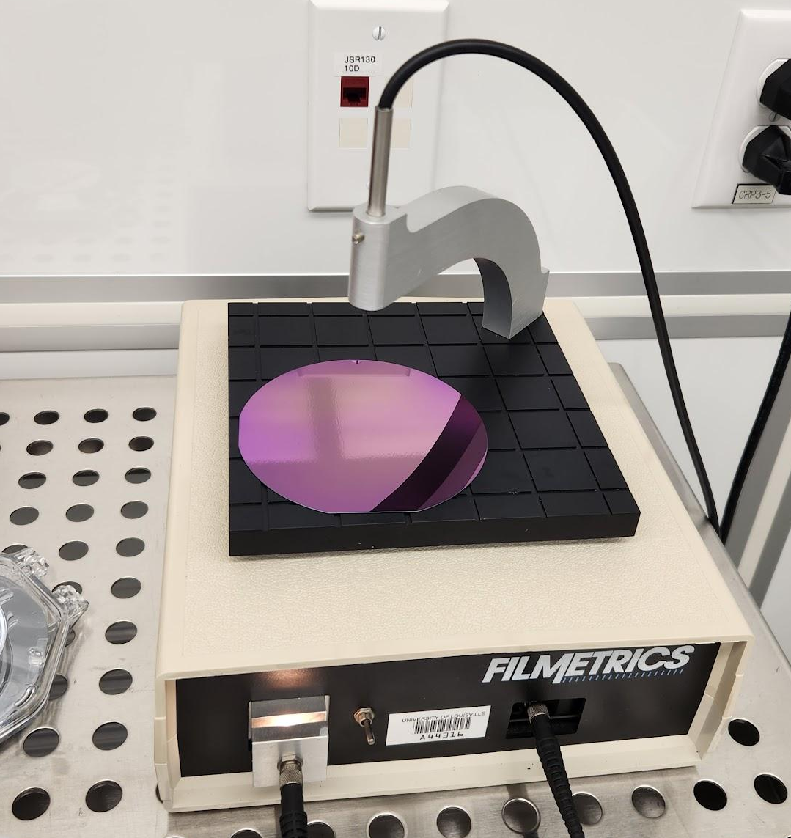
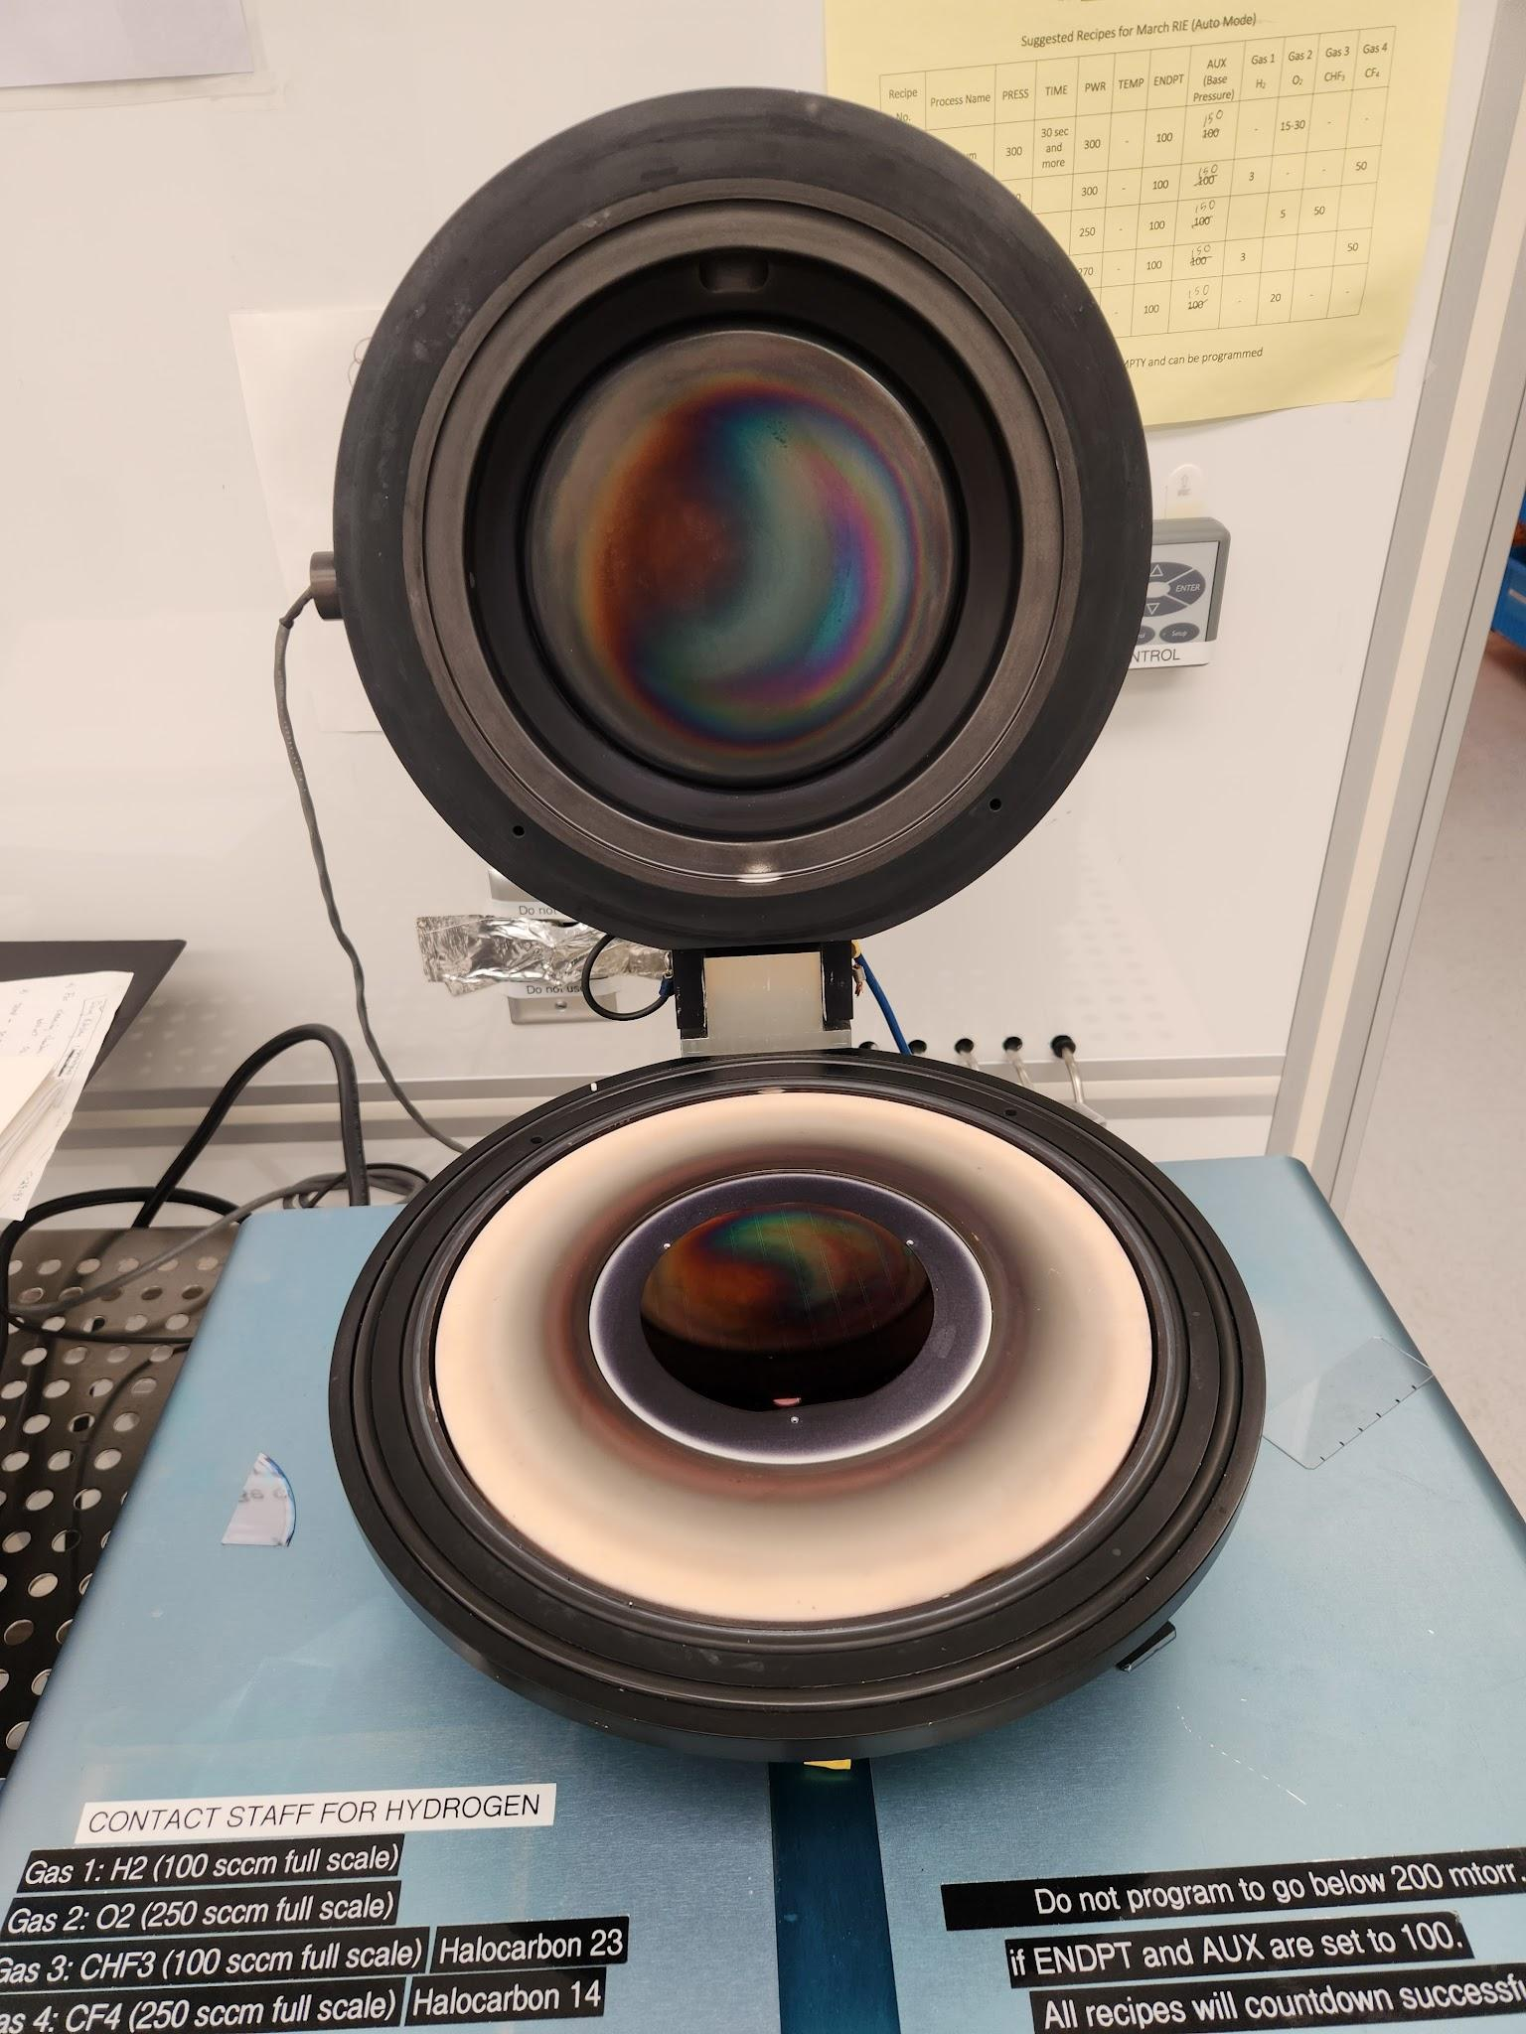
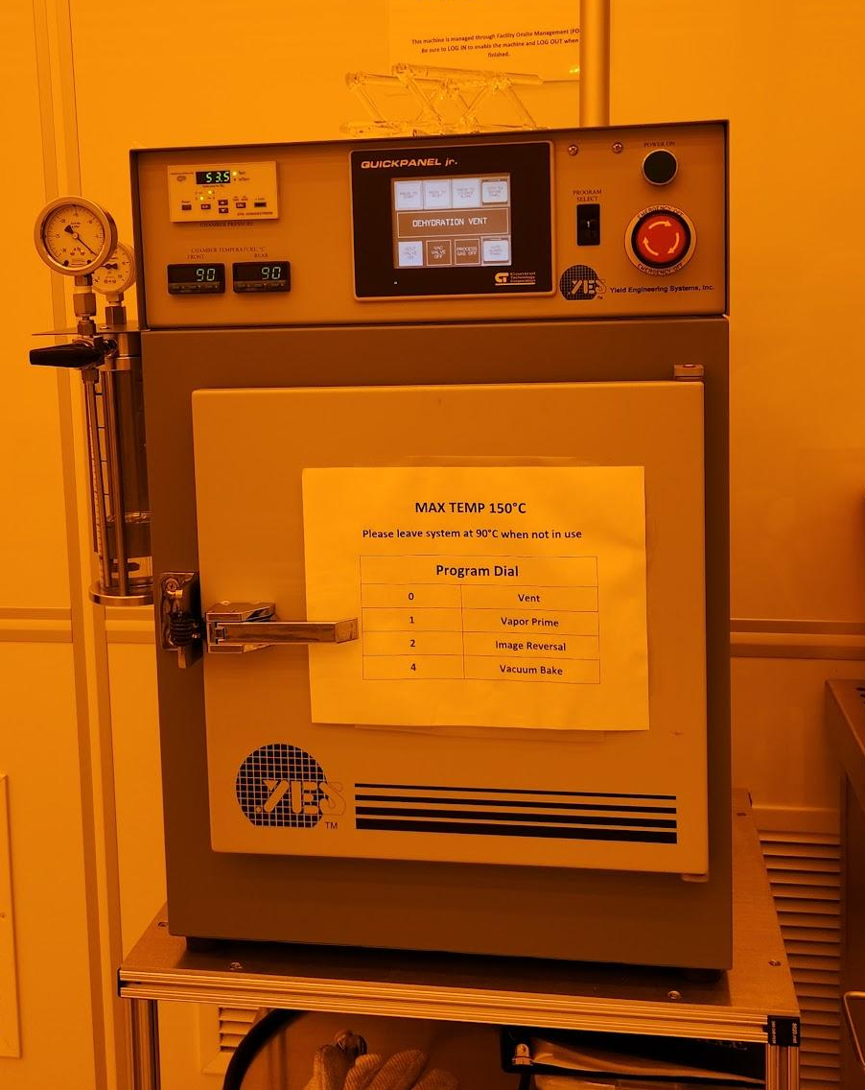
Fabricating the Sensors (Equipment)
Filmetrics
March RIE
YES Oven
Notes:
Filmetrics machine- used to measure the oxide thickness March RIE- used twice, once before the photoresist and once after, YES
Oven also used twice, first time to vapor prime the wafer second time for image reversal(first before the photoresist, second after)

Slide 13
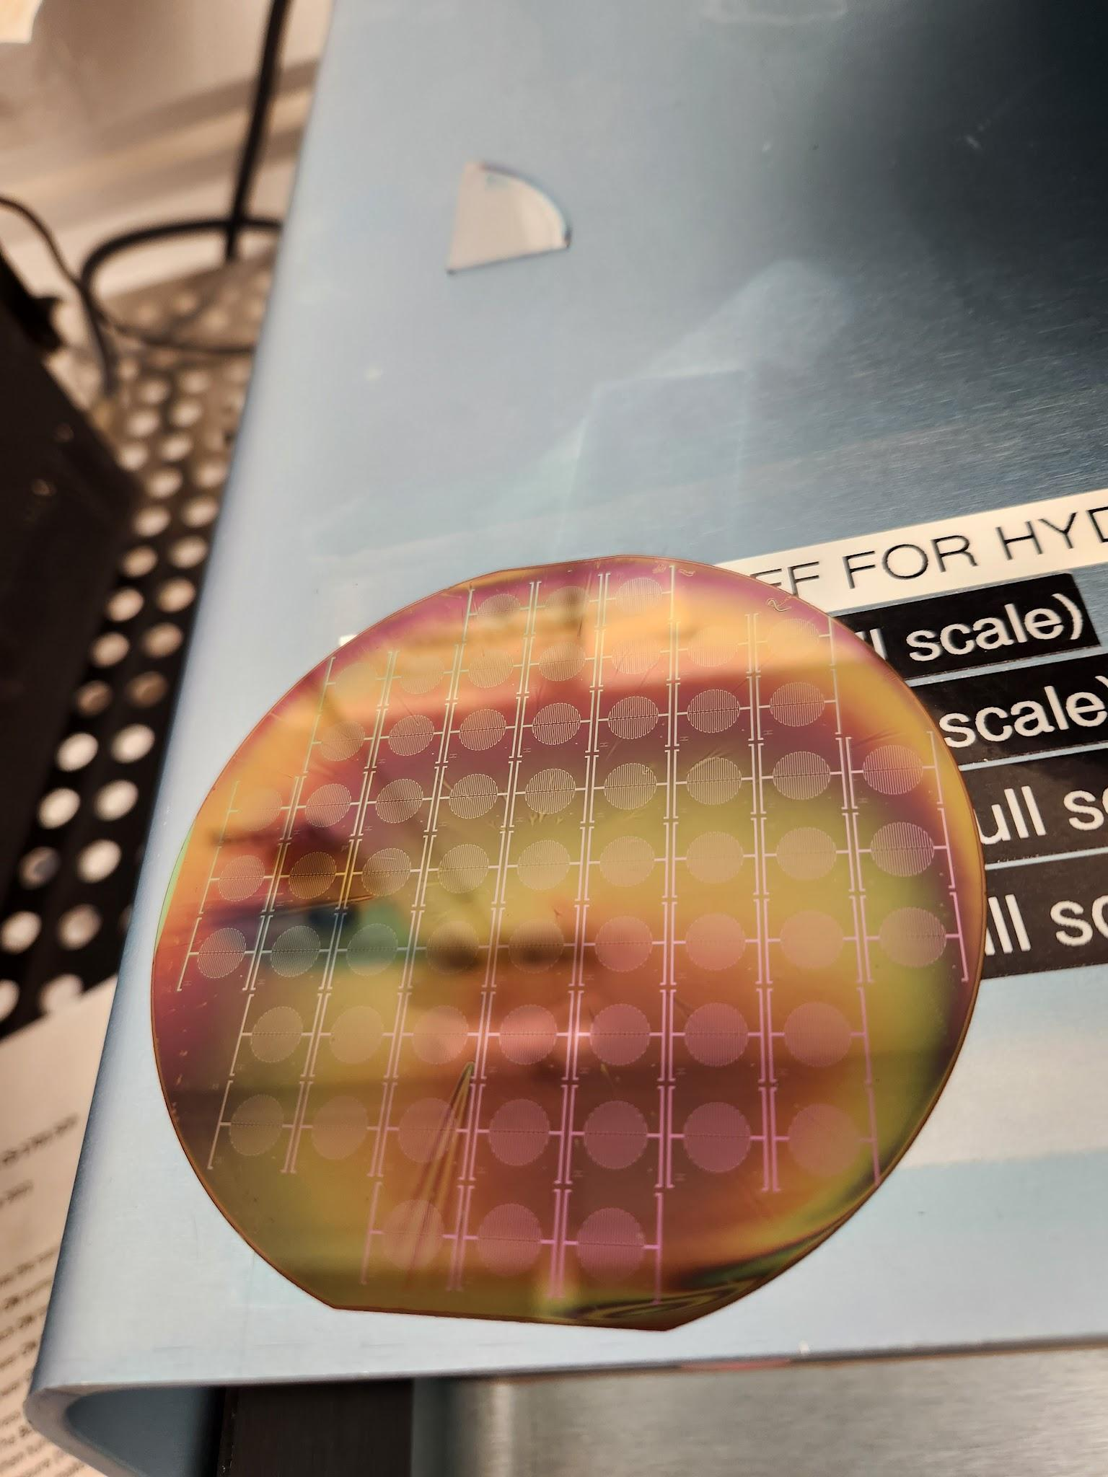
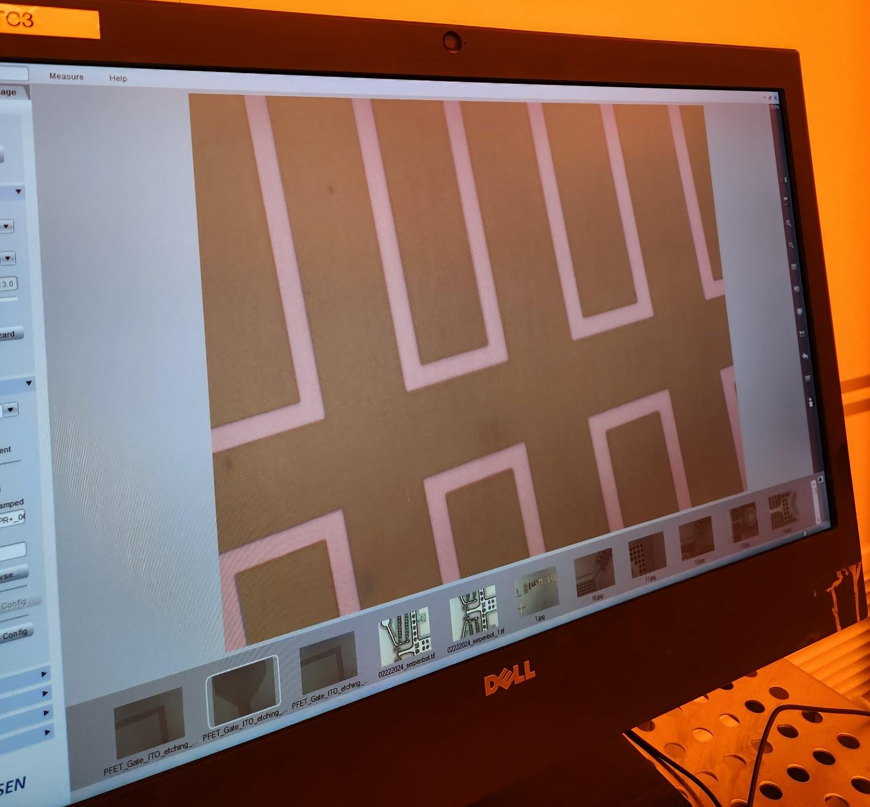
Fabricating the Sensors
Heater Traces
6.6mm
Features had to be uniform in color to show we had removed all of the photoresist off the oxidized layer
Features in the wafer
Yield: 60 devices/wafer
Wafer after developing
Notes:
A profilometer was also used to make sure we got down to the oxidized layer.

Slide 14
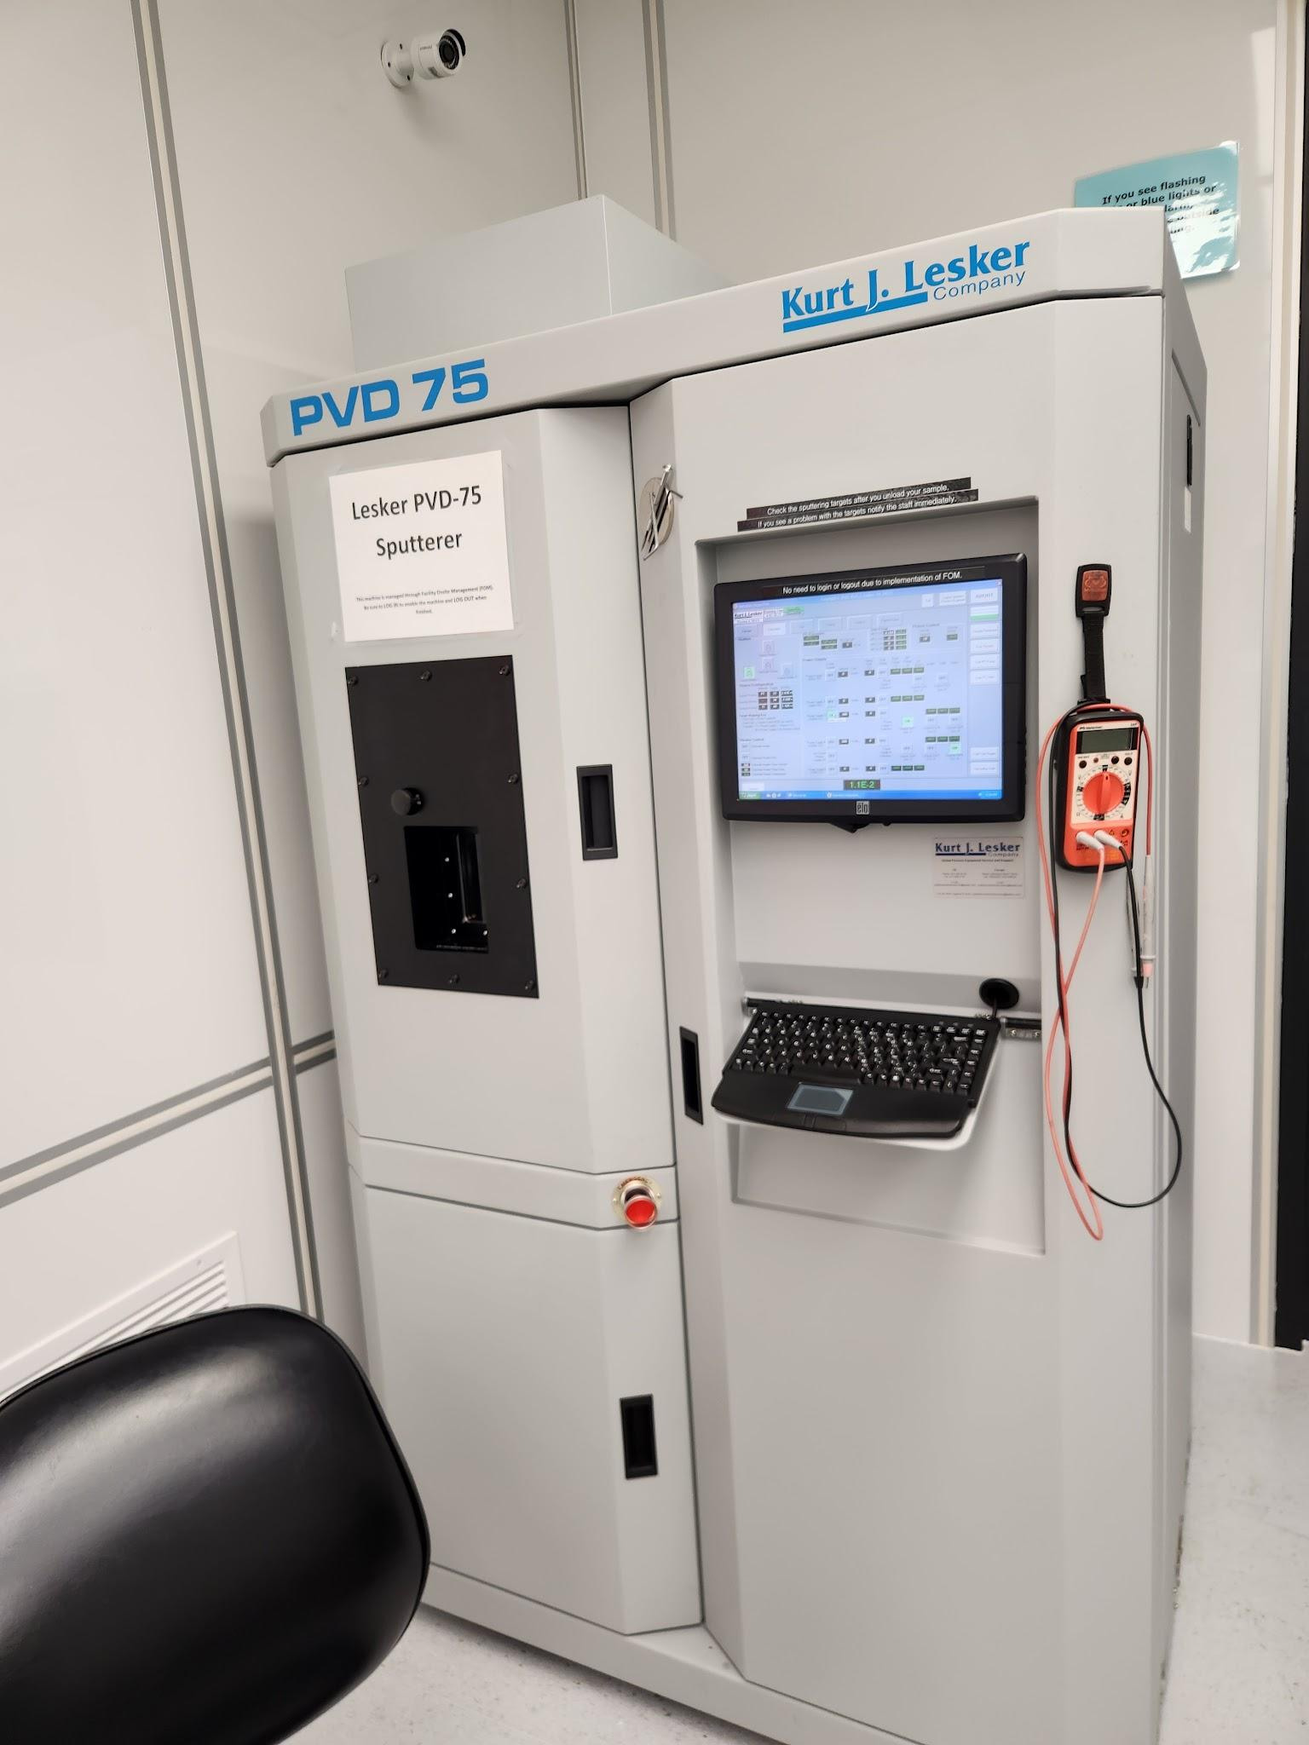
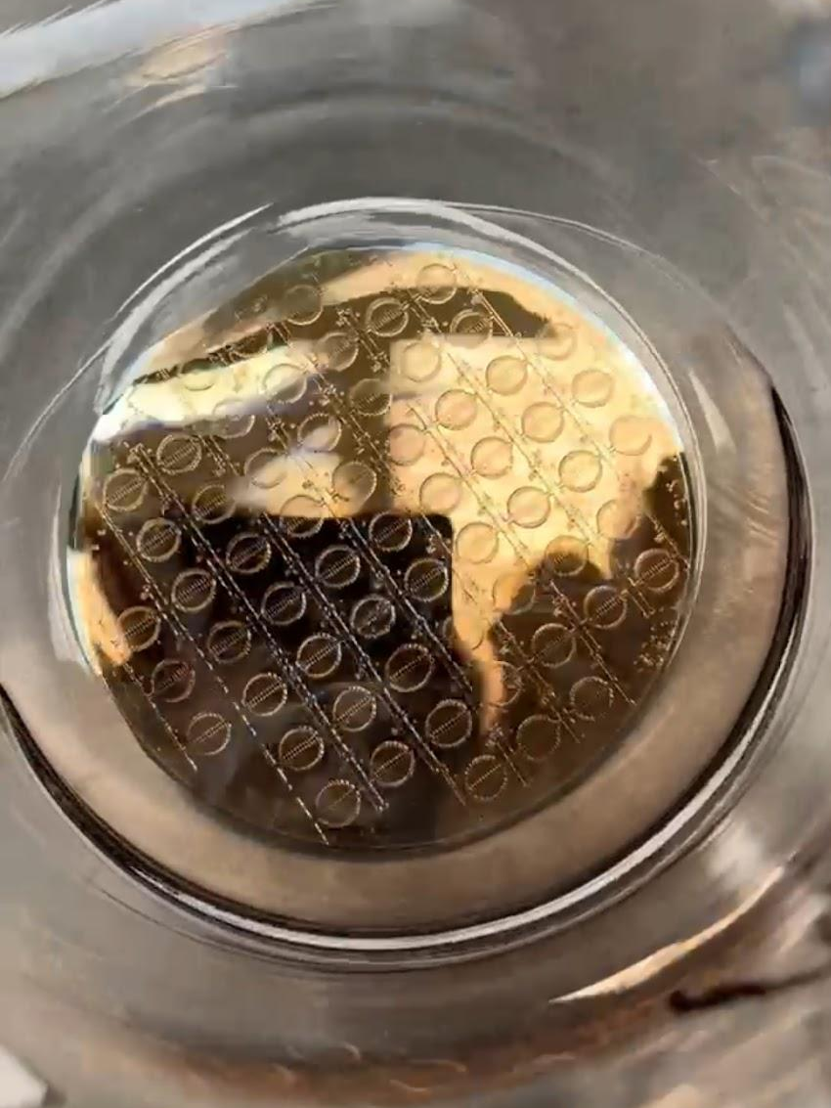
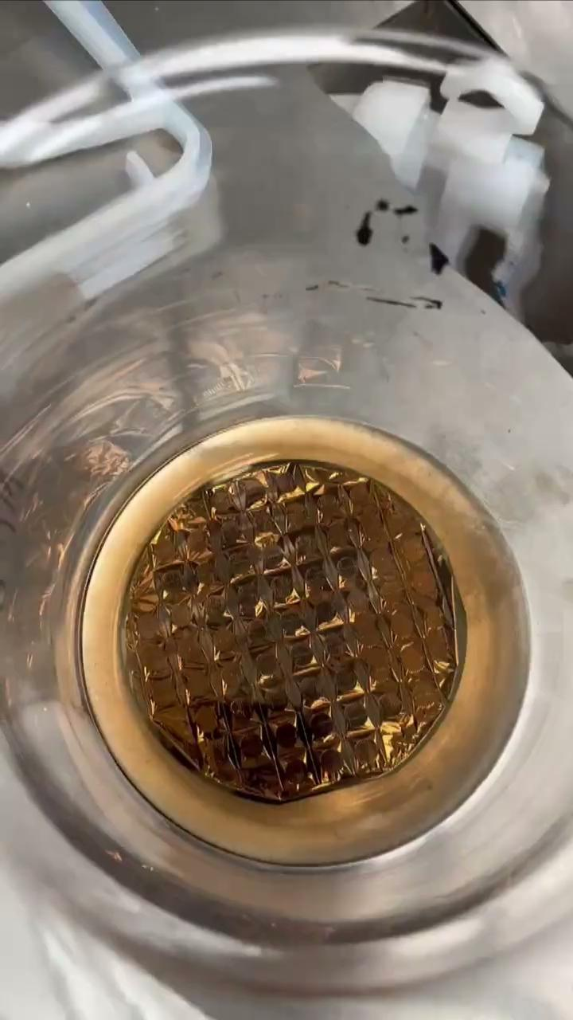
Fabricating the Sensors
Sputtering was used to deposit titanium and platinum onto the substrate
Resulting metal thickness
765 nm
Lesker PVD 75
Sputtering
Notes:
The Lesker PVD 75 machine was used to sputter a layer of titanium onto the substrate, then platinum in five intervals of sputtering and pausing to ensure the photoresist did not melt, then a final layer of titanium the measured metal thickness after liftoff was about 765 nm

Slide 15
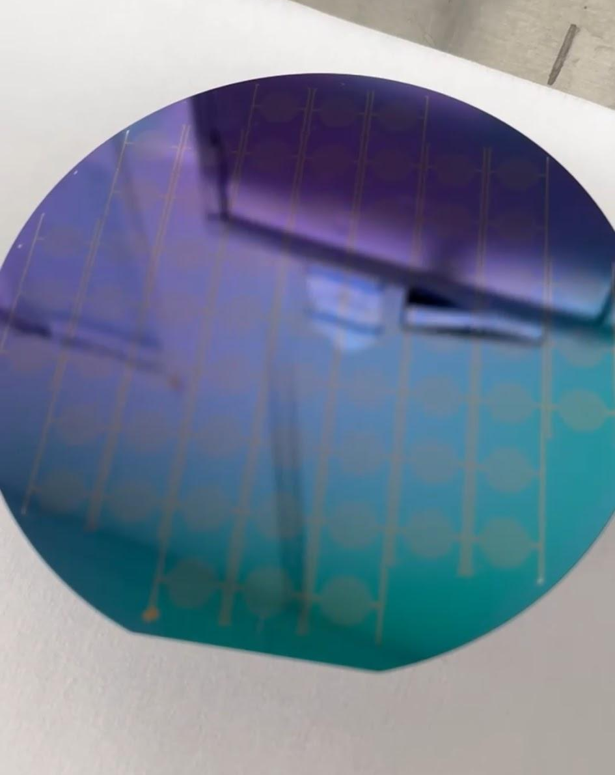
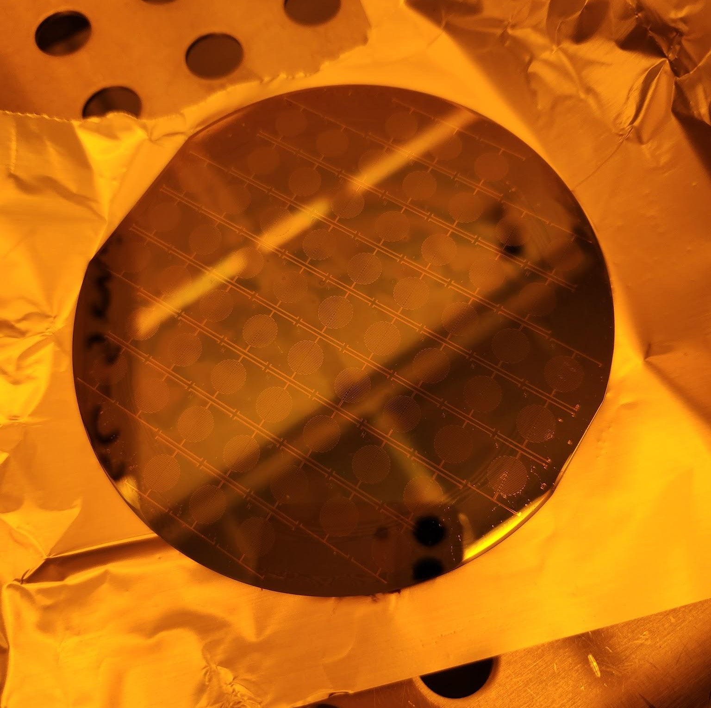
Fabricating the Sensors
After sputtering, VM 651 (adhesion promoter) is spin coated (1500 RPM x 2) onto the substrate to improve the adhesion of polyimide
Polyimide thickness of about 3 micrometers

Slide 16
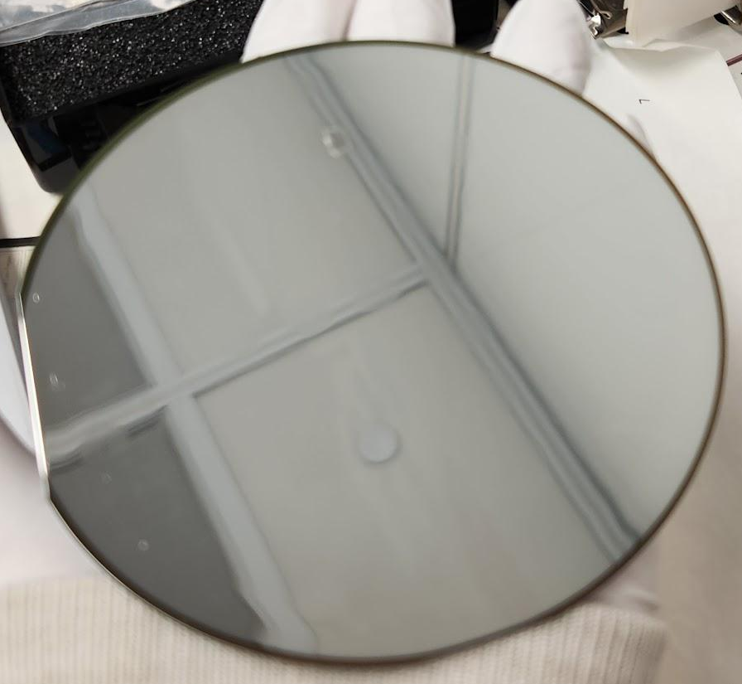
Fabricating the Sensors
Aluminum is deposited onto the substrate with a thickness of about 110 nm
Plasma ASH is performed before to ensure the aluminum adheres to the wafer

Slide 17
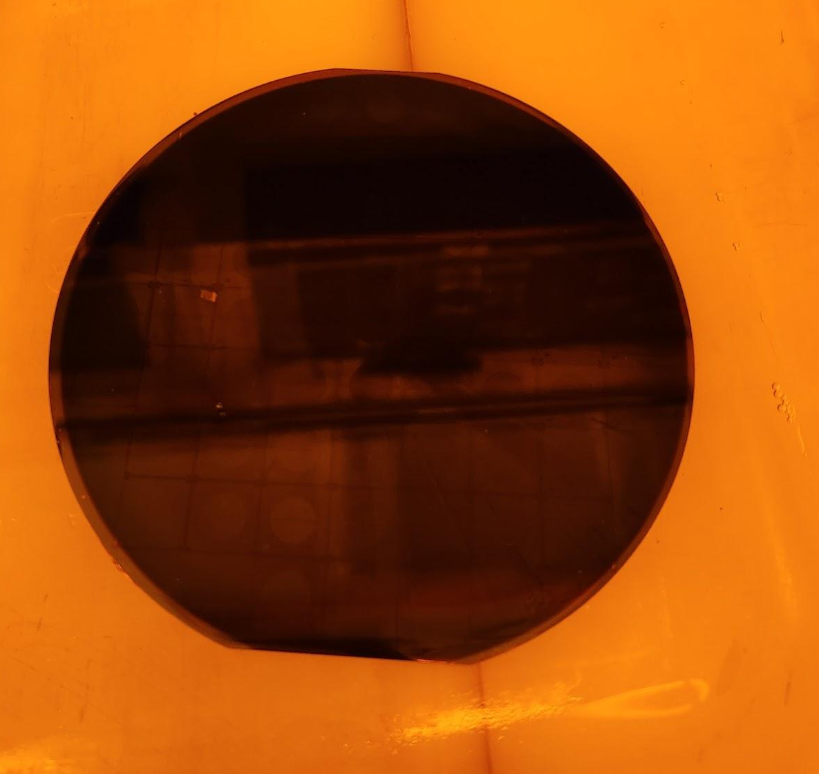
Fabricating the Sensors
Aluminum on the next two wafers appeared blackened instead of typical silver-possibly carbon?
Significantly thicker than expected(368nm)
No changes compared to previous run
Layer was non-conductive
Trion etching unexpectedly removed layer
Suspected contamination lead to piranha etching of target and stripping of this layer
Post-clean deposition yielded better results

Slide 18
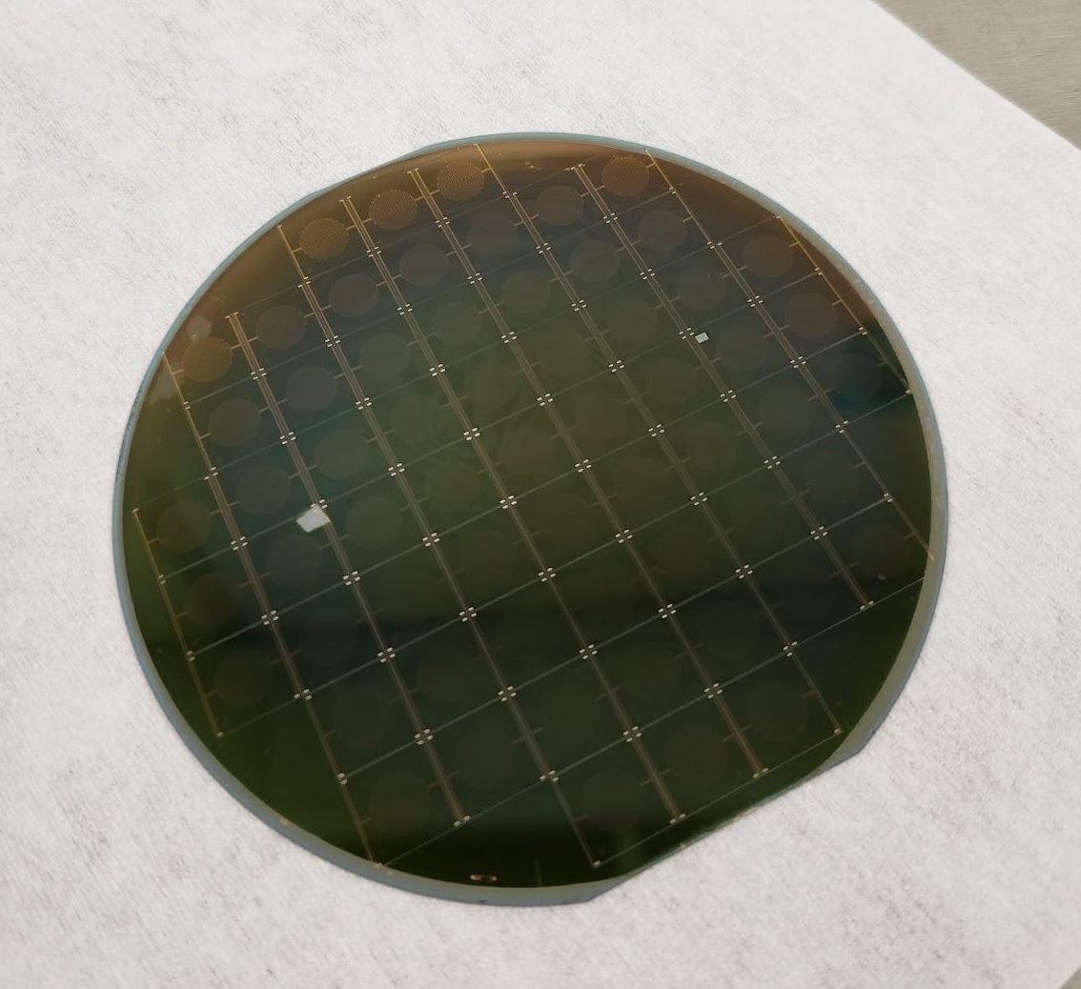
Fabricating the Sensors
Then spun photoresist (S1827) onto substrate and expose a new mask
Performed an aluminum etch afterwards
Spun polyimide onto the substrate and cured
Deposit another layer of aluminum onto the substrate

Slide 19
Future Steps:
Continue fabrication of heating element
Generate photomask of both RTD Designs
Develop recipe to fabricate the RTD traces
Add the RTD designs to the wafers being processed
Characterization of Resistance vs. Temperature sensitivity

Slide 20
Experience and Skills Gained
Cleanroom experience and certification
Properly record processes and results
Accurately report information
Understanding of microfabricated sensors
Materially contributing to an ongoing, NIH-supported research project

Slide 21

Acknowledgements
Dr. Michael Martin
Dr. Thomas Roussel
Dr. Nichola C. Garbett
Dr. Kevin Walsh/Ana Sanchez Galiano
National Science Foundation
IMPACT-NG REU Program
KY Multiscale
University of Louisville JB Speed School of Engineering
University of Kentucky Pigman College of Engineering
NSF REU Award ID # 2348869

Slide 22
References
McCarthy, Mary, and Jellenie Rodriguez. “How to Select and Design the Best RTD Temperature Sensing System | Analog Devices.” Analog.com, 2024,
Wu, Joseph. A Basic Guide to RTD Measurements. June 2018. Wu, Joseph
Feng, Jianguo, et al. “High-Performance Microcalorimeters: Design, Applications and Future Development.” TrAC Trends in Analytical Chemistry, vol. 109, Dec. 2018, pp. 43–49, https://doi.org/10.1016/j.trac.2018.09.017. Accessed 30 Aug. 2020.
Yang, Fan, et al. “Thermal Sensing in Fluid at the Micro-Nano-Scales.” Biomicrofluidics, vol. 12, no. 4, 1 July 2018, pubs.aip.org/aip/bmf/article/12/4/041501/385737, https://doi.org/10.1063/1.5037421. Accessed 11 July 2025.

Slide 23
Thank you!

