Slide 1



FluiDuck – A Microfluidic-based, Machine Learning Workflow for High-throughput CRISPR-editing and screening of Live Duckweed
Presented by Joshua D Scheel¹
Principal Investigator: Samuel M.D. Oliveira²
Additional authors: Bukola A. Akindipe², Tasmia Islam³, Hamed Rastaghi², Eric A. Josephs^{3,4}
¹Department of Biomedical Engineering, University of Texas at Austin, 110 Inner Campus Dr, Austin, TX 78712, USA ²Joint School of Nanoscience and Nanoengineering (JSNN), North Carolina Agricultural and Technical State University (NCAT), Greensboro, 27401-NC, USA ³Department of Nanoscience, University of North Carolina at Greensboro, Greensboro, 27412-NC, USA ⁴Department of Biomedical Engineering, Stony Brook University, 100 Nicolls Road, Stony Brook, NY 11794, USA
Notes:
Hi my name is Josh Scheel, I am Biomedical eng…
This summer through the SUIN REU I had the opportunity to join Dr. Sam Oliveira’s at the Joint School of NanoScience and NanoEngineering in Greensboro, North Carolina
My project is titled…
Essentially we are developing a platform to control and automate gene editing expiriments and imaging of duckweed and other organisms

Slide 2
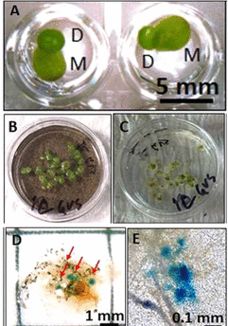
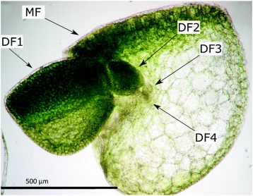
Significance of Duckweed (Lemnaceae)
Genus Spirodela
Genus Wolffia
Reinard and Wichmann, 2020
Islam and Josephs, 2023
Notes:
First we need to understand why we care about duckweed…
Duckweed is a small free floating aquatic plant
Bioremediation – rapid growth, high biomass accumulation, ability to effectively absorb various pollutants (i.e. Nitrogen, phosphorus, or heavy metals) (cadmium, chromium, copper, lead, nickel, and others)
Biofuel – again rapid growth, high starch content, and doesn’t compete with food crops. Making it suitable for Ethanol, Butanol, and biogas
Model organism in Plant biotechnology – simplified morphology, relatively small genome, and (Genus Wolffia) is the smallest and fastest growing flowing plant in the world
Arguably duckweeds most interesting attribute is that despite being a multicellular plant, sexual reproduction is very rare (divides asexually like yeast)
**Walk through figure on the right**

Slide 3
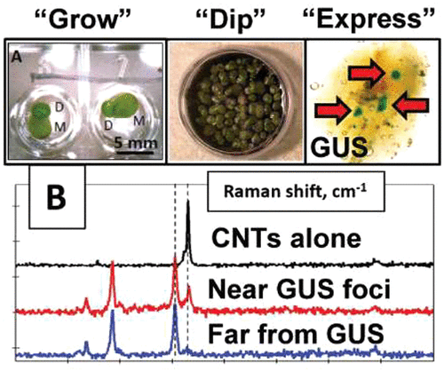
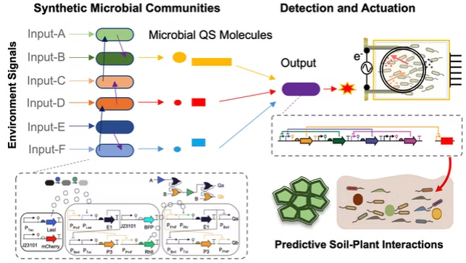
Context: Collaboration
Oliveira Lab
Josephs Lab
oliveiralab.me
Islam and Josephs, 2023
Challenges:
1 - Control delivery of CRISPR components over time
2 - Track duckweed growth and measure morphology
Notes:
This project is a collaboration between my group and the Josephs lab
Oliveira – specializes in microfluidics and large scale synthetic microbial communities
Josephs – interested in the gene editing of duckweed and its potential applications in plant biotechnology
So, they asked us to build a platform to help…
- Streamline and automate both data collection and organization as well as experimental design and processes for the Josephs Lab.
This presents to main challenges…

Slide 4
Platform Design
Manual Inputs
Imaging Database
MCs
Solenoid controlled
Custom automatic experimental design
3D Multilayer Chip
Real-time metrics
Organic experimental datapoints
Deep-learning framework
(Valves, Pumps, MUX)
2D Monolayer Chip (MC)
(Species Flexible)
Notes:
To combat these challenges we designed a plaform with 3 main componants…
1st - Multilayer Microfluidic Chip: Solenoid controlled, custom, is the central hub of our expiriemnt (”highway system”)
2nd – Monolayer chip(s): monolayer wells (where the organism grows)
3rd – Imaging database: camera, deep-learning framework, real time metrics

Slide 5
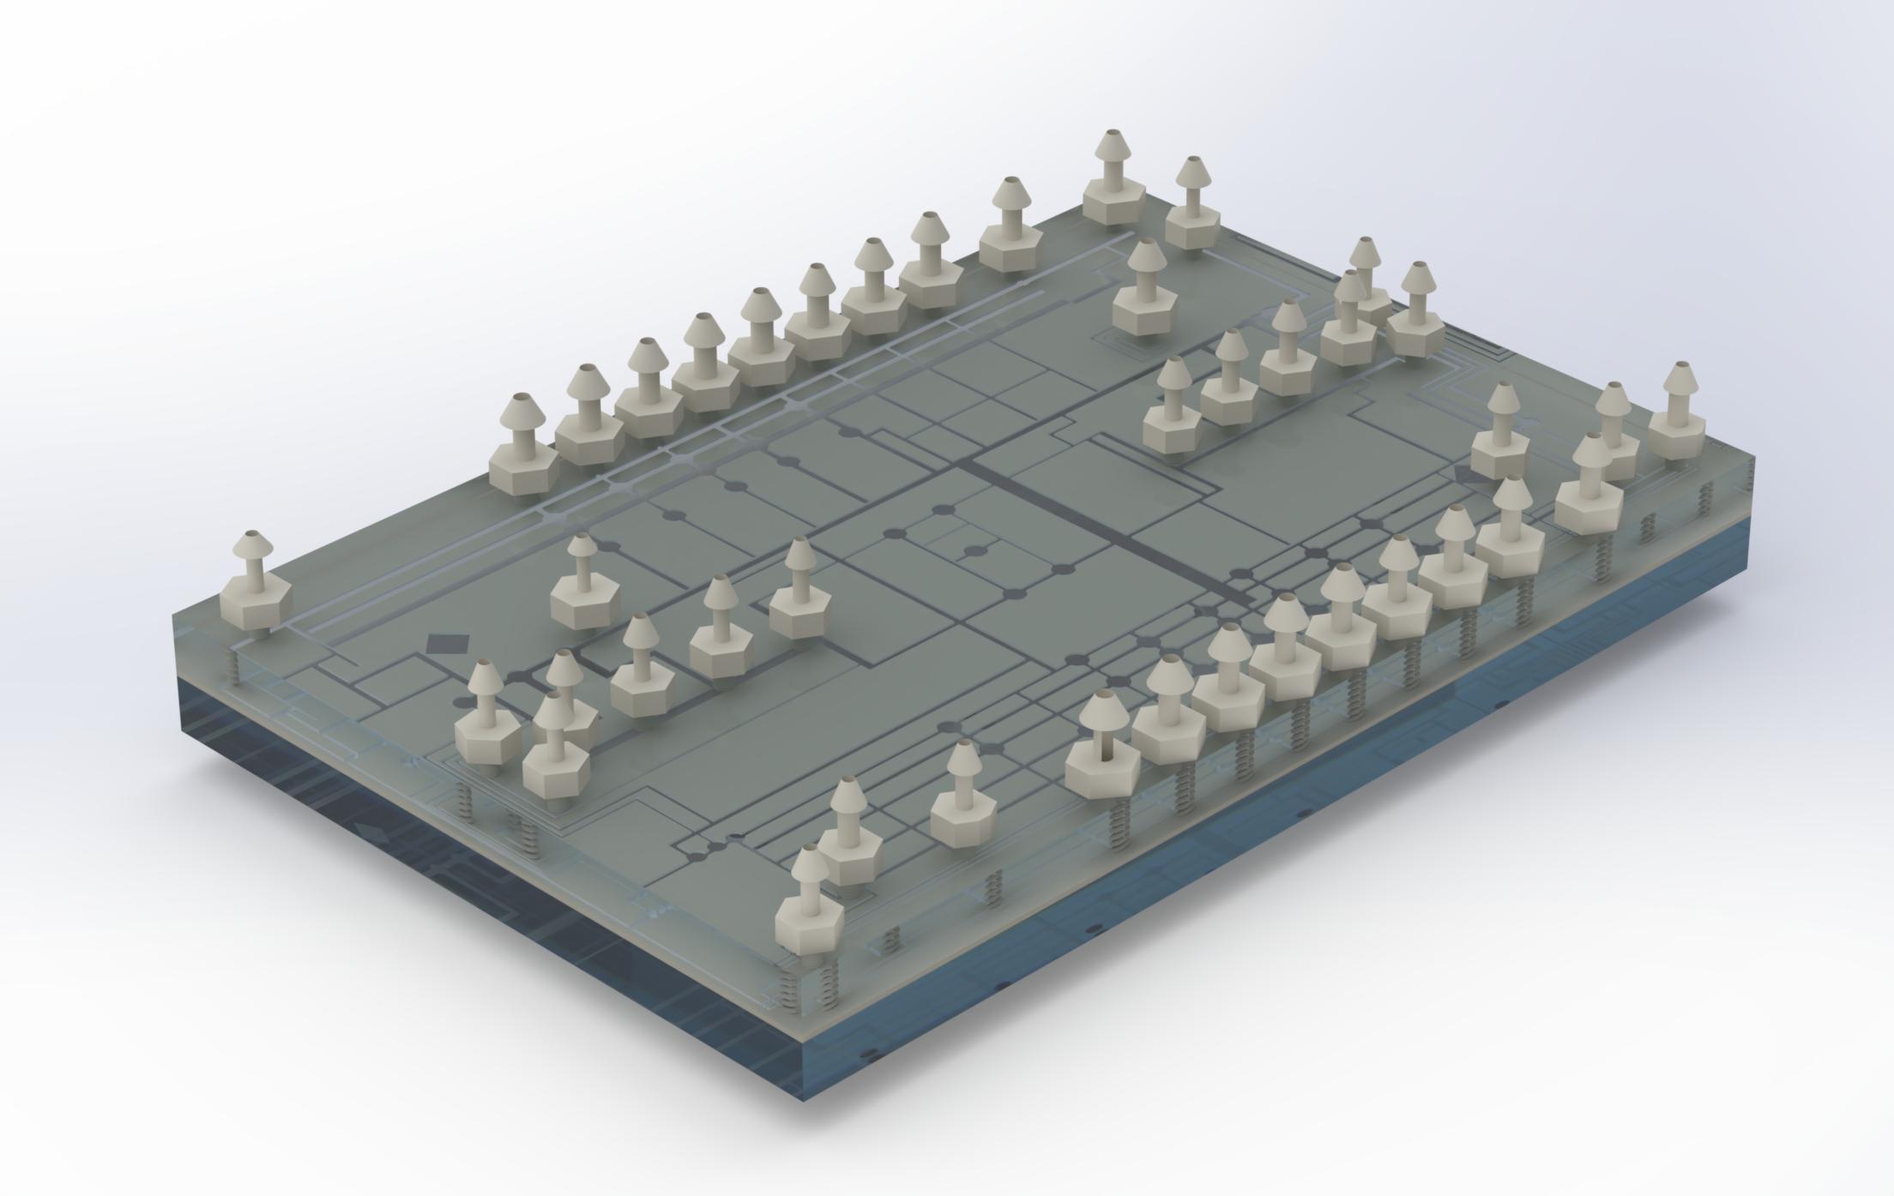
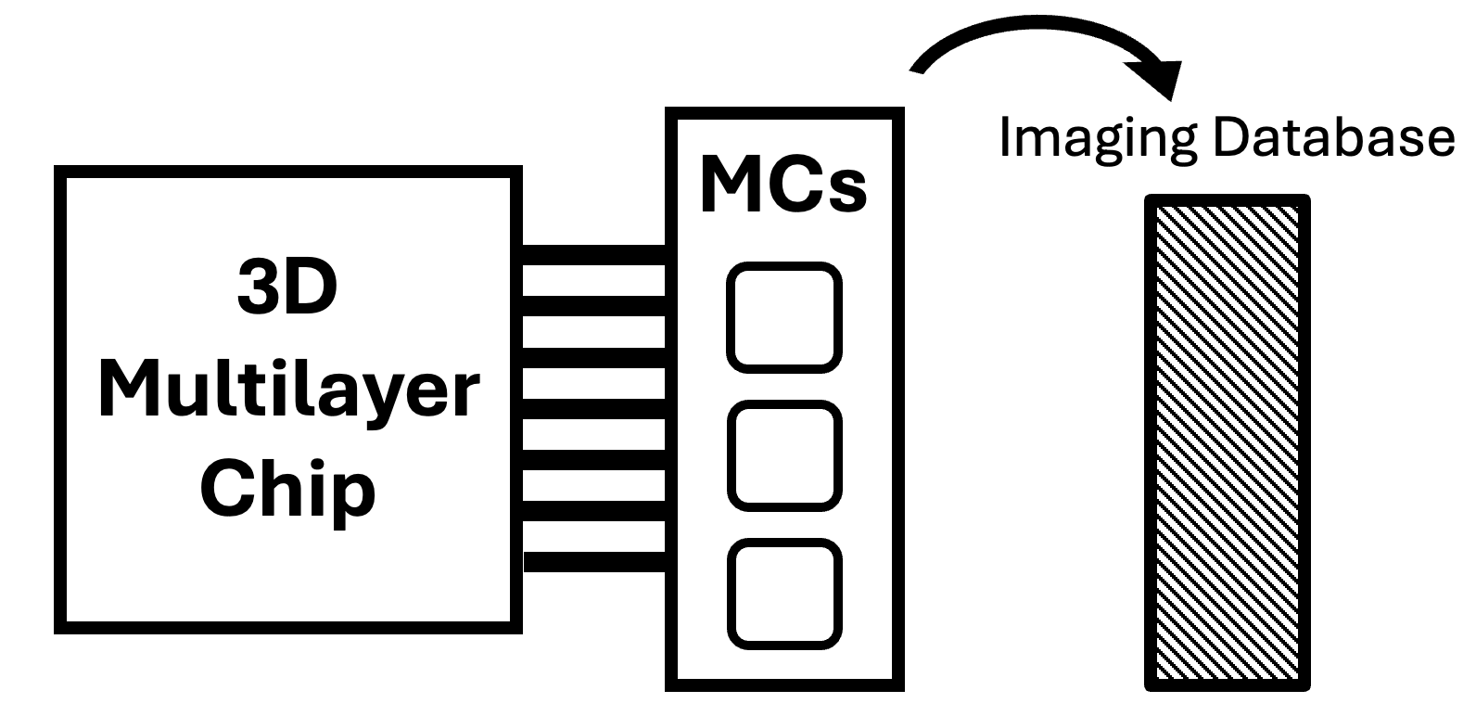
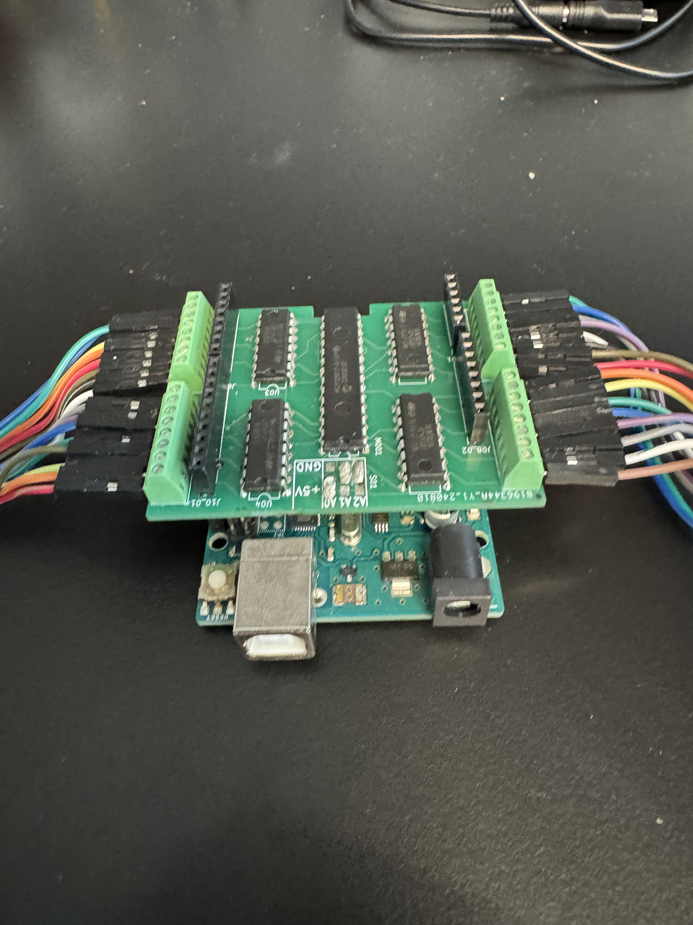
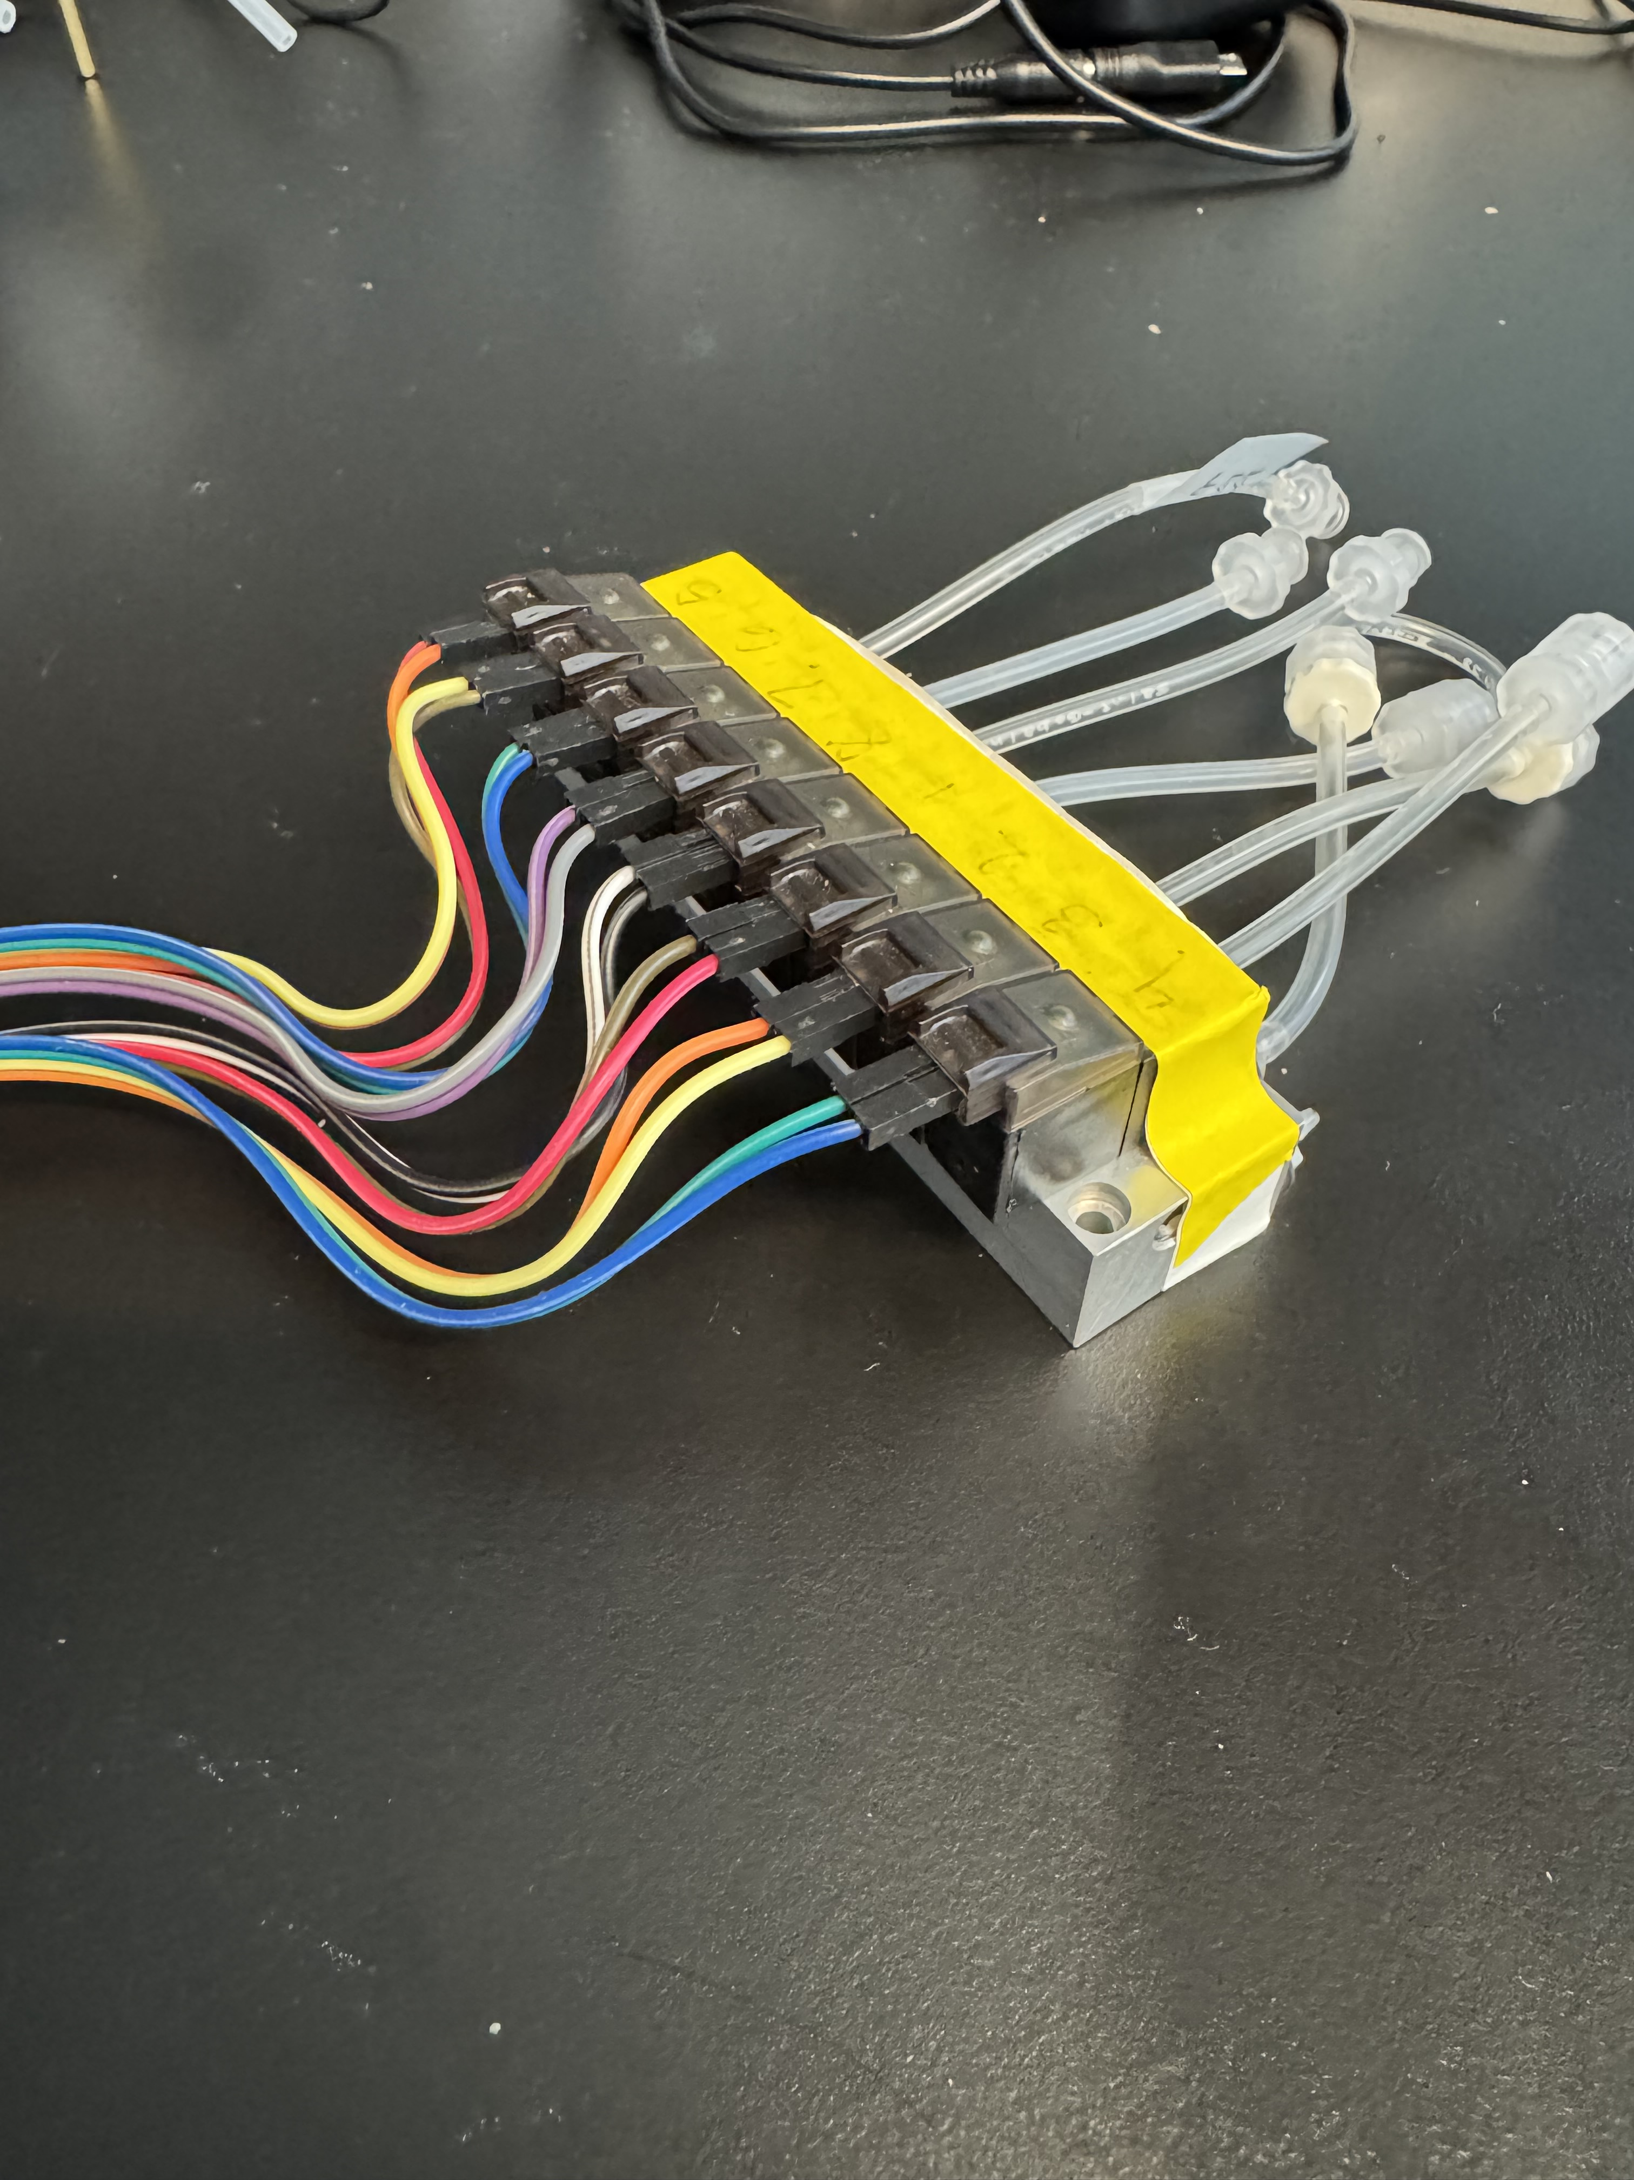
3D Multilayer Chip
Micro-controller
Solenoids
Notes:
The 3D multilayer chip has a Silicone backbone and a PDMS based internal membranes (PDMS stands for polydimethylsiloxane, a type of silicone polymer)
Nozels connect to control and flow layers
The solenoids (3 way closed from pnuemedyne) connect to the control layer and use air pressure and vacuum to actuate the valves (the mechanism of which I will get into in a few slides)
The solenoids are controlled by a microcontroller (we used an Arduino uno), the microcontroller is how we control the state of the solenoids and thus determine the the delivary of componants

Slide 6
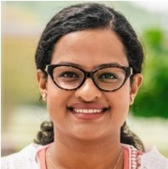
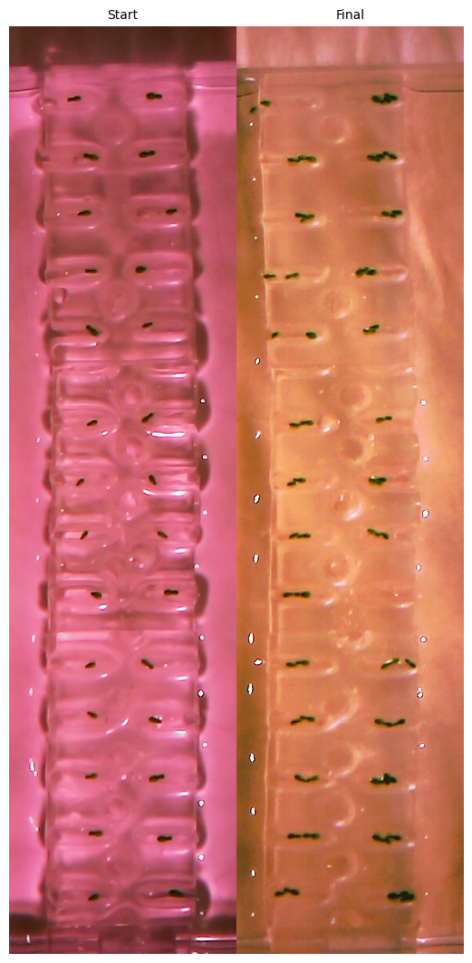
2D Monolayer Chip
Dr. Tasmia Islam
Notes:
The 2D monolayer chip contains a single PDMS based layer with wells for the cells
This chip was made by Dr. Tasmia Islam, one of our collaborators, it contains 28 isolated wells and as you can see in the right half of the image the duckweed will grow in these wells throughout the experiment
These chips can customized and easily made by 3D printing a mold to fill with PDMS

Slide 7
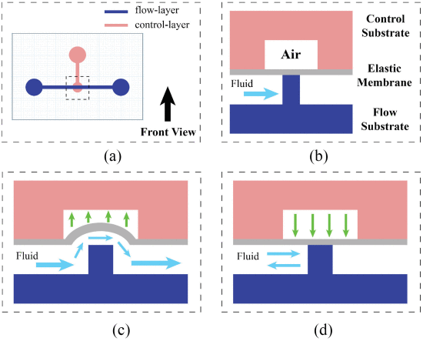
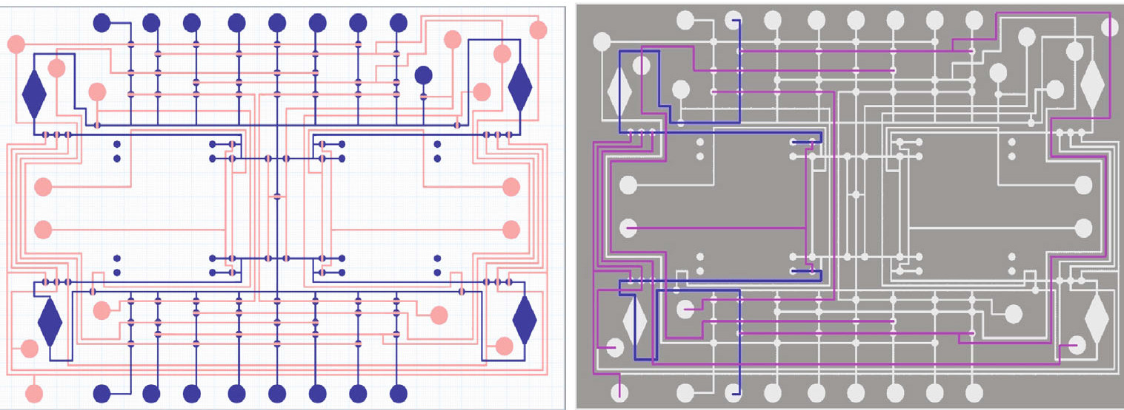
Challenge 1
Controlling and automating the delivery of CRISPR editing components over time.
Oliveira and Densmore, 2022
Zhou, Oliveira, and Densmore, 2024
Notes:
Tying back to our first challenge, how are we going to automate the delivary of CRISPR components over time?
Using our multilayer chip “highway” system (pictured on the left) , we can ”open and close roads” or path ways to manipulate when and where medium is delivered
This is accomplished using a control mechanism between layers (pictured on the right)
Using the solenoids, we can apply a vacuum to ”lift up” the elastic membrane allowing fluid to flow through, and then we can apply pressure to close the membrane, stopping flow again

Slide 8
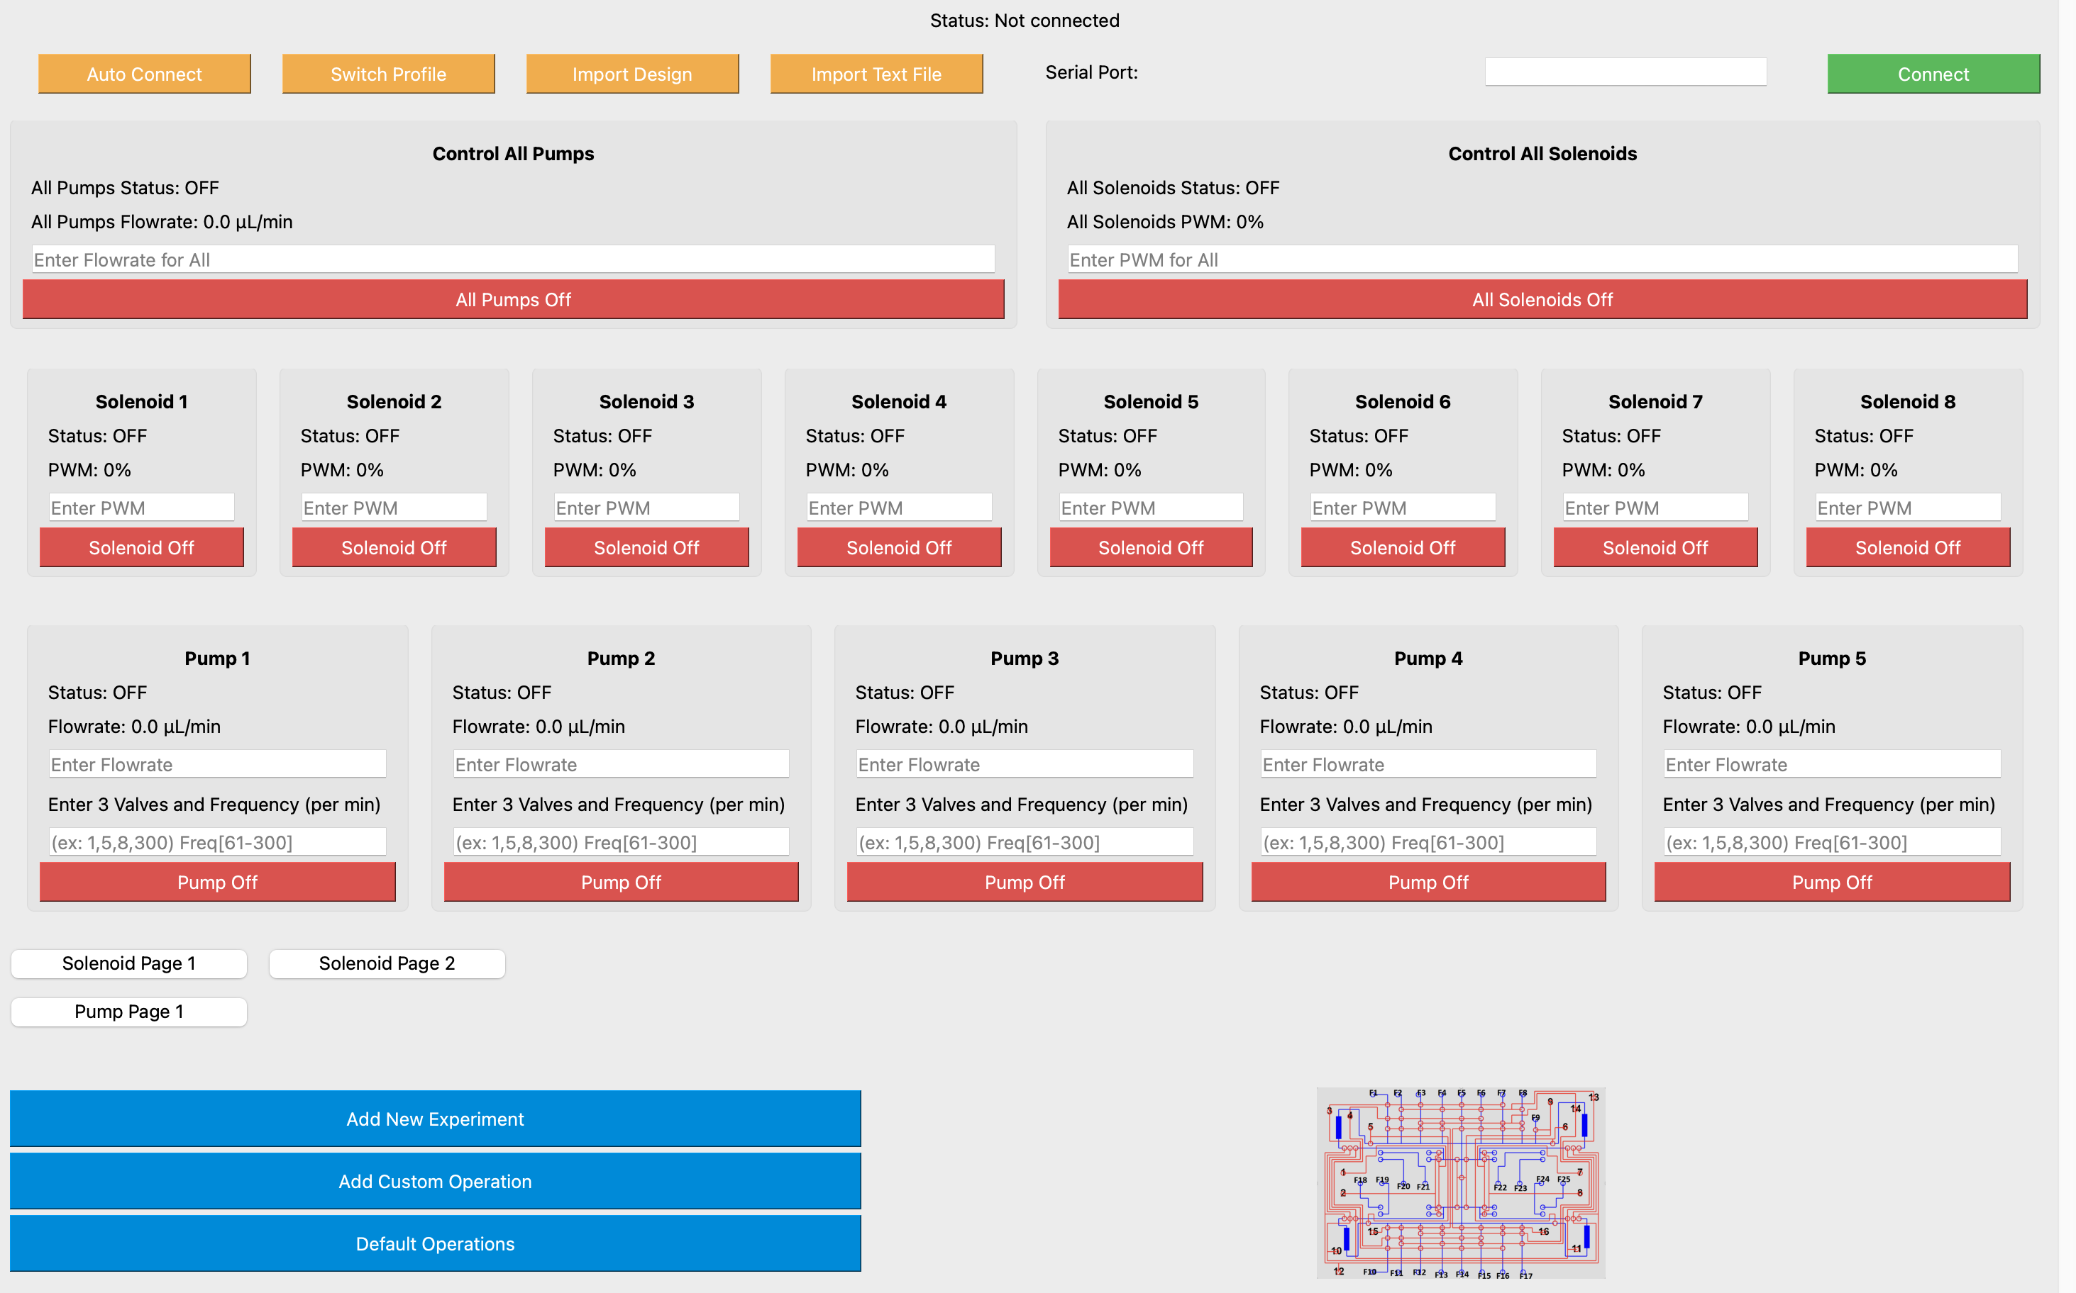
User Interface
Real-time control of solenoids and pumps
Create custom experiments
Custom chip design
Multi-species application
Notes:
To control these microfluidic functions I programed a user interface that communicates with the microcontroller
This enables the user to controlled the valves, pumps, and their pairings in real time, if you are looking to manually observe the process
But arguably more useful, it allows you to program and upload an pre-set expiriemnt to run autonomously.
Duckweed growth can take 1-2 weeks
Additonally, the software is custom to the parameters of your experiment, making it widely useful for experimenting on other species as well

Slide 9
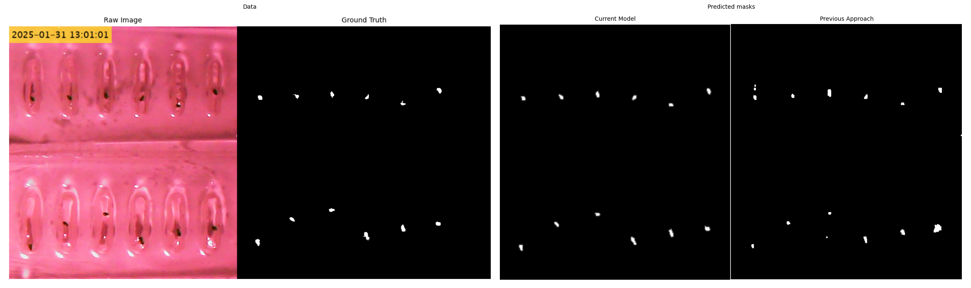
Challenge 2
Tracking duckweed throughout an experiment to collect morphological measurements and generate lineage information.
Color Segmentation vs Machine Learning:
Notes:
Moving on from microfluidics and back into the imaging side of things, our second challenge is how are we going to analyze changes in the duckweed automatically
Our first approach was to use color based segmentation
(walk through figure)
So, we shifted to a machine learning approach using binary image segmentation to better characterize the duckweed growth

Slide 10
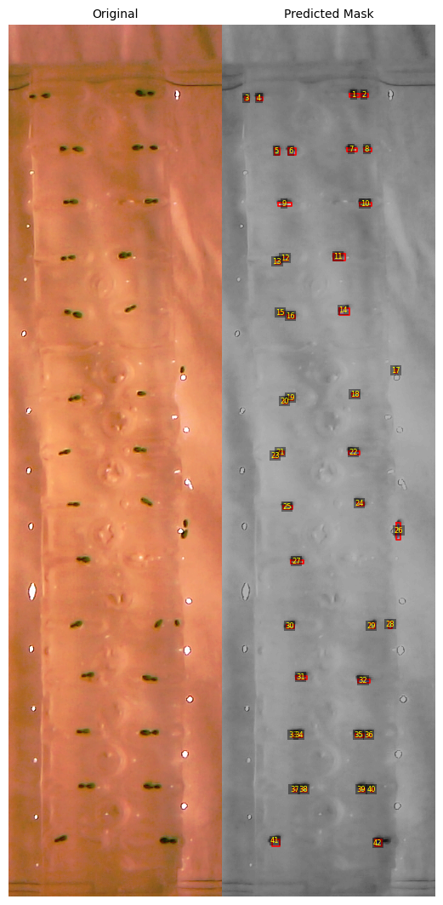
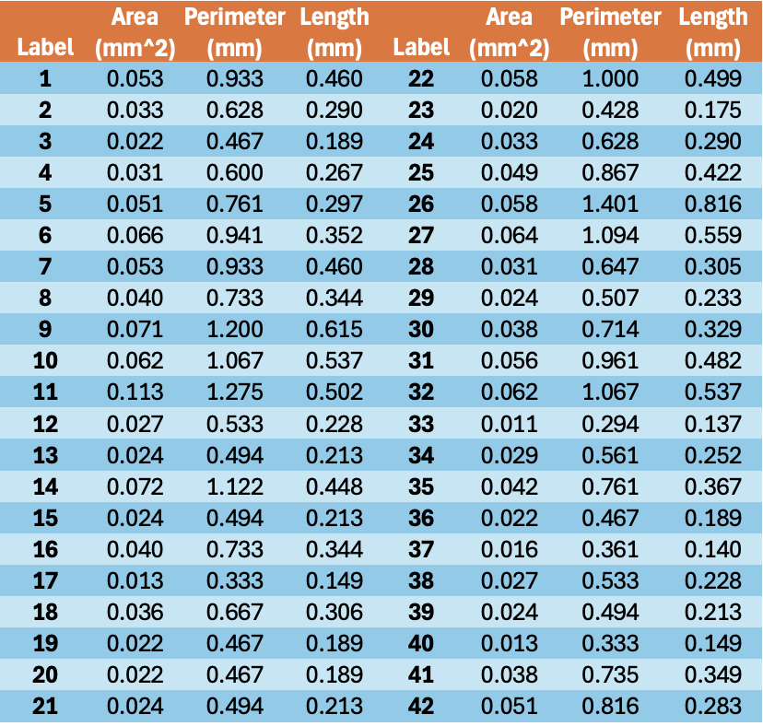
Performance on Unseen Data
Notes:
This figure shows the models analysis on an unseen frame of data, from a little over a day into an expiriemnt
Left side is the raw image, each brown cell is a duckweed (they are eginnin got divide)
The right represents that models prediction of where the duckweed are, each number is one cell and the red bounding box signifies the models tracking
The hardest part is determining when the daughter splits from the mother (middle images)
From this we can get morphological measurements (size genes, or fluorescence genes)

Slide 11
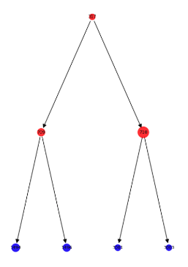
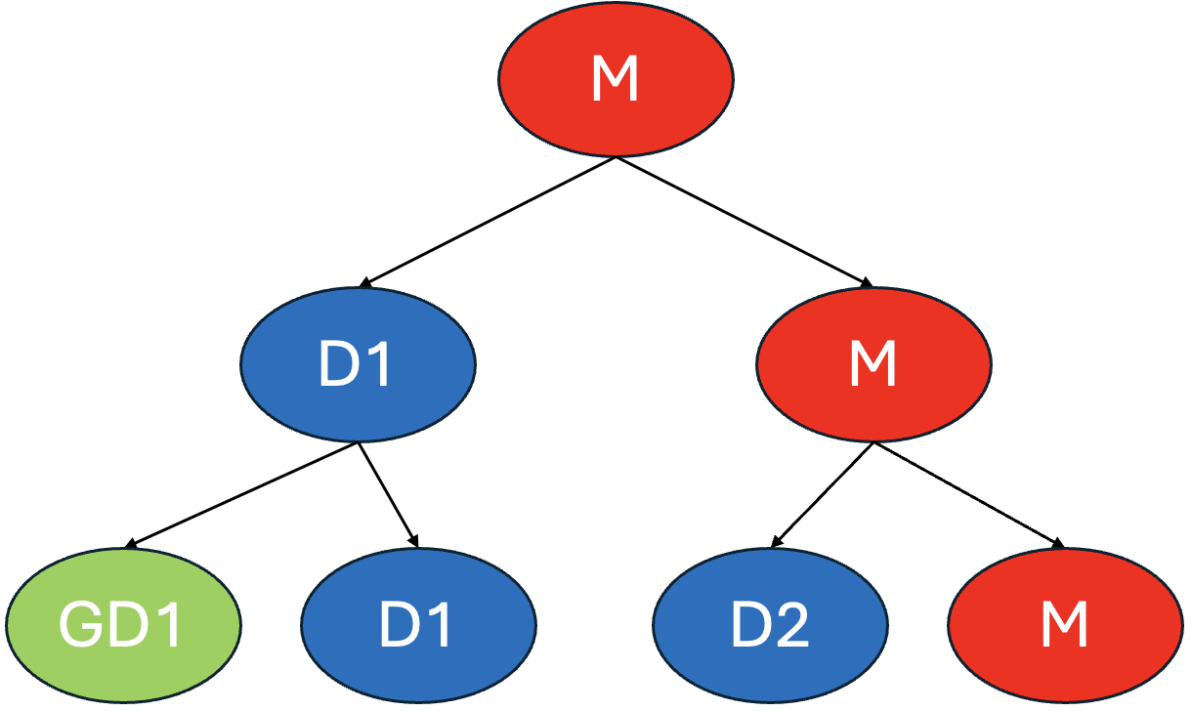
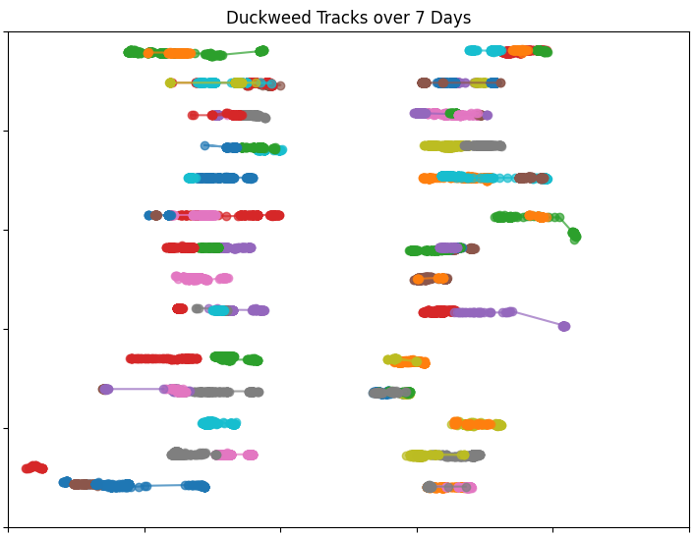
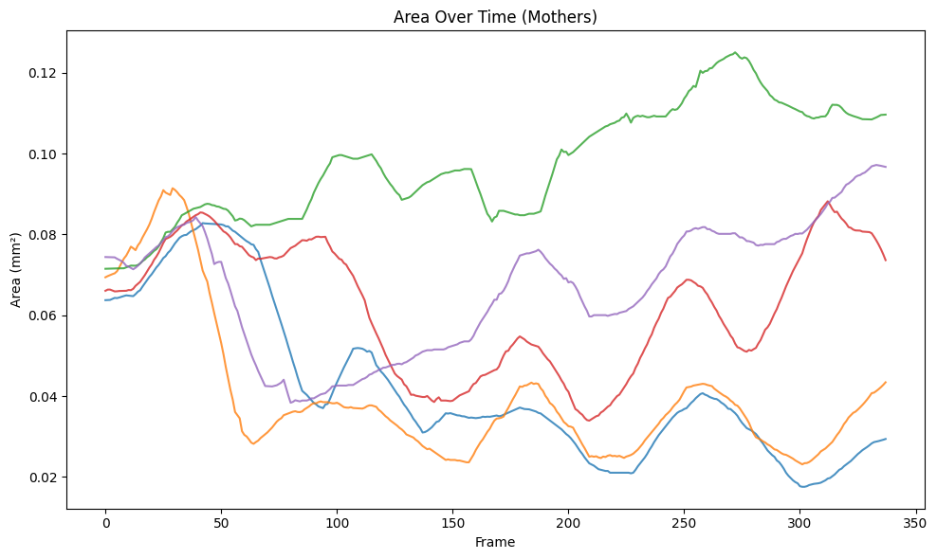
Duckweed Tracking
Ex. Lineage Tree – Well 4
Notes:
Beyond these measurements, the model is also useful because of its ability to track the duckweed over time
(Walk through left figure)
This is significant because it allows us to generate lineage information for the duckweed, giving us insight into how genes are passed down
(walk through right figures)

Slide 12
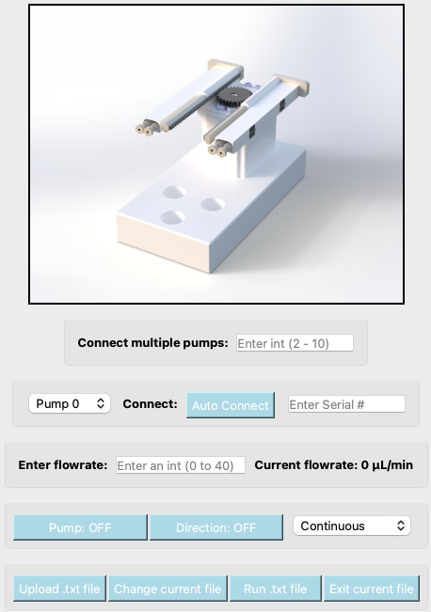
Conclusion and Future Directions
Designed a microfluidic platform to automate experimental procedures, and implemented a machine learning model to monitor duckweed growth and reproduction.
Implement CRISPR elements into platform
Optimize CNN with experimental variation
Integrate dual syringe pump into microfluidic controller
Notes:
To summarize: experimental --> microfluidics , image analysis → deep-learning
Our immediate next steps are…
In the future…
Talk about how this is a continuing project virtually, I will be building off this to work towards my own paper

Slide 13

Acknowledgements
This research was partially supported by NSF: Southeastern Undergraduate Internship in Nanotechnology (SUIN), under award# EEC-2349519
This work was performed at the Joint School of Nanoscience and Nanotechnology, a member of the National Nanotechnology Coordinated Infrastructure (NNCI), which is supported by the National Science Foundation (Grant ECCS-2025462)
Notes:
I’d like to acknowledge SUIN REU programe, the National Nanotechnology Coordinated Infrastructure, and the Southeastern nanotechnology infrastructure corridor for their funding and support this summer!

Slide 14
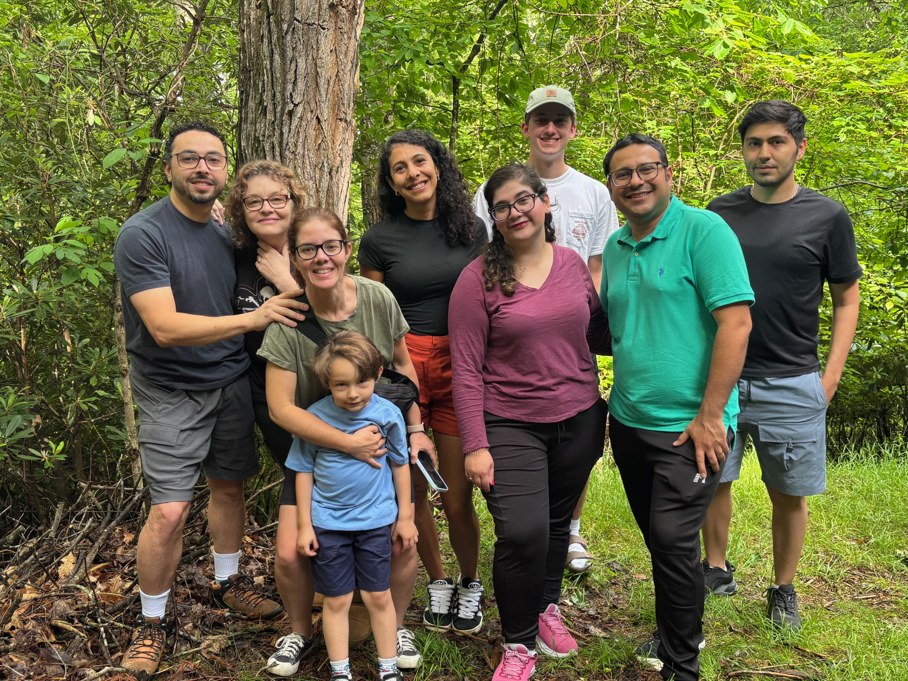

Thank you!
Questions?
Notes:
PDMS stands for polydimethylsiloxane, a type of silicone polymer

Slide 15
References
1. The “Duckweed Dip”: Aquatic Spirodela polyrhiza Plants Can Efficiently Uptake Dissolved, DNA-Wrapped Carbon Nanotubes from Their Environment for Transient Gene Expression Tasmia Islam, Swapna Kalkar, Rachel Tinker-Kulberg, Tetyana Ignatova, and Eric A. Josephs ACS Synthetic Biology 2024 13 (2), 687-691 DOI: 10.1021/acssynbio.3c00620
2. Samuel M. D. Oliveira, Douglas Densmore. Hardware, Software, and Wetware Codesign Environment for Synthetic Biology. BioDesign Res. 2022;2022:9794510.DOI:10.34133/2022/9794510
3. Y. Zhou, S. M. D. Oliveira, R. Sanka, D. McIntyre and D. Densmore, "Vespa: Logic-Level Constraint-Based Validation for Continuous-Flow Microfluidic Devices," in IEEE Transactions on Computer-Aided Design of Integrated Circuits and Systems, vol. 44, no. 2, pp. 483-496, Feb. 2025, doi: 10.1109/TCAD.2024.3435706
4. Feng Li, Jing-Jing Yang, Zong-Yi Sun, Lei Wang, Le-Yao Qi, Sina A, Yi-Qun Liu, Hong-Mei Zhang, Lei-Fan Dang, Shu-Jing Wang, Chun-Xiong Luo, Wei-Feng Nian, Seth O’Conner, Long-Zhen Ju, Wei-Peng Quan, Xiao-Kang Li, Chao Wang, De-Peng Wang, Han-Li You, Zhu-Kuan Cheng, Jia Yan, Fu-Chou Tang, De-Chang Yang, Chu-Wei Xia, Ge Gao, Yan Wang, Bao-Cai Zhang, Yi-Hua Zhou, Xing Guo, Sun-Huan Xiang, Huan Liu, Tian-Bo Peng, Xiao-Dong Su, Yong Chen, Qi Ouyang, Dong-Hui Wang, Da-Ming Zhang, Zhi-Hong Xu, Hong-Wei Hou, Shu-Nong Bai, Ling Li, Plant-on-chip: Core morphogenesis processes in the tiny plant Wolffia australiana, PNAS Nexus, Volume 2, Issue 5, May 2023, pgad141, https://doi.org/10.1093/pnasnexus/pgad141
5. Quantification of Genome Editing and Transcriptional Control Capabilities Reveals Hierarchies among Diverse CRISPR/Cas Systems in Human Cells Mario Escobar, Jing Li, Aditi Patel, Shizhe Liu, Qi Xu, and Isaac B. Hilton ACS Synthetic Biology 2022 11 (10), 3239-3250 DOI: 10.1021/acssynbio.2c00156 6. Reinard, T., Londenberg, A., Brychcy, M., Lühmann, K., Behrendt, G., Wichmann, M. (2020). Editing the Genome of Wolffia australiana. In: Cao, X., Fourounjian, P., Wang, W. (eds) The Duckweed Genomes. Compendium of Plant Genomes. Springer, Cham. https://doi.org/10.1007/978-3-030-11045-1_17

