Slide 1

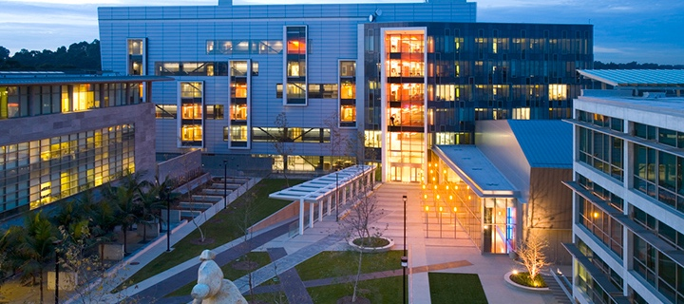




Analyzing Age-Dependent Differences in Injury Response to Traumatic Brain Injury using Calpain Nanosensor
By
Emily Yan from UC Santa Barbara &
San Diego Nanotechnology Infrastructure (SDNI)
Faculty PI: Ester J. Kwon, Shu Chien-Gene Lay Department of Bioengineering, UC San Diego
Mentor: Jordan Nichols, Shu Chien-Gene Lay Department of Bioengineering, UC San Diego
Presented at the 2025 NNCI REU Convocation, University of California San Diego, CA
August 4-5, 2025
Notes:
Hello, my name is Emily Yan and I am from UC Santa Barbara. My research project under Dr. Ester J. Kwon is focused on analyzing age-dependent differences in injury response to traumatic brain injury using a calpain nanosensor.

Slide 2
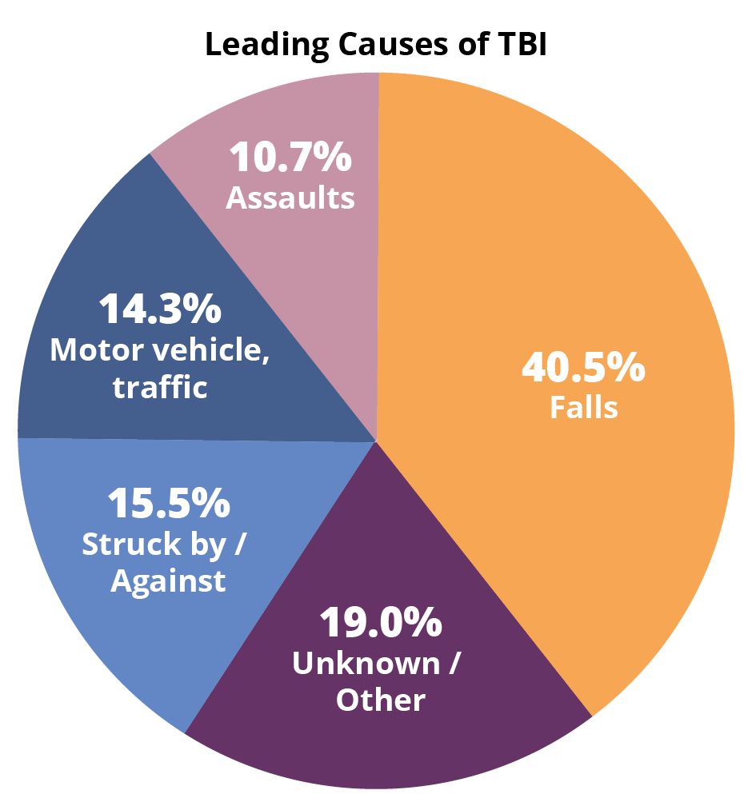
Prevalence of TBI
Traumatic Brain Injury (TBI) is caused by blunt force trauma to the head
50 million TBI incidents globally
Worldwide annual economic burden = US $400 billion dollars
CDC TBI Surveillance Report states:
  In 2018, adults aged ≥75 years account for the highest TBI-related hospitalization (32%) and deaths (28%)
TBI in the US, Centers for Disease Control and Prevention (2014), Brain Injury Alliance of Connecticut
Notes:
Traumatic Brain Injury, or TBI, is a major public health concern with an estimated 50 million incident cases of TBI globally and worldwide economic burden of $400 billion dollars annually. The leading causes of TBI are often outside of an individual’s control including motor vehicle accidents in young adolescents and falls in elderly adults. The CDC TBI Surveillance Report states that in 2018, adults aged 75 and above accounted for the highest traumatic brain injury related hospitalization rate at 32% and deaths at 28% with the second highest age group being young adolescents. Because there is increased prevalence of TBI hospitalization and mortality in these age groups, it is pivotal to learn more about how injury progression in TBI differs by age.

Slide 3
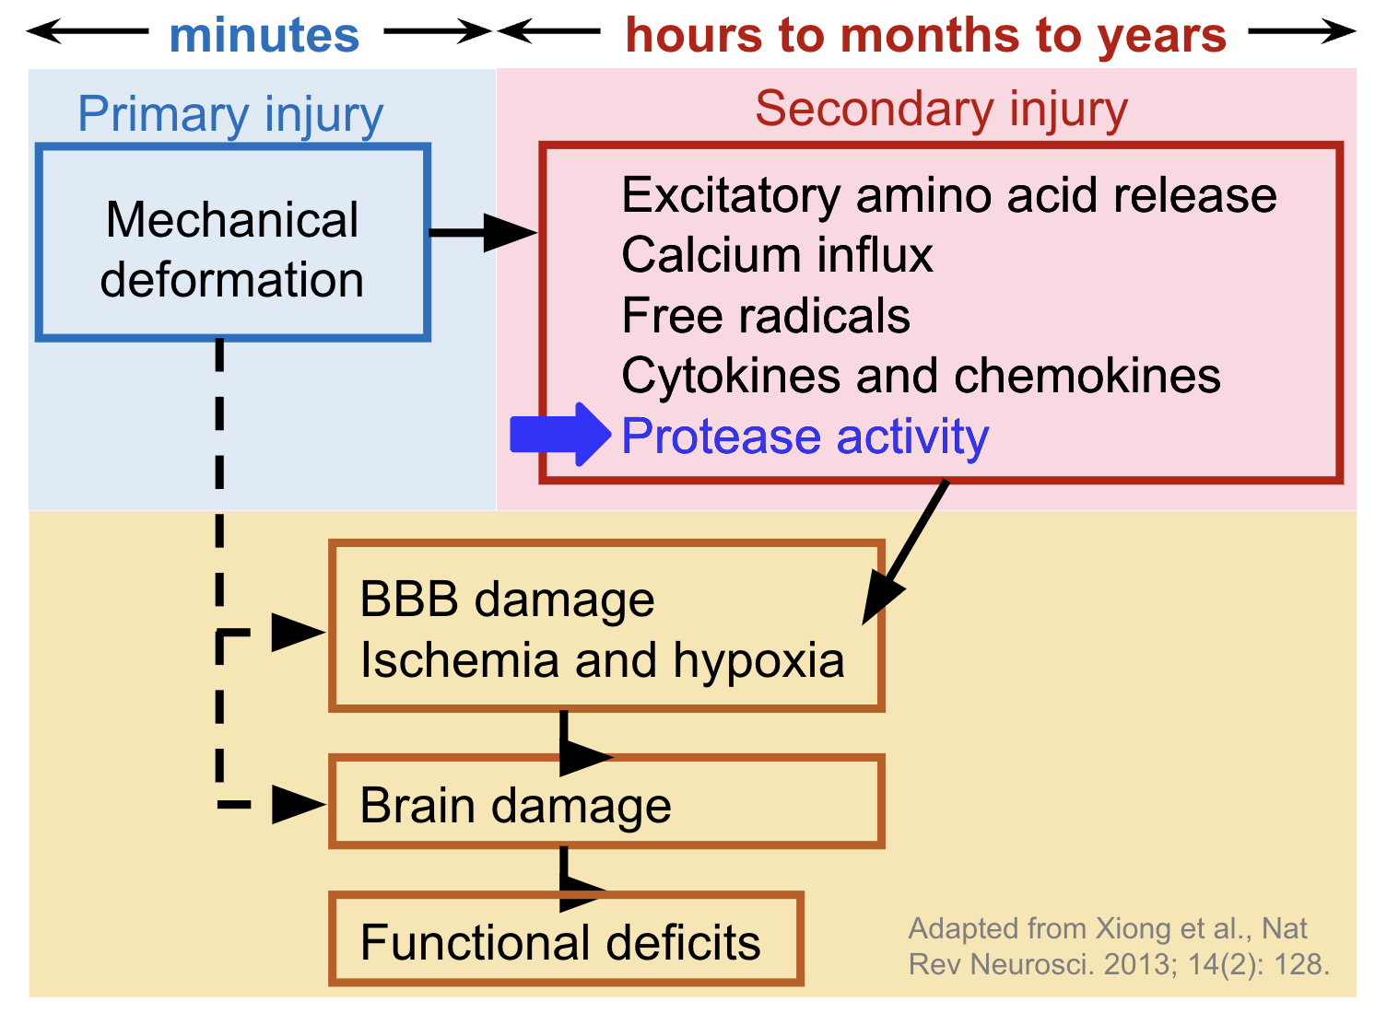
Pathology of TBI
Traumatic Brain Injury (TBI) characterized by two main phases (biphasic):
  Primary Injury - mechanical, occurs immediately after impact
  Secondary Injury - molecular, occurs from minutes to years
Progression of secondary injury can lead to long-term cognitive impairment and progressive neurodegeneration
Blood-Brain Barrier (BBB) refers to the protective semipermeable layer between the bloodstream and the brain
  BBB breakdown caused by secondary injury exposes brain to foreign and neurotoxic substances
Notes:
TBI is biphasic, meaning it is characterized by two main phases: the first is the primary injury which is mechanical and occurs immediately after impact and the second is secondary injury which is biochemical and can begin within minutes and continually progress for years. Both phases lead to the breakdown of the blood-brain barrier, a semipermeable layer between the bloodstream and the brain that protects the brain from foreign and neurotoxic substances in the bloodstream, which ultimately causes brain damage and functional deficits. Progression of secondary injury is complex and can lead to long-term cognitive impairment and progressive neurodegeneration, so it is important that we explore specific pathways in secondary injury pathology in order to find possible therapeutic targets. One of the hallmarks of secondary injury is elevated protease activity which is the specific aspect of secondary injury that I studied this summer.

Slide 4
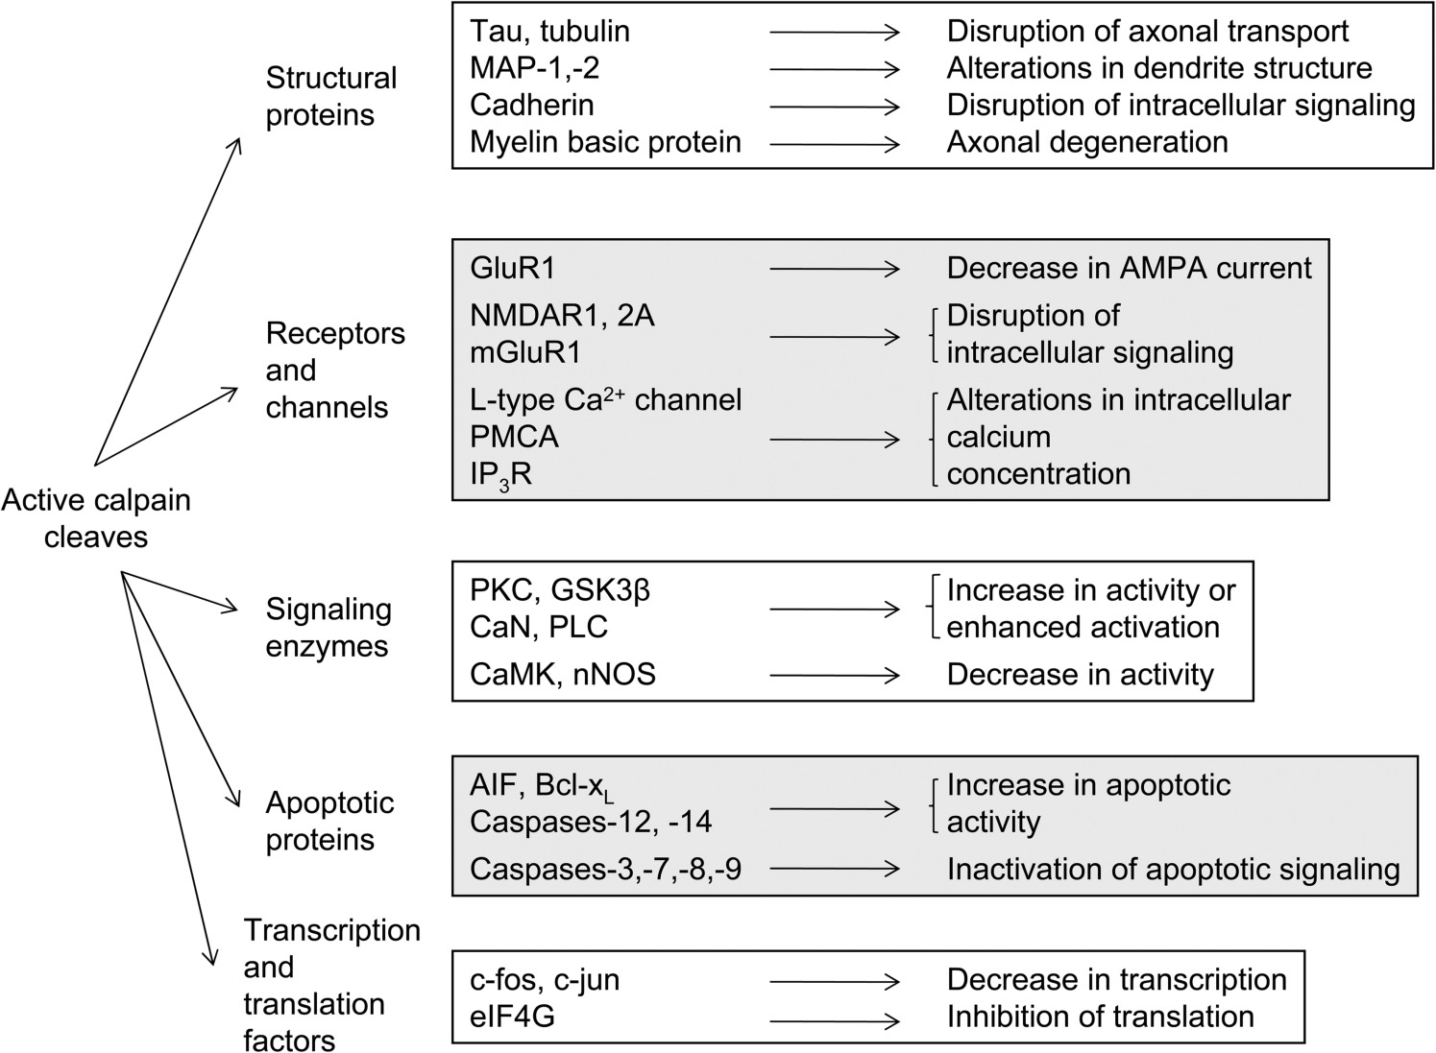
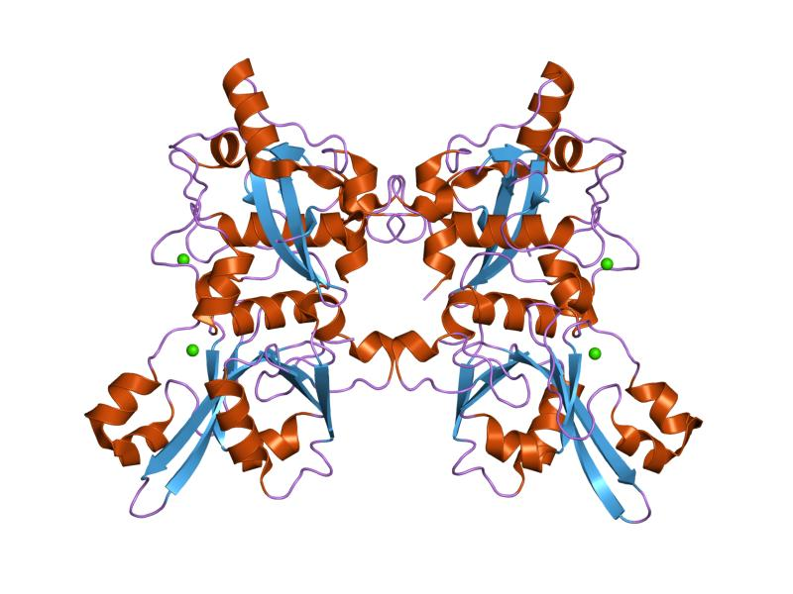
Calpain as an Acute Mediator of Secondary Injury
Calpain
  Calcium-dependent protease triggered by calcium influx within minutes after TBI
  Contributes to neurodegeneration and blood-brain barrier dysregulation
Diagram from Saatman KE, Creed J, Raghupathi R. Calpain as a therapeutic target in traumatic brain injury. Neurotherapeutics. 2010 Jan;7(1):31-42. doi: 10.1016/j.nurt.2009.11.002. PMID: 20129495; PMCID: PMC2842949.
Adapted from Protein Data Bank in Europe (PDBe), https://www.ebi.ac.uk/pdbe/entry/pdb/1mdw
Notes:
One of the proteases that is elevated during secondary injury is calpain, a calcium-dependent protease triggered by calcium influx after TBI. Calpain cleaves structural proteins, cell receptors and channels, signaling enzymes, and more causing disruptions in intracellular signaling and increasing apoptotic activity. It contributes to blood-brain barrier dysregulation and is a critical mediator of neurodegeneration, which is why we chose to focus on studying its activity post-TBI.

Slide 5
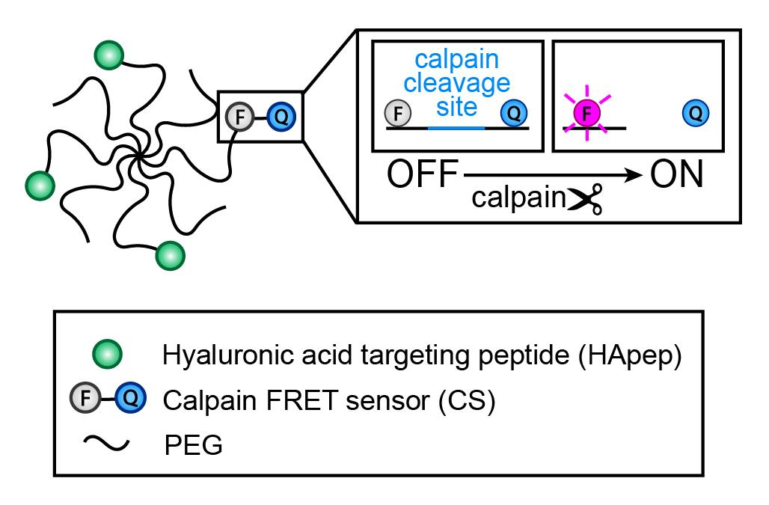
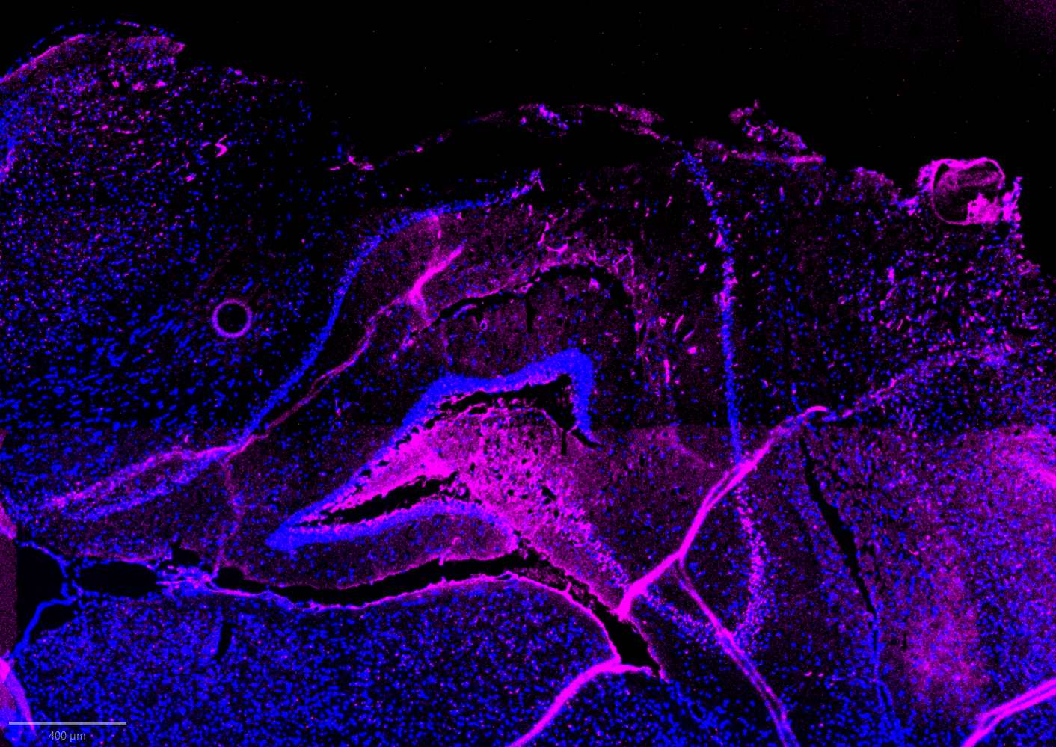
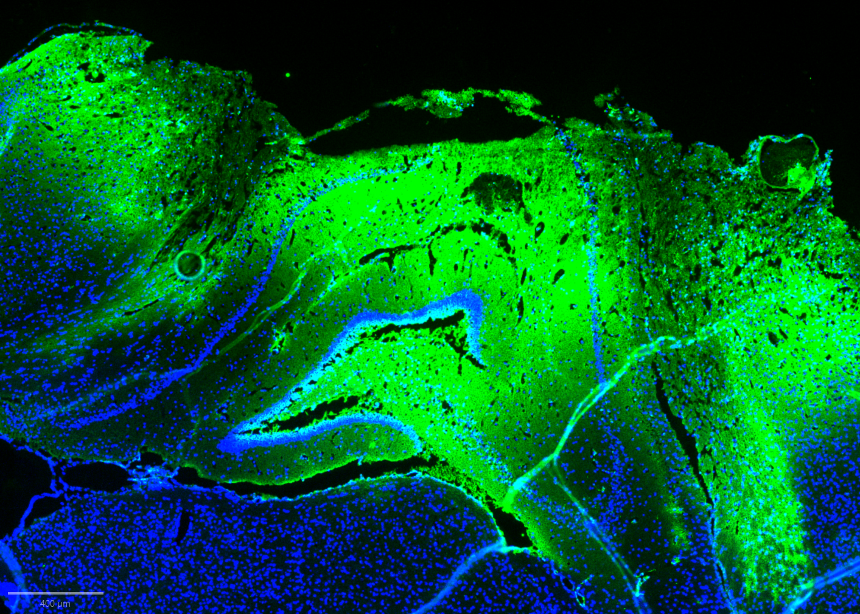
Visualizing Calpain Activity
Nanosensor Components (TBI-ABN with HA-targeting peptide)
  Hyaluronic acid targeting peptide conjugated to fluorescein amidite (FAM)
  Calpain Förster Resonance Energy Transfer (FRET) sensor
    Cy5 Fluorophore (Donor), Quencher (Acceptor), Calpain Cleavage Site
Spatially measures calpain activity and can quantify calpain activity in predefined windows of time post-TBI
Schematic of Calpain Nanosensor [3]
Fluorescent Imaging of Cy5 (left) and FAM (right)
Notes:
The Calpain nanosensor I utilize in this study is engineered by the Kwon lab. Here is a schematic of the nanosensor, it is made of 8-PEG arms which act as a hydrophilic carrier to improve pharmacokinetics. Attached to the PEG arms are a Calpain Forster resonance energy transfer, or FRET, sensor with a Cy5 fluorophore and black hole quencher that absorbs emissions from Cy5 until it is cleaved by calpain, as shown in the schematic. Hyaluronic acid targeting peptides conjugated to fluorescein amidite, or FAM, are also attached to increase signal generation. The main advantages of our calpain nanosensor is that it can spatially measures calpain activity with heterogenous activation at a cellular resolution and can quantify calpain activity in predefined windows of time post-TBI. Below are some fluorescent brain images of Cy5 activation in magenta and FAM in green.
Heterogeneous activation of calpain sensor with cell-types: why is it active in certain cells or accumulated in certain cells and not active

Slide 6
Project Outline
Goal: Measure region- and cell-specific activation of calpain to determine if calpain activity (measured by calpain activity-based nanosensor) differs by age.
Measure calpain activation in neurons, astrocytes, and microvasculature in injured brains from two groups: young (8-12 weeks) and aged (over 12 months)
Image regions of interest in the perilesional cortex and hippocampus and complete image analysis to quantify calpain activation colocalized in neurons, astrocytes, and microvasculature in mice by age group (young/old) and brain region
Experimental Design
Groups* | Young (8-12 weeks) | Intermediate (3-5 months) | Aged (>12 months)
Experimental (injured + sensor) | n=3, all 9 weeks | n=1, ~4 months | n=2, all >14 months
Control (uninjured + sensor) | n=2, all 9 weeks | N/A | n=1, >15 months
Control (injured + saline) | n=3 | N/A | N/A
*sex-matched: all female mice
Notes:
The goal of my project is to measure region- and cell-specific activation of calpain to determine if calpain activity (measured by calpain activity-based nanosensor) differs by age. I looked at calpain activation in neurons, astrocytes, and microvasculature in injured brains from two groups: young which is 8-12 weeks old and aged which is over 12 months old. I imaged and quantified calpain activation in regions of interest colocalized with these cell-types. Here is a brief overview of the experimental design including experimental group and controls. We had 3 mice in the young experimental group and two mice in the aged experimental group. We only have one intermediate aged mouse at 3-5 months old that will not be used in analysis but is included since I have the data.

Slide 7
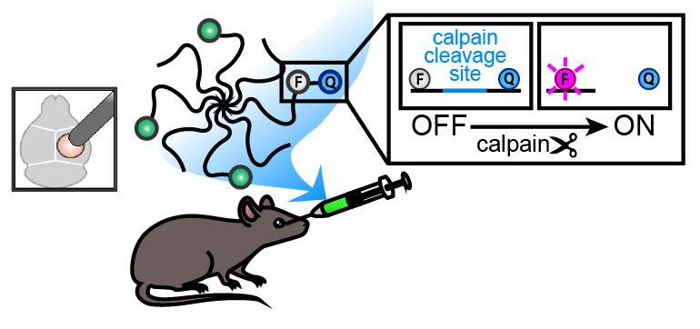
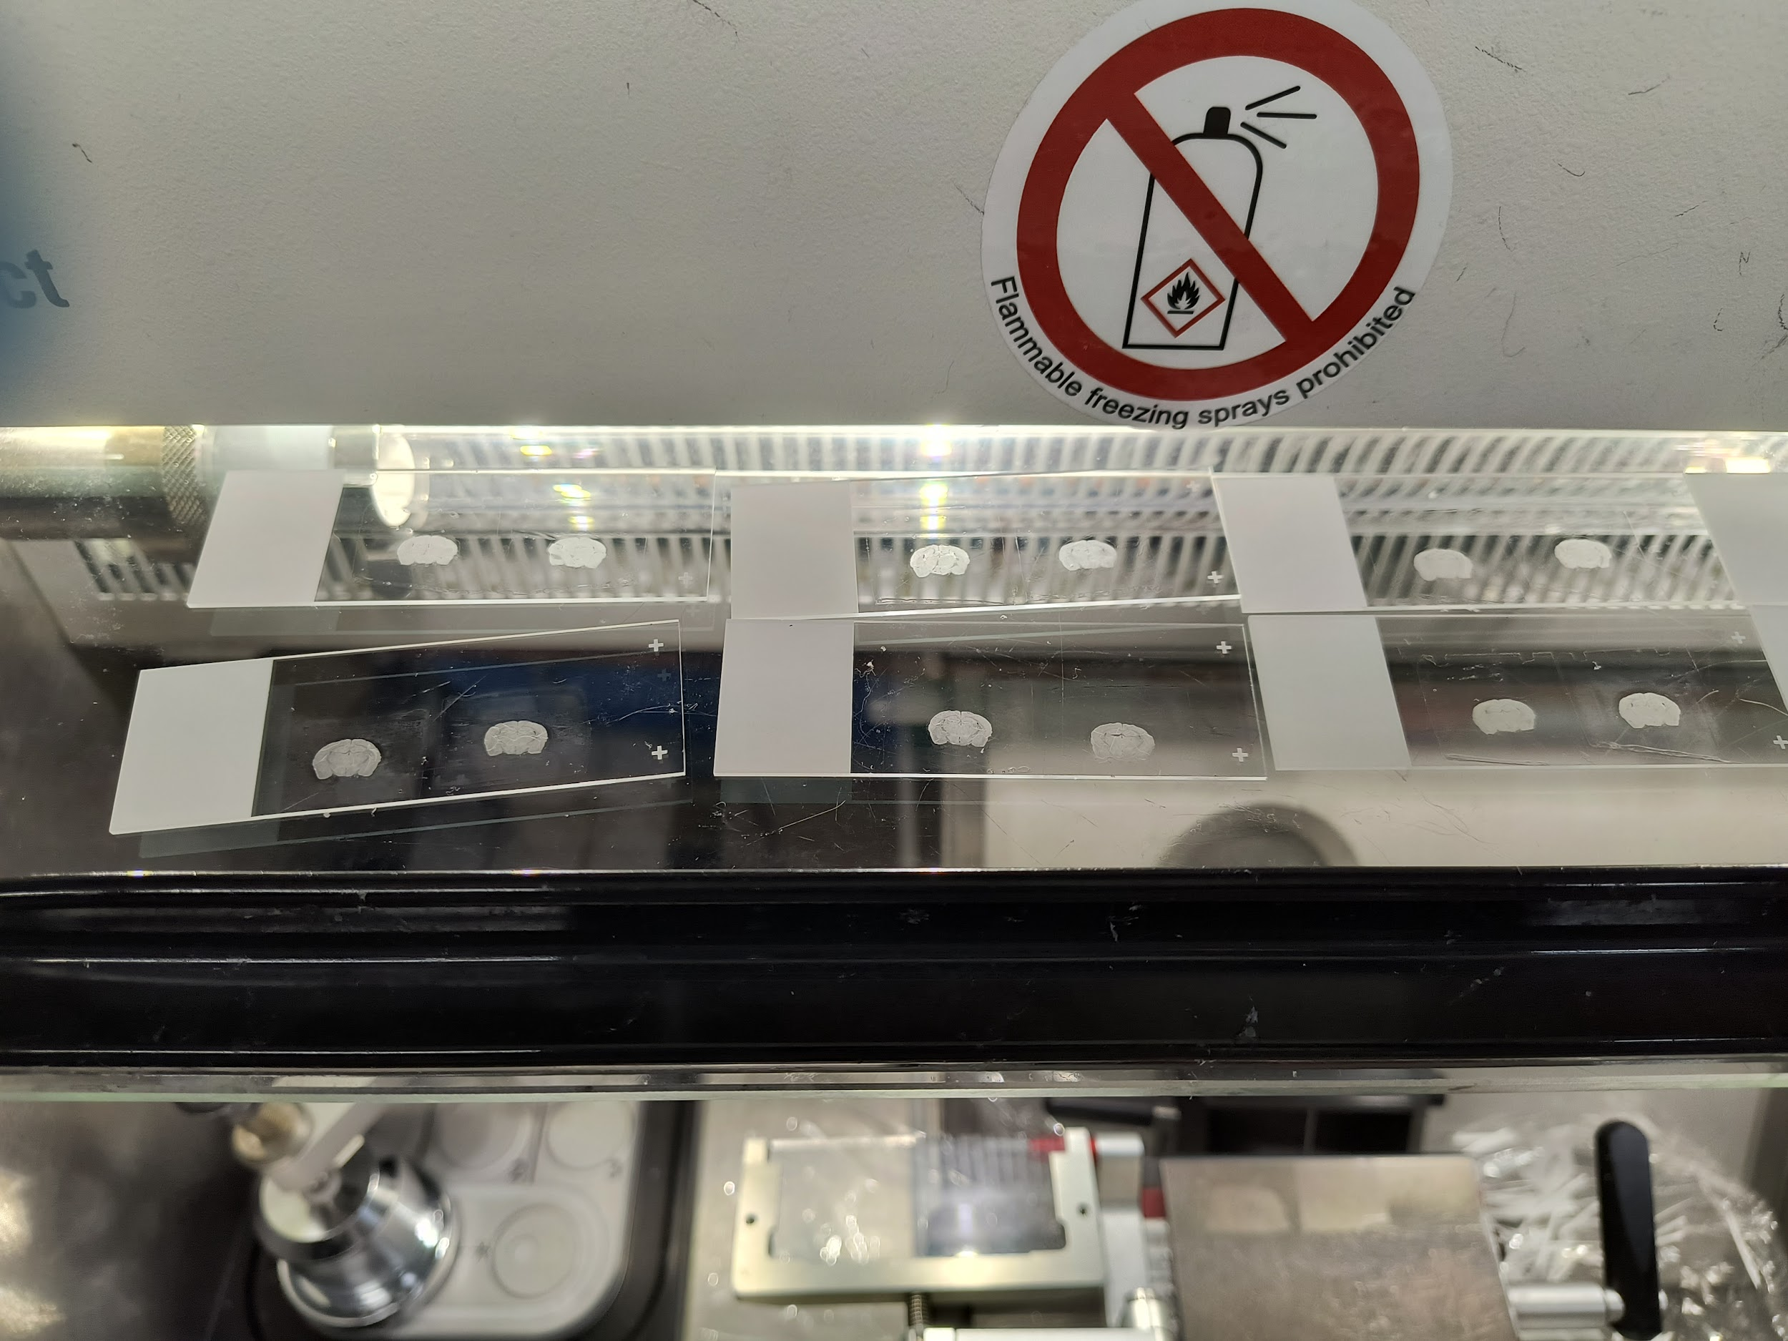
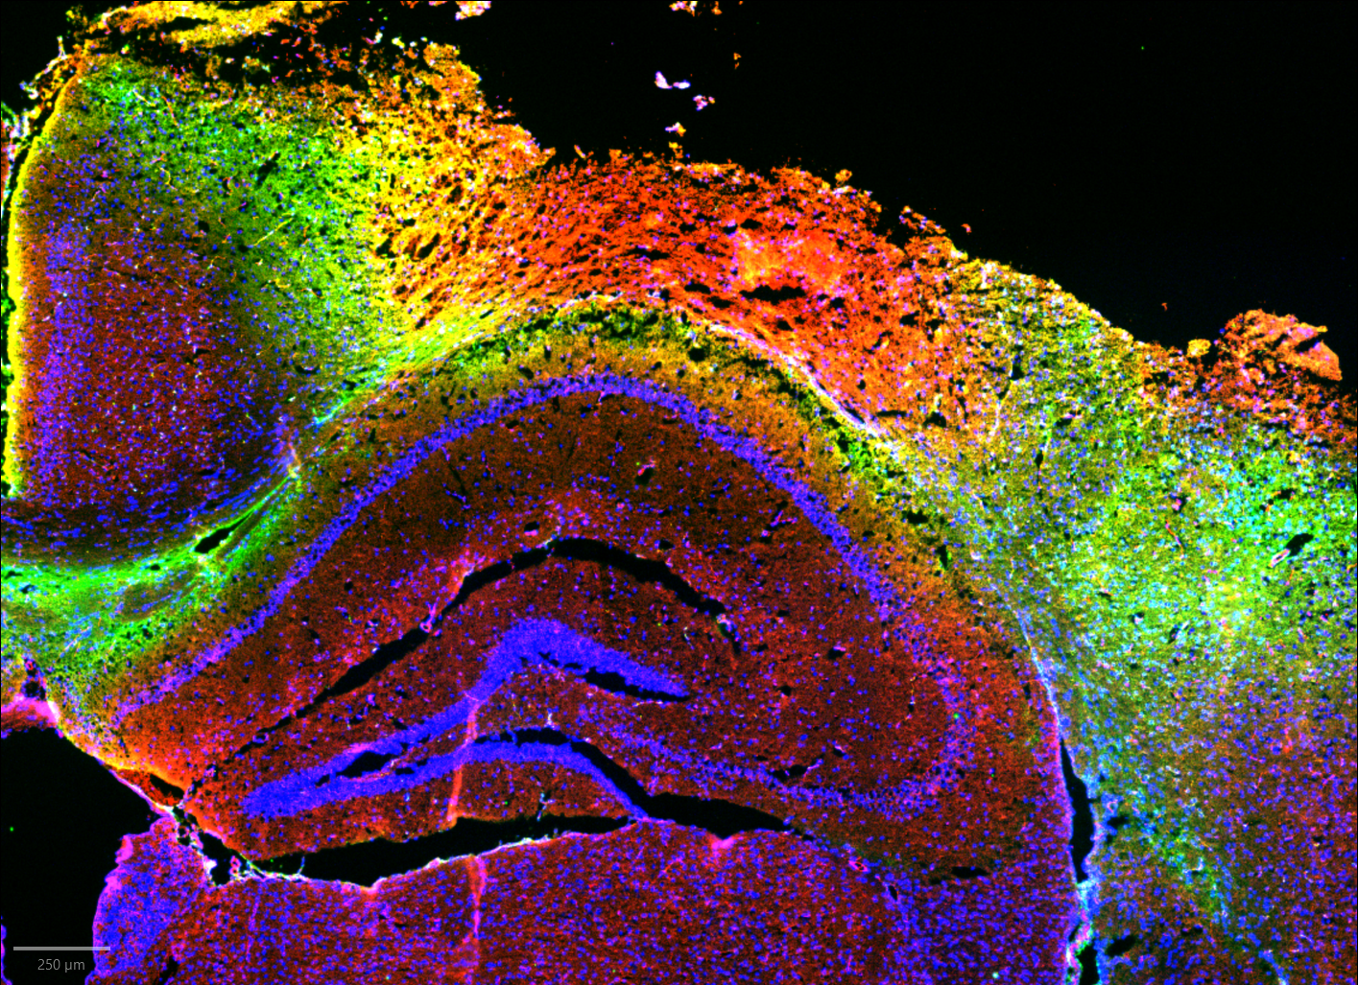


Project Timeline
In Vivo
Preparing Brain Slices
5 hours
1 hour
CCI
Inject sensor
Perfusion
16 hours
Post-fix solution
Sucrose then Embed brains
Section on Cryostat
Immunostaining
Imaging + Colocalization Analysis
Notes:
Talk <30 seconds about methods
This is a brief overview of how we collect brain slices. In vivo, we subject a mouse to controlled cortical impact, a well-known and reproducible TBI model, then inject the calpain nanosensor 5 hours later. We perfuse and collect the brain one hour after injection, and post-fix the brain in formalin for 16 hours. Once the brain is fixed, we dehydrate with sucrose and embed brains for sectioning on the cryostat. After the slices are collected, we immunostain for cell surface markers that we’re interested and image using epifluorescence microscopy. Finally, we analyze the images using QuPath and GraphPad Prism.
Q: why 5 hour timeline? A: biphasic opening of bbb is maximally permeable and calpain activity is highest in 3-5 hour window after TBI

Slide 8
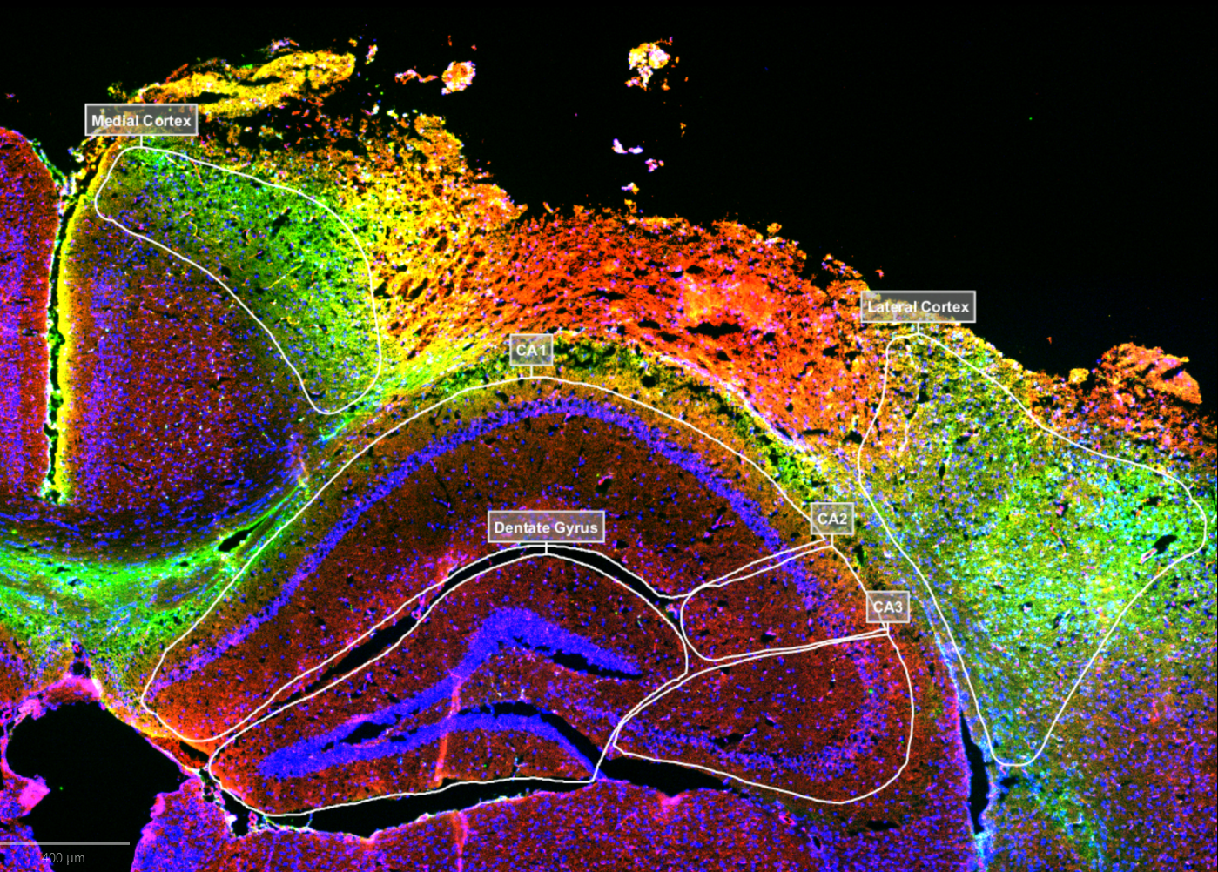
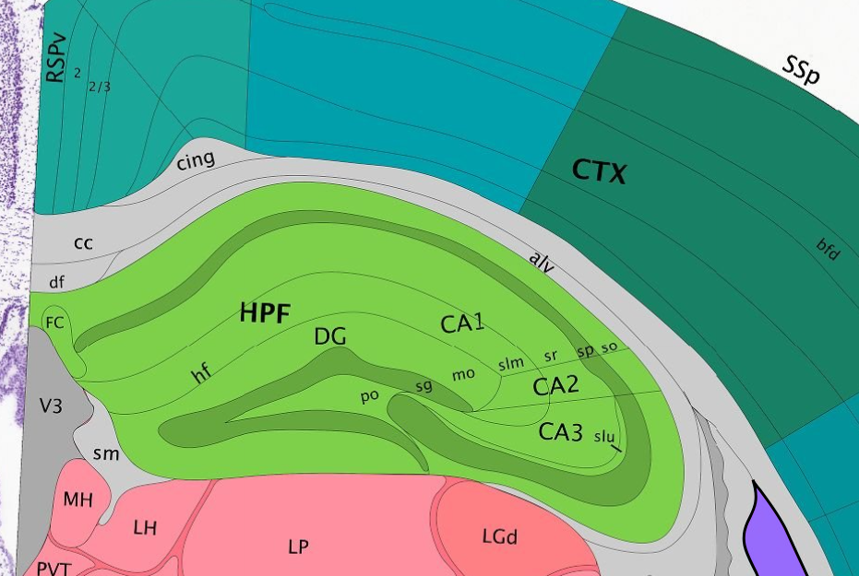
Colocalization Analysis
Spatial Annotations using QuPath
  Annotating regions of interest in injured brain: Perilesional Cortex (Lateral Cortex, Medial Cortex) and Hippocampus (Dentate Gyrus, CA1, CA2, CA3)
  Training pixel classifiers to more accurately recognize GFAP and CD31; object classifier for NeuN
Mean fluorescence intensity data analysis by age, region, and cell-type using GraphPad Prism
Hippocampus of Coronal Mouse Brain Slice
Source: Allen Mouse Brain Atlas
Notes:
There are two main parts of colocalization analysis. First is spatial annotations on brain images which include annotating regions of interest in the brain and annotating our cell-types. We chose to look at the perilesional cortex because it is involved in high order neurological function and the hippocampus because the molecular mechanisms behind activity-dependent change is well understood. Within these two main regions, we have subgroups which are the medial and lateral cortex for the perilesional cortex and the dentate gyrus, CA1, CA2, and CA3 for the hippocampus as shown in these photos. To annotate cell types, I trained AI classifiers to recognize astrocytes immunolabeled by GFAP, microvasculature immunolabeled by CD31, and neurons immunolabeled by NeuN. After annotations, I took the mean fluorescence intensity data within these annotations to conduct colocalization analysis by age, region, and cell-type.

Slide 9
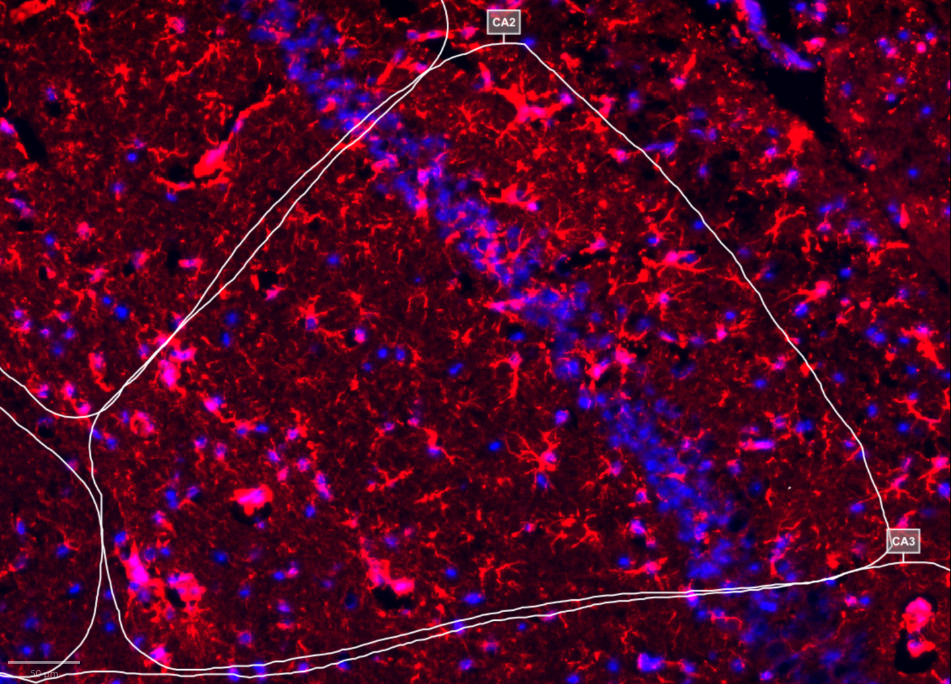
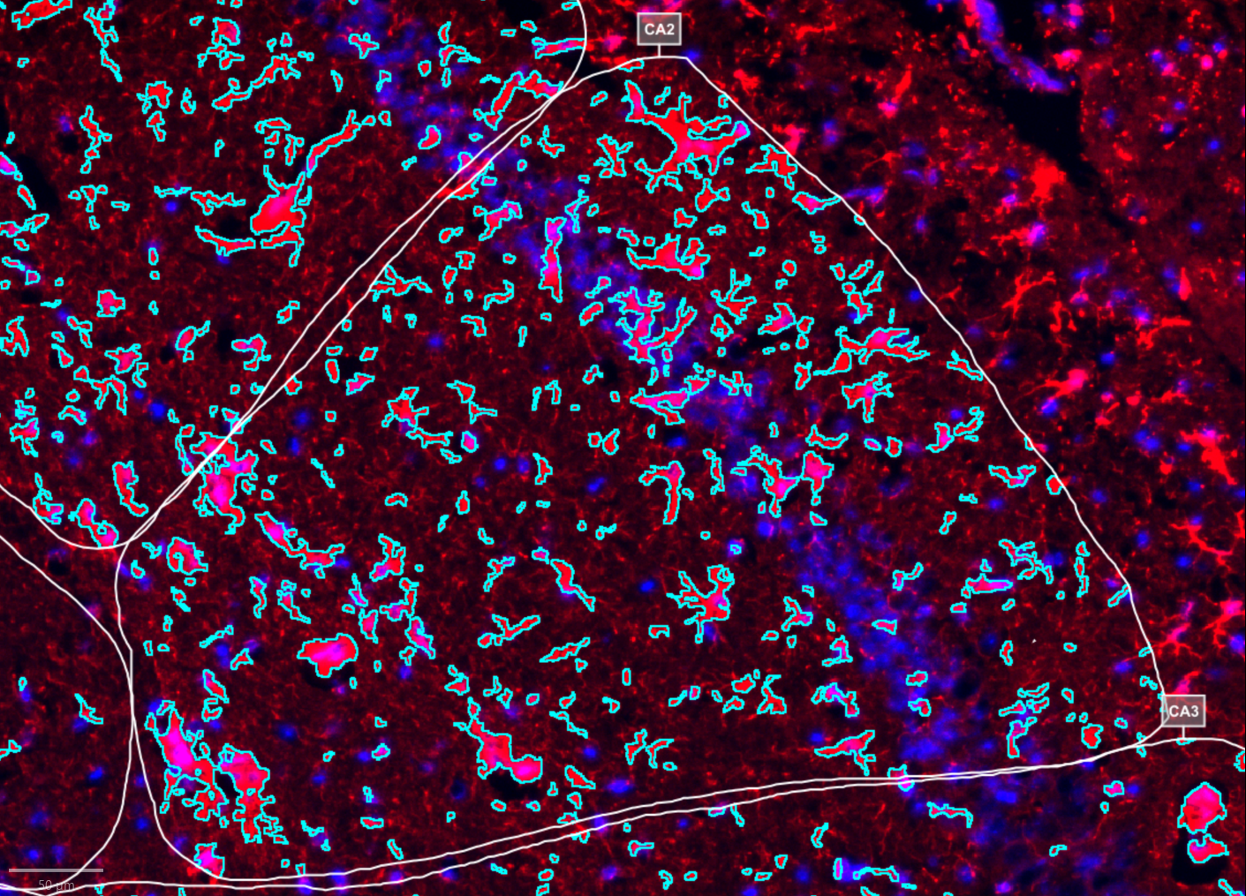
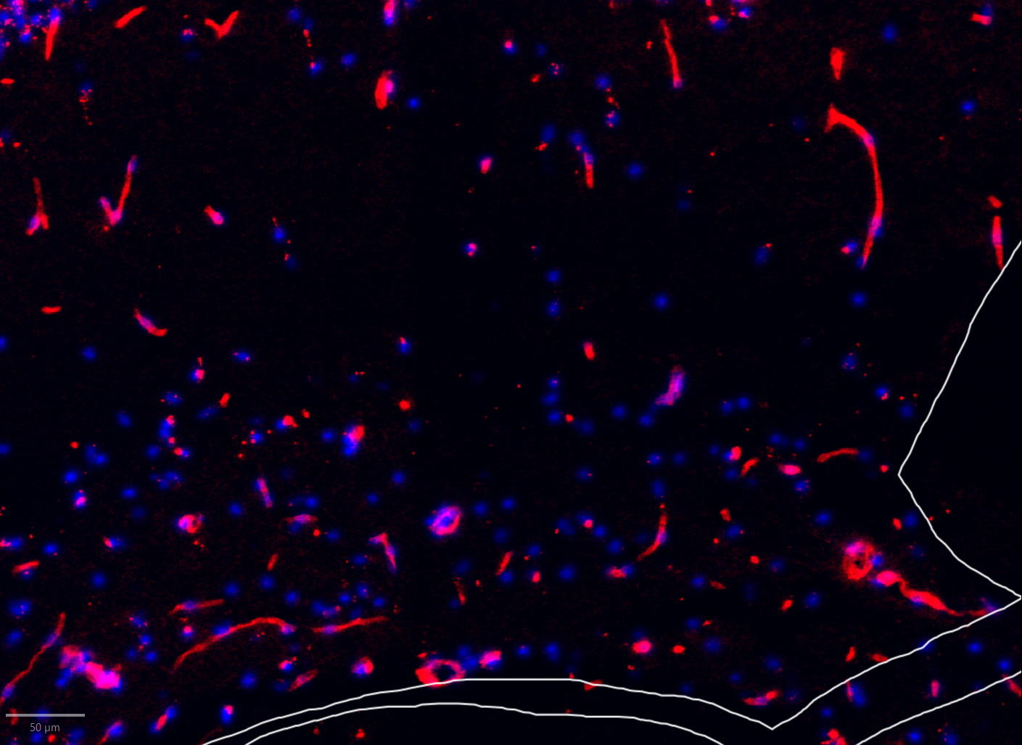
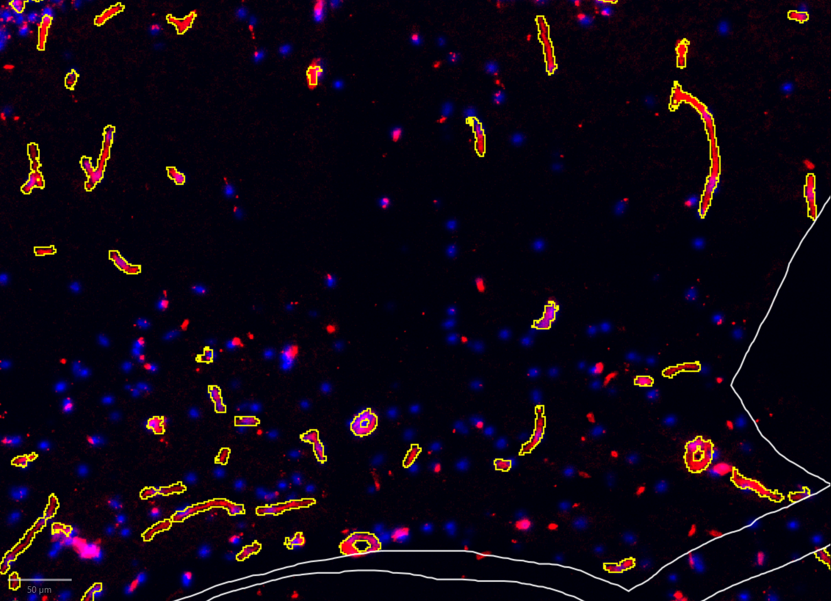
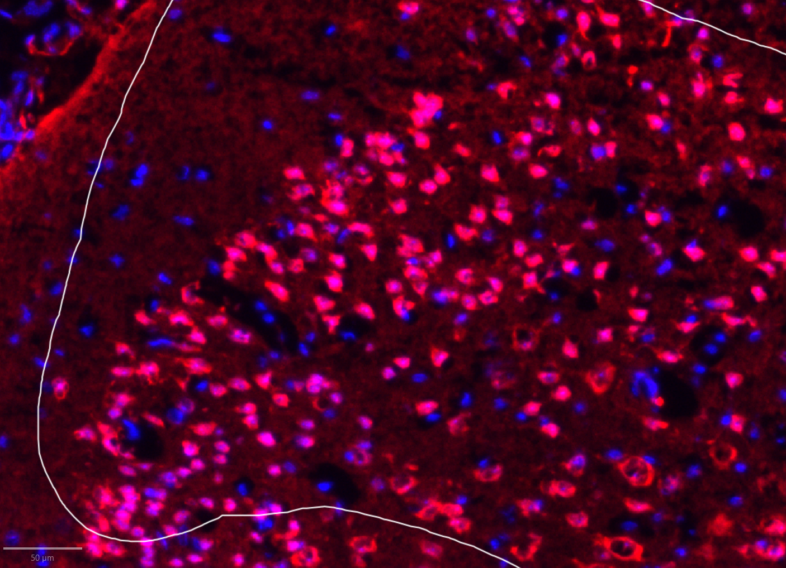
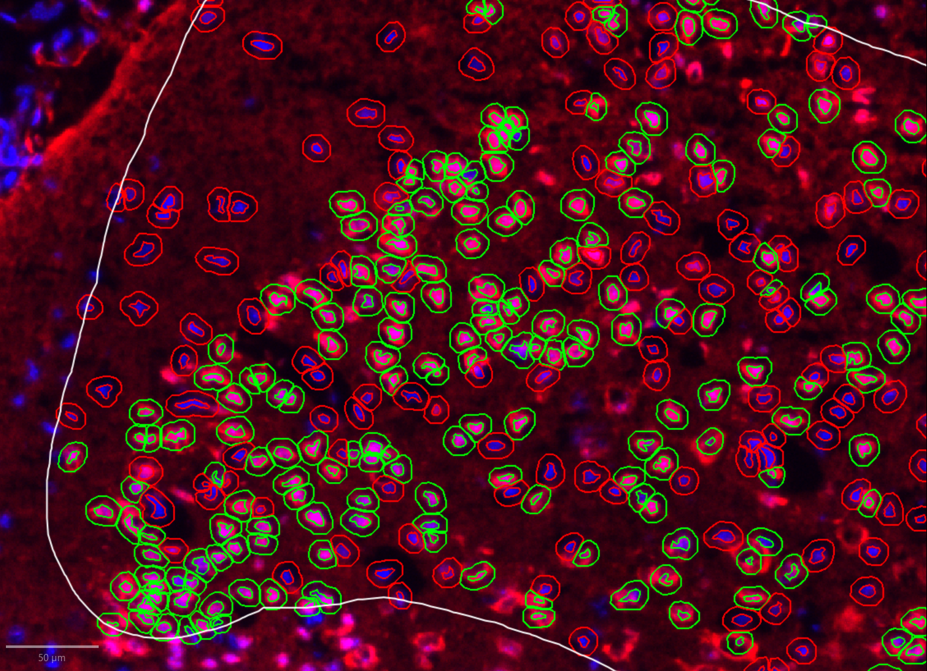
QuPath Workflow
Manual Annotation of Regions
Manual Training of Pixel Classifiers for Astrocytes/Microvasculature
Young Brain CA2 Region
DAPI
GFAP
GFAP Detections
Cell Detection & Object Classifier for Neurons
Young Brain Medial Cortex
Aged Brain CA1 Region
DAPI
NeuN
DAPI
CD31
NeuN Detections
CD31 Detections
Notes:
Here is an overview of my workflow. First I manually annotated brain regions of interest then I trained pixel classifiers to recognize GFAP and CD31 and an object classifier for NeuN. These pictures show the final trained classifier and its predicted detections for each cell type. The cell marker staining is in red for each respective cell-type and cell nuclei staining is in blue to ensure that detections labeled by the classifiers corresponded to actual cells.

Slide 10
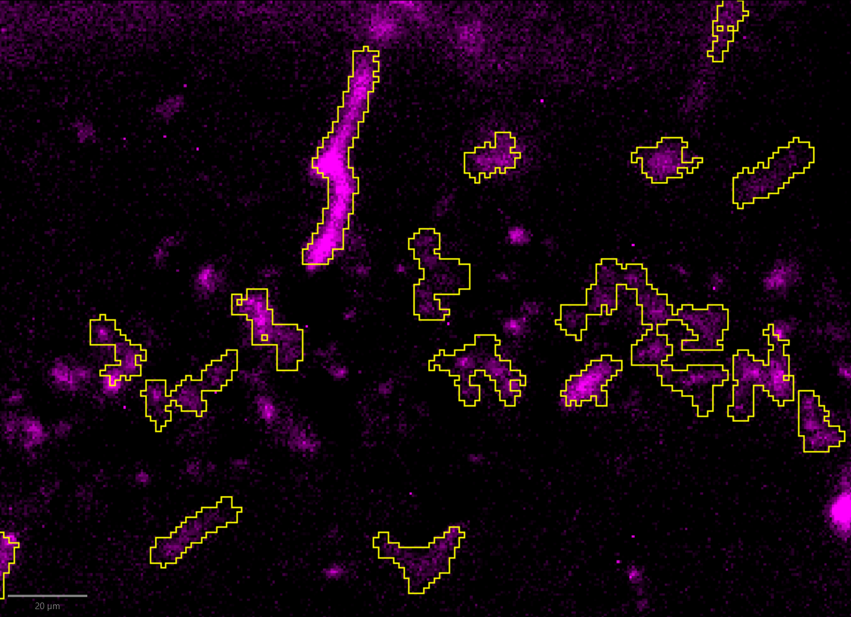
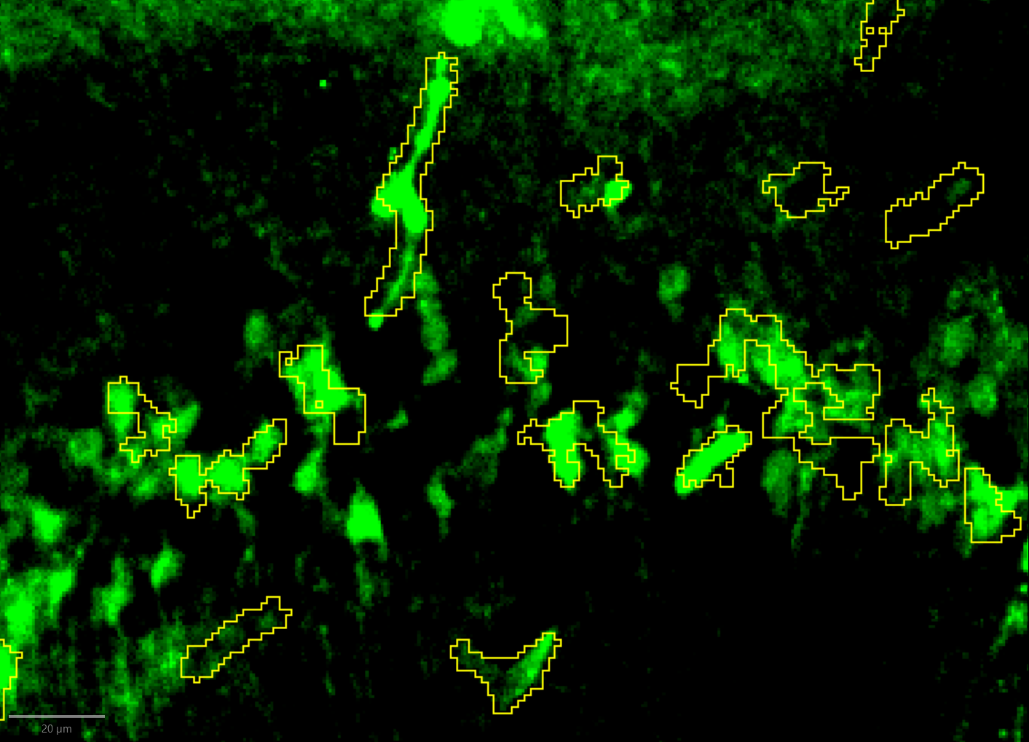
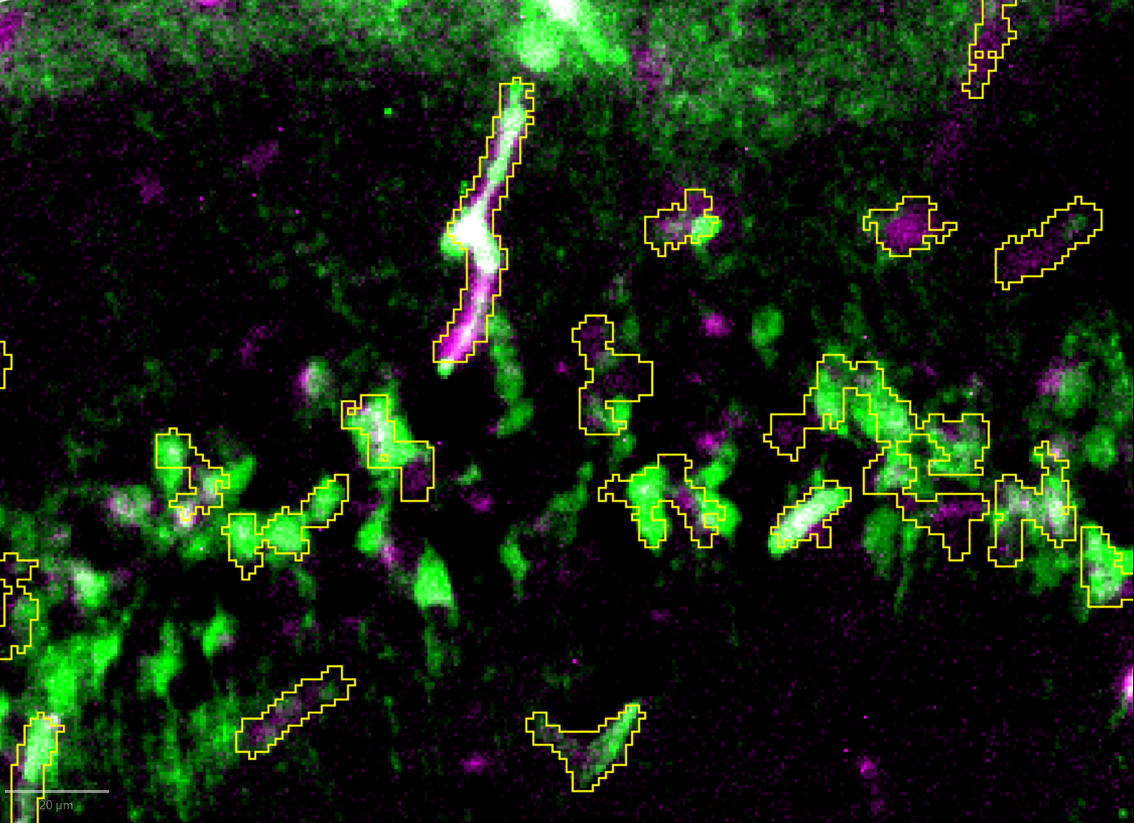

Google Sheets-Prism Workflow
Nanosensor Activation (Cy5)
Nanosensor Accumulation (FAM)
Colocalized Cy5 and FAM
CD31 Detections
CD31 Detections
CD31 Detections
For every detection in Injured Mice with Nanosensor
Cy5 MFI - Saline avg(Cy5 MFI)
FAM MFI - Saline avg(FAM MFI)
[Cy5 MFI - Saline avg(Cy5 MFI)]
[FAM MFI - Saline avg(FAM MFI)]
Remove background signal in each channel
Normalize for sensor accumulation
MFI Data organized using Google Sheets
Statistical analysis and visualization done using GraphPad Prism
Notes:
In these fluorescent images, nanosensor activation is represented by Cy5 in magenta, nanosensor accumulation is represented by FAM in green, and colocalized nanosensor activation and accumulation is represented by white. After all the annotations were made, I took mean fluorescence intensity for Cy5 and FAM in every detection and corrected for auto-fluorescence by region using data from our saline brains. Then, I normalized for sensor accumulation by dividing the MFI of Cy5 by the MFI of FAM to get a ratio for calpain activation in every detection.

Slide 11
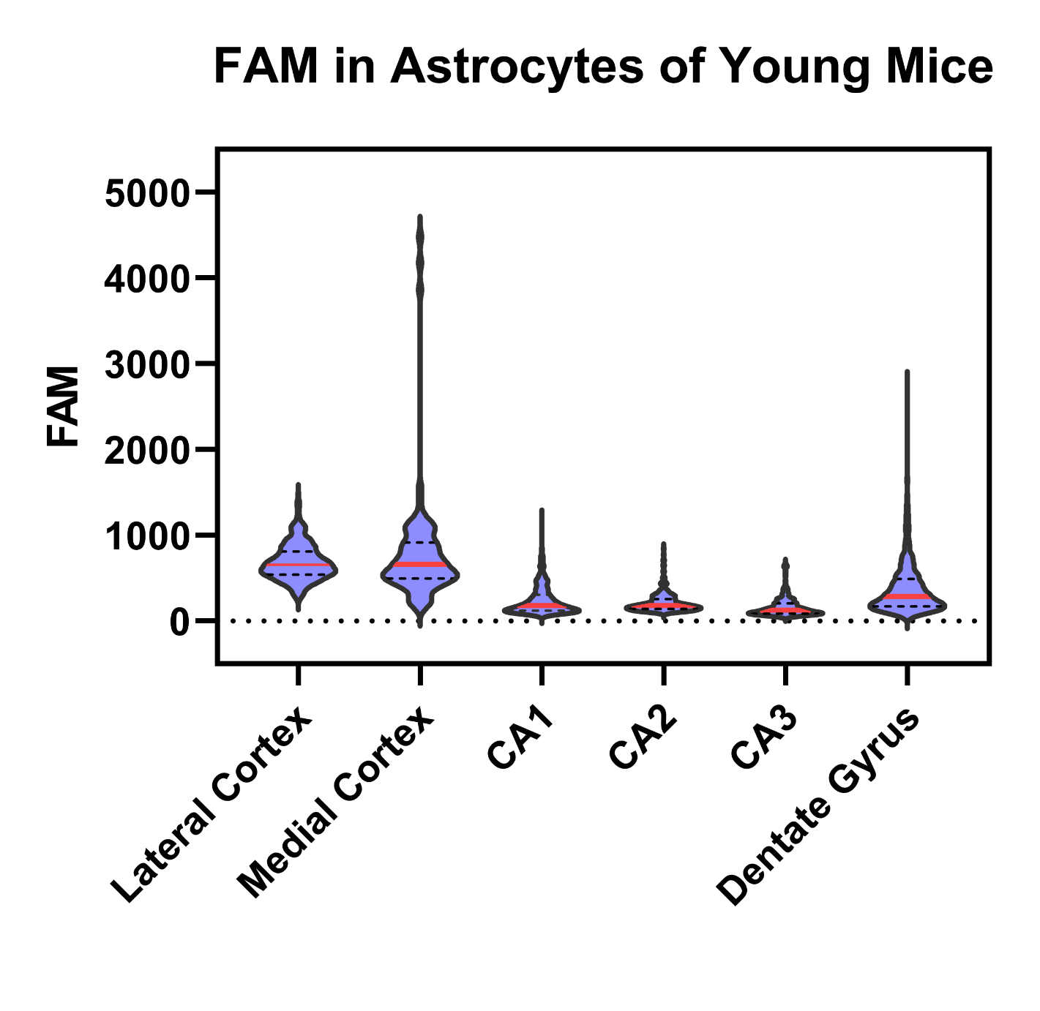
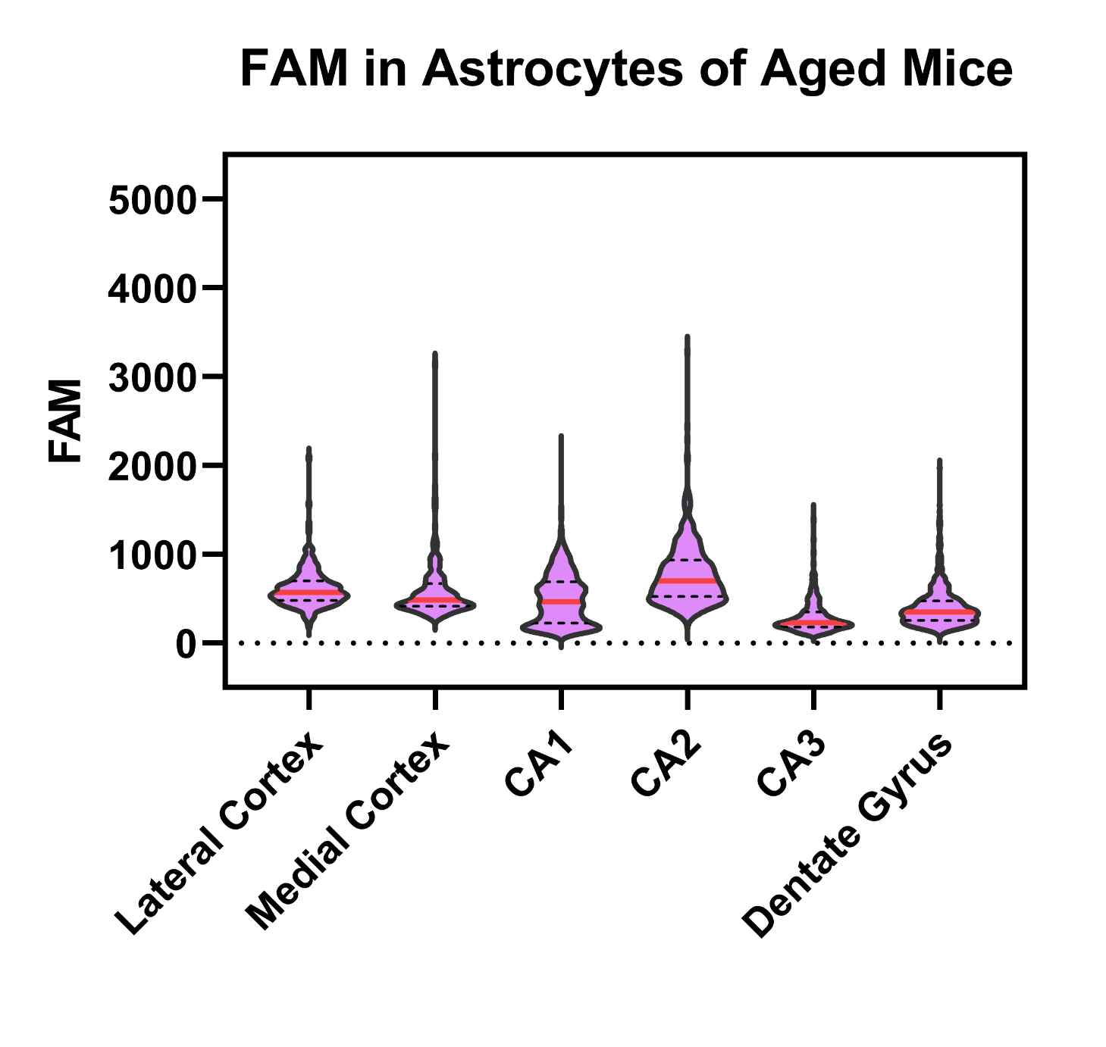
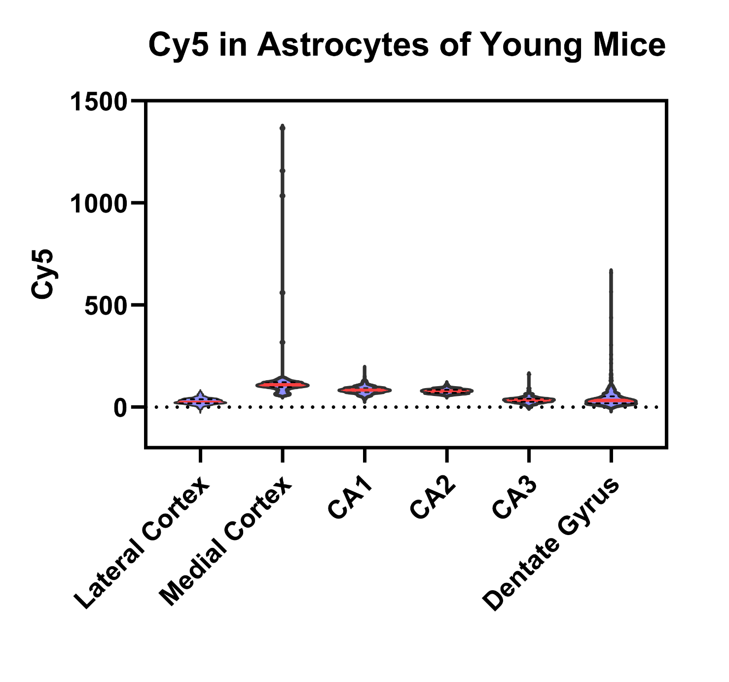
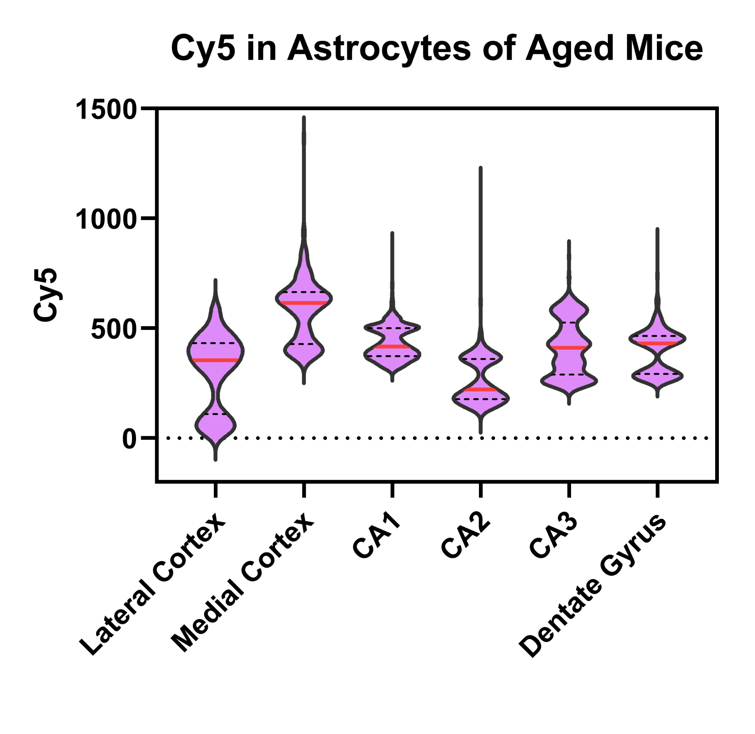
Nanosensor Accumulation and Activation in Astrocytes by Age
Nanosensor Accumulation (FAM)
Nanosensor Accumulation (FAM)
Nanosensor Activation (Cy5)
Nanosensor Activation (Cy5)
Notes:
The top row of graphs are nanosensor accumulation in astrocytes and the bottom row of graphs are nanosensor activation in astrocytes with the young group in the left column and the aged group in the right column. As we can see, there is higher nanosensor accumulation and activation in the aged group compared to the young group. This is unsurprising since blood brain barrier permeability is known to increase with age therefore allowing more nanosensor to accumulate in aged brains.

Slide 12
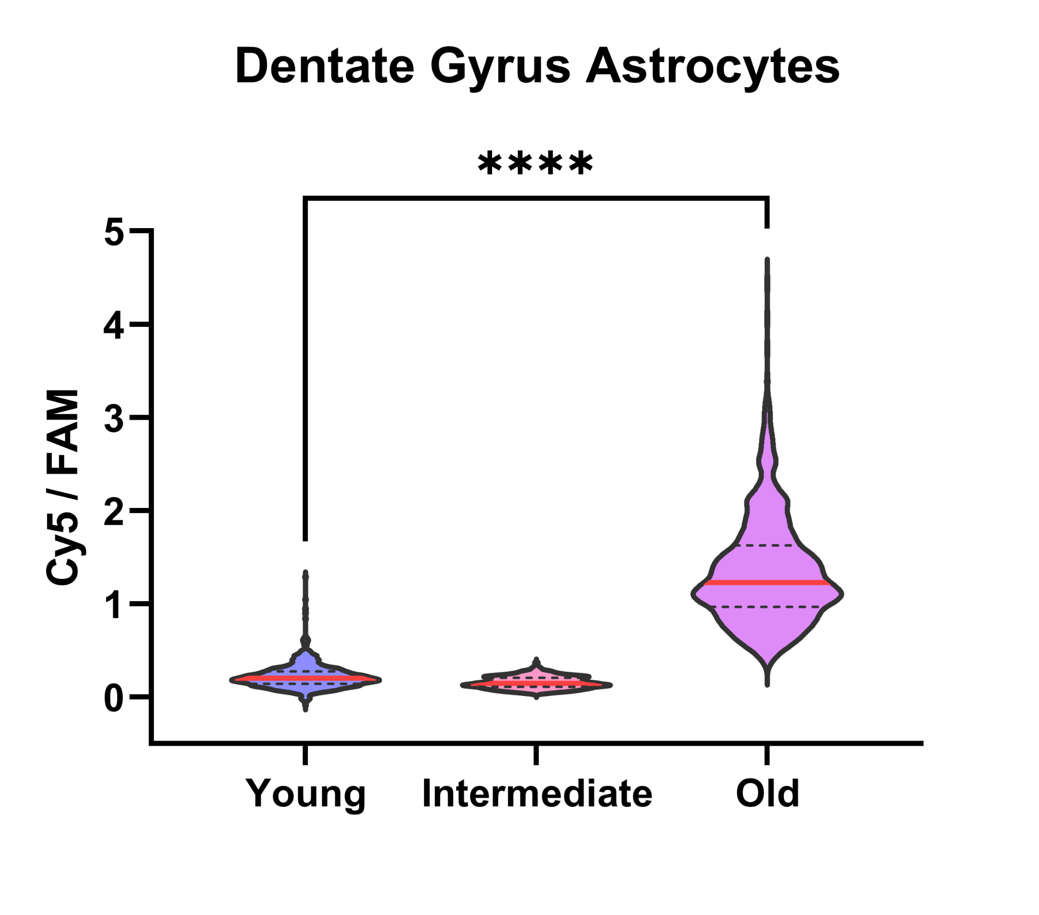
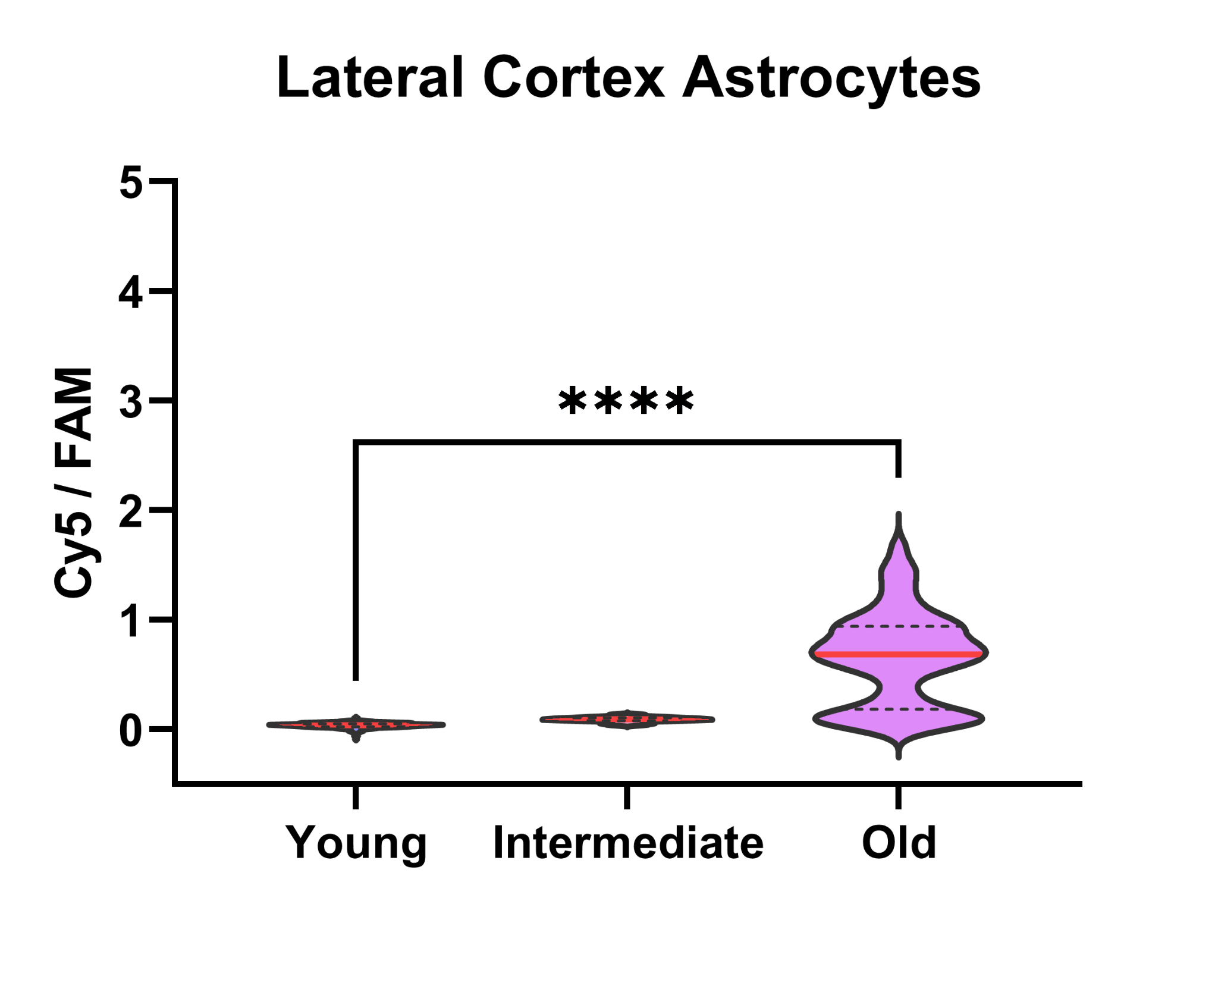
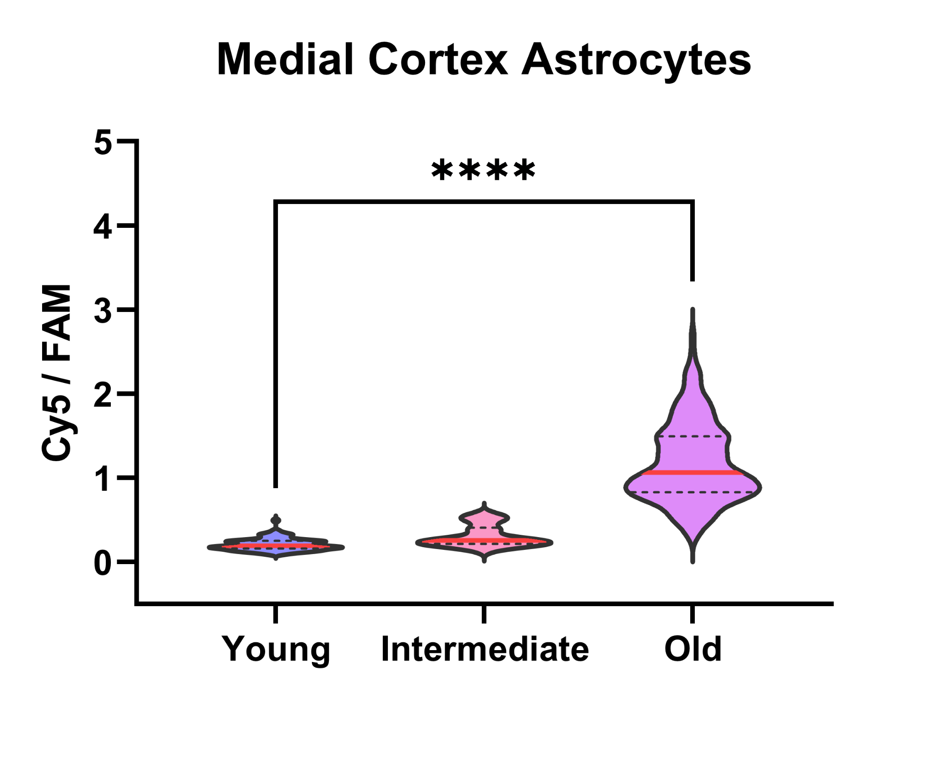

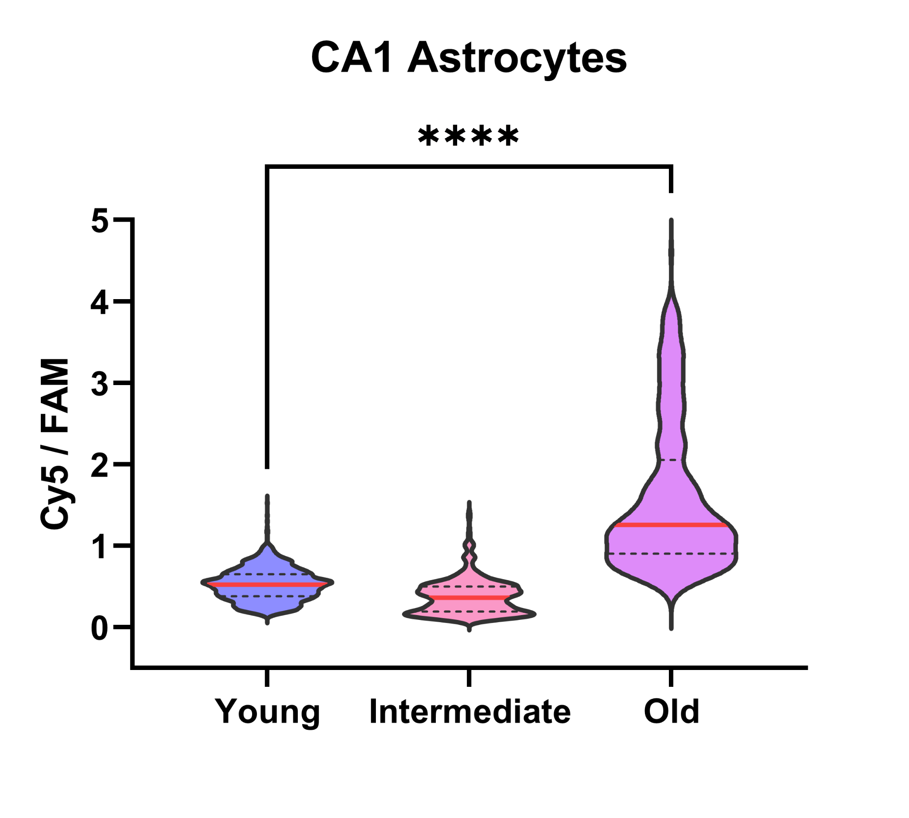
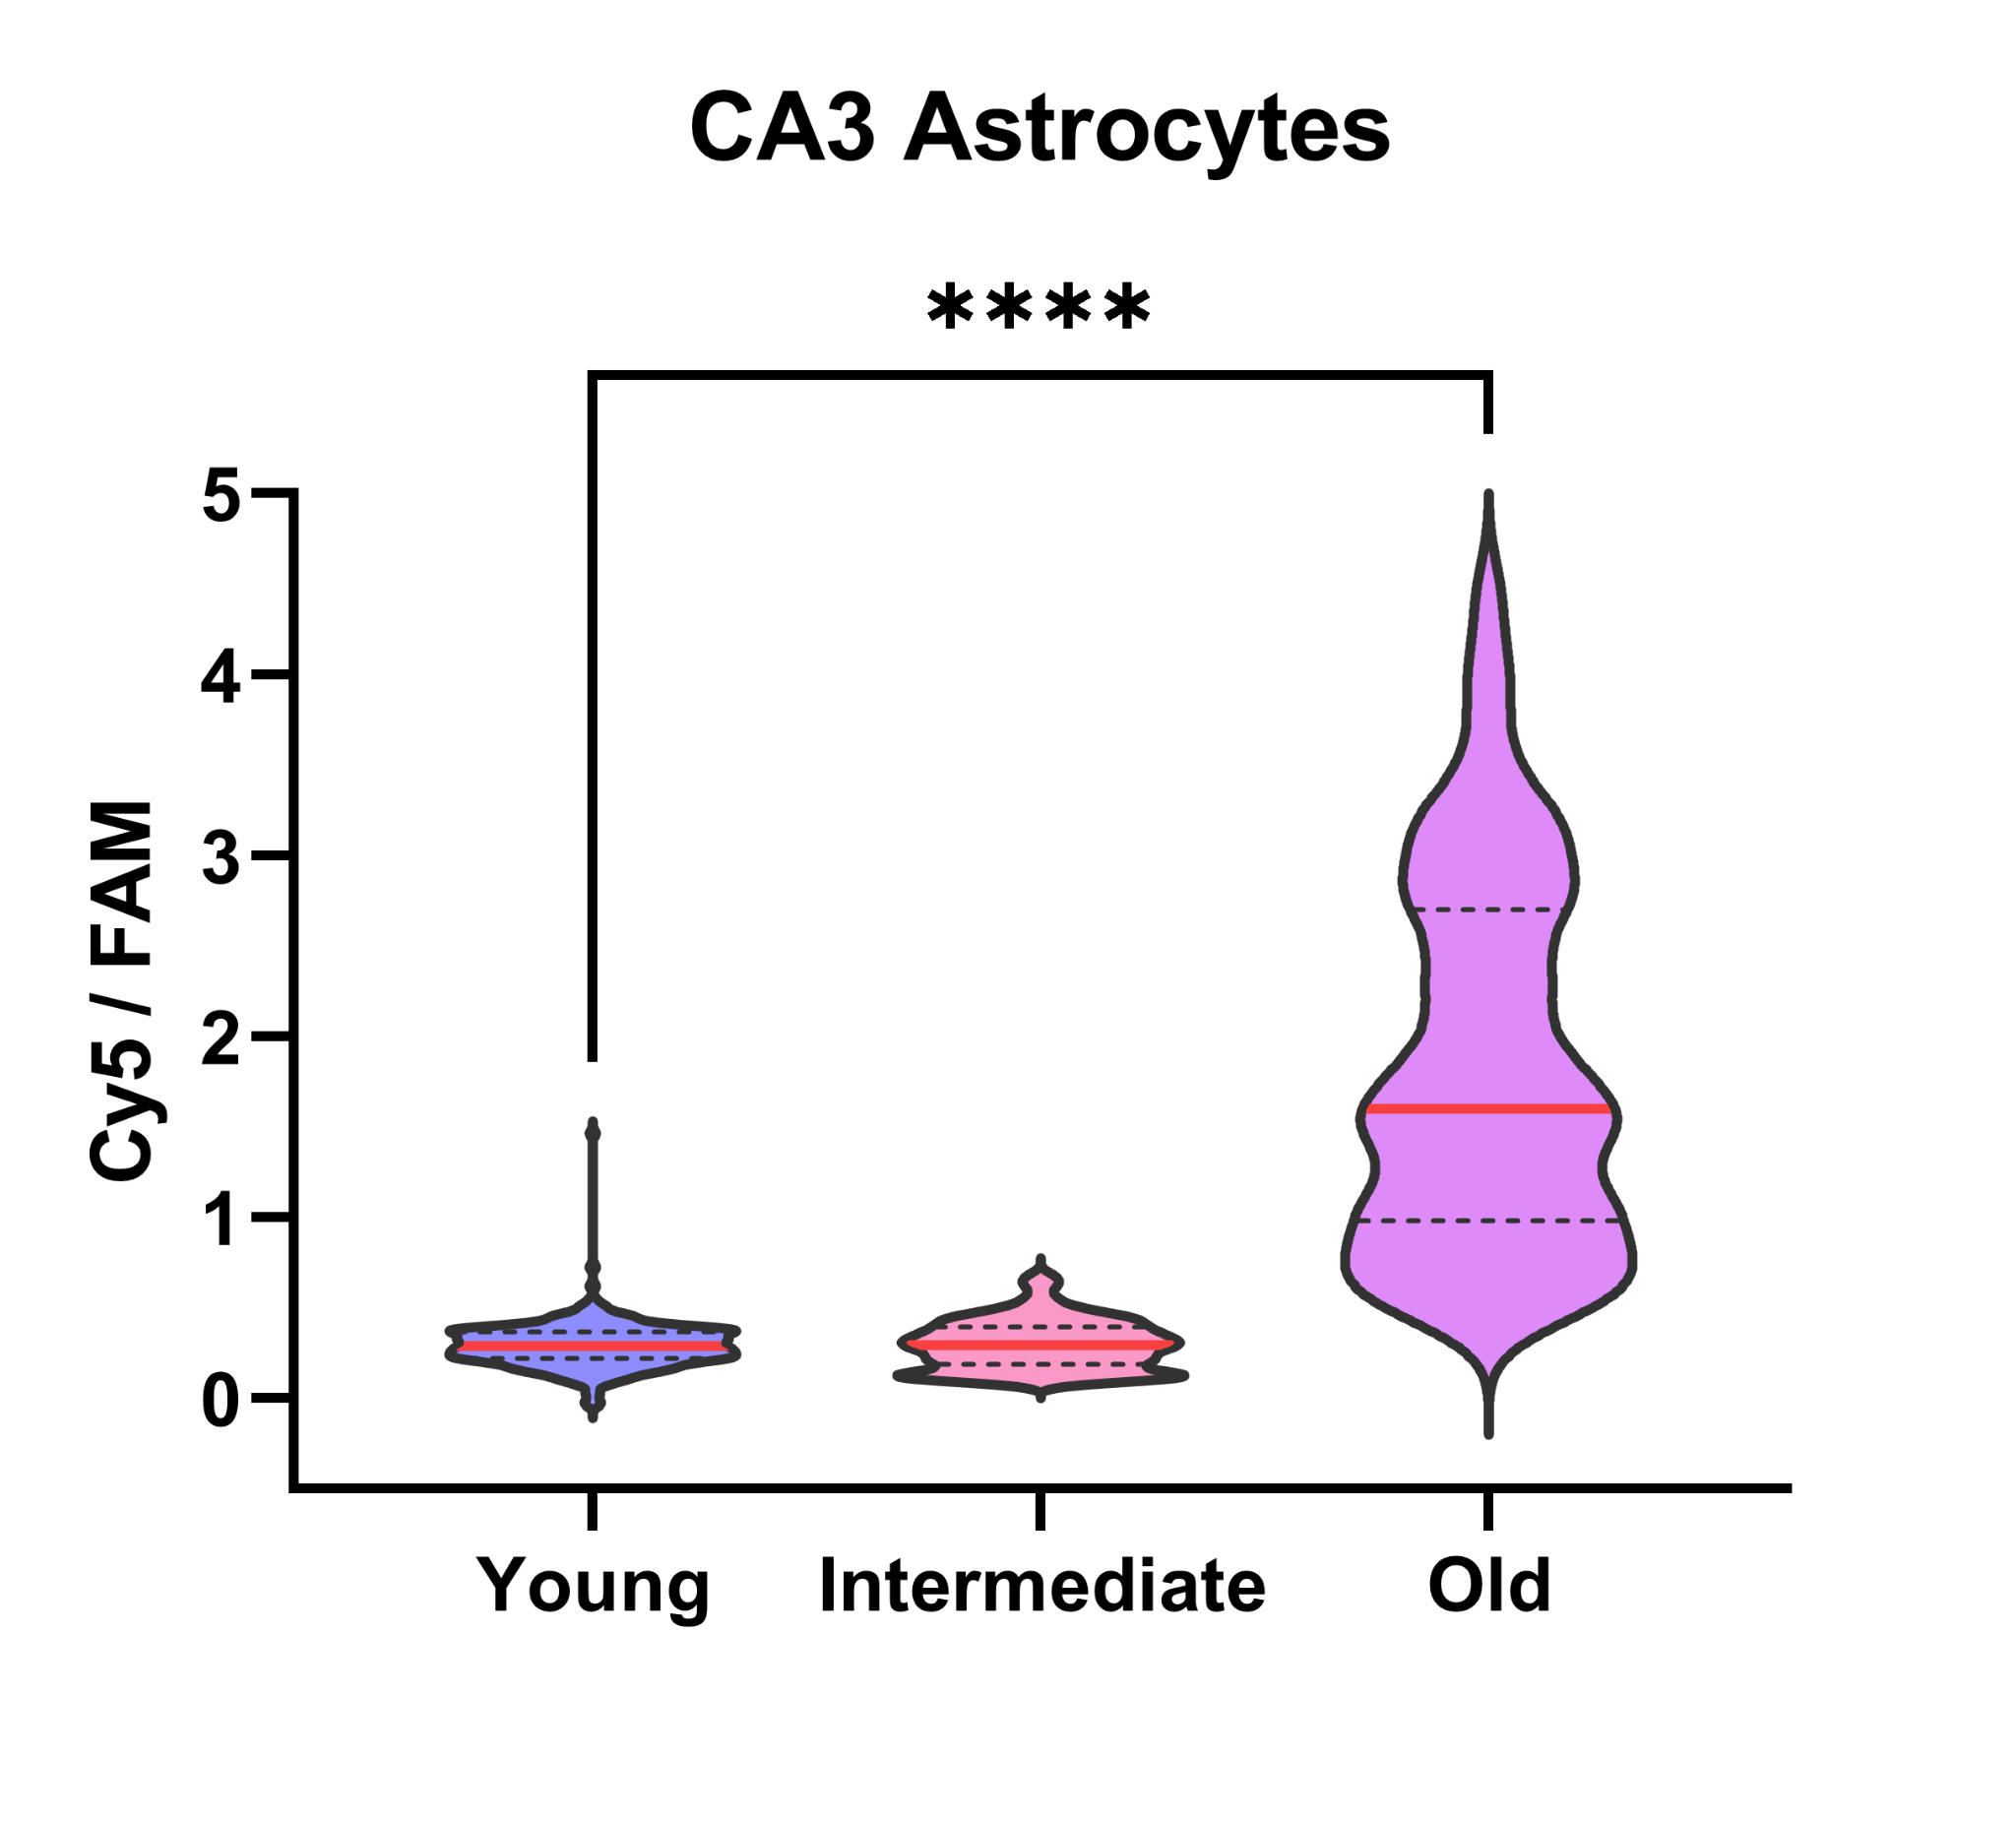
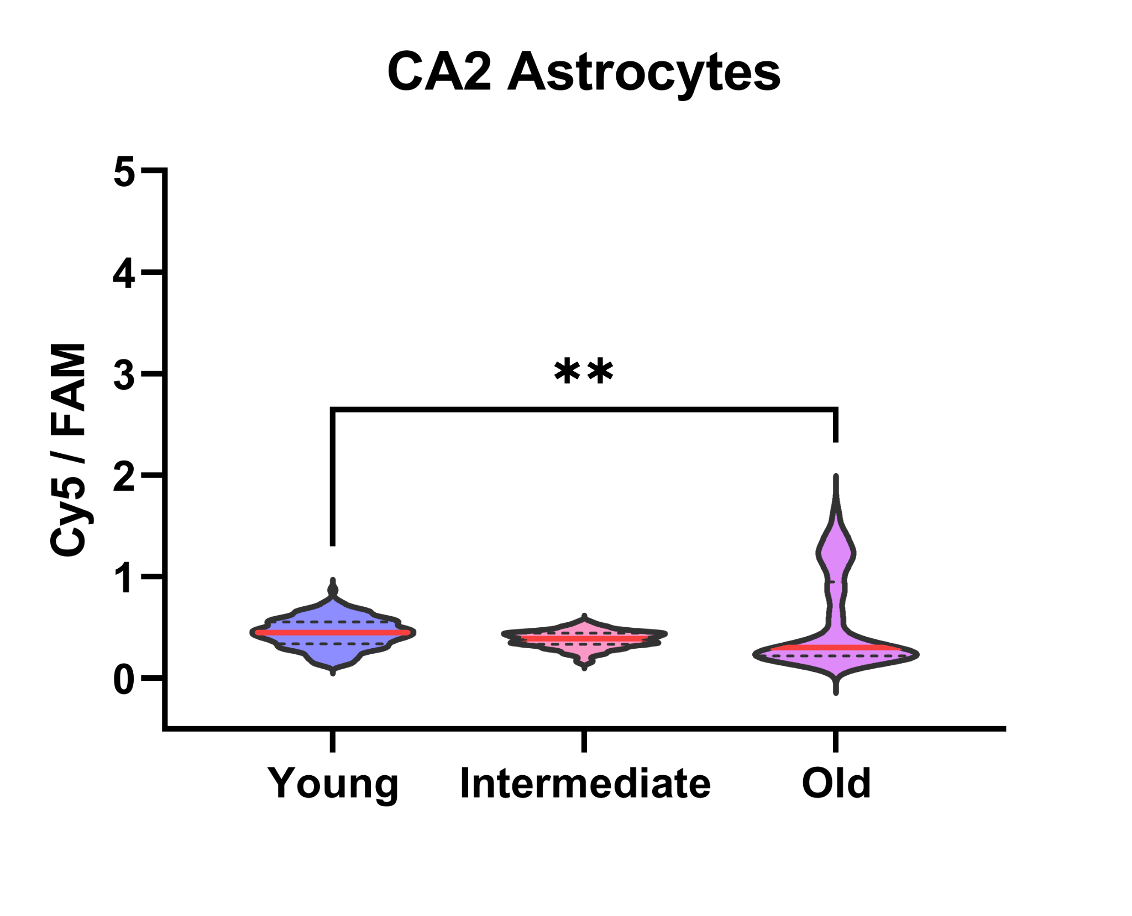
Astrocytic Calpain Activation Across Regions
Statistical significance determined using Mann-Whitney (nonparametric test)
*p = 0.05, **p = 0.01, ***p=0.001, ****p=0.0001
n=3 n=1 n=2
n=3 n=1 n=2
n=3 n=1 n=2
n=3 n=1 n=2
n=3 n=1 n=2
n=3 n=1 n=2
Notes:
When we compared the ratios of calpain activation by region in astrocytes, we found a significantly greater amount of calpain activation of aged brains across all regions except CA2. These results are also expected since aged brains are known to have increased gliosis, or proliferation of astrocytes.

Slide 13
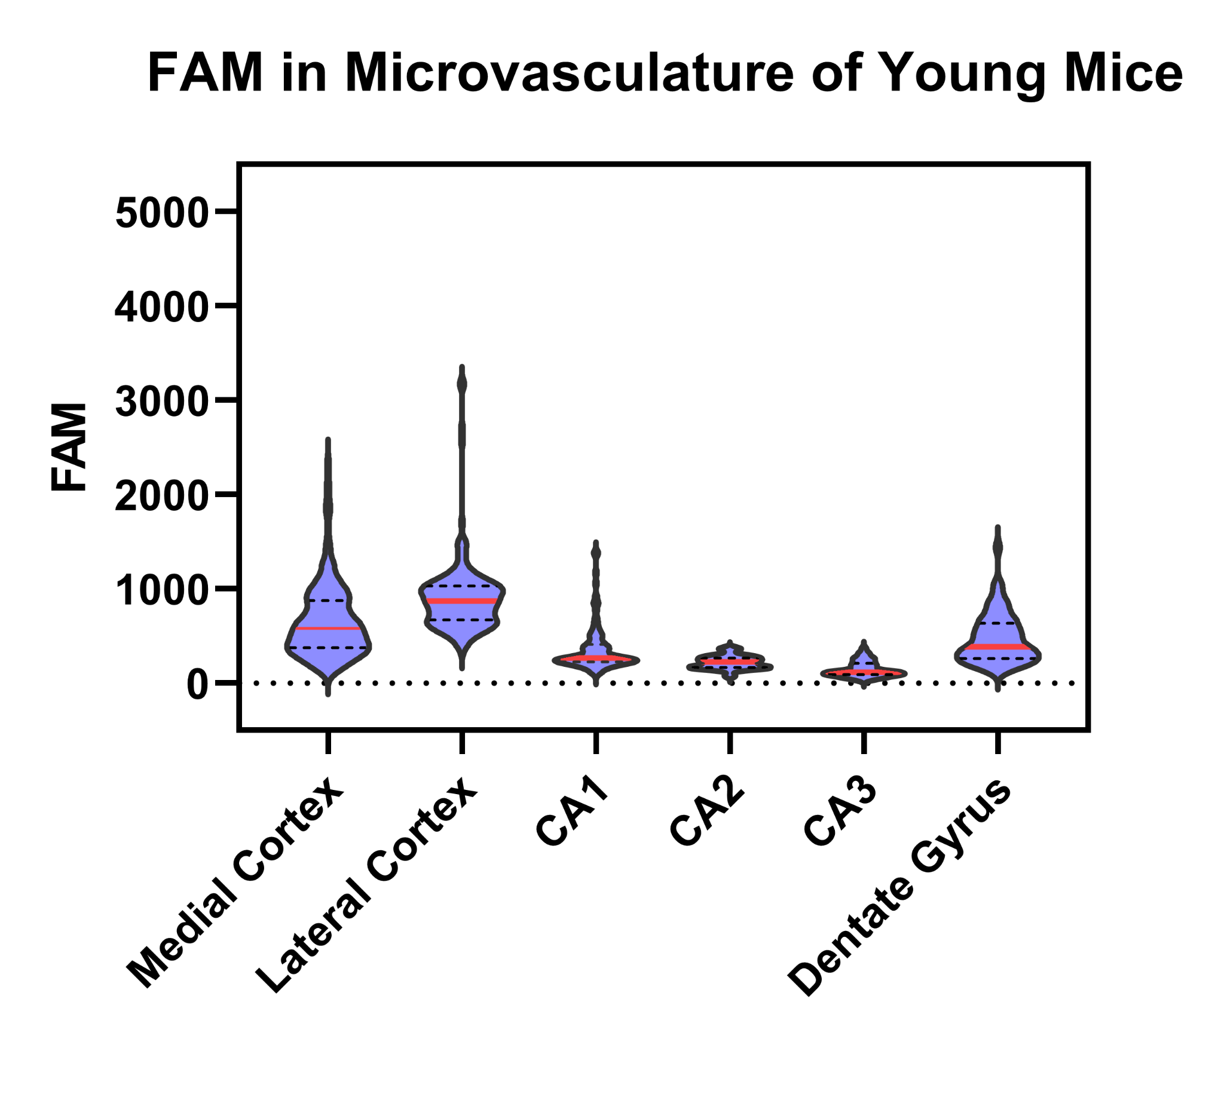
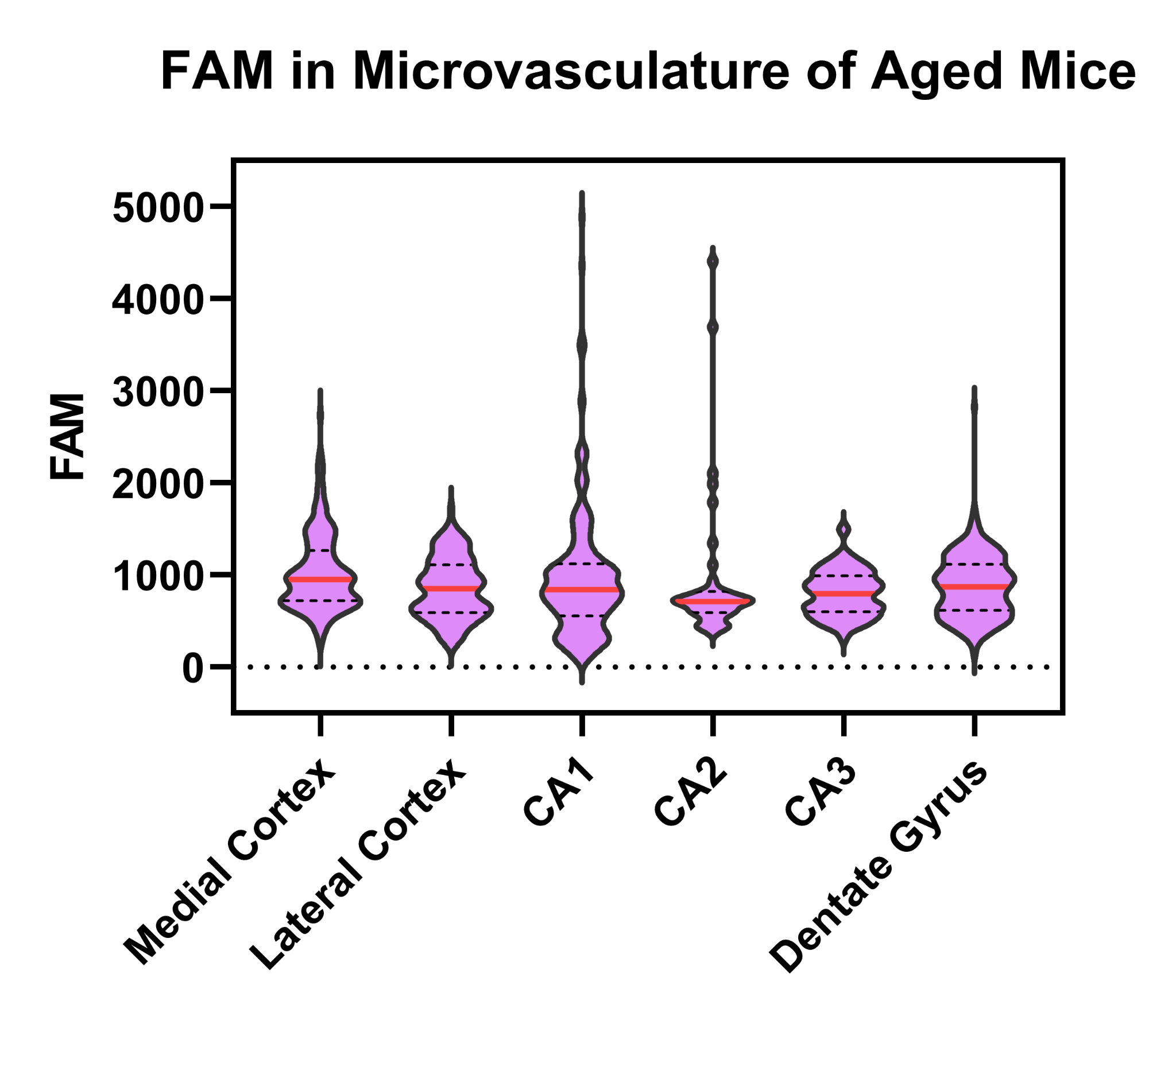
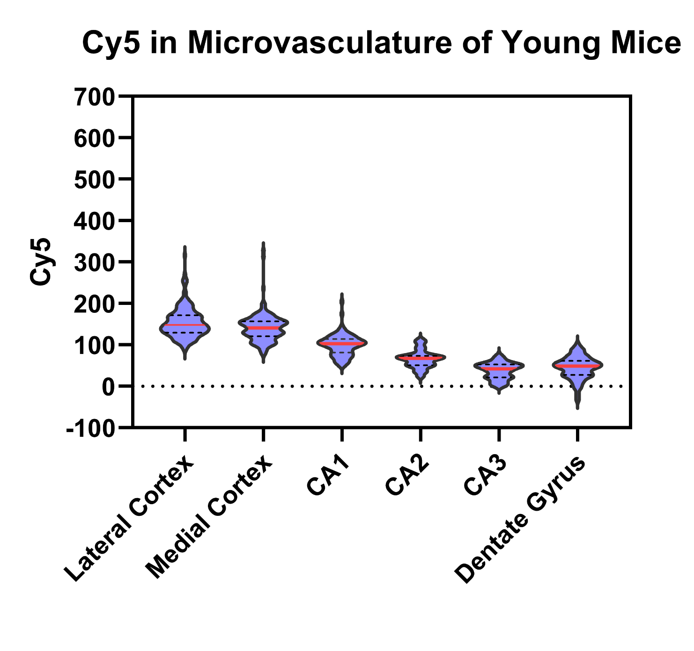
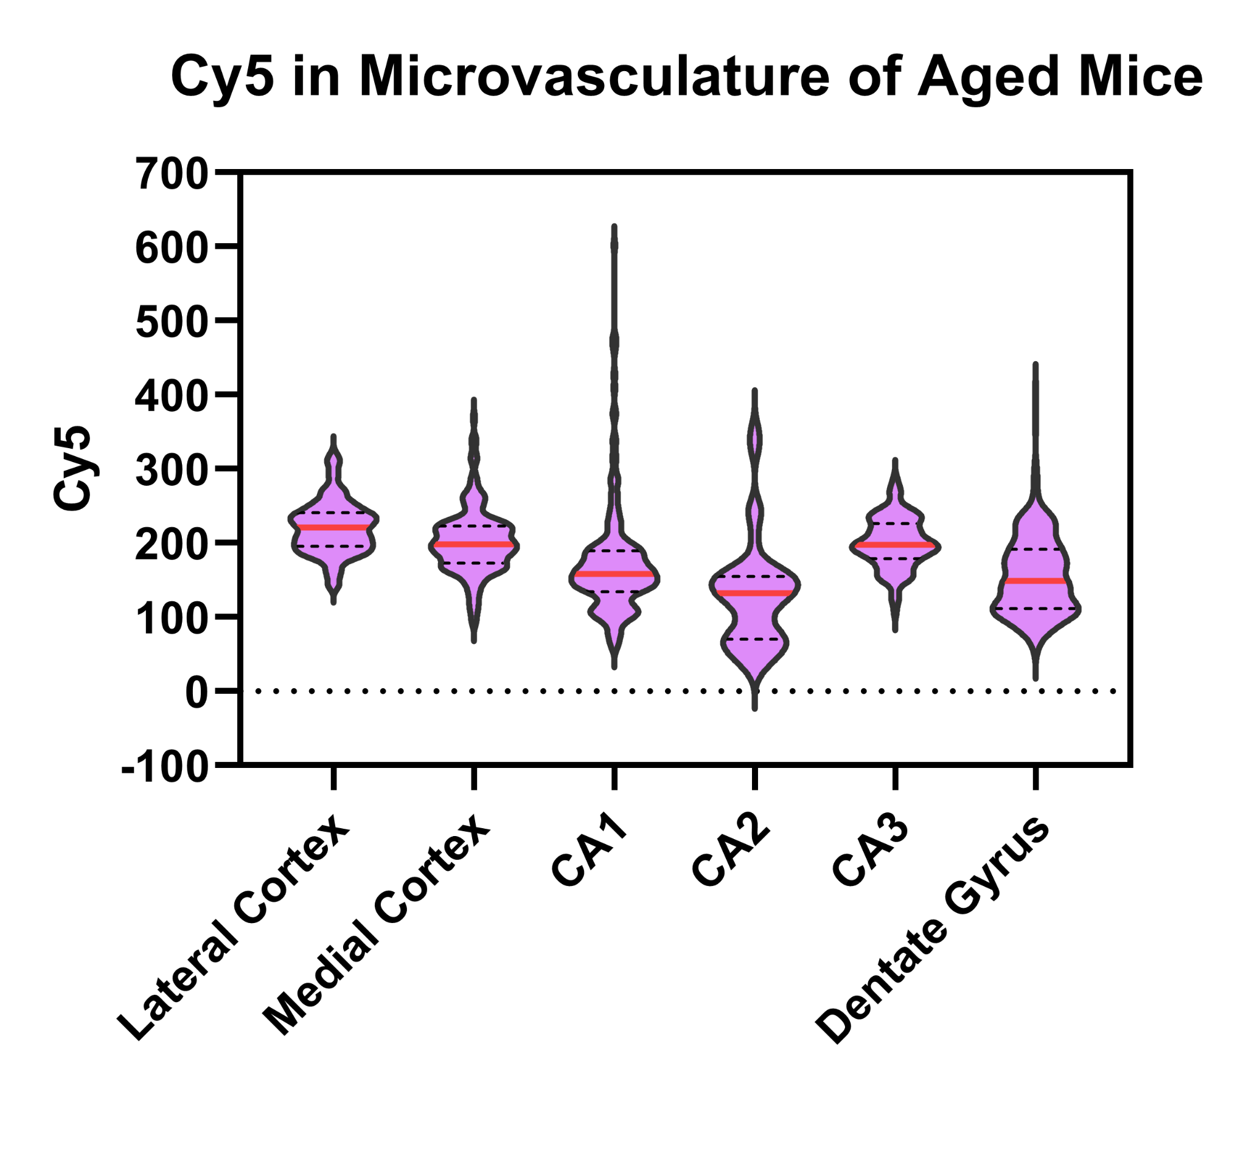
Nanosensor Accumulation and Activation in Microvasculature by Age
Nanosensor Accumulation (FAM)
Nanosensor Accumulation (FAM)
Nanosensor Activation (Cy5)
Nanosensor Activation (Cy5)
Notes:
For microvasculature, we saw a similar trend in nanosensor accumulation and activation that we saw in astrocytes where the aged group overall had greater amounts in both.

Slide 14
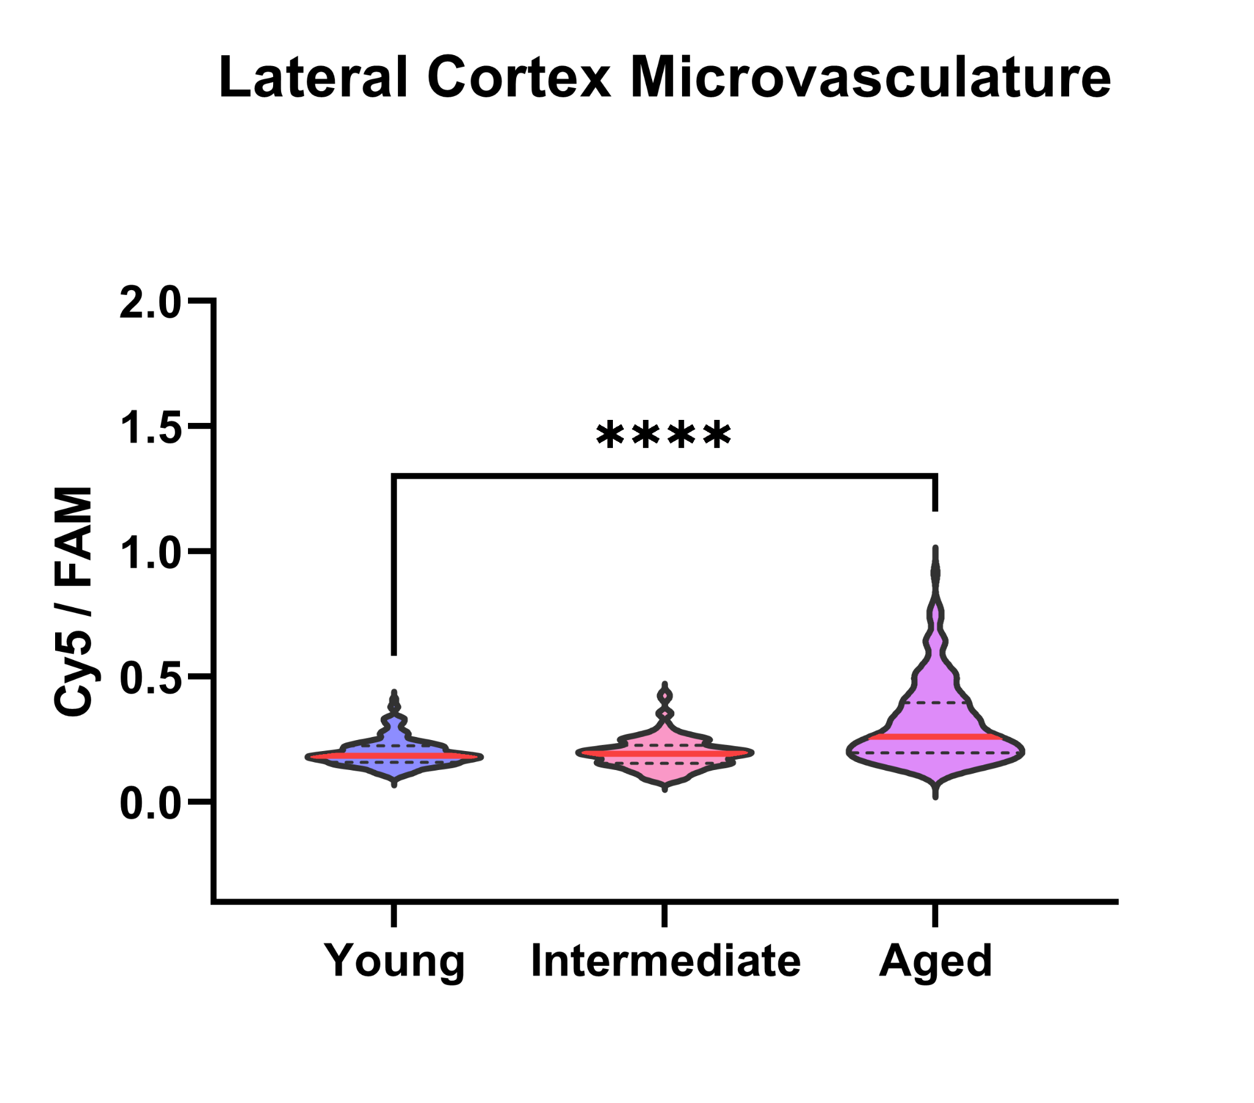
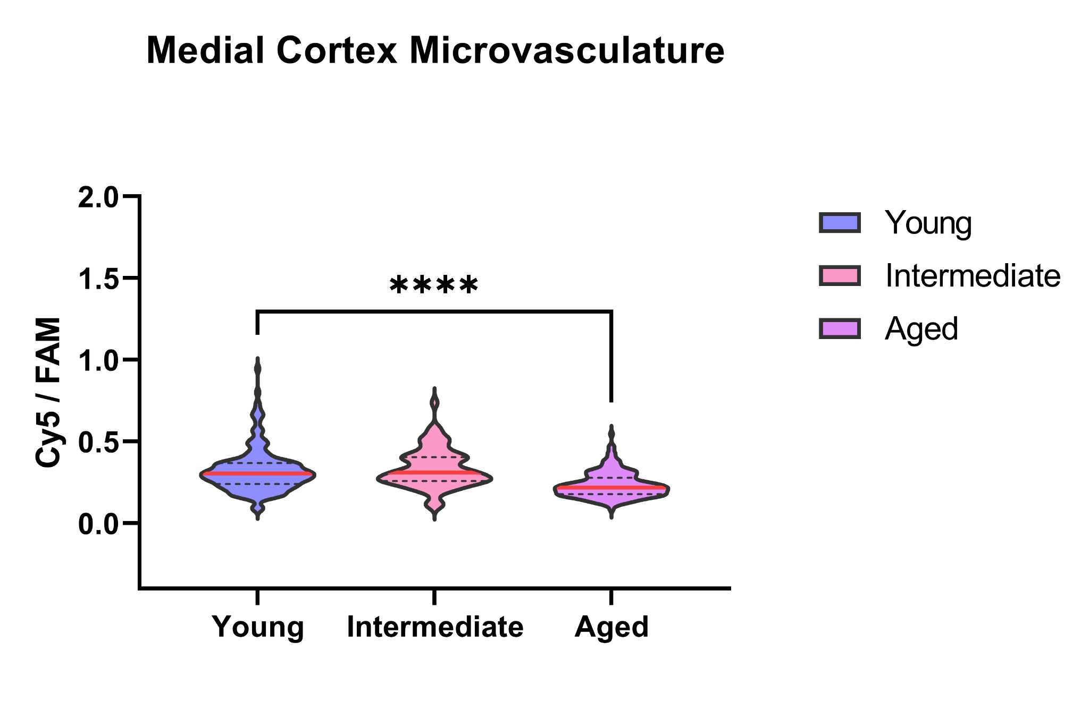
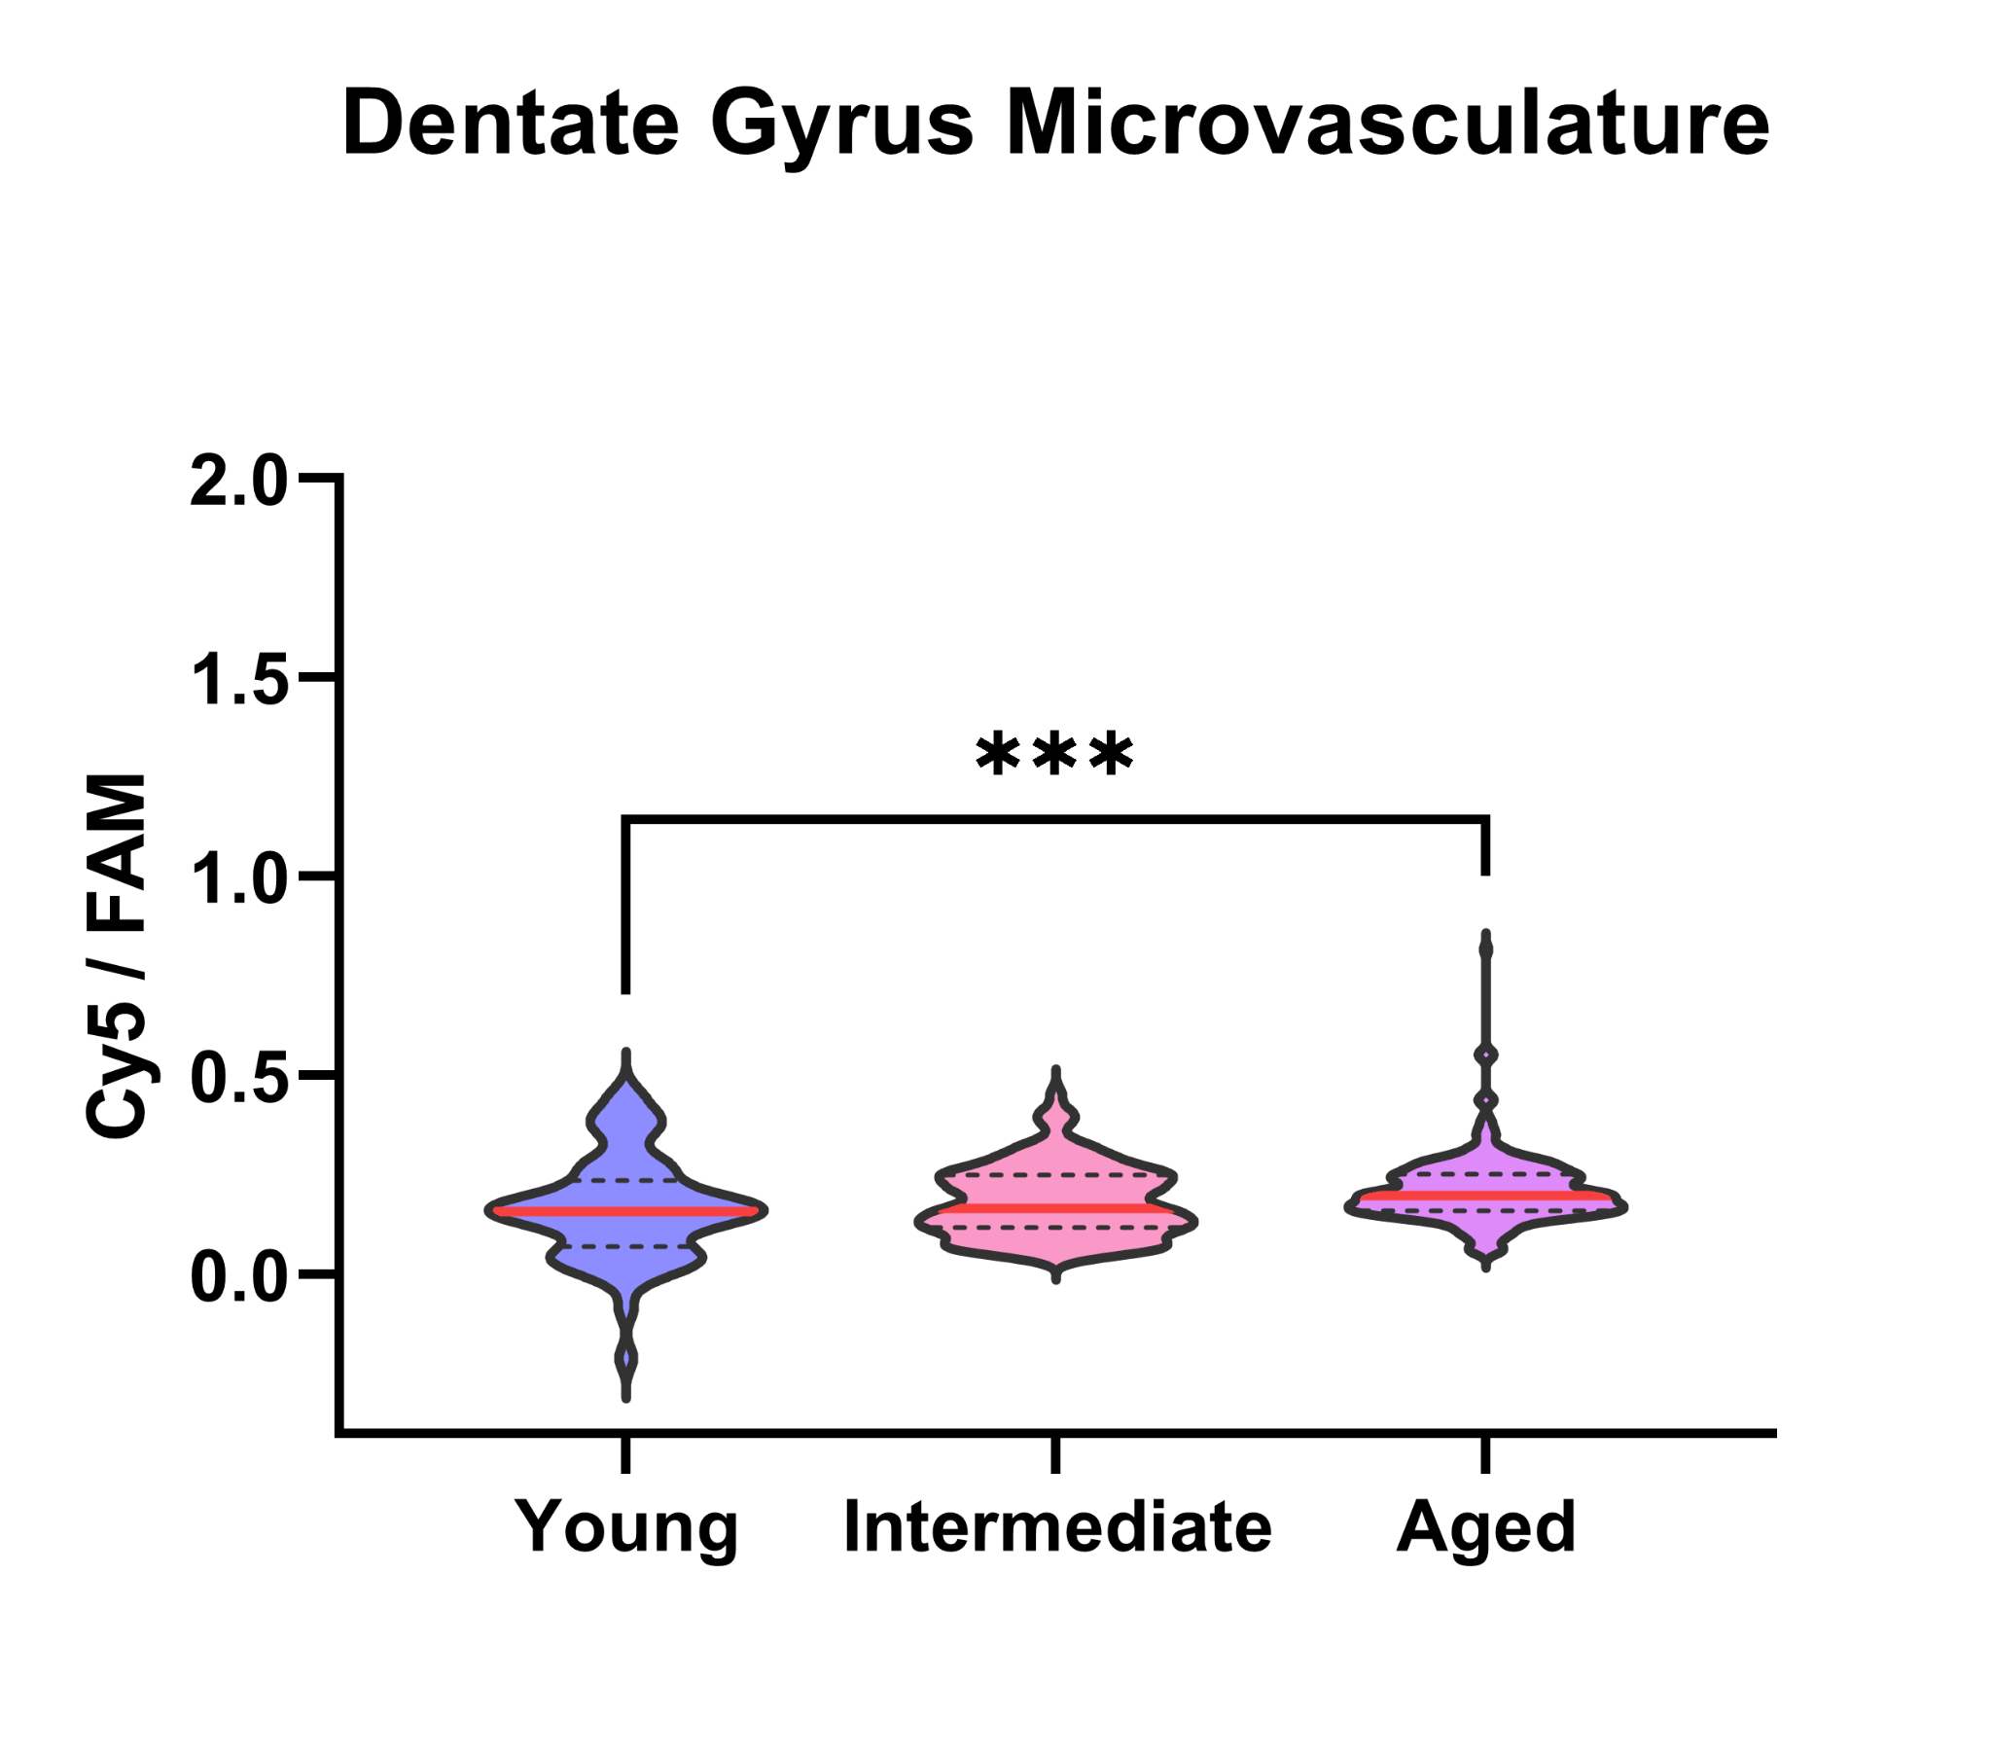
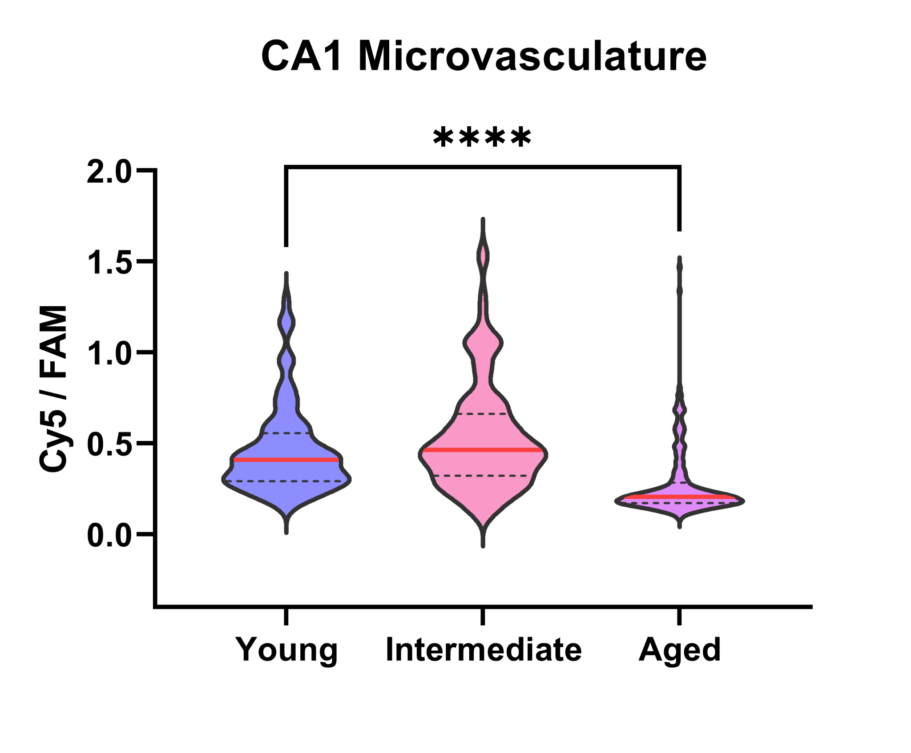
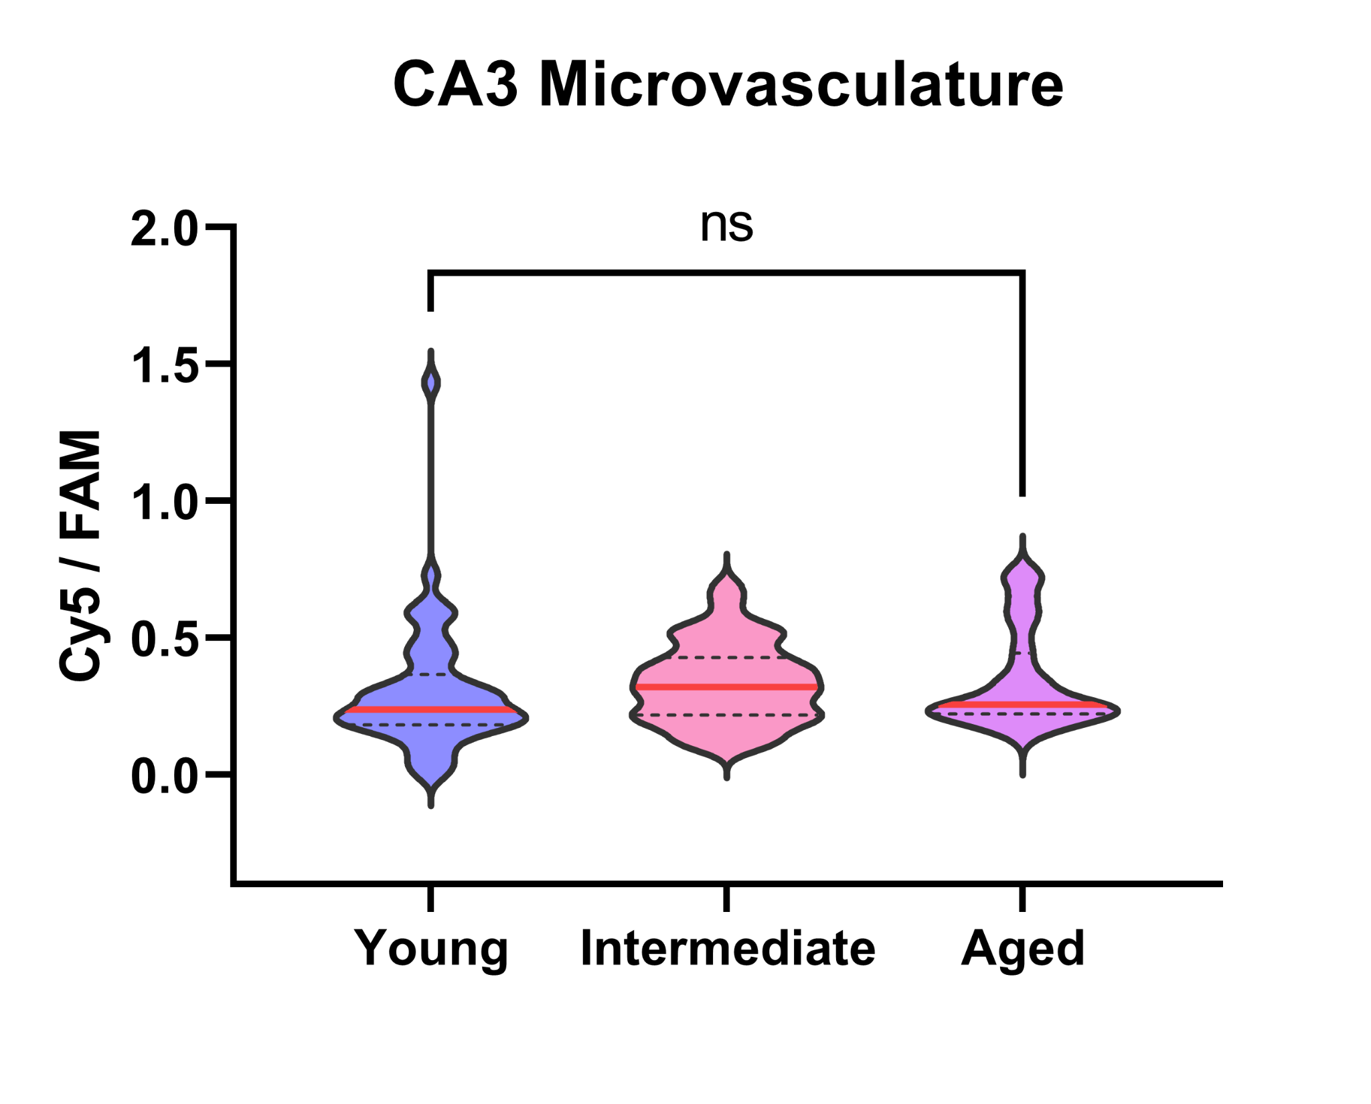
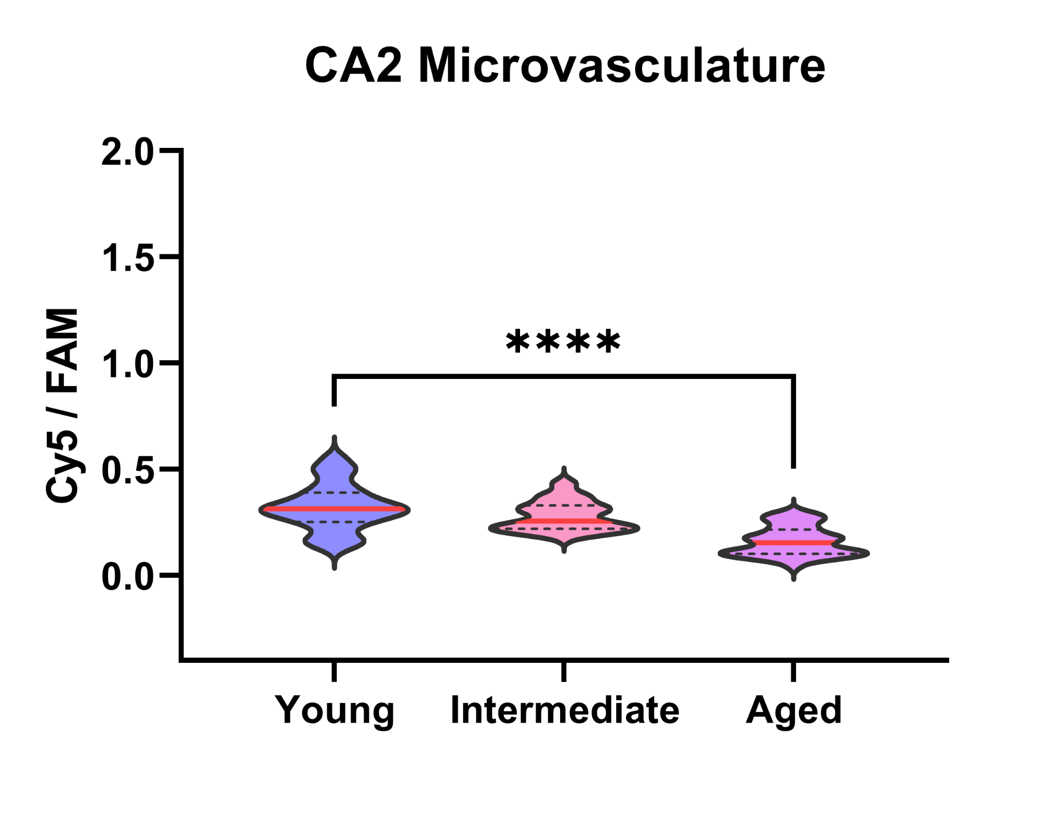
Microvasculature Calpain Activation Across Regions
Statistical significance determined using Mann-Whitney (nonparametric test)
*p = 0.05, **p = 0.01, ***p=0.001, ****p=0.0001
n=3 n=1 n=2
n=3 n=1 n=2
n=3 n=1 n=2
n=3 n=1 n=2
n=3 n=1 n=2
n=3 n=1 n=2
Notes:
However, despite the similar trend in nanosensor accumulation and activation, we found that young brains had greater microvasculature calpain activation in the medial cortex, CA1, and CA2 while aged brains had greater microvasculature calpain activation in the lateral cortex and dentate gyrus. More sensor accumulated in the hippocampal and medial cortex microvasculature of aged brains but we saw less activation in certain regions. Prior studies have shown that aging decreases calcium signaling in endothelial cells, which may partly explain the lower vascular calpain activation in these hippocampal regions and the medical cortex of aged brains.

Slide 15
Results and Discussion
Results:
Aged brains have increased astrocytic calpain activation across all brain regions except CA2 in TBI compared to young brains.
Aged brains have increased microvasculature calpain activation in the lateral cortex and dentate gyrus in TBI compared to young brains. Young brains have increased microvasculature calpain activation in the medial cortex, CA1 region, & CA2 region in TBI compared to aged brains.
Discussion:
Possible explanation of observed results:
  Calcium dysregulation after traumatic brain injury is age, region, and cell-dependent.
Aging is known to decrease calcium signaling in endothelial cells [4], increase gliosis [6] and increase BBB permeability [7].
Future direction: Repeat study on neurons. Possibly investigate age-dependent differences in levels of calcium and calpastatin (endogenous calpain inhibitor) post-TBI [5] and age-dependent response to calpain inhibitors as a therapeutic treatment post-TBI [3].
Notes:
In conclusions, we saw.. read slide
These patterns suggest that calpain activation after TBI is not only age-dependent, but also varies by brain region and cell type. Since calpain activity is calcium-deoendent, this could reflect underlying age, region, and cell-specific differences in calcium dysregulation after TBI which will be important to consider when developing therapeutics targeted towards calpain.
More specific studies need to be conducted to draw more definitive conclusions.
Our future directions include repeating this study on neurons, since our stains were not as reliable as we had hoped, and possibly investigating age-dependent differences in levels of calcium and calpastatin post-TBI and age-dependent response to calpain inhibitors as a therapeutic treatment post-TBI.

Slide 16
References
1. Kudryashev JA, Waggoner LE, Leng HT, Mininni NH, Kwon EJ (2020) An Activity-Based Nanosensor
for Traumatic Brain Injury. ACS Sensors, 5(3):686–692. https://doi.org/10.1021/acssensors.9b01812
2. Kandell RM, Kudryashev JA, Kwon EJ (2021) Targeting the Extracellular Matrix in Traumatic Brain
Injury Increases Signal Generation from an Activity-Based Nanosensor. ACS Nano, 15(12):20504–20516.
https://doi.org/10.1021/acsnano.1c09064
3. Madias MI, Stessman LN, Warlof SJ, Kudryashev JA, Kwon EJ (2024) Spatial Measurement and
Inhibition of Calpain Activity in Traumatic Brain Injury with an Activity-Based Nanotheranostic Platform.
ACS Nano, https://doi.org/10.1021/acsnano.4c06052
4. Boerman EM, Everhart JF, Segal SS (2016) Advanced age decreases local calcium signaling in endothelium of mouse mesenteric arteries in vivo. Am J Physiol Heart Circ Physiol, doi: 10.1152/ajpheart.00038.2016
5. Kenessey A, Banay-Schwartz M, DeGuzman T, Lajtha A. Calpain II activity and calpastatin content in brain regions of 3- and 24-month-old rats. Neurochem Res. 1990 Mar;15(3):243-9. doi: 10.1007/BF00968667. PMID: 2366929.
6. Unger JW. Glial reaction in aging and Alzheimer's disease. Microsc Res Tech. 1998 Oct 1;43(1):24-8. doi: 10.1002/(SICI)1097-0029(19981001)43:1<24::AID-JEMT4>3.0.CO;2-P. PMID: 9829455.
7. Knox EG, Aburto MR, Clarke G, Cryan JF, O'Driscoll CM. The blood-brain barrier in aging and neurodegeneration. Mol Psychiatry. 2022 Jun;27(6):2659-2673. doi: 10.1038/s41380-022-01511-z. Epub 2022 Mar 31. PMID: 35361905; PMCID: PMC9156404.
Notes:
Here are my references and key papers used in my project.

Slide 17
Acknowledgements
I would like to sincerely thank:
The National Science Foundation
Our host, University of California San Diego
San Diego Nanotechnology Infrastructure (SDNI)
Dr. Ester J. Kwon, Faculty PI
Jordan Nichols, Mentor
Yves Theriault, SDNI Executive Director, Education and Outreach
Yuhwa Lo, SDNI Faculty Director
The audience for listening and for their time!
This program was supported by NSF grant ECCS 2025752
Notes:
I would like to sincerely thank: the National Science Foundation; our host, University of California San Diego; the San Diego Nanotechnology Infrastructure (SDNI); my faculty PI, Dr. Ester J. Kwon; my mentor, Jordan Nichols; Yves Theriault, SDNI’s Executive Director of Education and Outreach; Yuhwa Lo, the SDNI Faculty Director; and the audience for listening and for their time.

