Slide 1
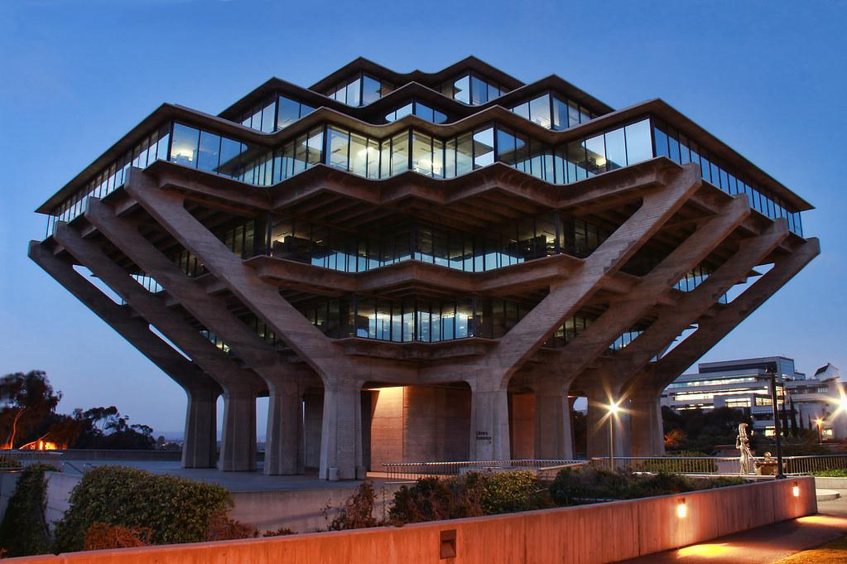
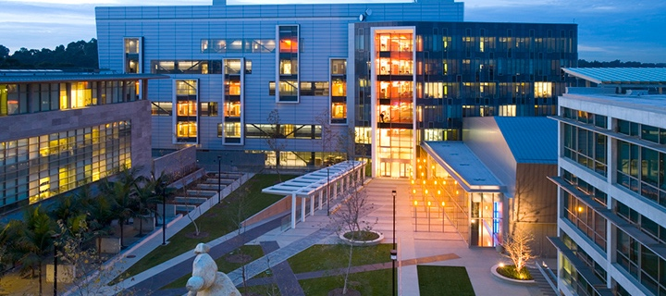




Thickness dependence of QD films on responsivity of GR-QD photodetectors
By
Ksenia Avrutina
College of William and Mary &
San Diego Nanotechnology Infrastructure (SDNI)
Faculty PI: Oscar Vazquez Mena, Department of Chemical and Nano Engineering, UC San Diego
Mentor: John Navarro, Suraj Patel, Department of Chemical and Nano Engineering, UC San Diego
Presented at the 2025 NNCI REU Convocation, University of California San Diego, CA
August 4-5, 2025

Slide 2
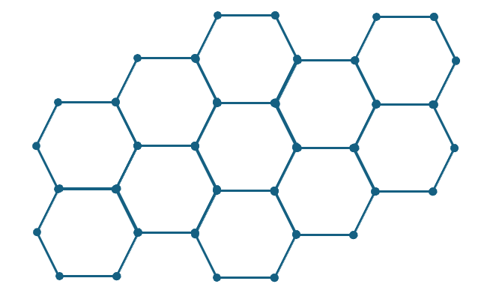
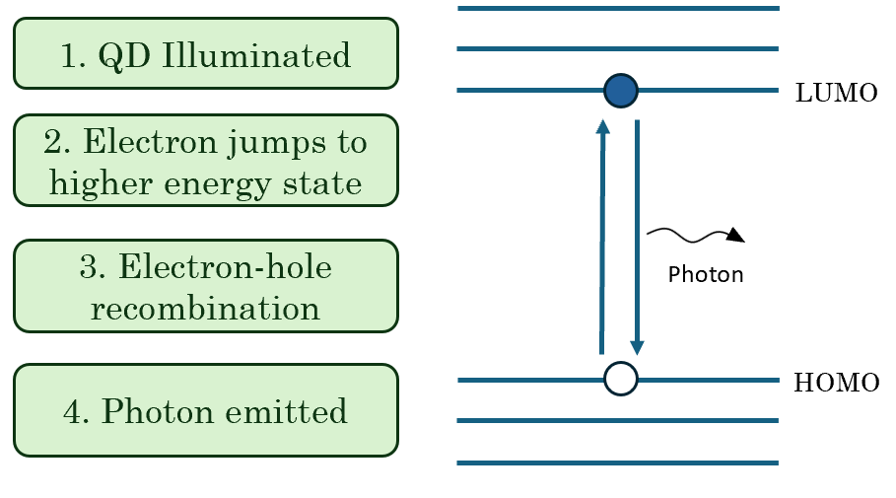
Introduction
Quantum Dots (QDs)
Graphene
Semiconductor particle of a few nanometers in size
Quantum confinement occurs when the QD is smaller than the separation between an electron and hole in an exciton
Quantum confinement results in discrete energy levels
Electrons are confined to move between HOMO and LUMO → narrowband emission!
Single layer of carbon atoms arranged in planar honeycomb
Carbon has 4 valence electrons, but only forms three bonds in the graphene lattice
Structure allows delocalized electrons move freely across plane
Exceptionally conductive and optically transparent

Slide 3
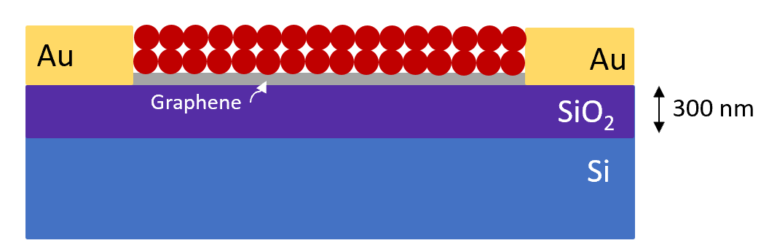
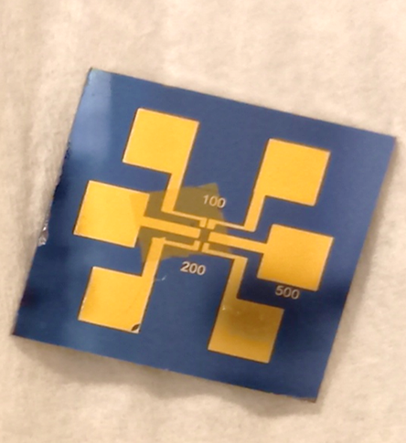
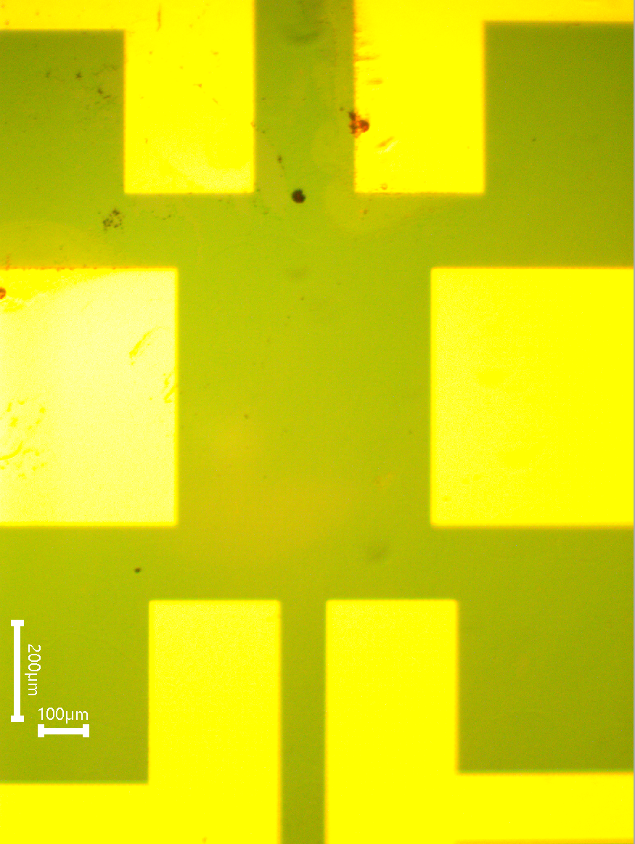
PbS QDs on Graphene for Photodetectors
Lead sulfide (PbS) QDs offer a high absorption coefficient and tunable band gap
QDs exhibit excellent light absorption and tunability, but poor charge carrier mobility (organic ligands)
Graphene exhibits exceptional charge carrier mobility
When we put QDs on graphene:
  Charge carriers photogenerated in QDs are transferred to graphene
  We achieve excellent charge collection and photoresponsivity
Photogating Effect
  Light hits the QDs, forming electron-hole pairs
  Electrons remain trapped in QDs while holes in are transferred to graphene, where they can circulate multiple times
  Result → high gain!
Chip Design
Graphene and QDs on silicon dioxide (SiO₂)/silicon (Si) chip with gold contacts
3 sets of gold contacts: 100, 200, and 500 µm channels
Greater QD film thickness can strengthen light absorption, but lower charge collection and photoresponse
  Electron-hole pairs can recombine in QDs
We need to find ideal QD film thickness to optimize photoresponse!

Slide 4
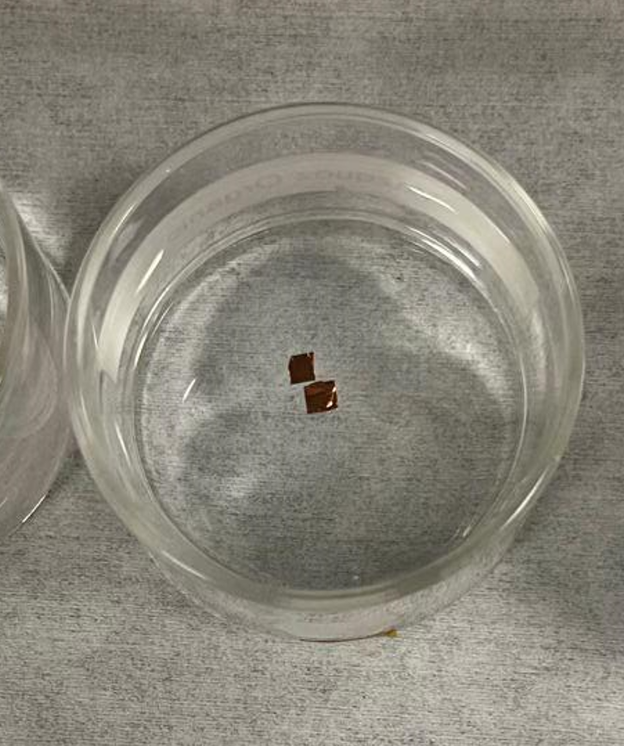
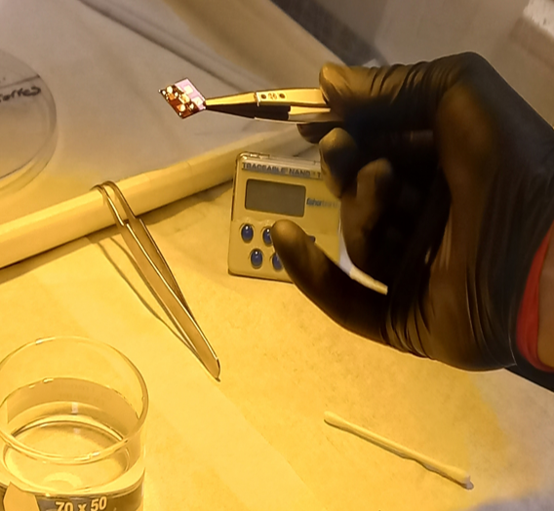
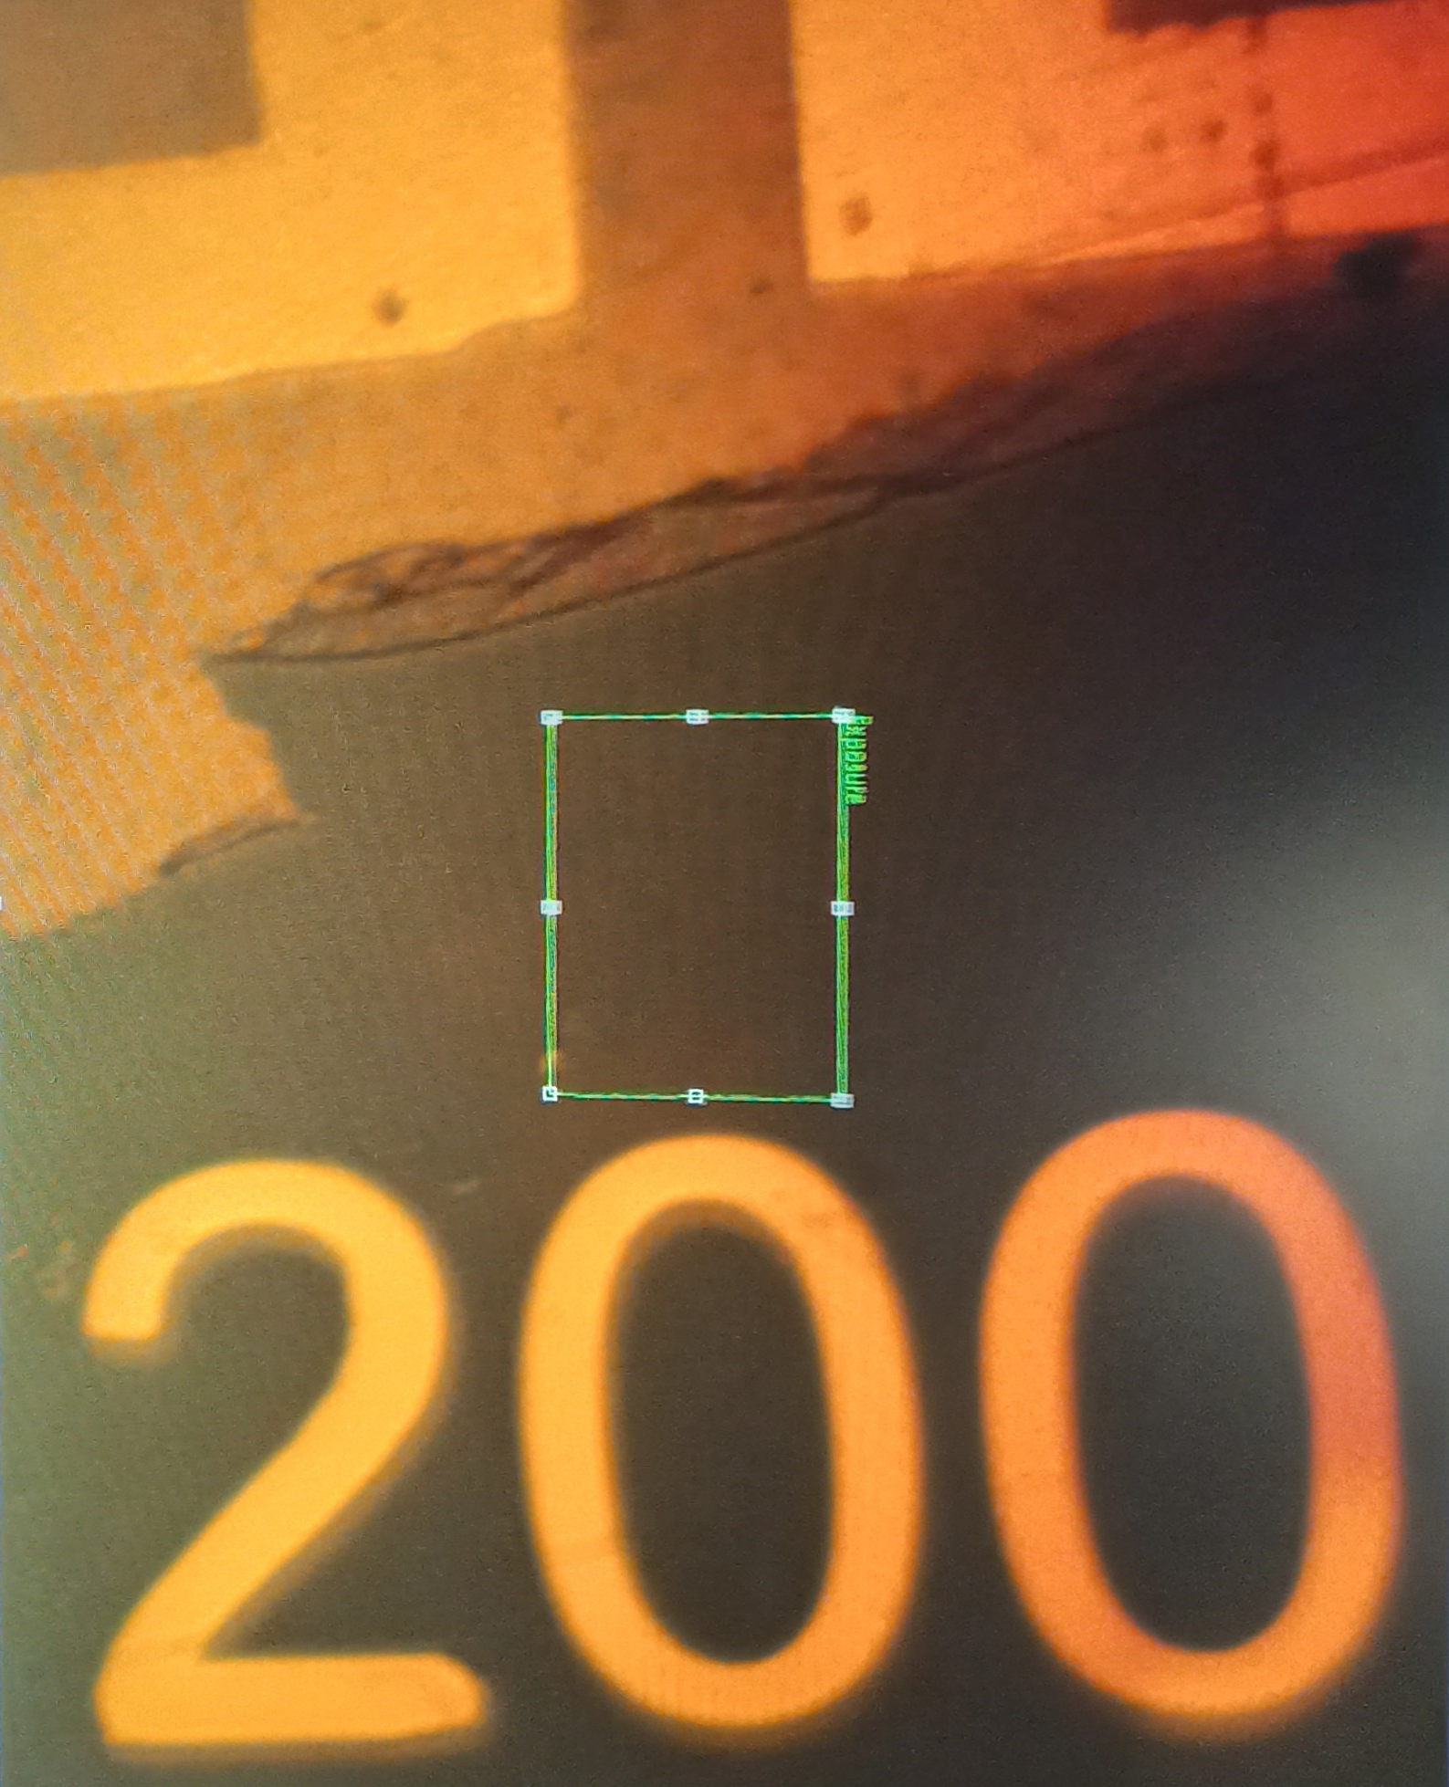
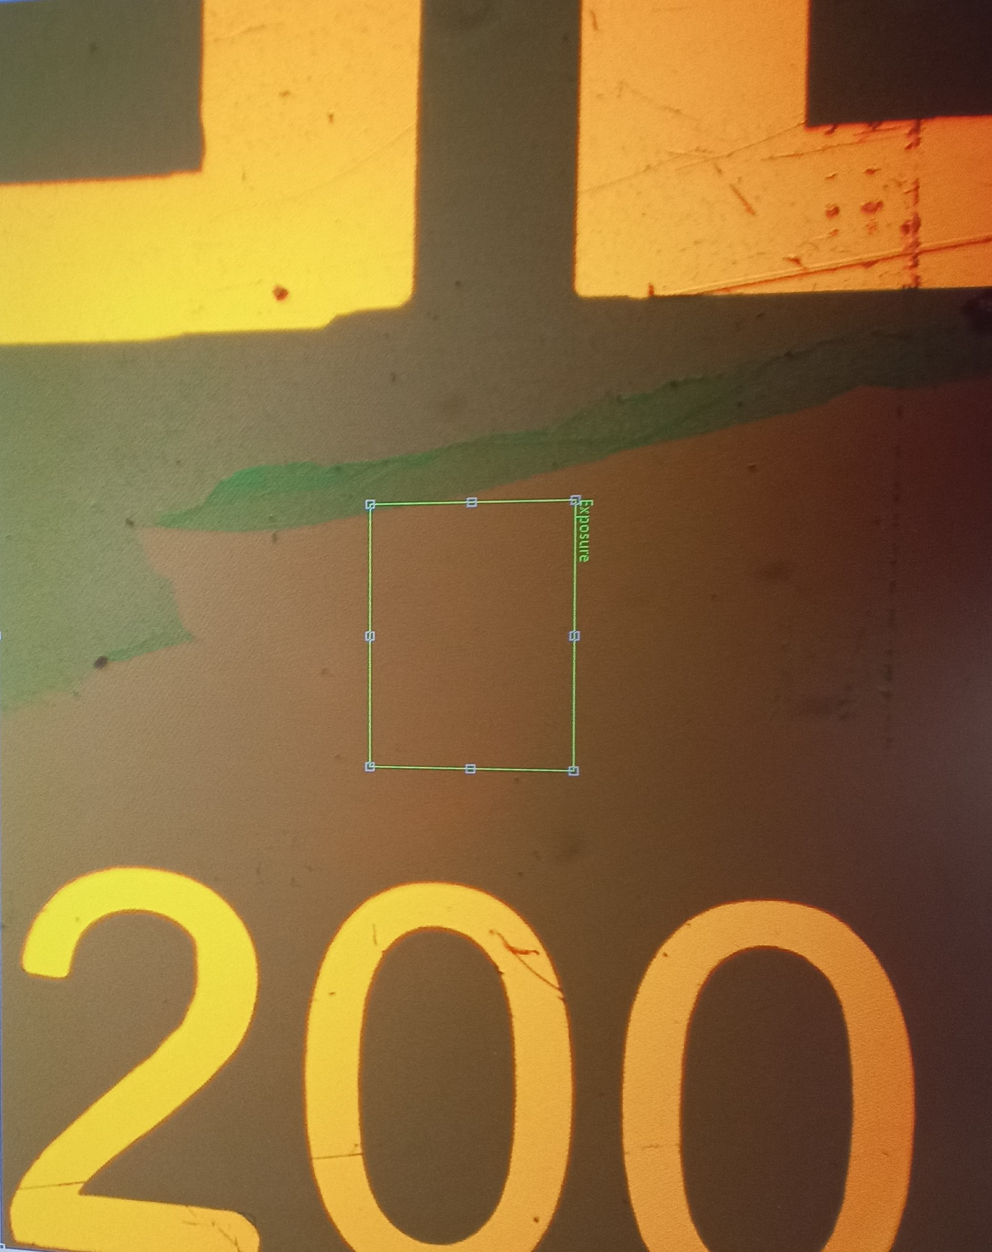
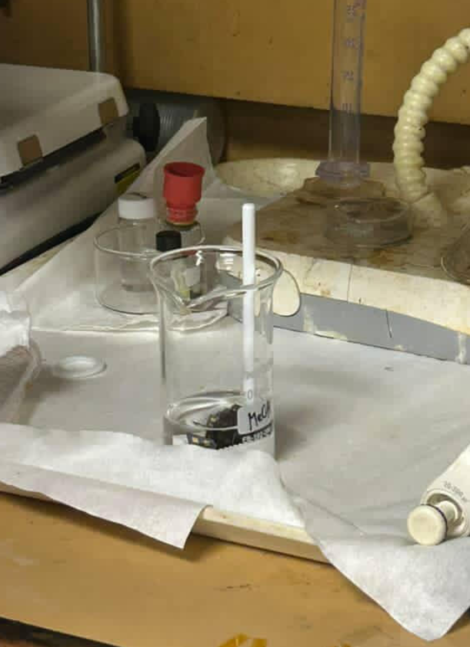
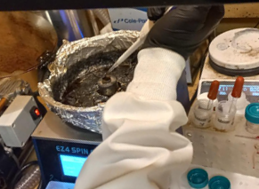
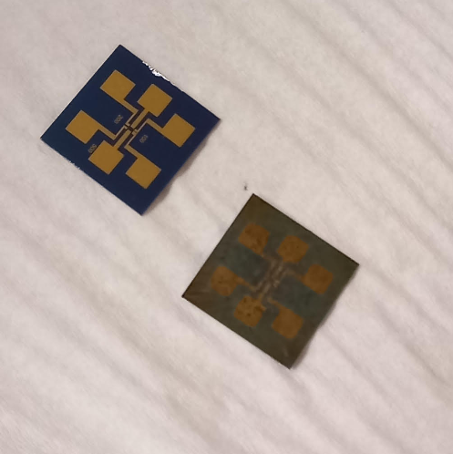
Fabrication
PMMA removal can be observed via color change under microscope:
5x5 mm square of graphene on copper foil is submerged in ammonium persulfate solution (APS) to etch copper
Graphene is transferred onto the SiO₂/Si chip
Chip with and without QDs:
Poly(methyl methacrylate) (PMMA) layer on graphene is etched using acetone and isopropanol
PbS QDs are spin-coated on
Tetrabutylammonium iodide (TBAI) methanol used for ligand exchange

Slide 5
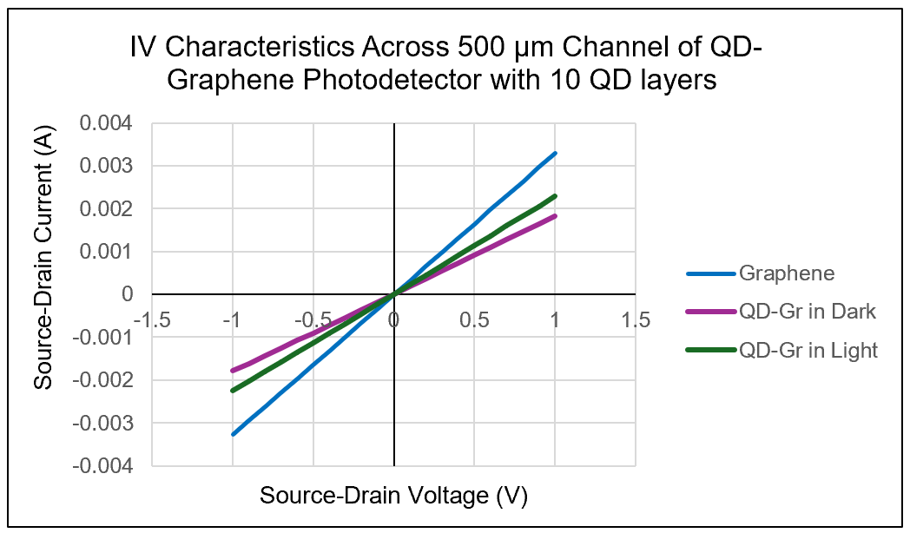
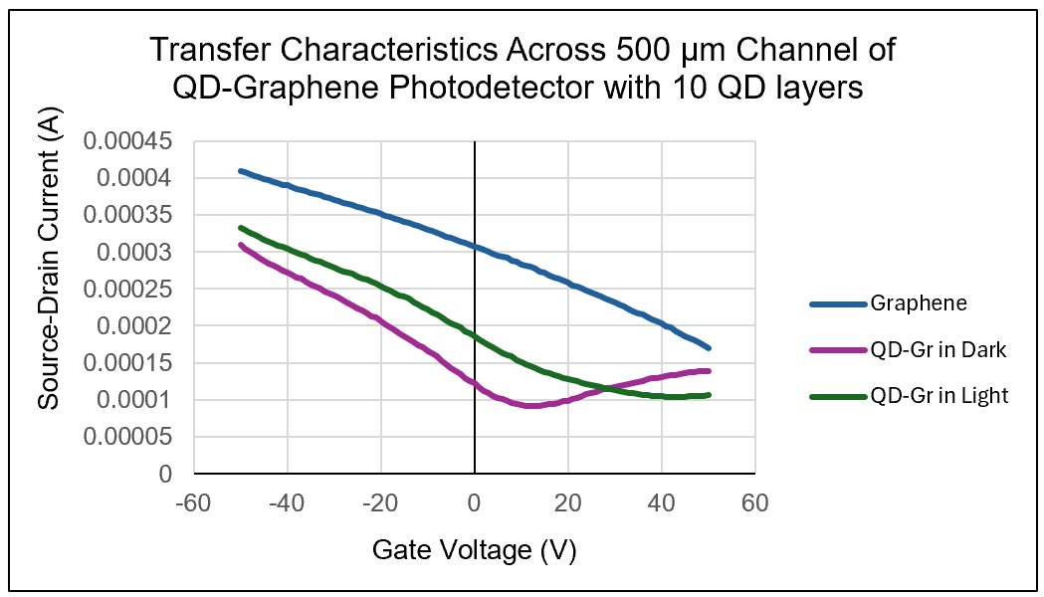
Electrical Characterization
IV Characteristics
Transfer Characteristics
Measure the response of source-drain current to applied source-drain voltage
A linear plot indicates good quality of contact
Increased slope under illumination shows photocurrent generation
Measure the response of source-drain current to applied gate voltage
Transfer curve minimum indicates the dirac point
  Point at which conduction and valence bands meet
The dirac point shifts towards more negative gate voltage with the addition of QDs due to induced charge transfer into graphene
The dirac point shifts towards more positive gate voltage under illumination due to increased hole conduction

Slide 6
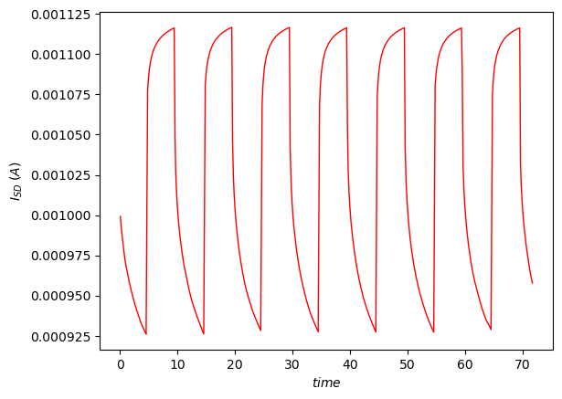
Photoresponse
Photoresponse is measured to evaluate how effectively light is converted to electrical signal
Source-drain current is measured over time as a laser is pulsed on/off
Laser: 635 nm wavelength and 5 mW power output
Photoresponse = I_{dark} – I_{light}
  Difference between maximum and minimum current
QD excitation results in the generation of electron-hole pairs and a subsequent increase in current
Photoresponse Measurement Across 500 µm Channel for QD-Graphene Photodetector With 10 QD layers

Slide 7
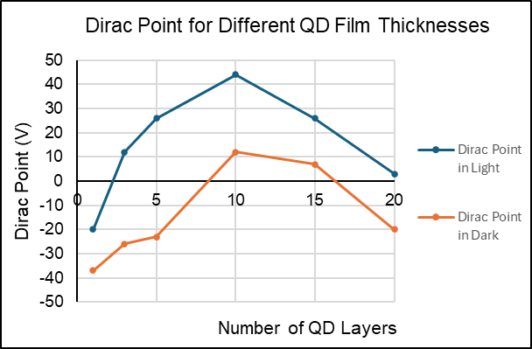
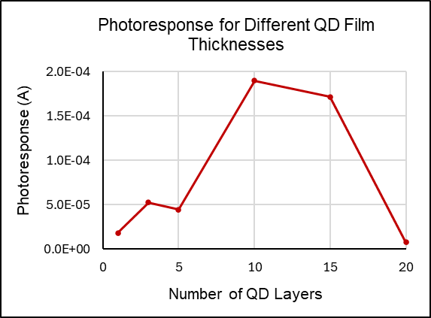
Results and Conclusions
The dirac point and photoresponse were found for samples manufactured with 1, 3, 5, 10, 15, and 20 QD layers
Photodetector with 10 QD layers performs the best
The intermediate thickness likely achieves the best balance between high light absorption and efficient carrier transport

Slide 8
Acknowledgements
I would like to sincerely thank:
The National Science Foundation
Our host, University of California San Diego
San Diego Nanotechnology Infrastructure (SDNI)
Dr. Oscar Vazquez Mena, Faculty PI
Suraj Patel, Mentor
John Navarro, Mentor
Yves Theriault, SDNI Executive Director, Education and Outreach
Yuhwa Lo, SDNI Faculty Director
The audience for listening and for their time!
This program was supported by NSF grant ECCS 2025752

