Slide 1





Quantum Sensing in the classroom:Low-Cost ODMR Experiments Using NV Centers in Diamond
Juan Luis Gonzalez, Cal State Channel Islands
Dylan Chapman , Northern Arizona University
Ryan Behunin, Northern Arizona University
1
Notes:
Hello everyone, welcome, and good afternoon, my name is Juan Luis Gonzalez and thank you guys for being here.
I am a student from Cal State Channel Islands and I did my research at Northern Arizona University.
Today, I’ll be presenting how we can bring quantum sensing into classrooms using an affordable, modular setup based on Nitrogen Vacancy centers in diamond.
This research combines nanotechnology, optics, and digital tools to help students explore real quantum phenomena—like spin transitions and magnetic resonance with their own hands.
This work is based of Haverkamp and Stegemann, who created and improved a low-cost setup to teach these concepts in high schools and undergraduate labs.

Slide 2
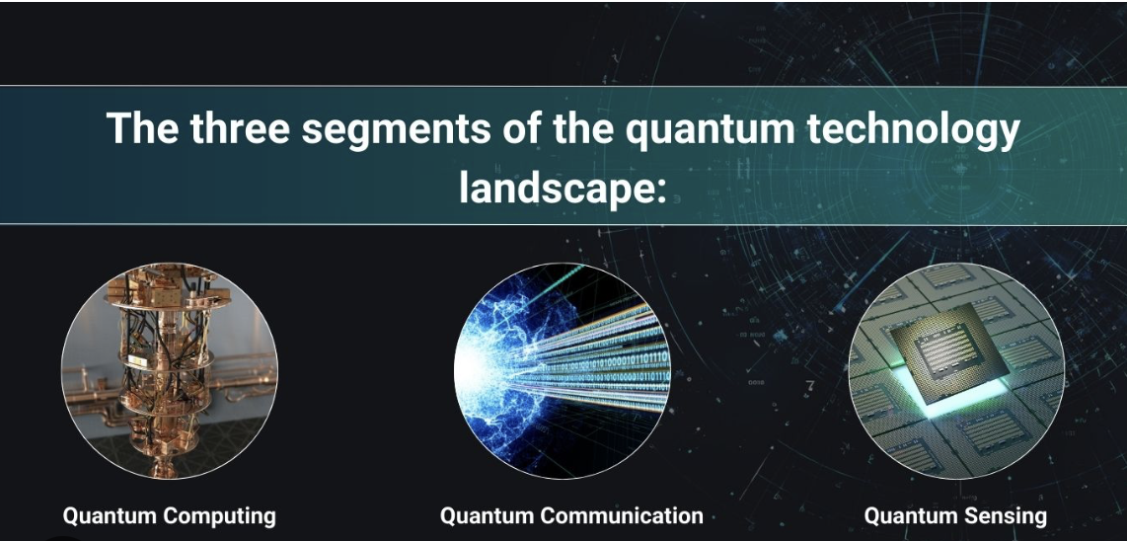
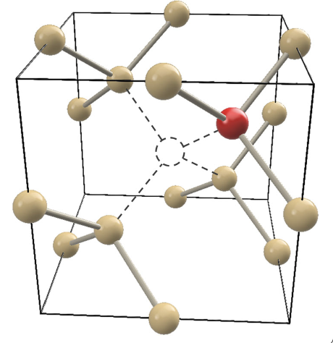
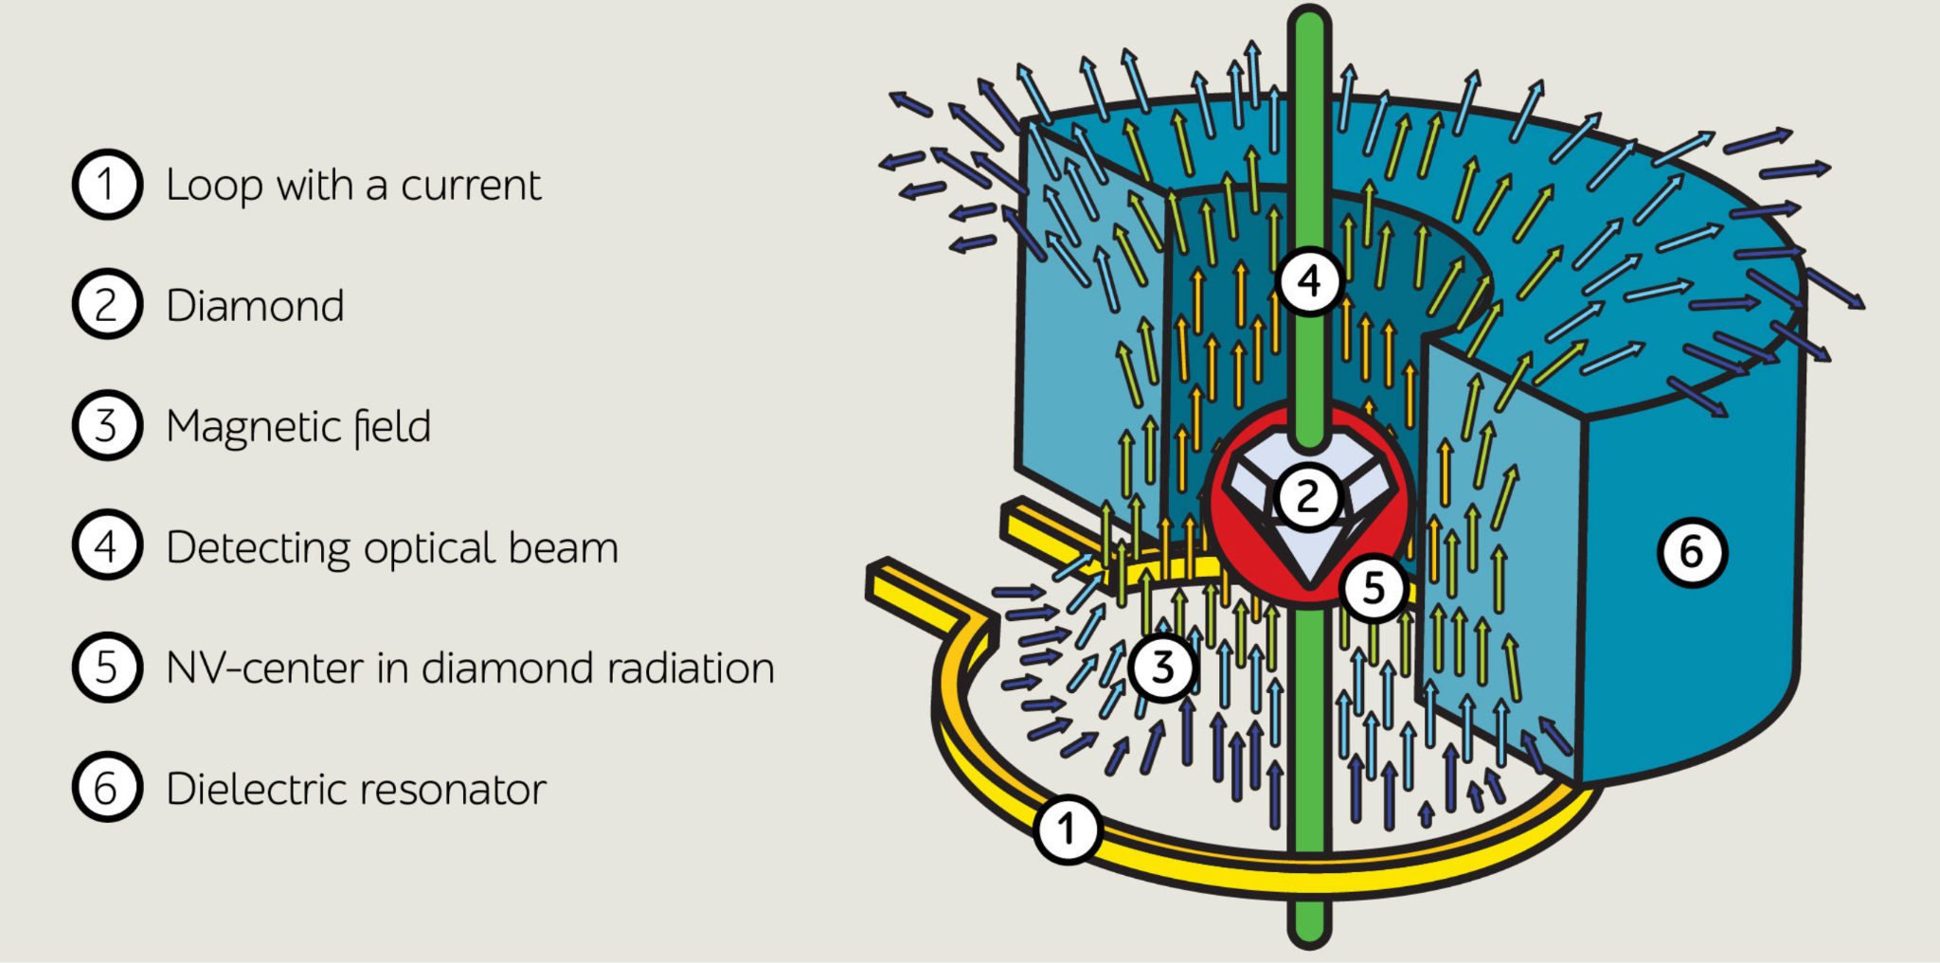
The Second Quantum Revolution Needs a Workforce
Quantum technologies are transformative
Hard to teach due to few hands-on tools.
NV centers offer low-cost quantum demos.
Education lags behind, lacking accessible quantum experiment
Figure 3 (above): Diamond Lattice with NV center
Figure 1 (above): 3 Segments of Quantum Technology
Figure 2 (left): An ultra sensitive magnetic field sensor
Figure 1: “The Three Segments of the Quantum‑Technology Landscape.” Quantum Industries Insights, 18 Apr. 2024, Quantum Industries. Diagram.
Figure 2: “Physicists design new antenna for next‑generation super‑sensitive magnetometers.” Phys.org, 6 Nov. 2018, ITMO University. Retrieved 30 July 2025.
Figure 3:Haverkamp, Nils, et al. “Low‑Cost ODMR Experiments with Nitrogen‑Vacancy Centers in Diamonds: A Didactical Approach to Theory and Experiment.” EPJ Quantum Technology, vol. 12, no. 27, 21 Feb. 2025, pp. 1–19.
2
Notes:
As you may know, We’re entering the "second quantum revolution"—a shift driven by technologies like quantum computers, quantum communication, and especially quantum sensors.
One of the most promising sensing platforms is based on nitrogen-vacancy (NV) centers in diamond or NV centers for short.
NV centers are tiny atomic-scale defects in a diamond lattice that behave like artificial atoms.
What makes them special is their ability to interact with light and microwaves in a measurable and controllable way—even at room temperature.
These properties allow them to function as ultra-sensitive magnetic field sensors, useful in medicine, neuroscience, and material science.
But until now, these tools were too complex or expensive for students to engage with directly.

Slide 3
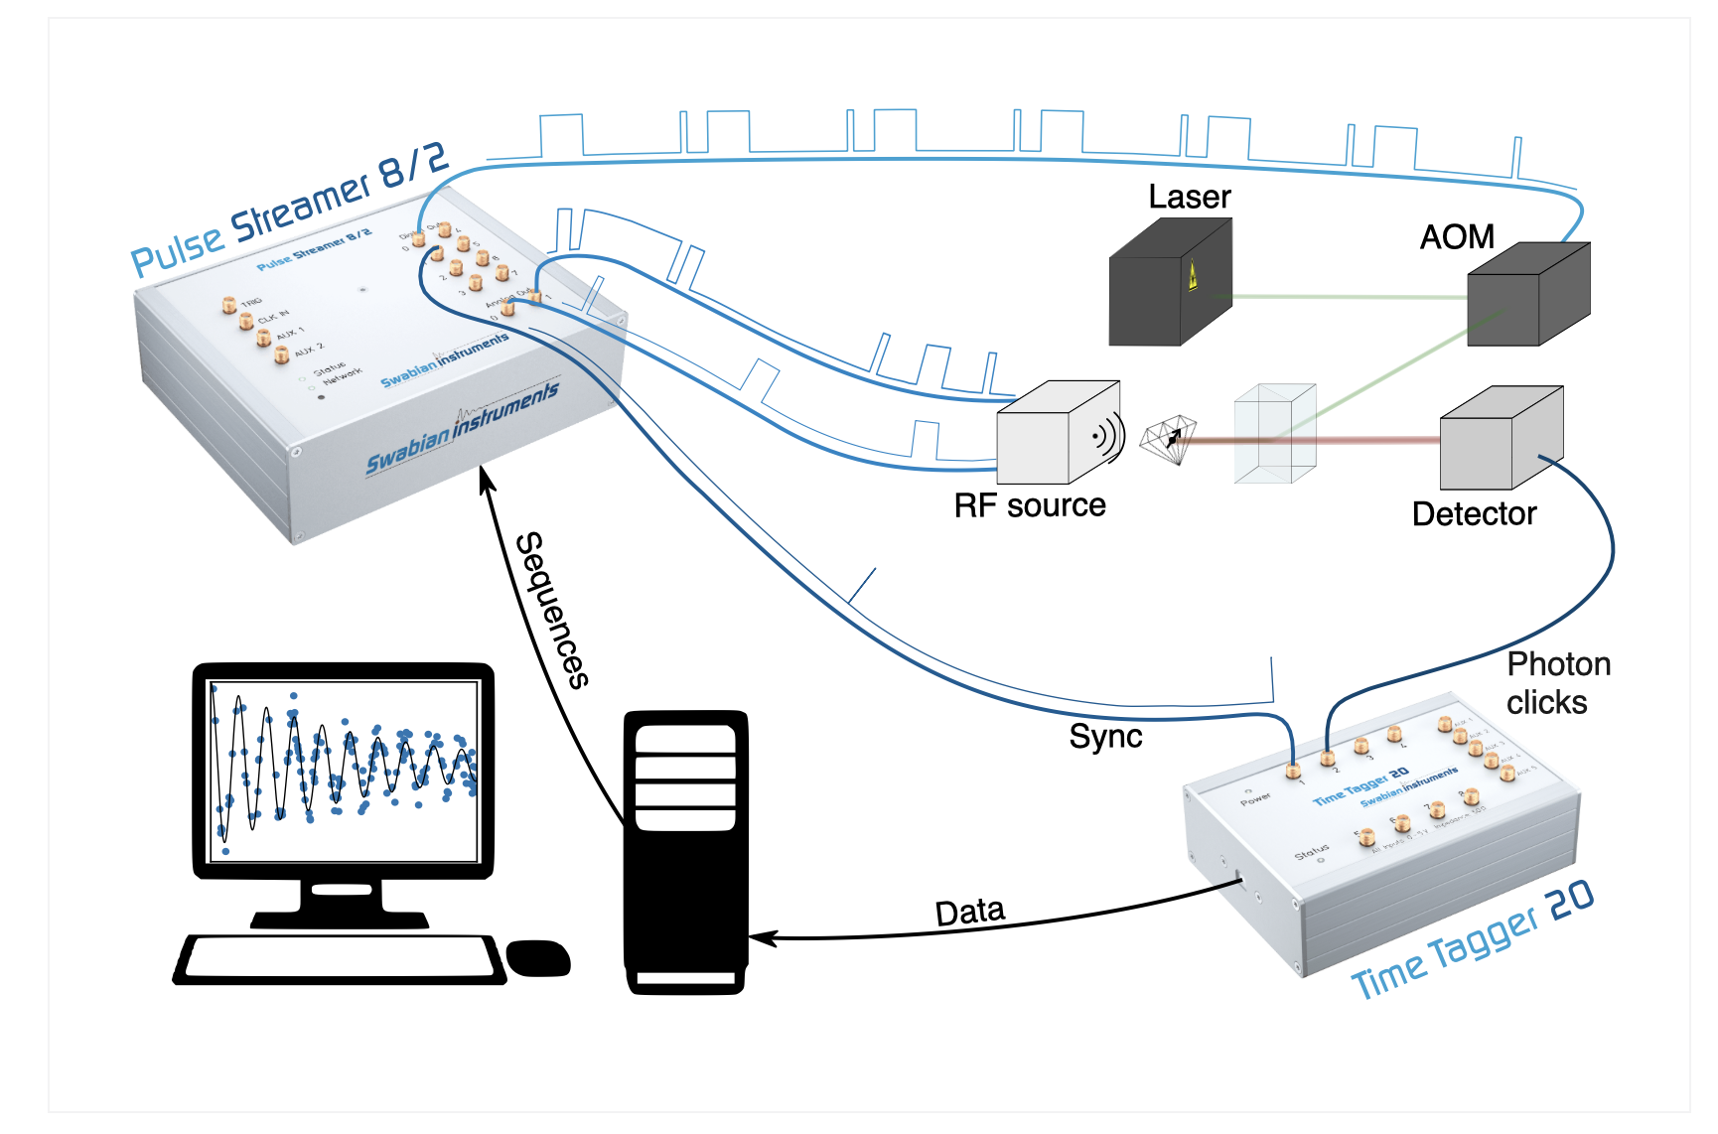
Hands-On Quantum Sensing Is Too Expensive and Complex
Optically Detected Magnetic Resonance (ODMR)
Commercial ODMR setups cost > $10,000
Teachers lack hands-on tech skills.
Result: students miss the chance to work with real quantum phenomena.
Figure 4::“Optically Detected Magnetic Resonance (ODMR).” Swabian Instruments, Swabian Instruments GmbH, n.d. Web. Accessed 30 July 2025
Figure 4: Commercial ODMR Setup
3
Notes:
The technique that is being used for this research is called Optically Detected Magnetic Resonance or (OMDR) for short.
ODMR experiments, while powerful, are generally not feasible in educational settings.
They often require thousands of dollars' worth of equipment and expert-level technical skills.
Even when resources are available, the setups can be too fragile or too complicated for students to use without supervision.
The specific challenge addressed in this study is how to dramatically lower those barriers.
Teaching quantum sensing is usually limited to elite labs with expensive tools.
Teachers often lack access to tools like oscilloscopes or training in microwave systems, optics, or 3D printing.
As a result: students are left out of hands-on quantum science, which is key for building the future quantum workforce.

Slide 4
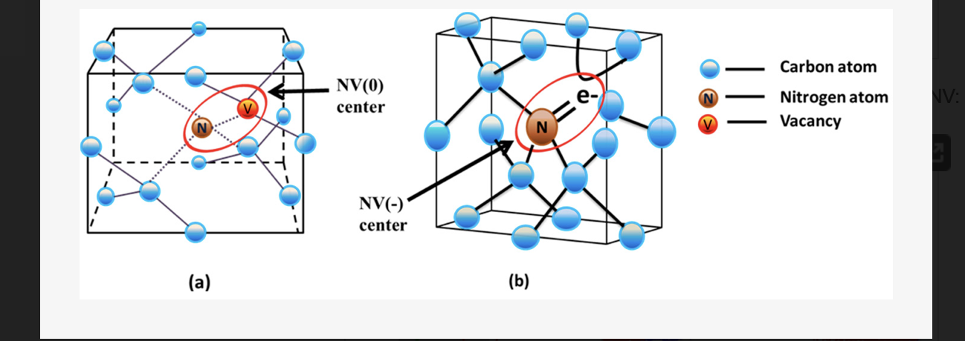
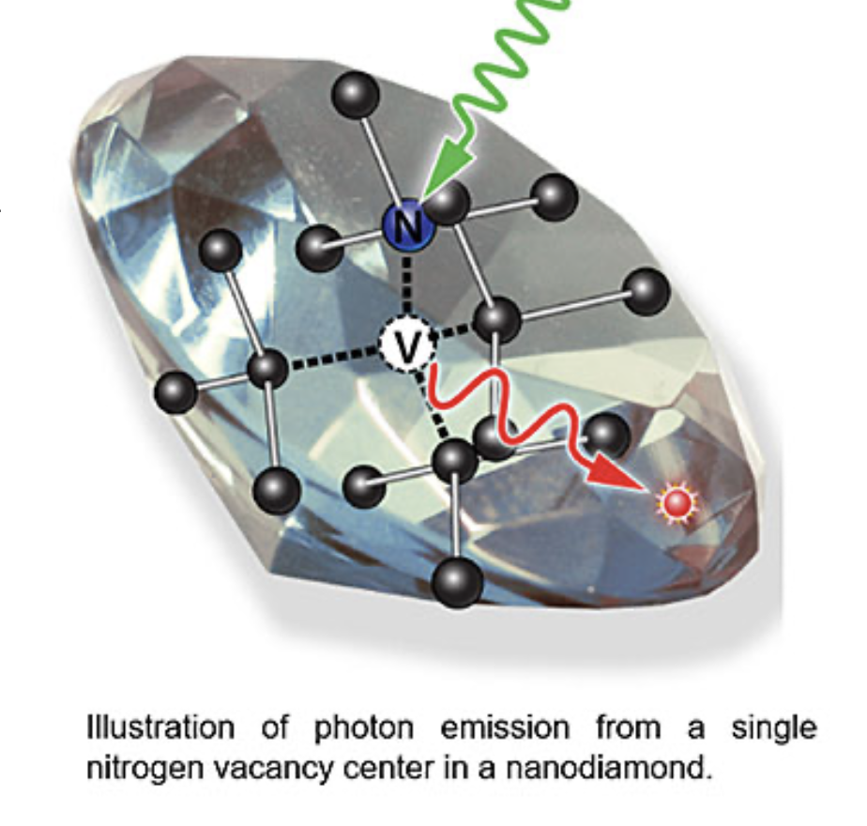
Our Solution: NV Centers & 3D printed ODMR I
Use nanoscopic nitrogen-vacancy (NV⁻) centers in diamonds.
Detect spin transitions via ODMR using a 532 nm laser and microwaves (~2.87 GHz).
3D-printed optical cubes with modular components form the setup.
Figure 5(a):Schematic of a NV(0) Center
Figure 5(b):Schematic of a NV(-) Center in a diamond
Figure 6: Photon Emissions from a single Nitrogen Vacancy Center in a diamond
Figure 5 a/b:Haque, Ariful, and Sharaf Sumaiya. “An Overview on the Formation and Processing of Nitrogen‑Vacancy Photonic Centers in Diamond by Ion Implantation.” Journal of Manufacturing and Materials Processing, vol. 1, no. 1, 2017, article 6.
Figure 6:“Nanodiamonds Shine with Single Photons.” Brookhaven National Laboratory, Center for Functional Nanomaterials, 31 Jan. 2020. Web. Accessed 30 July 2025
4
Notes:
Our approach uses the negatively charged NV⁻ center, which is a defect in the diamond lattice consisting of a nitrogen atom next to a missing carbon atom (vacancy).
These NV centers have unpaired electrons whose spin state can be manipulated using microwave radiation and read out using optical fluorescence.
When you shine a green laser (around 532 nm) on an NV center, it fluoresces red.
But if microwaves at ~2.87 GHz hits the diamond it flips the electron's spin, and the fluorescence drops.
This drop is what we call Optically Detected Magnetic Resonance (ODMR).

Slide 5
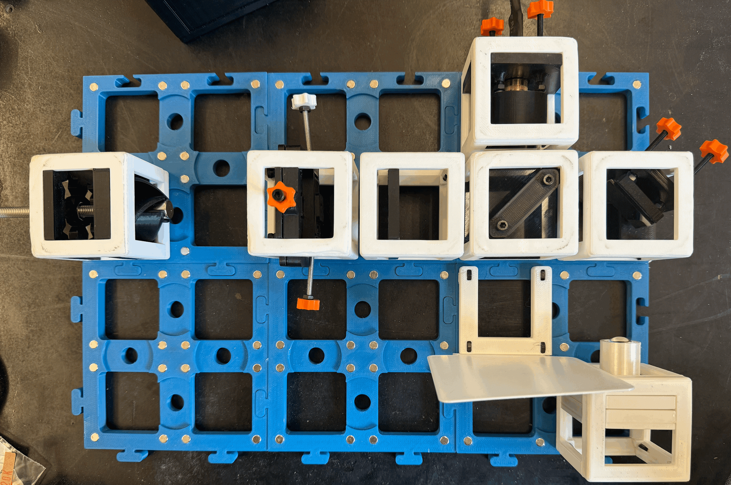
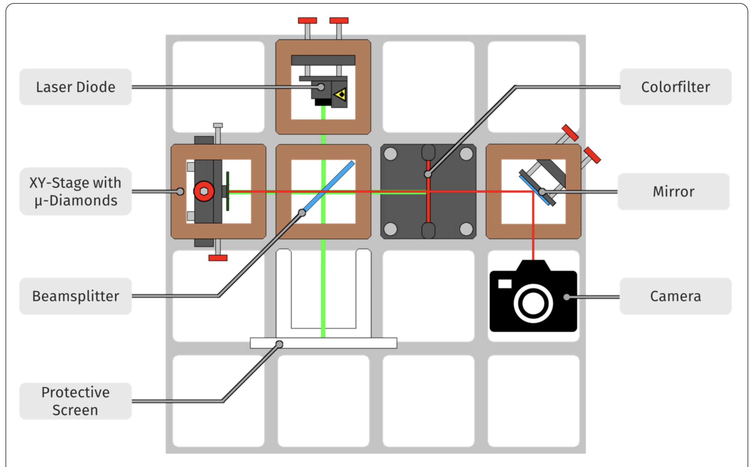
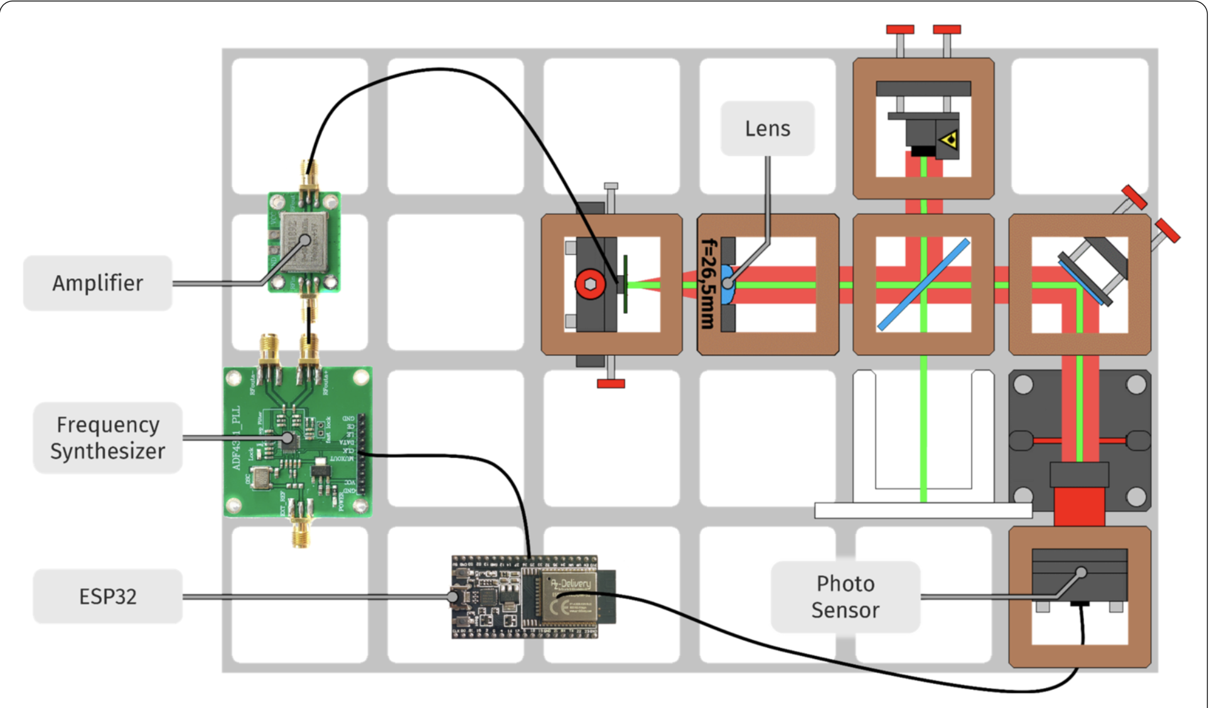
Our Solution: NV Centers & 3D printed ODMR II
Use nanoscopic nitrogen-vacancy (NV⁻) centers in diamonds.
Detect spin transitions via ODMR using a 532 nm laser and microwaves (~2.87 GHz).
3D-printed optical cubes with modular components form the setup.
Figure 7:Schematic setup for fluorescence observation
Figure 9: OMDR set up
Figure 7 & 8:Haverkamp, Nils, et al. “Low‑Cost ODMR Experiments with Nitrogen‑Vacancy Centers in Diamonds: A Didactical Approach to Theory and Experiment.” EPJ Quantum Technology, vol. 12, no. 27, 21 Feb. 2025, pp. 1–19.
figure 8: Schematic setup for measuring fluorescence
5
Notes:
This setup uses low-cost components: such as a green laser, a 3D-printed modular optical system, an (ESP32) microcontroller to make our own web server and see the data, a microwave source (ADF4351), and an adafruit photosensor (TSL2591).
Everything is modular, visible, and designed for hands-on inquiry. And Students build it, align it, and run real quantum experiments.

Slide 6
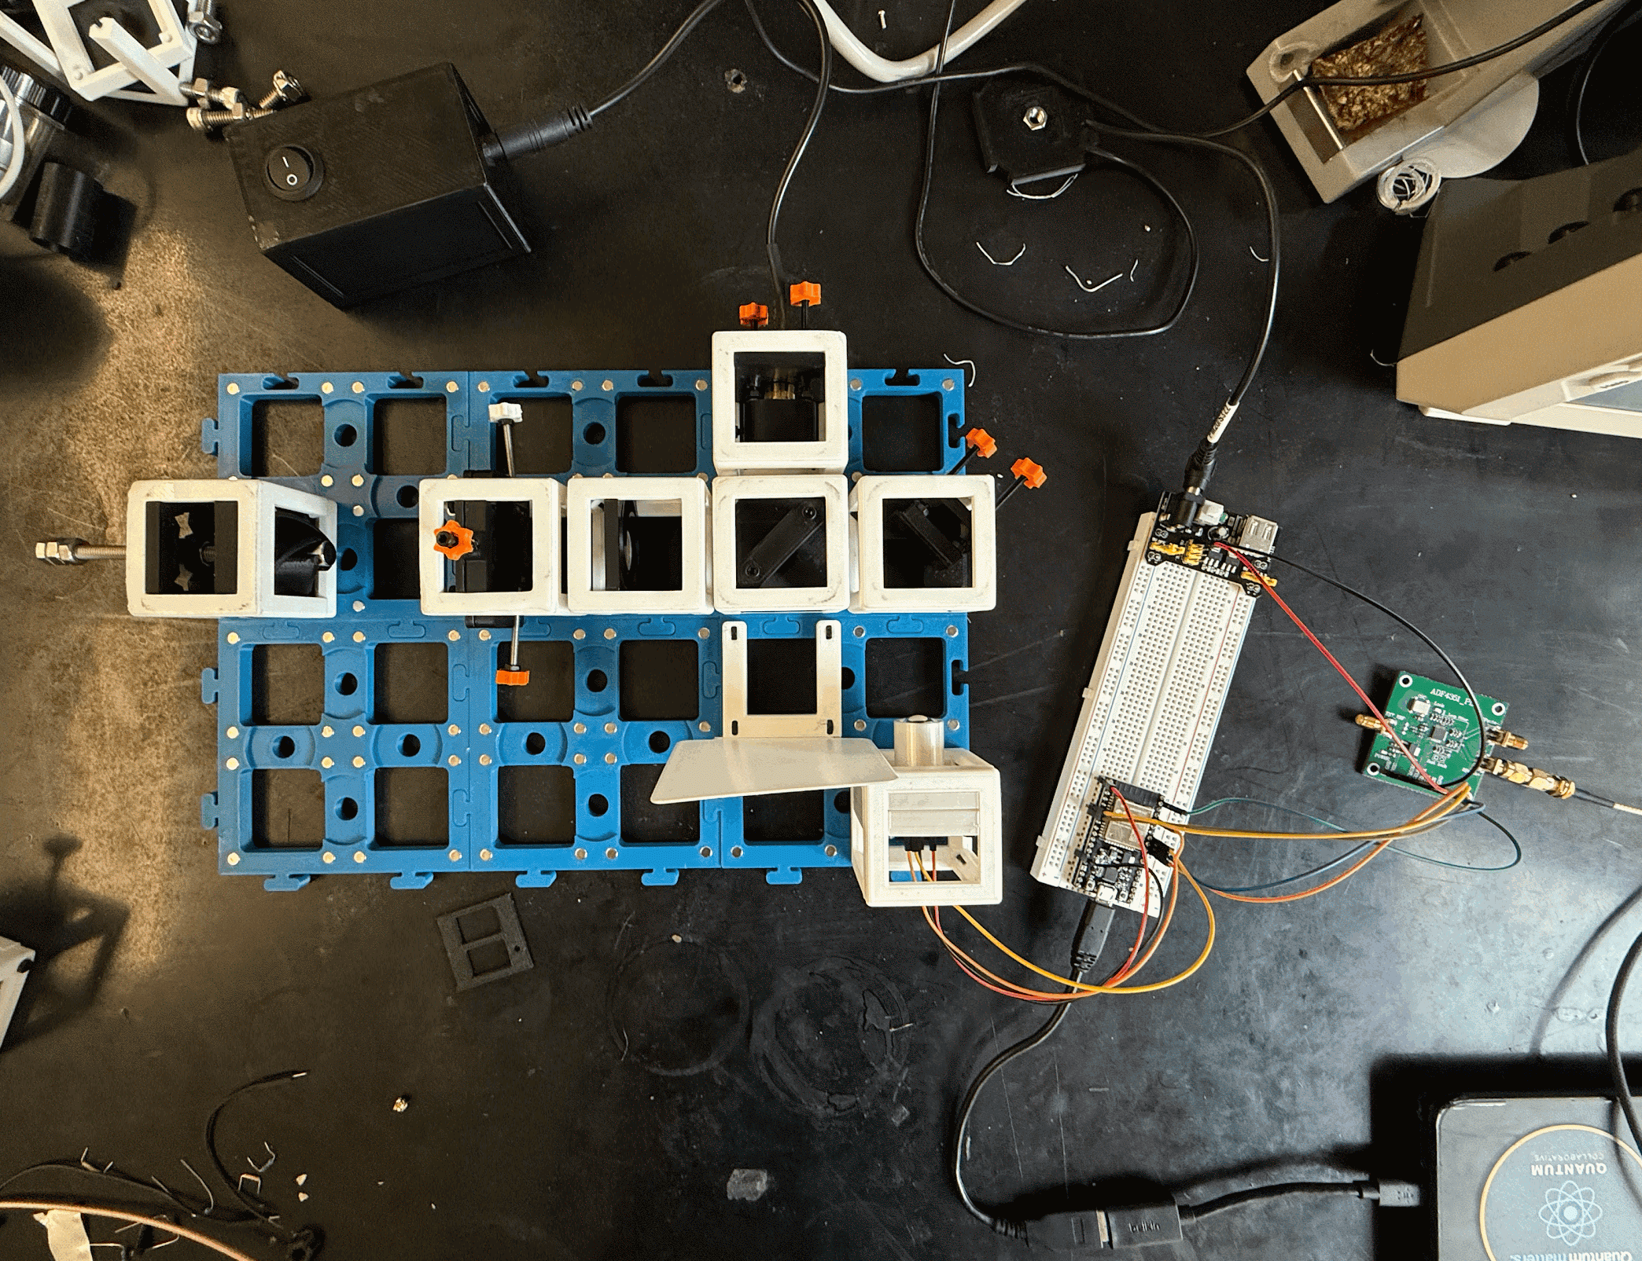
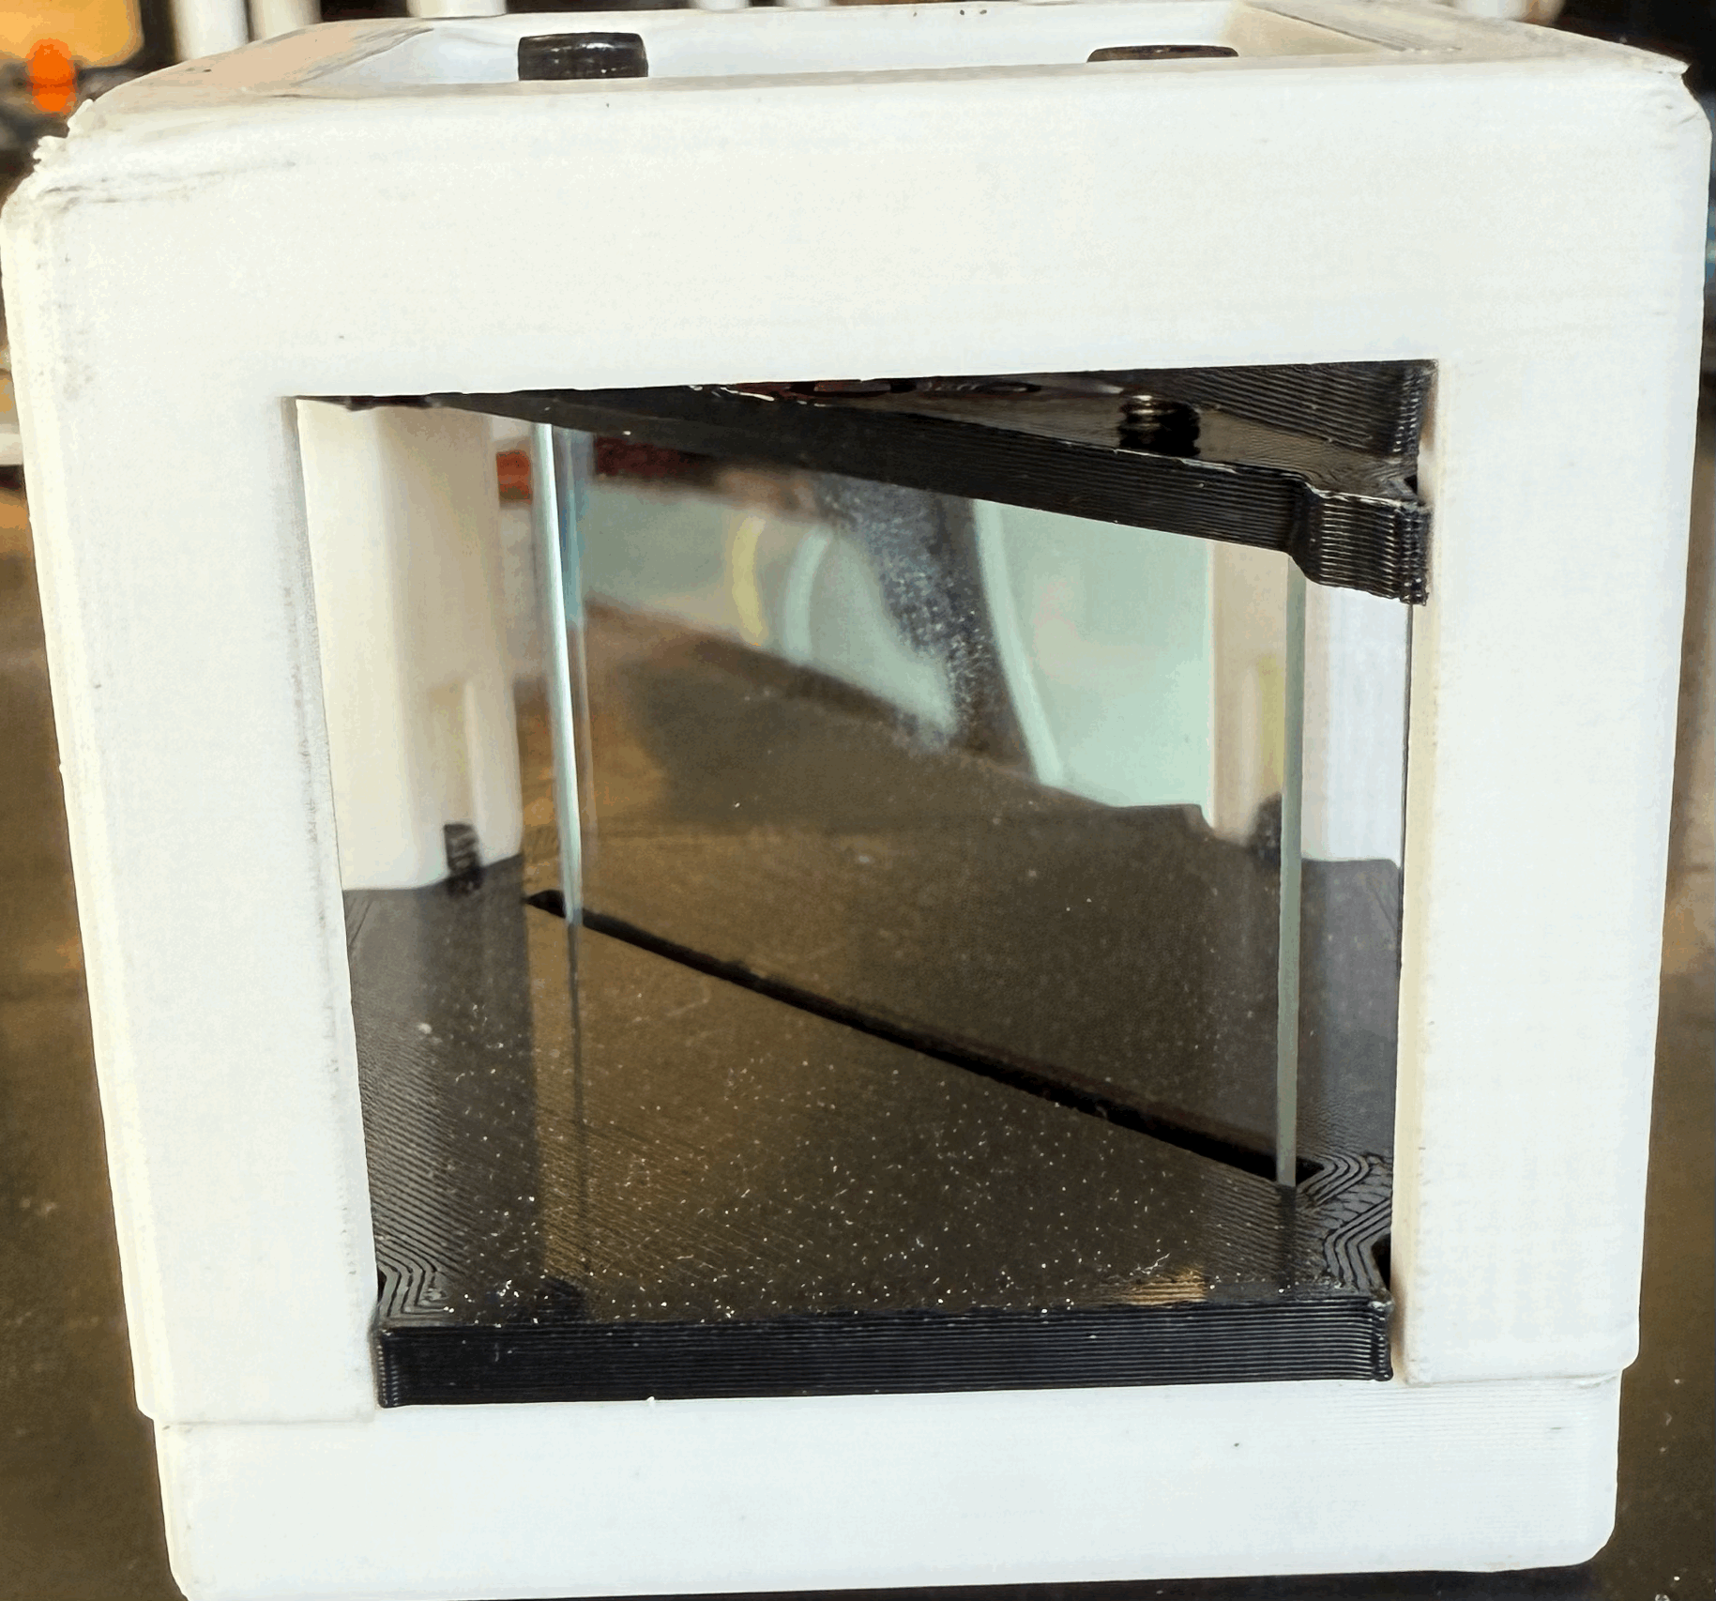
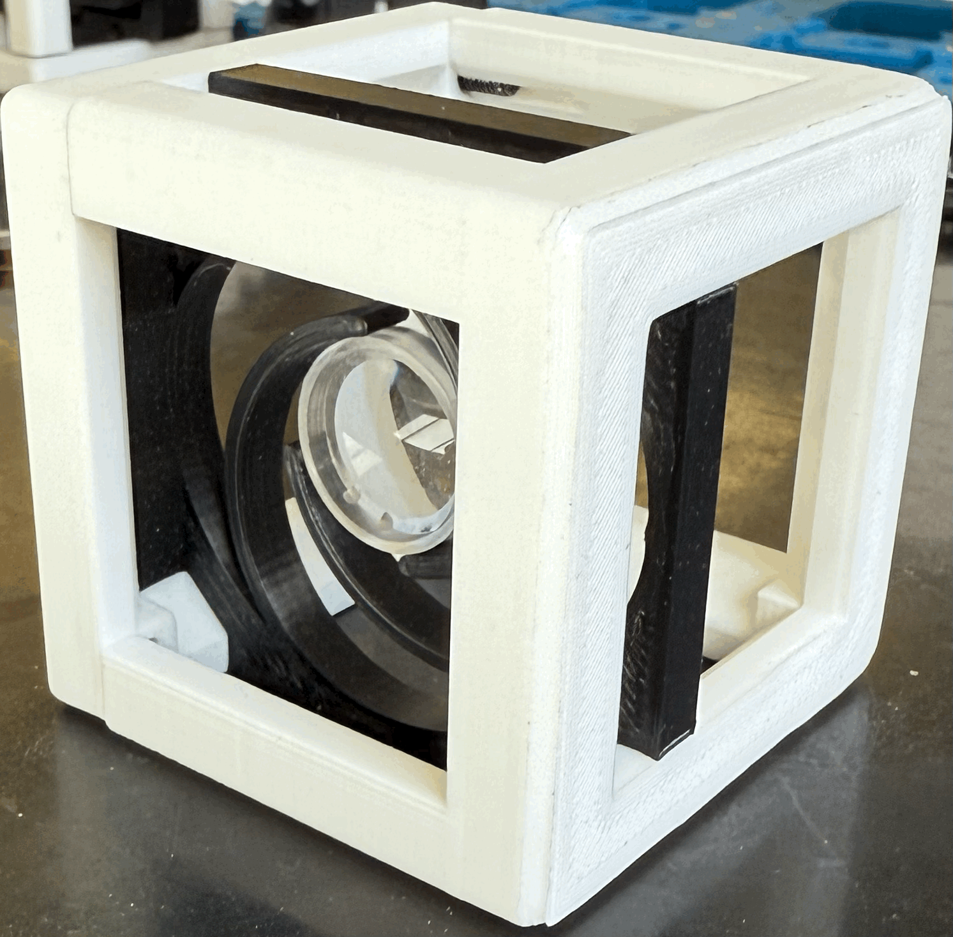
3D Printed Modular Optical Cubes
Purpose
Modular Optical cubes structure to contain ODMR components
Figure 10: Cube with beam splitter
Figure 11: Cube with focusing lens
Figure 12: OMDR set up with microcontroller and frequency synthesizer
6
Notes:
In our group, we were interested in building an ODMR set up with data acquisition capabilities
This 3D setup can be use for many other optical applications but for this research we are making a ODMR build. It consist of a 6 by 4 grid where it can be modular due to the base having magnets at the bottom of their feet and eliminating the need to manually adjust the optical mounts compare to comercial ones.
Within each of these cubes it can be placed with different optical components to make an optical set up.
For example, here are some cubes with different components like in figure 10 that cubes houses the beam splitter and in figure 11 that cube houses the focusing lens
Lastly on figure 12, the whole optical setup for ODMR is wired with the electrical components

Slide 7
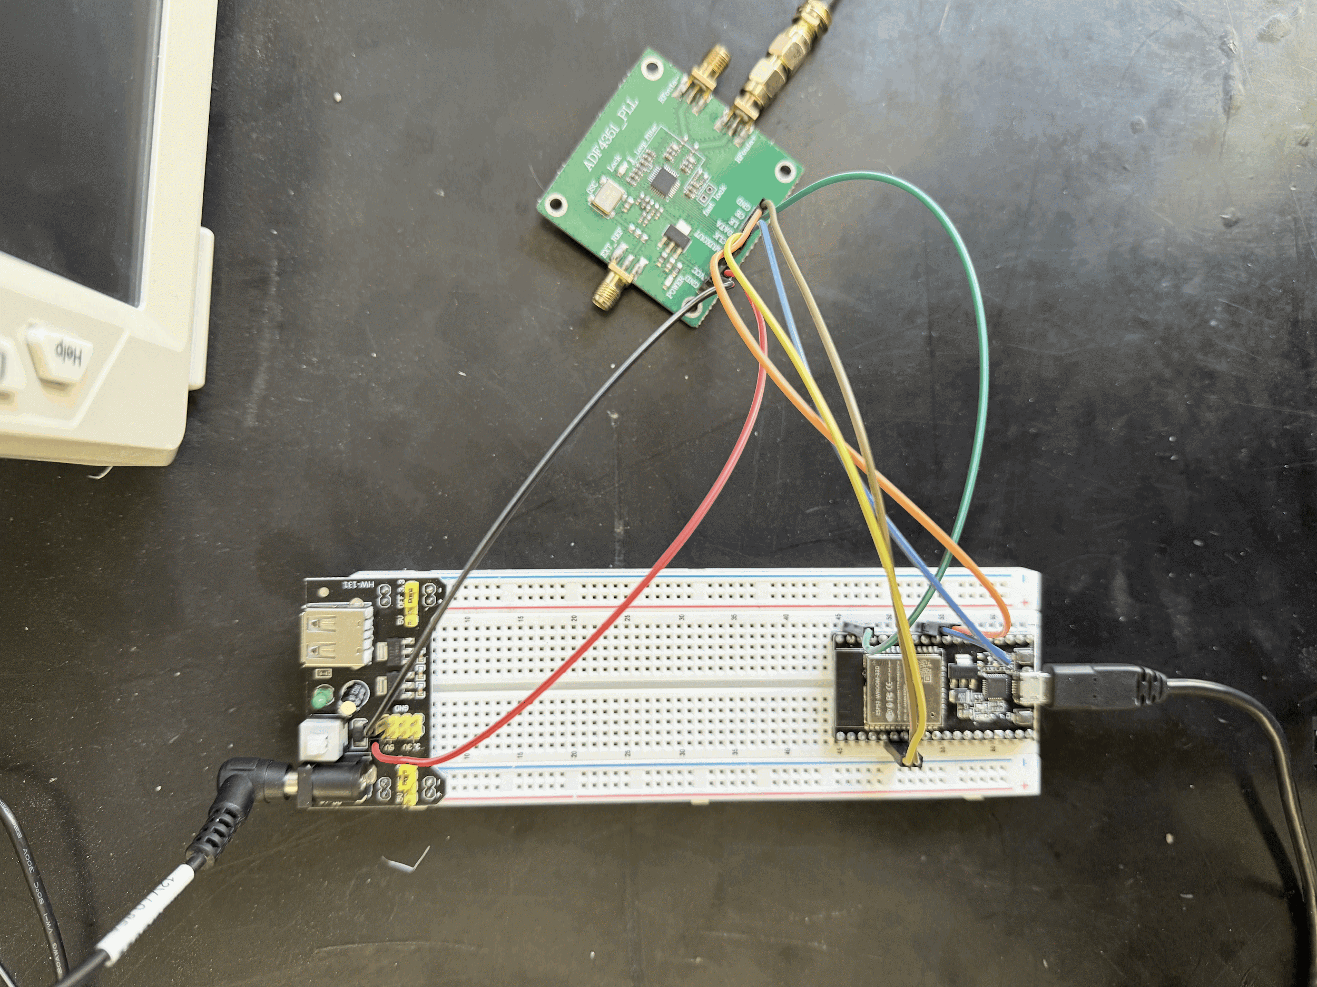
Frequency Synthesizer (ADF4351)
Purpose
Outputs tunable microwave signals
Low cost solution
ADF4351 has a range of 35MHz - 4.4GHz
Frequency resolution is high
To excite vacancy center at 2.87 GHz
Perform a frequency sweep between 2.6 - 3.0 GHZ
ADF4351
Power Supply Module
ESP32 Microcontroller
Figure 13: ADF4351 being powered by a dedicated power module
7
Notes:
To keep a low budget build we used a generic frequency synthesizer that you can buy at Aliexpress as our source to excite the vacancy center in the diamond.
Unlike commercial microwave sources, which are expensive, the ADF4351 is a low-cost solution (around $20–$30).
It can generate a clean and stable microwave signal over a wide range (35 MHz to 4.4 GHz).
The frequency resolution is high, allowing for precise control over the signal — essential for accurate resonance detection.
Also It outputs tunable microwave signals, which in our setup is going to be centered around 2.87 GHz.
By sweeping this microwave signal across a range of frequencies, we can resonate with the spin transitions in the NV center's electronic ground state while also gather data through arduino.
.
Detecting this changes allows us to observe ODMR.
.

Slide 8
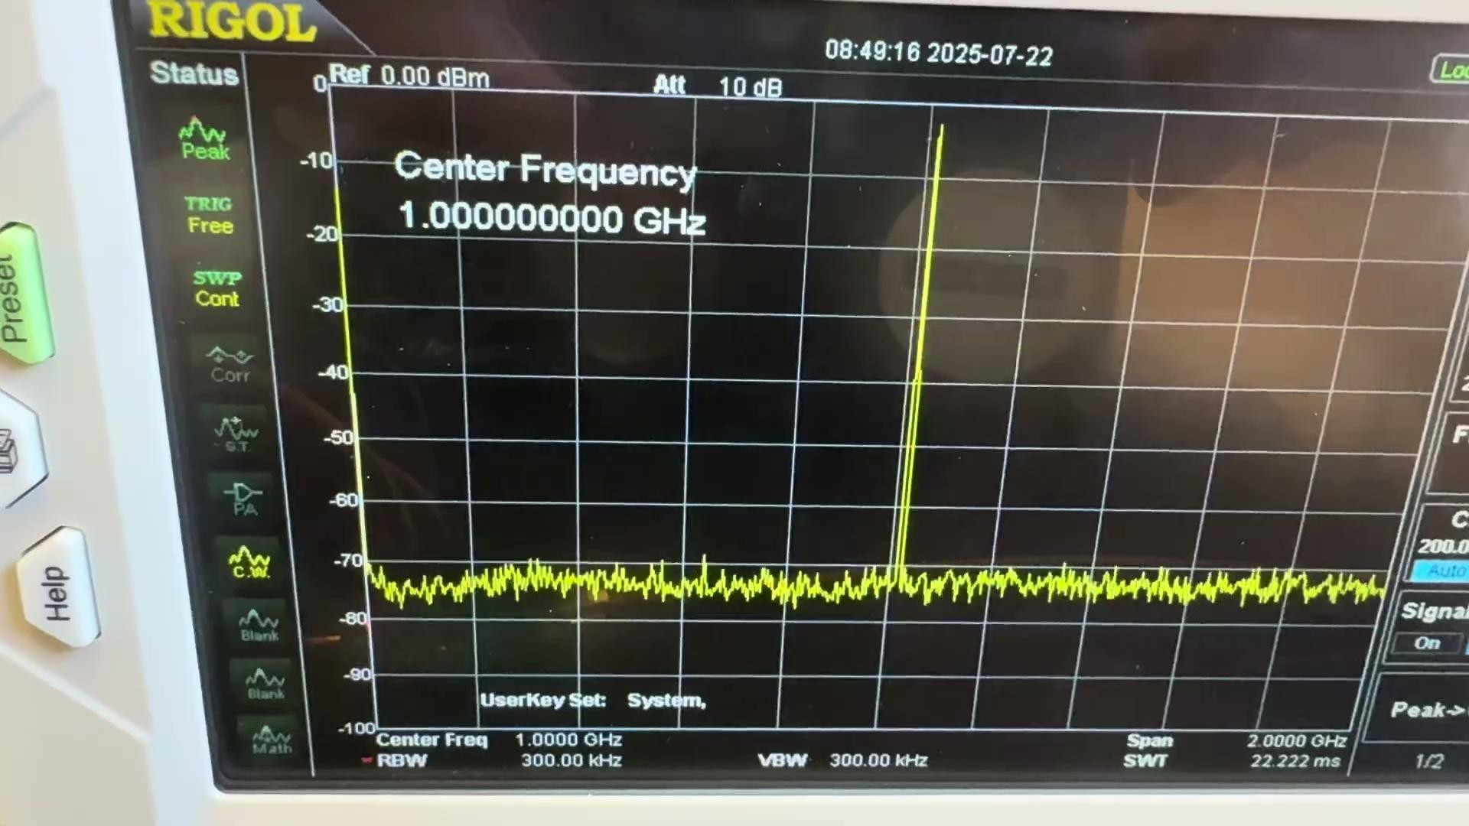
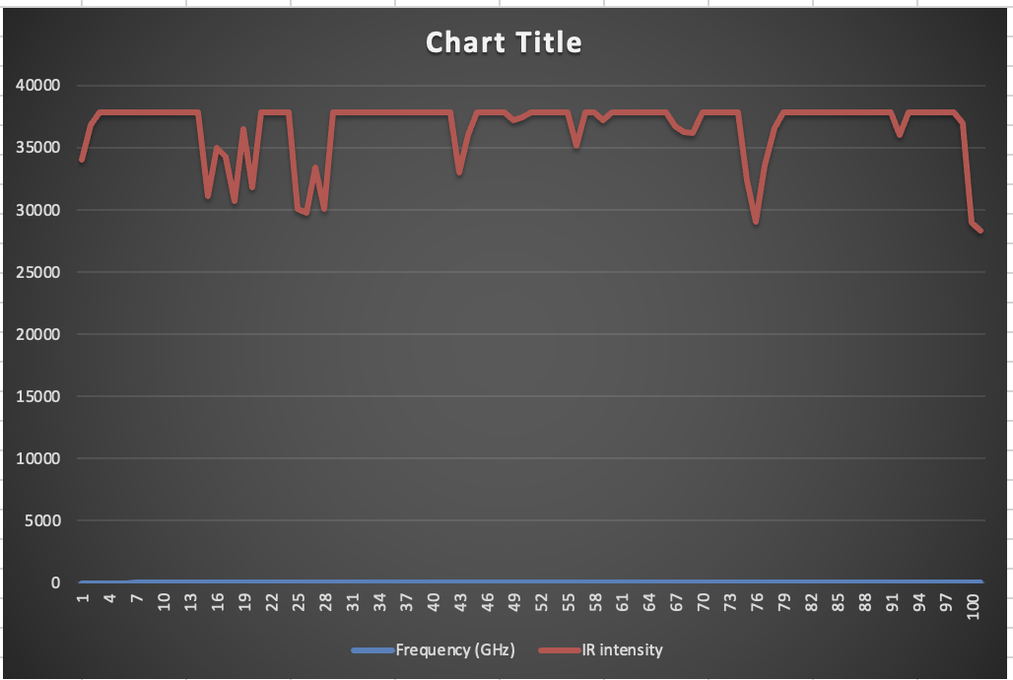
Example of Sweep using Frequency Synthesizer
Figure 14: Live video of the frequency sweep
Figure 15: Excel plotted graph of Frequency vs Intensity
8
Notes:
In figure 14 we used a spectrum analyser to show the output of the frequency synthesizer.
In the same figure, the X coordinate shows the frequency and the Y coordinate shows the power level in dBm
This video shows an example of the frequency synthesizer doing a sweep.
On figure 15, there is measured data of light intensity, and a measurement of this type will be used to measure the fluorescence of the nitrogen vacancy center in diamonds.

Slide 9
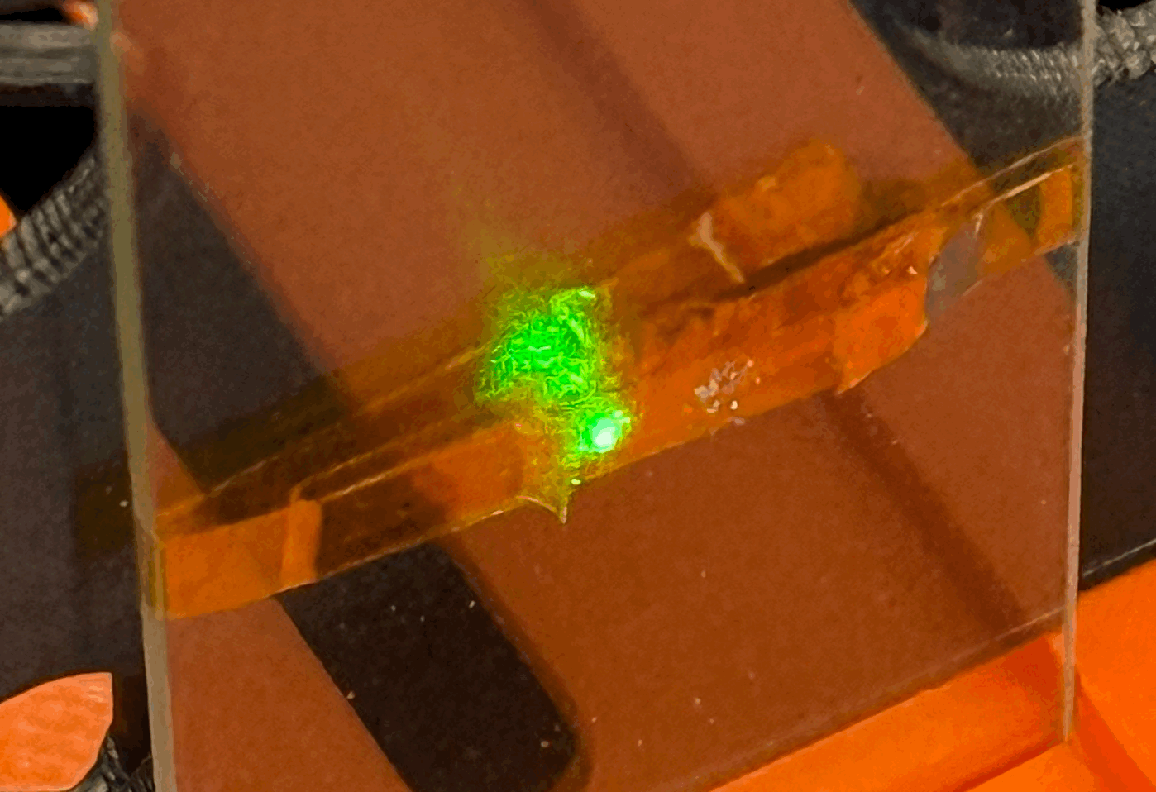
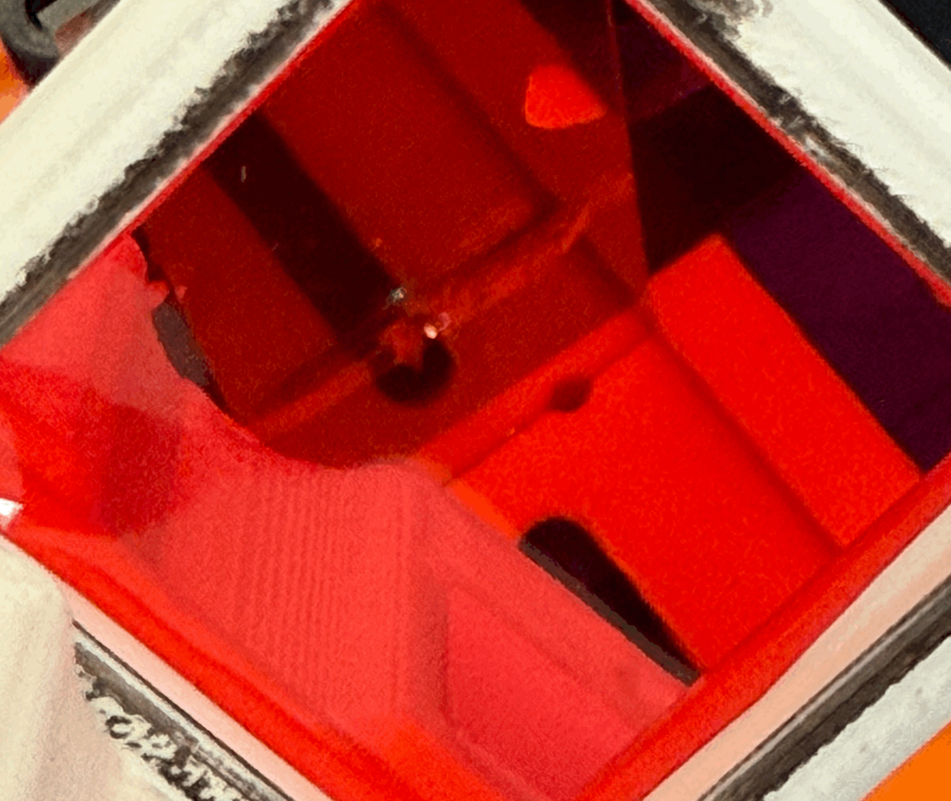
Fluorescence in NV diamonds
Microdiamond
Microdiamond
Figure 16: Diamond Giving NV emissions without filter
Figure 17: Diamond giving NV emissions with filter
9
Notes:
And as for the diamond ,on my final days in NAU, I got to finally show Fluorescence in the diamond.
In figure 16 we excited the diamond with a green laser
And on figure 17, there is the same diamond showing a fluorescence of red with a filter in front of the diamond.

Slide 10
Future Work
Add a microwave antenna for spin flip
Measure fluorescence in diamonds
See fluorescence dips with a frequency sweep
Show Zeeman splitting by showing the spectra with an external magnet
10
Notes:
As for the next steps for future work for this research would be to add a microwave antenna behind the diamonds to control the orientation of the spin flip.
Be able to detect and measure fluorescence on the diamonds.
See the fluorescence dips with a frequency sweep when the sweep passes at 2.87 GHz .
Show Zeeman splitting by showing the spectra with an external magnet.
These steps would would be the start of showing real quantum physics and build the confidence to deploy the system as kits in labs

Slide 11
Conclusion
Recap
Capability of Quantum Technology
ODMR systems are expensive
Making an low cost ODMR Systems is now possible
Students can physically observe and measure real quantum effects
At a low price point this build can be deployable
Ultimate goal is to implement this system to school courses
Contributions
Building an inexpensive ODMR system is possible
$
$
$
$
11
Notes:
In conclusion, Quantum technology is a powerful and capable of doing new things
ODMR systems can be expensive to have.
ODMR experiments, once only possible in elite research labs, can now be done for at a low cost using open-source materials and basic electronics.
Now students can physically observe and measure real quantum effects at a low cost.
As for my contribution for this research I was able to show and build a inexpensive ODMR system
Hopefully, this system would be implemented to future courses especially non R1 universities.
Finally, doing research has taught me the importance of patience, going through the research with an open mind and that research is never linear you will have hiccups that you have to solve in clever ways.

Slide 12
Acknowledgements
We acknowledge the use of the Nanofab core facilities at Arizona State University supported in part by ECCS-2025490 and NCI Southwest for a fellowship to Juan Luis Gonzalez
This summer research would not be possible without the support of my faculty advisor, Dr. Ryan Behunin, and my mentor, Dylan Chapman.
I am sincerely grateful to Northern Arizona University, Arizona State University, and Nanotechnology Collaborative Infrastructure - Southwest for the opportunity to participate in the Research Experience for Undergraduate program.
12
Notes:
Lastly this summer research would not be possible without the support of my faculty advisor, Dr. Ryan Behunin, and my mentor, Dylan Chapman.

Slide 13
Thank you
Contact: Juan.gonzalezmorales336@myci.csuci.edu
12
Notes:
Thank you all for your time
I am now open on taking questions

Slide 14
References
Haverkamp, N., Malessa, M., & Müller, T. (2025). Low-cost ODMR experiments with nitrogen-vacancy centers in diamonds: A didactical approach to theory and experiment.
Stegemann, J., Haverkamp, N., Malessa, M., & Müller, T. (2023). A low-cost table-top experiment for quantum sensing using the optically detected magnetic resonance of nitrogen-vacancy centers in diamond.
All resources are from the STL files to the software can be found at https://o3q.de/odmr/
9
Notes:
Thank you all for your time
I am now open on taking questions

Slide 15
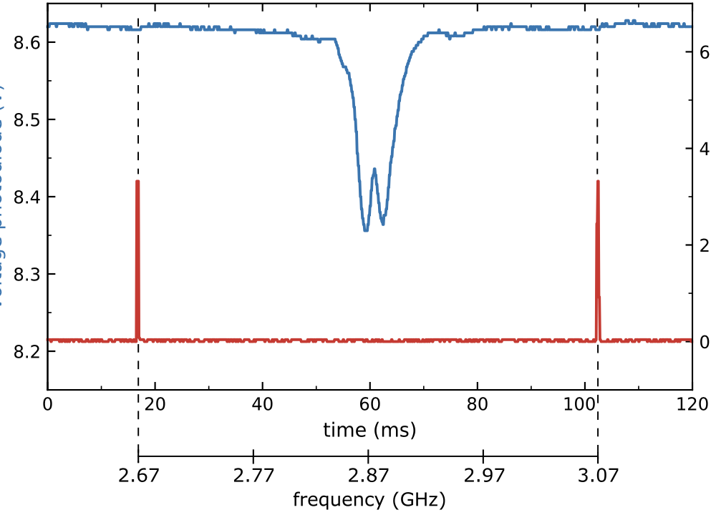
7
Notes:
Second was to do a frequency sweep of 2.6-3.1 GHz. At 2.8GHz the NV centers undergo a spin transition .This transition leads to a non-radiative decay path through a singlet “dark” state, which decreases the red fluorescence.The fluorescence dip is recorded by a photosensor and shown on a screen via a WiFi custom made interface

Slide 16
3D printed Modular Optical cubes
Purpose
Modular Optical cubes structure to contain ODMR components
Challenges
3D printing took a couple of weeks to finish due to nozzle issues
Did not had the proper equipment to clean the nozzles
Finally clean the nozzles by making the nozzles to heat up and used pliers to clean the clogged up residue
Figure 10: OMDR set up with microcontroller and frequency synthesizer
6
Notes:
So in my time in NAU, I was introduced to do this research by my advisor by reading a couple of papers in building an ODMR set up with data acquisition capabilities. In my time there I got to build this set up by seeing some of the schematics provided by my mentors and the papers that I read. Printing the 3D parts was the easy part of this research but not without its issues. There was a point when working with the 3D printer and printing the cubes with the internals that the cubes would not fit well anymore. The main reason the printer started doing that was that the printer nozzle was slowly clogging over time and because of the lack of cleaning utensils this would happen after every print. To fix this issue we had to manually heat up the nozzle and clean the PLA gunk with small pliers. But once I got my hands on the microcontroller with the other boards, that is where I started to experience the complexity of this research.

Slide 17
Frequency Synthesizer (ADF4351)
Purpose
To excite vacancy center at 2.87 GHz
Perform a frequency sweep between 2.6 - 3.0 GHZ
Challenges
The ADF4351 would not turn with the microcontroller
The datasheet provided was misleading because its a basic chinese board
Finally got the ADF4351 board to turn on with a power module
ADF4351
Power Supply Module
ESP32 Microcontroller
Figure 12: ADF4351 being powered by a dedicated power module
7
Notes:
We used a frequency synthesizer as our source to excite the vacancy center in the diamond while also running a frequency sweep but there were challenges. When working with the frequency synthesizer board, the first thing that I encountered was that the board would not turn on. The reason was that I originally wired the board to the 5 Volts pin on the microcontroller because I was following the data sheet provided when you buy the board. The datasheet was misleading because this is a generic board but by reading further on the data sheet it was recommended to run a constant 5 Volts to power the board, so the solution for this was to add a power supply module that gives out a constant 5 Volts.

Slide 18
Future Work
Make a working web server
Get the Frequency Synthesizer to
Lock better & look through forums
look for Computer Science majors and ask for assistance
Improve on the 3D printing design
Gather data through arduino serial port and plot it through excel or python
Experiment with Python instead of Arduino
Implement into Quantum courses as kits
10
Notes:
As For future work, I need to find a way to make the web server to work properly because for some reason, that i still don't know yet, the web server loses its connection. Also get the frequency synthesizer to lock better because when seeing the frequency on a spectrum analyzer the signal skips. Also figure out why my board turns off and loses its locking capabilities after 2 GHz. I am thinking of asking computer science majors to look at my code and hopefully it would be an easy fix. Next is to Improve on the 3D printing designs preferably using a smaller nozzle for higher detail printing. Also Gather real data from the diamond through arduino serial port and plot it through excel or python. Perhaps experiment with python instead of arduino just to see if the reason the frequency synthesizer does not lock properly is due to using arduino IDE. And finally Implement this into Quantum courses as kits.

Slide 19
Conclusion
Recap
ODMR systems are expensive ~ $10,000
We are working towards making ODMR Systems for under $600
Students can physically observe and measure real quantum effects
Ultimate goal is to implement this system to school courses
Lessons Learned
The importance of having patience when doing research
Research is never linear
$
$
$
$
11
Notes:
In conclusion, ODMR systems can be expensive to have. ODMR experiments, once only possible in elite research labs, can now be done for under $600 using open-source materials and basic electronics. Now students can physically observe and measure real quantum effects at a low cost. Hopefully, this system would be implemented to future courses especially non R1 universities. Finally, doing research has taught me the importance of patience, going through the research with an open mind and that research is never linear you will have hiccups that you have to solve in clever ways. Thank you for your time.

Slide 20
Example of Sweep using Frequency Synthesizer
Figure 12: Live video of the frequency sweep
Figure 13: Excel plotted graph of Frequency vs Intensity
8
Notes:
But the main issue that I had with the frequency synthesizer is the the way you have code in arduino because is highly sensitive. The synthesizer incorporates a Phase Lock Loop along with prescalers, dividers and multipliers and special libraries like “BigNumbers” that I didn’t know you had to run on this board. This took me weeks to figure out before I got it to run. On my finals weeks at NAU I went as far as running a frequency sweep of 1 GHz to 1.1 GHz and collecting ambient light data from the room using the photosensor, just to prove that it can be done and here is my result on figure 13. The last thing I need to work on is for the synthesizer to work pass 2 GHz because after it passes that frequency it shuts down at me and my goal is to run a sweep from 2.6Ghz to 3 GHz and that is where I left off at.

Slide 21
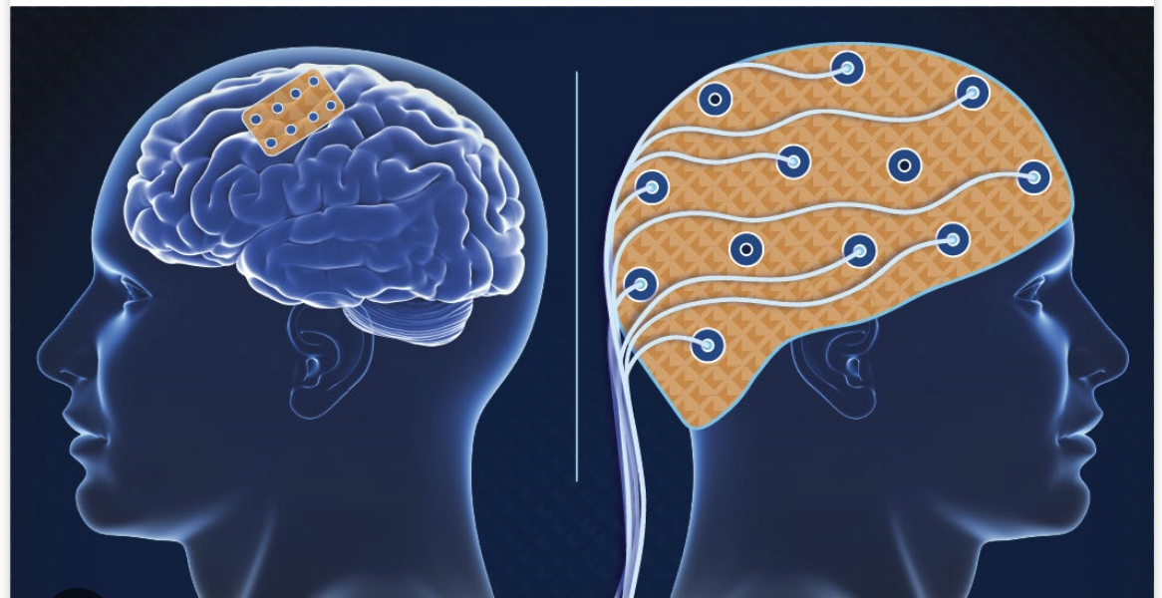
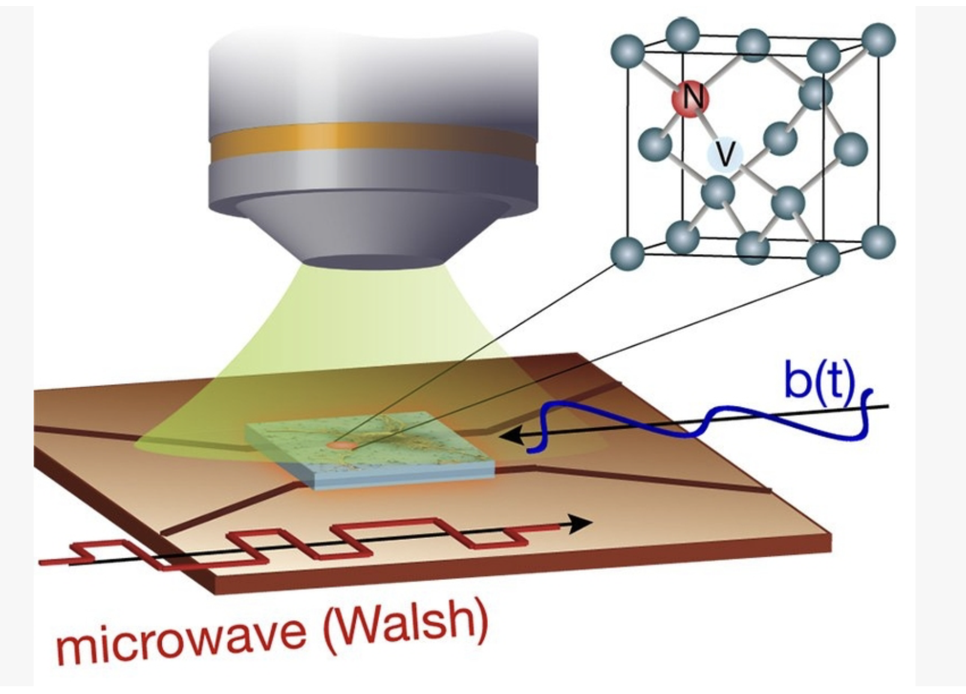
The Second Quantum Revolution Needs a Workforce
Quantum technologies are transforming fields like medicine, materials science, and data security.
However, quantum concepts remain difficult to teach in schools due to lack of accessible experiments.
Nitrogen Vacancy (NV) centers in diamonds can be used to teach real-world quantum sensing affordably.
Figure 3: Diamond Lattice with NV center
Figure 1:Brain-Computer Interface
Applications include brain-computer interfaces, nanoscale magnetic sensing, and biological research.
Education has yet to catch up, leaving a major gap in accessible quantum experimentation.
Figure 1:
Figure 2:
Figure 3:
Figure 2: Using Quantum Sensing on a artificial Neuron
2
Notes:
As you may know, We’re entering the "second quantum revolution"—a shift driven by technologies like quantum computers, quantum communication, and especially quantum sensors.
One of the most promising sensing platforms is based on nitrogen-vacancy (NV) or NV for short centers in diamond.
NV centers are tiny atomic-scale defects in a diamond lattice that behave like artificial atoms.
What makes them special is their ability to interact with light and microwaves in a measurable and controllable way—even at room temperature.
These properties allow them to function as ultra-sensitive magnetic field sensors, useful in medicine, neuroscience, and material science.
But until now, these tools were too complex or expensive for students to engage with directly.

Slide 22
Hands-On Quantum Sensing Is Too Expensive and Complex
Optically Detected Magnetic Resonance (ODMR)
Commercial ODMR setups cost > $10,000 and hide physics behind “black boxes”.
Many teachers lack experience in 3D printing, soldering, or signal detection.
Result: students miss the chance to work with real quantum phenomena.
Figure 4::
Figure 4: Commercial ODMR Setup
3
Notes:
The technique that is being used for this project is called Optically Detected Magnetic Resonance or (OMDR) for short.
ODMR experiments, while powerful, are generally not feasible in educational settings.
They often require thousands of dollars' worth of equipment and expert-level technical skills.
Even when resources are available, the setups can be too fragile or too complicated for students to use without supervision.
The specific challenge addressed in this study is how to dramatically lower those barriers.
Teaching quantum sensing is usually limited to elite labs with expensive tools.
Teachers often lack access to tools like oscilloscopes or training in microwave systems, optics, or 3D printing.
As a result: students are left out of hands-on quantum science, which is key for building the future quantum workforce.

Slide 23
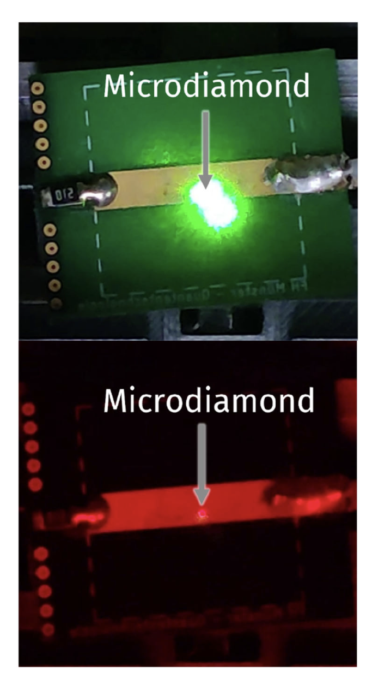
Optically Detected Magnectic Set
XY-Stage with Diamonds
Green Laser
Focusing Lens
Movable Permanent Magnet
Figure 10: Expected NV Fluorescence with filter
Figure 11: ODMR setup with directions
6
Notes:
Due to Time constraints and the diamonds still on their way, we couldn't do our experiments with the system. But here is our future goals for the experiment. The first is one is to show NV Fluorescence with the alignment of the green laser and capturing the red Fluorescence with a red filter and this is the emissions from the NV center. Figure is is the ODMR set that we build for this project

Slide 24
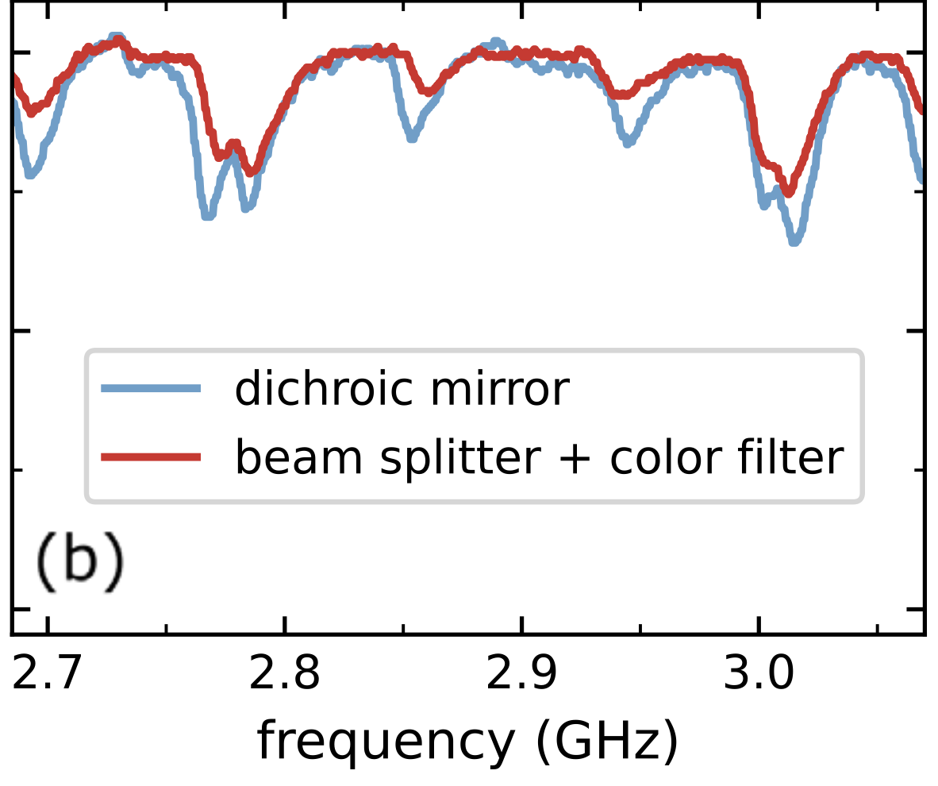
8
Notes:
In the third step, we add an external magnetic field with a movable permanent magnet. This causes Zeeman splitting—the single dip splits into up to eight dips, due to the four different orientations of NV centers in the diamond lattice.This not only visualizes spin transitions, but also lets students map the vector components of the magnetic field.

Slide 25
What are your plans for follow-up work?
8

Slide 26
From Fluorescence to Magnetic Field Mapping
Explain some experimentation steps that have led to results.
6

Slide 27
What do the results mean?
Tell us what you think it means
What do you think it means for the next step?
Present your data – modelled and measured (if applicable)
7

