Slide 1
Space-Related Magnetic Field Effects on Human Neuronal Signaling Behavior
Erika Landree, Nate Oftedal, and Dr. Anja Kunze
Montana State University
Kunze Neuroengineering Laboratory
Contact: erika.landree@montana.com
Research: www.kunzelab.org
Follow us: @TheKunzeLab
Notes:
Should I really include gradient on here
Update website
Do things get capitalized after -

Slide 2
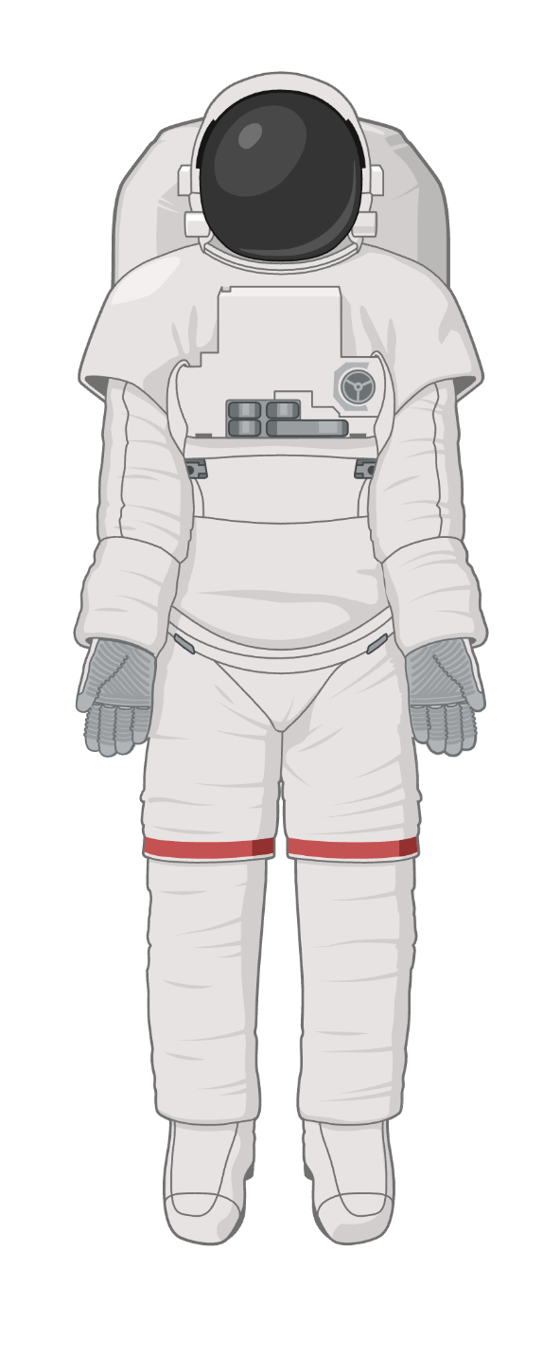
Introduction
NASA is currently interested returning to the moon
Science & Discovery
To prepare for travel to Mars
Side effects of space travel:
  Micro-gravity: Muscle atrophy, bone loss, fluid redistribution
  Radiation: Increases cancer risk, damages DNA
  Isolation: Phychological effects, circadian rhythm disruption (Demontis et al., 2017)
  Magnetic Field Changes: ?
Image created with biorender.com
Notes:
Change first two bullets

Slide 3
Magnetic Fields Impact Neural Behavior
What we know:
Moderately strong (1 mT - 1T) magnetic fields impact human and rat brain function
Effects depend on the strength and the area of the brain receiving stimulation
Moderately strong magnetic fields have potential to treat motor disorders (Wang et al., 2024)
What we do not know:
How low magnetic fields ( < 1mT) impact the human brain
How the removal and reapplication of Earth’s magnet field impacts the human brain during travel to the Moon

Slide 4


25-65 µT (Finlay et al., 2010)
Short term side effects:
Depression
Altered mood
Cognitive changes (Gupta et al., 2023)
~ 0 µT
4
Image created with biorender.com

Slide 5
25-65 µT (Finlay et al., 2010)
Short term side effects:
Depression
Altered mood
Cognitive changes (Gupta et al., 2023)
How does neuronal signaling adapt to magnetic field changes associated with travel to the Moon?
~ 0 µT
5
Image created with biorender.com

Slide 6
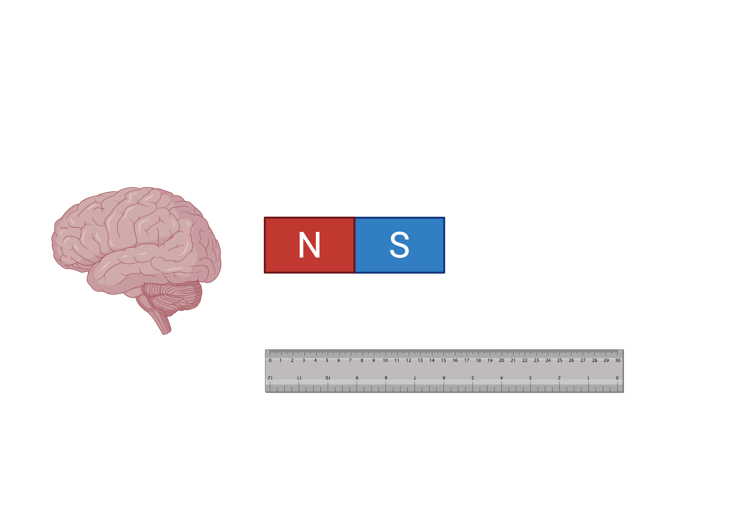
How Can We Investigate This?
1. Brain Model
2. Magnetic Field
3. Measurement

Slide 7
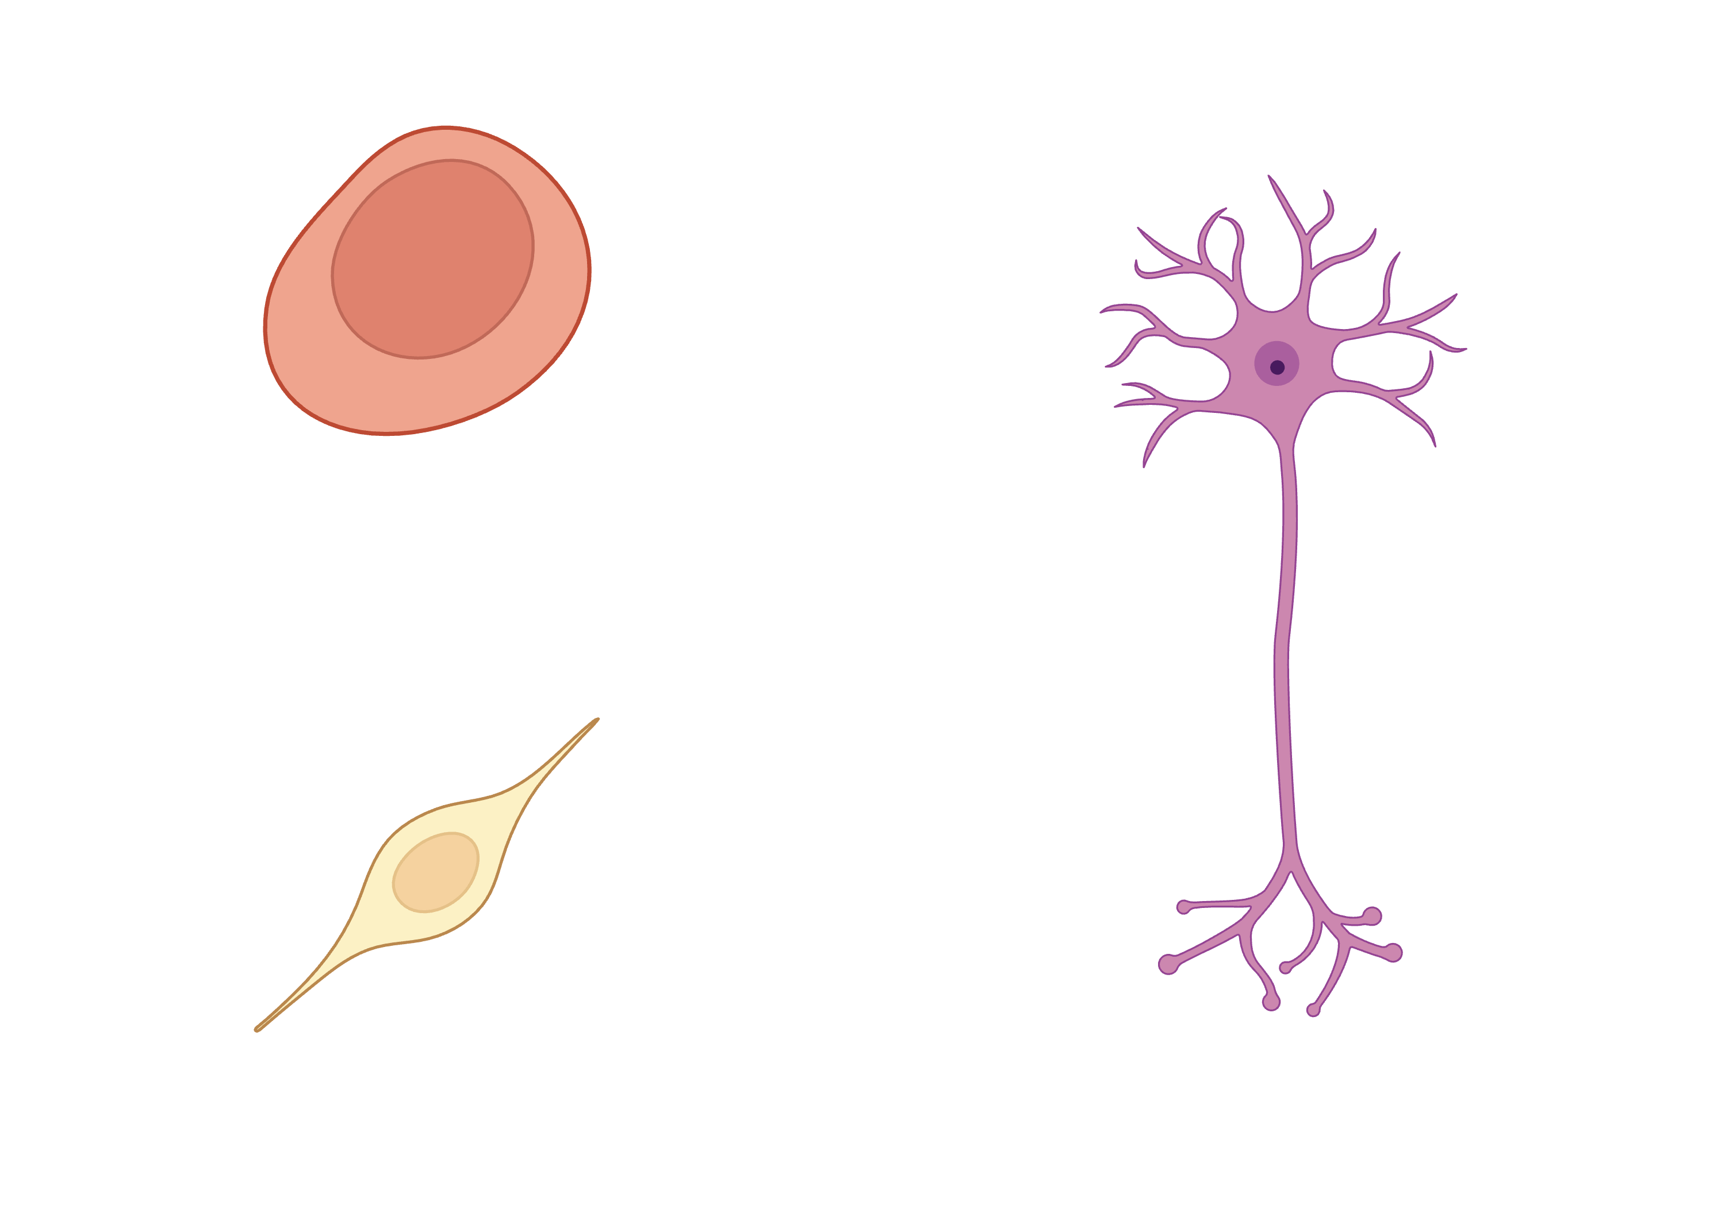
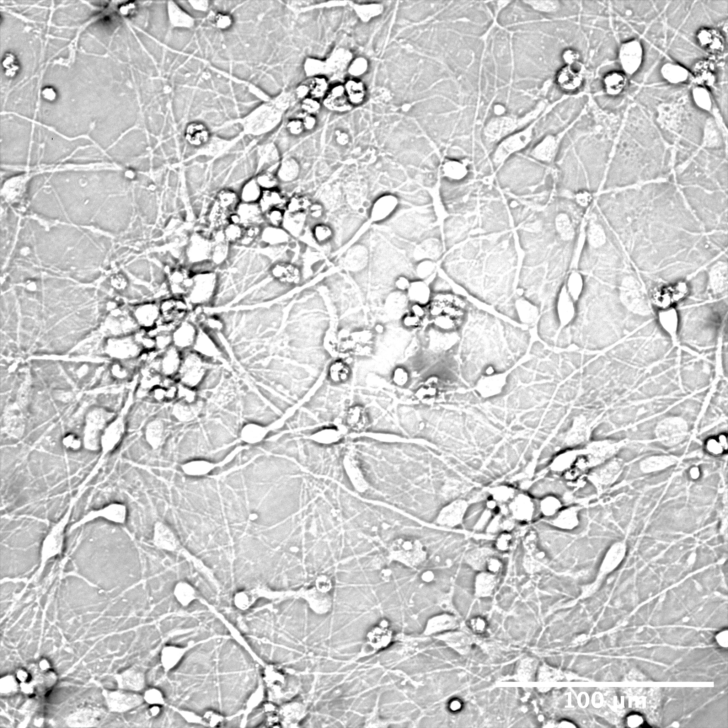
1. Brain Model
Neural Progenitor Cells
Neurons
Forebrain Neurons

Slide 8
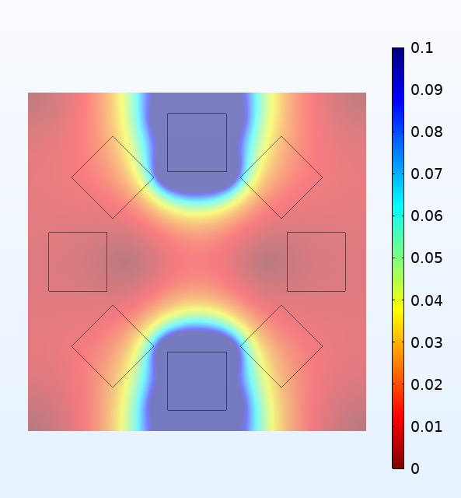
2. Magnetic Field
[ T ]
Magnetic Field Strength:
18 – 100 mT
Magnetic Field Gradient:
686 mT/m

Slide 9
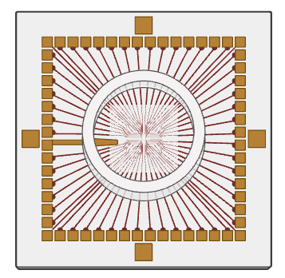
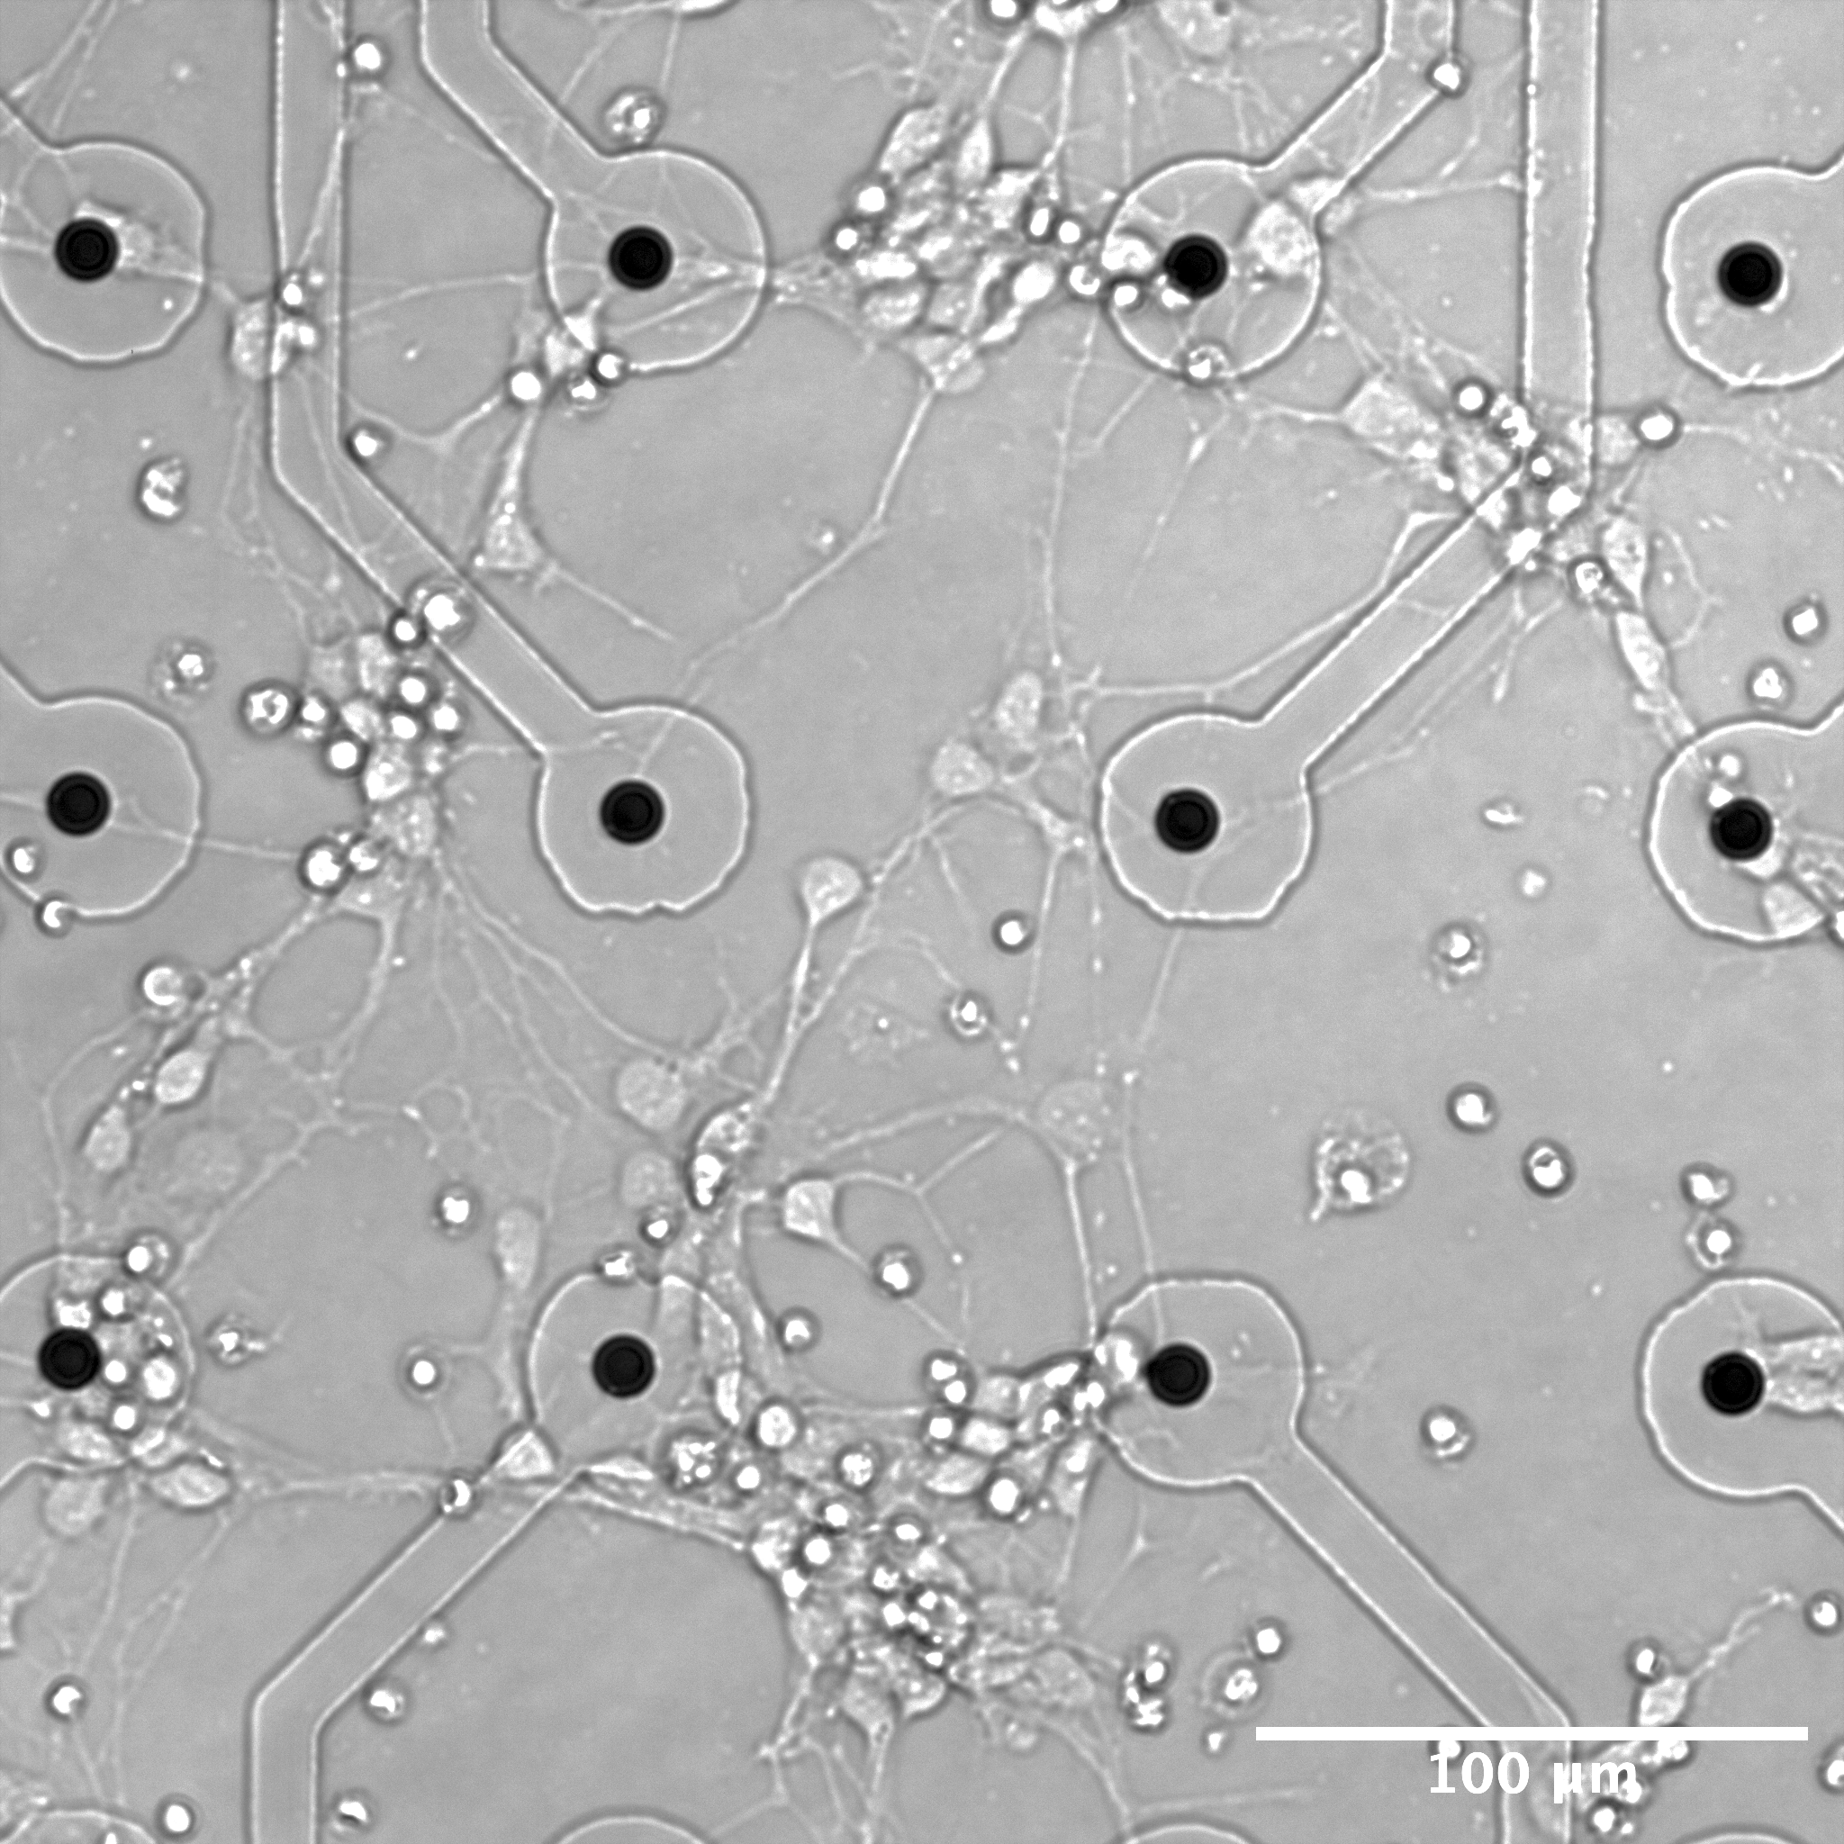
3. Measurement
Micro-Electrode Array
Spike rates
Spike amplitude
Burst rate
Image created using biorender.com
Notes:
Add a scale bar

Slide 10
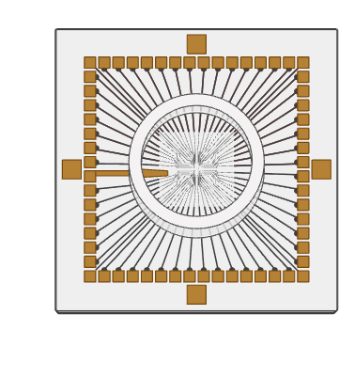
The System
A) Permanent magnetic ring
B) Magnetic field generated by the magnetic ring
C) Micro-electrode array with neurons cultured on the surface
A
B
C
Image created using biorender.com

Slide 11

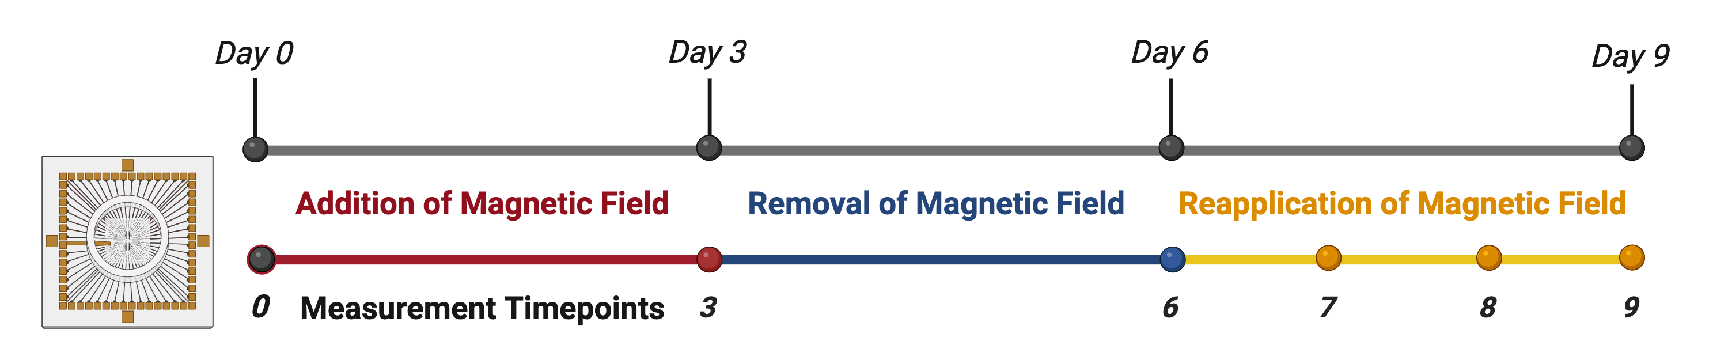
Experimental Timeline
Image created using biorender.com

Slide 12
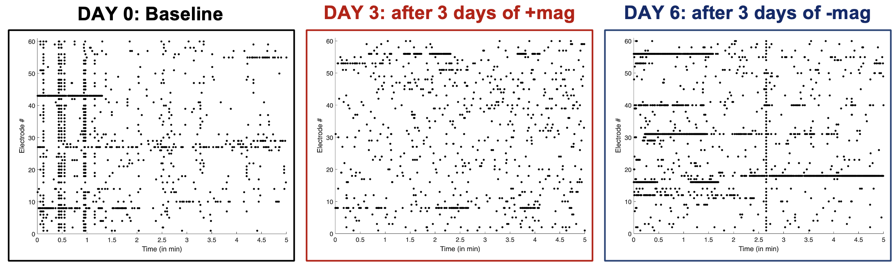
Filtering Raw Data – Spike Detection
Notes:
Raster Plots

Slide 13
Quantifying Spike Detection
Average Spike Rate
Large differences between the group receiving magnetic stimulation and the control
The addition and removal of the magnetic field led to a slight increase in average spike rate
Reapplication of the field resulted in a gradual decrease in spike rate over three days
Notes:
Raster Plots

Slide 14
Conclusions
The “time on Earth” and ”time on the Moon” both increased neuronal activity.
The neuronal activity returned to baseline after 3 days back “on Earth”.
This system has proven to be an effective platform to non-invasively measure the effects of magnets on human neurons.
Future experiments can shed light on the potential impacts space-related magnetic field changes and ways to mitigate side effects.
Notes:
Figure out how to reword

Slide 15



Acknowledgements
This material is based upon work supported by the National Science Foundation under Grant No. 2349091.​
Nate Oftedal
Mackenna Landis
Dr. Zeynep Malkoc
NASA EPSCORE R3 award
(#24-2024 R3-0114, RFA071)
Dr. Anja Kunze &
The Kunze Neuroengineering Lab

Slide 16
References
Demontis, Gian C., et al. "Human pathophysiological adaptations to the space environment." Frontiers in physiology 8 (2017): 547.
Wang, X., Ye, Y., Zuo, H. et al. Neurobiological effects and mechanisms of magnetic fields: a review from 2000 to 2023. BMC Public Health 24, 3094 (2024). https://doi.org/10.1186/s12889-024-18987-9
Gupta, Udit, et al. "The neurology of space flight; How does space flight effect the human nervous system?." Life Sciences in Space Research 36 (2023): 105-115.
C. C. Finlay, S. Maus, C. D. Beggan, T. N. Bondar, A. Chambodut, T. A. Chernova, A. Chulliat, V. P. Golovkov, B. Hamilton, M. Hamoudi, R. Holme, G. Hulot, W. Kuang, B. Langlais, V. Lesur, F. J. Lowes, H. Lühr, S. Macmillan, M. Mandea, S. McLean, C. Manoj, M. Menvielle, I. Michaelis, N. Olsen, J. Rauberg, M. Rother, T. J. Sabaka, A. Tangborn, L. Tøffner-Clausen, E. Thébault, A. W. P. Thomson, I. Wardinski, Z. Wei, T. I. Zvereva, International Geomagnetic Reference Field: the eleventh generation, Geophysical Journal International, Volume 183, Issue 3, December 2010, Pages 1216–1230, https://doi.org/10.1111/j.1365-246X.2010.04804.x

Slide 17
Questions?
17
Image created with biorender.com
Notes:
Could this be a cool pictureI took or what?

