Slide 1





Custom Strain Gauge Fabrication Using Aerosol Jet Printing
Luther Busching, University of Nebraska-Lincoln
Dr. Dilan Ratnayake, University of Louisville
Dr. Kevin Walsh, University of Louisville
NSF REU Award ID #2348869
NSF REU Award ID #2025075

Slide 2
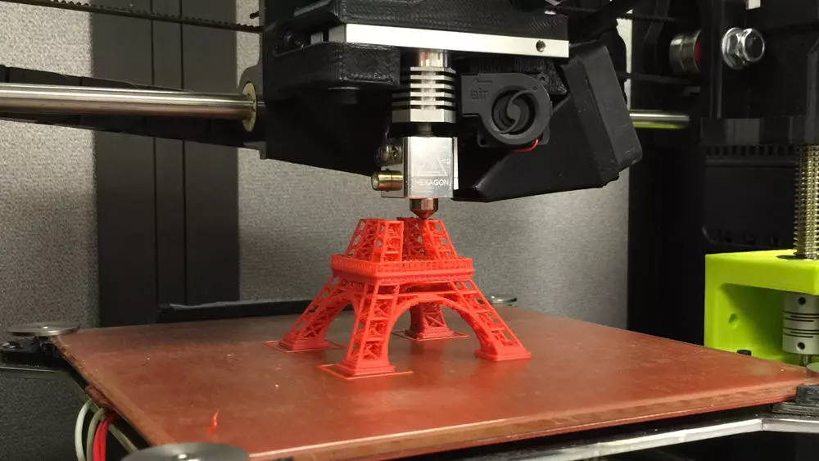
3D Printing
Deposition Material: Plastics
Substrate: Flat build plate
Resolution: 50-200 microns [1]
Benefits:
Cheap
Customizable
Rapid prototyping
91.45 μm
3D printer [9]

Slide 3
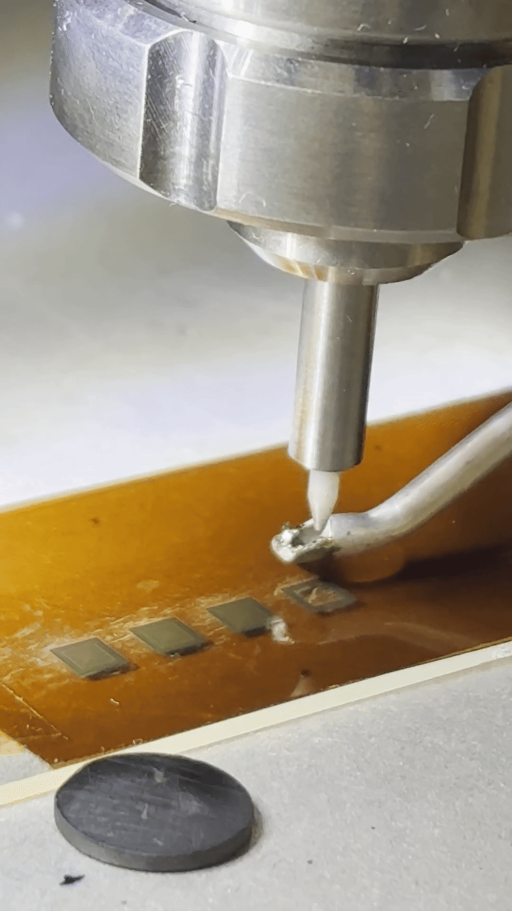
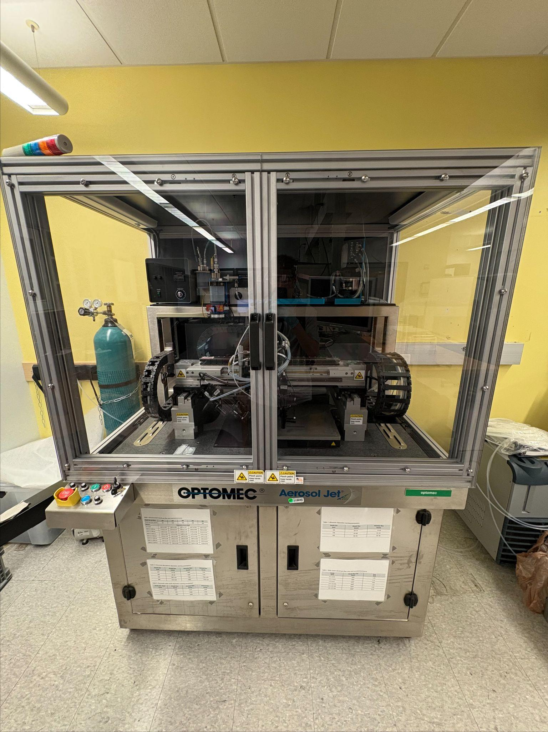
Aerosol Jet Printing (AJP)
Deposition Materials: Wide variety of inks (metals, polymers)
Substrate: Wide variety (glass, silicon, nonplanar objects)
Resolution: <30 micron features [6]
Benefits:
Customizable
Rapid prototyping
Flexible
91.45 μm
91.45 μm
Optomec AJ-300 Aerosol Jet Printer
AJP Deposition Head

Slide 4
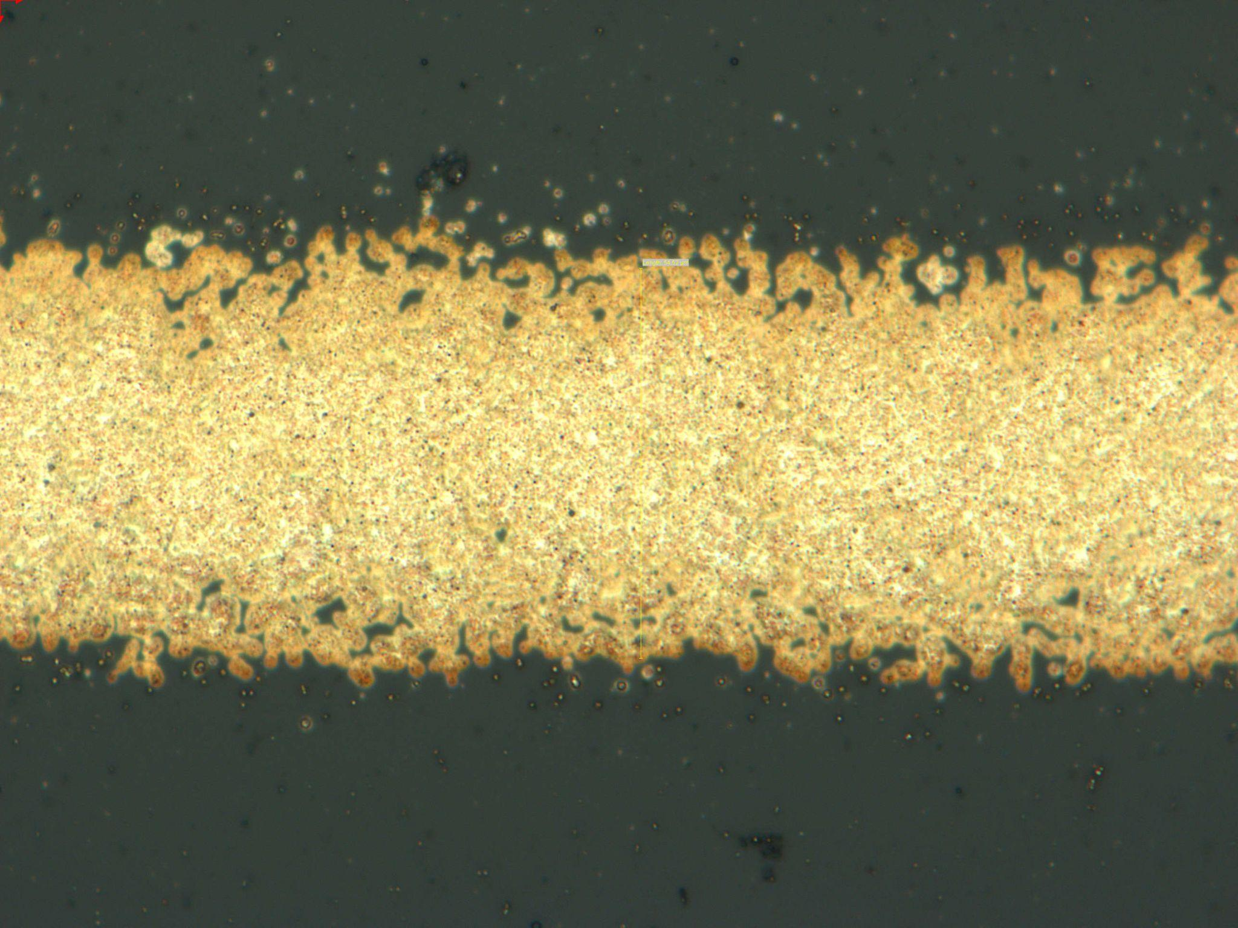
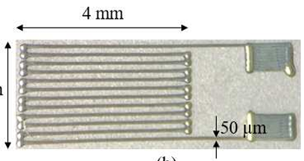
Project Goals
Characterize the AJP deposition process for silver (Ag) ink and various printing patterns
Fabricate and characterize custom strain gauges using the results from the characterization process of the silver ink
Test printed strain gauges and compare to commercially available strain gauges
91.45 μm
1.7 mm
Aerosol Jet printed strain gauge [7]
AJP silver lines on glass substrate

Slide 5
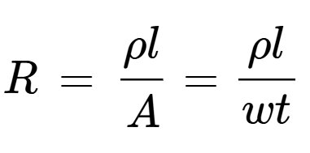
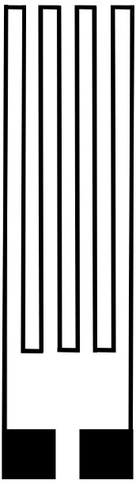
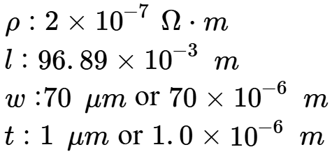
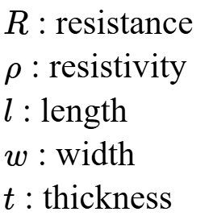

Strain Gauge Design
Target Parameters:
15 mm
Target Resistance:
Strain Gauge Design
4 mm

Slide 6
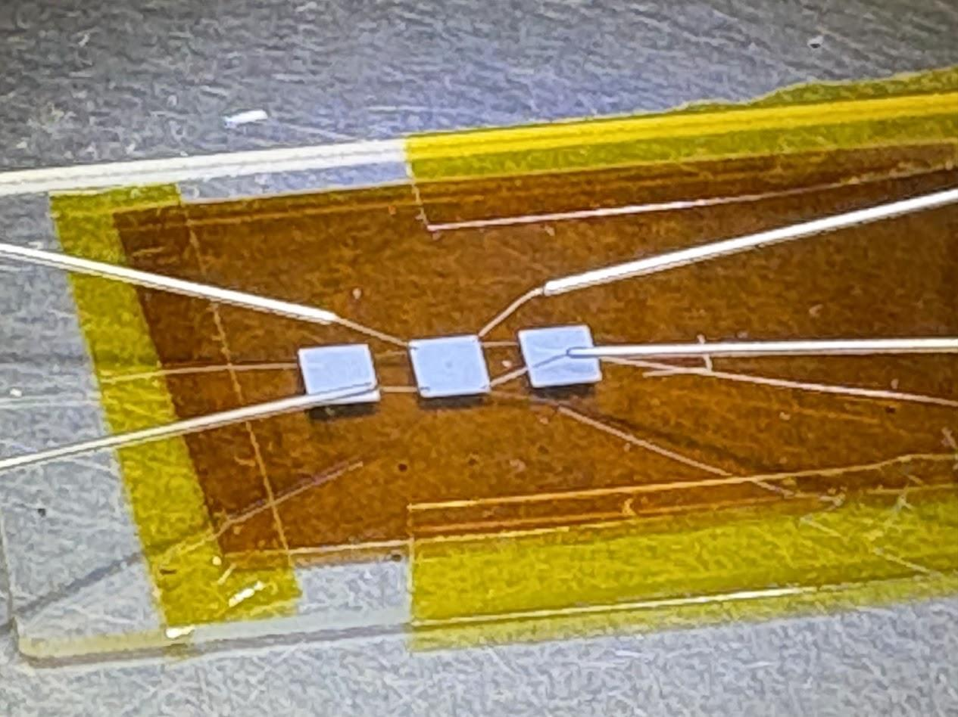
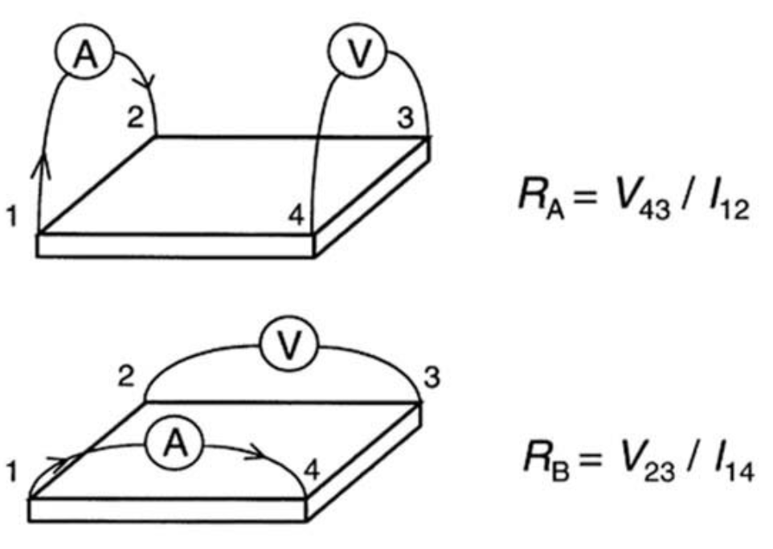
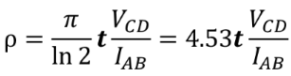

Van der Pauw Method
Resistivity:

Slide 7
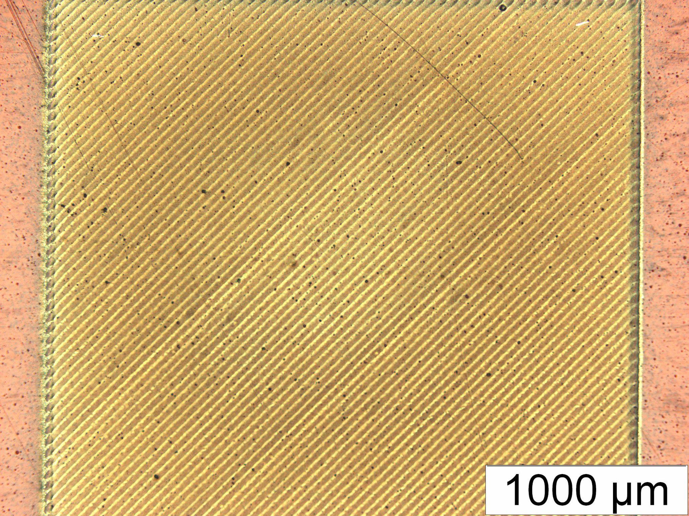
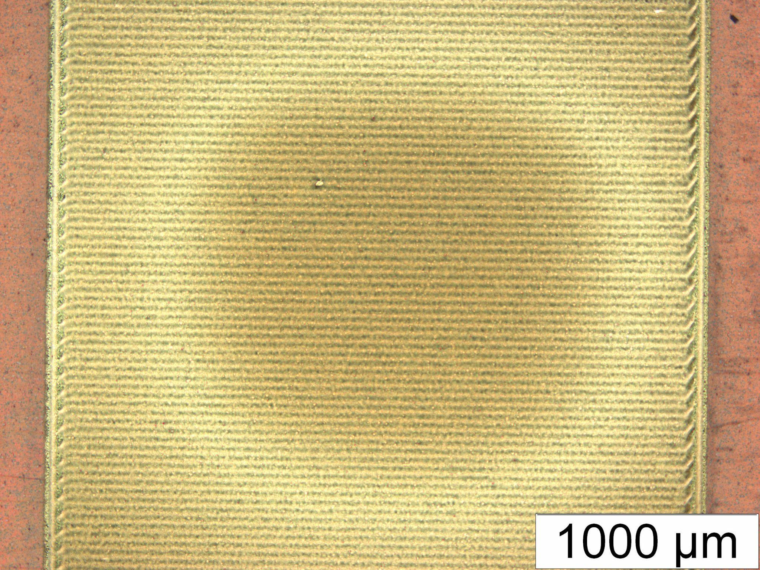
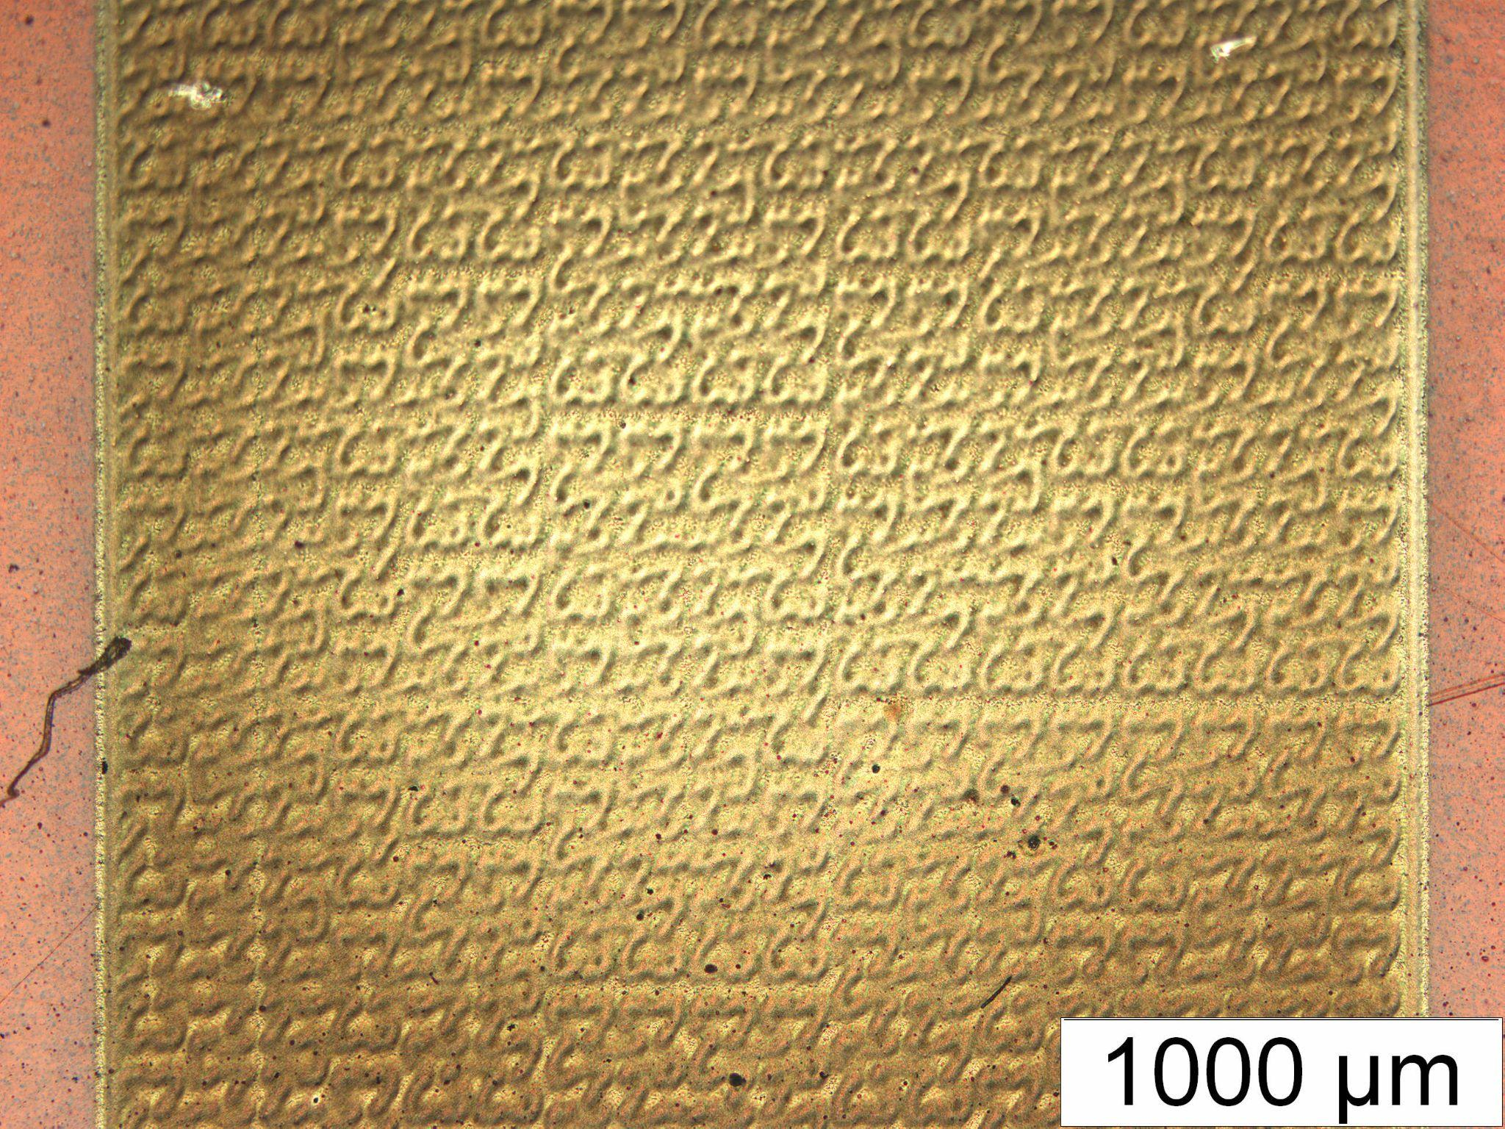
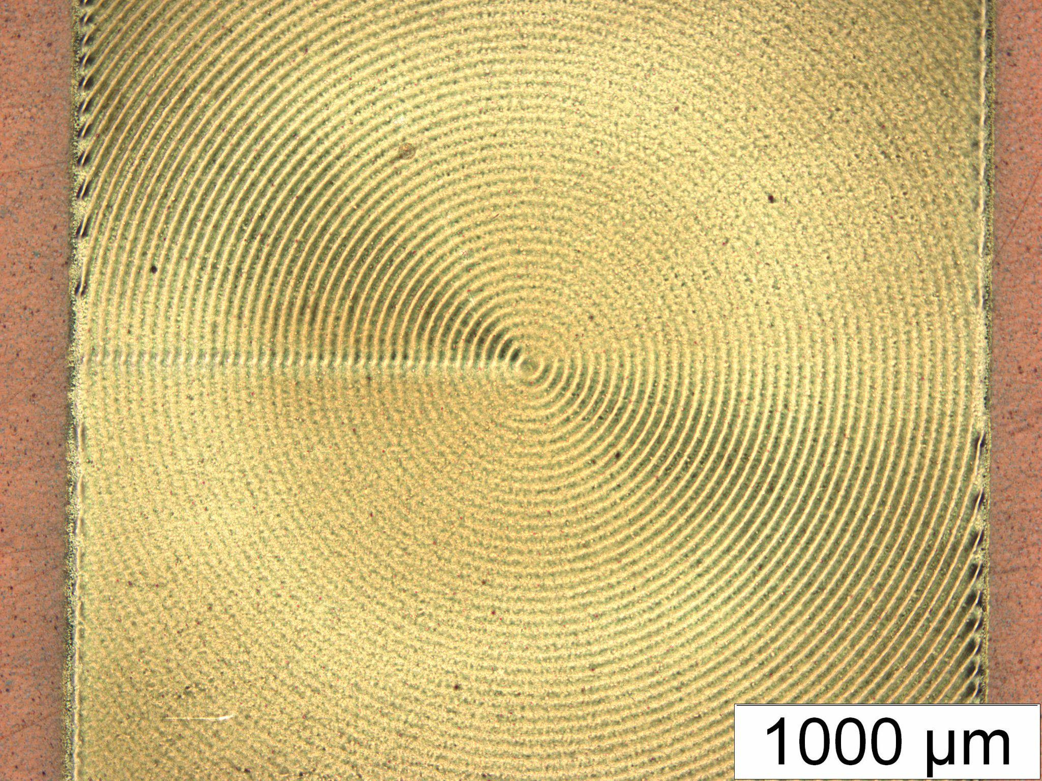
Pad Designs
Hilbert
Circles
Diagonal
Serpentine
All pad design printing patterns produced similar resistivity results

Slide 8
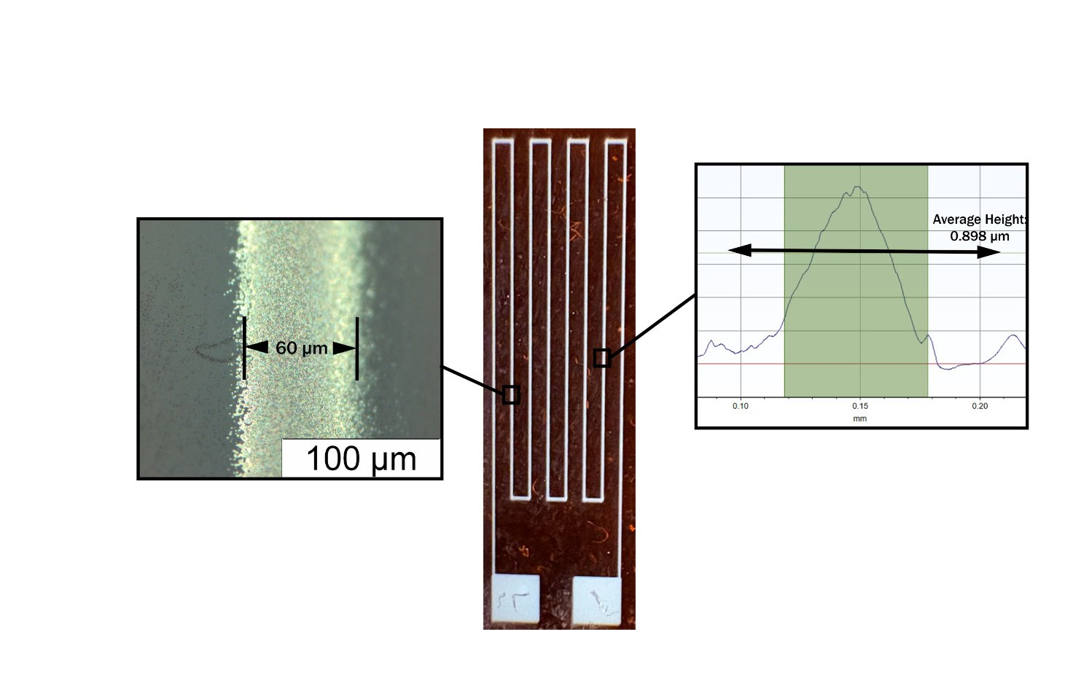
Strain Gauge Characterization
The line thickness was measured using a profilometer
The line width was measured using a high power optical microscope

Slide 9
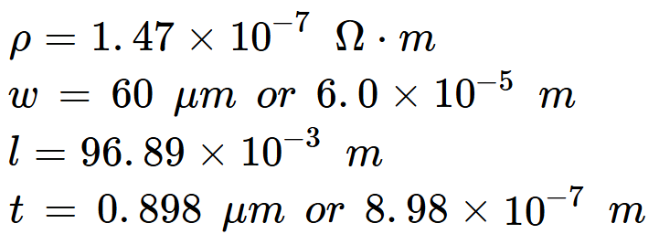
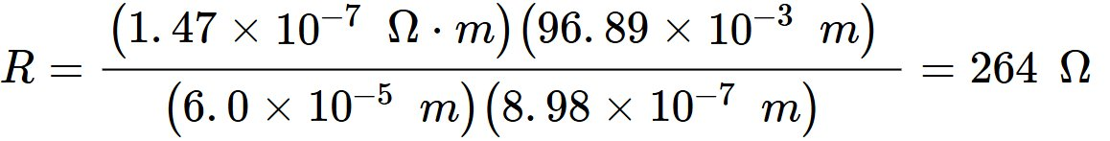
Theoretical Resistance Based Upon Measured Dimensional Values
Measured Values:

Slide 10

Experimental Results
Using a multimeter, the experimental resistance was determined to be:
Target Resistance: 277 Ω
Theoretical Resistance: 264 Ω
Experimental Resistance: 279 Ω
Percent Error from Target Resistance: 0.91%​
Percent Error from Theoretical Resistance: 5.67%

Slide 11
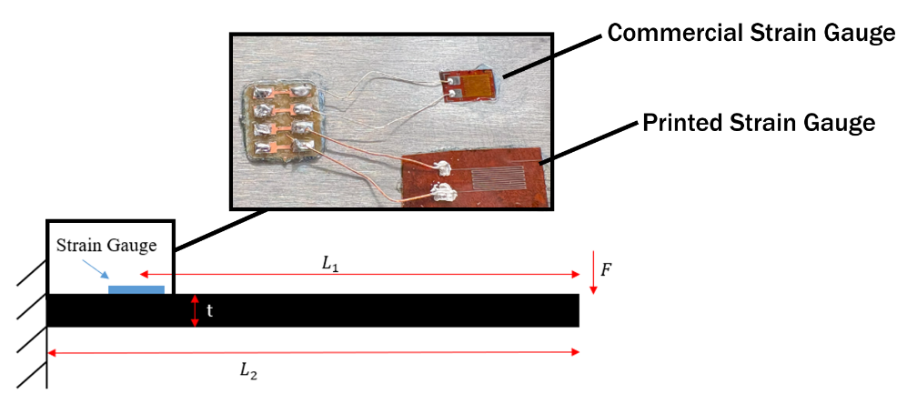

Gauge Factor
The gauge factor is a measure of how sensitive a strain gauge is.
Higher gauge factor means higher sensitivity
Commercial strain gauges have gauge factors of approximately 1.8-2.0
Change in resistance of printed strain gauge measured by multimeter
Experimental strain calculated from strain gauge with known gauge factor

Slide 12
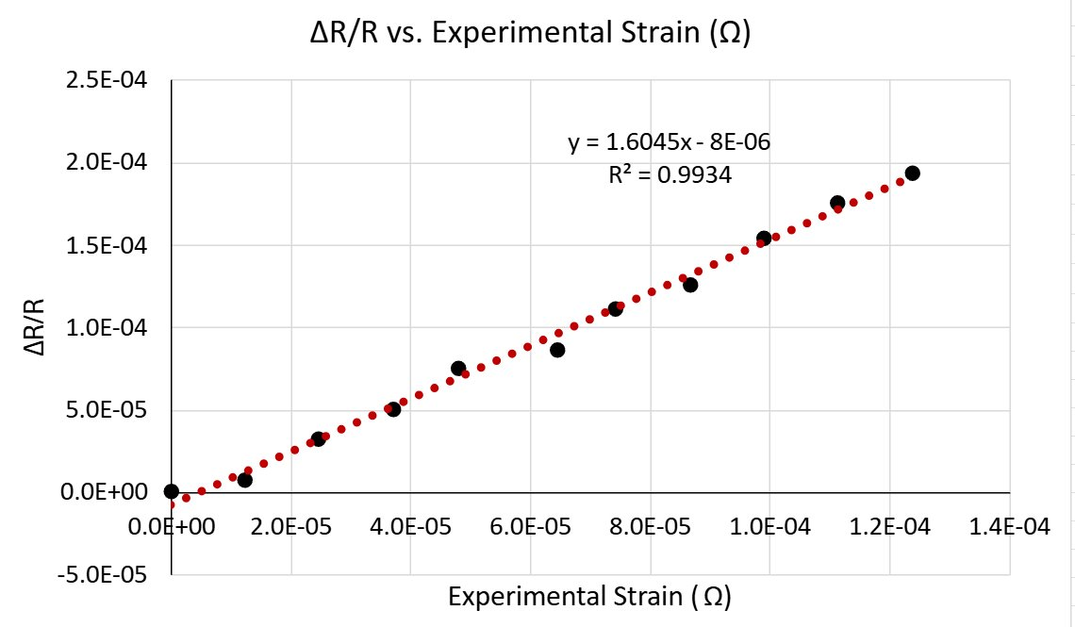

Gauge Factor Results
Slightly lower than that of a commercial strain gauge (~2), but the ability to quickly print on curved surfaces is a unique advantage to traditional manufacturing methods

Slide 13
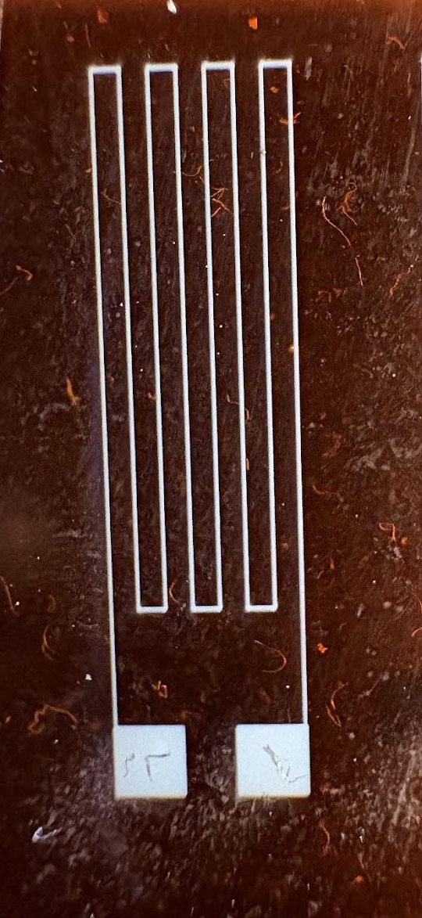
Conclusion
Achieved experimental resistance (279 Ω) within 0.91% of the target (277 Ω) and within 5.67% of the theoretical value (264 Ω)
Measured the gauge factor to be 1.60, slightly less than that of commercial strain gauges of ~2
Takeaway: This work demonstrates that AJP can rapidly produce custom strain gauges with competitive electrical performance, offering a promising alternative to traditional manufacturing.

Slide 14
Acknowledgements
Mentors: Drs. Dilan Ratnayake and Kevin Walsh
REU Coordinator: Ana Sanchez-Galiano
Micro/Nano Technology Center - University of Louisville
NSF REU Award ID #2025075

Slide 15
References
1. “3D Printing Resolution: Meaning, Importance and Optimization – RAISE3D: Reliable, Industrial Grade 3D Printer.” Raise3D, 7 Sept. 2024, www.raise3d.com/blog/3d-printing-resolution/?utm_source=chatgpt.com.
2. Bottiglieri, Lorenzo. “Out of stoichiometry CuCrO2 as transparent p-type semiconductor for photo-voltaics and transparent electronics.” Chemical engineering. Université Grenoble Alpes [2020-..], 2022. English. NNT : 2022GRALI019. tel-03794053
3. Cheek, Kevin, et al., “Aerosol Jet - Deposition System Manual - Nanoqam.” NanoQAM, OPTOMEC Inc, 10 May 2013, nanoqam.ca/wiki/lib/exe/fetch.php?media=aj300_system_manual_2011.pdf.
4. Choi, Tae-Yang, et al. “Directly Patterned ITO Nanoparticle-Based Transparent Electrode Using Co-Solvent-Based Aerosol Jet Printing for Transparent Thin Film Heaters.” Chemical Engineering Journal, vol. 498, 15 Oct. 2024, pp. 1–11, https://doi.org/10.1016/j.cej.2024.154692.
5. “Common Liquid Viscosity Chart.” VKPAK, 10 Aug. 2021, www.vkpak.com/common-liquid-viscosity-chart.html.
6. D. Ratnayake, A. Curry and K. Walsh, "Demonstrating a new ink material for aerosol printing conductive traces and custom strain gauges on flexible surfaces," 2021 IEEE International Conference on Flexible and Printable Sensors and Systems (FLEPS), Manchester, United Kingdom, 2021, pp. 1-4, doi: 10.1109/FLEPS51544.2021.9469773.
7. D. Ratnayake, et. Al. "Characterization of Aerosol Printing Conductive Traces​ and Custom Strain Gauges on PCB." MSEC, 26 June 2025
8. Jeong, Hakyung, et al. “Optimization of Process Parameters in Micro-Scale Pneumatic Aerosol Jet Printing for High-Yield Precise Electrodes.” Scientific Reports, U.S. National Library of Medicine, 2 Dec. 2023, pmc.ncbi.nlm.nih.gov/articles/PMC10693603/.

Slide 16
References
9. M., K. “A Comprehensive Guide to the Working of 3D Printers.” CDHPL, 8 June 2022, www.cdhpl.com/how-3d-printers-work/.
10. McKibben, N., Ryel, B., Manzi, J. et al. Aerosol jet printing of piezoelectric surface acoustic wave thermometer. Microsyst Nanoeng 9, 51 (2023). https://doi.org/10.1038/s41378-023-00492-5
11. O. O. Olowo et al., "PEDOT: PSS Polymer Aerosol Jet-printing for Robotic Skin Sensors," 2022 IEEE International Conference on Flexible and Printable Sensors and Systems (FLEPS), Vienna, Austria, 2022, pp. 1-4, doi: 10.1109/FLEPS53764.2022.9781502.
12. Rich, J., Cole, B., Li, T. et al. “Aerosol Jet Printing of Surface Acoustic Wave Microfluidic Devices.” Microsyst Nanoeng 10, 2 (2024). https://doi.org/10.1038/s41378-023-00606-z
13. Singh, Akanksha D., and Rajendra M. Patrikar. “Design and fabrication of pdms‐based electrostatically actuated MEMS cantilever beam.” Micro &amp; Nano Letters, vol. 15, no. 5, Apr. 2020, pp. 302–307, https://doi.org/10.1049/mnl.2019.0728.
14. Vlnieska, V., Gilshtein, E., Kunka, D., Heier, J., & Romanyuk, Y. E. (2022). “Aerosol Jet Printing of 3D Pillar Arrays from Photopolymer Ink Polymers.” 14(16), 3411. https://doi.org/10.3390/polym14163411

Slide 17
References
15. “Viscosity Comparison Chart.” Hapco, Inc., 26 Aug. 2021, hapcoincorporated.com/resources/viscosity-comparison-chart/.
16. Watson, Shayna. “OPTOMEC Receives New Patents for 3D Micro-Printing with Aerosol Jet.” Global Press Release & Newswire Distribution Services, Business Wire, 29 June 2021, www.businesswire.com/news/home/20210629005886/en/Optomec-Receives-New-Patents-for-3D-Micro-Printing-with-Aerosol-Jet.

