Slide 1



Solid State Nanopores for Protein Detection
Carolina Campos
PI: Dr. Eric Vogel
Mentor: Noah Baughman

Slide 2
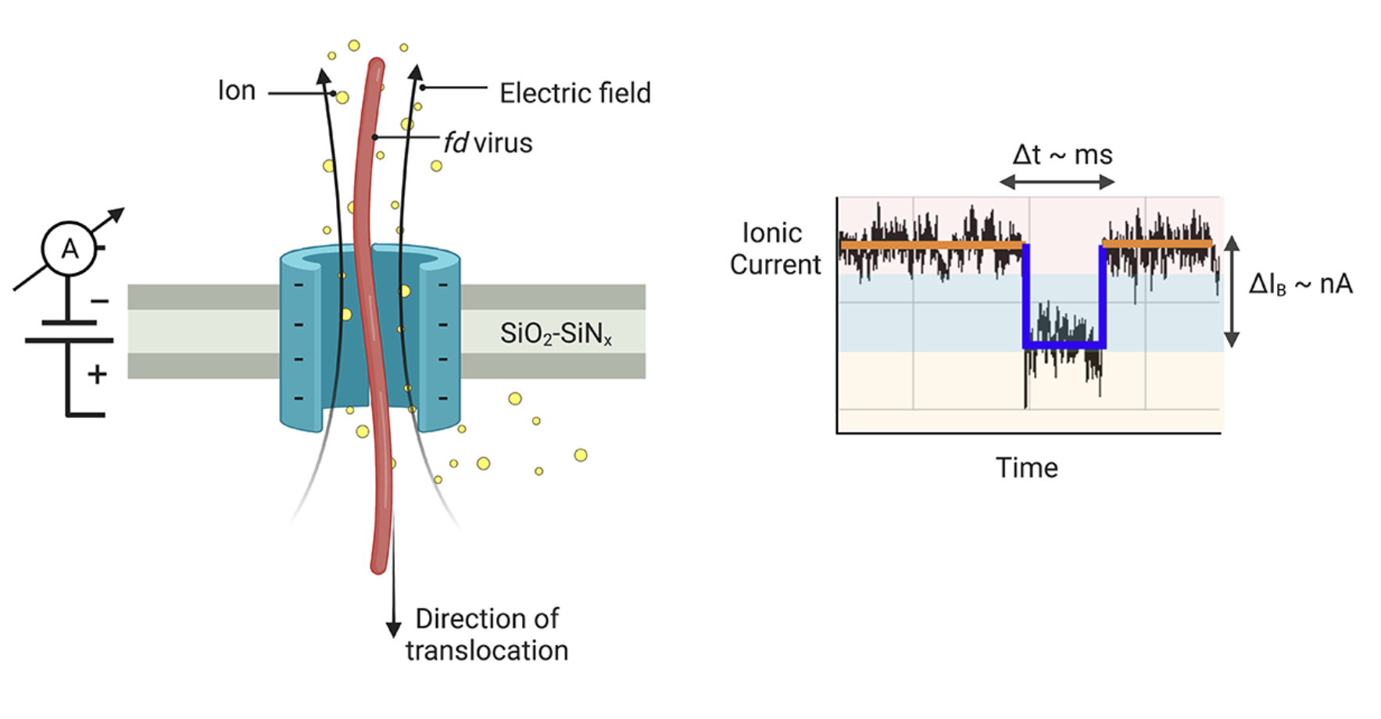
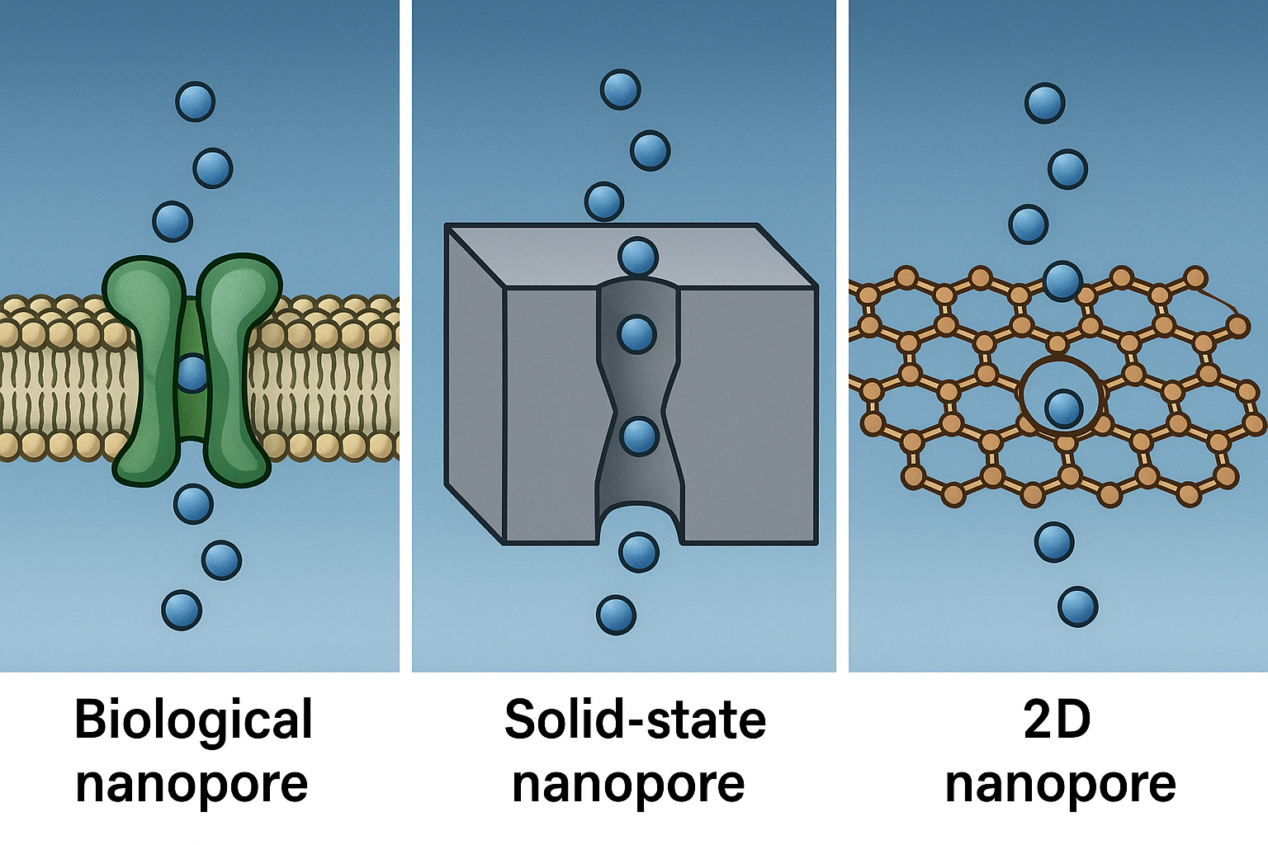
What is a Nanopore?
A nanopore is a nanoscale hole in an insulating membrane that is used to detect
and analyse individual molecules, such as DNA, RNA, or proteins.
Sharma et al. 2021; 2019; Narsimhan et al. 2016
Voltage drives ions through the nanopore. Protein entry blocks the pore, causing a current drop.
2
Notes:
Applying voltage across the membrane drives ions through the nanopore, creating a steady current. When a protein enters the pore, it disrupts the flow, causing a detectable drop in current.
Biological nanopore is a naturally occurring pore that is a pore-forming protein, typically a-hemolysin-typically embedded in a lipid membrane—that allows ions and molecules to pass through
Solid state nanopore is a nanoscale hole drileld into a thin, solid membrane —usually made of materials like silicon nitride or graphene. Unlike biological pores, these are synthetic and highly durable, allowing for precise control over pore size and surface properties.
2D nanopore is formed in an atomically thin two-dimensional material, such as graphene or MoS₂. Because the membrane is just one or a few atoms thick, it offers ultra-high spatial resolution. Not as scaleable as solid state nanopores

Slide 3
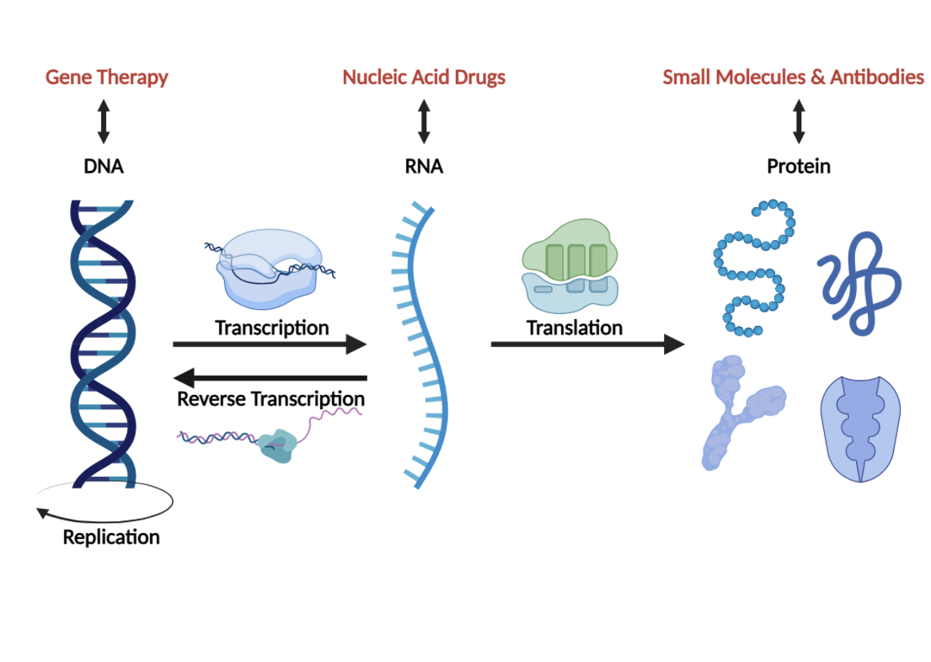
Why Do We Care About Proteins?
Unlike DNA/RNA, proteins can’t be amplified, making analysis harder.
Protein modifications impact function and serve as biomarkers or drug targets.
  P53 tumor suppressor protein-13 different
  proteoforms
Protein sequencing is still immature and underdeveloped.
  Mass Spectrometry
Liu, BioRender Template (2025)
3
Notes:
Each proteoform can have a different function and the only way u can see this is by long-real sequencing
Once information goes into a protein it can not go out again
P53 has many different proteoforms having different functions, culd be a biomarker or drug target and the only way that we would be able to know this is if you achieve long read sequencing
Health and the way the way we age is dependant on proteins
Proteins are closer to phenotype, reflecting actual biological activity
Protein function depends heavily on post-genomic modifications, which can alter activity
MASS SPEC
Mass to charge ratio -Determine proteins from structure, function, folding, all post-translational modifications
You may be able to identify many different proteins, but you're just recognizing short fragments and your missing lots of information so you cant reconstruct full length molecules
Complex and expensive

Slide 4
Solid-State Nanopores vs. Traditional Detection Methods
Feature | ELISA | PCR | Solid-State Nanopores
What it detects | Peptides, proteins, antibodies, and hormones | The presence of specific DNA or RNA sequenced | Single molecules, particularly molecules like DNA, RNA, and proteins.
Sensitivity | 0.1 to 1 fmole or 0.01 ng to 0.1 ng (Moderate) | Highly sensitive for RNA or DNA | Highly sensitive for single molecule detection
Detects Post-Translational Modifications | No | No | Yes
Sample Preparation | Multi-step, lab-based | Requires amplification & enzymes | Minimal-label-free
Speed | A few hours to all day | A few hours to a few days | Minutes to hours
Cost | Moderate to High | High | Low
4
Notes:
All sequencing technologies rely on replication or something to copy the given molecule for both dna and rna
We want label free since there is no extra sample prep, no need for additional molecules to bind, and it does not interfere with folding or binding activety of the protein in particular.

Slide 5
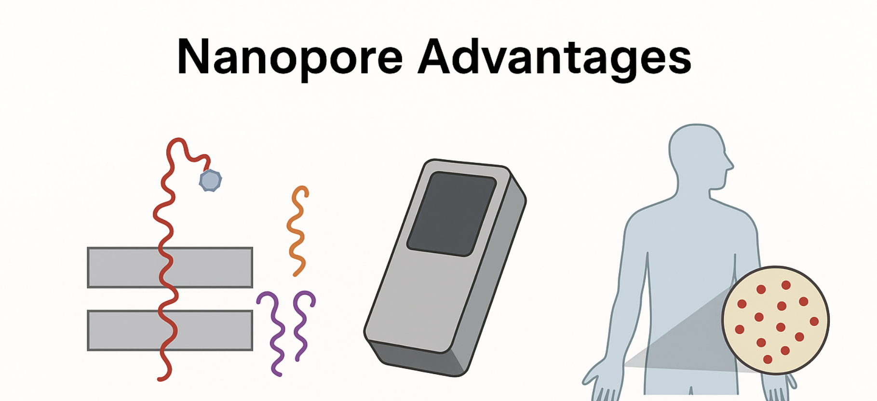
Nanopore Sensing for Early Cancer Detection
The Challenge:
Early-stage cancers often involve the detection of post-translational modifications or isoforms of proteins.
Limitations of Traditional Methods:
Lack sensitivity
Does not detect different isoforms
Identification of smaller peptides is limited
Expensive equipment
The Opportunity:
Solid-State Nanopores
Detects Individual protein molecules
Portable Systems
Detection in low- abundance sample
5
Notes:
Isoforms are different forms of a protein or RNA molecule that arise from the same gene
Early cancer detection using protein biomarkers has a public health impact and nanopore sensing has strengths that are easy to highlight: lable free, portable, single-molecule sensitiity
Protein Isoforms
Result from alternative splicing of mRNA or different gene variants.
Produce proteins with differences in amino acid sequence.
These differences are "built-in" during protein synthesis.
Example: Different isoforms of p53 that are transcribed from the same gene but have different domains or lengths.
Post-Translational Modifications
Happen after the protein is made.
Include chemical changes like phosphorylation, acetylation, ubiquitination, glycosylation, etc.
These modifications regulate protein activity, stability, location, and interactions.
Detects individual protein molecules, including their primary, secondary, tertiary forms and post-translationall modified varients
Portable systems can be use at point of care without complex sample prep which could benefit rural and resource limited settings because you do not need an abundance of sample or a laboratory
Low-abundance samples in the pM or nM range can make a huge difference in early stage detection ELISA cant detect these levels without amplification

Slide 6
Project Goals
Validate custom nanopore functionality using nanoparticles for sensing.
Transition from nanoparticle sensing to model protein detection.
Achieve reliable detection of individual model proteins.
Differentiate two or more distinct proteins.
  Switch to focus on the stability of our custom nanopores.
6

Slide 7
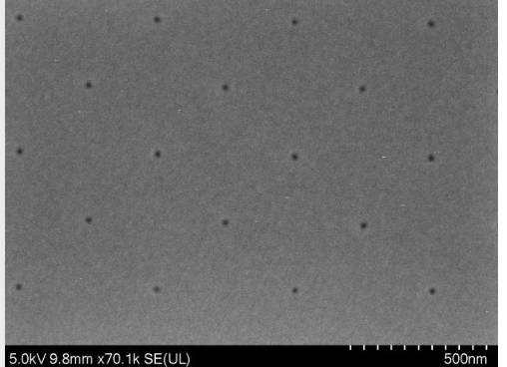
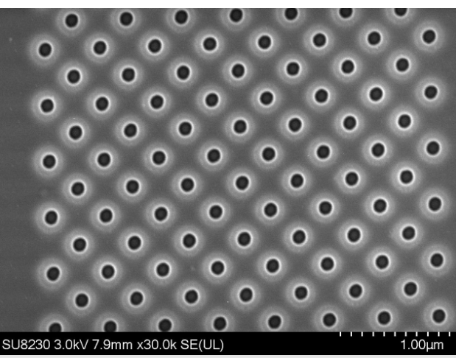
SEM Image of a Custom Nanopore
SEM image of custom ~60 nm diameter pores
SEM image of 100 nm nanopore array
Credit: Noah Baughman
Credit: Noah Baughman
7

Slide 8
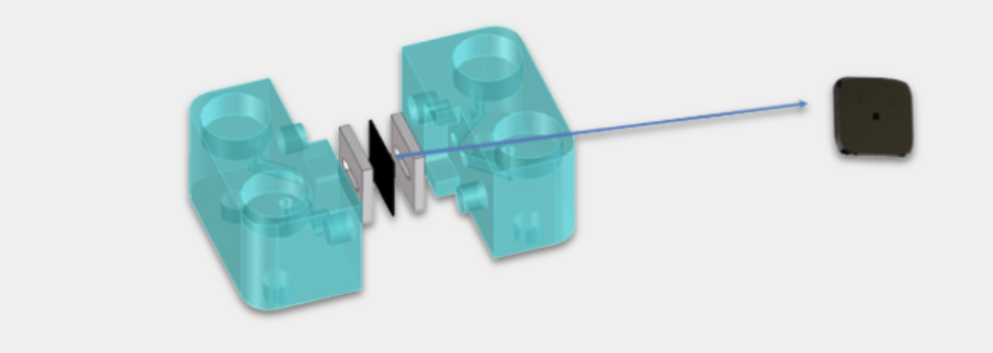
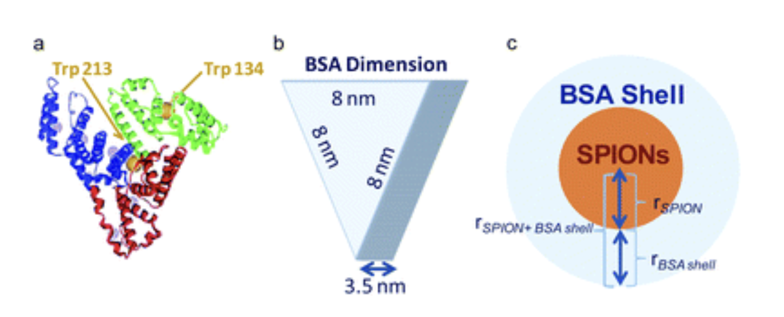
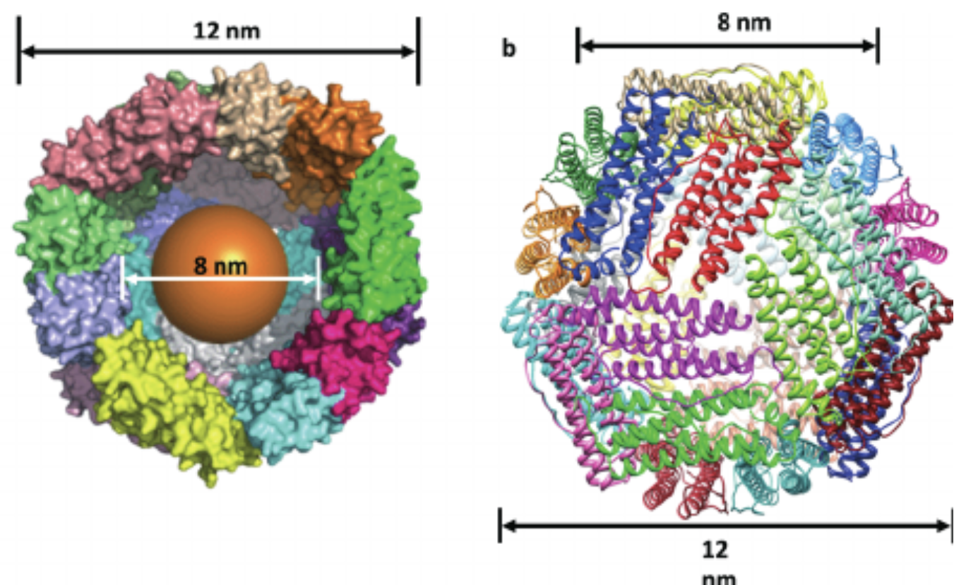
Experimental Methods
Elements Srl, https://elements-ic.com/nanopores-2/
Use of Bovine Serum Albumin (BSA) and Ferritin as model proteins in a nanopore.
Protein Concentration:
  Observe changes in translocation frequency
Voltage Dependence:
  Voltage that is applied is used to study signal amplitude
Repeated Trials
  All conditions are repeated in at least three trials to
Ensure reproducibility
Nanoscale, 2016,8, 14393-14405
8
(Watt et al. 2013;)
Notes:
(BSA) plays key roles in blood plasma as a carrier protein and blood pressure regulator. Ferritin is responsible for storing iron in the body, acting as a reservoir and releasing it when needed.

Slide 9
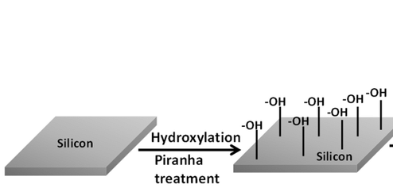
Surface Treatment: Piranha Treatment
Treatment Protocol
  4:1 Piranha solution (H₂SO₄:H₂O₂) used for 1 hour while heated at 120 degrees C
  Followed by thorough DI water rinse and nitrogen drying
Removes organic contaminants, hydrophilizes the surface, improves electrolyte wetting, reduces electrical noise.
Hydroxylation
9
Sarkar & Daniels-Race, 2013, Electrophoretic Deposition of Carbon Nanotubes, Nanomaterials.
Notes:
Hydroxylation is a chemical process that involves adding a hydroxyl group (-OH) to a molecule
A charged, polar surface can reduce the chances of protein sticking nonspecifically.

Slide 10
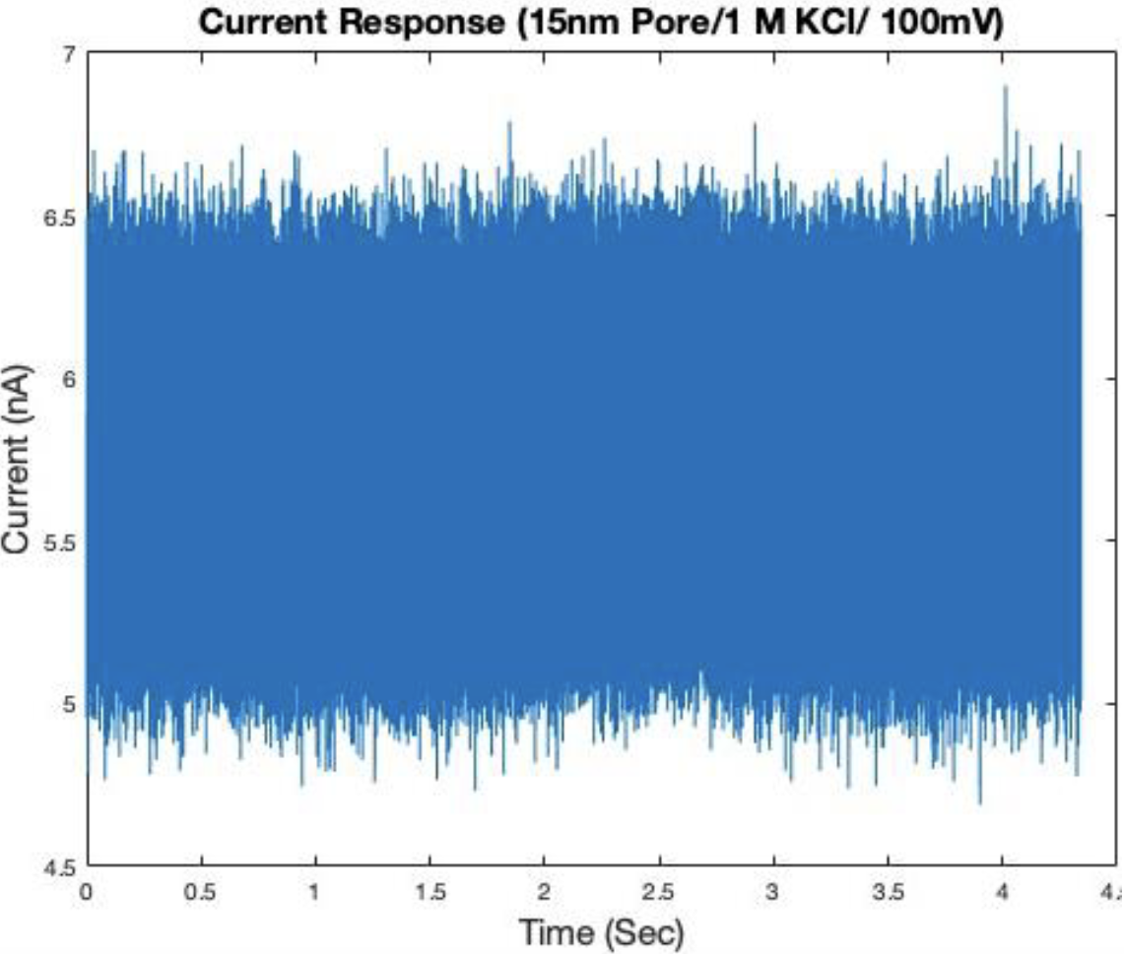

Nanopore Reaction During a Translocation
When voltage is applied and a molecules translocates through a nanopore, it causes changes in the ionic current.
The ionic conductance of the nanopore, G, can be expressed by
σ - conductivity of the solution
L is the membrane thickness
D- the pore diameter
The size of the current is directly proportional to conductance G. When a molecule blocks the pore, it alters the effective diameter, reducing conductance and thus causing a dip in the current that we can detect.
10
Notes:
Open pore current

Slide 11
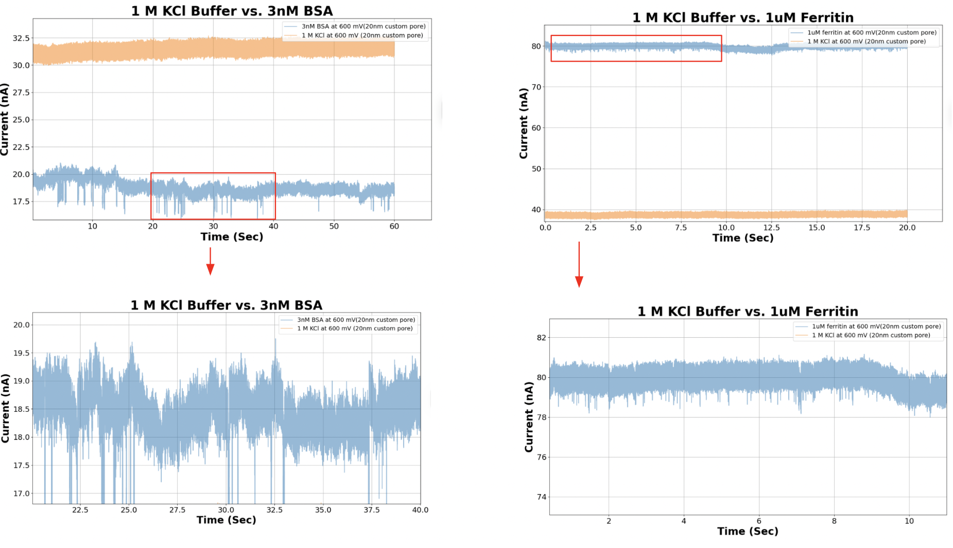
Protein Sensing with Custom Nanopores
12
Notes:
When proteins enter or interact with a solid-state nanopore, they block ionic flow, creating measurable drops in current. The depth, duration, and shape of these blockades encode information about:
Protein size and volume- larger proteins-larger drop
Conformation and unfolding dynamics
Interaction with pore walls
Charge properties and orientation

Slide 12
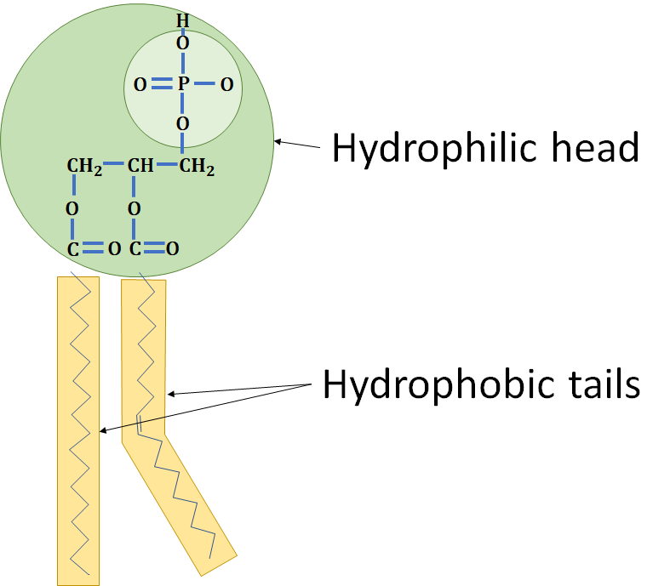
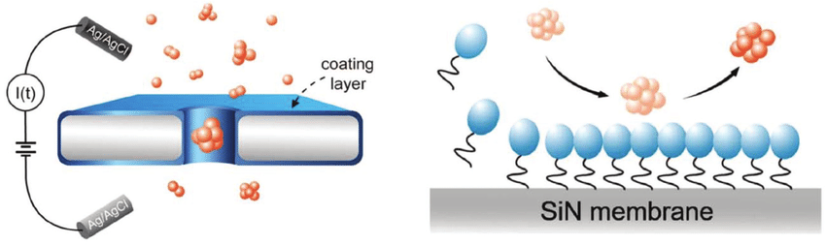
Surfactants: Modifying Nanopore Sensing
Surfactants - Surface Active Agents
  Molecules that posses hydrophilic and hydrophobic components.
  This allows them to reduce the surface tension between two immiscible layers
  Tween 20: exists as a non-ionic surfactant, giving great chemical stability and acid resistance in electrolytes.
    Prevents non-specific adhesion of biomolecules
Works well for nanoparticles
May damage nanopores over time during protein sensing
Italia, Valeria. (2021). Understanding novel protein-derived biopolymers to enable biomimetic devices.
Li, Xiaoqing, et al. "Non-sticky translocation of bio-molecules through Tween 20-coated solid-state nanopores in a wide pH range." Applied Physics Letters 109.14 (2016).
12
Notes:
While Tween 20 reduced electrical noise, it was found to interfere with protein entry, likely by forming a dense layer that obstructed access in small diameter pores.
Make sure to discuss that surfactants (in theory) block hydrophobic pockets

Slide 13
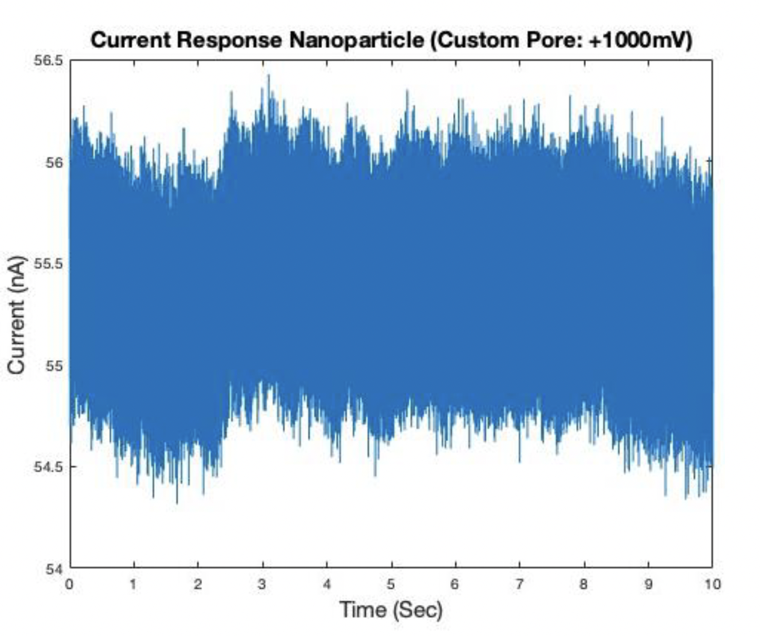
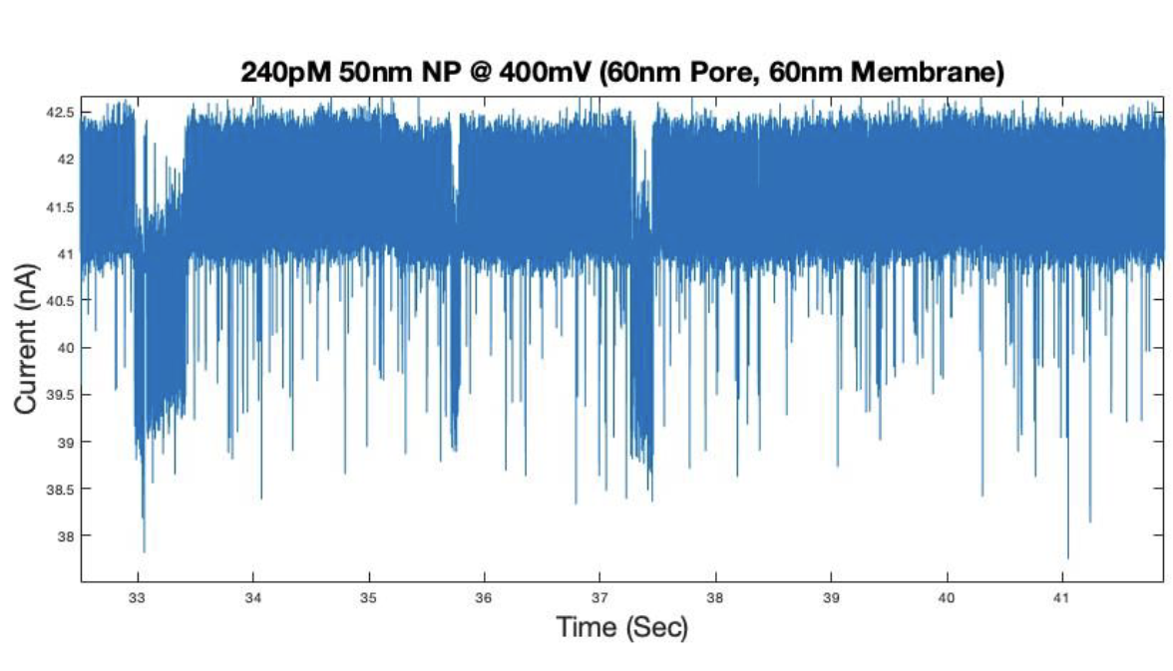
Nanoparticle Sensing with Tween-20
240 pM 50nm NP @400mV (60nm Pore) without tween
240 pM 50nm NP @400mV (60nm Pore) with tween
Tween-20 enables translocations and detection of 25 nm diameter and 50 nm diameter nanoparticles.
13

Slide 14
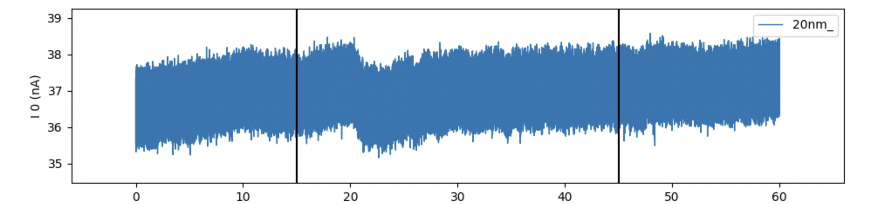
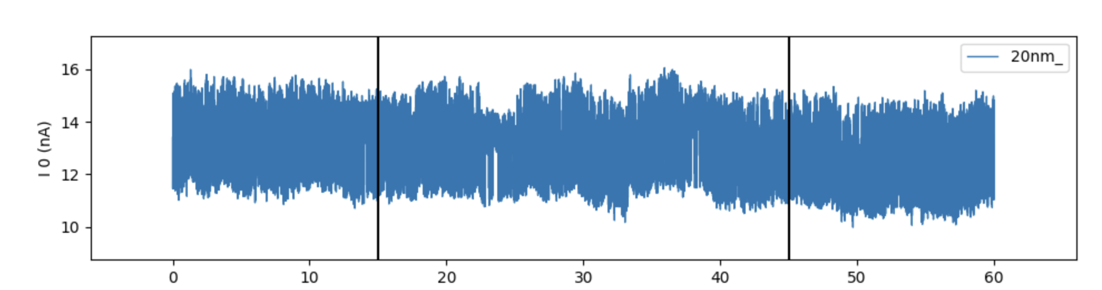
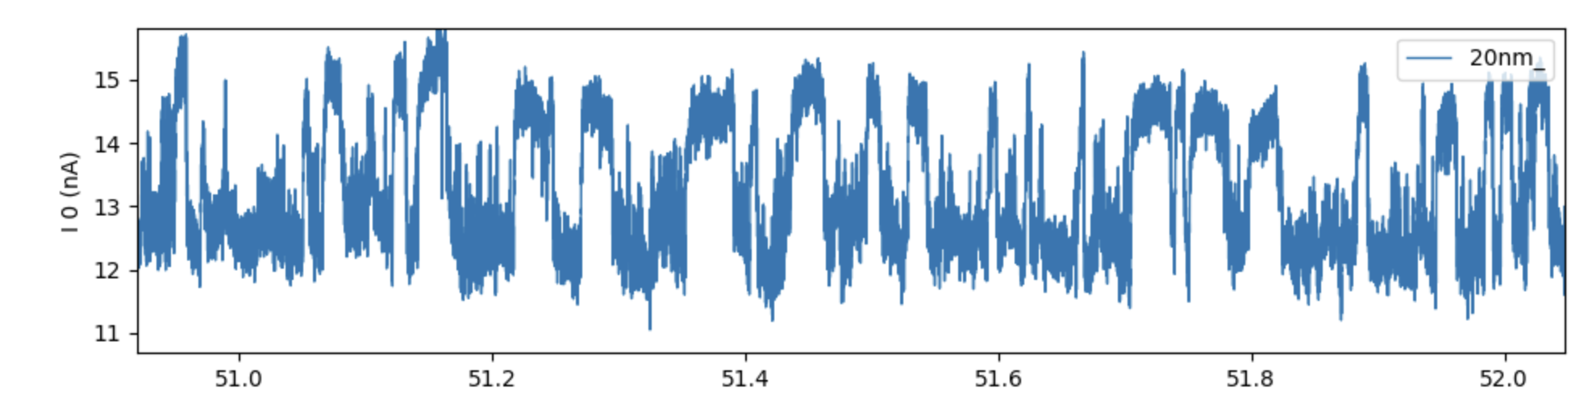
BSA Sensing with Tween-20
20 nm custom nanopore 1 M KCl 30 nM BSA sensing with Tween 20
20nm custom nanopore 1 M KCl 30nM BSA sensing without tween (600mV)
Custom nanopore treated with Tween-20 for protein sensing produces less translocations.
Tween may be too thick and impeding the way that proteins translocate.
14

Slide 15
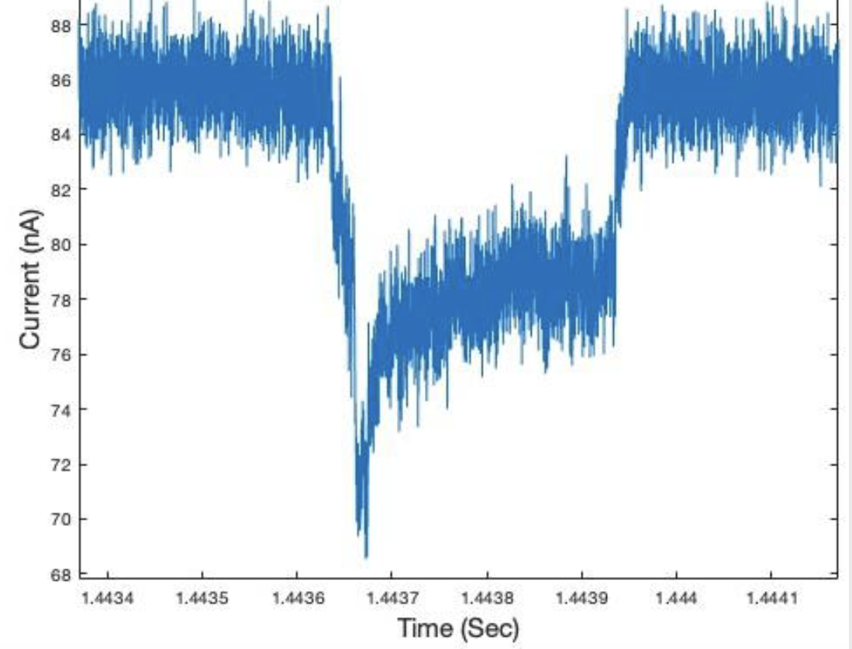
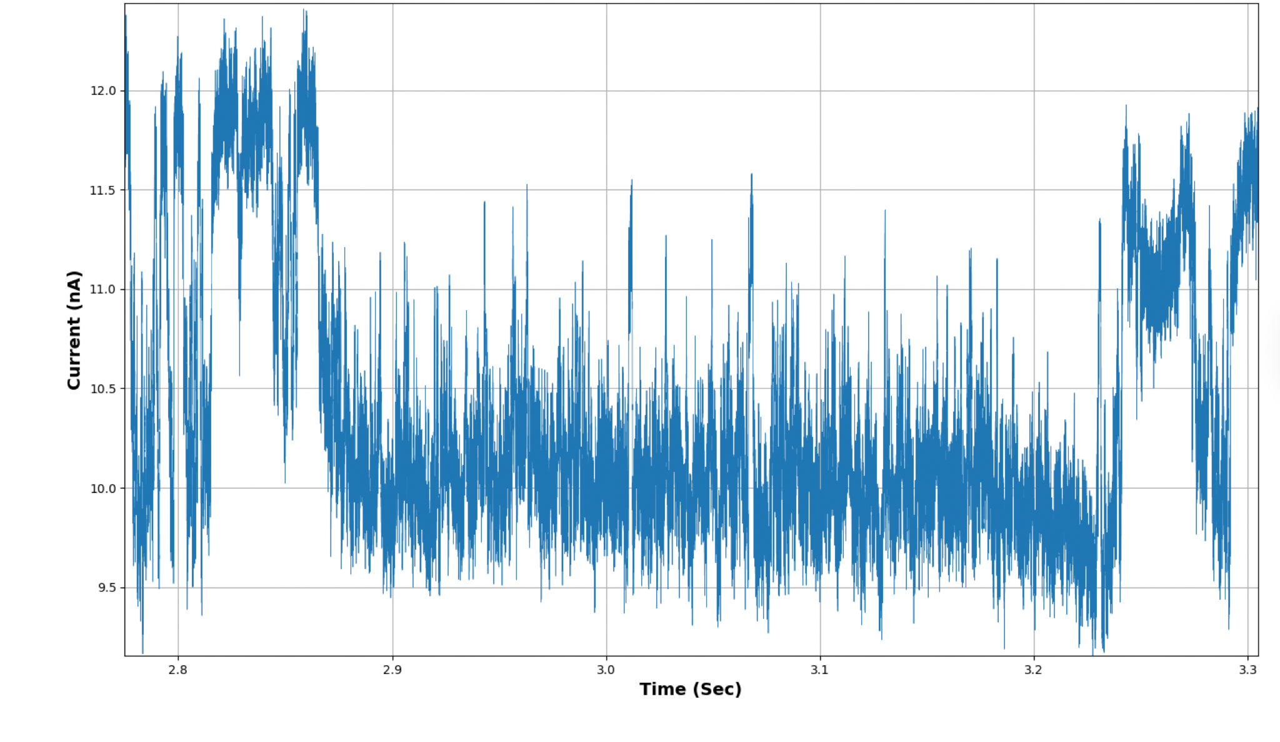
Types of Signals During a Translocation
When the proteins experience electrical, chemical, and physical forces during a translocation, there may be varied outcomes:
    (A)Smooth translocation: protein passes without interruption
    (B)Adsorption: temporary or permanent sticking to pore walls.
A
B
15

Slide 16
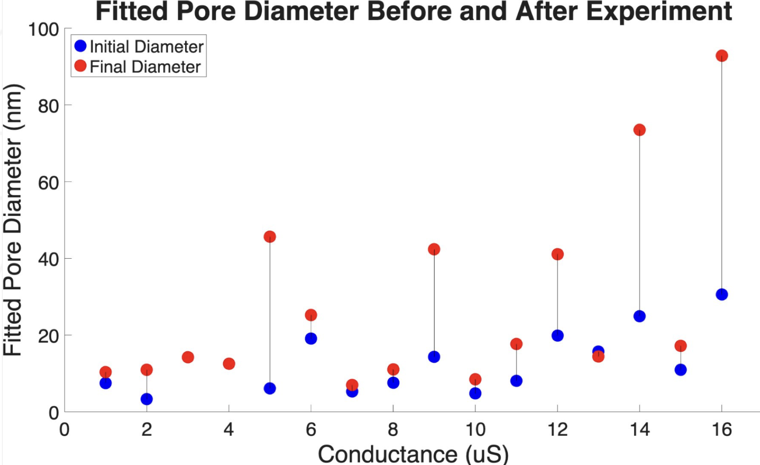
Pore Size Variety and Pore Widening
Custom nanopores are fabricated using electron beam lithography, which can result in slight variations in initial pore diameter.
Pore size is estimated using our continuum conductance model.
We observe that conductance increases during experiments.
  This may suggest pore widening
    Electric field effects
    Hydrolysis of the nitride layer
16
Credit: Noah Baughman
Notes:
Hydrolysis of a nitride layer refers to the chemical reaction where a nitride compound reacts with water, breaking down the nitride bonds

Slide 17
Experimental Takeaways
Tween-20 improves nanoparticle translocations, likely by coating hydrophobic pockets in the pore, reducing nonspecific interactions.
  Protein sensing remains inconsistent, possibly due to Tween forming a thick interior layer that restricts protein entry in smaller pores.
Conductance often increases over time, suggesting pore widening during use, which may alter transport behavior and sensing sensitivity.
Pore stability is limited — performance degrades over time, reinforcing the need for surface modification strategies to improve long-term reliability.
Device-to-device variability remains a challenge, underscoring the importance of more consistent pore fabrication and treatment protocols.
17

Slide 18
References
Elements Srl. Nanopores; https://elements-ic.com/nanopores-2/ (accessed Jul 15, 2025).
Italia, V. Understanding Novel Protein-Derived Biopolymers to Enable Biomimetic Devices. 2021.
Li, X.; et al. Non-sticky Translocation of Bio-Molecules through Tween 20-Coated Solid-State Nanopores in a Wide pH Range. Appl. Phys. Lett. 2016, 109 (14), 143701. https://doi.org/10.1063/1.4964370.
Liu, Y. BioRender Template (2025).
Sarkar, A.; Daniels-Race, T. Electrophoretic Deposition of Carbon Nanotubes on 3-Amino-Propyl-Triethoxysilane (APTES) Surface Functionalized Silicon Substrates. Nanomaterials 2013, 3 (2), 272–288. https://doi.org/10.3390/nano3020272.
18

Slide 19
Thank You & Acknowledgments
Dr. Eric Vogel – Principal Investigator
Noah Baughman – Mentor
Dr. Mikkel Thomas – Program Coordinator
Leslie O’Neill – Program Coordinator

