Slide 1






Dielectric Consequences of Protein Tagging
Nathan Bund, Texas A&M University
Dr. Stuart Williams, University of Louisville
Aaditya Venkatesha Babu Bangaru, University of Louisville
NSF Grant Number: 2140245
NSF REU Award ID: #2348869
NSF NNCI Award ID # 2025075

Slide 2
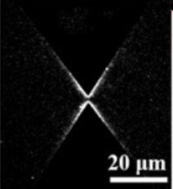

What is the problem?
Dielectrophoresis (DEP) traps proteins
Visual observation of fluorescent proteins is the main way to study protein DEP [1]
Proteins without fluorescent tags may have a different trapping rate compared to tagged proteins
Objective: We aim to design a system capable of integrating impedance analysis with fluorescent imaging for experiments on dielectrophoretic trapping
Trapped proteins!
Figure 1. Trapped fluorescent proteins [2]
Notes:
Dielectrophoresis is a known technique for trapping proteins. However, studies on protein dielectrophoresis generally use proteins with fluorescent tags so they can be observed visually as seen in this image. This may be an issue because native proteins, in the human body for example, of course do not have fluorescent tags. If these tags affect the trapping behavior of the proteins, the studies’ results cannot be used for natural or medical applications. My hypothesis is that proteins without fluorescent tags will have a significantly different trapping rate compared to tagged proteins. I believe this is specifically due to dielectric changes, as the tags are only about 1% of the protein’s mass and therefore would not cause size-related changes.

Slide 3
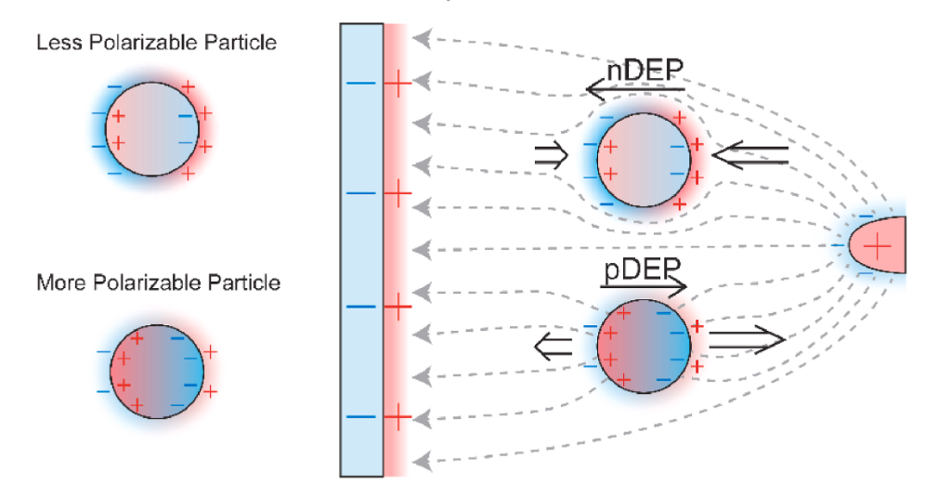
Dielectrophoresis
Movement of neutral particles in a non-uniform electric field
Temporary dipole moment → polarization
Positive DEP (pDEP) vs negative DEP (nDEP)
Figure 2. Positive and negative dielectrophoresis illustration [3]
Notes:
Dielectrophoresis is the movement of neutral particles in a non-uniform electric field. A temporary dipole moment is created, the particles polarize, and the particles are trapped at the electrodes. Dielectrophoresis happens in two ways: positive and negative, based on the permittivity of the particle and the medium. A higher permittivity particle will be easily polarized and will become attracted to an opposite-charged electrode in positive DEP, while a lower permittivity particle will not polarize strongly, instead being repelled by a same-charged electrode in negative DEP. My study specifically focuses on the positive dielectrophoresis of the protein bovine serum albumin.

Slide 4
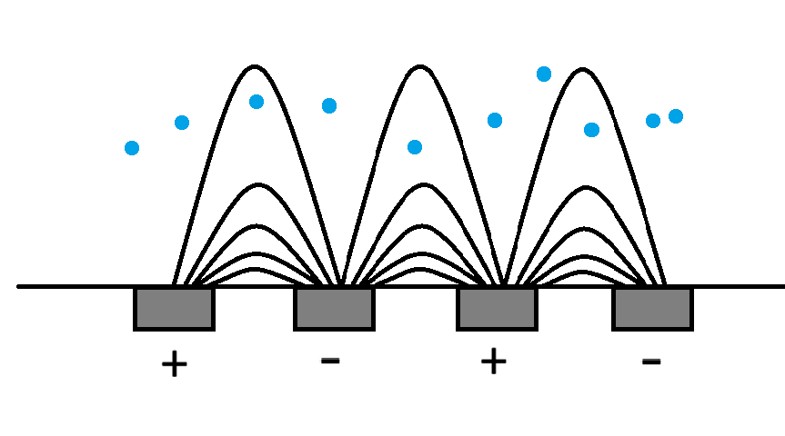
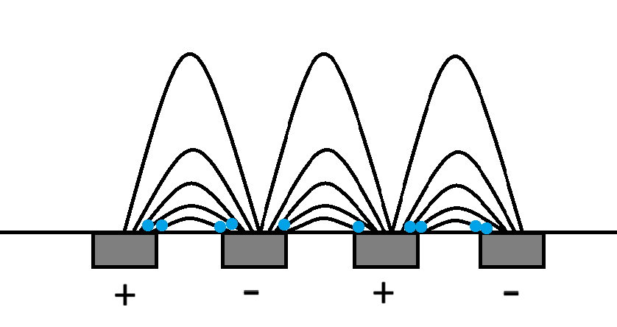
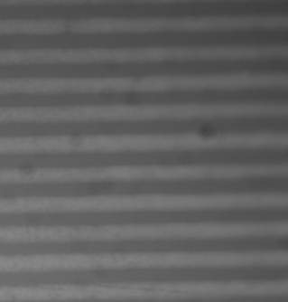
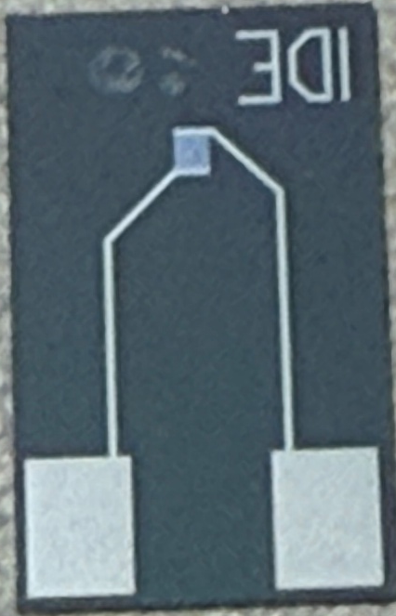
Electric field
11 mm
Well (50 μm)
Well (50 μm)
18 mm
90x magnification
2 μm
2 μm
Figure 3. Interdigitated electrode platform
Figure 4. Sketch of platform cross-section
Notes:
Here you can see the electrode platform that I will be using to perform DEP trapping on the proteins. It consists of many interdigitated electrode fingers, kind of like this *demonstrate with hands* with a space of 2 micrometers between them. Zooming in to 90x magnification, you can see the array of electrodes. Why 5 microns? This is a sketch of this platform’s cross-section at a single instant, where the blue dots represent proteins and the arcs are the electric field between electrodes. When the waveform generator is turned on to begin dielectrophoresis, *switch to next image* the proteins become trapped at the areas with the strongest electric fields: the electrode edges.

Slide 5
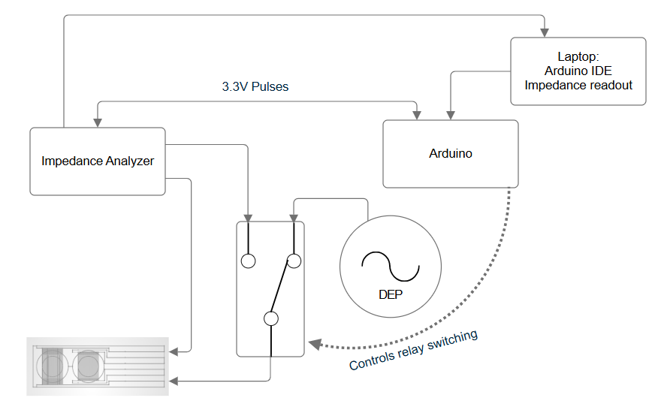
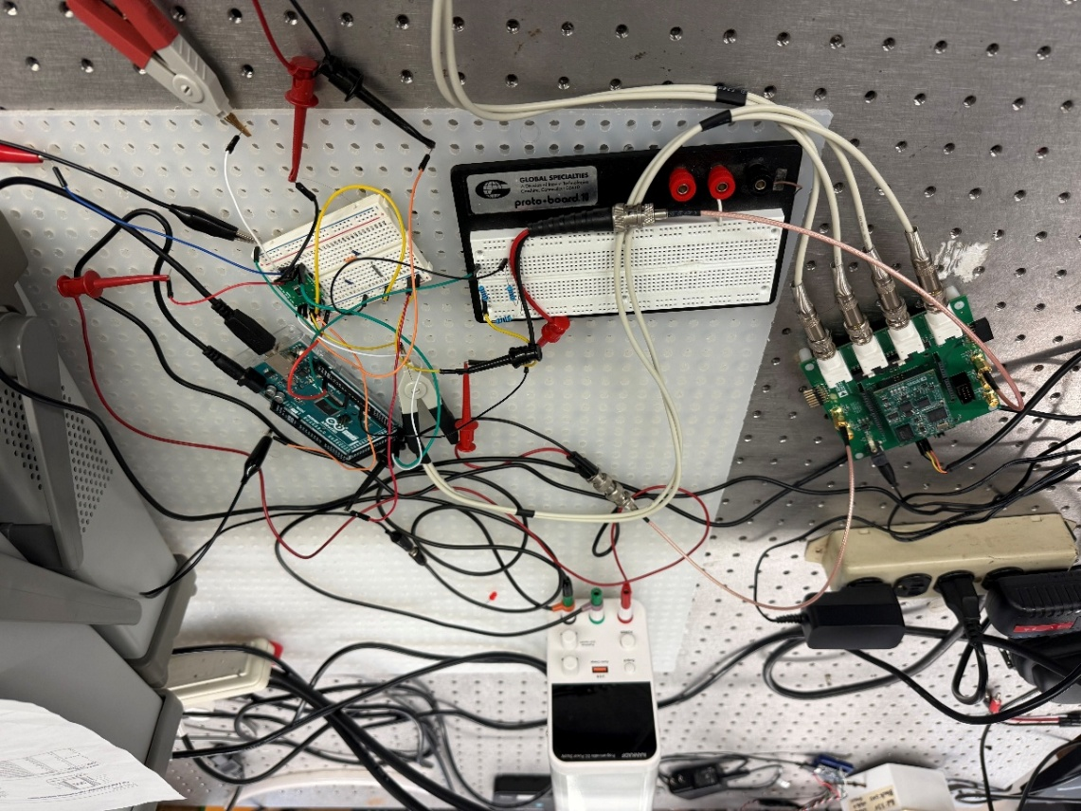
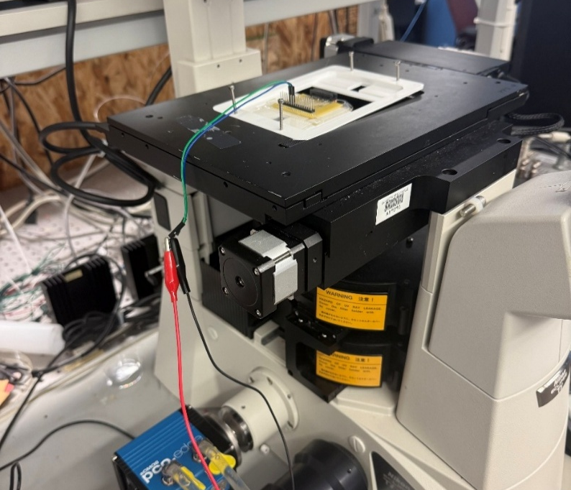
2
1
1
2
4
4
3
3
Chip platform on microscope
ADMX2001B impedance analyzer and waveform generator connected to relay
Arduino switches relay for 60 ms every 20 sec, while also triggering an impedance measurement
Laptop connected to ADMX, displays impedance data

Slide 6
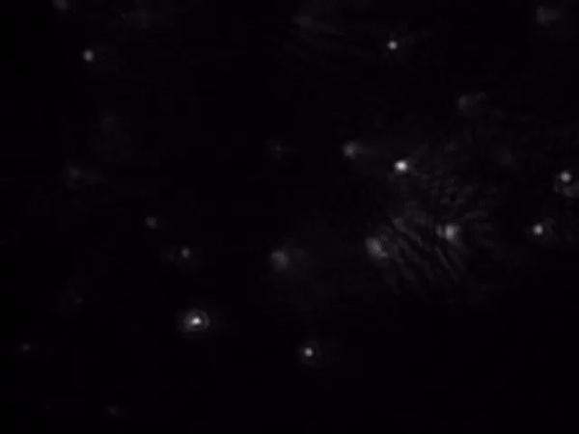
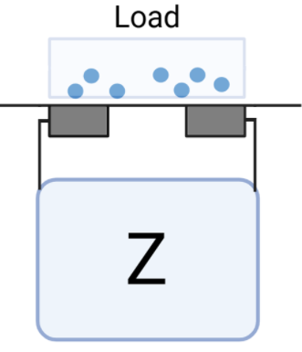
How do we measure proteins we can’t “see”?
Impedance spectroscopy: measures total opposition of a system to alternating current
Measuring impedance takes time, must happen while DEP is off: proteins diffuse
3.3V pulses from Arduino: ~62 ms
  Diffusion ~2 μm
A DEP:Impedance ratio of at least 20:1 is adequate to minimize diffusion
Figure 5. Impedance of a protein load between two electrodes
Figure 6. Brownian motion of 350 nm polymer nanoparticles
Notes:
After we trap the proteins, we need some way to quantify the concentration. For tagged proteins, the fluorescent area can be easily observed, but label-free proteins are functionally invisible. To solve this, I will use impedance spectroscopy to measure the opposition that the current experiences right where the proteins are trapped. A higher protein concentration will have a higher impedance reading, so this can be used to monitor increasing protein concentration as more get trapped. However, impedance cannot be measured while the waveform generator is active, so a relay has been implemented to switch between the two devices periodically. While the impedance analyzer is measuring, the proteins are no longer trapped and have the opportunity to diffuse. This video demonstrates the Brownian motion of nanoparticles, which my proteins will experience for as long as the measurement takes. The fastest measurement method was able to get as short as 52 milliseconds, which has an expected diffusion distance of about 2 micrometers. The overall process will consist of about 20 seconds of DEP trapping, then only about 60 milliseconds of impedance measurement, so the diffusion distance should not greatly impact results.

Slide 7
Impedance Conditions
Impedance vs. Frequency for Dry and Wet Chip
A frequency sweep was performed using the ADMX2001B and validated using a 4294a precision impedance analyzer
Target frequency of 5-50 kHz, and minimal voltage of 130 mV_{pp}
Ideal frequency range
Figure 7. Impedance spectrum from 40 Hz to 10 MHz.

Slide 8
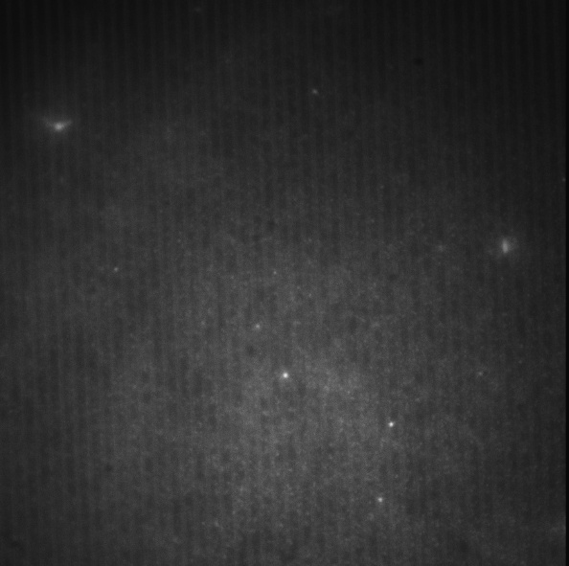
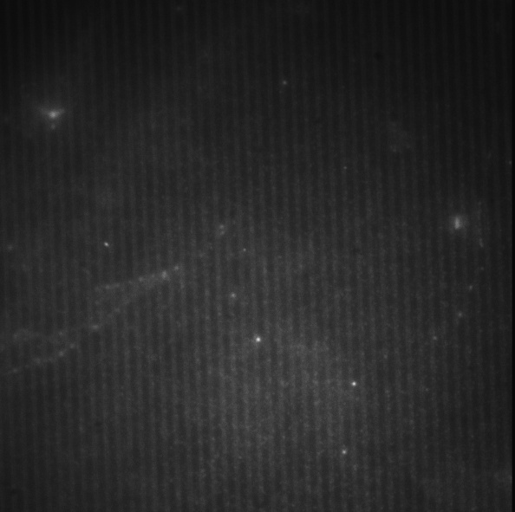

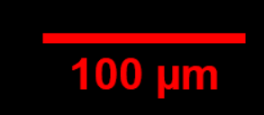
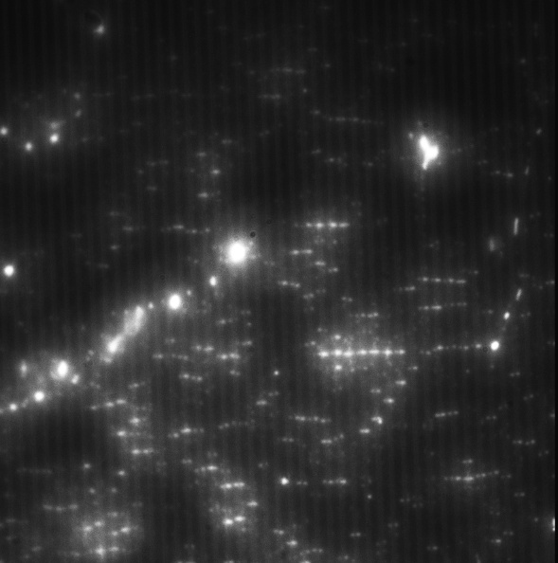
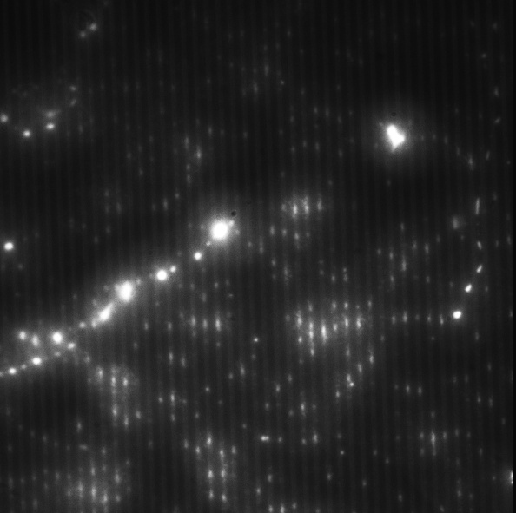
DEP Conditions
DEP trapping demonstrated using 500 nm carboxylate particles
A frequency of 200-800 kHz and voltage of 3-4 Vrms were consistent for pDEP particle trapping
  Exact values vary with particle size
t = 0
t = 5 sec
t = 10 sec
t = 30 sec
Figure 8. 500 nm carboxylate polystyrene particles at 300 kHz and 3.5 V_{rms}

Slide 9
Fluorescence Proof-of-Concept
Images of 40nm particle trapping over a 20-minute span were analyzed using ImageJ
Background subtraction and contrast were used to assist in optical analysis
t = 0
t = 7 min
t = 14 min
t = 20 min
Figure 9. 40 nm carboxylate polystyrene particles at 800 kHz and 3.5 V_{rms}

Slide 10
Fluorescence Proof-of-Concept
Fluorescence Intensity Over Time
Fluorescence intensity increases over the 20-minute trapping period
The particles experienced Brownian motion as well as DEP
Figure 10. Fluorescence intensity of 40 nm carboxylate polystyrene particles over time

Slide 11
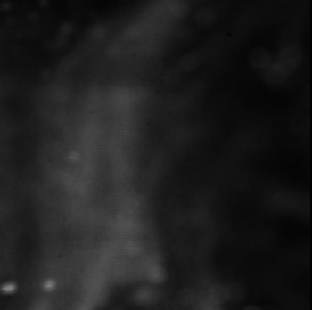

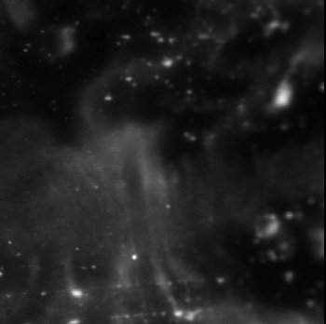
Impedance Results
no field
(control)
positive DEP
(attraction)
negative DEP
(repulsion)
Comparison between no DEP, positive DEP, and negative DEP reveals statistically distinct impedance values
Figure 11. Impedance measurements at different DEP conditions

Slide 12
Conclusions
Designed a system capable of performing both DEP and impedance analysis with minimal downtime
Determined operational impedance parameters for the silicon chips
Demonstrated pDEP trapping on 500nm and 40nm carboxylate polystyrene particles
Imaged and plotted the increase in fluorescence as 40nm particles were trapped
Proved that impedance can distinguish between different DEP conditions and particle concentrations

Slide 13
Future Work
Tagged proteins can be trapped using DEP and quantified
  Repeated at different frequencies
Time constant (τ) for capture rate using both methods
Label-free protein trapping measured, τ compared with tagged
For x frequencies
?
τImage ≈ τImpedance
τLabel-Free
Tagged
Fluorescent intensity ↔ Protein concentration ↔ Impedance load
Notes:
Once I finalize my methods, tagged proteins will be trapped using DEP and quantified by fluorescent area. This will be repeated at least 5 times at different frequencies. Each trial will be graphed, and a time constant will be determined. Then, I will measure impedance for tagged proteins as they are trapped and compare the time constants. They should exhibit extremely similar trapping rates, as they are the same proteins, just measured using different methods. Finally, label-free proteins will be trapped and have their rate quantified by impedance, using the same measurement parameters as the tagged proteins. As stated in the hypothesis, label-free proteins are expected to have a significantly different trapping rate than tagged proteins, which means that we would need to reevaluate our methods for studying the dielectric properties of proteins.

Slide 14



Thank You!!
Acknowledgements
References
This work was supported by the National Science Foundation (NSF) under award #2348869 and grant #2140245, and the National Nanotechnology Coordination Infrastructure (NNCI) KY Multiscale under award #2025075.
Camacho-Alanis F, Ros A. Protein dielectrophoresis and the link to dielectric properties. Bioanalysis. 2015;7(3):353-71. doi: 10.4155/bio.14.306. PMID: 25697193; PMCID: PMC4559587.
Zavatski S, Bandarenka H, Martin OJF. Protein Dielectrophoresis with Gradient Array of Conductive Electrodes Sheds New Light on Empirical Theory. Anal Chem. 2023 Feb 7;95(5):2958-2966. doi: 10.1021/acs.analchem.2c04708. Epub 2023 Jan 24. PMID: 36692365; PMCID: PMC9909730.
Hagness DE, Yang Y, Tilley RD, Gooding JJ. The application of an applied electrical potential to generate electrical fields and forces to enhance affinity biosensors. Biosens Bioelectron. 2023 Oct 15;238:115577. doi: 10.1016/j.bios.2023.115577. Epub 2023 Aug 7. PMID: 37579531.

Slide 15
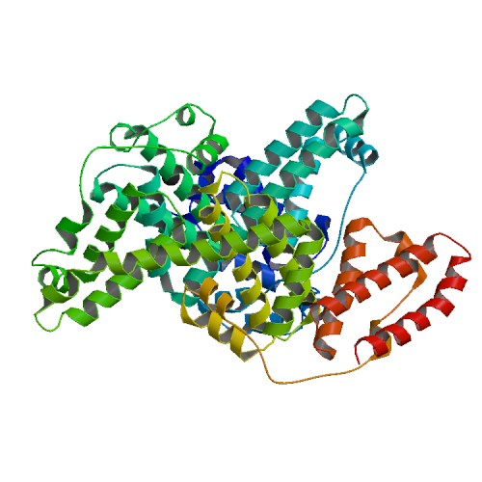
Supplementary slides
Figure 12. Bovine serum albumin structure

Slide 16

Dielectrophoretic Force
$f=\left(p·∇\right)\text{E}=2πa^{3}ℜ\left.\left[\frac{ε_{2}\left(ε_{1}−ε_{2}\right)}{\left(ε_{1}+2ε_{2}\right)}\right.\right]∇E^{2} [N]$

Slide 17
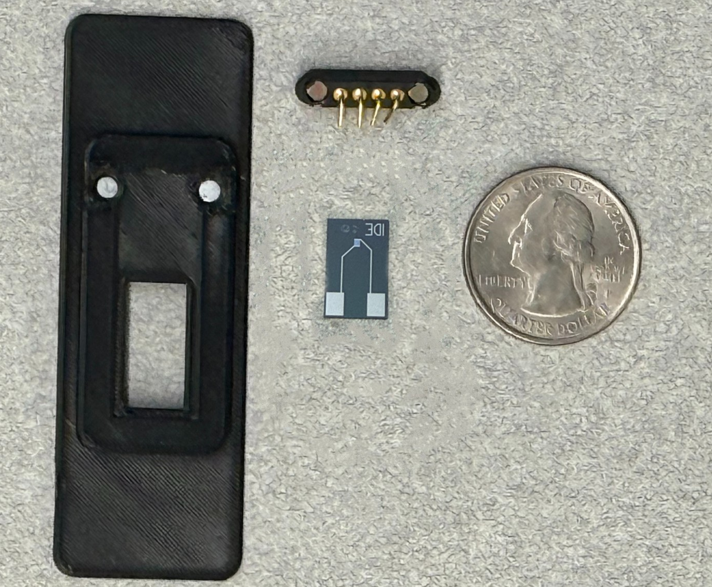
Experimental Process
Clean chip and cover slide
Treat with plasma for ~60 sec
Coat the surface with 100 μL DI water wait 30-45 min
  Prevents non-specific adsorption
Add ~10 μL particle solution to well
Place cover slide over well
Slot chip into platform, begin DEP trapping
Notes:
Now, how do I actually perform the experiment? First, both the chip and a 12mm cover slide must be cleaned with an acetone, IPA, and DI water wash. Then, both components are treated with plasma for about 60 seconds. Then, about 100 microliters of PLL-g-PEG, a surface coating polymer, is applied to the entire surface of both the chip and cover slide. This step is crucial to prevent non-specific adsorption of the proteins, which is when they become attached to the surface of the chip by weak chemical forces. Then, the cover slide is placed over the well to prevent any proteins from escaping. Finally, the chip is slotted into the platform and DEP trapping is turned on.

