Slide 1




Selective Chemical Adsorption of Li⁺ from Simulated Brine Water
Alyssa Bauer
Mentor: Guangxing Zhang
PI: Hailong Chen

Slide 2
Goals
Main Objective: Develop and evaluate adsorbent materials for selective Li⁺ recovery from brine water
Identify material properties affecting:
  Adsorption capacity
  Kinetics
  Stability
Establish experimental protocol through classic adsorption papers
  Compare results to literature values
  Find ways to optimize results
Design, synthesize, and evaluate the potential of iron-based materials to selectively adsorb lithium ions from simulated brine.
2

Slide 3
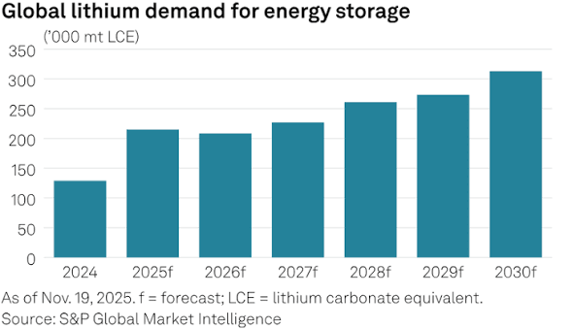
Background
Why is lithium important?
  Lithium is essential for lithium-ion batteries
  Used in EVs, electronics, and energy, aerospace, and nuclear fields (Global demand is increasing)
2. Hard-rock minerals are difficult to exploit
  Inevitably harms the soil and causes air contamination.
  Complex and expensive extraction process
  Finite nature of the material
3

Slide 4
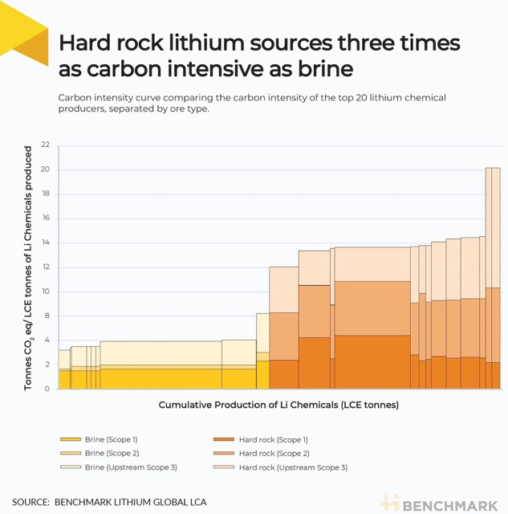





Background
3. Li⁺ is also found in Salt Lake brines
  Adsorption is most promising due to its ability to have high Li⁺ selectivity, high efficiency, and a simple process, without any being toxic or expensive
4

Slide 5
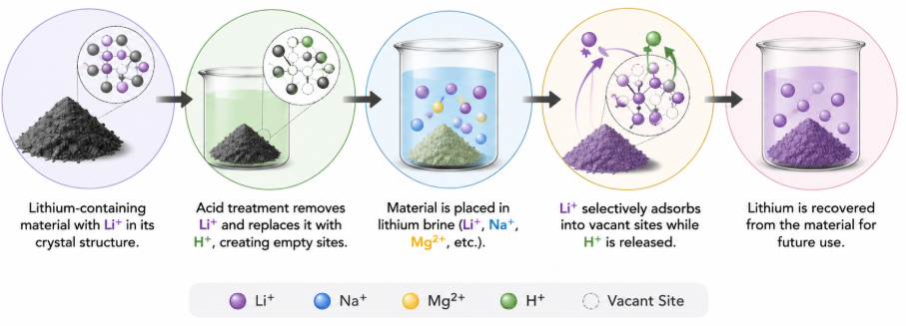
How Li⁺ Adsorption Works
Commercial or Synthesized Li⁺-Containing Adsorbent
Acid Activation
(ion-sieve)
Contact with Lithium Brine
Selective Li⁺ Adsorption
Lithium Recovery
5

Slide 6
Current Progress
Material | Capacity (mg/g) | Kinetics | Stability | Key limitation
LiMn₂O₄ / HMn₂O₄ | 30–47 | Fast (4h equilibrium) | Poor | Mn dissolution
Al-doped LiMn₂O₄ | 31-46 | Slightly slower | Improved | More complex synthesis
LiFePO₄ / FePO₄ | 9-46 | Very fast (15 min) | Good | Lower/variable capacity, mostly electrochemistry
6

Slide 7
Material #1 Plan: LiMn₂O₄
Commercial LiMn₂O₄
Acid Treatment (HCl)
XRD (X-Ray Diffraction)
Li+ Adsorption Test
XRD + ICP (Inductively Coupled Plasma)
Goal: Use a well-established LiMn₂O₄ adsorption protocol as a reference to evaluate experimental materials.
Material: LiMn₂O₄
7

Slide 8
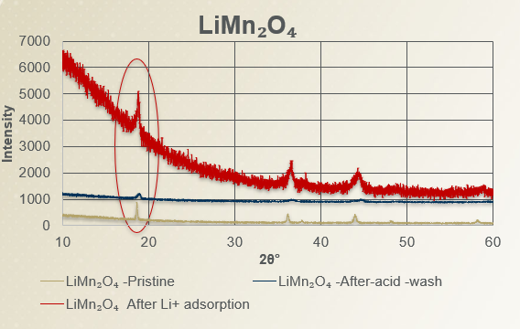
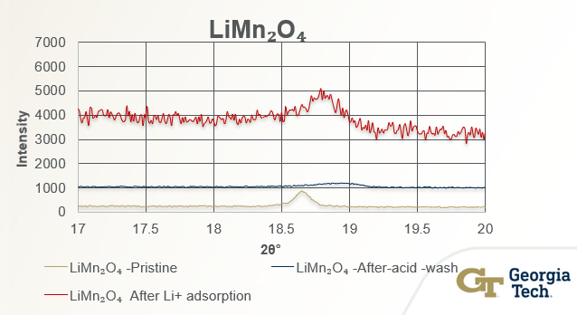
XRD Results: LiMn₂O₄
After Acid Wash:
Major peaks remain at 18°, 36°, 44°, and 64°, indicating the spinel structure is preserved
Peaks shift slightly to higher 2θ and decrease in intensity, consistent with Li⁺ extraction.
After Li⁺ Adsorption:
Peaks shift back toward lower 2θ, indicating lattice expansion as Li⁺ is reinserted.
8

Slide 9
ICP Results
Material LiMn₂O₄ :
Li/Mn ratio = Li concentration / Mn concentration
Because manganese remains part of the material's crystal framework while lithium is removed and reinserted, the Li/Mn ratio reflects how much lithium is present in the material
Sample | Li/Mn Ratio | Interpretation
Pristine material | 0.521 (0.5) | High Li+ content
After acid wash | 0.039 (-92.5%) | Most Li+ removed
After adsorption | 0.058 (+48.7%) | Partial lithium re-adsorption, could improve under different brine conditions
9

Slide 10
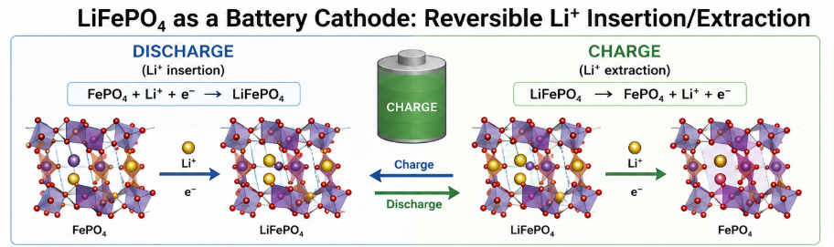
Iron Based Materials
Research Gap:
  Lithium iron phosphate have been extensively studied as battery material and is well known in electrochemistry
  No studies investigate this material as a physical lithium-ion sieve
  Advantages: Abundant, lower cost, and relatively easy to prepare
10

Slide 11
Material #2 Plan: LiFePO₄
Goal: Make a detailed experimental plan of a battery material to assess its potential for selective lithium adsorption
Material: LiFePO₄
Commercial LiFePO₄
XRD Characterization
XRD + ICP MS Characterization
Acid Treatment (HCl)
Li+ Adsorption Test
11

Slide 12
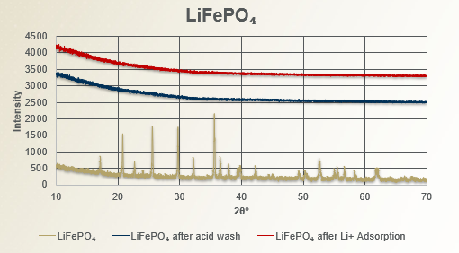
XRD Results: LiFePO₄
After acid wash:
Shows significant reduction in diffraction peak intensity
Sample lost its crystallinity and became amorphous
Probably not suitable for Li⁺ Adsorption
After Adsorption
No change
12

Slide 13
ICP Results
Material LiFePO₄ :
Li/Fe ratio = Li concentration / Fe concentration
Due to the XRD and ICP results, this material did not survive acid wash and most likely is not a promising material under these conditions
Sample | Li/Fe Ratio | Interpretation
Pristine material | 1.186661 (1.0) | Close to the expected composition, high Li⁺
After acid wash | BDL (Below Detectable Limit) | Li⁺ was removed below the detectable level
After adsorption | BDL | No detectable Li⁺ uptake under these conditions
13

Slide 14
Material #3 Plan: LiFeO₂
Goal: Investigate an iron oxide based material as a potential lithium ion sieve
Material: LiFeO₂
Synthesize LiFeO₂
Confirm phase with XRD
Acid Treatment (HCl)
XRD Characterization
Li+ Adsorption Test
XRD + ICP MS Characterization
14

Slide 15
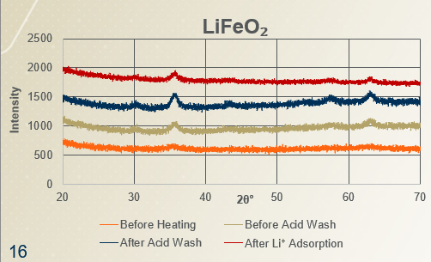
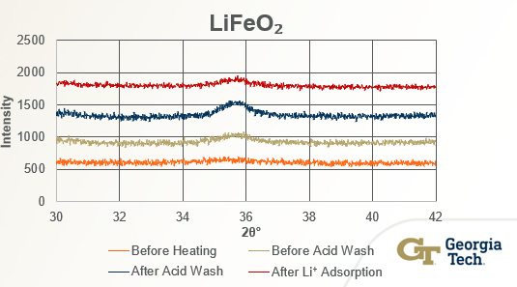

XRD Results: LiFeO₂
Synthesis:
Calcination: Sharp diffraction peaks confirm crystalline LiFeO₂ formation
Structural Stability:
Acid wash: Minor peak shifts; crystal structure preserved
Li⁺ adsorption: Little change after adsorption, indicating low Li⁺ uptake
16
15

Slide 16
ICP Results
Material LiFeO₂ :
Li/Fe ratio = Li concentration / Fe concentration
Material remained stable after acid treatment and removed a good amount Li⁺ suggesting under different brine water conditions (pH) is a promising material
Sample | Li/Fe Ratio | Interpretation
Pristine material | 0.278 (1.0) | Lower than expected ratio
After acid wash | 0.054 (-80.6%) | Good Li⁺ removal
After adsorption | BDL | No detectable Li⁺ uptake under these conditions
17

Slide 17
Summary and Future Work
Summary
  Successfully reproduced the LiMn₂O₄ adsorption protocol and showed partial Li⁺ re-adsorption
  LiFePO₄ lost crystallinity after acid treatment, suggesting it would be a poor lithium-ion sieve under these condition
  LiFeO₂ remained structurally stable after acid treatment but showed little Li⁺ uptake
Future Work
  Optimize adsorption conditions (pH, contact time, temperature, and adsorbent dosage).
  Improve LiFeO₂ synthesis to increase the initial Li/Fe ratio.
10

Slide 18
Acknowledgements
Dr. Hailong Chen
Guangxing Zhang
Dr. Chen’s Research Group
Dr. Mikkel Thomas and Leslie O’Neill
REU Cohort
National Science Foundation Award: #2349519
10

Slide 19
Work Cited
AI Assistance: ChatGPT (OpenAI), Claude (Anthropic), and Elicit were used to assist with literature review, scientific paper search, and reference formatting. All cited scientific information was verified against the original publications
Hu, Y., Liu, W., Zhang, Y., Liu, C., Zeng, M., & Wang, Y. (2018). A simple, quick and eco-friendly strategy of synthesis nanosized α-LiFeO₂ cathode with excellent electrochemical performance for lithium-ion batteries. Materials, 11(7), 1176. https://doi.org/10.3390/ma11071176
Maisch, M. (2024, December 20). Annual lithium-ion demand surpasses 1 TWh for the first time. ESS News. https://www.ess-news.com/2024/12/20/annual-lithium-ion-demand-surpasses-1-twh-for-the-first-time/
Huang, Y., et al. (2023). Lithium adsorption properties of lithium iron oxide–based ion sieve materials. Journal of Materials Science, 58, 8730–8744. https://doi.org/10.1007/s10853-023-08327-4.
Kim, J., et al. (2024). Recent advances in lithium ion-sieve adsorbents for lithium recovery from brines. Journal of Industrial and Engineering Chemistry. https://doi.org/10.1016/j.jiec.2024.05.026
Lee, Y.-S., Cho, S.-J., Sun, Y.-K., Kobayakawa, K., & Sato, Y. (2005). Development of lithium iron oxide cathode materials for lithium secondary batteries. Electrochemistry, 73(10), 874–882. https://doi.org/10.5796/electrochemistry.73.874
Kumar, A., Fukuda, H., Hatton, T. A., & Lienhard, J. H. (2019). Lithium recovery from desalination brine: A review of opportunities, challenges, and potential technologies. Water Research, 150, 396–409. https://doi.org/10.1016/j.watres.2018.11.056
19

Slide 20
Questions?
2

