Slide 1



Comparative Characterization of Extracellular Vesicles Released by Cancer Cell Lines from Distinct Tissue Origins
By: Sanya Braddy
Mentor: Jenlu Pagnotta
PI: Dr. Jina Ko

Slide 2
Background

Slide 3

What is an Extracellular Vesicle?
Extracellular vesicles are tiny membrane-bound particle released by the cell during cell-to-cell communication
Extracellular vesicles contain proteins, lipids, and nucleic acids
Surface antigen
Adhesion molecules
Cargo:
Proteins, lipids, and nucleic acids
Lipid raft
Tetraspanin
Tetraspanin

Slide 4
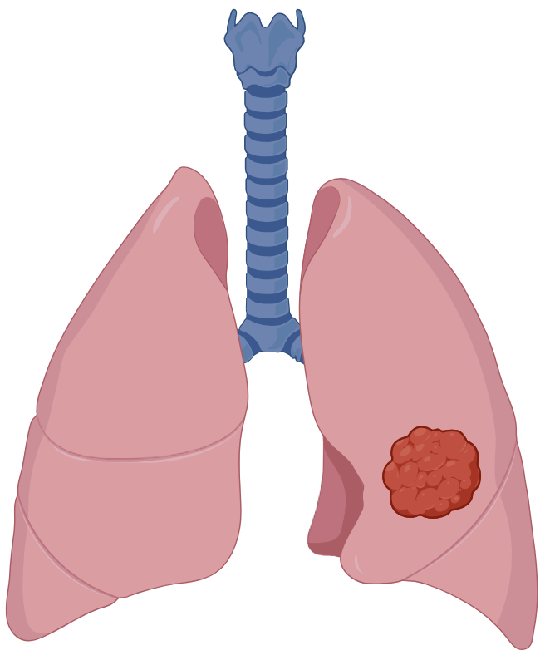



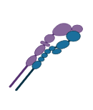


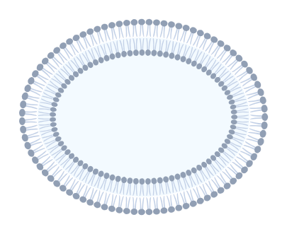



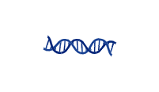

























Why Should We Care About Extracellular Vesicles?
Extracellular Vesicle (EV)
Cargo:
-Nucleic acids
-proteins
- lipids
Parent cell
EVs in Blood Sample
Recipient
cell
Detected EVs (A549 Cell Line)
Early cancer detection and personalized medicine
Intercellular communication
Notes:
Now that we've discussed what extracellular vesicles are, let's talk about why they are important.
Point to the lung: "Here we have a cancer cell..."
Point to the EV: "...which releases extracellular vesicles..."
Point to the blood tube: "...that circulate through the bloodstream..."
Point to the fluorescence image: "...where we can detect them..."
Point to the doctor/patient: "...with the long-term goal of improving early diagnosis and personalized medicine.” OR “By analyzing these EVs, researchers hope to detect signs of cancer earlier, improve diagnosis, and ultimately support more personalized treatment strategies."

Slide 5
Goals
Notes:
-Cancer is often detected late.
"One of the biggest challenges in cancer research is that many cancers are not diagnosed until they have already progressed to later stages, making treatment more difficult and reducing patient survival rates. “
-We need non-invasive biomarkers.
“Because of this, researchers are looking for non-invasive biomarkers—molecules that can be detected through simple samples like blood instead of requiring invasive tissue biopsies. “
-EVs may provide earlier diagnosis.
“By analyzing these EVs, researchers hope to detect signs of cancer earlier, improve diagnosis, and ultimately support more personalized treatment strategies.”
So our question became... Next slide

Slide 6
Objectives and Goals
Study how cancer cell lines from different tissue origins release extracellular vesicles with distinct characteristics
Cancer Cell Lines
-A549 (Lung)
-A431 (Epidermoid Carcinoma)
-A375 (Melanoma)

Slide 7
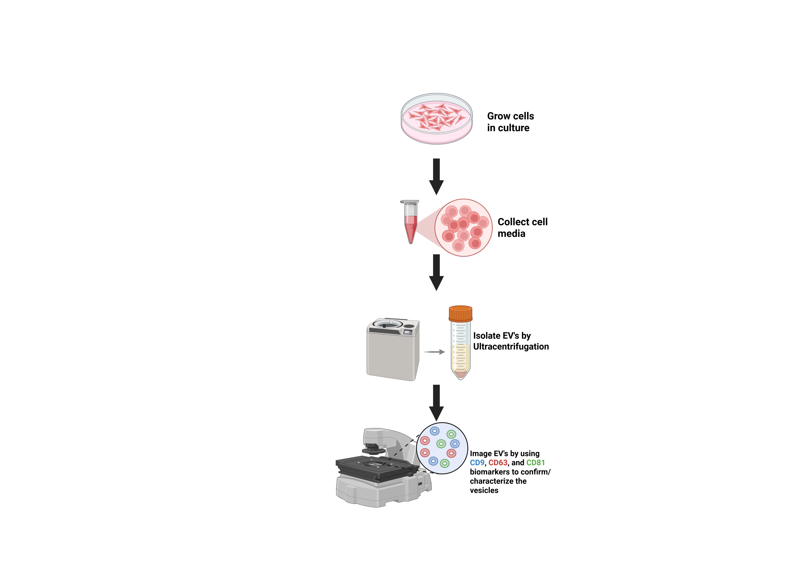
Procedure
Grow cells in culture
Collect conditioned media
Isolate EVs using Ultracentrifugation
Image EVs using RCA with CD9 biomarker to characterize the vesicles
Notes:
Ultracentrifugation
-Ultracentrifugation uses extremely high centrifugal forces to separate particles based on their size and density."
-During this process, the larger cells and debris are removed first, leaving the smaller extracellular vesicles suspended in the media."
"The sample is then spun at much higher speeds—typically around 100,000 × g for 2 hours—which causes the extracellular vesicles to pellet at the bottom of the tube.”
Image
"Now that we've isolated the extracellular vesicles, the next step was determining whether they expressed the CD9 biomarker using Rolling Circle Amplification."

Slide 8
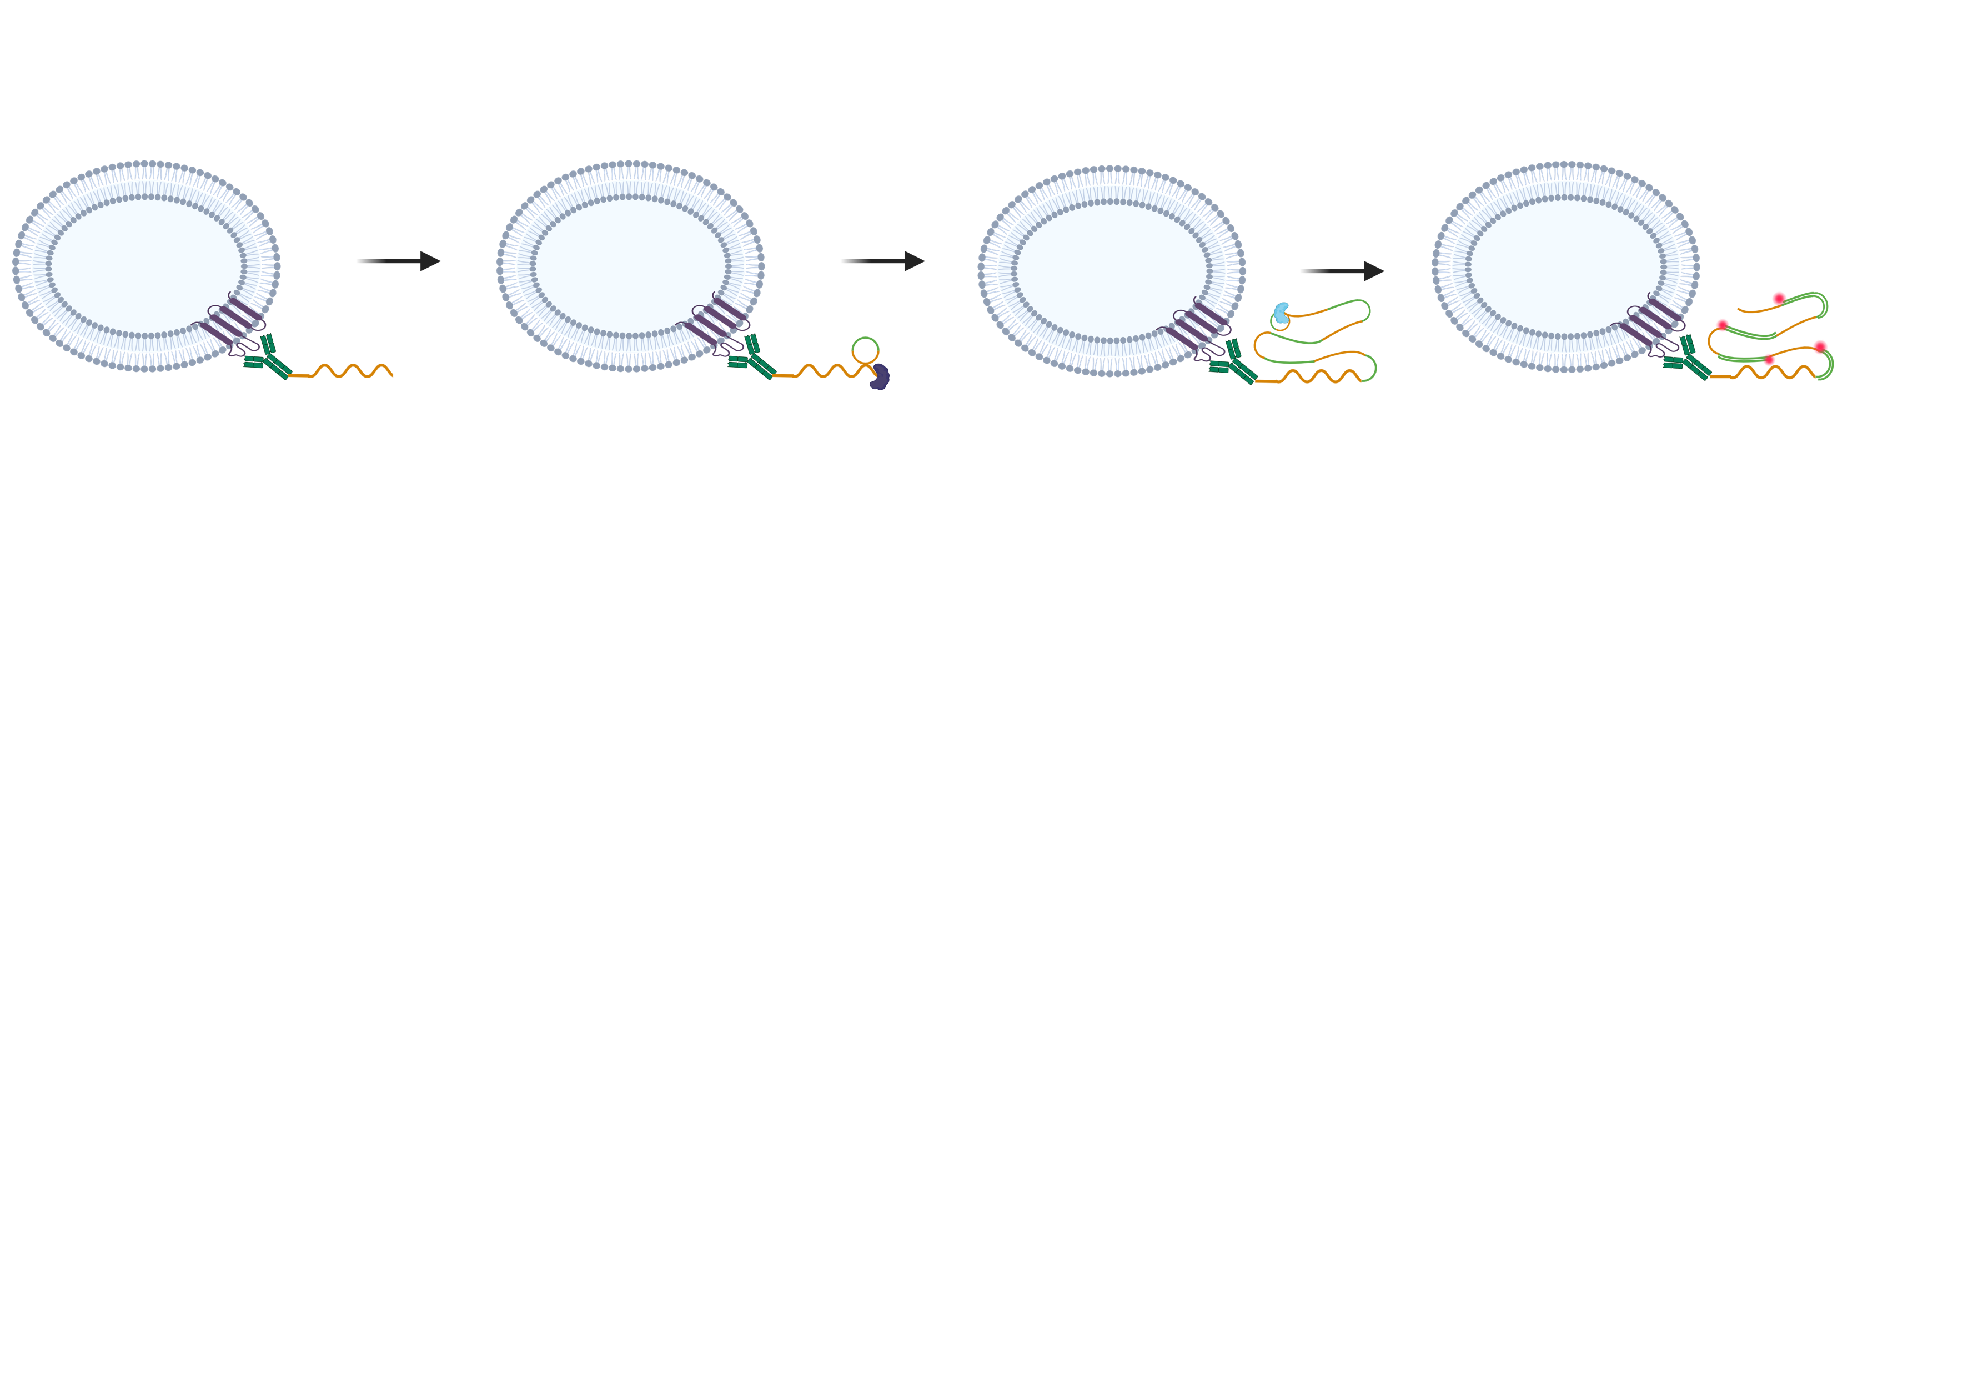



Procedure cont.
Rolling Circle Amplification (RCA)
CD9 Antibody-DNA
T4 Ligase and Padlock Probe
Phi29 Polymerase
Fluorophore DNA
Notes:
So to elaborate more on RCA and its purpose
“RCA or (Rolling Circle Amplification) is a highly sensitive image technique method that amplifies DNA, making very small targets easier to detect giving us a better readout compared to regular IF Imagining”
a CD9 antibody conjugated to a DNA strand binds specifically to the CD9 proteins located on the surface of the extracellular vesicles."
-a padlock probe binds to the DNA attached to the antibody, and T4 ligase joins the ends of the probe together to form a circular DNA molecule."
Phi29 DNA polymerase then continuously copies this circular DNA, producing a long DNA strand containing many repeated sequences. This amplification step greatly increases the detection signal."
-Finally, fluorescent DNA probes bind to the amplified DNA, producing bright fluorescent spots that can be visualized under a fluorescence microscope."

Slide 9
Results
Notes:
"Now that we've isolated and labeled the extracellular vesicles, let's look at the fluorescence images to see how EV detection differed among the three cancer cell lines."

Slide 10



Results
A549
A431
A375
- Control
Ab-DNA
(.25 µg/mL)
20µm
Notes:
Each fluorescent spot represents a successfully detected CD9-positive extracellular vesicle, allowing us to compare EV detection among the different cancer cell lines."

Slide 11
Results cont.

Slide 12
Conclusions

Slide 13
Conclusion
Results
CD9-positive EVs were successfully detected in all three cancer cell lines using RCA
A549 EVs exhibited the highest CD9-associated fluorescence signal, while the negative control exhibited minimal signal
These findings suggest that EV-associated CD9 expression differs among cancer cell lines and demonstrates the potential of RCA for sensitive EV detection
Future Work
Future studies will quantitatively evaluate additional EV biomarkers to further investigate differences among cancer cell lines

Slide 14

Acknowledgements
Mentorship:
Jenlu Pagnotta, Emily Huynh, Dr. Ashley Wallace, Dr. Adriana Santiago-Ruiz
PI:
Dr. Jina Ko
-This work was carried out in part at the Singh Center for Nanotechnology, which is supported by the NSF National Nanotechnology Coordinated Infrastructure Program under grant NNCI-2025608, and through the use of facilities supported by the University of Pennsylvania Materials Research Science and Engineering Center (MRSEC) DMR-2309043.

