Slide 1





Magnetic Field Gradient Effects on Mitochondrial Morphology in hNPCS and Using
Microfluidic PDMS Scaffolding
Presented by Hershel Nemer
Collaborator: Sam Cotton

Slide 2
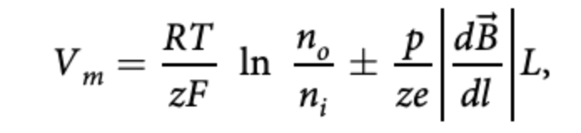
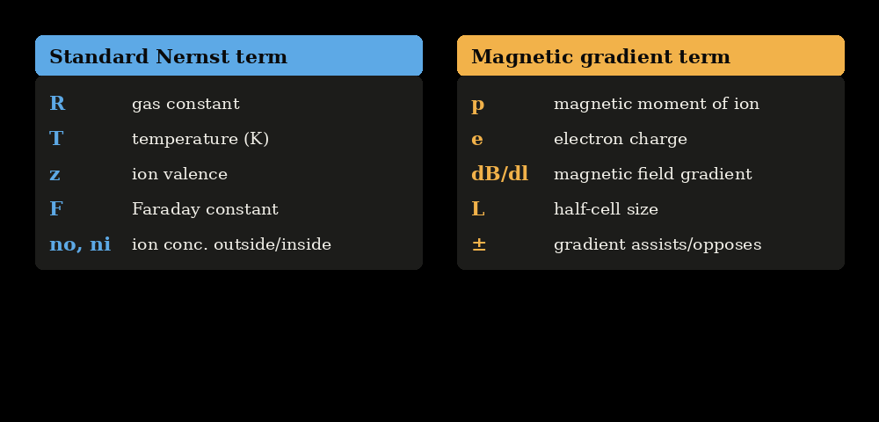
Background
Nernst Equation
(Zablotskii et al., 2016)
  Current work: how magnetic field gradients impact mitochondrial morphology
  Magnetic field gradients alter mitochondrial morphology
  Characterized via the Nernst equation (Zablotskii et al., 2016)

Slide 3
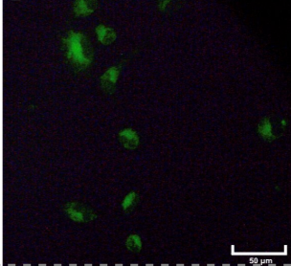
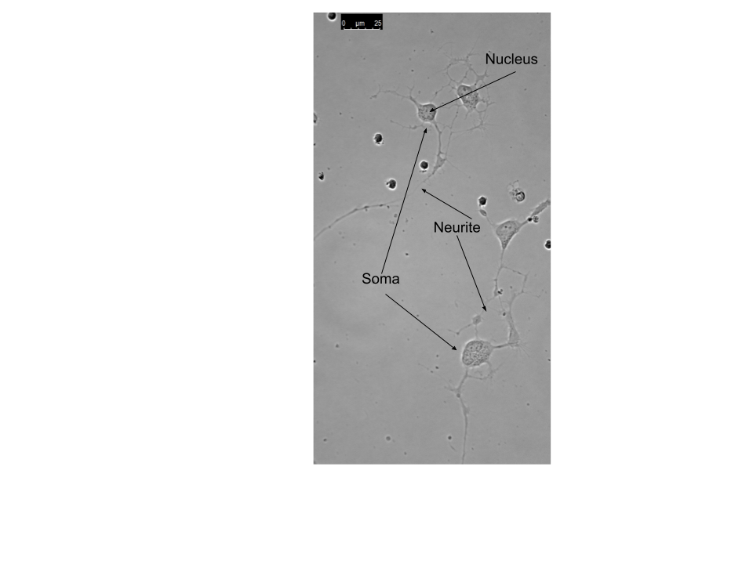
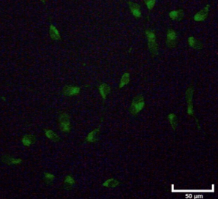
Cell Culturing
  Human neural progenitor cells were used
  (hNPCs) are cultured on 35 mm petri dishes
  Cells are exposed to varying magnetic field gradient strengths
  Imaged under Leica DMI8 and AmScope IN480T-FL microscopes
  Mito Tracker Green used as mitochondrial stain

Slide 4
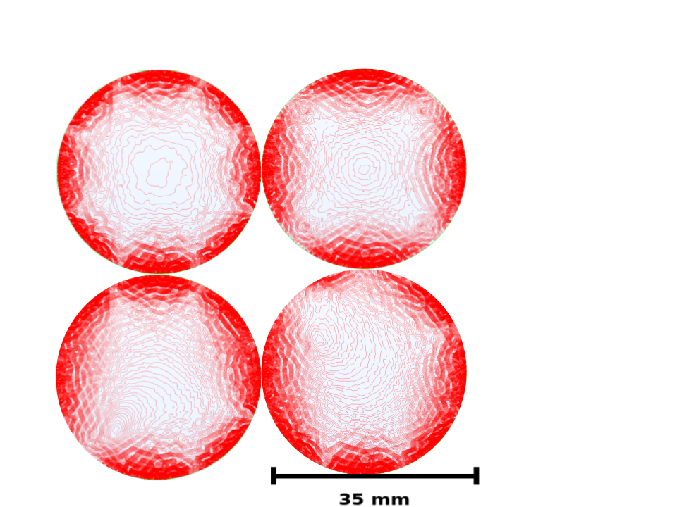
COMSOL Magnetic Field Gradient
  COMSOL simulated gradient distribution in petri dish
​
  Define and validate experimental gradient conditions
​
  Mapped spatial variation in field intensity to identify regions of highest gradient exposure ​
Contour plots of the magnetic field gradient for the magnet, generated from COMSOL simulation data for four configurations. Red contour lines represent constant-magnitude contours of the field gradient, with closely spaced lines indicating regions of steep gradient change and widely spaced lines indicating regions of relatively uniform field. ​

Slide 5
Problem
Without spatial confinement, hNPCs/neurons can adhere and grow across variable, uncontrolled regions of the dish, causing inconsistent positioning relative to the magnet array and exposure to inconsistent magnetic field gradient strengths across replicates

Slide 6
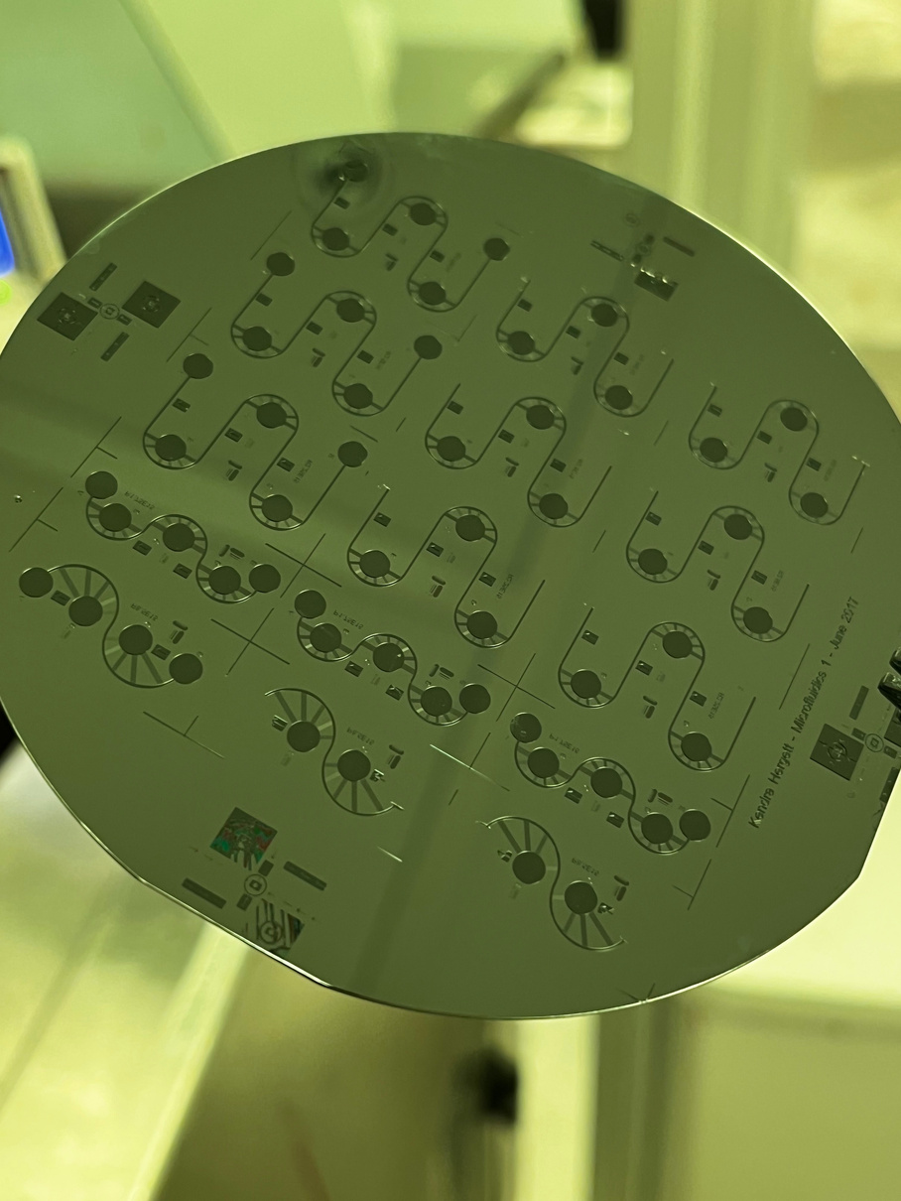
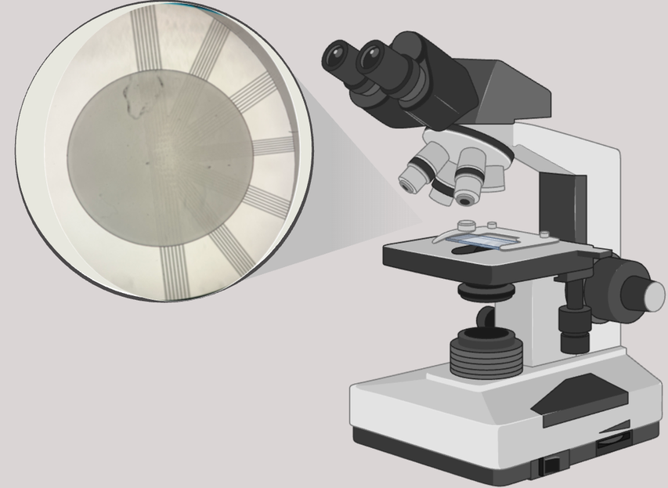
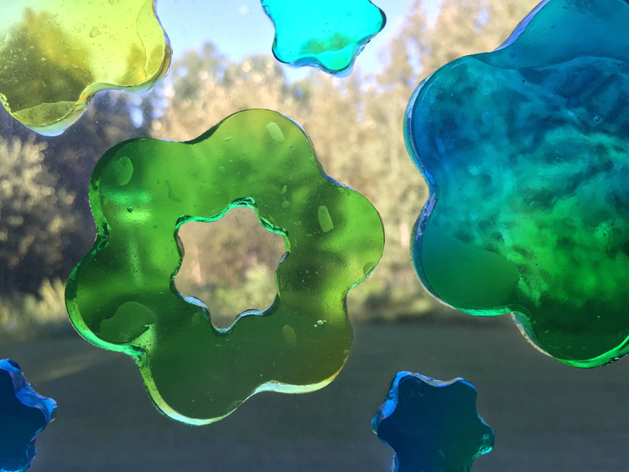
Solution: PDMS
  Silicone-based elastomer (like a gel window cling)
  Optical Transparency allows for live cell imaging compatibility
  Doesn’t interact with magnets
  Easy fabrication process
Notes:
1. PDMS is optically transparent, biocompatible, gas-permeable, non-magnetic/non-conductive
2. The project I've been working on revolves heavily around live cell imaging to detect changes in mitochondrial morphology...
3. Non-magnetic/non-conductive properties mean it won't distort magnetic field gradients from the ring magnet array or introduce confounds
4. Easily molded via soft lithography — practical for fabricating custom molds that overlay the Petri dish

Slide 7
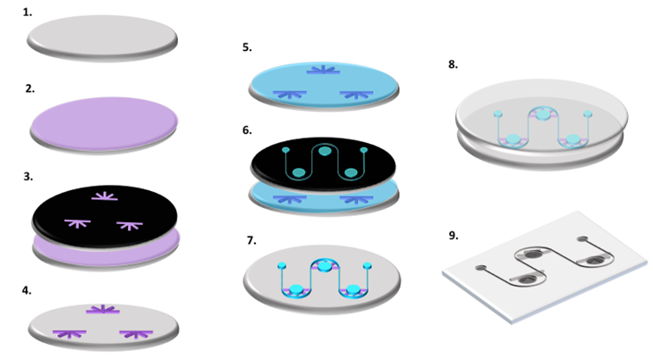
PDMS Preparation
  1–4. Primary photolithography: Spin-coat KMPR 1005 for junction microchannels
  5–7. Secondary photolithography: KMPR 1050 for somatic wells and perfusion channels
  8–9. Cast PDMS, then remove PDMS wafer and cut into 1×2 cm chips
  Punch 4 mm reservoirs and apply desired coating for cell culture
Image from Malkoc et al., 2026

Slide 8
How does PDMS help us?
Previous work in Kunze Lab (Malkoc et al., 2026)
  Precise separation of the different neural compartments (axon, dendrite, etc)
  Revealed distinct patterns in extracellular vesicle secretions across different parts of the neuron
Our Project
  The PDMS mold mechanically fixes cell seeding boundaries, preventing shift during transport
  Removable without disturbing the culture, unlike a permanent coating or barrier
  Allows us to explore mitochondrial morphology changes that differ by subcellular location, rather than only across the whole dish

Slide 9
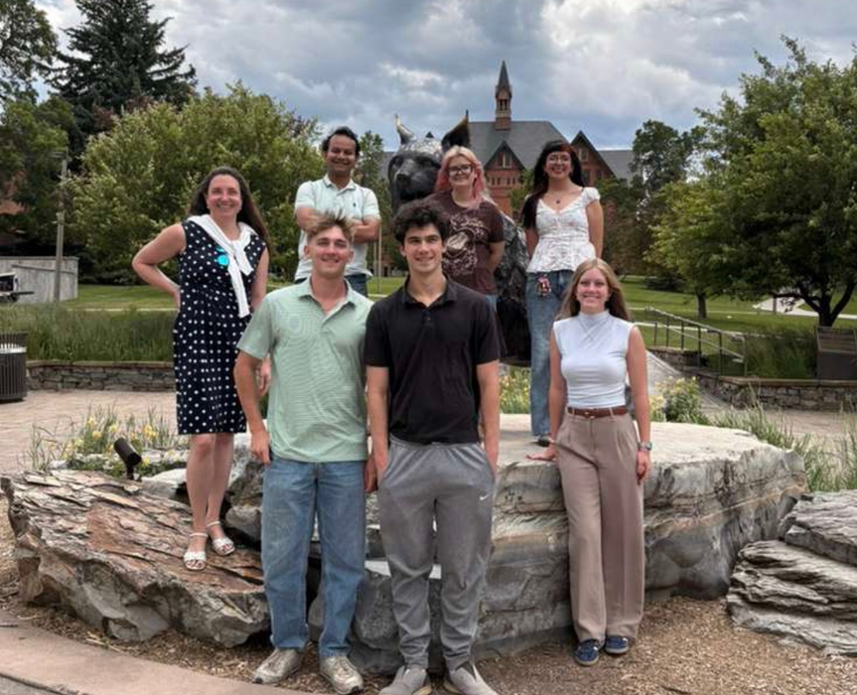
Acknowledgement
Thank you Anja Kunze (PI), Danna Renteria, Sam Cotton, Macager McAllister. Research reported was supported by the National Institute of General Medical Sciences of the National Institutes of Health under Award Number P20GM103474 along Montana INBRE and USP. Work performed at Montana State University, Montana Microfabrication Facility (MMF).​
​
This work was supported by NSF Grant ECCS-202539. Award number: 4W8689. Malkoc et al. (2026). Advanced Biology, 10(2), e00381.​

Slide 10
References
Chen, H., & Chan, D. C. (2009). Mitochondrial dynamics—fusion, fission, movement, and mitophagy—in neurodegenerative diseases. Human Molecular Genetics, 18(R2), R169–R176. https://doi.org/10.1093/hmg/ddp326
Malkoc, Z., Stopps, E., Asamoah, P. M. K., McCalla, S. E., & Kunze, A. (2026). Sub-neuronal network profiling of extracellular vesicle release using a compartmentalized neurofluidic platform. Advanced Biology, 10(2), e00381. https://doi.org/10.1002/adbi.202500381
Zablotskii, V., Polyakova, T., Lunov, O., & Dejneka, A. (2016). How a high-gradient magnetic field could affect cell life. Scientific Reports, 6, 37407. https://doi.org/10.1038/srep37407

