Slide 1

Photodegradable Sacrificial Templates for Embedded Microchannels
Nicolas E. Manning
PI: Paul A. Kohl
Mentor: Jose Lopez Ninantay
SUIN REU 2026
Notes:
Add more words in a few spots.

Slide 2
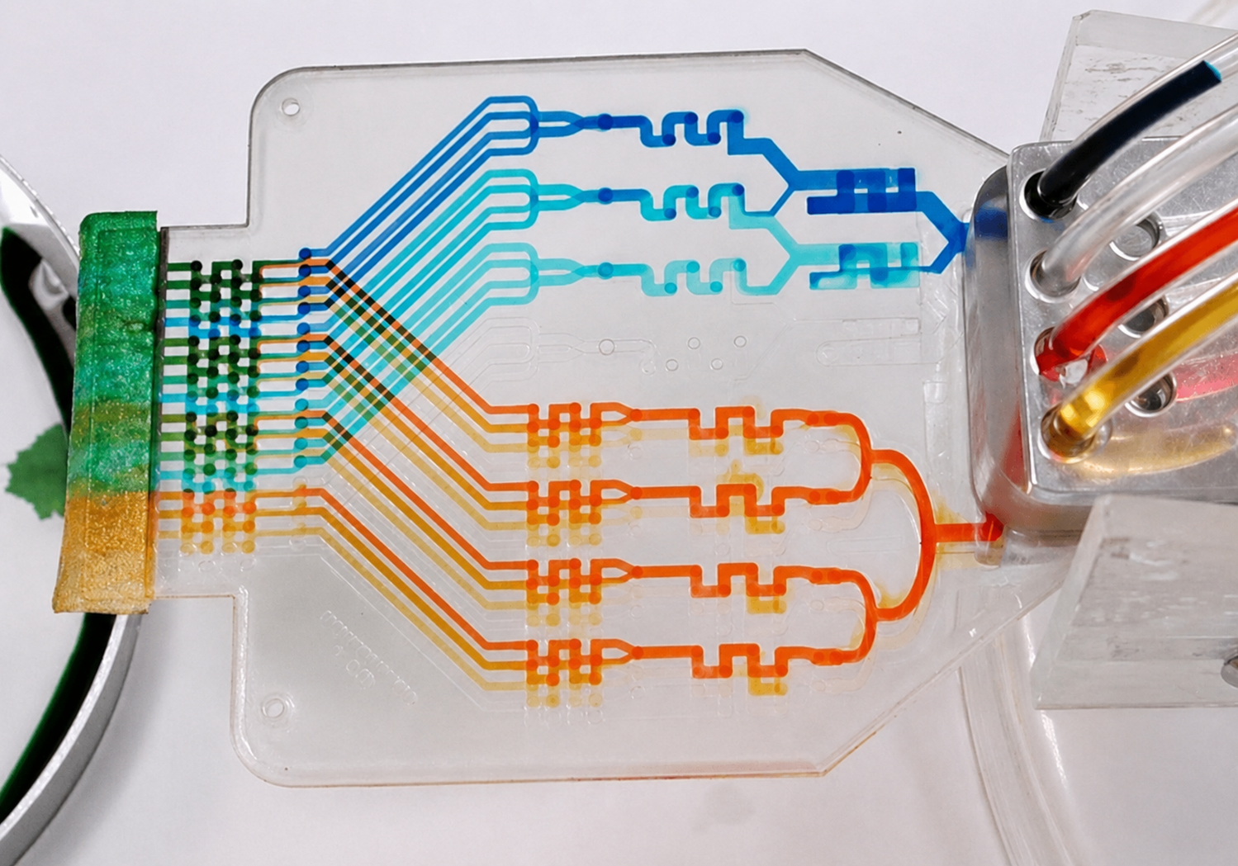
What are Embedded Microchannels?
Small pathways that move liquids or gases through a device.
Sensors, microfluidics, and electronics
Embedded microfluidic channels.
Image: L. Tran, “Microfluidics: Biology’s Liquid Revolution,” The Scientist.

Slide 3
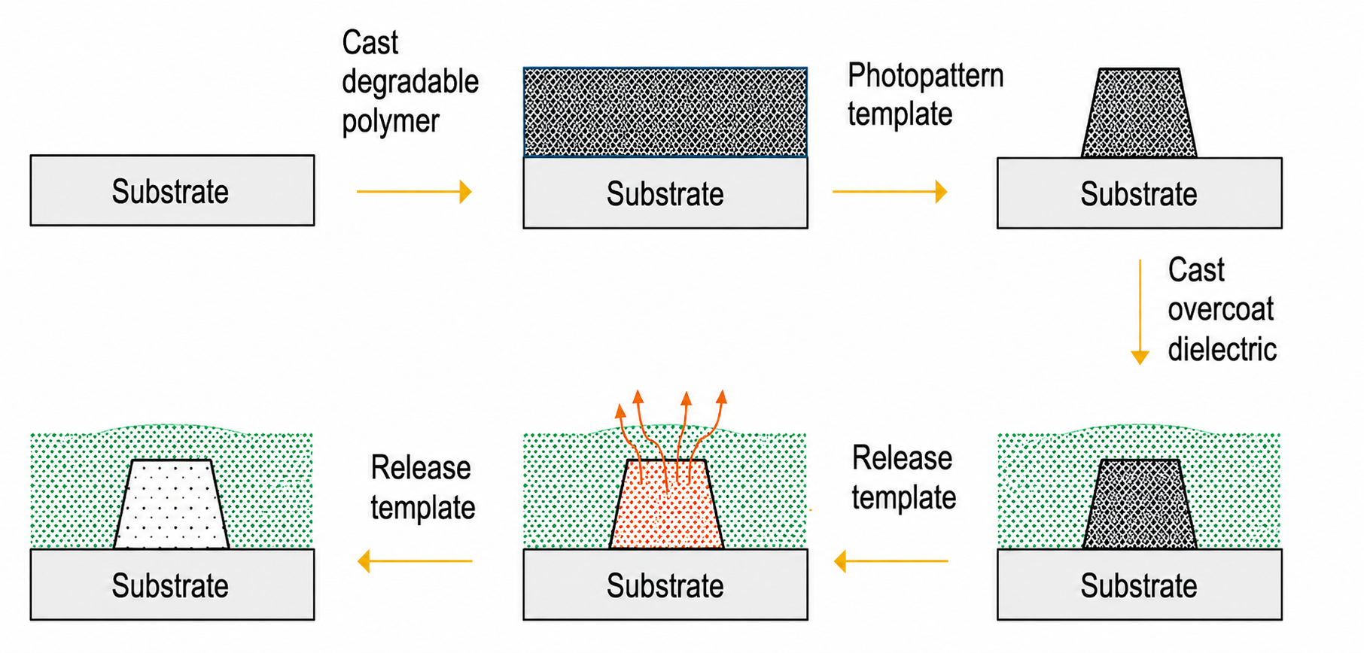
The Sacrificial Template Strategy
3

Slide 4
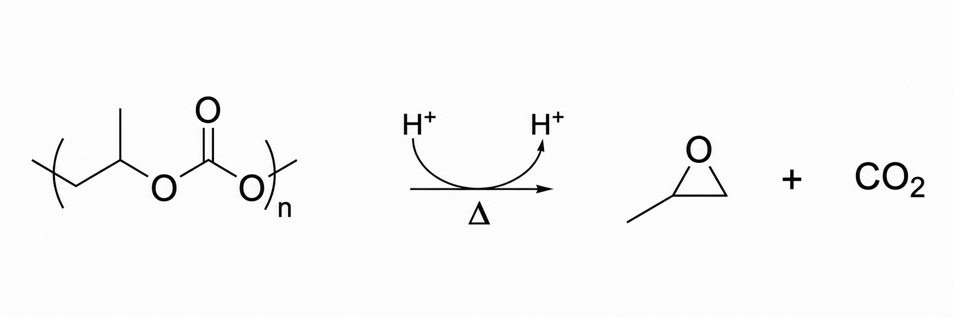
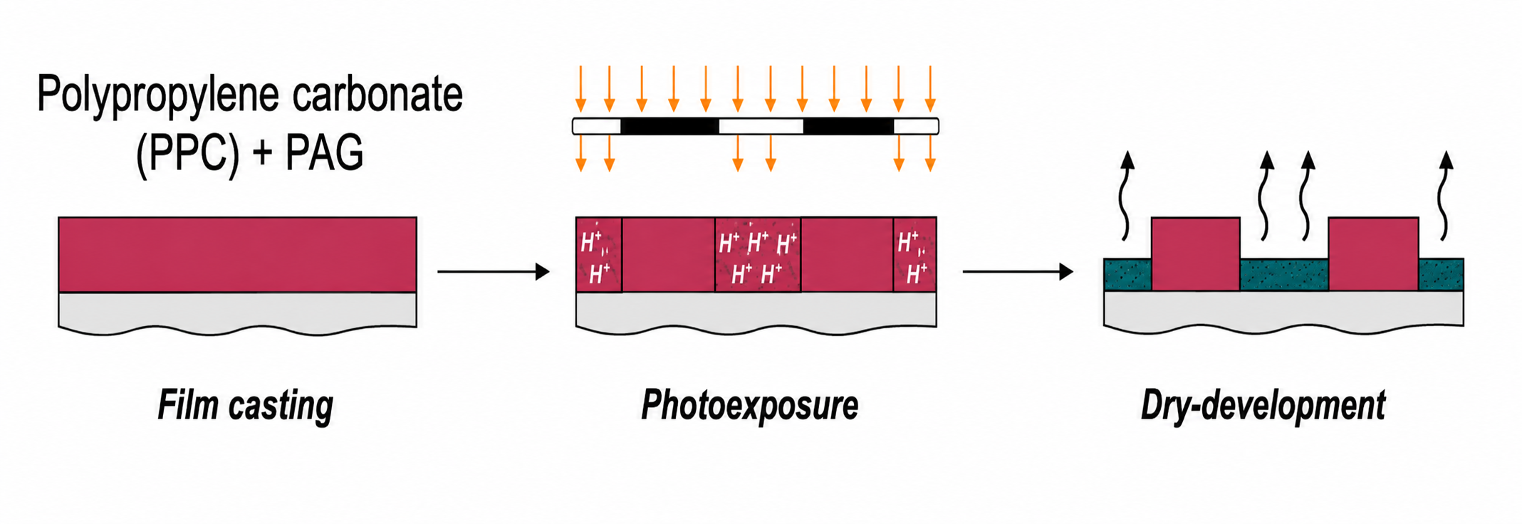
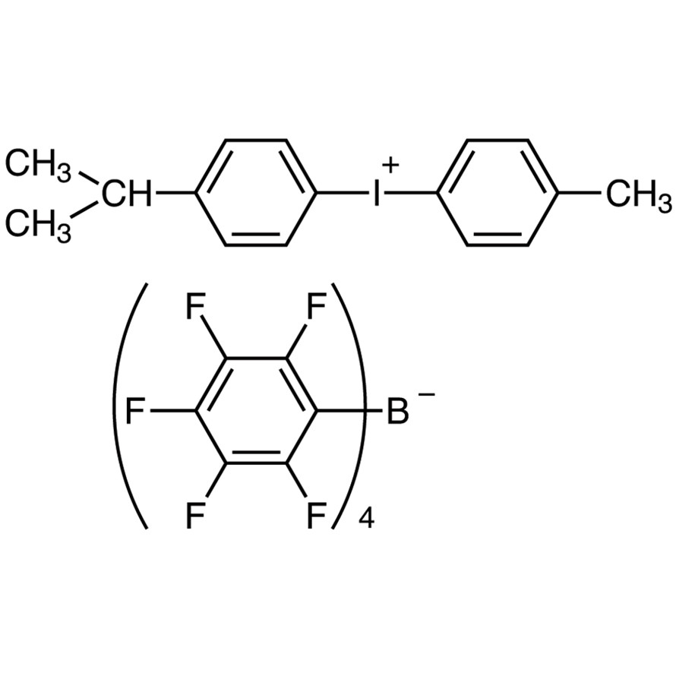

Light-Triggered PPC Depolymerization
Incident photons
Poly(propylene carbonate)
Products
Film-casting
Photo-exposure
Dry-development
PAG = photoacid generator:
acid + byproducts
248 nm
4

Slide 5
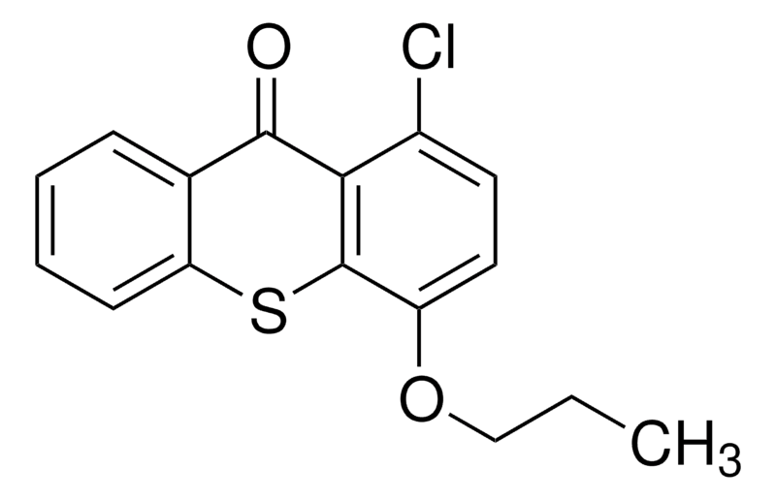
Research Question
Can photoacid generation be extended to 375 nm (near-UV)?
Approach 2: Chemical Sensitization
Approach 1: 365 nm (i-line) PAGs
Approach 2: Chemical Sensitization
Prevailing chemical species:
Rhodorsil-FABA (PAG)
CPTX (sensitizer)
5

Slide 6

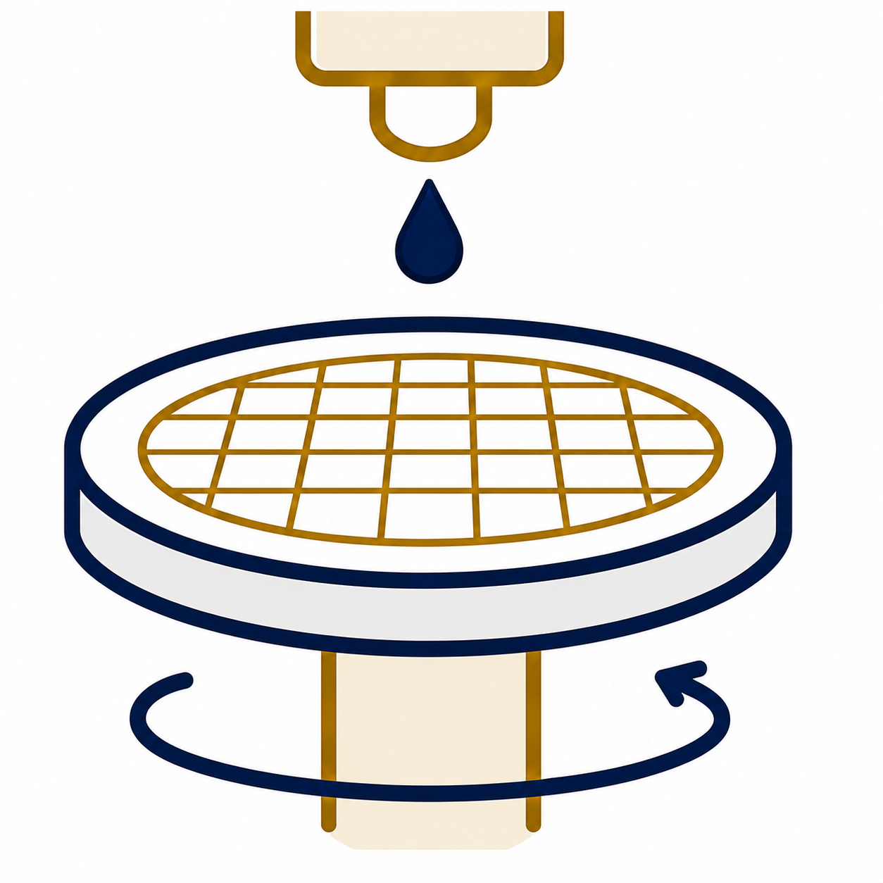
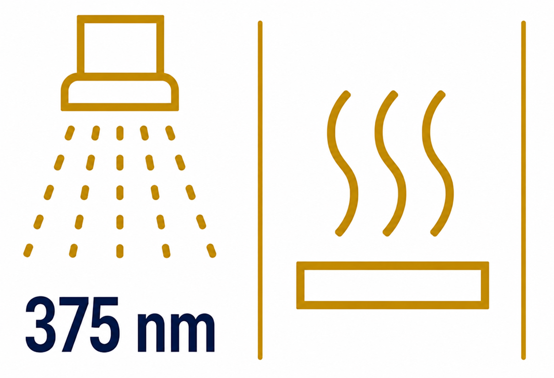

Experimental Overview
1
2
3
4
Measure removal and pattern quality
Prepare PPC formulations
Coat films on wafers
Expose and heat
6

Slide 7

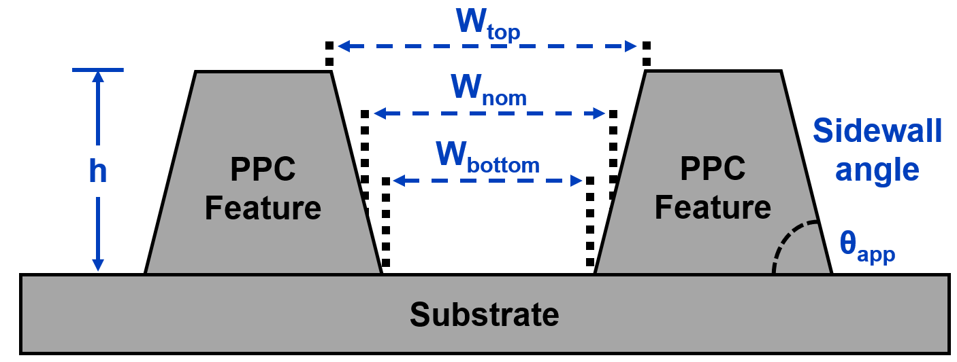
Finding a Working Formulation
Height Profile Traces:
Tested many different formulations
Grouped by outcome
Working mixtures selected for characterization
Partial removal
Complete removal
7

Slide 8
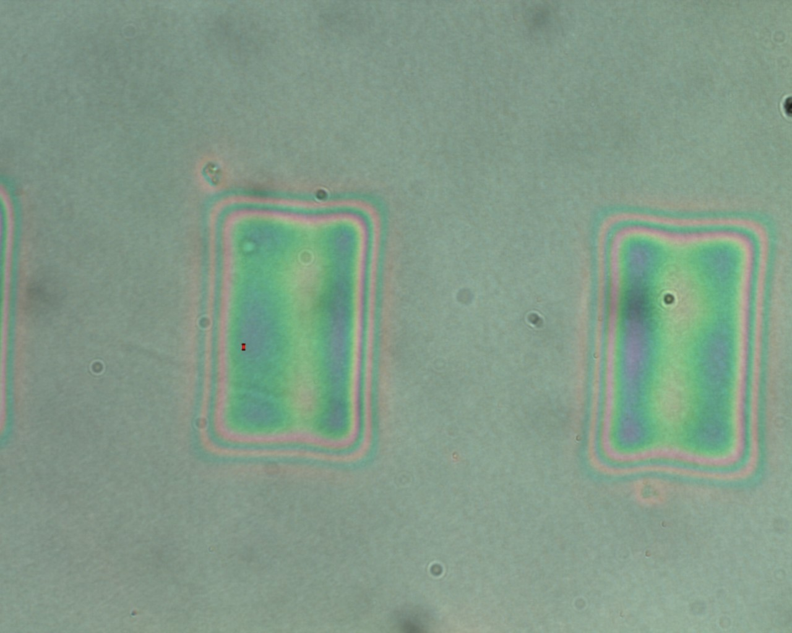
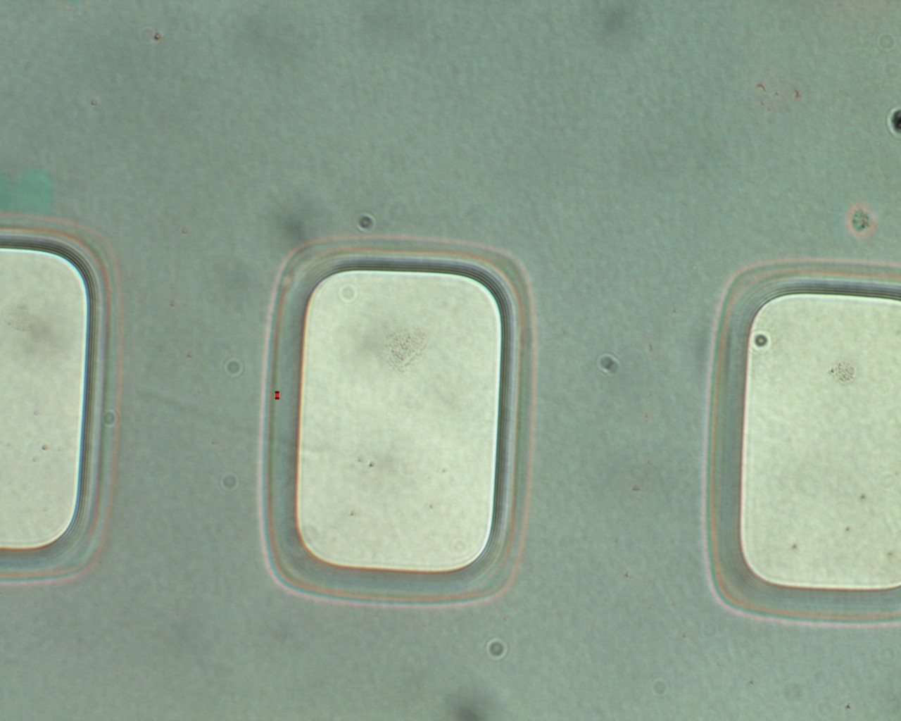
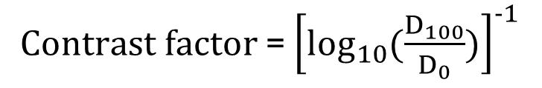
Quantifying Effective Exposure
Use contrast curves
Quantifies how efficiently a film clears as exposure dose increases
D₀
Clearing
starts
$Contrast factor$ = ${\left[\log_{10}{(\frac{D_{100}}{D_{0}})}\right]}^{−1}$
D₁₀₀
D₀ = Dose that clearing begins
D₁₀₀ = Dose that fully cleared
Fully cleared
8
Notes:
Spend more time here and say how this is also how photoresists are quantified.

Slide 9

Tuning the Process
Lowest concentration
Increasing sensitization with constant PAG concentration reduces required dosage
Control (248 nm)
Highest concentration
9
Notes:
with 248 nm sample, compare this with longer y
Find a way to describe what is different between each colored line.

Slide 10
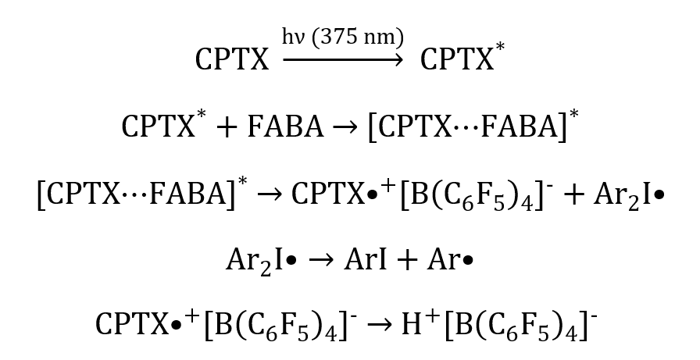
Chemical Scheme
CPTX-sensitized photoinduced electron-transfer pathway.
10

Slide 11
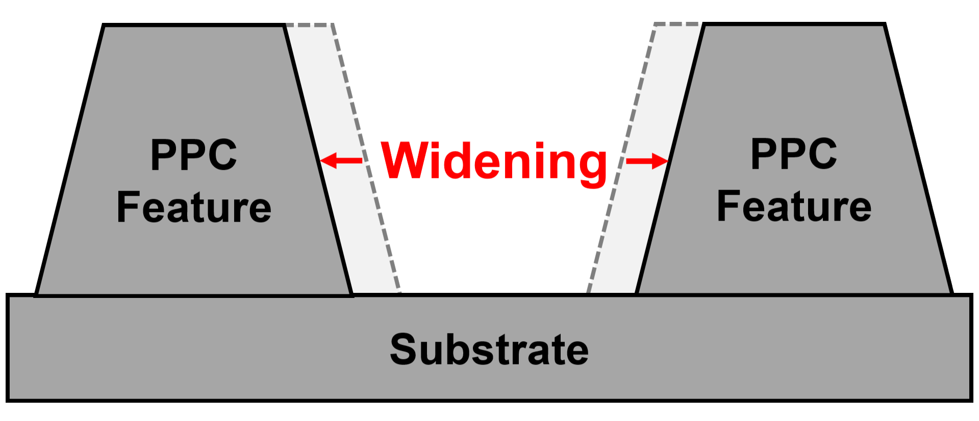
Testing Pattern Quality
Higher doses increase clearing rate
Longer development widens features
Thicker films amplify widening
Film thickness (µm) | Development time (min) | Widening (µm)
10 | 10 | 45
10 | 30 | 110
36 | 10 | 100
36 | 30 | 130
11
Notes:
Data is for 10 um, include 36 um data.

Slide 12
Summary
Deep-UV
(248 nm)
Near-UV
(375 nm)
Shifted the process from deep-UV to more accessible near-UV radiation
Sensitization approach was successful
Additives found optimal at 1:1 molar ratio
Dose, development, and thickness trade-offs
Rhodorsil-FABA (PAG)
CPTX (sensitizer)
Higher dose = faster film clearing, more acid
Greater development time = feature widening
Thicker films = amplified lateral widening
12

Slide 13
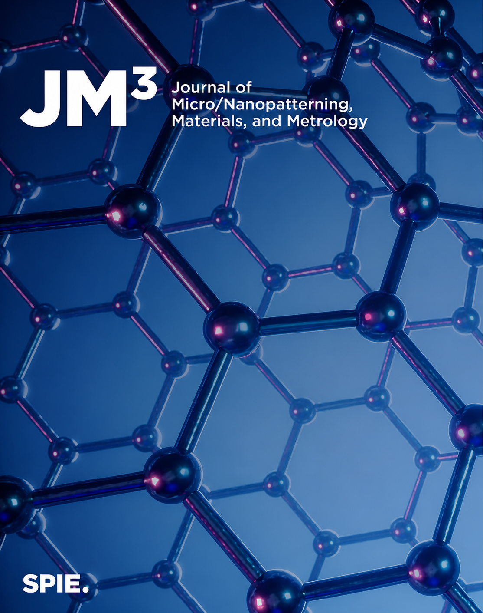
Manuscript Submitted
Photopatterning Poly(propylene carbonate) Sacrificial Films with Photoacid Generator and 375 nm Sensitizer
Nicolas E. Manning, Jose Lopez Ninantay, Paul A. Kohl
Submitted to: Journal of Micro/Nanopatterning, Materials, and Metrology
Status: In-review
13

Slide 14




Acknowledgements
PI: Professor Paul A. Kohl
  Opportunity to conduct this research.
Mentor: Jose Lopez Ninantay
  Training and guidance
Georgia Tech SENIC/SUIN REU Program
  Leslie O’Neill, Dr. Mikkel Thomas
National Science Foundation, and Program/Project Sponsors
  Supporting the REU program and this research.
Paul A. Kohl
Jose Lopez Ninantay
14

Slide 15
Connect with me!
Thank you!

