Slide 1
Characterizing and Modeling of Neural Population Activity in Bottom-up Engineered Neurite Networks
MSU ECE REU Site Summer 2026 Mid-term Project Presentation
Presenter: Polly Naneva
Collaborator: Rafat Tazim
Supervisor: Anja Kunze

Slide 2
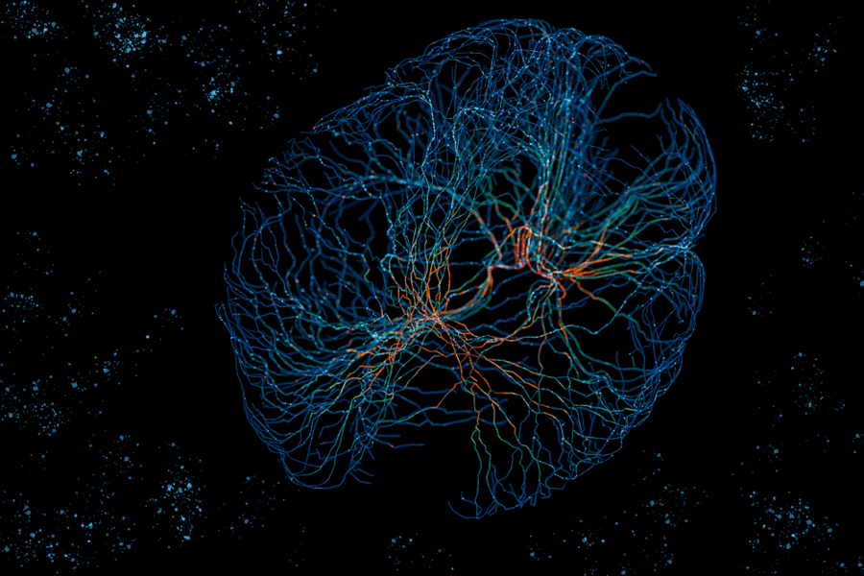
Introduction
The brain is remarkably energy efficient, in part because it communicates through structured networks
Thoughts, memories, and brain states depend on circuits switching on and off
We still don't fully understand how the wiring determines what gets computed
What can networks tell us about the brain?
[1] Daniloff (2022)
Notes:
The brain is incredibly efficient, more so than any computer or artificial intelligence out there
Part of the reason for this is because it neurons communicate through highly organized and purposeful networks rather than random collections of cells.
Everything that happens in the brain is controlled by these circuits or networks switching on and off
But we still don't fully understand how the structure of these circuits relate to what is being output

Slide 3
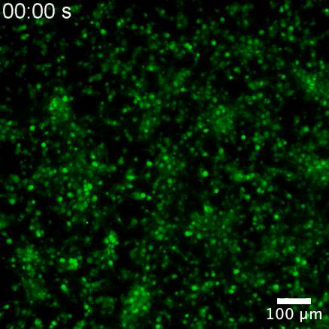

Background – Calcium Signaling
Ca²⁺ is involved in nearly every neuronal process
When a neuron fires voltage-gated calcium channels in the membrane snap open.
Signal timing and amplitude encode how neurons are connected
Neurons firing together produce correlated signals
[2] Beck et al. (2024)
Notes:
Before we get into the circuits themselves, we need to understand the signal we're actually recording and how we can observe it
The calcium ion Ca²⁺ is involved in pretty much every single function of the brain whether directly or indirectly
When a neuron fires, the electrical spike travels along the membrane, opening the calcium channels and flooding calcium ions into the cell
This is observed using a fluorescent dye that glows brighter the more calcium is present which is what you're seeing in this video
The size and timing of each calcium spike reflect how strongly that neuron was activated, and how it is connected to neighboring neurons
When groups of neurons fire together, their calcium activity becomes correlated, allowing us to infer network-level dynamics from these recordings.

Slide 4
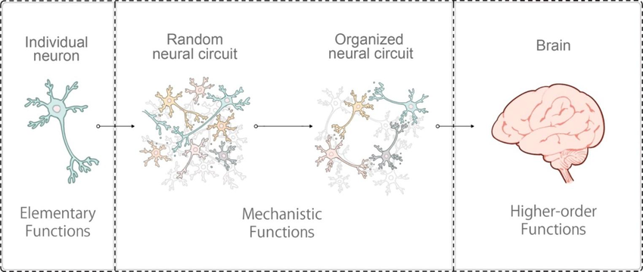
Background – Neuron Connectivity
Neurons grown in a petri dish, which gives a way to analyze the brain’s function outside of the body
If the neurons are just put into a petri dish they connect randomly
From batch to batch the topology of neuronal circuits is not reproducible
In actual brain activity there are organized circuit patterns
[3] Chow et al. (2022)
Notes:
If you look at the first panel here, a single neuron on its own just does basic things When we grow many neurons together in a dish, we move into that second panel, a random neural circuit. a low cost and quick way to analyze the brain’s function outside of the body.
But notice the difference between the second and third panels. when neurons are grown without constraints the connections form pretty much randomly, wherever neurons happen to reach each other
This creates a lot of variability between experiments and makes it difficult to study the relationship between structure and function. Since we can never perfectly recreate the same one.
What we really want is that third panel — an organized circuit with a defined, reproducible topology. if we could control the wiring, what topology should we choose that would actually tell us something meaningful?

Slide 5
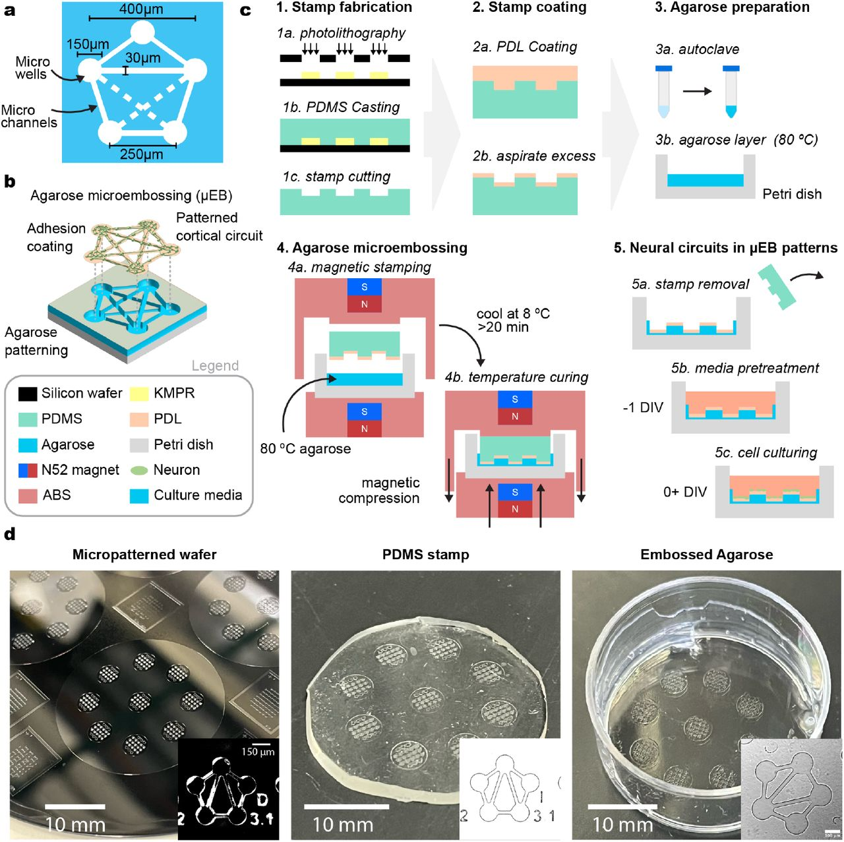

Background – Topology Shapes
Used microembossed agarose to create different topologies that form more reproducible circuit patterns
Neurons are physically confined to grow in a defined pattern
[4] Thompson et al. (2026)
Notes:
The Kunze lab, which I am working with uses microembossed patterns on agarose that guide neuronal growth into predefined topologies.
You can see a picture of one of these embossed patterns here, and here at the bottom is the actual connectivity of the nodes
The neurons are growing in a defined pattern, which is exactly what we want!
This creates more reproducible network structures and allows us to directly compare topology with activity.

Slide 6
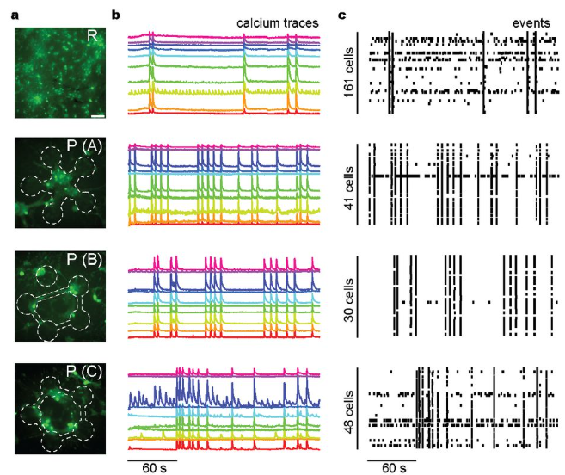
Background – Neuronal Code
[4] Thompson et al. (2026)
Notes:
On the left here we can see the different ways in which the neurons are connected.
This first one is just the randomly connected neurons, without any sort of predefined topology.
And then here you can see the different ways in which they were connected.
When we record calcium activity from a network over time, we observe recurring patterns of activation.
Here you can see the calcium spikes being recorded for each orientation, each color corresponds to a different neuron.
Specific groups of neurons repeatedly activate together in characteristic ways.
In the raster plot shown here, which is based off of these graphs, each row corresponds to a neuron and each dot represents a calcium event.
These reproducible patterns are what we refer to as the neuronal code, the ways in which the neurons are being activated.
The pattern of activity across all neurons encodes information about the state of the network.

Slide 7
Research Question
To what extent can we predict the neuronal code in our experimental setup of bottom up engineered neuronal networks based on topologically shaped calcium signaling?
Notes:
My goal is to determine:
More simply if we know the structure of a network, the way in which the neurons are connected, can we predict the activity patterns that emerge from it?
Answering this question could provide insight into how network architecture influences information processing in the brain

Slide 8
Preliminary Research
Need to find a model pipeline that will allow simulations of neurons
There is no one model that can do everything
Most available models work in the opposite direction, inferring spikes from fluorescence, not generating fluorescence from spikes
Not all models have publicly accessible code
Notes:
We only have a couple of experimental examples, we need a way to simulate the activity of the neurons
Need to find a model pipeline that will allow us to do this
Trying to find these models was not easy, there is no one model that can do everything we need it to including generating the spikes of activating neurons and simulating the calcium propagation going through the network
A lot of models are made for the exact opposite purpose, given the fluorescence recording of the calcium propagation, predicting when the spikes occurred.
Which is useful for analyzing experimental data, but we need to start from a circuit topology, generate spike trains, and then produce synthetic fluorescence traces.
And on top of that some models don't even provide their code to the public, only publishing equations used
So it was a lot of weighing the pros and cons of different models

Slide 9
Auryn Spiking Neural Network Simulator
IFGroup
Robust standard integrate-and-fire neuron model
Membrane voltage accumulates incoming current and resets after hitting a threshold.
Instantaneous spikes, no spike shape
No history dependence
Fast and simple, good for large networks
TIFGroup
Conductance-based neurons, inputs affect the neuron differently depending on its current voltage, unlike IFGroup which adds a fixed current each time
After firing, the neuron cannot fire again for a fixed time window
More biologically realistic than IFGroup but slightly slower computationally
AIFGroup
Adaptive IF
History dependent
The neuron remembers its own recent firing, adaptation current builds up inside the cell
Making the neuron itself more realistic
IzhikevichGroup
Not based on IF
Two variables that interact with each other, v: membrane voltage
u: recovery variable
When voltage gets high enough, neuron fires, both variables reset
By tuning parameters you can make the model reproduce a variety of neuron behaviors ex: spiking, bursting, chattering, fast spiking
Parameters don’t have direct biological meaning, tuned to match observed firing patterns
AdExGroup
Adaptive Exponential IF
Same adaptation current as AIF
More realistic voltage trajectory near threshold
Notes:
Different ways to implement the neuron spiking within auryn
Mention izhikevich group
Say I focused on ifgroup and tifgroup

Slide 10
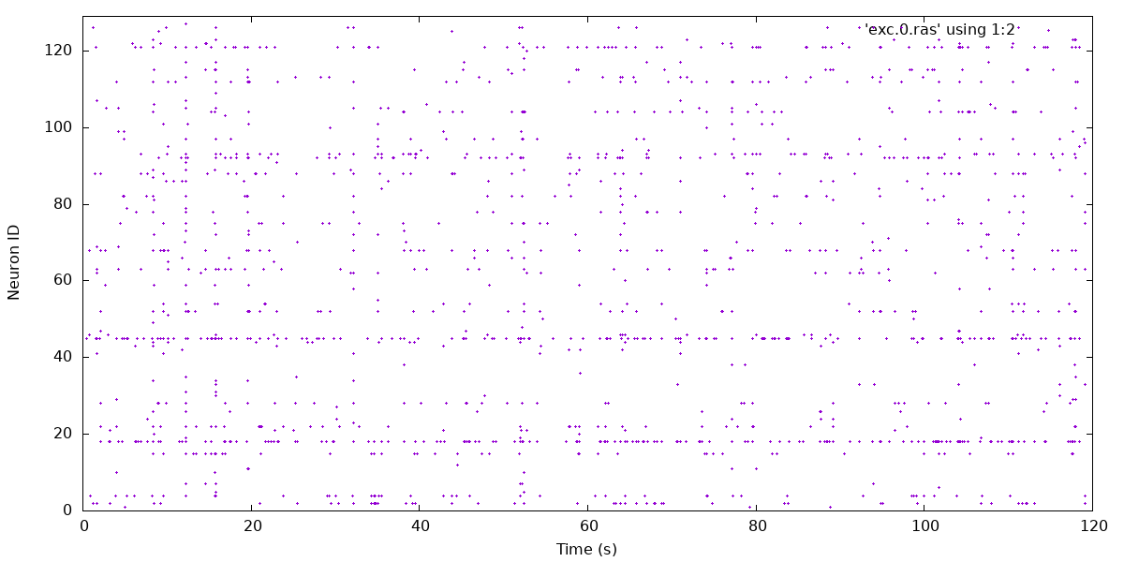
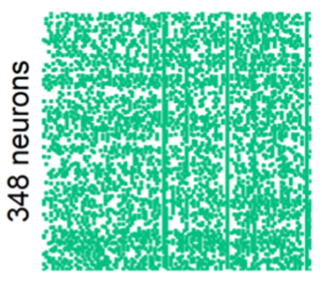
Auryn Spiking Neural Network Simulator
IFGroup
Robust standard integrate-and-fire neuron model
Membrane voltage accumulates incoming current and resets after hitting a threshold.
Instantaneous spikes, no spike shape
No history dependence
Fast and simple, good for large networks
[10] Beck et al. (2024)

Slide 11
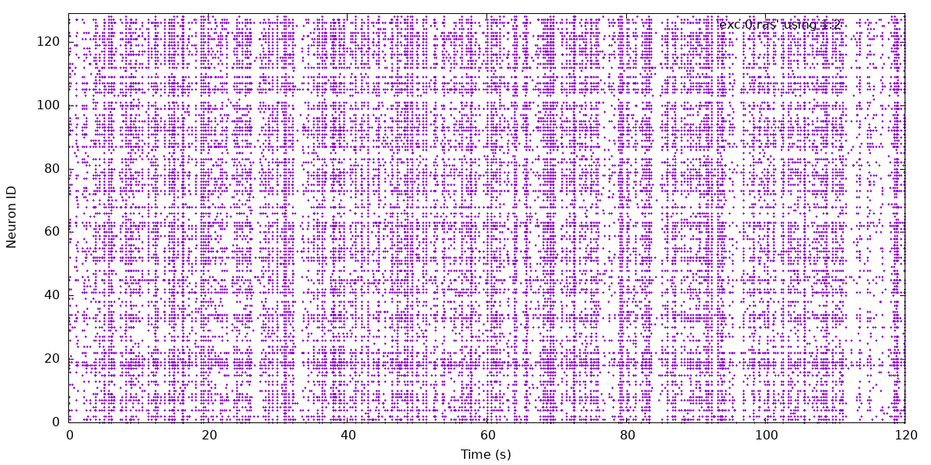
Auryn Spiking Neural Network Simulator
TIFGroup
Conductance-based neurons, inputs affect the neuron differently depending on its current voltage, unlike IFGroup which adds a fixed current each time
After firing, the neuron cannot fire again for a fixed time window
More biologically realistic than IFGroup but slightly slower computationally
[10] Beck et al. (2024)

Slide 12
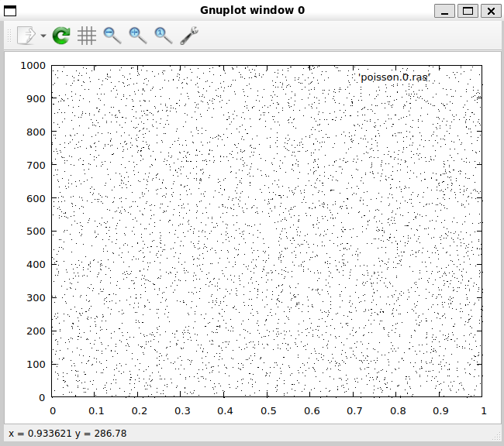
Auryn Spiking Neural Network Simulator
PoissonGroups
At 14 DIV rat cortical neurons begin to spike on their own
Not something that you can directly recreate in Auryn, must use a PoissonGroup
Population of input neurons that fire randomly and independently at a set average rate
Auryn's standard source of background input/stimulation
Utilized CorrelatedPoissonGroup: neurons are split into subgroups that share a common, slowly fluctuating firing rate
Notes:
real neurons in a culture (or in intact tissue) do experience correlated background activity
more biologically realistic than perfectly independent Poisson noise, which assumes every neuron's background is completely private

Slide 13
The Lütcke Forward Model
Auryn gives me spike times, but the experimental data is calcium fluorescence, the Lütcke forward model bridges the two
Recalibrated the indicator dissociation constant for the Fluo-4 / Calbryte indicator mixture used experimentally
Sampled at 4 Hz to match the experimental imaging frame rate
Each neuron's spike train is converted into a synthetic ΔF/F calcium trace using the Lütcke et al. (2013) model
Used only the forward direction, generating calcium from spikes, not inferring spikes from calcium

Slide 14
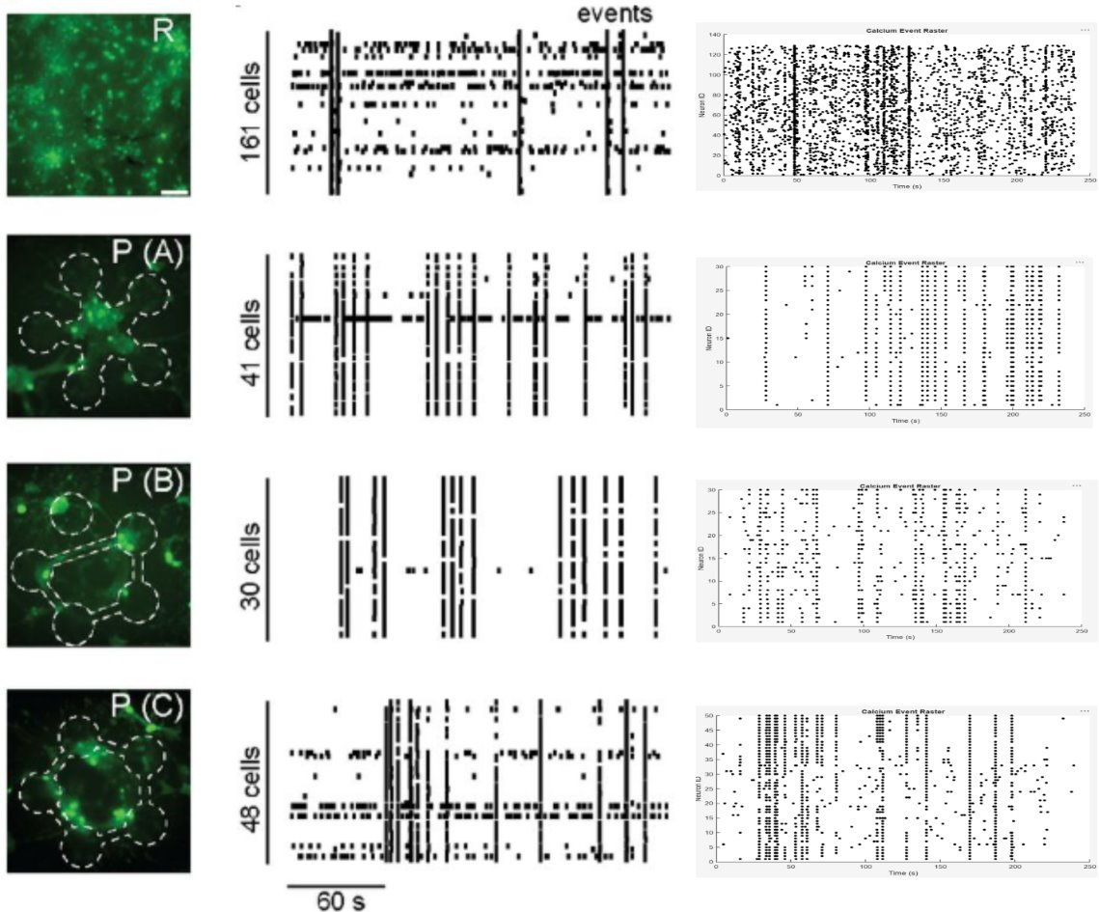
Results

Slide 15
Conclusions
The model reproduced key features of the experimentally observed activity and indicated that circuit topology modulates the rate of synchronous calcium events.
Future Directions:
Numerical accuracy metrics
Testing more topologies
Tweaking P(B) further

Slide 16
Acknowledgments
This material is based upon work supported by the National Science Foundation under Grant No. 2349091.
This work was supported by the National Science Foundation [CAREER award, Grant # CBET-1846271].​
This work was performed in part at the Montana Nanotechnology Facility, and NNCI member supported by NSF Grant ECCS-2025391.
Thank you to the Kunze Lab members for their support.
Thank you to Dr. Nakagawa, Dr. Whitaker and the rest of the ECE REU.

Slide 17
References
[1] Trafton, Anne. “Study Urges Caution When Comparing Neural Networks to the Brain.” MIT News | Massachusetts Institute of Technology, news.mit.edu/2022/neural-networks-brain-function-1102. Accessed 18 June 2026.
[2] Beck, Connor L., and Anja Kunze. “Parallelized mechanical stimulation of neuronal calcium through cell‐internal Nanomagnetic forces provokes lasting shifts in the network activity state.” Small, vol. 21, no. 1, 26 Oct. 2024, https://doi.org/10.1002/smll.202406678.
[3] Chow, Siu Yu, et al. “Advances in construction and modeling of functional neural circuits in vitro.” Neurochemical Research, vol. 47, no. 9, 9 Aug. 2022, pp. 2529–2544, https://doi.org/10.1007/s11064-022-03682-1.
[4] Thompson, Mckennah, et al. Microembossing Hydrogel Meso-Circuits for Patterning Dissociated Neurons Promotes Ensemble Formation*, 5 Mar. 2026, https://doi.org/10.64898/2026.03.03.709093.
[5] E. M. Izhikevich, "Simple model of spiking neurons," in IEEE Transactions on Neural Networks, vol. 14, no. 6, pp. 1569-1572, Nov. 2003, doi: 10.1109/TNN.2003.820440.
[6] Vogelstein JT, Packer AM, Machado TA, Sippy T, Babadi B, Yuste R, Paninski L. Fast nonnegative deconvolution for spike train inference from population calcium imaging. J Neurophysiol. 2010 Dec;104(6):3691-704. doi: 10.1152/jn.01073.2009.
[7] Lütcke H, Gerhard F, Zenke F, Gerstner W and Helmchen F (2013) Inference of neuronal network spike dynamics and topology from calcium imaging data. Front. Neural Circuits 7:201. doi: 10.3389/fncir.2013.00201
[8] Orlandi, Javier G., et al. “Noise focusing and the emergence of coherent activity in neuronal cultures.” Nature Physics, vol. 9, no. 9, 21 July 2013, pp. 582–590, https://doi.org/10.1038/nphys2686.
[9] Stetter, Olav, et al. “Model-free reconstruction of excitatory neuronal connectivity from calcium imaging signals.” PLoS Computational Biology, vol. 8, no. 8, 23 Aug. 2012, https://doi.org/10.1371/journal.pcbi.1002653
[10] Connor L. Beck, Andrew M. Kirby, Samuel Roberts, Anja Kunze; Multimodal Characterization of Cortical Neuron Response to Permanent Magnetic Field Induced Nanomagnetic Force Maps. ACS Nano 24 December 2024; 18 (51): 34630–34645. https://doi.org/10.1021/acsnano.4c09542

Slide 18
Preliminary Research
Model Author(s) | Spike Generation | Ca²⁺ model | Network | Time Dynamics | Code Availability
Izhikevich Simple model of spiking neurons [5] | ✅ | ❌ | ❌ | ✅ | MATLAB
Vogelstein et al. Fast non-negative deconvolution [6] | ❌ | eqs only | ❌ | ✅ | Only in opposite direction
Lütcke et al. Network spike dynamics + topology [7] | Auryn Model | eqs only | ✅ | ✅ | C++ MATLAB
Orlandi et al. Noise focusing in neuronal cultures [8] | ❌ | ❌ | ✅ | ✅ | C++ Linux Focused
Stetter et al. Model-free connectivity reconstruction [9] | ❌ | eqs only | ✅ | ✅ | Only in opposite direction
Notes:
I evaluated several computational approaches from the literature.
I looked for models that could represent neuronal activity, generate calcium signals, incorporate network topology, and be implemented within the timeline of this project.
The table summarizes the major candidates.
Many models either focused solely on spike generation, solely on calcium reconstruction.
Among the models I reviewed, the approach by Lütcke and colleagues, I believe, provided the best combination of topology, network dynamics, and calcium signal generation.
This model is mainly focused on calcium signaling, and as I mentioned is made for the opposite direction. Calcium Signals → Spike Trains. But they did provide equations for the direction we needed as well as their MATLAB code that can be used as a starting point.
Additionally the lab that created this calcium model also has their own spike generator called auryn, which easily fits into the pipeline.
Network topology is considered in this spike generator and the whole thing is open source and accessible in C++
For these reasons, I selected the Lütcke framework as the basis for the modeling.

Slide 19
Auryn Spiking Neural Network Simulator
Common Parameters
Both inhibitory and exhibitory neurons used in an 80/20 split
Duration: 240 seconds
200 input neurons
GABA (gamma-aminobutyric acid) used as inhibitory neurotransmitter
Exhibitory to exhibitory neuron connections: .2 density, .2 probability
Exhibitory to inhibitory neuron connections: .3 density, .2 probability
Inhibitory to exhibitory neuron connections: .4 density, .2 probability
Inhibitory to inhibitory neuron connections: .4 density, .2 probability

Slide 20
Auryn Spiking Neural Network Simulator
Parameters
5 wells each except for R
R uses PoissonGroup; P(A), P(B), P(C) use CorrelatedPoissonGroup
  P(A), P(C): 5 groups, 40 neurons each, 10 ms delay
  P(B): 4 groups, 50 neurons each, 10 ms delay
R Poisson input rate: 1.6Hz; P(A), P(B), P(C) Poisson input rate: 2.0Hz

Slide 21

Lütcke Equation
ΔF/F - change in fluorescence over time
A - amplitude scale, dependent on calcium indicator dye
t - time
t₀ - time neuron fires
τon - speed at which fluorescence climbs to its peak after a spike
τoff - how slowly the fluorescence fades
[7] Lütcke et al. (2013)

Slide 22
Background – 5 Node Graph
Graphs with 2, 3, or 4 nodes have high rotational symmetry
High symmetry limits complexity, fewer distinct subgroups means fewer distinct activity patterns
The 5-node, fully connected graph is the first one to break symmetry
Generated by Claude
Notes:
Here we can see graphs with 2, 3, 4, and 5 nodes where all nodes are connected to all other nodes. For our sake these nodes represent different neurons.
Graphs with two, three, or four nodes possess high rotational symmetry. Meaning that you can rotate the graph and it looks identical. If you rotate this triangle 120 degrees such that each node maps onto another, there is effectively no difference between these two graphs every neuron experiences the same inputs.
This limits how many distinct patterns the network can produce.
A fully connected five-node graph is one of the first simple structures that cannot be drawn without edge crossings creating more complex signal propagation pathways through the circuit.
What makes this useful is that it can potentially generate richer and more diverse network dynamics in contrast to the other topologies which are pretty much doing the same thing every time.
We said that we want organized circuits with reproducible topologies, and we decided that 5 nodes would be a good amount to work with due to the diverse connections but how do we actually create these networks

