Slide 1









Fabrication and Characterization of Carbon-Polymer Piezoresistive Sensors using Aerosol Jet Printing
David Nguyen, Louisiana State University A&M
Dr. Dilan Ratnayake, University of Louisville
Dr. Kevin Walsh, University of Louisville
7/16/26
NSF REU Award ID #2348869
NSF NNCI Award ID # 2025075

Slide 2

Motivation and Goals
Motivation
    Traditionally piezoresistive strain sensors require expensive and complex cleanroom microfabrication equipment for their fabrication and can take several days to manufacture.
    A new type of direct printing technology called Aerosol Jet Printing (AJP) is much less expensive and could reduce the production time from days to hours.
Goals:
Develop a piezoresistive carbon-polymer ink formulation that is compatible with AJP printing and its viscosity requirements.
Optimize the carbon percentage so that the formulation operates near the percolation threshold where sensitivity is maximized.
Use the ink to fabricate piezoresistive strain sensors and compare their sensitivities, or GFs, to traditional metal foil strain gauges (~2).

Slide 3

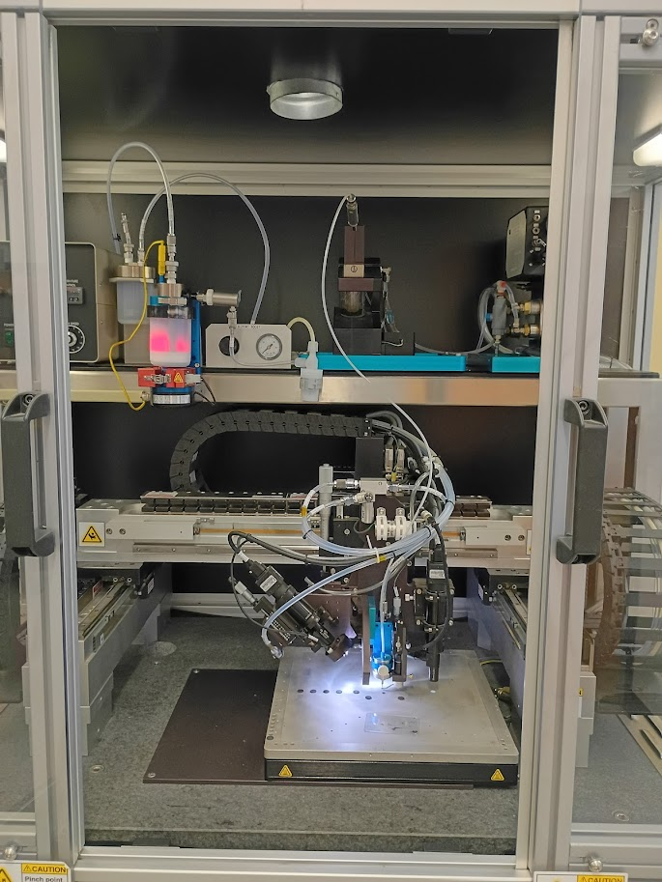
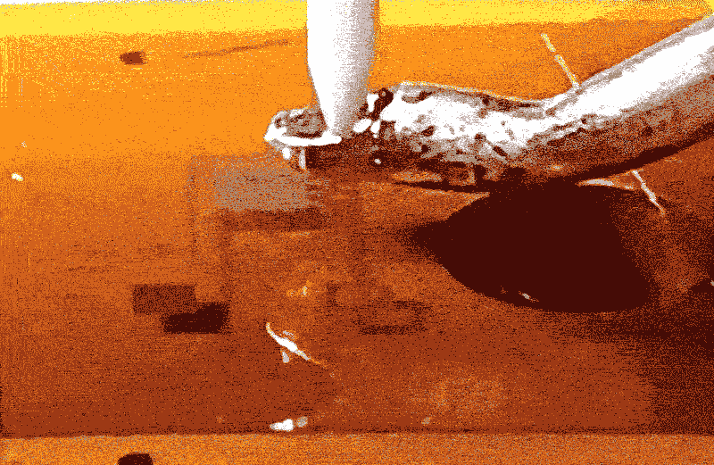
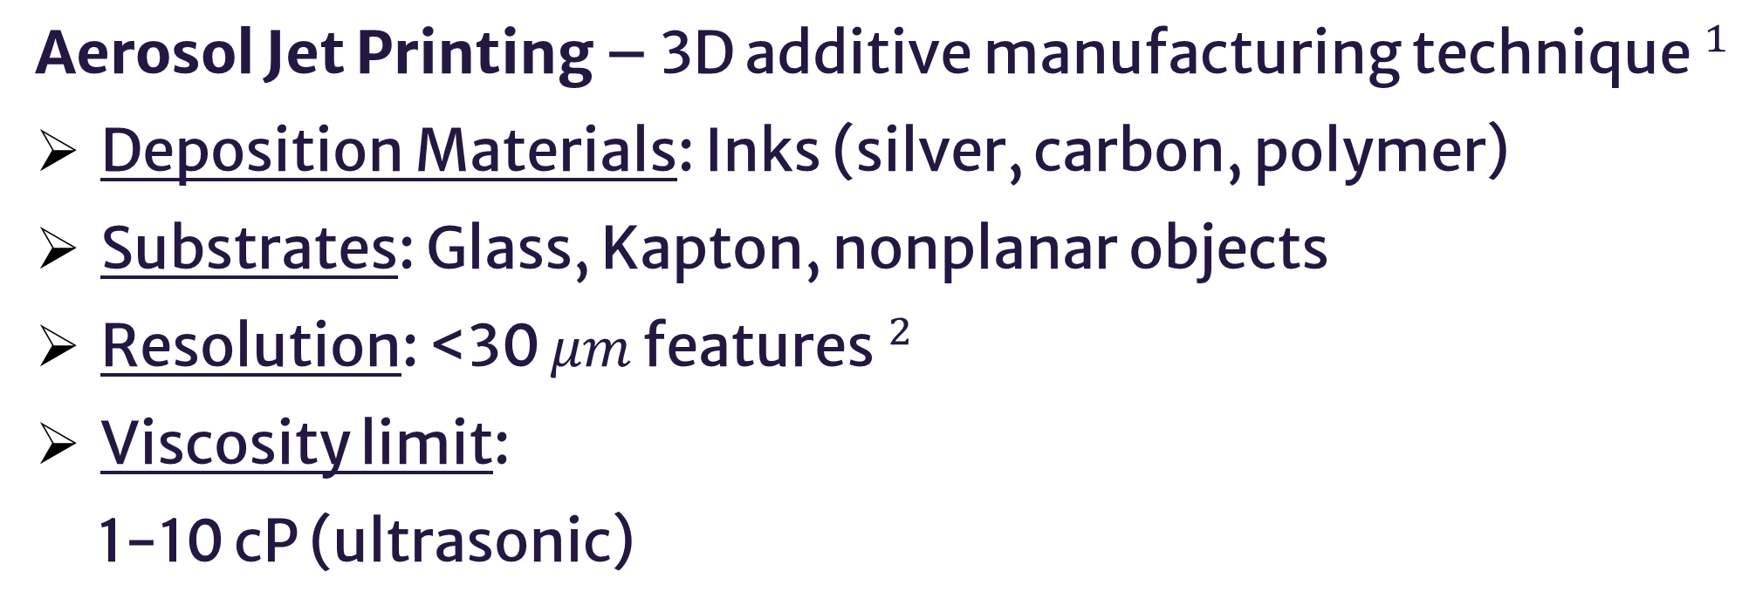
Aerosol Jet Printing (AJP)
Aerosol Jet Printing – 3D additive manufacturing technique$^{1}$
Deposition Materials: Inks (silver, carbon, polymer)
Substrates: Glass, Kapton, nonplanar objects
Resolution: <30 $μm$ features$^{2}$
Viscosity limit:
1-10 cP (ultrasonic)
Ultrasonic
Atomizer
Ink
Aerosol
Deposition Head
Substrate
Fig. 1: Aerosol Jet Printer depositing silver ink onto Kapton film
Fig. 2: Optomec Aerosol Jet Printing System.

Slide 4

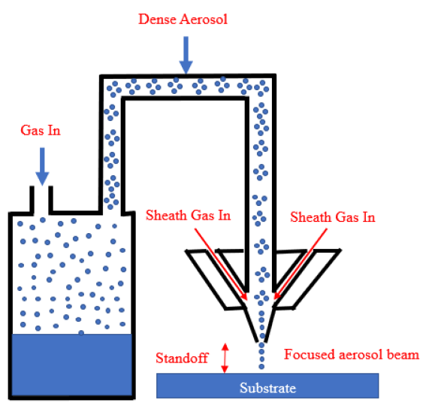
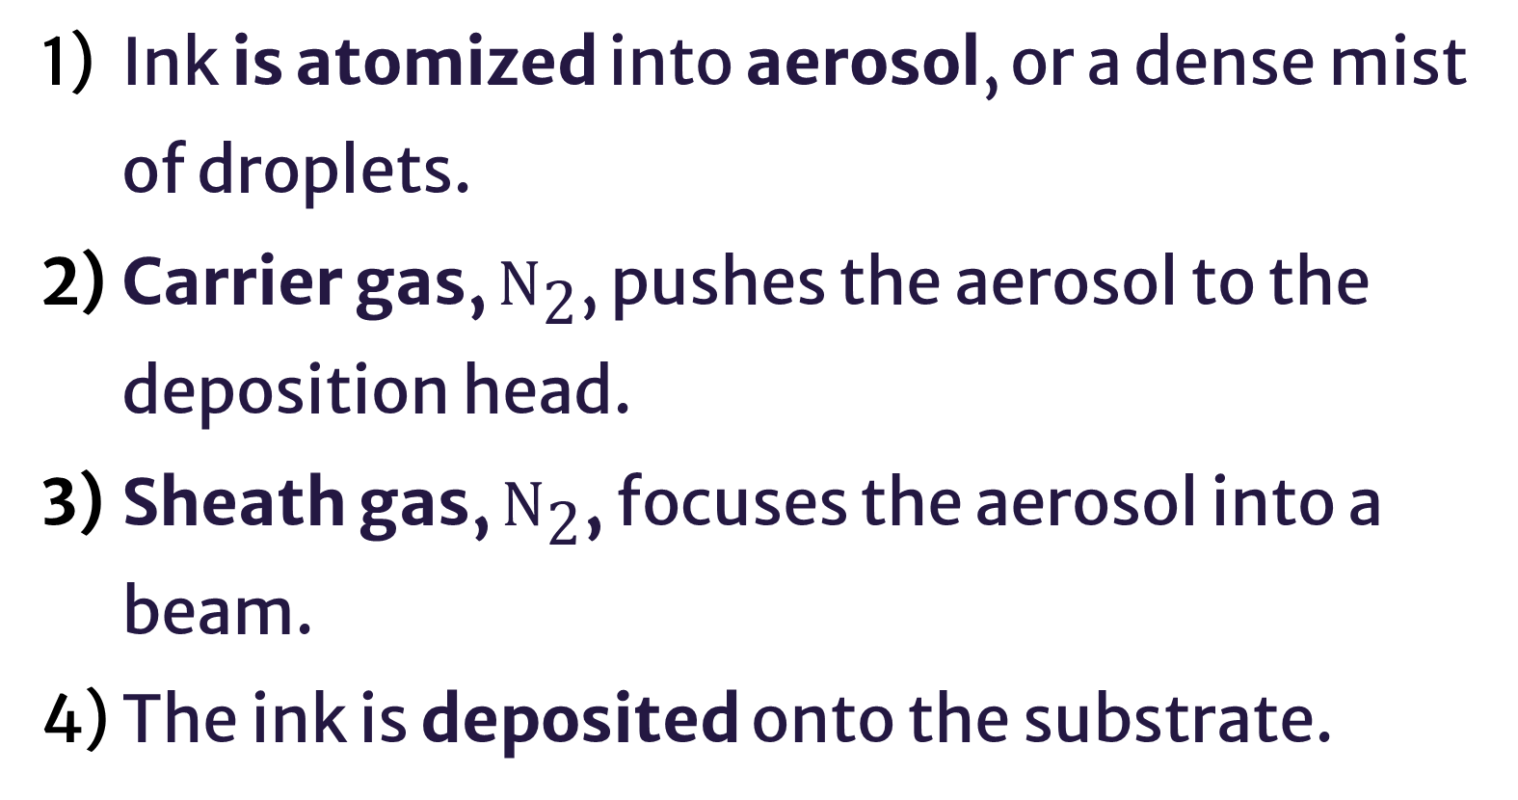

AJP Process
Ink is atomized into aerosol, or a dense mist of droplets.
Carrier gas, ${\text{N}}_{\text{2}}$, pushes the aerosol to the deposition head.
Sheath gas, ${\text{N}}_{\text{2}}$, focuses the aerosol into a beam.
The ink is deposited onto the substrate.
2
3
Fig 3: Schematic of the aerosol jet printing process$.^{3}$
1
4

Slide 5

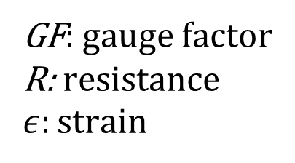


Piezoresistive Strain Sensor
Piezoresistive strain sensors change their electrical resistance (R) as it physically deforms due to geometric and resistivity changes$.^{3}$
$$GF=\frac{ΔR/R_{0}}{ε}$$
GF: gauge factor
R: resistance
$ε:$ strain
Gauge Factor (GF) measures the sensitivity of piezoresistive sensors $.^{6}$
[1]
Percolation effect contributes to resistivity change. Shown in the curve, the 3 regions are
Semi-log
Percolation Curve
Insufficient
Excessive
Insufficient conductive filler (carbon).
Optimal conductive filler.
Excessive conductive filler.
Resistance ($Ω$)
Optimal
Fig. 4: Conceptual graph modeling the percolation curve of carbon-polymer filler
Carbon Content (wt%)

Slide 6
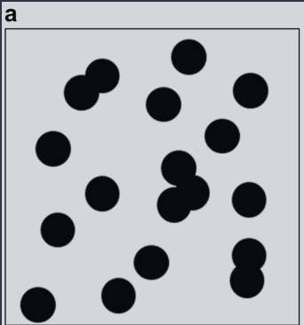
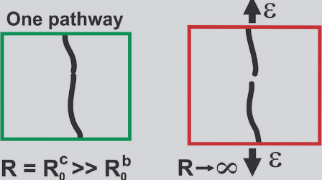
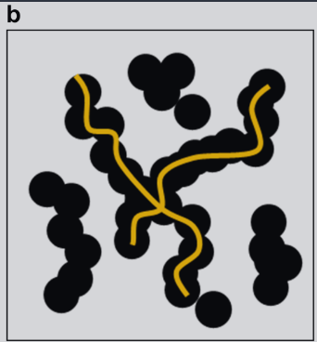
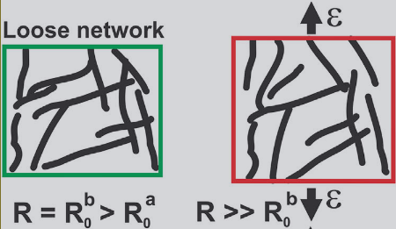
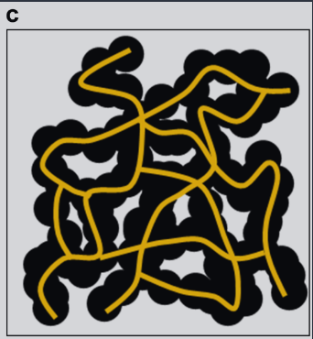
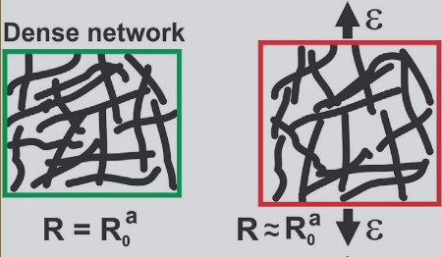
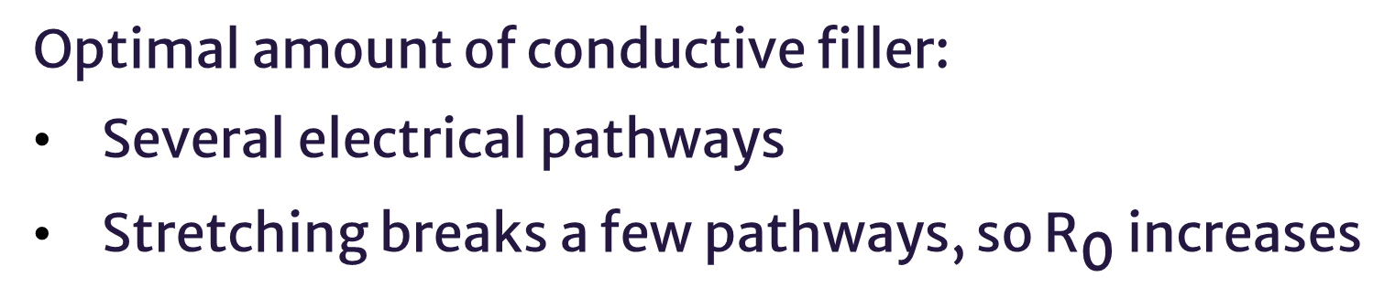
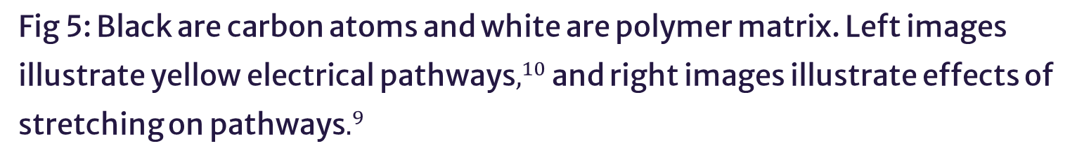
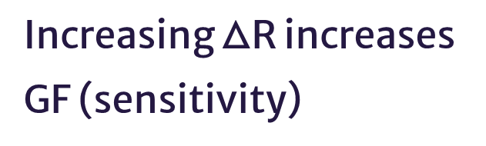
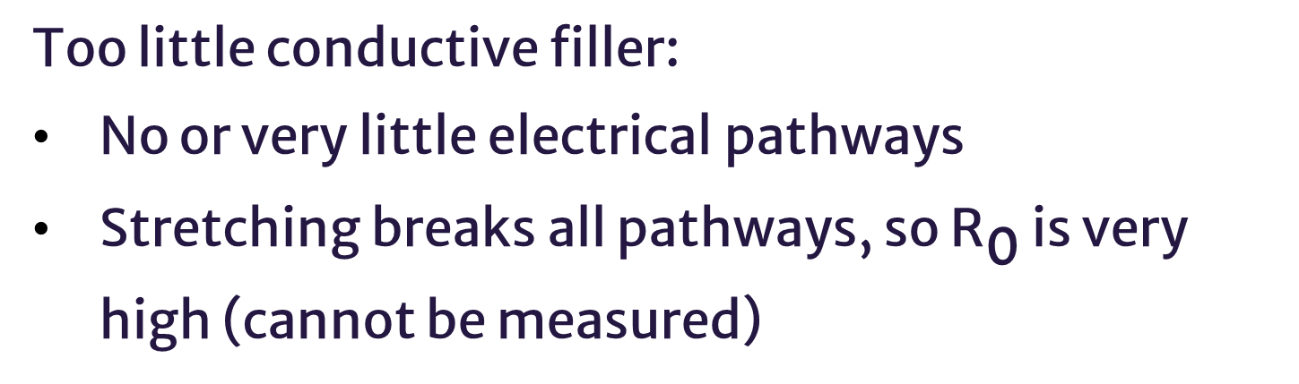

Percolation Effect
Insufficient:
Too little conductive filler:
No or very little electrical pathways
Stretching breaks all pathways, so ${\text{R}}_{\text{0}}$ is very high (cannot be measured)
Optimal:
Optimal amount of conductive filler:
Several electrical pathways
Stretching breaks a few pathways, so ${\text{R}}_{\text{0}}$ increases
Excessive:
Too much conductive filler:
Many electrical pathways
Stretching equally breaks and forms pathways, so R is roughly constant
Fig 5: Black are carbon atoms and white are polymer matrix. Left images illustrate yellow electrical pathways$,^{10}$ and right images illustrate effects of stretching on pathways$.^{9}$
$$GF=\frac{ΔR/R_{0}}{ε}$$
Increasing $\text{ΔR}$ increases GF (sensitivity)

Slide 7
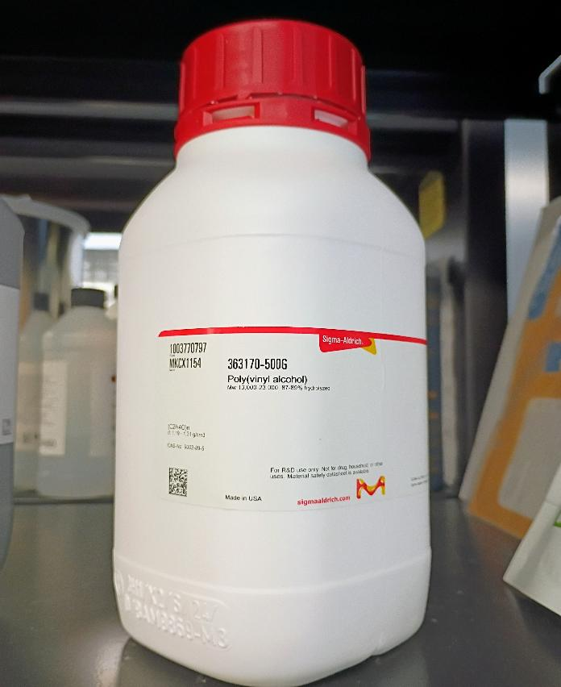
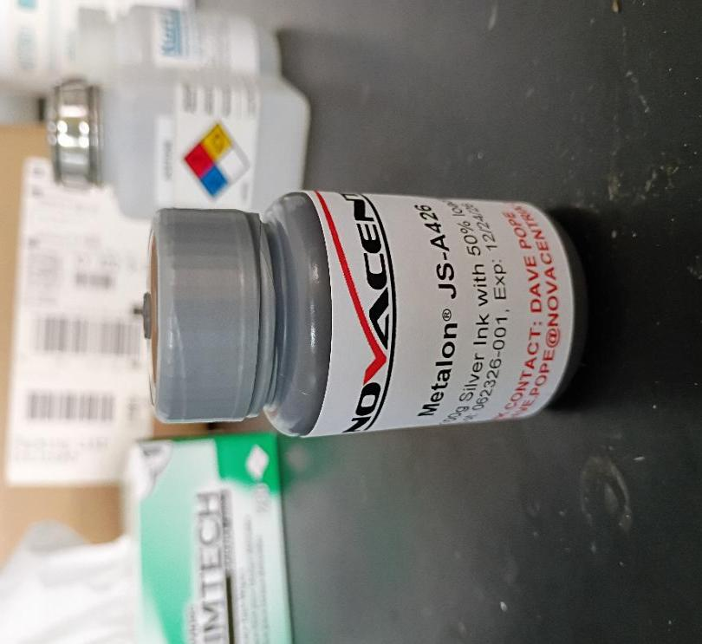
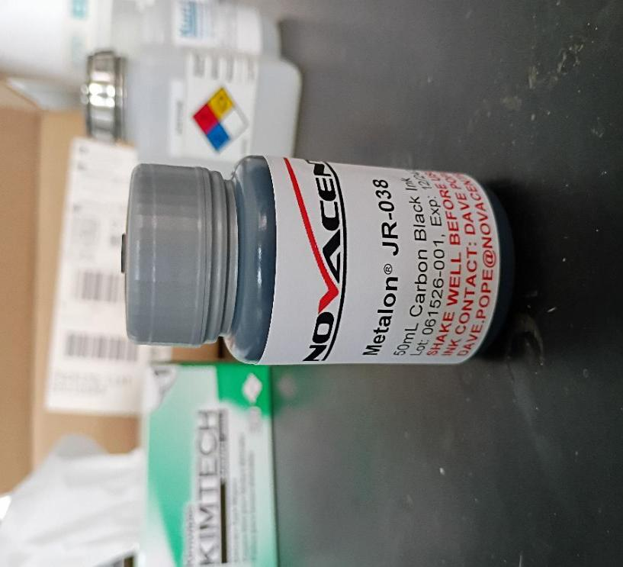
Deposition Materials
Novacentrix Silver Ink:
Viscosity: 7.8 cP
Particle size: 39 nm
Content: 50 wt% Silver
Purpose: electrodes
Novacentrix Carbon Ink:
Viscosity: 4.4 cP
Particle size: 105 nm
Content: 5 wt% Carbon Black (CB)
Purpose: conductive filler
Sigma Aldrich Polyvinyl Alcohol (PVA):
Viscosity: 3.5-4.5 cP
Particle size: ~nm
Content: 4 wt% PVA
Purpose: insulating filler

Slide 8
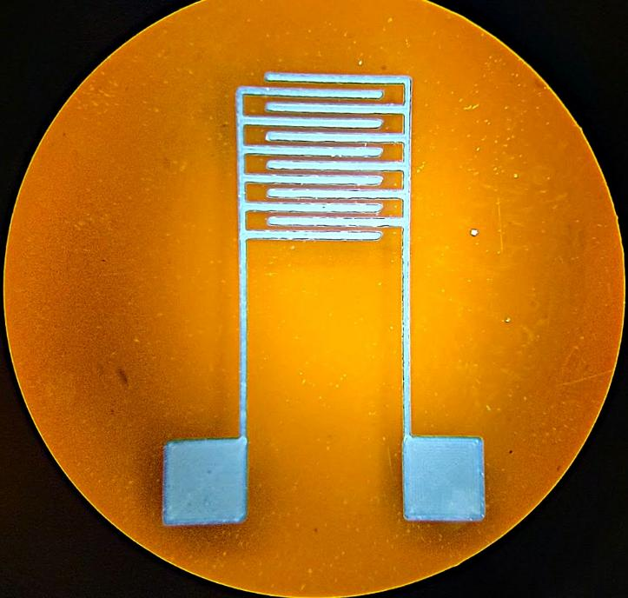
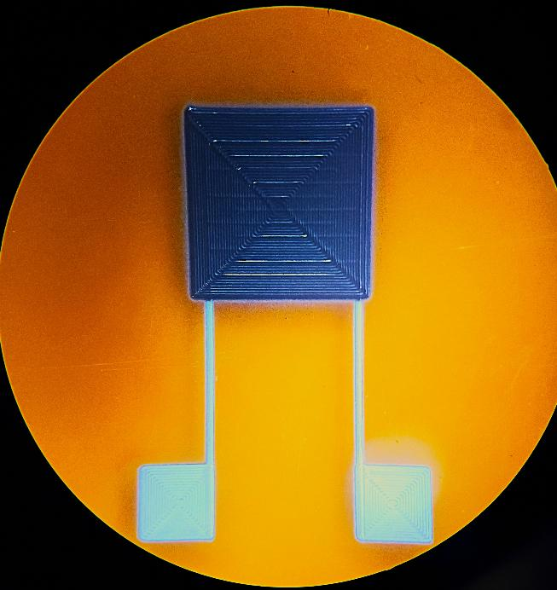
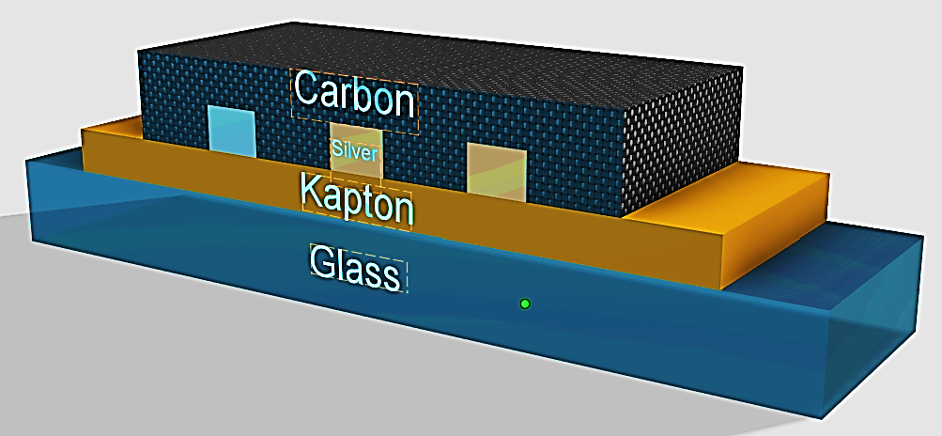
Sensor Design
In this project, piezoresistive strain sensor is fabricated using AJP with
silver interdigitated electrodes (IDEs)
carbon-polymer sensing layers.
Carbon-polymer sensing layer
Silver IDEs
1 mm
1 mm
Fig. 6: Silver IDEs through microscope at 1.5x.
Fig. 7: Carbon-polymer layers through microscope at 1.5x.
Fig. 8: Cross-sectional 3D model of piezoresistive sensor on glass slide

Slide 9

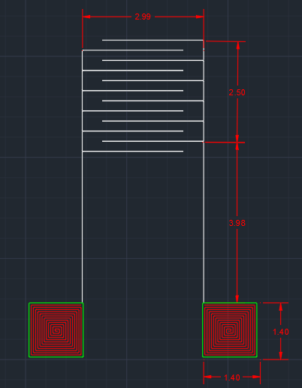
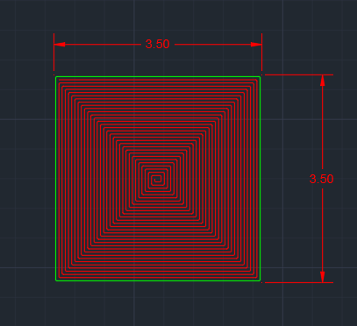
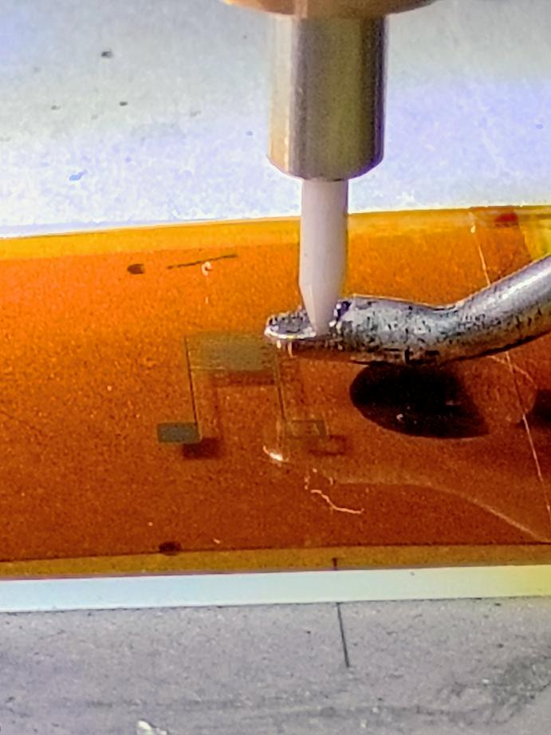
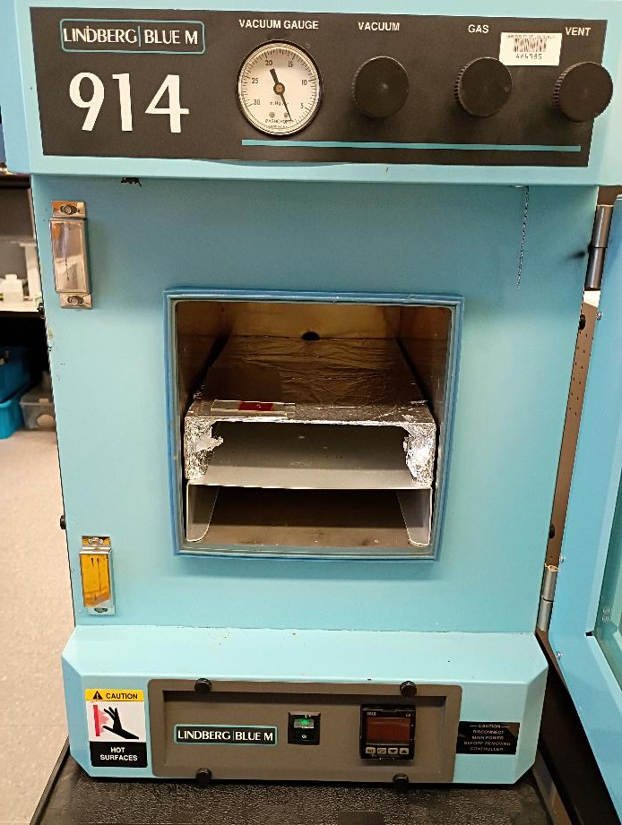
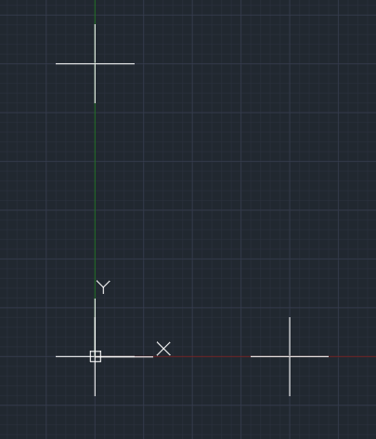
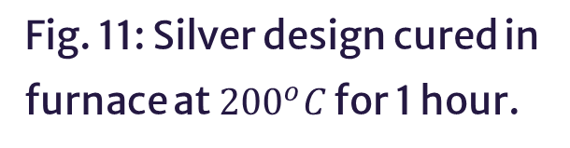
Silver Ink Deposition Process
AutoCAD design$→$ AJP with silver ink $→$ Cure in Furnace $→$ Inspect in Microscope
A
B
C
Fig. 9: AutoCAD designs. A) IDE fingers and contact pads. B) Carbon layer. C) Fiducials.
Fig. 10: 2:1 Silver Ink-DI water deposited on Kapton film using AJP
Fig. 11: Silver design cured in furnace at ${200}^{o}C$ for 1 hour.

Slide 10
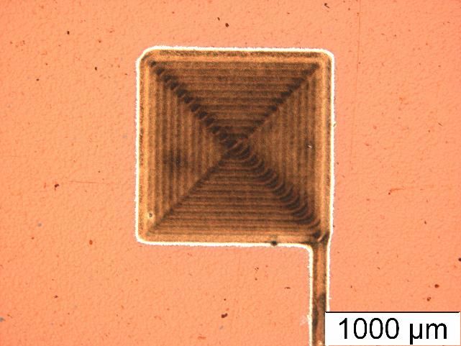
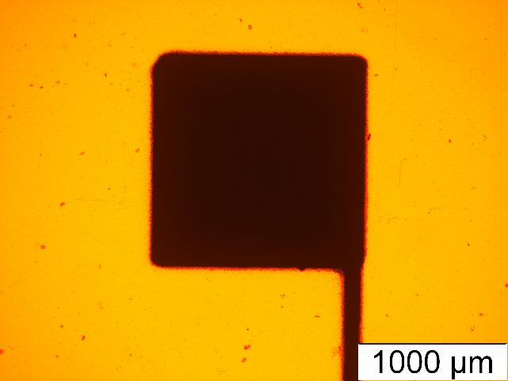
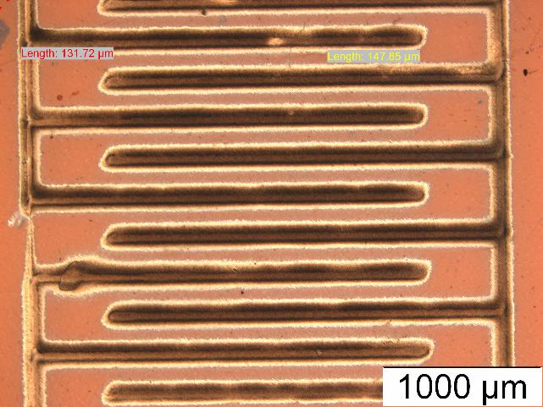
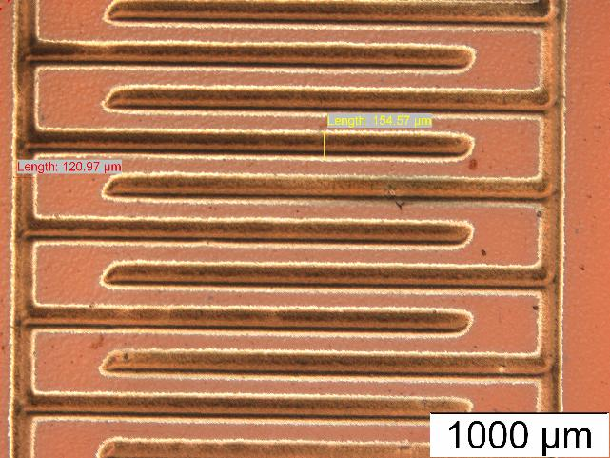
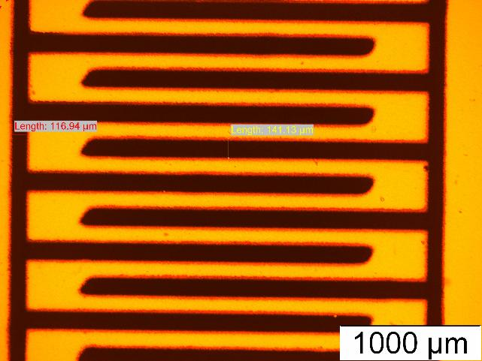
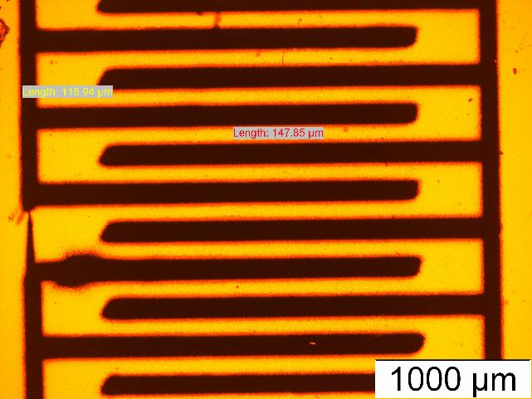
Silver Ink Deposition Process
AutoCAD design$→$ AJP with silver ink $→$ Cure in Furnace $→$ Inspect in Microscope
Use Bottom illumination to check for holes and connections
Possible Connection
Clogged
Unclogged
Fig. 12: Bright fields of contact pad and IDEs
Fig. 13: Contact pad and IDEs under bottom illumination
Fig. 14: Clog formed during printing IDEs

Slide 11
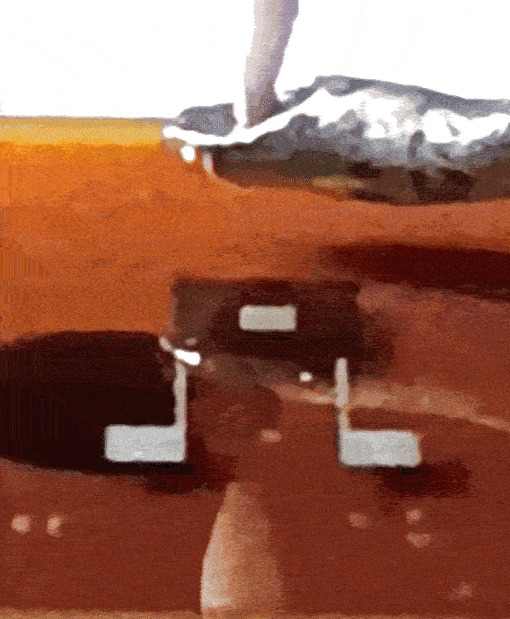
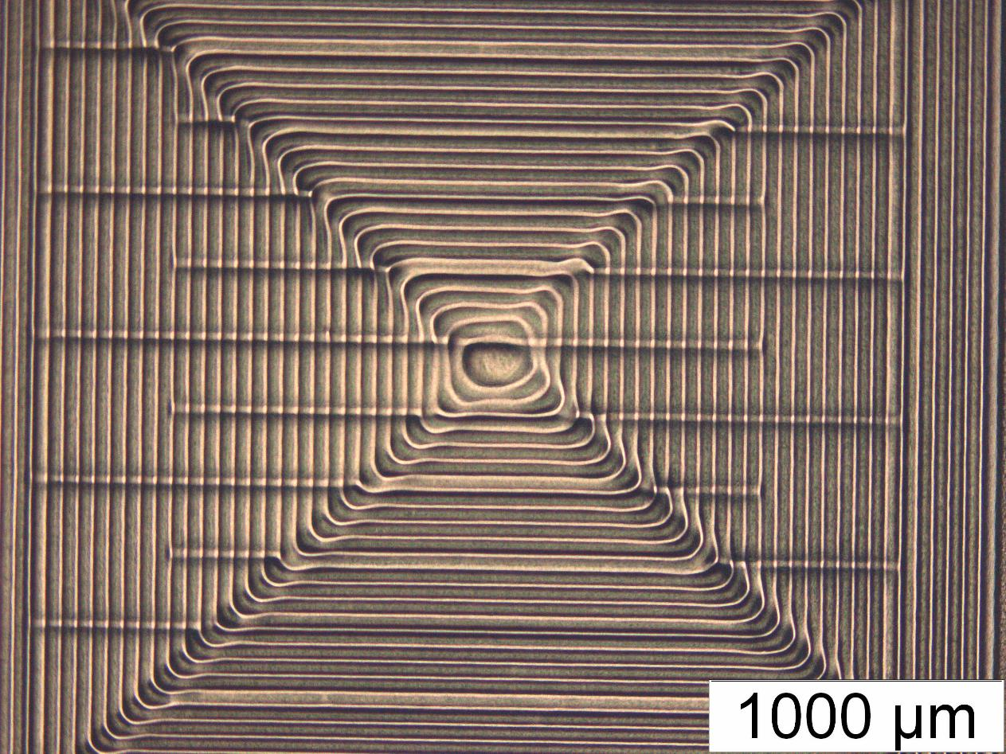

Carbon Ink Deposition Process
AJP carbon ink $→$Repeat 8 times $→$ Cure in Furnace $→$ Inspect in Microscope
Carbon layers cure at ${175}^{o}C$ for 1 hour.
Fig. 15: Carbon layer printed on top of silver interdigitated fingers
Fig. 16: Bright field of carbon layers over IDEs

Slide 12

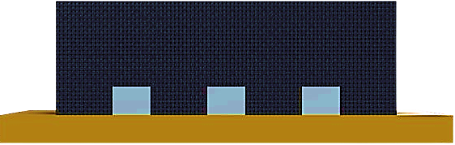
Why Eight Carbon-Polymer Layers?
More carbon-polymer layers
More electric pathways
Increase sensitivity
Carbon-polymer sensing layer
Silver IDEs
Kapton
Fig 17: Piezoresistive sensor through microscope at 1.5x focus.
Fig. 18: Cross-sectional 3D model of piezoresistive sensor with electric pathways between silver IDEs

Slide 13
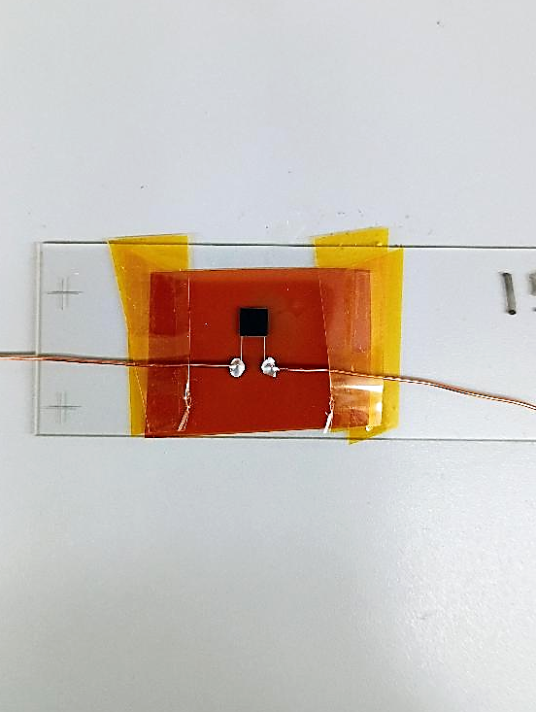
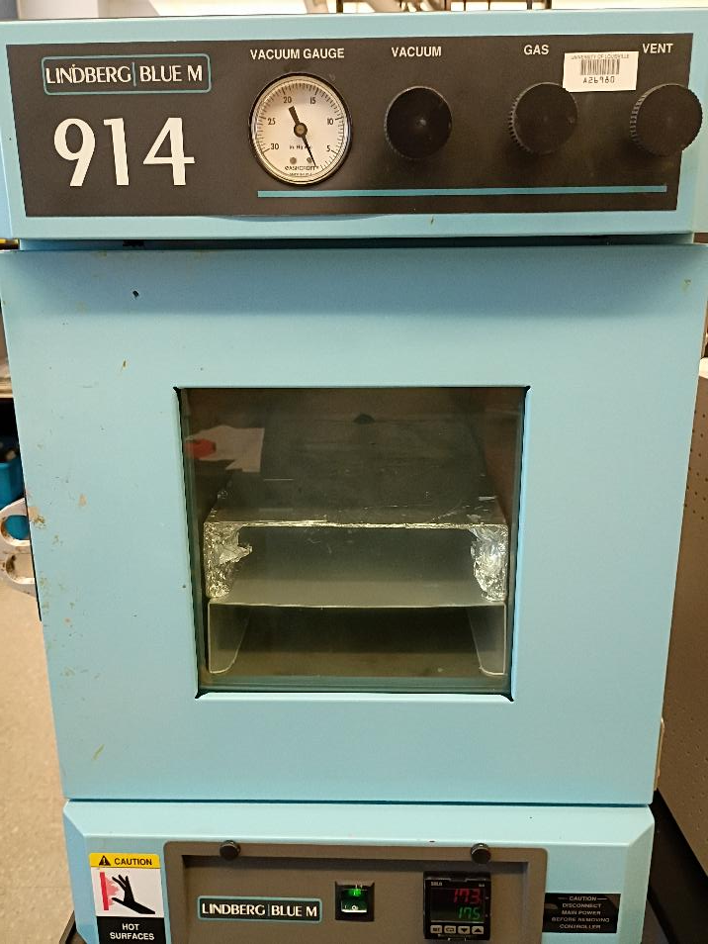
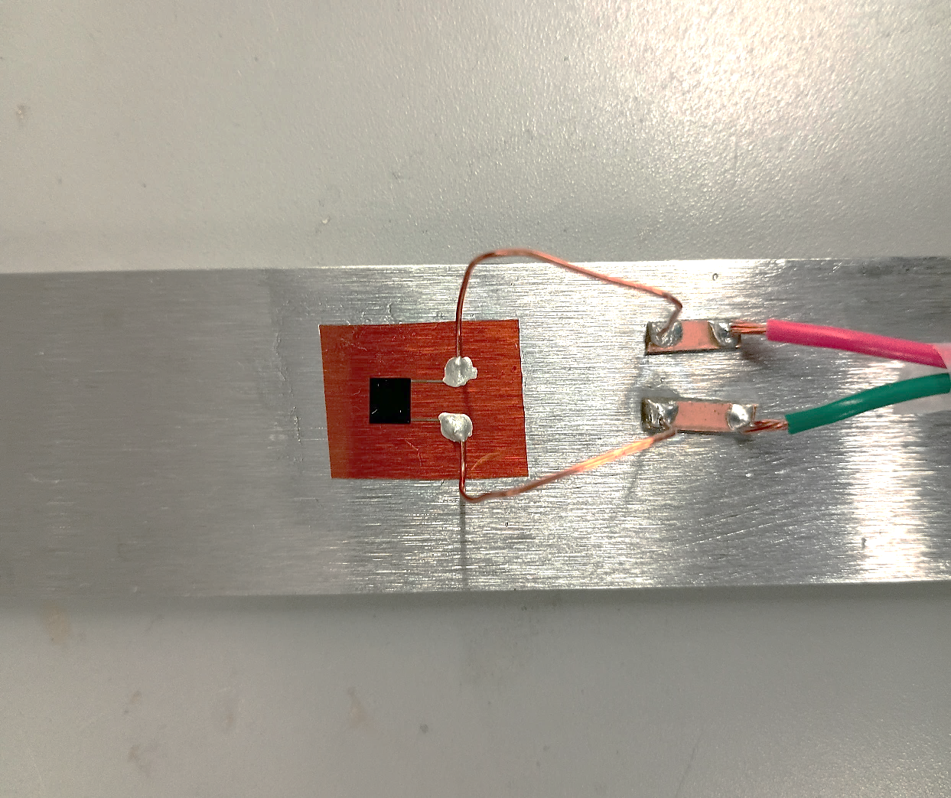
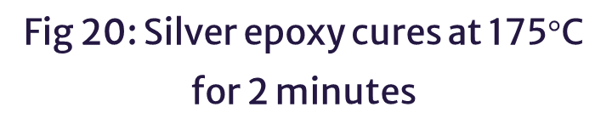
Wire and Cantilever Attachment
Attach wires with silver epoxy$→$ Cure in Furnace $→$Attach to Cantilever
Fig 19: Copper wires are attached to contact pad with silver epoxy
Fig 20: Silver epoxy cures at 175$°$C for 2 minutes
Fig 21: Sensor attached to cantilever using adhesive

Slide 14
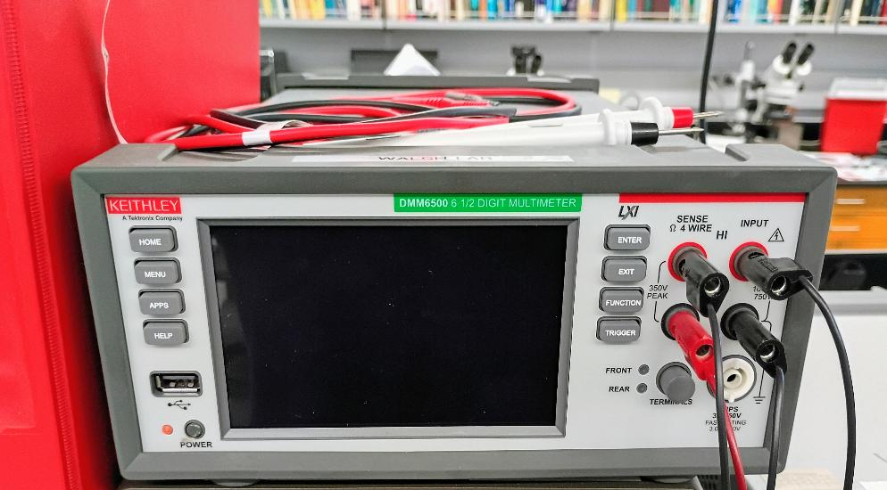
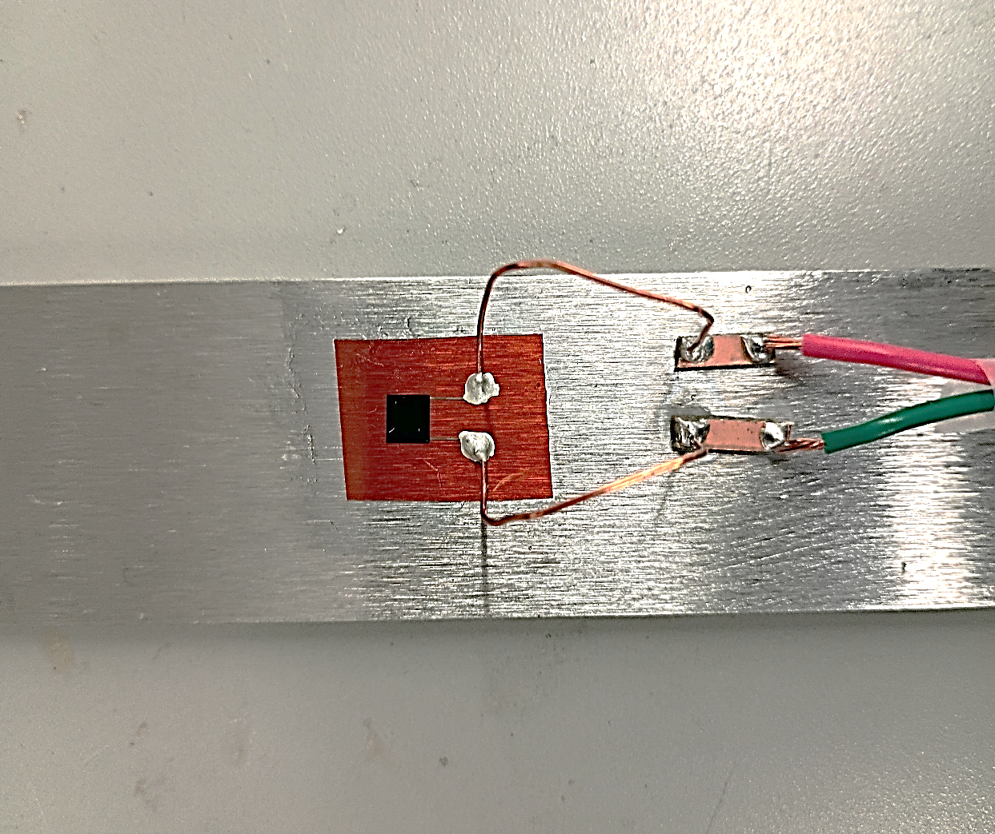
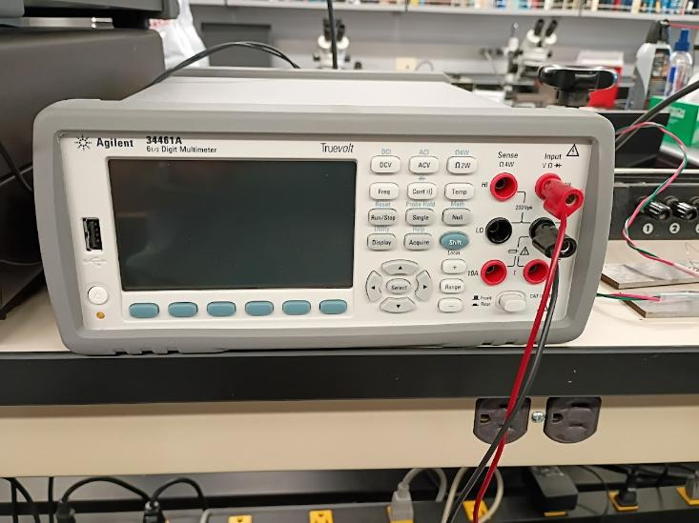
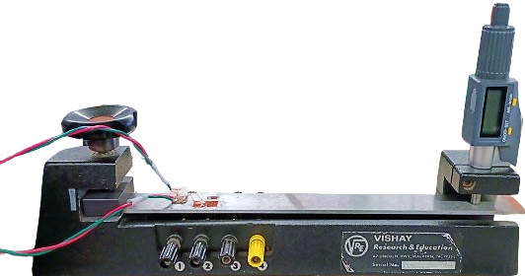
Characterization Test Setup
Mount the cantilever on the Vishay Strain Characterization Apparatus
Move the micrometer by increments, deforming cantilever and measure resistance changes using digital multimeter
Printed sensor
Micrometer
Clamp
Cantilever
Fig. 22: Keithley Digital Multimeter
Fig. 23: Vishay Strain Characterization Apparatus

Slide 15
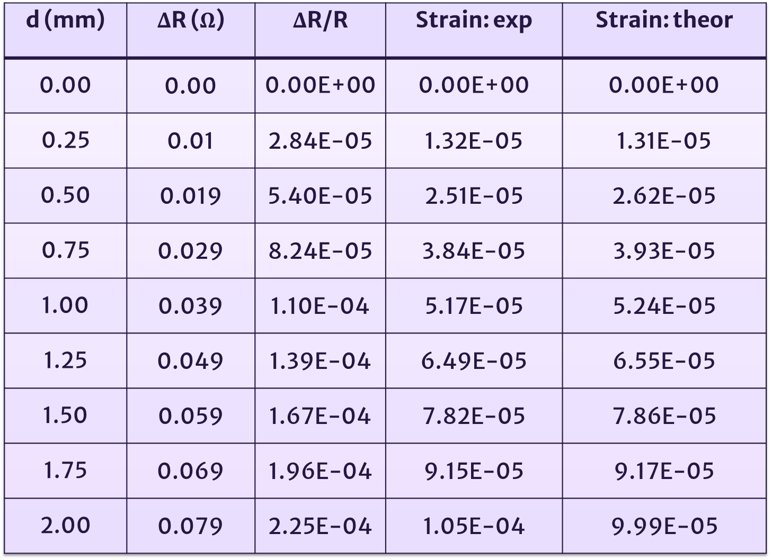





Cantilever Beam Strain Data
Using a commercial strain gauge for reference, check that the theoretical strain match the experimental strain
$$R_{0}=351 Ω$$
Table for commercial metal foil strain gauge
Commercial Strain Gauge ($\text{GF}=2.145$):
d (mm) | $Δ$R ($Ω$) | $Δ$R/R | Strain: exp | Strain: theor
0.00 | 0.00 | 0.00E+00 | 0.00E+00 | 0.00E+00
0.25 | 0.01 | 2.84E-05 | 1.32E-05 | 1.31E-05
0.50 | 0.019 | 5.40E-05 | 2.51E-05 | 2.62E-05
0.75 | 0.029 | 8.24E-05 | 3.84E-05 | 3.93E-05
1.00 | 0.039 | 1.10E-04 | 5.17E-05 | 5.24E-05
1.25 | 0.049 | 1.39E-04 | 6.49E-05 | 6.55E-05
1.50 | 0.059 | 1.67E-04 | 7.82E-05 | 7.86E-05
1.75 | 0.069 | 1.96E-04 | 9.15E-05 | 9.17E-05
2.00 | 0.079 | 2.25E-04 | 1.05E-04 | 9.99E-05
$$ε_{theor}=\frac{3dL_{1}t}{2L_{2}^{3}}$$
$$ε_{exp}=\frac{ΔR/R_{0}}{GF}$$
[2]
[3]
$d=deformation$; $t=thickness$; $ε=strain$;
$R=Resistance$; $GF=Gauge Factor$
Fig 23: Diagram of cantilever for theoretical strain calculation

Slide 16
Unstrained Resistance Results
Eight different carbon-polymer ratios were tested and fabricated into piezoresistive sensors:
5.00, 4.29, 3.75, 3.33, 2.50, 1.67, 1.50, 1.25 wt% CB
Measured the unstrained resistances of each sensor to try to model the percolation curve
Semi-log
Exp. data
Trendline
Follows the trend of the traditional S-shaped percolation curve.

Slide 17

Gauge Factor Results
Using strain values from commercial strain gauge, GF of each printed sensor is determined for tensile loading:
$$GF=\frac{ΔR/R_{0}}{ε}$$
Printed Sensor:
[4]
Then, if the cantilever is flipped, the GF can be determined for compressive loading.
Using 1.25 wt% CB under compressive loading,
Gauge factors were similar under tensile and compressive loadings.
GF = 7.70

Slide 18
Conclusions
Different carbon black-PVA polymer ink formulations were developed and deposited using AJP to create piezoresistive strain sensors which were characterized for GF.
The unstrained resistances seem to follow the trend of the percolation curve.
All sensors seem to be equally sensitive under tensile and compressive loading.
The sensor with 1.25 wt% CB achieved the highest GF (7.70), which is over three times higher than that of conventional metal foil strain gauges (GF ~2).
The enhanced sensitivity suggests that the sensor operates near the percolation threshold.
Future Steps
Improve the gauge factor by optimizing the carbon-polymer ink ratio to be at the percolation threshold and experiment with other polymers, such as PEDOT:PSS.
Test the effect of temperature on the gauge factor and stability of these sensors.

Slide 19







Thank You!
Any Questions
Acknowledgements
Mentors: Dr. Dilan Ratnayake and Dr. Kevin Walsh
REU Coordinator: Ana Sanchez-Galiano
Micro/Nano Technology Center – University of Louisville
NSF for sponsoring IMPACT-NG REU
QR code for my Linkedin profile
NSF REU Award ID #2348869
NSF NNCI Award ID # 2025075
19

Slide 20
References
[1]
[2]
[3]
[4]
[5]
N. J. Wilkinson, M. A. A. Smith, R. W. Kay, and R. A. Harris, “A review of aerosol jet printing—a non-traditional hybrid process for micro-manufacturing,” Int J Adv Manuf Technol, vol. 105, no. 11, pp. 4599–4619, Dec. 2019, doi: 10.1007/s00170-019-03438-2.
Optomec, aerosol Jet Printed Electronics Overview, OPTOMEC, Albuquerque, NM, USA, 2014.
A. S. Fiorillo, C. D. Critello, and S. A. Pullano, “Theory, technology and applications of piezoresistive sensors: A review,” Sensors and Actuators A: Physical, vol. 281, pp. 156–175, Oct. 2018, doi: 10.1016/j.sna.2018.07.006.
D. Ratnayake, A. Curry, C. Qu, D. Wei, E. Gerber, and K. Walsh, “Optimizing the Conductivity of a New Nanoparticle Silver Ink for Aerosol Jet Printing and Demonstrating Its Use as a Strain Gauge,” IEEE Flex. Electron., vol. 2, no. 3, pp. 248–255, May 2023, doi: 10.1109/JFLEX.2023.3234458.
J. Li, L. Fang, B. Sun, X. Li, and S. H. Kang, “Review—Recent Progress in Flexible and Stretchable Piezoresistive Sensors and Their Applications,” J. Electrochem. Soc., vol. 167, no. 3, p. 037561, Jan. 2020, doi: 10.1149/1945-7111/ab6828.

Slide 21
References
[6]
[7]
[8]
[9]
[10]
D. M. Ştefănescu, Handbook of Force Transducers: Principles and Components. Berlin, Heidelberg: Springer Berlin Heidelberg, 2011. doi: 10.1007/978-3-642-18296-9.
F. Luo, A. Ciesielski, and P. Samorì, “Design Strategies and Emerging Applications of High‐Performance Flexible Piezoresistive Pressure Sensors,” Adv Funct Materials, vol. 36, no. 47, p. e75473, Jun. 2026, doi: 10.1002/adfm.75473.
M. Wang et al., “A Percolation Model for Piezoresistivity in Conductor–Polymer Composites,” Advcd Theory and Sims, vol. 2, no. 2, p. 1800125, Feb. 2019, doi: 10.1002/adts.201800125.
F. Avilés, A. I. Oliva‐Avilés, and M. Cen‐Puc, “Piezoresistivity, Strain, and Damage Self‐Sensing of Polymer Composites Filled with Carbon Nanostructures,” Adv Eng Mater, vol. 20, no. 7, p. 1701159, Jul. 2018, doi: 10.1002/adem.201701159.
H. J. Choi, M. S. Kim, D. Ahn, S. Y. Yeo, and S. Lee, “Electrical percolation threshold of carbon black in a polymer matrix and its application to antistatic fibre,” Sci Rep, vol. 9, no. 1, p. 6338, Apr. 2019, doi: 10.1038/s41598-019-42495-1.

Slide 22













Derivation of Gauge Factor
Start with definition of resistance
Longitudinal Strain:
$$ε_{∥}=\frac{ΔL}{L}$$
$$R=\frac{ρL}{A}=\frac{ρL}{π{\left(\frac{D}{2}\right)}^{2}}=\frac{4}{π}\frac{ρL}{D^{2}}$$
Take ln of
$$\ln{R}=ln\frac{4}{π}{\frac{ρL}{D^{2}}}=\ln{\frac{4}{π}}+\ln{ρ}+\ln{L}−2 ln{D}$$
Both sides
Lateral Strain:
$$ε_{⊥}=−\frac{ΔD}{D}$$
Differentiate
$$\frac{ΔR}{R}=0+\frac{Δρ}{ρ}+\frac{ΔL}{L}−2\frac{ΔD}{D}$$
Divide by
$\frac{ΔR/R}{ΔL/L}=\frac{1}{ΔL/L} \frac{Δρ}{ρ}+1−2\frac{ΔD/D}{ΔL/L}$
$$ΔL/L$$
L
D
R: initial resistance
L: initial length
Carbon-Polymer
F
$$ν=\frac{ε_{⊥}}{ε_{∥}}=−\frac{ΔD/D}{ΔL/L}$$
$$GF=\frac{ΔR/R}{ΔL/L}$$
Poisson’s Ratio:
Gauge Factor:
Stretches
Cross-sectional
$$ΔL$$
$$ΔD$$
Length increase Area decrease Resistivity change
Carbon-Polymer
F
Substitute in GF, $ε$, and $ν$
$$GF=1+2ν+\frac{1}{ε}\frac{Δρ}{ρ}$$
[1]
Visualization of piezoresistive sensor as cylinders stretching

Slide 23



Piezoresistivity
Three main contributions to piezoresistivity$:^{7}$
A
B
Contact resistance modulation
Quantum Tunneling
Percolation effects
In contact resistance, a force compresses electrodes together, increasing contact with conductive filler.
In quantum tunneling, electrons can penetrate ultrathin potential barrier through spikes of “urchin-like” conductive filler.
In percolation effects, more charge transport pathways are created as a force compresses electrodes together
C
A) Force increases contact with electrodes; B) Electrons tunnel through ultrathin barrier; C) Percolation Threshold

Slide 24




Piezoresistive Sensors
Piezoresistive sensors measure small variations in resistance as material stretches due to geometric and restivity changes$.^{3}$
Gauge Factor measures the sensitivity of piezoresistive sensors $.^{6}$
L
D
F
Carbon-Polymer
Cross-sectional
Length increase Area decrease Resistivity change
Stretches
$$GF=1+2ν+\frac{1}{ε}\frac{Δρ}{ρ}$$
$$ΔL$$
[1]
$$ΔD$$
F
Carbon-Polymer
GF: gauge factor; $ν$: Poisson’s ratio; $ε$: strain; $ρ$: resistivity
Fig. 3: Visualization of piezoresistive sensor as cylinders stretching

Slide 25




Percolation Threshold
Percolation threshold is the point when insulating polymer matrix converts to a conductive network$.^{8}$
Carbon
atom
L
Optimal region near percolation threshold (~35-55 wt% Carbon)
D
Electrodes
Percolation Curve
Semi-log
F
Optimal region
Previous research done by Dr. Ratnayake$:^{8}$
10 wt% C: 65 $Ω$
90 wt% C: 131 $Ω$
Conductive Paths
Resistance ($Ω$)
Stretches
$$ΔL$$
$$ΔD$$
F
Carbon Content (wt%)
Fig. 4: Visualization of resistivity change due to percolation effect
Fig. 3: Conceptual graph modeling the percolation curve of carbon-polymer filler

Slide 26

Practical Applications
Different applications for piezoresistive sensors fabricated in three distinct methods.
AJP method is considered part of the conductive polymeric composite section, and some application include:
Wearable pressure/tactile sensors (electronic skin)
Integrated sensors in fabric for physical evaluation
J. Li, L. Fang, B. Sun, X. Li, and S. H. Kang, “Review—Recent Progress in Flexible and Stretchable Piezoresistive Sensors and Their Applications,” J. Electrochem. Soc., vol. 167, no. 3, p. 037561, Jan. 2020, doi: 10.1149/1945-7111/ab6828.

Slide 27



Carbon Ink Deposition Process
AJP carbon ink $→$ Inspect in Microscope $→$Cure in Furnace $→$ Repeat 4 times
Fig. 17: Bottom illumination of the 4 carbon layers
Novacentrix Polymer Ink:
Viscosity: >10 cP
Particle size: ~nm
Content: 44 wt% polymer
Fig. 16: Bright fields of the 4 carbon layers

Slide 28



Perpendicular Loading Test Setup
Characterize the sensitivity of the sensors from perpendicular loading.
Cantilever with the printed sensor is mounted to the apparatus where the load is directly over the carbon-polymer sensing layers.
Kapton film is used to cover the sensor to avoid damaging the layers.
When a load is added, $\text{ΔR}$ is measured using a digital multimeter.
Load
Printed sensor
Sensing layers

Slide 29









Perpendicular Loading GF Calculations
Reuss’s Model assumes that all phases within material experience the same stress when perpendicular load is applied.
Used to theorize an effective Young’s Modulus for the carbon-polymer sensing layers.
$$\frac{1}{E_{eff}}=\frac{V_{CB}}{E_{CB}}+\frac{V_{PVA}}{E_{PVA}}$$
$E_{CB}$~ 9-12 GPa
$E_{PVA}$ ~ 2.75-4.5 GPa
For the results, the middle value of these ranges were used.
After determining $E_{eff}$, the strain $ε$ is determined using Hooke’s law..
$$F=mg$$
$$m=2.7651 kg$$
$$g=9.81\frac{m}{s^{2}}$$
$$σ=Eε$$
$σ$: mechanical stress
$$σ=\frac{mg}{A}=\frac{(2.7651 kg)(9.81\frac{m}{s^{2}})}{25⋅{10}^{−6} m^{2}}=1.09 MPa=Eε$$
$$σ=\frac{F}{A}$$
$F$: perpendicular load
$A$: area of contact, $25 mm^{2}$

Slide 30

Perpendicular Loading GF Results
Then, substitute the volume ratios of carbon black and polymer used to determine the effective Young’s Modulus, strain, then GF.
CB (v/v%) | PVA (v/v%) | $E_{eff}$ (MPa) | Strain | ΔR/R | GF
100.0 | 0.0 | 10.50 | 1.03E-04 | 8.58E-05 | 0.83
85.7 | 14.3 | 8.26 | 1.31E-04 | 8.73E-05 | 0.66
75.0 | 25.0 | 7.12 | 1.52E-04 | 1.18E-04 | 0.77
66.7 | 22.3 | 8.00 | 1.36E-04 | 2.67E-04 | 1.97
50.0 | 50.0 | 5.39 | 2.01E-04 | 3.82E-04 | 1.90
33.3 | 66.7 | 4.64 | 2.34E-04 | 4.16E-04 | 1.78
30.0 | 70.0 | 4.51 | 2.41E-04 | 5.83E-04 | 2.42
25.0 | 75.0 | 4.33 | 2.50E-04 | 1.43E-03 | 5.70

