Slide 1




Engineering Sustainable Lignin-Functionalized Ionomer Separators for Energy Technologies
Jonathan Herold¹,² · Moses Dike² · Sourav Sutradhar² · Shudipto Dishari²
¹ FAMU-FSU Department of Chemical and Biomolecular Engineering
² University of Nebraska-Lincoln Department of Chemical and Biomolecular Engineering
1

Slide 2

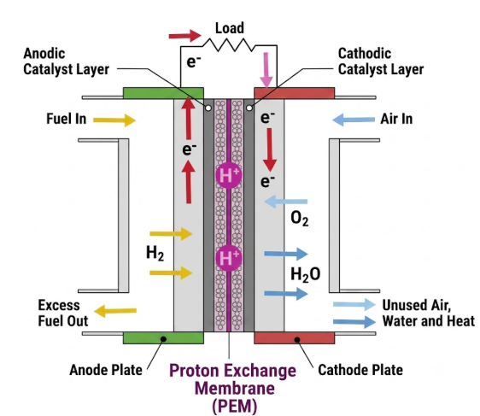
Why Separators Matter
The global transition toward sustainable energy has intensified demand for advanced electrochemical technologies.
Fuel cells and emerging aqueous battery systems both depend on ion-conducting membranes to separate electrodes while selectively transporting protons.
The membrane material determines efficiency, cost, and environmental footprint - making it a critical design target.
Proton Exchange Membrane Fuel Cell (PEMFC)
PEMFC is a device that converts Chemical Energy to Electrical Energy with the use of H₂ as a fuel.
At Anode: H₂ → 2H⁺ + 2e⁻
At Cathode: 2H⁺ + 2e⁻ + ½ O₂ → H₂O + heat
Overall reaction: H₂ + ½ O₂ → H₂O + heat
Proton exchange membrane (PEM) fuel cell schematic
2

Slide 3
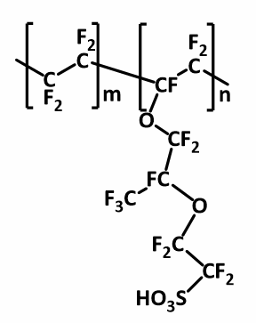
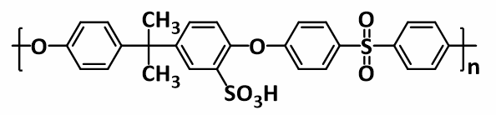
Two Membrane Materials-Two Trade-offs
Nafion
Sulfonated Polysulfone (SPSf)
Standard proton conductivity - the field's benchmark ionomer.
High cost and environmentally persistent: a PFAS-based, fluorinated polymer.
Cheaper, fluorine-free hydrocarbon alternative to Nafion.
Needs a higher ion-exchange capacity (IEC) to match Nafion's performance - risking excess water uptake and swelling.
3

Slide 4
THE CHALLENGE
Improving sustainability is critical for both materials - given Nafion’s severe environmental persistence and SPSf’s non-renewable, petroleum-based origin.
Nafion → PFAS-based, environmentally persistent
SPSf → non-renewable, petroleum-derived backbone
A renewable additive that improves performance while cutting reliance on both materials is the goal of this project.
4

Slide 5
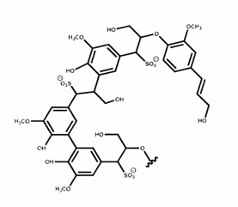
Lignosulfonate: A Renewable Fix
Lignin is an abundant, renewable biopolymer - a byproduct of pulp and paper processing.
Incorporating Sulfonated Lignin (LS) into Nafion and SPSf matrices lowers reliance on petroleum-based and PFAS-based materials.
Its sulfonate and hydroxyl groups offer a promising route to enhance proton conductivity and sustainability in both ionomer systems.
Lignosulfonate (LS)
5

Slide 6
From Solution to Membrane: A Six-Step Process
1
Prep solutions
2
Cast
3
Dry
Dissolve Nafion / SPSf in DMAc; LS in 3:1 acetone–DI water
Cast blended solution onto a Petri dish
Oven dry at 65°C for 24 hours
4
Acid soak
5
Rinse
6
Test
Soak in H₂SO₄ for 24 hours
Soak in DI water to equilibrate / measure swelling
Electrochemical Impedance Spectroscopy (EIS)
6

Slide 7
Baseline: Nafion Outperforms SPSf
Pristine Nafion (IEC 0.92) shows significantly higher baseline proton conductivity than pristine SPSf (IEC 0.85).
Conductivity increases steadily for both membranes across the full 20–80°C temperature range.
This baseline gap sets the target that lignosulfonate functionalization aims to close.
7

Slide 8
Lignosulfonate Boosts Conductivity in Both Membrane Systems
LS loading and proton conductivity are positively correlated — in both the Nafion and SPSf matrices.
8

Slide 9
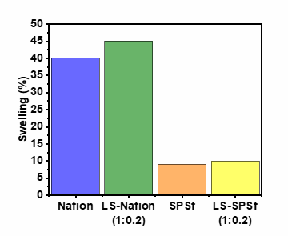
Dimensional Stability (Swelling)
~40%
~10%
Nafion swelling
SPSf swelling
Reduced swelling reflects SPSf's discontinuous, tortuous, poorly phase-separated morphology and its lower IEC.
LS increases water uptake somewhat, but LS-SPSf maintains strong dimensional stability.
9

Slide 10
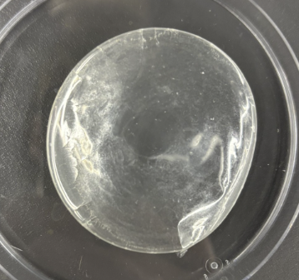
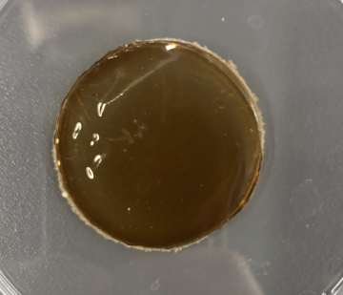
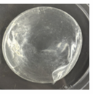
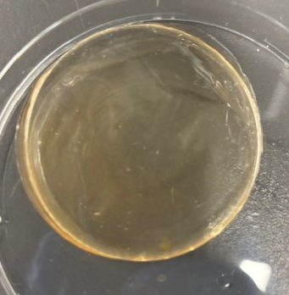
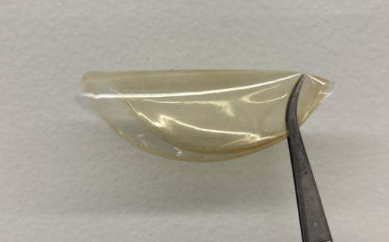
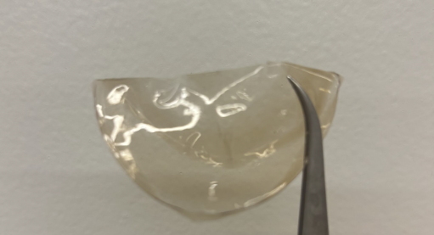
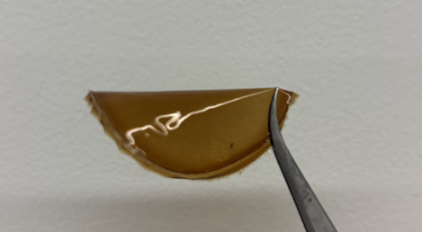
Higher Lignin Loading Did Not Compromise Flexibility
Nafion
Nafion + LS
SPSf
SPSf + LS
Flexibility retained across increasing LS content →
Higher LS loading did not make the LS-Nafion membranes brittle — indicating strong mechanical stability.
10

Slide 11
Conclusions
1
Incorporating sulfonated lignin effectively enhances proton conductivity across both Nafion and SPSf membranes.
2
The LS-SPSf composite offers a promising, low-cost, fluorine-free alternative with excellent dimensional stability.
3
Functionalized lignin demonstrates real potential to advance sustainability in next-generation electrochemical energy technologies.
11

Slide 12
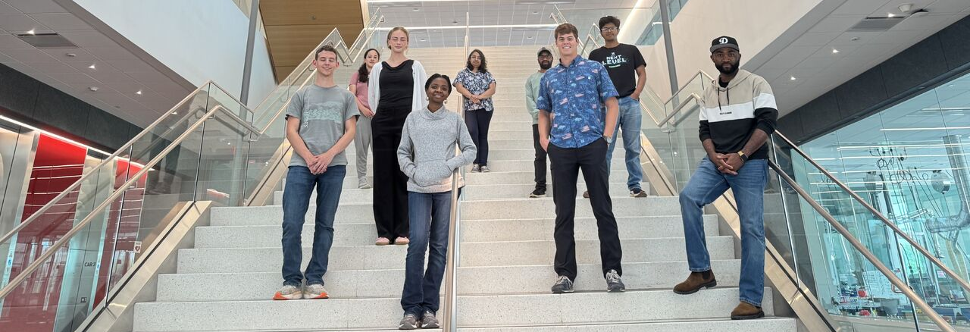
Acknowledgments & References
Acknowledgments
References
This work was supported by NSF grant #1950137, and Dr. Dishari’s NSF-CBET #2310185 and NSF-DMR #2520078 grants.
Jonathan thanks PI Dr. Shudipto Dishari for the opportunity, and mentors Moses Dike and Sourav Sutradhar for their guidance throughout this research.
Anukam, A., et al. (2021). A review of the mechanism of bonding in densified biomass pellets. 148, 10.
Kreuer, K. D. (2001). On the development of proton conducting polymer membranes for hydrogen and methanol fuel cells. 185, 4.
Zhang, Y., et al. (2019). Sulfonated polysulfone proton exchange membrane influenced by a varied sulfonation degree for vanadium redox flow battery. 584, 5.
12

Slide 13
Thank You
13

