Slide 1







Generation of Alginate Force Probes to Quantify Intratumoral GBM Compression
THIAGO PIRES, CENTRE COLLEGE ​| DR. JOSEPH CHEN, UNIVERSITY OF LOUISVILLE​ | BRYCE THOMPSON, UNIVERSITY OF LOUISVILLE
NSF REU Award ID #2348869
NSF NNCI Award ID # 2025075​
Notes:
Good Morning/Afternoon,
My name is Thiago Pires, Today I will be talking a little about how we're quantifying intra-tumoral GBM compression utilizing alginate force probes.

Slide 2
Cancer
Notes:
Cancer is a word we all know too well, being one of the world's deadliest battles, Cancer brings sentiments of grief and sadness, but also curiosity. Although we won't tackle cancer as a whole within this presentation, I believe it is necessary to consider this project as a small part of a greater whole, a broader cause fueled by an unwavering curiosity. Sharing one goal, one purpose, one aim, to end the suffering of many.

Slide 3
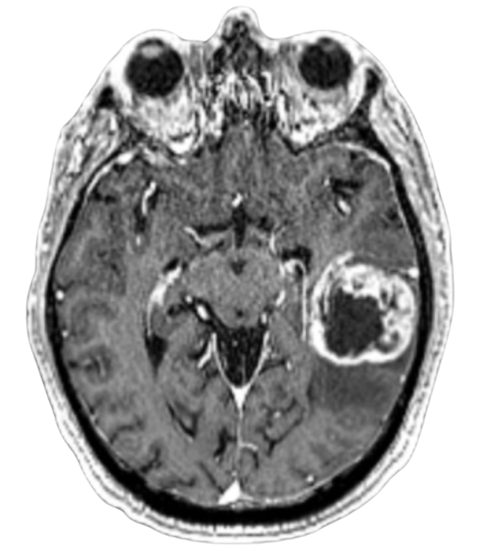
What is GBM?
Notes:
What is GBM?

Slide 4
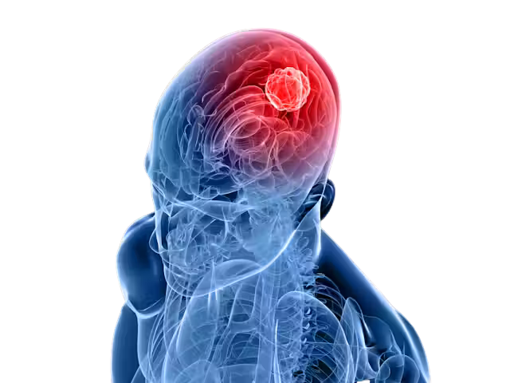
“GLIOBLASTOMA (GBM) IS THE MOST COMMON MALIGNANT PRIMARY BRAIN TUMOR.”
(Chen,2021)
Notes:
“Glioblastoma (GBM) is the most common malignant primary brain tumor.”
GBM metastasizes from Glial cells; primarily astrocytes which are responsible for supporting neurons and maintaining the Blood Brain Barrier. Its ability to disrupt such important functions is evident in the poor prognosis of those that are diagnosed.

Slide 5
GBM Stats
  ~3 cases per 100,000 per year in the U.S.
    1.6x higher diagnosis in males
  ~13,000 new GBM cases per year in the US
  Median age of diagnosis: ~64 yrs
  Avg. lifespan Postdiagnosis ~14 mos
  Less than 5% Five-year survival rate
Notes:
To put into perspective how harsh this subtype of Cancer truly is I've here on the screen the most relevant statistics. For every 100,000 people in the United States, there are approximately 3 cases of GBM, although this may not seem like an abhorrent amount of cases but in the US we have approximately 13,000 new cases of GBM each year. The median age of diagnosis, and unfortunately most patients only live 14 months post diagnosis, and the number of those who are able to battle GBM for 5 years are below 5%.
Enough about death. What is it like for someone to live with GBM?

Slide 6
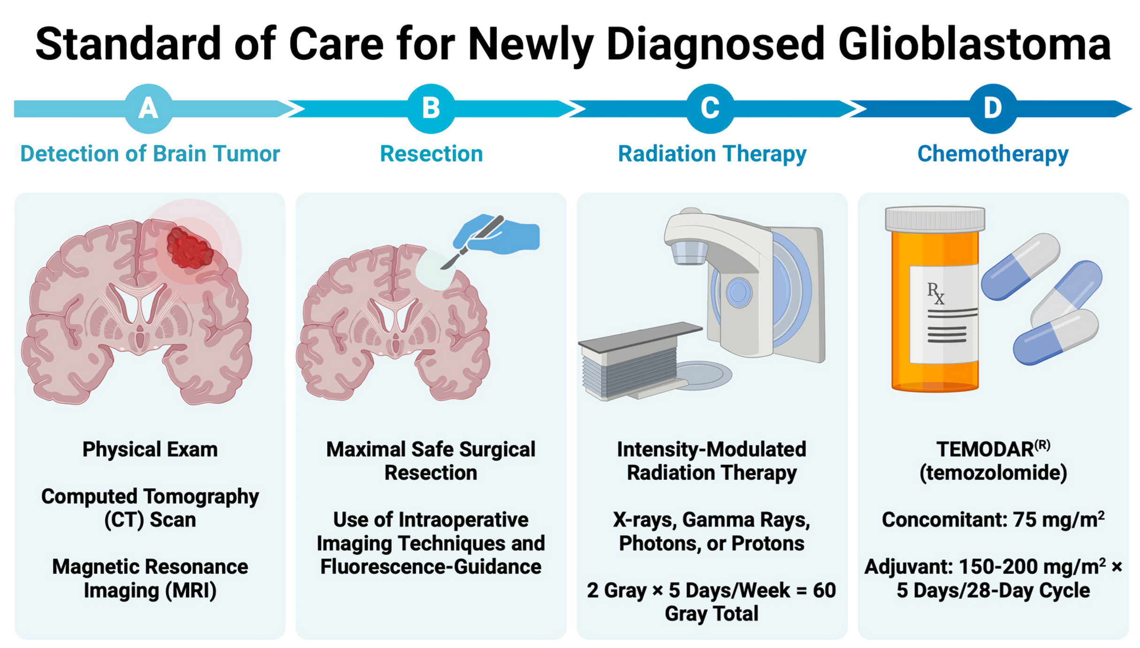
Standard of Care
Notes:
Unfortunately for patients of GBM, the standard of care has remained rudimentary for far too long. Currently the only avenue of treatment includes first a surgical resection in which the maximal amount of the tumor is cut from the brain, followed by radiation therapy, and then chemotherapy. These treatments inevitably do not prevent the recurrence of GBM and have yet to effectively stop the proliferation of GBM.

Slide 7
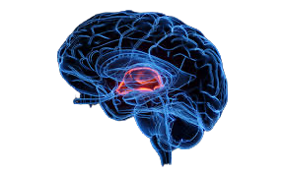
Why so Elusive ?
Notes:
Begging the question, Why is GBM so elusive to treatment?

Slide 8
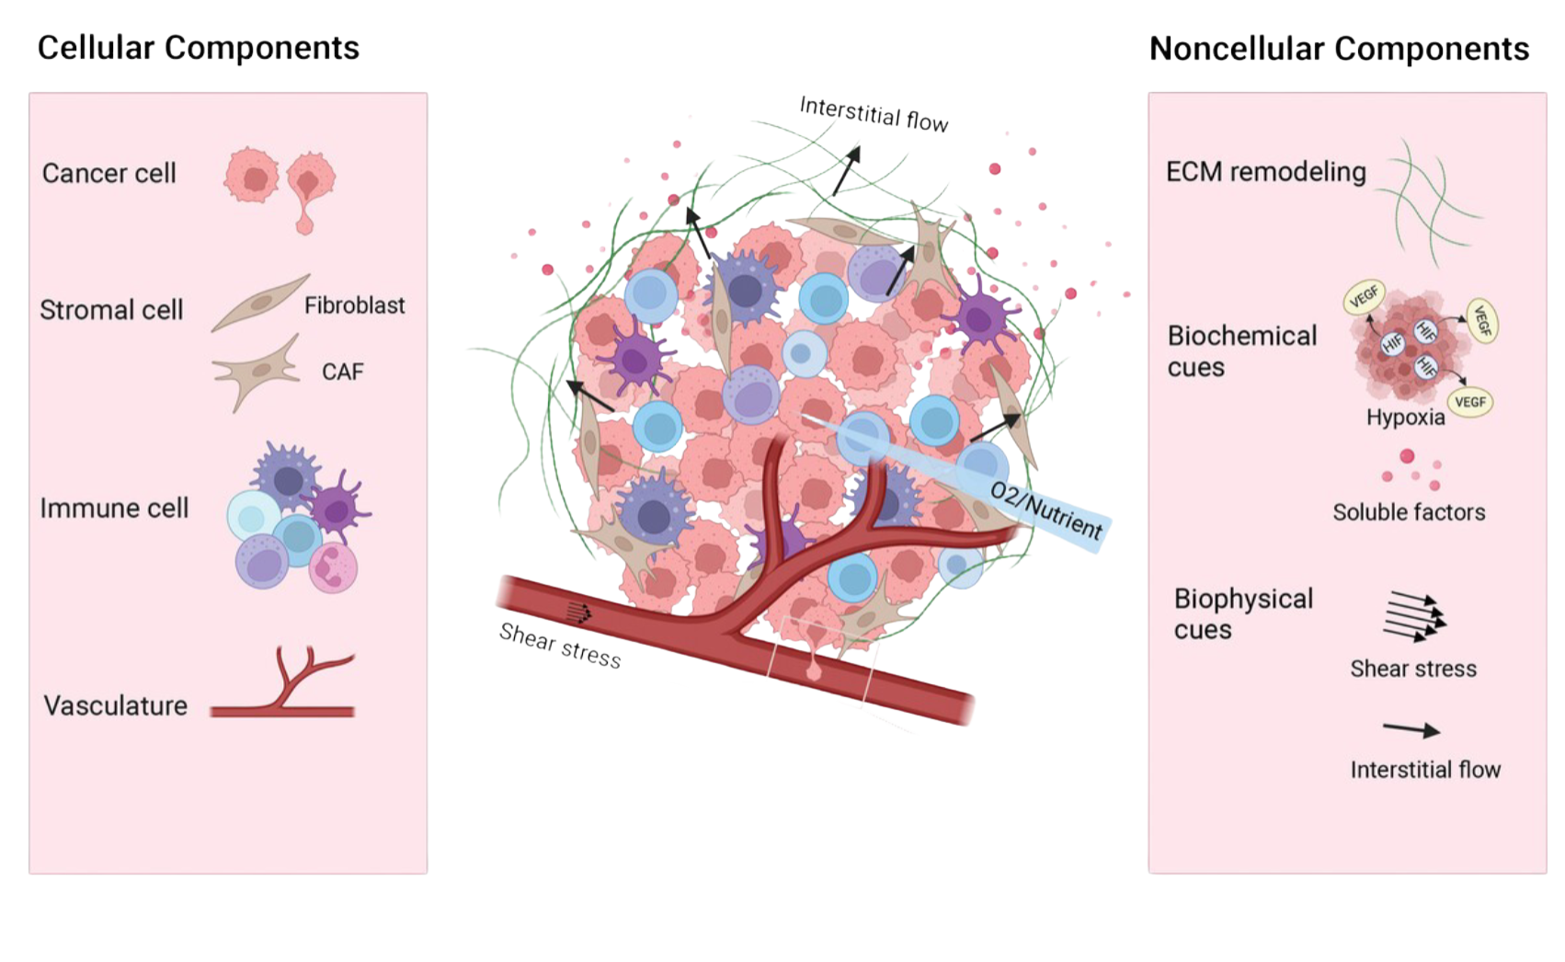
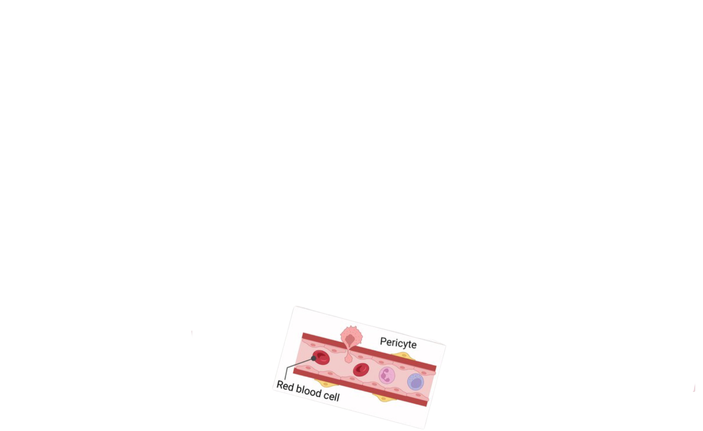
Tumor Microenvironment

Slide 9
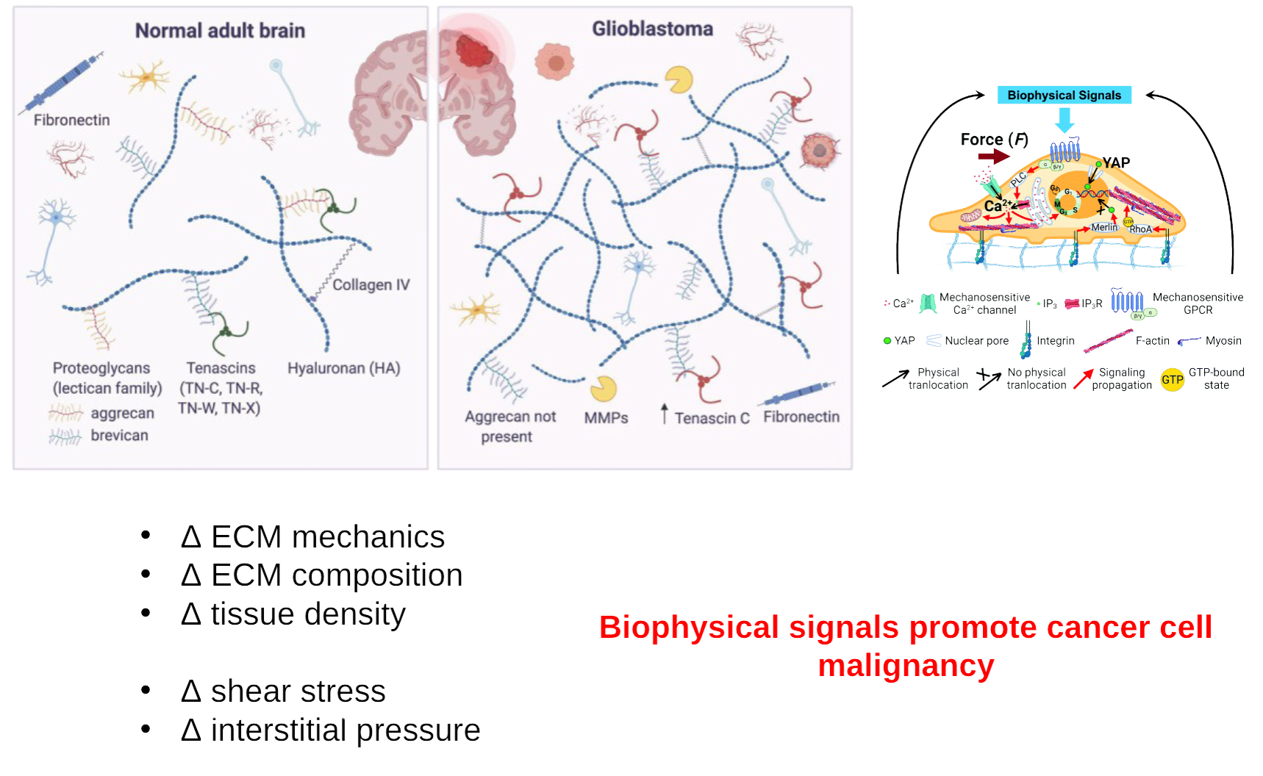
Tumor Progression
  ECM mechanics
  ECM composition
  Tissue density
  Shear stress
  Interstitial pressure
BIOPHYSICAL SIGNALS PROMOTE CANCER CELL MALIGNANCY

Slide 10
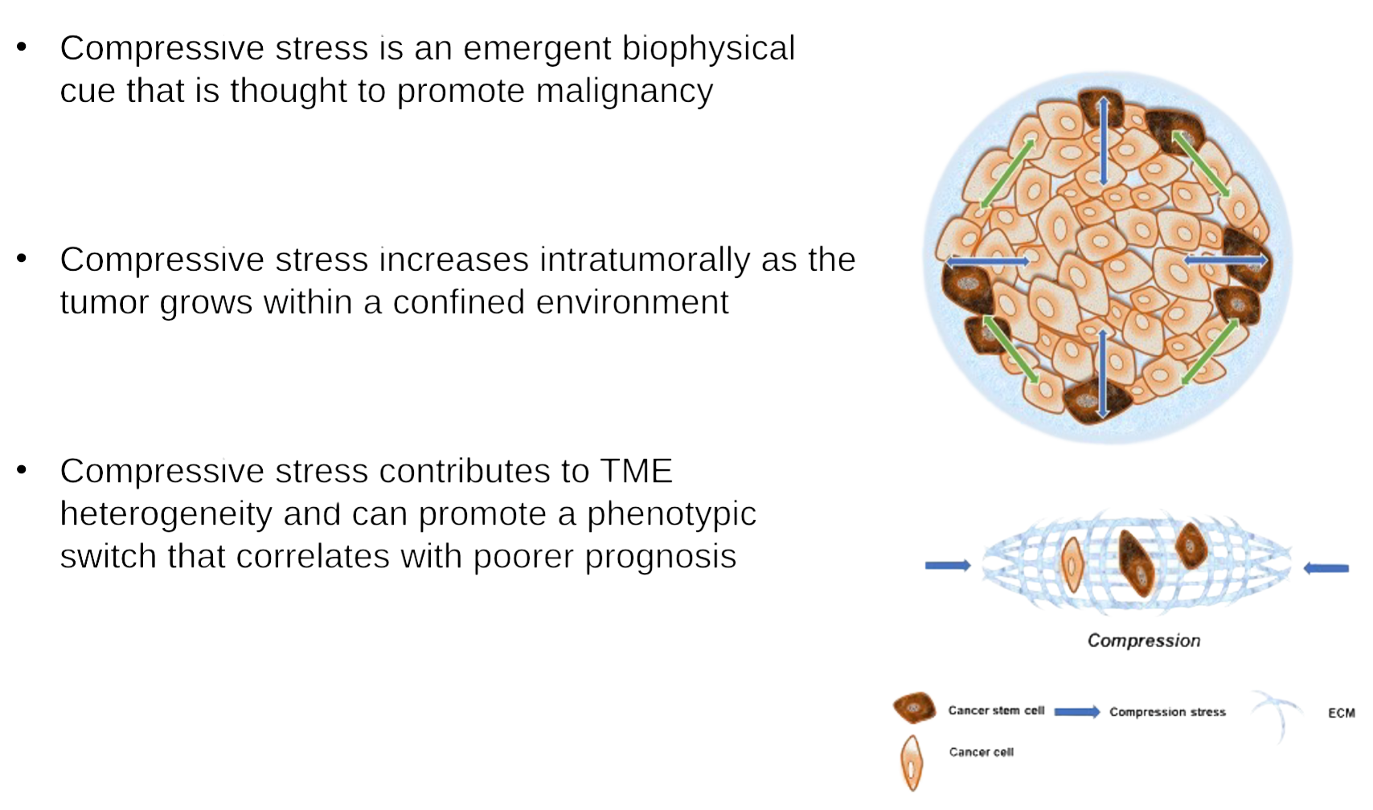
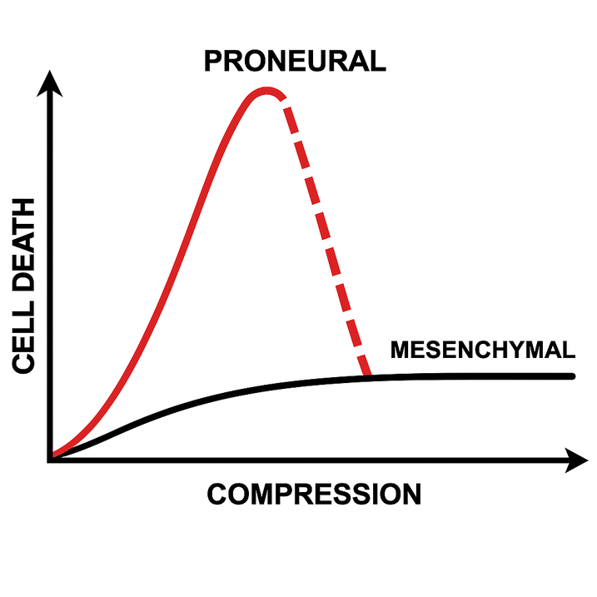
Compression
  Compressive stress is an emergent biophysical cue that is thought to promote malignancy
  Compressive stress increases intratumorally as the tumor grows within a confined environment
  Compressive stress contributes to the TME heterogeneity and can promote a phenotypic transition (proneural-mesenchymal) that correlates with poorer prognosis

Slide 11
Problem Definition
Notes:
Specifically the purpose of this project is to address two problems.
How does intra-tumoral compression develop over time?
How does intra-tumoral compression development differ among GBM subtypes

Slide 12
Lack of Tools: There is a lack of a reliable in vitro platform to quantify compressive stress as tumors develop over time or across phenotypes.
Knowledge Gap: Mechanical forces like ECM stiffness are well-understood however the role of intra-tumoral compression in driving GBM aggressiveness remains poorly understood.
Notes:
The first being, there is a lack of a reliable in vitro platform to quantify compressive stress within tumors over time.
The second being, that although mechanical forces are understood within cells, there is still a gap in understanding in how intra-tumoral compression drives GBM aggressiveness.

Slide 13
Objective
TO DEVELOP AN IN-VITRO PLATFORM TO QUANTIFY COMPRESSIVE FORCES OVER TIME AND ACROSS VARYING GBM AGGRESSIVENESS
Notes:
Per the Chen lab, we hypothesize that As compression increases within the tumor microenvironment, able cells adopt malignant characteristics. What does that mean? Well as we see here, as compression increases within the tumor microenvironment, so does cell death, which being cancer cells would be a good thing, but as we reach a certain threshold, there are cells that become resistant to the compressive stress and go from proneural to mesenchymal.

Slide 14
Project Specifics
Notes:
Understanding these problems let us get into how this project begins to solve them.

Slide 15
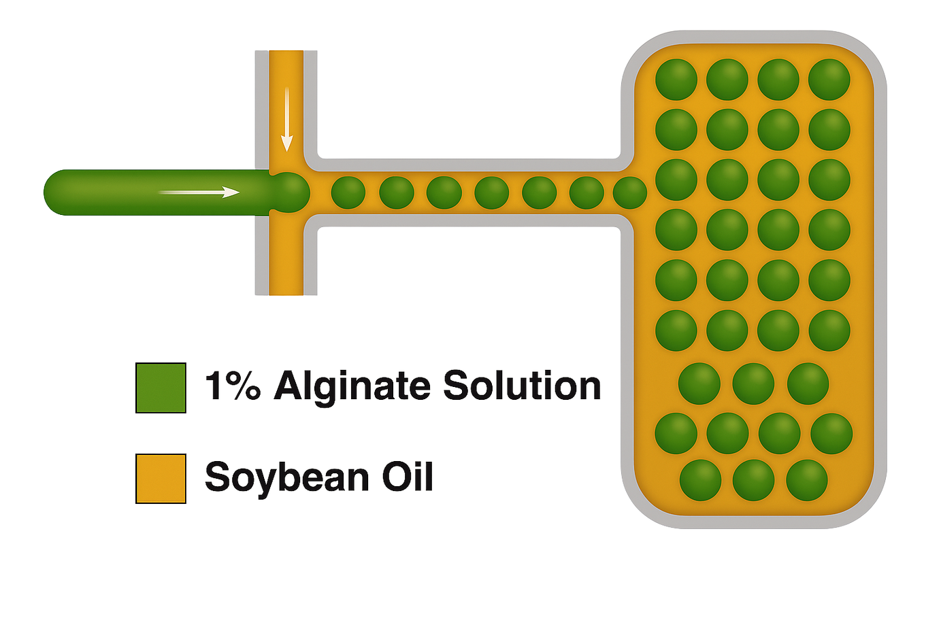
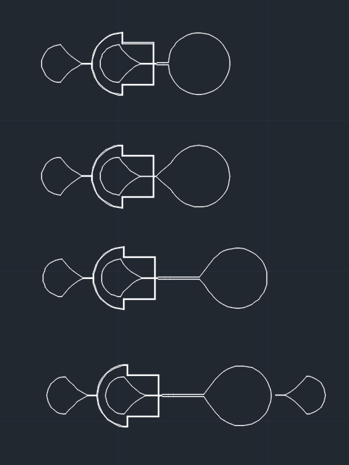
  (Inlet 3) Soybean Oil / 5% Surfactant (Sorbitan Monooleate)
  (Inlet 2) Alginate Fluorescein / 1% Phosphate Buffered Saline (PBS)
  (Outlet 3) Calcium Chloride collection outlet
“Water in oil” Method
1
2
3
Notes:
Our platform utilizes small microprobes that are able to be embedded within the tumor microenvironment, using a microfluidic device we are able to employ a "water in oil” method, in which we pump soybean oil and alginate fluorescein at various rates to create droplets that are then gelled using calcium chloride to isolate the microprobes.
Surfactant helps to reduce the surface tension between water/oil like emulsions to prevent them from separating
PBS Solubilizes the Alginate Amine/Fluorescein because they require to maintain in a constant state of ionization so they do not aggregate or protonate which would reduce their solubility
Calcium Chloride is used in the outlet to crosslink the alginate transforming the liquid alginate within the droplets into gel beads

Slide 16
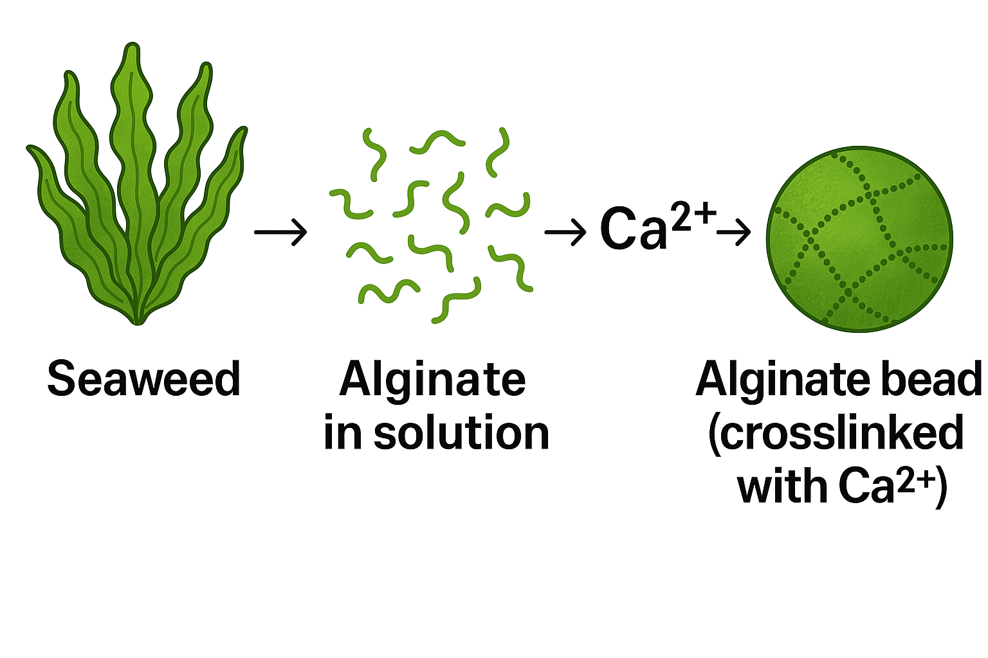
Alginate Background
Naturally derived anionic polymer with versatile applications
Offers biocompatibility, minimal toxicity, and low production cost
Gelation triggered by cations such as calcium (Ca²⁺)
Notes:
Alginate is a naturally derived anionic polymer that is cost effective and bio inert allowing for it to be utilized without impacting the tumor microenvironment.

Slide 17
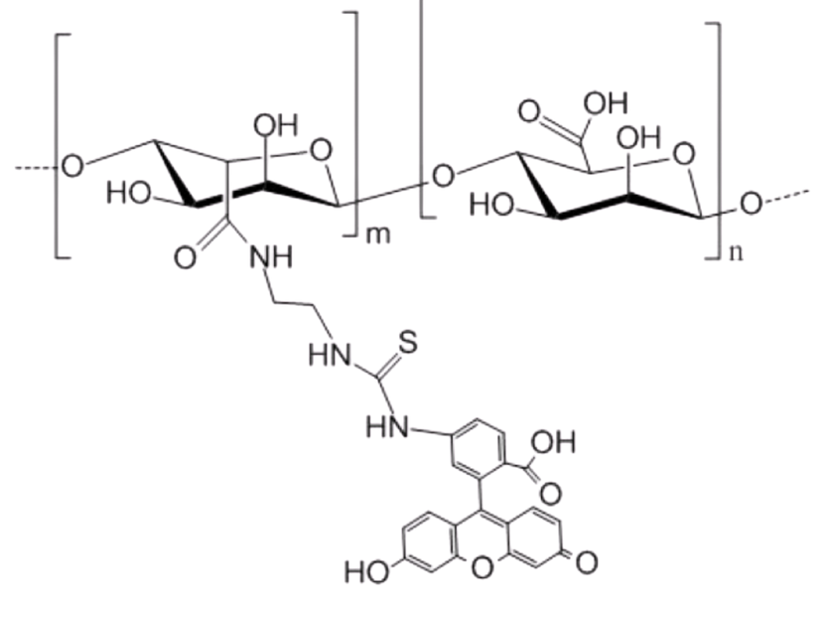
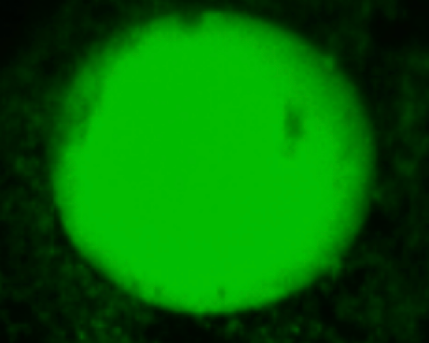
Alginate Fluorescein
  Excitation wavelength: 494 nm
  Emission wavelength: 518 nm
  Emits bright green fluorescence, ideal for confocal and fluorescence microscopy
Notes:
Specifically our platform utilizes Alginate Fluorescein, which is simply given fluorescent characteristics allows for intra-tumoral imaging of the probes by confocal and fluorescent microscopy.

Slide 18
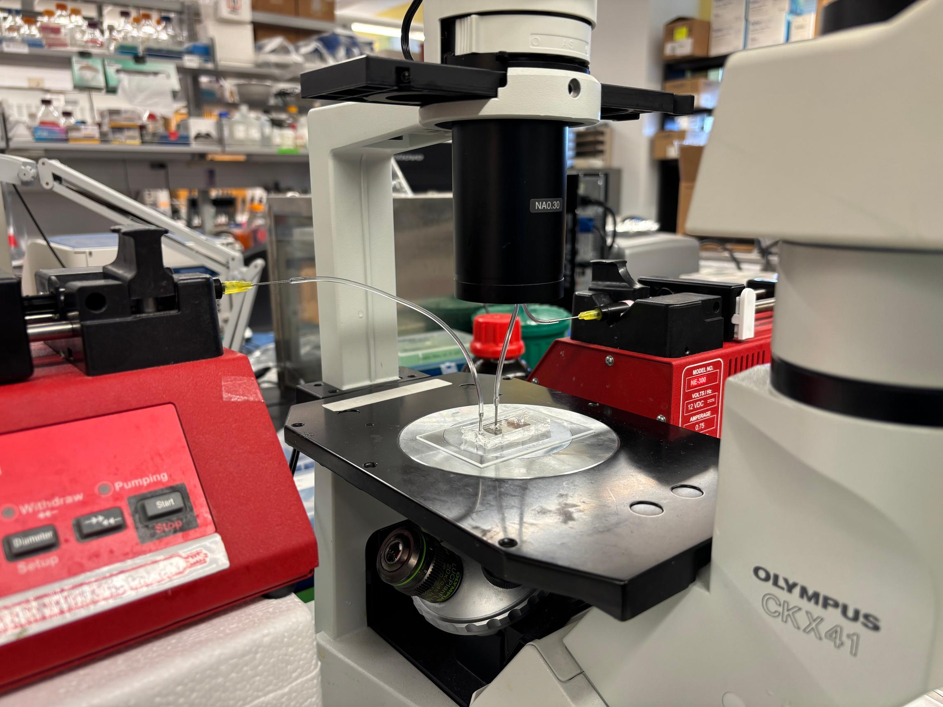
Microfluidic Design
Alginate Syringe
Oil Syringe
Syringe Pump
Microfluidic Device
Syringe Pump
Notes:
Here we have the experimental setup, in which two pumps pump microliters of our polymer and oil the microfluidic device which can all be observed under the microscope.

Slide 19

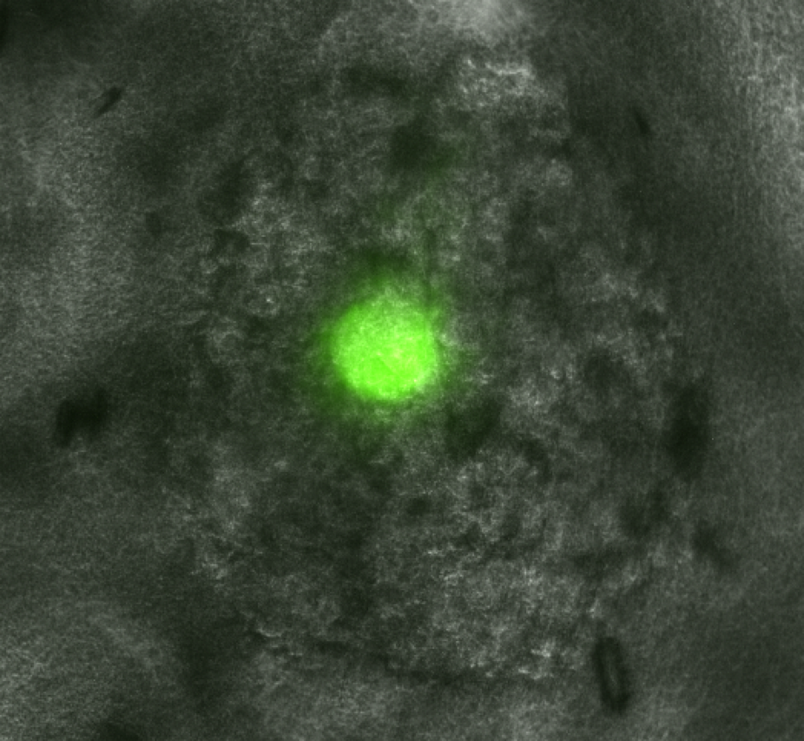
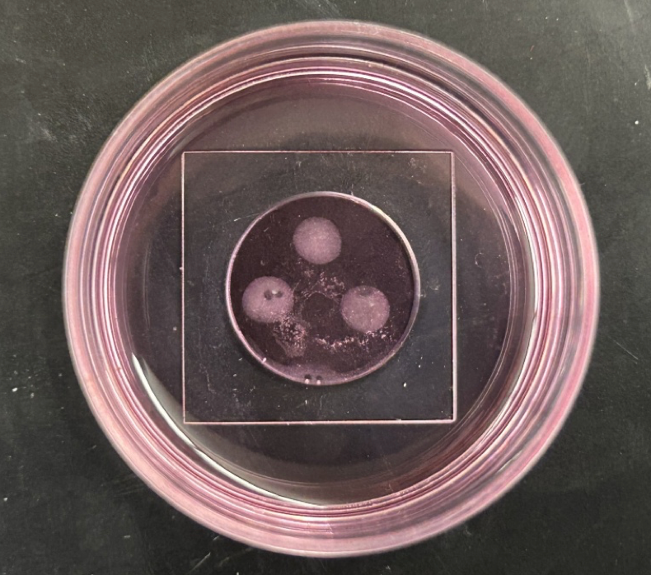
Embedding
  GSCs and collected microprobes were counted using a hemocytometer and mixed at a 100:1 ratio
  100 µL of the mixture was plated per well and incubated for 48 hours
  A hyaluronic acid (HA) matrix was used for its abundance in brain tissue
  3D HA gels were formed using HA, DTT (as a thiol-based crosslinker), and DMEM (nutrient rich cell culture media)
Three HA gels with GSC20 tumorspheres embedded, (right) fluorescent Alginate microbeads embedded in GSC20 tumorsphere captured at 20x magnification,
Notes:
Once we have generated and collected these microprobes we embed them into tumor spheres of differing GBM stem cell lines, all incapsulated in an hyaluronic acid matrix to mimic the brain.

Slide 20
Preliminary Results
Notes:
Now for the important bit.

Slide 21
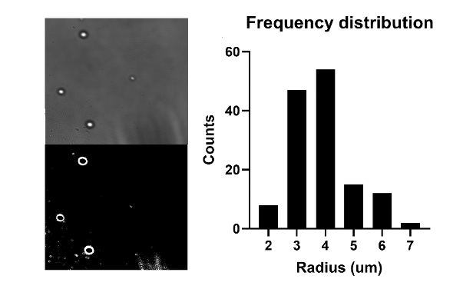
Probe Size
Notes:
Utilizing contrast features under a fluorescent microscope the median diameter of a microprobe came to be 6-8 micrometers.

Slide 22
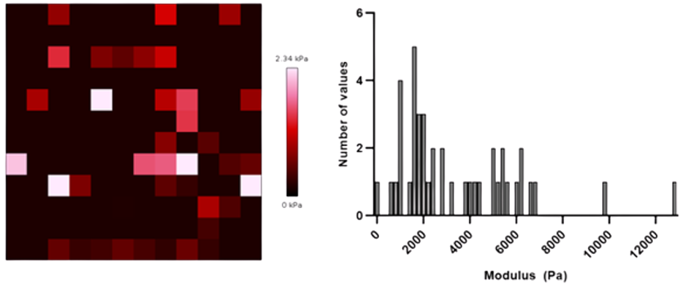
Probe Properties
Notes:
Then utilizing atomic force microscopy we were able to isolate the mechanical properties of our microprobes, in which we found that the median stiffness was 2 kPa.

Slide 23
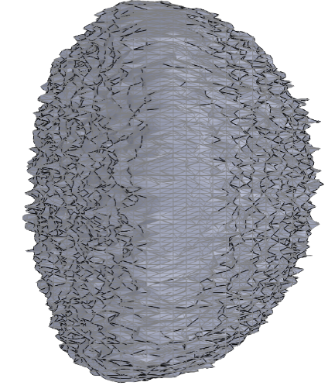
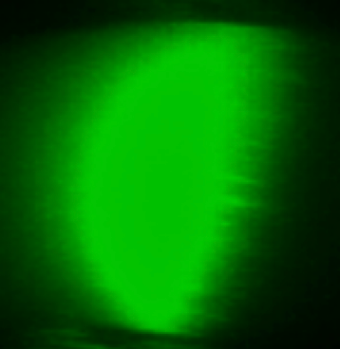
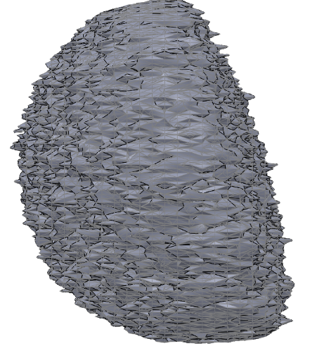
Probe Mesh Body
Notes:
Following the embedding we were able to capture imaging within the tumor microenvironment in which the microprobe is deformed by compressive forces. Utilizing imageJ and solid works a mesh body was then generated to be studied.

Slide 24
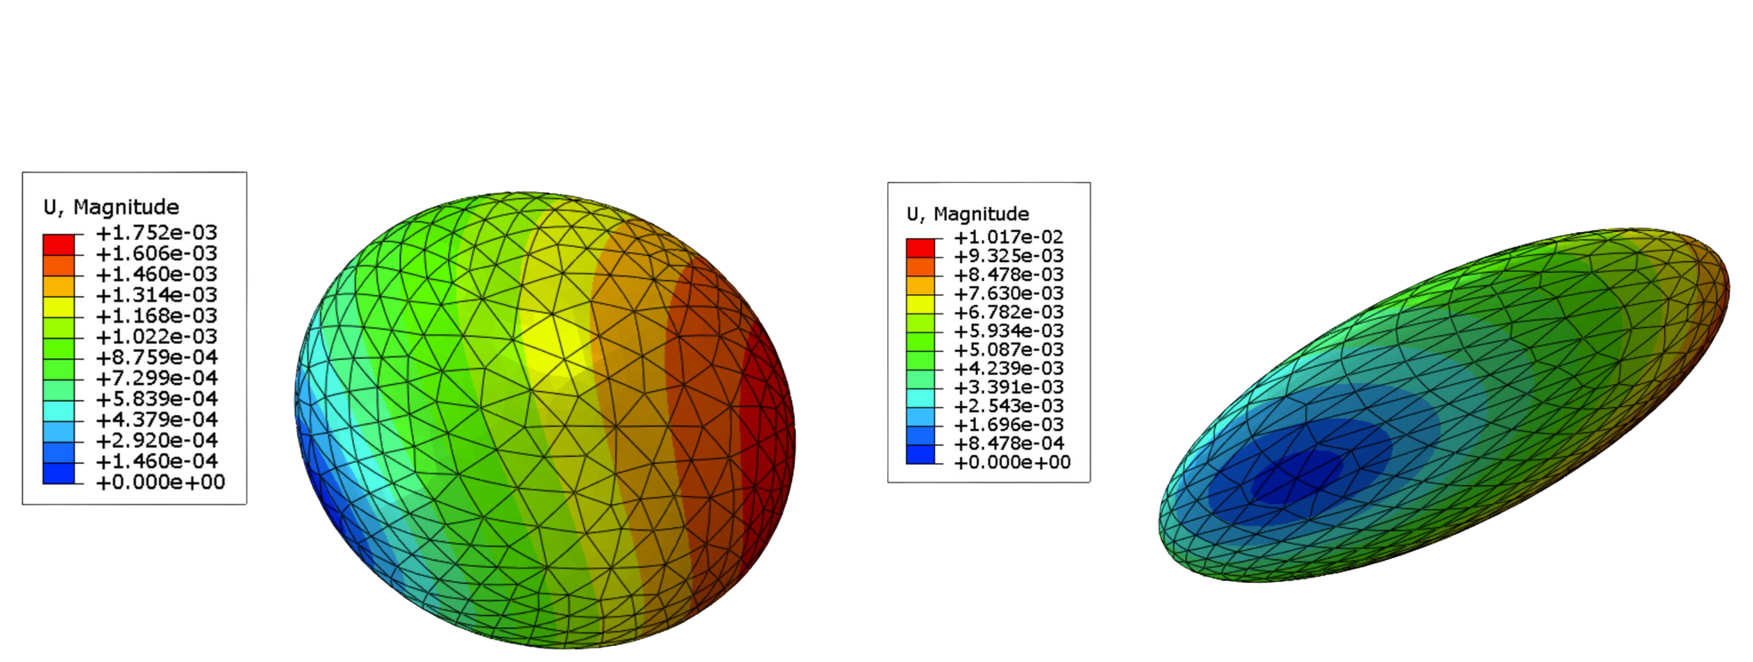
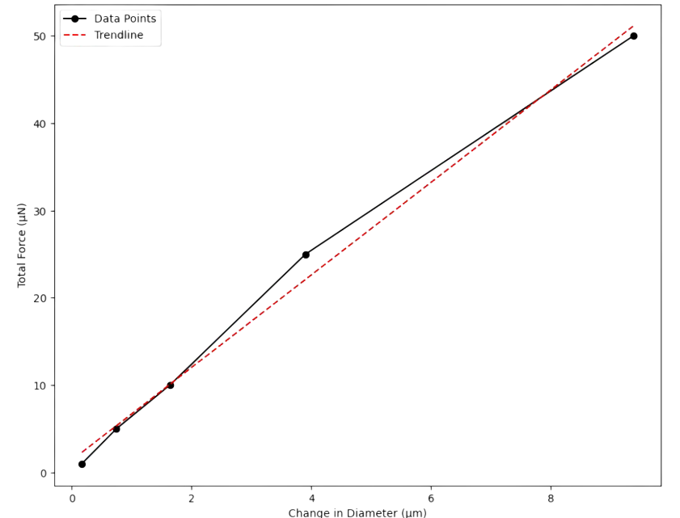
Probe Quantification
10 MICRO-NEWTON TOTAL FORCE
µ
TOTAL FORCE( N)
50 MICRO-NEWTON TOTAL FORCE
µ
CHANGE IN DIAMETER( M)
(MATTHEW PRIDDY, PHD)
Notes:
Through collaboration with Dr. Matthew Priddy at Mississippi state these mesh bodies were used to study the effect of various compressive forces on the probes to gauge their effectiveness, here we see that the beads are capable of demonstrating compressive loads.

Slide 25
Conclusions
  PDMS-based microfluidic devices enable controlled production of alginate force probes.
  AFM analysis verified uniform probe morphology and mechanical stiffness.
  FEA confirmed consistent alginate probe deformability under compression.
  Embedding and imaging in tumors validated the platform for in vitro compression modeling.
Notes:
Through this project we have concluded that pdms based microfluidic devices allow for the generation of force probes, probes were of a good size, the mechanical properties of the probes are suitable, finite element analysis confirms the ability to be deformed, and most importantly the embedding and imaging of probes within tumor validates the platform’s capability to qualify in vitro compression.

Slide 26
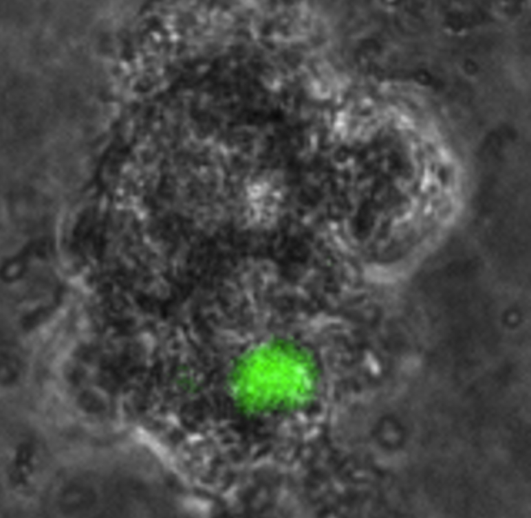
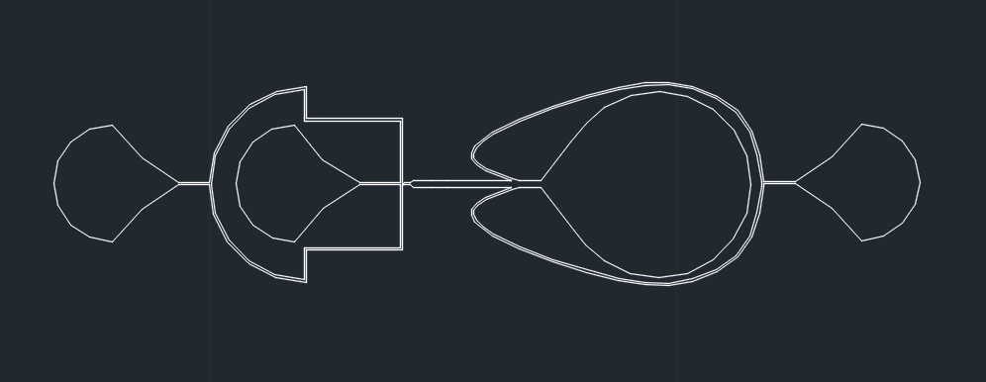
Future Work
  TRACK COMPRESSIVE STRESS OVER TIME TO MONITOR PROGRESSION
  COMPARE STRESS PROFILES ACROSS TUMORS OF VARYING AGGRESSIVENESS
  OPTIMIZE MICROFLUIDIC DEVICE
Notes:
Some future work includes optimizing the embedding process, long term storage, tracking compressive force over time, compare stress profiles of varying gbm phenotypes, gathering enhanced AFM data, and optimizing the microfluidic device.

Slide 27
Acknowledgements
Project Mentor-Bryce Thompson, MEng, UofL
REU Mentor-Dr. Joseph Chen, PhD, UofL
REU Program Manager-Ana Sanchez Galiano,MEng,UofL
REU Director-Dr. Kevin Walsh, PhD, UofL
Collaborator- Dr. Matthew Priddy, PhD, Mississippi State
Micro and Nano Technology Center, UofL
Additive Manufacturing Institute of Science & Technology, UofL

Slide 28

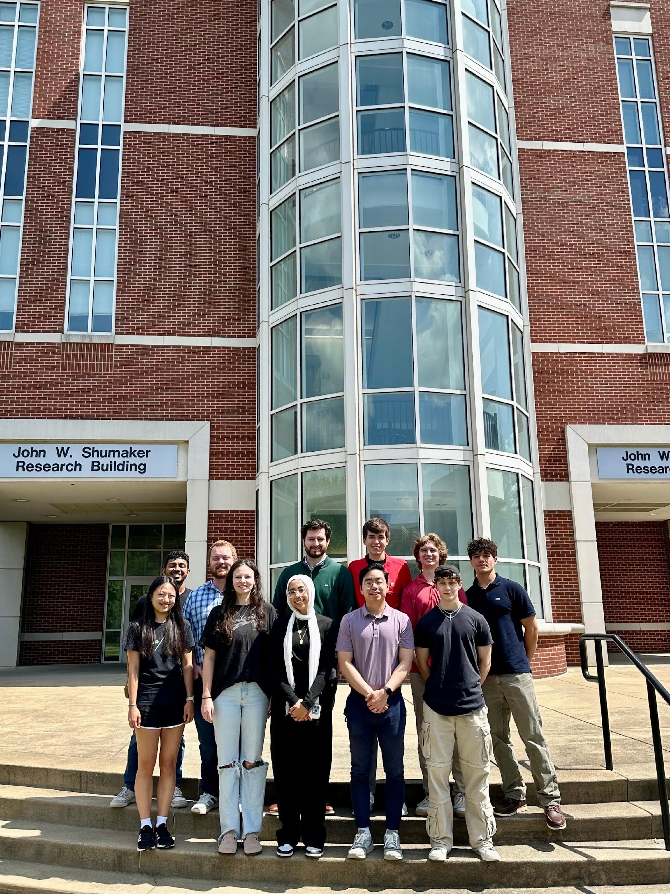
Notes:
Thank you to Dr. Chen and all of my lab mates for their invaluable help.

Slide 29
REFERENCES
  CHEN, J., LEE, H., SCHMITT, P., CHOY, C. J., MILLER, D. M., WILLIAMS, B. J., BEARER, E. L., & FRIEBOES, H. B. (2021). BIOENGINEERED MODELS TO STUDY MICROENVIRONMENTAL REGULATION OF GLIOBLASTOMA METABOLISM. JOURNAL OF NEUROPATHOLOGY & EXPERIMENTAL NEUROLOGY, 80(11), 1012–1023. https://doi.org/10.1093/jnen/nlab092
  Dhamecha, D., Movsas, R., Sano, U., & Menon, J. U. (2019). Applications of alginate microspheres in therapeutics delivery and cell culture: Past, present and future. International Journal of Pharmaceutics, 569, 118627. https://doi.org/10.1016/j.ijpharm.2019.118627
  Glioblastoma (GBM) - american brain tumor association | learn more. (n.d.). https://www.abta.org/tumor_types/glioblastoma-gbm/
  Lee, K. Y., & Mooney, D. J. (2012). Alginate: properties and biomedical applications. Progress in Polymer Science, 37(1), 106–126. https://doi.org/10.1016/j.progpolymsci.2011.06.003
  Mahaffey, B. J., Fowler, Z. P., Lung, Z., Dang, V., Lee, H., Johnson, A. M., Munoz, M. A., Goodin, D. A., Frieboes, H. B., Williams, B. J., & Chen, J. (2024). The prognostic effect of mechanical, ultrastructural, and ECM signatures in glioblastoma core and rim. APL Bioengineering, 8(3), 036101. https://doi.org/10.1063/5.0203570
  Mohagheghian, E., Luo, J., Chen, J., et al. (2018). Quantifying compressive forces between living cell layers and within tissues using elastic round microgels. Nature Communications, 9, 1878. https://doi.org/10.1038/s41467-018-04245-1
  Nguyen, V. B., Wang, C. X., Thomas, C. R., & Zhang, Z. (2009). Mechanical properties of single alginate microspheres determined by microcompression and finite element modelling. Chemical Engineering Science, 64(5), 821–829. https://doi.org/10.1016/j.ces.2008.10.050
  Pogoda, K., Chin, L., Georges, P. C., Byfield, F. J., Bucki, R., Kim, R., Weaver, M., Wells, R. G., Marcinkiewicz, C., & Janmey, P. A. (2014). Compression stiffening of brain and its effect on mechanosensing by glioma cells. New Journal of Physics, 16, 075002. https://doi.org/10.1088/1367-2630/16/7/075002
  Rodgers, L. T., Villano, J. L., Hartz, A. M. S., & Bauer, B. (2024). Glioblastoma standard of care: Effects on tumor evolution and reverse translation in preclinical models. Cancers (MDPI), 16(15), 2638. https://www.mdpi.com/2072-6694/16/15/2638
  Teer, L., Yaddanapudi, K., & Chen, J. (2024). Biophysical control of the glioblastoma immunosuppressive microenvironment: Opportunities for immunotherapy. Bioengineering (Basel), 11(1), 93. https://doi.org/10.3390/bioengineering11010093

Slide 30
Questions?
NSF REU Award ID #2348869
NSF NNCI Award ID # 2025075​

