Slide 1






Improving Mechanical Strength of Agarose Hydrogels via Desmodur Crosslinking
By: Valerie Lentine
Mentors: Jonthan Geiger and Sondai Riddick
PI: Dr. Jerald Dumas

Slide 2
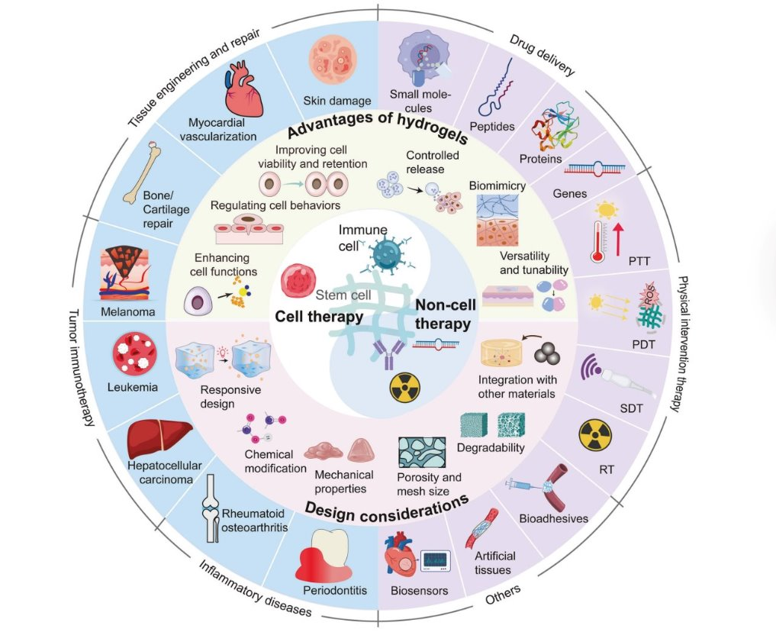
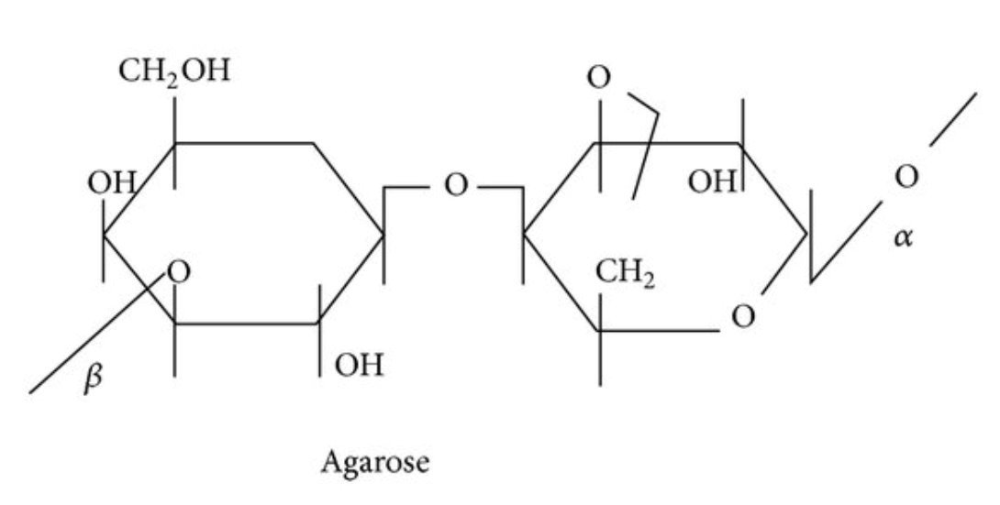
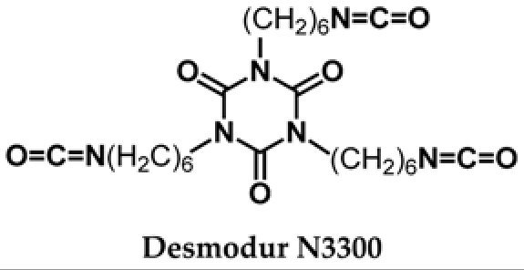
Background
Agarose hydrogels have one major drawback:
  Brittleness
Our Approach:
  Add Desmodur to form urethane crosslinks
  Creates a stronger, more stable hybrid agarose–polyurethane hydrogel
Figure 2. Structure of agarose, a natural polysaccharide used in hydrogel systems for its gel-forming properties. Adapted from [2].
Figure 3. Chemical structure of Desmodur N3300, a trifunctional isocyanate crosslinker used to improve mechanical strengthening hybrid hydrogels. Adapted from [3].
Figure 1. Illustration highlighting the versatility of hydrogel-based biomaterials in biomedical applications. Adapted from Zhou et al. [1].

Slide 3
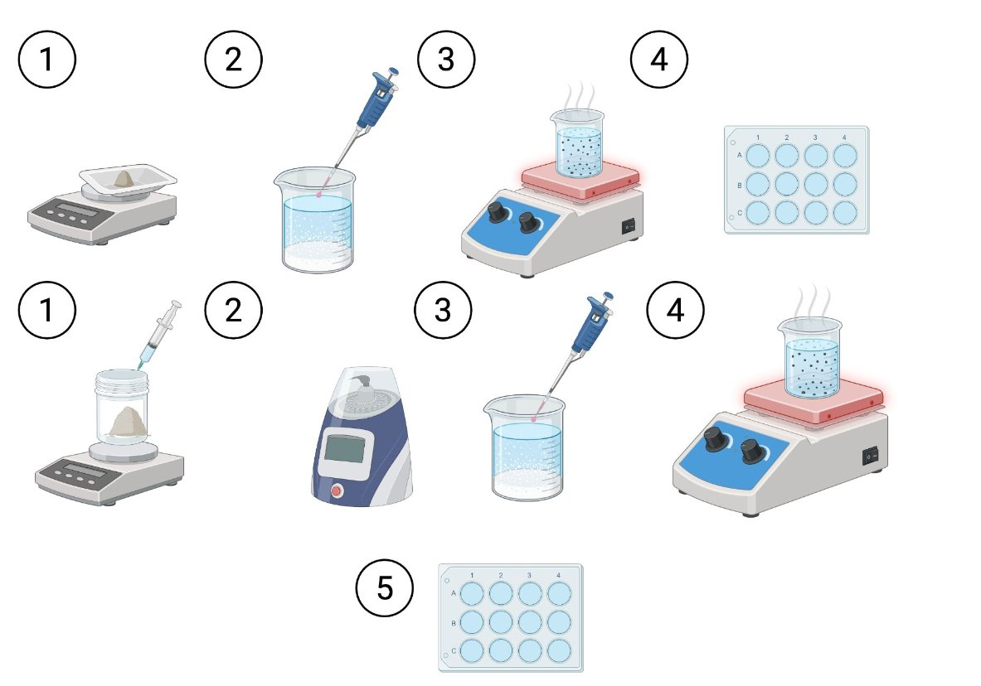
Synthesis
Outcome:
  Compared unmodified vs. crosslinked gels
  Assessed effects of concentration & crosslinking
Figure 4. Agarose is dissolved in Tris buffer for both gels, then mixed with a Desmodur prepolymer blend and cast into molds to form a crosslinked hydrogel.

Slide 4
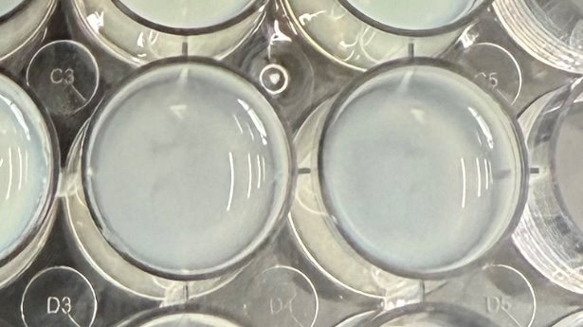
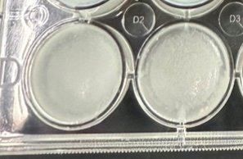
Synthesis
Desmodur Gels:
  More rigid and stable
  Textured, defined surface
Agarose Gels:
  Softer
  Smooth, less structured
Conclusion:
  Improved structural integrity
  Likely due to urethane crosslinking
    Agarose hydroxyl groups and Desmodur isocyanates
Figure 5. Agarose gel, prepared at 1% concentration.
Figure 6. Agarose gel with Desmodur added at 1% concentration.

Slide 5
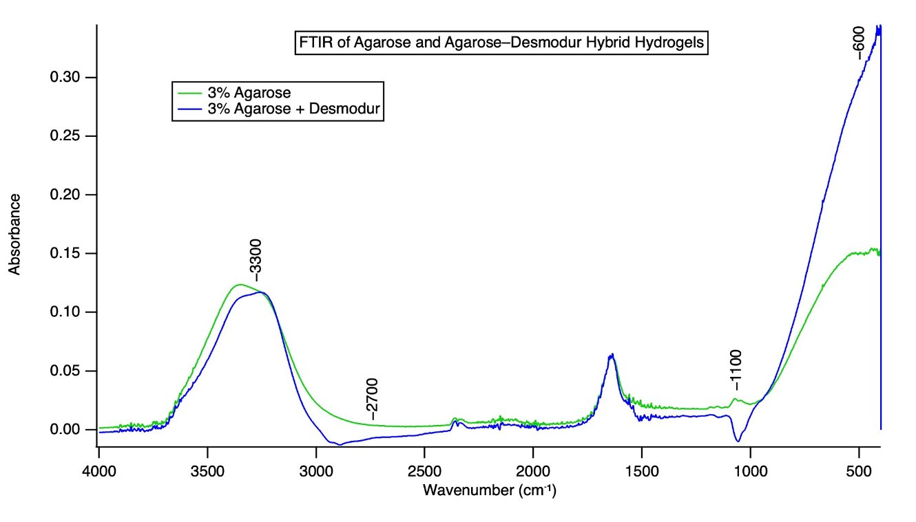
FTIR Spectra
O–H Stretching (~3300 cm⁻¹):
  Hydrogen bonding with urethane groups and agarose–OH groups.
C–O / C–N Stretching (1000–1100 cm⁻¹):
  Key urethane region
  Reflect a reduction in free hydroxyl-containing groups
    Chemical bonding with isocyanate groups from Desmodur.
Backbone Vibrations (~600 cm⁻¹):
  Agarose alone does not absorb strongly in this range
  Jump seen in the hybrid gel
    Consistent with vibrational features from the formation of urethane bonds.
Figure 7. FTIR analysis shows spectral differences between 3%agarose and 3% Desmodur-crosslinked hydrogels.

Slide 6
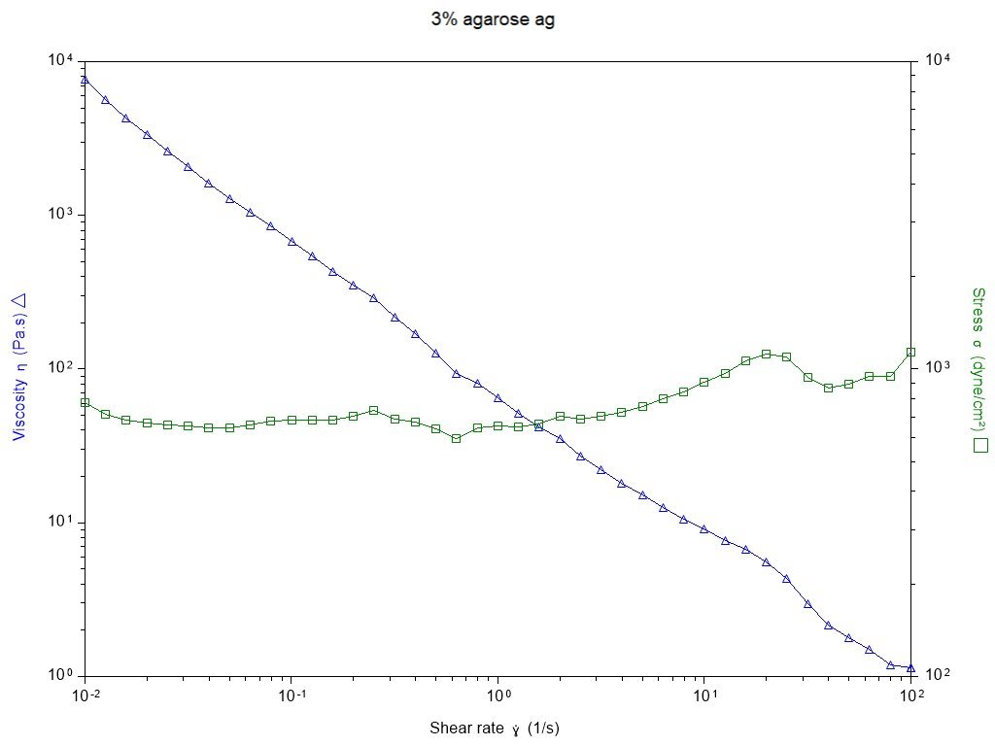
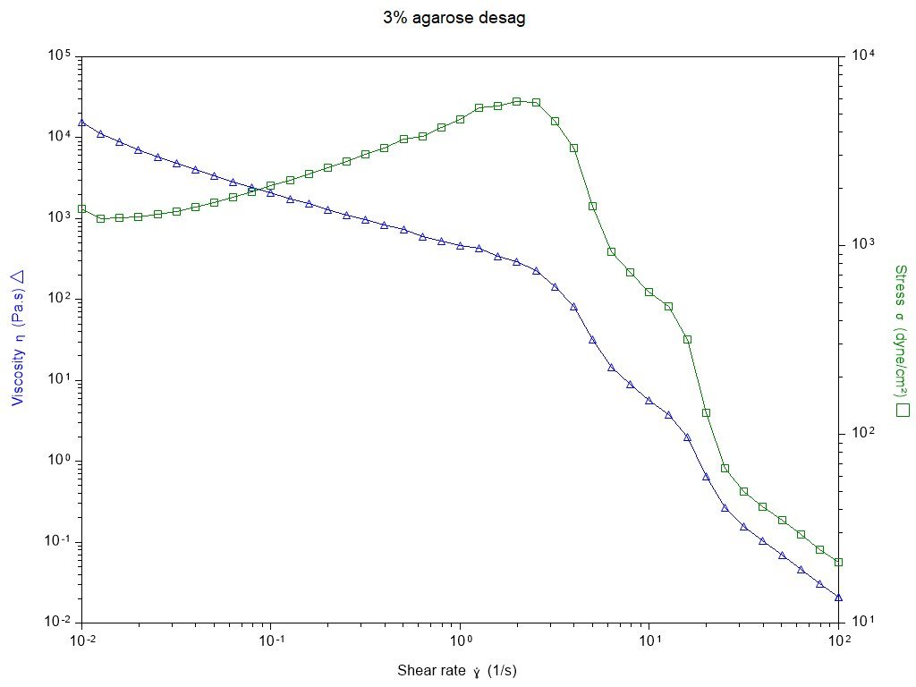
Mechanical Testing
Figure 8. Rheological behavior of 3% agarose gels without Desmodur. Viscosity (blue) decreases steadily.
Figure 9. Rheological behavior of 3% agarose gel with Desmodur crosslinker.
Desmodur gel showed higher viscosity across all shear rates
Indicates greater resistance to flow → stiffer, stronger gel
Confirms Desmodur strengthens the agarose network via urethane crosslinking

Slide 7
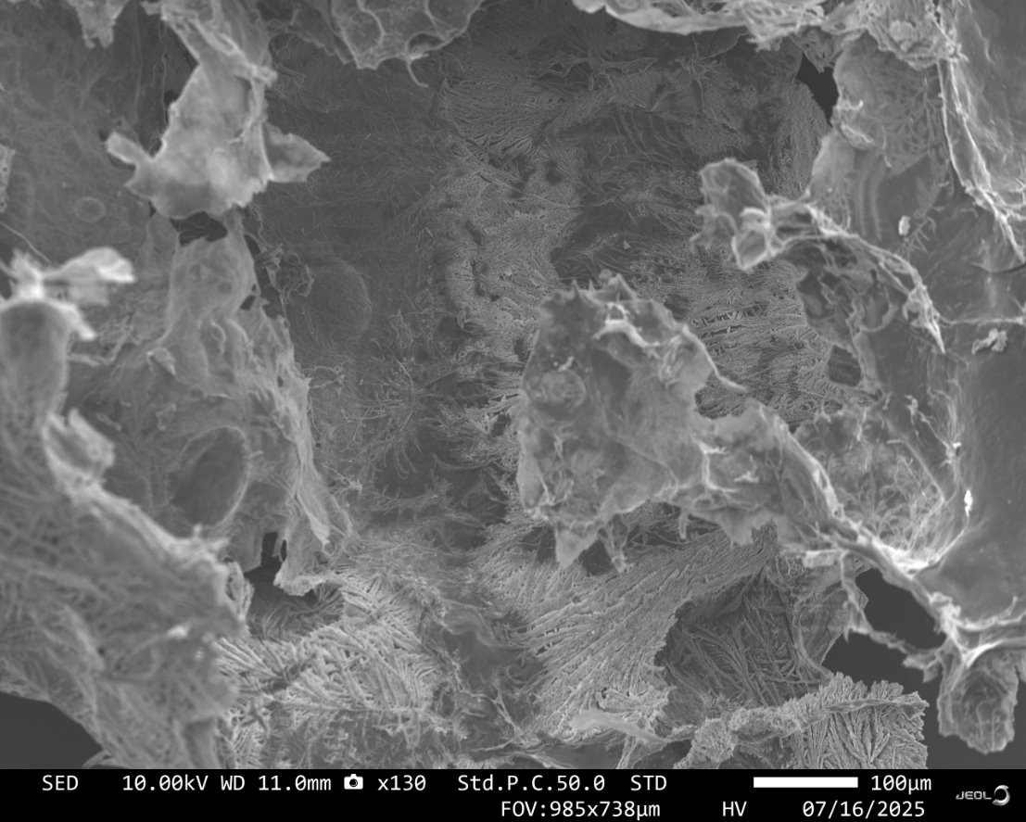
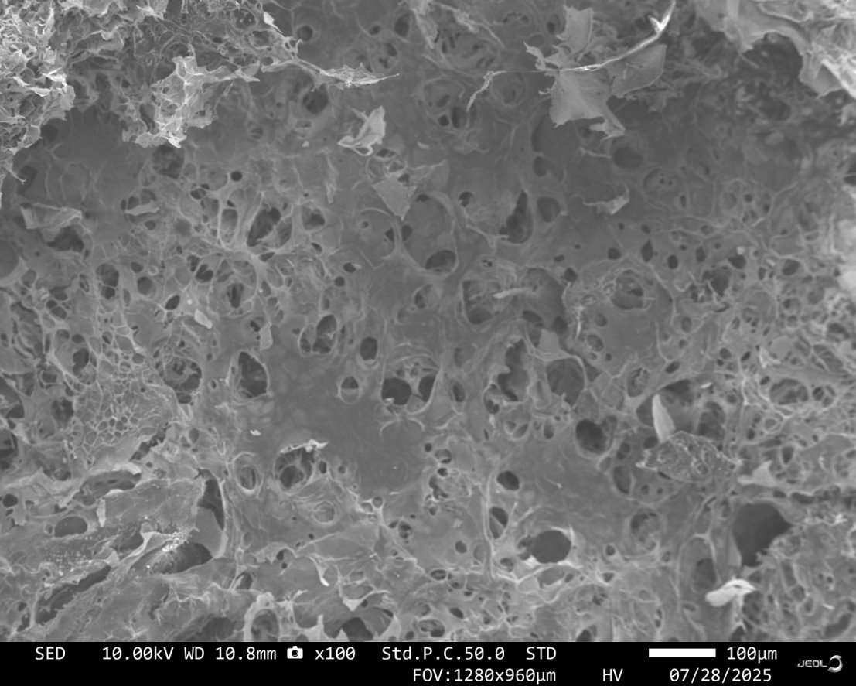
Scanning Electron Microscopy
Figure 10. SEM image of unmodified 5% agarose hydrogel showing a tight, fibrous network.
Figure 11. SEM image of 5% Desmodur crosslinked agarose hydrogel. The more porous structure results from chemical modification.
Agarose-only gel: tight, fibrous microstructure
Desmodur gel: more porous, open network
Crosslinked gels showed greater rigidity despite porosity
Suggests strength comes from chemical crosslinks, not just structure
SEM supports morphological changes due to Desmodur incorporation

Slide 8
Conclusion and Future Direction
Desmour crosslinking improved agarose hydrogel rigidity and mechanical strength
  FTIR and SEM data support successful chemical modification and structural changes
  Rheology confirmed enhanced resistance to flow and deformation
These results show promise for tailoring hydrogels to suit specific biomedical needs
Next Steps:
  Explore 3D printing of unmodified agarose
    Enables precise control over scaffold geometry
    Supports fabrication of complex, tissue-specific structure

Slide 9
Acknowledgment
Thank you to Dr. Dumas, Jonathan Geiger and Sondai Riddick for their mentorship and support, as well as the BPEL lab group for their guidance and collaboration.
This work was performed at the Joint School of Nanoscience and Nanotechnology, a member of the National Nanotechnology Coordinated Infrastructure (NNCI), which is supported by the National Science Foundation (Grant ECCS-2025462)

Slide 10
References
[1] Thermo Fisher Scientific. (2015). Organic Functional Group Characterization by FTIR Spectroscopy
[Poster]. Thermo Fisher Scientific.
[2] Badri, A., Razak, S., Nawawi, W. I., Sabani, N., Norizan, M. N., Abul Shukor, A., & others. (2023).
Synergistic effect of agarose biopolymer gel electrolyte with modified TiO₂ for low-cost electrochemical device
applications. Polymer Bulletin, 80(9), 9437–9450. https://doi.org/10.1007/s00289-022-04524-4
[3] ResearchGate. (2015). Structure of agarose [Figure]. In Preparation, Optimization and Screening of the
Effect of Processing Variables on Agar Nanospheres Loaded with Bupropion HCl by a D-Optimal Design.
https://www.researchgate.net/publication/277930055_Preparation_Optimization_and_Screening_of_the_Effect_o
f_Processing_Variables_on_Agar_Nanospheres_Loaded_with_Bupropion_HCl_by_a_D-
Optimal_Design/figures?lo=1
[4] MDPI. (2018). Bio-Based Polyurethane Coatings Derived from Renewable Isocyanates and Polyols: Recent
Progress and Future Perspectives. Gels, 4(3), 66. https://www.mdpi.com/2310-2861/4/3/66

