Slide 1






Performance Effect of Graphene Placement on GR-QD Hybrid Photodetectors
By
John Navarro
University of California San Diego &
San Diego Nanotechnology Infrastructure (SDNI)
Faculty PI: Oscar Vazquez Mena, Department of Aiiso Yufeng Li Family Department of Chemical and Nano Engineering, UC San Diego
Mentor: Freddy Garcia and Suraj Patel, Department of Chemical and Nano Engineering, UC San Diego
Presented at the 2025 NNCI REU Convocation, University of California San Diego, CA
August 4-5, 2025

Slide 2
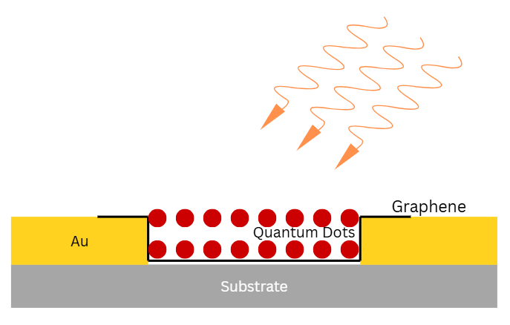
Gr-PbS Hybrid Photodetector
PbS QDs absorb incident light and generate electron-hole pairs, but are poor electron and hole conductors.
Graphene provides transportation with high carrier mobility and fast response time.
Promising for: IR cameras, wearable sensors, optical communication, and flexible and printed electronics.
Photons
QDs on Top

Slide 3
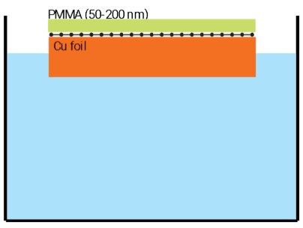
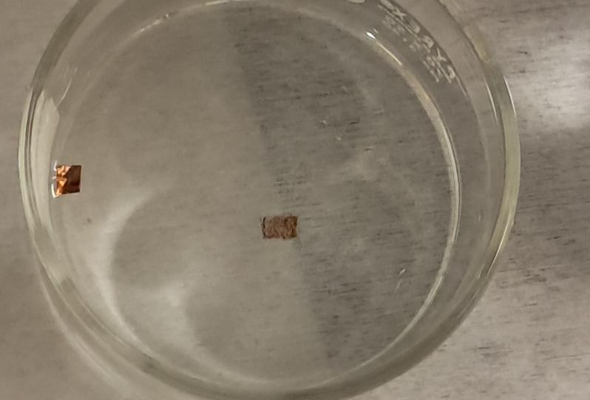
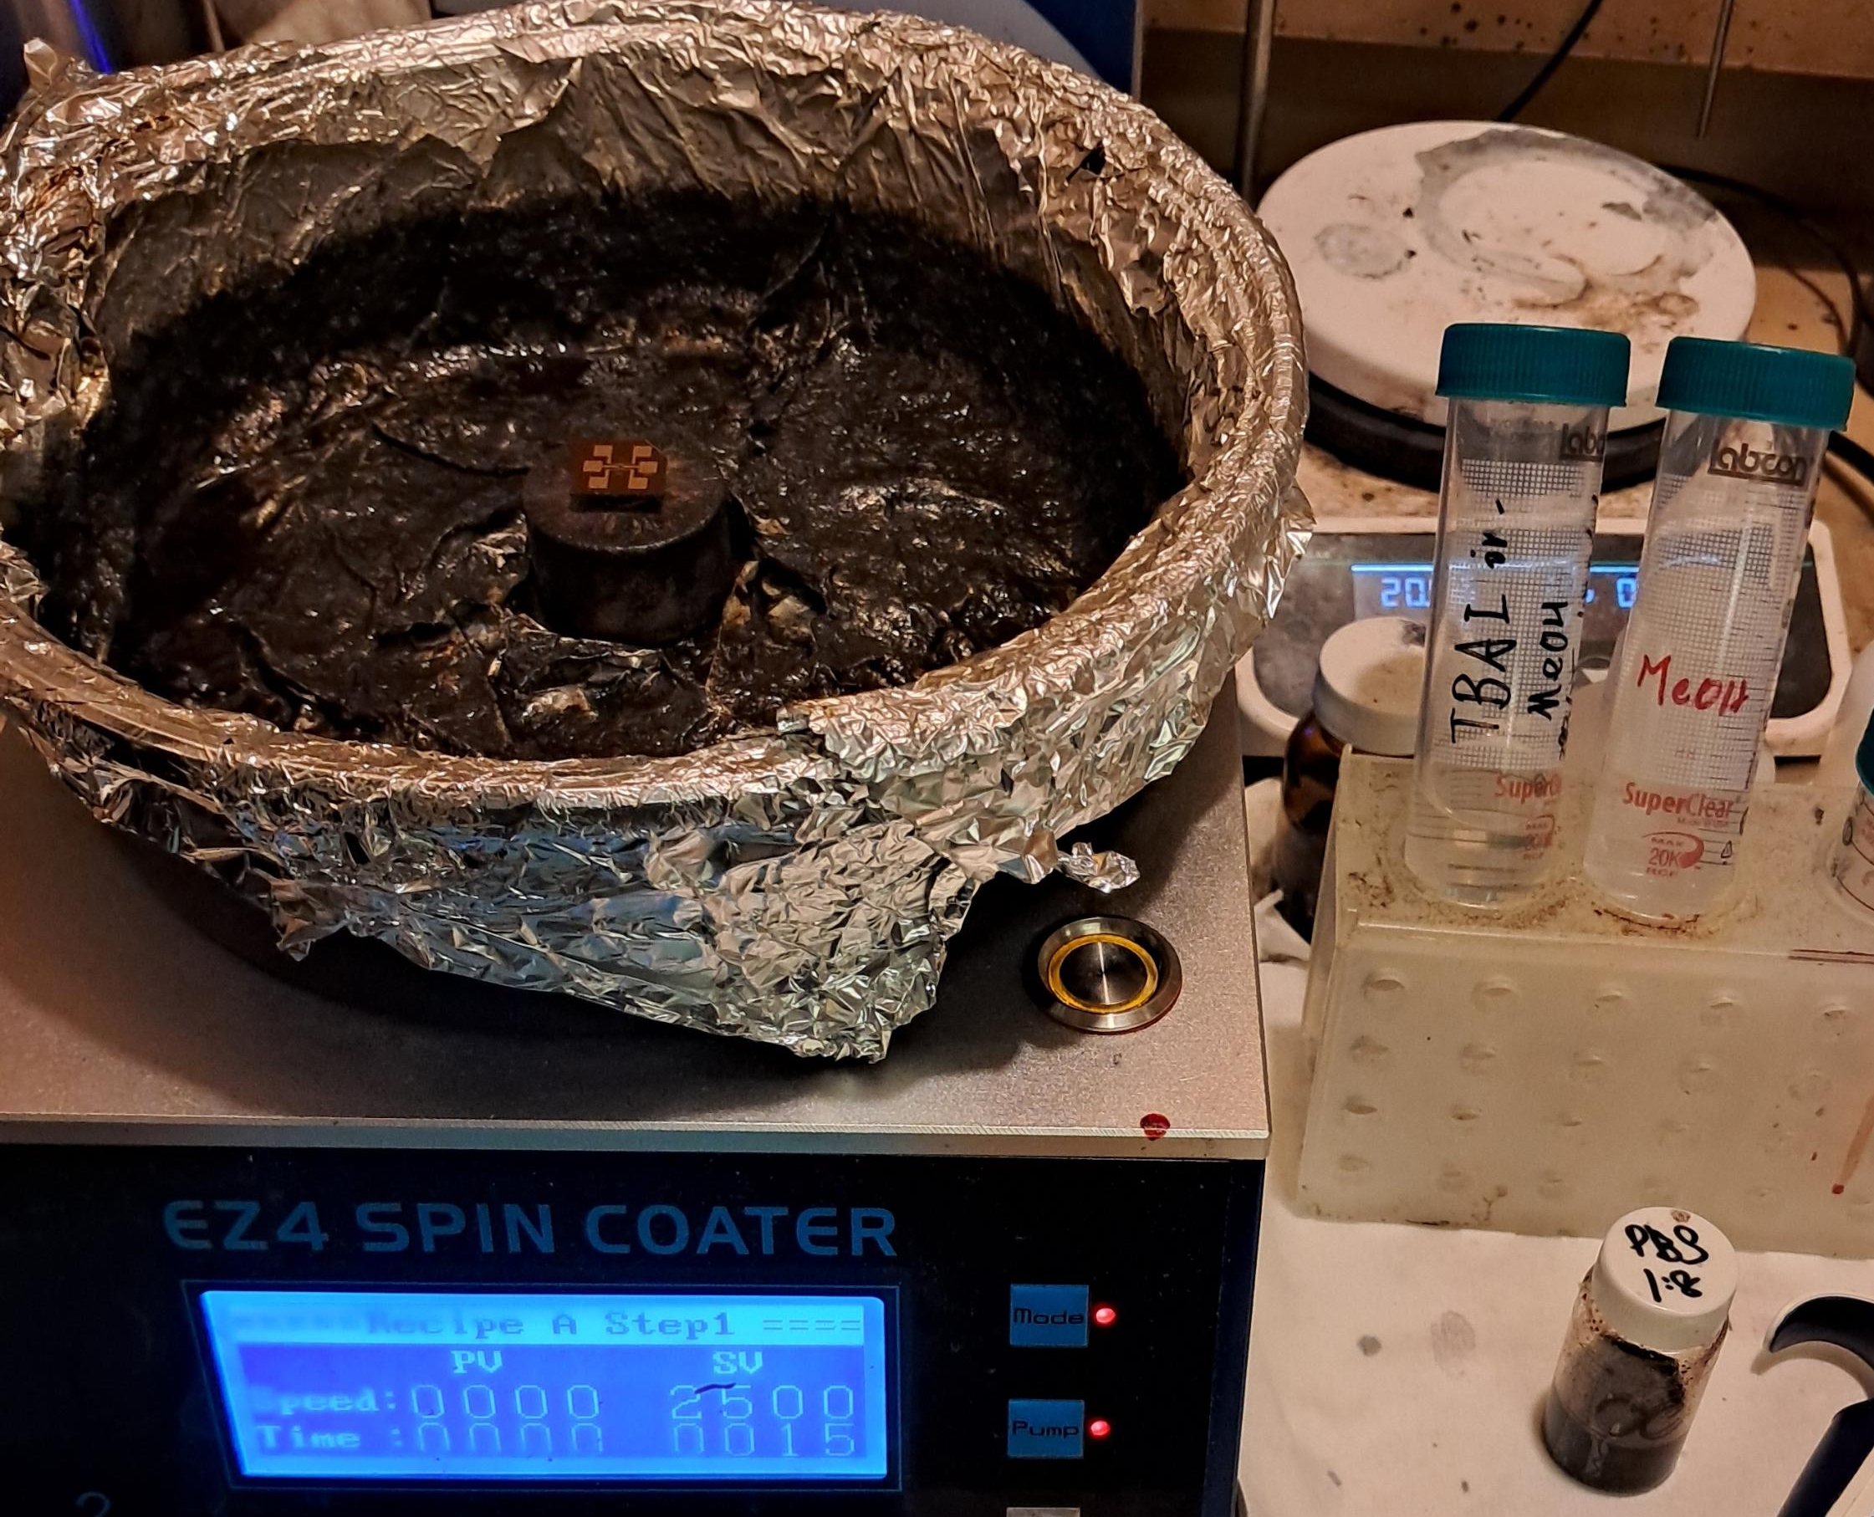
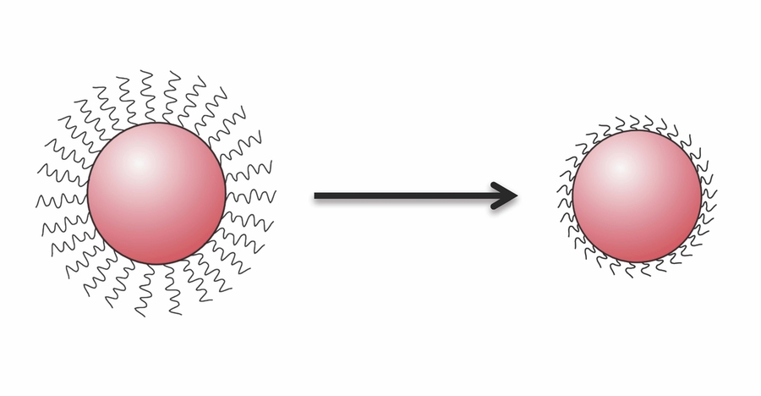
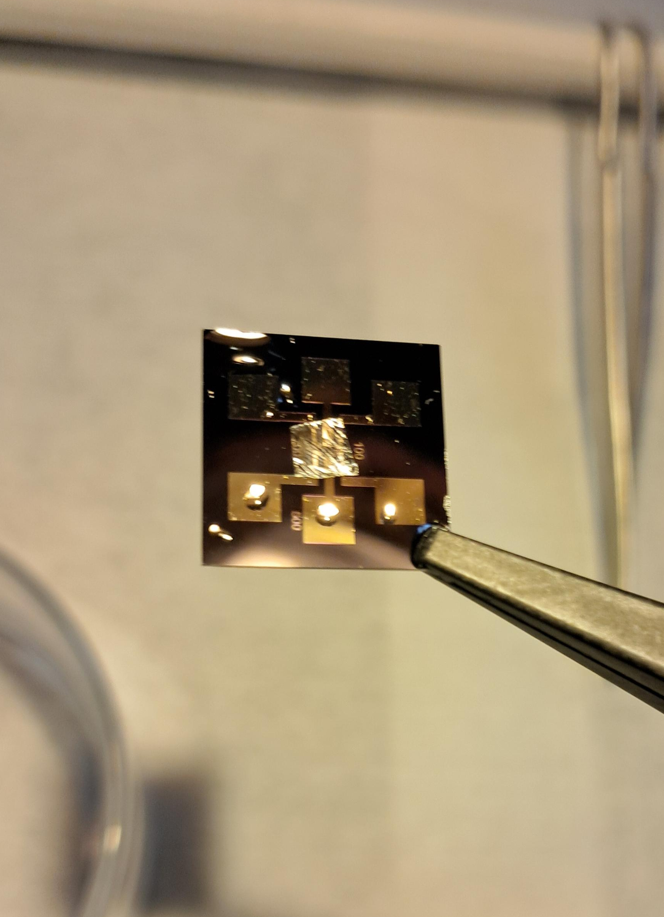
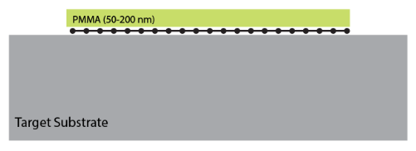
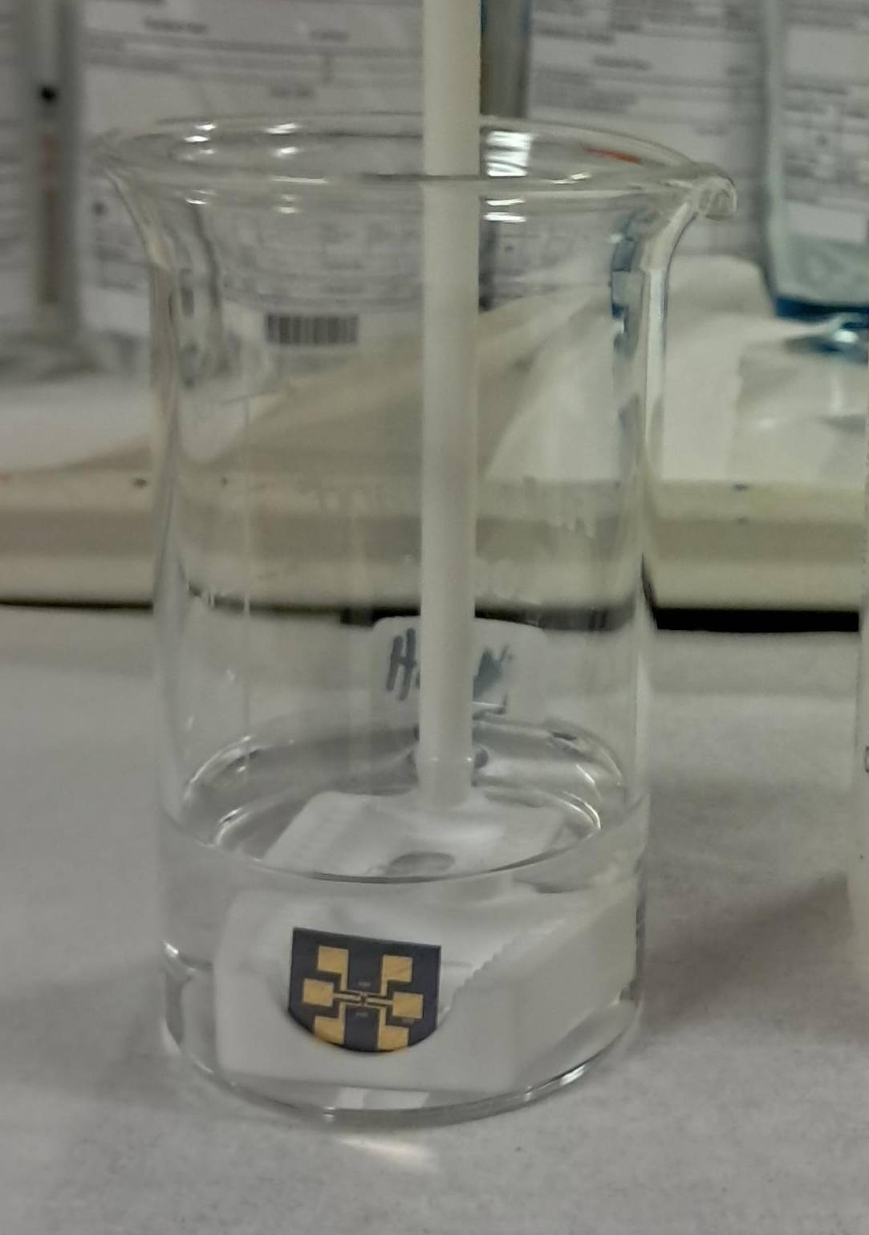
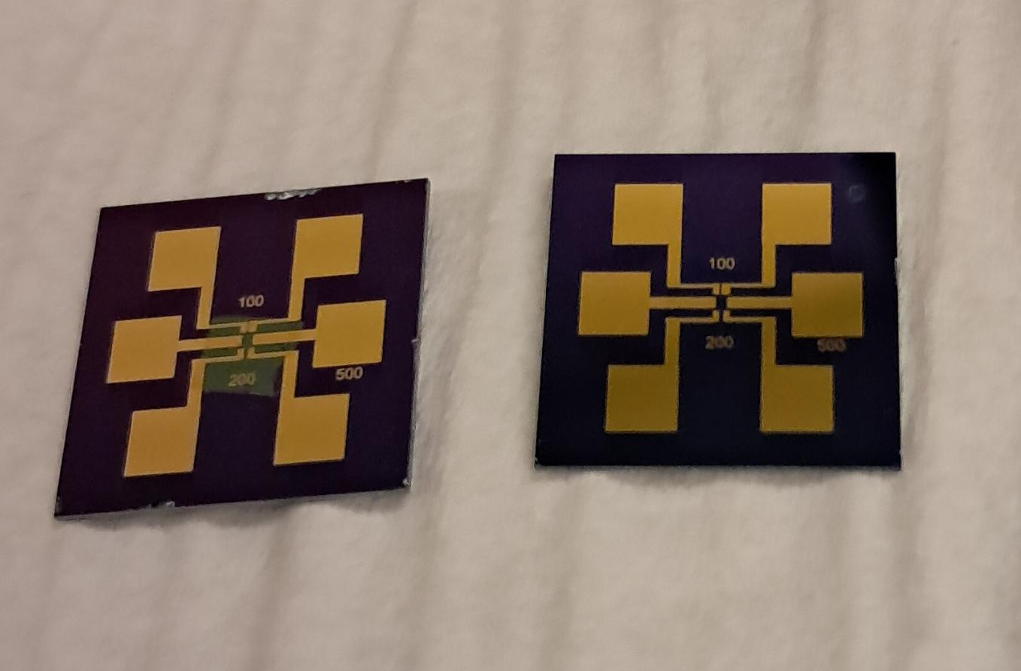
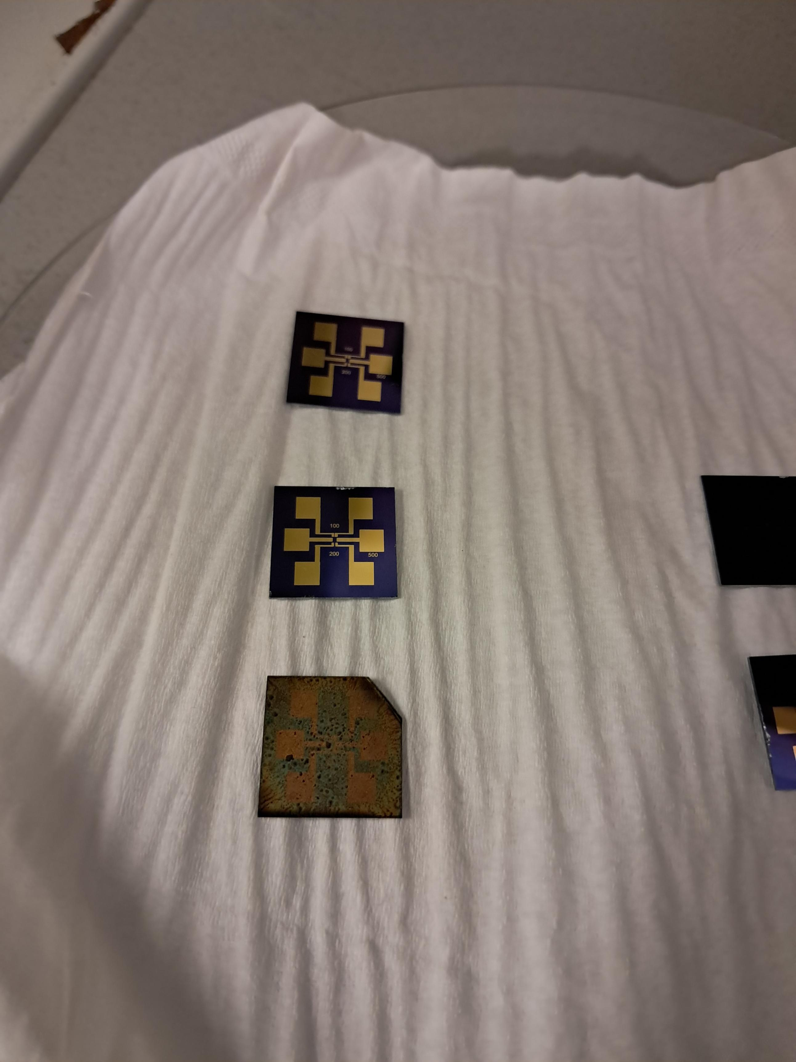
Photodetector Fabrication
Wet Transfer
Spin Coating
PbS QDs spin-coated onto chip using
Tetra-n-butylammonium iodide methanol (TBAI MeOH) for ligand exchange
5x5 mm square of graphene on Cu foil in ammonium persulfate solution (APS) to etch Cu
Graphene transfer onto SiO2/Si chip
Ligand exchange
Polymethyl methacrylate (PMMA) layer etching using acetone and isopropyl alcohol
Chip with graphene and PMMA (left)
Chip with graphene only (right)
Chip with Gr only (left)
Chip with Gr/QDs (right)

Slide 4
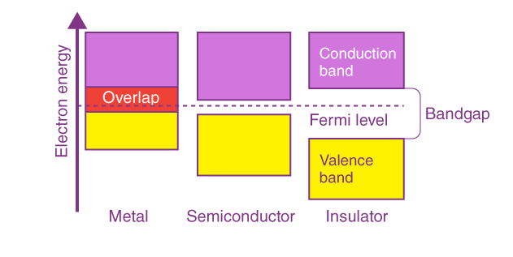
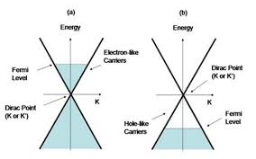
Electrical Characterization:
Transfer Curve
Fermi level: the highest energy level of the electrons in a system.
Dirac point: where conduction and valence bands touch, and the equilibrium point where the number of electrons and holes is in balance.
Transfer curve shows source-drain current (Isd) change as a function of gate voltage (Vg) in a field-effect transistor (FET).
N-type.
P-type.
Notes:
Explain what a transfer curve is for a mosfet and tell what Vsd and Isd are, then explain dirac point, fermi level

Slide 5
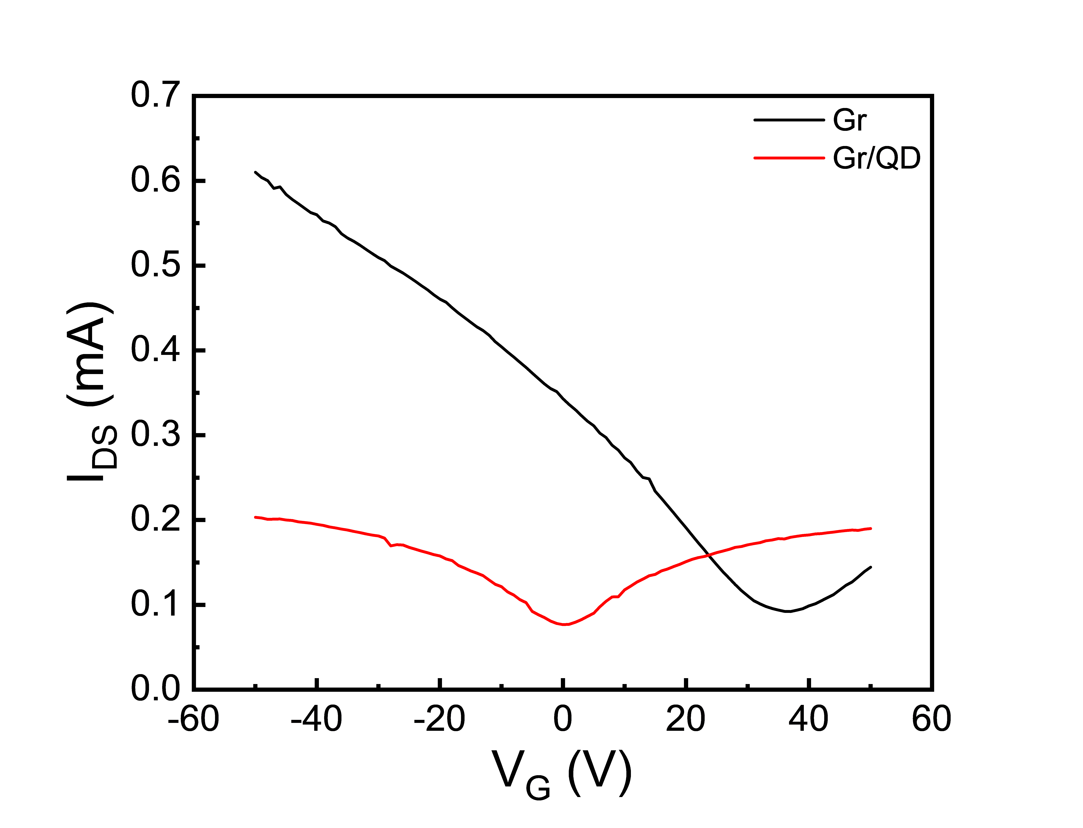
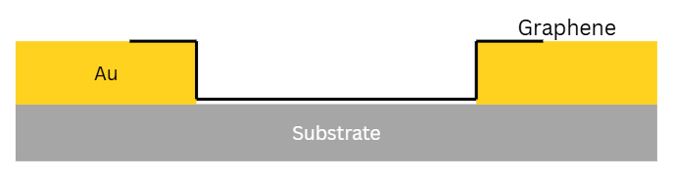
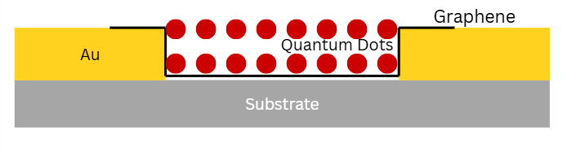
Electrical Characterization:
Transfer Curve
Fermi level shift to the left and near the Dirac point.
This means that graphene has near zero carrier density and high resistance.
Good as a reference point, grants high sensitivity, takes advantage of the photogating effect, and shows ambipolar behavior.
Transfer curve of Gr before QDs are placed on top.
Gr Only
QDs on Top
Transfer curve of Gr after QDs are placed on top.
Notes:
The minimum of the blue line tells where the Femi level is at

Slide 6
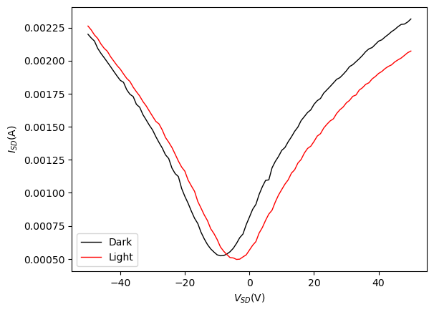
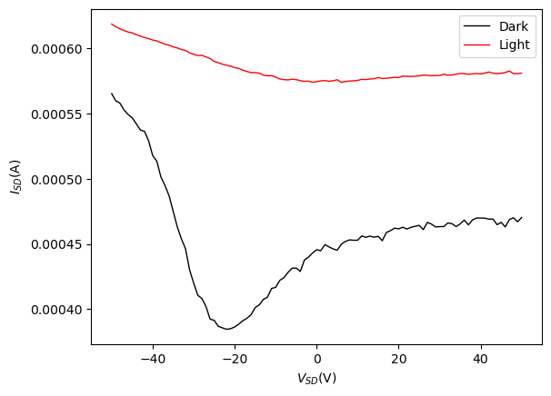
Transfer Curve
Transfer Curve of 500um channel with Gr on bottom.
Transfer Curve of 500um channel with Gr on top.
Observations: Slight shift to the right under Light condition due to the photoresponse (e.g., response to light).
Notes:
Add more content, explain in more detail

Slide 7
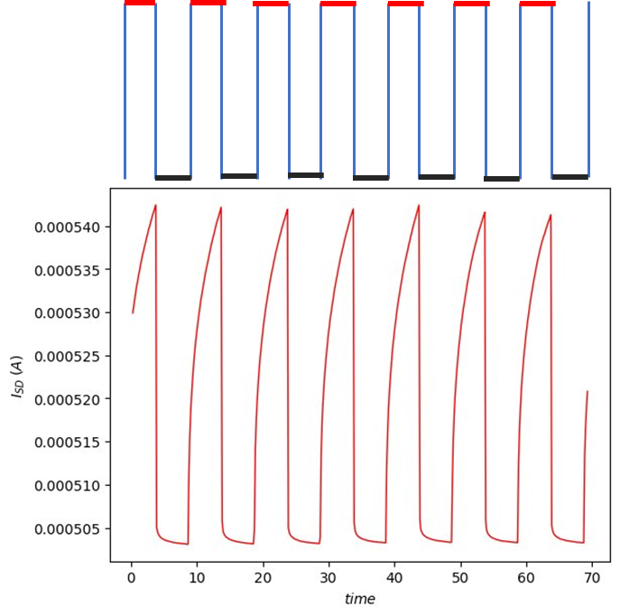
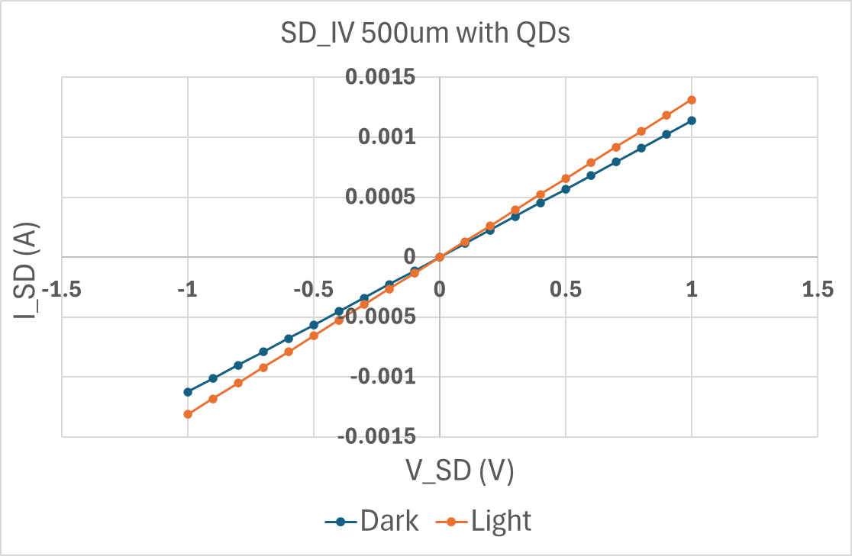
Photodetection
Transfer Curve of 500um channel with Gr on bottom.
Photodetection of 500um channel operated at 0.5 V with Gr on bottom in real time.
ON
OFF
Laser
Gr/QD
Devices
Light
No light
Vg (V)
(s)
(Sec)
Notes:
If you have any material say graphene, put on the bottom of the time response 635nm laser and 0.5 Vg

Slide 8
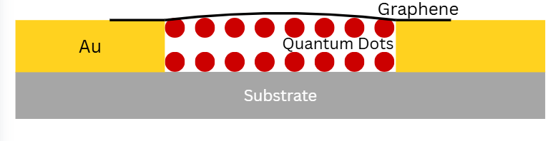
Why is this happening?
The Gr on top is not in direct contact with the Au.
When you put the Gr on the bottom, it lands on a nice, smooth, clean silicon oxide.
When you put the Gr on top of the QDs, the surface is not clean due to the ligands and is not smooth.
QDs on Top
QDs on Bottom

Slide 9
In Conclusion
Made Gr/QD and QD/Gr photodetectors.
Both devices have shown a change in current under illumination vs. when they are in the dark.
The transfer curve for Graphene on top looks unusual, and more research needs to be performed to explore its applications.
Transfer Curve of 500um channel with Gr on top.
Transfer Curve of 500um channel with Gr on bottom.

Slide 10
Acknowledgements
I would like to sincerely thank:
The National Science Foundation
Our host, University of California San Diego
San Diego Nanotechnology Infrastructure (SDNI)
Dr. Oscar Vazquez Mena, Faculty PI
Freddy Garcia, Suraj Patel, Mentor
Yves Theriault, SDNI Executive Director, Education and Outreach
Yuhwa Lo, SDNI Faculty Director
The audience for listening and for their time!
This program was supported by NSF grant ECCS 2025752

