Slide 1




Magneto-optic imaging of Ferromagnetic Thin Films
Leo Turner, University of Alabama
Dr. Shireen Adenwalla, University of Nebraska - Lincoln Rabindra Oliya, University of Nebraska - Lincoln
NSF Award ID #1950137

Slide 2

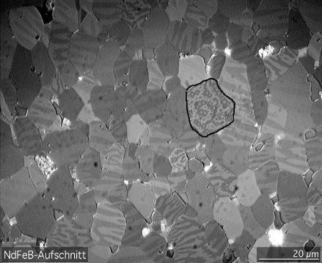
Magnetic Domains
https://commons.wikimedia.org/wiki/File:NdFeB-Domains.jpg

Slide 3
Magneto-Optic Kerr Effect (MOKE)
Measures magnetic hysteresis loops of thin films
Polarized light reflects off a magnetized material, and the polarization changes based on the magnetization of the material, allowing for easy measurement

Slide 4
MOKE Setup
Can measure magnetic susceptibility and other constants using a simple laser setup
Magnetic field can be applied to the sample in-plane (LMOKE) or out of plane (PMOKE). Comparison between the two can find the easy axis of the thin film.
Detector
Polarizer
Analyzer
Sample
PMOKE LMOKE

Slide 5
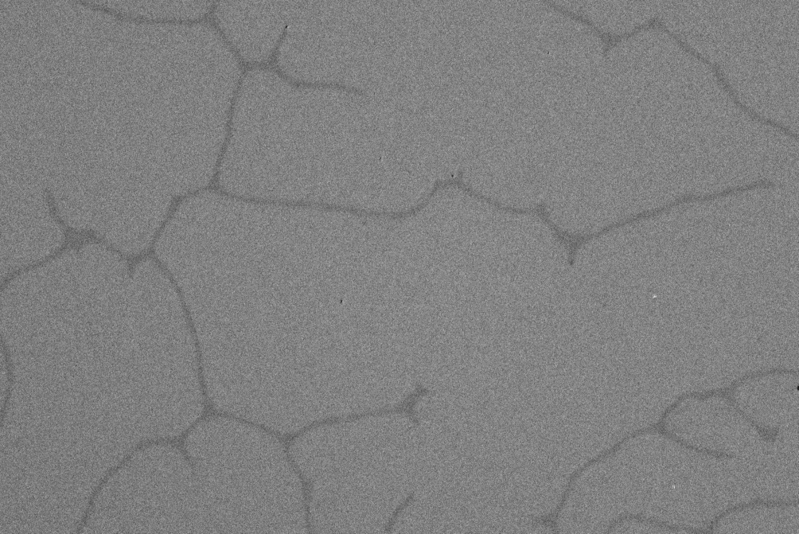
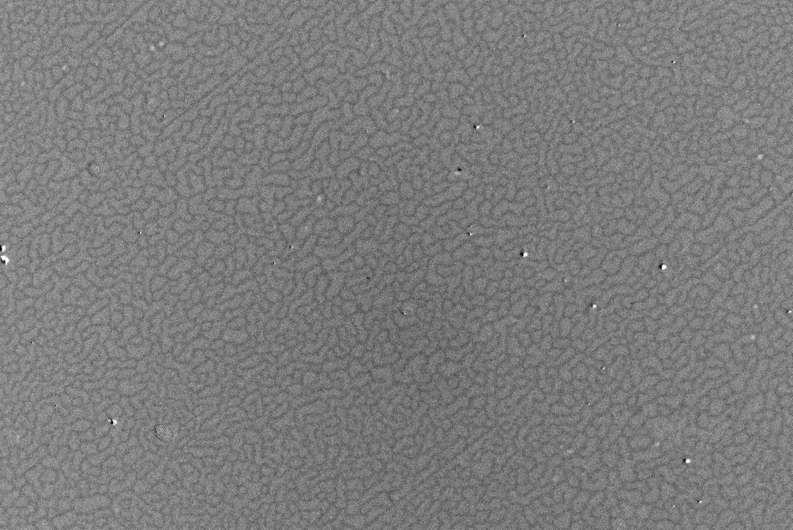
MOKE Microscope
Can measure magnetic domain walls using a camera and some signal processing
Before signal processing – scratches and optical aberrations are visible

Slide 6
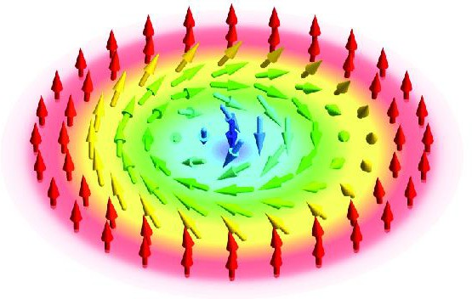
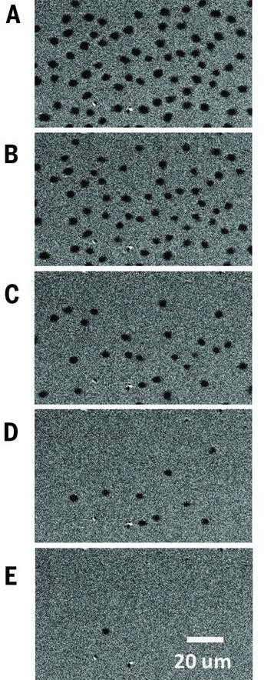
Skyrmions
Skyrmions are a swirling magnetic
texture.
These textures are a focus of study because of their stability and their potential to manipulated by current and other means.
Balance of the Dzyaloshinskii – Moriya interaction (perpendicular) and exchange interaction (parallel).
Schütte & Garst (2014)
MOKE Skyrmion images in similar film, with decreasing magnetic field applied.
Jiang et al, Blowing magnetic skyrmion bubbles

Slide 7
Samples
Our samples used CoFeB as the Ferromagnetic layer of our thin film, with varying thicknesses to vary the magnetic constants of the film.
 | Pt (2 nm)
 | CoFeB (0.4-0.6 nm)
 | Pt (2 nm)
 | Ta (1 nm)
 | Cr (2 nm)
Silicon/Lithium Niobate Substrate
- Ta dusting – under 1 Angstrom

Slide 8
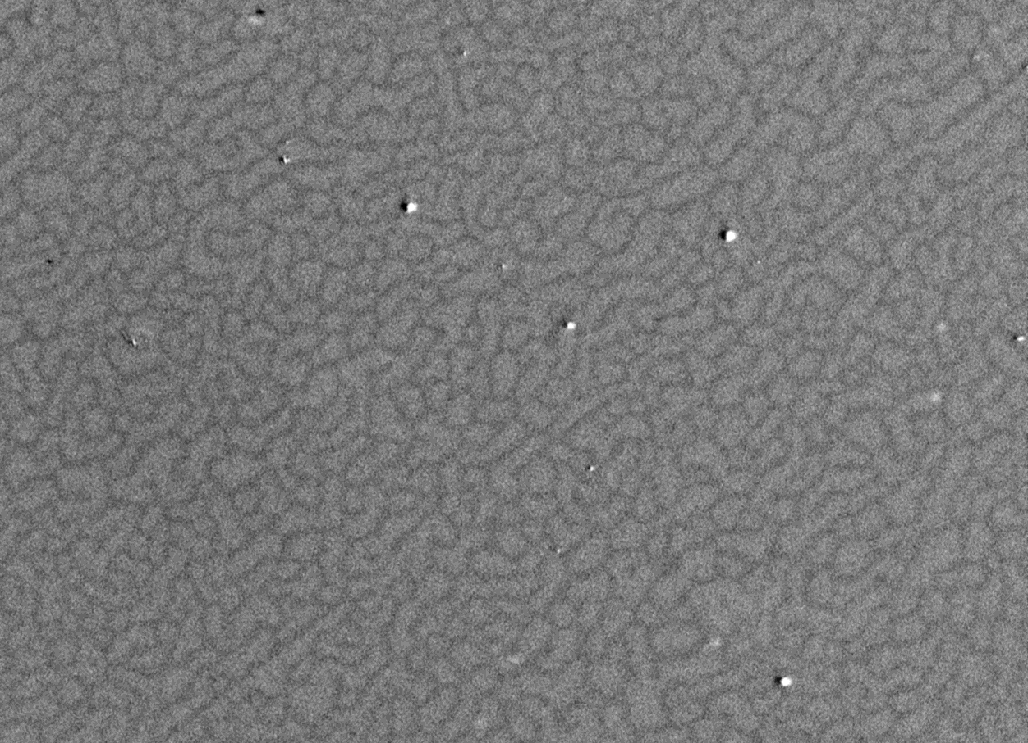
Image Processing
MatLab is used to do image processing.
We need to balance intensity across the image, remove optical aberrations, and distinguish between up and down domains
Large amounts of data
The microscope automatically takes a base image and subtracts it from the rest of the images.

Slide 9
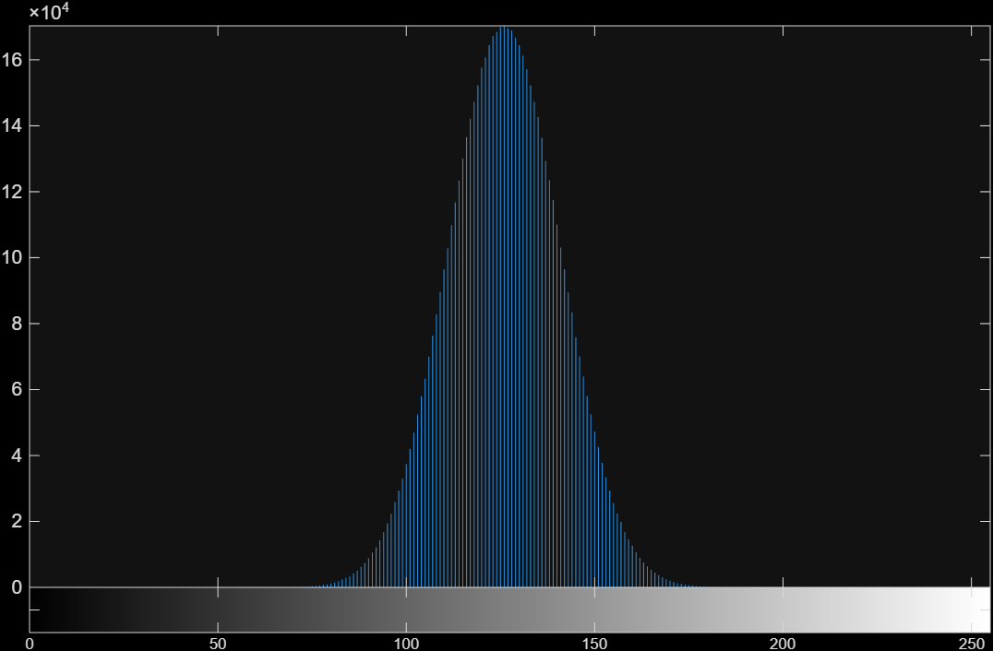
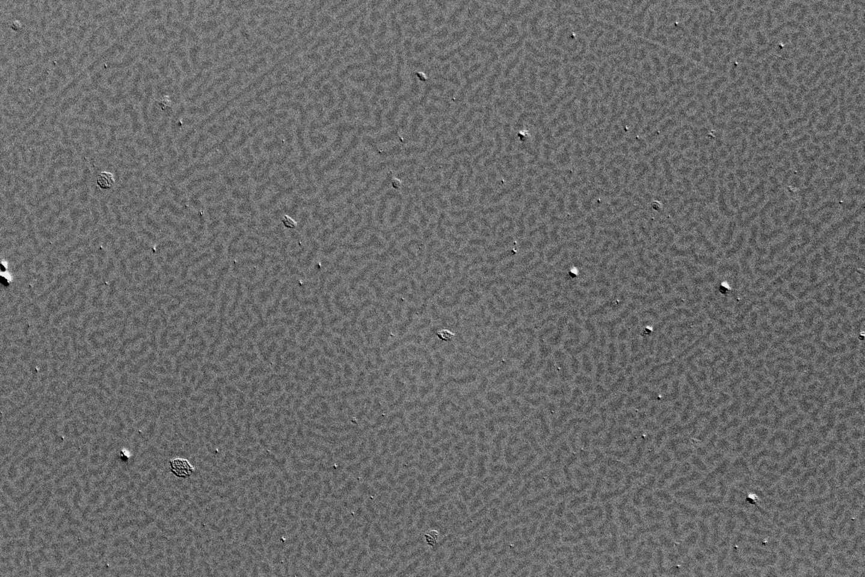
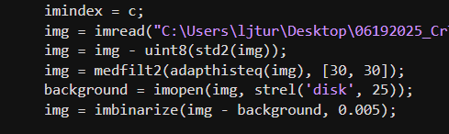
Adaptive Histogram Equalization and 2-D Median filter

Slide 10
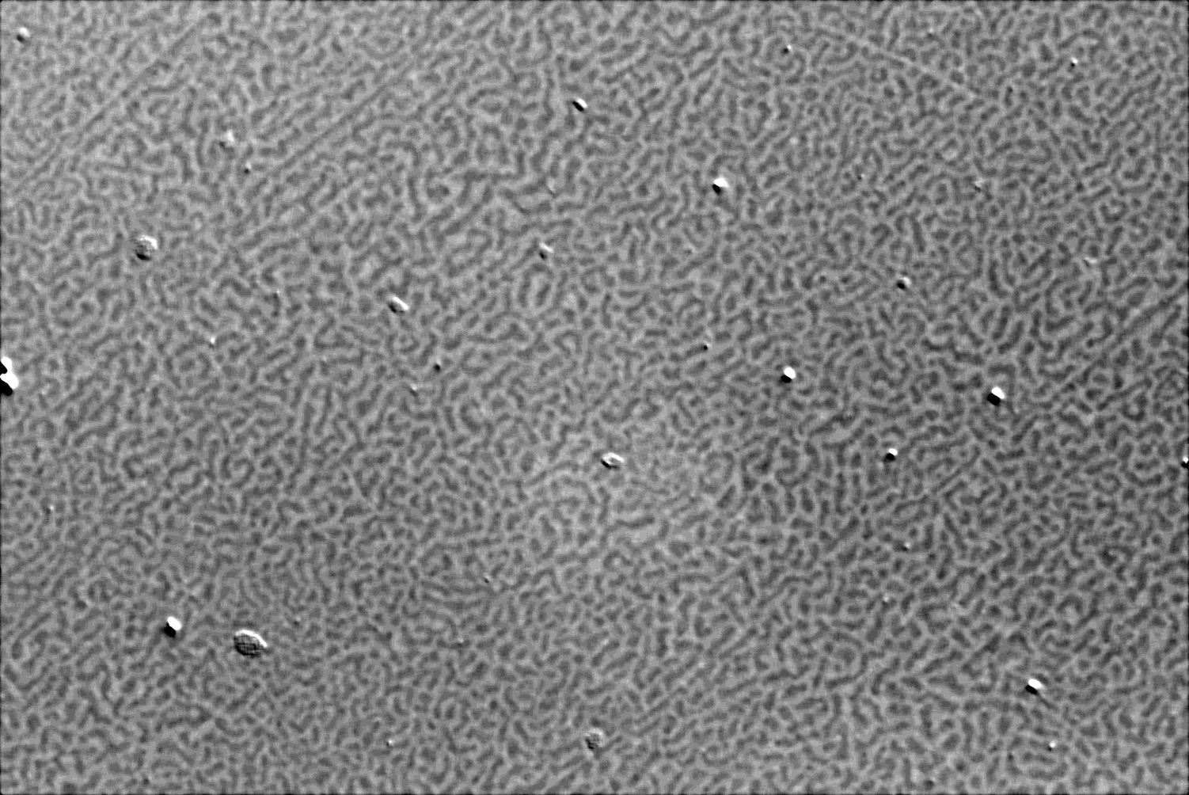
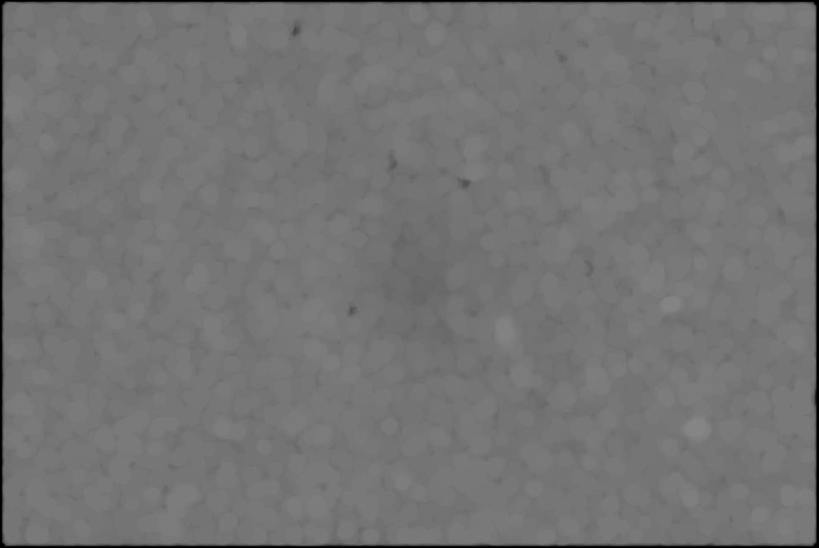
Background subtraction

Slide 11
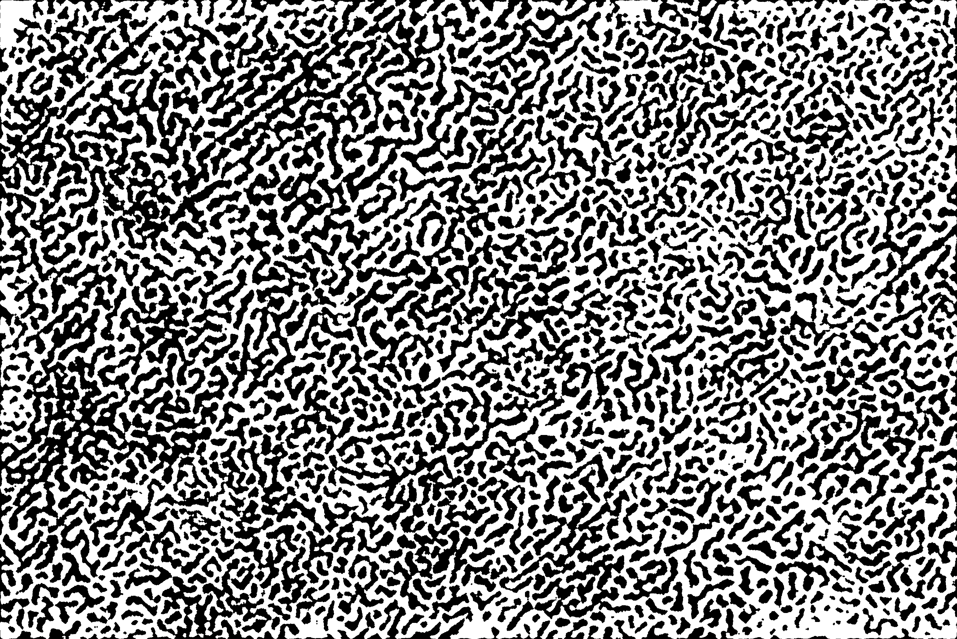
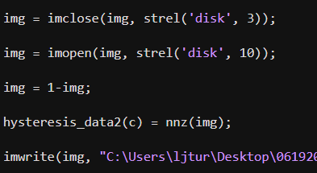
Image binarization
Thresholding values

Slide 12
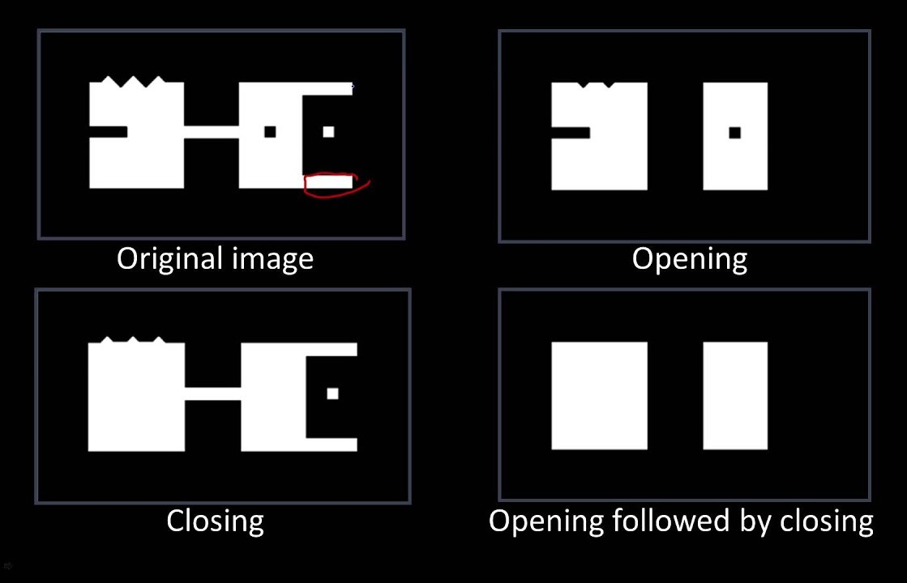
Morphological Opening and Closing Operations
Udacity on YouTube

Slide 13
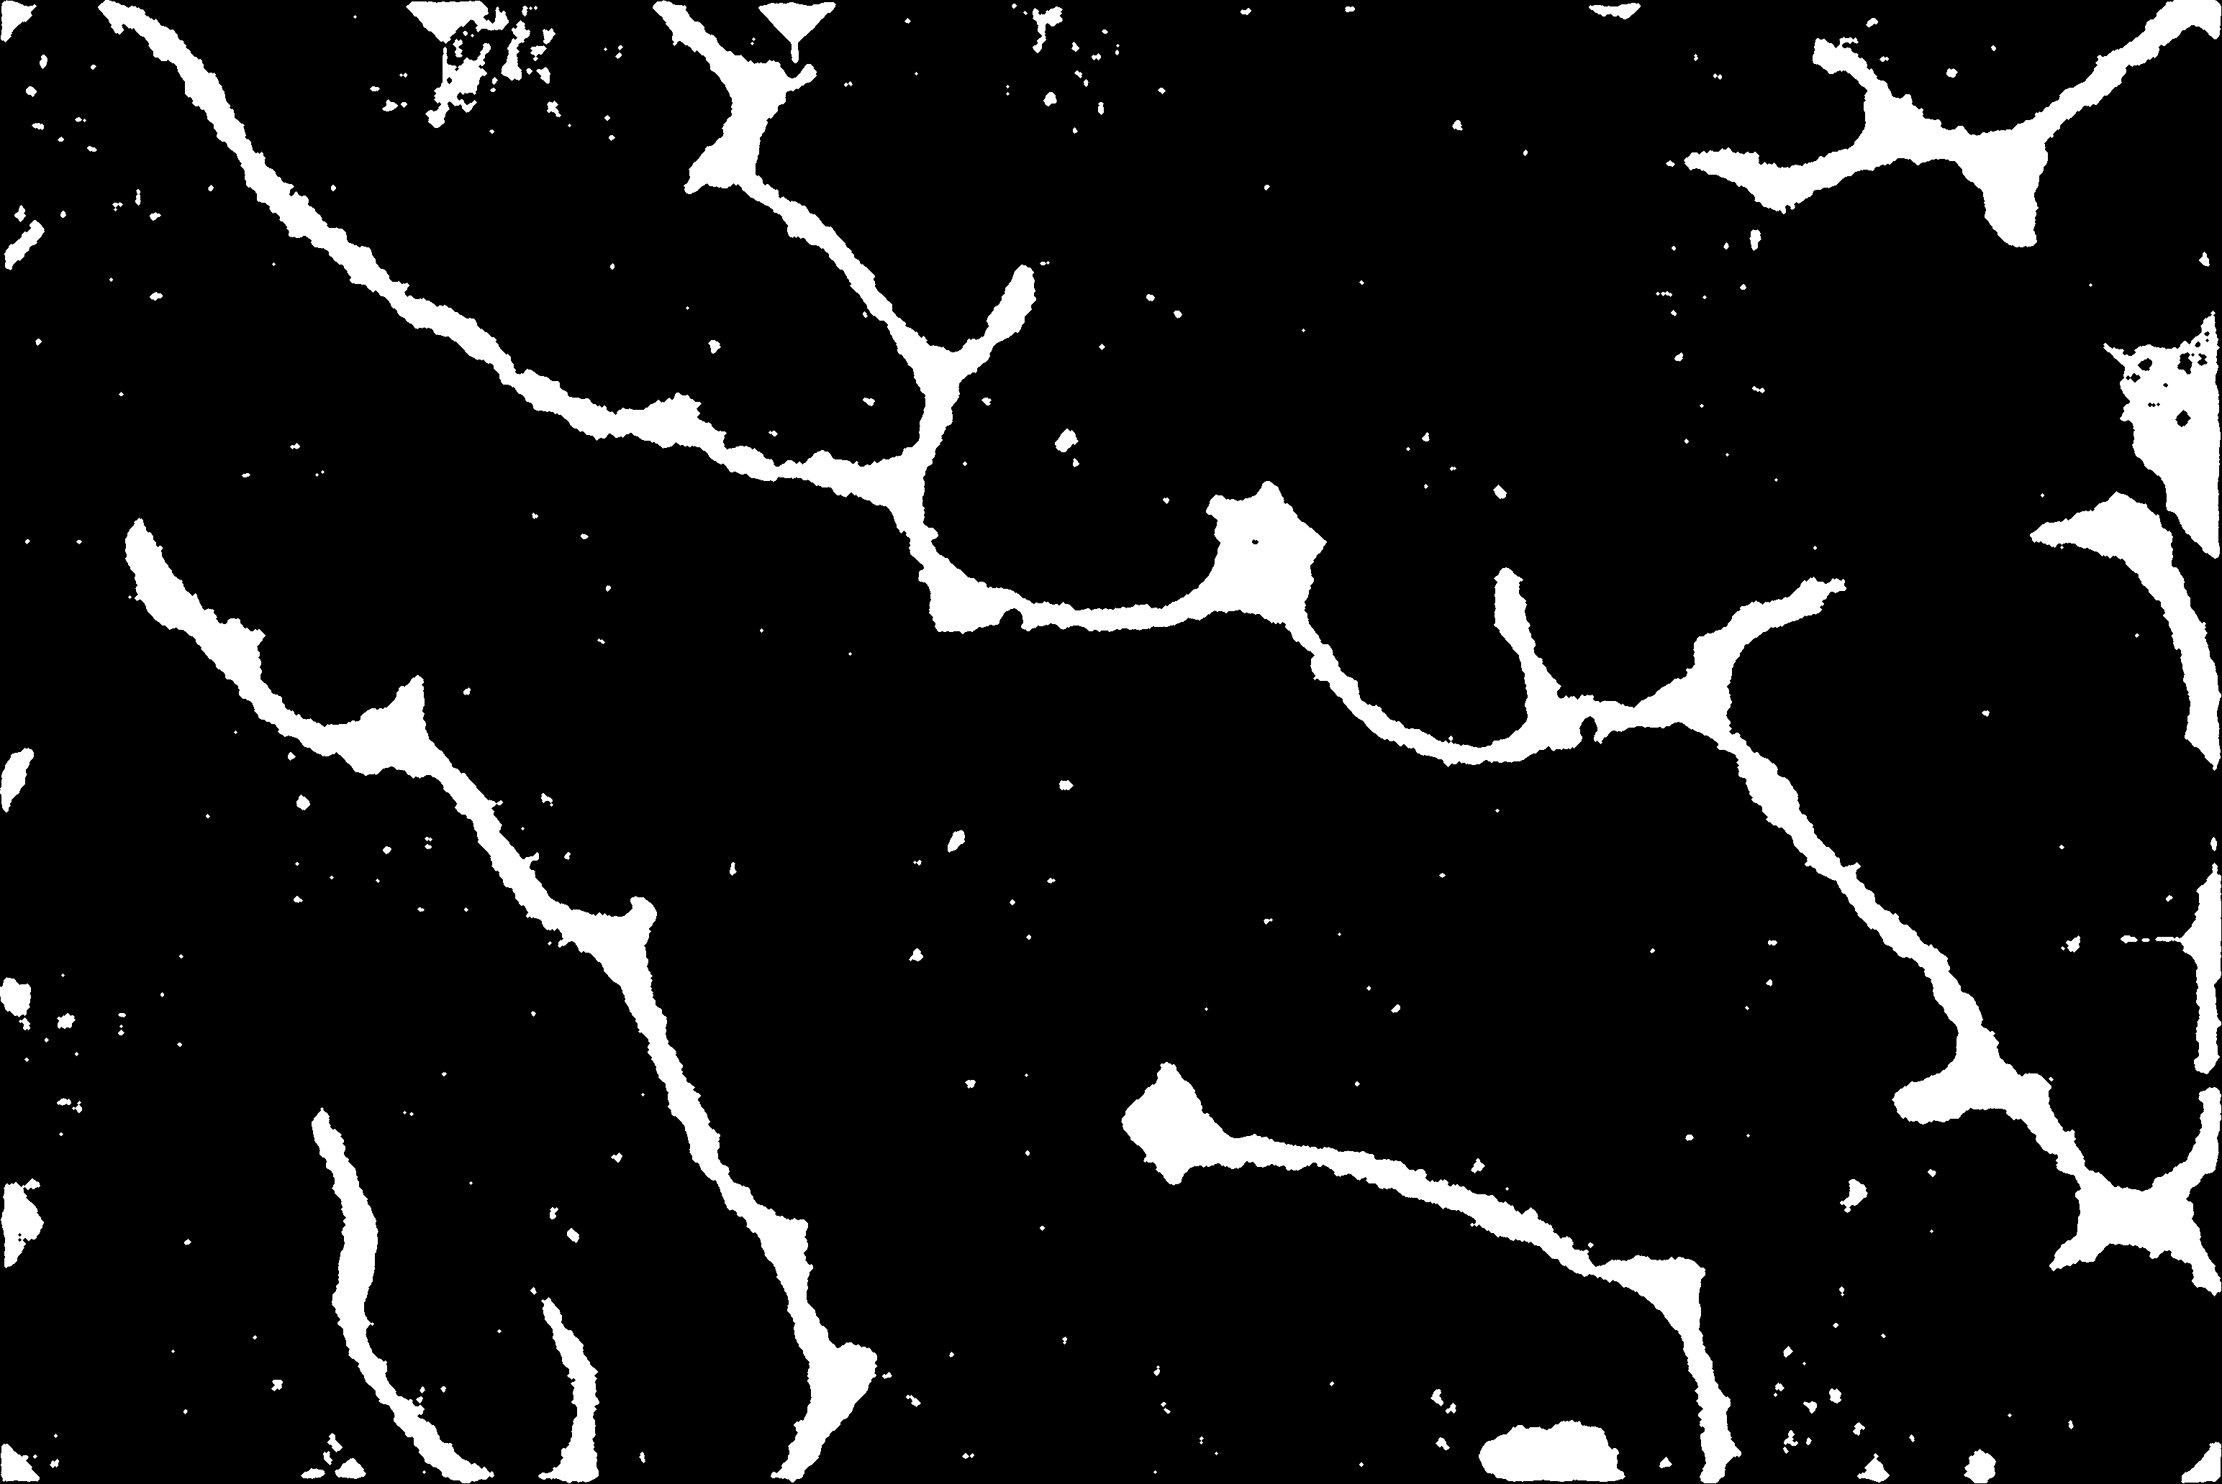
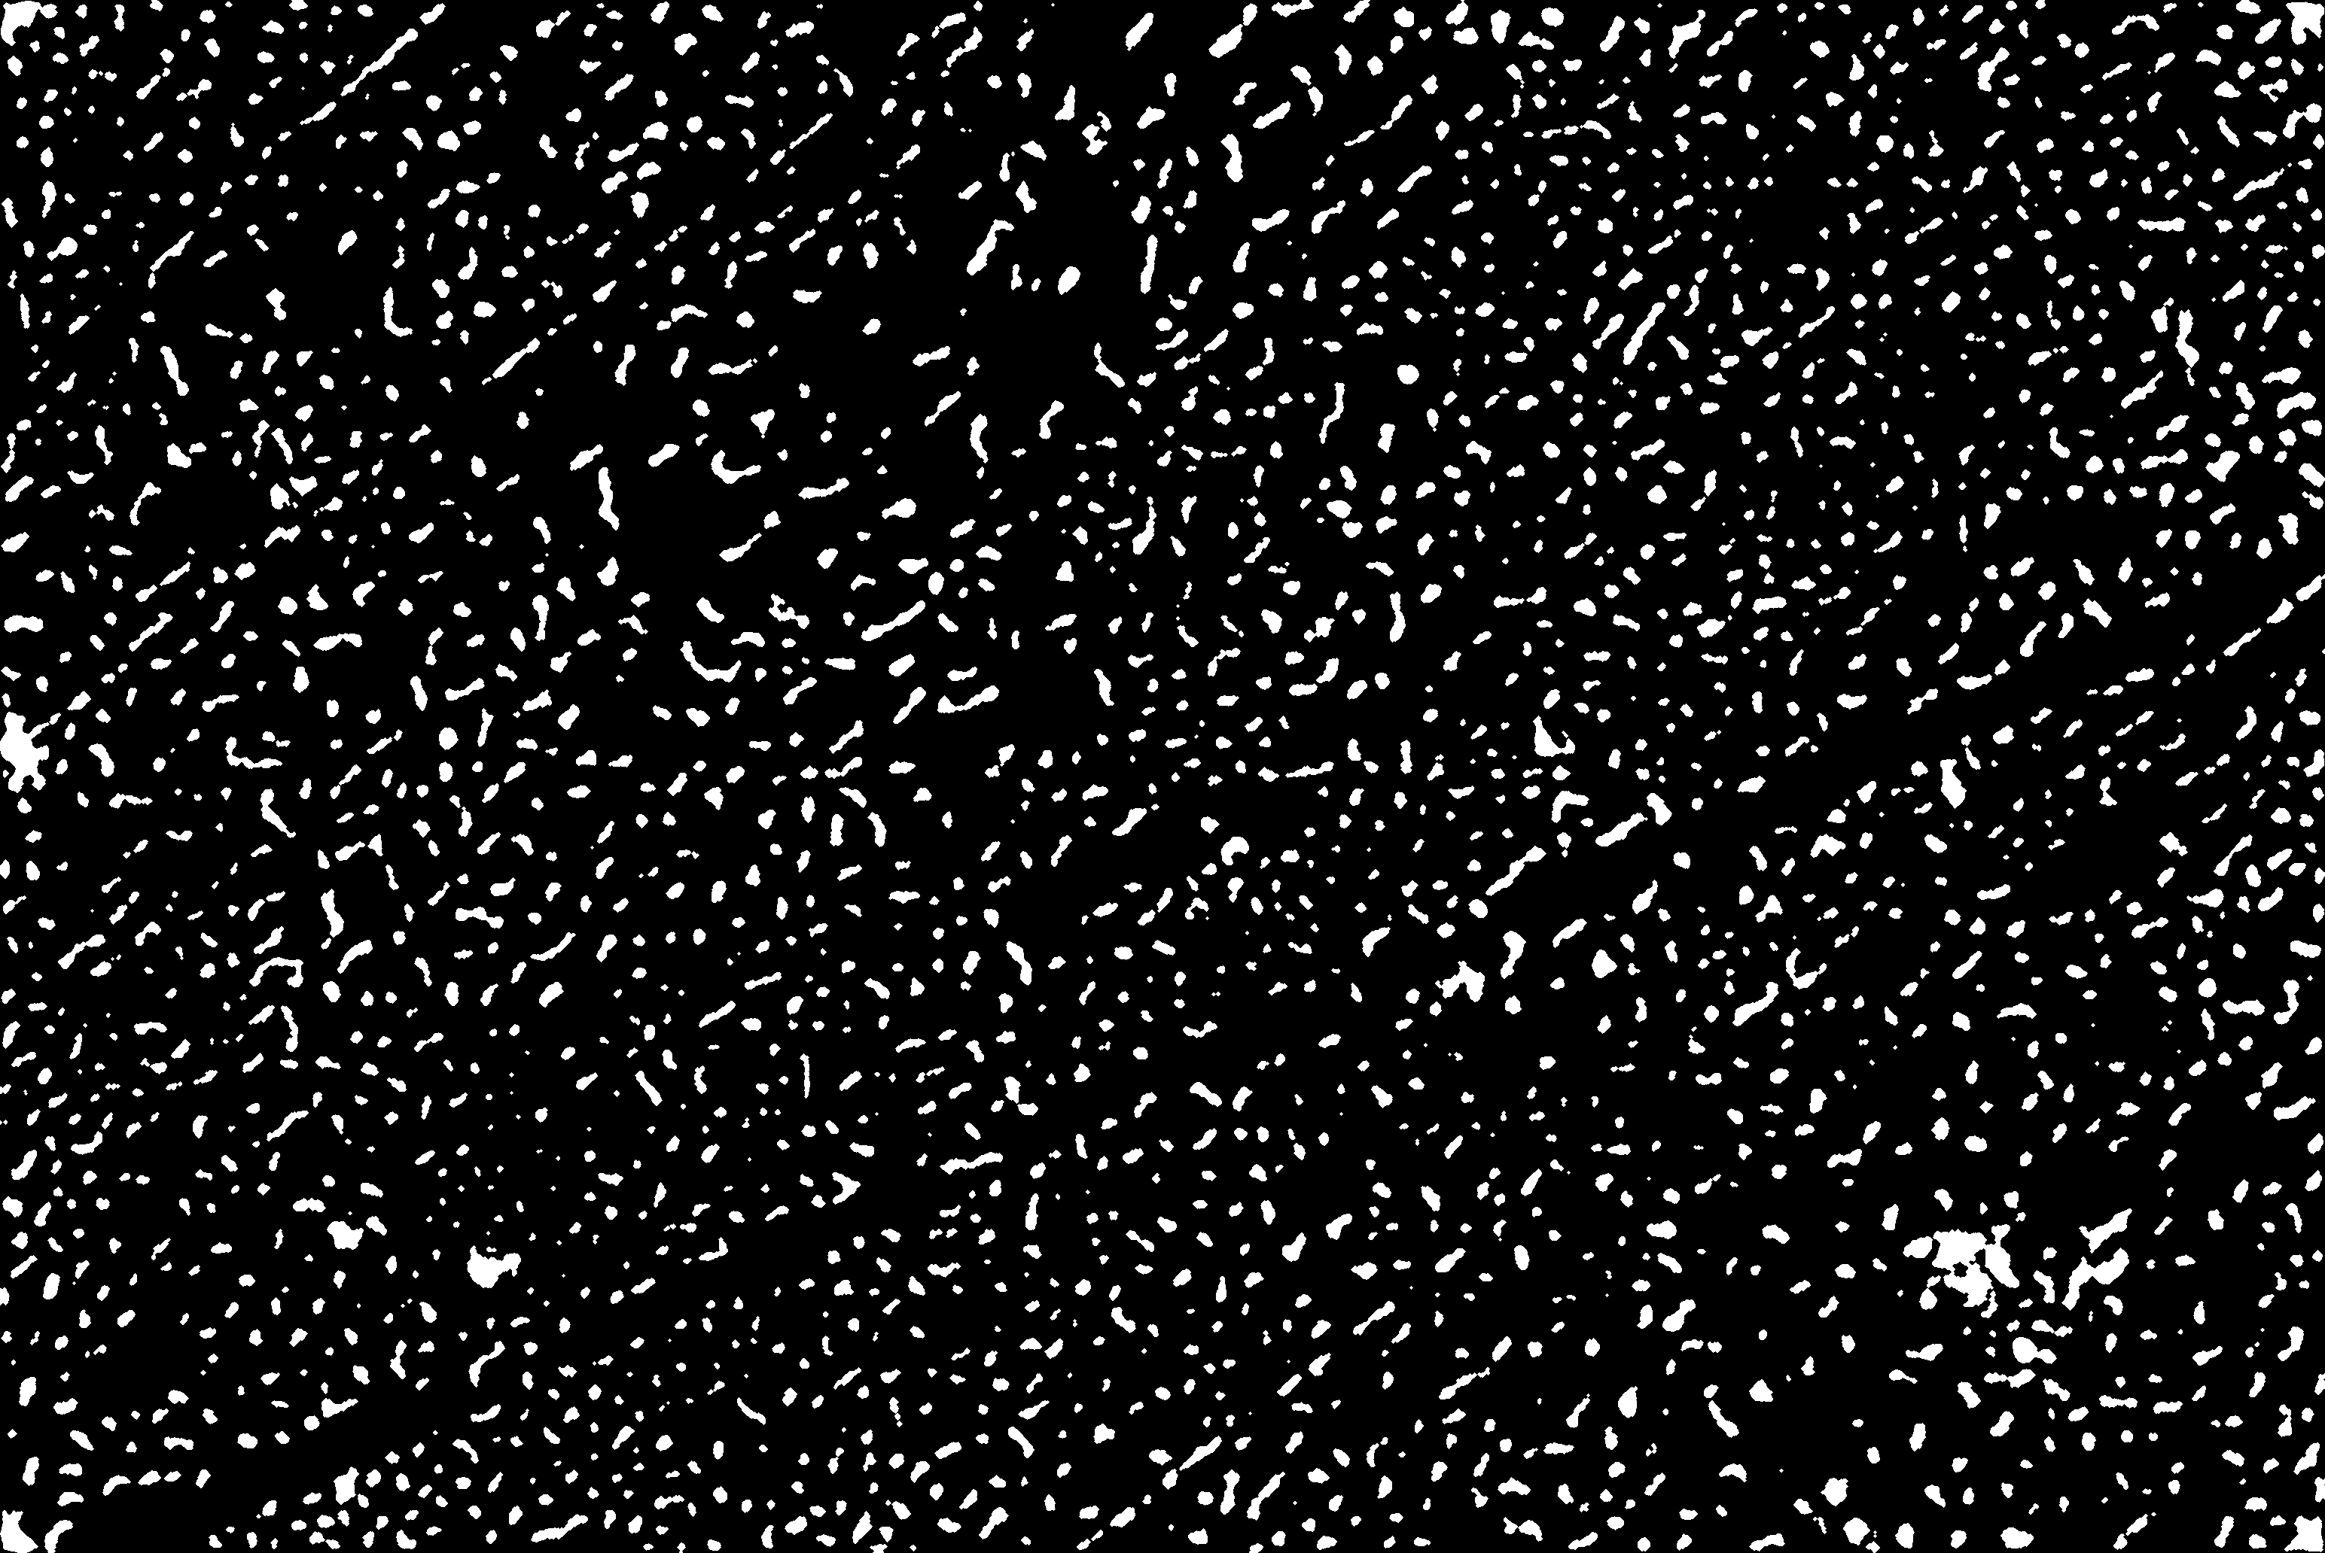
Final Images
Stripe domains
“Dendritic” domains
Bubble domains

