Slide 1
Optical Characterization of a Thin-film Faraday Rotator at Oblique Incidence Angles
MSU ECE REU Site Summer 2025 Final Project Presentation
Presenter: Isabel Garcia
Co-authors: Jordan Baker
Mentor: Wataru Nakagawa

Slide 2
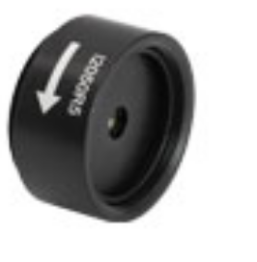
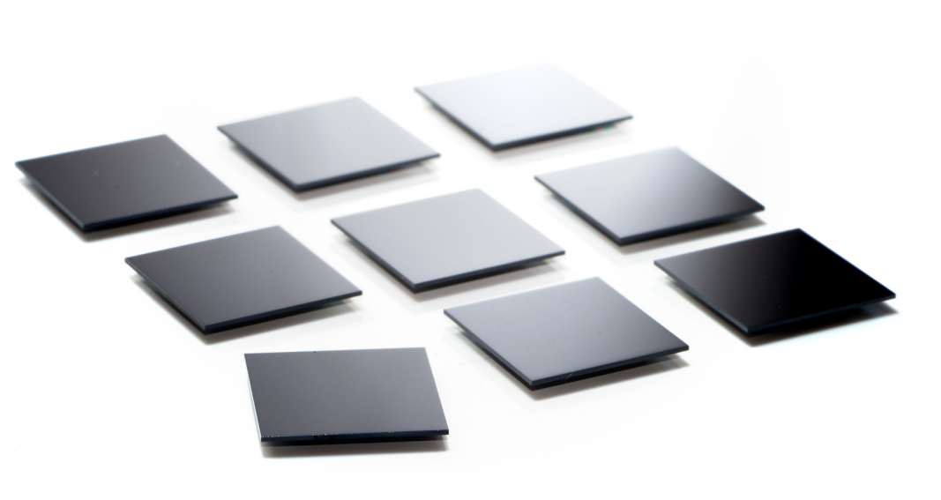
Motivation
Optical fiber communication
  Optical Isolators
  Optical Circulators
Miniaturization
Novel Applications:
  Specific use in a compact beam scanner at non-normal incidence angles (Baker et al. 2024)
30 mm
ThorLabs, “Faraday rotators” I2050R5, 2050 nm CWL
29.2 mm
11 mm
11 mm
Coherent Corp. “Thick-Film Faraday rotators”

Slide 3
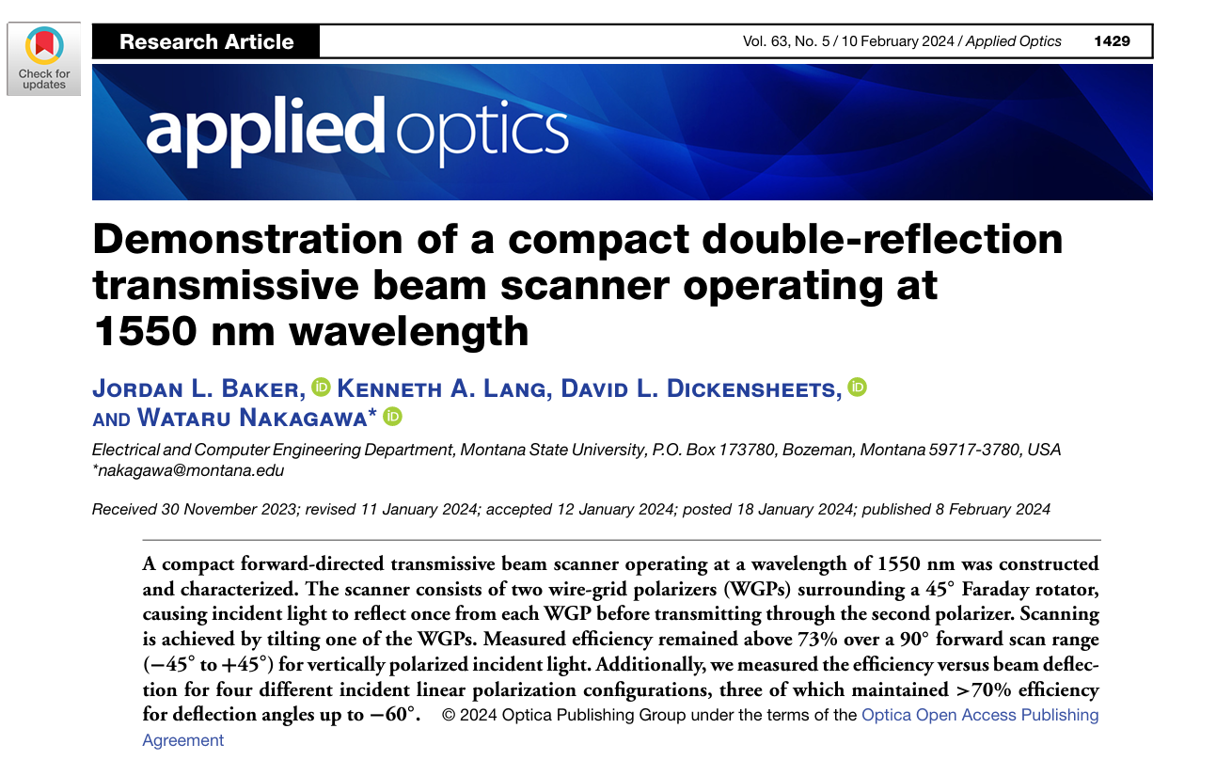
Motivation
Optical fiber communication
  Optical Isolators
  Optical Circulators
Miniaturization
Novel Applications:
  Specific use in a beam scanner at non-normal incidence angles (Baker et al. 2024)
11 mm
11 mm
Coherent Corp. “Thick-Film Faraday rotators”
ThorLabs, “Faraday rotators” I2050R5, 2050 nm CWL
30 mm
29.2 mm

Slide 4
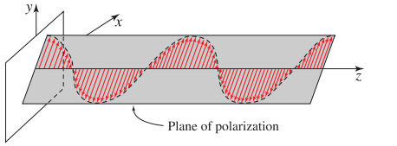
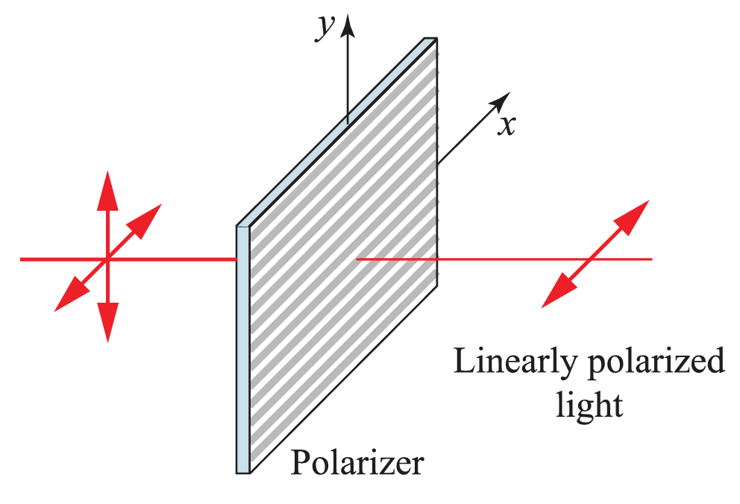
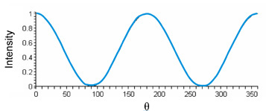
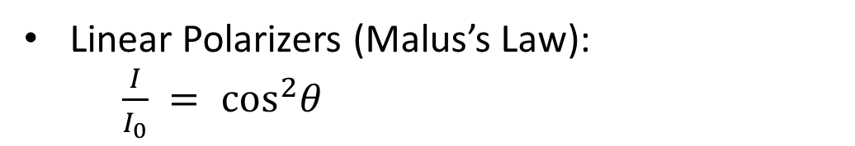
Polarization
The path that the electric field component of an electromagnetic wave traces as the wave oscillates in time.
Affects how light interacts with materials
  Reflection
  Transmission
  Absorption
(Saleh and Teich, 2019)
Linear Polarizers (Malus’s Law):
  $\frac{I}{I_{0}} = \cos^{2}θ$
(Saleh and Teich, 2019)
(Collett 2005)

Slide 5
Polarization
The path that the electric field component of an electromagnetic wave traces as the wave oscillates in time.
Affects how light interacts with materials
  Reflection
  Transmission
  Absorption
(Saleh and Teich, 2019)
Linear Polarizers (Malus’s Law):
  $\frac{I}{I_{0}} = \cos^{2}θ$
(Saleh and Teich, 2019)
(Collett 2005)

Slide 6
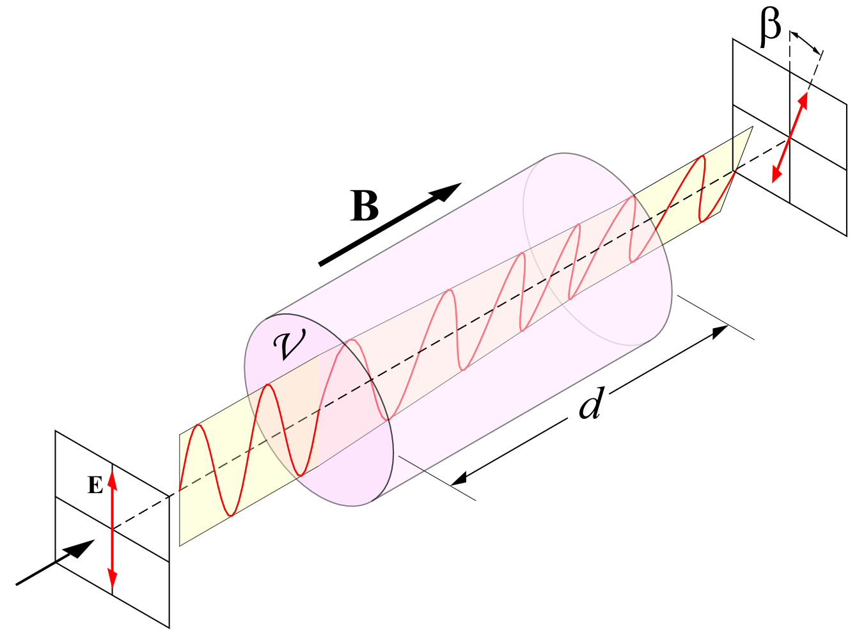


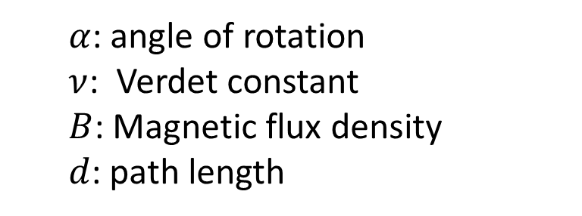
What is a Faraday Rotator?
$α= νBd$
Nonreciprocal magneto-optical device that rotates the linear polarization of an incident beam.
Faraday effect:
  A polarization rotation occurs when linearly polarized light is in a magnetic field.
Historically, Faraday rotators required a long path or a very strong bias magnet.
However, recent innovations have created latching Faraday rotators which don’t need an external magnet because the magnetic field is latched to the material
  $α$: angle of rotation
  $ν$: Verdet constant
  $B$: Magnetic flux density
  $d$: path length
$$α$$
https://en.wikipedia.org/wiki/Faraday_effect
(Lipson, Lipson, Lipson, 2010)

Slide 7
Research Question
How does changing the incidence angle and initial polarization state affect the performance of a thin-film latching Faraday rotator?
Quantify through the max transmittance, contrast ratio, and Faraday rotation angle.
Ultimately…
Is the performance angularly tolerant enough such the thin-film Faraday rotator can be used for novel applications such as the compact transmissive beam scanner?

Slide 8
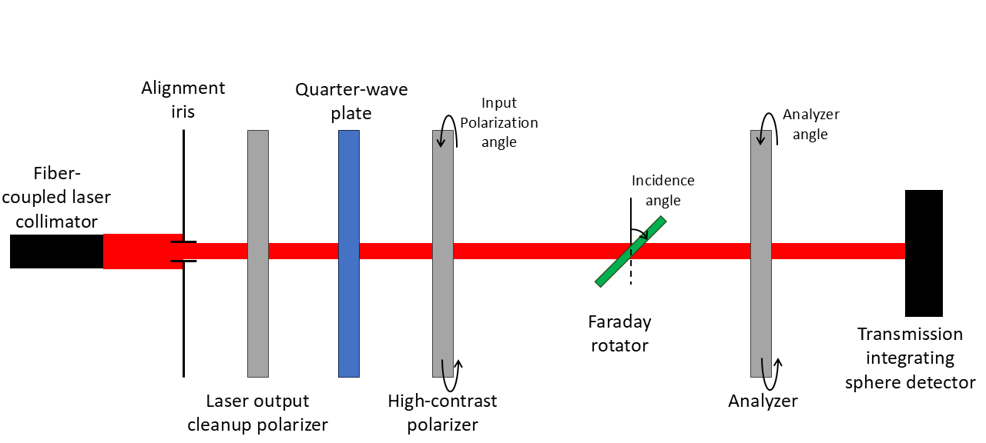
Experiment Overview

Slide 9
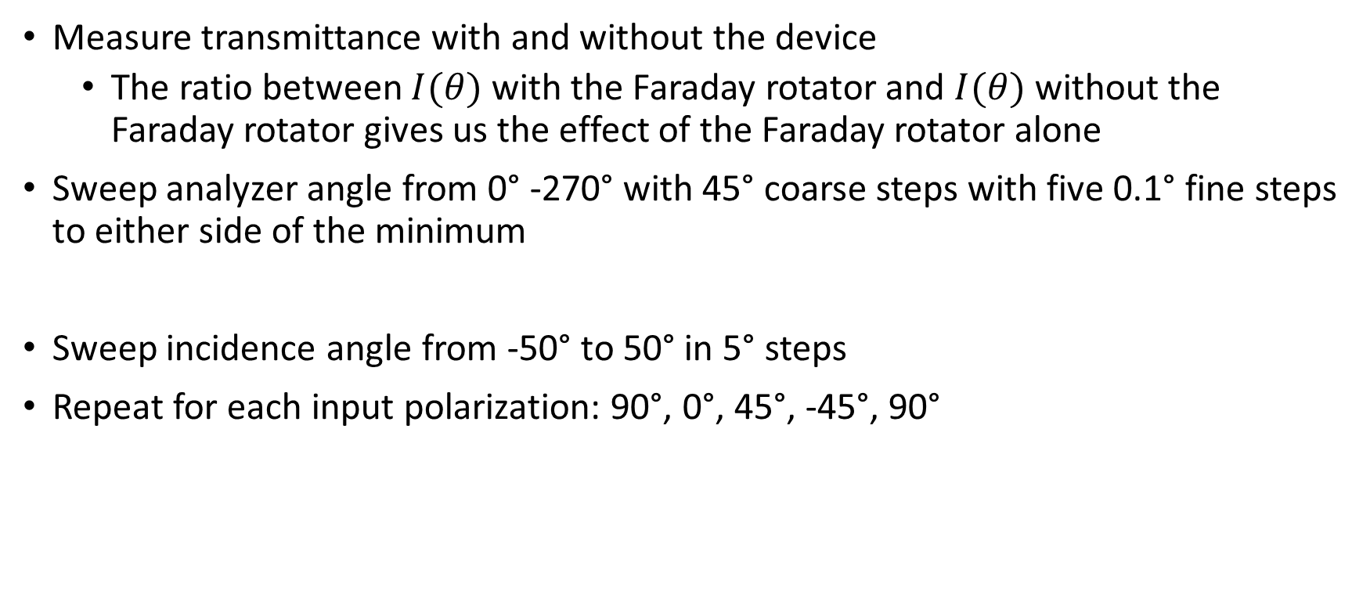
Faraday Rotator Characterization
Measure transmittance with and without the device
  The ratio between $I(θ)$with the Faraday rotator and $I(θ)$without the Faraday rotator gives us the effect of the Faraday rotator alone
Sweep analyzer angle from 0° -270° with 45° coarse steps with five 0.1° fine steps to either side of the minimum
Sweep incidence angle from -50° to 50° in 5° steps
Repeat for each input polarization: 90°, 0°, 45°, -45°, 90°

Slide 10
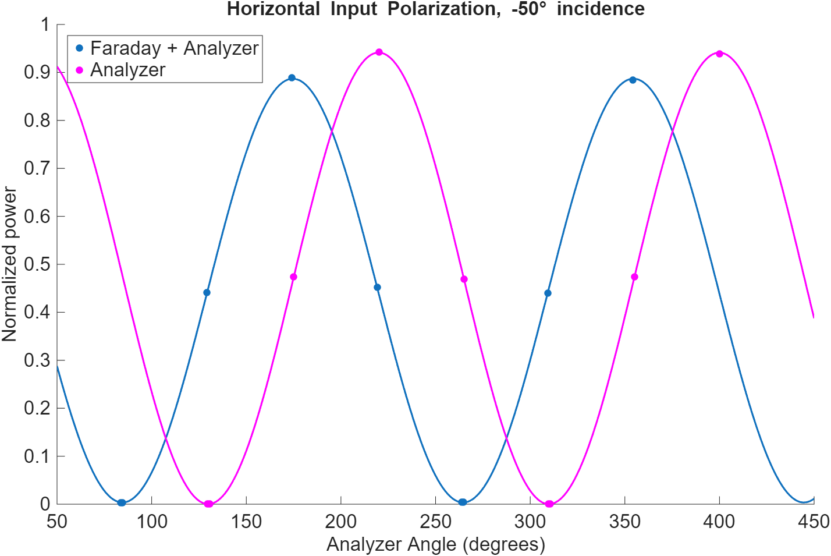




$$Analyzer Max$$
$$Faraday Max$$
$$Faraday Min$$
$$α$$
$$T=\frac{Faraday Max}{Analyzer Max} CR=\frac{Faraday Max}{Faraday Min} α=Faraday Min Angle−Analyzer Min Angle$$

Slide 11
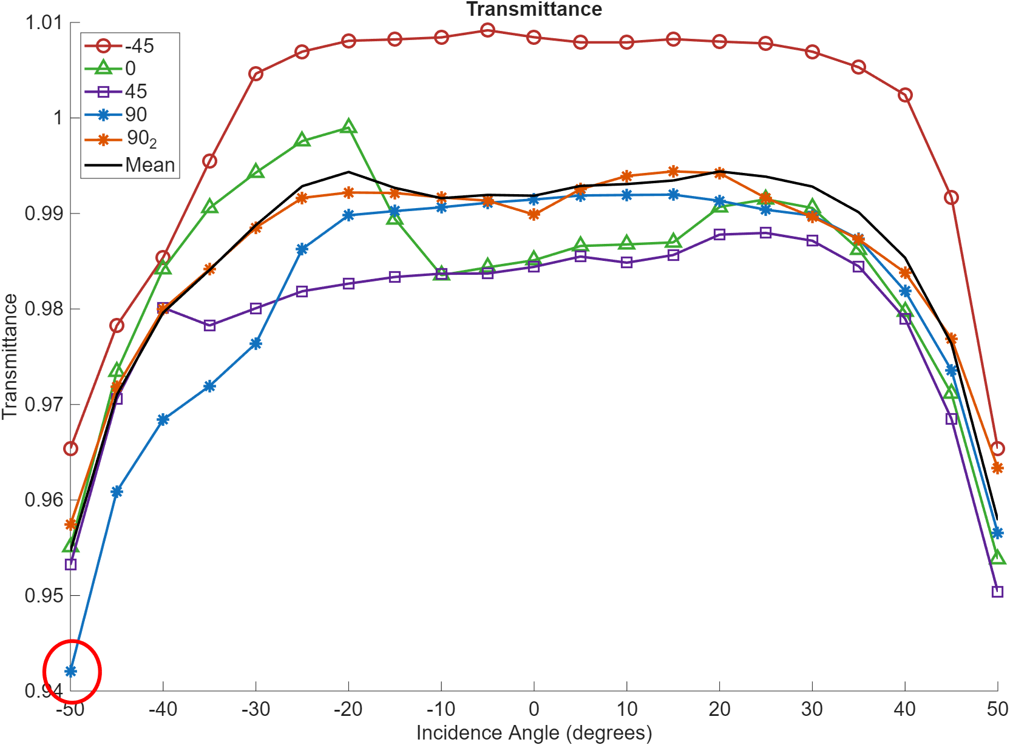

Results- Max Transmittance
Stable at 99.1% ± 2.3% within incidence angles of -30° to 30°
Decreases by as much as 3.7% at -50° incidence
Manufacturer says > 98.9%
$$T=\frac{Faraday Max}{Analyzer Max}$$

Slide 12
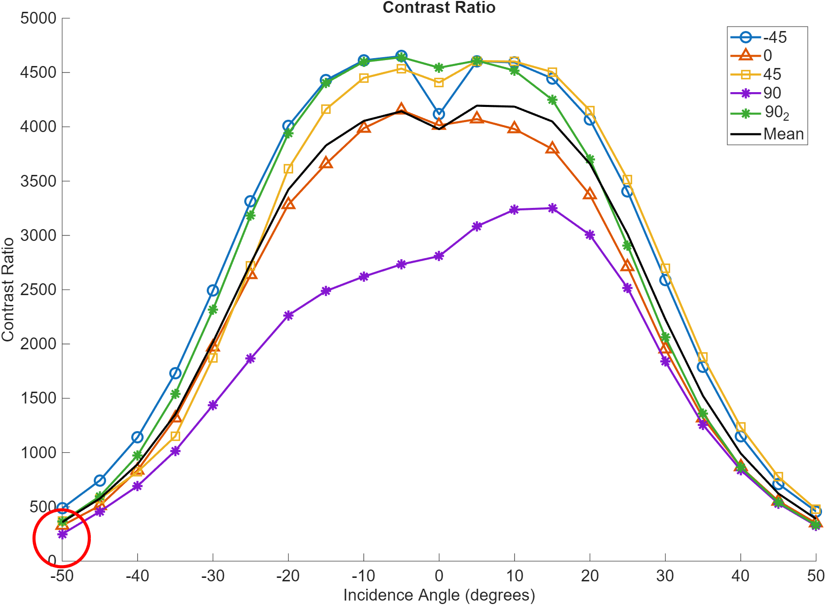

Results- Contrast Ratio
Decreases by 91.0% from 0° incidence to -50° incidence
Stable within
Outlier behavior from the first trial of horizontal input polarization
$$CR=\frac{Faraday Max}{Faraday Min}$$

Slide 13
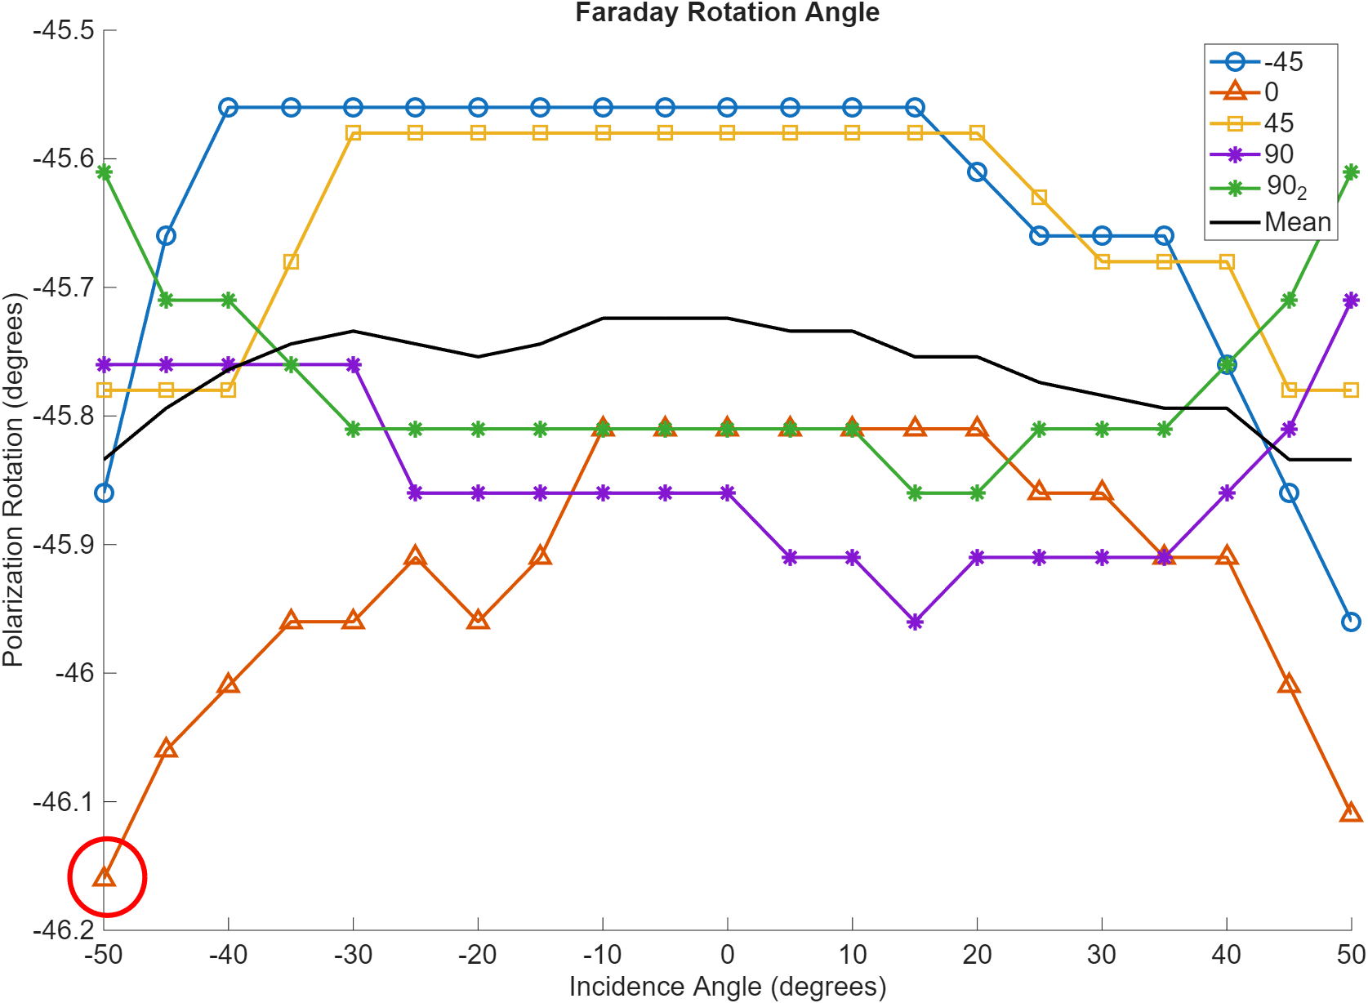
Results- Rotation angle
All measurements were higher in magnitude than 45°
Stable within -45.8° ± 0.4° with resolution of 0.1°
Manufacturer says 45° ± 1°
$$α=Faraday Min Angle−Analyzer Min Angle$$

Slide 14
Discussion
Transmittance |  | Contrast Ratio |  | Rotation Angle
Threshold | Incidence Angle | Threshold | Incidence Angle | Not dependent on incidence angle
High (> 99%) | < ± 30 | High (>4000) | < ± 10
Good (> 96%) | < ± 45 | Good (>1000) | < ± 35
Risky (< 96%) | > ± 50 | Risky (< 1000) | > ± 35

Slide 15
Discussion
Transmittance |  | Contrast Ratio |  | Rotation Angle
Threshold | Incidence Angle | Threshold | Incidence Angle | Not dependent on incidence angle
High (> 99%) | < ± 30 | High (>4000) | < ± 10
Good (> 96%) | < ± 45 | Good (>1000) | < ± 35
Risky (< 96%) | > ± 50 | Risky (< 1000) | > ± 35
☺
☺

Slide 16
Discussion
Transmittance |  | Contrast Ratio |  | Rotation Angle
Threshold | Incidence Angle | Threshold | Incidence Angle | Not dependent on incidence angle
High (> 99%) | < ± 30 | High (>4000) | < ± 10
Good (> 96%) | < ± 45 | Good (>1000) | < ± 35
Risky (< 96%) | > ± 50 | Risky (< 1000) | > ± 35
Problem | Theories
Noticeable degradation at high incidence angles | Anti-reflection coatings
 | change in path length
Difference between input states | Spatial non-uniformity
 | Power fluctuations

Slide 17
Summary
We successfully characterized a latching Faraday rotator for non-normal incidence angles with different input polarization states.
Input polarization does not significantly affect transmittance, contrast ratio, or rotation angle
Faraday rotation angle is stable within -45.8° ± 0.4° for change in incidence angle and input polarization state.
If transmittance greater than 98% is desired, then incidence angle magnitudes less than 30° should be used
If a contrast ratio greater than 3500 is desired, then incidence angle magnitudes less than 15° should be used

Slide 18
Future Work
Anti-reflection Coatings:
  Are the transmittance and contrast ratio decreases due to the anti-reflection coatings, or if it is intrinsic to the device?
  Are there that are optimized?
  Could anti-reflection coatings be optimized for use at a large range of incidence angles for the most sustained transmittance and contrast ratio at oblique incidence?
Latching Faraday rotators in visible wavelengths:
  What are the limiting factors for production of latching Faraday rotators that work in the visible regime?

Slide 19
Acknowledgements
This material is based upon work supported by the National Science Foundation under Grant No. 2349091.
My mentor: Wataru Nakagawa
My graduate student: Jordan Baker
The rest of the Nano-optics lab
My REU cohort for their continued support!
  Special thanks to Daphne and Nash for their help proofreading my final report

Slide 20
References
Baker, J. L., Lang, K. A., Dickensheets, D. L., and Nakagawa, W., “Demonstration of a compact double-reflection transmissive beam scanner operating at 1550 nm wavelength,” Applied Optics 63(5), 1429–1437 (2024).
Baker, J. L., Graham, J. C., Oliver, A., Dickensheets, D. L., Nakagawa, W., “Fabrication and optical characterization of a silicon bilayer wire-grid polarizer at a wavelength of 1550 nm” in Photonic Instrumentation Engineering XII Conference: OPTO., vol., no. 13373, pp. 133730S - 133730S-8, doi: 10.1117/12.3038762 (2025).
E. Collett and S. of Photo-optical Instrumentation Engineers., Field guide to polarization, SPIE field guides ; v. FG05(SPIE Press, Bellingham, Wash, 2005).
Karki, D., Stenger, V., Pollick, A., Levy, M., “Thin-film magnetless Faraday rotators for compact heterogeneous integrated optical isolators.” J. Appl. Phys; 121 (23): 233101. https://doi.org/10.1063/1.4986237. (2017)
Lang, K., Baker, J., Dickensheets, D., Nakagawa, W., “Experimental characterization of a commercial wire grid polarizer as a polarizing beam splitter at 1.55 µm wavelength.” Optics Continuum. 2. 250-258.10.1364/OPTCON .476912. (2023).
A. Lipson, S. G. Lipson, and H. Lipson, Optical Physics (Cambridge University Press, 2010), 4th ed.
Meadowlark Optics, Grid VersaLightTM Polarizer, Accessed 2025.
Saleh, B. and Teich, M., “Fundamentals of Photonics”, Wiley, 3rd Edition (2019).
https://en.wikipedia.org/wiki/Faraday_effect#/media/File:Faraday-effect.svg

Slide 21
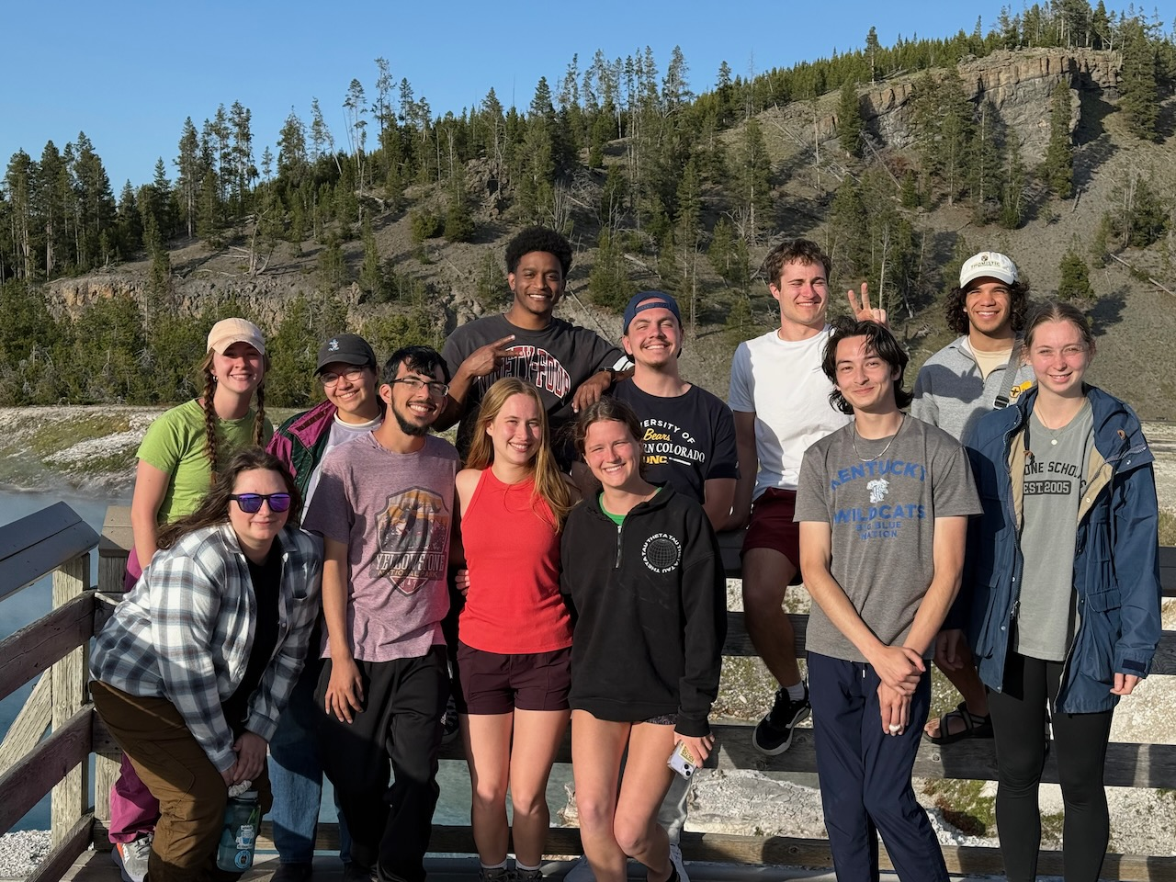
Questions?

Slide 22
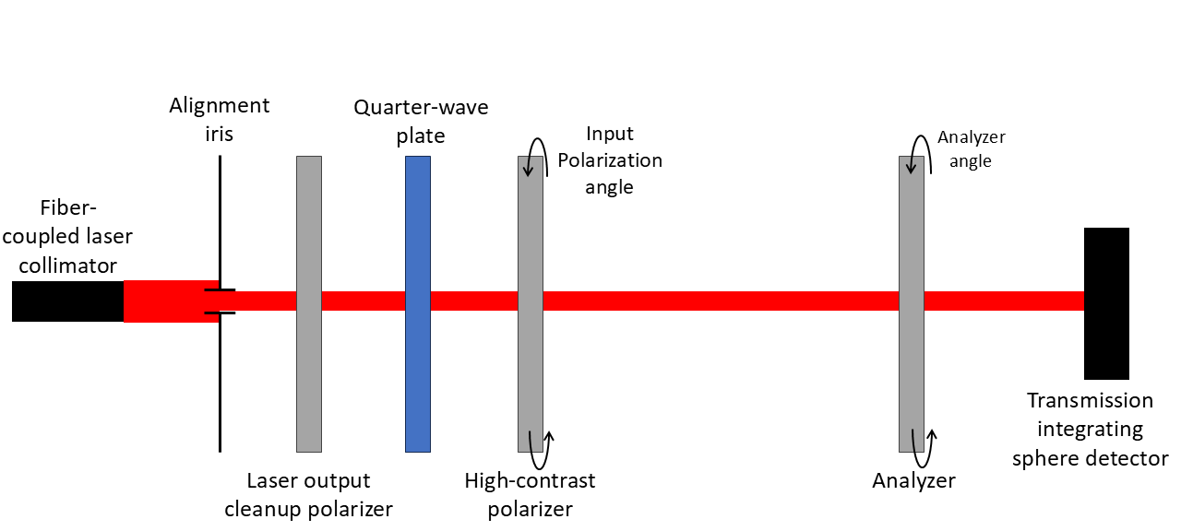
Analyzer Characterization

Slide 23
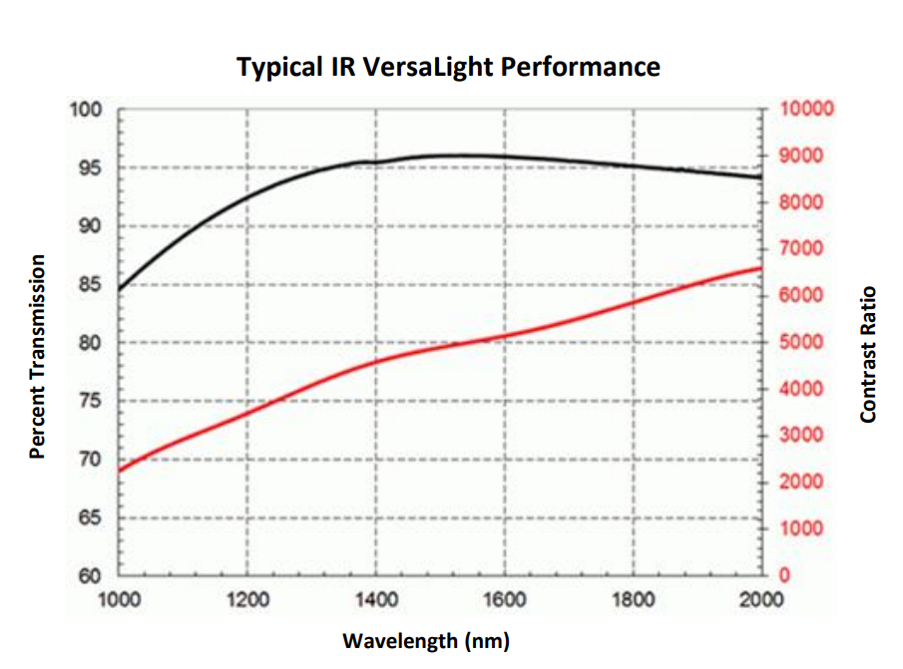
Analyzer Characterization
Measure transmission though analyzer as a function of analyzer angle Sweep wavelength 1546-1554 nm in 0.2-nm steps
Sweep analyzer from 0° -360° in 45° steps or 15° steps
Start measurements at minimum transmission angles
For our analyzer with a 1550 nm laser:
Expected Transmittance: 96%
Expected Contrast Ratio: 5000

Slide 24
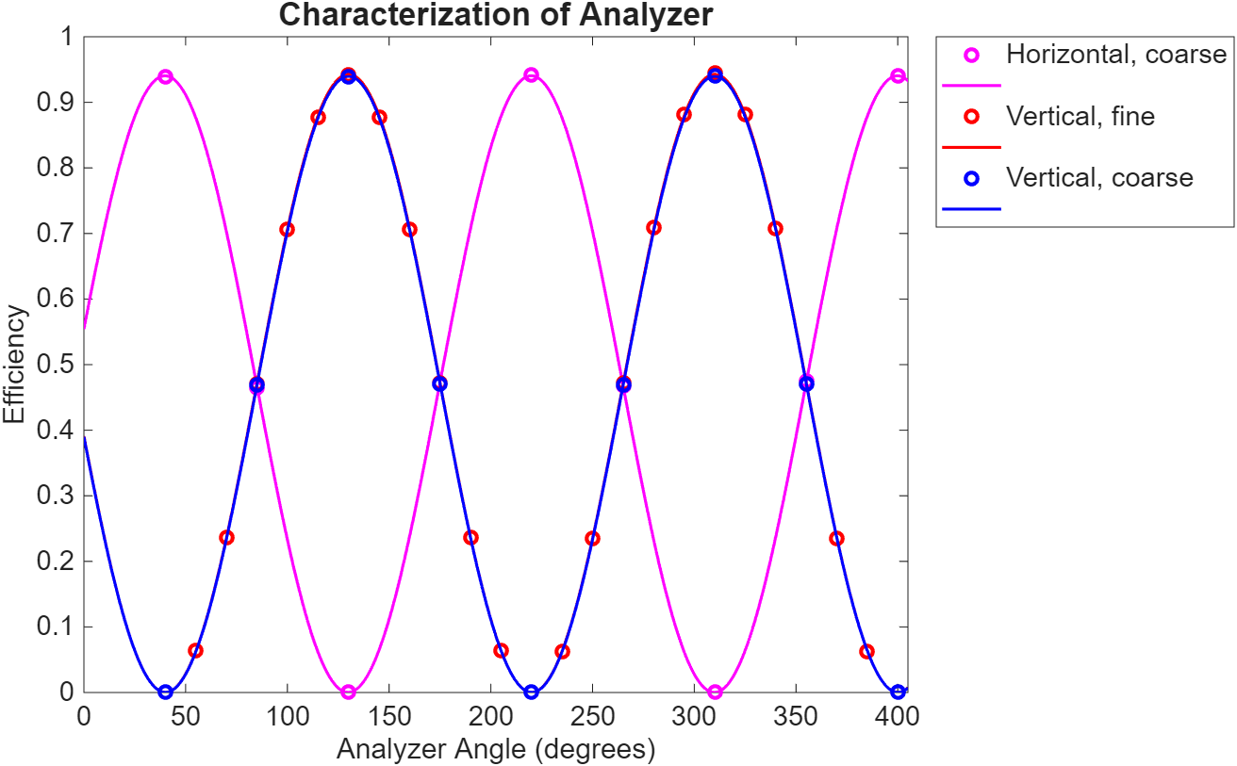
Analyzer Characterization: Results
Trial | Step size | Analyzer angle in block state | Maximum Transmittance | Contrast Ratio
1 | 45° | 40.10 | 97.8% | 5,180
2 | 15° | 40.07 | 98.5% | 5,180
3 | 45° | 129.86 | 94.2% | 5,070
mean ± max deviation |  |  | 96.8% ± 2.6% | 5140 ± 70
Block state

Slide 25
Analyzer Characterization: Results
Trial | Step size | Analyzer angle in block state | Maximum Transmittance | Contrast Ratio
1 | 45° | 40.10 | 97.8% | 5,180
2 | 15° | 40.07 | 98.5% | 5,180
3 | 45° | 129.86 | 94.2% | 5,070
mean ± max deviation |  |  | 96.8% ± 2.6% | 5140 ± 70
Block state

Slide 26
Faraday Rotator Characterization

Slide 27
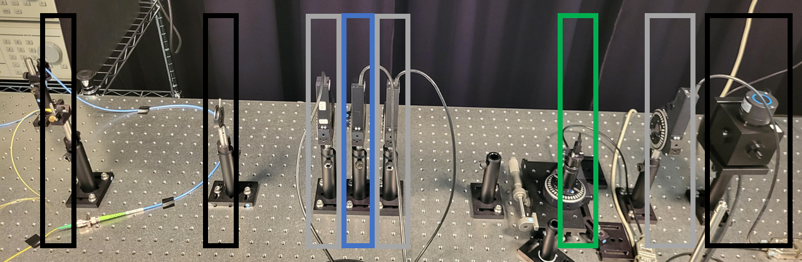
Experiment Overview

Slide 28
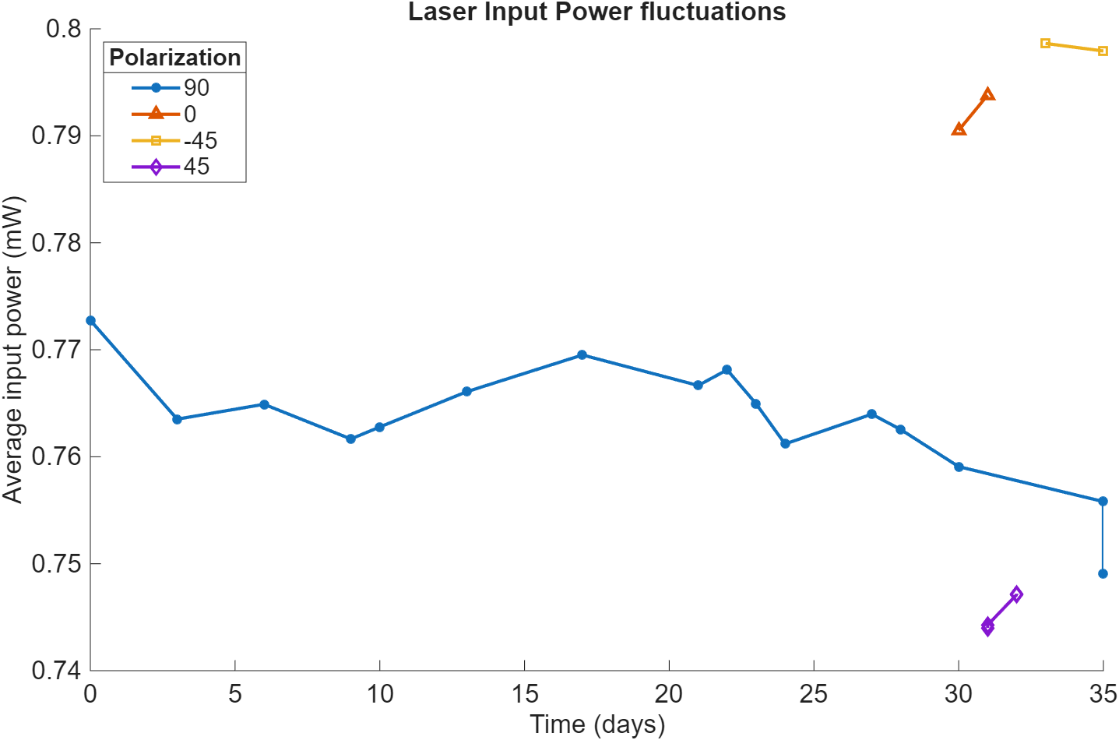

Slide 29
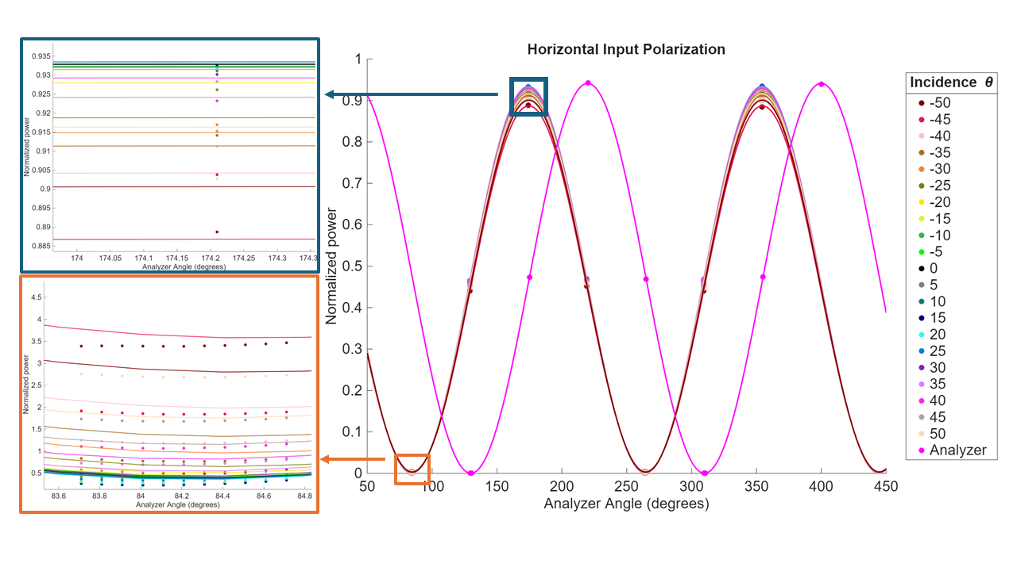

Slide 30
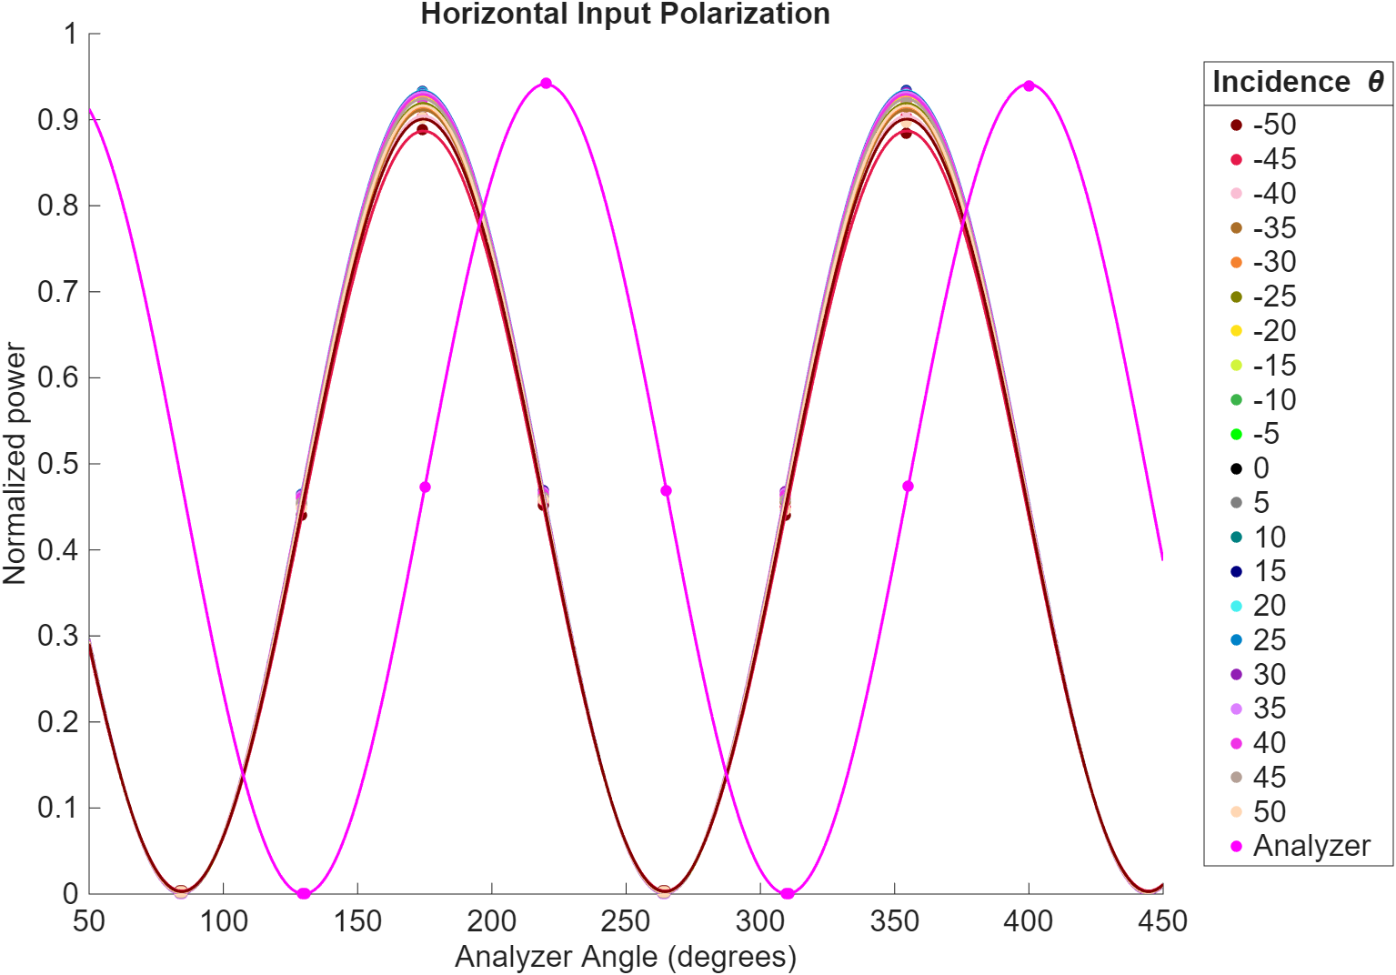

Slide 31
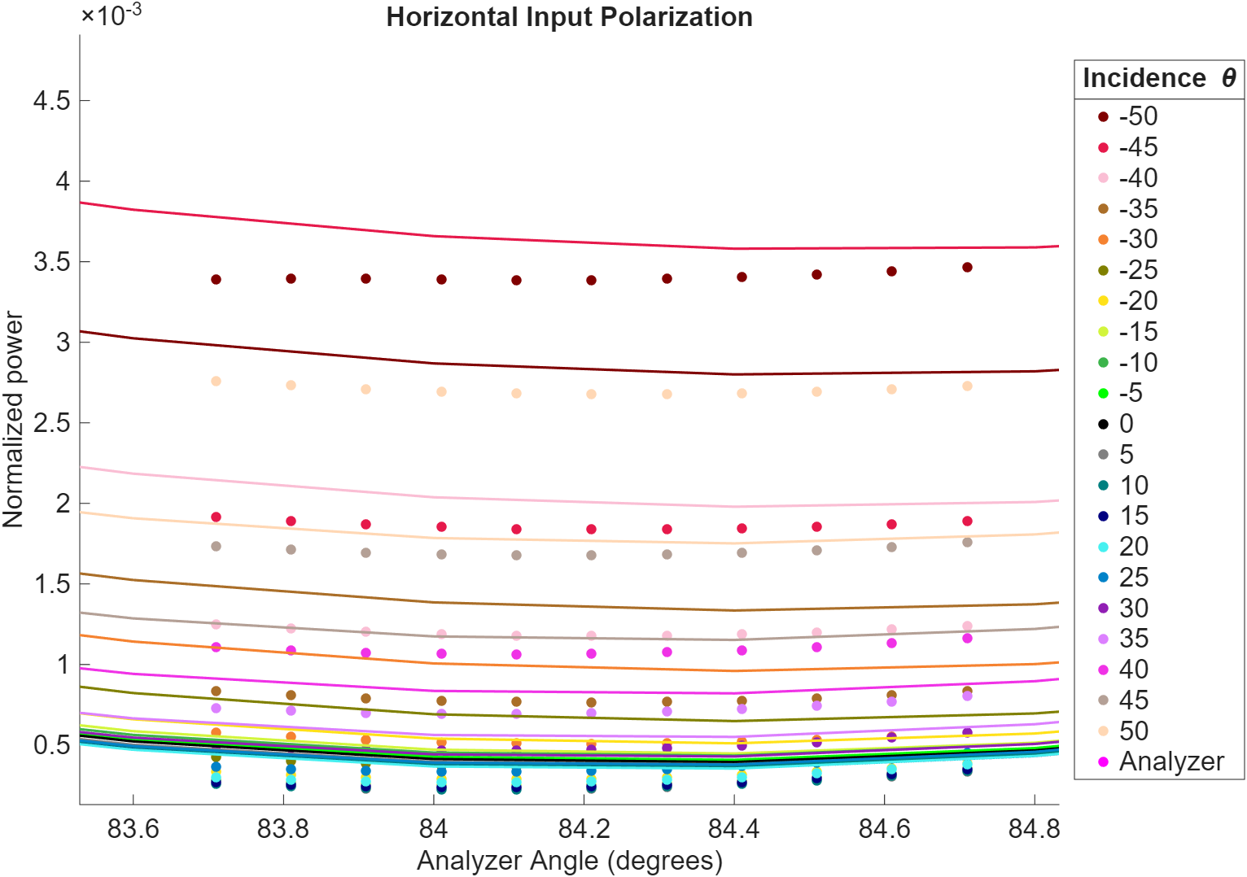
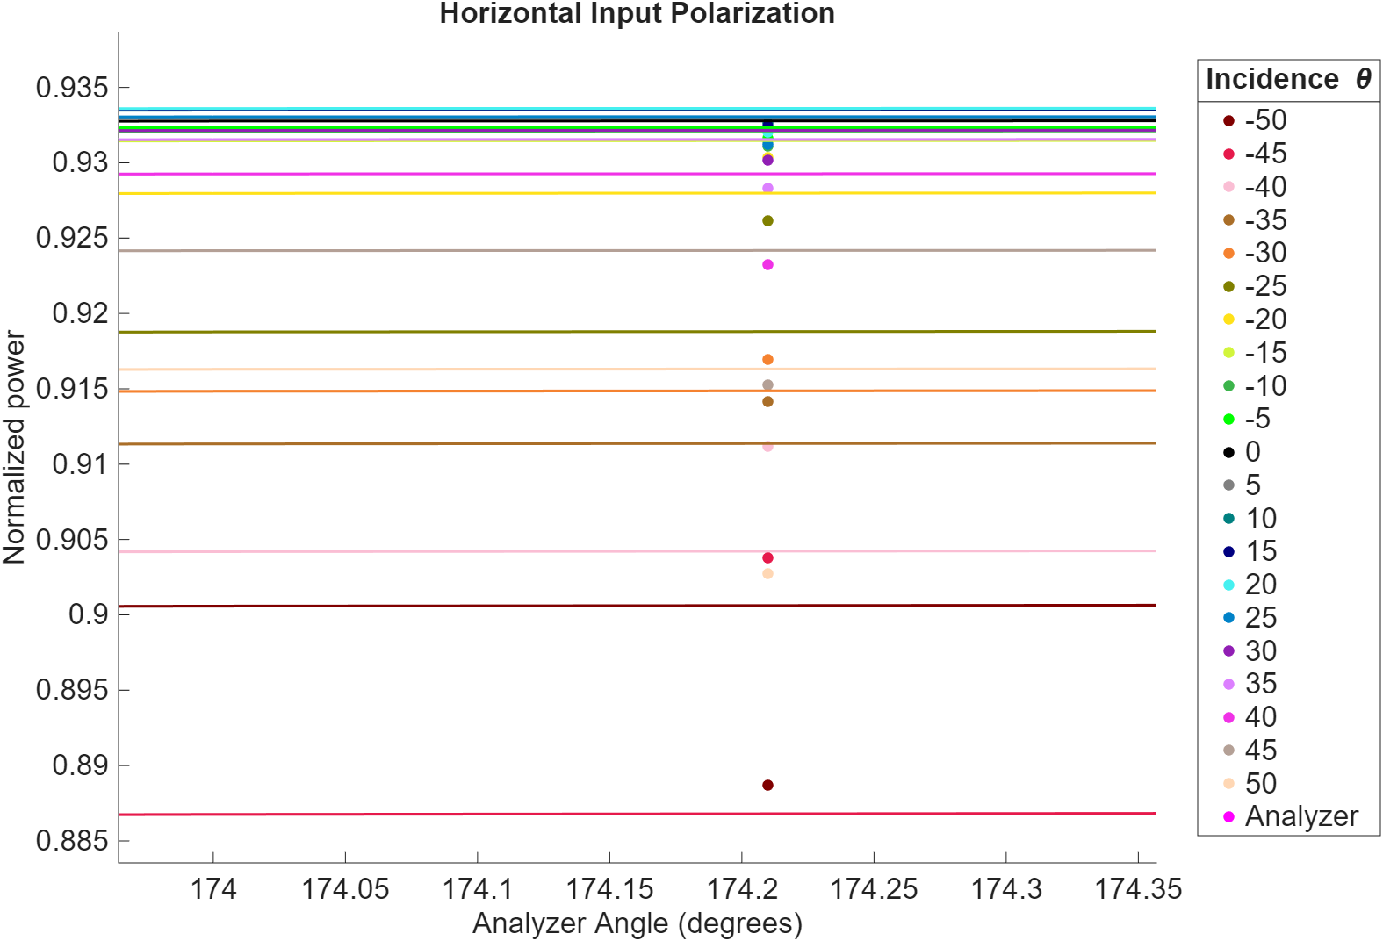

Slide 32
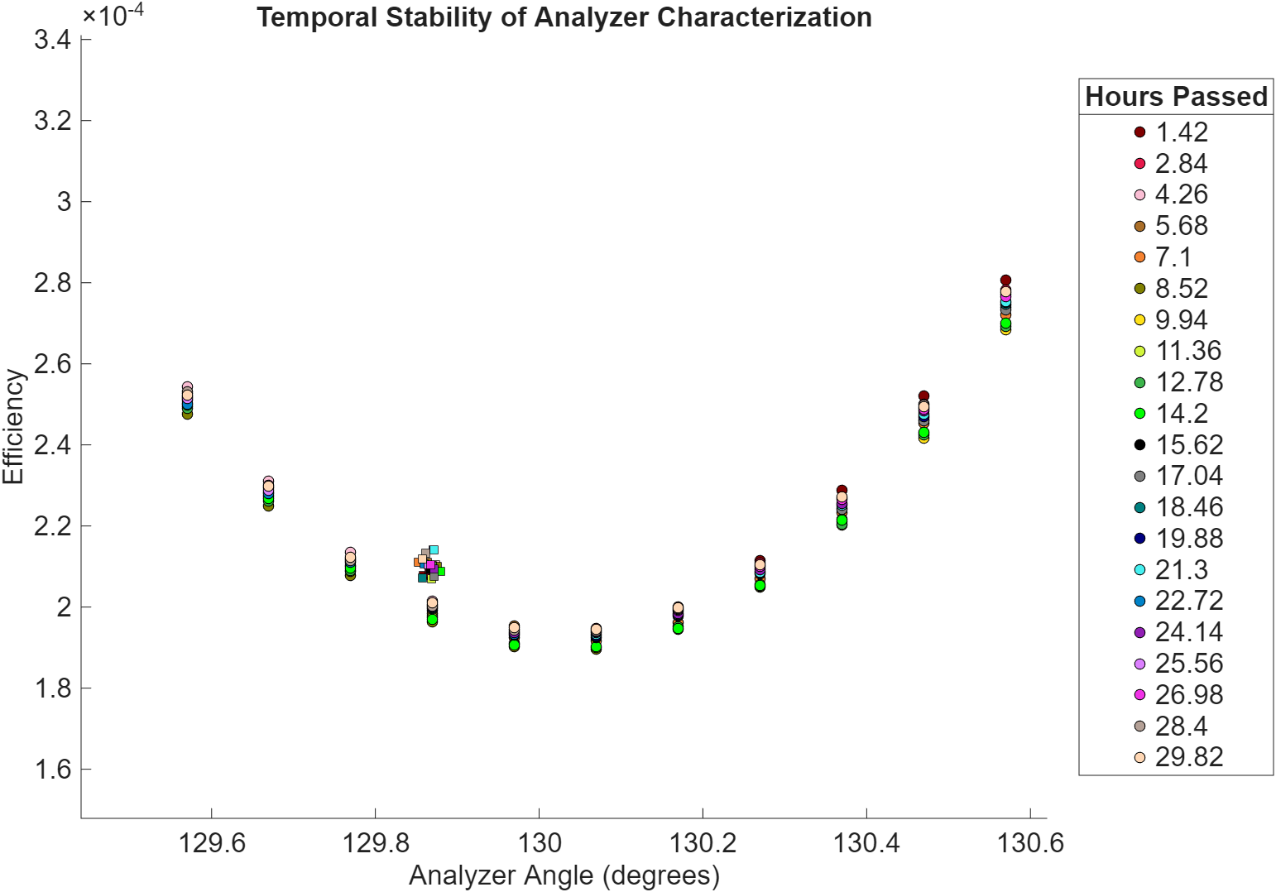
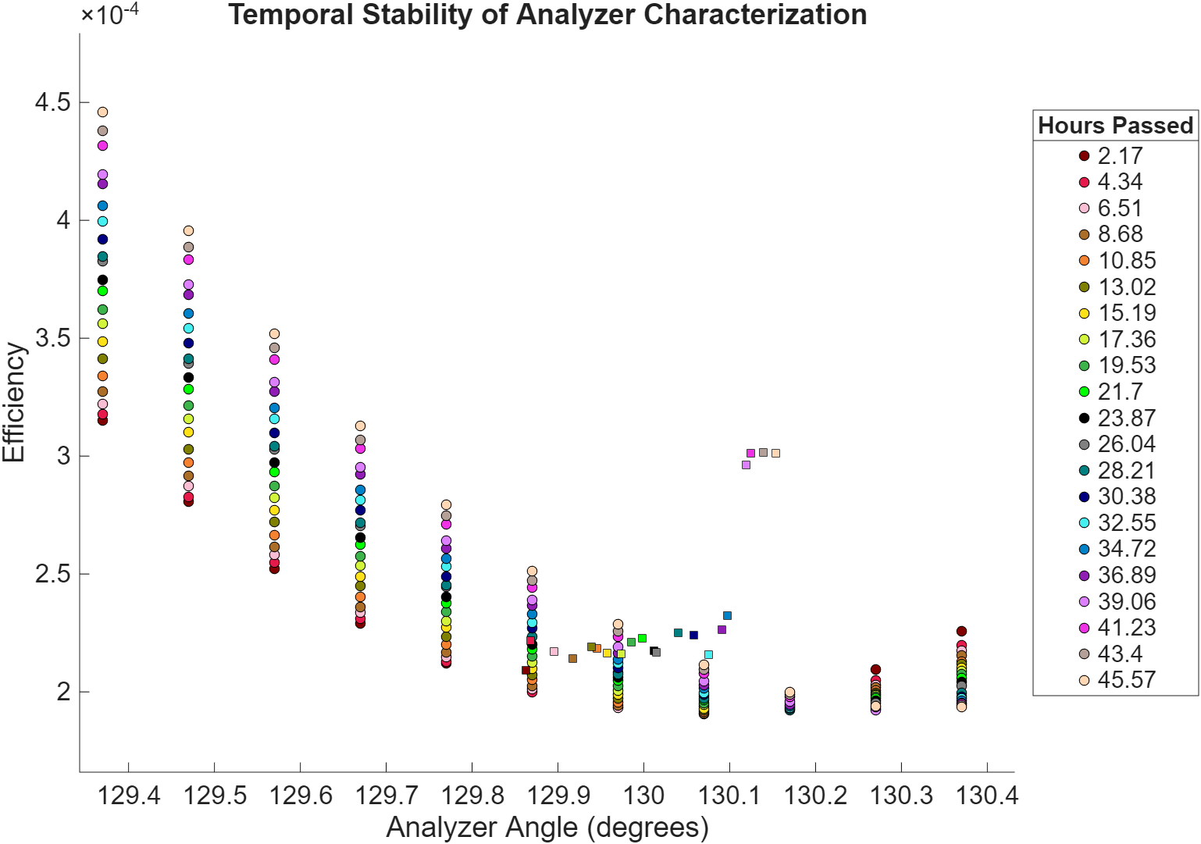

Slide 33
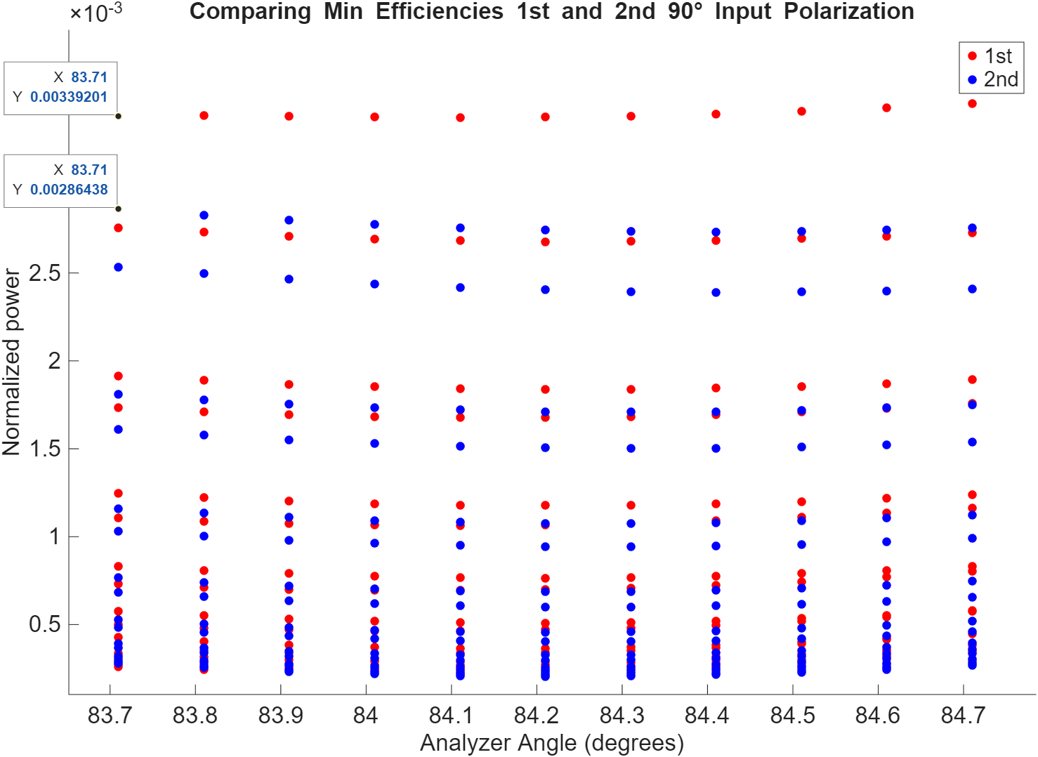
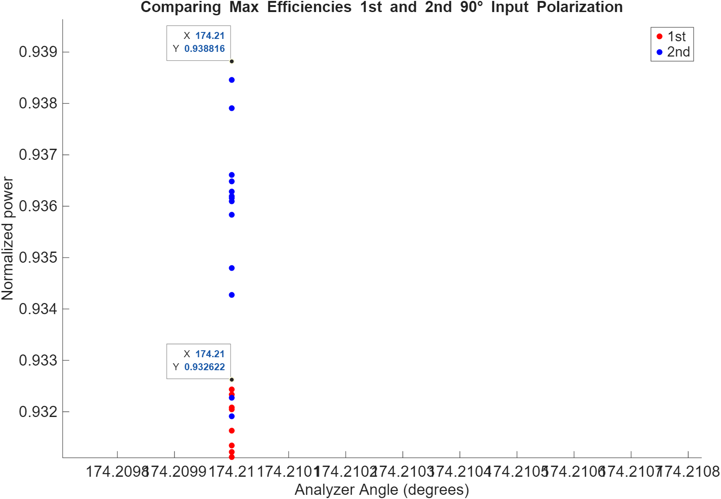

Slide 34
