Slide 1




Microfabricated Gas Sensor Array for Detection of Airborne Toxic Organic Compounds
Joseph Babcock¹, Dr. Xiao-An Fu², Shadmin Chowdhury²
¹Department of Chemistry, Transylvania University, Lexington, KY.
²Department of Chemical Engineering, University of Louisville, Louisville, KY.
NSF REU Award ID #2348869
NSF NNCI Award ID # 2025075

Slide 2

Environmental Injustice
Occurs when marginalized communities bear a disproportionate burden of environmental hazards and have limited access to environmental benefits and resources
  “Cancer Alley”, Louisiana
  Flint, Michigan
One of the most common forms, is increased exposure to volatile organic compounds (VOCs) in the air, which can cause serious health complications, including cancer, cardiovascular and many other diseases.

Slide 3
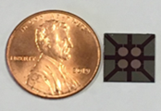
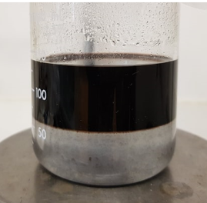
Background
We are using chemiresistors with thiol-capped gold nanoparticles (AuNP) to detect change in resistance when exposed to VOCs
VOCs being detects include:
  Acetone
  Ethanol
  Hexane
  BTEX (Benzene, Toluene, Ethyl benzene, Xylene)
Beaker containing:
Top layer - Thiol-capped AuNPs in toluene
Bottom layer - Water

Slide 4
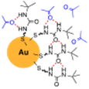
Goals for the Summer
Identify thiols that are effective nanoparticle caps for detecting different VOCs
Be able to use the sensors to accurately identify the concentration of the VOCs

Slide 5
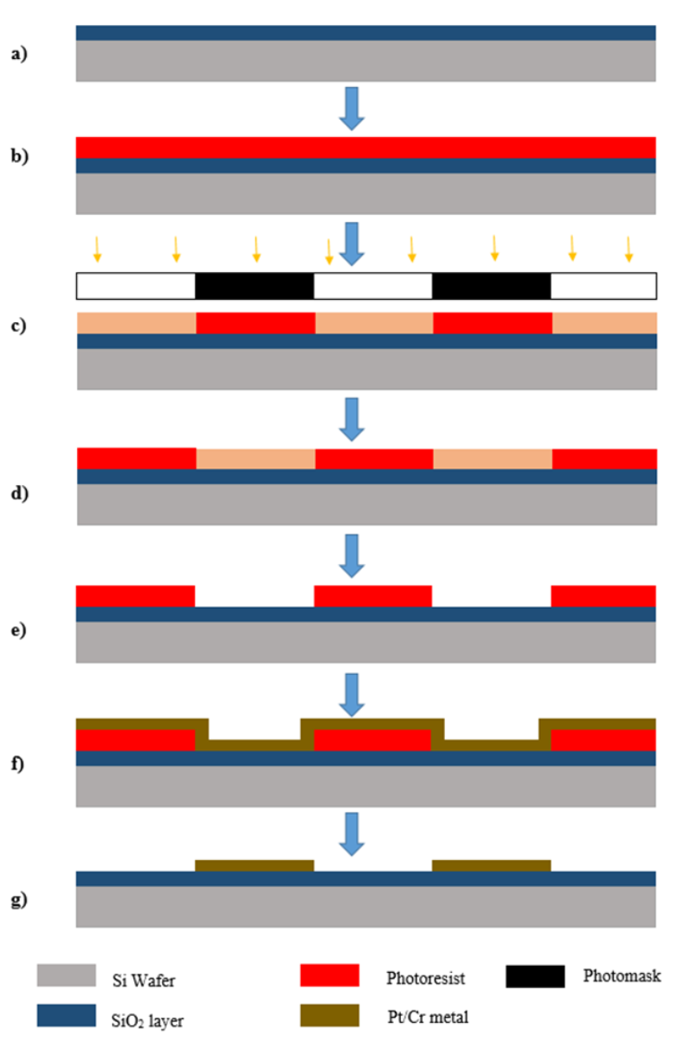
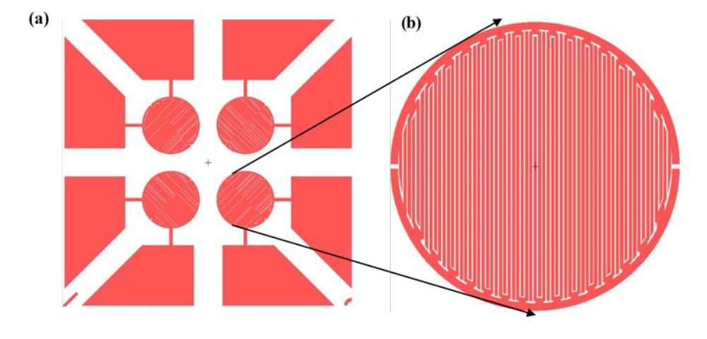
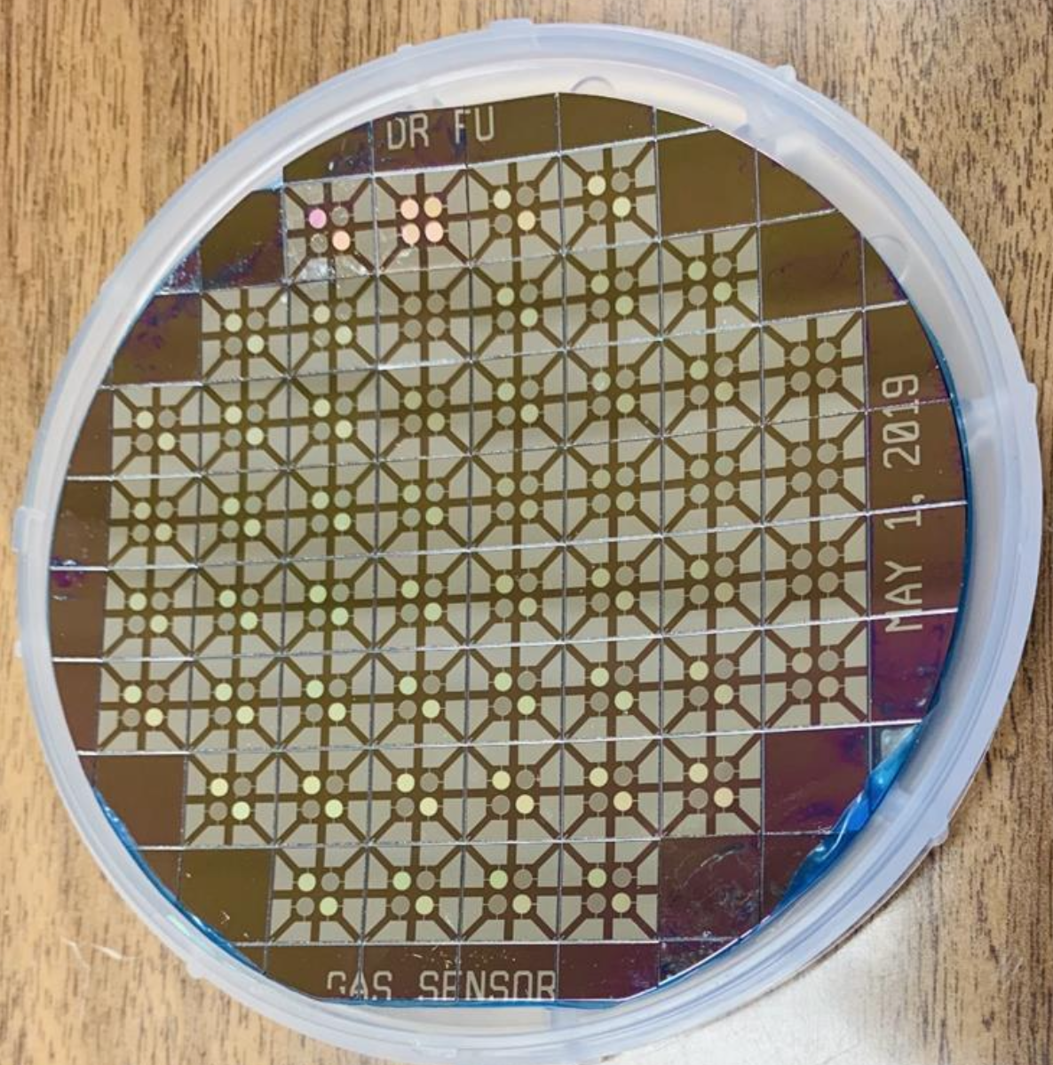
Microsensor Design and Fabrication
SiO₂ layer applied to wafer
Photoresist spin coating
Photolithography
YES Image Reversal
Development
Metal Sputtering
Lift-Off
Au/Ti metal

Slide 6
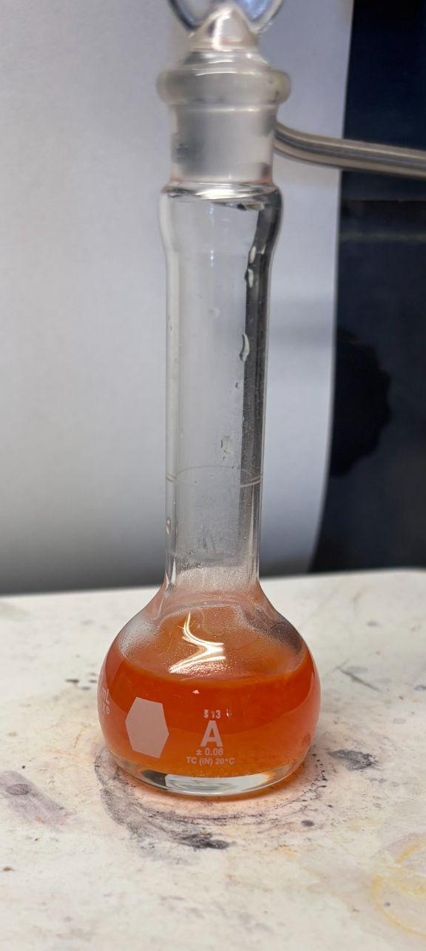
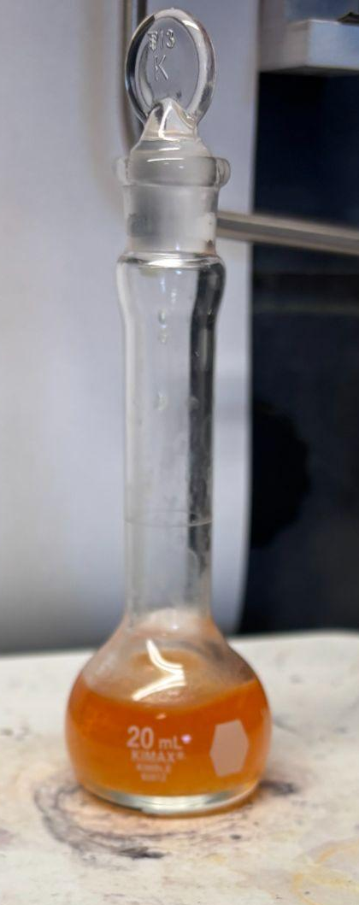
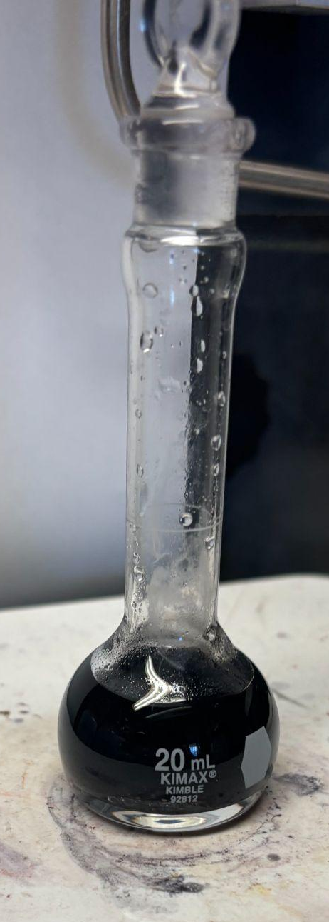
Synthesis of Thiol-Capped Gold Nanoparticles
Before adding thiol
Some thiol added
All thiol added
Synthesis of thiol-capped gold NPs to test the effectiveness of detecting different VOC’s
Solution of HAuCl4*3H2O & Nanopure Water
Solution of TOAB & Toluene
Mix solutions from steps 1 and 2 and stir for about 30 minutes to separate the water layer from the organic phase
Add thiol at a ratio of 1:1 (Au:Thiol) and stir for 1 hour
Add NaBH4 & Nanopure Water solution dropwise and stir for 3 hours
Left in ethanol overnight to rinse any excess thiols from AuNPs

Slide 7
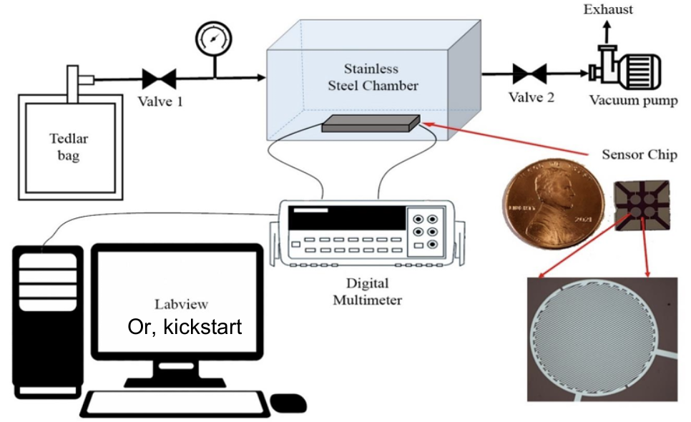
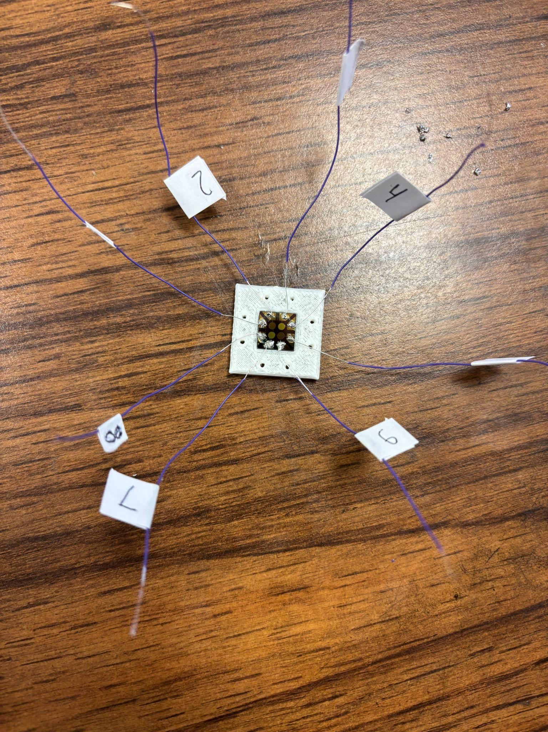
Sample Prep and Trials
General trial:
We place the chip into the vacuum chamber
Alternate between vacuum and sample after a specified period of time
Some exchange of samples from less concentrated to more concentrated or vise versa
One second increments between resistance detection
Sample Prep:
Add designated amount of VOC into 1 L of air in a tedlar bag to prepare a 1000 ppm sample
Series dilution of sample to create multiple concentrations
VOC | Amount
Hexane | 5.34 uL
Ethanol | 2.39 uL
Acetone | 3.00 uL
Benzene | 4.03 uL
Toluene | 4.34 uL
Ethyl Benzene | 5.01 uL
Xylene | 5.05 uL

Slide 8
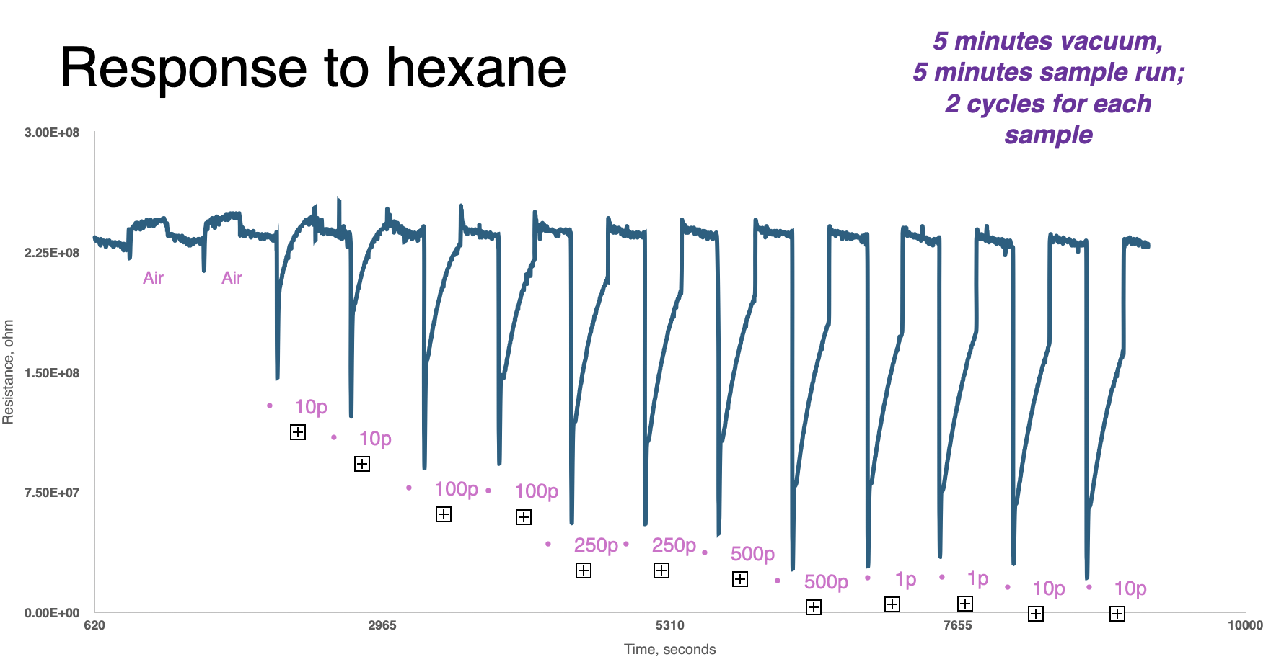
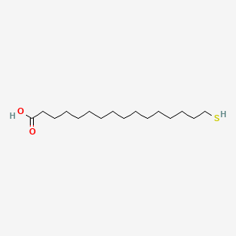
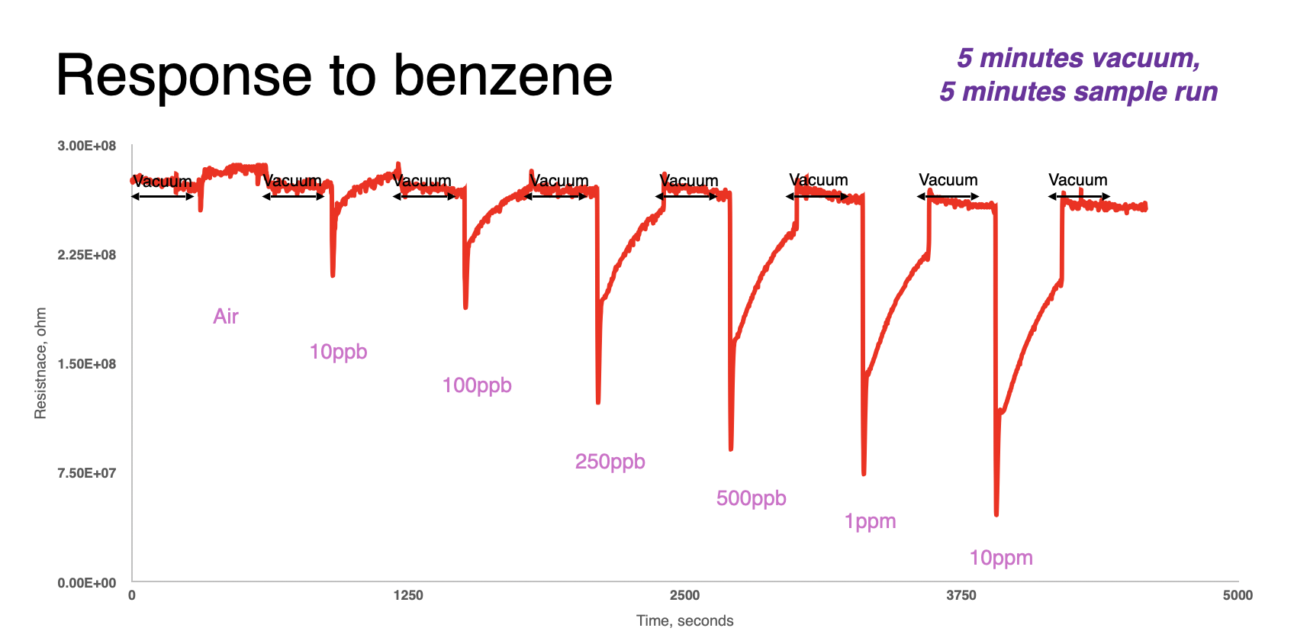
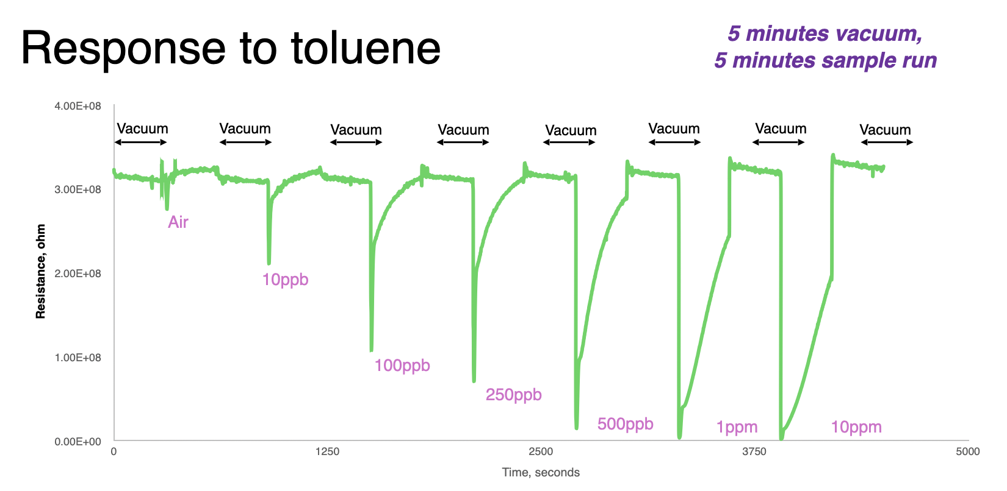
Response of 16-MHA capped AuNP
16-Mercaptohexadecanoic acid (16-MHA)
Shows sensitivity to concentrations of alkanes and BTEX
Some inconsistencies with hexane, but mostly good
Some problems with higher concentrations of toluene and hexane

Slide 9
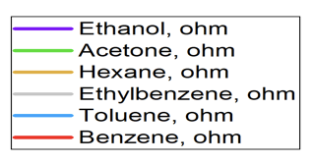
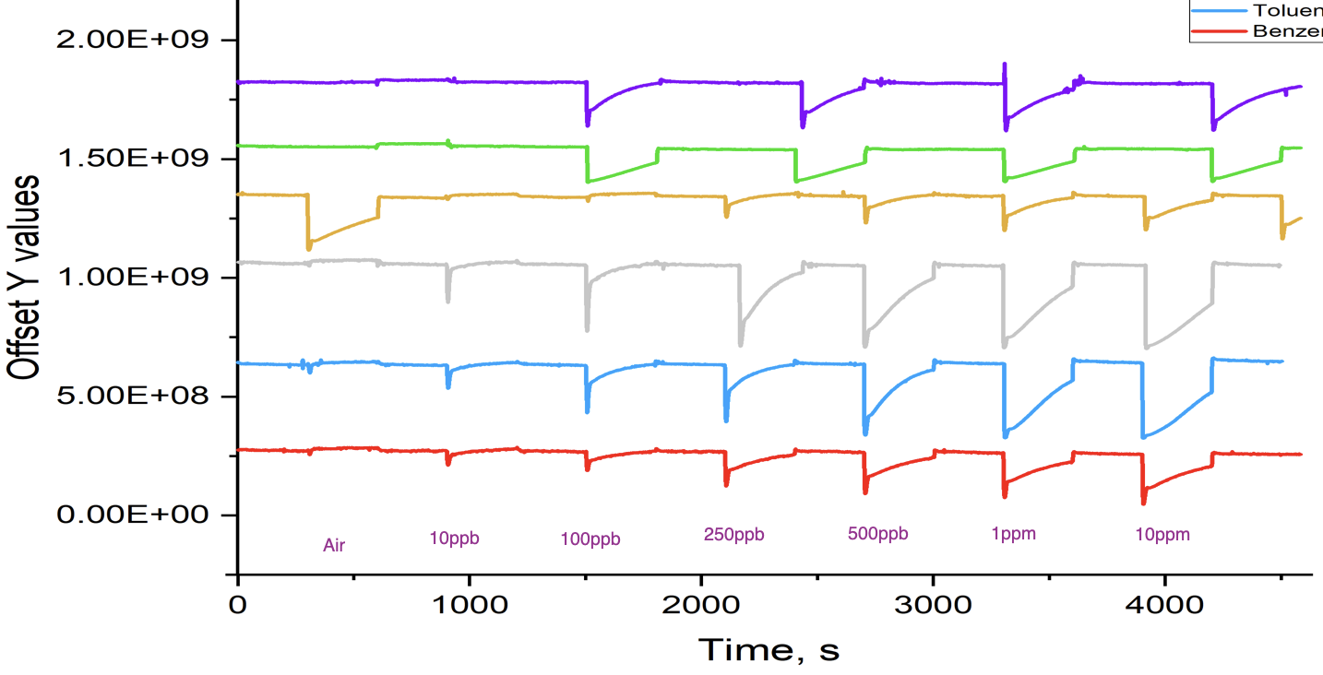
Response of 16-MHA capped AuNP
16-Mercaptohexadecanoic acid (16-MHA)
Responds to VOCs at different resistance levels, making it so that we can accurately identify the present VOC

Slide 10

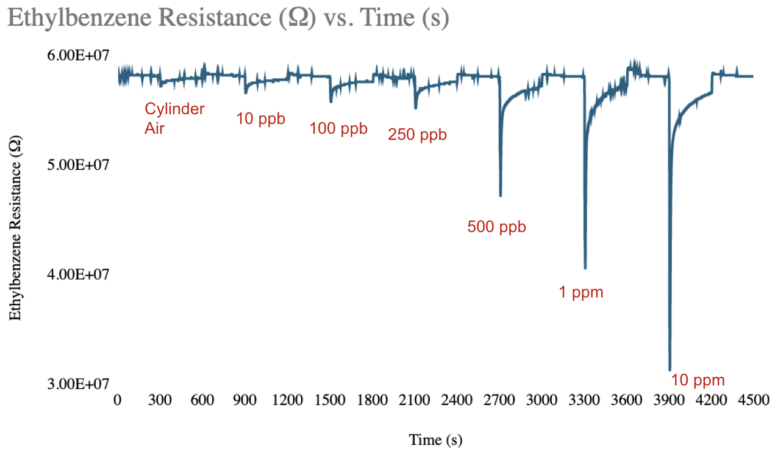
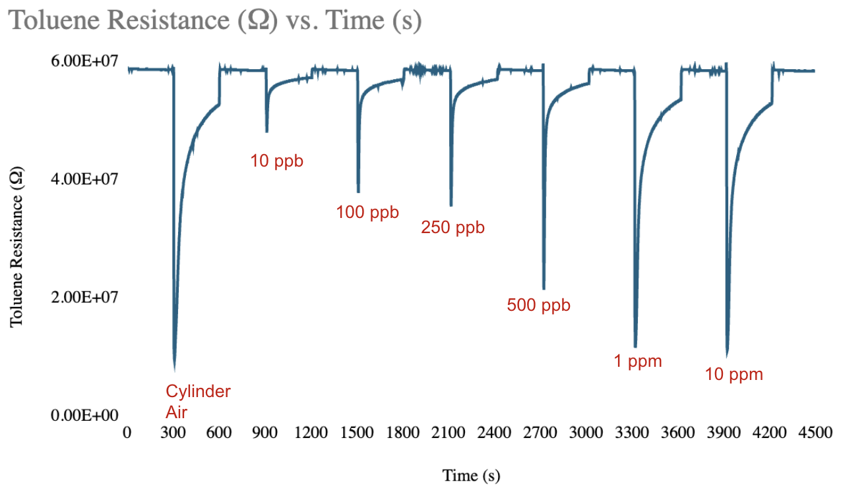
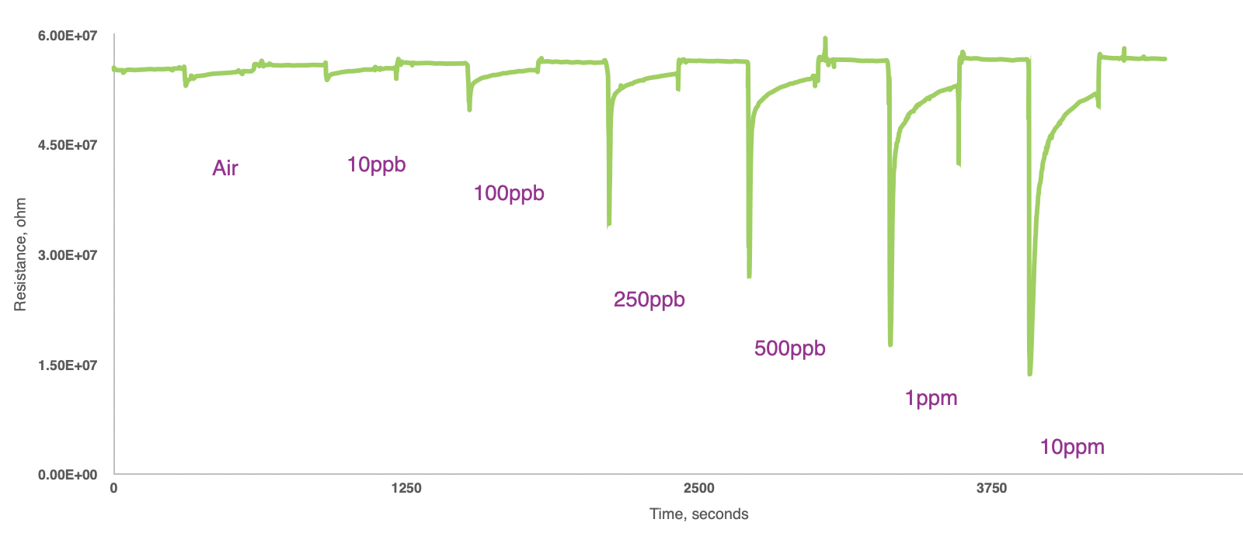
Response of DT capped AuNP
Response to ethylbenzene
Decanethiol (DT)
Shows best sensitivity to carbonyl compounds
Has some trouble with small concentrations
Shows inconsistencies with BTEX compounds
Response to toluene
Response to acetone

Slide 11
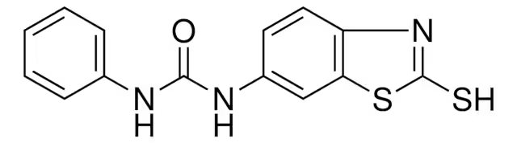
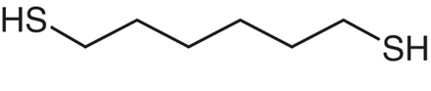
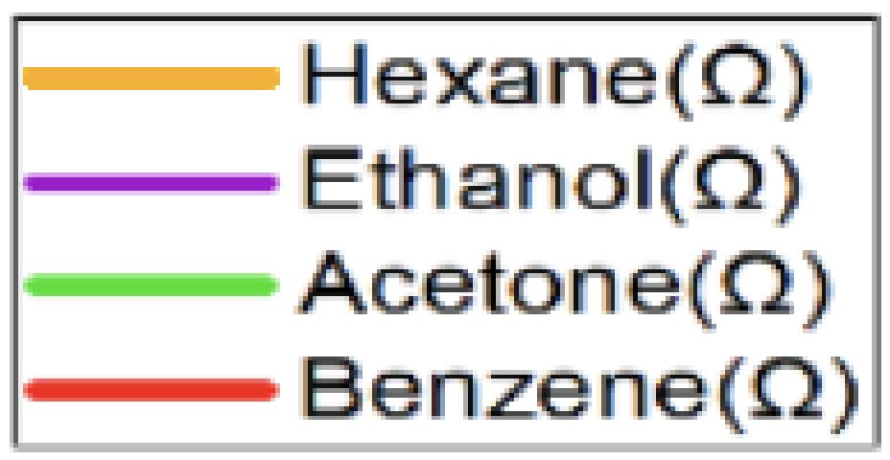
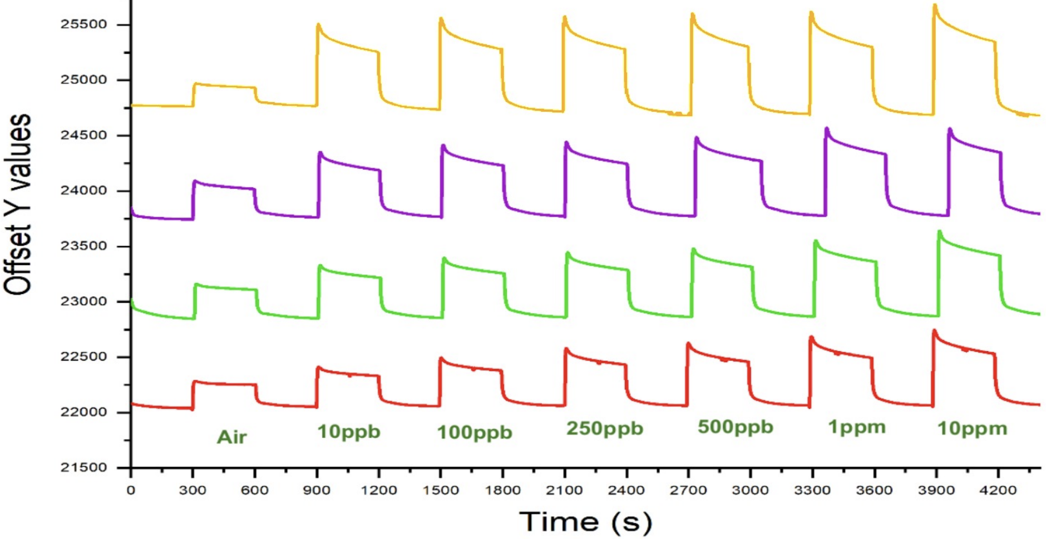
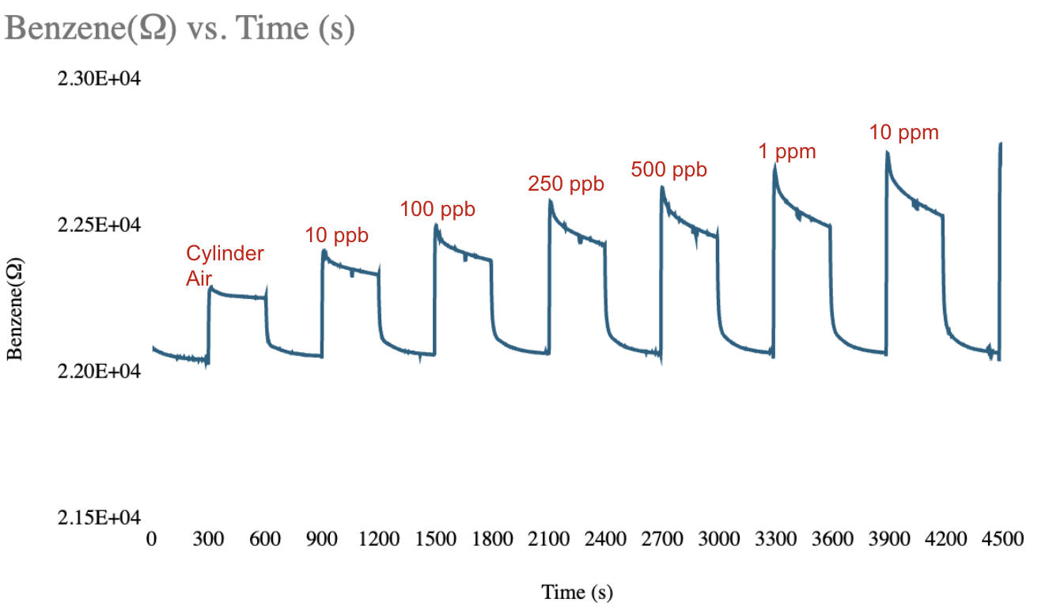
Response of Au6-YL Crosslinked with HDT capped AuNP
Hexanedithiol (HDT)
1-(2-Mercaptobenzothiazole-6-YL)-3-phenyl urea (6-YL)
Response to benzene

Slide 12
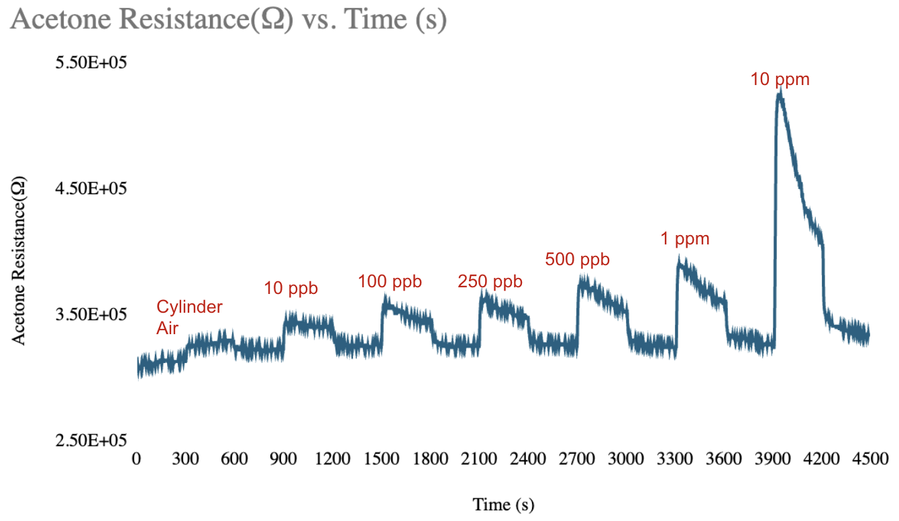
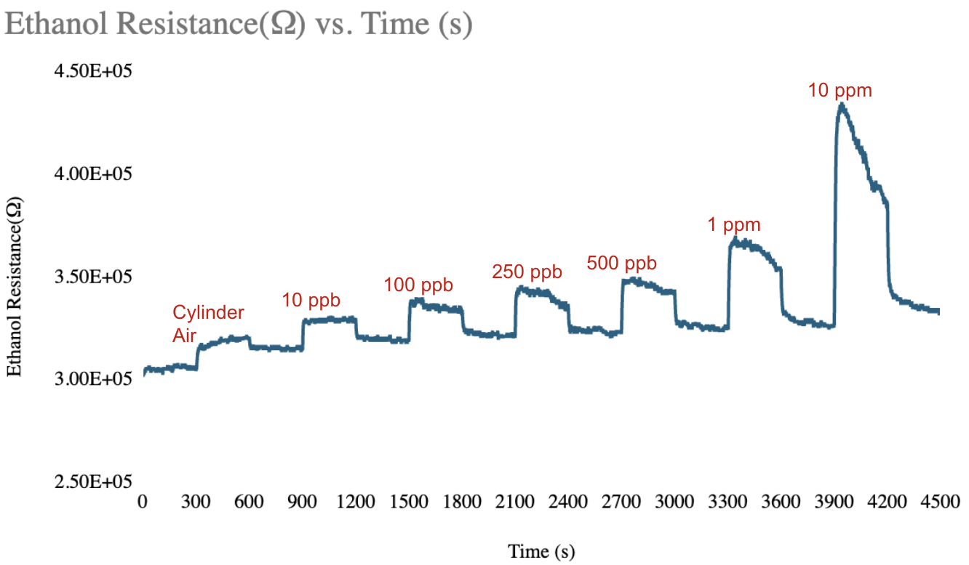
AuDT Crosslinking with HDT
Decanethiol (DT)
Hexanedithiol (HDT)
Crosslinked the DT capped AuNP with 1,6-hexanedithiol (HDT) by using 30 uM solution of AuDT in hexane (solution 1) and 50 mM solution of HDT in hexane (solution 2).
Shows decent trends, however very noisy and responds inconsistently to high concentrations
Does not return to consistent original resistance

Slide 13
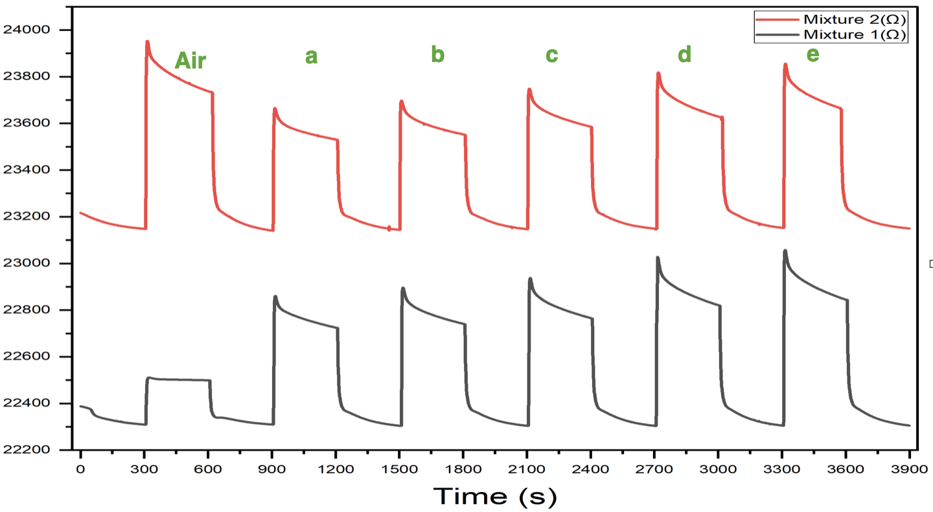
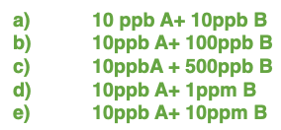
Au-6-YL response to VOC mixtures
1-(2-Mercaptobenzothiazole-6-YL)-3-phenyl urea (6-YL)
Mixture 1: 10 ppb benzene (A) & 10 ppb - 10 ppm acetone (B)
Mixture 2: 10 ppb acetone (A) & 10 ppb - 10 ppm benzene (B)
When the mixture is predominantly benzene, higher resistance is shown
Shows some sensitivity to concentration.

Slide 14
Conclusion and Future Uses
While we have made good progress on identifying thiols that effectively detect different groups of VOCs including BTEX, carbonyls, alcohols, and alkanes, using the sensors for concentration detection will take more time
Once further developed, these sensors will be capable of identifying specific areas that are more severely affected by these chemicals, ensuring that all people are aware of their surroundings and can indicate if the conditions they are in are unsafe.
This could lead to improvements of the environmental injustice of underrepresented communities being more exposed to these toxic chemicals, and hopefully limit the amount of people in high risk areas.

Slide 15
References
Acknowledgements
Halder, Sujoy. Novel Microdevices to Analyze Toxic Volatile Organic Compounds. May 2023.
Foster, Sheena. “What Is Environmental Racism, and How Can We Fight It?” Reader's Digest, 2 August 2022, https://www.rd.com/article/environmental-racism/. Accessed 17 July 2025.
This work was supported by the NSF and NNCI KY Multiscale. I would also like to acknowledge Dr. Xiao-An Fu, Shadmin Chowdhury and Ana Sanchez Galliano for their feedback on my presentations, poster, and paper.

