Slide 1
The Potential of Carbon-Coated Perovskite Solar Devices
Luca Felicioli, Arizona State University
Marco Casareto, Arizona State University
Dr. Nicholas Rolston, Arizona State University

Slide 2
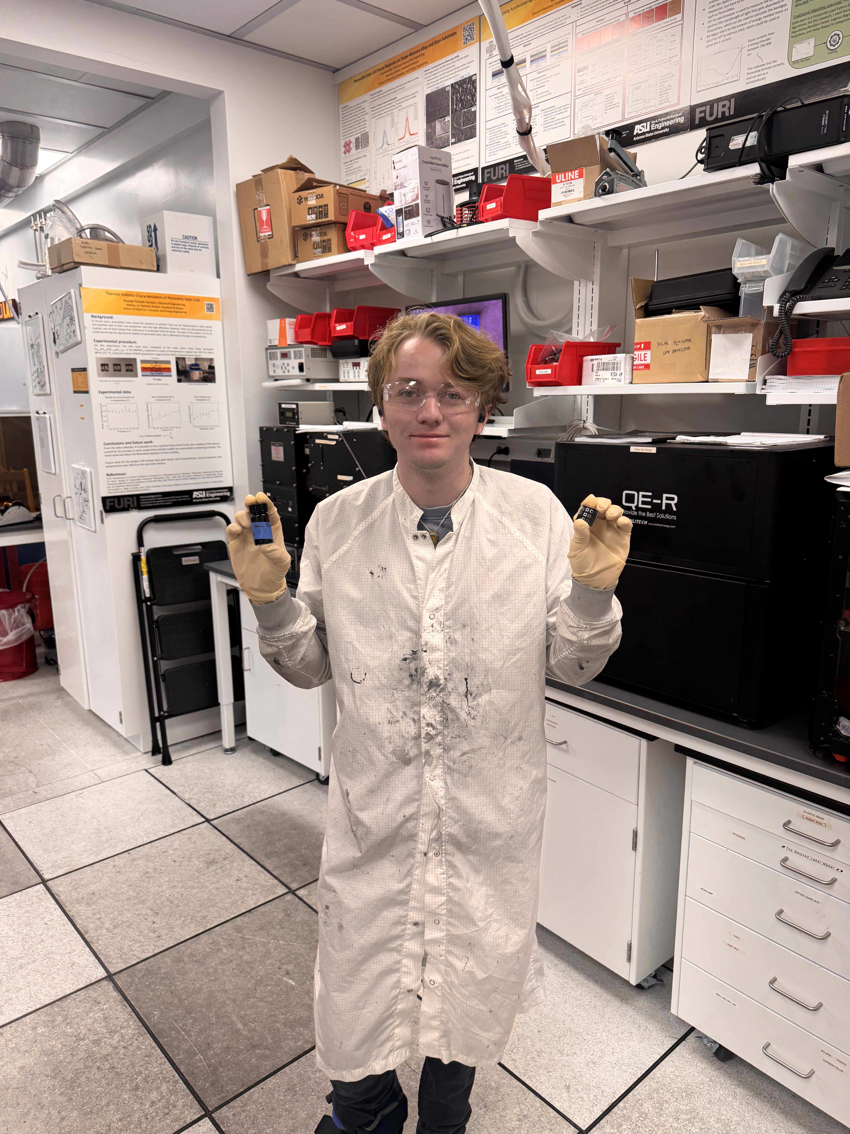
About Me
Chemical Engineering Major.
Arizona State University.
Graduating May 2027.
Notes:
I am a chemical engineering student at Arizona State University
I am currently researching at the Rolston Lab
I plan to graduate in May of 2027

Slide 3
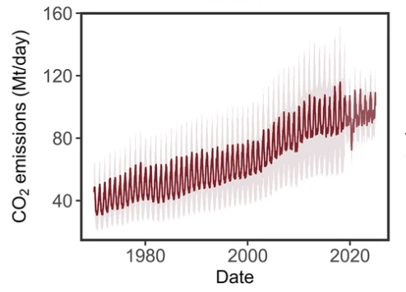
Background
Figure 1. Worldwide carbon emissions over the past decades [1].
Non-Renewable Energy
Transportation
Carbon Emissions
AI
Agriculture
AI Data Centers
Figure 2. Contributions to carbon emissions [2].
Worldwide carbon emissions keep rising.
Rising carbon emissions contribute to climate change and environmental harm.
Sustainable innovation and renewable energy solutions are needed [1] [2].
Notes:
Worldwide carbon emissions have been rising throughout the past decades and are expected to continue
Non-renewable energy, agriculture, transportation, and AI data centers are contributors to this trend.
Carbon emissions contribute to climate change, which can result in not only harm to the environment but also human health.
This looming threat creates demand for sustainable innovations and renewable energy solutions.

Slide 4
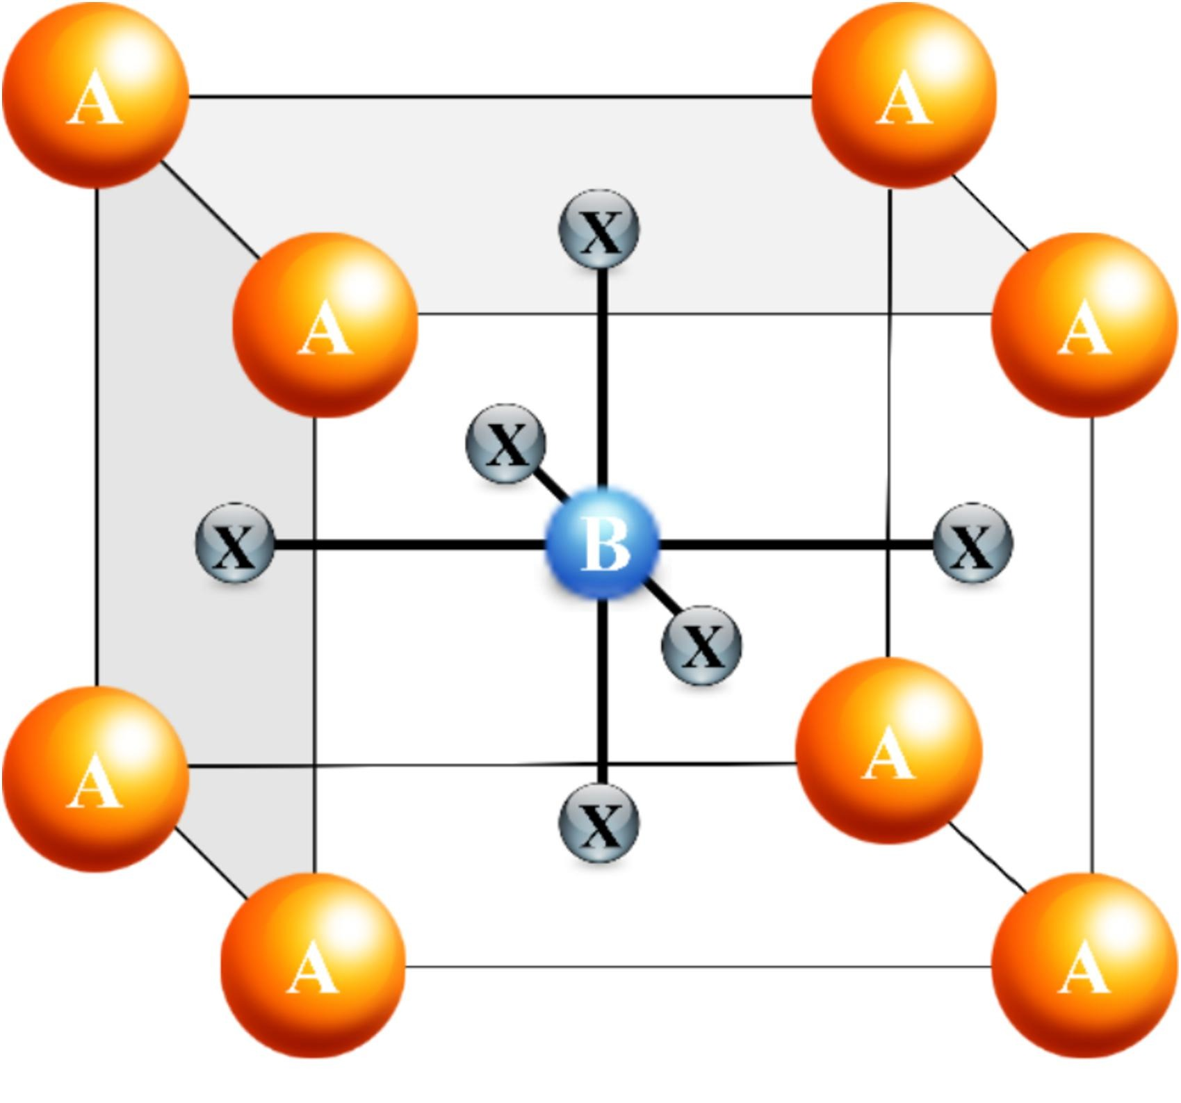
What are perovskites?
Formula: ABX₃
FA⁺, Cs⁺
Pb²⁺
  I⁻
A
B
X
PVSK Used: Cs_{0.2}FA_{0.8}PbI₃
Next generation of solar technology.
Low cost.
High efficiency (>25%).
Follows the formula: ABX₃ [3].
Figure 3. The structure and formula of perovskite [3].
Notes:
Perovskites are viewed as the next generation of solar panel technology
They are low cost and highly efficient, exceeding efficiencies of 25 percent.
They follow the formula of ABX3, which is arranged in a lattice structure seen above.
For my research, I used a cesium formadinium lead iodide recipe as the perovskite.

Slide 5
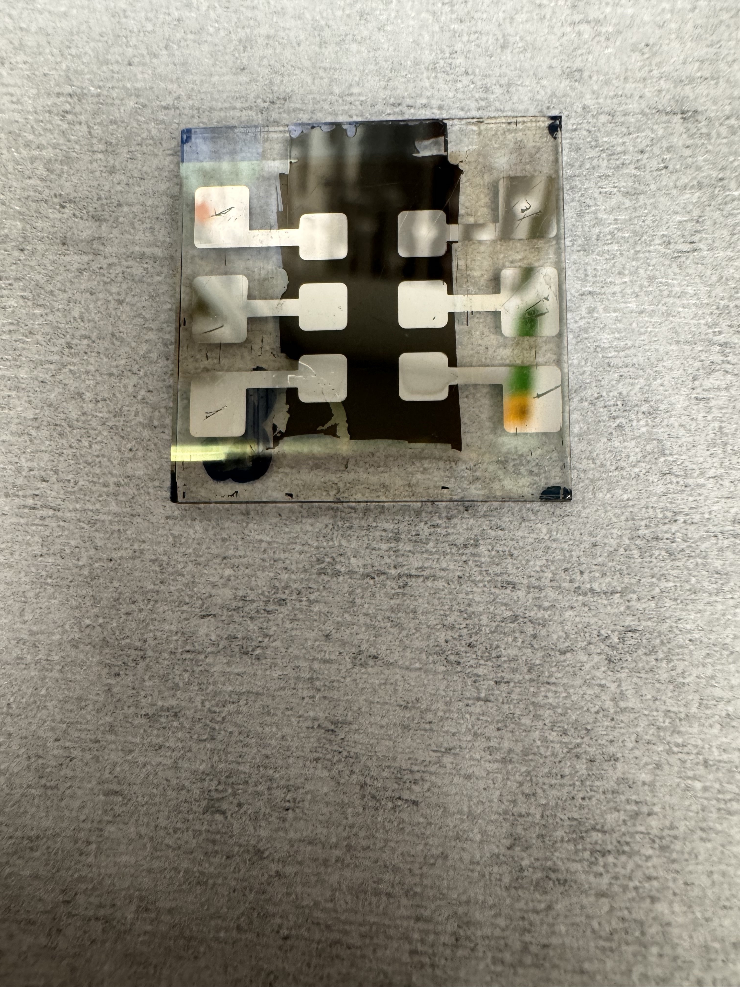
The Problem
Silver
+
C60
Perovskite
-
HTL
ITO
Glass
Figure 4. Diagram of the silver perovskite solar cell (PSC) stack used and the degradation that occurs.
The electrodes on perovskite solar devices is commonly made of rare and expensive metals.
Are reactive with devices layers, resulting in unstable devices [4].
Notes:
Although perovskites are impressive, they do carry some caveats.
Perovskite solar devices typically use expensive and rare metals, such as silver, as the back electrode.
These materials can allow for ion migration to occur, reducing the stability and lifetime of these devices.

Slide 6
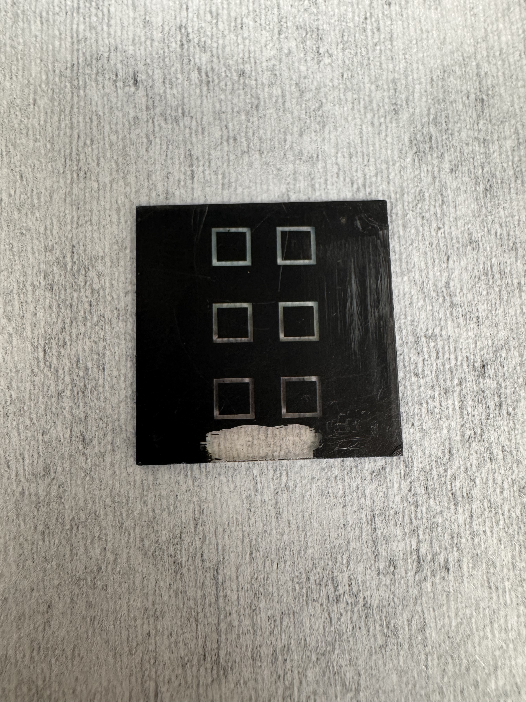
The Research
Carbon
Perovskite
SnO₂
ITO
Glass
Figure 5. Diagram of the carbon-coated PSCs used in this project.
Replacing the rare metal electrode with carbon.
Improves stability of perovskite solar devices.
Carbon is lower cost and abundant [5].
Notes:
My research focuses on replacing the silver electrode with carbon
Carbon is cheap and abundant, reducing the cost of devices
The carbon electrode also improves stability by reducing ion migration and being naturally hydrophobic
The hydrophobicity of the electrode prevents moisture from degrading the perovskite layer.
However, carbon has its challenges and requires careful experimentation and optimization.

Slide 7
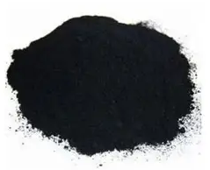
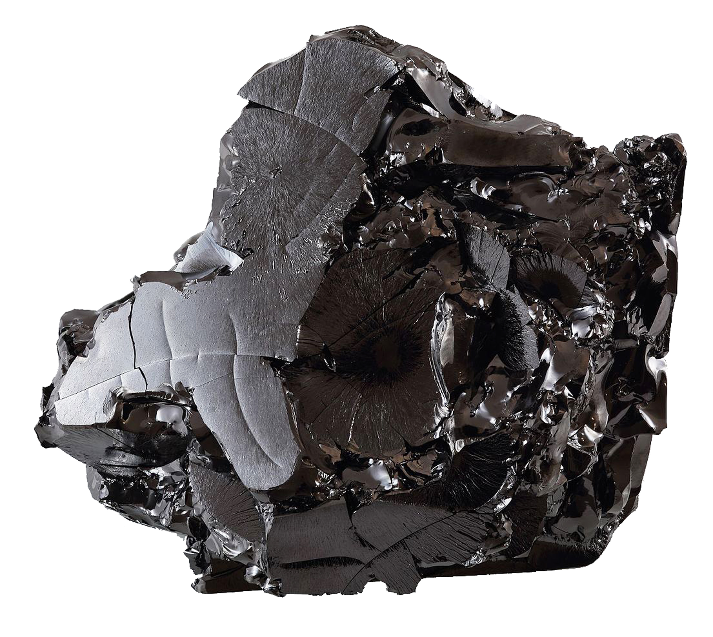
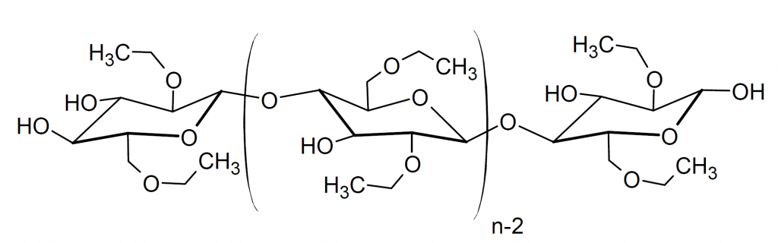
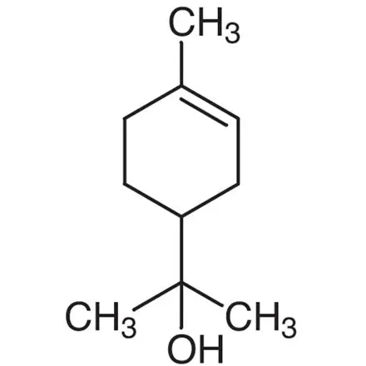
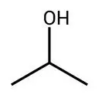
Materials and Methods – Carbon Ink
Carbon Black
Ethyl Cellulose
Isopropyl
Alcohol
Graphite
α-Terpineol
Mortar and Pestle
Ball Milling
Carbon Paste
Figure 6. Procedure for making the carbon ink before it is blade coated onto the substrate.
The ratio of ethyl cellulose to carbon black to graphite was varied (mainly using 1:2:2 and 1:1:3 ratios).
Isopropyl alcohol allows for ink viscosity to be varied.
Acknowledgement: This material is based upon work primarily supported by the National Science Foundation under award No.ECCS-2025490.
7
Notes:
The carbon layer is made by depositing carbon ink onto the perovskite that is made in lab.
The ink consists of carbon black, graphite, alpha-terpineol, ethyl cellulose, and isopropyl alcohol.
The ingredients are mixed in a mortar and pestle and are treated with ball milling to make the ink less granular.
The carbon paste ratio of ethyl cellulose to carbon black to graphite is varied, with 1:2:2 and 1:1:3 being mainly investigated.
Isopropyl alcohol is included to vary viscosity.

Slide 8
Materials and Methods – PSC Procedure
Methods for carbon-coated PSC scribing and fabrication are scalable.
Desirable cost effectiveness due to open-air manufacturing methods [5].
Substrate Cleaning
SnO₂ Spin Coating
Perovskite Spin Coating
Indirect Laser Marking
Direct Laser Marking
Blade Coating
Figure 7. General procedure for making carbon-coated PSCs.
Notes:
My research also focuses on using fabrication methods that are scalable, allowing for easier mass production.
Processing done in open air reduces costs but can also reduce efficiency.
However, devices made in open air are still economically competitive with fancier devices despite the downsides.

Slide 9
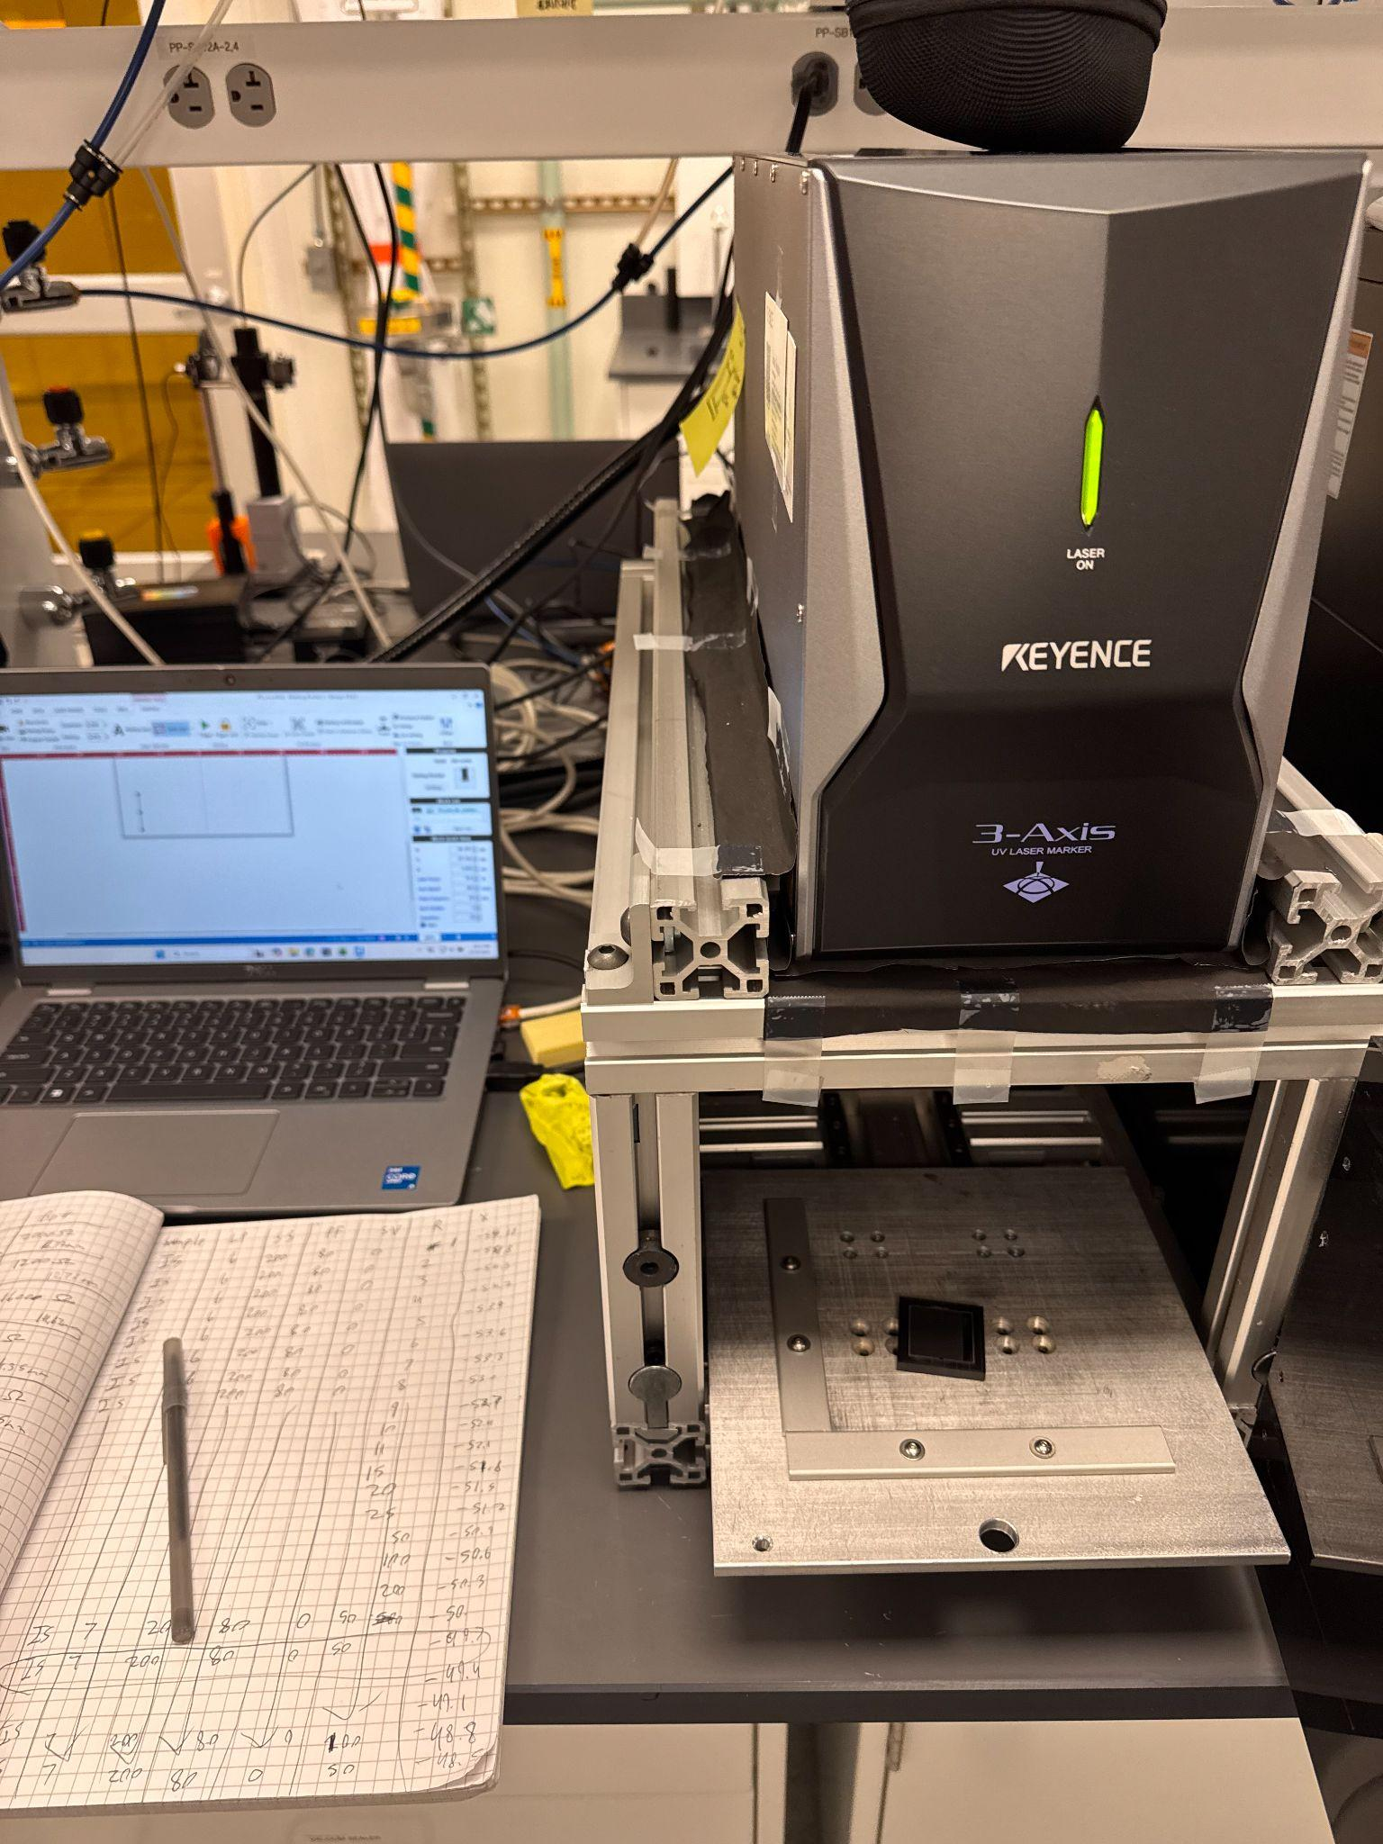
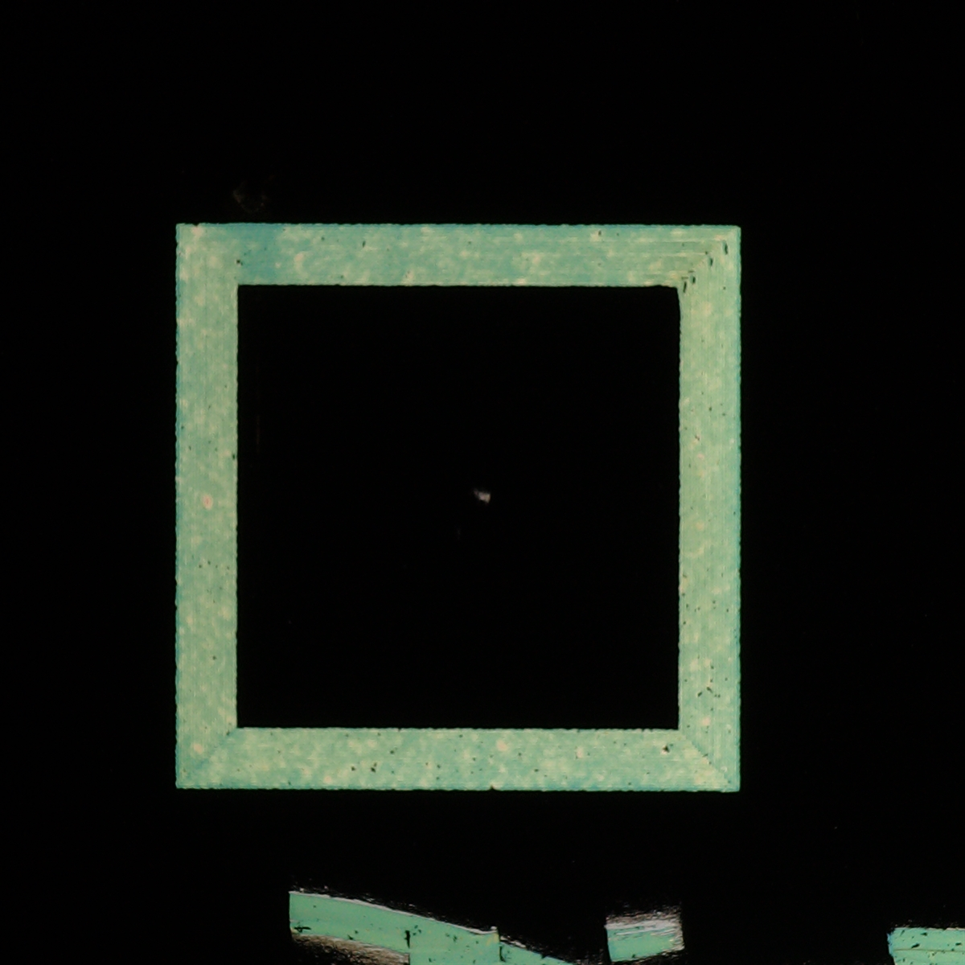
Materials and Methods
Step 1: Direct Laser Marking
Laser Power: 8%
Scan Speed: 450 mm/s
Pulse Frequency: 50 kHz
Step 2: Indirect Laser Marking
Laser Power: 9%
Scan Speed: 450 mm/s
Pulse Frequency: 100 kHz
90 μm
Carbon
Perovskite
SnO₂
ITO
Glass
Figures 8-11. Keyence MD-X1000 Laser Marker and the laser parameter steps used to make a device pixel on carbon-coated PSCs.
Notes:
I use a UV laser marker to isolate desired pixels to create the devices by focusing the UV light on samples.
Direct and indirect scribing.
You can see what the pattern looks like above.

Slide 10
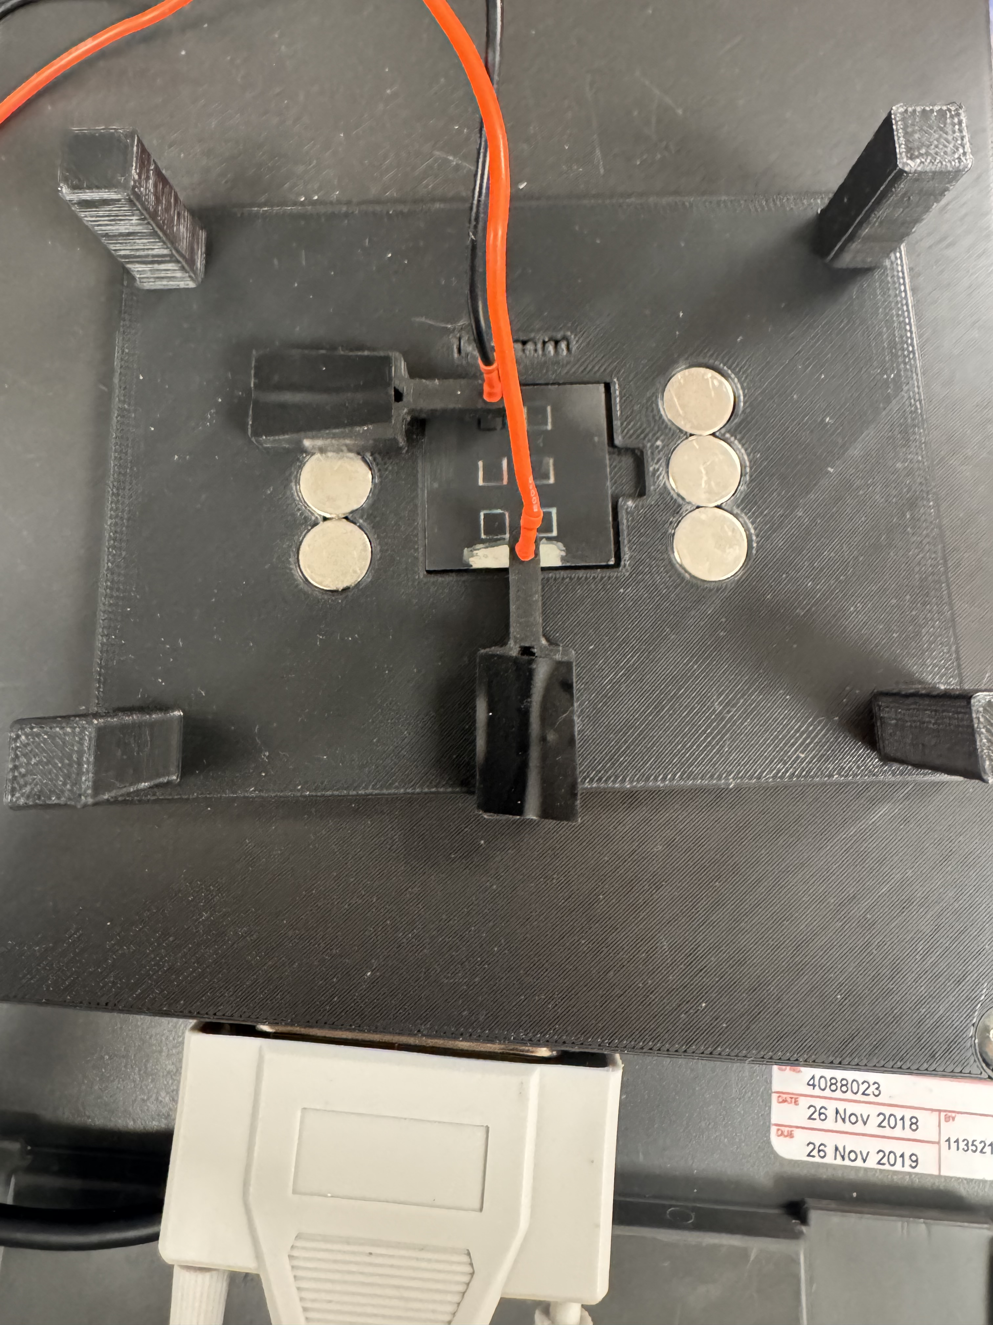
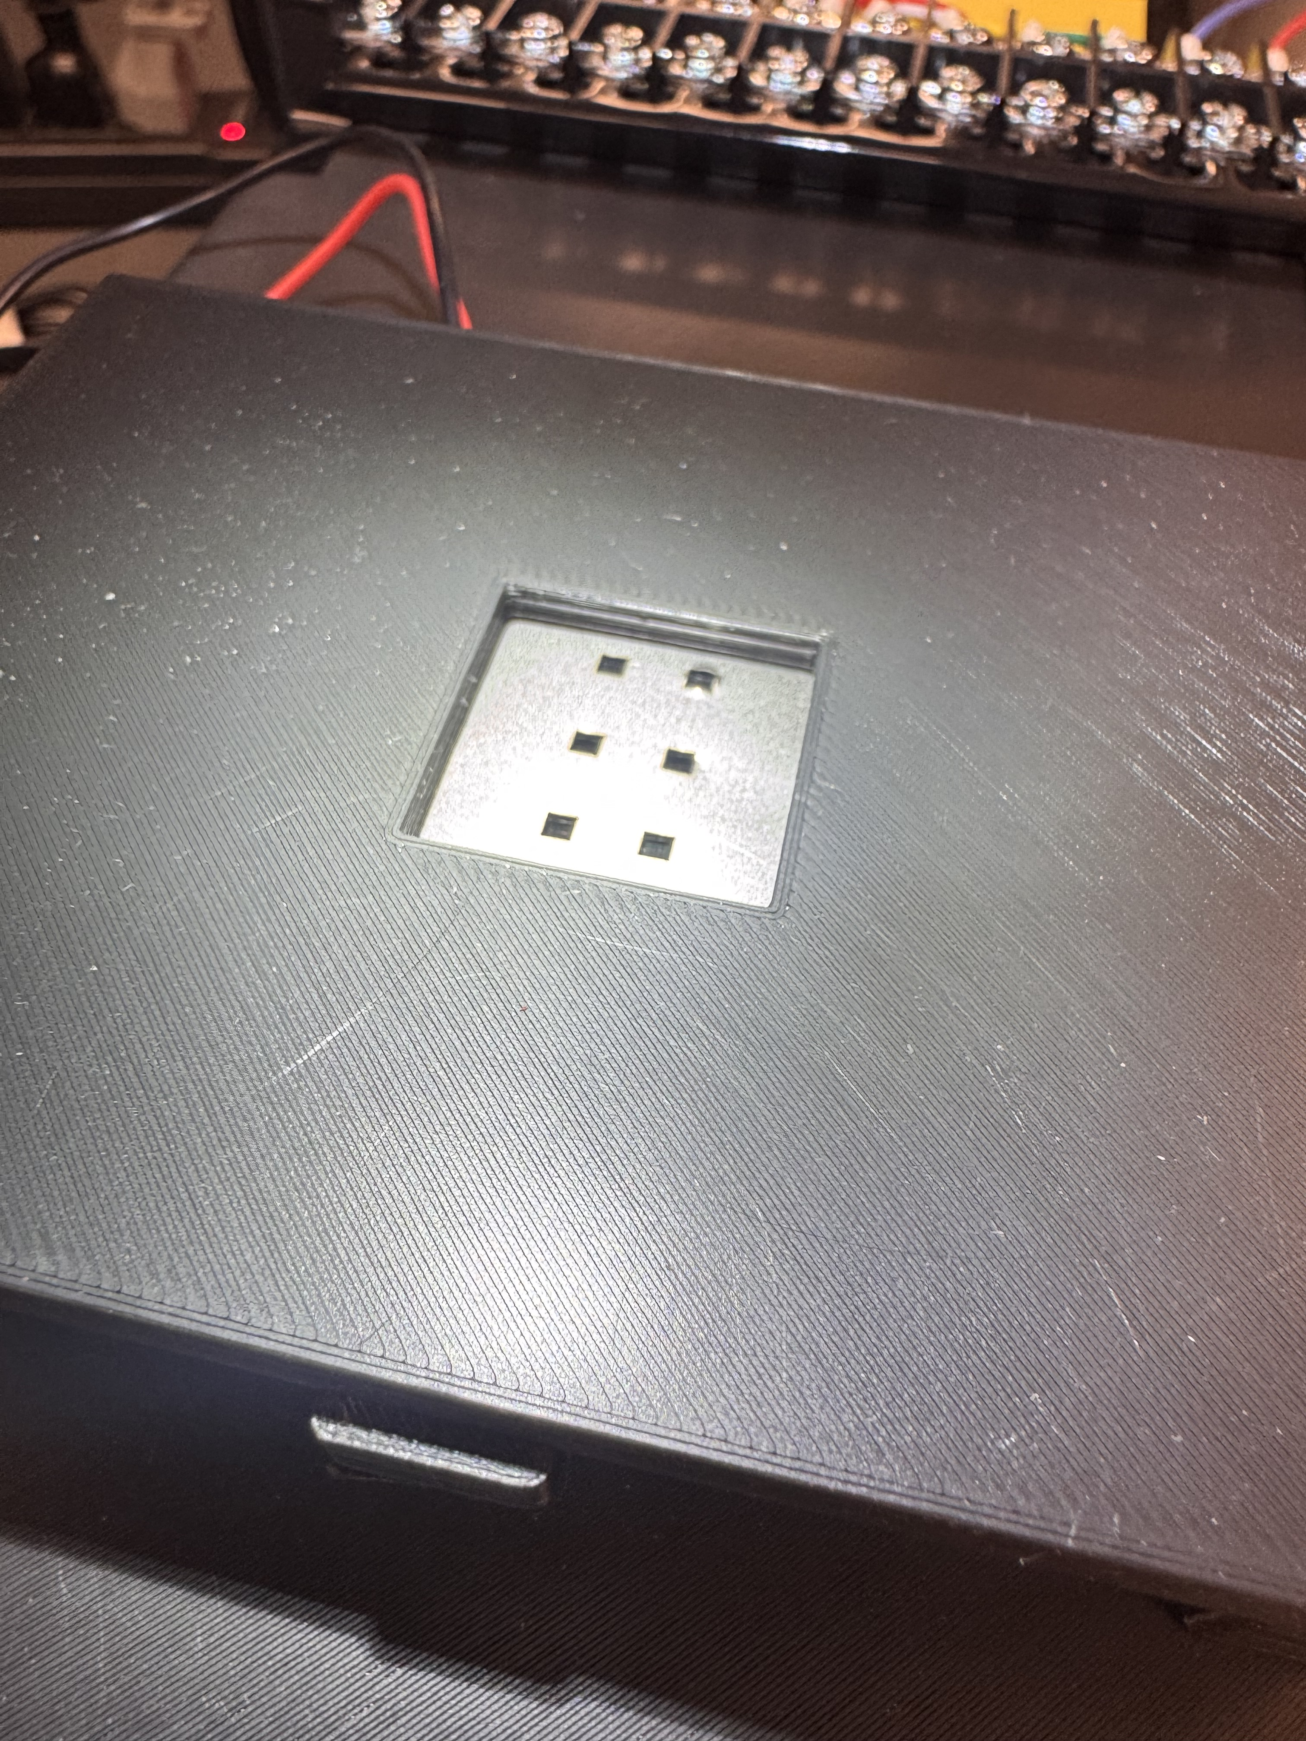
Materials and Methods – Solar Simulator
Figure 12. Probe station of the solar simulator for testing device efficiency and fill factor.
Figure 13. Sample undergoing solar simulator measurement with a photo mask.
Notes:
Solar simulator apparatus that is useful in determining the properties of devices such as efficiency and fill factor.
Uses probes that measure each pixel as they experience light that is like the sun.

Slide 11
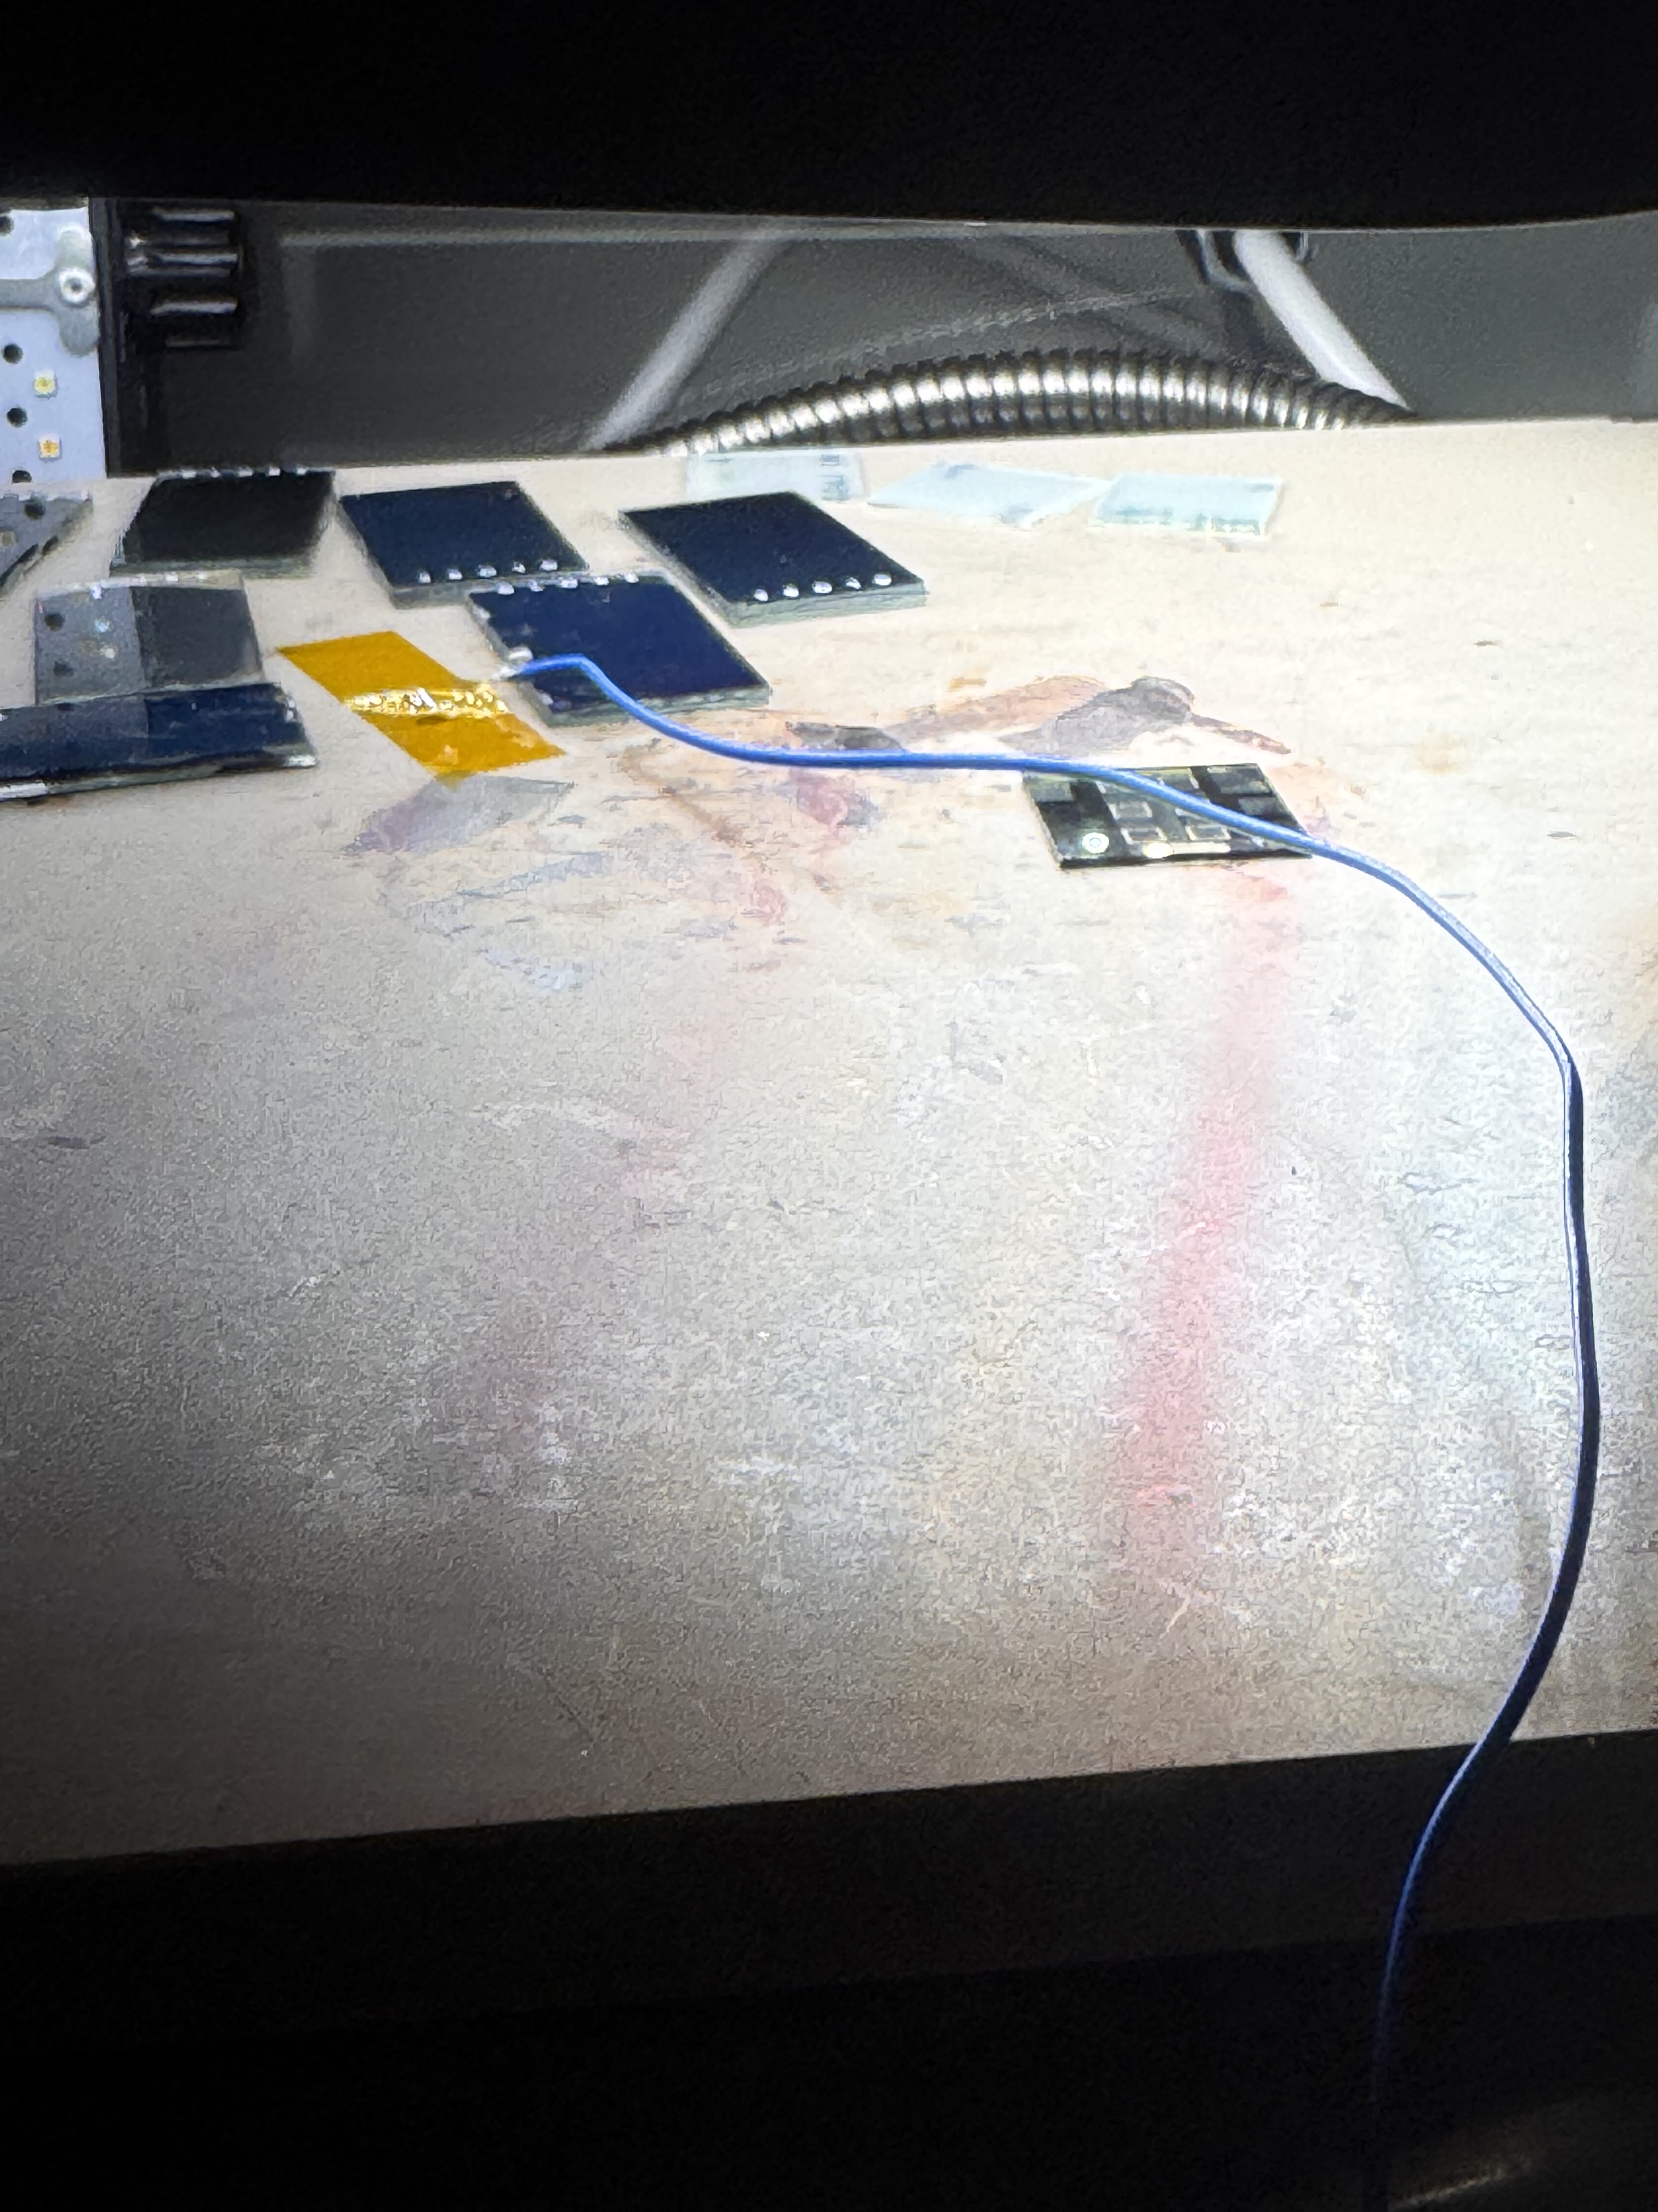
Materials and Methods – Aging Tests
80-100° Celsius
Figure 14. Apparatus for aging devices with either heat, light, or both.
Figure 15. Carbon-coated PSC undergoing light and heat aging.
Acknowledgement: This material is based upon work primarily supported by the National Science Foundation under award No.ECCS-2025490.
11

Slide 12


Results – Silver Device JV Curve
Figures 16. Ideal JV curve that is exhibited from a silver coated PSC.
FF = $\frac{Pmax}{Voc ×Jsc}$
Jsc
ƞ = $\frac{FF ×Jsc ×Voc}{Pin}$
Pmax
Voc
Acknowledgement: This material is based upon work primarily supported by the National Science Foundation under award No.ECCS-2025490.
12

Slide 13
Results – Carbon Device JV Curves
Figure 17. JV curve of a device with a carbon layer thickness of around 2 micrometers.
Figure 18. JV curve of a device with a carbon layer thickness of around 6 micrometers.
No Diode Response!!
Acknowledgement: This material is based upon work primarily supported by the National Science Foundation under award No.ECCS-2025490.
13
Notes:
When measuring device performance using the solar simulator, thinner samples the best performances.
Devices with carbon layer thicknesses lower than 5 micrometers showed a diode response.

Slide 14
Results – Silver Device Aging
Figure 19. Efficiency of a silver-coated PSC as it undergoes temperature and light aging at 80-85° Celsius.
Acknowledgement: This material is based upon work primarily supported by the National Science Foundation under award No.ECCS-2025490.
14
Notes:
Silver coated samples were temperature and light aged by annealing them at 80-85 degrees celsius for 140 hours.
For most pixels, the efficiency increases in the first 24 hours
However, some pixels failed early and eventually they all failed once the 140 hour mark arrived.

Slide 15
Results – Carbon Device Aging
Figure 20. Efficiency of a carbon-coated PSC as it undergoes temperature and light aging at 80-85° Celsius.
Notes:
Carbon coated samples were temperature and light aged by annealing them at 80-85 degrees celsius for 140 hours.
For all pixels, the efficiency increases in the first 24 hours
The devices were able to maintain their performance for 140 hours, showing great stability

Slide 16
Results – Carbon Device Extreme Aging
Figure 21. Efficiency of a carbon-coated PSC as it undergoes temperature aging at 100° Celsius.
Acknowledgement: This material is based upon work primarily supported by the National Science Foundation under award No.ECCS-2025490.
16
Notes:
Carbon devices were also thermally aged at 100 degrees Celsius for 140 hours.
The efficiency of the pixels increased in the first 24 hours and increased overall in the whole-time span
This is considered very extreme aging.

Slide 17
Conclusions
Stability
Stability
Conductivity
Cost Effectiveness
Conductivity
Cost Effectiveness
Efficiency
Scalability
Efficiency
Scalability
Figure 22. Radar chart comparisons of silver-coated PSCs and carbon-coated PSCs.
Acknowledgement: This material is based upon work primarily supported by the National Science Foundation under award No.ECCS-2025490.
17
Notes:
While silver samples showed high efficiencies and fill factors, they didn’t show much promise when it comes to stability, cost effectiveness, and scalability
The carbon samples showed lower efficiencies and fill factors, but showed great feats in stability, cost effectiveness, and scalability.
Efficiencies and fill factor can be improved, while the inherent properties of silver cannot .
If the carbon devices were aged for longer, they would eventually generate more power than the silver devices.

Slide 18
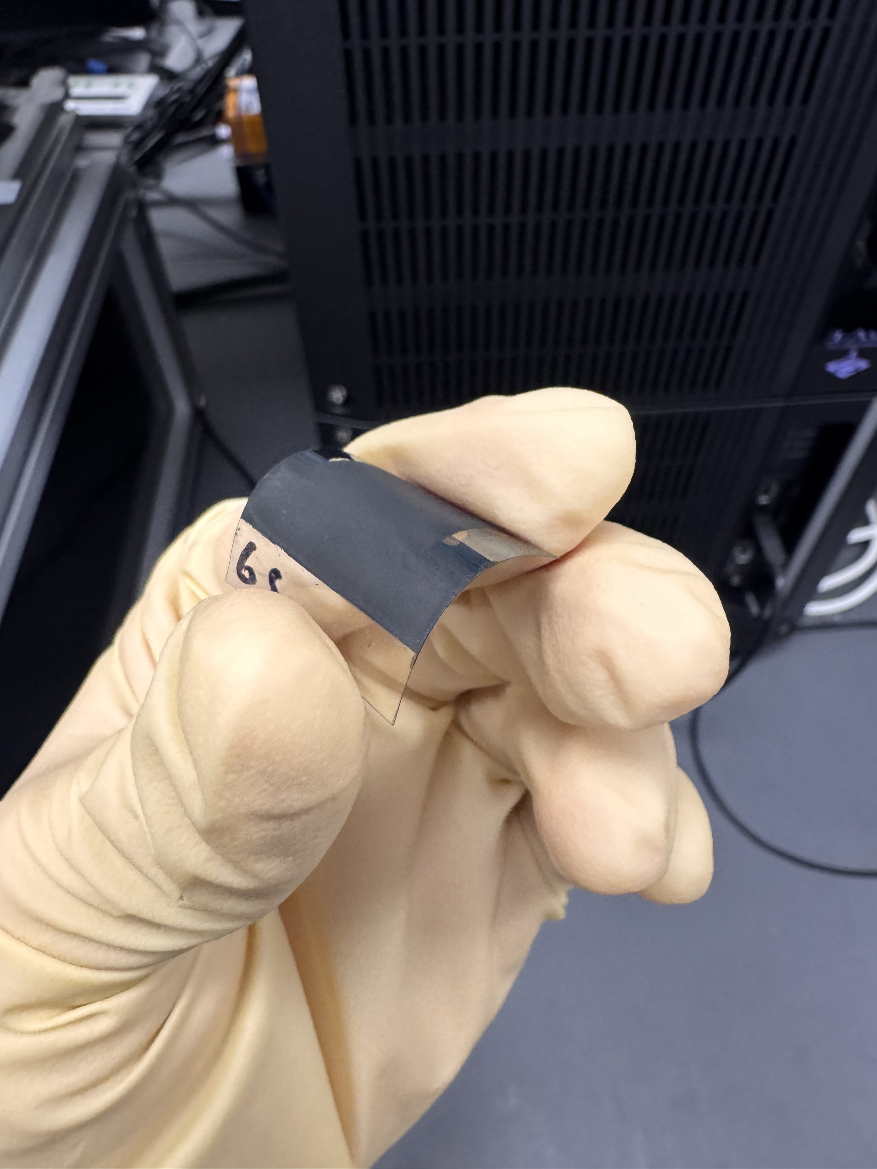
Future Work
More aging methods.
Flexible carbon-coated PSCs.
Full carbon-coated solar modules.
Figure 23. Flexible carbon-coated PSC being bent.

Slide 19





Acknowledgements
Dr. Nicholas Rolston
Marco Casareto
Jessica Hauer

Slide 20
Acknowledgements
[1] Li T, Wang L, Qiu Z, et al. Global Daily CO2 emissions from 1970 to 2024. Scientific Data. 2026;13(1). doi:10.1038/s41597-026-06621-9
[2] Filonchyk M, Peterson MP, Zhang L, Hurynovich V, He Y. Greenhouse Gases Emissions and global climate change: Examining the influence of CO2, ch4, and n2o. Science of The Total Environment. 2024;935:173359. doi:10.1016/j.scitotenv.2024.173359
[3] Afroz M, Ratnesh RK, Srivastava S, Singh J. Perovskite Solar Cells: Progress, challenges, and future avenues to clean energy. Solar Energy. 2025;287:113205. doi:10.1016/j.solener.2024.113205
[4] 22.1% carbon-electrode perovskite solar cells by spontaneous passivation and self-assembly of Hole-Transport Bilayer. doi:10.1021/acsnano.4c16916.s001
[5] Flick AC, Dauskardt RH. Challenging conventional assumptions in PV: A high-throughput open-air approach to low-cost perovskite module production. Energy &amp; Environmental Science. 2026;19(9):3049-3062. doi:10.1039/d6ee00488a

Slide 21
Questions?
Acknowledgement: This material is based upon work primarily supported by the National Science Foundation under award No.ECCS-2025490.
21

